Slide 1
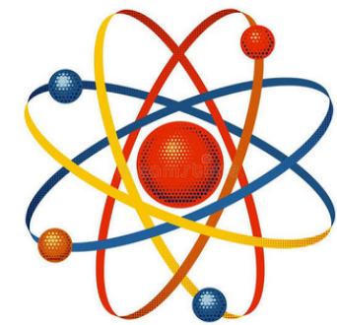

Recent Advances and Methods in Nuclear and Atomic Physics
Interplay of pairing localization and deformation in the newly observed ¹²C cluster decay of proton-rich ¹¹⁶Cs
Majekodunmi Joshua
University of South Africa, College of Science, Engineering and Technology (CSET)
Outline:
The longstanding interest in cluster decay
The experimental evidence for ¹²C emission from ¹¹⁶Cs
Questions about nuclear structure and tunnelling
The physical conclusions.

Slide 2
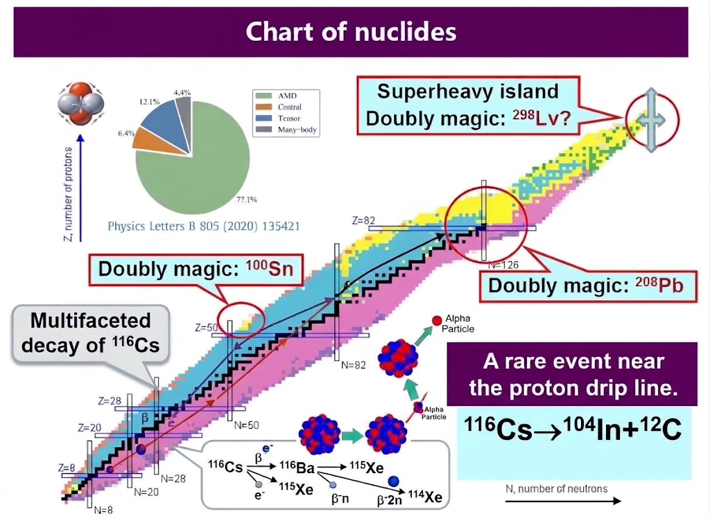
1

Slide 3
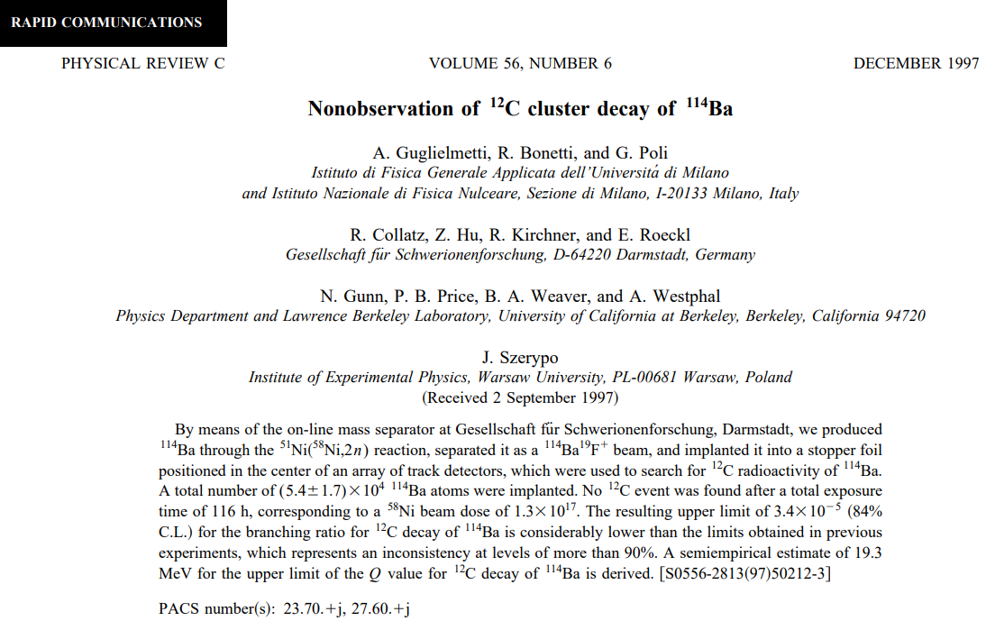
The study pushed experimental boundaries near the proton drip line but only succeeded in setting lower limit > 4.10
Experimental lower limit: extremely rare or hindered, but the channel is not strictly forbidden
3
Notes:
• ¹²C emission was not observed in the reported search.
• The result establishes an experimental lower limit on the partial half-life.
• Non-observation constrains the channel; it does not prove that the channel is forbidden.

Slide 4
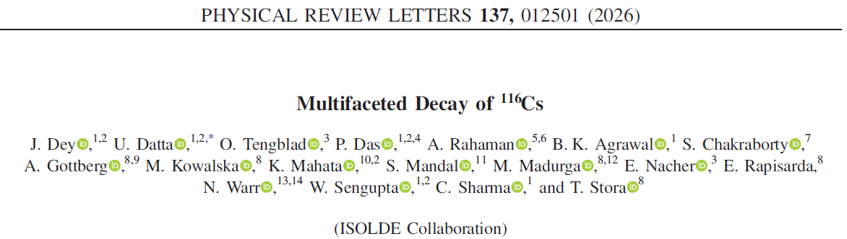
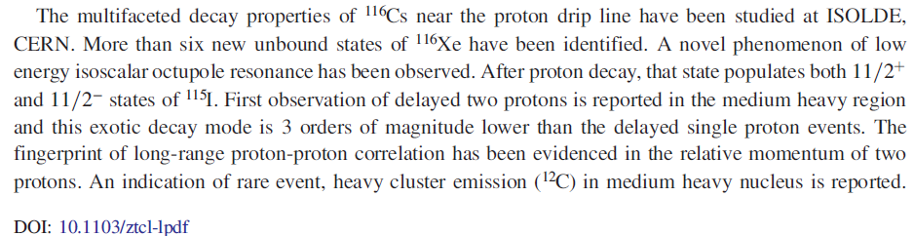
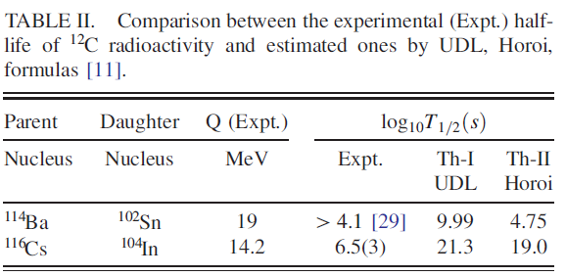
The PRL reports ¹²C emission from the odd–odd, proton-rich nucleus ¹¹⁶Cs.
• The measured decay was more probable than the liquid-drop estimates considered in that paper.
• This motivates a microscopic analysis of structure and tunnelling.
Clear observation: ¹¹⁶Cs
“As it is evident, the present data for emission of ¹²C is more probable than theoretical prediction. For this purpose microscopic calculation may be important to understand the phenomena of quantum tunneling effect of macroscopic system in the nuclei.”
4

Slide 5
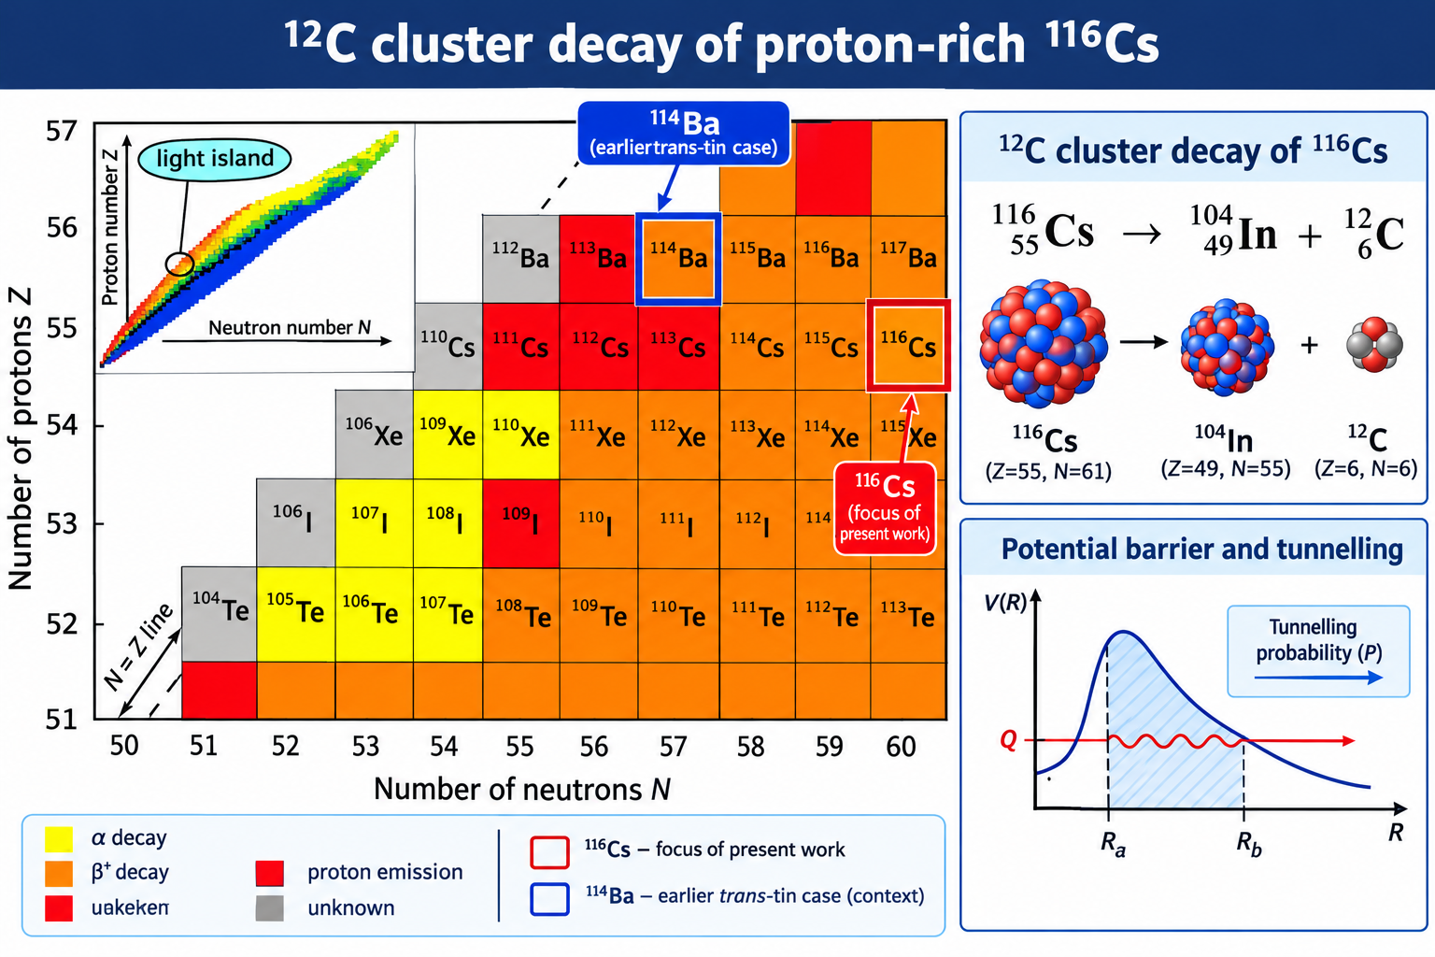
2

Slide 6
Questions addressed in this study
Structure:
How do pairing localization and deformation alter binding energies and density distributions?
Energetics:
How do parent–daughter binding-energy differences determine Q and the barrier turning points?
Decay:
How do Q, cluster preformation and WKB penetrability combine to determine the half-life?
Experimental question: what controls the difference in decay behaviour (of ¹¹⁴Ba and ¹¹⁶Cs)?
5

Slide 7
Microscopic structure and decay framework
1 Nuclear structure
2 Interaction
3 Tunnelling
4 Lifetime
HFBTHO calculations
• Binding energies
• Self-consistent densities
• Pairing prescriptions
• Spherical/deformed cases
Double-folding model
• Nuclear interaction from densities
• Coulomb contribution
• Barrier height and radius
WKB approximation
• Turning points
• Barrier penetrability P
Decay rate
λ = ν P₀ P
T₁/₂ = ln 2 / λ
HFBTHO supplies structure; folding and WKB supply the barrier and penetrability.
6

Slide 8
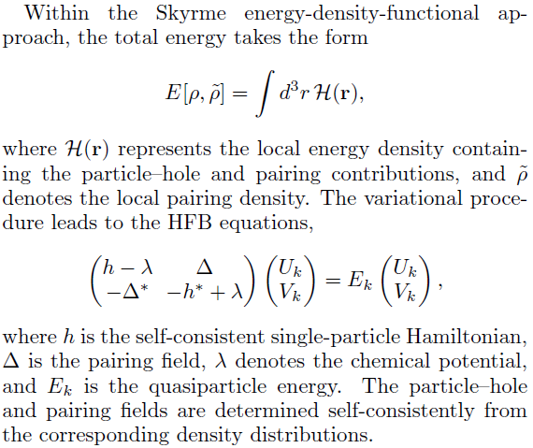
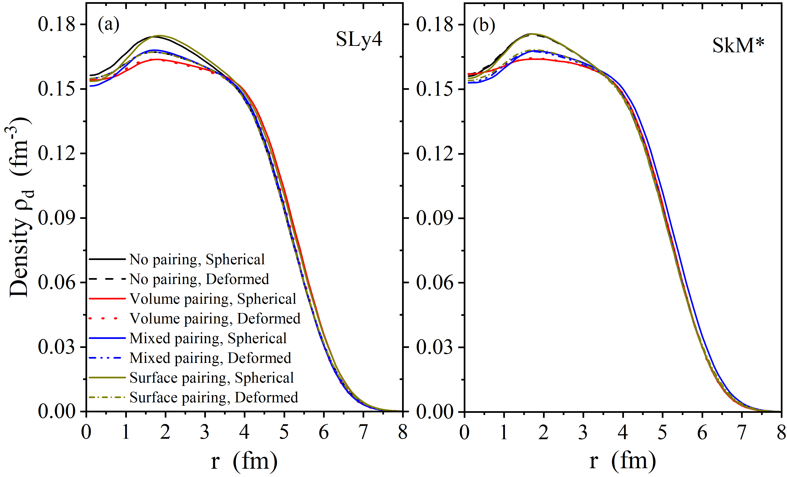



Microscopic nuclear structure within the Skyrme-HFB framework
Effect of pairing correlations
7

Slide 9
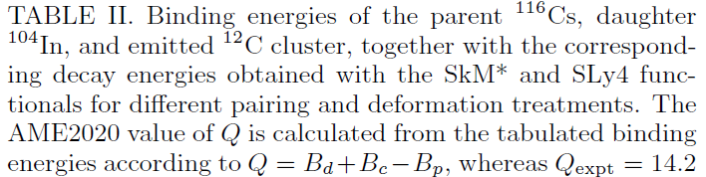
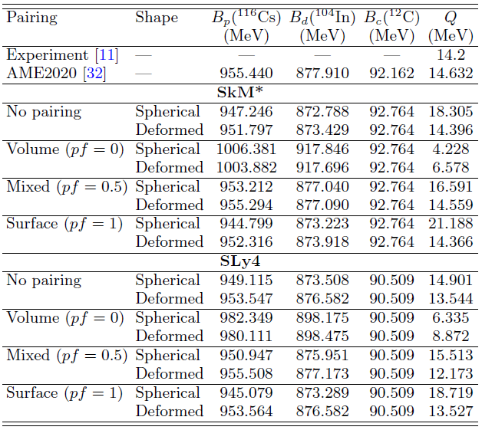
Effect of pairing correlations
8

Slide 10



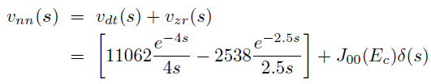




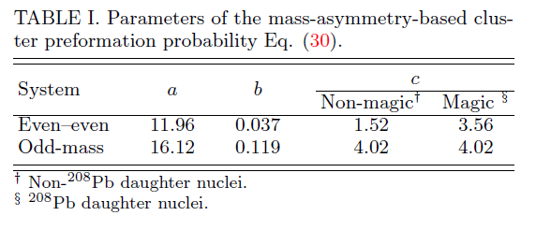


Double folding and Half-life Calculations
The integral in V_{DF} (R) is evaluated Fourier transform
9

Slide 11


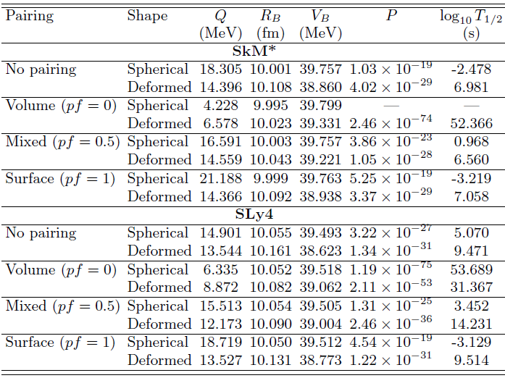
Trans-tin region
Decay and barrier properties for the ¹¹⁶Cs → ¹⁰⁴In+ ¹²C
P₀ = 0.668
SkM* • mixed, deformed
SLy4 • mixed, deformed
Q = 14.559 MeV
R_{B} = 10.043 fm
V_{B} = 39.221 MeV
Q = 12.173 MeV
R_{B} = 10.090 fm
V_{B} = 39.004 MeV
A difference of about 2.39 MeV in Q coexists with similar barrier radii and heights.
These results show that the experimentally relevant lifetime is controlled by the combined structural and tunnelling dynamics: pairing and deformation set the relative parent–daughter energetics and hence Q, while the WKB barrier exponentially converts these energy differences into the observed sensitivity of the cluster-decay half-life.
10

Slide 12
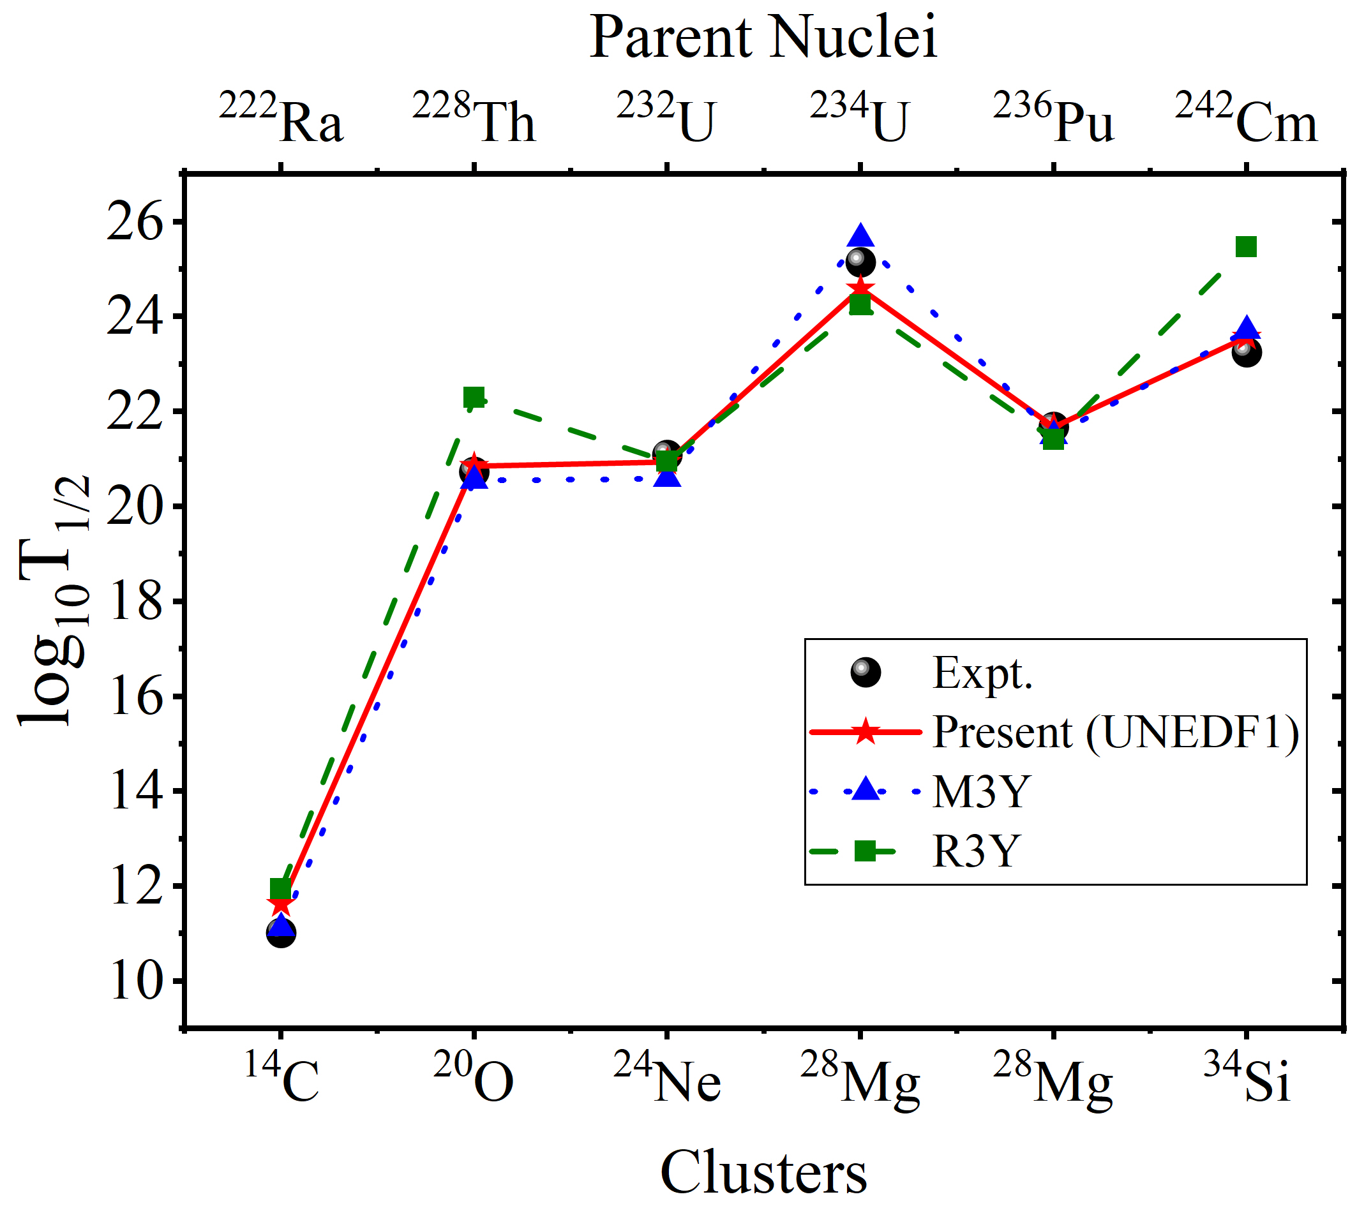
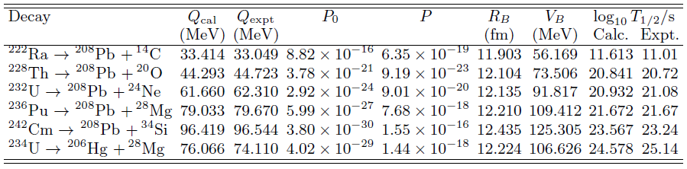
Trans-lead region
Decay and barrier properties of conventional cluster decays
11

Slide 13
Conclusion
1. Cluster decay: an important problem with renewed interest
Light island (doubly magic 100Sn)
Doubly magic 208Pb
2. Pairing and deformation influence the predicted decay properties primarily through changes in nuclear binding energies and the resulting Q-value, whose effects are amplified by the exponential dependence of the WKB tunnelling probability.
3. Different shell-structure environments reveals a different balance between cluster formation and barrier penetration
4. Further experimental measurements and consistent theoretical comparisons are needed to establish whether the two regions exhibit systematic differences in cluster preformation and decay dynamics.
5. Superheavy island (next doubly magic nucleus) 298Lv (Z=114,N=184)?
Searching for a new shell closure around mass 298 (such as N = 184) is crucial because it promises to reveal the "Island of Stability," where quantum magic numbers dramatically slow radioactive decay and allow physicists to test the fundamental limits of nuclear stability
12
Thanks to my co-author: Prof. Bahati Mukeru

