Slide 1

NRF-iThemba LABS
Training - Research - Expertise
Peane Maleka
HoD SSC Laboratory

Slide 2
National Research Foundation (Act No 23 of 1998 as amended)
The NRF derives its mandate from the National Research Foundation Act. The objective is to contribute to national development (Section 3 of the Act)
Supporting, promoting and advancing Research and Human Capacity Development through fund and the provision of the necessary research infrastructure,
Developing, supporting and maintaining national research facilities;
Supporting and promoting public awareness of, and engagement with, science;
Promoting the development and maintenance of the national science system and support of Government priorities.

Slide 3
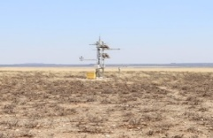
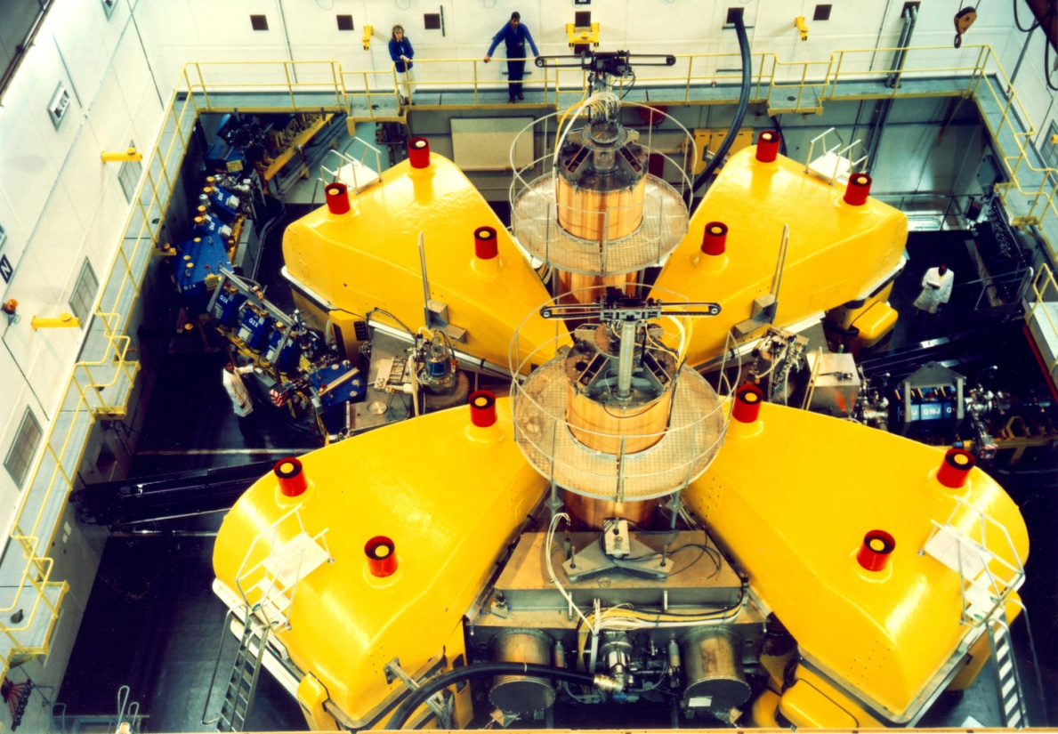
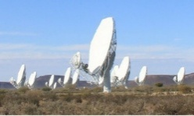
OneNRF: Facilities
National Research Foundation
Support, promote and advance Science and Innovation through funding
Human Capacity Development, Research, Innovation and Research Equipment Grants Management
Support, promote and advance science awareness and engagement
Public Awareness of, and engagement with, science
National Research Infrastructure Platforms
Biodiversity and Environmental Sciences
Nuclear Sciences
Astronomy and Geodentic Sciences
iThemba Laboratory for Accelerator Based Sciences (iThemba LABS)
South African Astronomy Observatory (SAAO)
South African Radio Astronomy Observatory (SARAO)
South African Institute for Aquatic Biodiversity (SAIAB)
South African Environmental Observatory Network (SAEON)
South African Agency for Science & Technology Advancement (SAASTA)
+
Other BUs
Research Innovation Support & Advancement (RISA)
+
Other BUs

Slide 4
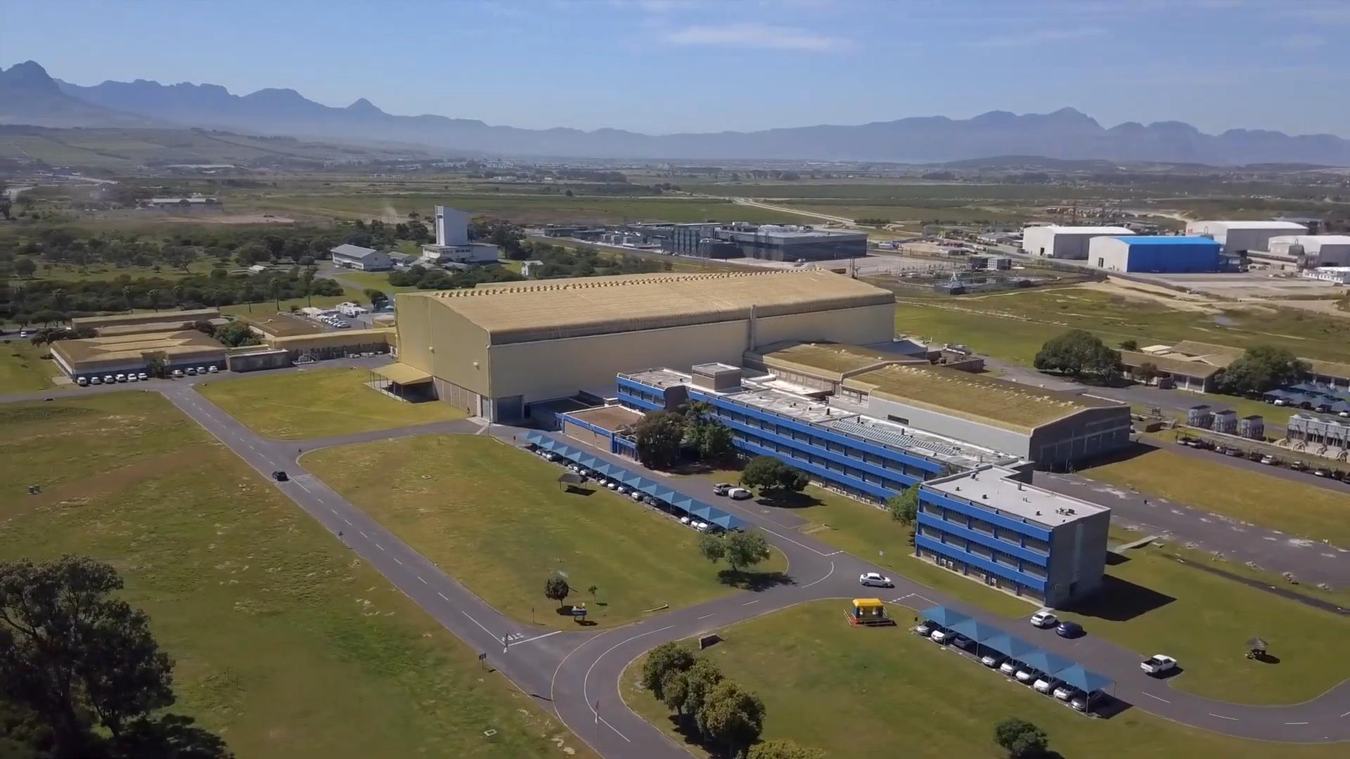
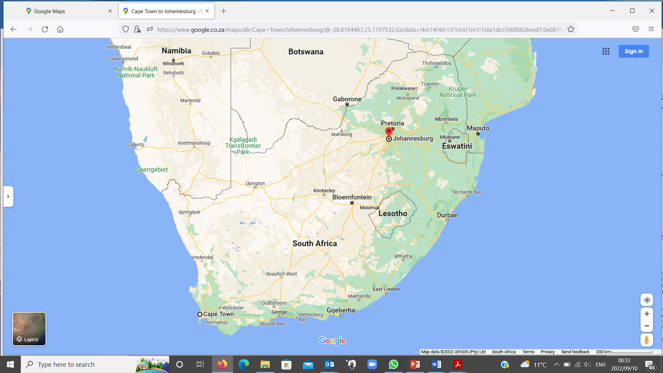
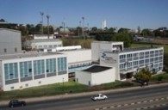
Two Campuses
1. NRF-iThemba LABS (HQ) Faure, Cape Town
2. NRF-iThemba LABS (TAMS) Gauteng

Slide 5
Key Statistics 2025/(26)
Annual Budget R 442M (22M€)
Core Parliament Grant: 54%
Isotope Production Revenue: 38% (Significant percentage ploughed back to research >50%)
Ring-fenced Parliamentary Grant: 7%
Research Contracts: 6% (subset of ring-fenced)
Staff Complement :248 ( Long term contracts + Permanent = 232)
33 Scientists / Researchers
Post-graduate students Co-supervised: 63

Slide 6
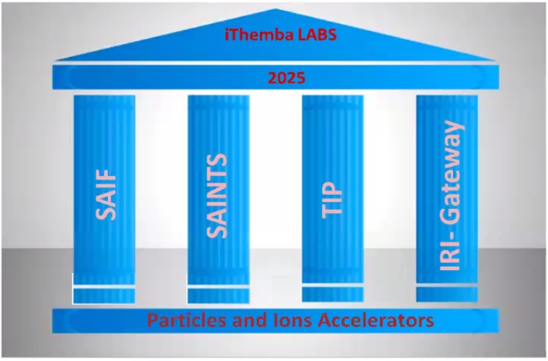
PILLARS OF iThemba LABS 2020 - 2025
Science (For Societal Benefit)
Training (For HCD)
Technology (For Innovation)
Global Research Infrastructure (Access)
Notes:
Using Fundamental Research as the Bridge to Technology advancement and Innovation
SAIF (South African Isotope Facility) – Contribution with radioisotope for medical purpose (societal benefit)
SAINTS (Southern African Institute for Nuclear Technology and Sciences) – Education and Training Platform for Human Capacity Development
TIP (Technology Innovation Platform) – Platform for Technology Development to drive Innovation
IRI-Gateway (International Research Infrastructure Gateway) – Facilitate collaborations on behalf of SA researchers for global access to facilities similar or complementary to iThemba LABS

Slide 7
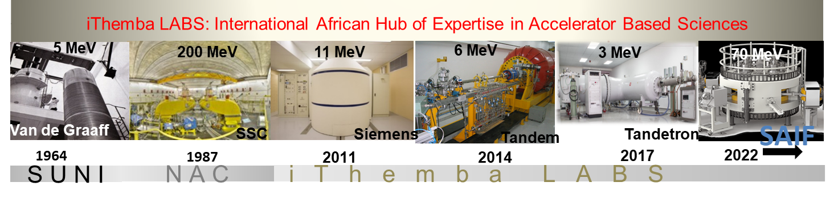
iThemba LABS is a research platform for pure and applied research, development and training in Accelerator Based Sciences
fundamental studies of nuclear phenomena,
applications of ion beams and associated techniques in materials and nanoscience research,
accelerator mass spectrometry
the production of radionuclides,
radiation biology and medical physics

Slide 8
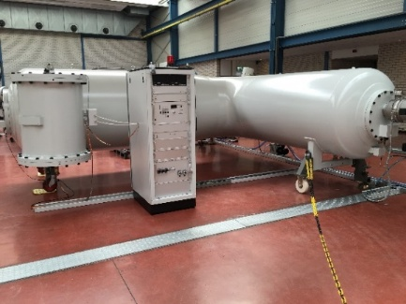
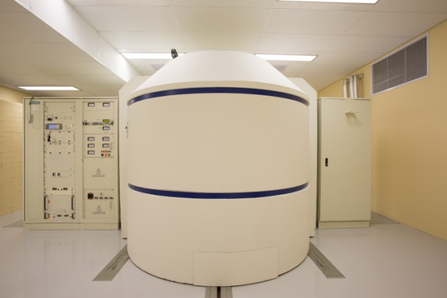
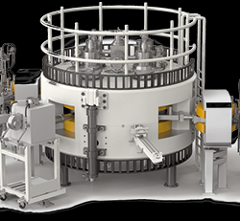
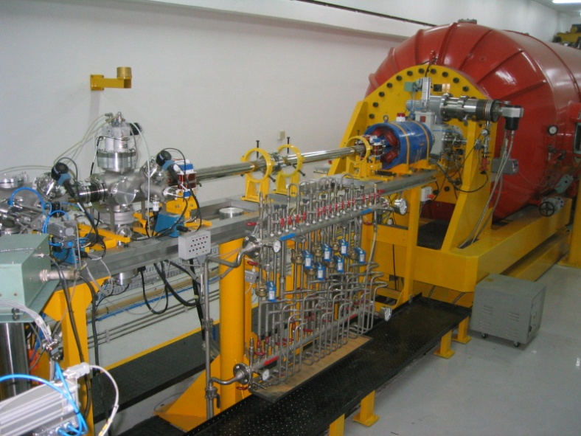
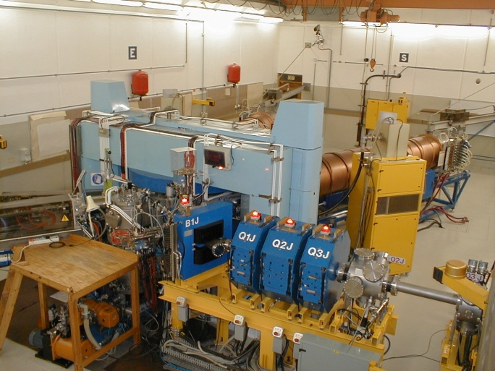
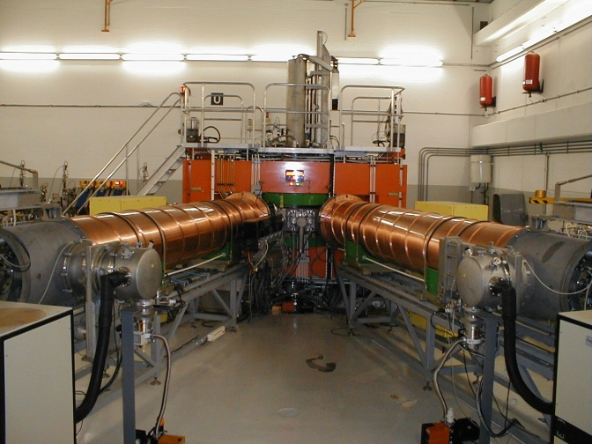
iThemba LABS: Laboratories for Accelerator Based Science
K11 Cyclotron
K200 Separated Sector Cyclotron
Subatomic Physics and Applications, Nuclear Medicine
3 MV Tandetron
Radioisotope Production
Materials Research and Nanoscience
K8 Injector Cyclotron 1
K8 Injector Cyclotron 2
6 MV Tandem
IBA C70 Cyclotron
Materials Research and Accelerator Mass Spectrometry (AMS)

Slide 10
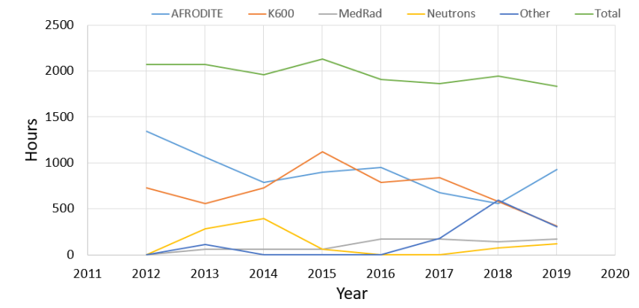
Pre COVID: SSC Beam allocation for research: 2012-2019
Total number of available hours (assumed 64% of year) ~ 5600 h
Typical beamtime scheduled 2012-2019 = 2000 h → 35.7 %
Notes:
10
1. First evidence of the IVGDR: 1937
2. The second GR to be found: ISGQR seen in 1971
Why did it take so long to see the GMR?
 accelerators and detectors became available
to study (α,α’) at 100-250 MeV
Stable beam data: representing only RCNP and TAMU over past 20+ years
(prior to that KVI, TAMU, Grenoble, with ⁴He and ³He at 96-130 MeV)
16O, 24Mg, 28Si, 32S, Ca chain, Ti chain, 56Fe,
Ni chain, Zr chain, Mo chain
Cd chain, Sn chain, Sm chain, Pb chain

Slide 11
SSC Beam allocation for research: calendar year 2024
Total number of available hours (assumed 64% of year) ~ 5600 h
Beamtime actually received = 136 h → 2.4 %
SSC Beam allocation for research: calendar year 2025
Total number of available hours (assumed 64% of year) ~ 5600 h
Beamtime scheduled = 1080 h → 19.3 %
(9 slots of 5 days each in March, April, May, June, July, Sept, Oct, Nov, Dec)
Beamtime actually received = 257 h → 4.6 %
STAC considers as essential minimum beamtime for research → 30 %
Notes:
11
1. First evidence of the IVGDR: 1937
2. The second GR to be found: ISGQR seen in 1971
Why did it take so long to see the GMR?
 accelerators and detectors became available
to study (α,α’) at 100-250 MeV
Stable beam data: representing only RCNP and TAMU over past 20+ years
(prior to that KVI, TAMU, Grenoble, with ⁴He and ³He at 96-130 MeV)
16O, 24Mg, 28Si, 32S, Ca chain, Ti chain, 56Fe,
Ni chain, Zr chain, Mo chain
Cd chain, Sn chain, Sm chain, Pb chain

Slide 12
Total number of available hours (assumed 64% of year) ~ 5600 h
Typical beamtime scheduled pre-SAIF = 2000 h → 35.7 %
2024 2025

Slide 13
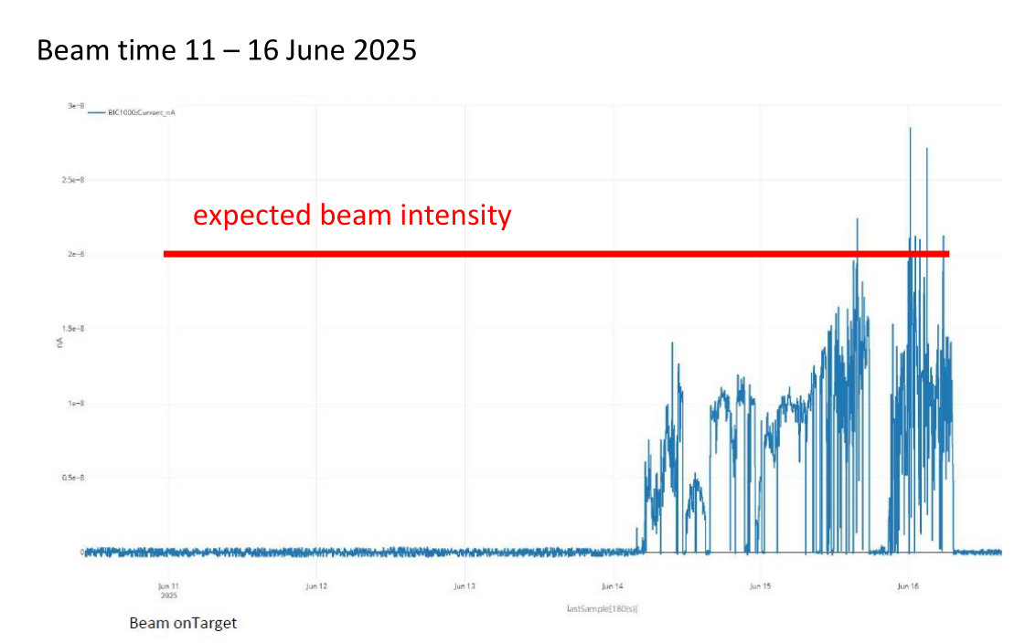
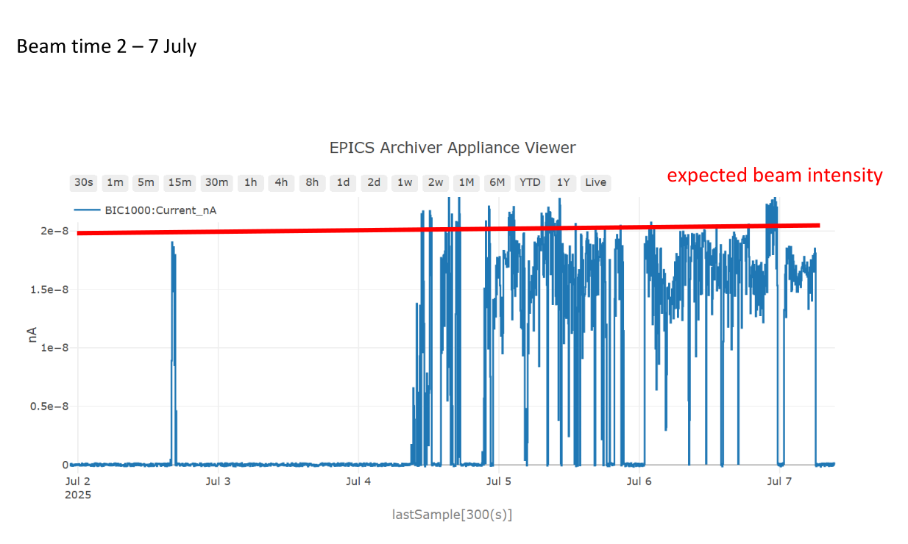
SSC: beam quality
Beam quality issues during A,B and D-line exp
Poor intensity and stability affect measurement viability

