Slide 1


Division reports/highlights in High Energy Particle Physics
Mukesh Kumar
Institute for Collider Particle Physics & University of the Witwatersrand
8-July-2026

Slide 2
Rationale of Pillar
Grow student-training capacity for a new generation of scientists
Involvement in ATLAS: data analysis, detector upgrades
CERN provides unparalleled training
Focus on human capacity & technology transfer to society
Challenges: students finish their PhDs need support system to prepare them for positions in Academia in South Africa.
KPI | Key Performance Indicators
 | Secondary KPI | Actual 2024/25 | Planned 2024/25 | YTD 2025/26 | # Black (ACI) | # Women | # Foreign
Research Outputs
Peer Reviewed Articles |  | 112 | 75 | 46
Full Length Conference Proceedings |  | 20 | 20 | 17
Human Capacity Development
Number of Students Supervised | Doctoral | 14 | 15 | 17 | 8 | 3 | 3
 | Masters | 32 | 30 | 35 | 23 | 3 | 2
 | Honours | 3 | 5 | 10 | 2 | 2 | -
Number of students graduated | Doctoral | 0 | 4 | 2 | 0 | 0 | 0
 | Masters | 4 | 10 | 2 | 1 | 0 | 0
Outreach
Number of interactions |  | 5 | 5 | 5
Membership
Students |  | 52 | 45 | 52 | 31 | 6 | 5
Post-Doctoral Fellows |  | 5 | 5 | 5 | 3 | 0 | 0
Scientific/Academic Staff |  | 8 | 9 | 11 | 2 | 1 | 6
Technical Staff |  | 3 | 7 | 3 | 0 | 0 | 0

Slide 3
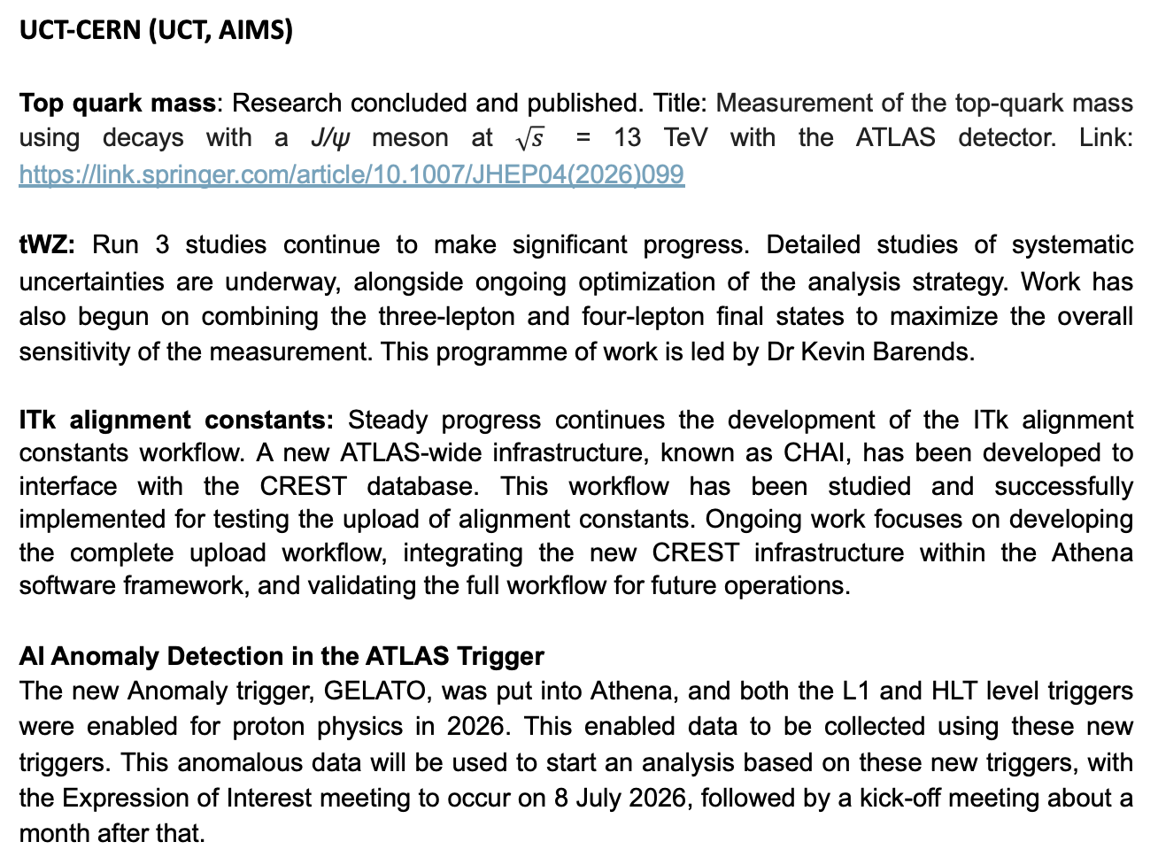
UCT-CERN (UCT, AIMS)
Top quark mass: Research concluded and published. Title: Measurement of the top-quark mass using decays with a J/ψ meson at $\sqrt{s}$ = 13 TeV with the ATLAS detector. Link: https://link.springer.com/article/10.1007/JHEP04(2026)099
tWZ: Run 3 studies continue to make significant progress. Detailed studies of systematic uncertainties are underway, alongside ongoing optimization of the analysis strategy. Work has also begun on combining the three-lepton and four-lepton final states to maximize the overall sensitivity of the measurement. This programme of work is led by Dr Kevin Barends.
ITk alignment constants: Steady progress continues the development of the ITk alignment constants workflow. A new ATLAS-wide infrastructure, known as CHAI, has been developed to interface with the CREST database. This workflow has been studied and successfully implemented for testing the upload of alignment constants. Ongoing work focuses on developing the complete upload workflow, integrating the new CREST infrastructure within the Athena software framework, and validating the full workflow for future operations.
AI Anomaly Detection in the ATLAS Trigger
The new Anomaly trigger, GELATO, was put into Athena, and both the L1 and HLT level triggers were enabled for proton physics in 2026. This enabled data to be collected using these new triggers. This anomalous data will be used to start an analysis based on these new triggers, with the Expression of Interest meeting to occur on 8 July 2026, followed by a kick-off meeting about a month after that.

Slide 4
UJ+UNISA+UWC+UP
Searchers for Dark matter: Analysis in the exotics Higgs decay sector for Beyond SM physics, HLRS-2018-55 (H→Z_{d}Z_{d}→4l) etc
UJ-ATLAS-TileCal TilePPr Phase-2 Upgrades
The UJ-TilePPr Phase-2 upgrades contribute 24% to TilePPr, in collaboration with other institutes, including Valencia. During the April to June quarter, UJ contributed to firmware, software, production, and testing of PCBs at UJ and at CERN. The following are contribution have been completed in the last quarter.
TileCoM Firmware and Software Updates.
The TileCoM is a Zynq UltraScale+ MPSoC-based FPGA board developed for the ATLAS Tile Calorimeter (TileCal) Phase-II Upgrade, serving as the "Computer on Module" within the on-detector electronics . It sits at the heart of the front-end readout and control chain, interfacing with the On-detector and Off-detector hardware to handle configuration, monitoring, and control of the calorimeter's readout electronics.
Production and testing
There has been 10 Tile GbE Switch boards have been produced from two South African companies, Jemstech and Trax Interconnect. These PCBs are currently tested in the UJ laboratory with high speed electronic equipment.
ITk Outer Barrel (Thermofluidic and Designing Tasks)
During the last few months, we continued to work on thermofluidic testing for CO₂ cooling components used in the ATLAS O.B. mainly titanium base blocks, capillaries, and longeron assemblies

Slide 5
ITk OB Functional Inclined Half-Rings Production
A member of the SA-ATLAS team is involved in the production of the ITk Outer Barrel Functional Inclined Half Rings (IHRs) in the CERN clean room located in Building 154.
ITk Fibre-Optic Sensors (FOS) (UJ+UNISA+UWC)
The Upgrade FOS team passed the PRR in January and is now well into Procurement, Production, calibration and Delivery.
ITk Strips Flushing (FOS) (UJ+UP+UKZN+UNISA+UWC)
We continue to develop CFD models of the flushing scheme in strips, pixels and OSV to aid in the design of the flushing schemes so as to ensure that the ITk is kept dry.
AI based Anomaly Detection in the TDAQ Network System
A new preventative-maintenance and fault-detection project has been initiated for the ATLAS TDAQ network system, linked to Prof C Harley’s Qualification Task and introducing a new student to this area (MEng student Angelos Anagnostopoulos)
ITk Polymoderator Design & Testing Activities
MSc Student Alex Ross completed the first prototype and installation testing of the ITk Polymoderator barrel at CERN in November 2025.

Slide 6
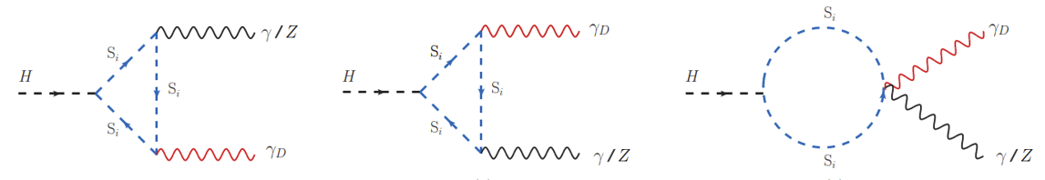
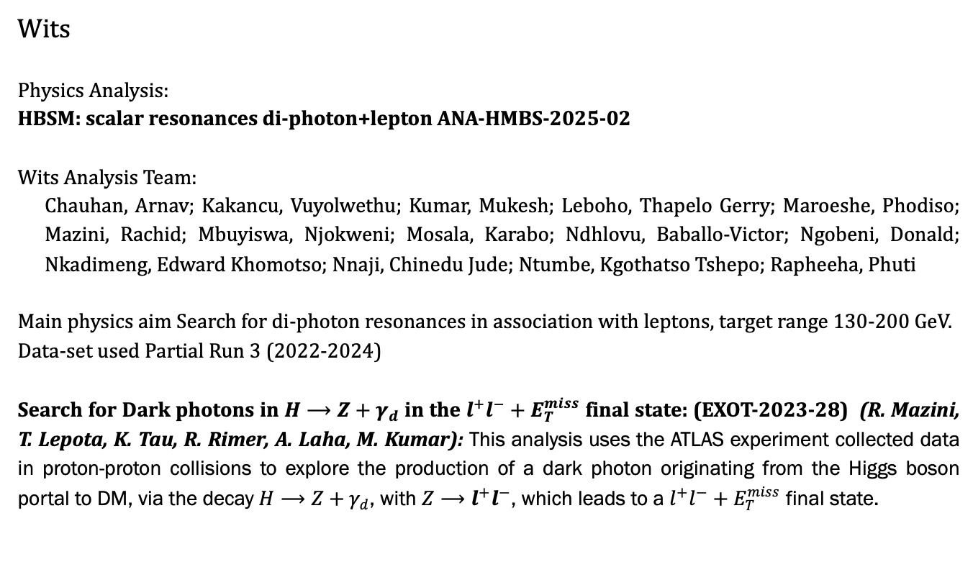
Wits
Physics Analysis:
HBSM: scalar resonances di-photon+lepton ANA-HMBS-2025-02
Wits Analysis Team:
Chauhan, Arnav; Kakancu, Vuyolwethu; Kumar, Mukesh; Leboho, Thapelo Gerry; Maroeshe, Phodiso; Mazini, Rachid; Mbuyiswa, Njokweni; Mosala, Karabo; Ndhlovu, Baballo-Victor; Ngobeni, Donald; Nkadimeng, Edward Khomotso; Nnaji, Chinedu Jude; Ntumbe, Kgothatso Tshepo; Rapheeha, Phuti
Main physics aim Search for di-photon resonances in association with leptons, target range 130-200 GeV.
Data-set used Partial Run 3 (2022-2024)
Search for Dark photons in $H⟶Z+γ_{d}$ in the $l^{+}l^{−}+E_{T}^{miss}$ final state: (EXOT-2023-28) (R. Mazini, T. Lepota, K. Tau, R. Rimer, A. Laha, M. Kumar): This analysis uses the ATLAS experiment collected data in proton-proton collisions to explore the production of a dark photon originating from the Higgs boson portal to DM, via the decay $H⟶Z+γ_{d}$, with $Z⟶l^{+}l^{−}$, which leads to a $l^{+}l^{−}+E_{T}^{miss}$ final state.

Slide 7
HGTD
HGTD modules test beam (K. Tau, R. Mazini)
Testbeam with several full HGTD modules (15x15 LGAD sensors + ALTROC ASIC) using the CERN SPS pion beams and the DESY electron beams provided a large amount of data
Qualification Task (T. Lepota): Integration of HGTD time information in the ATLAS Particle Flow (PFlow) algorithm.
The HGTD is designed to provide timing information for tracks in the forward region. Combined with a primary vertex time determination, the individual track timing can be used to remove pileup tracks from events. This project focuses on integrating the timing information provided by HGTD into the Charged Hadron Subtraction (CHS) procedure used in the ATLAS PFlow algorithm. Various timing consistency cuts and their impact on jet efficiency, energy resolution, and pileup rate are studied. The optimal result will be incorporated into the Run4 PFlow software. The work will be reported in the Global Performance (GPER) meetings, and occasionally to the HGTD and the Jet/METgroups.
The High Granularity Timing Detector (HGTD) for the ATLAS Phase-II upgrade (R. Mazini, T. Lepota, K. Tau, R. Rimer)
The Wits/ICPP group proposal to join the HGTD project was approved unanimously at the IB meeting in June 2025. Dr. Rachid Mazini is leading the group activities, with the main contribution consisting of developing, manufacturing and commissioning a Heaters system that avoids condensation effects on the cold-warm electronics interface of the HGTD vessel.

Slide 8
TileCal
Qualification Task (Karabo Mosala)
Study of the response of the gap/crack scintillators using collision muons in Run3 Description: The ATLAS calorimeter gap/crack region, pseudorapidity from ∼1.0 to ∼1.7, is characterized by lower active-to-passive material ratio due to large amount of dead material in between barrel and endcap calorimeters.
Tile Calorimeter Phase-II Upgrade Completion of fLVPS Brick Production, Testing and Delivery
A major milestone was achieved in the ATLAS Tile Calorimeter Phase-II Upgrade with the successful completion, shipment, and delivery of all 1,029 Front-End Low Voltage Power Supply (fLVPS) bricks to CERN.
Tile Calorimeter Phase-II Upgrade – LV Box Assembly
The assembly of Low Voltage Power Supply (LVPS) boxes for the ATLAS Tile Calorimeter Phase-II Upgrade continued during the quarter, with students contributing to the integration of Wits-produced fLVPS bricks into complete detector power supply units.
SiW-ECAL Beam Test Operations and IoT Environmental Monitoring
Contributions were made to the SiW-ECAL beam-test programme through participation in detector shifts, beam-test monitoring, and support of data-taking operations.

Slide 9
TileCal
Tile Calorimeter Phase-II Upgrade – LVPS Burn-in Testing and Thermal Stability Analysis
Progress continued in the ATLAS Tile Calorimeter Phase-II Upgrade burn-in testing campaign, with thermal and electrical performance evaluations performed on Front-End Low Voltage Power Supply (fLVPS) bricks under controlled eight-hour burn-in conditions.
TileDB2 Registration and Quality Control Data Management
Following the completion of Phase-II fLVPS brick production and delivery, registration and quality control (QC) data management activities were undertaken for the Wits-produced bricks within the TileDB2 database.
Radiation-Hard Dynode Material Studies for Future TileCal Upgrades
Research continued on the investigation of radiation-hard materials for potential application as dynode materials in photomultiplier tubes (PMTs) for the ATLAS Tile Calorimeter.
New Academic joined Wits:
Dr Edward Nkadimeng, Dr. Phuti Rapheeha

Slide 10

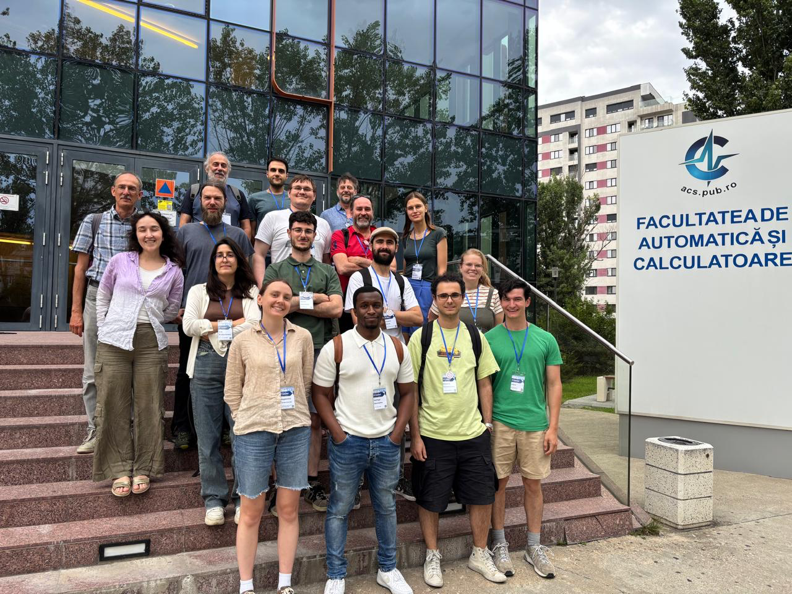
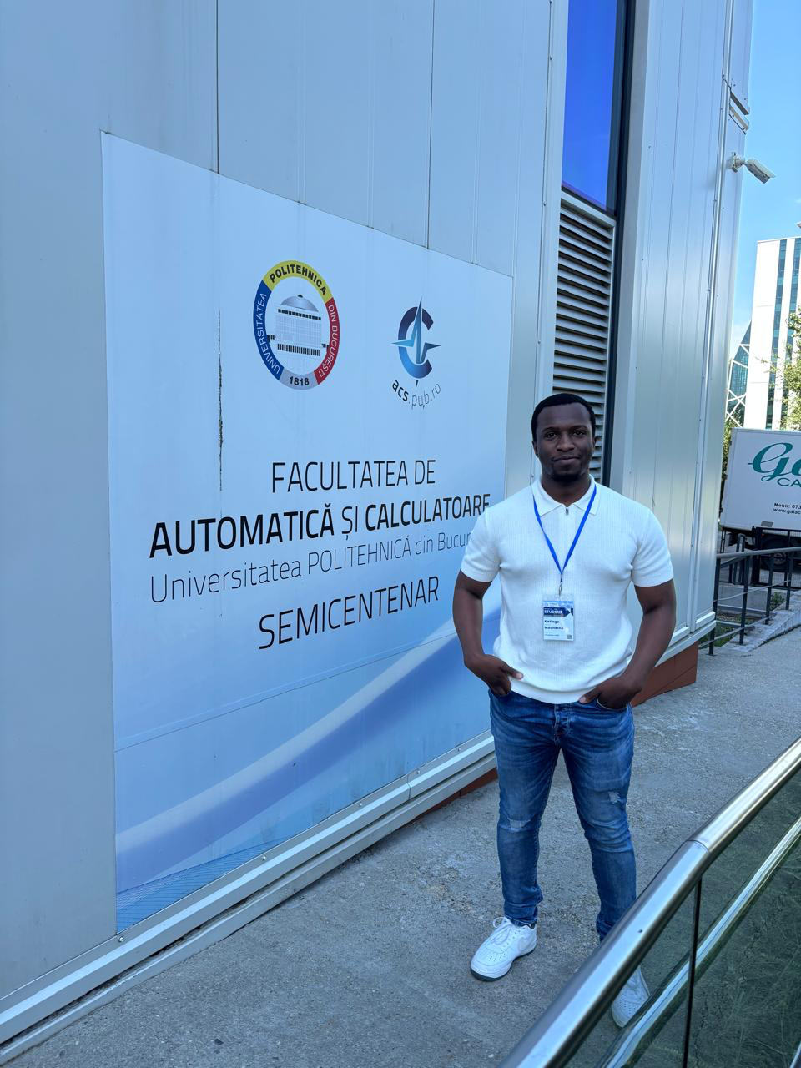
Bringing Expertise to SA
Since places are limited, acceptance to the school is done by a selection committee.
The 16th International School of Trigger and Data Acquisition is organized by CERN and National University of Science and Technology Politehnica Bucharest, Romania.

Slide 11

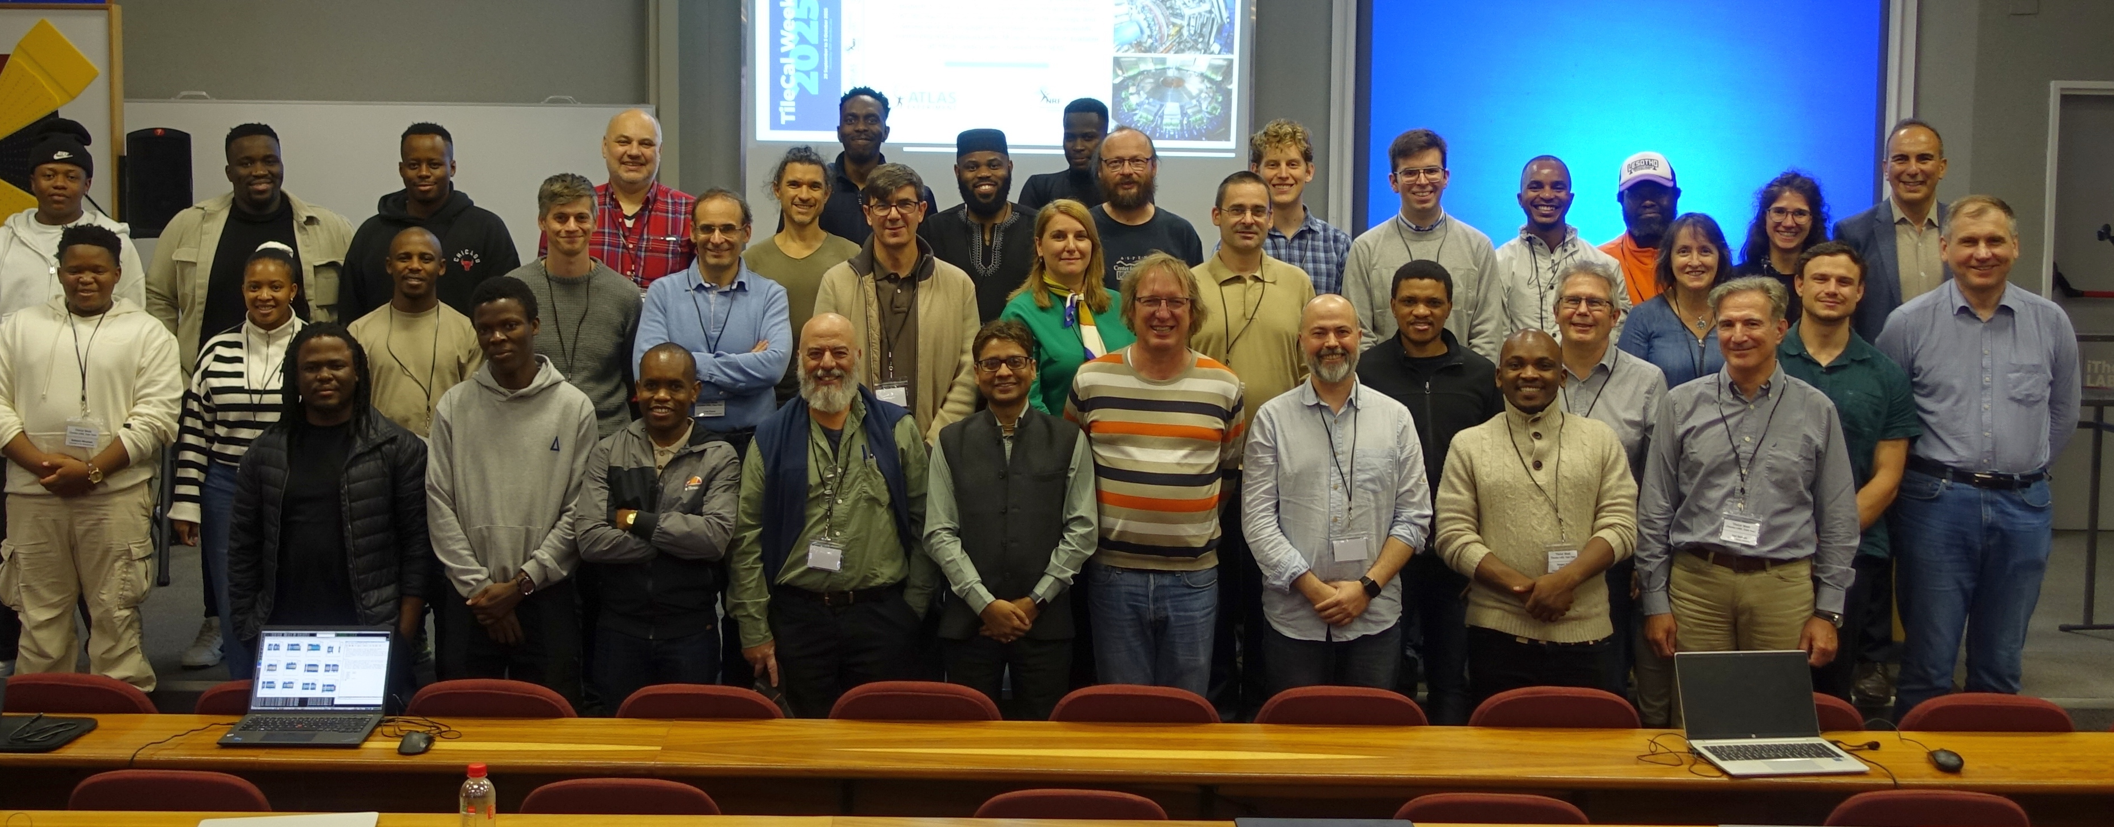
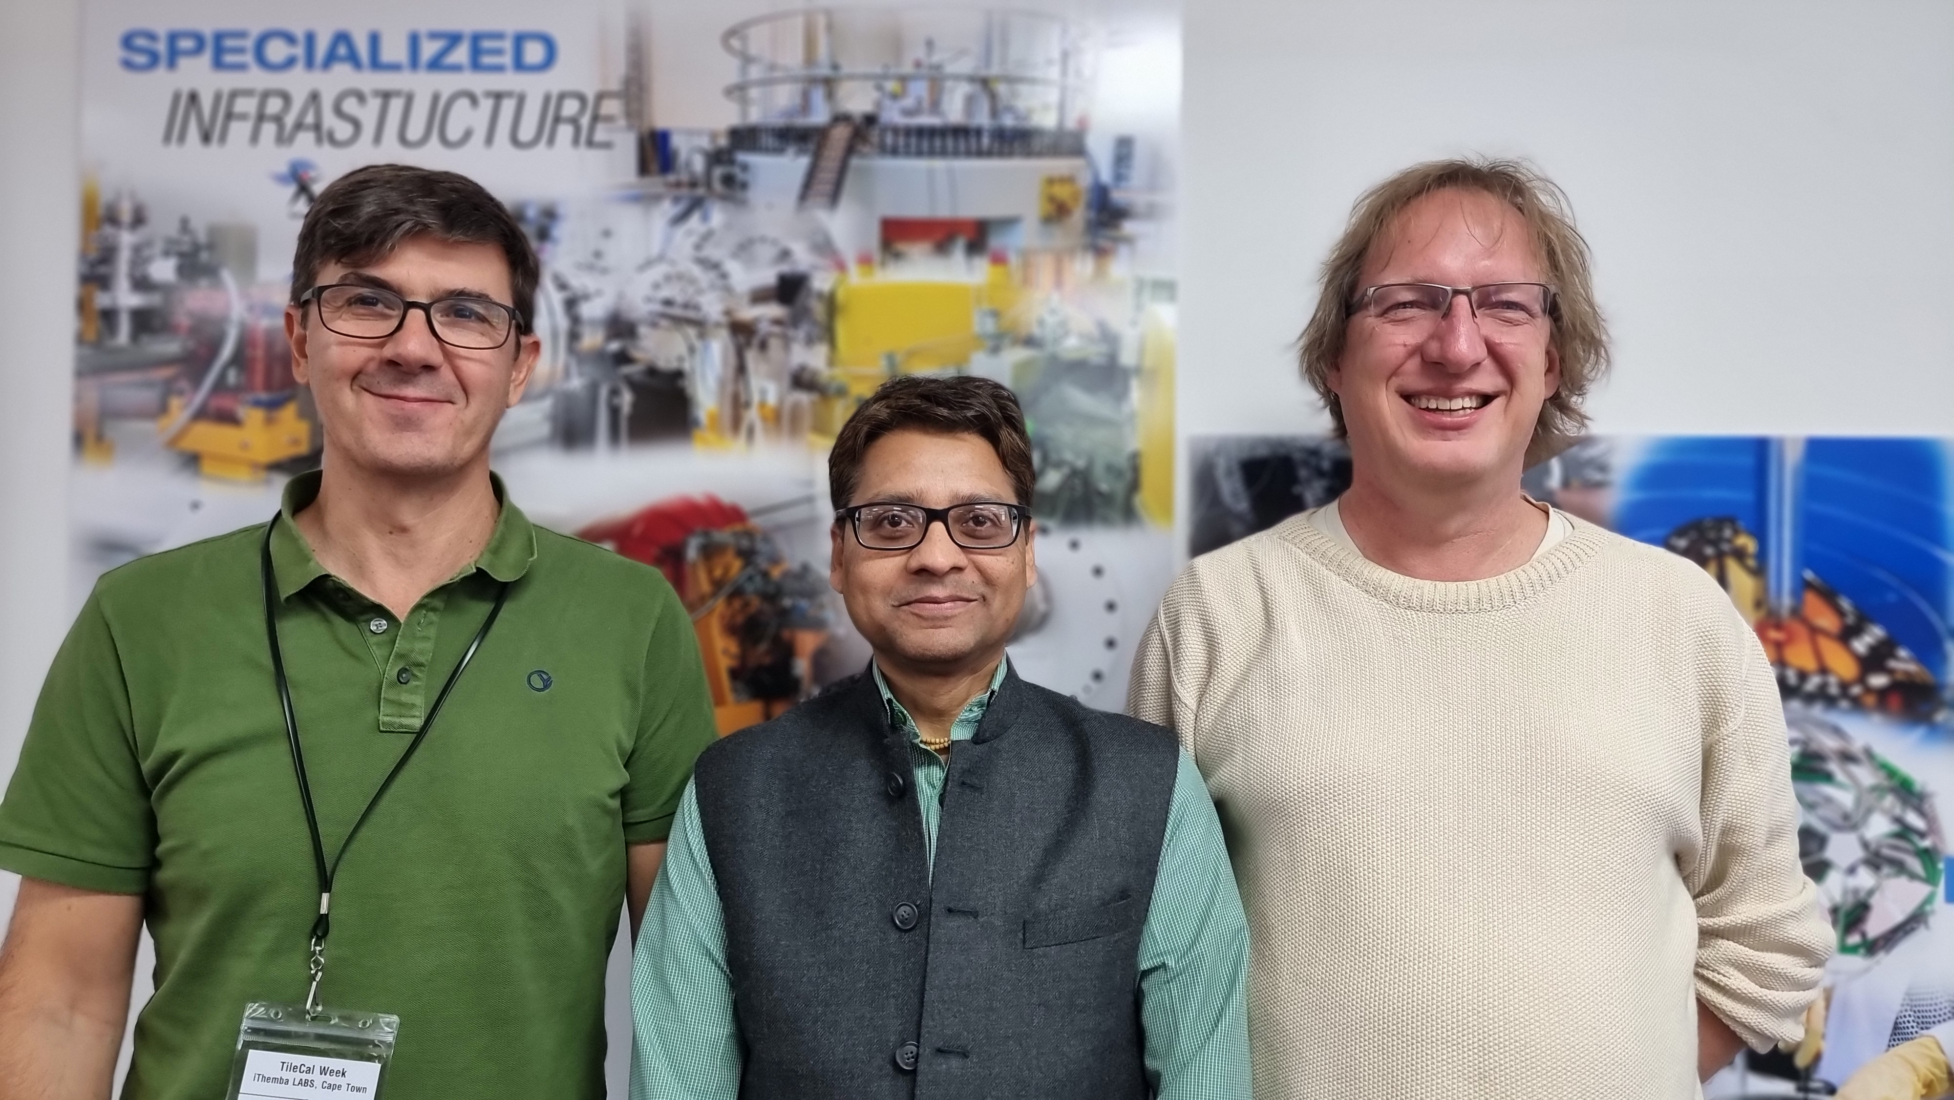
ATLAS TileCal Week (Outside CERN) at iThemba Labs, Cape Town
https://indico.cern.ch/event/1513435/overview
29 Sep – 3 Oct 2025

Slide 12

Discussions & Outlook
SAIP-2027 way forward
Overall engagements …
Funding Opportunities
New Chairs [nominations]
Student representatives & role(s)?
Proceedings Guidelines
To add?

Slide 13
Conference Proceedings
Papers presented at the conference are eligible for consideration for publication in the Proceedings of SAIP Conferences. The proceedings are peer-reviewed and produced in accordance with DHET guidelines, with recognition at the level of 0.5 units per article.
Deadline for Proceedings
Only papers that are submitted strictly on or before 23:59 SAST on 30 July 2026 will be considered for publication.
Author Guidelines
The guidelines for authors, the application procedure for recognition of your article, and other details relating to the proceedings will soon be available on SAIP2026 website.

Slide 14
Template
Follow the instructions from the template (Latex/Word), really!
DO NOT ADJUST THE TEMPLATE
Don't try to make your paper nicer than the template.
If you feel strongly about a styling issue, let us know for 2027.
The title of your proceedings *can* be *slightly* different than the title of your talk / poster.
Only write a proceedings if you actually presented, about what you presented.

