Slide 1
DFT Study of Ti-Reinforced NbMoTaW Alloy for hydrogen applications.
T.E Damuleli, T.S Ranwaha, L Phuthu, DM Tshwane and NE Maluta

Slide 2
OUTLINE
Introduction
Methodology
Results and Discussion
Conclusion
References

Slide 3
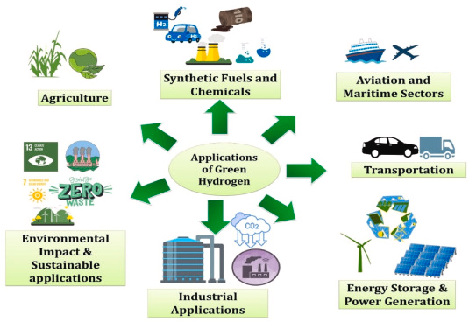

INTRODUCTION
Global energy demand is rapidly increasing due to population growth, industrialization, and technological advancement [1].
This rising demand is driving the need for sustainable, efficient, and reliable energy sources.
Figure 1: Clean Energy System with Hydrogen Storage [2]​
Figure 2: Applications of green hydrogen [2].​

Slide 4
INTRODUCTION (Refractory High-Entropy Alloys (RHEAs))
Examples: Zr, Nb, Mo, Hf, Ta, W
These elements are commonly combined in different near-equal ratios to form RHEAs.They contribute strong atomic bonding and high resistance to thermal degradation.
Excellent high-temperature stability
RHEAs retain their strength and microstructural stability at elevated temperatures. They resist creep, softening, and phase instability under long-term thermal exposure.
Suitable for hydrogen applications
RHEAs are promising for hydrogen-rich environments due to their resistance to degradation. They show improved tolerance to hydrogen embrittlement compared to many conventional alloys.

Slide 5
INTRODUCTION (Why RHEAs for Hydrogen)
Refractory High-Entropy Alloys (RHEAs) are promising because:
Their strong atomic bonding and high-melting-point elements reduce hydrogen-induced lattice weakening.
Their complex multi-element structure disrupts easy hydrogen diffusion pathways.
They maintain mechanical stability under extreme conditions.
High Corrosion Resistance.
Why Reinforced RHEAs (rRHEAs)
Improved strength and durability.
Better resistance to hydrogen damage.
Reinforcements act as barriers and trapping sites that reduce hydrogen mobility.
Enhanced high-temperature performance.

Slide 6
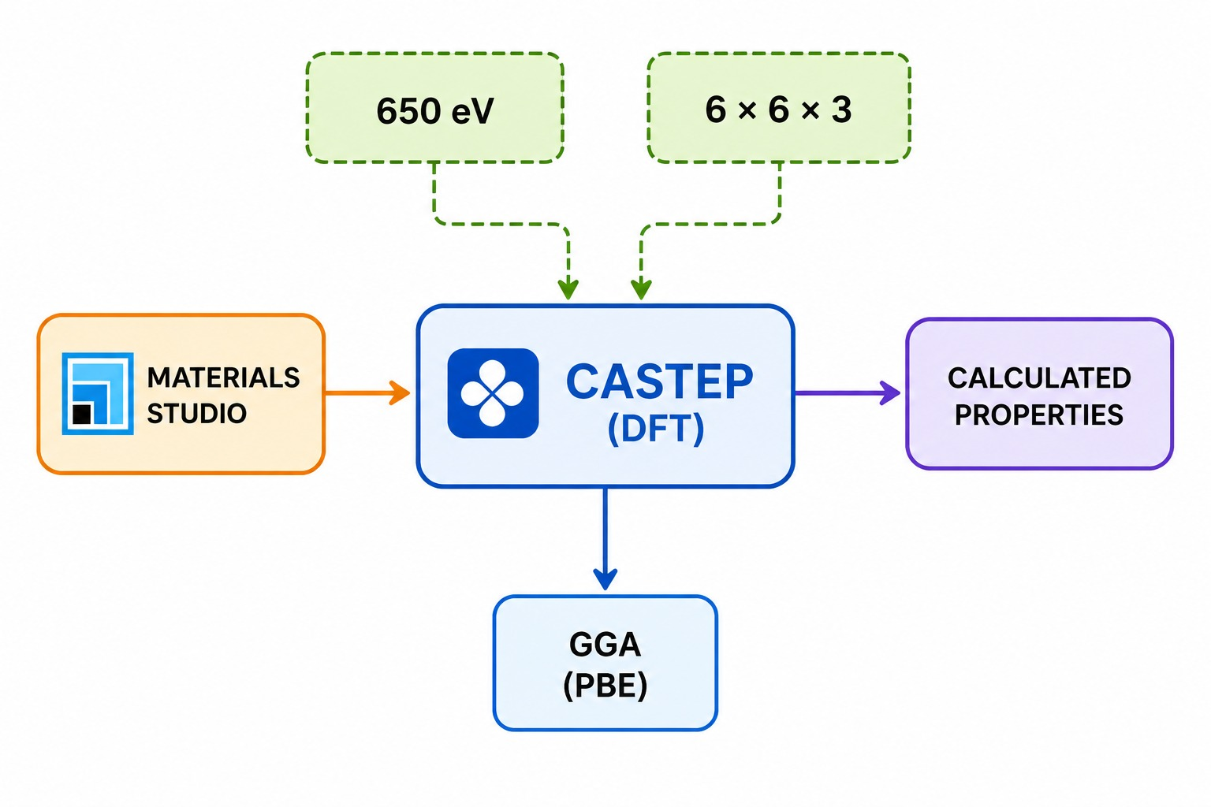
Computational Method
Figure. 3. Schematic representation of the computational method.

Slide 7
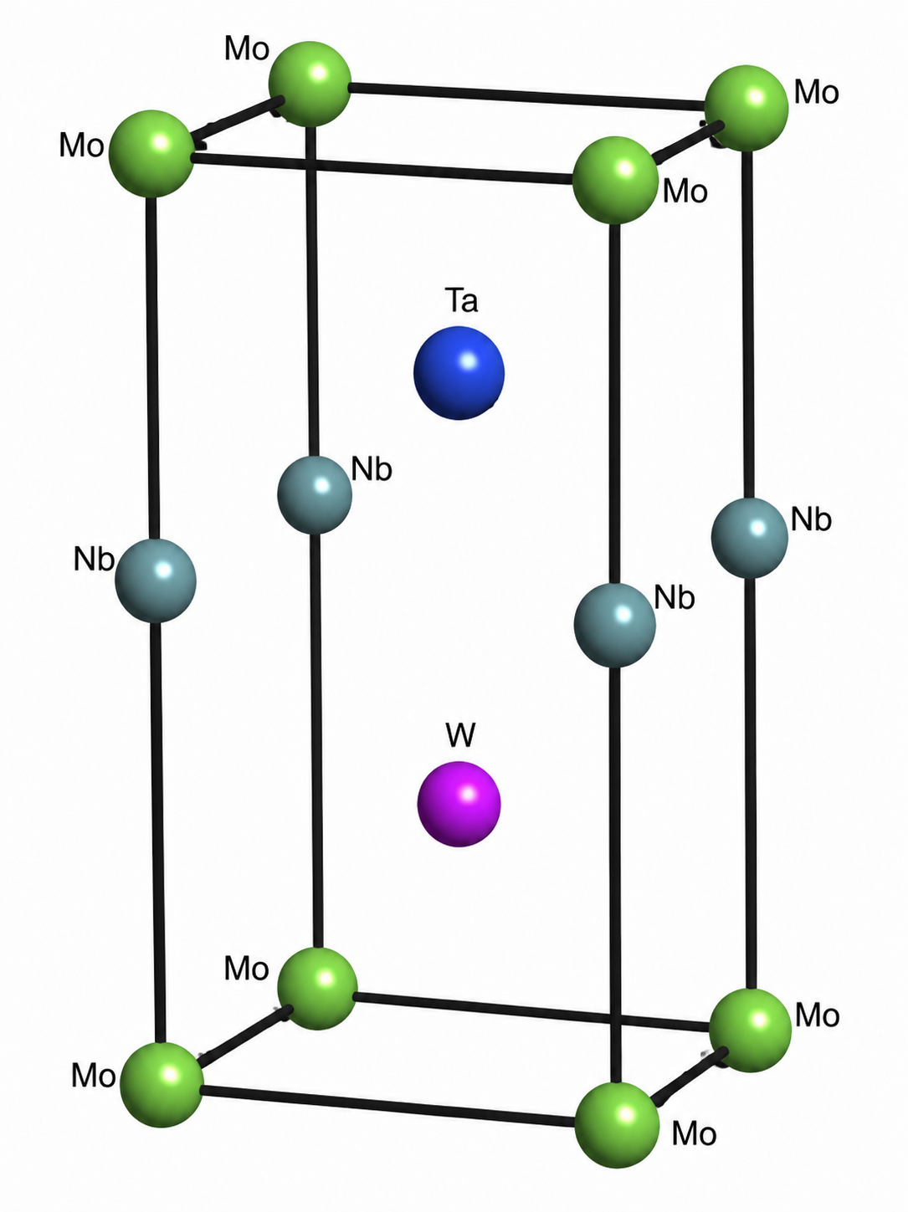
Results and Discussion
Table 1: Computed structural parameters of NbMoTaW and NbMoTaTiW.
RHEA (1x1x2) | Lattice parameter (Å) | This work | Experimental [5] | Theoretical [6]
 |  |  |  |  | Experimental | Theoretical
NbMoTaW | a | 3.194 | 3.213 | 3.271 | 0.019 | 0.077
 | b | 3.194 | 3.213 | 3.271 | 0.019 | 0.077
 | c | 6.388/2 | 3.213 | 3.271 | 0.019 | 0.077
 | ∆H(KJ.mol⁻¹) | -6.5
 | VEC (-) | 5.5
NbMoTaTiW | a | 3.166 | 3.185 | - | 0.019 | -
 | b | 3.166 | 3.185 | - | 0.019 | -
 | c | 6.332/2 | 3.185 | - | 0.019 | -
 | ∆H(KJ.mol⁻¹) | -5.28
 | VEC (-) | 5.2
Fig. 4. Optimised atomic structure Model.
(Pm-3m)

Slide 8
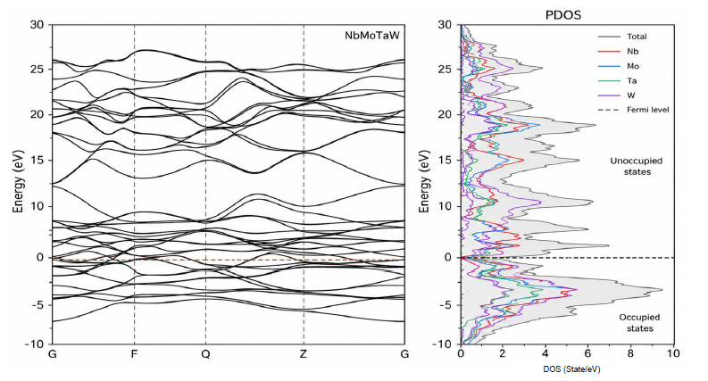
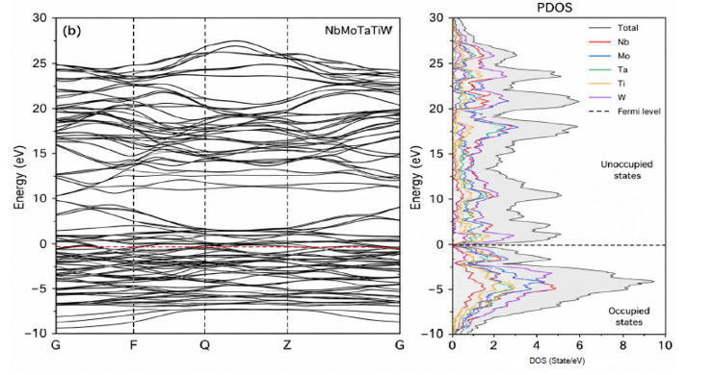
Electronic Properties
(a)
(b)
Figure 5: Electronic band structure and partial density of states of (a) NbMoTaW and (b) NbMoTaTiW.

Slide 9
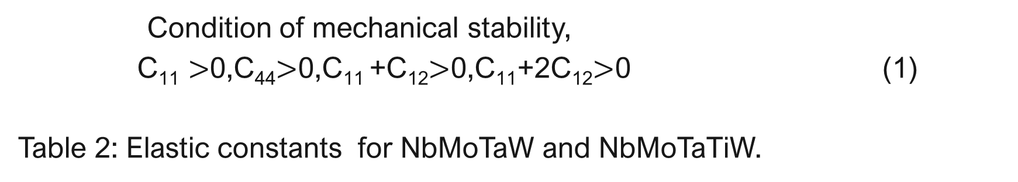
Mechanical Properties
Condition of mechanical stability,
$\text{C}\text{11}>$0,C₄₄$>$0,C₁₁ +C₁₂$>$0,$\text{C}\text{11}$+2C₁₂$>$0 (1)
Table 2: Elastic constants for NbMoTaW and NbMoTaTiW.
RHEA | C₁₁ (GPa) | C₁₂ (GPa) | C₄₄ (GPa) | C₁₂-C₄₄ (GPa)
NbMoTaW | 408.5 | 158.0 | 82.5 | 75.5
NaMoTaTiW | 400.0 | 143.5 | 68.5 | 75.0

Slide 10

Mechanical Properties
The Poisson's ratio (V) indicates how much material can expand when it is stretched, and Pugh’s ratio (G/B) predicts the brittleness and ductility of the material.
$V= \frac{3B−2G}{2(3B+G)}$
Table 3: Bulk, shear, young moduli, Pugh’s ratio and Poisson's ratio for NbMoTaW and NbMoTaTiW.
RHEA | B (GPa) | G (GPa) | G/B | V
NbMoTaW | 241.5 | 97.0 | 0.402 | 0.323
NaMoTaTiW | 229.0 | 88.0 | 0.384 | 0.337

Slide 11
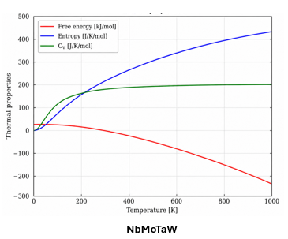
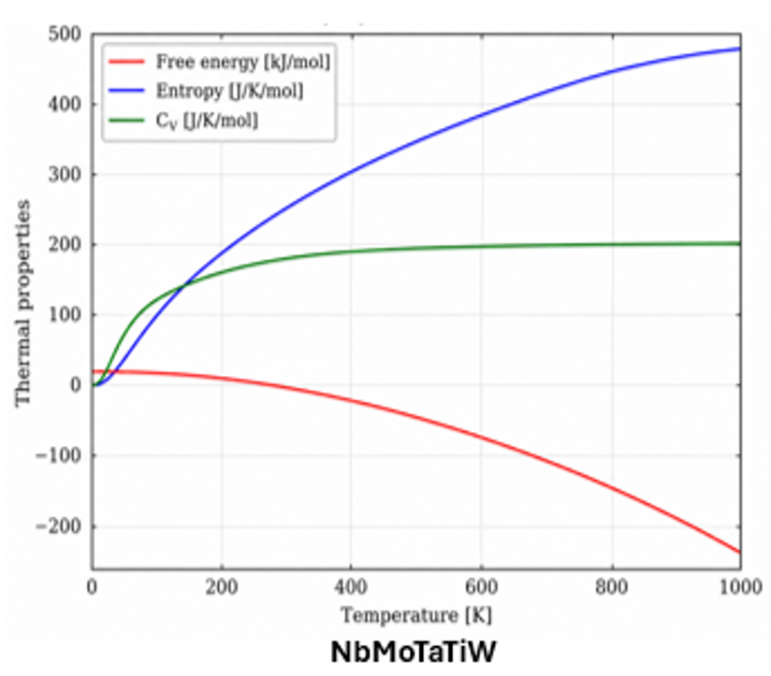
Thermodynamic properties
Figure 6: Thermodynamic properties of: NbMoTaW and (b) NbMoTaTiW

Slide 12
Conclusion
Ti reinforcement preserves the structural stability of NbMoTaW with only minor changes in lattice parameters.
NbMoTaTiW remains mechanically stable and ductile, making it suitable for hydrogen-related applications.
The thermodynamic properties indicate excellent thermal stability over the investigated temperature range.
Ti-reinforced NbMoTaW is a promising candidate for hydrogen storage applications.

Slide 13




Acknowledgements

Slide 14
REFERENCES
Mustafa, N. S., Yap, F. H., Yahya, M. S., & Ismail, M. (2018). The hydrogen storage properties and reaction mechanism of the NaAlH4+ Ca (BH4) 2 composite system. International Journal of Hydrogen Energy, 43(24), 11132-11140.
Kong, L., Cheng, B., Wan, D., & Xue, Y. (2023). A review on BCC-structured high-entropy alloys for hydrogen storage. Frontiers in Materials, 10, 1135864.
Liu, J., Zhao, M., & Rong, L. (2023). Overview of hydrogen-resistant alloys for high-pressure hydrogen environment: on the hydrogen energy structural materials. Clean Energy, 7(1), 99-115.
Zhu, X. H., & Zhang, Y. (2024). Functional applications and data-driven design of high-entropy ceramics. High Entropy Alloys & Materials, 2(2), 219-245.

