Slide 1





Deep Learning Prediction of the performance of a hybrid CsSn(I_{1-x}Br_{x})₃-based perovskite Lead-free using silicon (Si++) as hole transport layer (HTL)
Electrical characterisation of aluminium-polyaniline Schottky diodes using a machine learning approach.
Supervisor: Prof M Msimanga
Co-Supervisor: Dr AD Kapim
Masters Student: Hlulani Ndlovu
Presented by: Dr AD KAPIM KENFACK

Slide 2
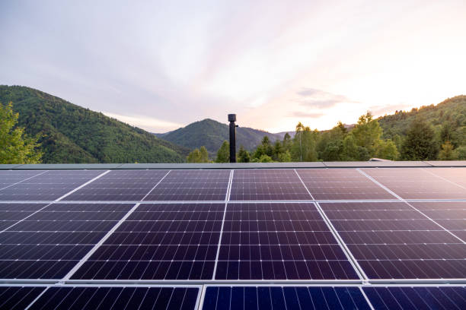
Introduction & Literature Review
Solar Cells:
Convert sunlight into electrical energy through the photovoltaic effect.
Growing demand for renewable and sustainable energy technologies.
Perovskite solar cells have emerged as promising alternatives due to:
High power conversion efficiency.
Low fabrication cost.
Simple processing techniques
1
Faculty of science
Department of physics

Slide 3
Introduction & Literature Review
Metal Contacts and Schottky Junctions:
Metal contacts collect charge carriers in solar cells
A metal-semiconductor interface can form a Schottky junction.
The resulting junction properties influence carrier transport and device performance
Al
PANI
FTO
2
Faculty of science
Department of physics

Slide 4
Introduction & Literature Review
Metal Contacts and Schottky Junctions:
(1) (2
Electrical behaviour is characterized by:
Barrier Height (Φ_{B})
Ideality Factor (n)
Saturation Current (I_{s})
Resistance (R)
3
Faculty of science
Department of physics

Slide 5
Problem Statement
Resistive deposition is a simple and low-cost method for fabricating metallic contacts for Schottky diode devices.
Electrical properties depend on structural parameters such as film thickness and crystallinity
Fabrication and characterization processes can have long iterative turnaround times in device development
4
Faculty of science
Department of physics

Slide 6
Problem Statement
Thin film fabrication
Thin film fabrication
No
No
Good structural properties?
Good structural properties?
No
Yes
Yes
ML predicted electrical properties
Desired electrical properties?
Yes
Functional device
Functional device
Proposed solution
Problem statement
5
Faculty of science
Department of physics

Slide 7
Aim & Objectives
Aim: To predict I-V characteristics from structural properties of Al-PANI contacts using a machine learning algorithm.
Objectives:
Fabricate Al- PANI contact layers of different thickness via resistive deposition.
Characterise the Al-PANI contacts (ERDA & I-V Measurements).
Build ML model to predict l-V parameters of Al –PANI contacts based on the thickness of aluminium layer.
6
Faculty of science
Department of physics

Slide 8
Methodology
FTO Substrate
PANI Electrodeposition
Aluminum Deposition
ERDA (thickness analysis)
Machine Learning Model
I-V Parameters Extraction
I-V Measurements
7
Faculty of science
Department of physics

Slide 9
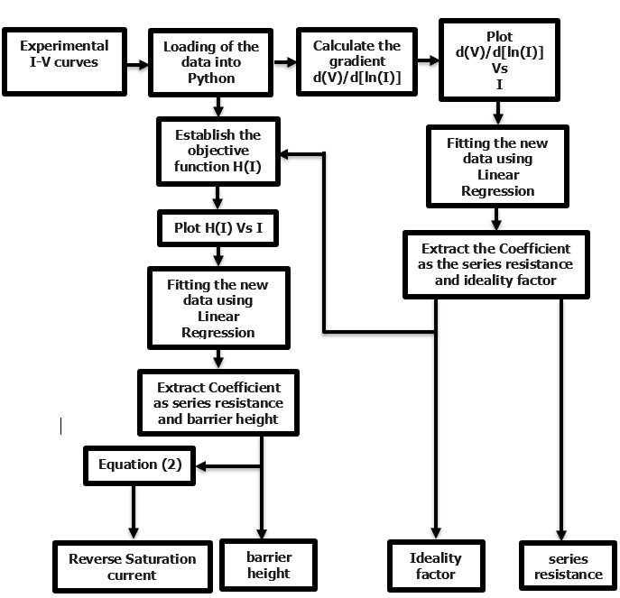
Methodology
I-V Parameters Extraction:
8
Faculty of science
Department of physics

Slide 10
Methodology
Machine Learning Work Flow:
Deposition Al
I-V Experimental data
Parameter Extraction
Data Cleaning + Normalization
Prediction of Electrical Parameters
Performance metric (R2, RMSE, Cross-validation)
KNN Regression Model
Splitting of data (Train/Test)
Neighbour as parameters of the model
9
Faculty of science
Department of physics

Slide 11
Results and Discussions
Al Depth Profile 160 nm:
10
Faculty of science
Department of physics

Slide 12
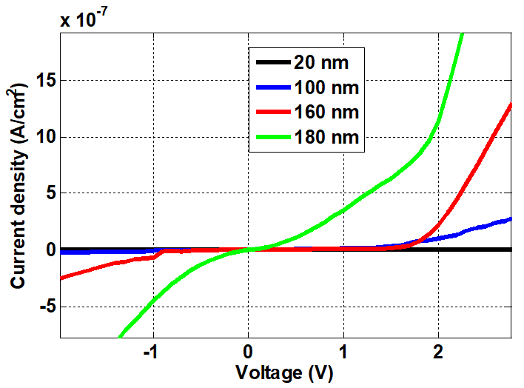
Results and Discussions
Al/PANI/FTO I-V Curves:
11
Faculty of science
Department of physics

Slide 13
Results and Discussions
Performance Metric Versus K-Neighbours:
12
Faculty of science
Department of physics

Slide 14
Results and Discussions
Best performance Metric:
Parameters | Values
K-Neighbours | 2
Score Train | 0.9989
Score Test | 0.9971
RMSE Train | 0.01
RMSE Test | 0.021
Cross-Validation | 0.9564
13
Faculty of science
Department of physics

Slide 15
Results and Discussions
Model Prediction:
14
Faculty of science
Department of physics

Slide 16
Results and Discussions
Model Prediction:
15
Faculty of science
Department of physics

Slide 17
Results and Discussions
Model Prediction:
16
Faculty of science
Department of physics

Slide 18
Results and Discussions
Model Prediction:
17
Faculty of science
Department of physics

Slide 19
Conclusion
Al/PANI/FTO Schottky contacts were successfully fabricated and characterized, with film thickness determined using ERDA and electrical properties extracted from I–V measurements.
The electrical parameters (ideality factor, barrier height, saturation current, and resistance) were found to be dependent on film thickness, demonstrating the influence of structural properties on device performance.
The K-Nearest Neighbors (KNN) model successfully predicted the electrical characteristics from structural data, demonstrating the potential of machine learning as a tool for faster characterization and optimization of Schottky contacts.
18
Faculty of science
Department of physics

Slide 20


4. Conclusion and limitations of the model
13
Faculty of science

