Slide 1
Notes:
Good afternoon, everyone. My name is Washington Mhike, from Tshwane University of Technology, in Pretoria. I will be presenting work from our Masters student Maria Skosana on the fabrication and characterization of polyaniline thin films for potential use in radiation sensors.
As a materials engineer presenting at a physics conference, I should say upfront that my strength here is in the structure-property relationships and the processing-morphology-performance connections.
Where detailed device physics or quantum transport questions arise, I will be transparent about the scope of the work.

Slide 2








Presentation Outline
01
Motivation & Problem Statement
05
Optical Properties
Why affordable polymer sensors?
UV-Vis & band gap (Tauc)
02
Polyaniline Background
06
Electrical Characterisation
ICP properties, synthesis, doping
I-V curves & Schottky diode
03
Experimental Approach
07
Results in Context
Synthesis → film → device
Literature comparison
04
Structural Characterisation
08
Conclusions & Future Work
FTIR · XRD · SEM
1
Notes:
I'll start by explaining why we're interested in organic materials for sensing, and then introduce polyaniline as our material of choice,
Then I will walk through our experimental approach, present structural, optical and electrical results, and close with context and future work.

Slide 3
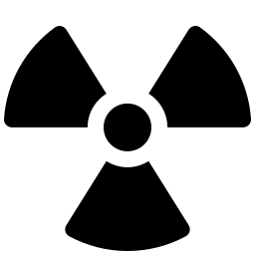
Motivation & Problem Statement
The Challenge
The Opportunity
Si/Ge detectors require high-purity crystals & expensive fabrication
High capital cost limits research & industrial accessibility
Alternative materials (GaAs, SiC, TiO₂) still rely on costly inorganic processing
Organic electronics promise simpler, cheaper fabrication routes
Polyaniline (PANI): relatively inexpensive, solution-processable conducting polymer
Conductivity tuneable over 10 orders of magnitude via acid doping
Schottky diodes from PANI → low-cost nuclear radiation sensor elements
Room-temperature synthesis & spin-coating — no vacuum processing needed
AIM: Study the electrical and optical properties of acid-doped PANI thin films and fabricate low-cost Schottky diode sensor elements.
2
Notes:
Conventional radiation detectors based on silicon or germanium require high-purity crystals and expensive fabrication processes.
This limits accessibility for research and industrial applications in developing-country contexts.
Organic semiconductors like polyaniline offer a different approach: they can be synthesized at room temperature, deposited from solution, and their properties tuned relatively easily.
Therefore, the motivation for this work to investigate whether PANI can be a viable low-cost material for sensor elements.
PANI has advantages in ease of synthesis, environmental stability and the simplicity of its doping chemistry.
Our focus was on demonstrating the proof-of-concept: that a simple, solution-processed material can form a functional Schottky diode suitable for sensor applications

Slide 4


Polyaniline (PANI) — Material Overview
Intrinsic Conductivity
Oxidation States
Advantages over Inorganic
Conjugated π-bond backbone enables charge delocalisation
Conductivity: 10⁻¹⁰ to 10⁵ S·cm⁻¹
Tuneable via acid doping — ideal for semiconductor device use
          (Chiang & MacDiarmid 1986)
Leucoemeraldine (fully reduced, insulating)
Emeraldine base → salt (semiconducting)
Pernigraniline (fully oxidised)
✓ Emeraldine salt (HCl-doped) studied here
(MacDiarmid 2001; Stejskal 2002)
Solution processable — very low cost
Room-temperature synthesis
Spin-coat deposition on any substrate
Chemically & environmentally stable
Modifiable electrical properties
(Stejskal & Gilbert 2002)
Schottky diode: metal–semiconductor junction exhibiting rectifying I-V behaviour — the core device architecture for this sensor application
3
Notes:
Polyaniline is one of the most studied intrinsically conducting polymers.
Its conductivity can be tuned over ten orders of magnitude through acid doping — specifically, the emeraldine base becomes conductive when protonated by acids such as hydrochloric acid to form the emeraldine salt.
This tunability, combined with chemical stability and solution processability, makes it attractive for electronic applications.
The Schottky diode is a metal-semiconductor junction that exhibits rectifying behaviour — current flows easily in one direction but is blocked in the other. That rectifying property is essential for a detector element

Slide 5
Polyaniline (PANI) — Material Overview
Oxidation States
Leucoemeraldine (fully reduced, insulating)
Emeraldine base → salt (semiconducting)
Pernigraniline (fully oxidised)
✓ Emeraldine salt (HCl-doped) studied here
4
Notes:
Polyaniline exists in three oxidation states; the emeraldine form (salt & base), leucoemeraldine, pernigraniline, which are shown here.
The conjugated structure in polyaniline allows for high mobility of charge carriers, and the emeraldine salt form behaves as a p-type semiconductor — this is the form we studied.

Slide 6



Experimental Approach
Synthesis → Doping → Film Fabrication → Device → Characterisation
1
2
3
4
5
Synthesis
Acid Doping
Film Fabrication
Contacts
Characterisation
Aniline hydrochloride
+
APS
in 1 M HCl
(0–5 °C, 12 h)
PANI-HCl → wash →
dedope (NH₄OH)
→ PANI-EB powder
PANI-EB in DMSO
Ultrasonic dispersion
40 °C, 30 min
PANI-EB doped with
HCl solutions: 0.5 M, 1.5 M, 2.5 M
HCl doped solution
spin-coated on
Si wafer & ITO glass Substrates
Al: e-beam evaporation
(Si devices)
Ag: silver paste
(ITO devices)
FTIR
XRD
SEM
UV-Vis (Tauc)
I-V at 300 K, ±1V
(Keithley 2700E)
5
Notes:
The experimental approach was entirely solution-based, which is central to the low-cost proposition.
We synthesized PANI through chemical oxidative polymerization at low temperature, dedoped it to the emeraldine base form, and then redoped with hydrochloric acid at three concentrations.
Films were then deposited by spin coating — a simple, scalable technique.
We fabricated two device configurations: an Al/PANI/n type Si device using e-beam evaporation for the aluminium contacts, and an Ag/PANI/ITO using silver paste contacts. The transparent ITO substrate is particularly interesting for future optically-coupled radiation studies, since light could be transmitted through it to the active PANI layer.
We used 0.5, 1.5 and 2.5 molar HCl solutions to explore how conductivity changes with doping level, and to find the optimal concentration for Schottky junction formation.

Slide 7
Experimental Approach
Synthesis
Synthesis
Aniline hydrochloride
+
APS
in 1 M HCl
(0–5 °C, 12 h)
6
Notes:
Here we present the reaction of the chemical oxidative polymerization of aniline with APS as the oxidising agent in the presence of an acid to produce polyaniline.
Low polymerization temperatures promote the formation of nanoparticles in the synthesis

Slide 8
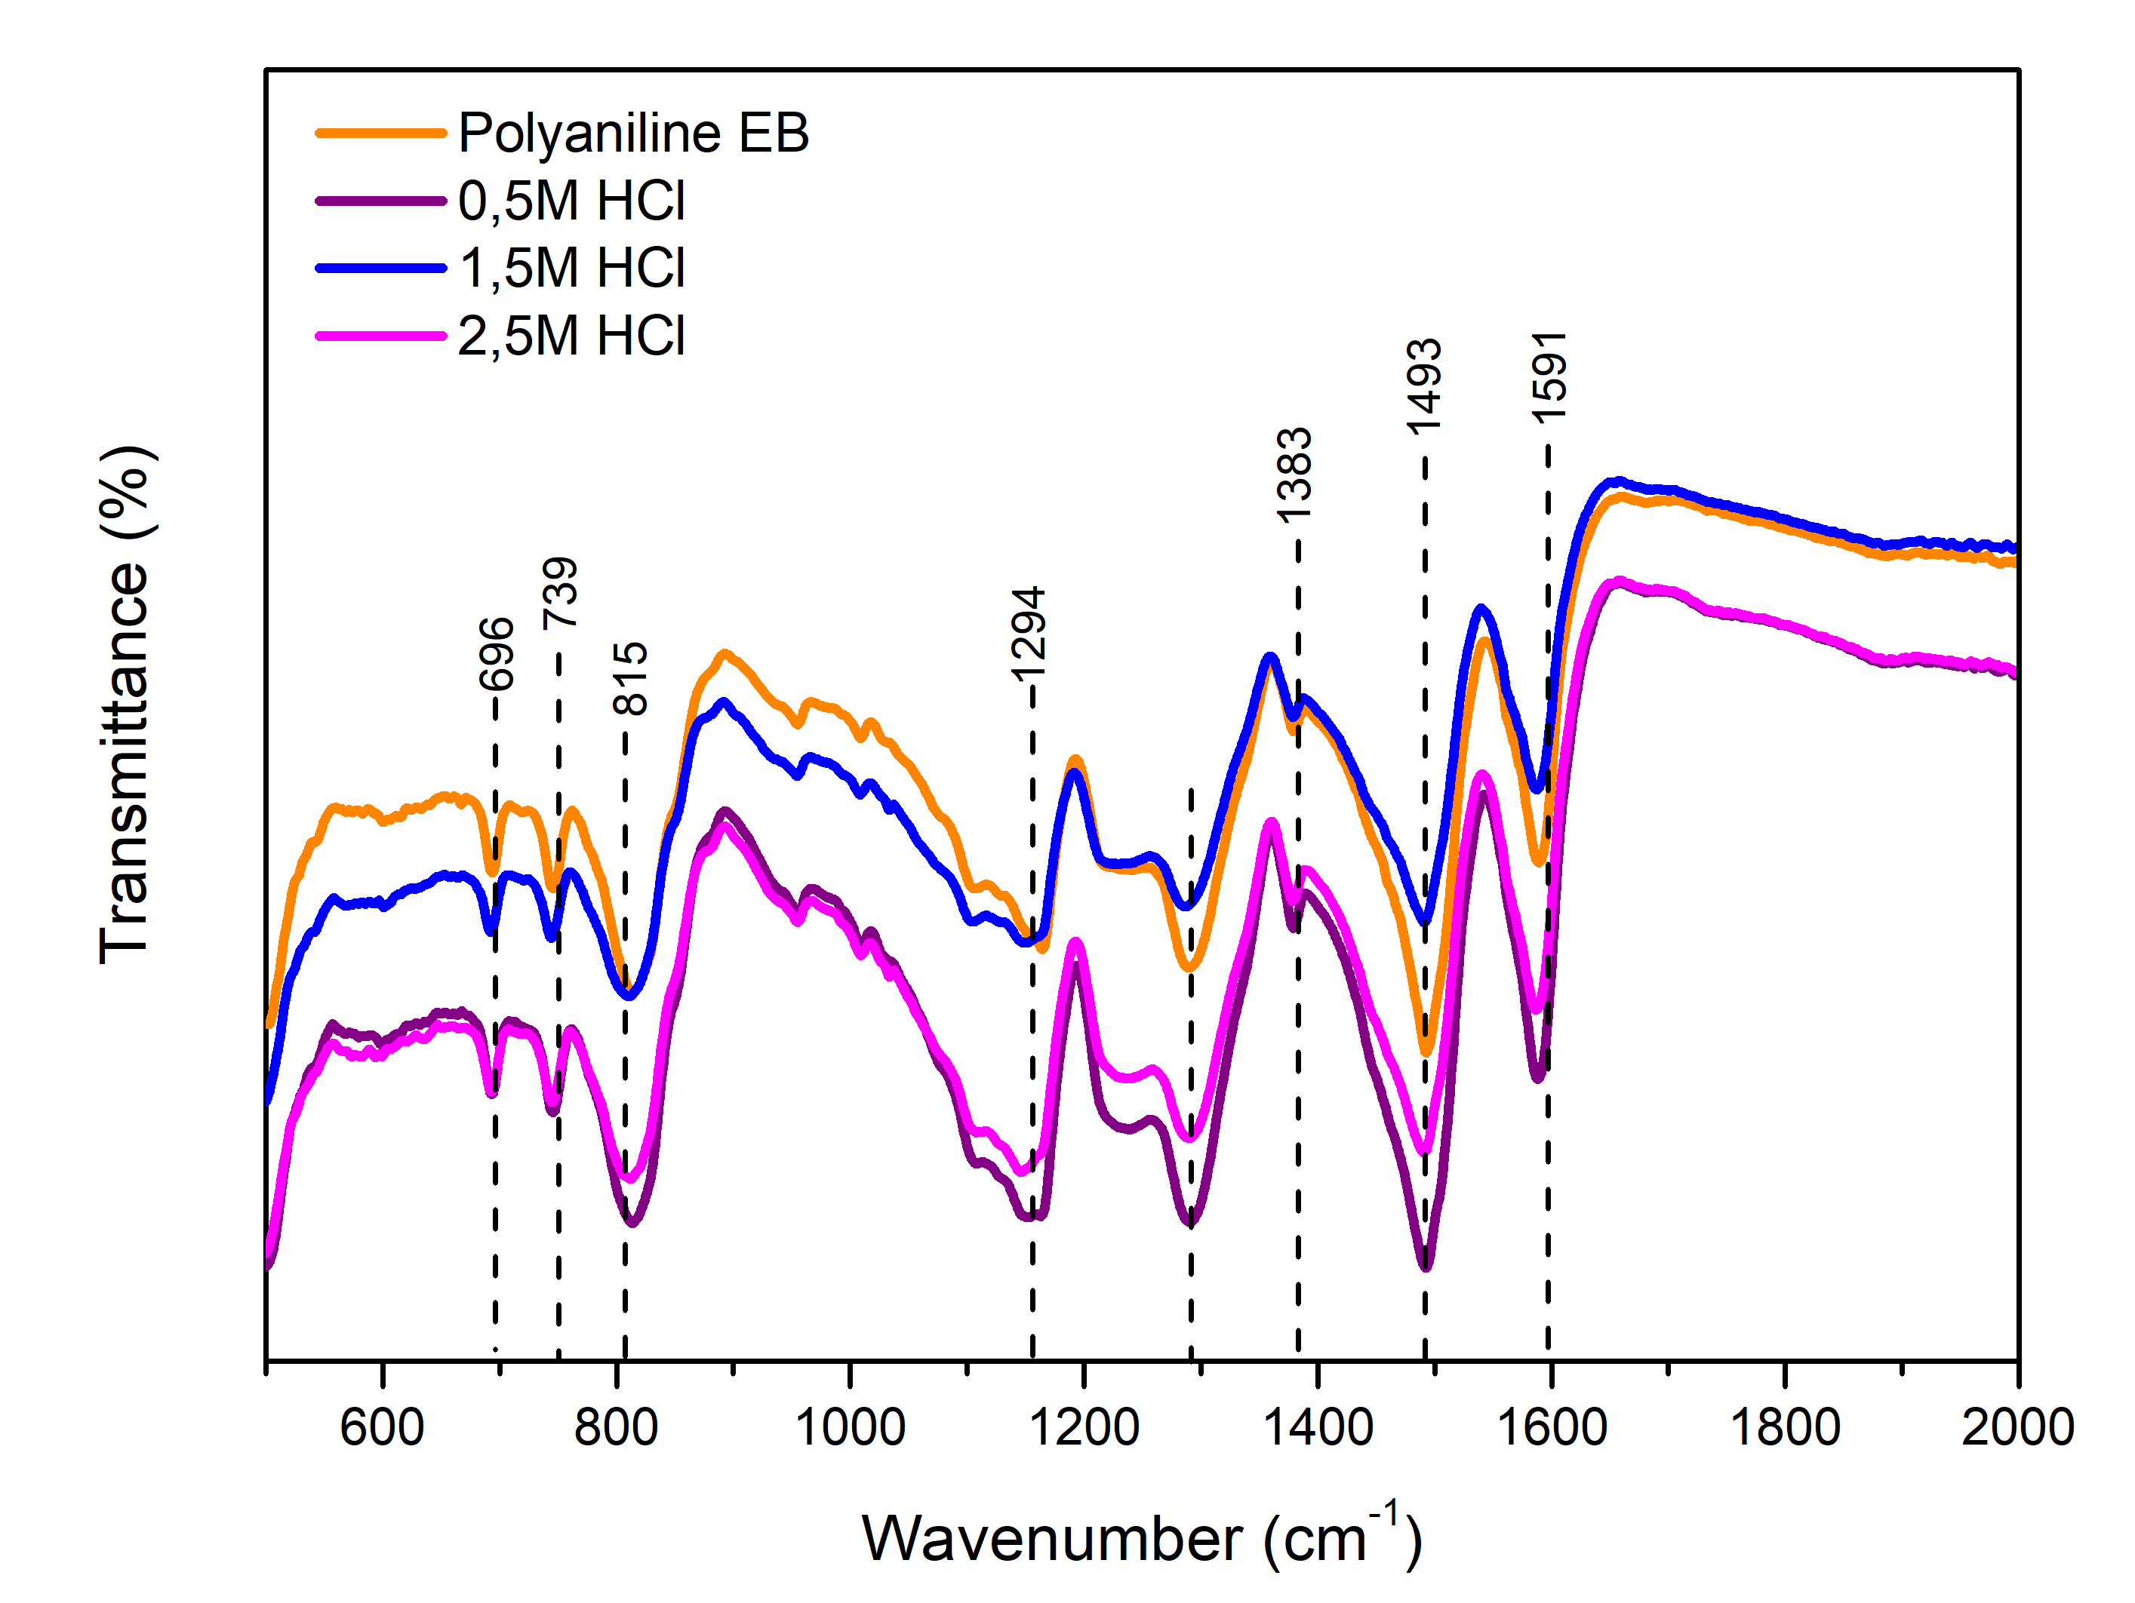
Results & Discussion: Structural Characterisation
FTIR: Confirmation of successful synthesis of PANI
Peak (cm⁻¹) | Assignment
1591 | Quinonoid ring stretching (C=C)
1493 | Benzenoid ring stretching (C=C)
1383 | C=N⁺ stretching — doping indicator
1294 | Quinonoid C–N stretching
815 | Benzenoid C–H bending (para-substitution)
All characteristic PANI bands confirmed (Stejskal & Gilbert 2002)
Protonic doping confirmed, backbone unchanged (Verma & Dutta 2007)
✓ Successful PANI synthesis
7
Notes:
Lets now get to the results and discussion:
Structural characterization confirmed successful synthesis.
FTIR shows all characteristic bands of polyaniline in the emeraldine form.
Importantly, the peak positions don't shift significantly with acid concentration. This tells us doping is protonic — it adds hydrogen ions to the polymer backbone without changing the chemical structure.

Slide 9
Results & Discussion: Structural Characterisation
XRD: Confirmation of semi-crystalline morphology
XRD: Broad peak at 2θ ≈ 22° — semi-crystalline PANI-EB with amorphous content
Consistent with literature for chemically synthesised PANI
No XRD peak shift with HCl doping
Semi-crystalline morphology
Doping is protonic (backbone structure unchanged)
8
Notes:
XRD shows a broad peak at 2 theta 22 degrees, indicating semi-crystalline material with significant amorphous content — this is typical for chemically synthesized PANI and consistent with literature values reported by Stejskal and Gilbert.

Slide 10
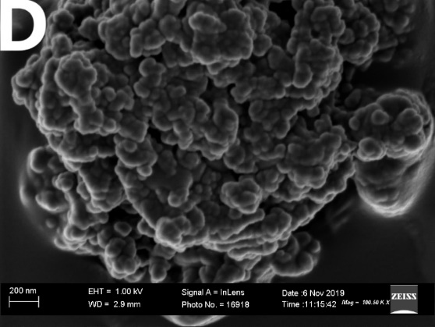
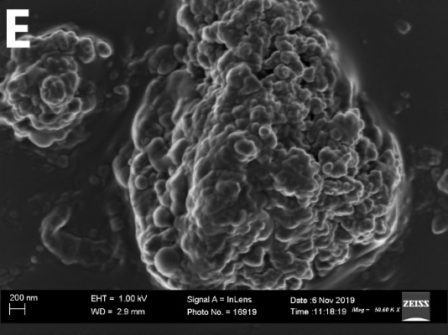
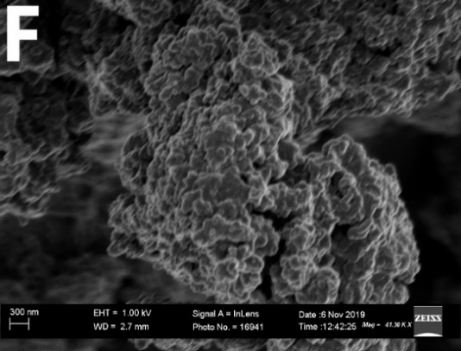
Results & Discussion: Structural Characterisation
SEM: Confirmation PANI morphology
a
b
c
(a) 1.5 M HCl/PANI on ITO
(b) 1.5 HCL/PANI on Silicon
(c) 1.5M HCl/PANI powder
Spherical agglomerated nanoparticles (<200 nm)
No morphology change with HCl doping
9
Notes:
SEM revealed agglomerated spherical nanoparticle less than 200 nm — consistent with the oxidative polymerization route.

Slide 11
Results & Discussion: Optical properties
UV-Vis Spectroscopy
Pristine PANI-EB:
Strong absorption at ~250 nm — π→π* transition (benzenoid rings)
HCl-doped PANI:
Absorption edge redshifts: 250 nm → 300 nm (lower energy)
Intensity decreases, band widens
Weak new band appears at ~300 nm — polaron formation
No morphology change with HCl doping
Redshift → band gap narrowing
New band → polaron formation (protonation creates mid-gap states)
10
Notes:
Optical characterization by UV-Vis spectroscopy allowed us to determine the band gap using the Tauc relation — a standard method for direct allowed transitions
Here we see that the UV-Vis spectra show clear changes after acid doping. The pristine PANI-EB shows a strong π to π absorption at 250 nanometres, characteristic of the conjugated backbone.
After HCl doping, the absorption edge shifts to lower energy — a redshift — and a new band appears at 300 nanometres. This new band is direct evidence that protonation has created polaron states — localised charge carriers that introduce new energy levels within the band gap — which is exactly what causes the band gap narrowing we observe in the Tauc plot.

Slide 12
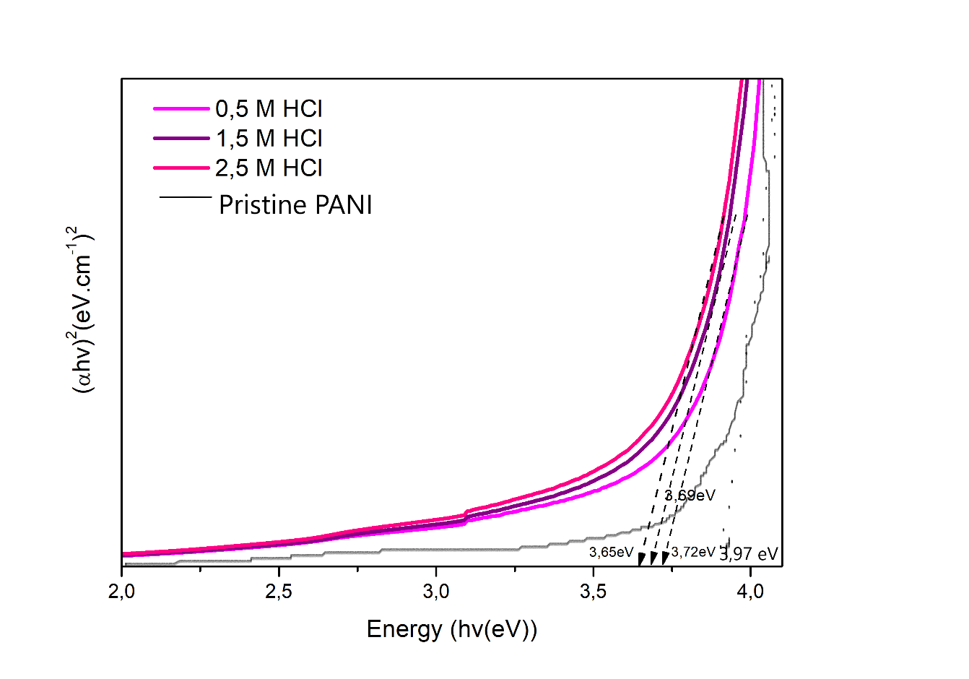
Results & Discussion: Optical properties
Energy band gaps: The Tauc Plot
Sample | Band Gap (eV)
Pristine PANI-EB | 3.97
0.5 M HCl | 3.72
1.5 M HCl | 3.69
2.5 M HCl | 3.65
Band gap narrows with doping (total: 0.32 eV)
Consistent with polaron formation
Wide-bandgap semiconductor regime (> 3 eV) → Suitable for radiation detection:
          Low dark current / leakage
          High breakdown voltage
          Good radiation hardness
Tauc Relation (direct allowed transitions):
(αhν)² = A(hν − Eɡ)
Band gap Eɡ from linear intercept of (αhν)² vs hν
(Tauc et al. 1966)
11
Notes:
Here we have plotted the Tauc relation. We fit a straight line to the absorption edge, and the intercept gives the band gap.
The undoped PANI-EB has a band gap of 3.97 electron volts, consistent with literature values. As HCl concentration increases, the gap narrows to 3.65 electron volts — a total reduction of 0.32 electron volts. This narrowing is due to the formation of polaron and bipolaron mid-gap states when the imine nitrogen is protonated — in other words, we are creating new energy levels within the gap.
All values remain above 3.6 electron volts, placing this material in the wide-bandgap regime. This is advantageous for radiation detection because wide-bandgap semiconductors have low dark current and high breakdown voltage.

Slide 13
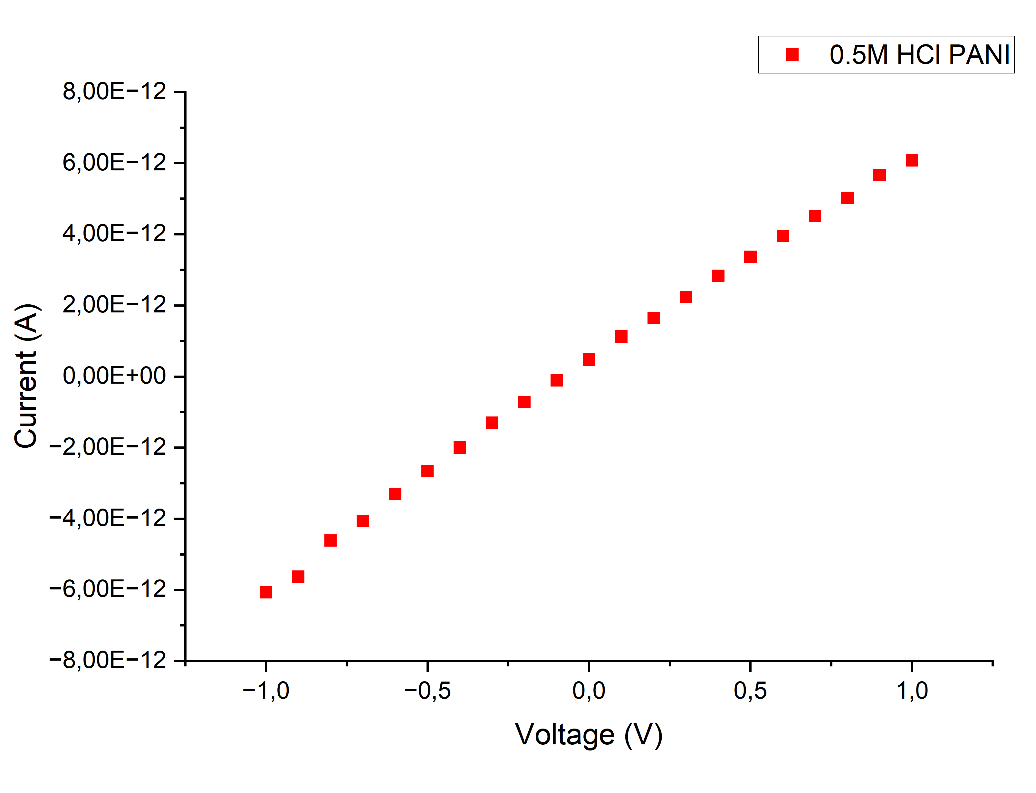
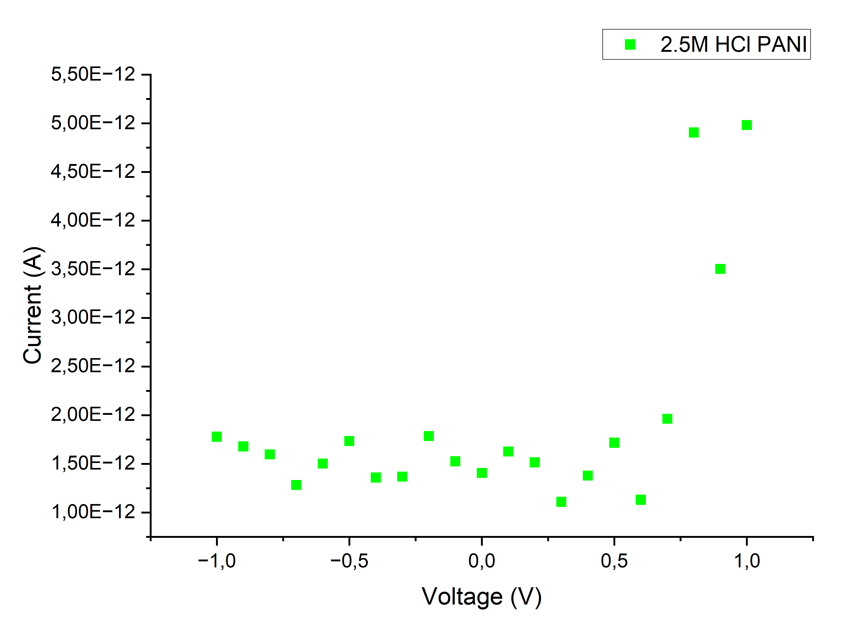
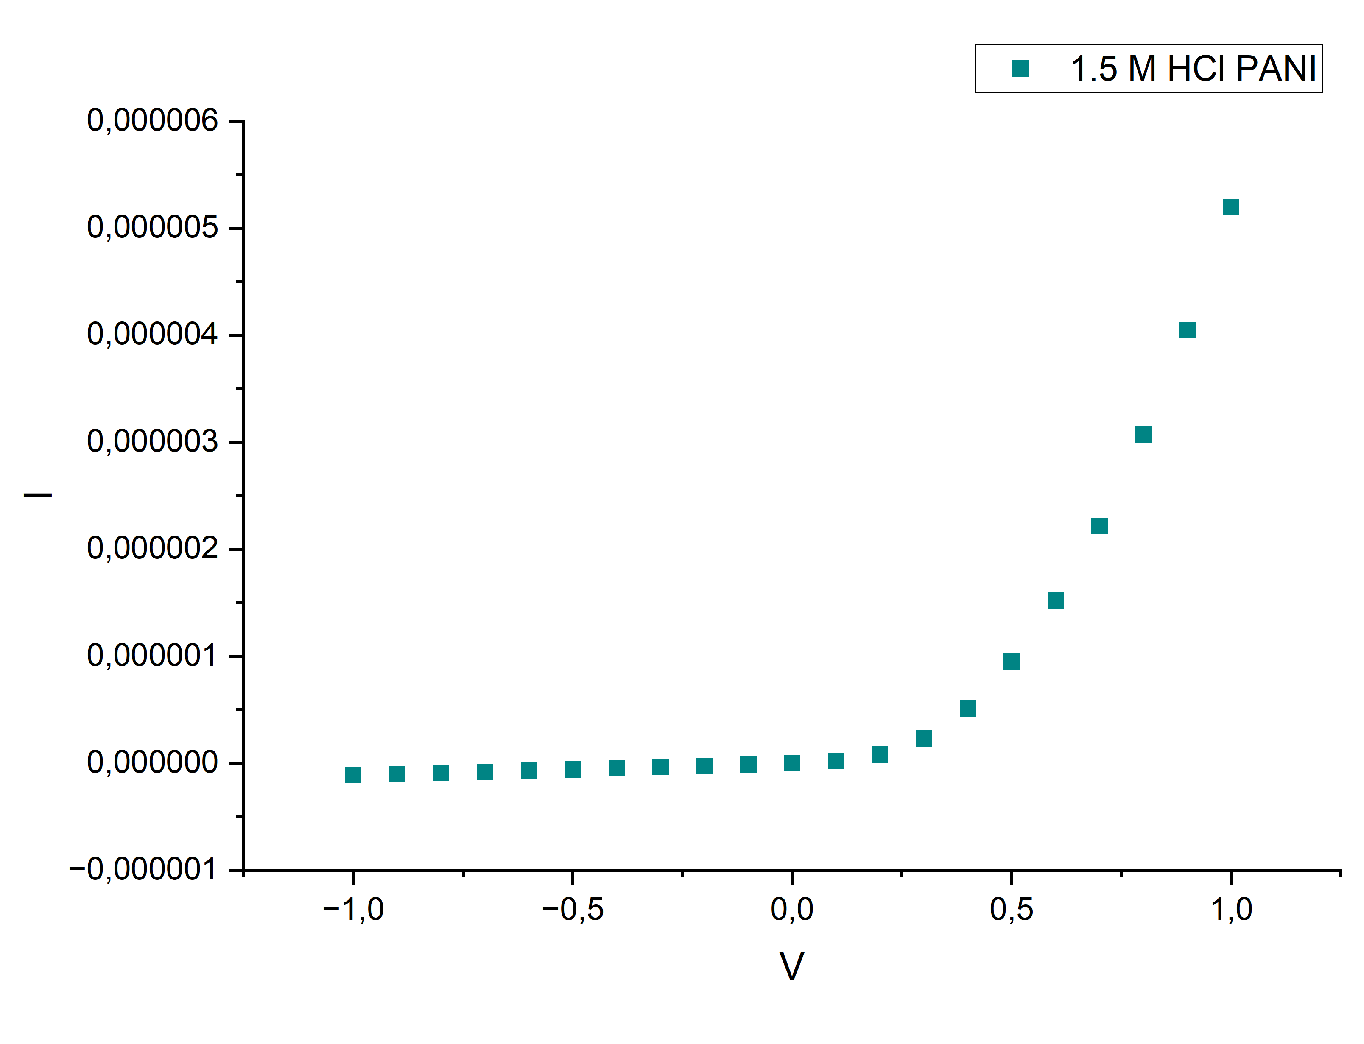
Results & Discussion: Electrical properties
I-V Measurements: Three device configurations tested at 300 K, bias range ±1 V (Keithley 2700E)
Current (A)
Voltage (V)
Al/PANI/n-Si: 0.5 M HCl
Ag/PANI/ITO: 2.5 M HCl
Ag/PANI/ITO: 1.5 M HCl
Device | Doping | I-V Behaviour | Diode?
Al / PANI / n-Si | 0.5 M HCl | Linear — ohmic (no rectification) | ✗ No
Ag / PANI / ITO | 2.5 M HCl | Fluctuating — inconclusive | ✗ No
Ag / PANI / ITO | 1.5 M HCl | Rectifying I-V — Schottky diode confirmed ✓ | ✓ YES
12
Notes:
Now to the electrical results:
Three device configurations were tested.
At 0.5 M doping the conductivity was insufficient to form a rectifying junction — the I-V was simply linear, ohmic behaviour.
At 2.5 M we suspect over-doping introduced structural disorder at the metal-polymer interface, giving unstable fluctuating current.
Only at 1.5 M HCl doping in the Ag/PANI/ITO configuration did we obtain clear rectifying behaviour — a Schottky diode.

Slide 14
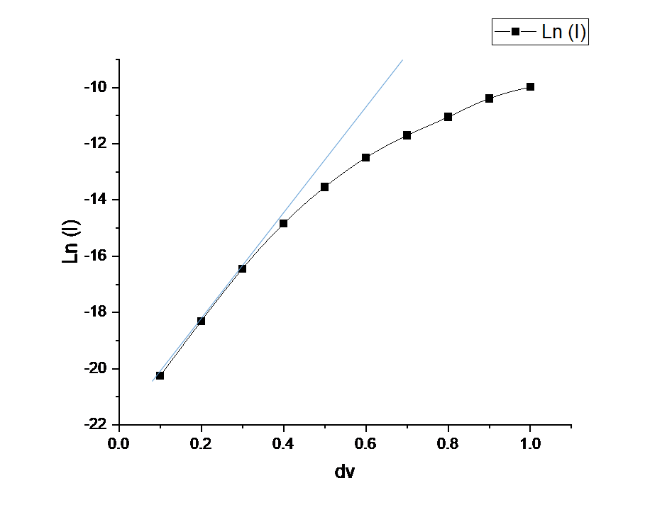
Results & Discussion: Electrical properties
I-V Measurements: Three device configurations tested at 300 K, bias range ±1 V (Keithley 2700E)
Shockley Thermionic Emission Equation
I = Iₛ · [ exp(qV / ηkT) − 1 ]
Iₛ = saturation current, η = ideality factor (Rhoderick & Williams 1988)
For V > 3kT/q:
I = I_{s} · exp(qV/ηkT)
Parameters extracted from ln I vs V plot:
Intercept → I_{s} current: 1.82 nA
Slope → η: 2
Ideality Factor (η):
η = 1 → ideal thermionic emission
η = 2 → recombination-dominated ← this device
η > 2 → interface traps / series resistance
ln I vs V curve of the ITO/PANI film doped with 1.5M HCl
13
Notes:
To quantify the junction quality, we extracted the Schottky parameters using thermionic emission theory.
We extracted an ideality factor of 2.0. An ideal diode gives η = 1 — pure thermionic emission.
An ideality factor of 2 indicates that recombination current in the depletion region is the dominant transport mechanism, rather than thermionic emission alone
This is widely reported for polymer-based Schottky junctions and attributed to interfacial states and series resistance.
This is consistent with the literature for polymer-based Schottky diodes — Yakuphanoglu et al. 2006 reported η = 4.59 for a similar system. Our value of 2.0 actually represents relatively good junction quality by comparison.

Slide 15
Results & Discussion: Electrical properties
Schottky Diode Parameters: Ag / PANI (1.5 M HCl) / ITO device — thermionic emission analysis
2.0
1.82 nA
0.9 eV
Ideality Factor (η)
Saturation Current (Iₛ)
Schottky Barrier Height Φ_{B}
Recombination-dominated
Low → consistent with high Φ_{B}
A* = 32 A·cm⁻²·K⁻² (thermionic)
Physical Interpretation
η = 2.0 → depletion-region recombination dominant; high-level injection regime
High Φ_{B} (0.9 eV) physically consistent with very low Iₛ (1.82 nA) — higher barrier suppresses majority carrier injection
Non-ideal contact: thin interfacial oxide at Ag/PANI → MIS (metal-insulator-semiconductor) behaviour
High-field linear regime: series resistance of PANI film + partial ohmic contribution from Ag contact
Φ_{B} calculated from: Φ_{B} = (kT/q) · ln(A*T²/Iₛ) where A* = Richardson constant = 32 A·cm⁻²·K⁻² (p-Si) (Rhoderick & Williams 1988)
14
Notes:
The three key Schottky parameters extracted from the ln(I) vs V plot are: ideality factor 2.0, saturation current 1.82 nanoamperes, and barrier height 0.9 electron volts.
As I mentioned, the ideality factor of 2 indicates recombination-dominated transport.
The saturation current of 1.82 nA is low, and this is physically consistent — a higher barrier height suppresses thermally-excited majority carrier injection across the junction, so you expect a lower Iₛ.
The barrier height of 0.9 eV is calculated from thermionic emission theory using Richardson's constant of 32 A·cm⁻²·K⁻² — the theoretical value for p-type silicon. We use this for comparative analysis, as a specific Richardson constant for our PANI films is not established in the literature.
This barrier height is among the highest reported for PANI Schottky diodes, suggesting good junction quality.

Slide 16
Results & Discussion: Context
PANI-based Schottky diodes: how does this work compare with literature?
Study | Device | η | Iₛ | Φ_{B} (eV)
Yakuphanoglu et al. (2006) | Ag/PANI/n-Si | 4.59 | — | 0.38
Asgar et al. (2013) | PANI/Au–Al | ~1.8 | — | ~0.6
Tharwat et al. (2011) | PANI-PMMA/Al | ~2.1 | ~nA | ~0.7
Reza et al. (2020) | ITO/PANI/N719/Ag | ~8 | — | 0.48
This work | Ag/PANI(1.5M)/ITO | 2.0 | 1.82 nA | 0.9 ★
★ Highest Φ_{B} in this comparison table
Significance of This Work
Φ_{B} = 0.9 eV — highest in this comparison, suggesting superior junction quality for solution-processed PANI
η = 2.0 — consistent with best results in literature (vs η = 4.59 for Yakuphanoglu et al.)
ITO substrate: transparent electrode → enables future optically-coupled radiation detection studies
Fully low-cost, scalable, solution-processed fabrication route — no vacuum synthesis required
15
Notes:
When we compare with published literature, the 0.9 eV barrier height stands out.
Yakuphanoglu et al. used a similar PANI/Ag system on n-Si and obtained a barrier height of only 0.38 eV with an ideality factor of 4.59 — much less ideal junction behaviour.
Reza et al. used an ITO substrate like ours but in a more complex multilayer structure and obtained only 0.48 eV. Our simpler Ag/PANI/ITO structure outperforms the literature on barrier height.
The transparent ITO substrate opens a specific possibility: future optically-coupled radiation detection, where photons from a scintillator could be transmitted through the ITO into the PANI active layer.
This is a distinct advantage over opaque silicon substrates

Slide 17

Conclusions & Future Work
Conclusions
Future Work
PANI synthesised by chemical oxidative polymerisation — confirmed by FTIR
Semi-crystalline films spin-coated on Si & ITO substrates
Band gap narrows 3.97 → 3.65 eV with HCl doping (protonic mechanism confirmed by XRD)
Schottky diode at 1.5 M HCl — η = 2.0, Iₛ = 1.82 nA, Φ_{B} = 0.9 eV
Φ_{B} = 0.9 eV — highest reported for PANI Schottky diodes in the literature surveyed
Fully solution-processed, low-cost, scalable fabrication route demonstrated
Vary metal contacts (Au, Pt, Cu) to optimise Φ_{B} and η
Temperature-dependent I-V to decouple thermionic vs. recombination contributions
Capacitance-voltage (C-V) → depletion width & interface state density
Direct radiation response characterisation (α, β, γ sources) — the critical validation step
PANI blends with ZnO / TiO₂ nanoparticles for improved junction quality
16
Notes:
To summarise: we successfully synthesised polyaniline and confirmed its structure by FTIR.
We deposited semi-crystalline thin films on both silicon and ITO substrates by spin coating. The band gap decreases with doping from 3.97 to 3.65 eV, confirming protonic doping.
We demonstrated a functional Schottky diode with η = 2.0, Iₛ = 1.82 nA, and ΦB = 0.9 eV — the highest barrier height reported for PANI Schottky diodes in our literature survey. The key message is that we've shown a solution, low-cost, scalable route to a device that could serve as a sensor element.
The most important next step is direct radiation response testing — that's where we can validate the device as a functional sensor rather than just a diode.

Slide 18
References
[1] Chiang, J.C. & MacDiarmid, A.G. (1986) Polyaniline: protonic acid doping of the emeraldine form to the metallic regime. Synthetic Metals, 13, pp. 193–205.
[6] Yakuphanoglu, F. et al. (2006) Electrical and optical properties of an organic semiconductor based on polyaniline and fabrication of Ag/PANI/n-Si Schottky diode. Journal of Physical Chemistry B, 110(34), pp. 16908–16913.
[2] MacDiarmid, A.G. (2001) 'Synthetic metals': a novel role for organic polymers. Angewandte Chemie International Edition, 40(14), pp. 2581–2590.
[7] Asgar, H. et al. (2013) Fabrication and characterisation of polyaniline based Schottky diodes. 21st Iranian Conference on Electrical Engineering (ICEE), pp. 1–5.
[3] Stejskal, J. & Gilbert, R.G. (2002) Polyaniline: preparation of a conducting polymer. Pure and Applied Chemistry, 74(5), pp. 857–867.
[8] Tharwat, M. et al. (2011) Fabrication and characterisation of PANI-PMMA/Al Schottky diode. Current Applied Physics, 11, pp. 724–730.
[4] Tauc, J., Grigorovici, R. & Vancu, A. (1966) Optical properties and electronic structure of amorphous germanium. Physica Status Solidi, 15, pp. 627–637.
[9] Reza, M., Steky, F.V. & Suendo, V. (2020) Effect of acid doping on junction characteristics of ITO/PANI/N719/Ag diode. Journal of Electronic Materials, 49(3), pp. 1835–1840.
[5] Rhoderick, E.H. & Williams, R.H. (1988) Metal-Semiconductor Contacts. 2nd edn. Oxford: Clarendon Press.
[10] Verma, D. & Dutta, V. (2007) Role of novel microstructure of polyaniline thin film deposited by spin coating. Solar Energy Materials and Solar Cells, 91(15–16), pp. 1305–1312.
17
Notes:
Here we present a few key references.

Slide 19

Acknowledgments
Grant No. 118537
18
Notes:
We are grateful to the NRF for funding this research under Grant No. 118537

Slide 20

Notes:
Thank you. I am happy to take any questions

