Slide 1
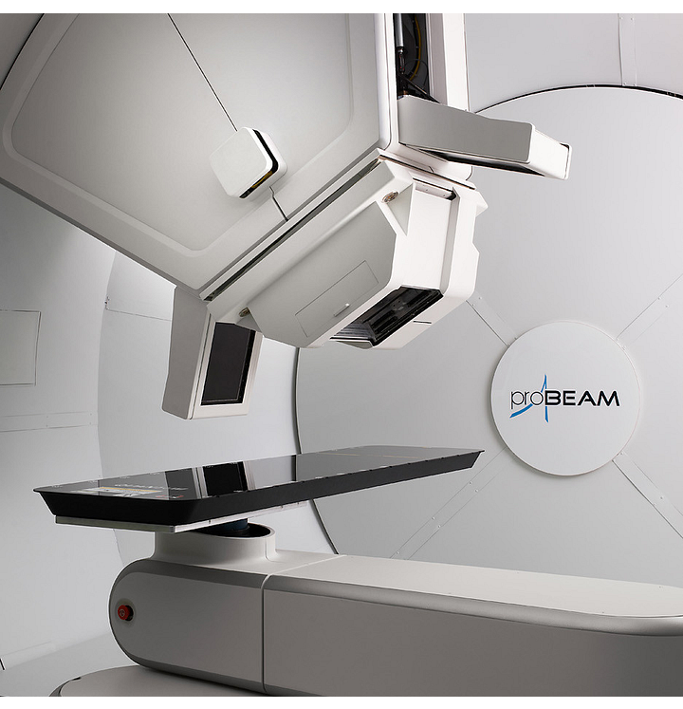




Prompt gamma imaging of a clinical proton beam using
Cd Zn Te Compton cameras with a maximum likelihood expectation maximization technique
Josiah De Klerk
University of Cape Town
Department of Physics
Farshad Safavi, Jerimy Polf, Lei Ren, Sina Mossahebi, Steve Peterson

Slide 2




Cancer – A treatable problem
Globally
Africa
Treatment
2020
A leading cause of death with 10 million deaths 1 in 6 deaths
2022:
1,185,216 cancer cases with 763,843 deaths
Surgery
Immunotherapy
100,000 new childhood cancer cases are being diagnosed annually in Africa.
Chemotherapy
Radiation Treatment

Slide 3


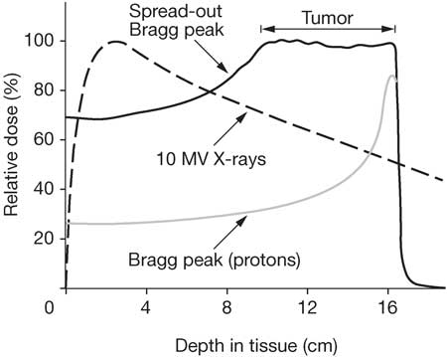
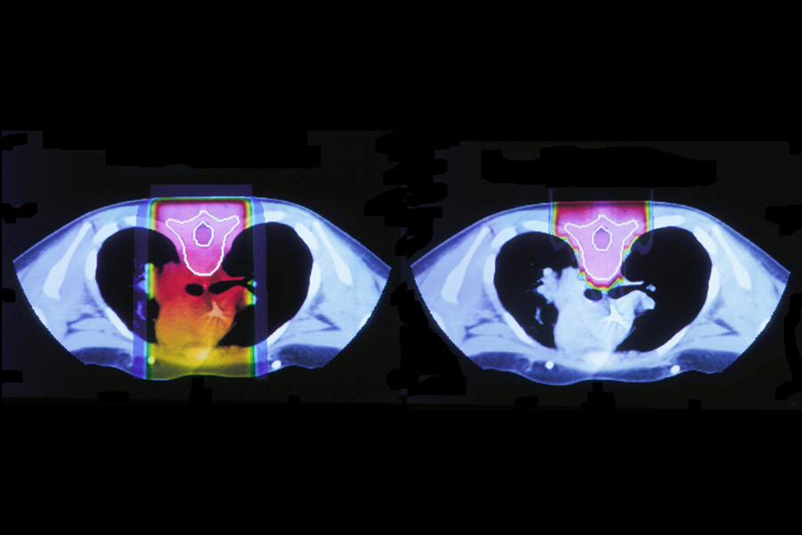
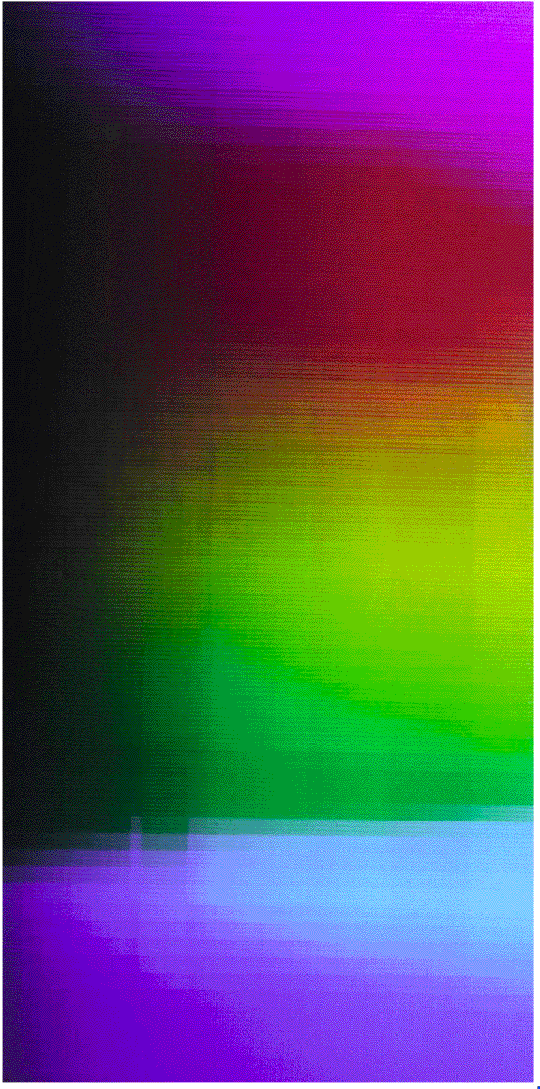
Radiation treatment: Proton therapy
Goal:
To deliver a therapeutic dose to the tumor while minimizing radiation exposure to surrounding healthy tissues
How:
Precise treatment planning and accurate dose delivery.
Photons
100
60
10
Protons
The Far Side – Gary Larson

Slide 4
Radiation treatment: Proton therapy
Goal:
To deliver a therapeutic dose to the tumor while minimizing radiation exposure to surrounding healthy tissues
How:
Precise treatment planning and accurate dose delivery.
Benefits
The low entry point and sharp distal fall-off
i.e., protons stop (Finite range)
The low-dose plateau with low energy transfer after the Bragg peak
Limitations
Beam range uncertainty: tissue density fluctuation, range straggling , large penumbra ….
Patient and organ movement

Slide 5
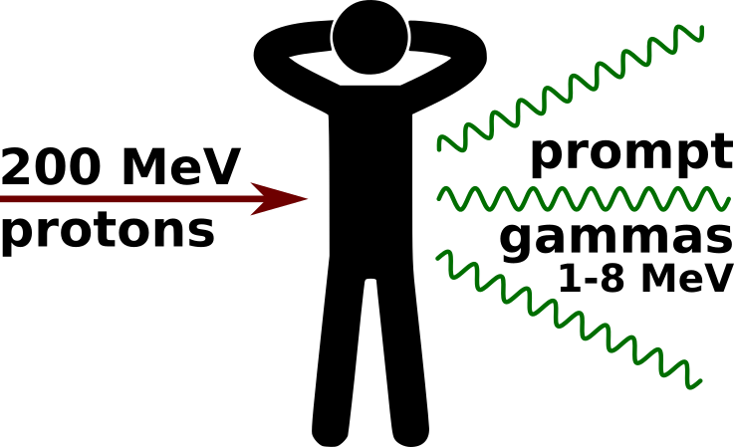
Prompt Gamma Imaging (PGI)
A solution to proton range verification
During proton therapy, accelerated protons excite atomic nuclei, which promptly de-excite and emit prompt gamma rays.
200 MeV protons
on water target
J Jeyasugiththan et al 2021 BioMed Express, 7, 025013

Slide 6
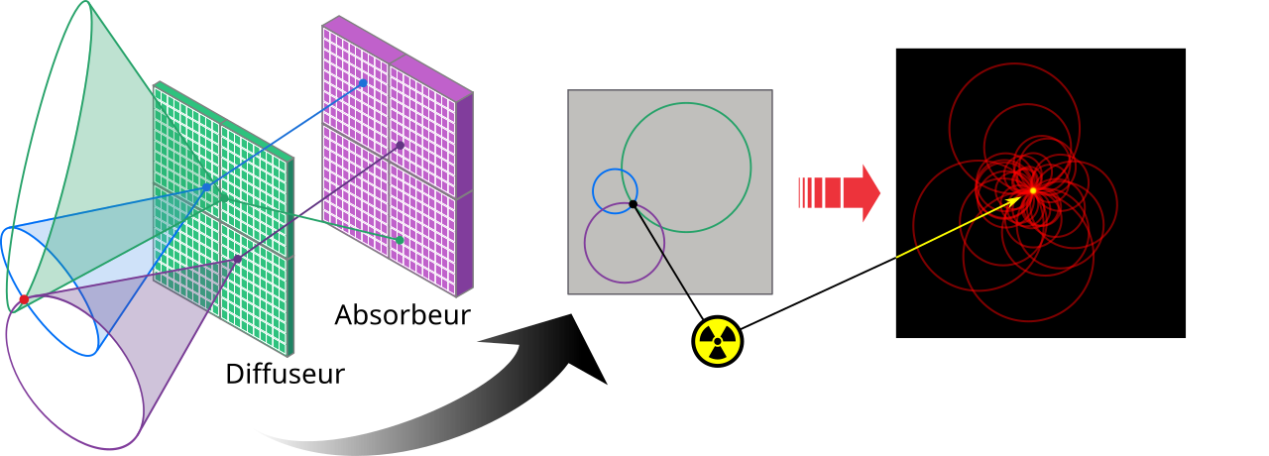

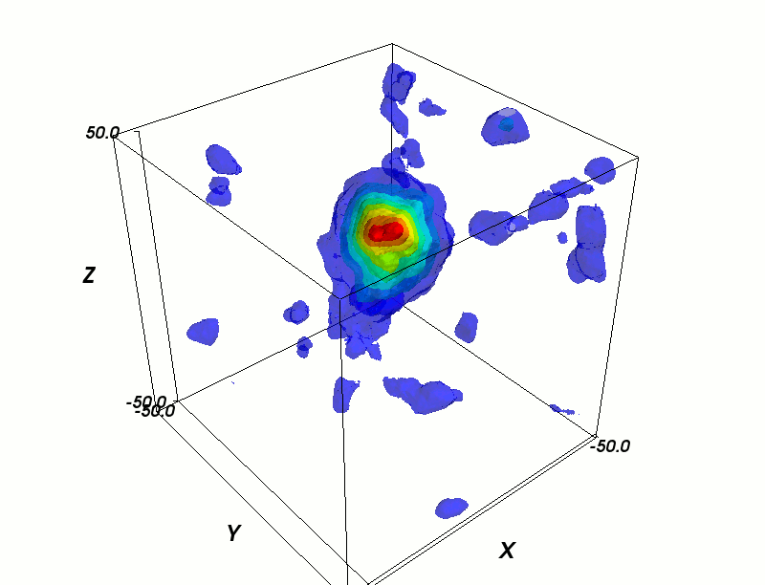
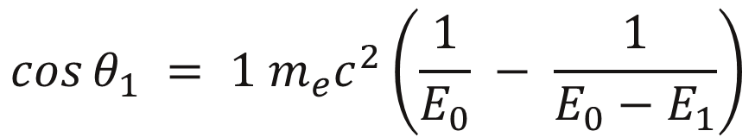
Prompt Gamma Imaging (PGI)
Compton Cameras
Each event in the Compton camera produces a
cone-of-origin.
$$\cos{θ_{1} = 1 m_{e}c^{2}\left(\frac{1}{E_{0}} − \frac{1}{E_{0}−E_{1}}\right)}$$
Absorber
The cones are overlapped to produce an image of the source location.
Scatterer
¹³⁷Cs point source using CORE algorithm from the UCT Polaris detector system
Notes:
an apex (scatter location) an axis (scatter direction) a cosine of the cone's opening angle (derived from Compton kinematics)

Slide 7
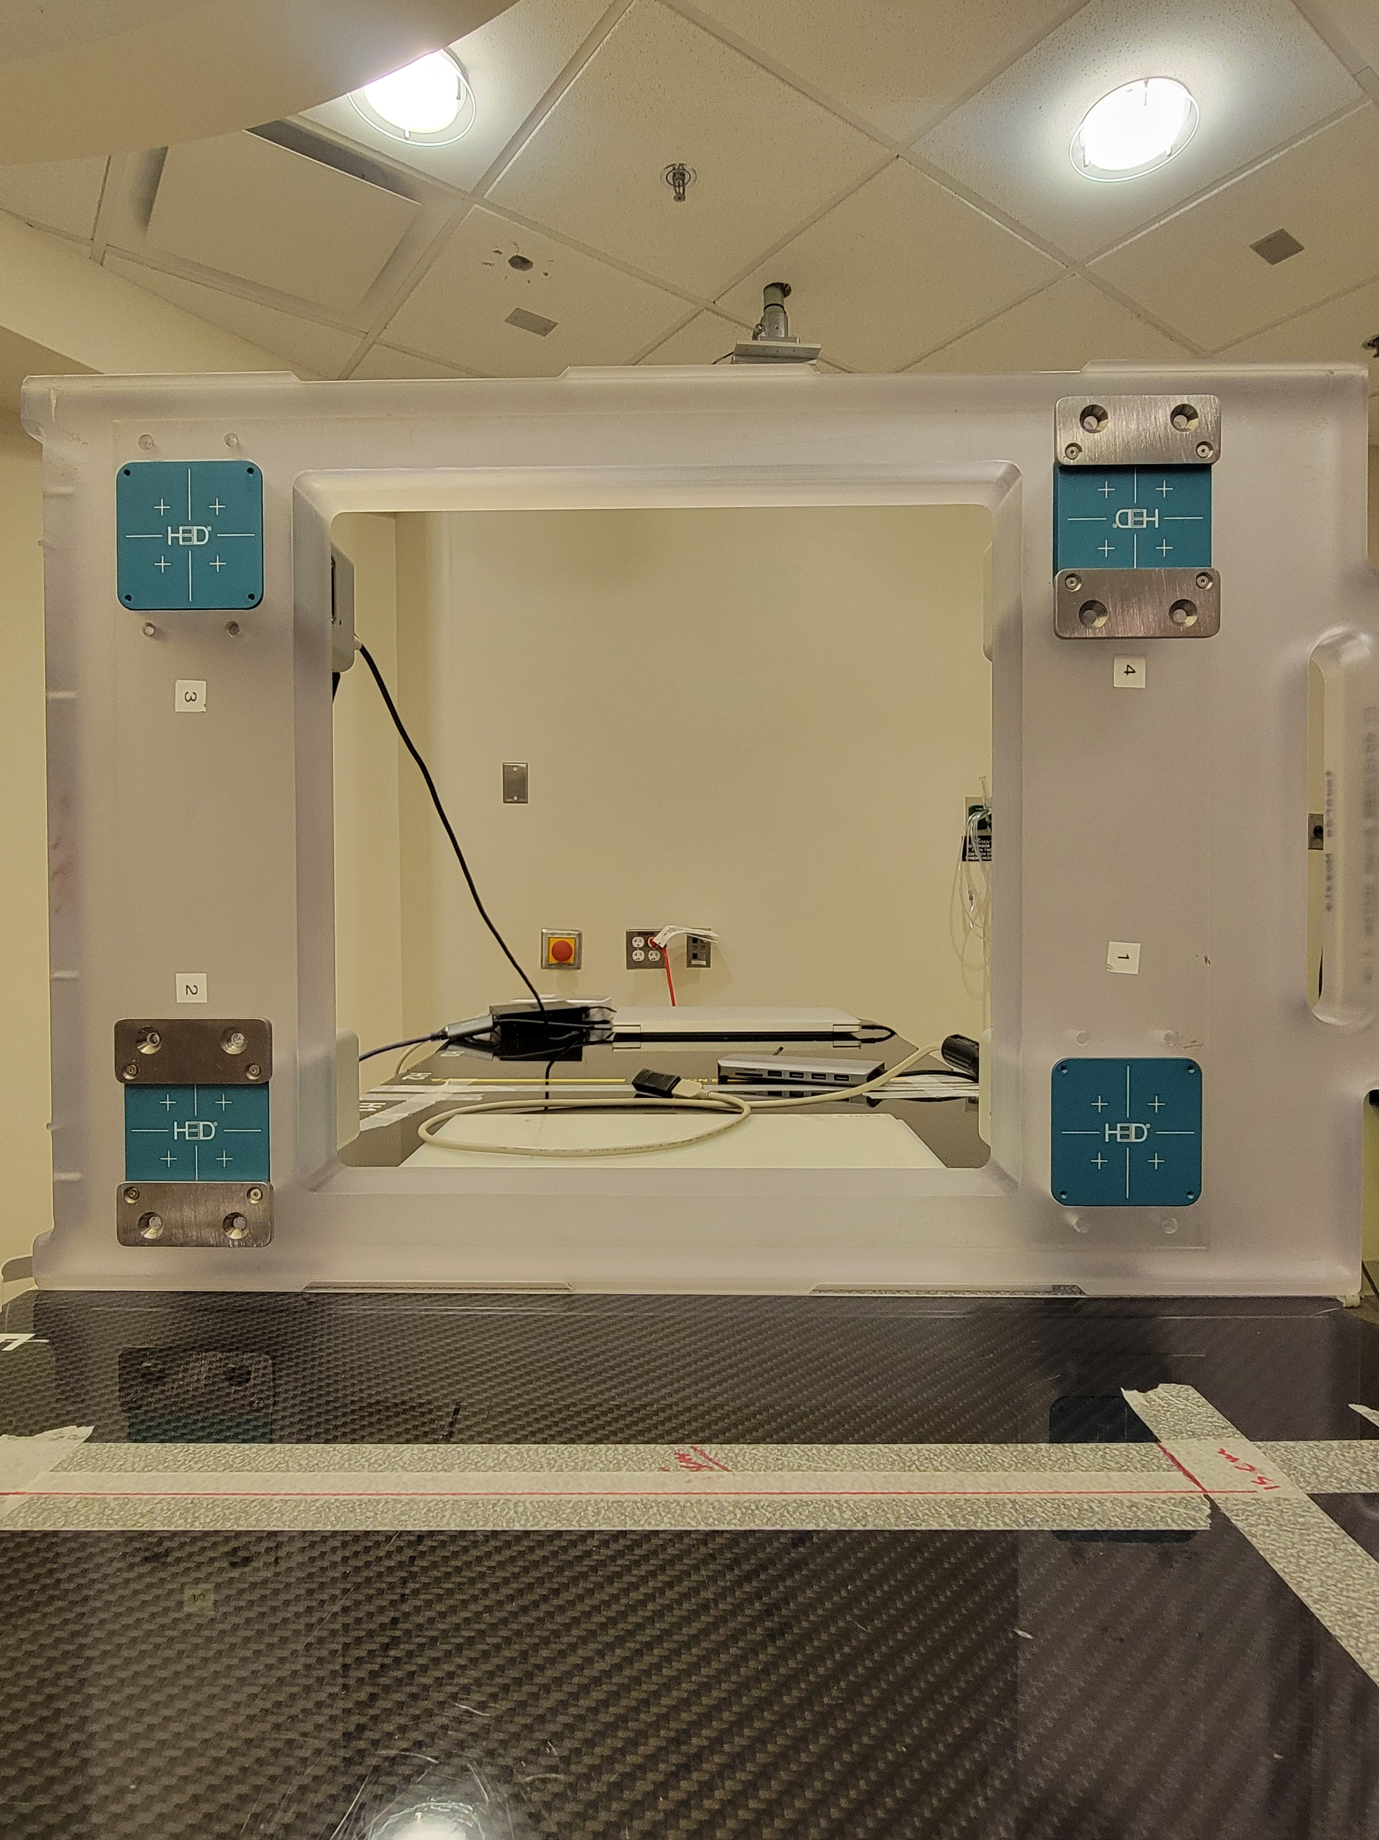
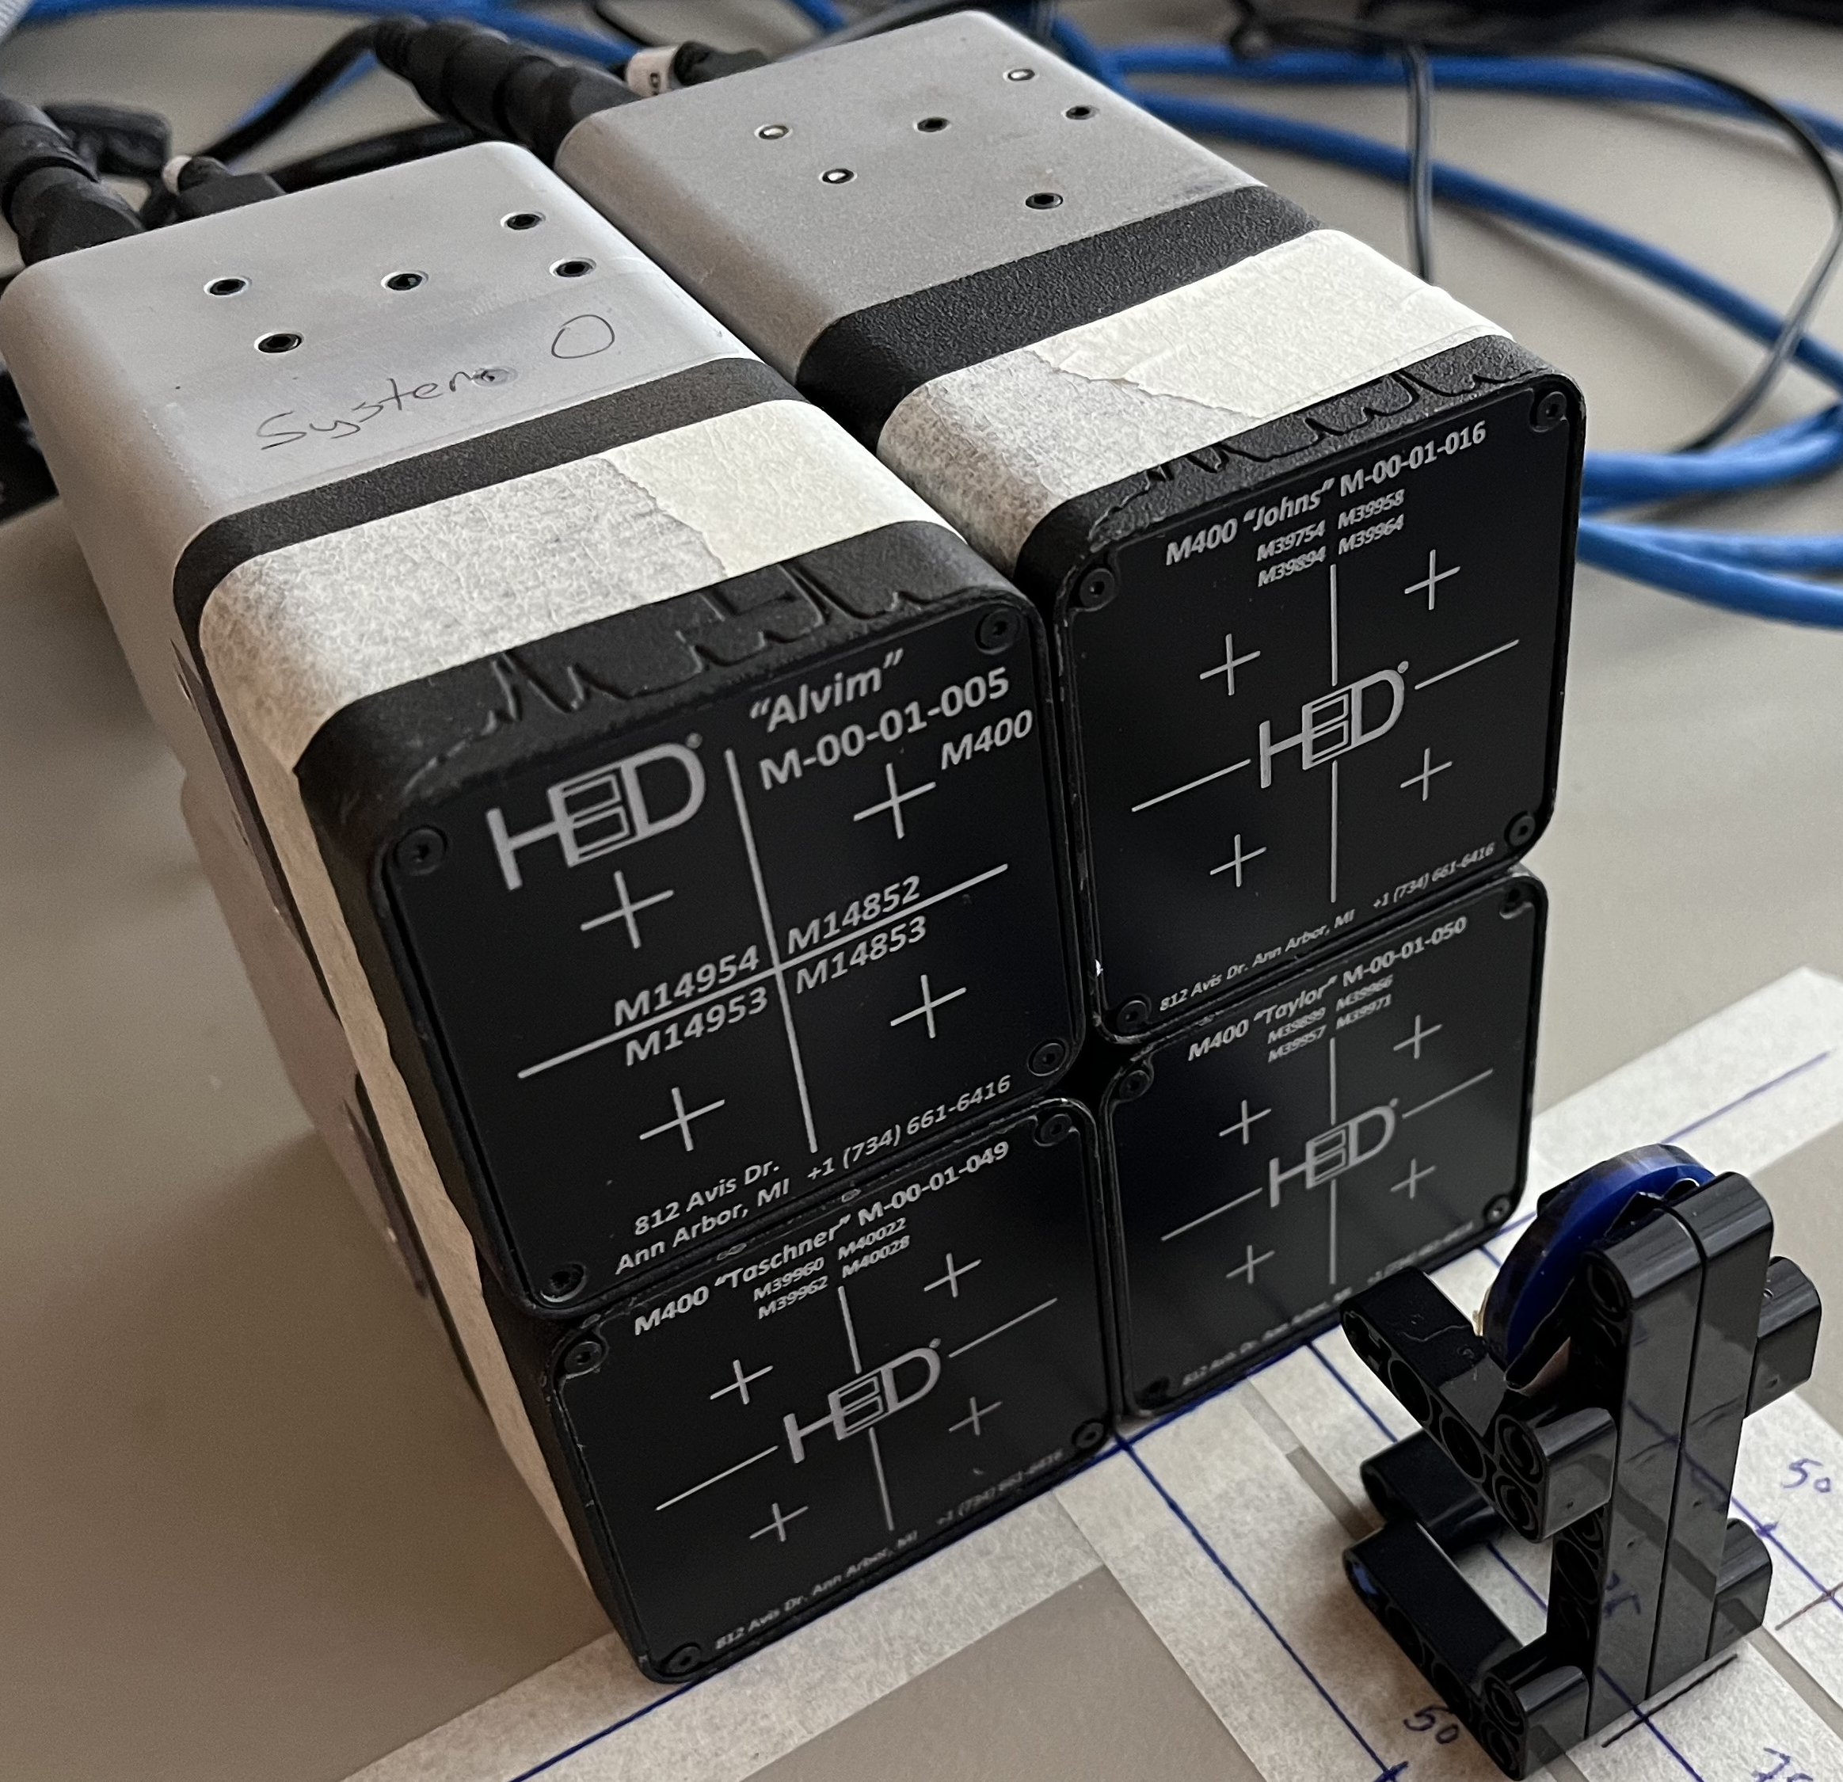
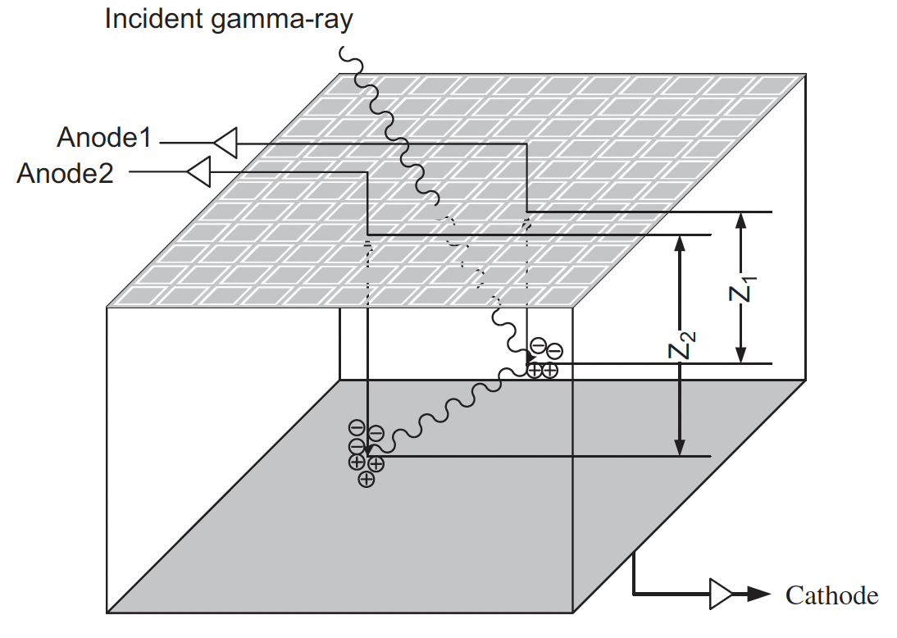
CdZnTe CC Detector Systems
UCT
UMMC Nozzle-mounted
D Xu et al – NIMA (2007) 574, 98–109
Four 20×20×10 mm³ cadmium zinc telluride crystals
Each crystal arranged in a 2×2 array, pixelated in a 11×11 x- and y- direction and a z- direction depth of interaction
3D Gamma detection
Room Temperature
Good Energy Resolution (0.8%
FWHM at 662 keV)
Compact
Notes:
Talk about the UMMC Nozle mounted detectors here -> segway into the gamma-attenuation

Slide 8
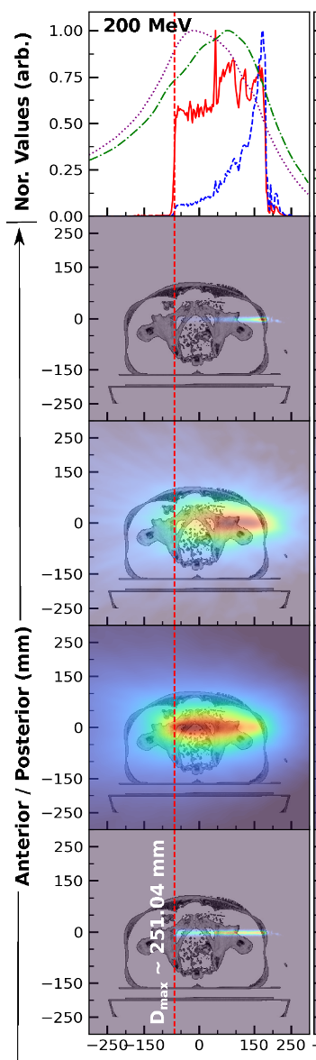
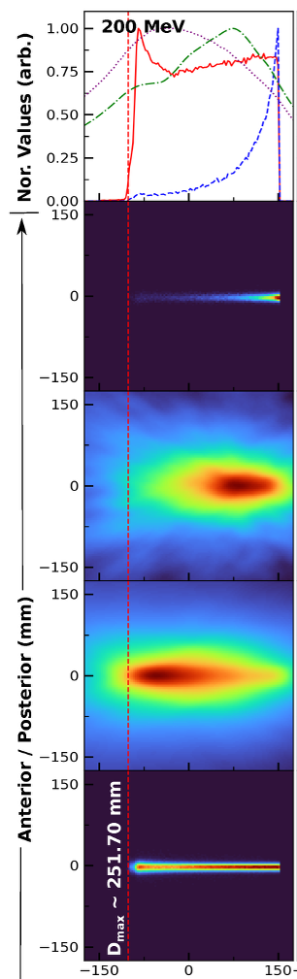
Gamma Attenuation
In a nozzle-mounted detector system, reconstruction along the direction of the beam is challenging due to attenuation of the gammas as they travel through the patient.
Direction
Raw
Reconstruction
Monte Carlo Simulations of 200 MeV protons incident on water target of the Maryland Clinical System
Corrected
Reconstruction
V Sharma et al 2025 IEEE Trans. Rad. Plas. Med. Sci., currently under review
Notes:
Treatment room:
“”””””””””””””””””””
Before treatment begins, patients receive comprehensive treatment planning and assessment using advanced imaging techniques including computed tomography (CT) and magnetic resonance imaging (MRI). Before each treatment, patients can be checked using a volumetric CT scan in the treatment room, a feature unique to MPTC that further increases each treatment’s precision.
Useful sight - https://mdproton.com/what-makes-mptc-different/about-us/?utm_source=chatgpt.com
--
Information about the quad design”
- The nozzle-mounted design ensures fixed detector alignment relative to the proton beam axis during gantry rotation, providing
stable system geometry for PGI under clinical treatment
conditions.
-This design provides a compact and mechanically
stable geometry that preserves standard clinical beam delivery
while enabling prompt-gamma acquisition during irradiation
without introducing additional structures into the treatment
room. Mention here the goals of the measurements.
UCT400:
UCT M400 Detectors combined to support the goals and help correct something known as gamma-attentuation.

Slide 9
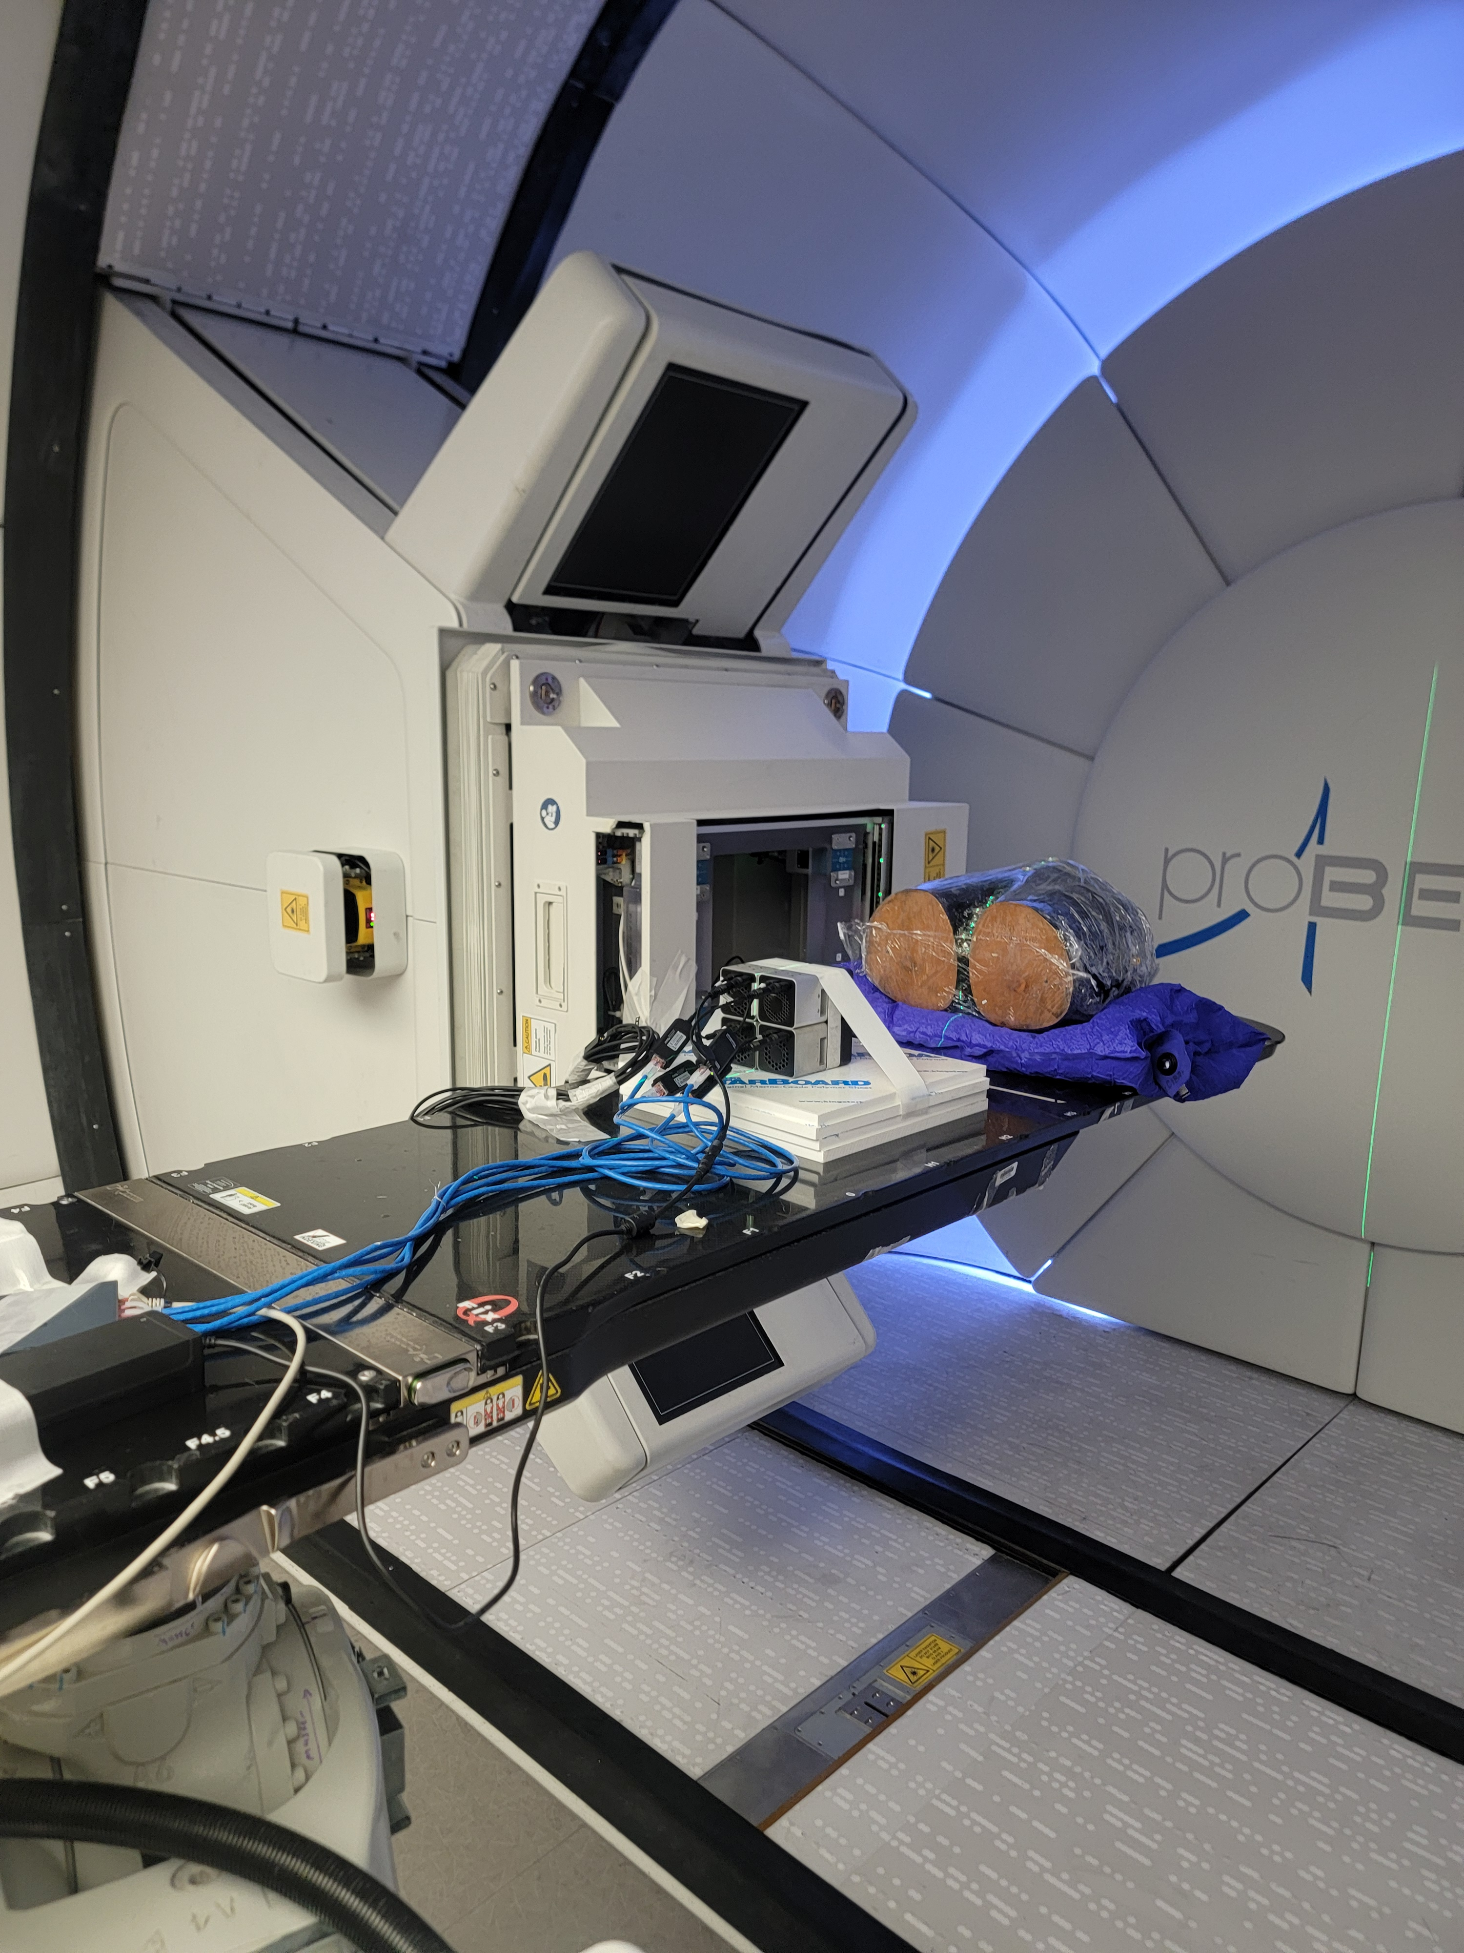
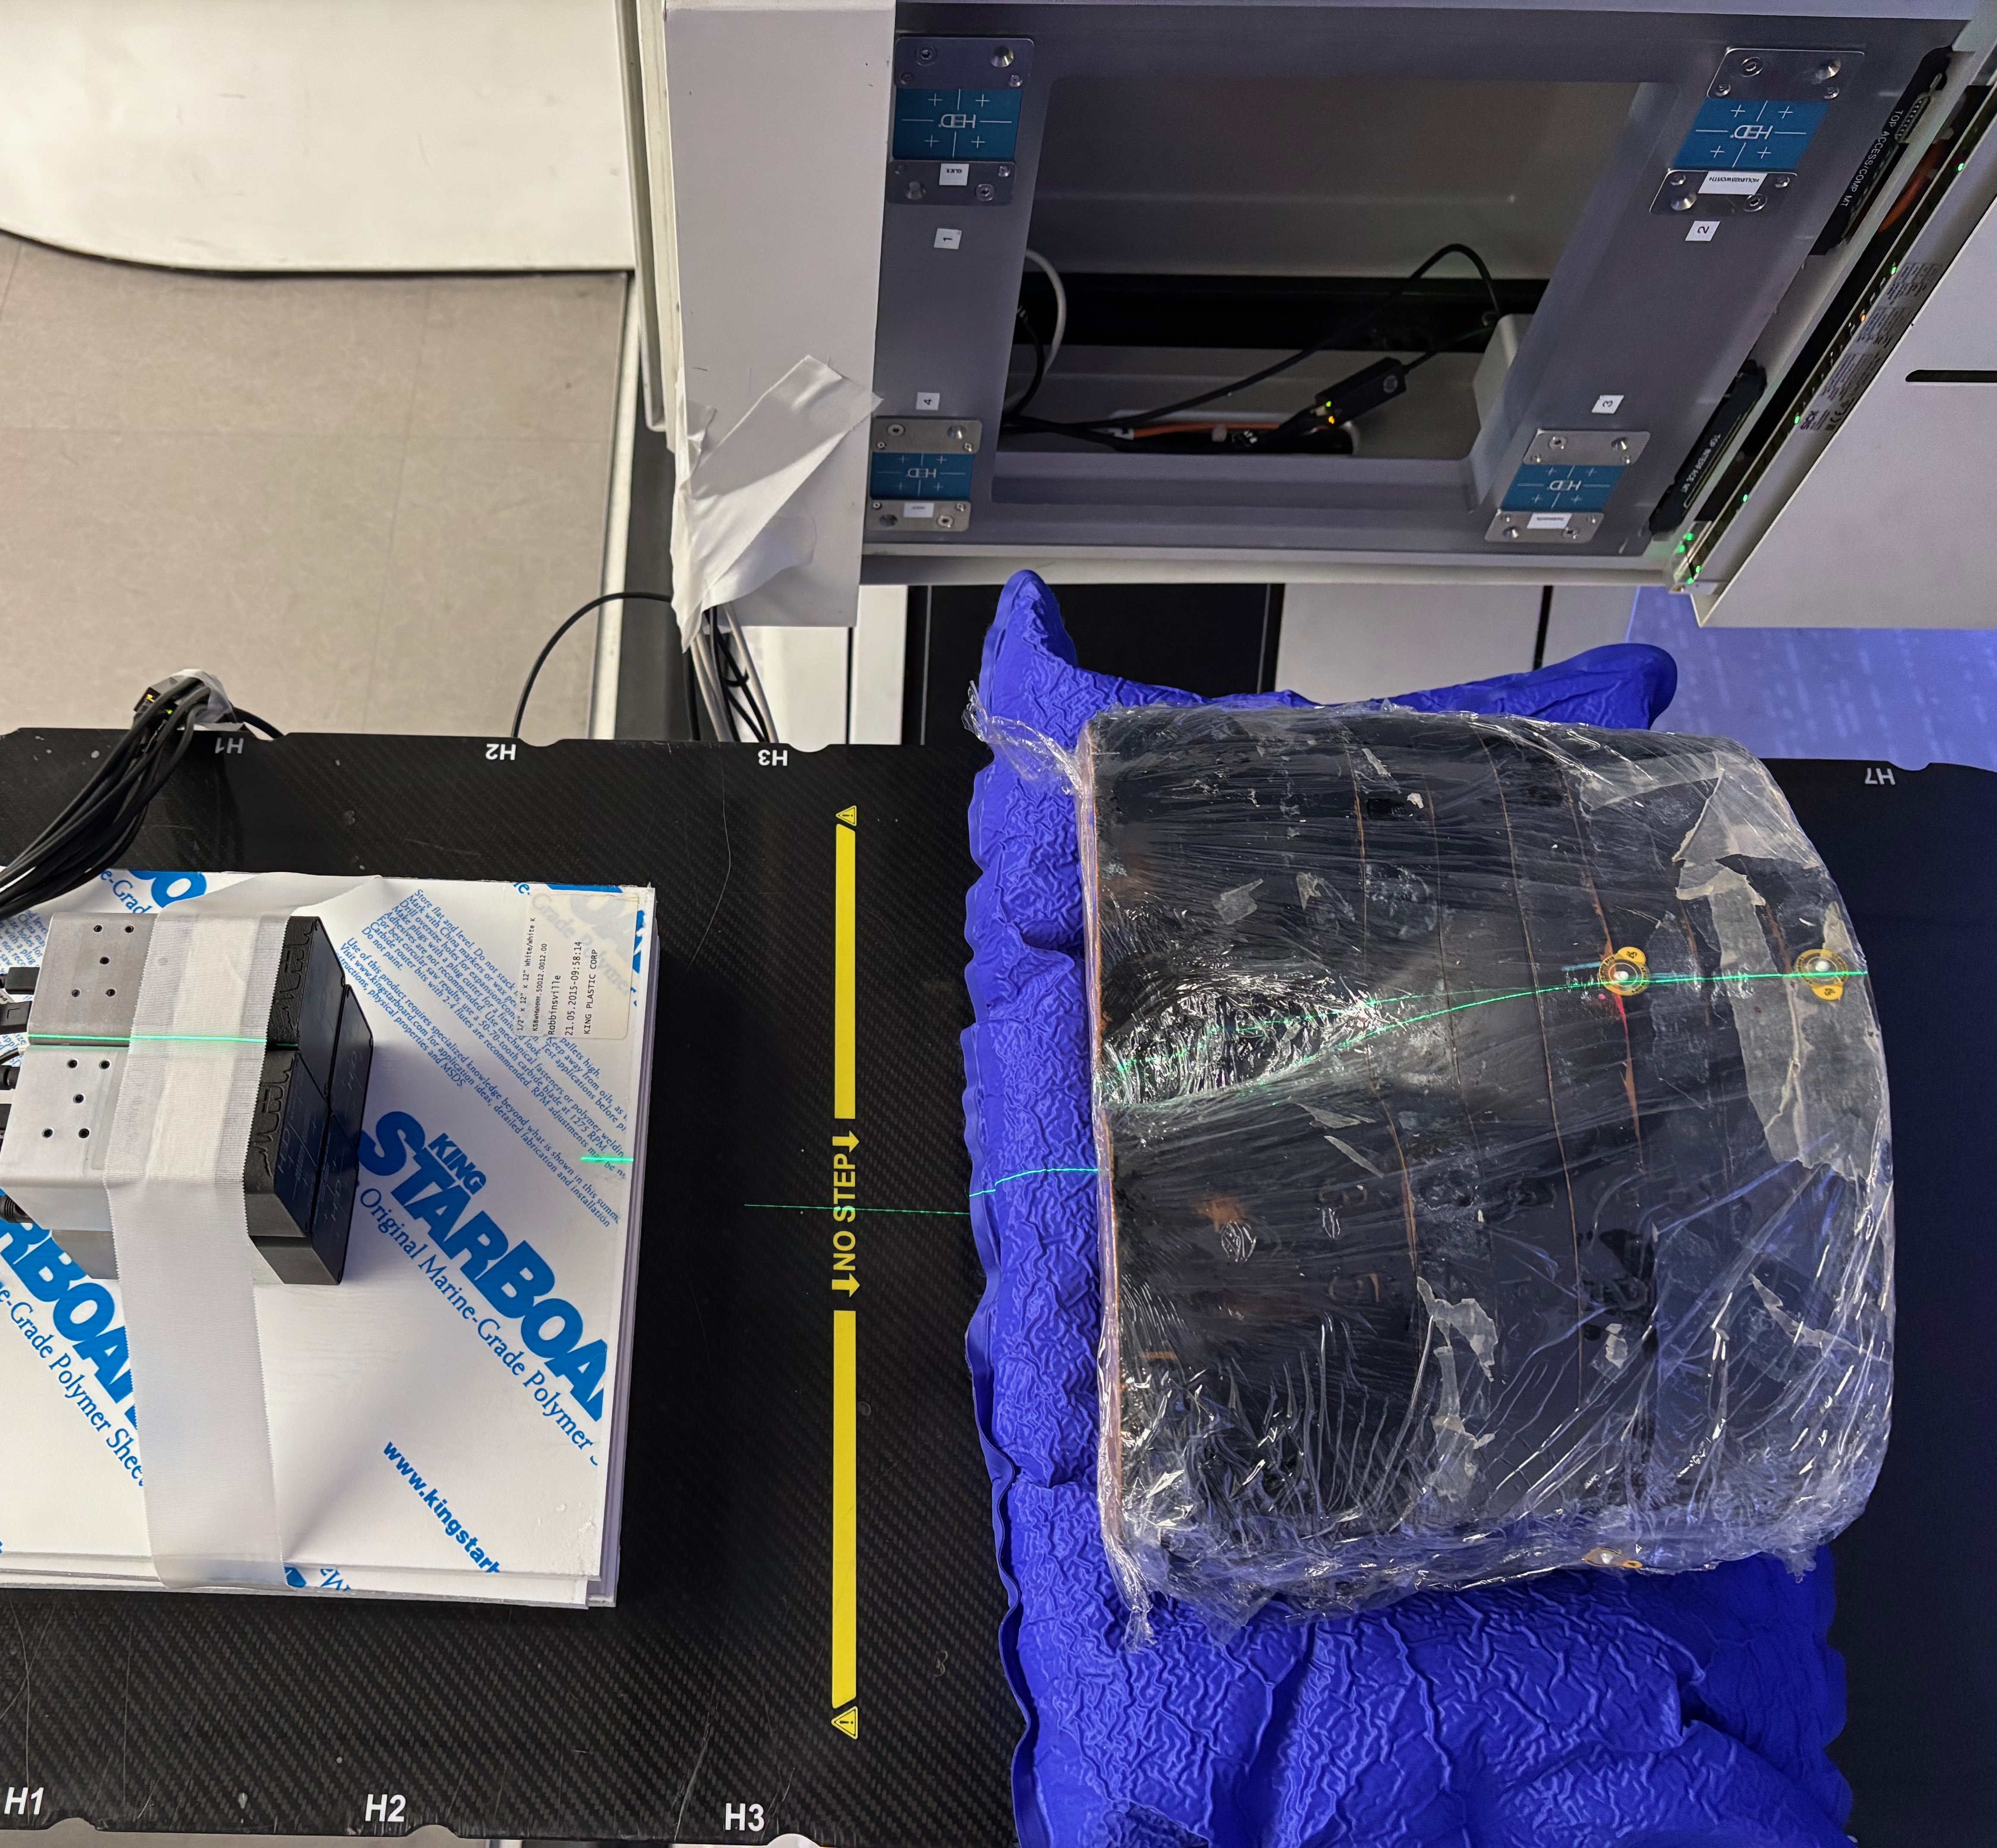
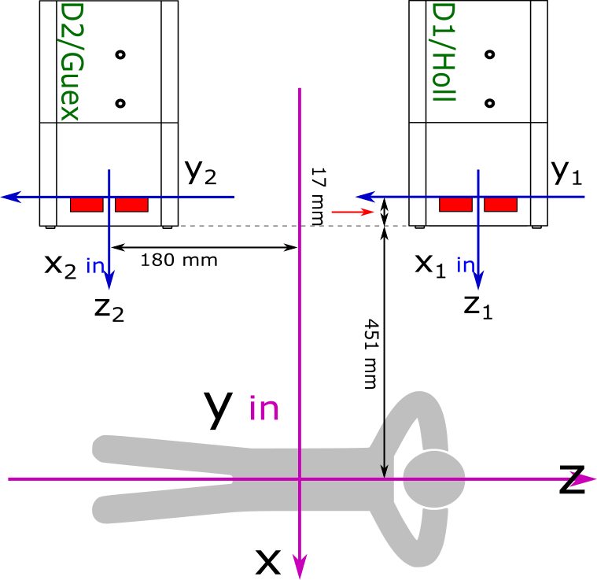
Maryland Proton
Treatment Centre
in Baltimore
1
Feasibility — Can the detector system reconstruct proton depth deposition?
2
Investigate gamma-ray attenuation
and range shift.
Beam
Direction
3
Using the UCT detector system to support the UMMC detector system
150 MeV single-spot beam
Gantry 270°
80 nA · 60 kMU

Slide 10
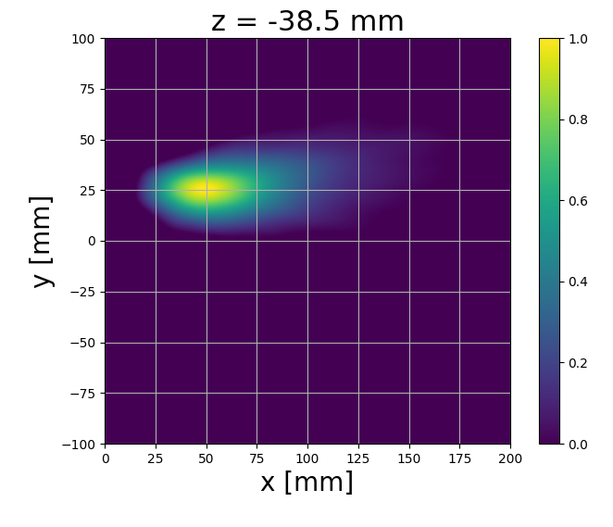
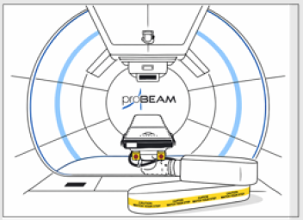
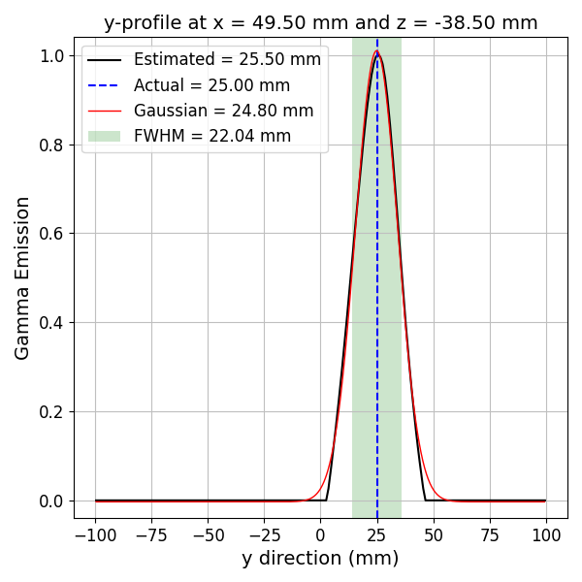
Image Recon. Pipeline
CORE Algorithm
Data Acquisition
Image Analysis
Quad CC System
UCT M400s
• Region of Interest Extracted
• Generate 2D Slices &
1D Profiles
• Gaussian Fitting
• Estimate Source Position &
Peak Intensity
Image Algorithm
Data Preprocessing
• SBP, SOE, Octane EM, KWPB
• 3D image source location
• Binary Format Conversion
• Coordinate transformation
• Filtration
• Merging data
Filtration
• Scattering distance, angle
• Energy windowing
• Energy lost etc.
• Double events

Slide 11
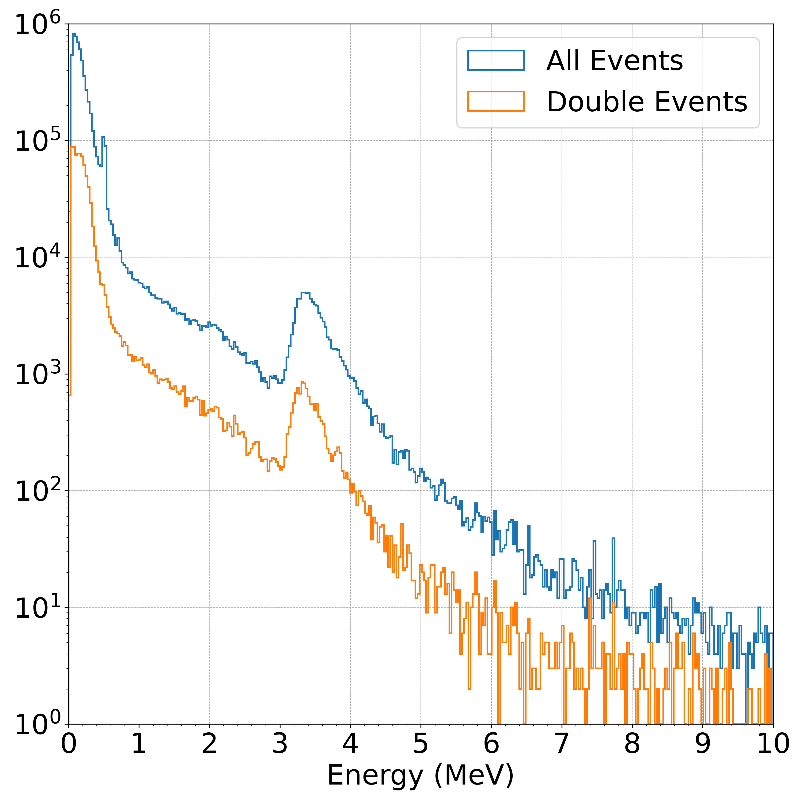
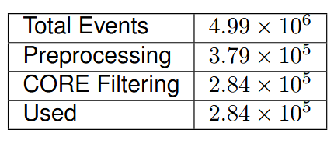
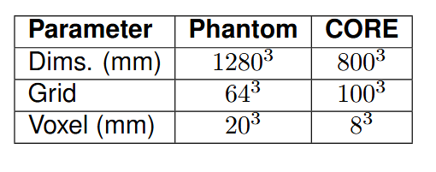
UCT Detector Results

Slide 12
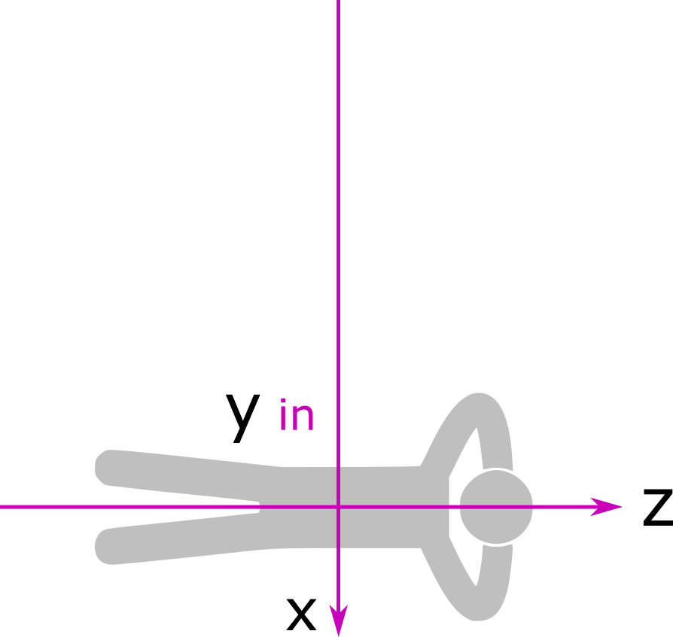
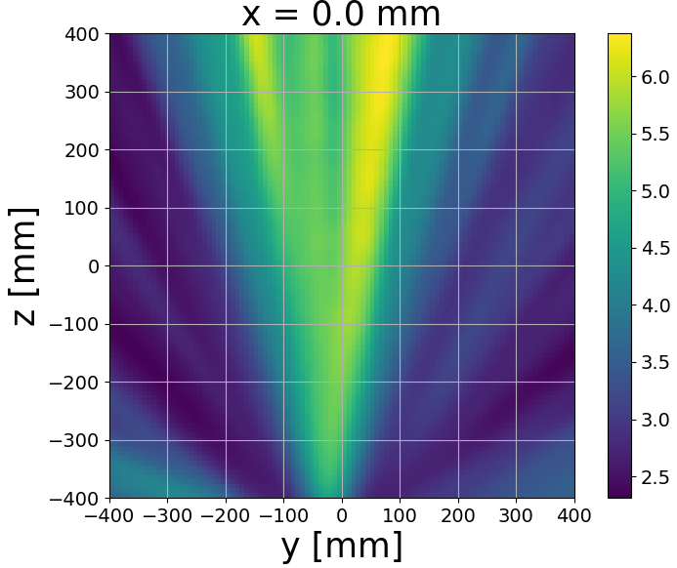
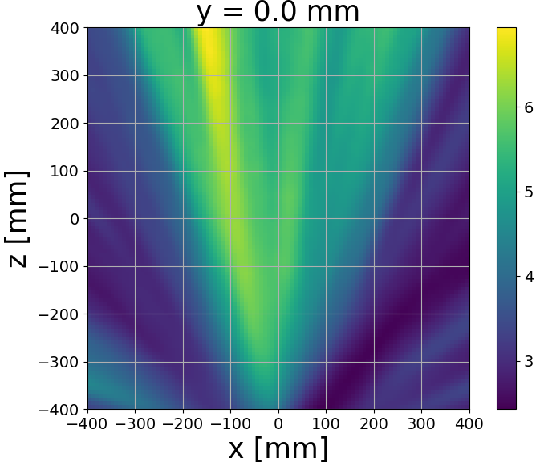
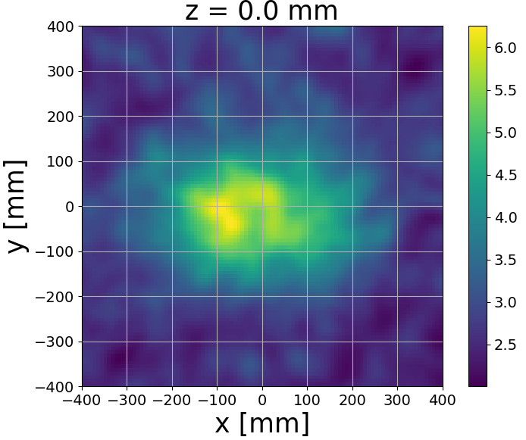
Experimental
Setup
UCT Detector Results
Beam
Direction
Expected Location

Slide 13
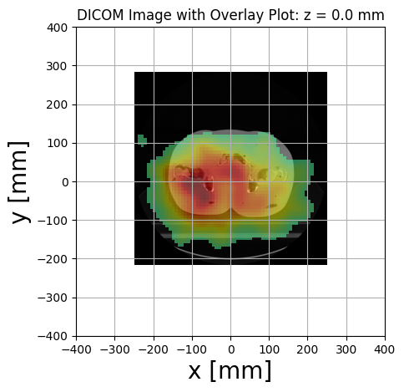
UCT Detector Results

Slide 14
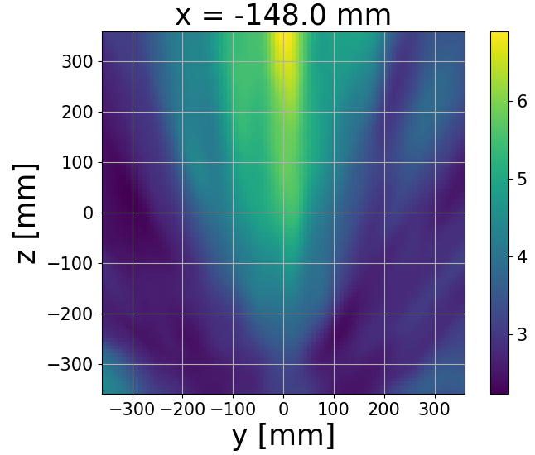
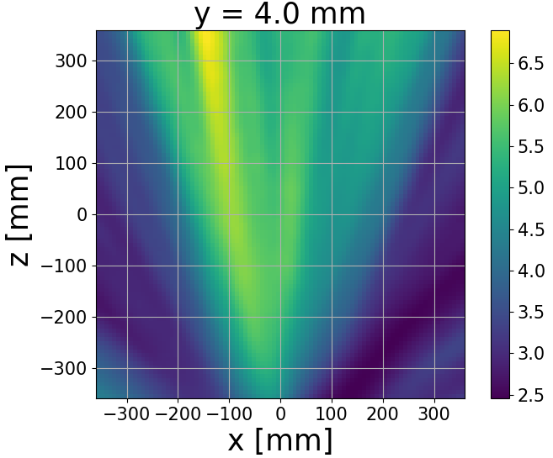
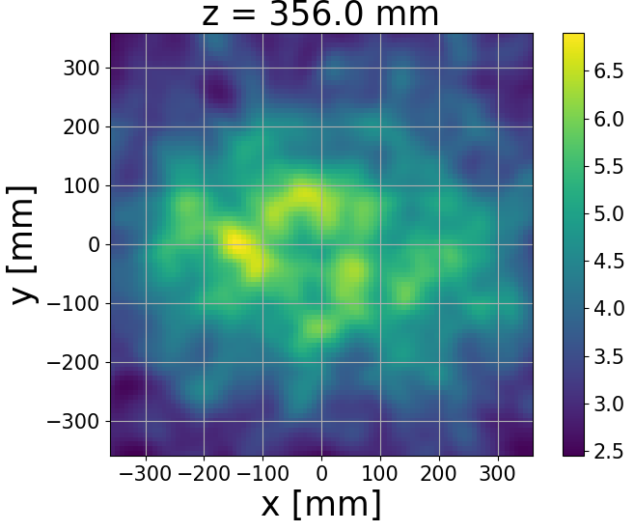
UCT Detector Results
Expected Location : (-148.0, 4.0, 356.0) mm

Slide 15
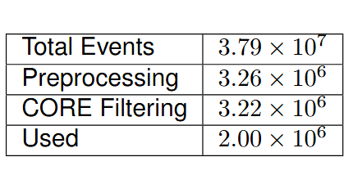
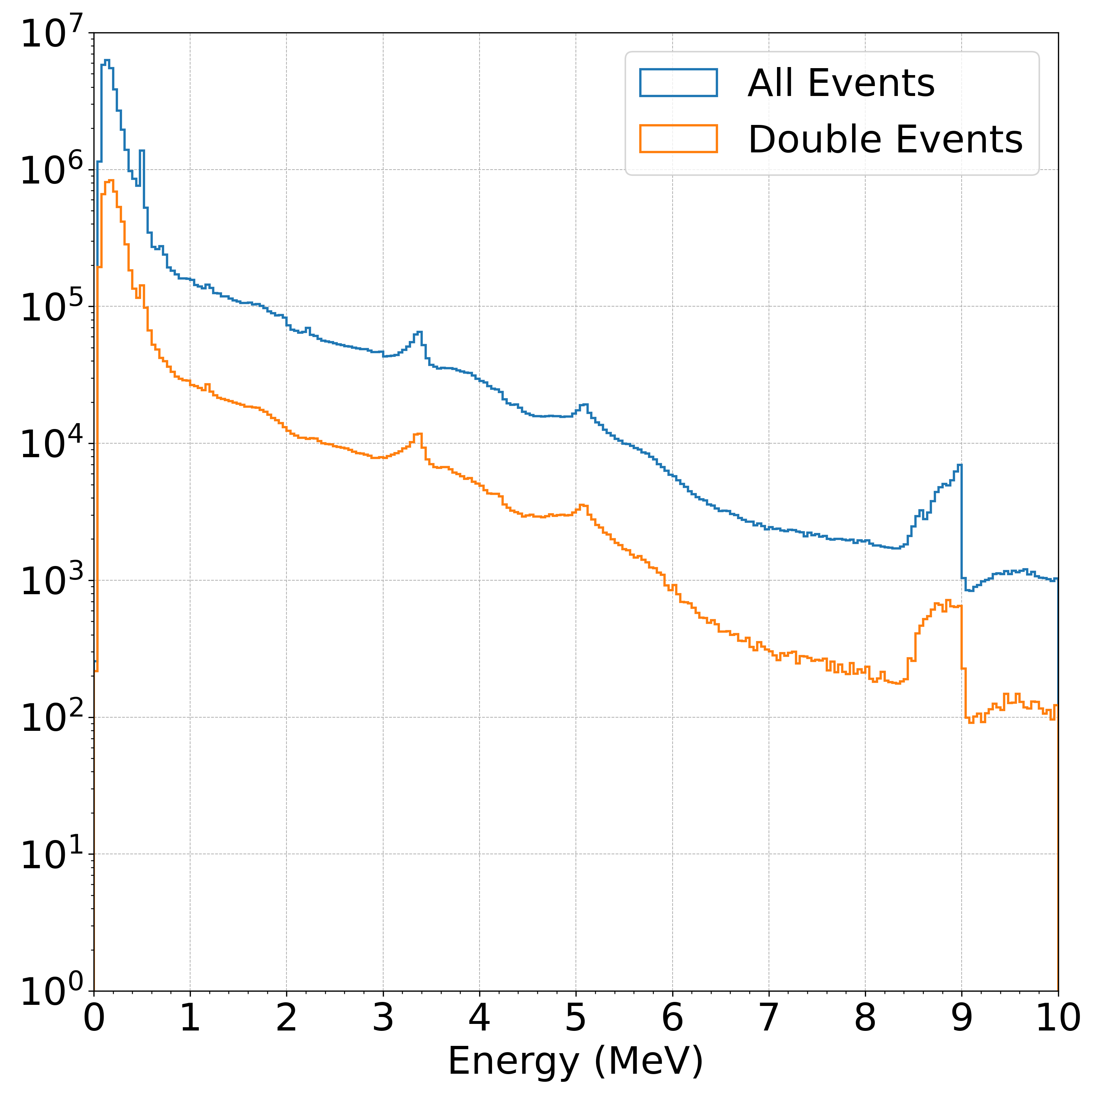
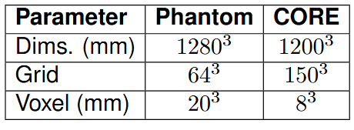
UMMC Nozzle-mounted Results

Slide 16
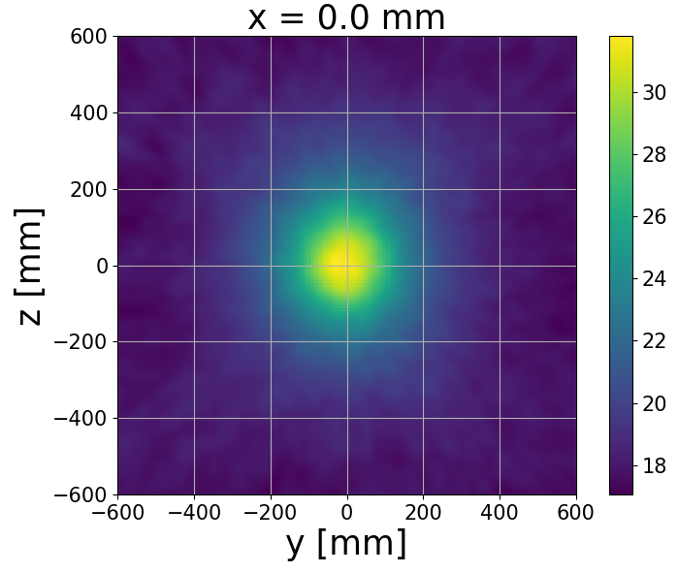
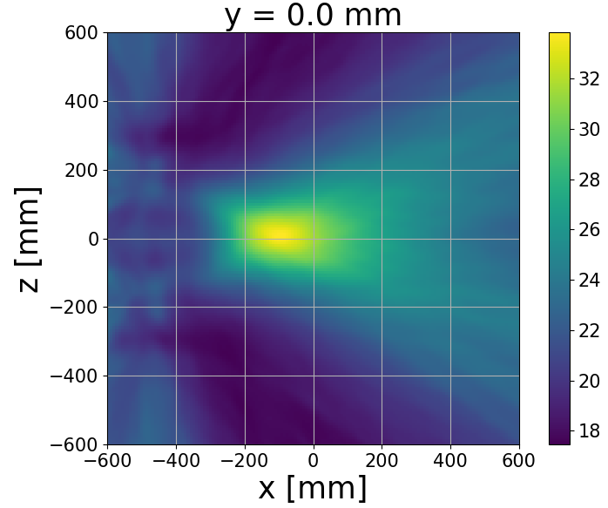
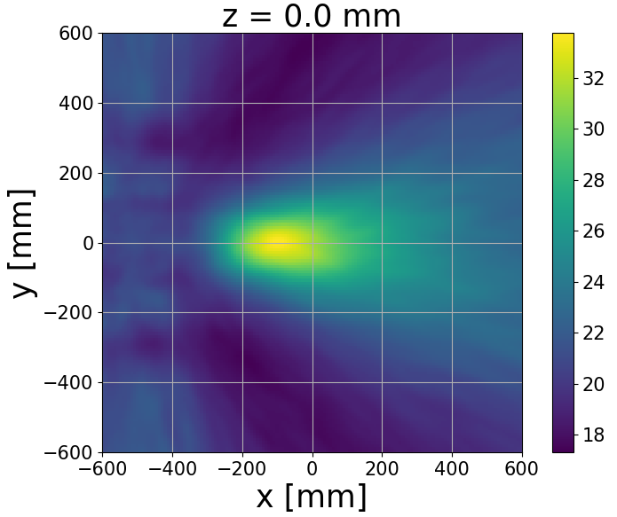
Experimental
Setup
UMMC Nozzle-mounted Results
Beam
Direction
Expected Location

Slide 17
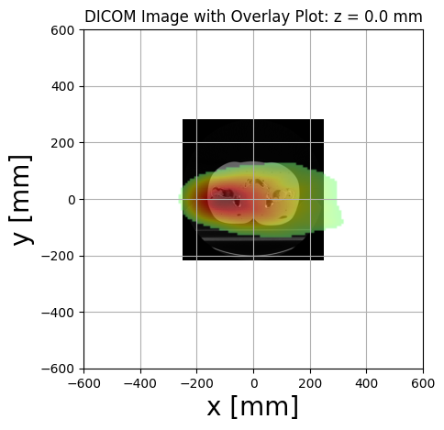
UMMC Nozzle-mounted Results
Notes:
Putting the beam in context

Slide 18
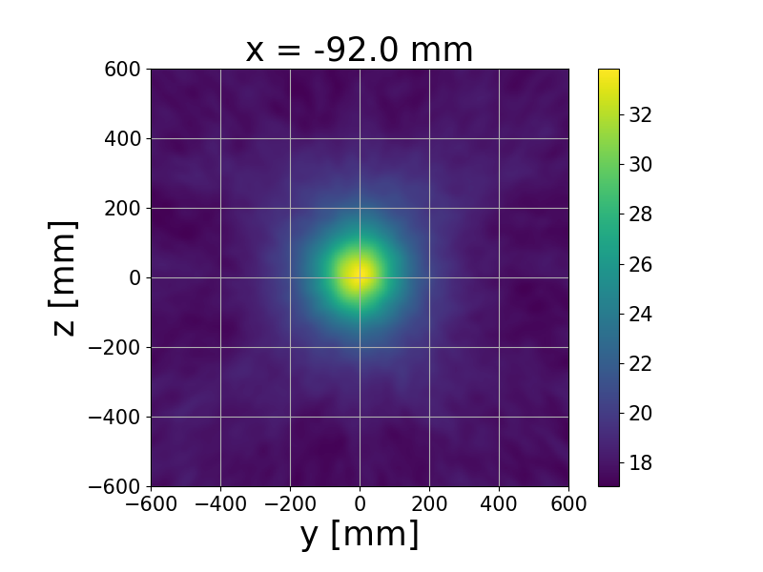
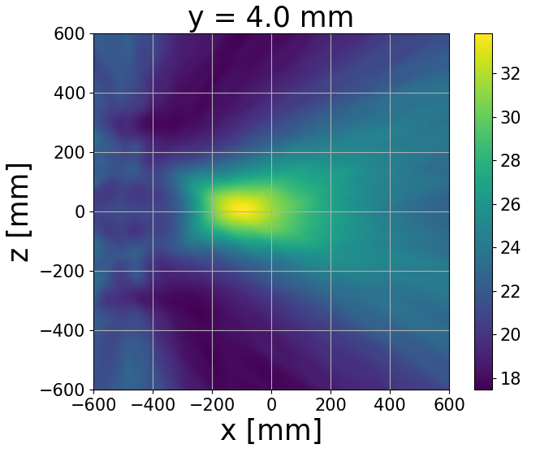
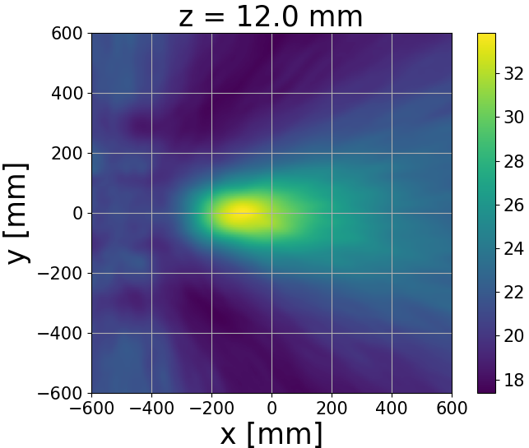
UMMC Nozzle-mounted Results
Expected Location : (-92.0, 4.0, 12.0) mm

Slide 19
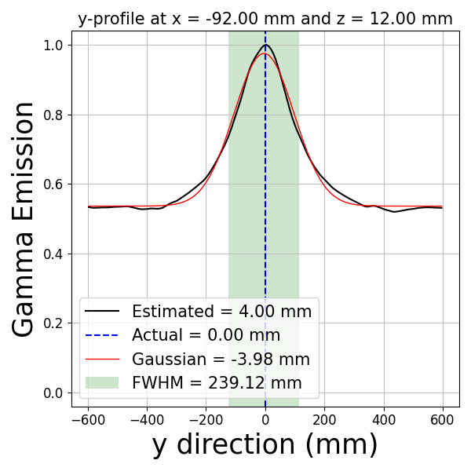
UMMC Nozzle-mounted Results

Slide 20
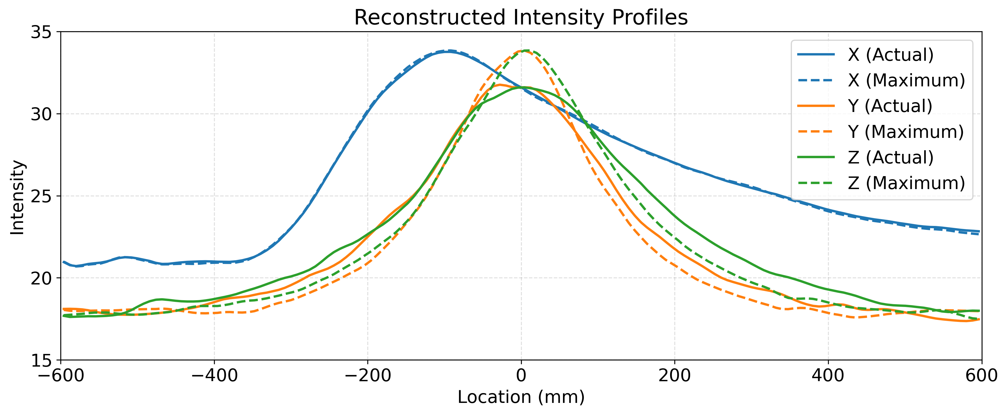
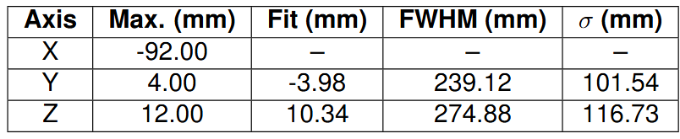
UMMC Nozzle-mounted Results
Distance (Estimated - Actual)
92.87 mm
Notes:
Insert max values hereThe introduction of a 10 mm range shift increased the localization error from 92.87 mm to 108.74 mm (≈17% increase), while the Gaussian FWHM remained largely unchanged. This indicates that the range shift primarily displaced the reconstructed source rather than degrading its spatial resolution.

Slide 21
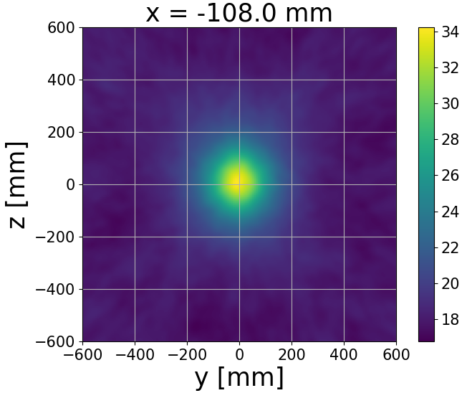
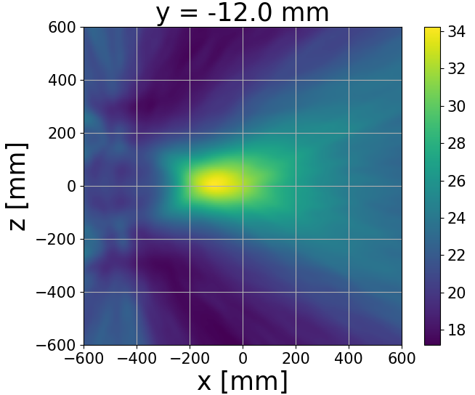
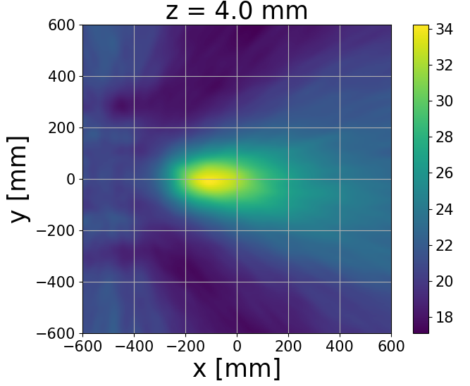
UMMC 10 mm Range Shift Results
Expected Location : (-108.0, -12.0, 4.0) mm

Slide 22
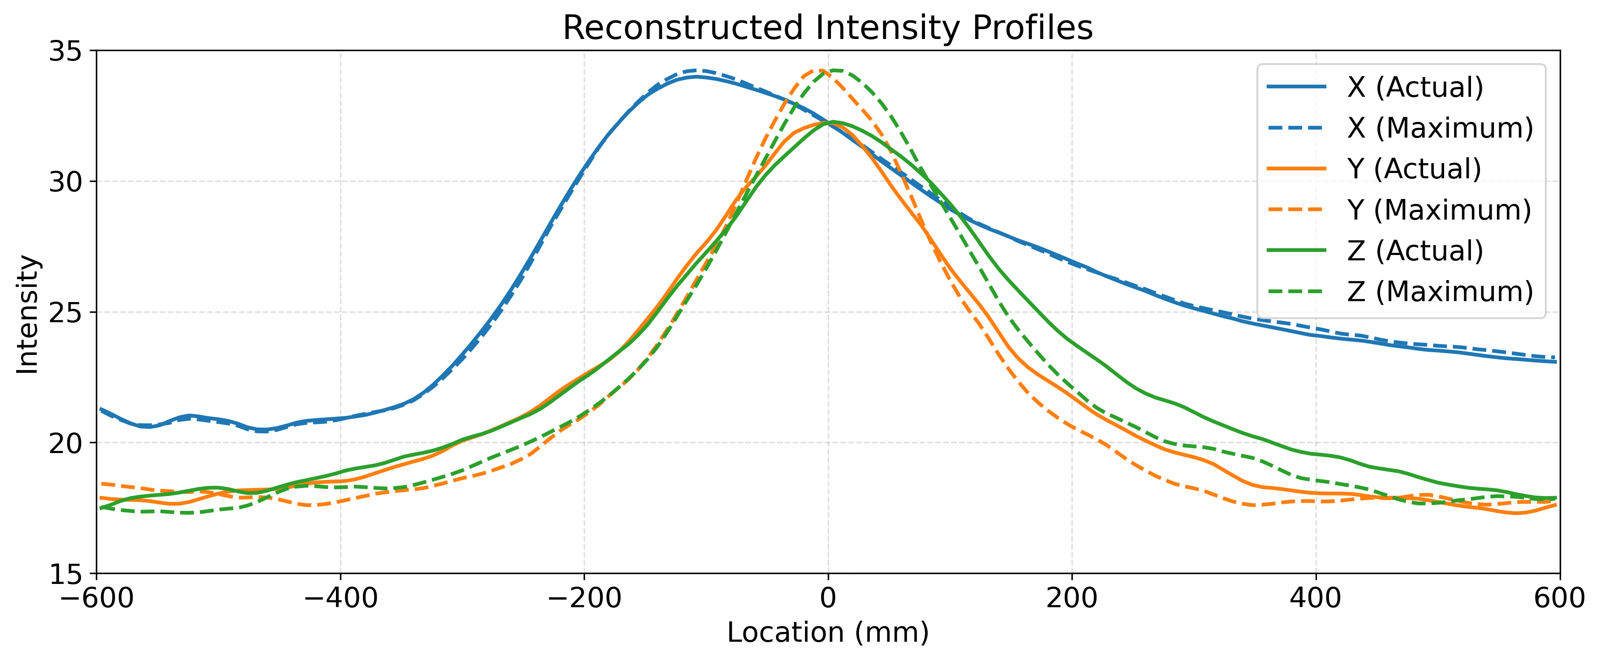
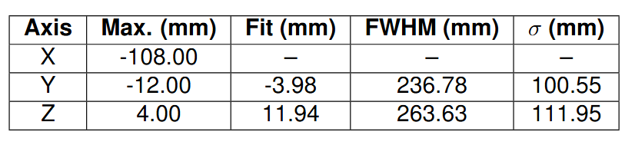
UMMC 10 mm Range Shift Results
Distance (Estimated - Actual)
108.74 mm
Notes:
Insert max values here

Slide 23
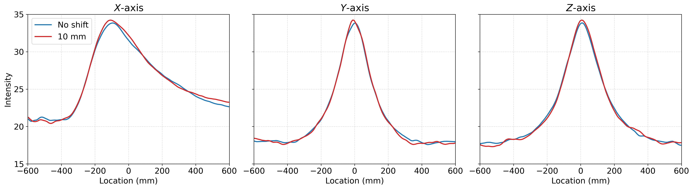
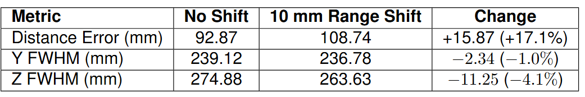
Range Shift Comparisons
Notes:
Insert max values hereThe introduction of a 10 mm range shift increased the localization error from 92.87 mm to 108.74 mm (≈17% increase), while the Gaussian FWHM remained largely unchanged. This indicates that the range shift primarily displaced the reconstructed source rather than degrading its spatial resolution.

Slide 24
Conclusion
1
The Quad CdZnTe PGI detector system reconstructed proton depth distributions within a phantom.
2
Gamma attenuation in the nozzle-mounted detector geometry. Sensitivity to beam range changes through a10 mm proton range shift demonstrated
3
The UCT measurands may require further optimization before it can effectively support the UMMC measurements.
Future work
1
Optimize preprocessing, event filtering and image reconstruction algorithms.
2
Investigate CT-based attenuation correction to compensate for prompt gamma attenuation.
3
Investigate machine learning-based image reconstruction and attenuation correction.
Notes:
Insert max values hereThe introduction of a 10 mm range shift increased the localization error from 92.87 mm to 108.74 mm (≈17% increase), while the Gaussian FWHM remained largely unchanged. This indicates that the range shift primarily displaced the reconstructed source rather than degrading its spatial resolution.

Slide 25
Thank You !
Notes:
Insert max values hereThe introduction of a 10 mm range shift increased the localization error from 92.87 mm to 108.74 mm (≈17% increase), while the Gaussian FWHM remained largely unchanged. This indicates that the range shift primarily displaced the reconstructed source rather than degrading its spatial resolution.

