Slide 1

Physics Principles Applied in Monitoring Photovoltaic Performance and Water Dynamics
Livhuwani Masevhe (PhD, Pr.Sci.Nat, CPhys)
University of Johannesburg
Department of Mechanical Engineering Science
SAIP Conference 2026
University of the Western Cape, Cape Town
Date: 9 July 2026

Slide 2

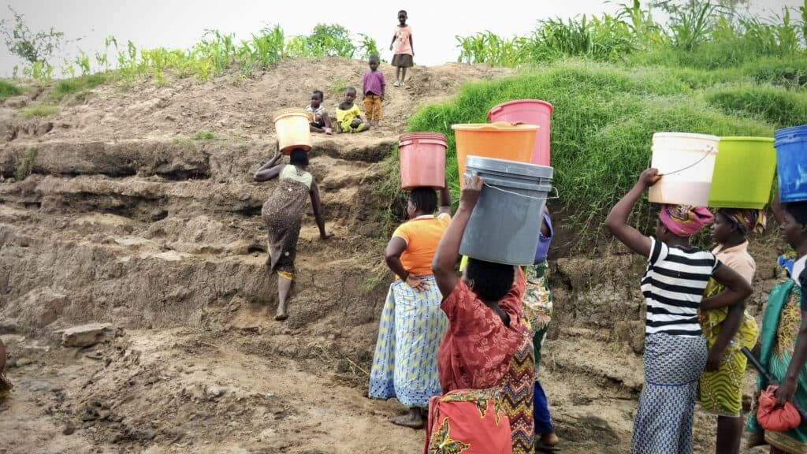


Introduction:
The Billion-Dollar Problem we are solving
Crop Loss: 40% of yield
Resource Waste: water, energy, and fertilizer
Data Poverty: critical decisions based
Market Size: R14 billion (2030) bottled water
Figure 1: African agriculture is plagued by uncertainty, leading to massive losses [1].

Slide 3
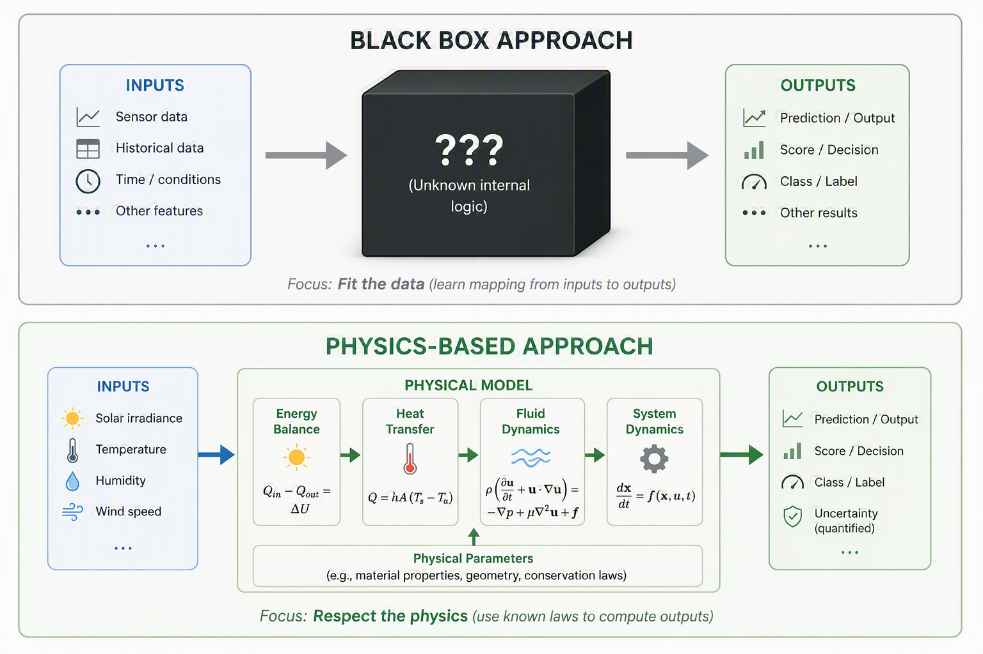
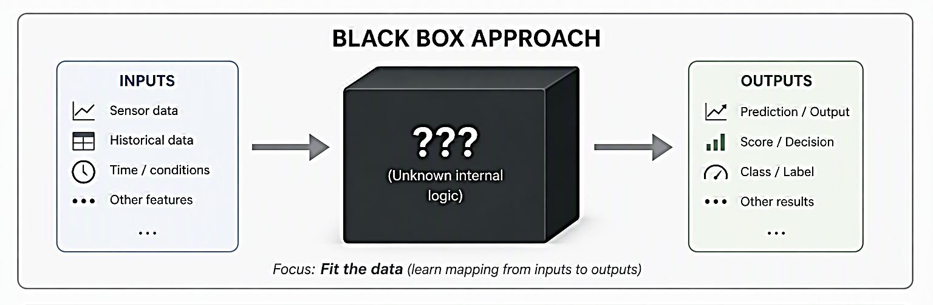
Introduction:
Why Current Systems Fall Short
  PVWPS are vital for off-grid, water-scarce regions but suffer from poor real-time oversight.
  Existing approaches treat electrical and hydraulic subsystems independently.
  Expected Outcome:
  A novel, physics-informed control paradigm enabling resilient, efficient, and sustainable closed-loop water management reducing costs and environmental footprint under climate uncertainty.
Figure 2: African agriculture is plagued by uncertainty, leading to massive losses [2].

Slide 4
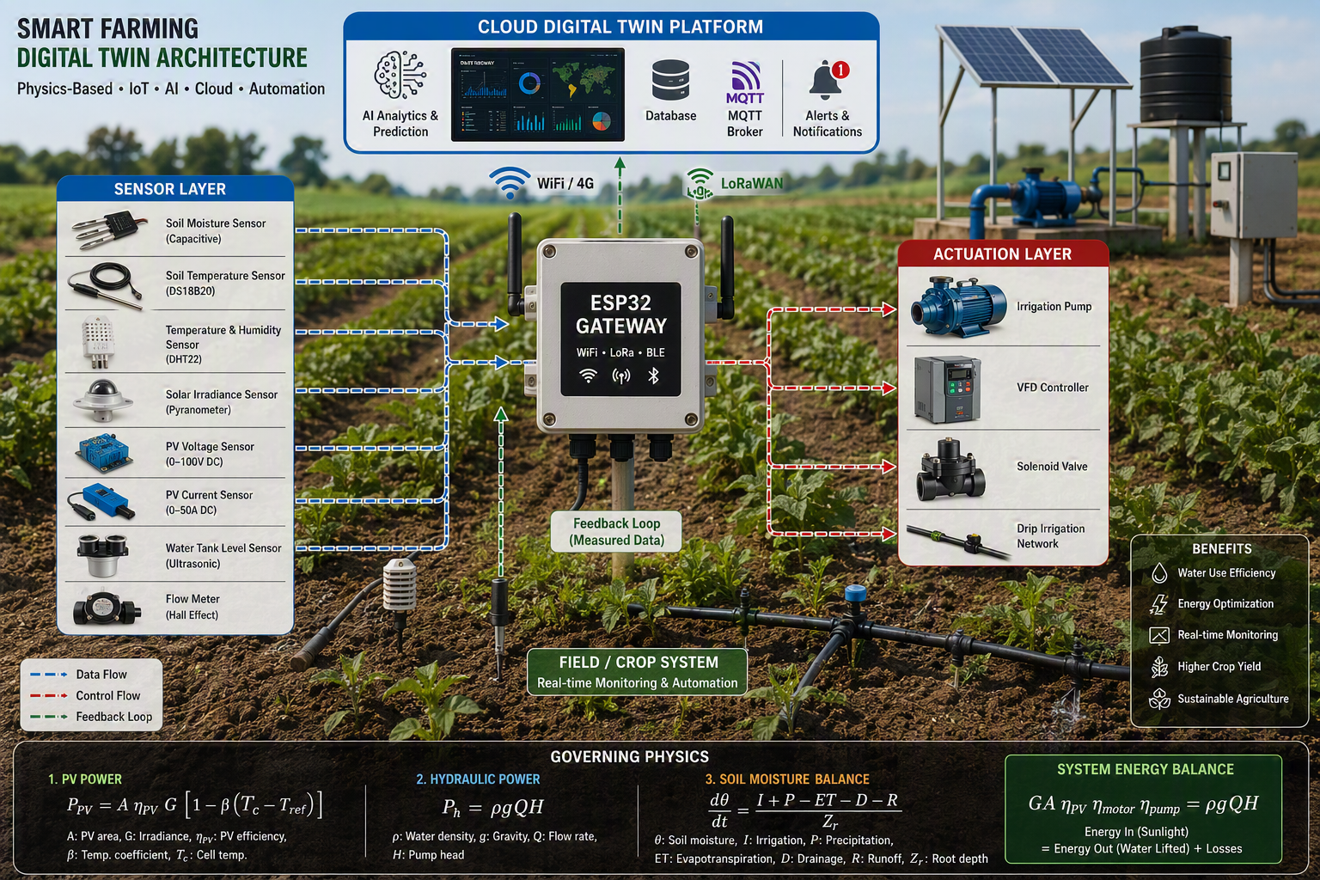
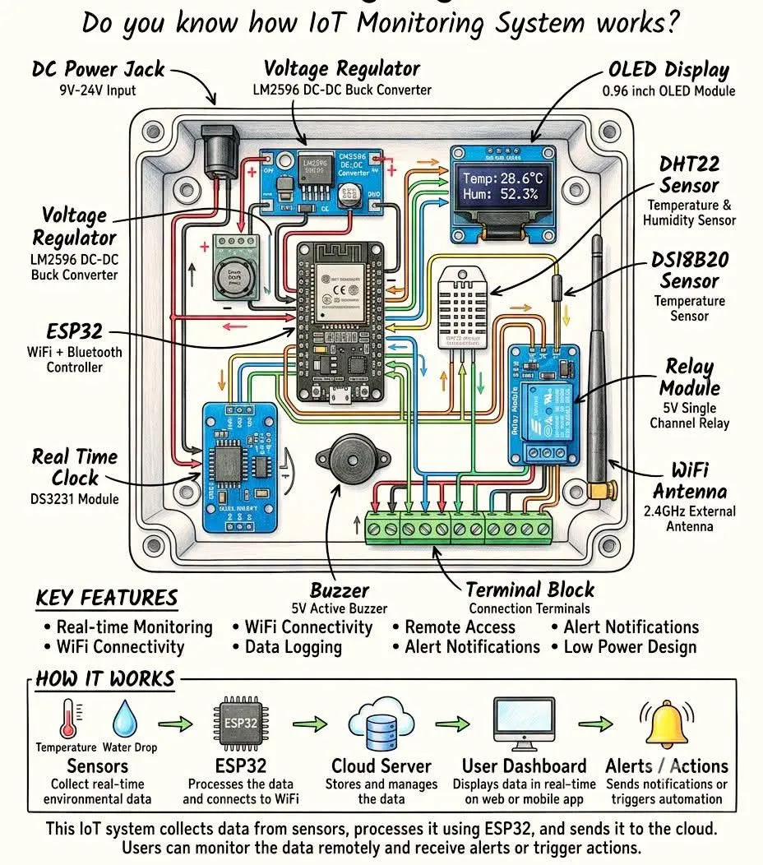
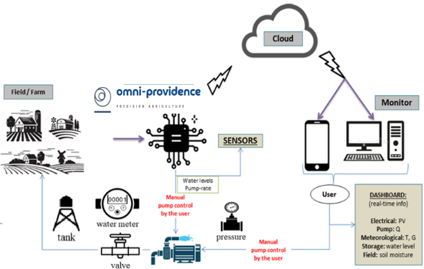
Overview & Methodology Flow
Stage 1: System modeling and Theoretical Sizing
Stage 2: RTU Hardware and Sensor Integration
Validation
Performance data and refinement
Stage 3: Communication and Cloud Infrastructure
Stage 4: Field Validation
Figure 3: 4-staged development model[1].
Figure 4: PVWPS operating framework [1].

Slide 5
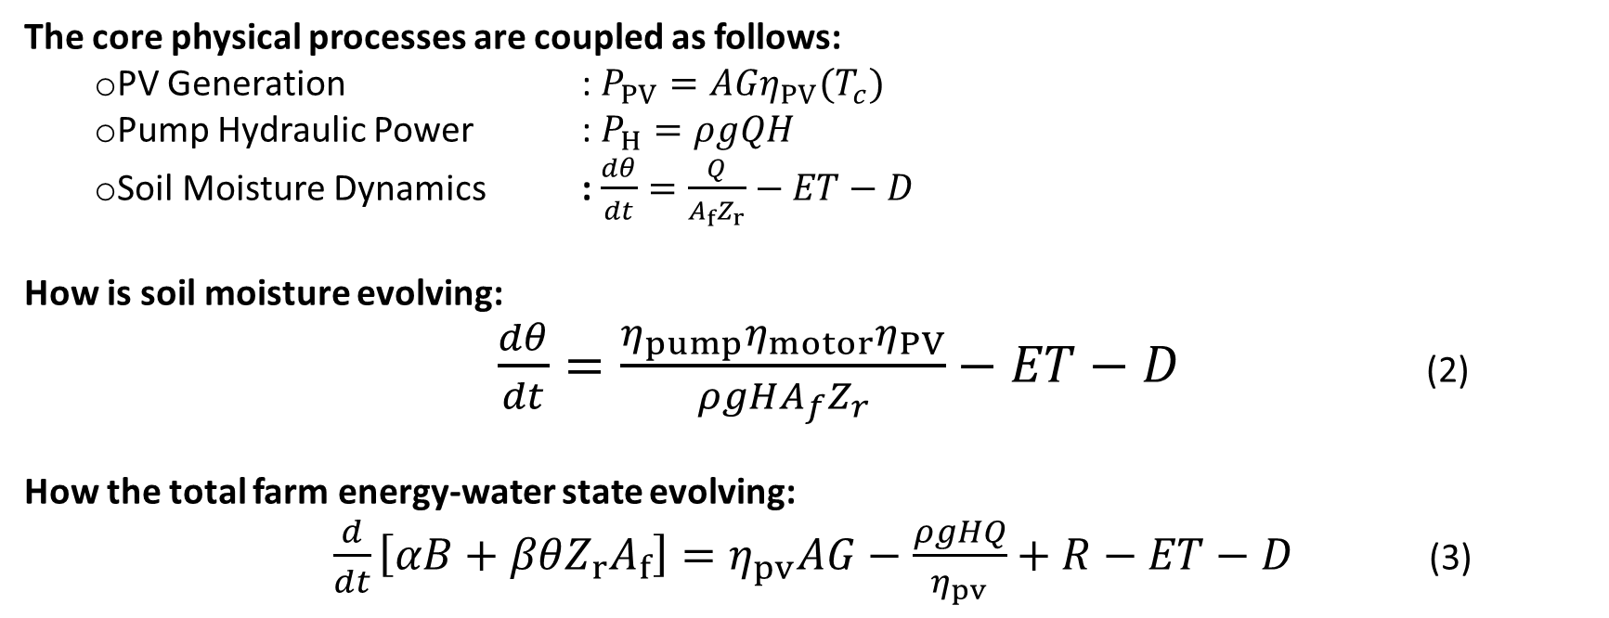
Mathematical model for system optimization
The core physical processes are coupled as follows:
  PV Generation : $P_{PV}=AGη_{PV}(T_{c})$
  Pump Hydraulic Power : $P_{H}=ρgQH$
  Soil Moisture Dynamics : $\frac{dθ}{dt}=\frac{Q}{A_{f}Z_{r}}−ET−D$
How is soil moisture evolving:
$\frac{dθ}{dt}=\frac{η_{pump}η_{motor}η_{PV}}{ρgHA_{f}Z_{r}}−ET−D$ (2)
How the total farm energy-water state evolving:
$\frac{d}{dt}\left[αB+βθZ_{r}A_{f}\right]=η_{pv}AG−\frac{ρgHQ}{η_{pv}}+R−ET−D$ (3)
(1)
Store energy
Stored soil water volume
Solar energy input
Hydraulic energy consumption
Water loss
Energy In (Sunlight) = Energy Out (Water Lifted) + Losses​
is the fundamental physical principle underlying the entire system.

Slide 6
Case Study: Field Testing (two locations)
1. Borehole testing in the Eastern Cape
2. Climatic testing in Limpopo
August 2025 – January 2026
+5 months trial with a number of iterations
Measured Parameters:
  Temp
  Humidity
  Soil moisture
  Water level (tank)
Hydraulic Demand:
  Total Dynamic Head (TDH): Static Lift (51.0m) + Drawdown (26.7m) + Friction Losses (5.0m) = 53.0m
Energy Requirement:
  Theoretical Hydraulic Energy: P_H = (ρ⋅g⋅Q⋅H) / 3600 = 9.97 kWh/day
PV Array Sizing:
  Required Array Power: 5.05 kWp (Accounting for Pump η & System Loss)
  Configuration: 20 Panels (255 Wp each) in a 10-series, 2-parallel configuration.
Figure 5: An overall circuit diagram of the proposed SCADA system.

Slide 7
Results and Discussion
Table 1: PV System Performance and Energy Utilization.
Table 2: Water Delivery and Hydraulic Performance.
Parameter | Expected (Theory) | Achieved (Experi.) | Deviation
Peak PV Power | 5.05 kWp | 4.83 kWp | -4.4% (temp. derating)
Daily Energy to Pump | 16.79 kWh/day | 15.42 kWh/day | -8.1% (cloud cover)
Energy Utilization Ratio (EUR) | N/A | 78.3% | N/A
Day Type | Avg. Flow Rate | Total Daily Volume | Target Met?
Clear Sky | 7.12 m³/h | 71.2 m³ (over 10 hrs) | Yes
Partly Cloudy | 5.89 m³/h | 53.0 m³ (over 9 hrs) | No
Overcast | 3.45 m³/h | 24.1 m³ (over 7 hrs) | No
  Upgrade to a predictive control algorithm.
  Use local weather forecasts to pre-emptively pump more water on sunny days to build a reserve in an elevated storage tank.
  A battery buffer or supercapacitor could smooth power delivery.

Slide 8
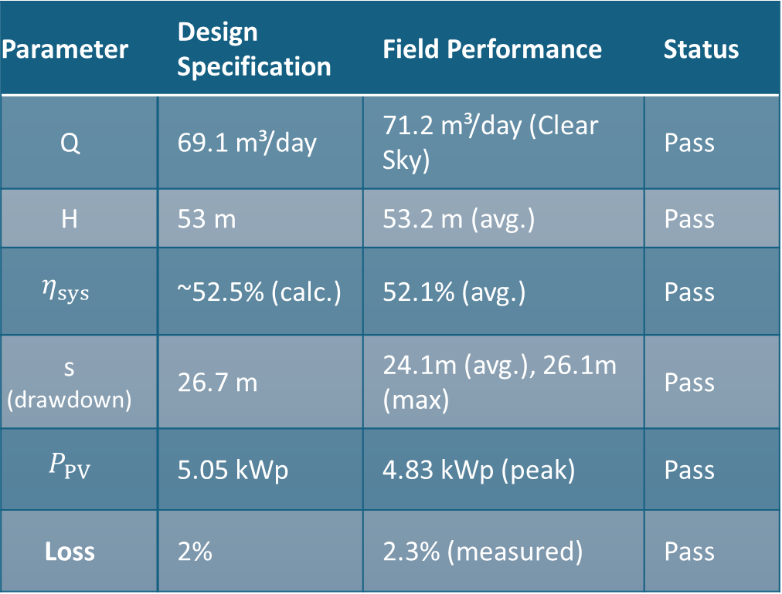
Results and Discussion
Table 3: SCADA Reliability & Design Comparison
Parameter | Design Specification | Field Performance | Status
Q | 69.1 m³/day | 71.2 m³/day (Clear Sky) | Pass
H | 53 m | 53.2 m (avg.) | Pass
$$η_{sys}$$ | ~52.5% (calc.) | 52.1% (avg.) | Pass
s (drawdown) | 26.7 m | 24.1m (avg.), 26.1m (max) | Pass
$$P_{PV}$$ | 5.05 kWp | 4.83 kWp (peak) | Pass
Loss | 2% | 2.3% (measured) | Pass
SCADA Reliability & Design Comparison:
Communication & SCADA Reliability
Uptime: 98.7% (operational for trial period).
Latency: Average end-to-end (sensor-to-dashboard) latency of 1.4 seconds.
Data Integrity: The LoRa backup successfully stored 100% of data during 1.3% network downtime, which was pushed to the cloud upon restoration.

Slide 9
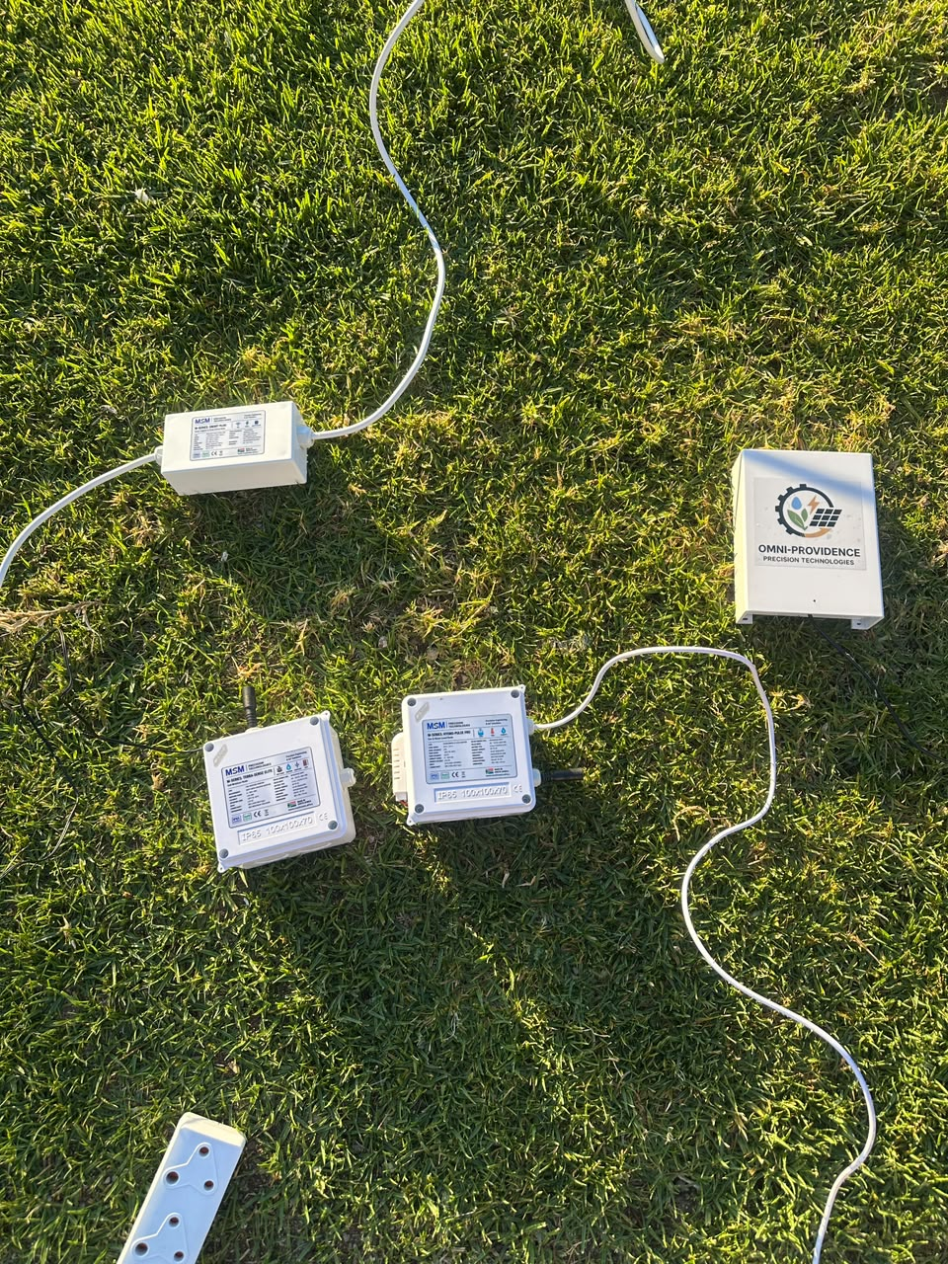
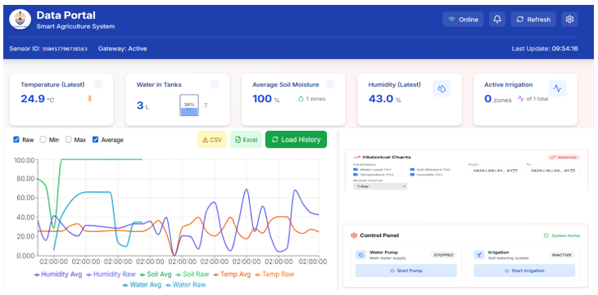
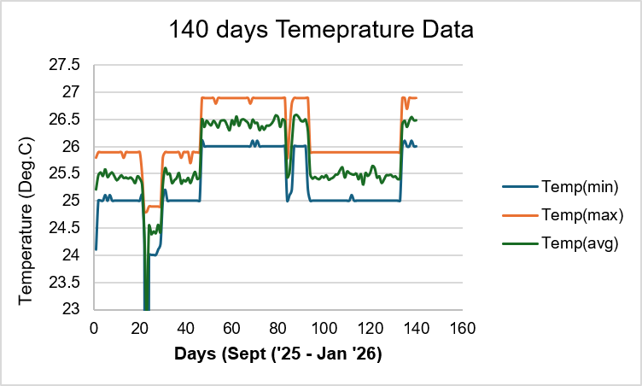
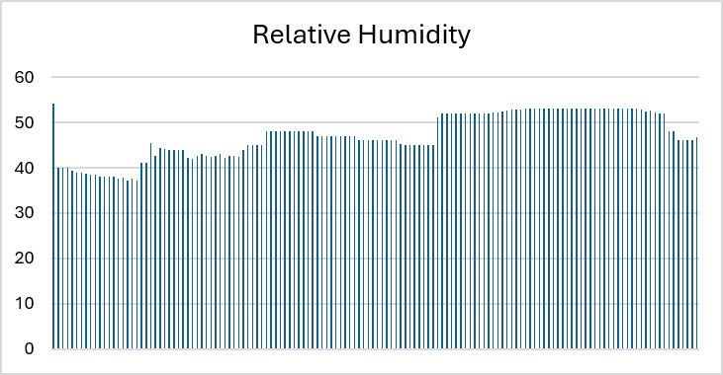
Results and Discussion
User interface:
Performance of device at the University of Venda, Thohoyandou in Limpopo Province. The figure represents the temperature data collected from 15 August 2025 to 31 January 2026.
Figure 6: Hardware and software (including the dashboard).

Slide 10
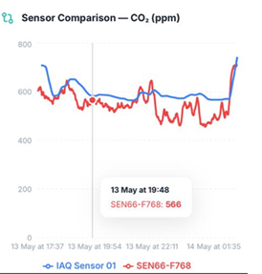
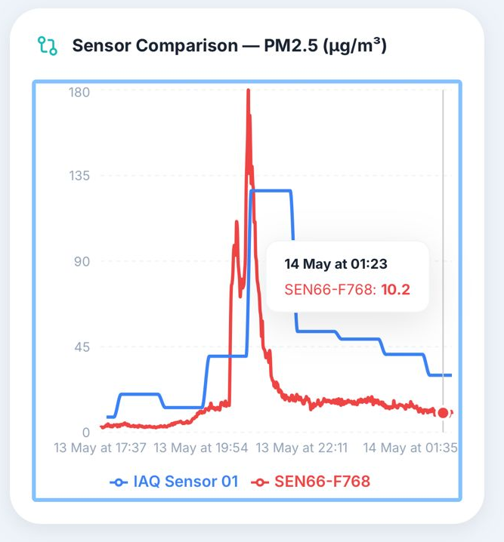
Benchmarking
Indoor Air Quality
BLUE: (IAQ Sensor) - device from the market (shelf)
RED: (SEN66) connected to our device
SEN66 sensor demonstrated:
strong agreement with the reference IAQ sensor in tracking indoor CO₂ concentrations
enhanced sensitivity and faster dynamic response to PM2.5 pollution events.
These results suggest that the SEN66 is suitable for real-time air-quality monitoring applications, particularly where rapid detection of transient particulate matter events is required.
Figure 7: Benchmarking.

Slide 11
Conclusion
The refined, iterative methodology successfully validated the design and performance of the IoT-enabled PVWPS.
Successful Validation: Hydraulic and energy performance closely matched theoretical design specifications under clear-sky conditions.
Advanced Monitoring & Control: The custom IoT-SCADA RTU demonstrated:
  Excellent real-time monitoring capabilities.
  Accurate edge computing (e.g., preventing dry-run in 2.3 seconds).
  Reliable hybrid communication (98.7% uptime, 100% data integrity).

Slide 12
Reference
[1]. Matimolane & Mathivha, Frontiers in Environmental Science, DOI:
10.3389/fenvs.2025.1550738, 2025
[2]. L. Masevhe, PhD Thesis, University of Venda, 2023.
[3]. M. E. Kararet al.: IoT and Neural Network-Based Smart Irrigation
[4]. E. Fortunato, Gaspar D, Duarte P, Pereira L, A´guas H, Vicente A,
[5]. F. Dourado, M. Gama, BacterialNanocellulose,Elsevier179-197, 2016

Slide 13




Acknowledgements
Prof Eric Maluta (GTCI)
Mr Isaiah Chiraira (Wits)

Slide 14
Thank you

