Slide 1

Inverse design of optical neural networks with qubit-based quantum computers
Only first letter and proper nouns capitalized in title
Full names with presenting author underlined
Nikita Azevedo, Adwait Gaikwad, Mwezi Koni, Emmanuel Azubuike, Josh Snyman, Pedro Ornelas, Ilya Sinayskiy, and Isaac Nape
Structured Light Laboratory
Notes:
Hi everyone. My name is Nikita, and I’m a first-year Master’s student at Wits. My research focuses on implementing machine learning algorithms using alternative computing technologies. ML algorithms are traditionally run on classical computers and GPUs, but they can also be implemented using other kinds of computers, light in photonic computers, as well as on existing quantum computers. The work I’ll be showing you today specifically investigates how machine learning procedures developed for one computing system can inform and improve learning procedures in other systems.

Slide 2

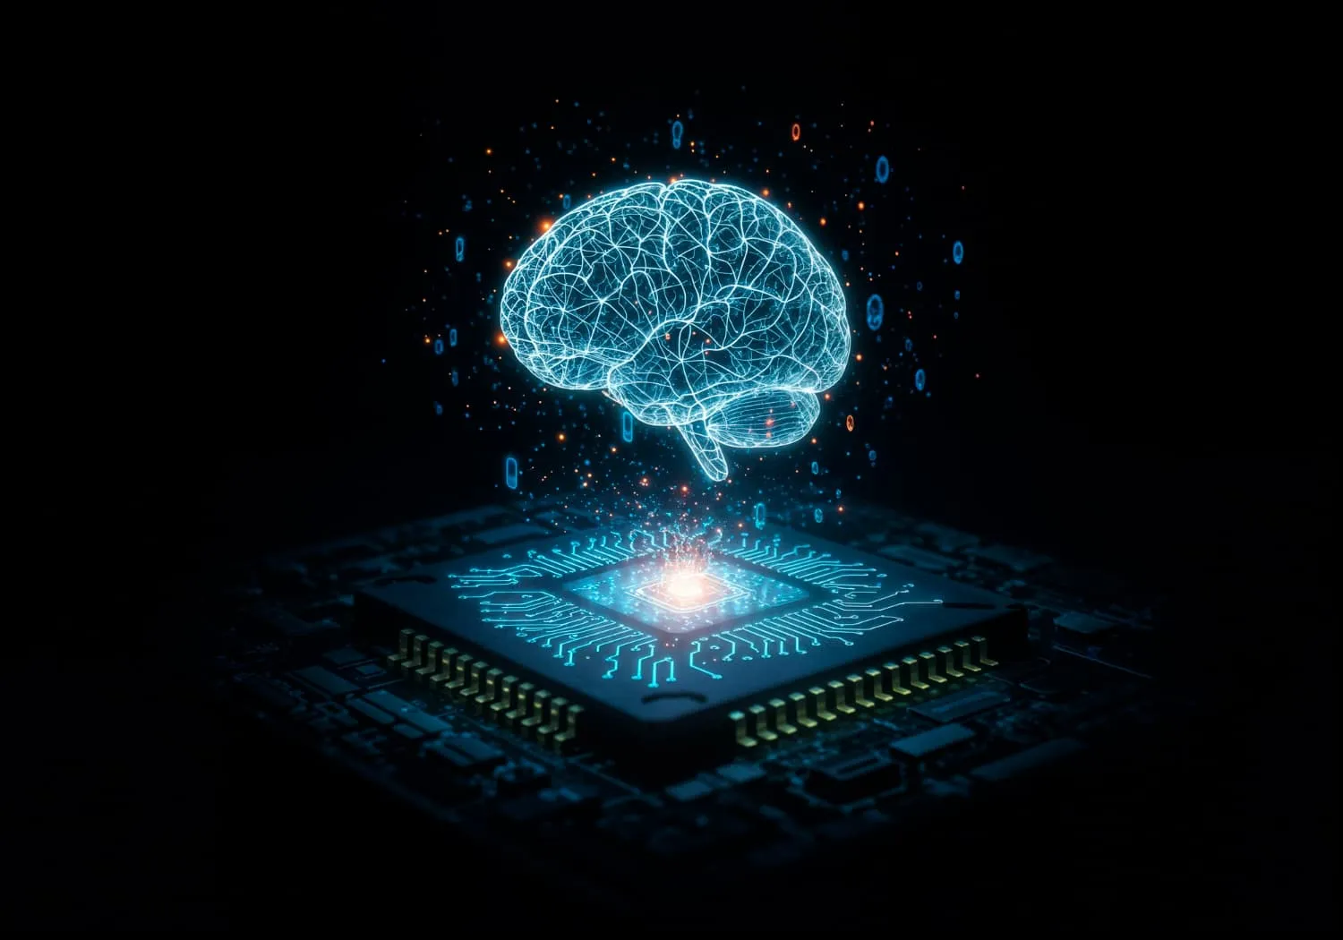
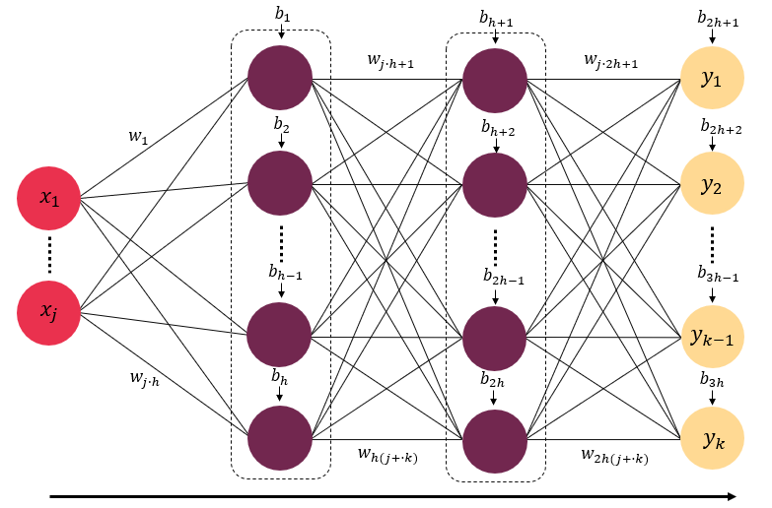
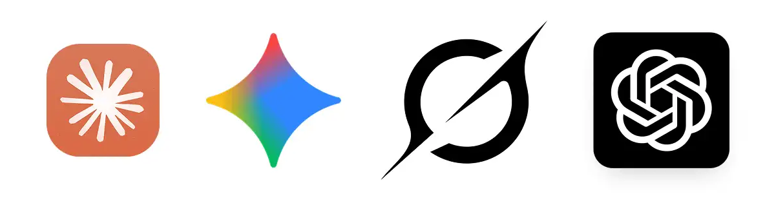
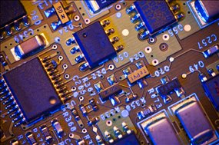


Artificial Intelligence is trained on supercomputers and require high computing power – we need better computing paradigms!
Arial 16
Transistors can only get so small!
Notes:
I’d like to start off with a fact that we are all familiar with: artificial intelligence has become integrated into our daily lives and has proven to be remarkable at a variety of tasks. Today, state-of-the-art AI models are typically trained on powerful supercomputers housed in large data centres. The demands of these systems however continue to grow. Neural networks which form the basis of these models continue to demand larger datasets for training, long training times, and high computing power.

Slide 3
Artificial Intelligence is trained on supercomputers and require high computing power – we need better computing paradigms!
Arial 16
Transistors can only get so small!
Notes:
In fact conventional electronic hardware may eventually become a bottleneck during training. This motivates the search for entirely new computing paradigms.

Slide 4
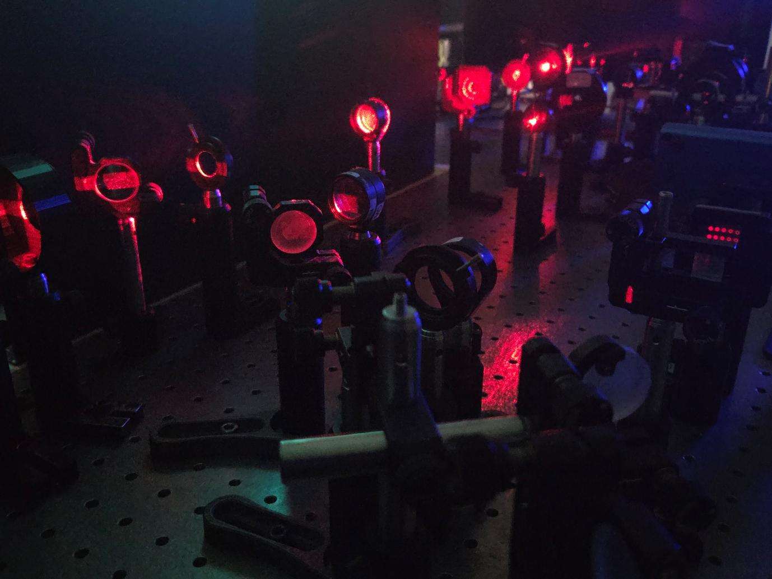
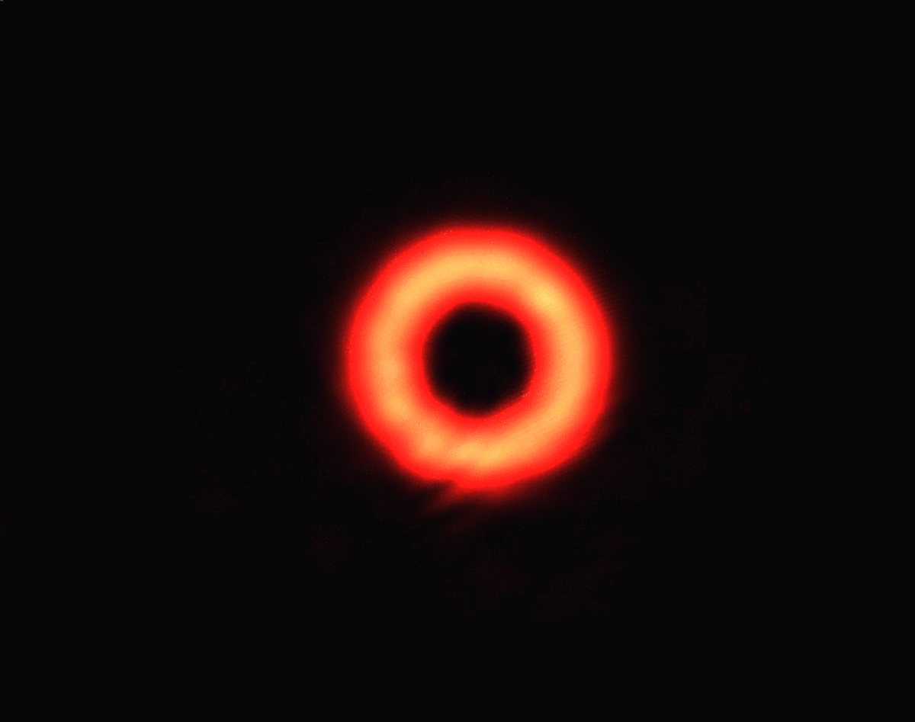
Title
Optical computing shows promise in this regard, with low power consumption and high speed information processing!
Arial 16
Notes:
This brings us to optical or photonic computing. In these systems, computation is performed directly as light propagates through the optical hardware with very low power consumption, making them an attractive alternative. In terms of AI, We can actually design optical systems that mimic the way in which classical neural networks learn,

Slide 5
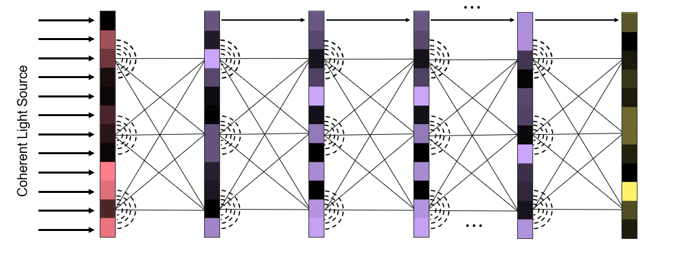
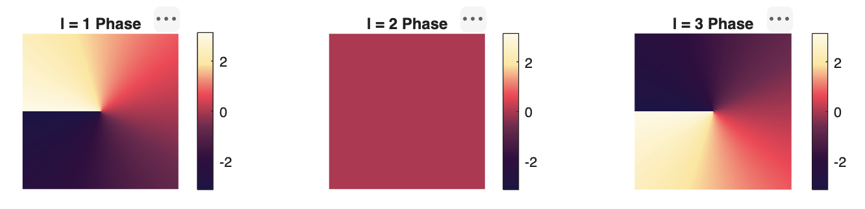
Deep Diffractive Neural Networks (D²NNs) are informed by Artificial Neural Networks (ANNs)
Input layer
Hidden layers
Output layer
D²NNs
ANN
Notes:
These systems are known as optical neural networks, or diffractive neural networks. A deep diffractive neural network has a structure very similar to that of a classical neural network. It consists of input and output layers separated by multiple hidden layers. As light propagates through these hidden layers, diffraction and interference naturally perform the computation.

Slide 6
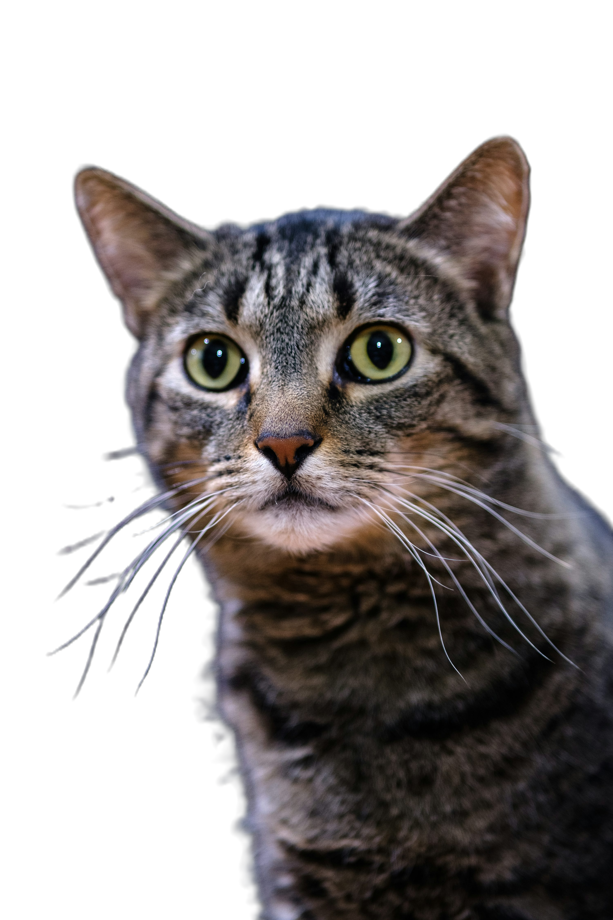

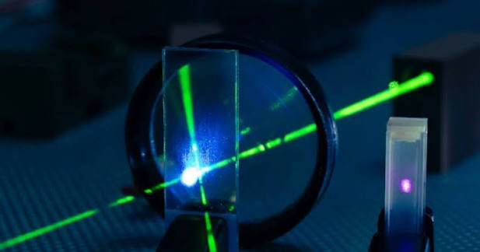

Research question: how can we design better optical neural networks?
Cat
f($\overline{x}$)
Output
Cat
Dog
Notes:
Although this design is advantageous as processing now occurs with low power consumption, But the design of these networks are not flawless and this will lead to my research question. How can we optimise the design of these networks for different machine learning tasks? We are particularly interested in using this optical network for image classification.

Slide 7
We start with classifying structured light, controlled in all its degrees of freedom
Arial 16
Nature Photonics 15, 253 (2021)
Light: Science & App. 11, 205 (2022)
Notes:
Since I work in the Structured Light Lab, the images we are trying to classify are these patterns, formally known as structured light. Successfully classifying these patterns provides a useful starting point before progressing to more complex natural images.
Classifying these patterns is valuable not only as an image classification problem but also because structured light has important applications in communication and measurement.

Slide 8
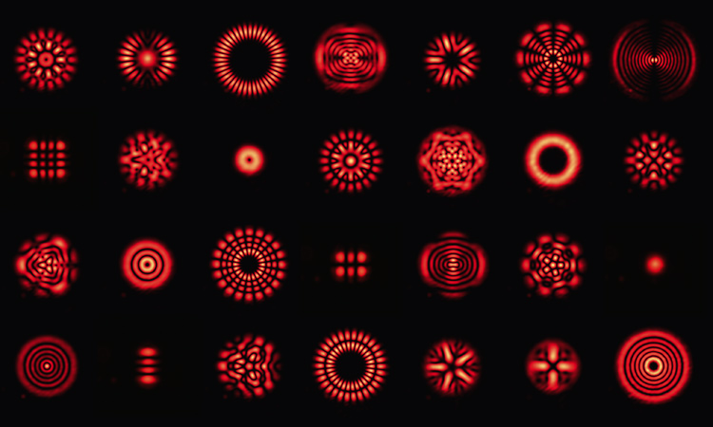

Controlling structured light is not easy!
Arial 16
Nature Photonics 15, 253 (2021)
Light: Science & App. 11, 205 (2022)
Light: Science & App. 5, 26 (2025)
“a d-dimensional entangled state generated using structured light requires an exponentially increasing number of measurements”
Notes:
If we encode a message into these patterns, in order to recover the transmitted information, these modes must first be accurately identified, and this remains a significant experimental challenge and this is where image classification by machine learning becomes particularly valuable. Since diffractive neural networks are inherently optical, they provide a natural platform for learning to classify structured light.

Slide 9
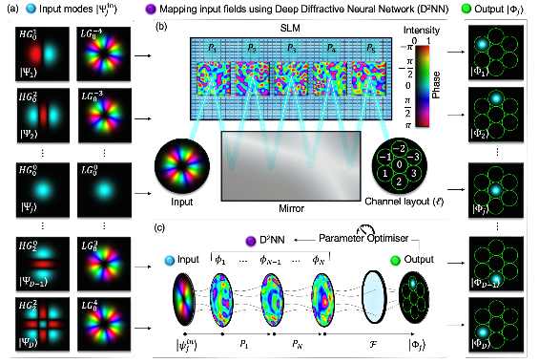
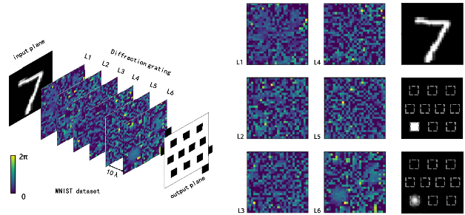
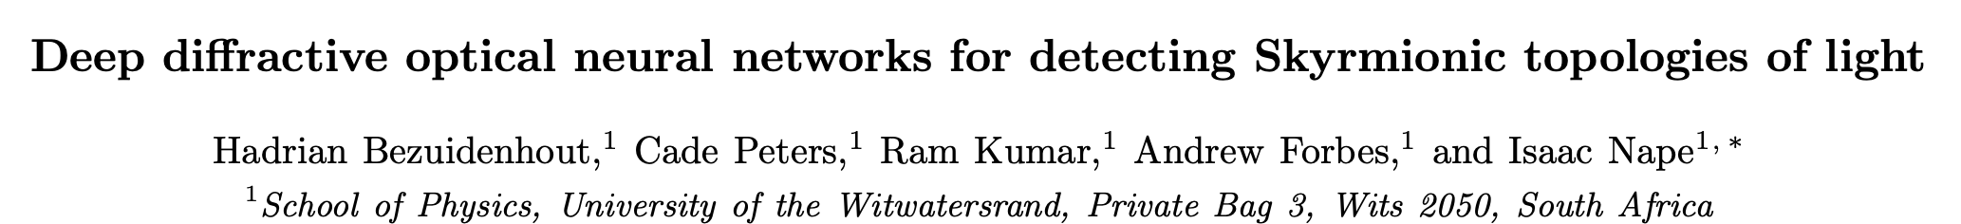
D²NNs have been used to classify topology and digits at the speed of light
Arial 16
Sun, Y. et al. (2023), Journal of the Optical Society of America B, 40(11), p. 2951.
Notes:
More broadly, diffractive neural networks have found applications in a wide range of image classification tasks, including handwritten digit recognition. Our group has developed a diffractive optical neural network specifically for classifying the topological structure of light.

Slide 10
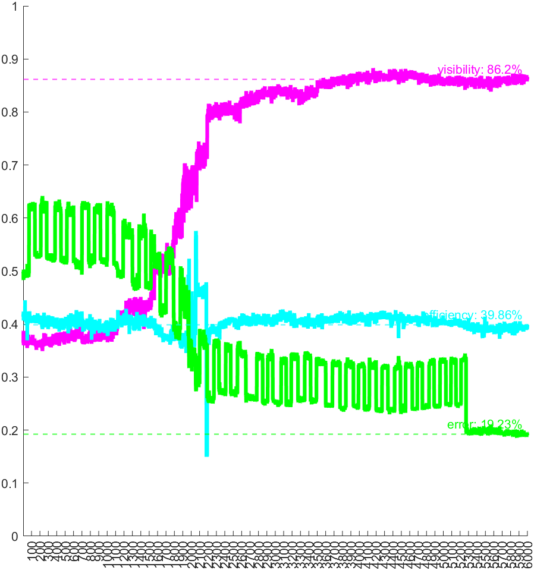
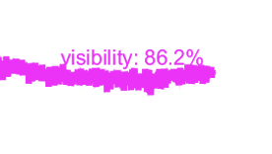
D²NNs have been used to classify topology– but falls short in classification accuracy and takes longer to train than we would prefer
Arial 16
Cost
Iterations
15000
Notes:
Although these systems demonstrate impressive performance, classification accuracy is not perfect and training them typically takes much longer than we would like. As you can see here, a visibility of 86% was achieved experimentally in about 15000 iterations, taking an entire day to train.

Slide 11
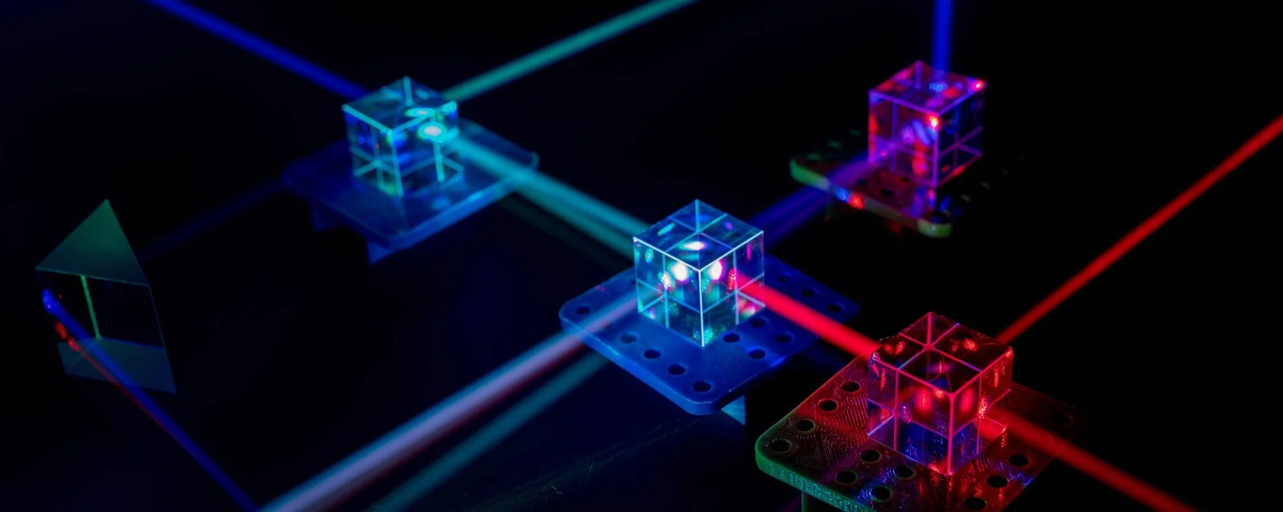
Research question: how can we design better optical neural networks? More specifically, is there an analogous system that can help?
Cat
f($\overline{x}$)
Output
Cat
Dog
Notes:
Going back to our research: given the advantages offered by optical computing, can we design these optical neural networks more efficiently?
More specifically, Is there an analogous system or approach that exists that can allow us to probe these systems, and improve their design?

Slide 12



Research question: how can we design better optical neural networks? More specifically, is there an analogous system that can help?
f($\overline{x}$)
Cat
$$≈$$
Output
Cat
Dog
f($\overline{x}$)
?
Notes:
Going back to our research: given the advantages offered by optical computing, can we design these optical neural networks more efficiently?
More specifically, Is there an analogous system or approach that exists that can allow us to probe these systems, and improve their design?

Slide 13

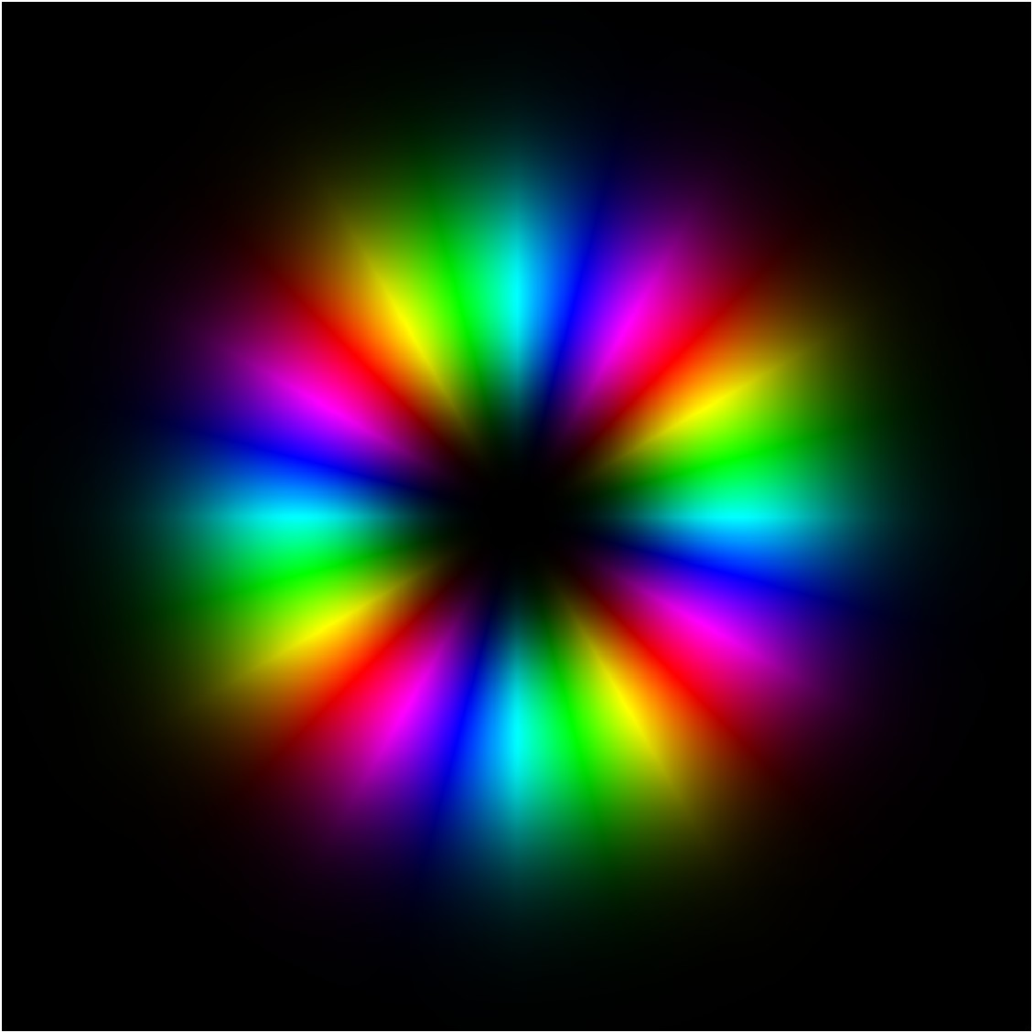

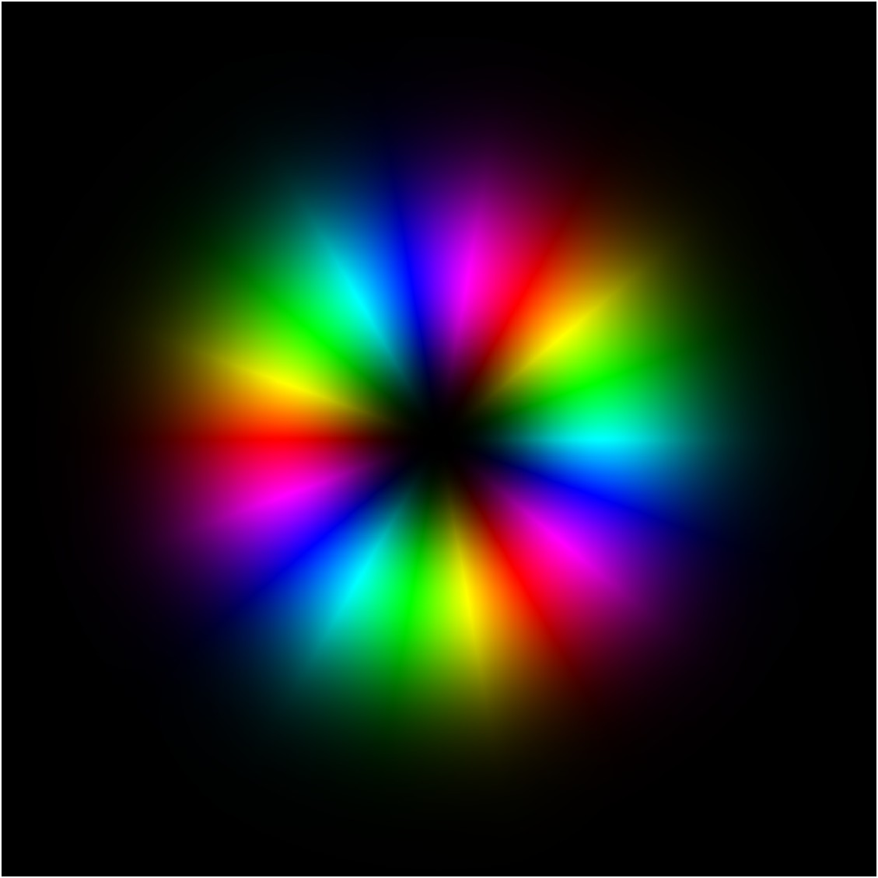

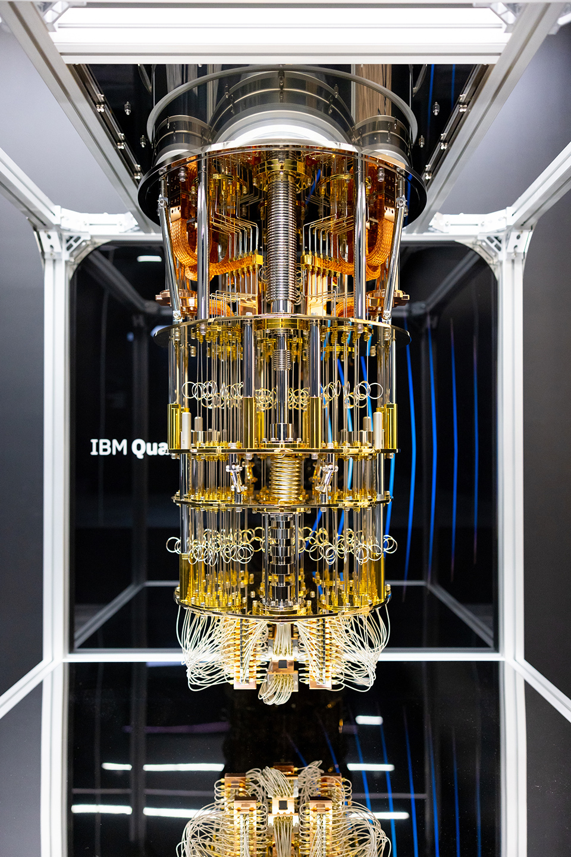
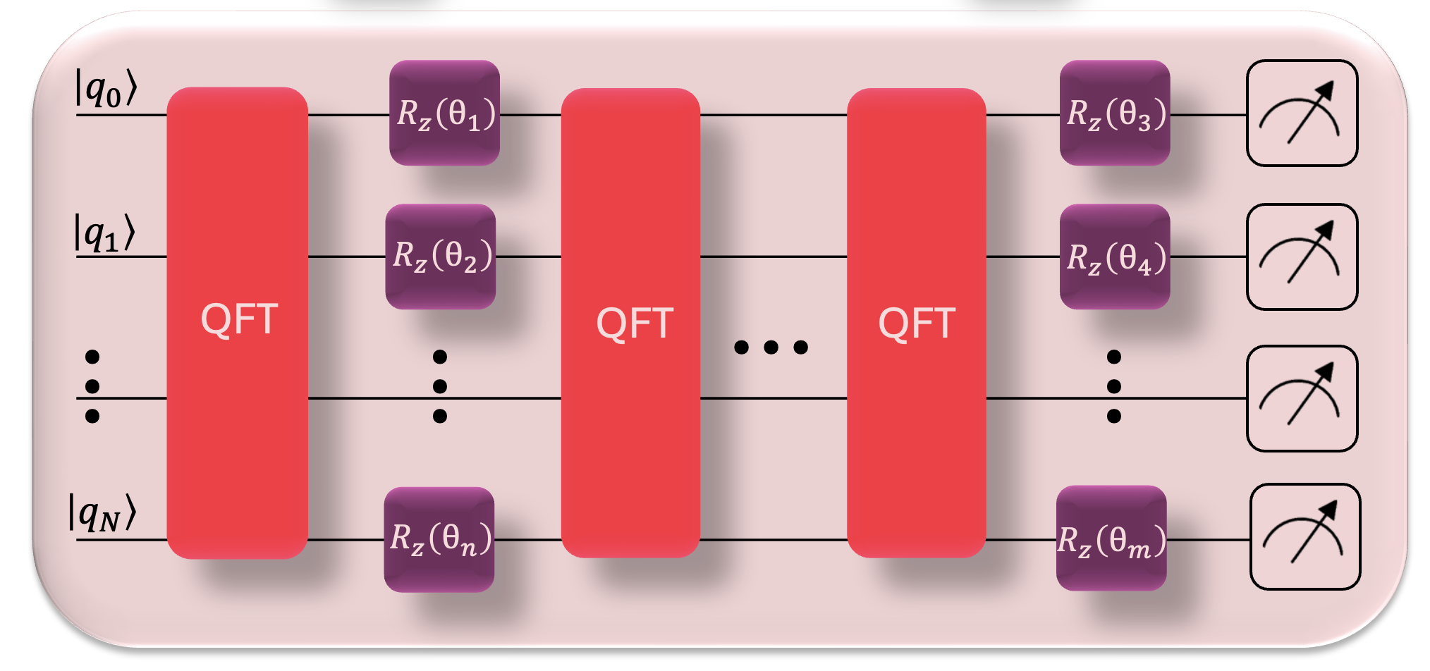




We design a Physics-Informed Neural Network (PINN), where the D²NN is represented on a quantum device
Arial 16
D²NN
Input fields
Output fields
$$LG_{0}^{−4}$$
$$|Φ_{1}⟩$$
$$LG_{0}^{−3}$$
$$|Φ_{2}⟩$$
Quantum Neural Network
Notes:
We can build a different kind of neural network that is inspired by the physics of our system and can be run on a different kind of processor – particularly, a quantum computer.
Although quantum computers are not yet near term, many quantum operations and quantum-inspired algorithms have proven to be useful.

Slide 14
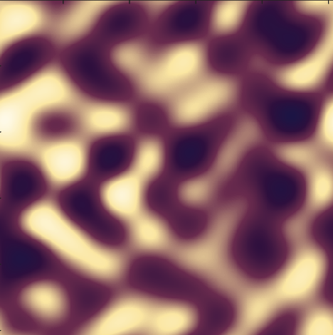
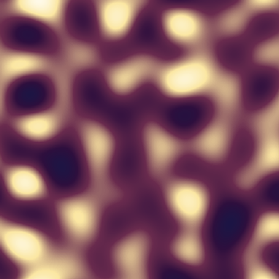
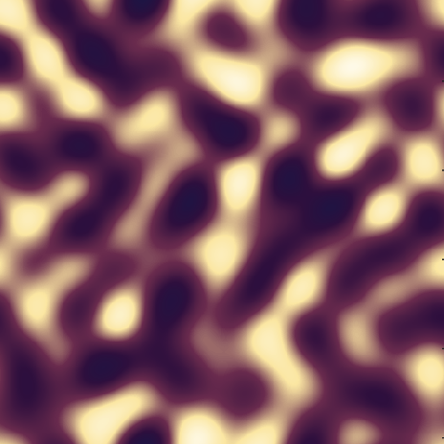










The layers of the D²NN are replaced by a quantum circuit
Arial 16
D²NN
Input fields
Output fields
$$D_{0}$$
$$D_{1}$$
$$D_{n}$$
$$LG_{0}^{−4}$$
$$|Φ_{1}⟩$$
$$LG_{0}^{−3}$$
$$\left|φ_{1}\right\rangle$$
$$\hat{F}$$
$$\hat{F}$$
$$\hat{F}$$
$$\hat{F}$$
$$|Φ_{2}⟩$$
Notes:
To solve our particular design problem, We’ve replaced the hidden diffractive layers in our optical network with a quantum circuit composed of qubits and quantum gates. We therefore propose that an equivalent quantum model be used to design better optical neural networks.

Slide 15
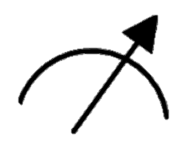














The layers of the D²NN are replaced by a quantum circuit
D²NN
Arial 16
Input fields
Output fields
$$D_{0}$$
$$D_{1}$$
$$D_{n}$$
$$LG_{0}^{−4}$$
$$|Φ_{1}⟩$$
$$LG_{0}^{−3}$$
$$\left|φ_{1}\right\rangle$$
$$\hat{F}$$
$$\hat{F}$$
$$\hat{F}$$
$$\hat{F}$$
$$≈$$
$$|Φ_{2}⟩$$
$$\left|q_{0}\right\rangle$$
$$\left|q_{1}\right\rangle$$
Quantum Neural Network
(QNN)
…
$$\overset{ˆ}{U}\left(θ\right)$$
$$\left|q_{N}\right\rangle$$
Notes:
To solve our particular design problem, We’ve replaced the hidden diffractive layers in our optical network with a quantum circuit composed of qubits and quantum gates. We therefore propose that an equivalent quantum model be used to design better optical neural networks.

Slide 16














There is a one-to-one mapping between the D²NN operators and the circuit operators
$$\overset{ˆ}{U}$$
Arial 16
Input fields
Output fields
$$D_{0}$$
$$D_{1}$$
$$D_{n}$$
$$\left|φ_{0}\right\rangle$$
$$LG_{0}^{−4}$$
$$|Φ_{1}⟩$$
Pattern 1
$$LG_{0}^{−3}$$
$$\left|φ_{1}\right\rangle$$
Pattern 2
$$\hat{F}$$
$$\hat{F}$$
$$\hat{F}$$
$$\hat{F}$$
$$|Φ_{2}⟩$$
Pattern 3
$$≈$$
$$\left|q_{0}\right\rangle$$
$$\left|q_{1}\right\rangle$$
…
$$\overset{ˆ}{U}\left(θ\right)$$
$$U^{†}U=UU^{†}=I$$
$$\left|q_{N}\right\rangle$$
Notes:
But how can we establish an equivalence between these two seemingly different systems?
There is a one-to-one correspondence between the mathematical operations in the optical neural network and those in the quantum circuit. Both systems evolve according to unitary transformations. A unitary operator is simply a transformation that preserves all the information in a system, so no information is lost, the transformation is reversible.
The unitary mapping input patterns to detectors can therefore be approximated by the unitary in a circuit. How can we so easily replace the components in our network with the components of a different system?

Slide 17






There is a one-to-one mapping between the D²NN operators and the circuit operators
$$\overset{ˆ}{U}$$
Arial 16
Input fields
Output fields
$$D_{0}$$
$$D_{1}$$
$$D_{n}$$
$$LG_{0}^{−4}$$
$$|Φ_{1}⟩$$
$$LG_{0}^{−3}$$
$$\hat{F}$$
$$\hat{F}$$
$$\hat{F}$$
$$\hat{F}$$
$$≈$$
$$|Φ_{2}⟩$$
$$\left|q_{0}\right\rangle$$
$$\left|q_{1}\right\rangle$$
…
$$\overset{ˆ}{U}\left(θ\right)$$
$$\left|q_{N}\right\rangle$$
Notes:
Here are the components of the ciruit we are using.

Slide 18

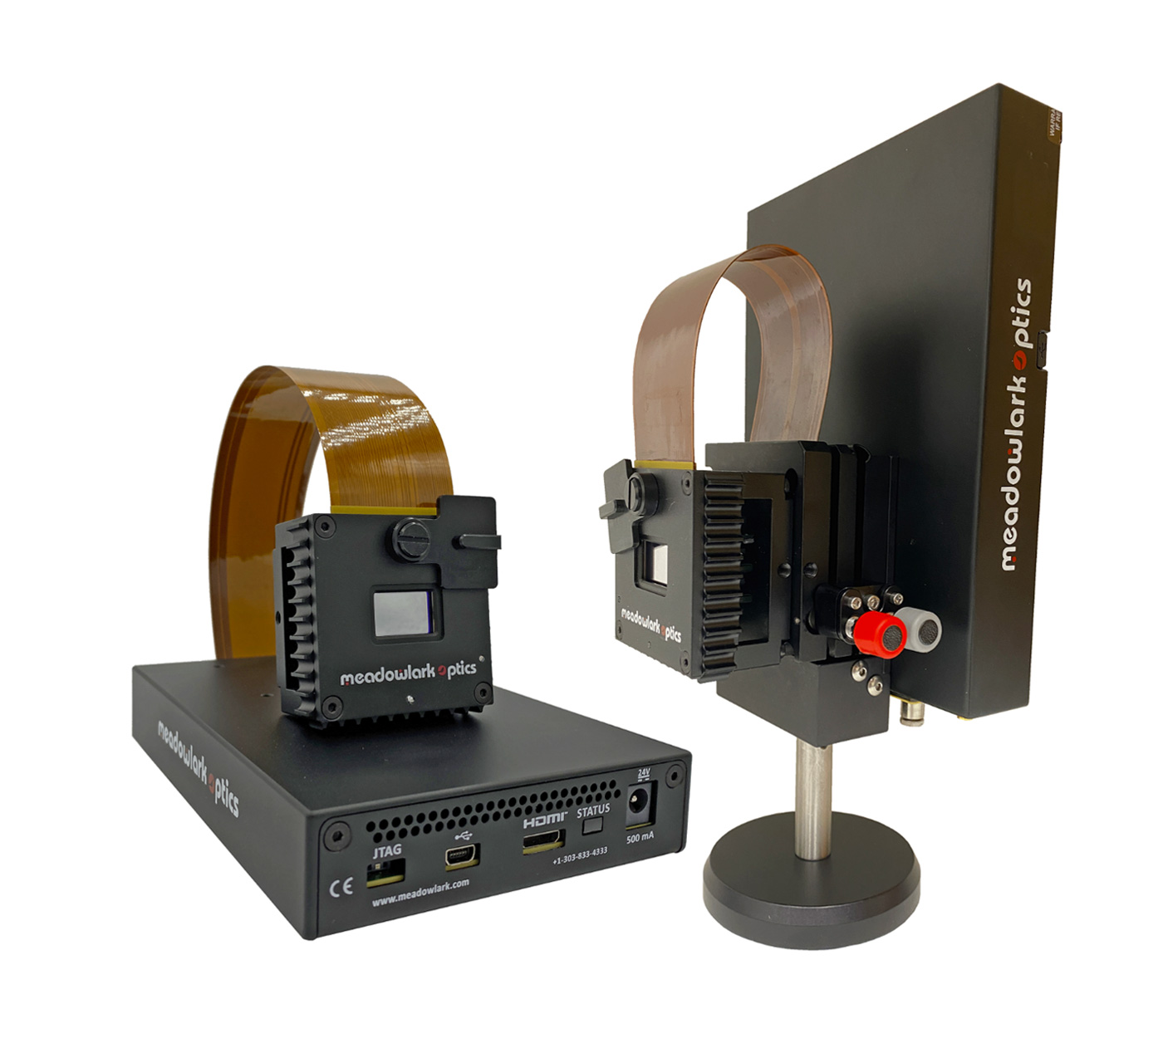
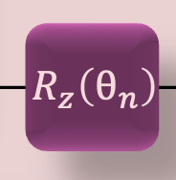

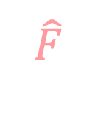





Trainable phase masks become quantum rotation gates
$$D_{0}$$
$$D_{1}$$
$$D_{n}$$
Arial 16
$$\hat{F}$$
$$\hat{F}$$
$$\hat{F}$$
$$\hat{F}$$
Spatial Light Modulator (SLM)
Operator
Matrix representations
$$D=\left(\begin{matrix}e^{iφ_{1}} & 0 & ⋯ & 0 \\ 0 & e^{iφ_{2}} & ⋯ & 0 \\ ⋮ & ⋮ & ⋱ & ⋮ \\ 0 & 0 & ⋯ & e^{iφ_{N}}\end{matrix}\right)$$
$$R_{z}\left(θ\right)=\left(\begin{matrix}e^{−iθ/2} & 0 \\ 0 & e^{iθ/2}\end{matrix}\right)$$
Notes:
If we zoom into the hidden diffractive layers that comprise our network, you’ll see that that are composed of free space propagation and phase modulation. The phase of the field, which is, is manipulated using phase masks created on a device called a Spatial Light Modulator. Athematically speaking Each phase layer is diagonal in the pixel basis. This operator on the field is equivalent to z rotation gates acting on single qubits.

Slide 19

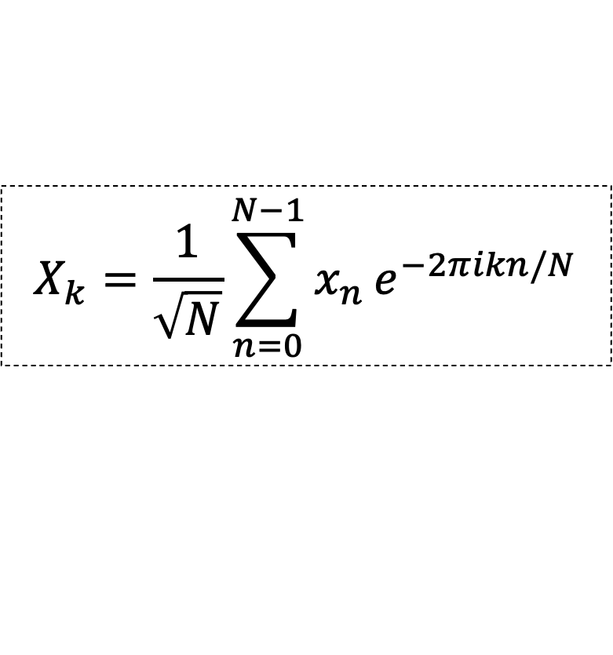



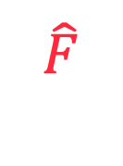


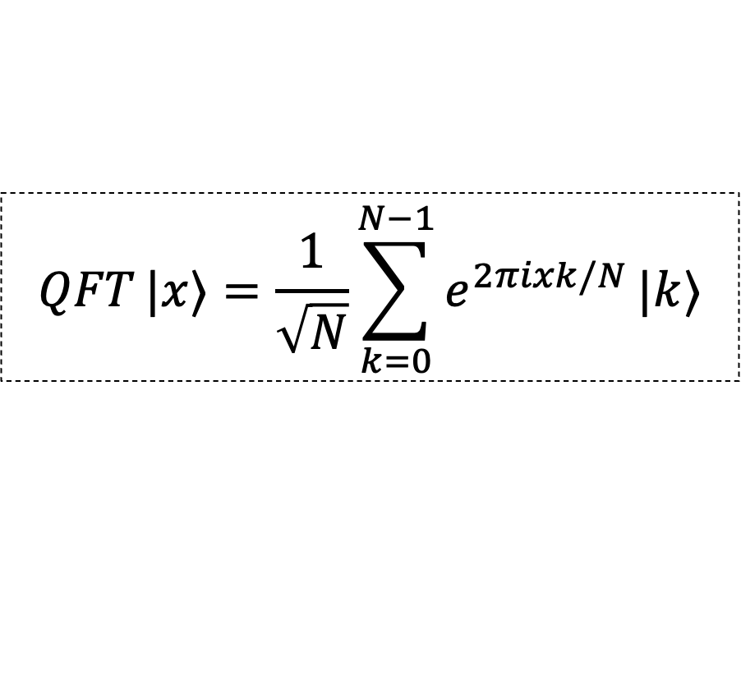
Free-space propagation is replaced by the Quantum Fourier Transform
$$D_{0}$$
$$D_{1}$$
$$D_{n}$$
Arial 16
$$\hat{F}$$
$$\hat{F}$$
$$\hat{F}$$
$$\hat{F}$$
Operator
Representation
$$X_{k}=\frac{1}{\sqrt{N}}\sum_{n=0}^{N−1}{x_{n}}e^{−2πikn/N}$$
$$\hat{F}$$
$$QFT |x⟩=\frac{1}{\sqrt{N}}\sum_{k=0}^{N−1}{e^{2πixk/N}}|k⟩$$
QFT
Notes:
We also have free space propagation is effectively applying a fourier transform to the optical field. In a quantum circuit, this operator is effectively a quantum fourier transform.

Slide 20
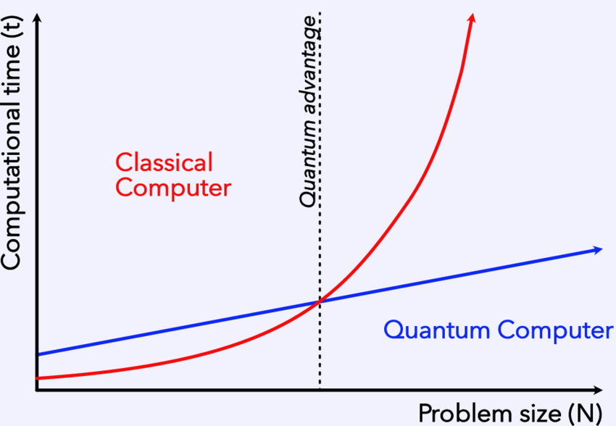
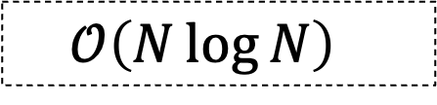
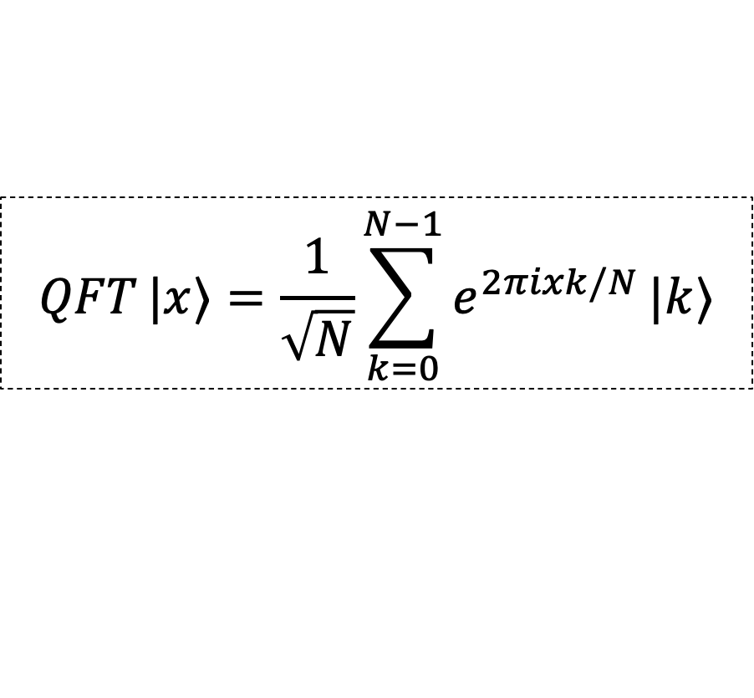
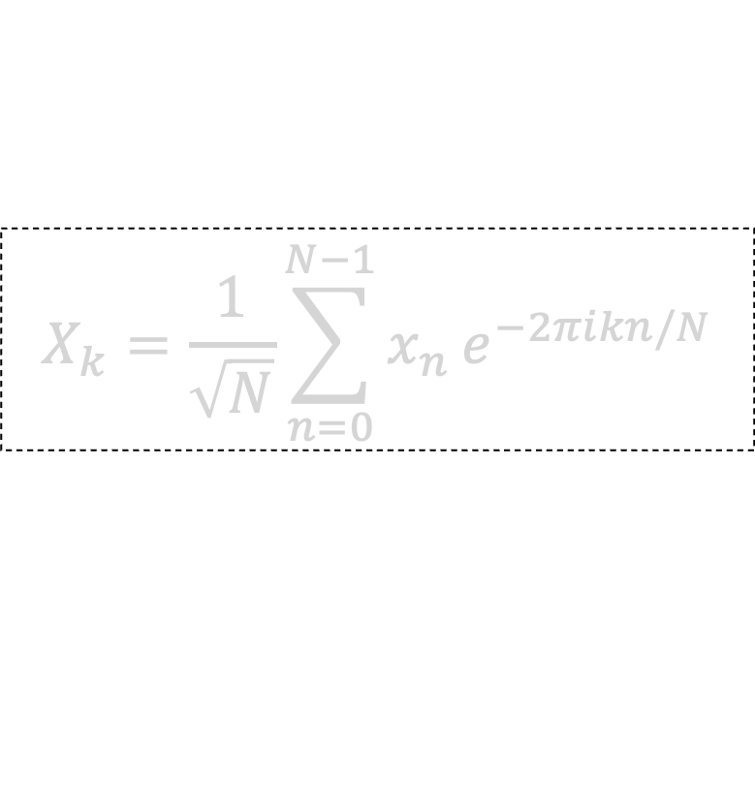
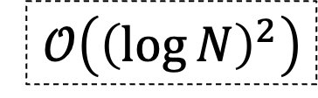
The Quantum Fourier Transform offers us exponential speedup!
Operator
Representation
Time complexity
Arial 16
$$X_{k}=\frac{1}{\sqrt{N}}\sum_{n=0}^{N−1}{x_{n}}e^{−2πikn/N}$$
$$𝒪\left(N\log{N}\right)$$
$$QFT |x⟩=\frac{1}{\sqrt{N}}\sum_{k=0}^{N−1}{e^{2πixk/N}}|k⟩$$
QFT
$$𝒪​\left({\left(\log{N}\right)}^{2}\right)$$
Notes:
In terms of qubits, a QFT is a change in basis from the computational basis, in which a single qubit is either in the state 0 or 1, to the Fourier basis. How does this correspondence manifest and why bother using quantum machine learning? What advantage does it give us? This process is known to be efficient in the number of amplitudes for many groups which implies an exponential—or sometimes even super-exponential— speedup compared to the classical Fast Fourier Transform. Here I have the time complexities. In the graph you can see that as we increase the problem size, the time it takes for classical computers to perform computations increases massively, but for a quantum computer, it takes less time to execute operations.

Slide 21



The Quantum Neural Network is trained using a Variational Quantum Algorithm (VQA)
Arial 16
Quantum subroutine
Classical processing
$$C(\vec{θ})$$
VQA
Notes:
Having established this correspondence, we can now construct a quantum neural network capable of classifying structured light modes.
The next question is how we train this network to make accurate predictions.
Quantum neural networks are typically trained using variational quantum algorithms. One part is run on a quantum computer while. Within the quantum portion of the algorithm, we construct a circuit containing tunable rotation gates that prepare and manipulate the quantum state.

Slide 22






The Quantum Neural Network is trained using a Variational Quantum Algorithm (VQA)
Arial 16
Updated parameters
Before
Input beam
Classical processing
Quantum subroutine
$$C(\vec{θ})$$
After
$$\left|ψ\right\rangle$$
VQA
Notes:
In the context of our classification problem, the first step is to encode each structured light pattern as a quantum state using amplitude encoding. The input image is compressed so that each pixel corresponds to the amplitude of a computational basis state. The output of this circuit is then passed to a classical optimizer, which evaluates a cost function and updates the circuit parameters to minimize that cost. This hybrid quantum-classical optimization process is repeated until the model converges.
To evaluate the performance of the model, we monitor two quantities.
First, we plot the cost function as a function of the optimization iterations. A decreasing loss indicates that the optimizer is successfully finding parameters that better approximate the desired optical transformation.

Slide 23


The Quantum Neural Network is trained using a Variational Quantum Algorithm (VQA)
Arial 16
Before
Input beam
Classical processing
Quantum subroutine
$$C(\vec{θ})$$
After
$$\left|ψ\right\rangle$$
VQA
Notes:
Second, we examine the confusion matrix. Here, the true labels are shown on the y-axis and the predicted labels on the x-axis. Early in training, several modes are misclassified. As optimization progresses, the ideal outcome is a perfect diagonal, indicating that every input mode has been assigned to its correct output label.

Slide 24




Classifying orthogonal modes and non-orthogonal modes (superposition states)
Arial 16
$$\left|{LG}_{p}^{ℓ}\right\rangle$$
$$\left\langle ψ_{i}∣ψ_{j}\right\rangle =δ_{ij}=\left\{\begin{matrix}1, & i=j \\ 0, & i≠j\end{matrix}\right.$$
Orthogonal
$$\left|{HG}_{m,n}\right\rangle$$
$$\left|φ_{j}\right\rangle$$
Non-orthogonal
$$\left\langle φ_{i}∣φ_{j}\right\rangle ≠0, i≠j$$
Notes:
Moving onto the simulation results. Id like to show you the structured light we are trying to classify. We have two families. The first are orthogonal which means mathematically they are perfectly distinguishable, so if you calculate the overlap It will be 0. Simpler task. Looking at our input data, we evaluate the model on both orthogonal and non-orthogonal structured light modes. Orthogonal modes provide a baseline since they are, in principle, perfectly distinguishable. Non-orthogonal modes present a much more challenging classification problem because they overlap in Hilbert space,
%making them more representative of realistic optical systems where noise and distortions are present.

Slide 25


The network distinguishes between orthogonal patterns by concentrating probability onto the correct label
Arial 16
Input probability distribution (before training)
Output probability distribution (during training)
Input beams
$$\left|{LG}_{p}^{ℓ}\right\rangle$$
Notes:
If we had to look at one class and four examples, I said we would have to encode them into our quantum state. Initially, the input state is distributed across many computational basis states after passing through the randomly initialized circuit. As training progresses, the variational optimizer adjusts the phase rotations so that the probability amplitude is concentrated onto the desired output label. The circuit is therefore learning to map each optical pattern onto a unique computational basis state.

Slide 26

The network is close to exhibiting a clear diagonal
Arial 16
Confusion matrix
Test accuracy: 92.9%
$$\left|{LG}_{p}^{ℓ}\right\rangle$$
Input probability distribution (before training)
Output probability distribution (before training)
Notes:
The confusion matrix summarizes the overall classification performance across the entire dataset. While most of the probability is concentrated along the diagonal, not every input mode is mapped perfectly to its correct output label, indicating that there is still room for improvement.

Slide 27



Classifying orthogonal modes and non-orthogonal modes (superposition states)
Arial 16
Test accuracy: 92.9%
$$\left|{LG}_{p}^{ℓ}\right\rangle$$
Cost function comparison
$$\left|{HG}_{m,n}\right\rangle$$
Test accuracy: 93.8%
Cost
Iterations
$$\left|φ_{j}\right\rangle$$
Test accuracy: 88.9%
Notes:
During training, we observe a steady decrease in the loss, demonstrating that the optimizer is successfully learning the desired transformation.

Slide 28










We introduce entanglement into the circuit (SWAP and CNOT), effectively permuting pixels
$$\left|q_{0}\right\rangle$$
x
x
$$R_{z}\left(θ_{1}\right)$$
$$R_{z}\left(θ_{1}\right)$$
Arial 16
$$\left|q_{1}\right\rangle$$
Amp.
encoding
$$R_{z}\left(θ_{2}\right)$$
…
$$R_{z}\left(θ_{2}\right)$$
QFT
QFT
…
…
…
$$\left|q_{N}\right\rangle$$
x
x
$$R_{z}\left(θ_{n}\right)$$
$$R_{z}\left(θ_{n}\right)$$
Notes:
One of the major advantages of moving to a quantum implementation is that we are no longer constrained by the architecture of the classical optical neural network. This gives us the freedom to explore new circuit designs that may ultimately inspire improved optical systems.
To investigate this, we modified our variational quantum circuit by introducing an ancilla qubit together with additional entangling operations, inspired by recent work on optimal ansatz design. The purpose of these additions is to increase the expressivity of the circuit.

Slide 29


We introduce entanglement into the circuit, effectively permuting pixels
Arial 16
Pixel mixing between layers
Notes:
One advantage of moving to a quantum implementation is that we are no longer constrained to the architecture of the classical optical neural network. We therefore investigated a modified variational circuit by introducing an ancilla qubit together with entangling operations, inspired by this paper on optimal ansatz design. This increases the expressivity of the ansatz, allowing it to explore a richer family of quantum transformations during optimization. Empirically, this led to a significant improvement in performance: the model converged to 100% classification accuracy in fewer iterations and with shorter training times. Perhaps most notably, it was also able to perfectly classify the non-orthogonal modes without requiring a nonlinear activation function.
What is the problem and clever solution, slide un

Slide 30



Classifying the same mode families using entanglement leads to higher accuracy
Arial 16
Test accuracy: 100.0%
$$\left|{LG}_{p}^{ℓ}\right\rangle$$
Cost function comparison
$$\left|{HG}_{m,n}\right\rangle$$
Cost
Test accuracy: 100.0%
Iterations
$$\left|φ_{j}\right\rangle$$
Test accuracy: 100.0%
Requires less training time for higher accuracy!
Notes:
We tested this modified circuit on the same families of structured light and we were able to achieve 100 accuracy each time. Empirically, this modification led to a significant improvement in performance. The enhanced model converged to 100% classification accuracy in fewer optimization iterations and with shorter training times. Perhaps even more remarkably, it was able to perfectly classify the non-orthogonal modes without requiring a nonlinear activation function. Just as optical neural networks offer a low power alternative to classical neural networks run on GPUs, switching the hidden layers in our optical network with a quantum circuit run on a quantum computer has now offered shorter training time and high classification accuracy that our optical networks were missing.
When training, we see a steady decrease in the loss, indicating that the optimizer is successfully finding parameters that better approximate the target optical transformation. Initially, the input state is distributed across many computational basis states after passing through the randomly initialized circuit. As training progresses, the variational optimizer adjusts the phase rotations so that the probability amplitude is concentrated onto the desired output label. The circuit is therefore learning a unitary transformation that maps each optical mode onto a unique computational basis state. The confusion matrix summarizes the classifier performance over the entire dataset. You’ll notice that not all probability is concentrated along the diagonal, indicating that each input mode is mapped onto its correct output label."

Slide 31











The experimental implications of our inverse design problem
D²NN
Input fields
Output fields
Arial 16
$$LG_{0}^{−4}$$
$$\left|q_{0}\right\rangle$$
$$θ^{∗}$$
$$\left|q_{1}\right\rangle$$
$$|Φ_{1}⟩$$
$$LG_{0}^{−3}$$
…
$$\overset{ˆ}{U}\left(θ\right)$$
$$\left|φ_{1}\right\rangle$$
$$|Φ_{2}⟩$$
$$\left|q_{N}\right\rangle$$
Spatial Light Modulator (SLM)
Notes:
So, we've demonstrated that a quantum neural network can effectively classify structured light modes. However, the significance of these results extends beyond quantum machine learning itself.
The optimized rotation angles learned by the quantum circuit are not simply neural network parameters—they correspond directly to phase modulations in the optical system. In principle, once the assumptions in our model are further refined, these learned parameters can be translated back into phase screens for a physical optical neural network.

Slide 32


The experimental implications of our inverse design problem
D²NN
Input fields
Output fields
Arial 16
$$LG_{0}^{−4}$$
$$\left|q_{0}\right\rangle$$
$$θ^{∗}$$
$$\left|q_{1}\right\rangle$$
$$|Φ_{1}⟩$$
$$LG_{0}^{−3}$$
…
$$\overset{ˆ}{U}\left(θ\right)$$
$$\left|φ_{1}\right\rangle$$
$$|Φ_{2}⟩$$
$$\left|q_{N}\right\rangle$$
Pixel mixing
Spatial Light Modulator (SLM)
Diffractive layers
Notes:
Beyond reconstructing phase masks which allow the network to learn, we can also try to implement the act of pixel mixing between the diffractive layers in our network, but I am still working on how this transformation can be physically realised
So we’ve demonstrated that the quantum nenural network architecture can effectively classify OAM modes. These optimized rotation angles are not just neural network parameters. They correspond to phase modulations in the optical system. In principle, once the assumptions in the model are refined, the learned parameters can be translated back into phase screens for a physical optical neural network.
The enhanced quantum circuit suggests that introducing controlled information exchange may improve the expressive power of diffractive optical neural networks. This could be achieved through programmable permutation or pixel-mixing operations inserted between diffractive layers.”
these results suggest that quantum machine learning can also guide the design of future optical systems.
"Ultimately, this work demonstrates that quantum computing is not only a platform for computation, but also a powerful framework for designing and understanding complex optical systems."
Link to problem statement

Slide 33
We created an algorithmic blend from different technologies to improve image classification
Arial 16
Quantum machine learning
Classical machine learning
Optical machine learning
Transistors can only get so small!
Notes:
We’ve been able to demonstrate that we've been able to take machine learning procedures from classical, optical and quantum computing and do something pretty cool at the interface of these computing frameworks.
These results suggest that ideas developed in quantum machine learning can directly inform the design of next-generation optical computing systems. Rather than viewing quantum and optical computing as separate technologies, they can instead be used to guide and improve one another.

Slide 34


bb
Diffractive and quantum neural networks provide an alternative for performing image classification, and we aim to classify more complex images
Arial 16
Body
Dog
Cat
Horse
Notes:
. This work highlights the potential of optical neural networks to perform machine learning tasks directly with light, offering a fast and energy-efficient alternative to conventional electronic computation.
Moving forward, the goal is to scale the network to classify a larger number of spatial modes and investigate more complex optical classification tasks.

Slide 35




Thank you to the collaborators whose expertise made this possible!

Slide 36

Thank you
Use email address with name, not student number
structured-light-lab.org
2572944@students.wits.ac.za
Notes:
-

Slide 37

























D²NNs performs computation by propagating light through multiple trainable phase layers
Arial 16
$$LG_{0}^{−4}$$
$$|Φ_{1}⟩$$
$$LG_{0}^{−3}$$
Spatial Light Modulator (SLM)
$$D_{0}$$
$$D_{1}$$
$$…$$
$$D_{n}$$
$$|Φ_{2}⟩$$
$$\left|φ_{1}\right\rangle$$
$$⋯$$
$$LG_{0}^{0}$$
$$\left|φ_{1}\right\rangle$$
$$|Φ_{j}⟩$$
$$LG_{0}^{3}$$
$$\left|ψ_{0}\right\rangle$$
$$\left|φ_{0}\right\rangle$$
$$\hat{F}$$
$$|Φ_{D−1}⟩$$
$$LG_{0}^{4}$$
$$|Φ_{D}⟩$$
Input fields
Hidden layers
Output fields
Notes:
Let’s look at the detailed structure of the architecture. Lets say we have the incident field with the following intensity profile, the field is converted to an output field by the phase elements of a spatial light modulator and freespace diffraction. As light propagates through each phase mask and the free-space region between them, diffraction and interference transform the optical field. Each layer gradually reshapes the incoming beam until, at the output plane, different input modes are directed to different spatial locations.

Slide 38

Structured light is useful because it forms an optical alphabet for communication
Arial 16
Nature Photonics 15, 253 (2021)
Light: Science & App. 11, 205 (2022)
Notes:
If we encode a message into these patterns, in order to recover the transmitted message, these modes must first be accurately identified, and this remains a significant experimental challenge and this is where image classification by machine learning becomes particularly valuable. Since diffractive neural networks are inherently optical, they provide a natural platform for learning to classify structured light.

Slide 39
D²NNs detect input spatial patterns and map them to simple Gaussian spots
Arial 16
$$LG_{0}^{−4}$$
$$|Φ_{1}⟩$$
$$LG_{0}^{−3}$$
Spatial Light Modulator (SLM)
$$D_{0}$$
$$D_{1}$$
$$…$$
$$D_{n}$$
$$|Φ_{2}⟩$$
$$\left|φ_{1}\right\rangle$$
$$⋯$$
$$LG_{0}^{0}$$
$$\left|φ_{1}\right\rangle$$
$$|Φ_{j}⟩$$
$$LG_{0}^{3}$$
$$\left|ψ_{0}\right\rangle$$
$$\left|φ_{0}\right\rangle$$
$$\hat{F}$$
$$|Φ_{D−1}⟩$$
$$LG_{0}^{4}$$
$$|Φ_{D}⟩$$
Input fields
Hidden layers
Output fields
Notes:
Let’s look at the detailed structure of the architecture. Lets say we have the incident field with the following intensity profile, the field is converted to an output field by the phase elements of a spatial light modulator and freespace diffraction. As light propagates through each phase mask and the free-space region between them, diffraction and interference transform the optical field. Each layer gradually reshapes the incoming beam until, at the output plane, different input modes are directed to different spatial locations.

