Slide 1

Inverse design of optical neural networks with qubit-based quantum computers
Only first letter and proper nouns capitalized in title
Full names with presenting author underlined
Nikita Azevedo, Adwait Gaikwad, Mwezi Koni, Emmanuel Azubuike, Josh Snyman, Pedro Ornelas, Ilya Sinayskiy, and Isaac Nape
Structured Light Laboratory
Notes:
Hi everyone. My name is Nikita, and I’m a first-year Master’s student at Wits. My research focuses on implementing machine learning algorithms using alternative computing technologies. ML algorithms are traditionally run on classical computers and GPUs, but they can also be implemented using other kinds of computers, light in photonic computers, as well as on existing quantum computers. The work I’ll be showing you today specifically investigates how machine learning procedures developed for one computing system can inform and improve learning procedures in other systems.

Slide 2

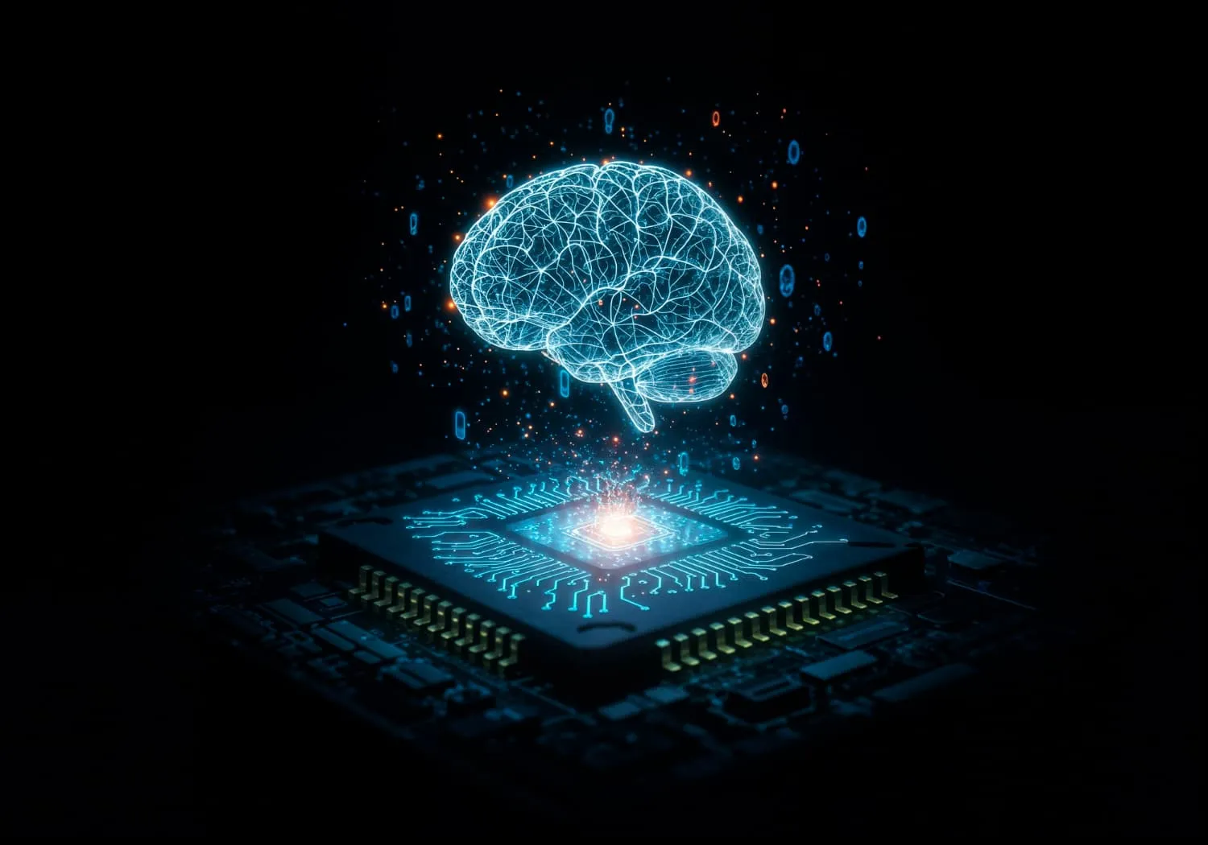
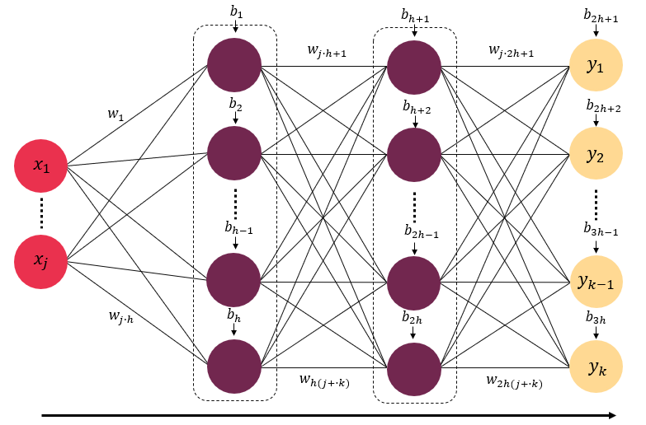

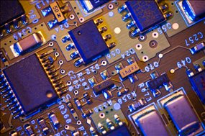


Artificial Intelligence is trained on supercomputers and require high computing power – we need better computing paradigms!
Arial 16
Transistors can only get so small!
Notes:
I’d like to start off with a fact that we are all familiar with: artificial intelligence has become integrated into our daily lives and has proven to be remarkable at a variety of tasks. Today, state-of-the-art AI models are typically trained on powerful supercomputers housed in large data centres. The demands of these systems continue to grow. Neural networks continue to demand larger datasets, advanced algorithms, and high computing power. Machine learning tasks are proving to be extremely resource demanding.

Slide 3
Artificial Intelligence is trained on supercomputers and require high computing power – we need better computing paradigms!
Arial 16
Transistors can only get so small!
Notes:
In fact conventional electronic hardware may eventually become a bottleneck during training. This motivates the search for entirely new computing paradigms.

Slide 4
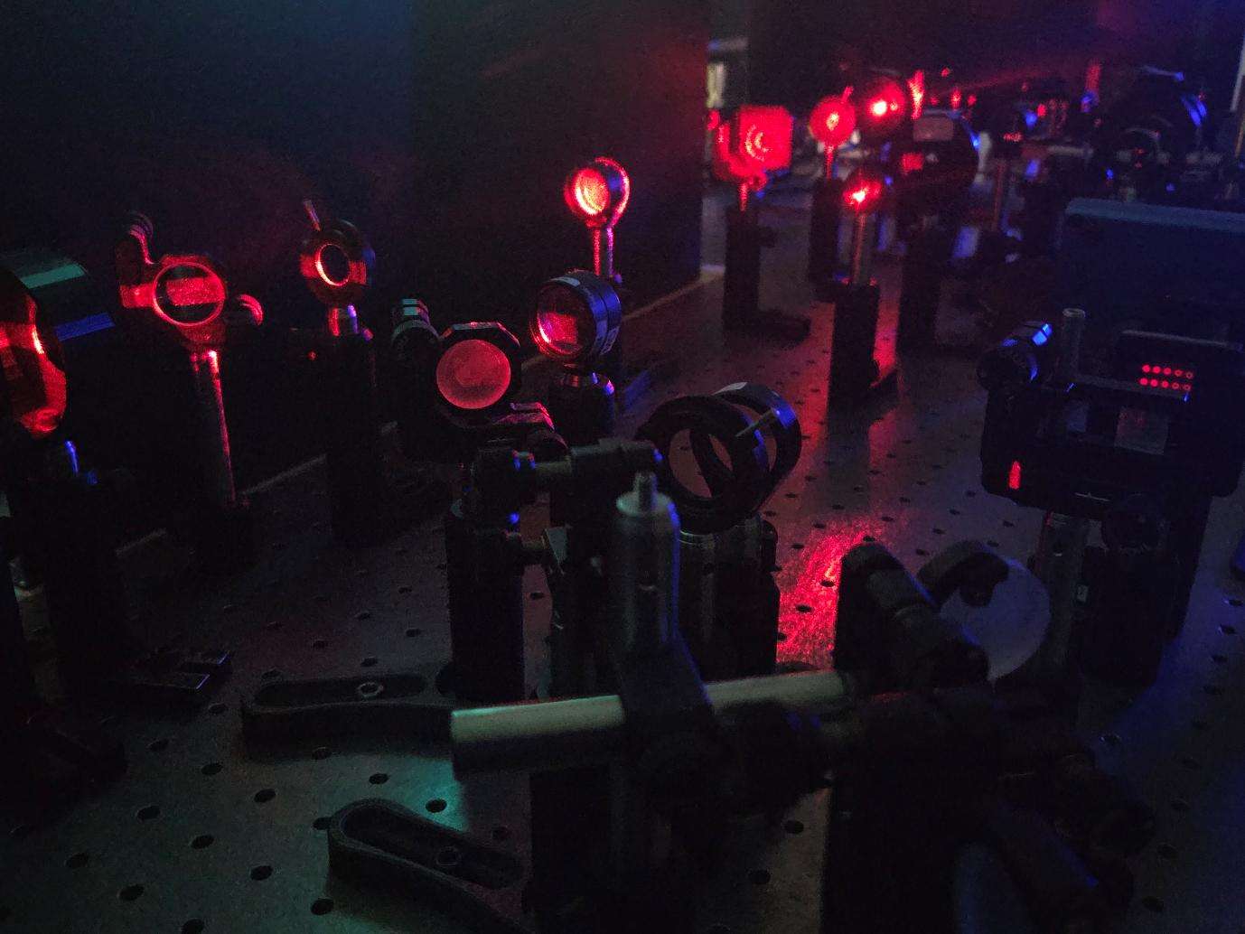
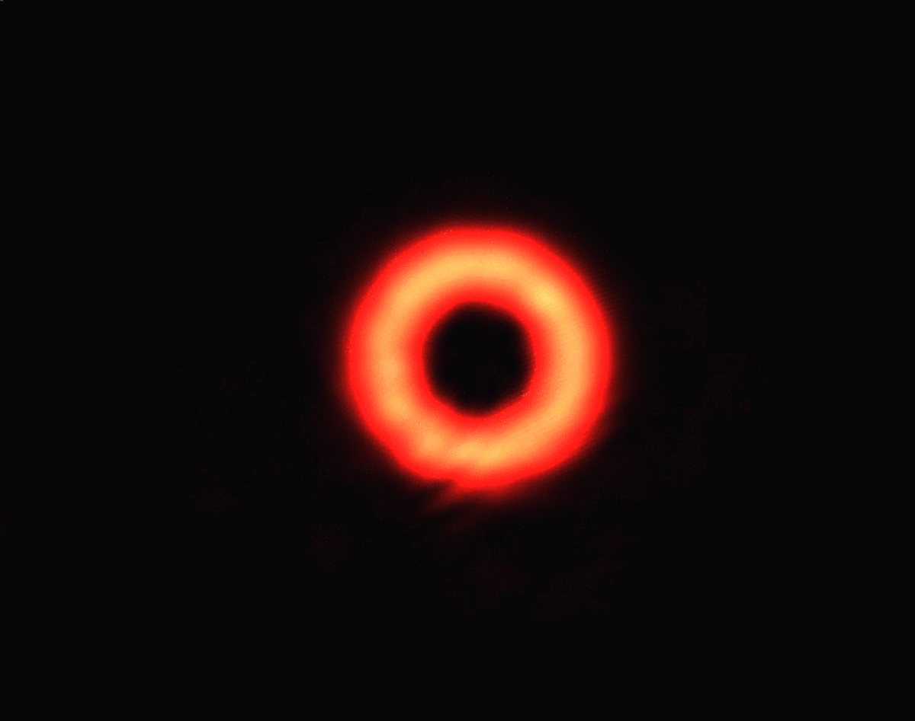
Title
Optical computing shows promise in this regard, with low power consumption and high speed information processing!
Arial 16

Slide 5
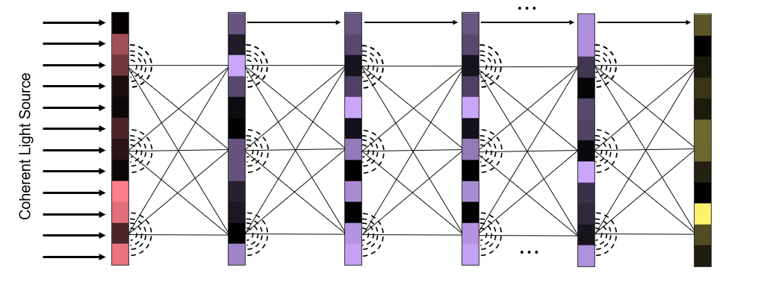
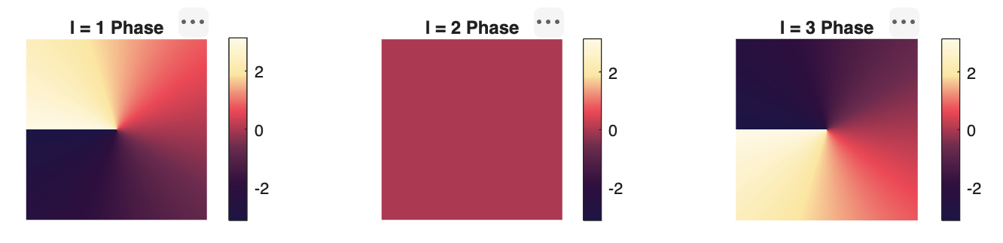
Deep Diffractive Neural Networks (D²NNs) are informed by Artificial Neural Networks (ANNs)
D²NNs
ANN
Notes:
These systems are known as optical neural networks, or diffractive neural networks. A deep diffractive neural network has a structure very similar to that of a classical neural network. It consists of input and output layers separated by multiple hidden layers. As light propagates through these hidden layers, diffraction and interference naturally perform the computation.

Slide 6
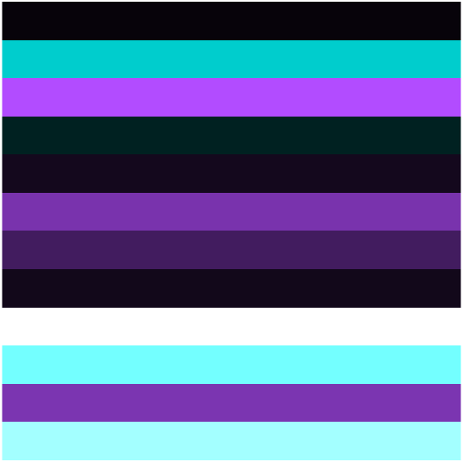
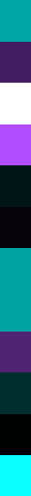
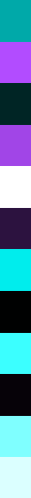
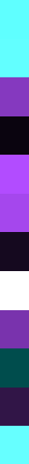
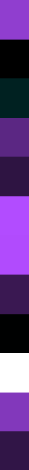









Deep Diffractive Neural Networks (D²NNs) learn through propagation and diffraction
$$F_{1}$$
$$F_{2}$$
$$⋯$$
$$F_{N}$$
Coherent Light Source
$$⋯$$
$$P_{1}$$
$$P_{2}$$
$$P_{3}$$
$$P_{N}$$
Input plane
Output plane
Secondary waves
Hidden layers

Slide 7
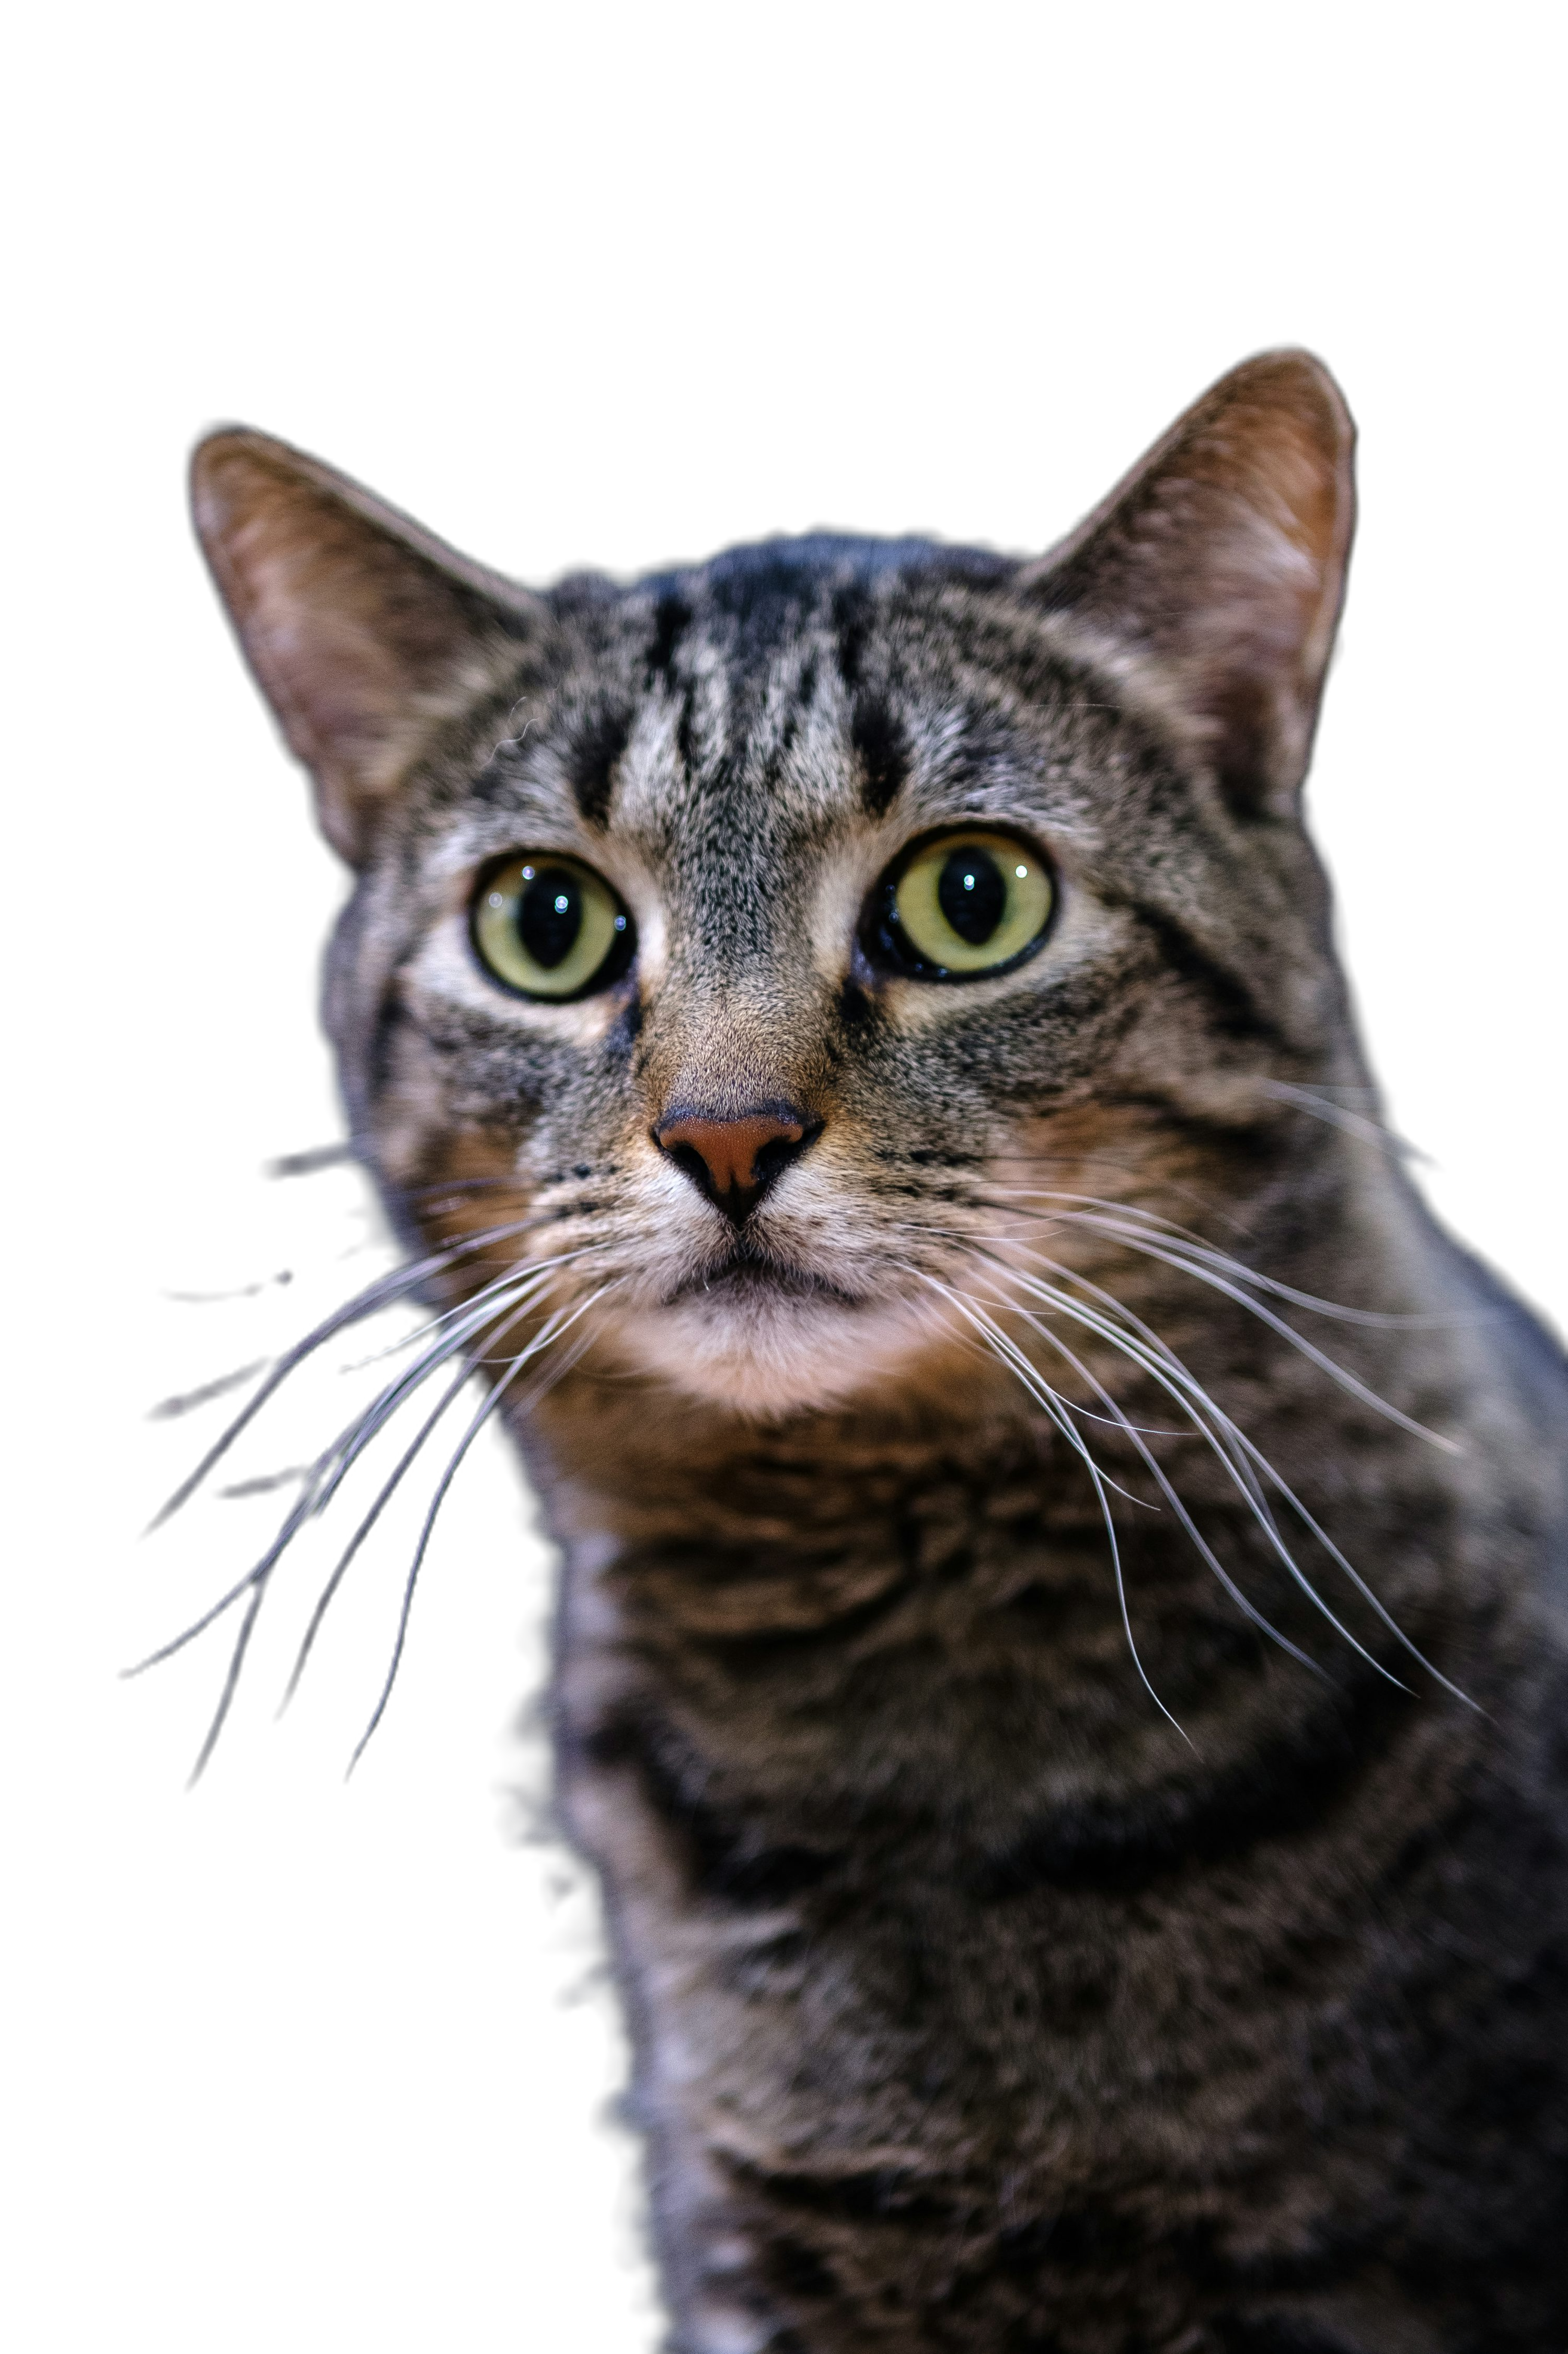

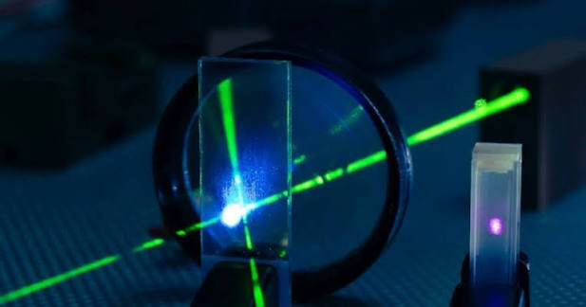

Research question: how can we design better optical neural networks?
Cat
f($\overline{x}$)
Output
Cat
Dog
Notes:
Although this design is advantageous as processing now occurs with low power consumption, But the design of these networks are not flawless and this will lead to my research question. How can we optimise the design of these networks for different machine learning tasks? We are particularly interested in using this optical network for image classification.

Slide 8
We start with classifying structured light, controlled in all its degrees of freedom
Arial 16
Nature Photonics 15, 253 (2021)
Light: Science & App. 11, 205 (2022)
Notes:
Since I work in the Structured Light Lab, the images we are trying to classify are these patterns, formally known as structured light. Successfully classifying these patterns provides a useful starting point before progressing to more complex natural images.
Classifying these patterns is valuable not only as an image classification problem but also because structured light has important applications in communication and measurement.

Slide 9
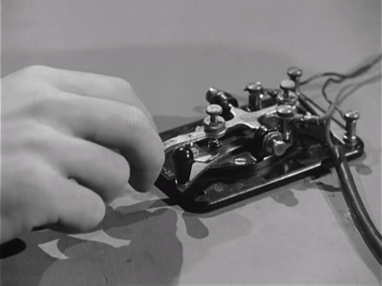
Structured light is useful because it forms an optical alphabet for communication
Arial 16
Nature Photonics 15, 253 (2021)
Light: Science & App. 11, 205 (2022)
Notes:
If we encode a message into these patterns, in order to recover the transmitted information, these modes must first be accurately identified, and this remains a significant experimental challenge and this is where image classification by machine learning becomes particularly valuable. Since diffractive neural networks are inherently optical, they provide a natural platform for learning to classify structured light.

Slide 10
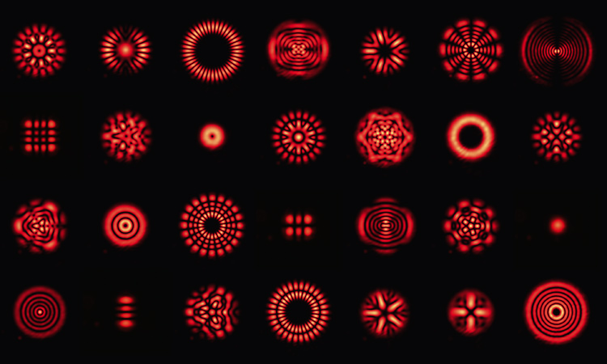
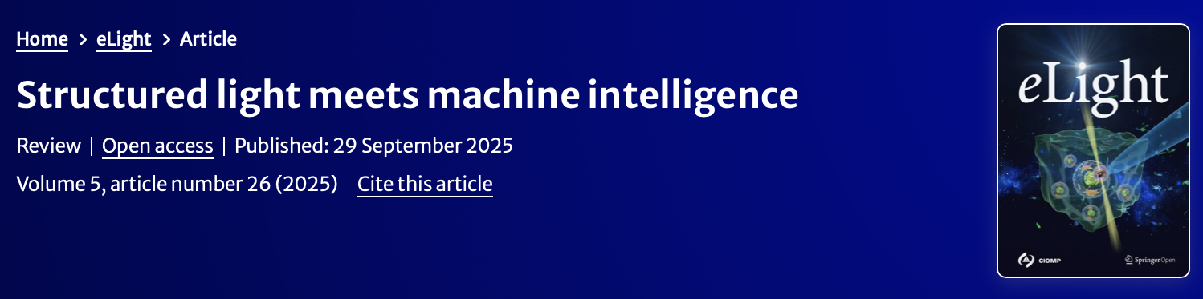
Information is encoded into distinct patterns – but they’re hard to measure!
Arial 16
Nature Photonics 15, 253 (2021)
Light: Science & App. 11, 205 (2022)
Light: Science & App. 5, 26 (2025)
“a d-dimensional entangled state generated using structured light requires an exponentially increasing number of measurements”
Notes:
If we encode a message into these patterns, in order to recover the transmitted information, these modes must first be accurately identified, and this remains a significant experimental challenge and this is where image classification by machine learning becomes particularly valuable. Since diffractive neural networks are inherently optical, they provide a natural platform for learning to classify structured light.

Slide 11
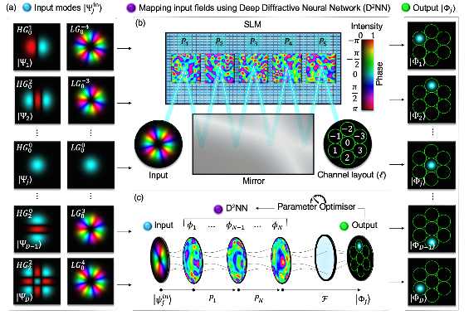
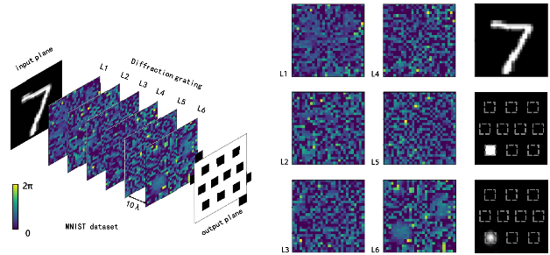
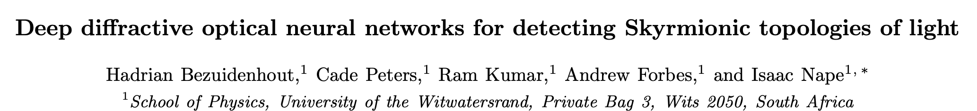
D²NNs have been used to classify topology and digits at the speed of light
Arial 16
Sun, Y. et al. (2023), Journal of the Optical Society of America B, 40(11), p. 2951.
Notes:
More broadly, diffractive neural networks have found applications in a wide range of image classification tasks, including handwritten digit recognition. Our group has developed a diffractive optical neural network specifically for classifying the topological structure of light.

Slide 12
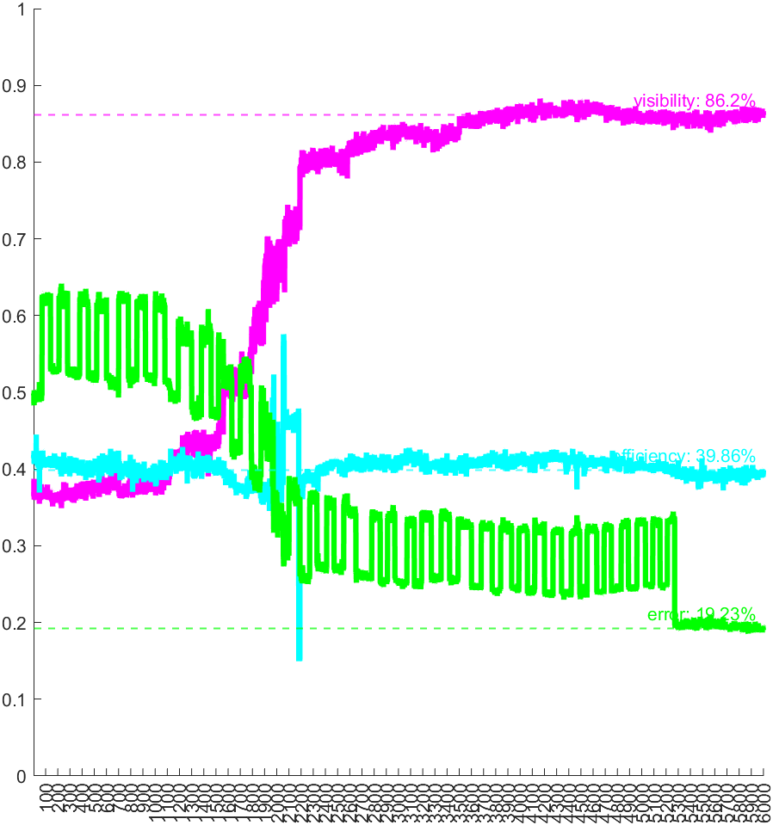
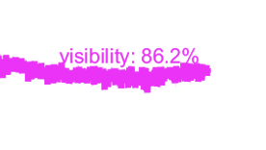
D²NNs have been used to classify topology– but falls short in classification accuracy and takes longer to train than we would prefer
Arial 16
Cost
Iterations
15000
Notes:
Although these systems offer a solution to the issue of power and demonstrate impressive performance, classification accuracy is not perfect and training them typically takes much longer than we would like.

Slide 13
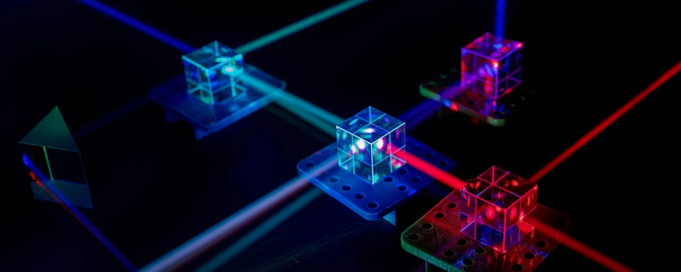
Research question: how can we design better optical neural networks? More specifically, is there an analogous system that can help?
Cat
f($\overline{x}$)
Output
Cat
Dog
Notes:
Going back to our research: given the advantages offered by optical computing, can we design these optical neural networks more efficiently?
More specifically, Is there an analogous system or approach that exists that can allow us to probe these systems, and improve their design?

Slide 14



Research question: how can we design better optical neural networks? More specifically, is there an analogous system that can help?
f($\overline{x}$)
Cat
$$≈$$
Output
Cat
Dog
f($\overline{x}$)
?
Notes:
Going back to our research: given the advantages offered by optical computing, can we design these optical neural networks more efficiently?
More specifically, Is there an analogous system or approach that exists that can allow us to probe these systems, and improve their design?

Slide 15

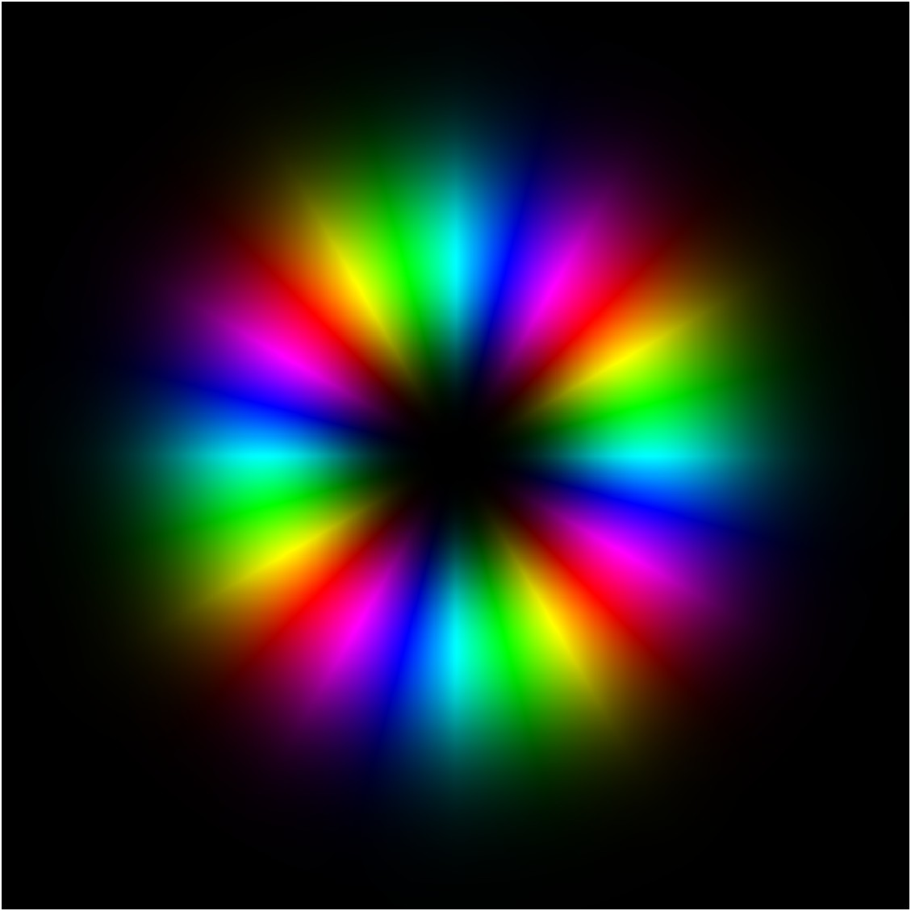

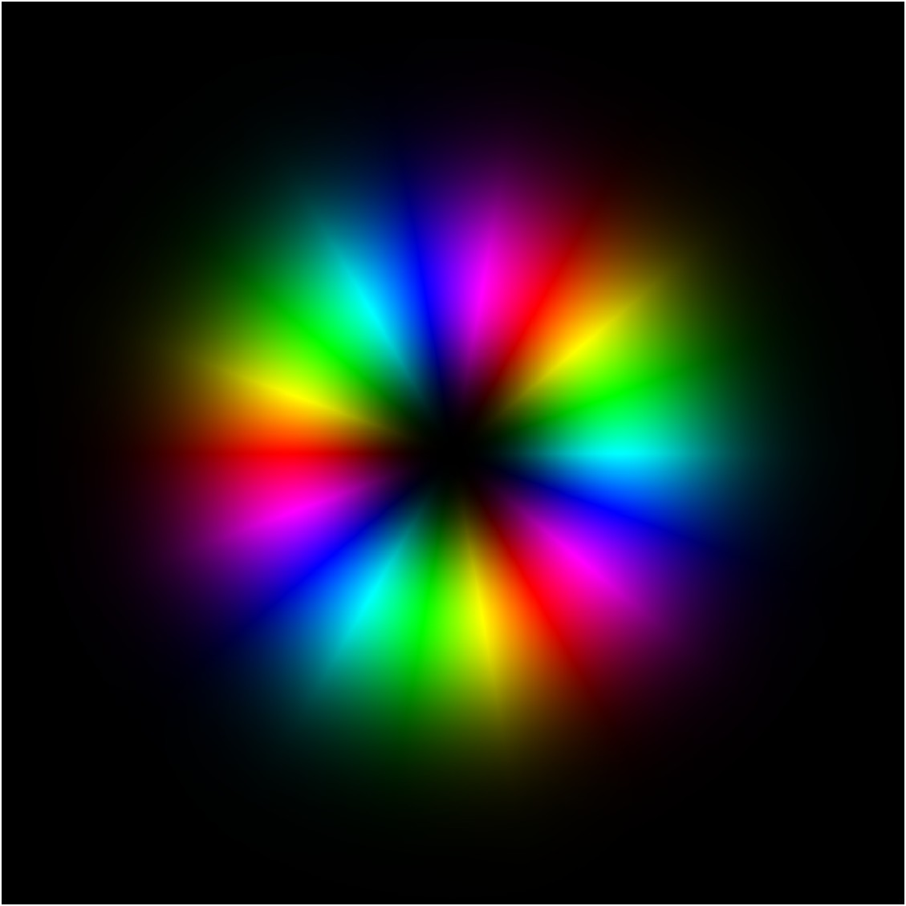

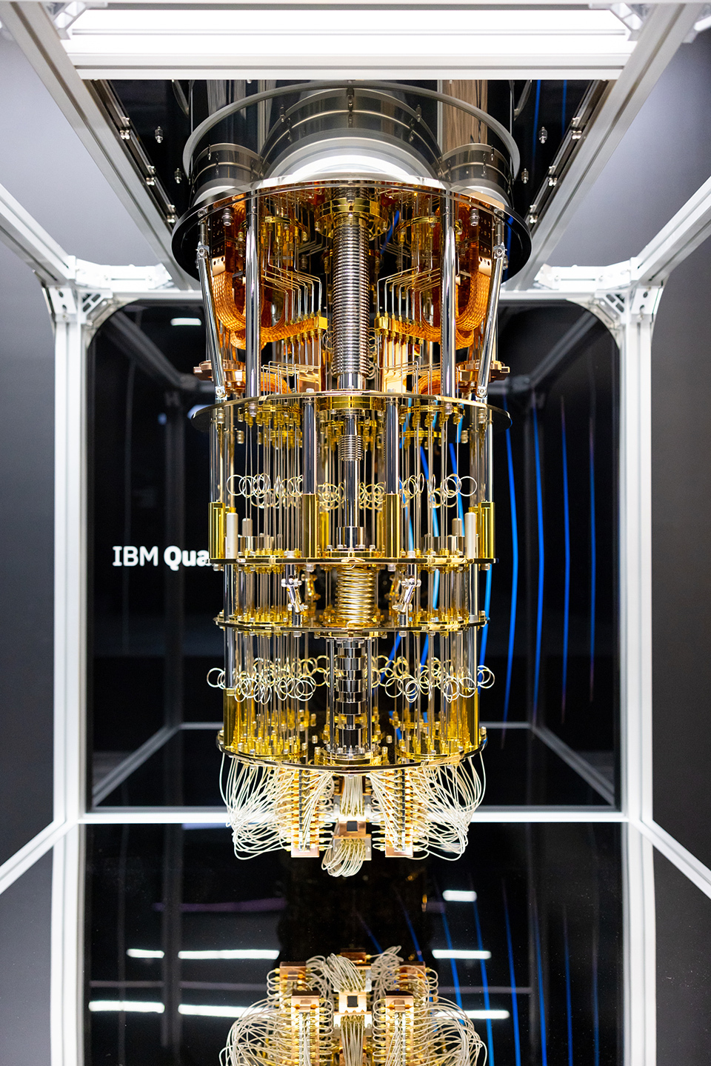
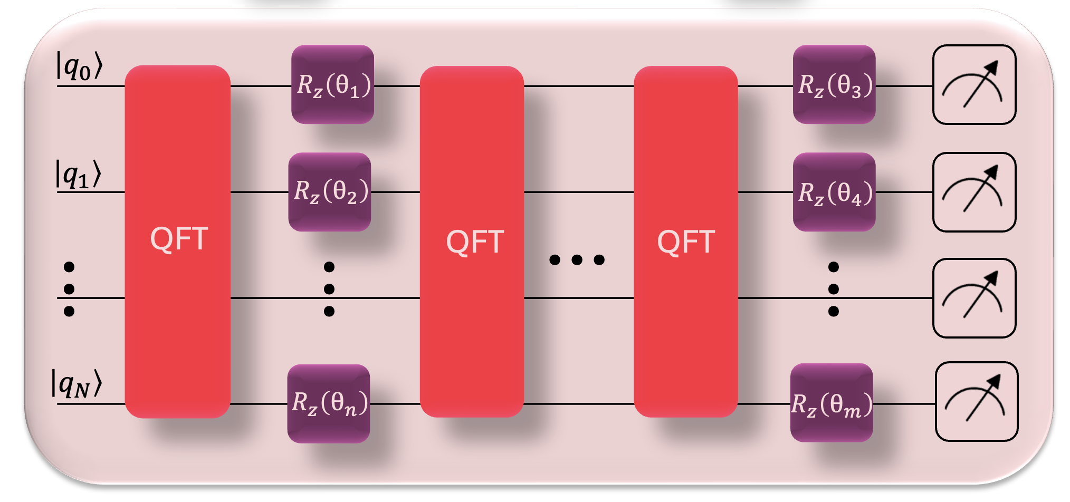




We design a Physics-Informed Neural Network (PINN), where the D²NN is represented on a quantum device
Arial 16
D²NN
Input fields
Output fields
$$LG_{0}^{−4}$$
$$|Φ_{1}⟩$$
$$LG_{0}^{−3}$$
$$|Φ_{2}⟩$$
Quantum Neural Network
Notes:
We can build a different kind of neural network that is inspired by the physics of our system and can be run on a different kind of processor – particularly, a quantum computer.
Although quantum computers are not yet near term, many quantum operations and quantum-inspired algorithms have proven to be useful.

Slide 16
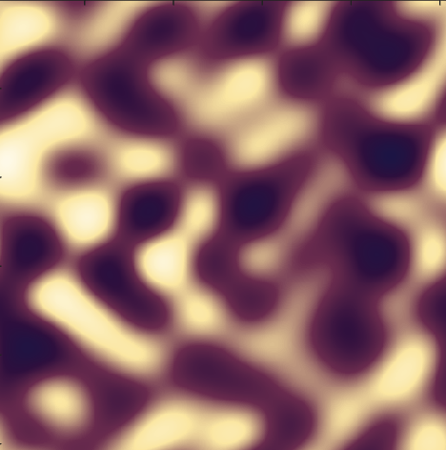
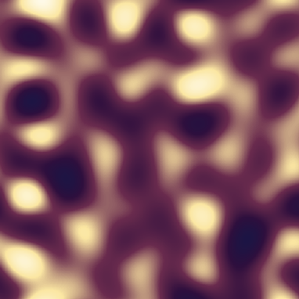
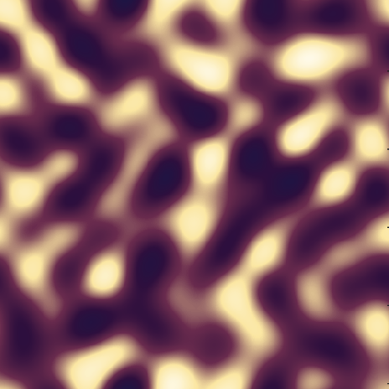










The layers of the D²NN are replaced by a quantum circuit
Arial 16
D²NN
Input fields
Output fields
$$D_{0}$$
$$D_{1}$$
$$D_{n}$$
$$LG_{0}^{−4}$$
$$|Φ_{1}⟩$$
$$LG_{0}^{−3}$$
$$\left|φ_{1}\right\rangle$$
$$\hat{F}$$
$$\hat{F}$$
$$\hat{F}$$
$$\hat{F}$$
$$|Φ_{2}⟩$$
Notes:
To solve our particular design problem, We’ve replaced the hidden diffractive layers in our optical network with a quantum circuit composed of qubits and quantum gates. We therefore propose that an equivalent quantum model be used to design better optical neural networks.

Slide 17
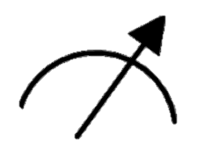










The layers of the D²NN are replaced by a quantum circuit
D²NN
Arial 16
Input fields
Output fields
$$D_{0}$$
$$D_{1}$$
$$D_{n}$$
$$LG_{0}^{−4}$$
$$|Φ_{1}⟩$$
$$LG_{0}^{−3}$$
$$\left|φ_{1}\right\rangle$$
$$\hat{F}$$
$$\hat{F}$$
$$\hat{F}$$
$$\hat{F}$$
$$≈$$
$$|Φ_{2}⟩$$
$$\left|q_{0}\right\rangle$$
$$\left|q_{1}\right\rangle$$
…
$$\overset{ˆ}{U}\left(θ\right)$$
$$\left|q_{N}\right\rangle$$
Notes:
To solve our particular design problem, We’ve replaced the hidden diffractive layers in our optical network with a quantum circuit composed of qubits and quantum gates. We therefore propose that an equivalent quantum model be used to design better optical neural networks.

Slide 18














There is a one-to-one mapping between the D²NN operators and the circuit operators
$$\overset{ˆ}{U}$$
Arial 16
Input fields
Output fields
$$D_{0}$$
$$D_{1}$$
$$D_{n}$$
$$\left|φ_{0}\right\rangle$$
$$LG_{0}^{−4}$$
$$|Φ_{1}⟩$$
$$LG_{0}^{−3}$$
$$\left|φ_{1}\right\rangle$$
$$\hat{F}$$
$$\hat{F}$$
$$\hat{F}$$
$$\hat{F}$$
$$≈$$
$$|Φ_{2}⟩$$
$$\left|q_{0}\right\rangle$$
$$\left|q_{1}\right\rangle$$
…
$$\overset{ˆ}{U}\left(θ\right)$$
$$U^{†}U=UU^{†}=I$$
$$\left|q_{N}\right\rangle$$
Notes:
But how can we establish an equivalence between these two seemingly different systems?
There is a one-to-one correspondence between the mathematical operations in the optical neural network and those in the quantum circuit. Both systems evolve according to unitary transformations. A unitary operator is simply a transformation that preserves all the information in a system, so no information is lost, the transformation is reversible.
The unitary mapping input patterns to detectors can therefore be approximated by the unitary in a circuit. How can we so easily replace the components in our network with the components of a different system?

Slide 19






There is a one-to-one mapping between the D²NN operators and the circuit operators
$$\overset{ˆ}{U}$$
Arial 16
Input fields
Output fields
$$D_{0}$$
$$D_{1}$$
$$D_{n}$$
$$LG_{0}^{−4}$$
$$|Φ_{1}⟩$$
$$LG_{0}^{−3}$$
$$\hat{F}$$
$$\hat{F}$$
$$\hat{F}$$
$$\hat{F}$$
$$≈$$
$$|Φ_{2}⟩$$
$$\left|q_{0}\right\rangle$$
$$\left|q_{1}\right\rangle$$
…
$$\overset{ˆ}{U}\left(θ\right)$$
$$\left|q_{N}\right\rangle$$
Notes:
Here are the components of the ciruit we are using.

Slide 20

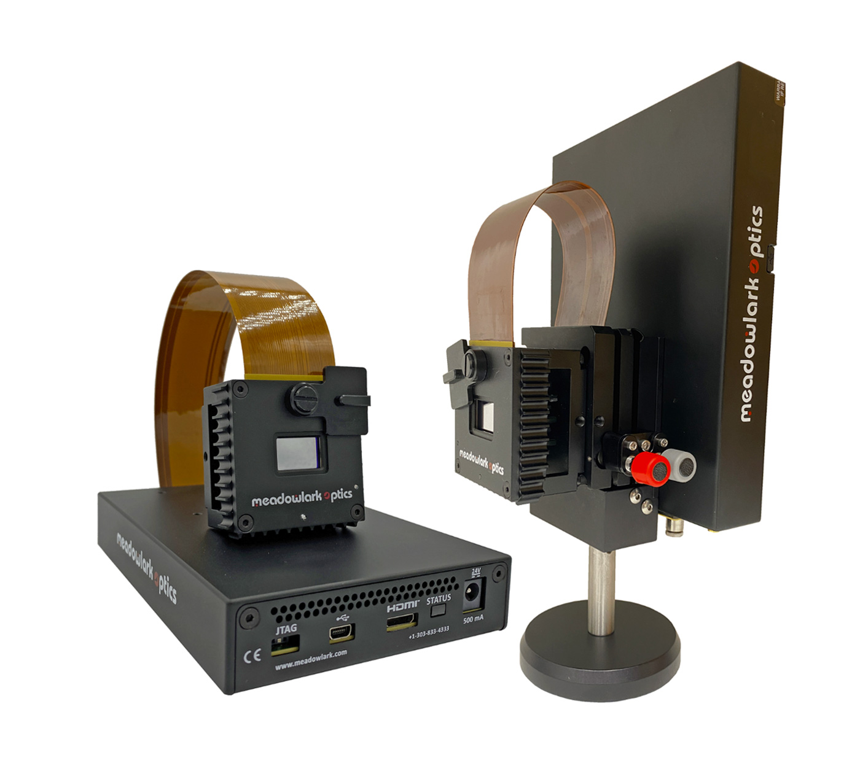
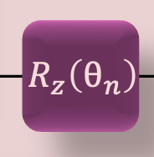







Trainable phase masks become quantum rotation gates
$$D_{0}$$
$$D_{1}$$
$$D_{n}$$
Arial 16
$$\hat{F}$$
$$\hat{F}$$
$$\hat{F}$$
$$\hat{F}$$
Spatial Light Modulator (SLM)
Operator
Matrix representations
$$D=\left(\begin{matrix}e^{iφ_{1}} & 0 & ⋯ & 0 \\ 0 & e^{iφ_{2}} & ⋯ & 0 \\ ⋮ & ⋮ & ⋱ & ⋮ \\ 0 & 0 & ⋯ & e^{iφ_{N}}\end{matrix}\right)$$
$$R_{z}\left(θ\right)=\left(\begin{matrix}e^{−iθ/2} & 0 \\ 0 & e^{iθ/2}\end{matrix}\right)$$
Notes:
If we zoom into the hidden diffractive layers that comprise our network, you’ll see that that are composed of free space propagation and phase modulation. The phase of the field, which is, is manipulated using phase masks created on a device called a Spatial Light Modulator. Athematically speaking Each phase layer is diagonal in the pixel basis. This operator on the field is equivalent to z rotation gates acting on single qubits.

Slide 21

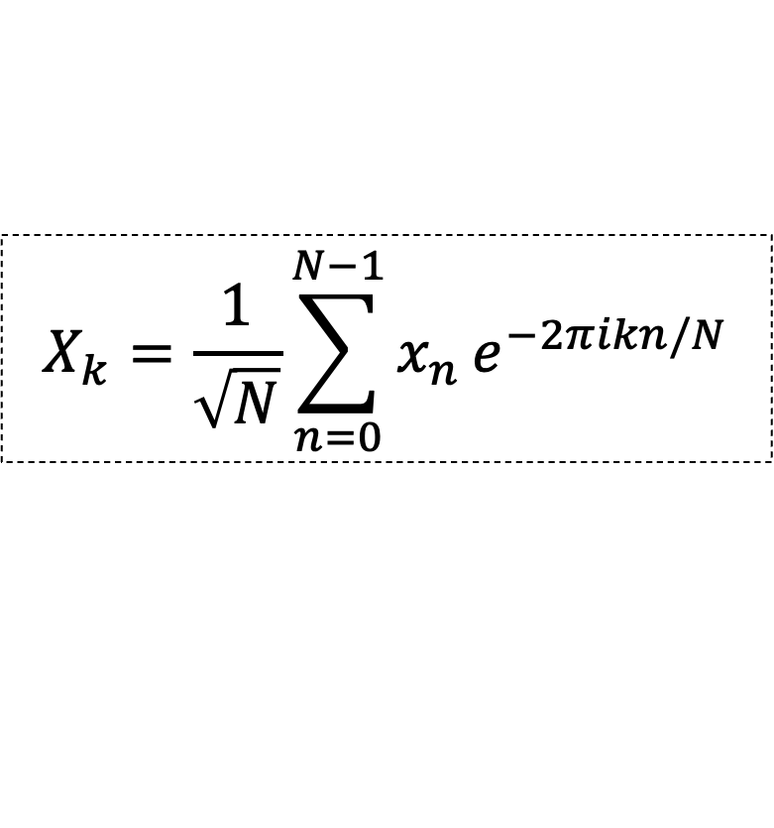

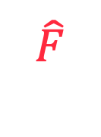

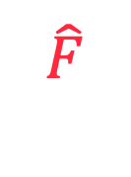


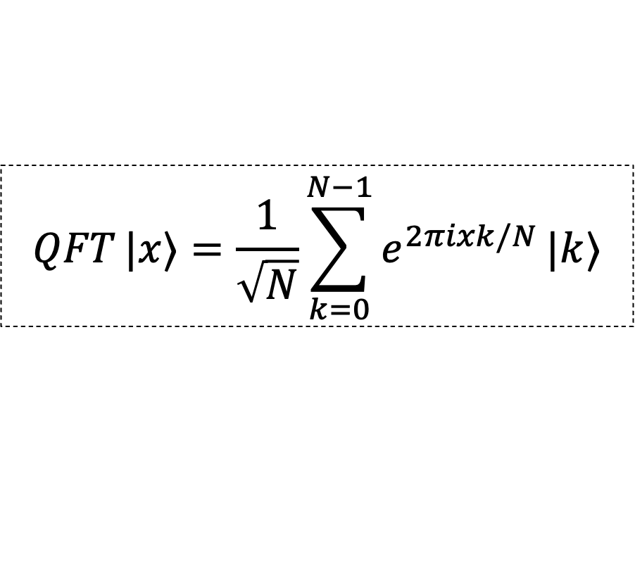
Free-space propagation is replaced by the Quantum Fourier Transform
$$D_{0}$$
$$D_{1}$$
$$D_{n}$$
Arial 16
$$\hat{F}$$
$$\hat{F}$$
$$\hat{F}$$
$$\hat{F}$$
Operator
Representation
$$X_{k}=\frac{1}{\sqrt{N}}\sum_{n=0}^{N−1}{x_{n}}e^{−2πikn/N}$$
$$\hat{F}$$
$$QFT |x⟩=\frac{1}{\sqrt{N}}\sum_{k=0}^{N−1}{e^{2πixk/N}}|k⟩$$
QFT
Notes:
We also have free space propagation is effectively applying a fourier transform to the optical field. In a quantum circuit, this operator is effectively a quantum fourier transform.

Slide 22
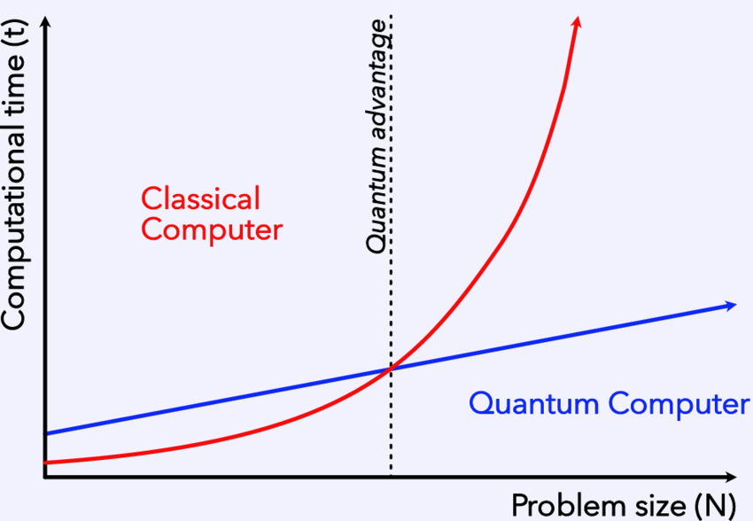
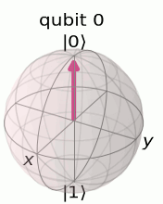






The Quantum Fourier Transform offers us exponential speedup!
Operator
Representation
Representation
Arial 16
$$X_{k}=\frac{1}{\sqrt{N}}\sum_{n=0}^{N−1}{x_{n}}e^{−2πikn/N}$$
$$𝒪\left(N\log{N}\right)$$
$$QFT |x⟩=\frac{1}{\sqrt{N}}\sum_{k=0}^{N−1}{e^{2πixk/N}}|k⟩$$
QFT
$$𝒪​\left({\left(\log{N}\right)}^{2}\right)$$
$$\sum_{x}{ψ_{θ}}\left(x\right) |x⟩ ⟶ \sum_{ω}{{\overset{ˆ}{ψ}}_{θ}}\left(ω\right) |ω⟩$$
Notes:
In terms of qubits, a QFT is a change in basis from the computational basis, in which a single qubit is either in the state 0 or 1, to the Fourier basis. How does this correspondence manifest and why bother using quantum machine learning? What advantage does it give us? This process is known to be efficient in the number of amplitudes for many groups which implies an exponential—or sometimes even super-exponential— speedup compared to the classical Fast Fourier Transform.

Slide 23



The Quantum Neural Network is trained using a Variational Quantum Algorithm (VQA)
Arial 16
Quantum subroutine
Classical processing
$$C(\vec{θ})$$
VQA
Notes:
Having established this correspondence, we can now construct a quantum neural network capable of classifying structured light modes.
The next question is how we train this network to make accurate predictions.
Quantum neural networks are typically trained using variational quantum algorithms. One part is run on a quantum computer while. Within the quantum portion of the algorithm, we construct a circuit containing tunable rotation gates that prepare and manipulate the quantum state.

Slide 24






The Quantum Neural Network is trained using a Variational Quantum Algorithm (VQA)
Arial 16
Before
Input beam
Classical processing
Quantum subroutine
$$C(\vec{θ})$$
After
$$\left|ψ\right\rangle$$
VQA
Notes:
In the context of our classification problem, the first step is to encode each structured light pattern as a quantum state using amplitude encoding. The input image is compressed so that each pixel corresponds to the amplitude of a computational basis state. The output of this circuit is then passed to a classical optimizer, which evaluates a cost function and updates the circuit parameters to minimize that cost. This hybrid quantum-classical optimization process is repeated until the model converges.
To evaluate the performance of the model, we monitor two quantities.
First, we plot the cost function as a function of the optimization iterations. A decreasing loss indicates that the optimizer is successfully finding parameters that better approximate the desired optical transformation.

Slide 25


The Quantum Neural Network is trained using a Variational Quantum Algorithm (VQA)
Arial 16
Before
Input beam
Classical processing
Quantum subroutine
$$C(\vec{θ})$$
After
$$\left|ψ\right\rangle$$
VQA
Notes:
Second, we examine the confusion matrix. Here, the true labels are shown on the y-axis and the predicted labels on the x-axis. Early in training, several modes are misclassified. As optimization progresses, the ideal outcome is a perfect diagonal, indicating that every input mode has been assigned to its correct output label.

Slide 26




Classifying orthogonal modes and non-orthogonal modes (superposition states)
Arial 16
$$\left|{LG}_{p}^{ℓ}\right\rangle$$
$$\left\langle ψ_{i}∣ψ_{j}\right\rangle =δ_{ij}=\left\{\begin{matrix}1, & i=j \\ 0, & i≠j\end{matrix}\right.$$
Orthogonal
$$\left|{HG}_{m,n}\right\rangle$$
$$\left|φ_{j}\right\rangle$$
Non-orthogonal
$$\left\langle φ_{i}∣φ_{j}\right\rangle ≠0, i≠j$$
Notes:
Moving onto the simulation results. Looking at our input data, we evaluate the model on both orthogonal and non-orthogonal structured light modes. Orthogonal modes provide a baseline since they are, in principle, perfectly distinguishable. Non-orthogonal modes present a much more challenging classification problem because they overlap in Hilbert space,
%making them more representative of realistic optical systems where noise and distortions are present.

Slide 27


The network distinguishes between orthogonal patterns by concentrating probability onto the correct label
Arial 16
Input probability distribution (before training)
Output probability distribution (before training)
Input beams
$$\left|{LG}_{p}^{ℓ}\right\rangle$$
Notes:
Initially, the input state is distributed across many computational basis states after passing through the randomly initialized circuit. As training progresses, the variational optimizer adjusts the phase rotations so that the probability amplitude is concentrated onto the desired output label. The circuit is therefore learning a unitary transformation that maps each optical mode onto a unique computational basis state.

Slide 28

The network is close to exhibiting a clear diagonal
Arial 16
Confusion matrix
Test accuracy: 92.9%
$$\left|{LG}_{p}^{ℓ}\right\rangle$$
Input probability distribution (before training)
Output probability distribution (before training)
Notes:
The confusion matrix summarizes the overall classification performance across the entire dataset. While most of the probability is concentrated along the diagonal, not every input mode is mapped perfectly to its correct output label, indicating that there is still room for improvement.

Slide 29



Classifying orthogonal modes and non-orthogonal modes (superposition states)
Arial 16
Test accuracy: 92.9%
$$\left|{LG}_{p}^{ℓ}\right\rangle$$
Cost function comparison
$$\left|{HG}_{m,n}\right\rangle$$
Test accuracy: 93.8%
Cost
Iterations
$$\left|φ_{j}\right\rangle$$
Test accuracy: 88.9%
Notes:
During training, we observe a steady decrease in the loss, demonstrating that the optimizer is successfully learning the desired transformation.

Slide 30

We introduce entanglement into the circuit, effectively permuting pixels
Arial 16
Notes:
One of the major advantages of moving to a quantum implementation is that we are no longer constrained by the architecture of the classical optical neural network. This gives us the freedom to explore new circuit designs that may ultimately inspire improved optical systems.
To investigate this, we modified our variational quantum circuit by introducing an ancilla qubit together with additional entangling operations, inspired by recent work on optimal ansatz design. The purpose of these additions is to increase the expressivity of the circuit.

Slide 31

We introduce entanglement into the circuit, effectively permuting pixels
Arial 16
Notes:
As an experimentalist, I was curious to see what would happen if I implemented the ansatz proposed in the literature. One intuitive way to think about the role of entanglement is that it allows information to be exchanged between different parts of the quantum state. It's a bit like solving a puzzle by rearranging the pieces until they naturally fit together. This additional flexibility appears to make it much easier for the optimizer to discover the desired transformation.

Slide 32

We introduce entanglement into the circuit, effectively permuting pixels
Arial 16
Notes:
One advantage of moving to a quantum implementation is that we are no longer constrained to the architecture of the classical optical neural network. We therefore investigated a modified variational circuit by introducing an ancilla qubit together with entangling operations, inspired by this paper on optimal ansatz design. This increases the expressivity of the ansatz, allowing it to explore a richer family of quantum transformations during optimization. Empirically, this led to a significant improvement in performance: the model converged to 100% classification accuracy in fewer iterations and with shorter training times. Perhaps most notably, it was also able to perfectly classify the non-orthogonal modes without requiring a nonlinear activation function.
What is the problem and clever solution, slide un

Slide 33



Classifying orthogonal modes and non-orthogonal modes (superposition states)
Arial 16
Test accuracy: 100.0%
$$\left|{LG}_{p}^{ℓ}\right\rangle$$
Cost function comparison
$$\left|{HG}_{m,n}\right\rangle$$
Cost
Test accuracy: 100.0%
Iterations
$$\left|φ_{j}\right\rangle$$
Test accuracy: 100.0%
Requires less training time for higher accuracy!
Notes:
When training, we see a steady decrease in the loss, indicating that the optimizer is successfully finding parameters that better approximate the target optical transformation. Initially, the input state is distributed across many computational basis states after passing through the randomly initialized circuit. As training progresses, the variational optimizer adjusts the phase rotations so that the probability amplitude is concentrated onto the desired output label. The circuit is therefore learning a unitary transformation that maps each optical mode onto a unique computational basis state. The confusion matrix summarizes the classifier performance over the entire dataset. You’ll notice that not all probability is concentrated along the diagonal, indicating that each input mode is mapped onto its correct output label."

Slide 34

The experimental implications of our inverse design problem
D²NN
Input fields
Output fields
$$θ^{∗}$$
Arial 16
$$D_{0}$$
$$D_{1}$$
$$D_{n}$$
$$LG_{0}^{−4}$$
$$|Φ_{1}⟩$$
$$LG_{0}^{−3}$$
$$\left|φ_{1}\right\rangle$$
$$\hat{F}$$
$$\hat{F}$$
$$\hat{F}$$
$$\hat{F}$$
$$≈$$
$$|Φ_{2}⟩$$
$$\left|q_{0}\right\rangle$$
$$\left|q_{1}\right\rangle$$
…
$$\overset{ˆ}{U}\left(θ\right)$$
$$\left|q_{N}\right\rangle$$
Notes:
So, we've demonstrated that a quantum neural network can effectively classify structured light modes. However, the significance of these results extends beyond quantum machine learning itself.
The optimized rotation angles learned by the quantum circuit are not simply neural network parameters—they correspond directly to phase modulations in the optical system. In principle, once the assumptions in our model are further refined, these learned parameters can be translated back into phase screens for a physical optical neural network.

Slide 35











The experimental implications of our inverse design problem
D²NN
Input fields
Output fields
Arial 16
$$LG_{0}^{−4}$$
$$\left|q_{0}\right\rangle$$
$$θ^{∗}$$
$$\left|q_{1}\right\rangle$$
$$|Φ_{1}⟩$$
$$LG_{0}^{−3}$$
…
$$\overset{ˆ}{U}\left(θ\right)$$
$$\left|φ_{1}\right\rangle$$
$$|Φ_{2}⟩$$
$$\left|q_{N}\right\rangle$$
Spatial Light Modulator (SLM)
Notes:
So, we've demonstrated that a quantum neural network can effectively classify structured light modes. However, the significance of these results extends beyond quantum machine learning itself.
The optimized rotation angles learned by the quantum circuit are not simply neural network parameters—they correspond directly to phase modulations in the optical system. In principle, once the assumptions in our model are further refined, these learned parameters can be translated back into phase screens for a physical optical neural network.

Slide 36


The experimental implications of our inverse design problem
D²NN
Input fields
Output fields
Arial 16
$$LG_{0}^{−4}$$
$$\left|q_{0}\right\rangle$$
$$θ^{∗}$$
$$\left|q_{1}\right\rangle$$
$$|Φ_{1}⟩$$
$$LG_{0}^{−3}$$
…
$$\overset{ˆ}{U}\left(θ\right)$$
$$\left|φ_{1}\right\rangle$$
$$|Φ_{2}⟩$$
$$\left|q_{N}\right\rangle$$
Pixel mixing
Spatial Light Modulator (SLM)
Diffractive layers
Notes:
So we’ve demonstrated that the quantum nenural network architecture can effectively classify OAM modes. These optimized rotation angles are not just neural network parameters. They correspond to phase modulations in the optical system. In principle, once the assumptions in the model are refined, the learned parameters can be translated back into phase screens for a physical optical neural network.
The enhanced quantum circuit suggests that introducing controlled information exchange may improve the expressive power of diffractive optical neural networks. This could be achieved through programmable permutation or pixel-mixing operations inserted between diffractive layers.”
these results suggest that quantum machine learning can also guide the design of future optical systems.
"Ultimately, this work demonstrates that quantum computing is not only a platform for computation, but also a powerful framework for designing and understanding complex optical systems."
Link to problem statement

Slide 37
We created an algorithmic blend from different technologies to improve image classification
Arial 16
Quantum machine learning
Classical machine learning
Optical machine learning
Transistors can only get so small!
Notes:
We’ve been able to demonstrate that we've been able to take machine learning procedures from classical, optical and quantum computing and do something pretty cool at the interface of these computing frameworks.
These results suggest that ideas developed in quantum machine learning can directly inform the design of next-generation optical computing systems. Rather than viewing quantum and optical computing as separate technologies, they can instead be used to guide and improve one another.

Slide 38


bb
Diffractive and quantum neural networks provide an alternative to performing image classification, and we aim to classify more complex images
Arial 16
Body
Dog
Cat
Horse
Notes:
. This work highlights the potential of optical neural networks to perform machine learning tasks directly with light, offering a fast and energy-efficient alternative to conventional electronic computation.
Moving forward, the goal is to scale the network to classify a larger number of spatial modes and investigate more complex optical classification tasks.

Slide 39




Thank you to the collaborators whose expertise made this possible!

Slide 40

Thank you
Use email address with name, not student number
structured-light-lab.org
2572944@students.wits.ac.za
Notes:
-

Slide 41

























D²NNs performs computation by propagating light through multiple trainable phase layers
Arial 16
$$LG_{0}^{−4}$$
$$|Φ_{1}⟩$$
$$LG_{0}^{−3}$$
Spatial Light Modulator (SLM)
$$D_{0}$$
$$D_{1}$$
$$…$$
$$D_{n}$$
$$|Φ_{2}⟩$$
$$\left|φ_{1}\right\rangle$$
$$⋯$$
$$LG_{0}^{0}$$
$$\left|φ_{1}\right\rangle$$
$$|Φ_{j}⟩$$
$$LG_{0}^{3}$$
$$\left|ψ_{0}\right\rangle$$
$$\left|φ_{0}\right\rangle$$
$$\hat{F}$$
$$|Φ_{D−1}⟩$$
$$LG_{0}^{4}$$
$$|Φ_{D}⟩$$
Input fields
Hidden layers
Output fields
Notes:
Let’s look at the detailed structure of the architecture. Lets say we have the incident field with the following intensity profile, the field is converted to an output field by the phase elements of a spatial light modulator and freespace diffraction. As light propagates through each phase mask and the free-space region between them, diffraction and interference transform the optical field. Each layer gradually reshapes the incoming beam until, at the output plane, different input modes are directed to different spatial locations.

Slide 42
D²NNs detect input spatial patterns and map them to simple Gaussian spots
Arial 16
$$LG_{0}^{−4}$$
$$|Φ_{1}⟩$$
$$LG_{0}^{−3}$$
Spatial Light Modulator (SLM)
$$D_{0}$$
$$D_{1}$$
$$…$$
$$D_{n}$$
$$|Φ_{2}⟩$$
$$\left|φ_{1}\right\rangle$$
$$⋯$$
$$LG_{0}^{0}$$
$$\left|φ_{1}\right\rangle$$
$$|Φ_{j}⟩$$
$$LG_{0}^{3}$$
$$\left|ψ_{0}\right\rangle$$
$$\left|φ_{0}\right\rangle$$
$$\hat{F}$$
$$|Φ_{D−1}⟩$$
$$LG_{0}^{4}$$
$$|Φ_{D}⟩$$
Input fields
Hidden layers
Output fields
Notes:
Let’s look at the detailed structure of the architecture. Lets say we have the incident field with the following intensity profile, the field is converted to an output field by the phase elements of a spatial light modulator and freespace diffraction. As light propagates through each phase mask and the free-space region between them, diffraction and interference transform the optical field. Each layer gradually reshapes the incoming beam until, at the output plane, different input modes are directed to different spatial locations.

