Slide 1

Enhancing Biogas Yield from Cow Dung:
A Comparative Study of Varying Fe₂O₃ Nanoparticle Concentrations
Takalani Nethavhanani
Supervisor: Prof. N.E. Maluta
Co-supervisors: Dr. V Nekhubvi; Dr. L Mathomu
09 July 2026

Slide 2


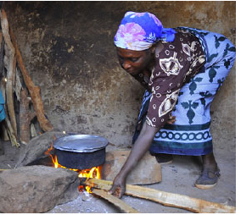

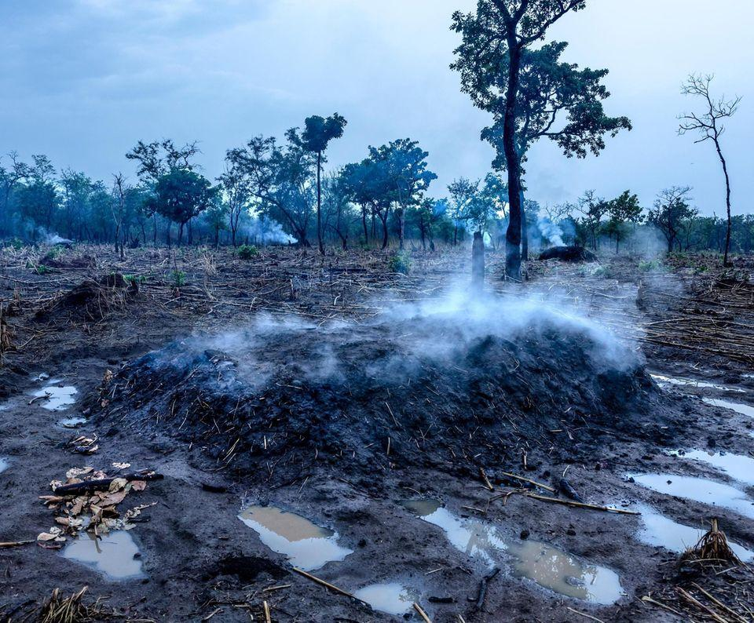
Background
Figure 2: Impact of household energy insecurity [2].
Figure 1: Factors that increase pressure on the energy system [1].
Notes:
Global increase in population, rapid industrialization and urbanization has led to a significant demand for energy.
The increased energy consumption puts pressure on resources and infrastructure.

Slide 3
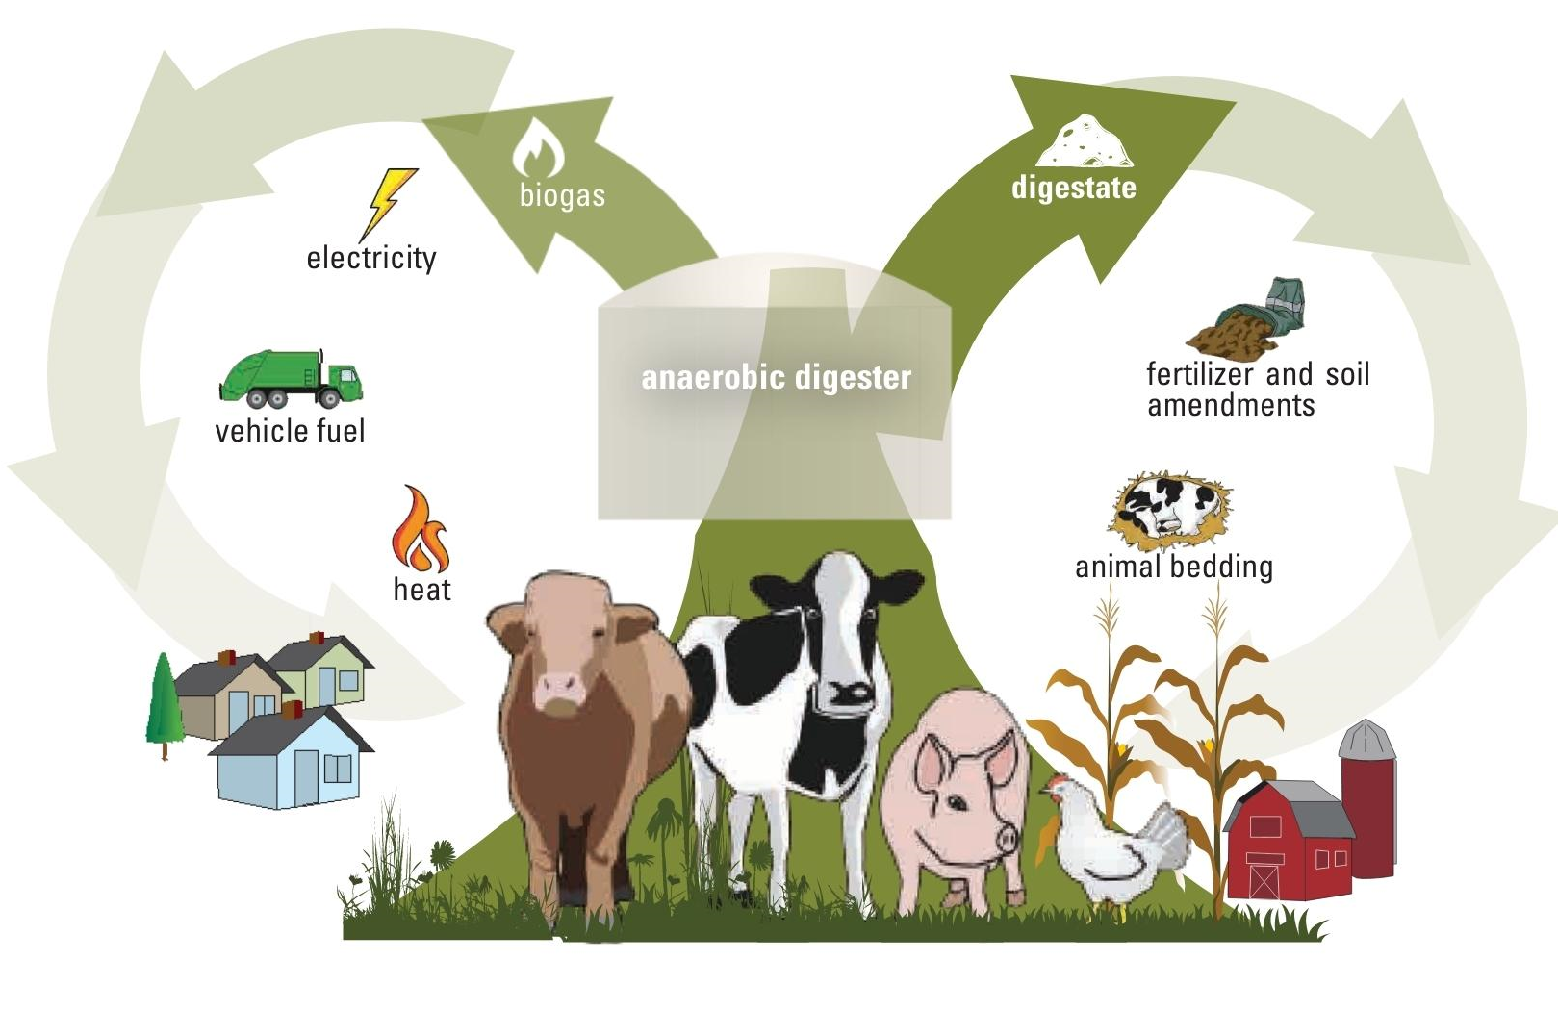
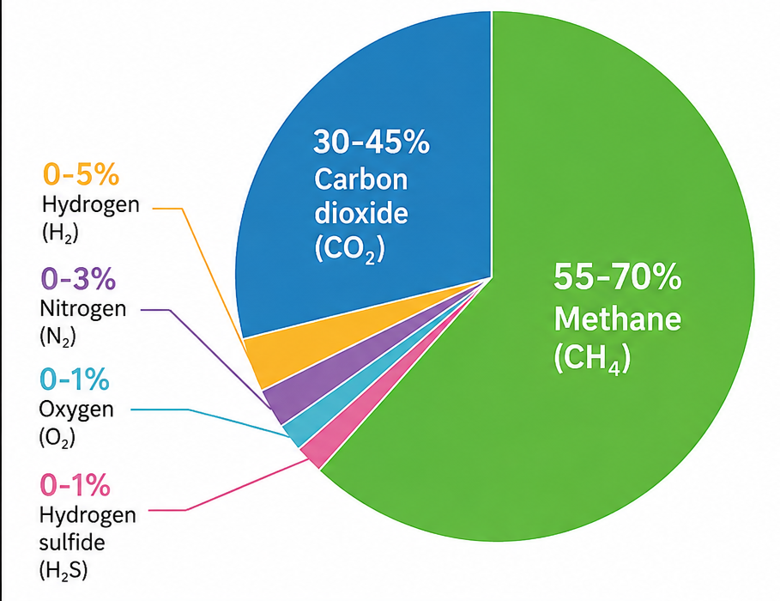
Introduction
Anaerobic digestion
Figure 3: The anaerobic digestion process and its multiple outputs [3].
Notes:
Anaerobic digestion (AD) is the natural breakdown of organic in the absence of oxygen.
AD is a major technology for converting organic waste into renewable energy and reusable digestate (Fig 1).
AD is a complex multi-step process involving 4 consecutive microbial stages performed by a group of microorganisms (Fig 2).
The microorganisms influence the performance and efficiency of the AD process (Baniamerian et al., 2019).

Slide 4
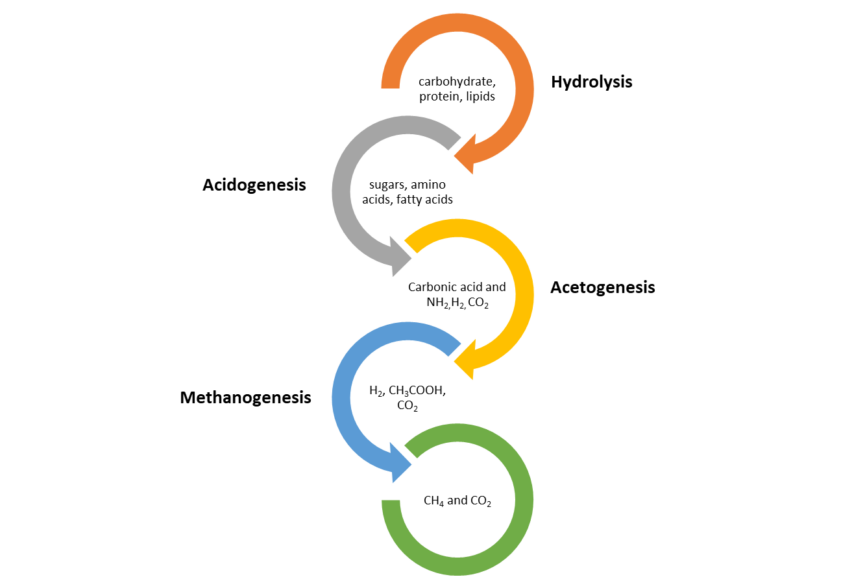
Introduction
Table 1. Summary of factors affecting anaerobic digestion performance.
Factor | Effect | Reference
1. Substrate & biochemical (e.g. rate limiting step) | Long HRTs and low biodegradation efficiency | [5]
2. Inhibition & toxicity (e.g. accumulation of H₂S) | Inhibit methanogens and cause process failure | [6]
3. Operational constraints (e.g. temp, pH, OLR, etc.) | leads to reduced methane yield or complete digester failure | [7]
4. Process stability (e.g. poor mixing, foaming, etc.) | reduces methane yield, disrupts microbial activity, and increases the risk of digester failure | [5]
Figure 4: Stages of the AD process [4].
Notes:
The rate-limiting step is the slowest step in a process, which determines the overall speed of the entire process.
In anaerobic digestion, even if all the other stages proceed rapidly, the process cannot move faster than its slowest stage.
The rate-limiting step depends on both the type of substrate and its concentration. For complex organic substrates like cow dung, hydrolysis is usually the rate-limiting step because it takes longer to break down complex polymers such as lignocellulosic material (Kulkarni, 2025). In contrast, easily biodegradable substrates such as sugars or volatile fatty acids often have methanogenesis as the rate-limiting step (Ma et al., 2013).
Since there is no single, fixed rate-limiting step, it is necessary to increase the overall reaction rate by accelerating whichever step is rate-limiting for the specific substrate being digested.

Slide 5
Introduction
Since there is no single, fixed rate-limiting step, it is necessary to increase the overall reaction rate by accelerating whichever step is rate-limiting for the specific substrate being digested.
Additives
Organic
Inorganic
Green
biomass
Microorganisms
Enzymes
Macro-nutrient
Micro-nutrients
Carbonous materials
Zero-valent metal
Metal oxides
Figure 5: Various additive strategies used to enhance the AD process [8].
Notes:
Since there is no single, fixed rate-limiting step, it is necessary to increase the overall reaction rate by accelerating whichever step is rate-limiting for the specific substrate being digested

Slide 6
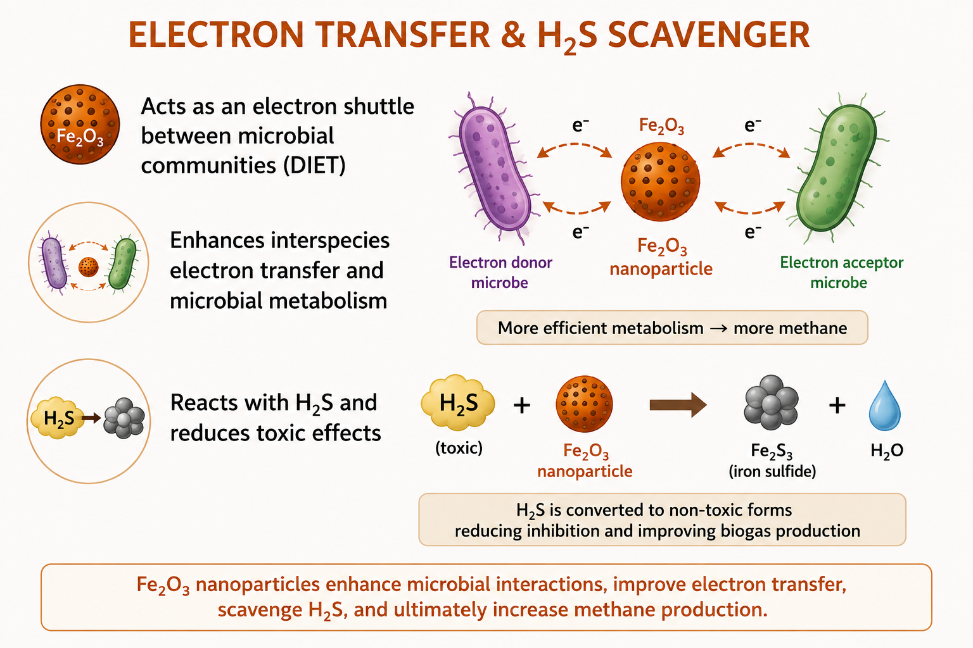
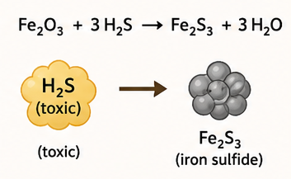
Benefits of using metal oxides
Metal oxide benefits
Enhances CH₄ production
Reduces H₂S
Faster degradation of organic material
Improves gas quality
Acts as an electron “shuttle” between microbial communities.
Enhances interspecies electron transfer and microbial metabolism.
Reacts with H₂S and reduces toxic effects.
Figure 5: Major benefits of metal oxide supplementation in anaerobic digestion for biogas production [9,10].

Slide 7
Aim and Objectives
This study aims to evaluate the effect of varying Fe₂O₃ nanoparticle concentrations on the anaerobic digestion of cow dung under mesophilic (37°C) and thermophilic (55°C) conditions.
Characterize the physicochemical properties of cow dung.
Evaluate the effect of Fe₂O₃ nanoparticles on daily and cumulative biogas production.
Determine the optimal Fe₂O₃ nanoparticle concentration under mesophilic (37°C) and thermophilic (55°C) conditions.

Slide 8
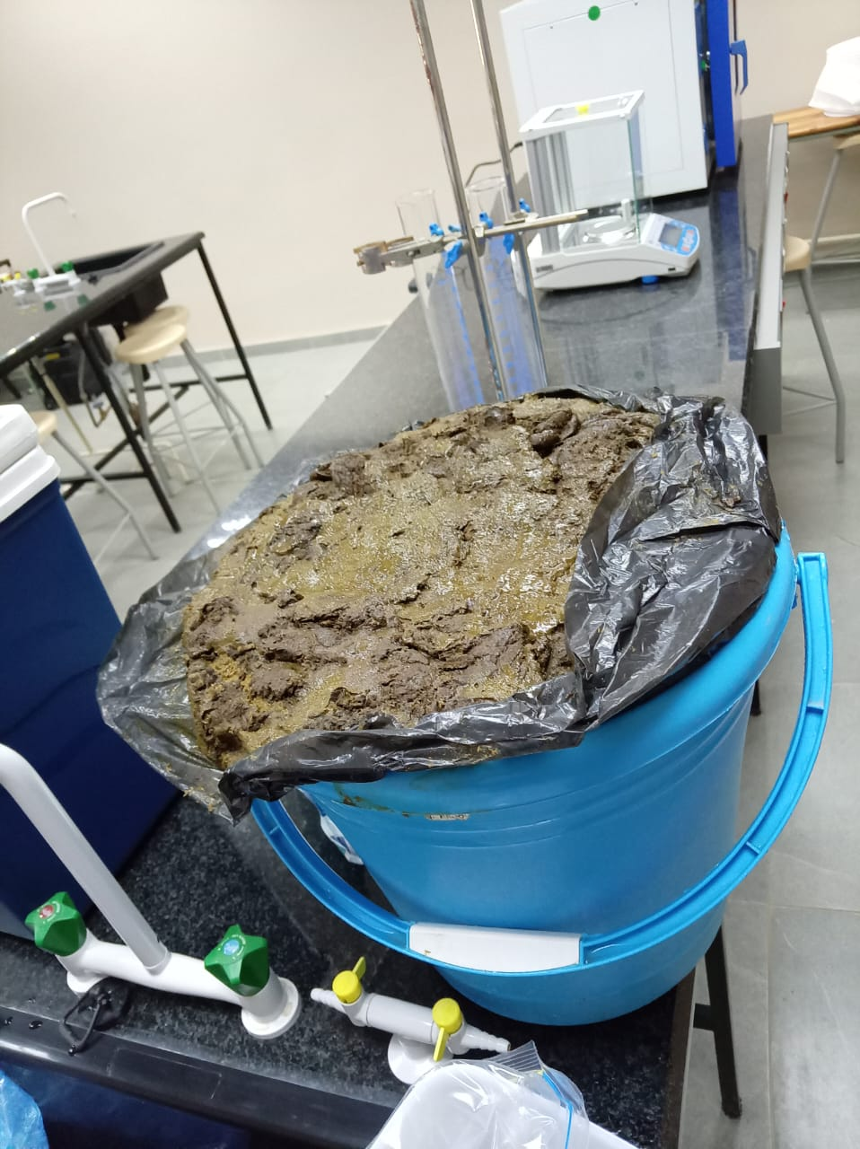
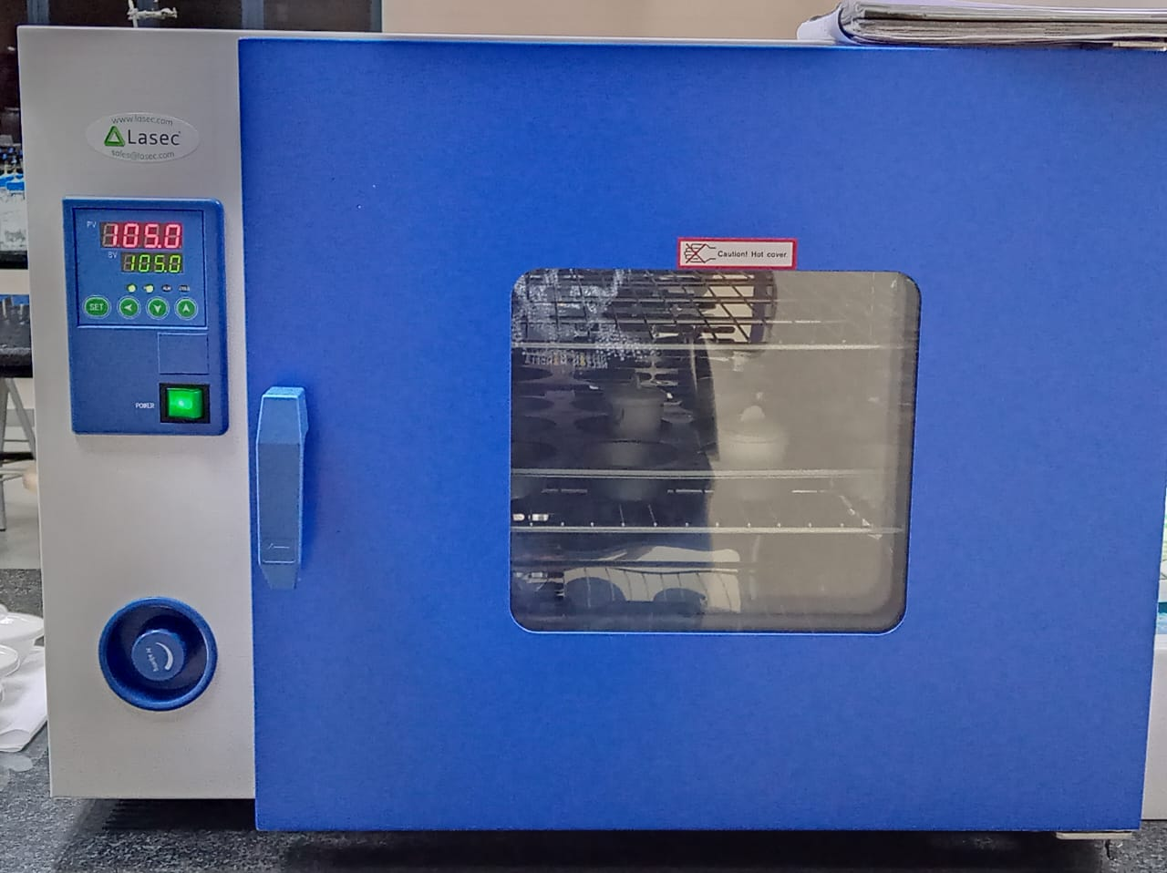
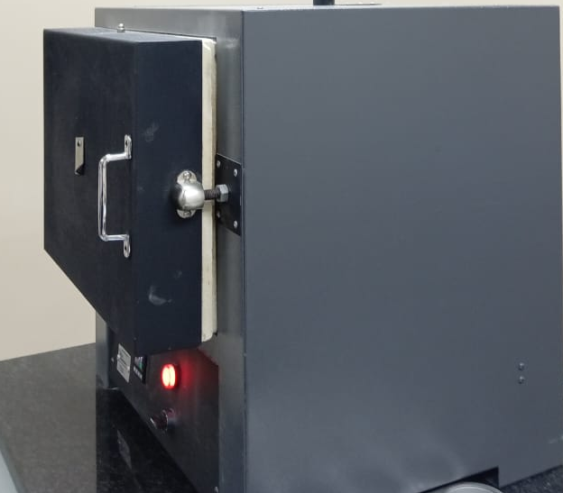
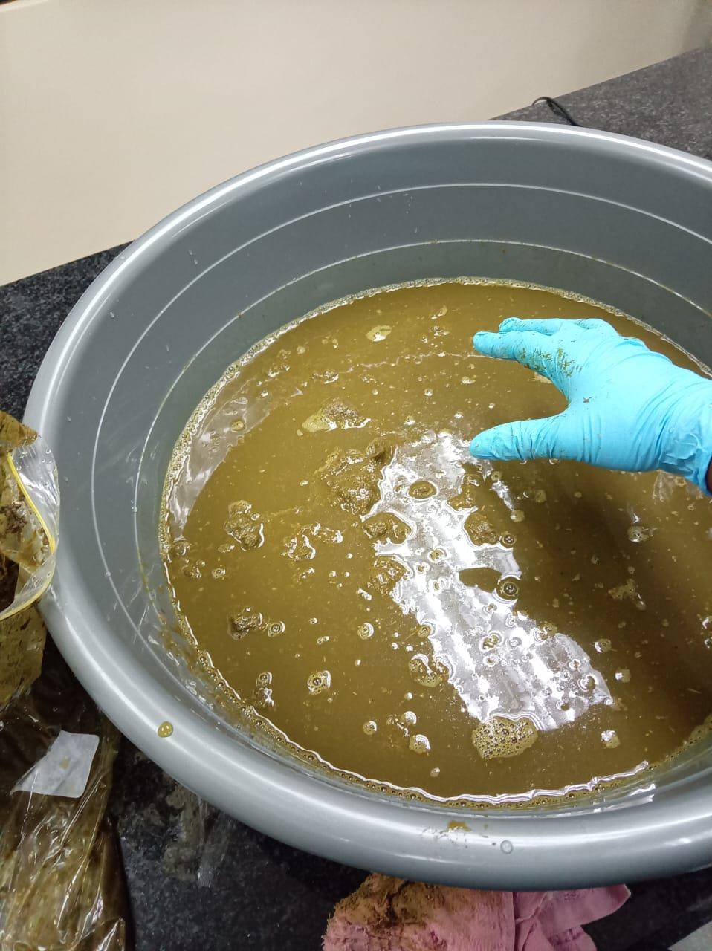
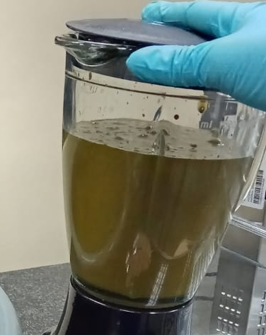
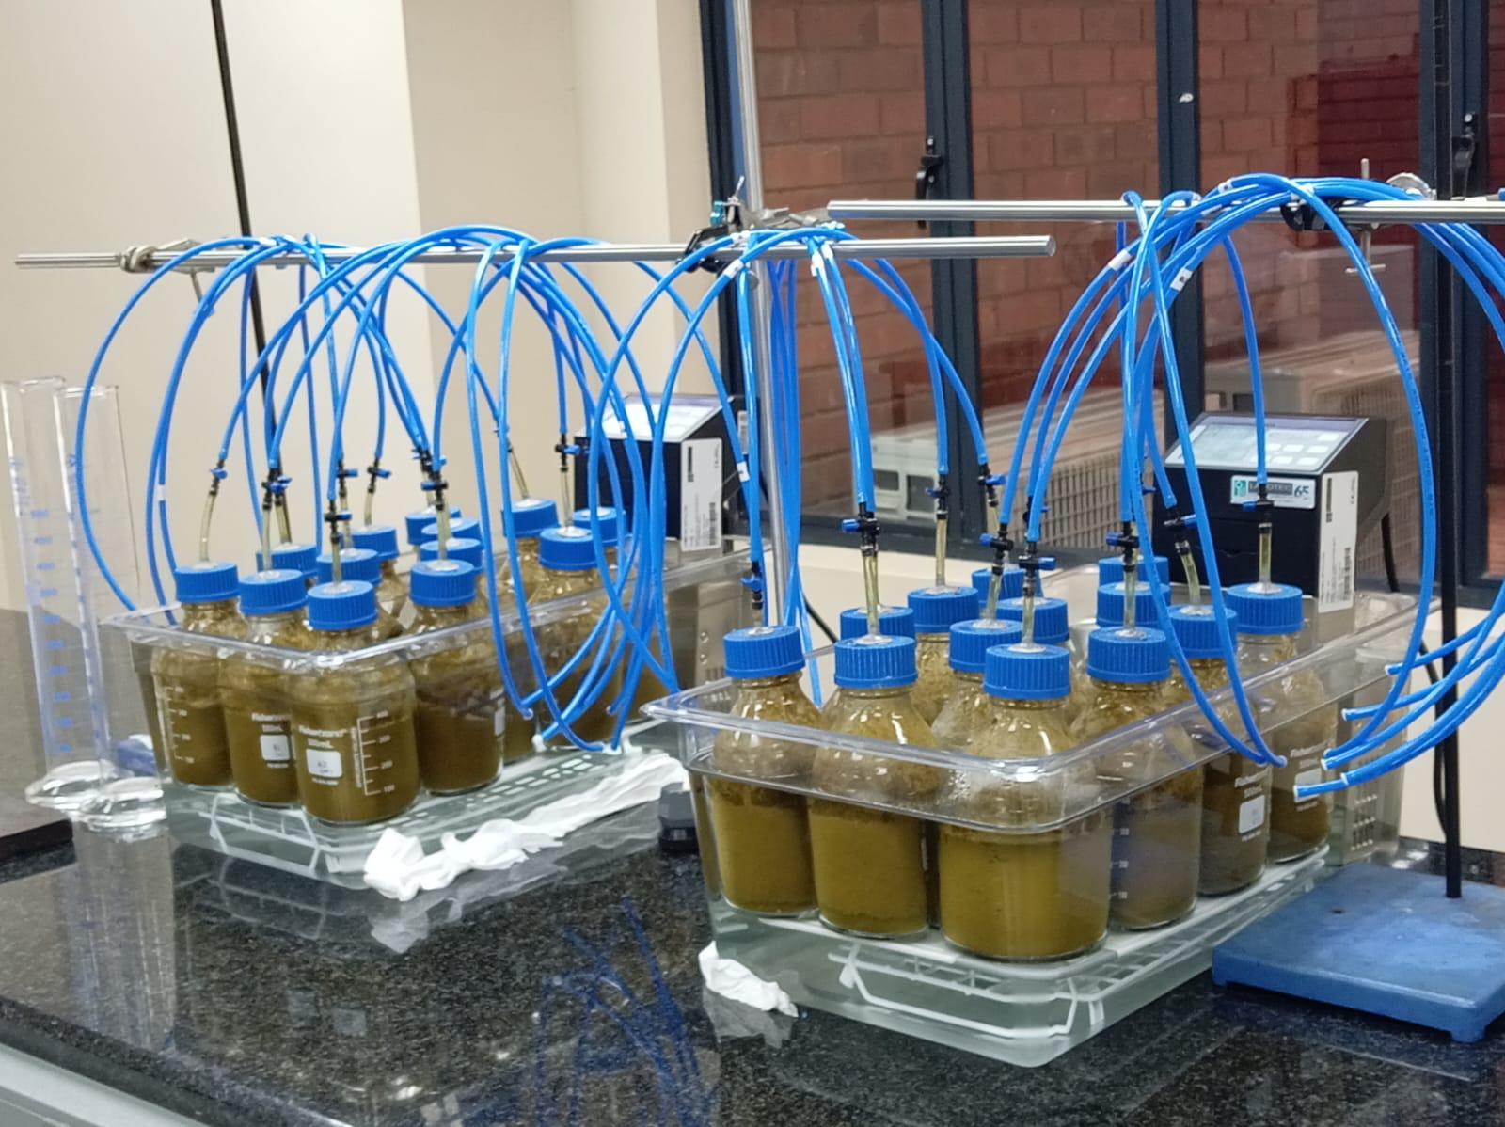
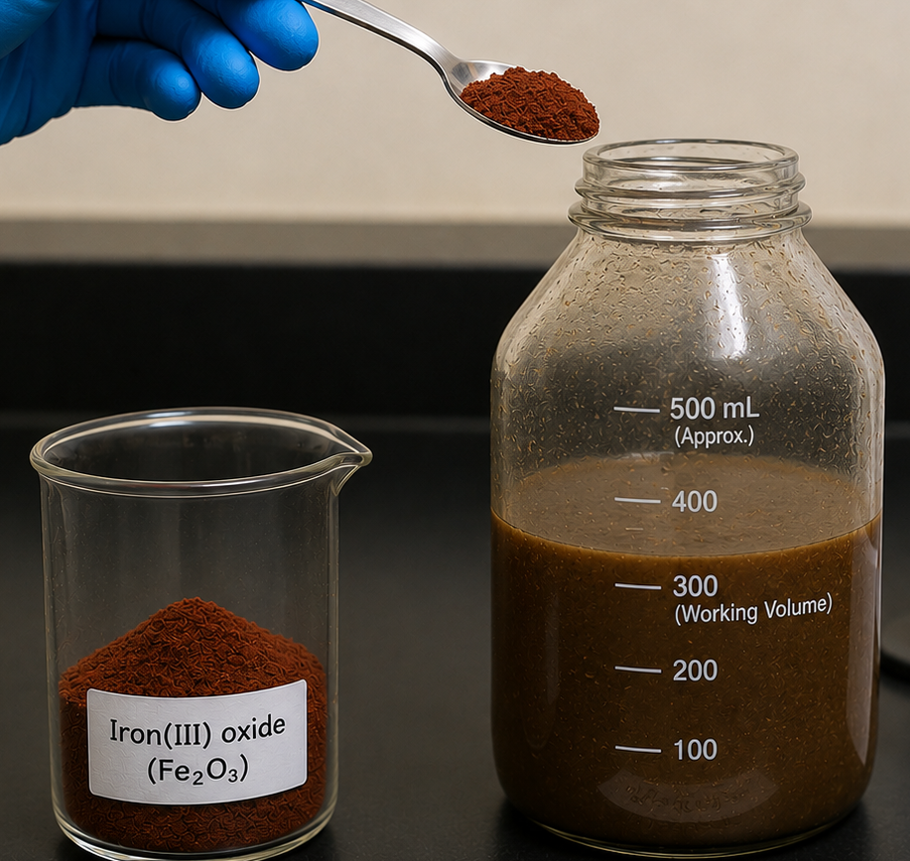




Methodology
A
B
Cow dung
Oven @ 105 $℃$
Furnace @ 550 $℃$
Slurry (1:1)
Blended
Tubes
Valves
Airtight 500ml reagent bottles
Temperature-regulated water baths
Dosages:
100 – 500 mg/L
M$esophilic (37 ±$ 0.5 $℃$)
T$hermophilic (55 ±0.5 ℃)$
Notes:
Experimental workflow:
Part A: Collected cow dung was characterized for total solids (TS), volatile solids (VS), and moisture content (MC).
Part B: The collected cow dung was mixed with water (1:1 ratio) to make a slurry, which was blended for homogeneity. After blending, the slurry was poured into 500 mL laboratory-scale anaerobic digesters maintained at 37°C and 55°C. Cumulative biogas production was quantified using the water displacement method over a 40-day retention period.

Slide 9
Results
(i) Physicochemical properties
Table 2. Physicochemical characteristics of cow dung.
pH - Within the optimal range for methanogens, indicating favourable conditions for methane production.
Total Solids (TS) - shifted from dry AD to the recommended wet AD range, improved substrate fluidity and microbial contact.
VS/TS ratio – indicates a greater proportion of biodegradable organic matter, suggesting improved substrate quality for anaerobic digestion.
Moisture Content (MC): falls within the range favourable for wet anaerobic digestion, enhances microbial activity, nutrient transport, and mixing.
 | Cow dung | Slurry (1:1) | Optimal ranges
pH | 6.80 | 6.88 | 6.8 – 7.2
TS (%) | 15.90 | 9.11 | 7 – 10 (Wet)
VS (%) | 10.20 | 6.58 | -
VS of TS (%) | 64.15 | 71.97 | >70%
MC (%) ª | 84.10 | 90.89 | 90 – 93 (Wet)
ª TS-total solids; VS-volatile solids; MC-moisture content.
TS (%) = (Weight after heating at 105℃)/(Weight before heating) ×100 (1)
VS (%) = (Weight after heating at 105℃-Weight after heating at 550℃)/(Weight before heating) ×100 (2)
MC (%) = (Wet weight-dry weight)/(Wet weight) ×100 (3)
Notes:
TS = everything inside the bag after removing water
VS = the edible part
VS reduction = how much of the edible part was actually eaten

Slide 10
Results
(ii) Effect of Fe₂O₃ on the biogas production
(a)
(b)
Figure 6: Daily biogas production of cow dung at (a) mesophilic and (b) thermophilic conditions.
Notes:
Key findings (Visual Inspections):
Mesophilic digestion exhibited a more stable and sustained biogas production profile
Thermophilic digestion generated higher initial production rates followed by rapid depletion of biodegradable substrates.
Across both operating temperatures, Fe₂O₃ nanoparticle supplementation did not demonstrate a consistent concentration-dependent enhancement in daily biogas production, with the control treatment frequently producing the highest daily yields.

Slide 11
Results
(iii) Effect of Fe₂O₃ on the cumulative biogas production
(a)
(b)
Figure 7: Cumulative biogas production of cow dung at (a) mesophilic and (b) thermophilic conditions.
Notes:
Key findings:
Mesophilic digestion produced substantially higher cumulative biogas yields than thermophilic digestion.
Control treatment performed best under mesophilic conditions.
150 mg/L Fe₂O₃ was the optimum concentration under thermophilic conditions.
500 mg/L Fe₂O₃ consistently produced the lowest cumulative yield under thermophilic conditions, suggesting inhibitory effects at higher concentrations.
The influence of Fe₂O₃ nanoparticles depended on both operating temperature and nanoparticle concentration.
Results are preliminary and subject to statistical validation.

Slide 12
Results
(iv) Optimum Fe₂O₃ NP concentration
(a)
(b)
Figure 8: Cumulative biogas production of cow dung at (a) mesophilic and (b) thermophilic conditions.
Notes:
Key findings:
Fe₂O₃ supplementation showed limited benefits under mesophilic conditions (37°C), with cumulative biogas yields remaining below the control.
Under thermophilic conditions (55°C), moderate Fe₂O₃ concentrations enhanced biogas production, with the highest yield achieved at 150 mg/L.
However, increasing the concentration to 500 mg/L reduced biogas production, suggesting potential inhibitory effects at higher nanoparticle concentrations.
Results are preliminary and subject to statistical validation.

Slide 13
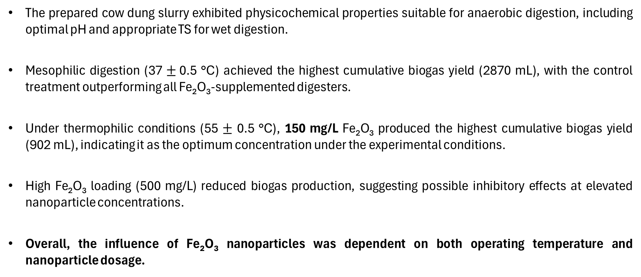
Summary of findings
The prepared cow dung slurry exhibited physicochemical properties suitable for anaerobic digestion, including optimal pH and appropriate TS for wet digestion.
Mesophilic digestion (37 $±$0.5 °C) achieved the highest cumulative biogas yield (2870 mL), with the control treatment outperforming all Fe₂O₃-supplemented digesters.
Under thermophilic conditions (55 $±$ 0.5 °C), 150 mg/L Fe₂O₃ produced the highest cumulative biogas yield (902 mL), indicating it as the optimum concentration under the experimental conditions.
High Fe₂O₃ loading (500 mg/L) reduced biogas production, suggesting possible inhibitory effects at elevated nanoparticle concentrations.
Overall, the influence of Fe₂O₃ nanoparticles was dependent on both operating temperature and nanoparticle dosage.

Slide 14
Future Work
Determine biogas composition (CH₄, CO₂ and H₂S) to evaluate gas quality and methane yield.
Characterize Fe₂O₃ nanoparticles and digestate using techniques such as SEM, XRF, and CHNS elemental analysis to investigate structural and compositional changes.
Perform statistical analyses (e.g., ANOVA) to determine the significance of treatment effects.

Slide 15
References
Sikayena, I., Abokyi, E., Boateng, F. O., & Ankomah, K. (2026). Cities, factories, and energy: How urbanization and industrialization shape renewable and fossil fuel use: Evidence from a developing economy. World Development Sustainability, 8, 100288. https://doi.org/10.1016/j.wds.2026.100288
Boateng, G. O., Balogun, M. R., Dada, F. O., & Armah, F. A. (2020). Household energy insecurity: Dimensions and consequences for women, infants and children in low- and middle-income countries. Social Science & Medicine, 258, 113068. https://doi.org/10.1016/j.socscimed.2020.113068
C-CHANGE. (2023). What is anaerobic digestion? Iowa State University. https://www.agchange.org
Prajapati, K., Pareek, N., & Vivekanand. (2018). Pretreatment and multi-feed anaerobic co-digestion of agro-industrial residual biomass for improved biomethanation and kinetic analysis. Frontiers in Energy Research, 6, Article 111. https://doi.org/10.3389/fenrg.2018.00111
Uddin, M. & Wright, M. (2023). Anaerobic digestion fundamentals, challenges, and technological advances. Physical Sciences Reviews, 8(9), 2819-2837. https://doi.org/10.1515/psr-2021-0068
Chen, Y., Cheng, J. J., & Creamer, K. S. (2008). Inhibition of anaerobic digestion process: a review. Bioresource technology, 99(10), 4044–4064. https://doi.org/10.1016/j.biortech.2007.01.057
Fagbohungbe, M. O., Dodda, I. C., Herbert, B. M. J., Li, H., Ricketts, L., & Semple, K. T. (2015). High solid anaerobic digestion: Operational challenges and possibilities. Environmental Technology & Innovation, 4, 268–284. https://doi.org/10.1016/j.eti.2015.09.003
Baniamerian, H., Isfahani, P. G., Tsapekos, P., Alvarado-Morales, M., Shahrokhi, M., Vossoughi, M., & Angelidaki, I. (2019). Application of nano-structured materials in anaerobic digestion: Current status and perspectives. Chemosphere, 229, 188-199. https://doi.org/10.1016/j.chemosphere.2019.04.193
Ajay, C. M. (2020). Review of impact of nanoparticle additives on anaerobic digestion and methane generation. Fuel, 277, 118234. https://doi.org/10.1016/j.fuel.2020.118234
Ganzoury, M., & Allam, N. K. (2015). Impact of nanotechnology on biogas production: A mini review. Renewable and Sustainable Energy Reviews, 50, 1392–1404. https://doi.org/10.1016/j.rser.2015.05.073
Møller, H. B., Sommer, S. G., & Ahring, B. K. (2004). Methane productivity of manure, straw and solid fractions of manure. Biomass and Bioenergy, 26(5), 485–495. https://doi.org/10.1016/j.biombioe.2003.08.008
Ward, A. J., Hobbs, P. J., Holliman, P. J., & Jones, D. L. (2008). Optimisation of the anaerobic digestion of agricultural resources. Bioresource Technology, 99(17), 7928–7940. https://doi.org/10.1016/j.biortech.2008.02.044

Slide 16




Acknowledgements

