Slide 1
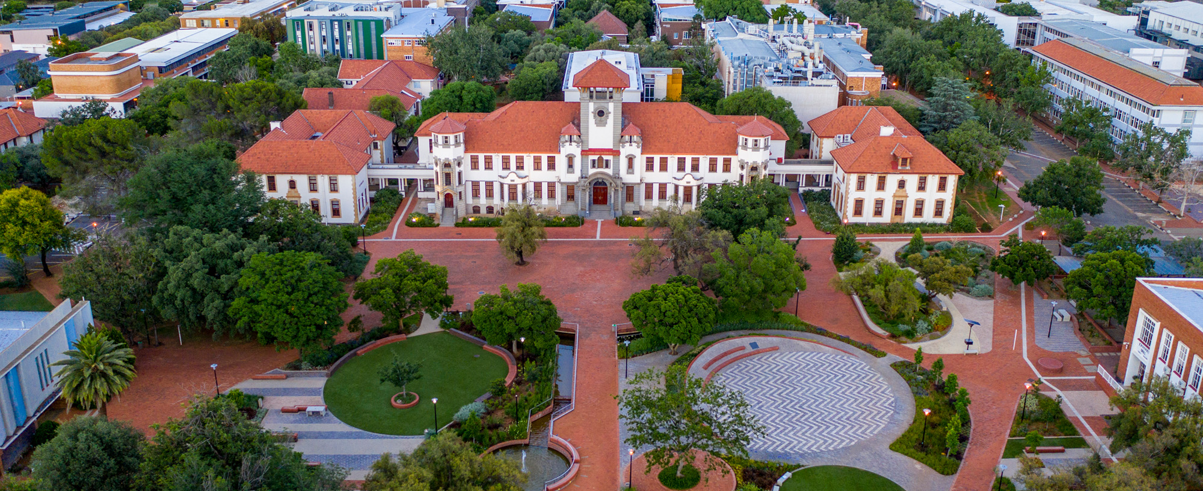



Design and Implementation of a Modular Telescope and Dome Control System (TelServer)
HJ van Heerden
www.ufs.ac.za
70th Annual Conference of SAIP
July 2026

Slide 2
Introduction
Project Aim: To research, design and implement upgraded systems and platforms for the 1.5m Boyden Reflector for full remote and semi-autonomous use utilizing the SAAO IO approach for operational effectiveness.
Telescope project and TelServer
July 2026

Slide 3
Project Components
Telescope Control
Dome Control
Science Instruments
Guiding systems
Environment
Network and Data systems
Telescope project and TelServer
July 2026

Slide 4
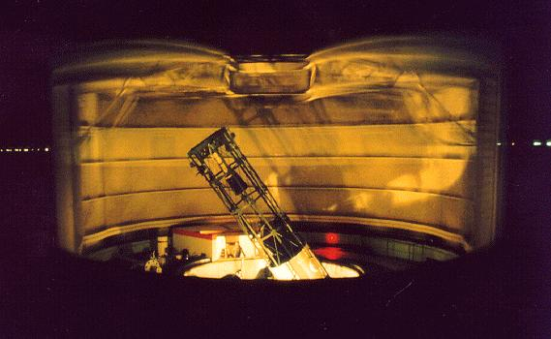
Introduction
Telescope project and TelServer
July 2026

Slide 5
What is TelServer
Integrates telescope and dome control into a unified framework
Interfaces with DFM Telescope Control System (RS232)
Controls dome rotation and shutters via PLCs
Socket-based architecture supports multiple clients:
  Python scripts, Web interfaces or C/C++ applications
Hardware abstraction separates control logic from device interfaces
Standardized APIs for:
  Telescope pointing, Dome rotation and Shutter control
Scalable, flexible, and extensible system architecture
Telescope project and TelServer
July 2026

Slide 6
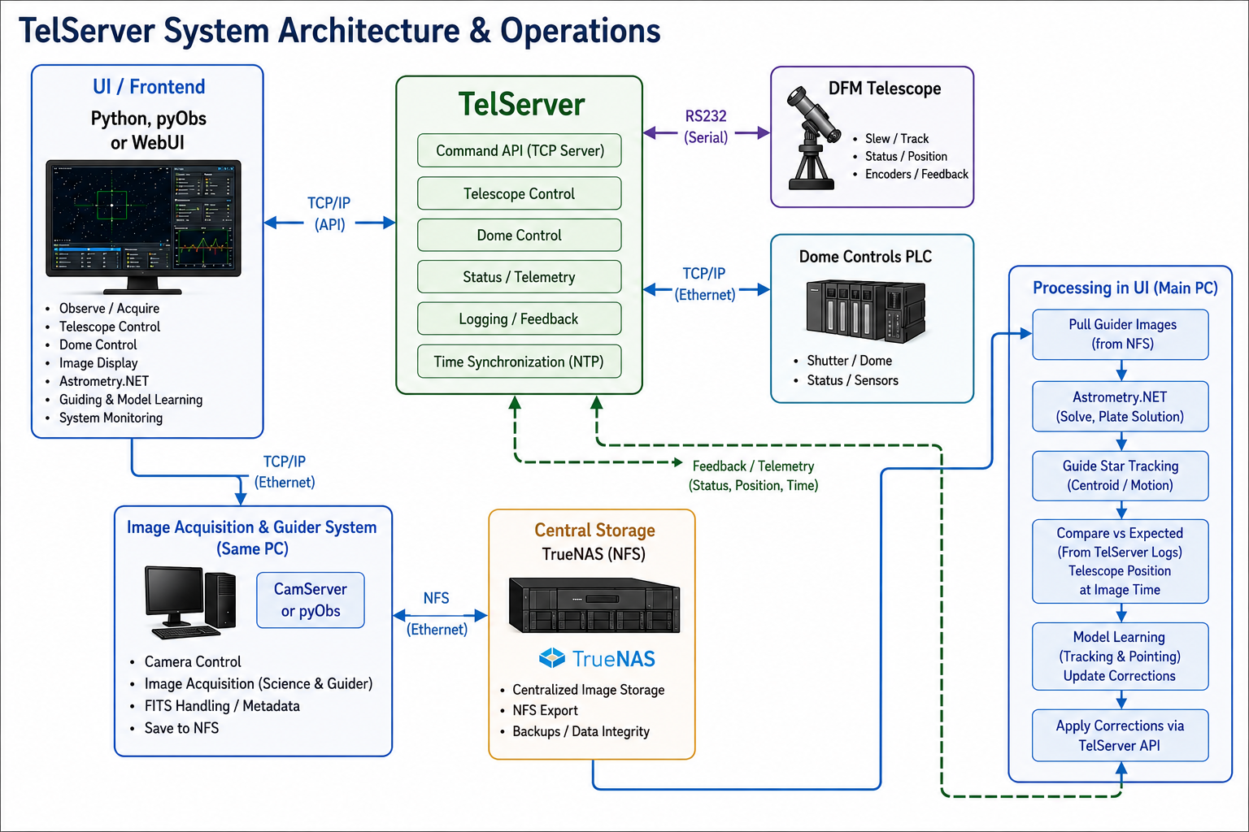
Telescope project and TelServer
July 2026

Slide 7
Standard control flow
1. UI sends observation, telescope, dome, and imaging commands to TelServer through the TCP/IP API.
2. TelServer validates requests, coordinates system state, and issues control commands.
3. TelServer controls the DFM Telescope via RS232 and continuously receives position, status, and telemetry.
4. TelServer communicates with the Dome Control PLC via TCP/IP to operate dome rotation, shutters, lighting, and safety systems.
5. The UI initiates image acquisition on the Camera/Guider PC using CamServer or pyObs over Ethernet.
6. Science and guider images are written directly to the central TrueNAS storage via an NFS share.
7. The UI accesses guider images from the same NFS storage for real-time processing.
8. Local Astrometry.net performs plate solving to determine the true telescope pointing.
9. Guide star tracking measures centroid motion to determine tracking errors.
10. Telescope position, timestamps, and telemetry logged by TelServer are correlated with each acquired image.
11. Measured tracking and pointing errors are compared with the expected telescope position.
12. Model-learning algorithms estimate corrections for telescope pointing and tracking models.
13. The updated corrections are sent back to TelServer through the TCP/IP API.
14. TelServer applies the refined pointing and tracking corrections, closing the feedback loop for future observations.
Telescope project and TelServer
July 2026

Slide 8
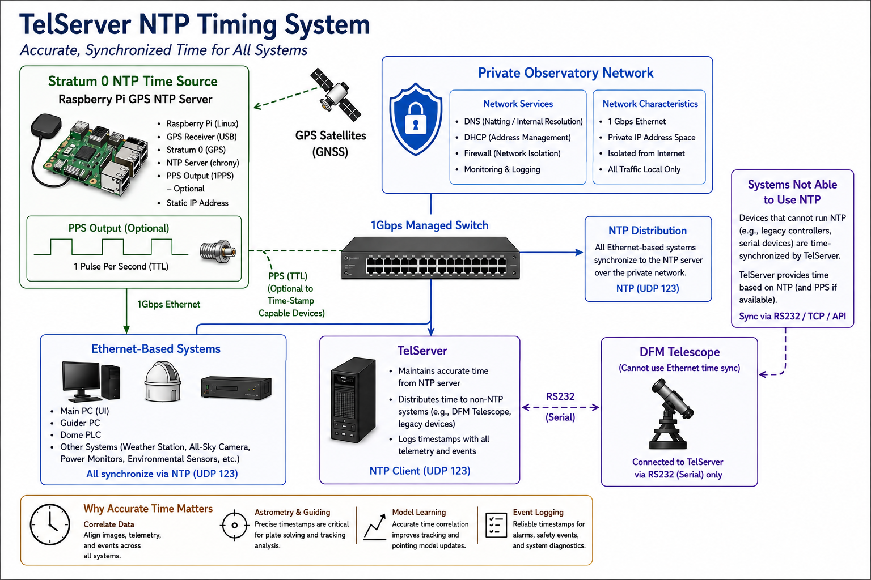
Telescope project and TelServer
July 2026

Slide 9
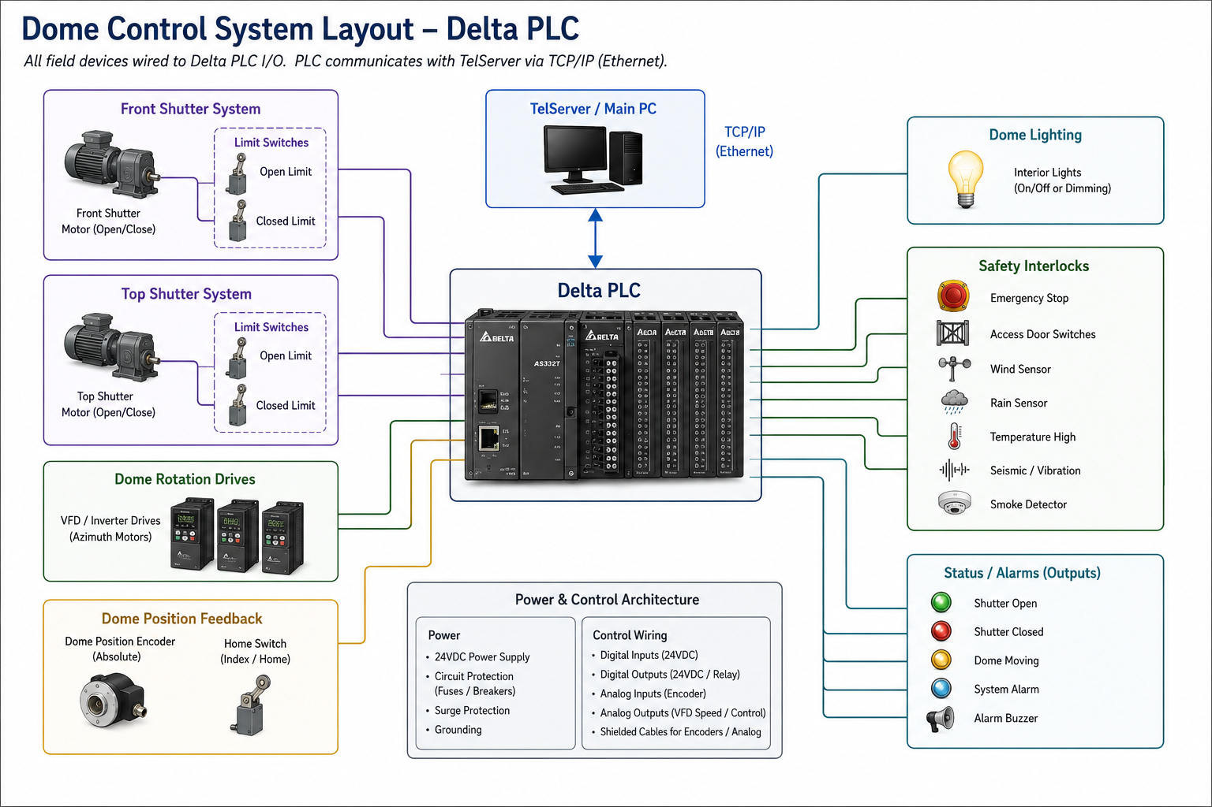
Telescope project and TelServer
July 2026

Slide 10
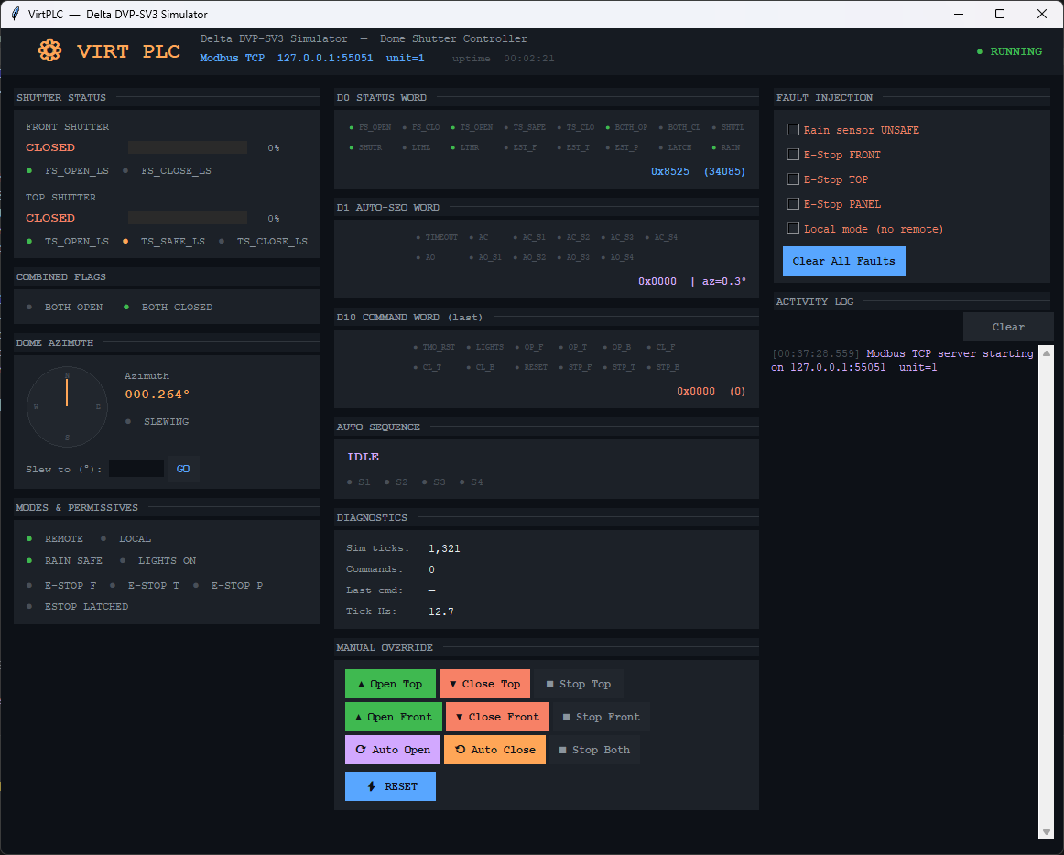
Introduction
Telescope project and TelServer
July 2026

Slide 11
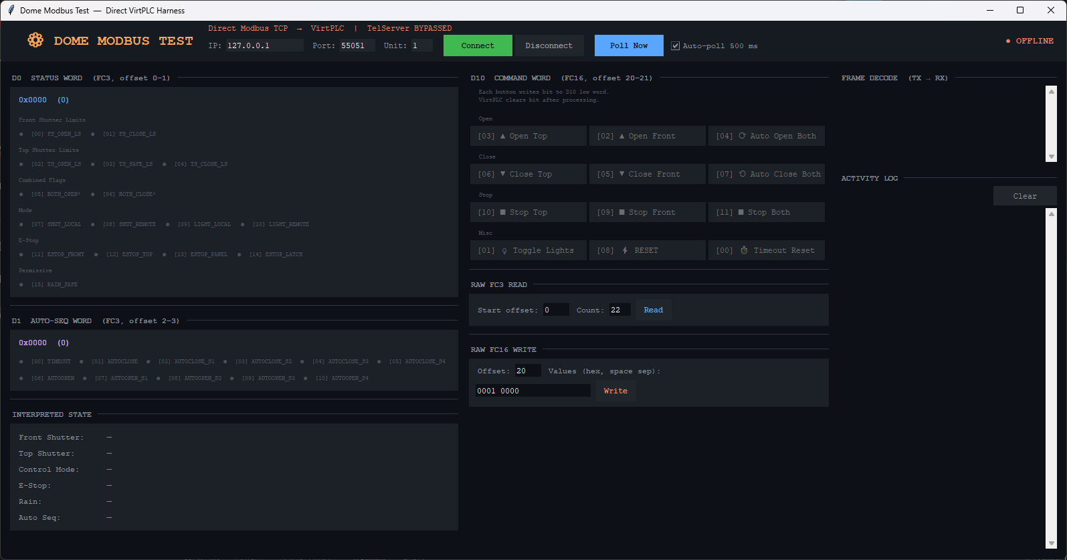
Introduction
Telescope project and TelServer
July 2026

Slide 12
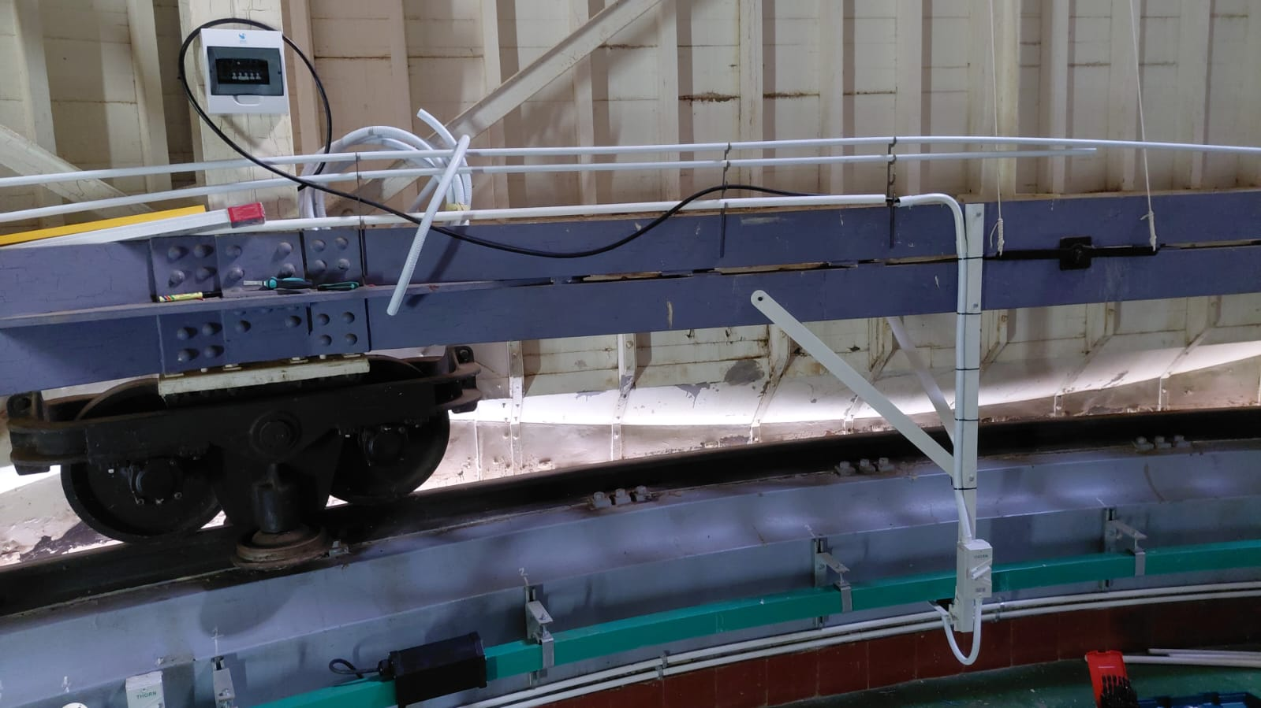
Introduction
Telescope project and TelServer
July 2026

Slide 13
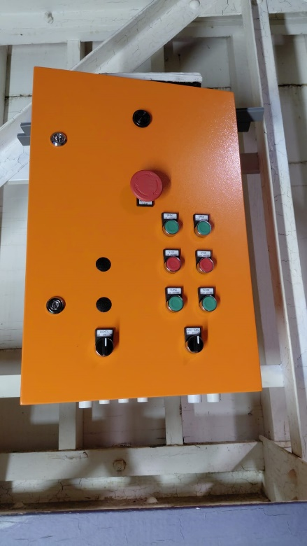
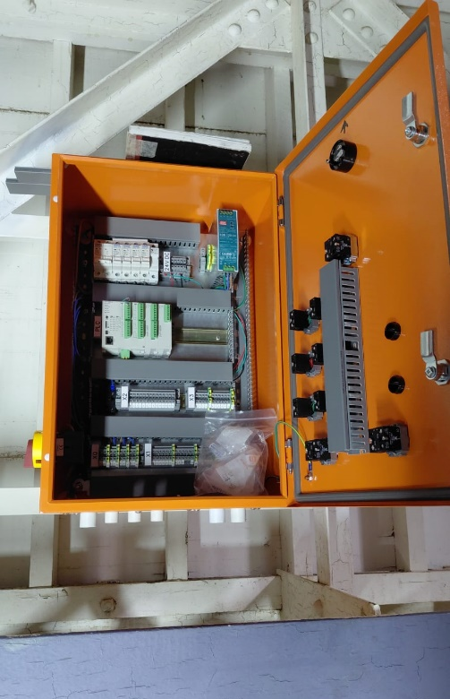
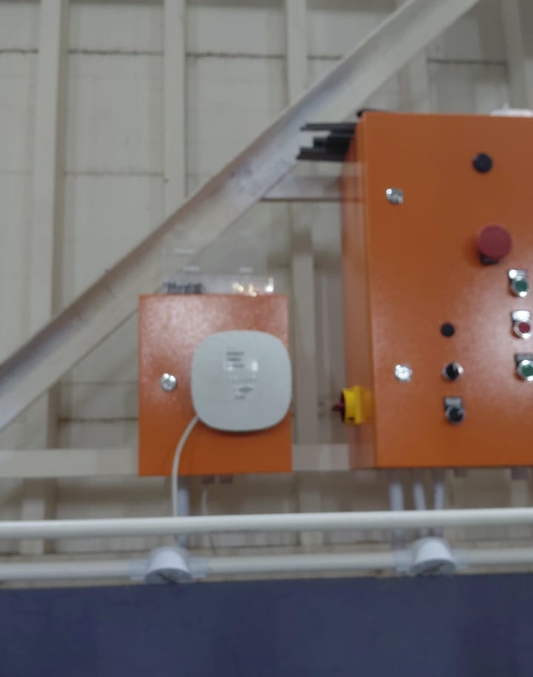
Introduction
Telescope project and TelServer
July 2026

Slide 14
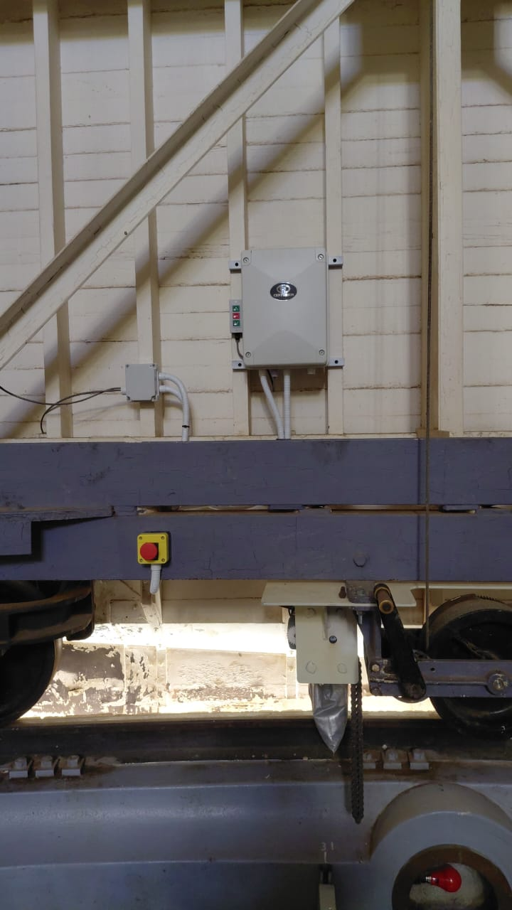
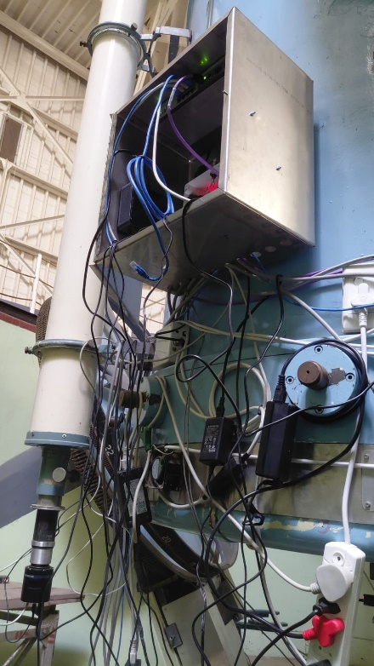
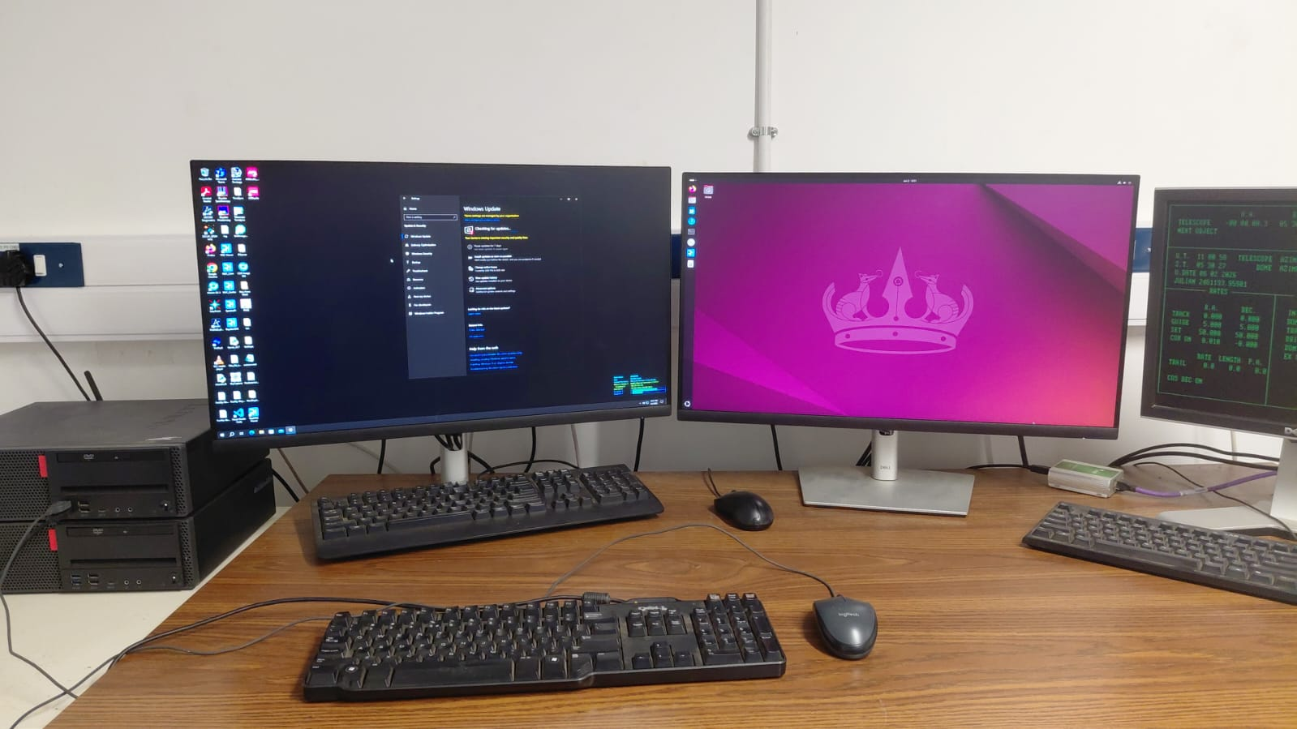
Introduction
Telescope project and TelServer
July 2026

Slide 15
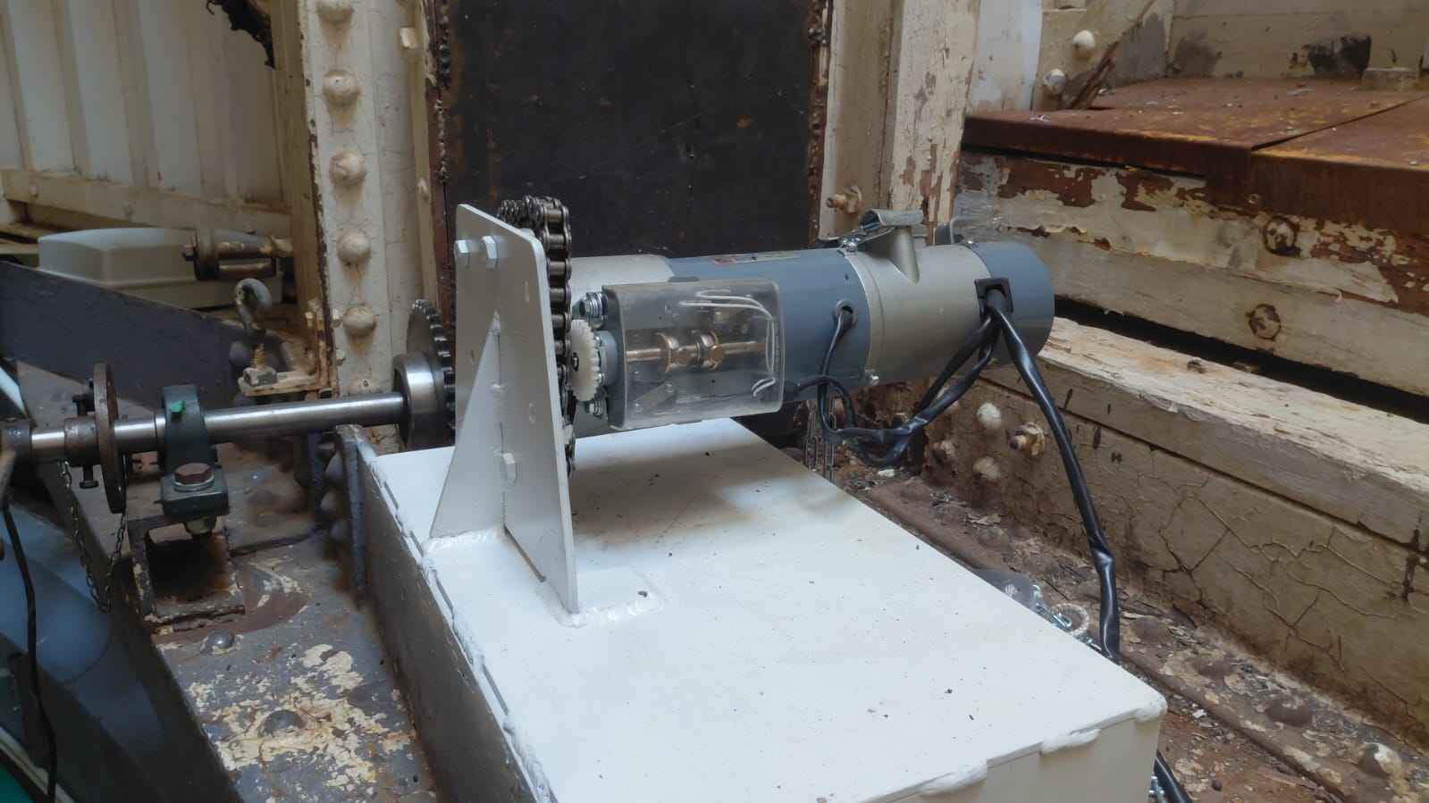
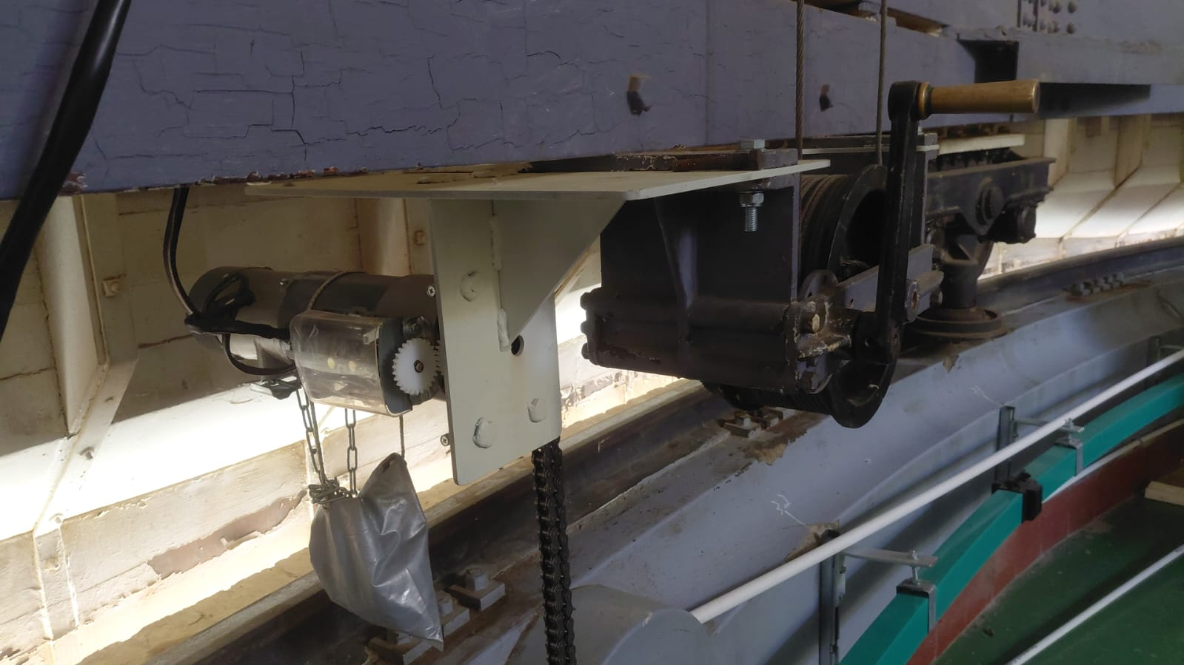
Telescope project and TelServer
July 2026

Slide 16
Still need to happen
Telescope dust cover controls
Telescope focus position encoder
Environmental – Weather station
Finalize network upgrades
Upgrade telescope DFM system to PLC system.
And etc…
Telescope project and TelServer
July 2026

Slide 17



This work is based on the research supported by the Department of Science and Innovation and the National Research Foundation of South Africa.
Thank You
Dankie
T: +27(0)51 401 3509 І vanheerdenhj@ufs.ac.za І www.ufs.ac.za

