Slide 1
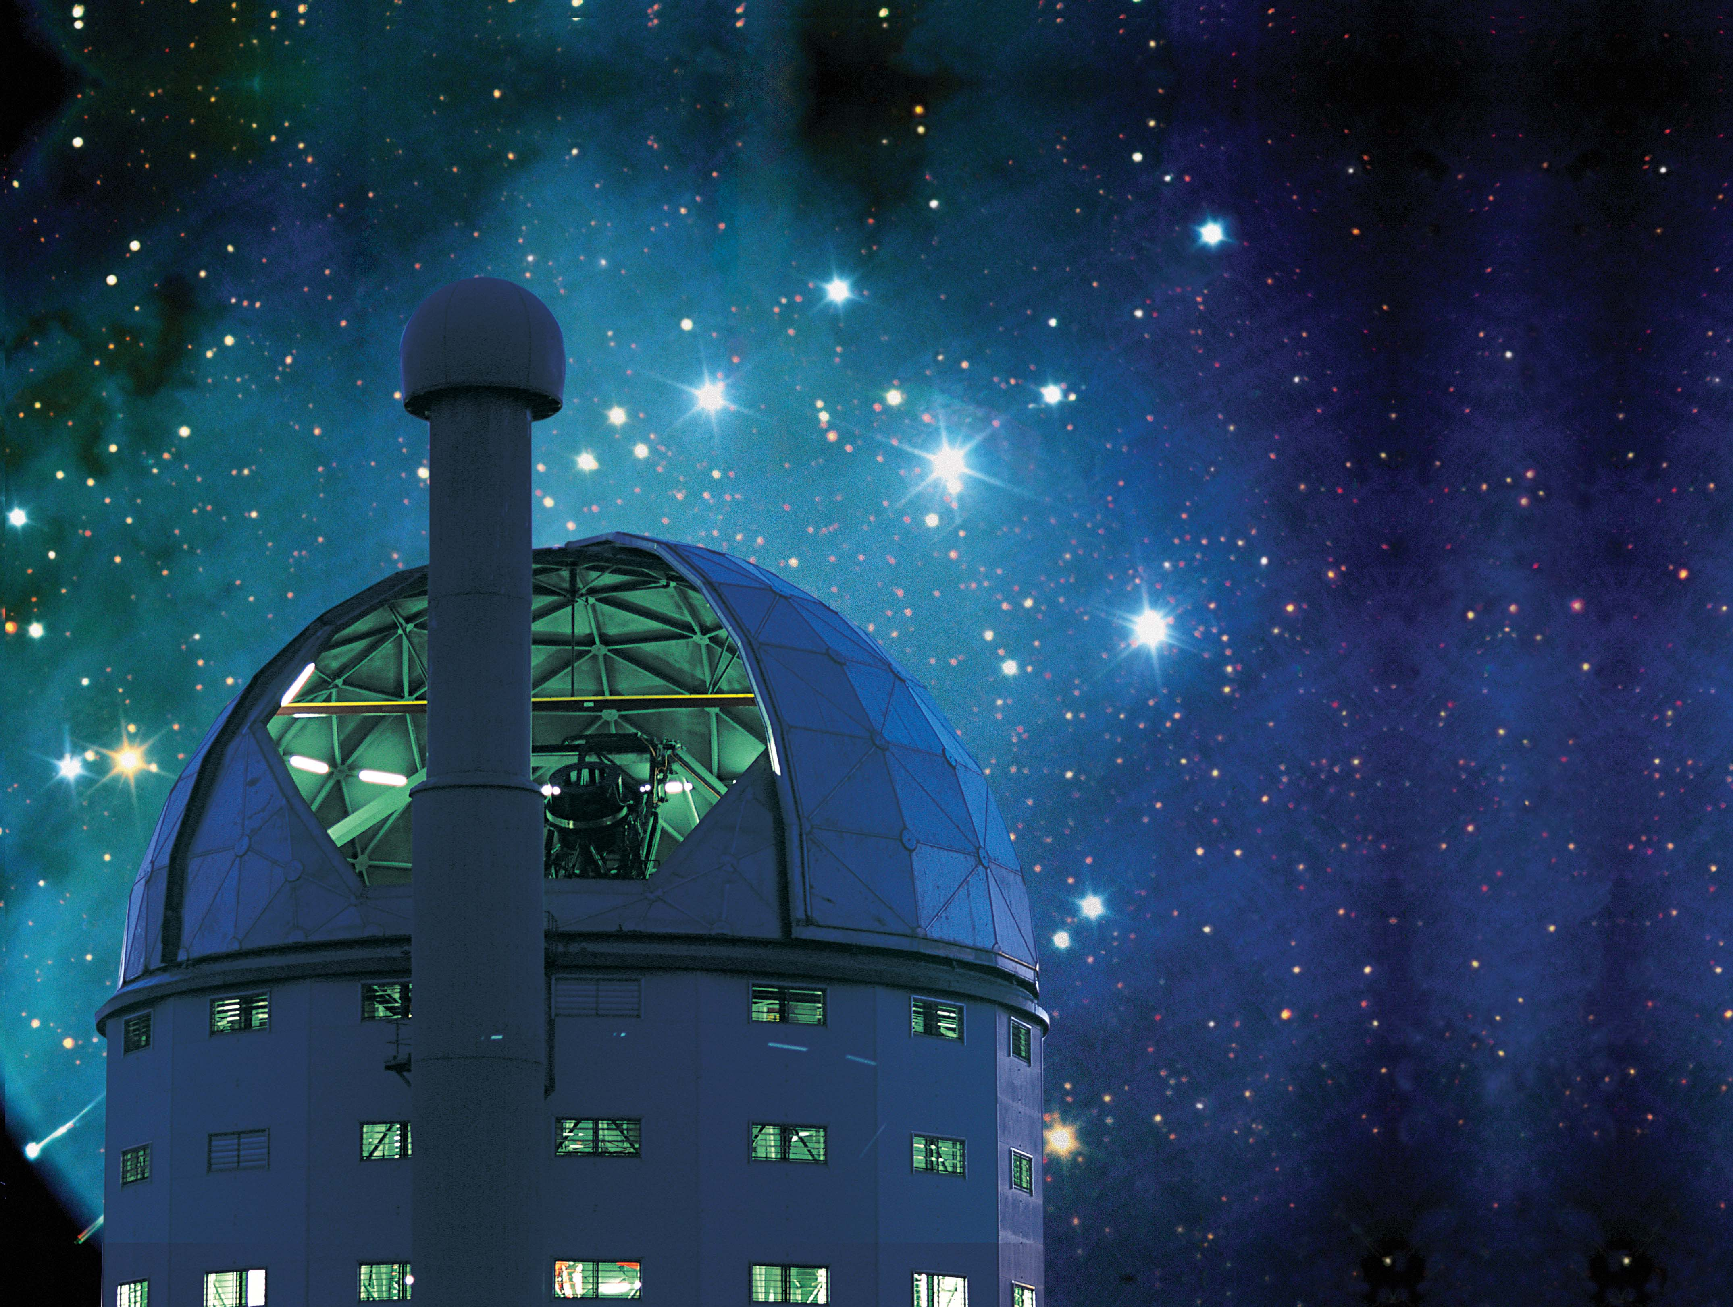
Future Plans for Global Transient Networks
David Buckley
National Astronomical Observatory of the Chinese Academy of Sciences
South African Astronomical Observatory
University of the Free State
Visiting Professor & CAS PIFI Fellow
SALT Transient Programme PI
South African Rubin LSST Affiliate PI for Transients

Slide 2
Overview
Transient and time domain astronomy
The SALT transient programme
BRICS Astronomy and the BRICS Intelligent Telescope and Data Network flagship programme (BITDN)
The SAAO Intelligent Observatory programme (IO)
The African Integrated Observation System (AIOS)
The Global Open Transient Telescope Array (GOTTA)

Slide 3
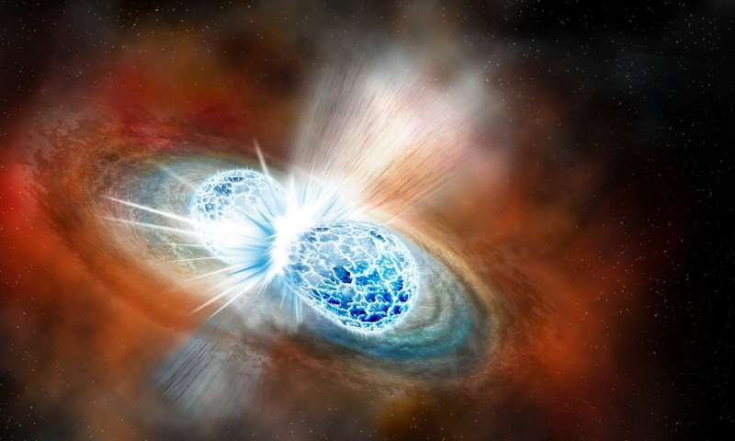
The Transient & Variable Universe
Time domain and transient astronomy is a growing frontier of discovery space
  “things that go bump in the night”
Allows studies of phenomena over timescales of milliseconds to decades
Observations of transient behaviour for a wide range of objects and timescales, including high energy events (X-rays/γ-rays/multi-messenger)
From Galactic to extragalactic objects
Many transients associated with accretion, magnetism and explosive outflows
New phenomena will inevitably be discovered as our ability to detect and investigate transient and variable phenomena improve
Merging neutron star binary
(e.g. kilonova GW170817)
Nova eruption

Slide 4
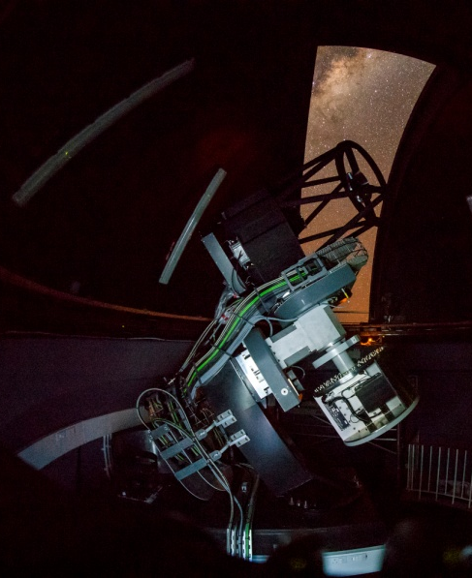
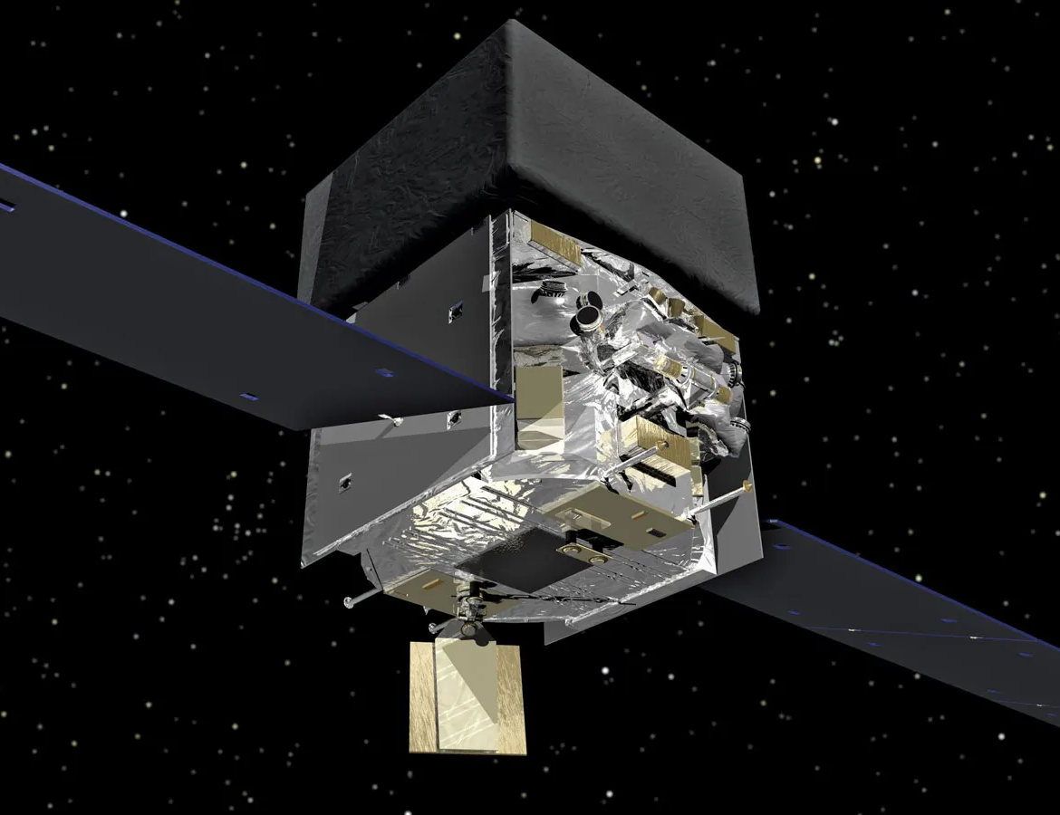
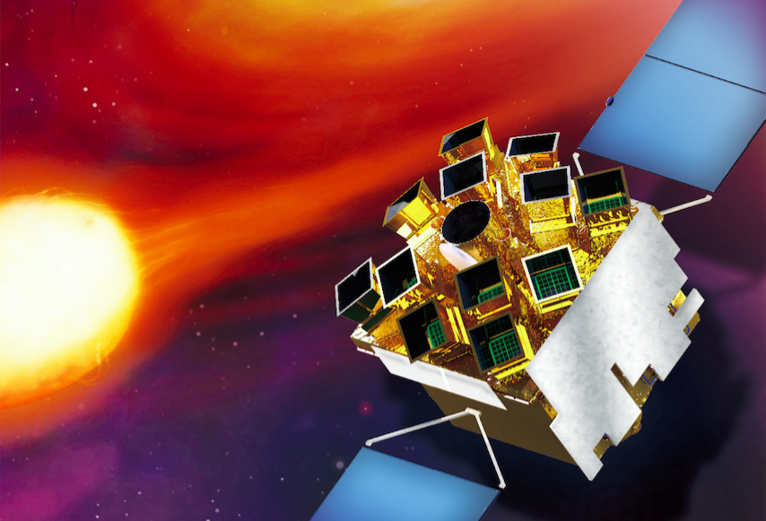
The Transient Universe across the E-M spectrum
Increasing number of facilities and surveys leading to discoveries of transients of all classes including optical facilities at SAAO (MASTER, ASASSN, MeerLICHT, ATLAS)
Some dedicated to specific classes of objects (e.g. supernovae, GRBs, asteroids)
Others find many different classes of transients as a by-product of wide-field surveys (e.g. Gaia, OGLE, PanSTARRS, ZTF, TESS)
Both ground-based and space-based facilities are sources of alerts
X-ray/γ-ray satellite for the latter (e.g. Swift, Fermi, MAXI)
A SALT large programme on transient followup began in 2018 and continues to evolve
Focuses on understanding the astrophysical nature of transients rather than their discovery
Mostly involves multi-wavelength and time domain studies with a variety of other of other global facilities both ground-based and space-based
Experience gained helping to pave the way for the next big transient discovery machine: the Rubin Observatory Legacy Survey of Space and Time(LSST)
MeerLICHT (optical followup
of radio transients)
Fermi (γ-ray)
Einstein Probe (X-ray)

Slide 5
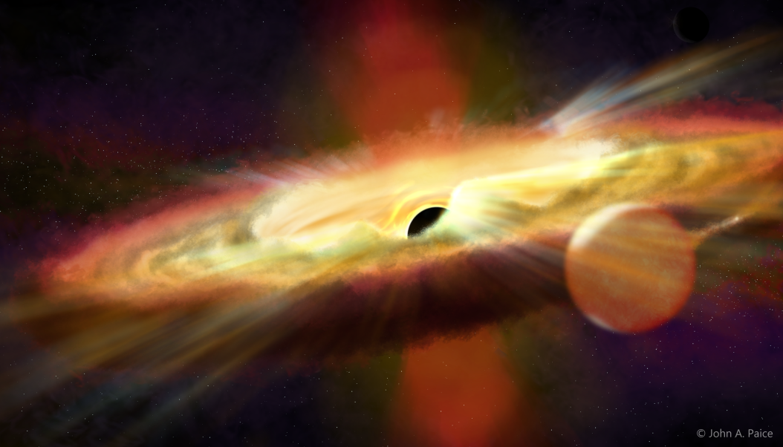
SALT Transient Science
Covering wide range in luminosity (& therefore distance)
Variability on a wide range of timescales
  Sub-sec domain is relatively unexplored
Covering many object classes
  X-ray transients (LMXs; HMXBs)
  Cataclysmic Variables
  Novae
  Intermediate luminosity transients
  Tidal Disruption Events (TDEs)
    From Gaia, OGLE, eROSITA
  Black Hole microlensing events
  Flaring Blazars
  Unusual supernovae (e.g. Super Luminous Supernovae)
  Gamma-Ray Bursts (GRBs)
  Multi-messenger (Gravitational Waves &
  Neutrino) events
  Radio transients with MeerKAT (ThunderKAT programme)
Jeff Cooke

Slide 6
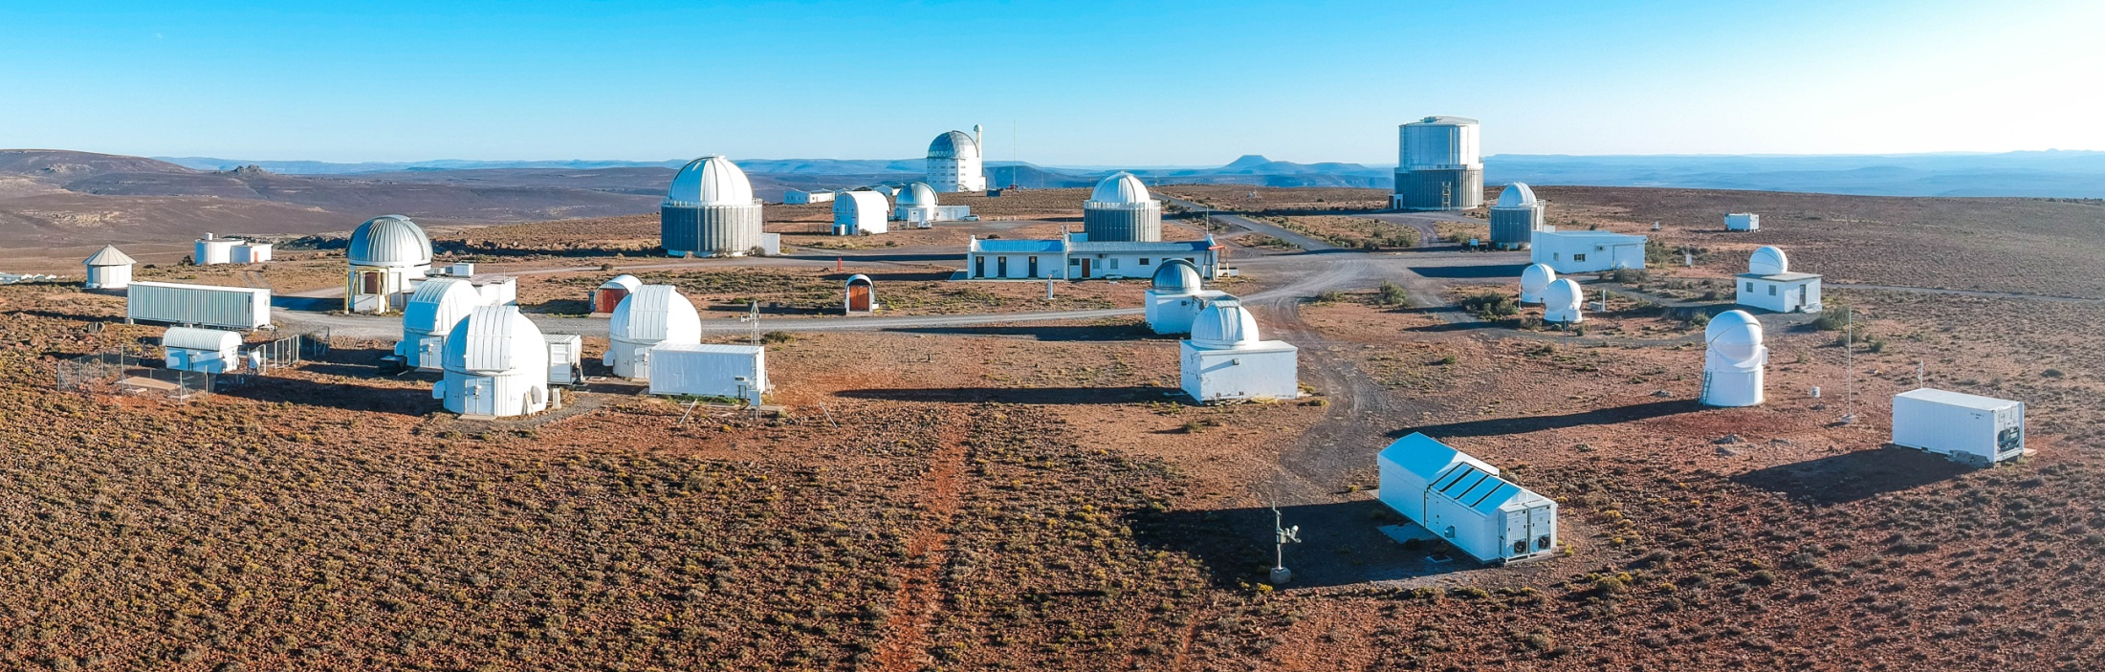
The Future of Transient & Variable Followup:
Automated Intelligent Observatory Networks
Example: SAAO’s Intelligent Observatory
Network telescopes on the Sutherland site to allow automated follow-up from multi-wavelength alert brokers
Science driver: follow-up on Rubin LSST transient & variable sources and transient alerts from other facilities (including space-based)
Project started in 2020 with 3 telescopes and utilizing SW system developed at LCO
Eventually extend to some of the other hosted facilities
Telescopes now routinely remotely operated and one in fully autonomous mode
Paving the way for automated global telescope networks including the BRICS Intelligent Telescope and Data Network plus the African Integrated Observation System (AIOS)

Slide 7
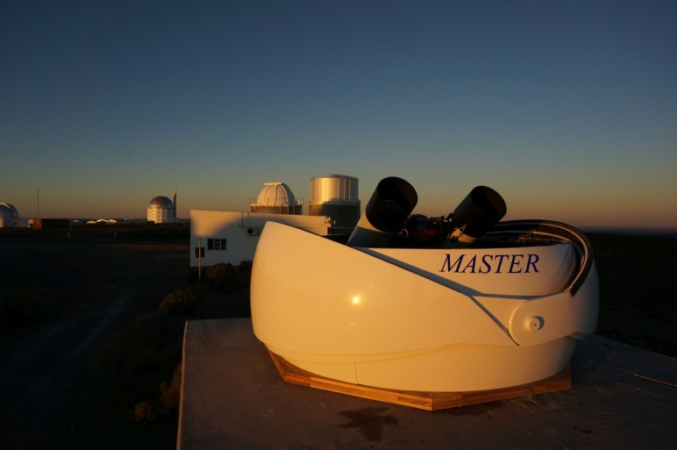
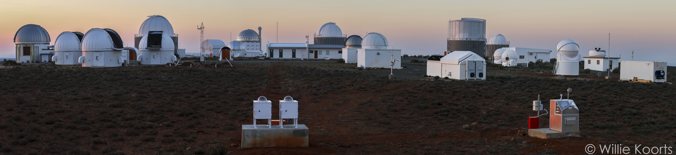
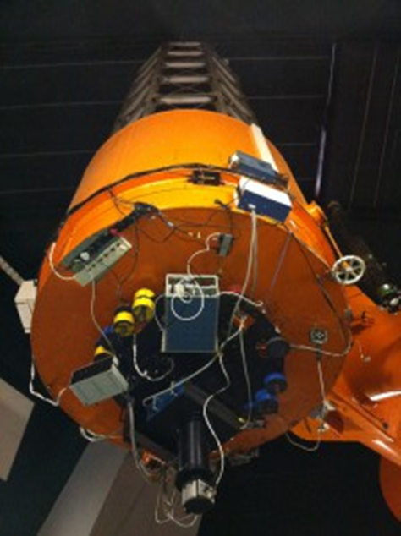
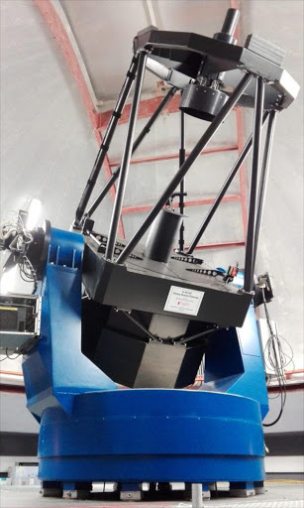
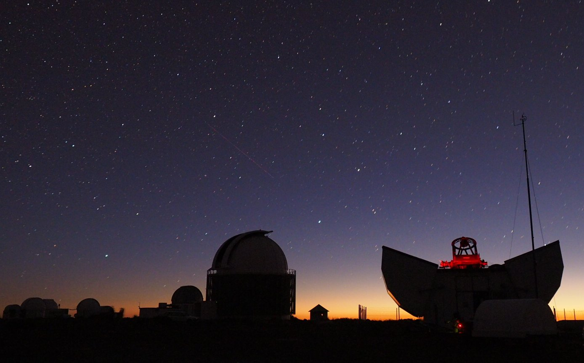
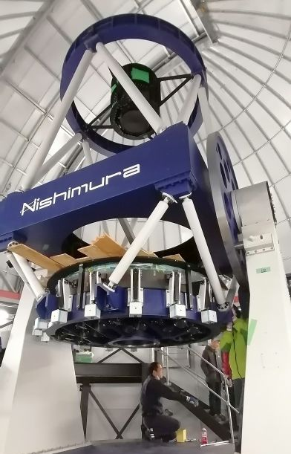
Supporting Optical Observations in South Africa
Majority of facilities at the SAAO site in Sutherland
~20 telescopes with 0.40 – 1.9-m apertures, in optical and NIR
Some dedicated to transients (ATLAS, MASTER, MeerLICHT)
Mostly supporting time series optical photometry, spectroscopy and photo-polarimetry
1.0-m
(Lesedi)
1.-8-m NIR (PRIME)
1.9-m
Monet 1.2-m

Slide 8


Expanding the IO Concept in Africa:
An African Astronomy Flagship Concept
African Integrated Observation System (AIOS)
Adopted by the African Astronomical Society
Leveraging the IO & BRICS programmes
Network existing (& future) African facilities

Slide 9
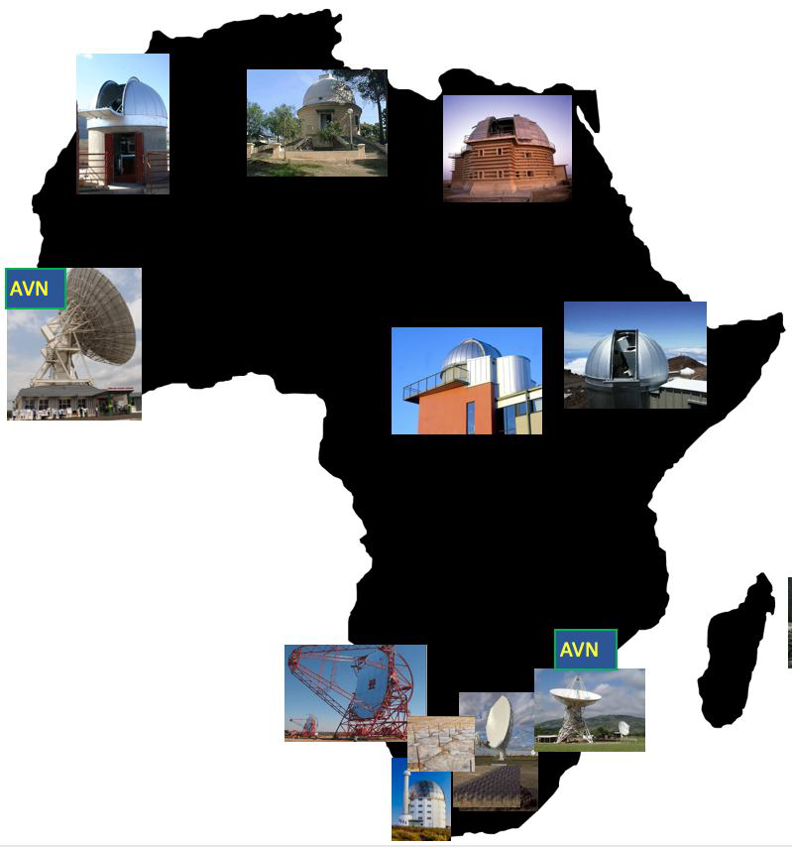
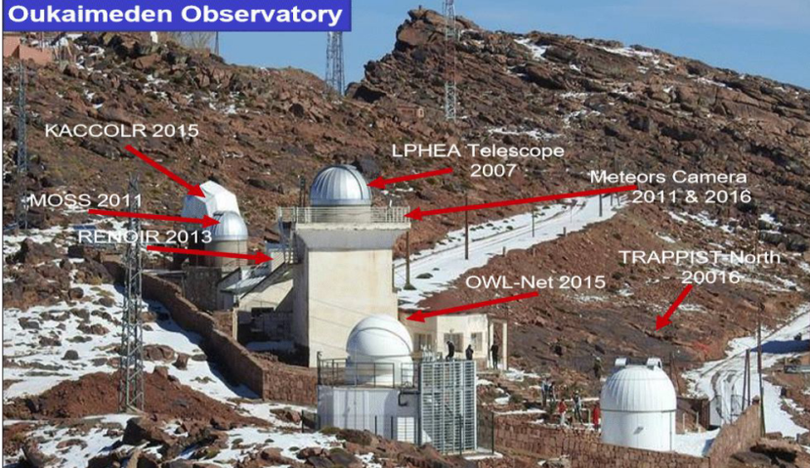
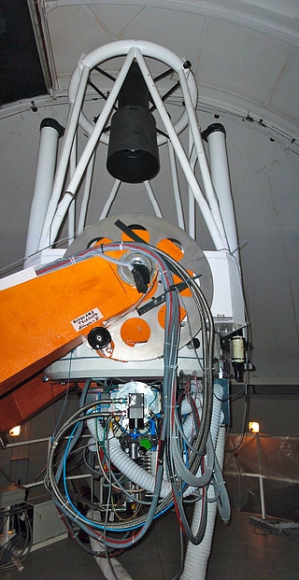
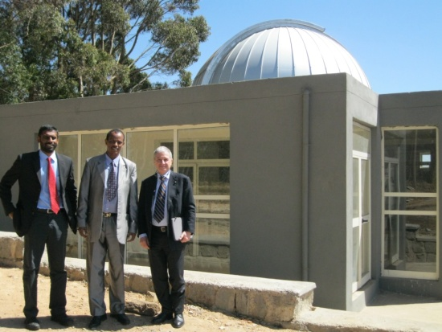
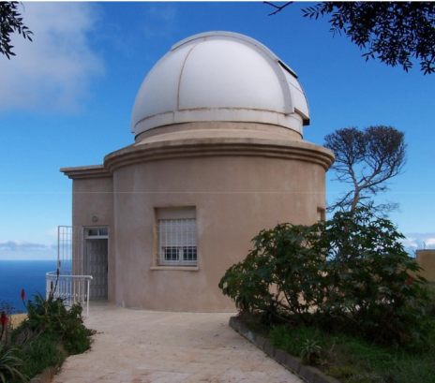
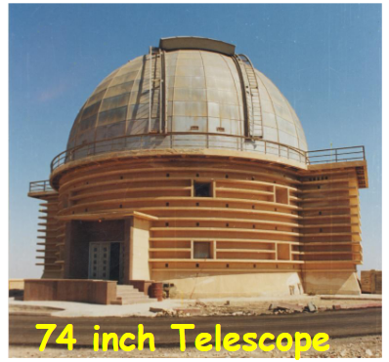
The AIOS
Expand an Intelligent Observatory concept into Africa
Use existing facilities networked together
  Morocco
  Algeria
  Egypt
  Ethiopia
  Burkino Faso
Develop international collaborations in transient/time
domain astronomy
Motivate for development of new facilities
Train young scientists/engineers
Need for maximize sky coverage (in position & time)
Morocco
Ethiopia
Algeria
From Jamal Mimouni
Egypt
Burkino Faso

Slide 10
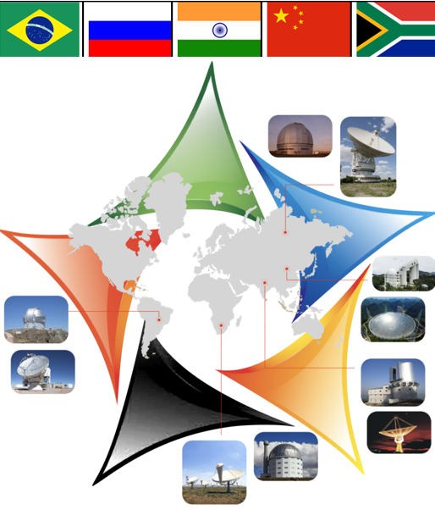
BRICS Astronomy
BRICS Astronomy Working Group set up in 2015 with South Africa as secretariat
Common aspirations for scientific and technological advancement through collaboration
Enhancing human capital development and wider benefits to our societies
Leveraging existing and future facilities within BRICS or for which BRICS has access
Develop an internationally competitive astronomy programme – a “flagship” – the BRICS Intelligent Telescope and Data Network
Focus on the enormous potential of the big astronomy survey programmes of the next 2 decades and the enormous data and compute challenges they bring:
  Optical: The Rubin Observatory Legacy Survey of Space and Time (LSST)
  Radio: The Square Kilometre Array (SKA)

Slide 11
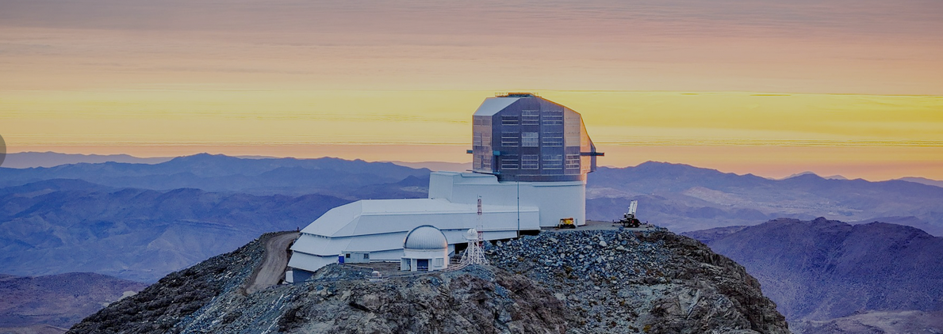
Rubin Observatory’s Simonyi Survey Telescope
Legacy Survey of Space and Time (LSST)
Just began the deepest wide field optical survey ever over next 10 years:
Expected to find transient and variable objects at an unprecedented rate (~10 million variable or transient alerts per night)
Many BRICS countries involved through in-kind contribution, like followup observations (e.g. South Africa)

Slide 12

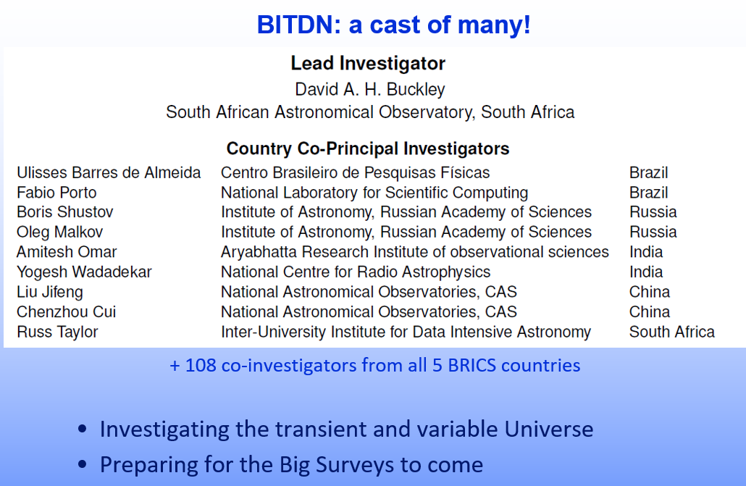
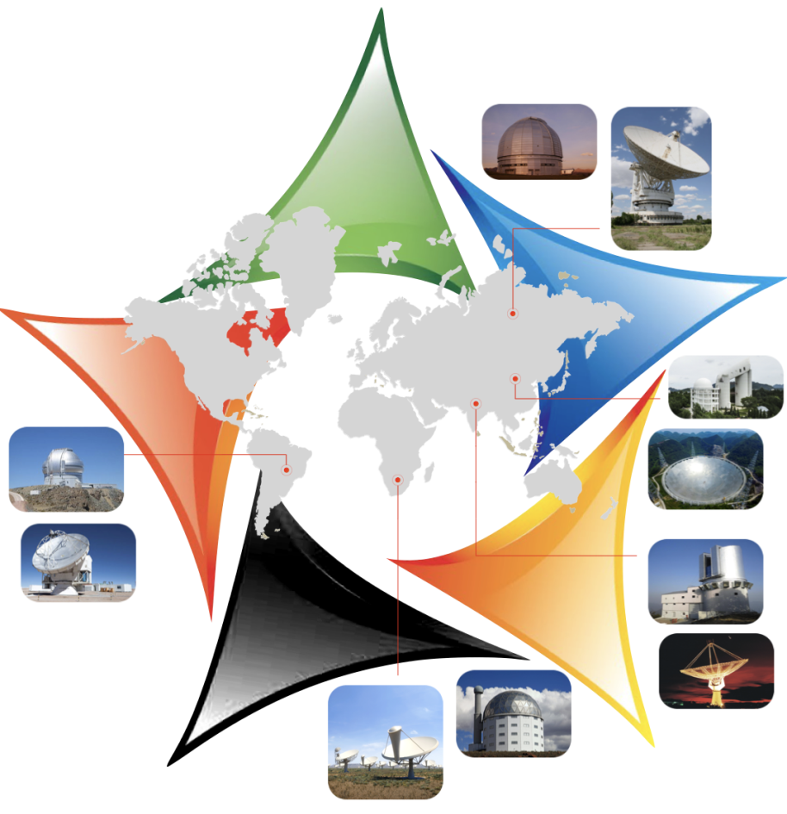
The Future
The BRICS Intelligent Telescope and Data Network Network
(BITDN)
Program approved in 2019
Two-phases:
Network existing facilities into a transient followup system
New build of many transient detection systems (70 x 1-m 25 sq deg FoV telescopes & camera)

Slide 13
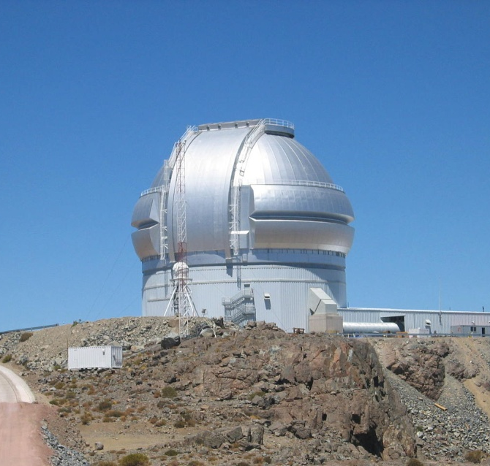
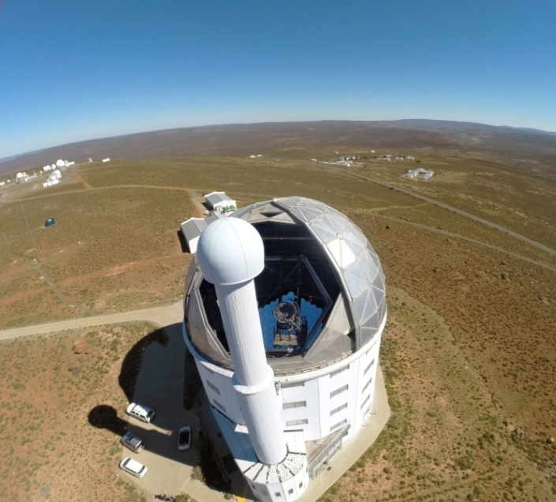
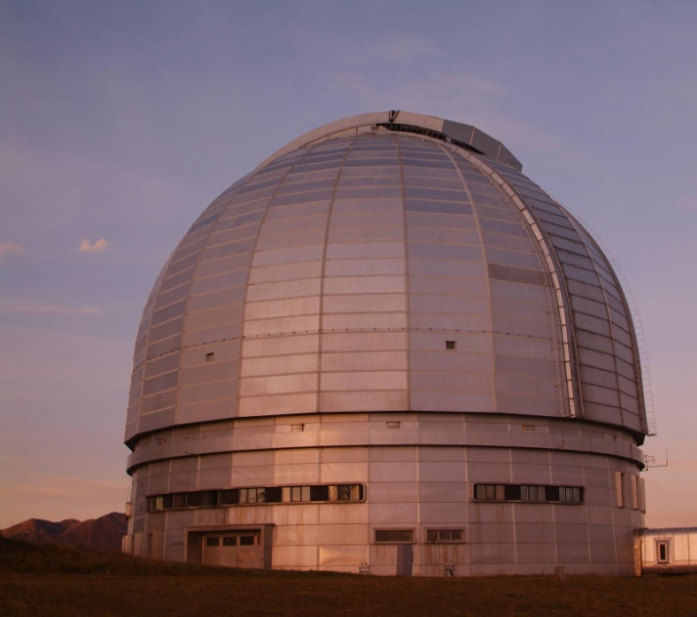
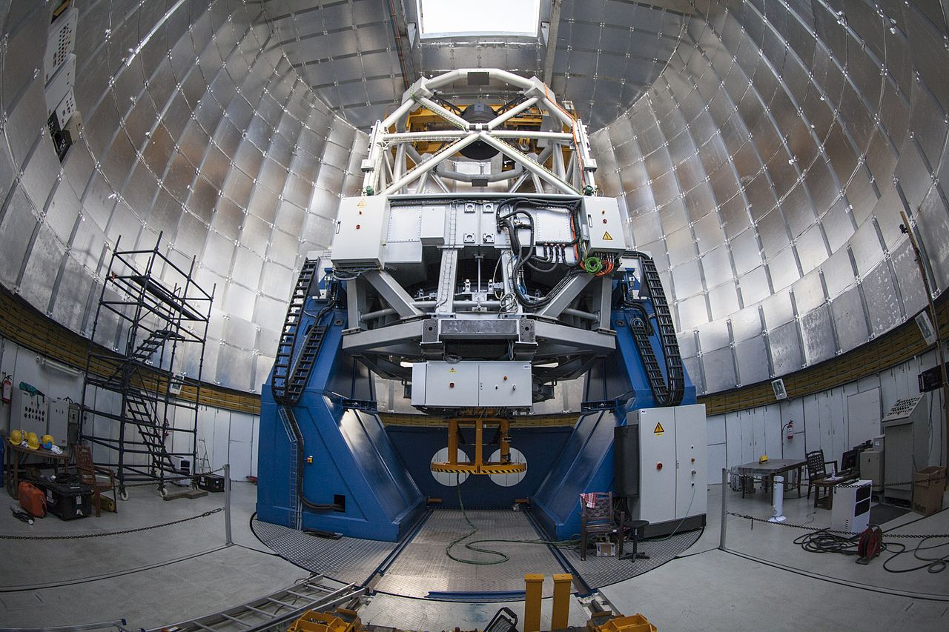
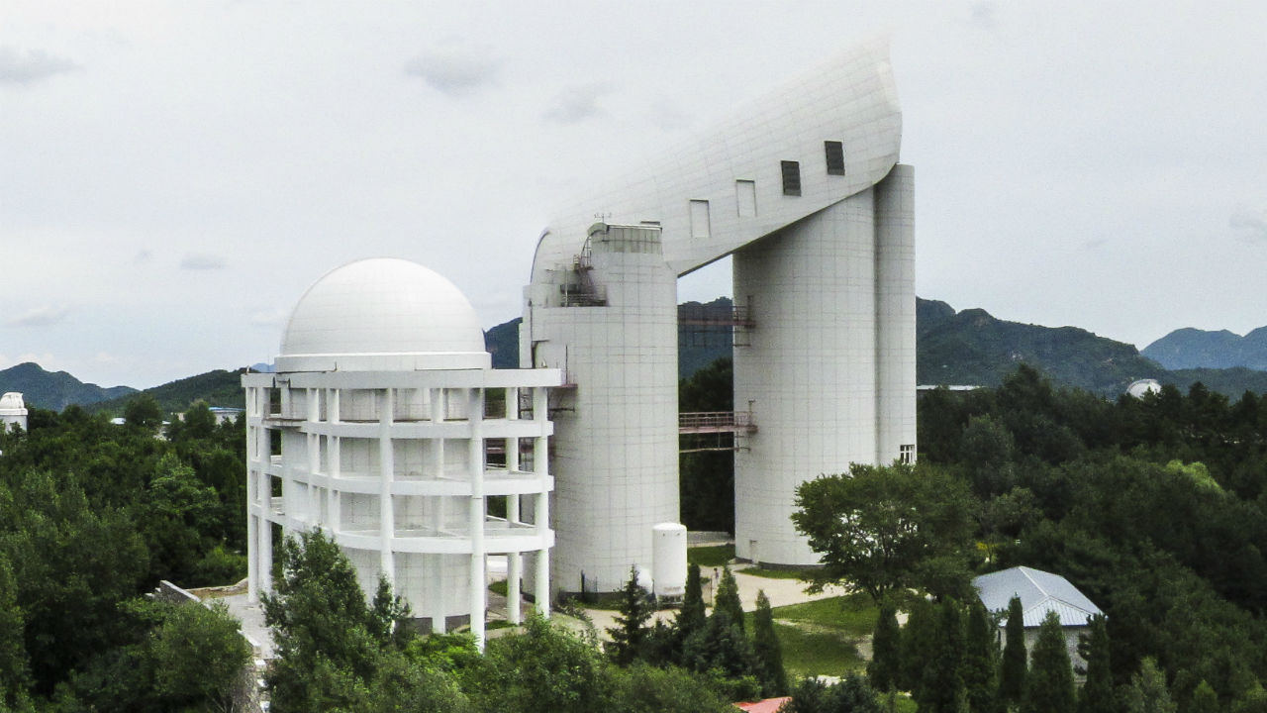
Phase 1: Exploit Existing BRICS Facility Access
Gemini South (Chile)
SALT (South Africa)
6-m BTA (Russia)
3.6m DOT (India)
LAMOST (China)

Slide 14
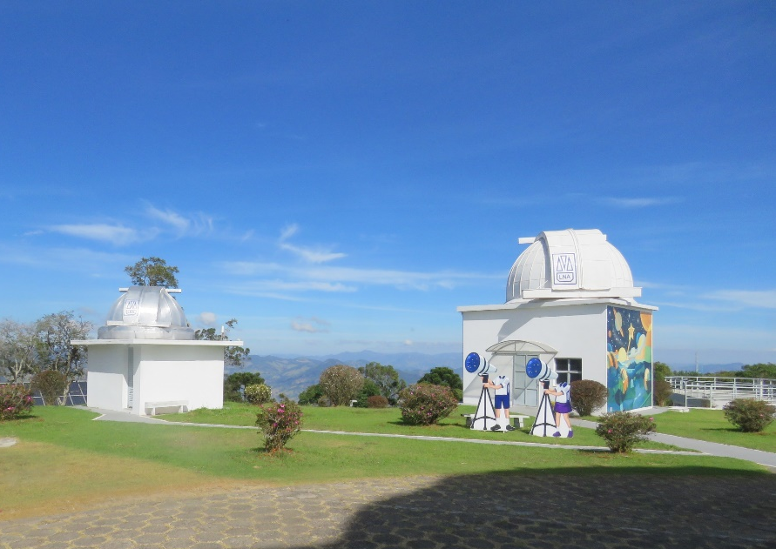
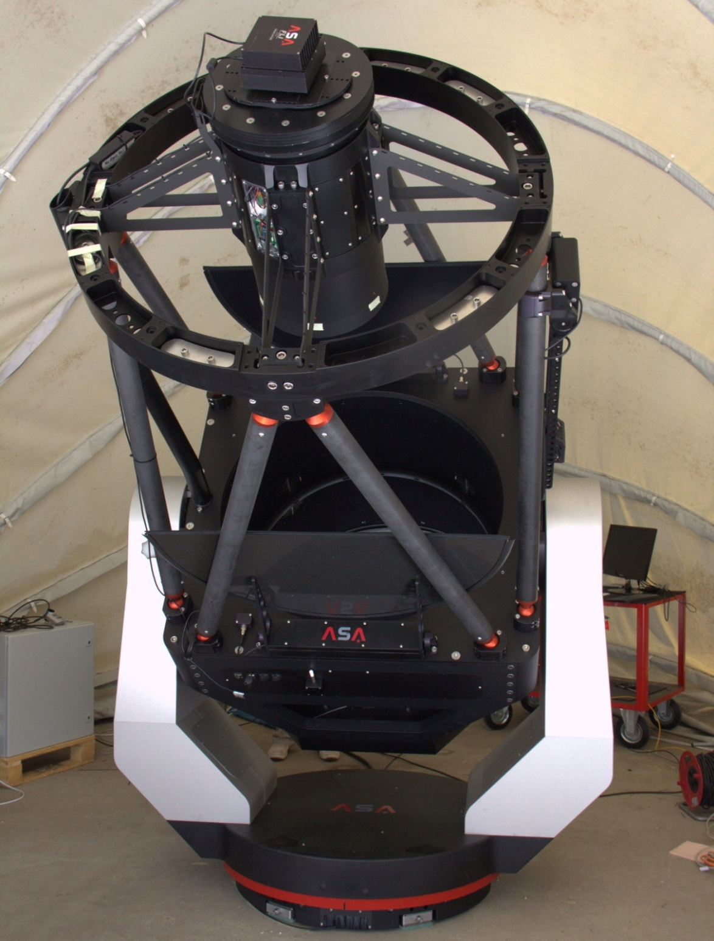
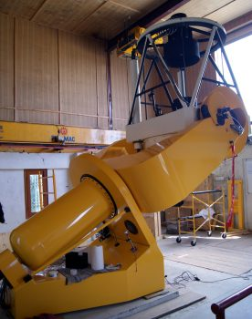
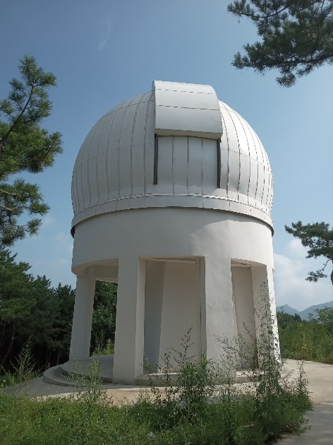
Phase 1: Extend the Intelligent Observatory concept within BRICS utilizing existing 1-m class facilities
Requirements:
agreement to dedicate telescope time for automated observations
software tools to select targets from event brokers
marshals to undertake automated observation scheduling
dedicate resources to collaboratively develop these systems with other groups
  use Las Cumbres Observatory robotic obsefvation tool (TOMs, AEON)
  Develop APIs for autonomous responses
start with 1-m telescopes (some already robotic)
  SAAO already using APIs for TNS, ATLAS, BlackGEM, Einstein Probe alerts on 1-m
MoU between Brazil, China & South Africa to site new networked facilities (0.4-m – 1.0m)
  First step in the GOTTA project for a global high cadence transient detection machine
Russia
Brazil
India
China

Slide 15
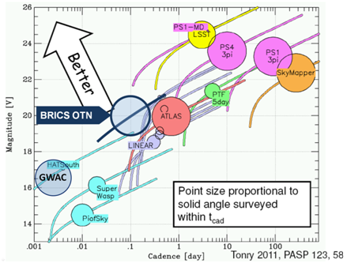
Phase 2: Development of a global network:
Global Open Transient Telescope Array (GOTTA)
Globally distributed network of >120 telescopes in longitude and latitude
All-sky (4π steradians) coverage in 3 filters simultaneously
Cadence of better than 1-h for anywhere on the sky
New discovery space:
GOTTA

Slide 16
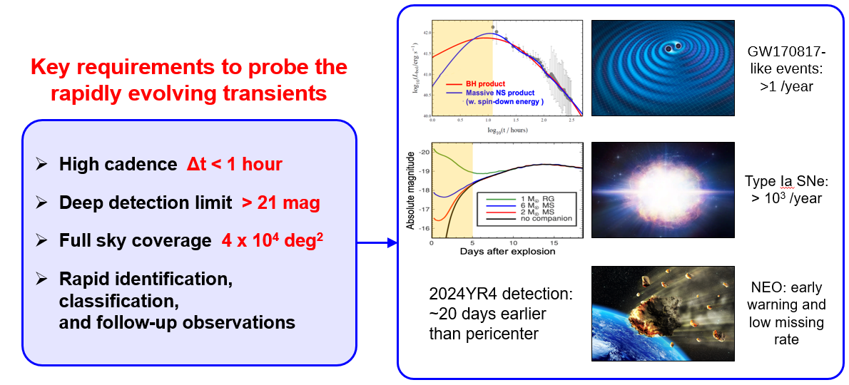
Phase 2: GOTTA
Science Drivers:
Pushing the boundaries of time domain studies of transients to higher cadences (~ hours or better)
All sky (4π steradians) coverage
Serves many classes of known transients
Probes a variety of known phenomena but also has discovery potential of fast transients, as yet undiscovered

Slide 17
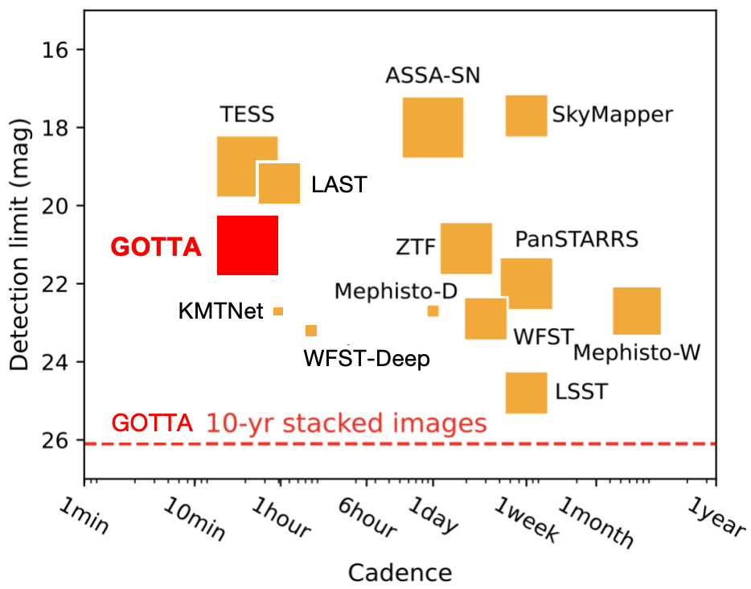
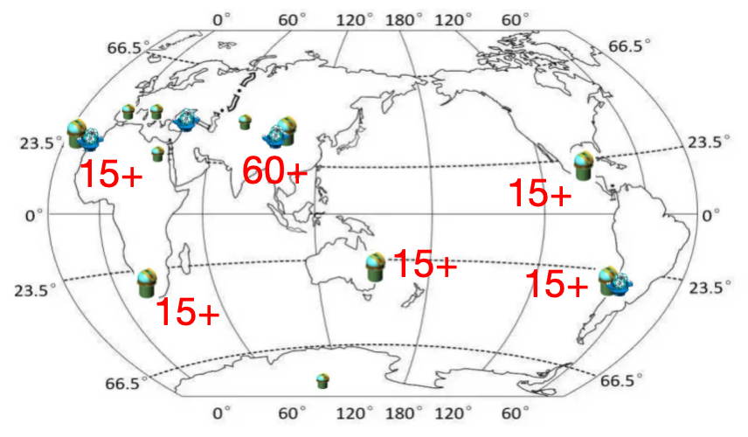
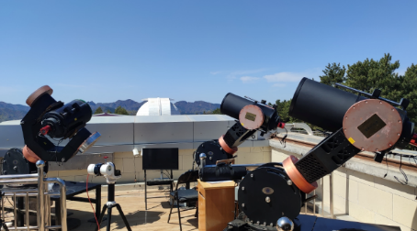
GOTTA
Plan:
Ultimate aim to site 135 x 1-m telescopes at multiple sites over the entire globe, also at new sites (e.g. Sinai, BRICS countries).
Will begin with groups of smaller scale/cheaper telescopes (e.g. 4 x 0.3m on a common mount)
GOTTA Pathfinder

Slide 18
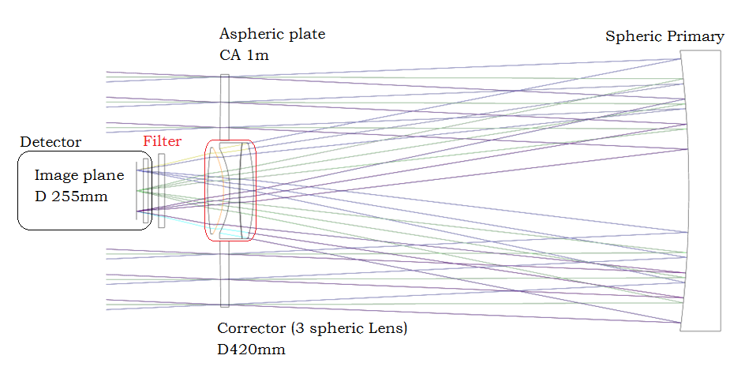
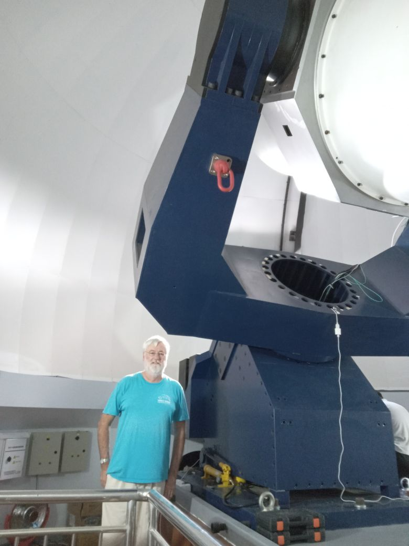
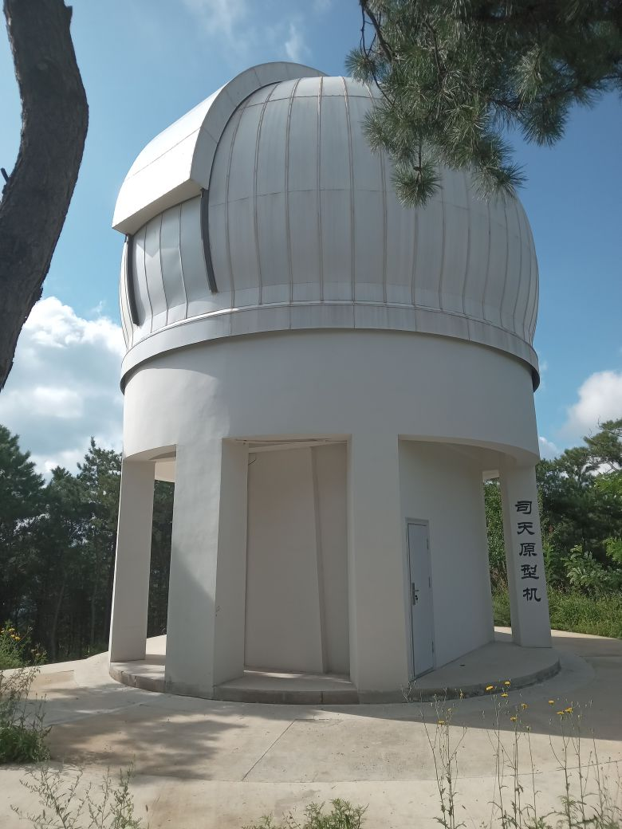
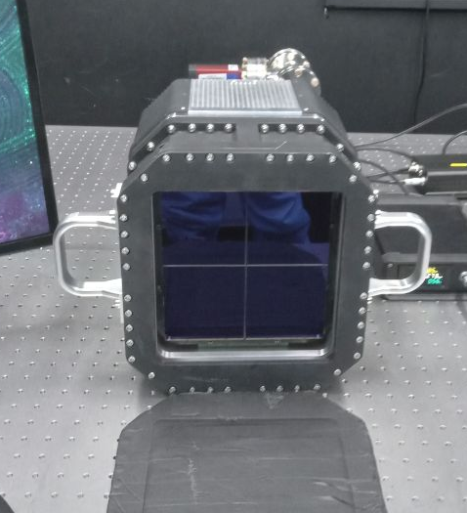
Wide Field 1-m Telescope Prototype
Installed in 2024 at the NAOC Xinglong observing station, China
1-m modified Schmidt design
25 sq degree CMOS camera (four 9k x 9k chips)
Second telescope to be installed at Lenghu (Tibet)
Eventual plan is to site 135 telescopes globally for all sky coverage with a Global Open Transient Telescope Array (GOTTA)

Slide 19
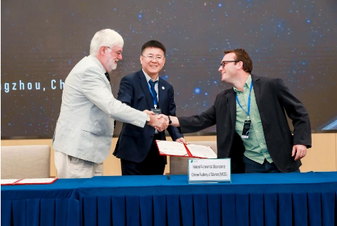
Immediate Plans for Further Telescopes
The second 1-m telescope is currently being completed and will be installed at Lenghu, China, this year
AI-enabled telescopes (0.5 – 0.8 m telescopes to be installed in Brazil (OPD) and South Africa (SAAO) in near future
MoU (Brazil-China-South Africa) for establishing initial network in 3 countries
Ready to plan for the installation of further telescopes (including BRICS +)

Slide 20
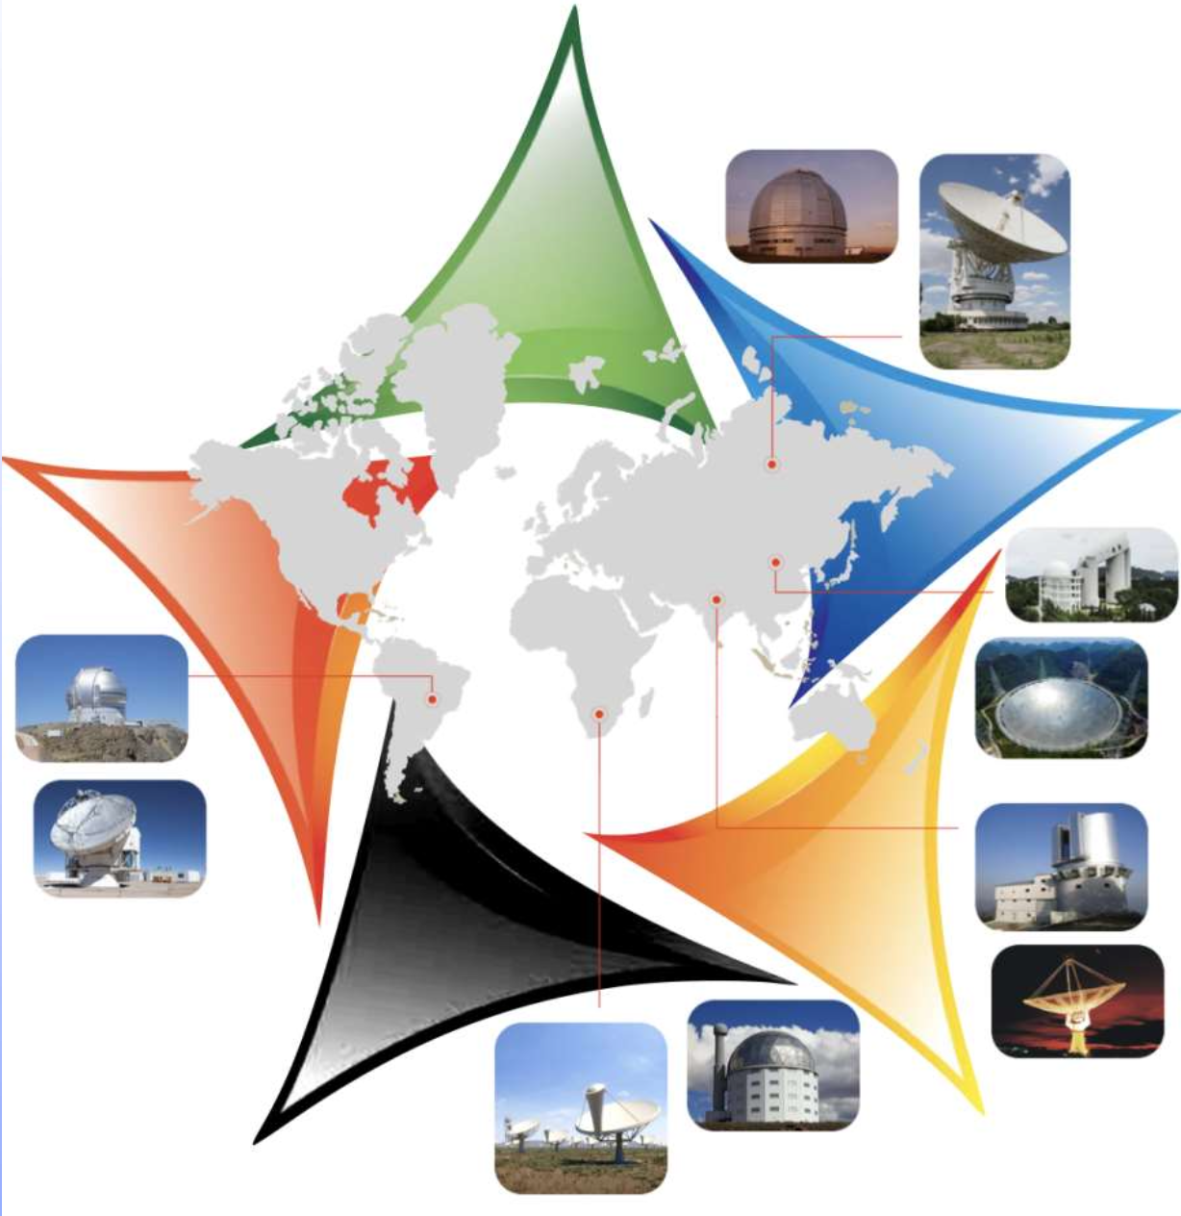
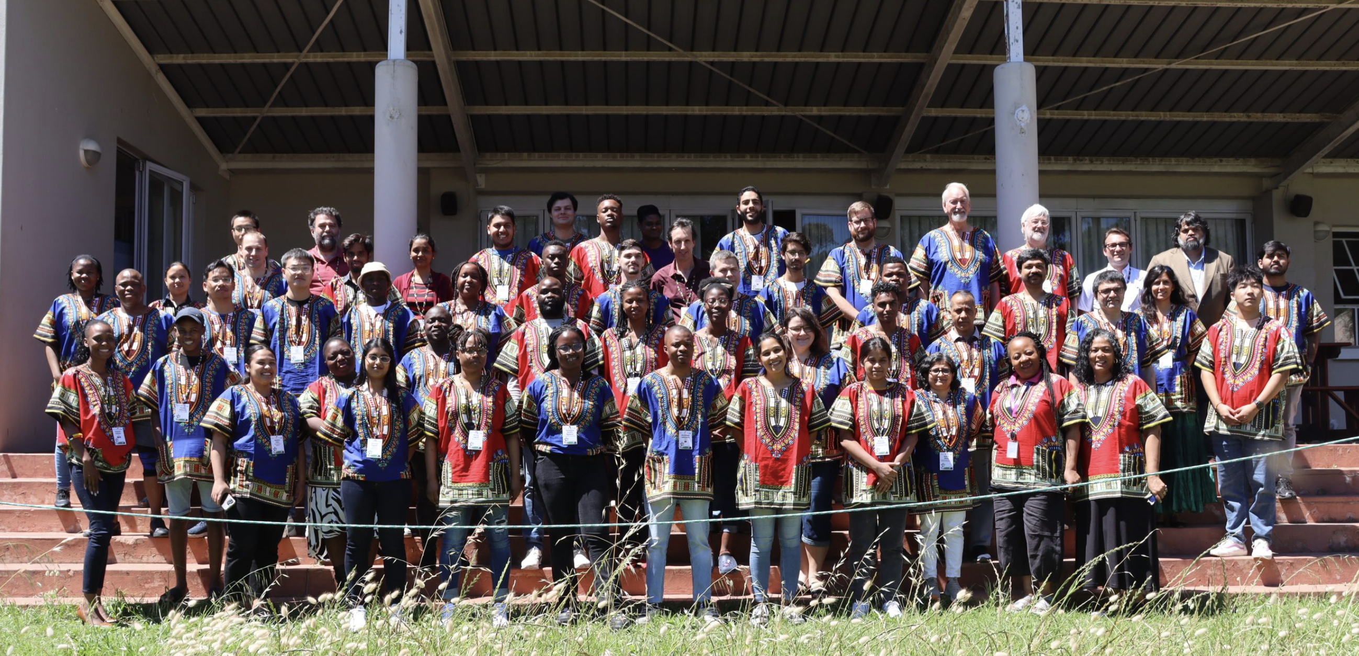

Global networking
BRICS
Intelligent
Telescope
and
Data
Network
The 9th Annual BRICS Astronomy Working Group Meeting @ South Cape Town
BITDN: a global open telescope and data network in the BRICS countries
Transient, Time Domain and Big Survey astronomy (e.g. LSST, SKA)
Original 5 countries now expanded to 10 (Egypt, Ethiopia, Iran, UAE & Indonesia)
New call for BRICS flagship will focus on BITDN
Extend to global project with GOTTA
Build on exiting new discovery potential with international partnerships
Refs: BUCKLEY+21: “Towards a BRICS Optical Transients Network (BRICS-OTN)”
Notes:
We are also making progress in the global networking. Within the BRICS countries, the astronomy working group is now promoting the BITDN project: the BRICS intelligent telescope and data network, which plans to build a global 1-m telescope network in the BRICS countries. This project involves more than 100 investigators from all former-5 BRICS countries, Brazil, Russia, India, China and South Africa. At this conference, Prof. David Buckley will give a talk on BITDN. At this conference, Brazil, South Africa and China are going to sign a letter of intent to place a telescope in each country.
Beyond this, we need even more international collaborators.

Slide 21
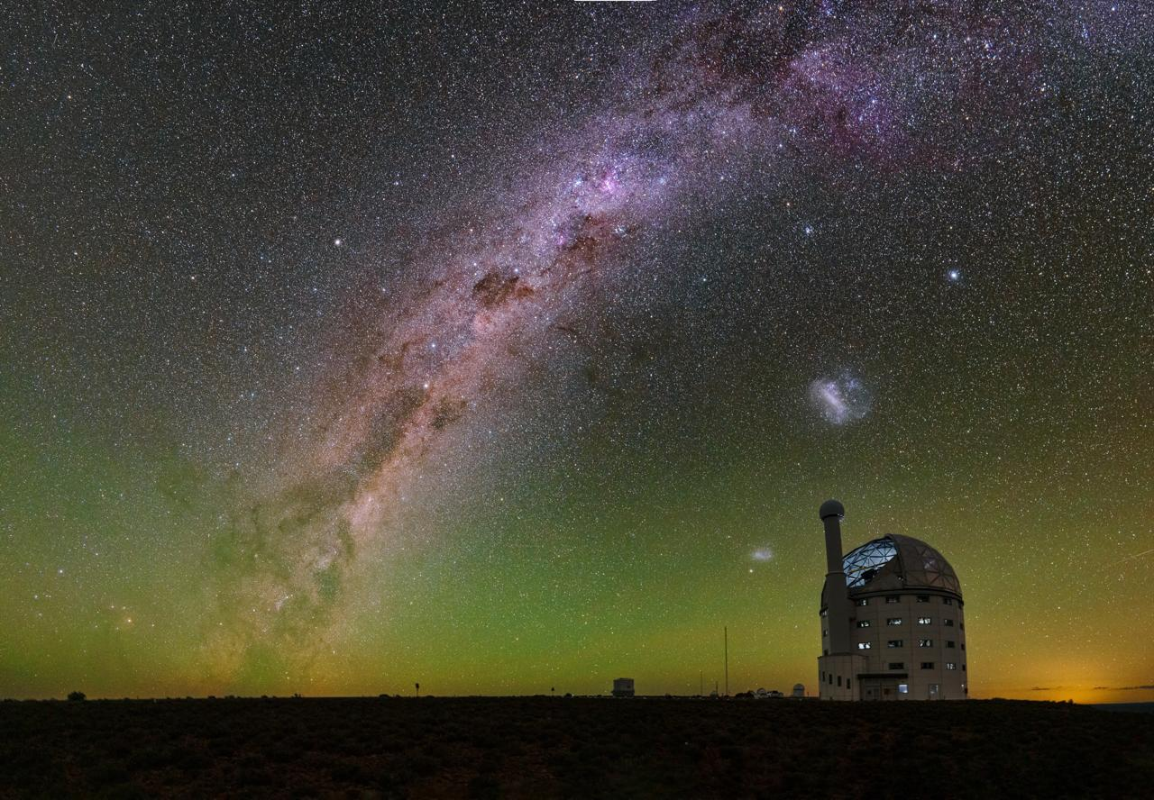
The End

