Slide 1


KOSMULATOR IDE:
MCMC Module for
Interacting Dark Energ
SAIP2026
MARCEL VAN DER WESTHUIZEN, RENIER HOUGH
SUPERVISOR: PROF AMARE ABEBE

Slide 2
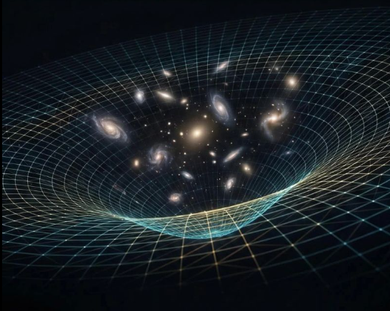
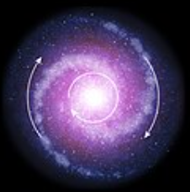



Wait a minute…
Is dark matter even real? (Like yeti?)
Is dark energy even a thing? (Like big foot?)
Interactions between dark matter and dark energy =
love between yeti and bigfoot?
Maybe…
lets look at the argument

Slide 3







1. FIVE REASONS FOR DARK INTERACTIONS BEYOND $Λ$CDM
$$r$$
$$H_{0}$$
$$S_{8}$$
$$Λ$$
$$w_{a}$$

Slide 4




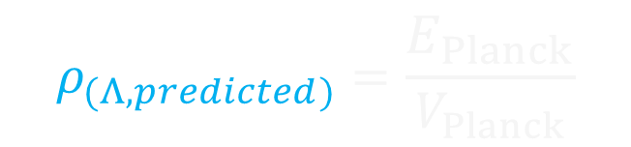
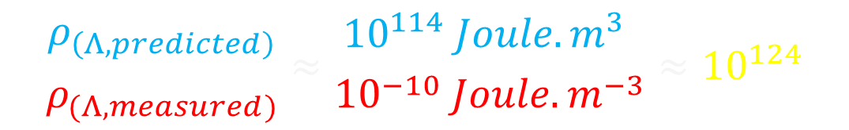
1. COSMOLOGICAL CONSTANT PROBLEM
Cosmological constant predicted from QM as energy of empty space
$E≠0 → ΔE=0$(Violates Heisenberg’s uncertainty principle)
$$ρ_{(Λ,predicted)}=\frac{E_{Planck}}{V_{Planck}}$$
$$≈{10}^{114} Joule.m^{−3}$$
$$l_{planck}$$
$$Λ$$
$$ρ_{(Λ,measured)}={10}^{−10} Joule.m^{−3}$$
Comparing the two values gives the worst prediction in all of physics…
$$\frac{ρ_{\left(Λ,predicted\right)}}{ρ_{(Λ,measured)}}≈\frac{{10}^{114} Joule.m^{3} }{{10}^{−10} Joule.m^{−3}}≈{10}^{124}$$
Motivates research for dark energy beyond the cosmological constant.

Slide 5







2. COINCIDENCE PROBLEM
Consider expanding volume with dark energy and dark matter
$$r_{Distant Future}=\frac{ρ_{(dm,Future)}}{ρ_{(de,Future)}}≈0$$
$$r_{Planck}=\frac{ρ_{(dm,Planck)}}{ρ_{(de,Planck)}}≈{10}^{95}$$
$$Λ$$
$$Λ$$
$$Λ$$
$$Λ$$
$$Λ$$
$$r_{ΛCDM}=\frac{ρ_{dm}}{ρ_{Λ}}=\frac{2}{1}=2$$
$$r_{ΛCDM}=\frac{ρ_{dm}}{ρ_{Λ}}=\frac{2}{4}=0.25$$
DM dilutes fast, $ρ_{dm}∝a^{−3}$ and DE remains constant $ρ_{Λ}=constant$
Why are we alive when the density is approximately equal? $(r_{0}≈0.4$)

Slide 6




2. COINCIDENCE PROBLEM
Analogy: Imagine you fly past an island.
half the people are busy drinking away all their money,
other half have buried their money safely.
$$ρ_{dm}$$
$$ρ_{Λ}$$
You hear this has always been the case for the last 1 000 generations.
You happen to fly past at a time when both groups have the same amount of money.
Is this a coincidence?
Theft?
Taxes?

Slide 7















DARK INTERACTIONS: THE BASIC IDEA
What happens if dark matter and dark energy decay into each other?
DE $→$ DM
DM $→$ DE
(Taxing the rich)
(Taxing the poor)
$$Λ$$
$$Λ$$
$$Λ$$
$$Λ$$
$$Λ$$
$$Λ$$
$$Λ$$
$$Λ$$
$$Λ$$
$$r_{ΛCDM}=\frac{ρ_{dm}}{ρ_{Λ}}=\frac{2}{1}=2$$
$$r_{ΛCDM}=\frac{ρ_{dm}}{ρ_{Λ}}=\frac{4}{2}=2$$
$$r_{ΛCDM}=\frac{ρ_{dm}}{ρ_{Λ}}=\frac{2}{1}=2$$
$$r_{ΛCDM}=\frac{ρ_{dm}}{ρ_{Λ}}=\frac{1}{5}=0.2$$
If DE decays into DM (iDEDM regime) we alleviate Coincidence Problem
If DM decays into DE (iDMDE regime) we worsen Coincidence Problem

Slide 8
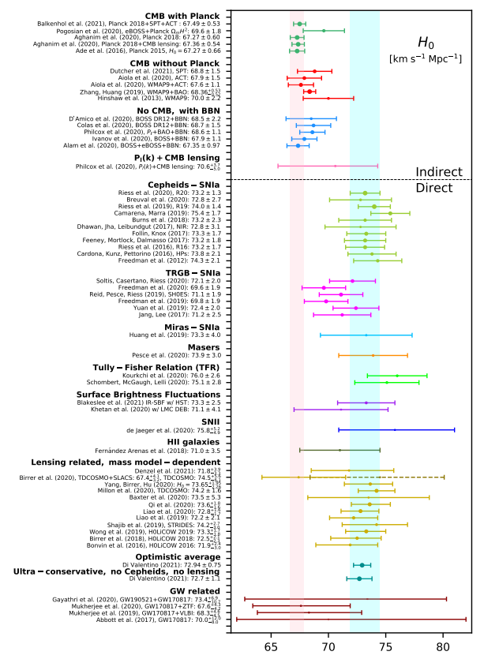
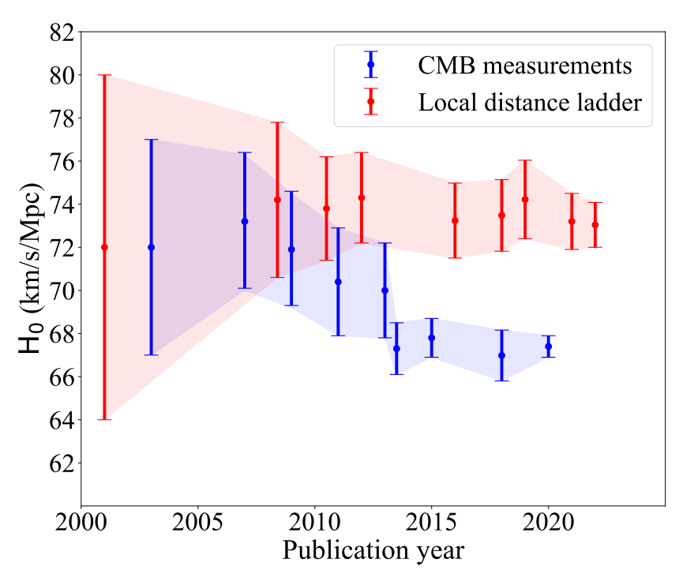
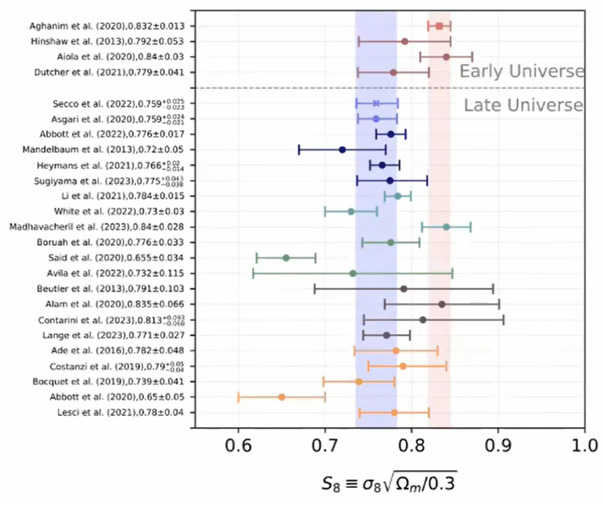


3. & 4. THE $H_{0}$ and $S_{8}$ TENSION
Early (CMB) and late time (SN, LSS) measurements of the expansion $H_{0}$ and clustering $S_{8}$ rates differ by $3−5 σ$, depending on the source

Slide 9
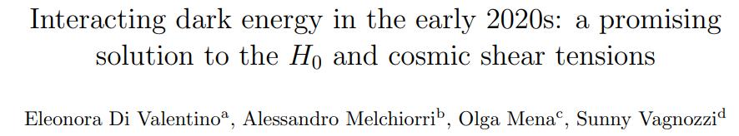
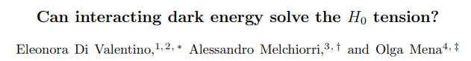
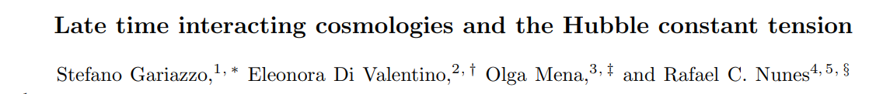
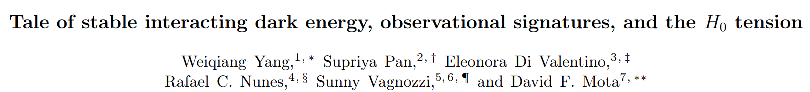
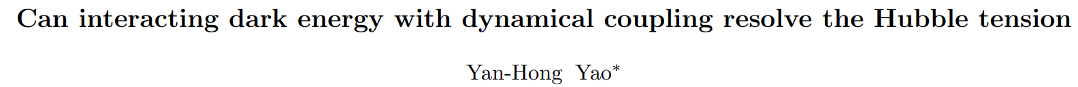

$H_{0}$ and $S_{8}$ TENSION = INTERACTION?
IDE models introduce new physics to address either one or both of these issues. For example

Slide 10
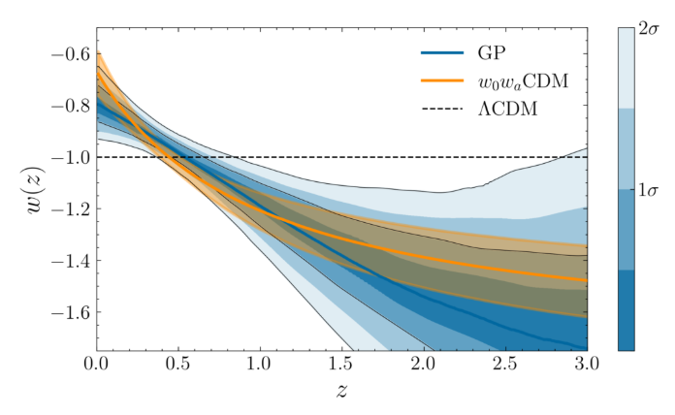
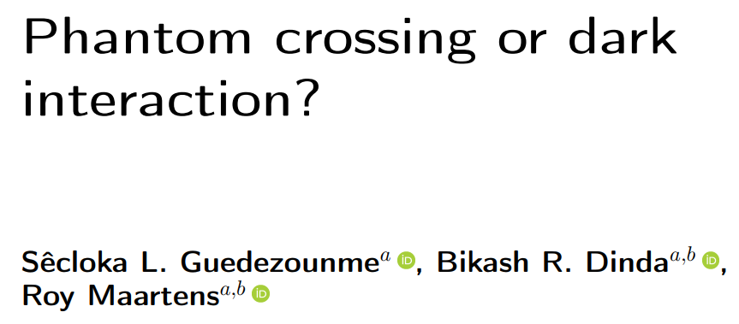
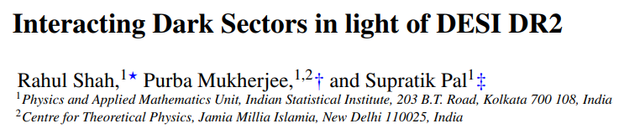
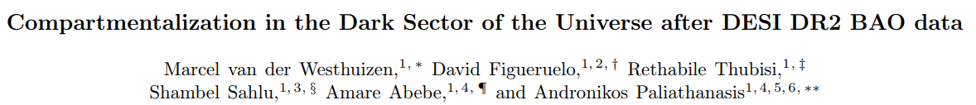



5. COSMOLOGICAL (NOT SO) CONSTANT
2025: DESI collaboration released data on Baryonic acoustic oscillations prefers dynamical dark energy
($2.8−4.2σ$)
Dark energy increasing in distant past, decreasing at present?
IDE models provide a mechanism?
$$DE↓$$
$$DE↑$$

Slide 11
INTERACTIONS SOLVE ALL PROBLEMS?
42
NO, OF COURSE NOT…

Slide 12
3. NEGATIVE ENERGIES AND ITS CONSEQUENCES

Slide 13



CONSERVING THE DARK SECTOR
In interacting dark energy models, the total dark sector is conserved. Energy lost $Q$ by DM is gained by DE, and vice versa.
$\dot{ρ_{dm}}+3Hρ_{dm}=Q$ ;
$$\dot{ρ_{de}}+3Hρ_{de}\left(1+ω_{de}\right)=−Q$$
$Q$ must have units: energy per volume per second
$$Ansatz:Q∝δ H ρ_{dm/de}$$
$>0$ Dark Energy $→$ Dark Matter (iDEDM regime)
$$Q$$
$<0$ Dark Matter $→$ Dark Energy (iDMDE regime)

Slide 14
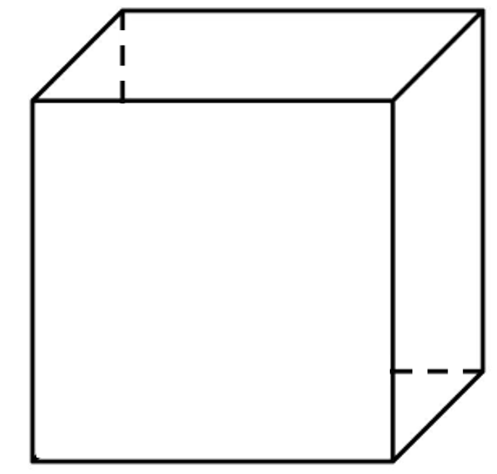


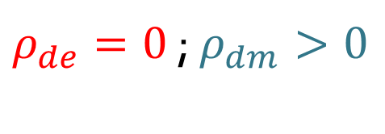

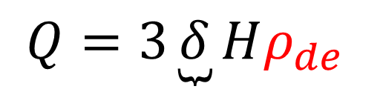



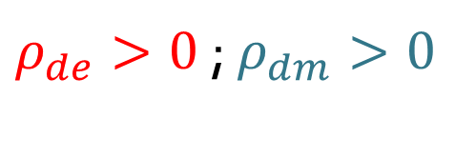





ENERGY TRANSFER BRAKING MECHANISM
Consider a volume element for a model where Q is proportional to DE:
$$Present$$
$$Universe expands (H>0)$$
$$Future$$
$ρ_{de}>0$ ; $ρ_{dm}>0$
$ρ_{de}=0$ ; $ρ_{dm}>0$
$ρ_{de}=0$ ; $ρ_{dm}>0$
$Q>0 (DE→DM)$
$Q=0 (no transfer)$
$Q=0 (no transfer)$
$Q=3\underbrace{δ}Hρ_{de }$
$$=volume element$$
$${=ρ}_{de}$$
$${=ρ}_{dm}$$
$$>0 (iDEDM)$$
Since there is a braking mechanism, DE never becomes negative!

Slide 15














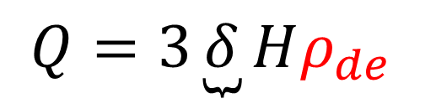
NO TRANSFER BRAKING MECHANISM
Consider a volume element for a model where Q is proportional to DE:
$$Present$$
$$Universe expands (H>0)$$
$$Future$$
$ρ_{de}>0$ ; $ρ_{dm}>0$
$ρ_{de}>0$ ; $ρ_{dm}=0$
$ρ_{de}>0$ ; $ρ_{dm}<0$
$Q<0 (DM→DE)$
$Q<0 (DM→DE)$
$Q<0 (DM→DE)$
$Q=3\underbrace{δ}Hρ_{de }$
$${=+ρ}_{de}$$
$${=+ρ}_{dm}$$
$$=volume element$$
$$<0 (iDMDE)$$
$${=−ρ}_{dm}$$
Since there is no braking mechanism, DM becomes negative!

Slide 16
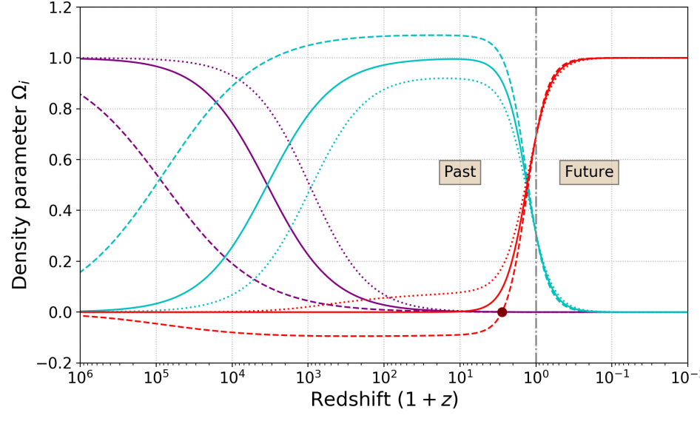
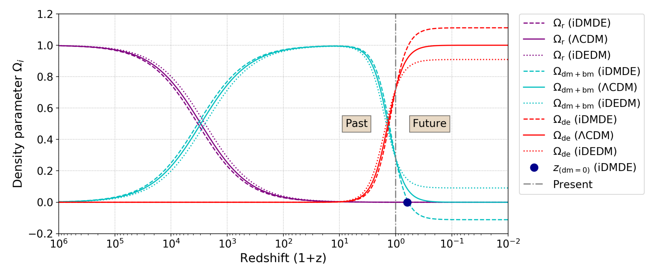
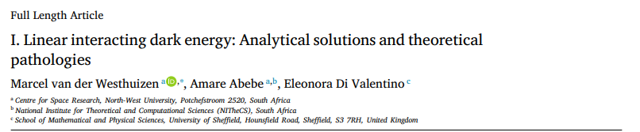
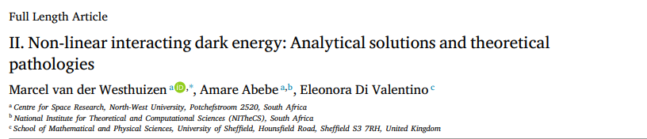
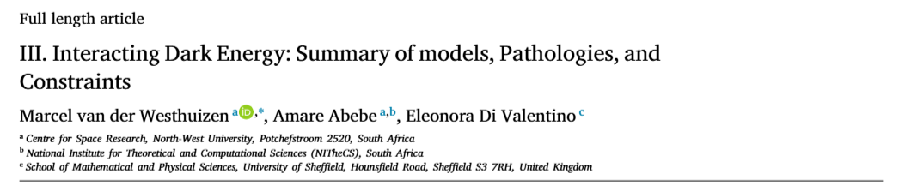

3 PATHOLOGIES IN PARAMETER SPACE
1. We predict negative DE densities in the past, and negative DM densities in the future if $δ<0 (DM→DE)$
DE<0 in past
DM<0 in future

Slide 17
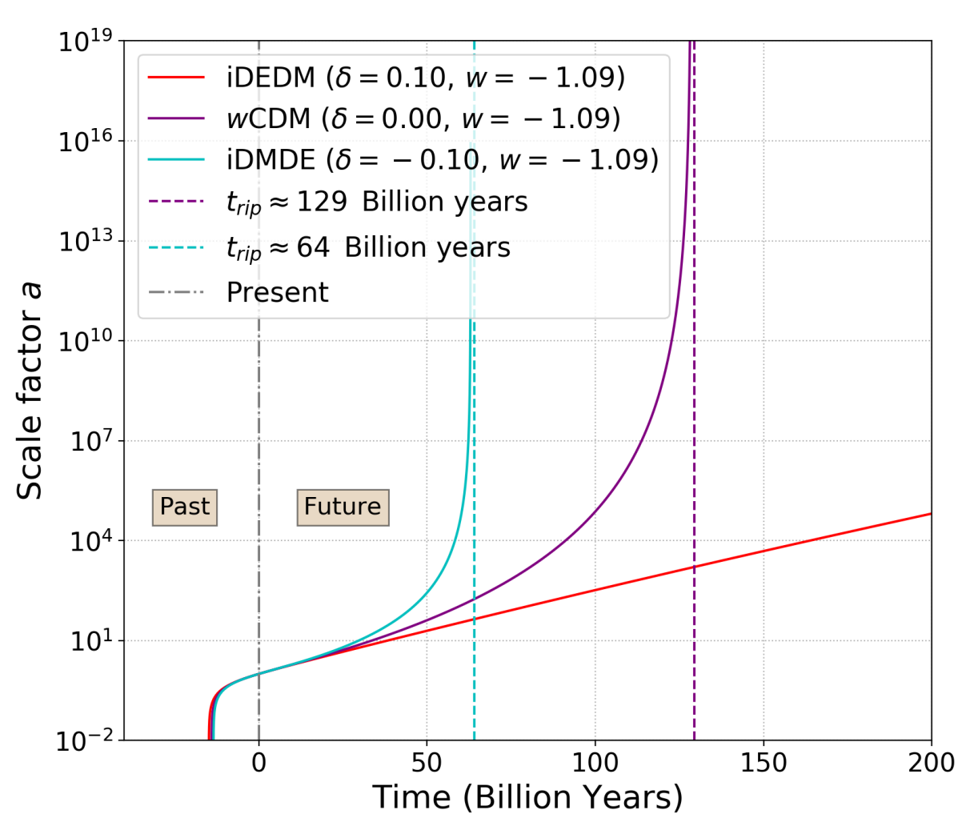
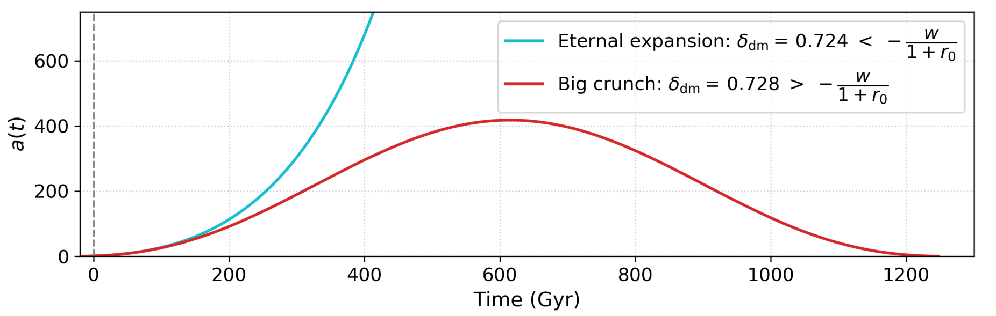
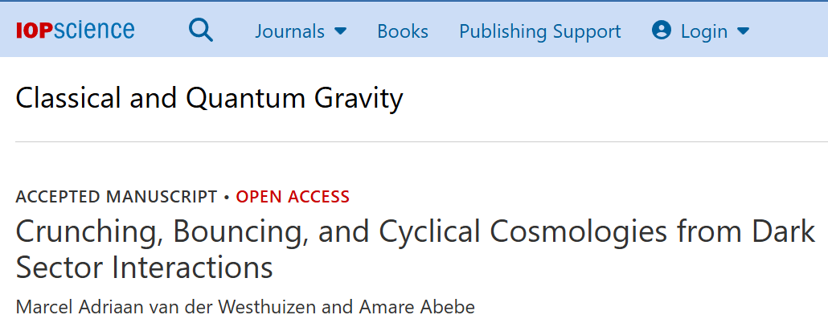
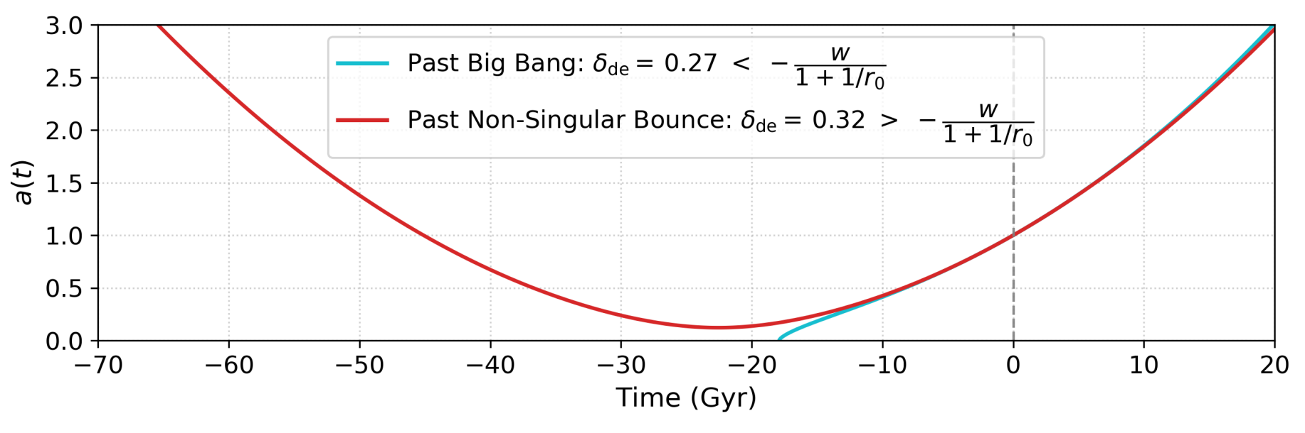
3 PATHOLOGIES IN PARAMETER SPACE
Negative energies can lead to big rip singularities, and even a big crunch or big bounce
(singularities considered unphysical by some)

Slide 18

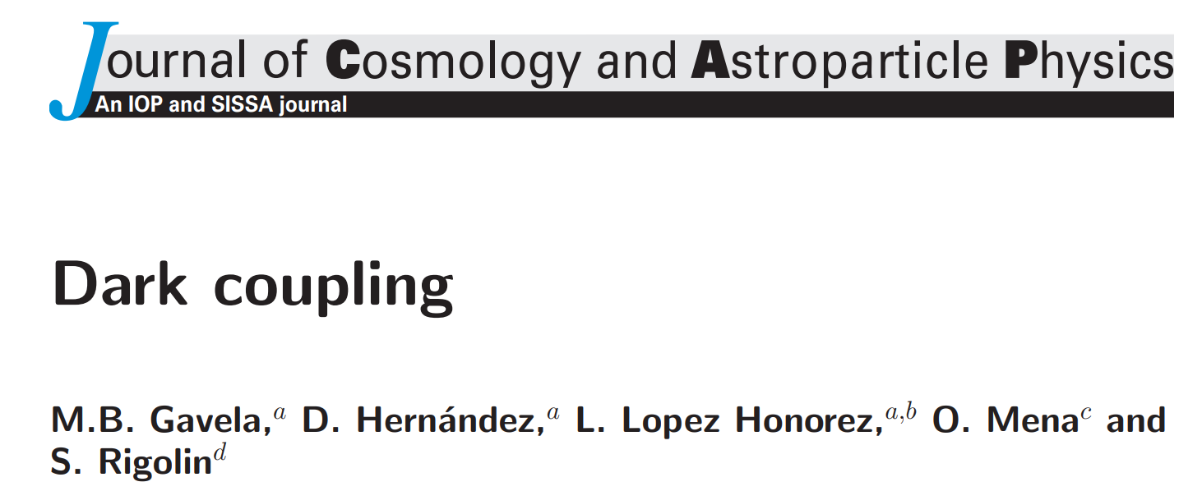




3 PATHOLOGIES IN PARAMETER SPACE
3. Perturbation cause early-time runaway instabilities, stopping present universe from forming
Use Doom factor $d$ analysis [Gavela, 2009]
$$d=\frac{Q}{3Hρ_{de}(1+w)}$$
$d>1 →$Unstable regime
if
$d<0 →$ apriori free of instabilities
Two safe regimes:
$Q>0$ (DE $→$ DM) with $w<−1$ (Phantom DE)
$Q<0$ (DM $→$ DE) with $w>−1$ (Quintessence DE)

Slide 19
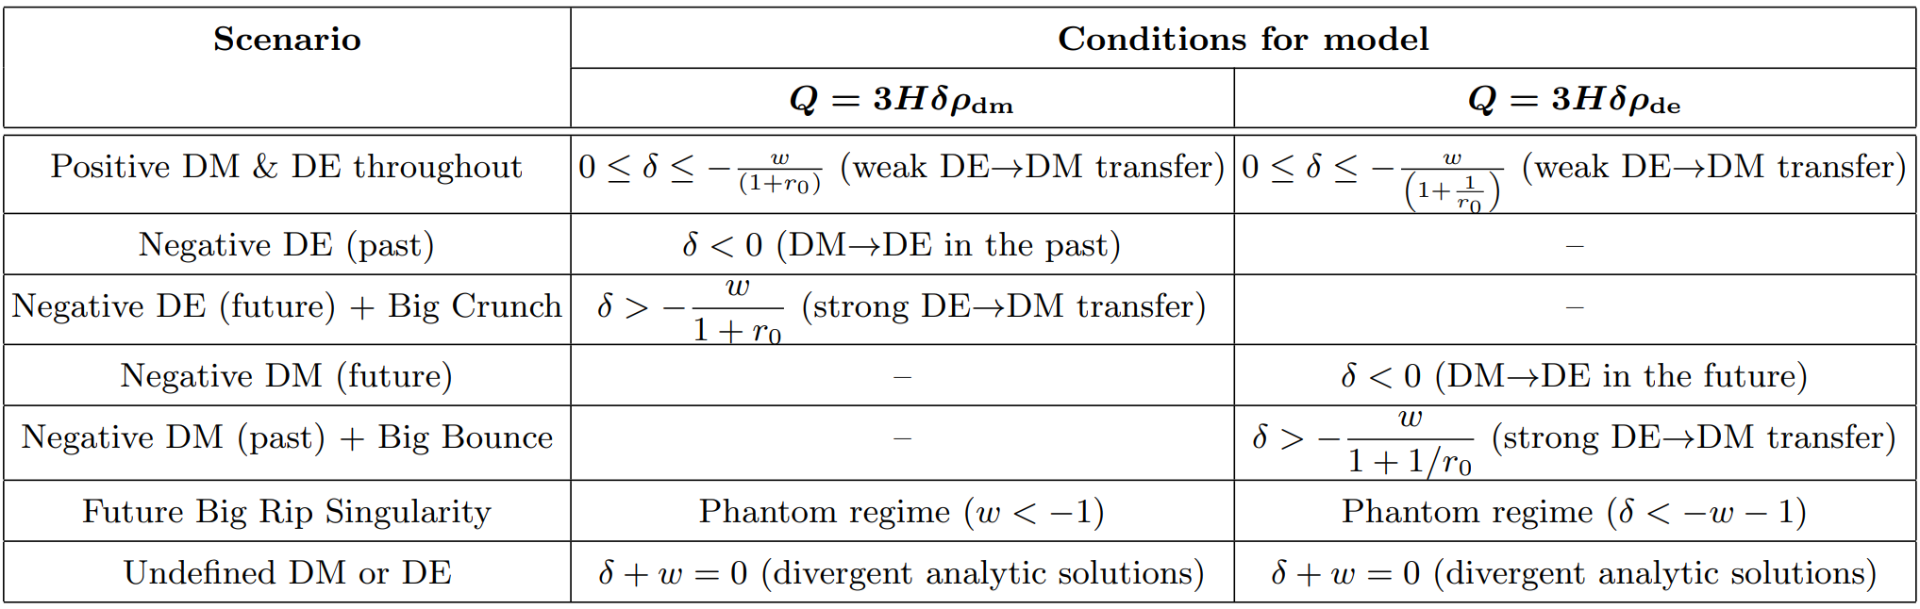
COMPLICATED PARAMETER SPACE
Mathematical conditions have been arrived for 8 models
Theoretical preference for small energy flow from DE to DM

Slide 20

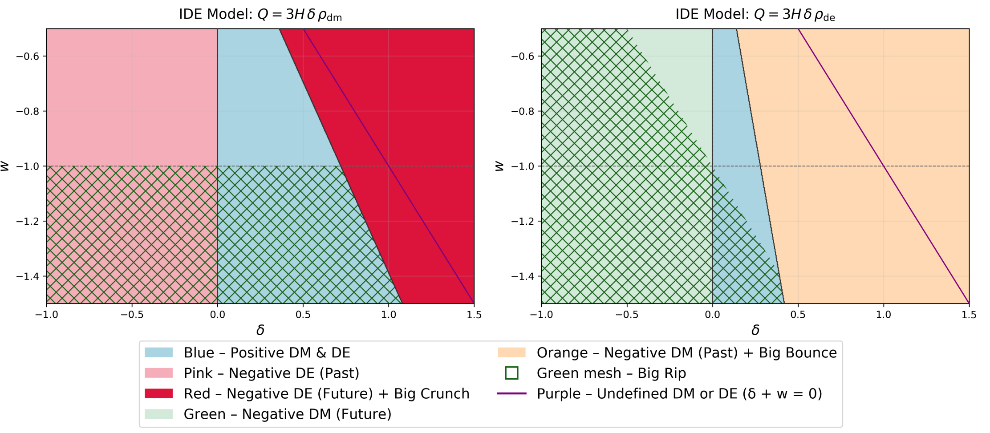
COMPLICATED PARAMETER SPACE
Mathematical conditions have been arrived for 8 models
Theoretical preference for small energy flow from DE to DM

Slide 21
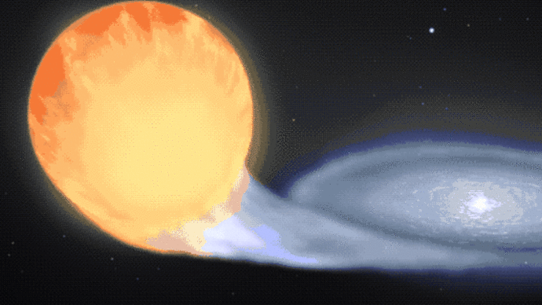
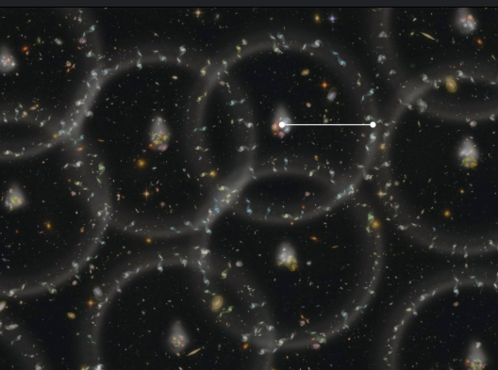
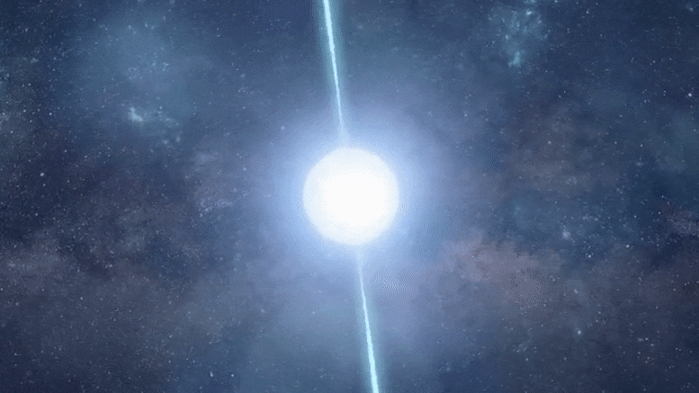
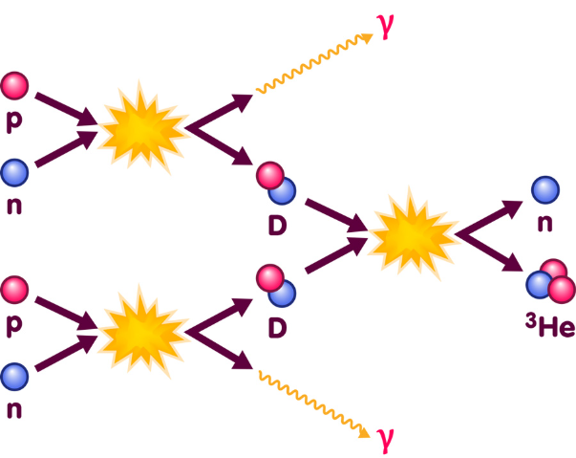
OBSERVATIONAL DATA TO FIND OUT!

Slide 22
5. MCMC AND OBSERVATIONAL CONSTRAINTS

Slide 23
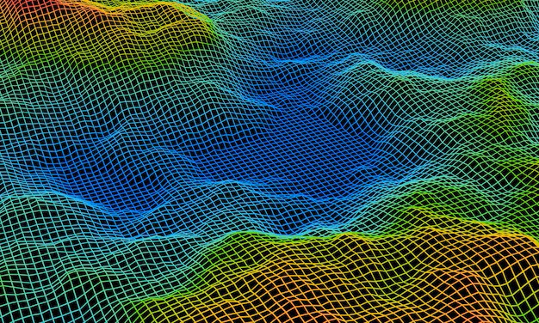


RANDOM WALKERS AND BEST PARAMETERS
n-dimensional parameter space seen as a physical landscape
MCMC lets random walker look for best parameter combo for $H(z)$
Analogy
Caveman looking for a new home, parameters considered:
Temperature, shading, water, etc.
Coordinates=
Different parameter combos
Random Walker = Caveman
Parameter Space = Mountainous Landscape

Slide 24

RANDOM WALKERS AND BEST PARAMETERS
n-dimensional parameter space seen as a physical landscape
MCMC lets random walker look for best parameter combo for $H(z)$
This combo is the best fit to the data for a specific model
Analogy
Caveman looking for a new home, parameters considered:
Temperature, shading, water, etc.
Coordinates=
Different parameter combos
Random Walker = Caveman
Parameter Space = Mountainous Landscape

Slide 25


RANDOM WALKERS AND BEST PARAMETERS
n-dimensional parameter space seen as a physical landscape
MCMC lets random walker look for best parameter combo for $H(z)$
This combo is the best fit to the data for a specific model
Walkers converge = caveman build house!
Analogy
Caveman looking for a new home, parameters considered:
Temperature, shading, water, etc.
Coordinates=
Different parameter combos
Random Walker = Caveman
Parameter Space = Mountainous Landscape

Slide 26

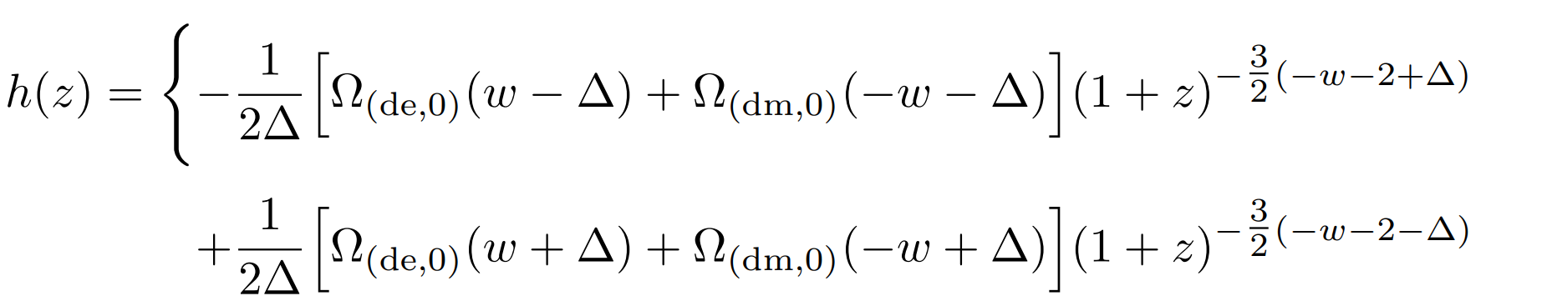


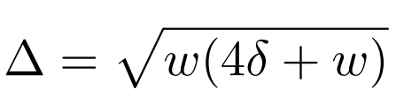


MCMC CRASHES = INFINITIES/IMAGINARY
In reality, parameter combos often crash MCMC!
Divisions by zero can lead to NaN
Negative values in square roots can lead to imaginary values
Edit code to avoid these:

Slide 27
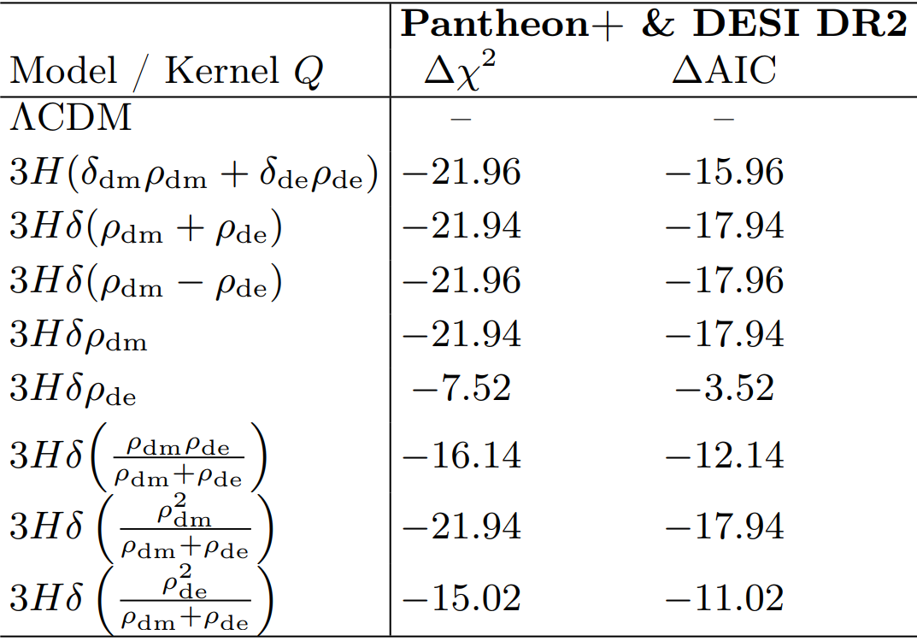
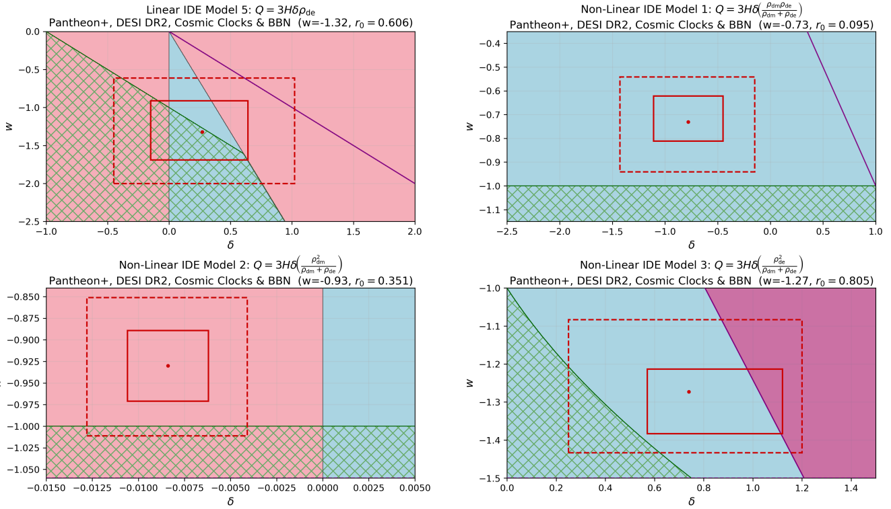
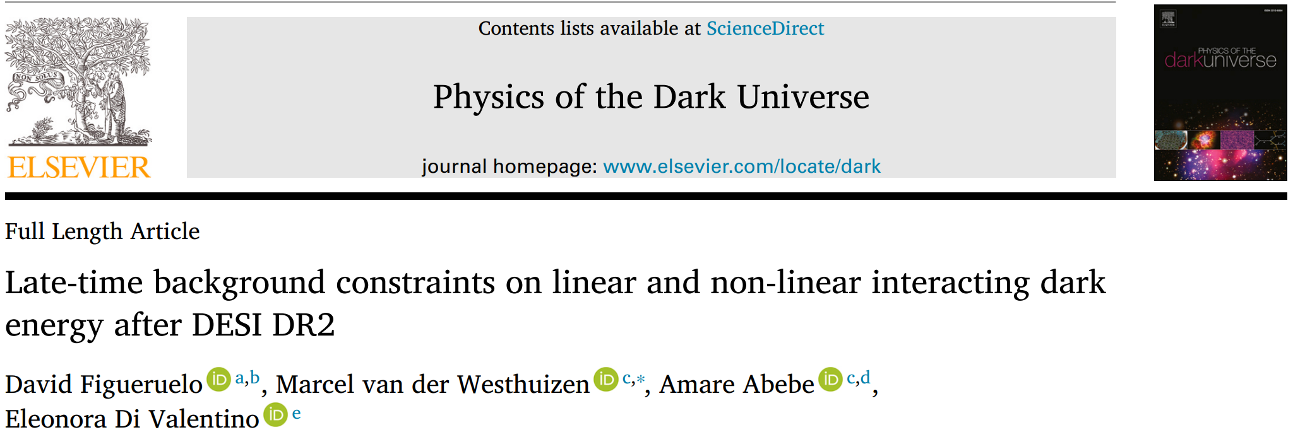
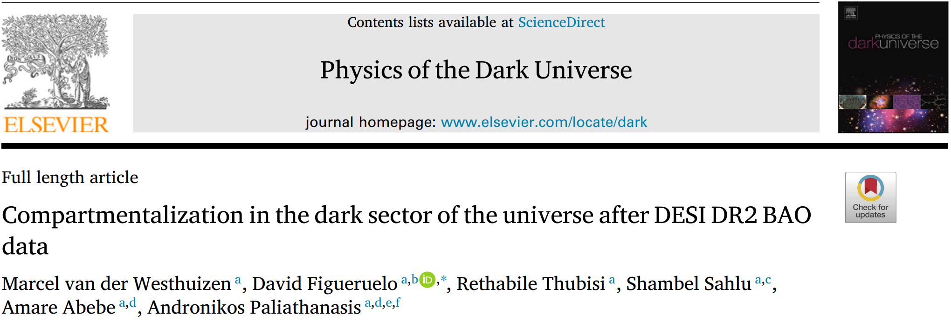
IDE PARAMETER SPACE
IDE models showed improved fit,
but in problematic regions.
Be careful about the cost of new problems to solve old problems

Slide 28

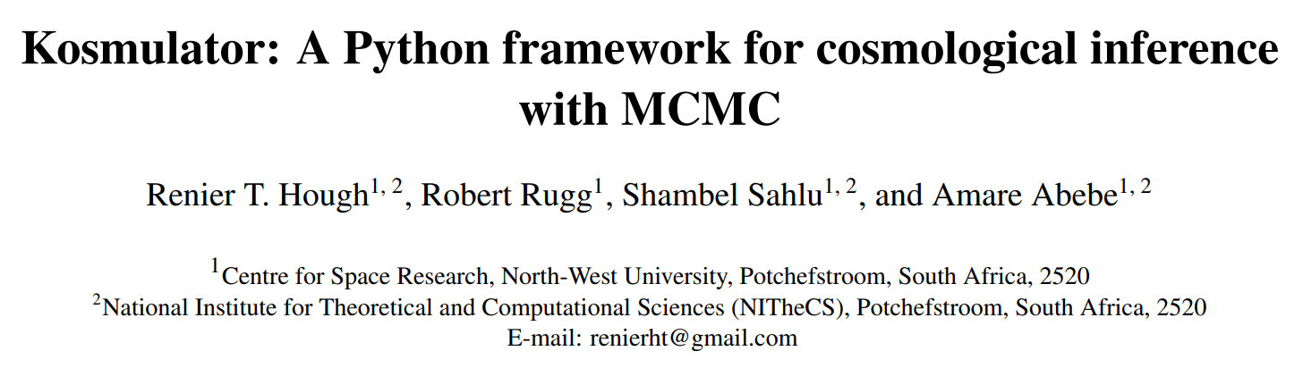
5. KOSMULATOR:
AN EASY MCMC TOOL

Slide 29


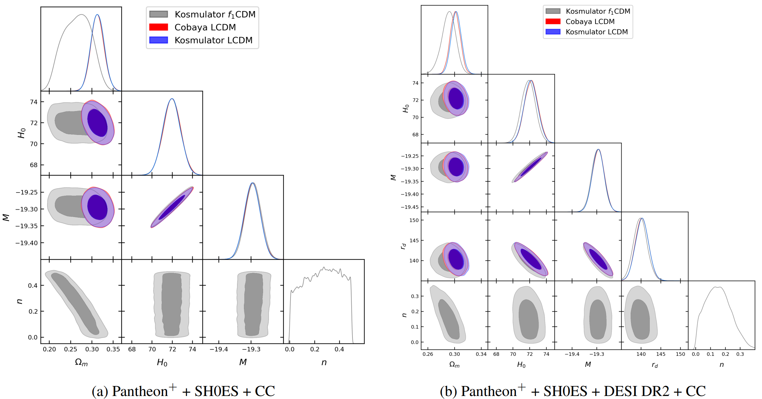

KOSMULATOR = FAST AND EASY TO USE
Easy to install and edit, works for non-analytical H(z)
Can reproduce posteriors from industry standard like Cobaya
Modular and vectorized = Speeds up computational time (4.5x Cobaya)
“Fail-Fast” Philosophy (Don’t let your illiterate son study medicine…):
Identify degeneracies, qualitative behavior and best models from a group
Save time, only do industry standard analysis in Cobaya for best models

Slide 30


KOSMULATOR FOR INTERACTING DE
Kosmulator branch ready to download right now (Ts & Cs apply)

Slide 31


KOSMULATOR FOR INTERACTING DE
Kosmulator branch ready to download right now
This includes safe analytical H(z) for 8 Interaction Dark Energy Models

Slide 32



KOSMULATOR FOR INTERACTING DE
Kosmulator branch ready to download right now
This includes safe analytical H(z) for 8 Interaction Dark Energy Models
Each model has switches to allow/avoid negative energies, big rip or perturbation instabilities, based on mathematical conditions.

Slide 33
PATHOLOGIES = FLOOR IS LAVA
Parts of parameter space has negative energy, instabilities, singularities
The best fit may be in this pathological section (First house)

Slide 34


PATHOLOGIES = FLOOR IS LAVA
Parts of parameter space has negative energy, instabilities, singularities
The best fit may be in this pathological section (First house)
These section can be ruled out (Floor is LAVA!)
KOSMULATOR IDE has physical switches
Choose what you tolerate!

Slide 35




PATHOLOGIES = FLOOR IS LAVA
Parts of parameter space has negative energy, instabilities, singularities
The best fit may be in this pathological section (First house)
These section can be ruled out (Floor is LAVA!)
KOSMULATOR IDE has physical switches
Choose what you tolerate!

Slide 36
PATHOLOGIES = FLOOR IS LAVA
Parts of parameter space has negative energy, instabilities, singularities
The best fit may be in this pathological section (First house)
These section can be ruled out (Floor is LAVA!)
Walkers find new best fit in physically well-behaved area
KOSMULATOR IDE has physical switches
Choose what you tolerate!

Slide 37
PATHOLOGIES = FLOOR IS LAVA
Parts of parameter space has negative energy, instabilities, singularities
The best fit may be in this pathological section (First house)
These section can be ruled out (Floor is LAVA!)
Walkers find new best fit in physically well-behaved area
KOSMULATOR IDE has physical switches
Choose what you tolerate!

Slide 38










CORNER PLOTS FOR IDE MODEL
Well behaved fits, usually at the cost of a worst fit
DE>0 DM>0,
Early-time instabilities
DE>0 DM>0,
Early-stability
DE<0 in past
DM$→$ DE
DE$→$ DM
DE$→$ DM
$$w>−1$$
$$w>−1$$
$$w<−1$$

Slide 39
5. Conclusions

Slide 40






IDE=PROMISING BUT PROBLEMATIC
IDE models relevant for addressing key cosmological problems
Theoretical preference for small energy flow from DE to DM
Often accompanied by negative energies, perturbation instabilities or future singularities
Develop MCMC modules to avoid these
WARNING: Improved fits not always physical
$$r$$
$$H_{0}$$
$$S_{8}$$
$$Λ$$
$$w_{a}$$

Slide 41

KOSMULATOR IDE = PROMISING…
PROS
CONS
Analytical solutions for H(z) for 8 IDE models
Imaginary and undefined values always avoided (No CRASH!)
Switches for negative energy, instabilities, or big rip singularities
Fast initial test and easy to edit
Free online = reproducibility!
Not as well tested as MONTEPYTHON, COBAYA
CMB integration still being finalized
More models need to be added

Slide 42
THE END

Slide 43
QUESTIONS?

Slide 44










OUR PAPERS

Slide 45



AVOIDING NEGATIVE ENERGIES
Set priors to avoid negative energies, i.e. DE $→$ DM: $δ [0 ;0.3]$
Only use models where DM and DE always positive .i.e. $Q∝ρ_{dm}ρ_{de}$
Allow that domain of applicability small, so pathologies will not occur
Non-fluid DE description i.e. scalar field or holographic principle
Conserved total dark sector i.e. Unified Dark Fluid or Chaplygin Gas

