Slide 1


Conversion of Pine Wood Residue for Enhanced Hydrogen Production via Catalytic Pyrolysis
Presented by
MITHAYELANGA MAZITSHANA
(MSc Candidate)
Department of Chemistry
06 – 10 JULY 2026
University of the Western Cape

Slide 2




ACKNOWLEDGEMENTS
Pyrolysis and catalytic chemistry research group
Dr. A Mabuda
Dr. P Mpungose
Prof. J Görgens

Slide 3
PRESENTATION OUTLINE
Introduction
Aim and objectives
Methodology
Results and Discussion
Ongoing work
References

Slide 4
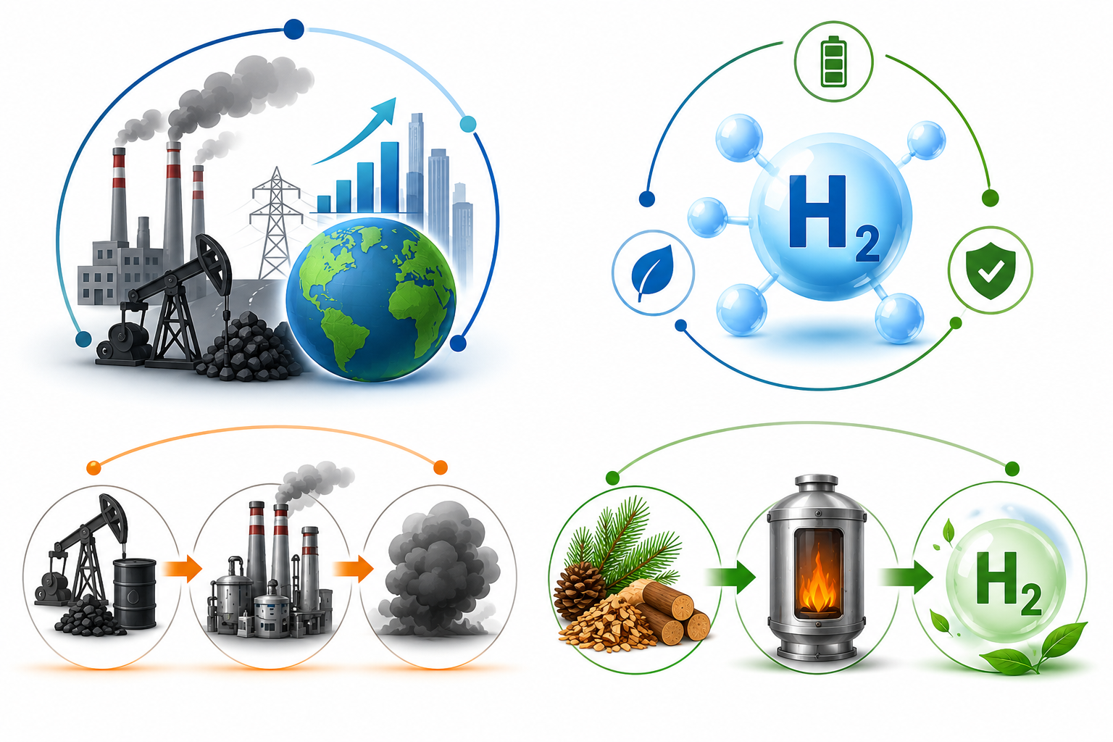
INTRODUCTION
Increasing energy demand and the need to reduce greenhouse gas emissions have accelerated the search for sustainable energy sources.
Hydrogen is a promising clean energy carrier due to its high energy density and zero carbon emissions at the point of use.
However, most hydrogen is still produced from fossil fuel-based processes, resulting in significant carbon emissions.
Biomass offers a renewable and carbon-neutral alternative for sustainable hydrogen production through thermochemical conversion.

Slide 5
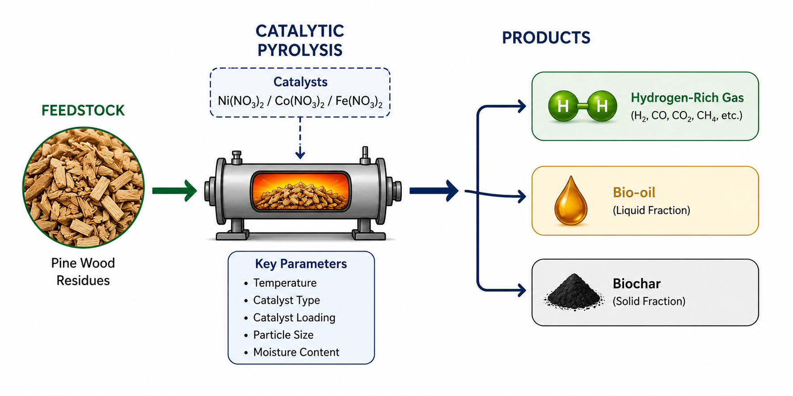
INTRODUCTION
Catalytic pyrolysis has emerged as a promising route for renewable hydrogen production.
Converts the biomass into syngas, bio-oil, and the biochar.

Slide 6

INTRODUCTION
For the gaseous fraction to be rich in hydrogen, these parameters must be optimized.
Temperature
Biomass type
550, 600, and 650⁰C.
Pinewood
Lignin and hemicellulose
550°C → lignocellulosic components begin extensive secondary cracking.
Particle size: 2-2.5mm
Higher surface-area-to-volume ratio.
Catalyst
Moisture content
Ni(NO₃)_{2,} Fe(NO₃)₂ and Co(NO₃)₂
  8-15 %
High solubility in water.
Balances dryness to reduce energy loss with enough moisture to preserve quality and stability.
Promote gas-forming reactions.

Slide 7
AIM AND OBJECTIVES
OBJECTIVES:
1. Identifying the optimal conditions for maximum hydrogen yield in a lab-scale pyrolysis system.
AIM:
To optimize a lab-scale pyrolysis system to maximize hydrogen production.
2. To identify catalysts suitable for enhancing hydrogen production.
3. To determine the effect of pine wood on hydrogen production through catalytic pyrolysis experiments.

Slide 8
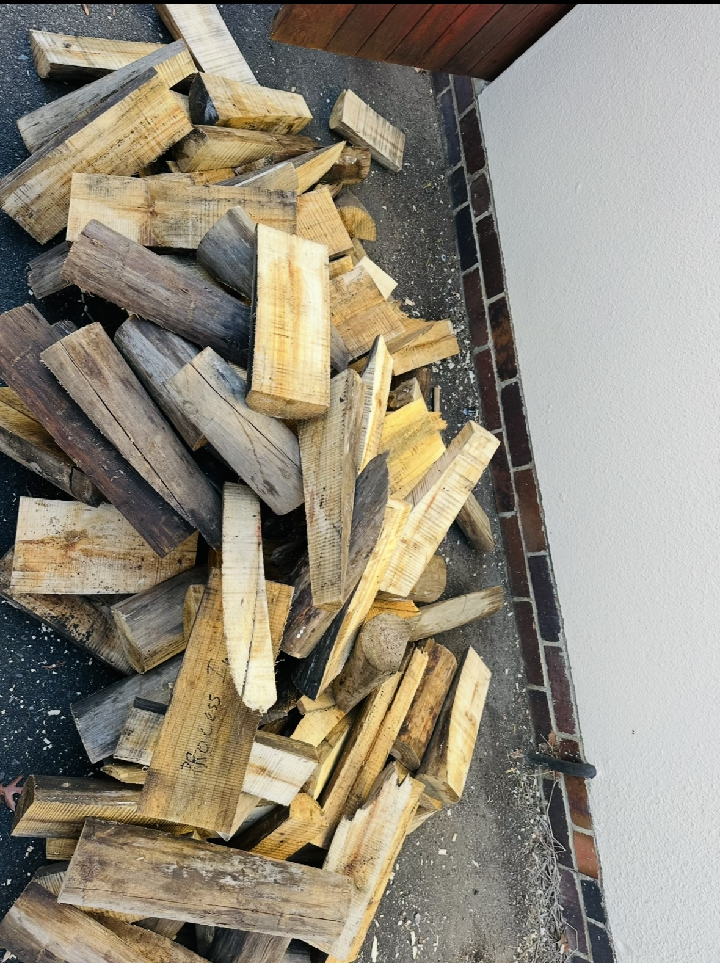
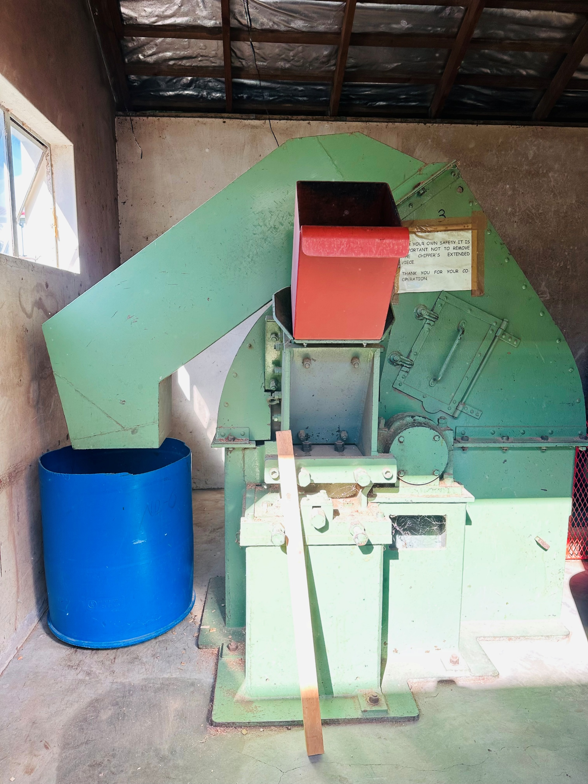
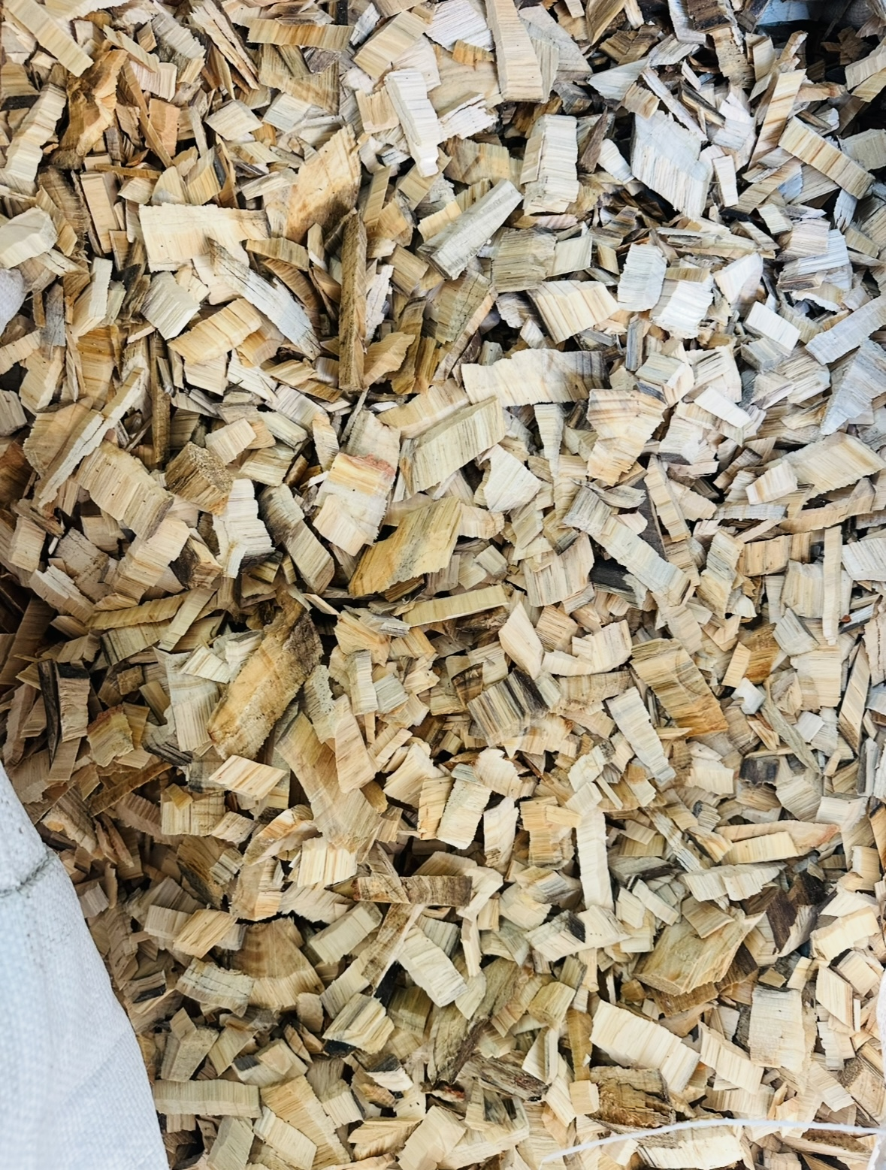

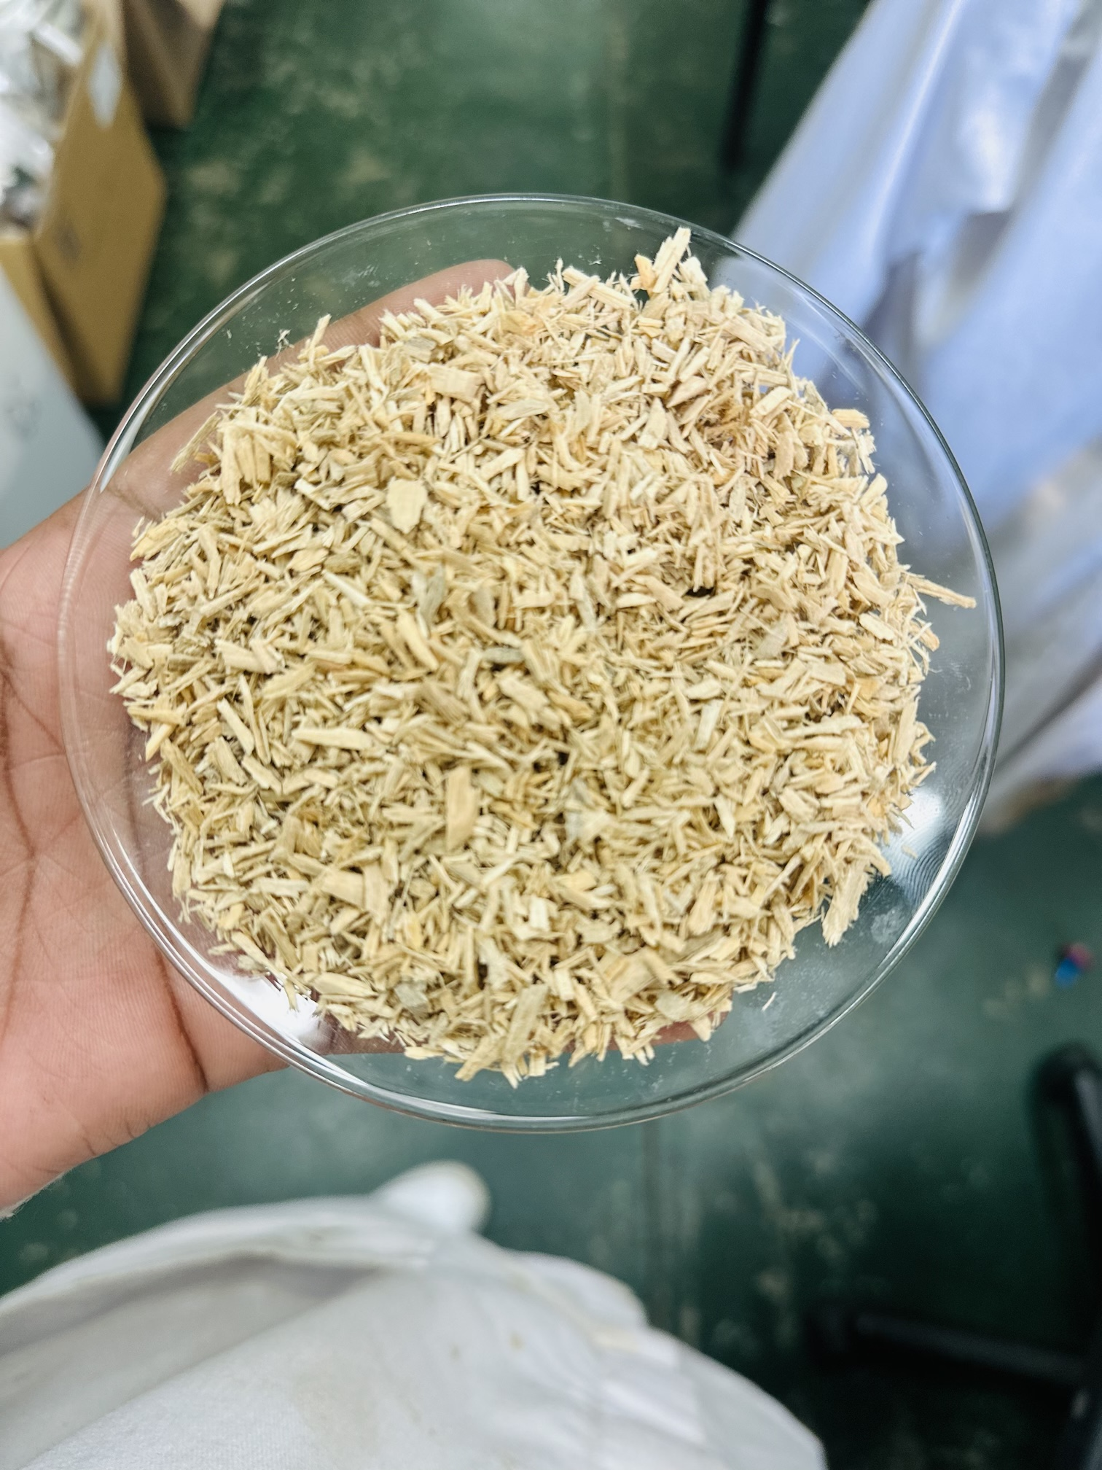
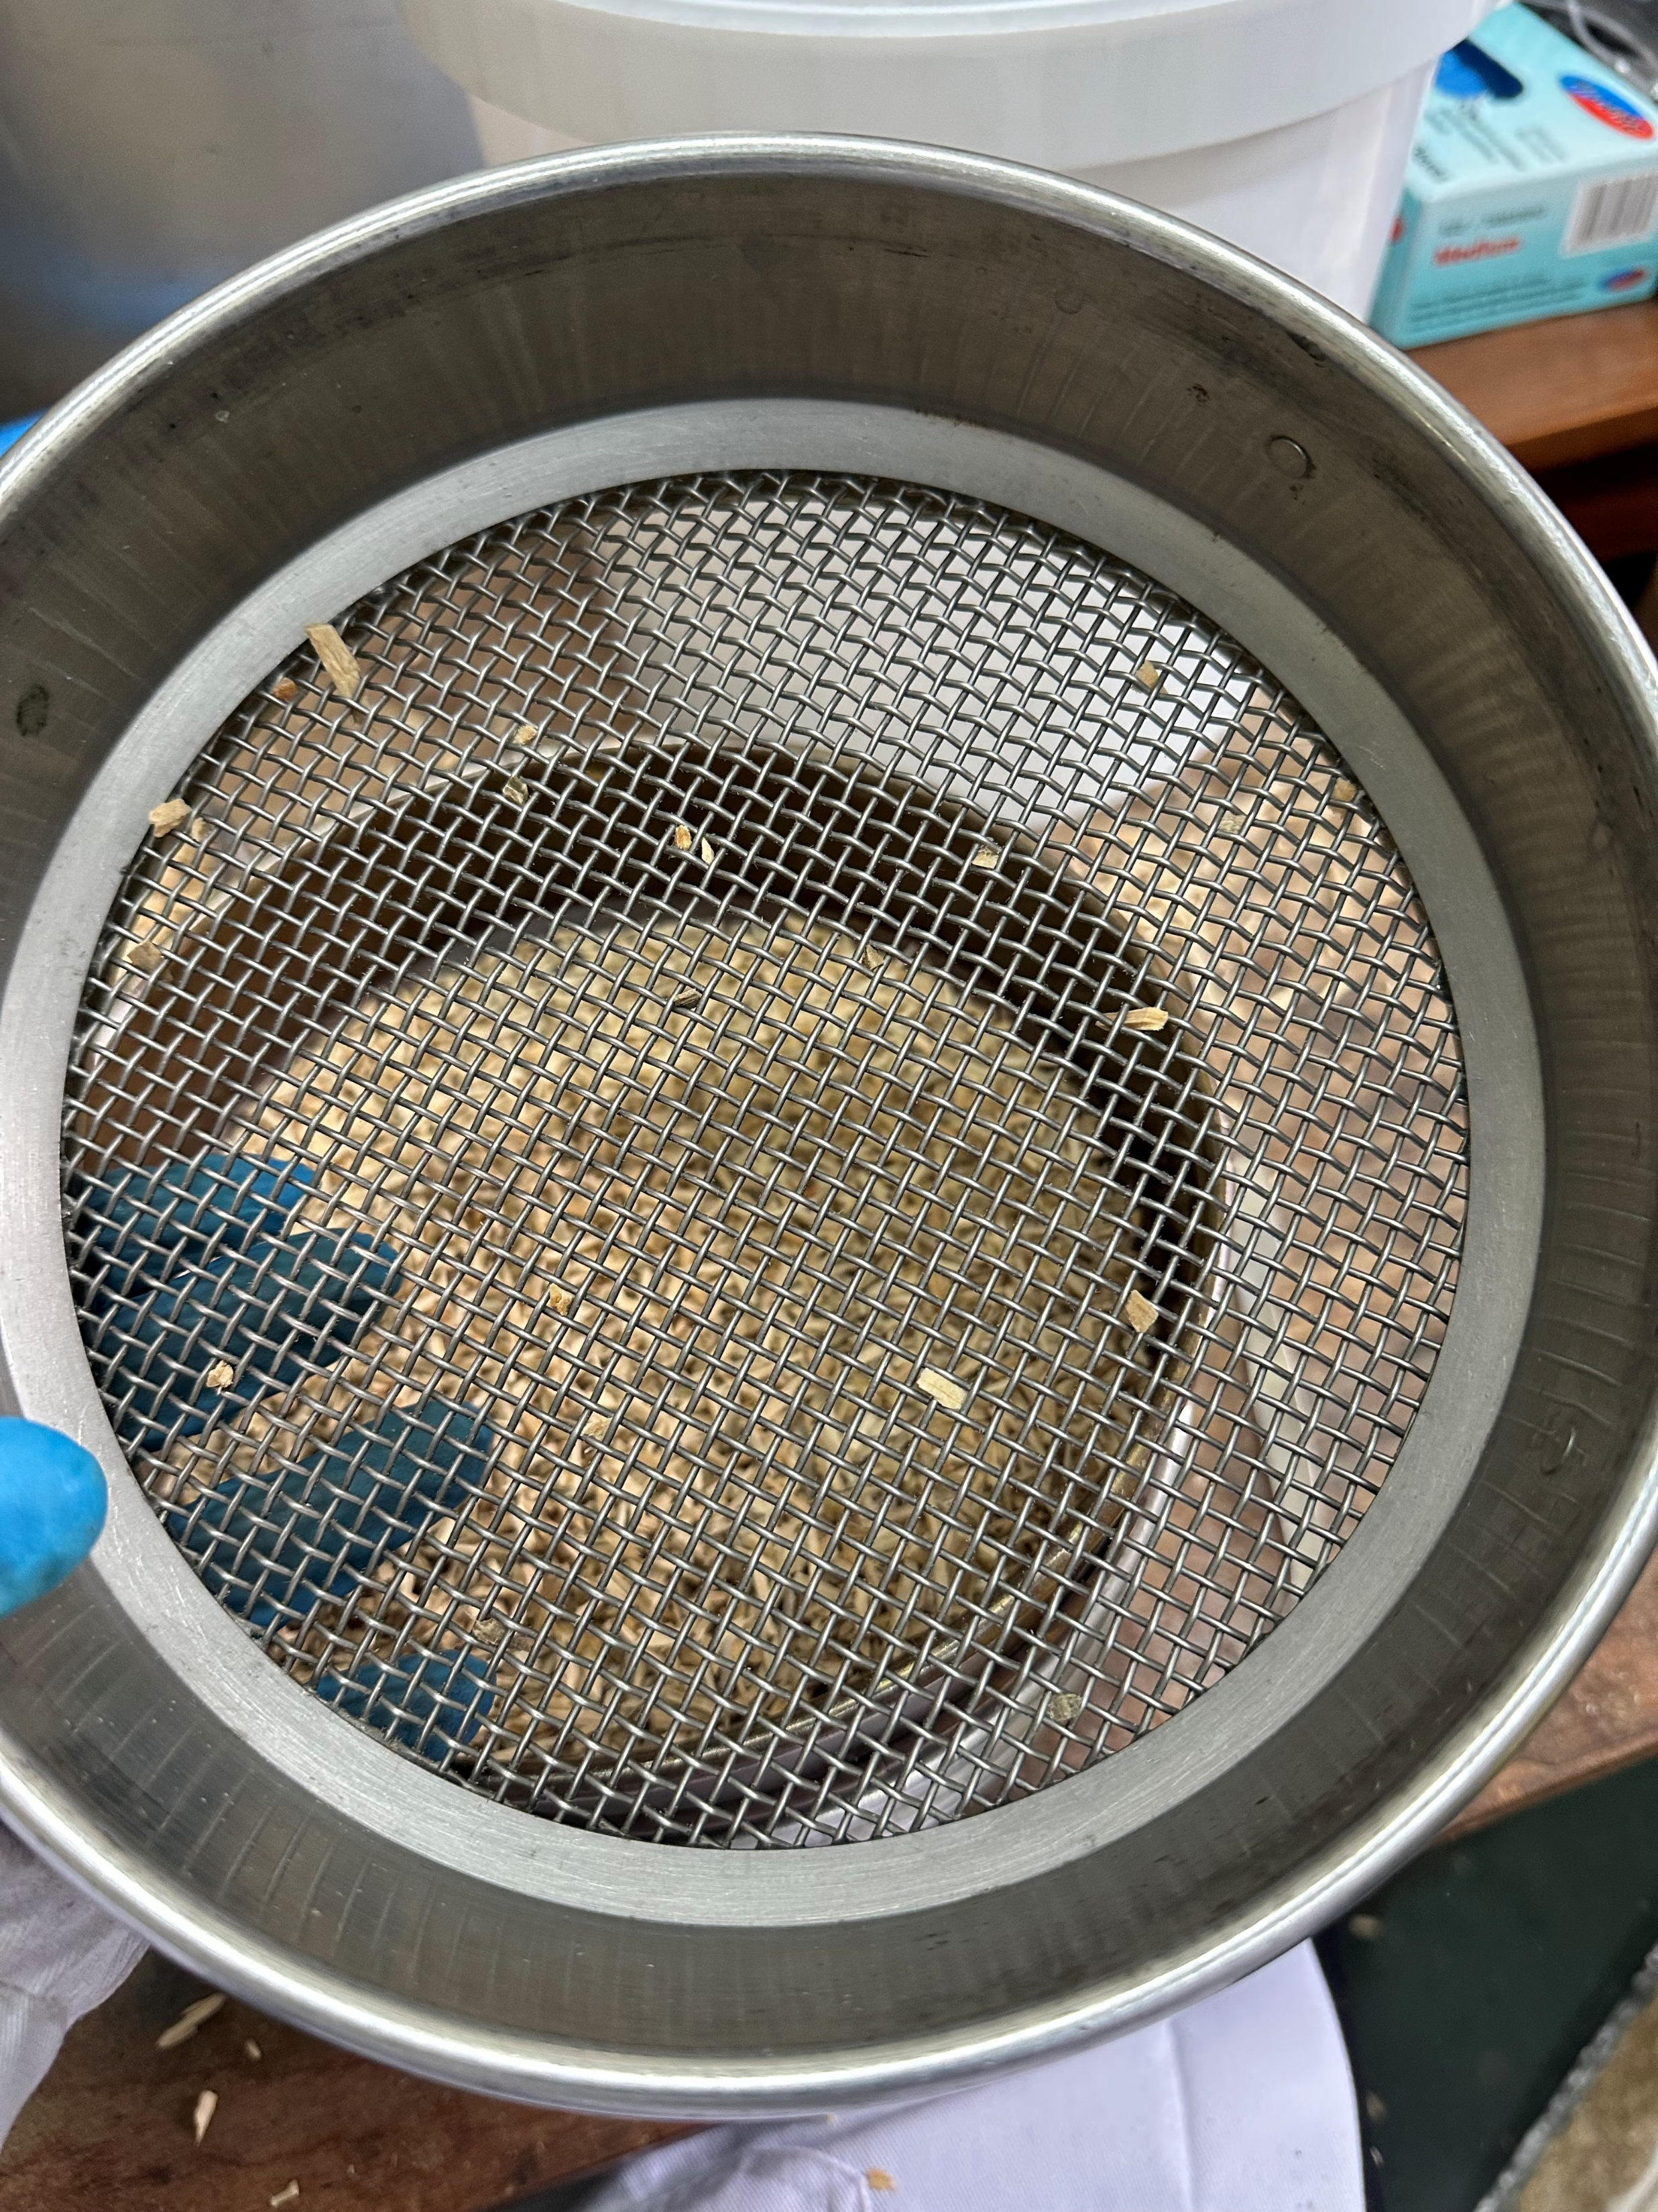
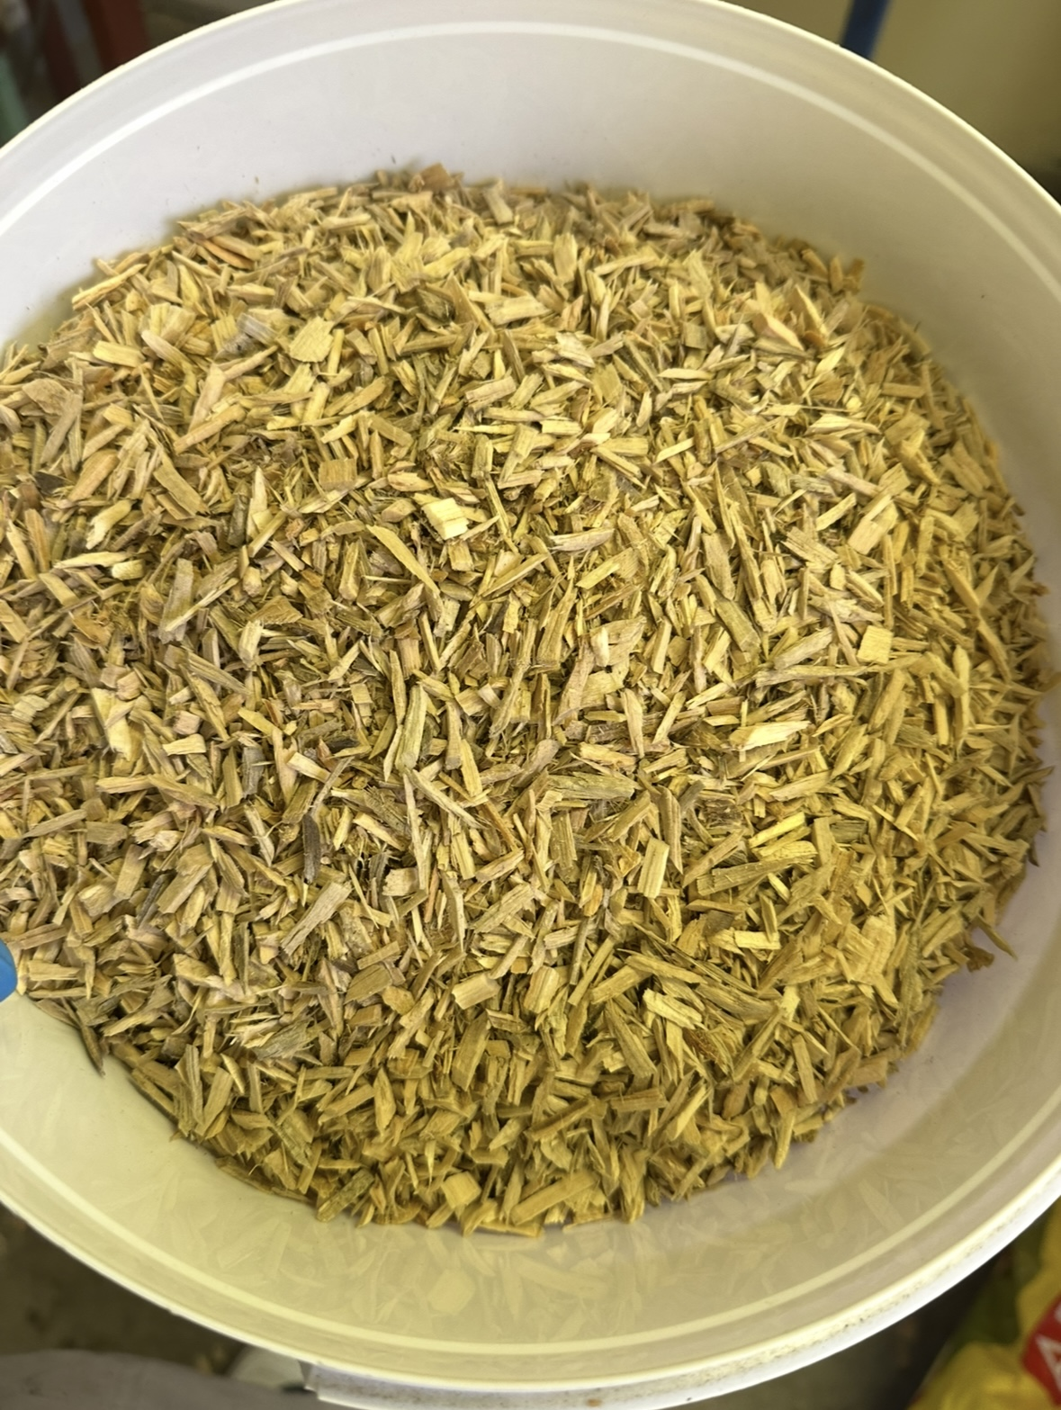
METHODOLOGY
Part I: Biomass preparation
chipping
milling
Pine wood
Chipper
Chips
Retsch mill
sieving
2-2.3mm sieve

Slide 9
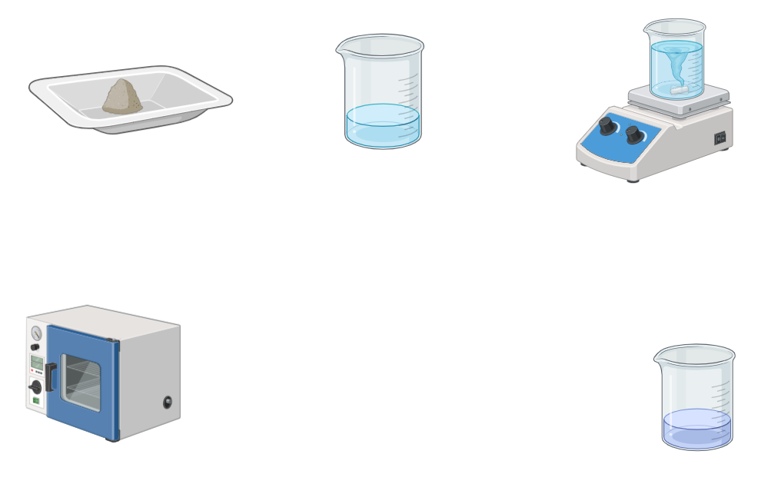
METHODOLOGY
Part III: Impregnation of the catalysts
stirring
Ni(NO₃)₂/Co(NO₃)₂
DI water
Magnetic stirrer
drying
Oven
Pine wood
Solution

Slide 10
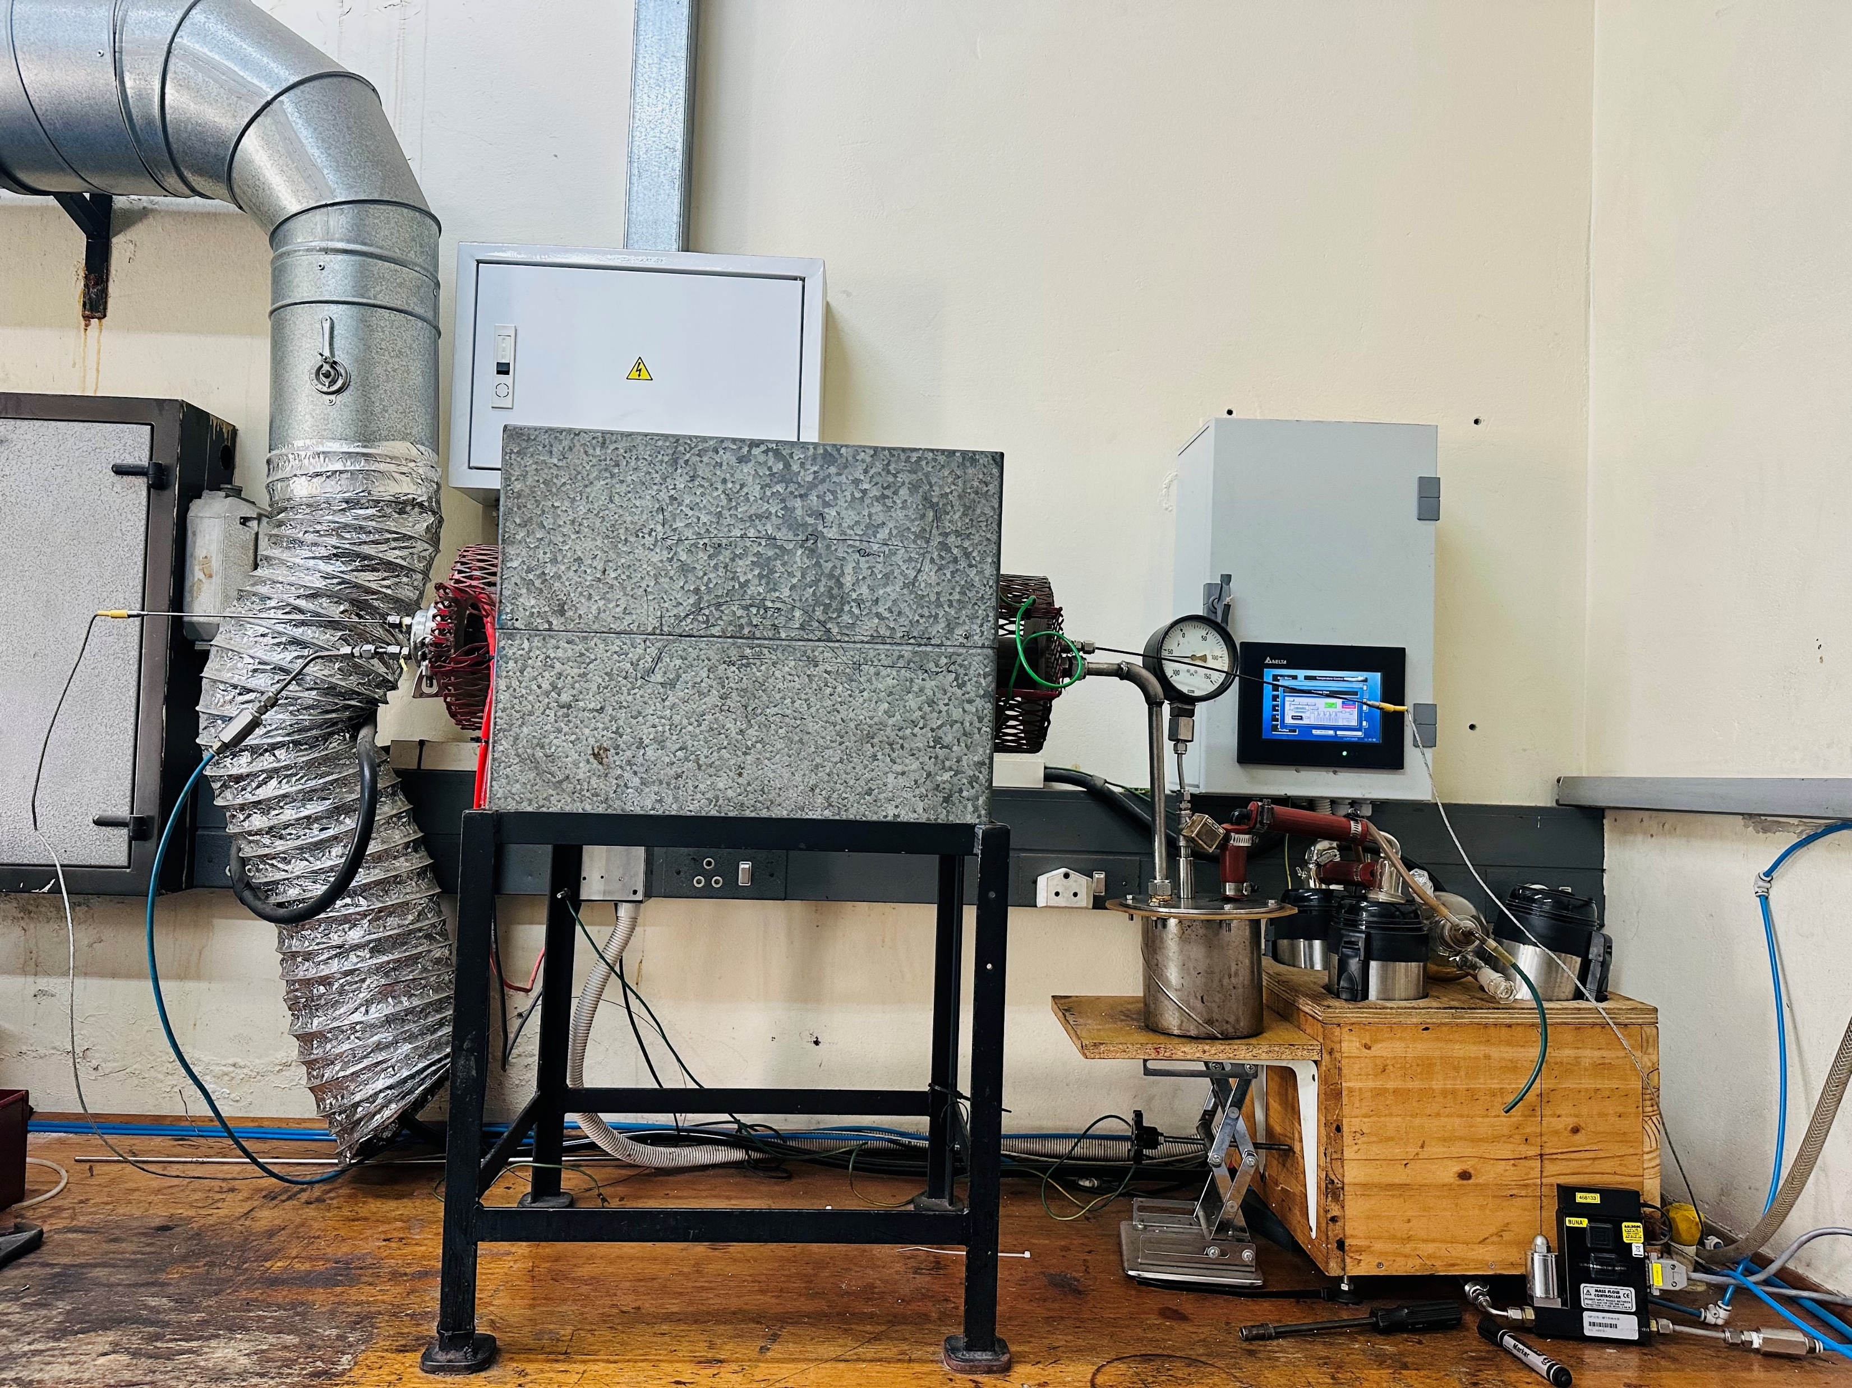
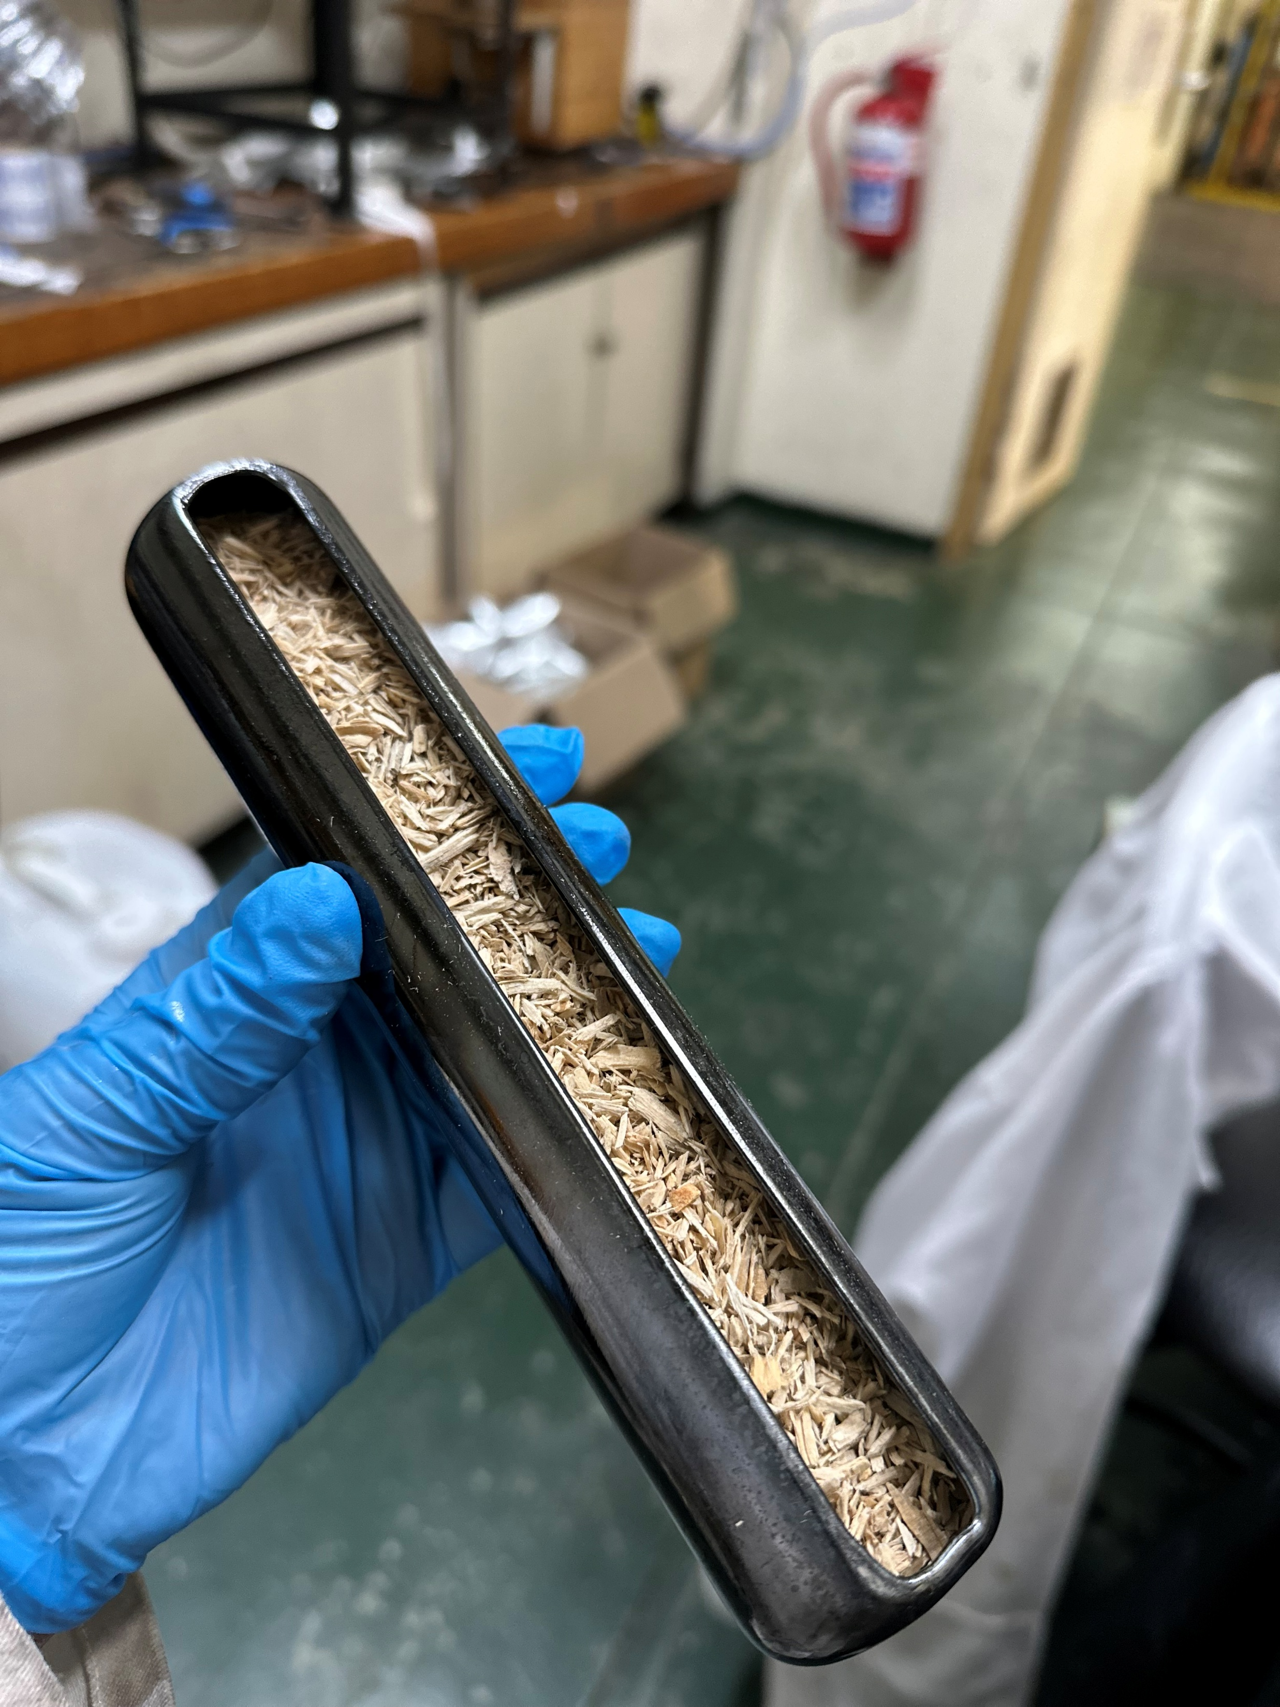
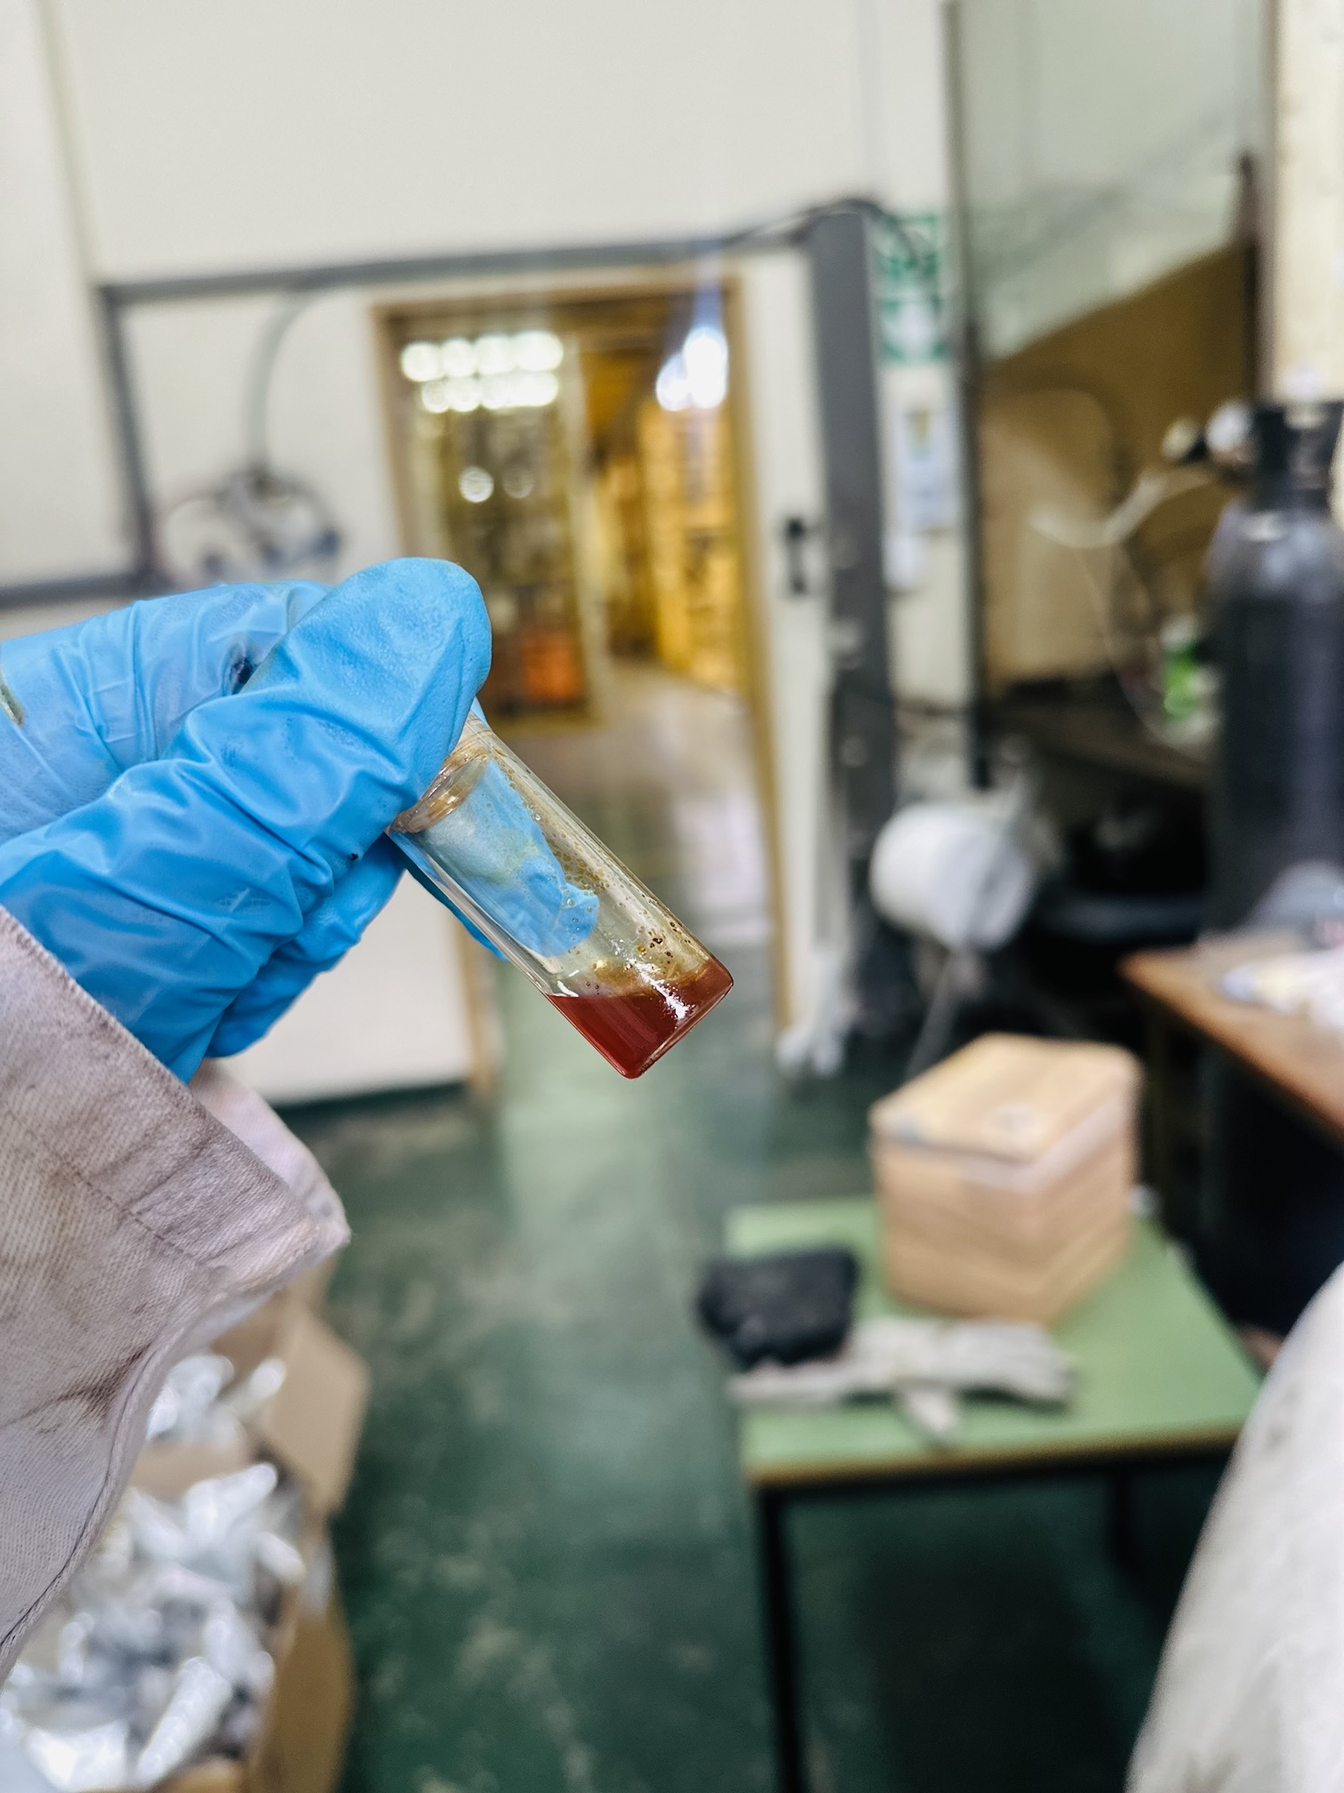
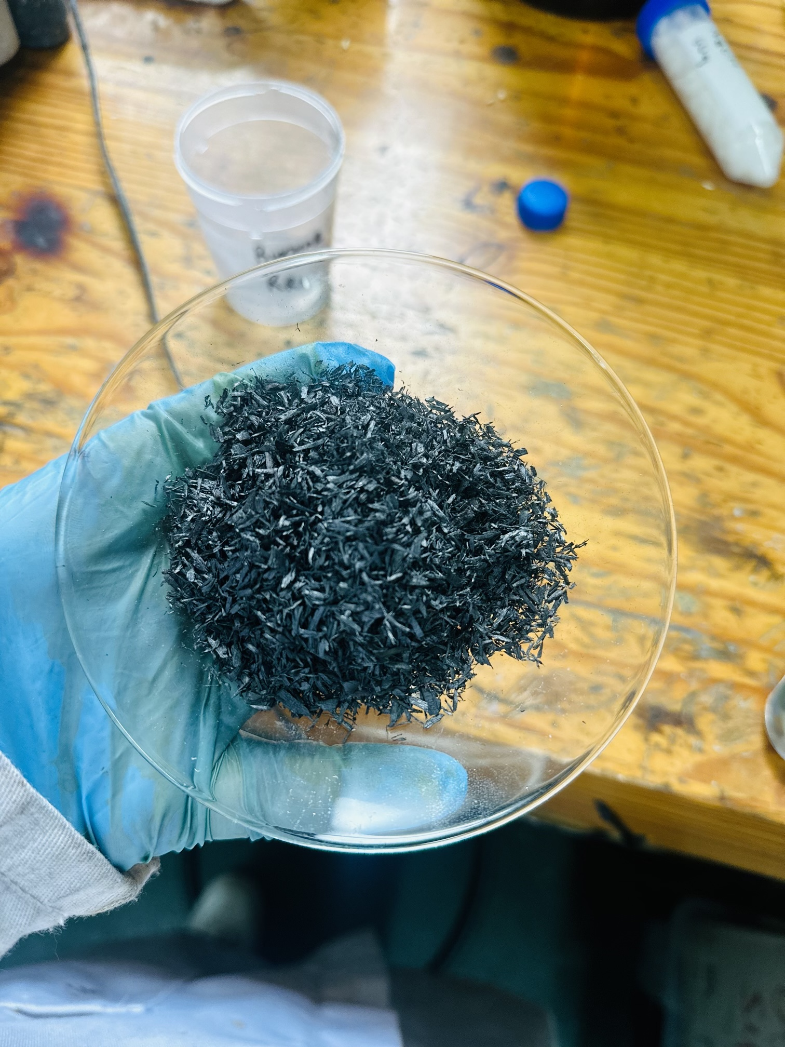
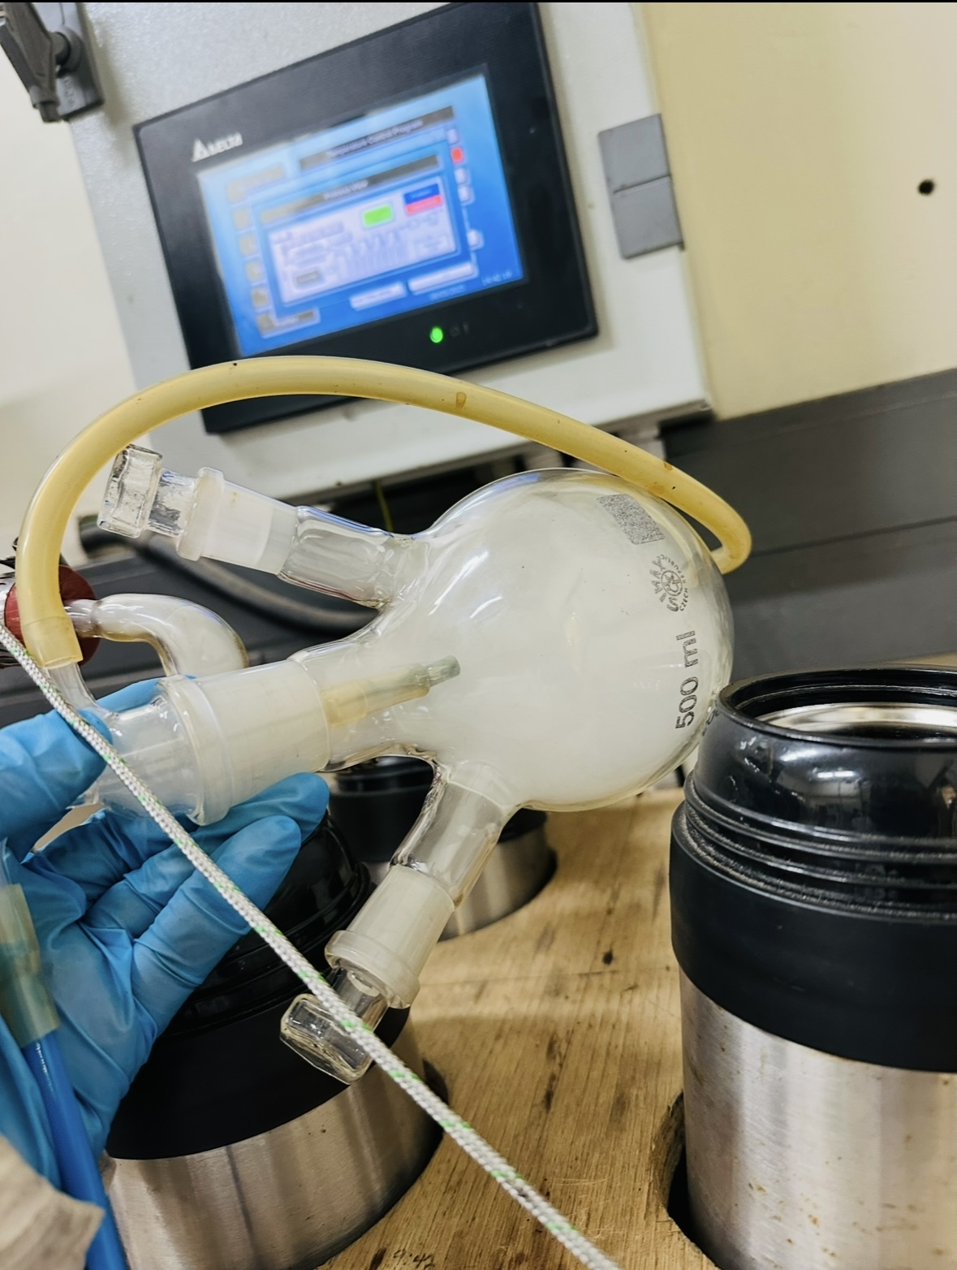
METHODOLOGY
Part II: Experimental pyrolysis setup
transfer
Pine wood chips
Sample boat
Pyrolysis setup
Bio-oil
Biochar
Syngas

Slide 11
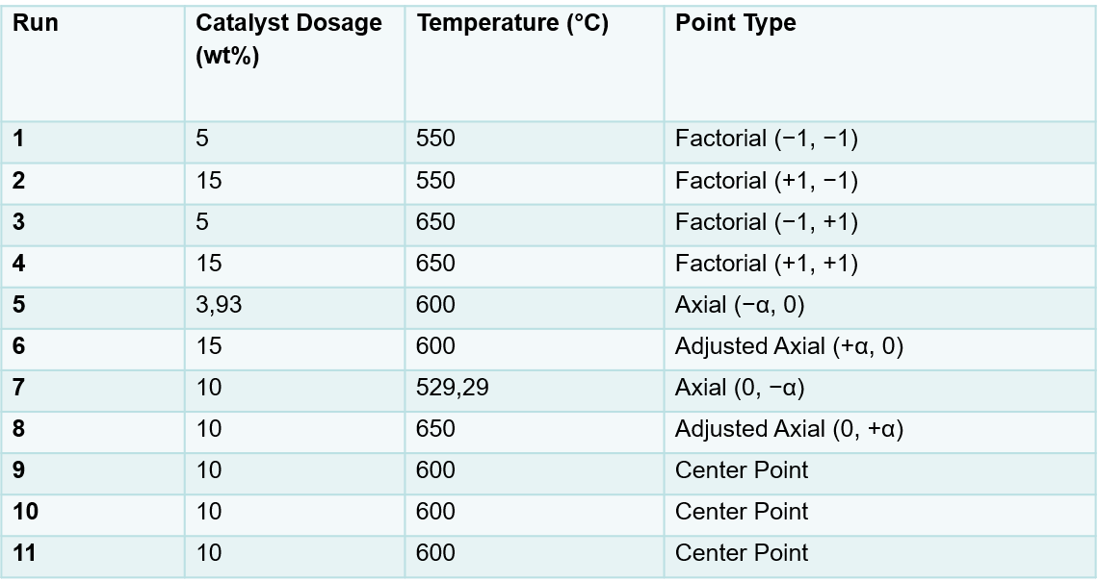
METHODOLOGY
Part IV: Breakdown of experimental parameters using 2-factor central composite design (CCD)

Slide 12
RESULTS AND DISCUSSION
Elemental analysis results of pine wood
CHN - to determine the elemental composition of biomass
Biomass | Weight (mg) | %Nitrogen | %Carbon | %Hydrogen
Pine wood | 10.685 | 0.15 | 42.97 | 6.80
Pine wood duplicate | 10.051 | 0.12 | 43.22 | 8.70
High carbon and hydrogen contents indicate that pine wood is a suitable feedstock for hydrogen production.
The low nitrogen content is advantageous as it minimizes the formation of nitrogen-containing pollutants during pyrolysis.
Duplicate analysis confirmed the reliability of the results.

Slide 13
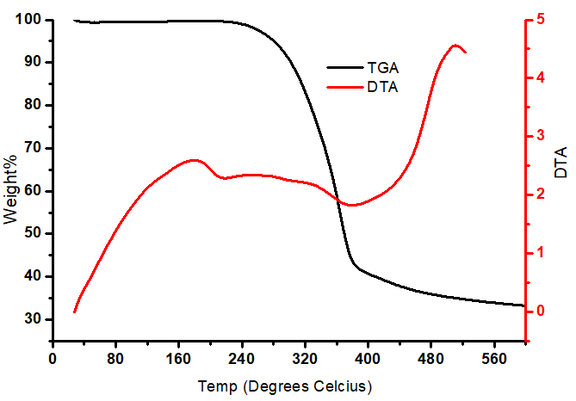
RESULTS AND DISCUSSION
Proximate analysis results of pine wood
TGA analysis – to measure how the mass of a biomass sample changes as it is heated.
Below 250⁰C – minimal weight loss due to moisture evaporation.
Between 300 - 380⁰C – Rapid weight loss as hemicellulose and cellulose decompose releasing volatile gases.
Above 400⁰C – Lignin decomposes more slowly promoting secondary cracking and reforming reactions which enhances hydrogen production.

Slide 14
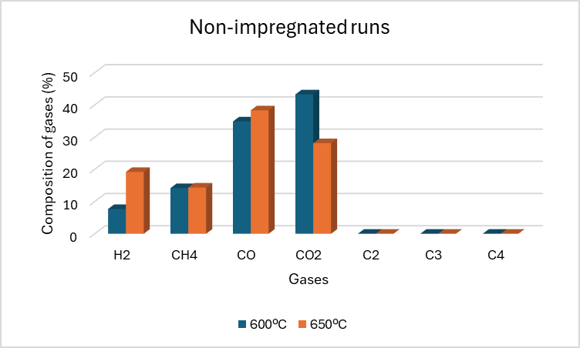
RESULTS AND DISCUSSION
Basic pyrolysis conditions experimental runs
Increasing the pyrolysis temperature from 600 °C to 650 °C significantly increased H₂ production while reducing CO₂, indicating that higher temperatures favour hydrogen-forming reactions.
CO remained the dominant gas at both temperatures, while CH₄ changed very little; the gas product was mainly composed of H₂, CO, and CO₂.

Slide 15
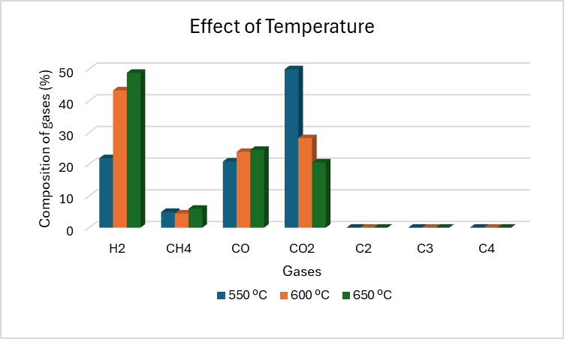
RESULTS AND DISCUSSION
Temperature investigation studies at 550, 600, 650ºC using 15wt% catalyst loading
As the temperature increased, CO₂ decreased significantly, while CO remained relatively stable.
This suggests that higher temperatures favour the conversion of CO₂ into hydrogen-rich syngas, improving the overall gas quality for hydrogen production.

Slide 16
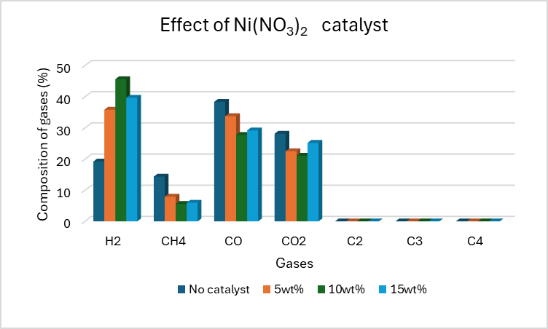
RESULTS AND DISCUSSION
Effect of optimizing the catalyst loading
The addition of the Ni(NO₃)₂ catalyst significantly improved H₂ production compared to the non-catalytic run.
Increasing the catalyst loading from 5 wt% to 10 wt% reduced CO and CH₄ while increasing H₂, but at 15 wt% the hydrogen yield decreased. This suggests that 10 wt% is the optimum catalyst loading.

Slide 17
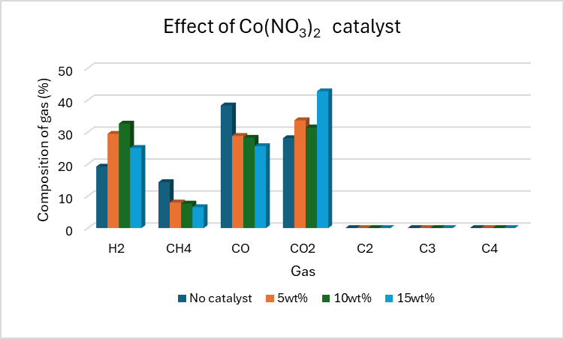
RESULTS AND DISCUSSION
Investigating effect of different types of catalysts
Ni(NO₃)₂ catalyst produced the highest hydrogen yield, with the optimum performance at 10 wt%, because nickel is highly active for cracking, reforming, and water-gas shift reactions that promote hydrogen formation while reducing CO.
Co(NO₃)₂ catalyst also enhanced hydrogen production, with the optimum performance at 10 wt%, but it was less effective than Ni(NO₃)₂ because cobalt has lower catalytic activity for hydrogen-producing reactions.

Slide 18
CONCLUSION
The elemental analysis confirmed that pine wood is a suitable feedstock for hydrogen production due to its high carbon and hydrogen contents.
TGA analysis showed that moisture was removed below 250 °C, rapid decomposition of hemicellulose and cellulose occurred between 300–380 °C, and lignin decomposed above 400 °C, promoting secondary cracking and reforming reactions that enhance hydrogen production.
Hydrogen production increases when the temperature increases.
Nickel nitrate [Ni(NO₃)₂] demonstrates higher efficiency in hydrogen production due to its strong catalytic ability to break C–H bonds.
The lack of heavier hydrocarbons (C₂–C₄) indicates efficient conversion to lighter gases, favoring a hydrogen-rich gas composition, particularly at higher temperatures.

Slide 19
ONGOING WORK
Analyse the 3rd catalyst results
01
Calculate the yield of the biochar and bio-oil produced
02
03
Calculate the H₂ yield per 20g/biomass

Slide 20
REFERENCES
[1] H. Ishaq, I. Dincer, and C. Crawford, “A review on hydrogen production and utilization: Challenges and opportunities,” Int. J. Hydrogen Energy, vol. 47, no. 62, pp. 26238–26264, 2022.
[2] T. Egeland-Eriksen, A. Hajizadeh, and S. Sartori, “Hydrogen-based systems for integration of renewable energy in power systems: Achievements and perspectives,” Int. J. Hydrogen Energy, vol. 46, no. 63, pp. 31963–31983, 2021.
[3] C. Acar and I. Dincer, “Review and evaluation of hydrogen production options for better environment,” J. Clean. Prod., vol. 218, pp. 835–849, 2019.

Slide 21
[4] M. Ni, D. Y. C. Leung, M. K. H. Leung, and K. Sumathy, “An overview of hydrogen production from biomass,” Fuel Process. Technol., vol. 87, no. 5, pp. 461–472, 2006.
[5] M. G. Eloffy et al., “Biomass-to-sustainable biohydrogen: Insights into the production routes, and technical challenges,” Chem. Eng. J. Adv., vol. 12, no. September, p. 100410, 2022.
[6] A. S. N. Huda, S. Mekhilef, and A. Ahsan, “Biomass energy in Bangladesh: Current status and prospects,” Renew. Sustain. Energy Rev., vol. 30, pp. 504–517, 2014.
[7] S. E. Hosseini, M. A. Wahid, and A. Ganjehkaviri, “An overview of renewable hydrogen production from thermochemical process of oil palm solid waste in Malaysia,” Energy Convers. Manag., vol. 94, pp. 415–429, 2015.

Slide 22


