Slide 1




Deep Learning Prediction of the performance of a hybrid CsSn(I_{1-x}Br_{x})₃-based perovskite Lead-free using silicon (Si++) as hole transport layer (HTL)
Electrical characterisation of a 2D Schottky diode based on heterojunction polyaniline and graphene with Magnesium as contact based on SILVACO TCAD.
Presented by: Dr AD KAPIM KENFACK
SAIP2026
Presented by: Dr. AD KAPIM KENFACK

Slide 2
Content
1. Introduction
1.1. Overview of Schottky diodes and their application
1.2. Limitations of the existing Schottky diodes.
1.3. Perspective of a Novel Schottky Diodes Architecture
2. Methodology
2.1. Presentation of the Schottky Diodes Architecture
2.2. Presentation of the mathematical model of a Schottky diode.
2.3. Workflow of the extraction technique of the electrical parameters.
3. Results and discussion
4. Conclusion and Acknowledgment
1
Faculty of science
Department of physics

Slide 3
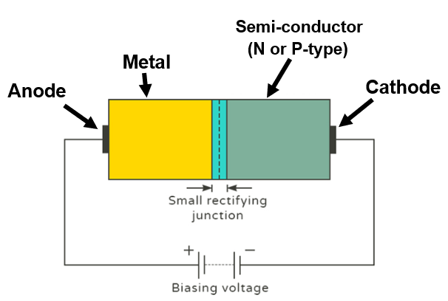
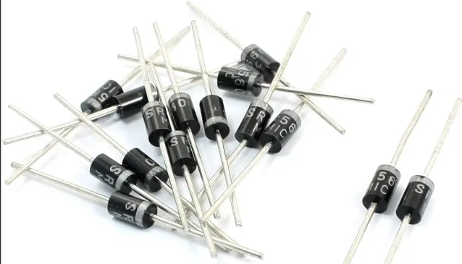
1. Introduction
1.1. Overview of Schottky diodes and their application
Fig 2: Schottky diode schematic
Fig 1: Commercialised Schottky diode
APPLICATIONS
1-Very fast switching compared to PN
junction diode
2-Ideal for high-frequency applications
3-More efficient for low-voltage applications
compared to PN junction diode
4-Low power loss
1-Rectifiers
2-Sensors( Photodetector)
3-Solar cells (Hole and electron transport
layer for perovskite solar cell)
2
Faculty of science
Department of physics

Slide 4
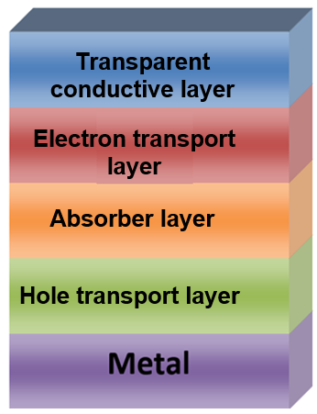
1.2. Limitations of the existing Schottky diodes.
Limitation
1-Leakage and instability
2- Limited tunability of barrier height
3- Expensive material
4-Poor extraction power of hole.
Fig 3: Standard perovskite solar cell
3
Faculty of science
Department of physics

Slide 5
1.3. Perspective of Novel Schottky diodes Architecture
Proposed Architecture :
• Polyaniline (PANI)/Graphene heterojunction
• Magnesium contact
Advantage of PANI
Inconvenient of PANI
1-Easy to synthesize
2-Low-cost compared to the
existing Hole transport layer
3-Highly thermal stable.
4-Organic material (Environmentally friendly).
1-Low mobility (electron and hole)
2-Low barrier height
3-Low extraction power (does not block the electron efficiently)
Role of Graphene: Improve the main role of PANI as Hole transport layer
4
Faculty of science
Department of physics

Slide 6
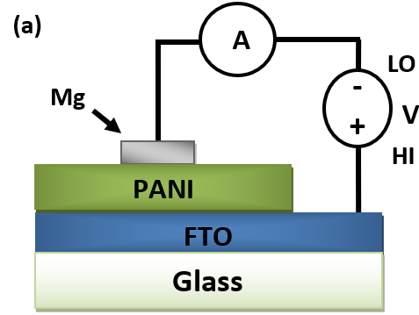
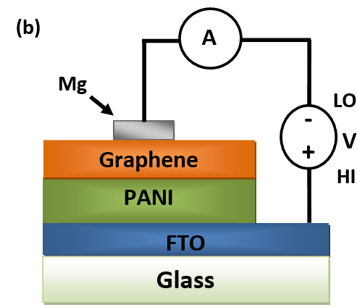
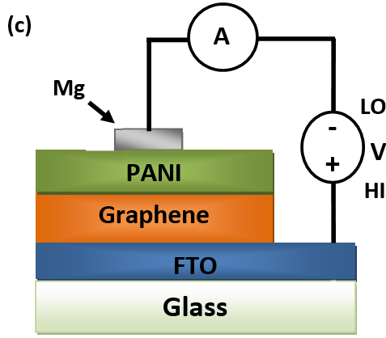
2. Methodology
2.1. Presentation of Novel Schottky Diodes Architecture
Mg/PANI/FTO
Mg/Graphene/PANI/FTO
Mg/PANI/Graphene/FTO
Figure 4 : Architecture of Schottky diodes based on heterojunction polyaniline and graphene with Magnesium as the contact. (a) No graphene, (b) graphene between PANI/Metal, (c) Graphene between PANI/substrate.
5
Faculty of science
Department of physics

Slide 7
2. Methodology
2.2. Presentation of the mathematical model of a Schottky diode.
Parameters | FTO |  | PANI | Graphene (GO)
H(nm) | 400 |  | 200 | 70
Eg(eV) | 3.5 |  | 2.4 | 2.5
χ (eV) | 4.1 |  | 2.05 | 2.5
ε_{r} | 10 |  | 7 | 3
Nc (1/cm³) | 2×10¹⁸ |  | 2.8×10¹⁹ | 10²¹
Nv (1/cm³) | 1.8×10¹⁹ |  | 2×10¹⁹ | 10²¹
μ_{n}(cm²/Vs) | 20 |  | 10⁻⁴ | 10⁹
μ_{p}(cm²/Vs) | 10 |  | 2.7x10⁻⁵ | 10
N_{D} (1/cm³) | 10²⁰ |  | 0 | 0
N_{A} (1/cm³) | 0 |  | 9x10¹⁹ | 9x10¹⁷
V_{t} (cm/s) | 10⁷ |  | 10⁷ | 10⁷
Nt(1/cm³) | 10¹⁵ |  | 10¹⁵ | 10¹⁵
SILVACO TCAD
1-Continuity equations for electrons and hole charge carriers
2- Poisson equation
6
Faculty of science
Department of physics

Slide 8
2. Methodology
2.2. Presentation of the mathematical model of a Schottky diode.
(1)
(2)
Output current
Richardson constant
Output voltage
Temperature
Series resistance
Barrier height
Ideality factor
Thermal potential
Reverse saturation current
Cross-section of the sample
Chueng’s method
7
Faculty of science
Department of physics

Slide 9
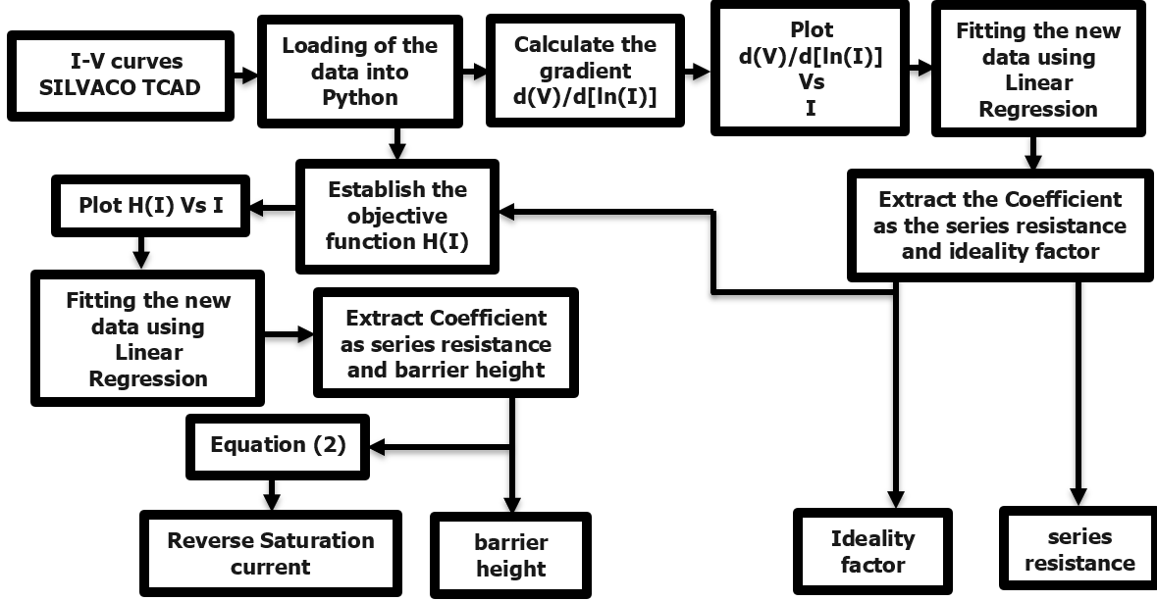
2. Methodology
2.3. Workflow of the extraction technique of the electrical parameters
Figure 5 : Flowchart of the extraction technique of the electrical parameters of the Schottky diodes on based on Cheung and Cheung method
8
Faculty of science
Department of physics

Slide 10
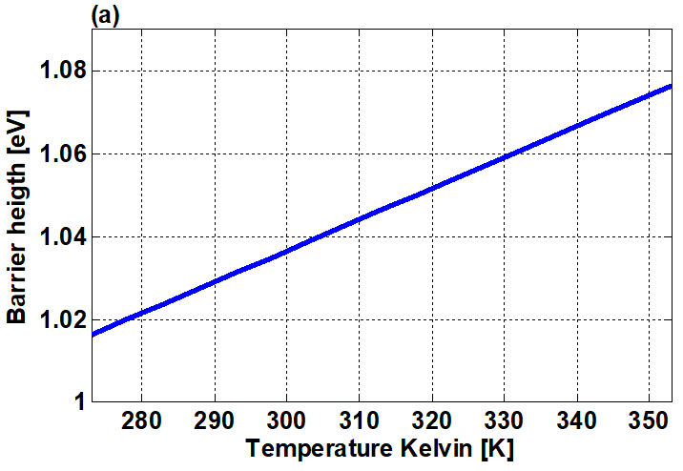
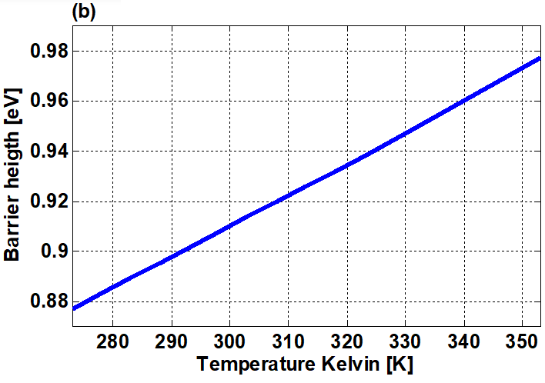
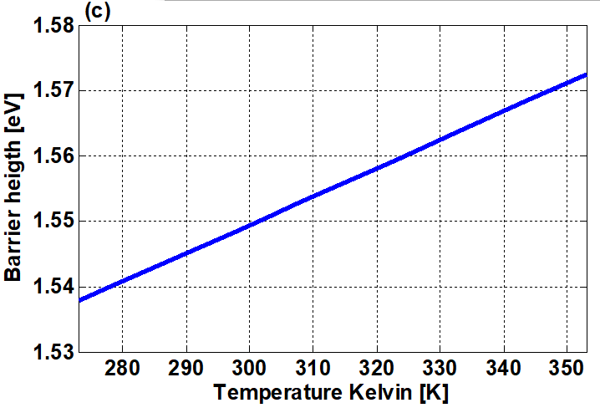
3. Results and discussion 273-360 degree kelvin
Mg/PANI/FTO
[Fig 6(a)]
Mg/Graphene/PANI/FTO
[Fig 6(b)]
Mg/PANI/Graphene/FTO
[Fig 6(c)]
Fig 6: Barrier height
9
Faculty of science
Department of physics

Slide 11
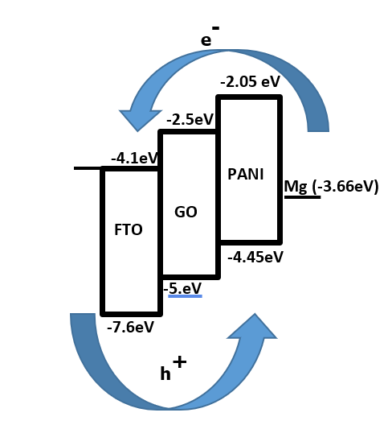
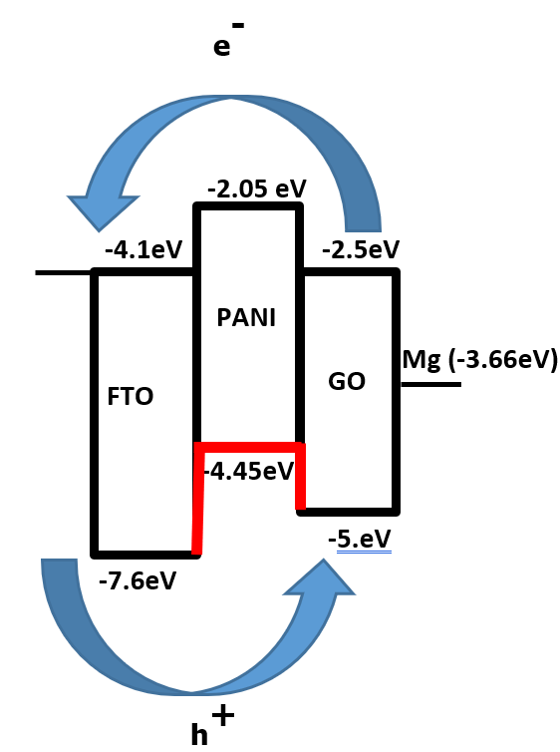
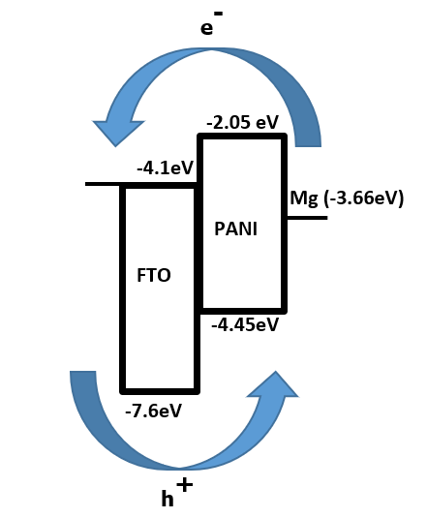
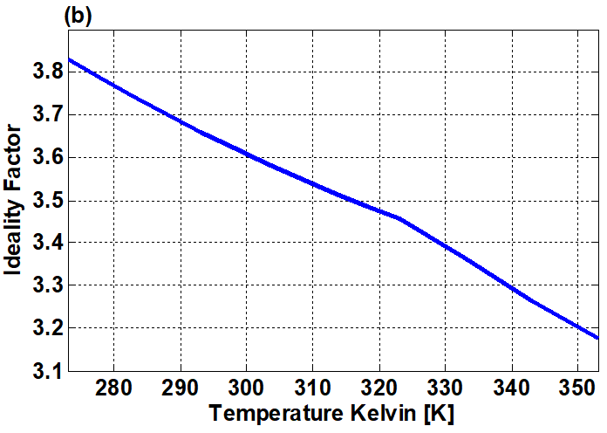
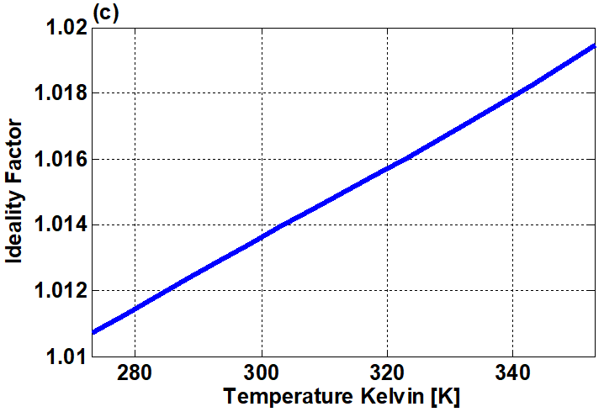
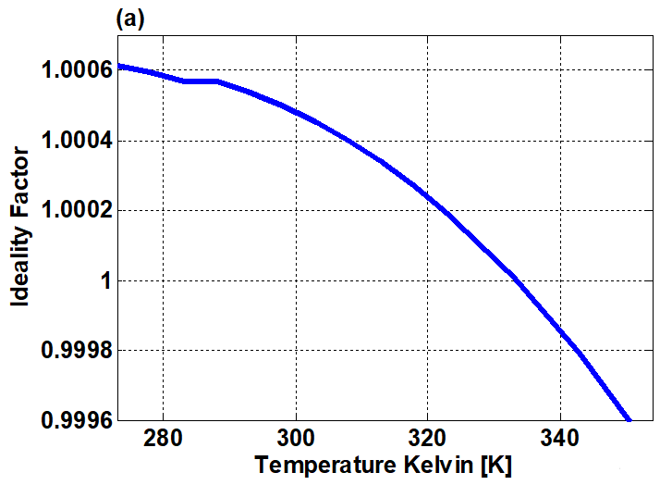
3. Results and discussion 273-360 degree kelvin
Mg/PANI/FTO
[Fig 7(a)]
Mg/Graphene/PANI/FTO
[Fig 7(b)]
Mg/PANI/Graphene/FTO
[Fig 7(c)]
10
Fig 7: Ideality Factor
Faculty of science
Department of physics

Slide 12
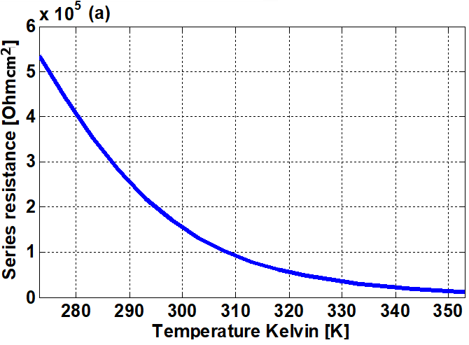
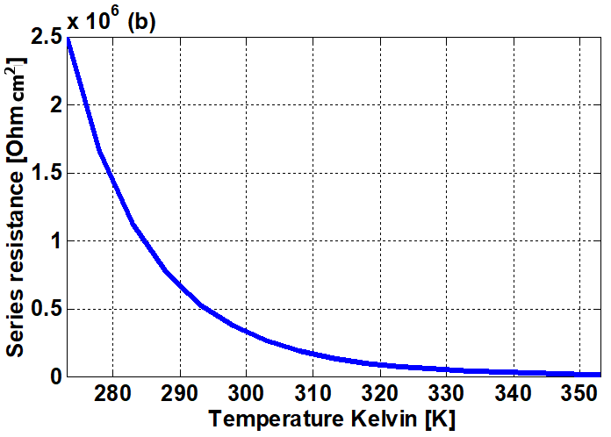
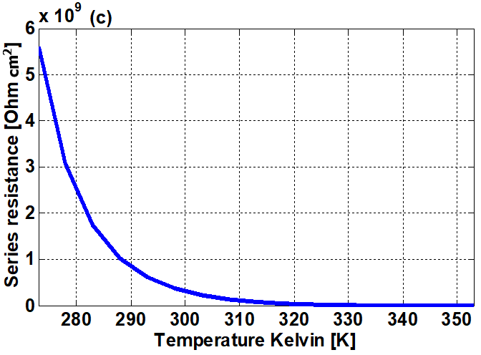
3. Results and discussion 273-360 degree kelvin
Mg/PANI/FTO
[Fig 8(a)]
Mg/Graphene/PANI/FTO
[Fig 8(b)]
Mg/PANI/Graphene/FTO
[Fig 8(c)]
Fig 8: Series Resistance
11
Faculty of science
Department of physics

Slide 13
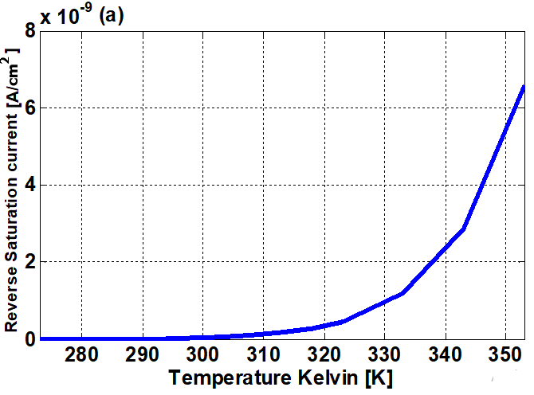
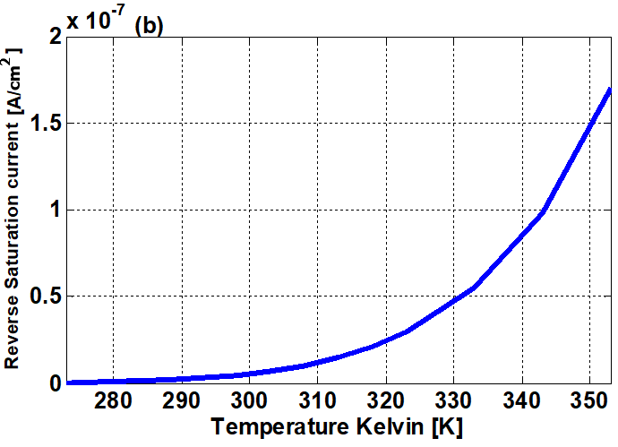
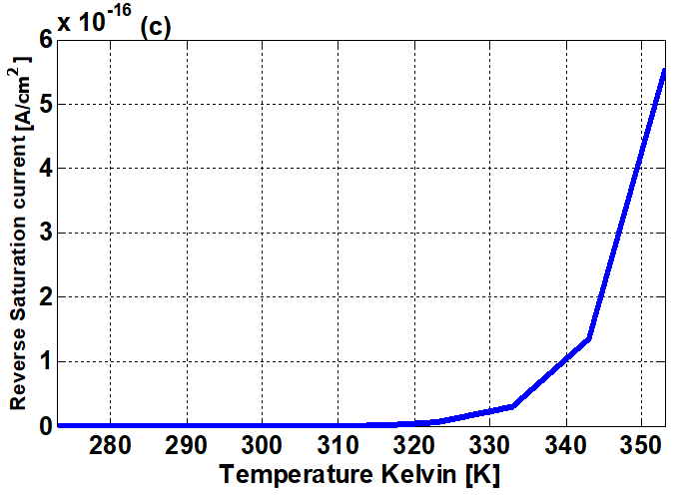
3. Results and discussion 273-360 degree kelvin
Mg/PANI/FTO
[Fig 9(a)]
Mg/Graphene/PANI/FTO
[Fig 9(b)]
Mg/PANI/Graphene/FTO
[Fig 9(c)]
Fig 9: Reverse saturation current
12
Faculty of science
Department of physics

Slide 14
4. Conclusion and Acknowledgment
1. The FTO/PANI/Mg reference device establishes a well-defined Schottky junction with a moderate barrier height and low reverse saturation current governed by the PANI/Mg interface
2. Inserting GO directly at the metal contact (FTO/PANI/GO/Mg) minimises the Schottky barrier through band realignment, offers the highest reverse saturation current and therefore the highest recombination.
3. Repositioning GO to the substrate side (FTO/GO/PANI/Mg) preserves the PANI/Mg Schottky junction, restoring a larger barrier height and suppressed reverse leakage comparable to the reference device
13
Faculty of science

Slide 15
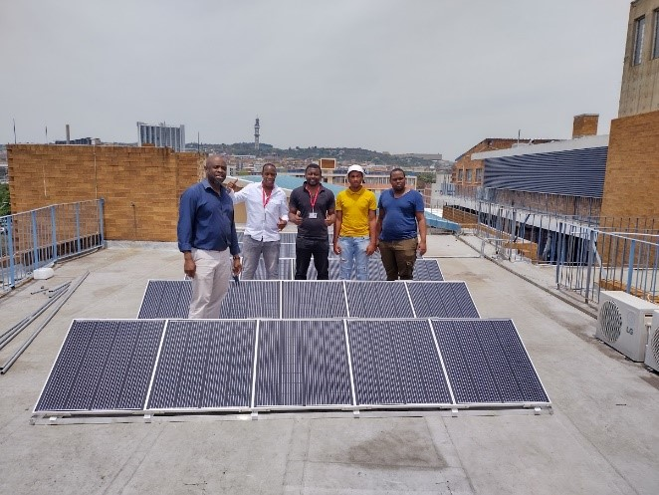
PV Nanocomposite Research Group
14
Faculty of science

Slide 16


4. Conclusion and limitations of the model
13
Faculty of science

