Slide 1




Ultra-Sensitive and Energy Efficient NO Gas Sensor Based on Pd-sensitized Co₃O₄/NiTiO₃ Heterojunctions
Z.P. Tshabalala,
B.C. Tladi-Baloyi, K.L. Morulane,
H.C. Swart, D.E. Motaung
www.ufs.ac.za
SAIP 2026
6-10 July 2026

Slide 2
Outline
Introduction
Synthesis and Fabrication
Results and Discussion
  Gas sensor Performance
  Power Consumption
Sensing Mechanism
Conclusion
SAIP 2026
6-10 July 2026

Slide 3

Introduction
Problem Context
  Increasing NOₓ (NO and NO₂) emissions with severe impact on: Air quality, environment and human health
  Detection during medical diagnostics
  Demand for real-time, ultra-sensitive, low-cost monitoring technologies
Limitations of Current Sensors
  Poor sensitivity
  Humidity interference
  High operating temperature
AIM: Develop a low-power, highly sensitive (ppb-level) NO sensor Noble metal-sensitized Co₃O₄/NiTiO₃ heterojunctions
SAIP 2026
6-10 July 2026
Notes:
> There is a global surge in the emission of Nitrogen oxide (NOx) gases, which are primarily nitric oxide (NO), nitrogen dioxide (NO₂) and Nitrous oxide (N2O) “the laughing gas”.
> Primary sources of NOx emissions include human activities and industrialization such as energy production, metallurgical operations, and automotive exhaust emissions.
> These gases are highly reactive and toxic posing severe impact on Air quality, Environment sustainability and human health.
Furthermore, recent medical studies have identified NO as an important biomarker for respiratory diseases, detectable in exhaled breath. Therefore, there is a critical need for real-time, ultra-sensitive, selective and low-cost monitoring technologies.
Current gas sensor devices based on semiconducting metal oxides have limitation/drawbacks such as poor sensitivity, limited selectivity, humidity interference, and most importantly they operate at elevated temperatures leading to high energy consumption and shorter life span.
Here in we present low-power, highly sensitive NOₓ gas sensors with improved stability owing to Pd-sensitized Co₃O₄/NiTiO₃ heterostructures.

Slide 4
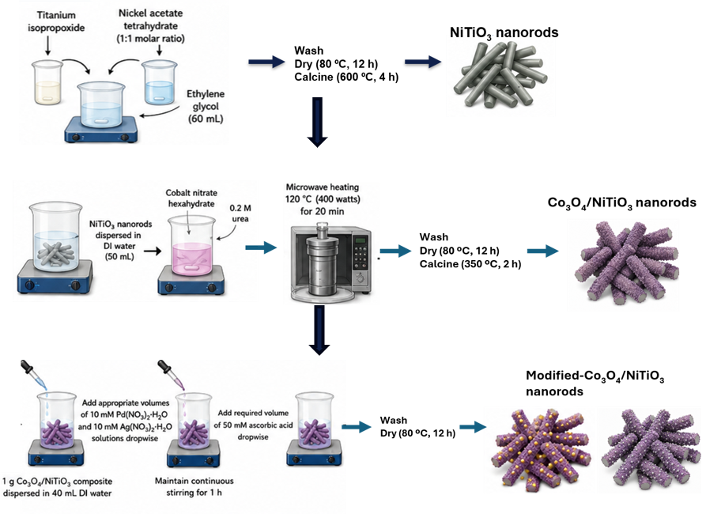

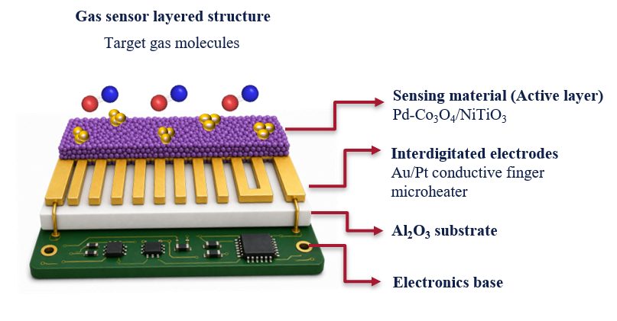
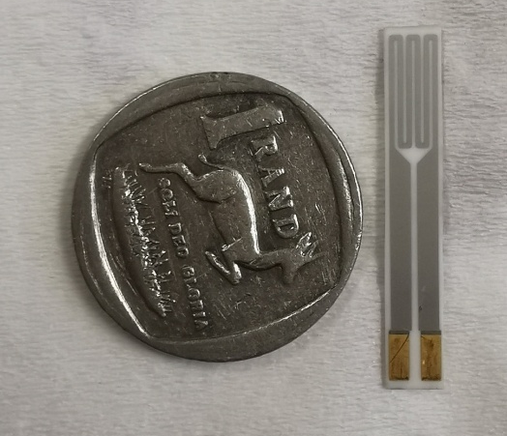
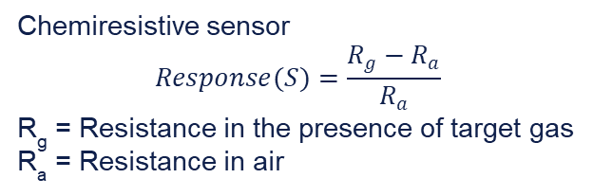
Synthesis
FRONT
BACK
Chemiresistive sensor
$$Response(S)=\frac{R_{g}−R_{a}}{R_{a}}$$
R_{g} = Resistance in the presence of target gas
R_{a} = Resistance in air
Figure 1: Schematic depiction of the synthesis process and sensor fabrication.
Notes:
Substrate = 25 x 4 x 0.25 mm
Active/heater area= 8x 3 mm

Slide 5
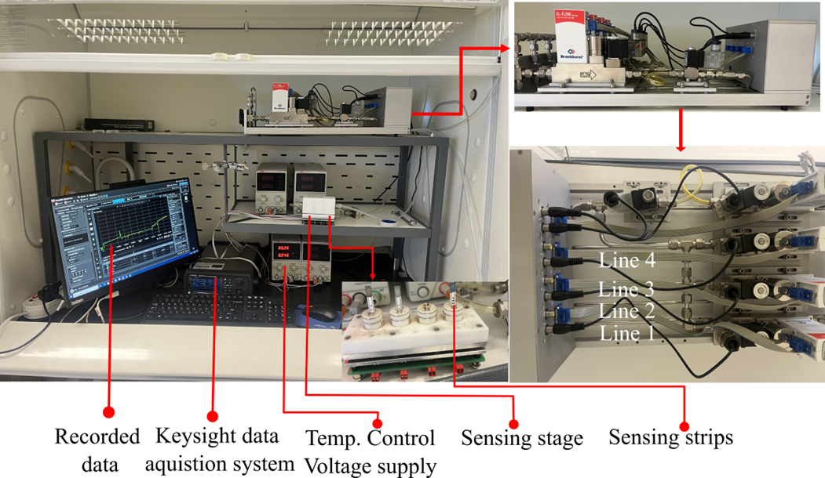
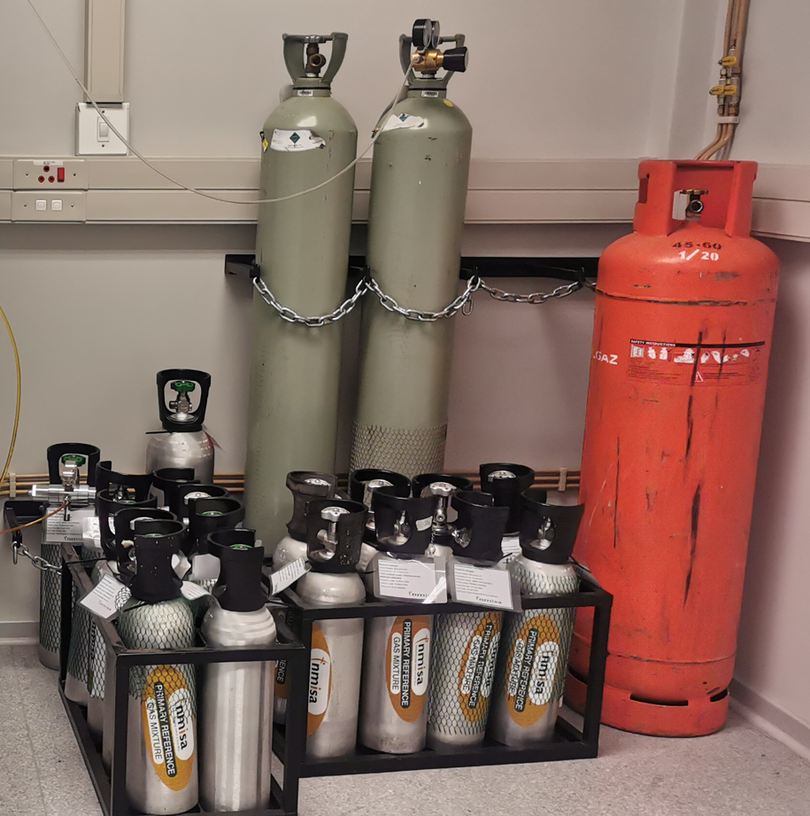
Synthesis

Slide 6
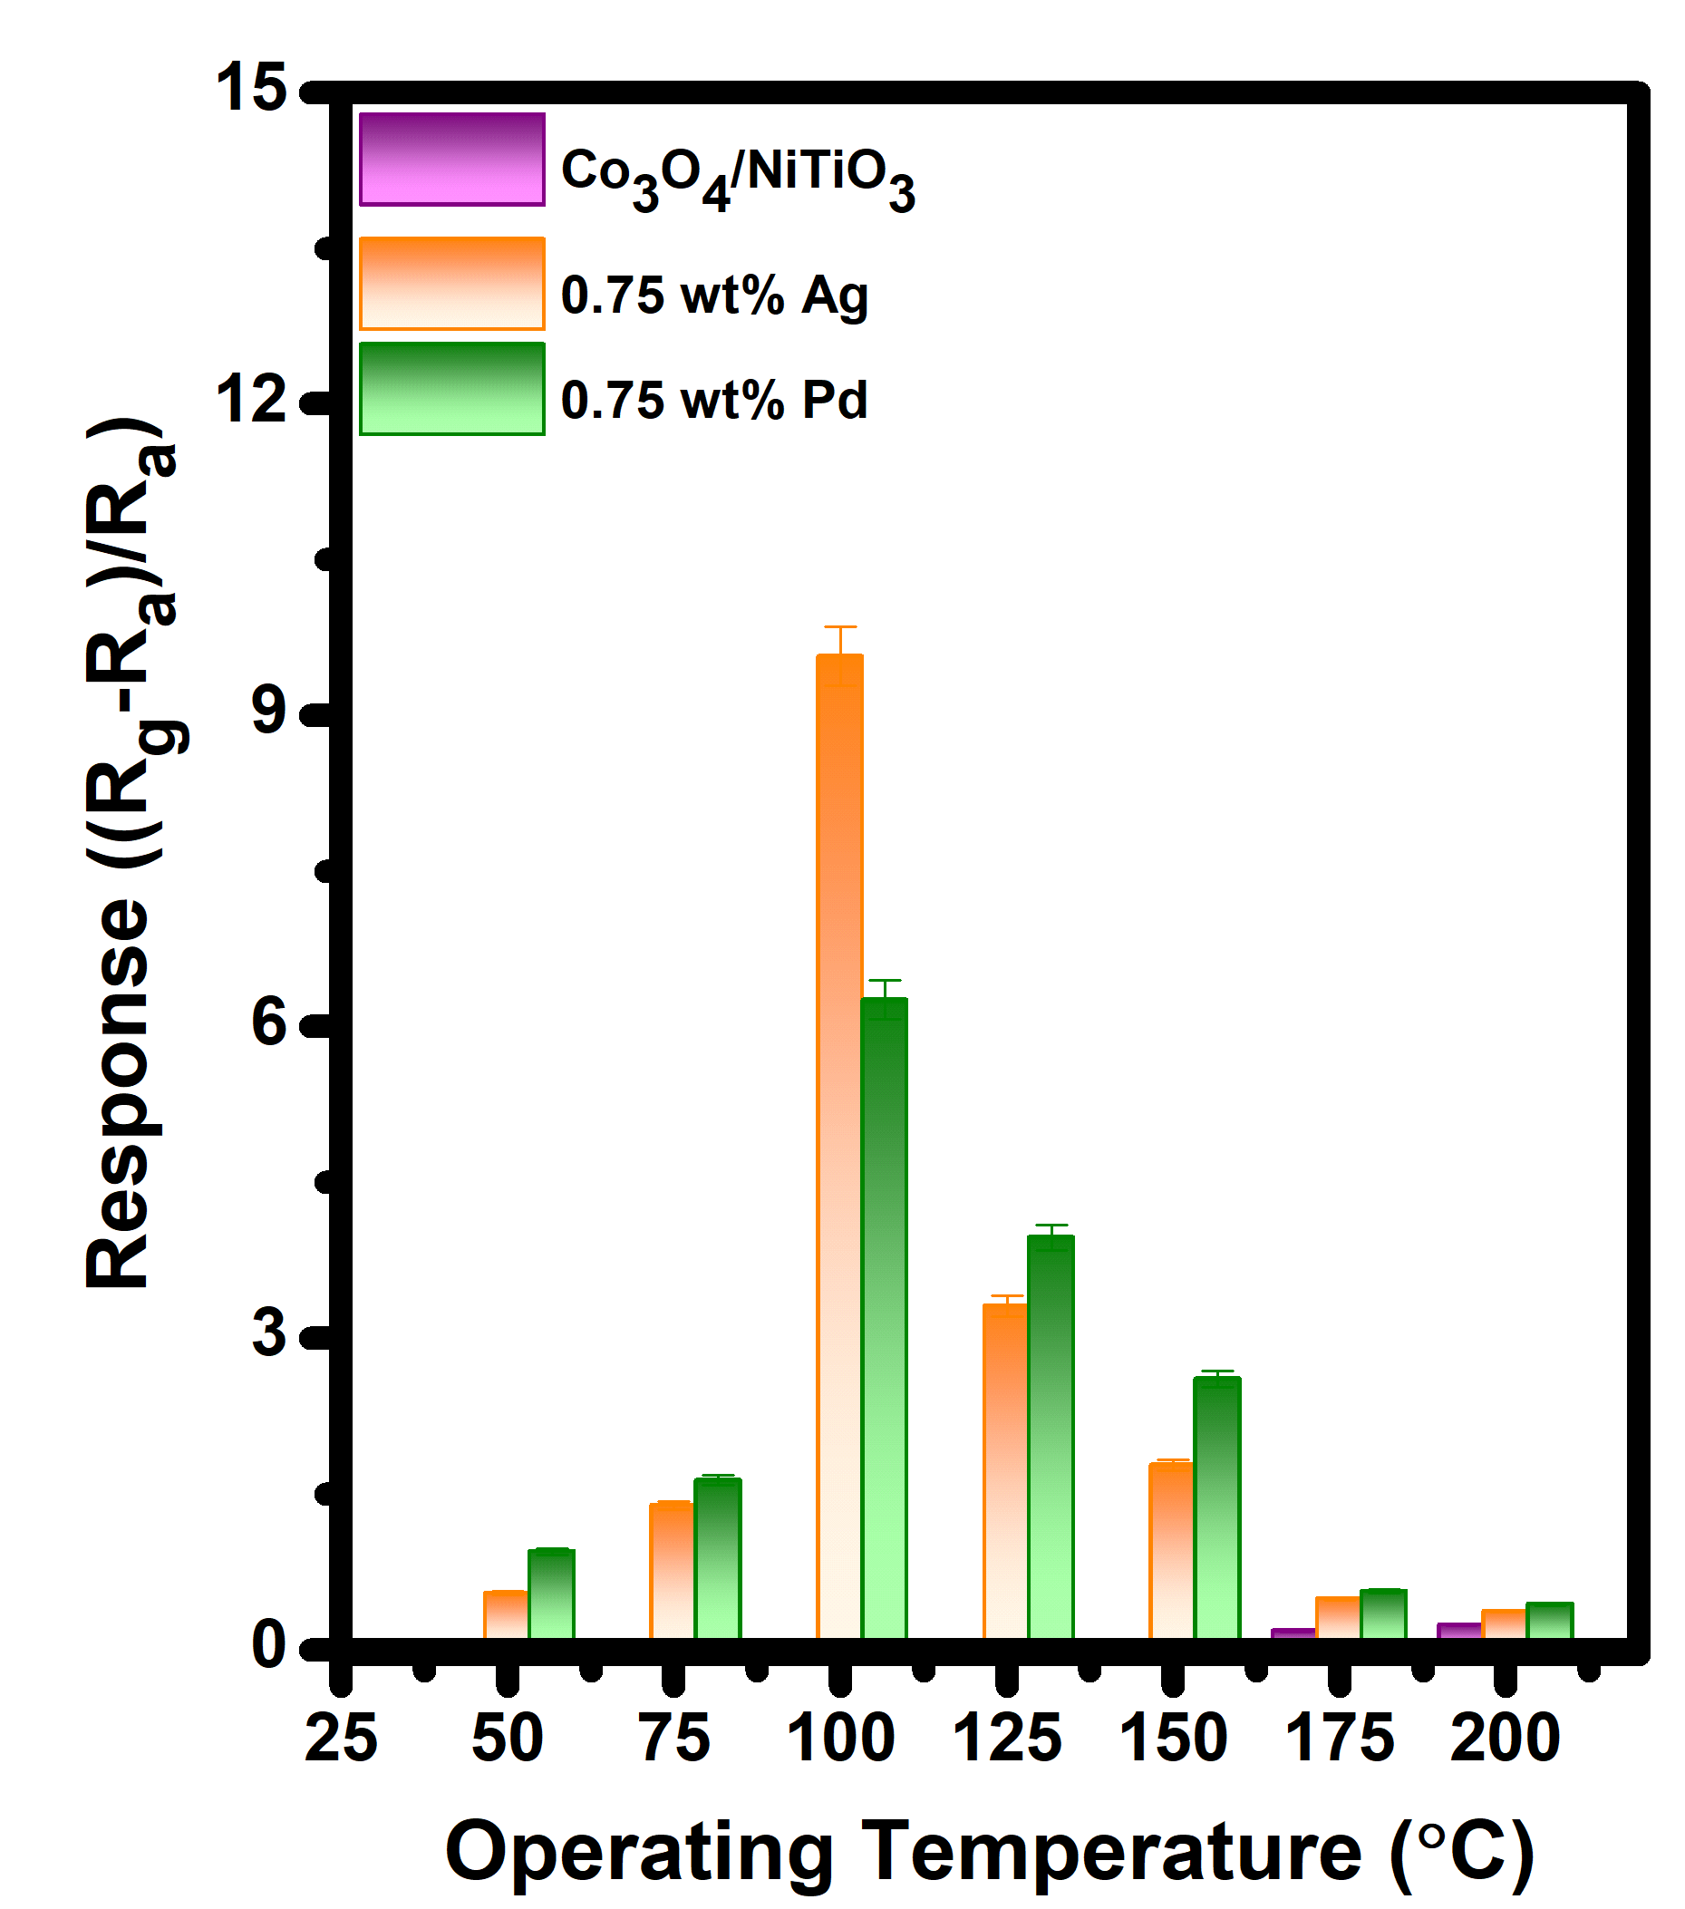
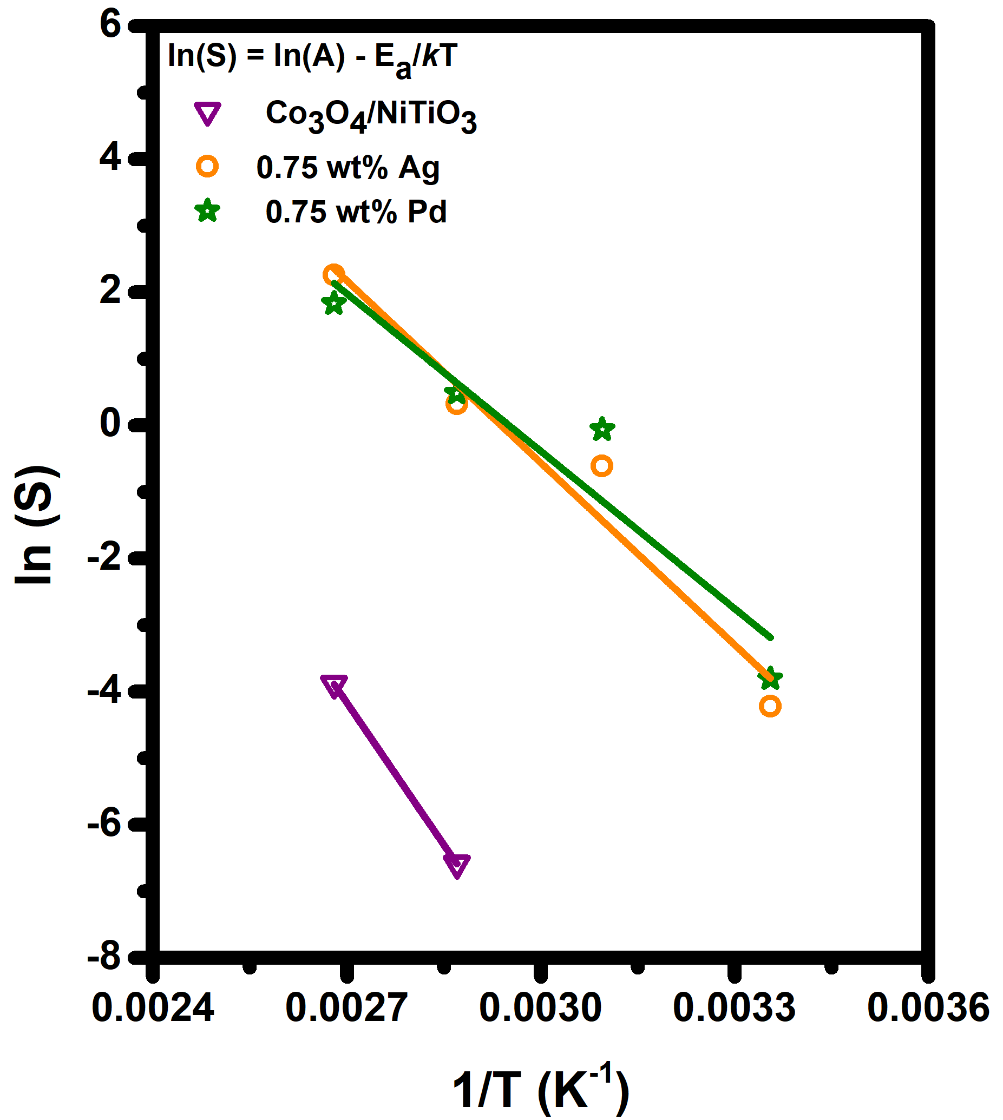
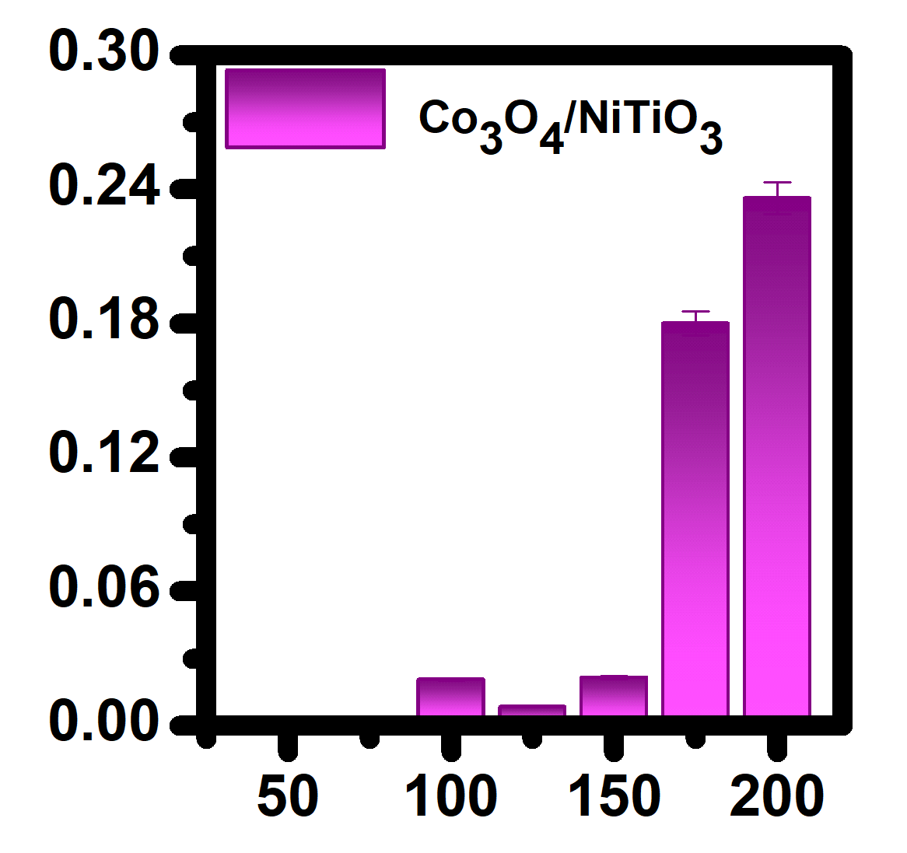


Results and Discussion
(a)
(b)
Gas Sensor Performance
  Metal loading significantly improve NO detection capability.
  Optimum Operating Temperature:
  Activation energy (E_{a}):
  Arrhenius equation
  $$S= S_{0} exp ( − \frac{E_{a}}{K_{B}T })$$
  S = response
  S₀​ = pre-exponential factor
  E_{a} = activation energy (eV)
  K_{B} = Boltzmann constant (8.617×10⁻⁵ eV)
  T = absolute temperature (K)
  Activation energy (E_{a}):
    Co₃O₄/NiTiO₃ = 1.23 eV
    0.75 wt% Ag = 0.79 eV
    0.75 wt% Pd = 0.68 eV
  Gaussian-like temperature-dependent response: Adsorption/Desorption, and surface reaction rate.
  OT = 100$℃$: Dominance of highly reactive oxygen species ${(O}^{−})$and efficient NO adsorption and conversion.
Figure 2: (a) Sensor response as a function of operating temperature toward 100 ppb NO. (b) Activation energy estimation using natural log of Arrhenius plot.
SAIP 2026
6-10 July 2026
Notes:
The metal-loaded sensors exhibit asymmetric Gaussian-like temperature dependence of the sensing response, as shown in Fig. 2(a). The response increases with temperature , reaches a maximum at the optimum operating temperature, and subsequently decreases at higher temperatures. This behavior reflects the dynamic balance between gas adsorption-desorption kinetics, and surface reaction.
The optimal Operating temperature was found to be at T=100 C which is significantly lower than that of Pristine Co/Ni (200 C). This enhanced performance at 100 °C can be attributed to adequate thermally activated charge-carrier mobility, the predominance of highly reactive chemisorbed oxygen species and Efficient adsorption and catalytic conversion of NO.
Beyond 100 °C, the sensor response decreases due to reduced surface coverage, accelerated desorption and possible oxidation or deactivation of catalytic sites.
Moreover, the reduction in the optimum operating temperature after noble-metal loading can be attributed to the lower activation energy Ea induced by surface sensitization. This activation energy was estimated utilising the natural log of Arrhenius relationship between sensor response and temperature (25-100 C) shown in Fig2(b).
Among all investigated sensors, the Pd-loaded variant exhibited the lowest activation energy toward NO detection. Thus confirming that Pd provides the most effective catalytic activation of NO molecules, promoting faster surface reaction kinetics at lower temperatures.
Which is Interesting since Ag, exhibit the highest response

Slide 7
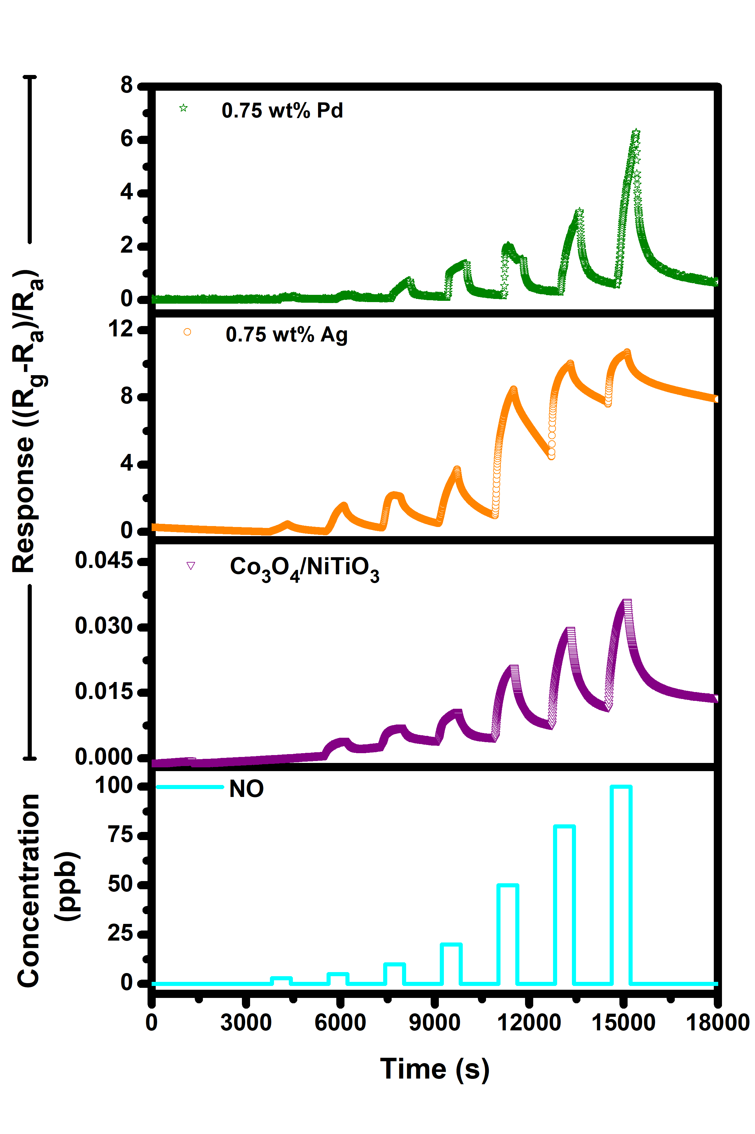
Results and Discussion
  Response-Recovery Dynamics:
  Pristine and 0.75 wt% Ag-loaded sensors display potential sensor poisoning:
    Poor recovery due to accumulation of surface species.
    Baseline shift and signal drift.
    Reduces sensor reliability.
  0.75 wt% Pd-loaded sensor exhibits:
    Faster reaction reversibility preventing surface poisoning.
    Significantly reduced signal drift and enhanced stability.
  Response time
    Co₃O₄/NiTiO₃ ~ 86 sec
    0.75 wt% Pd ~ 38 sec
    Pd –rapid adsorption kinetics
Figure 3: Dynamic sensing curve under varying NO concentration at 100 $℃$.
SAIP 2026
6-10 July 2026
Notes:
The response-recovery dynamics towards NO at 100 C revealed a systematic p-type behaviour towards a reducing gas with changes in sensor response as gas concentration increases between 3- 100 ppb. (NOTE: ppb (parts per billion) indicates the detection of 1 NO molecule among one billion air molecules, highlighting the exceptional sensitivity of these sensors towards trace levels of NO.)
The pristine and 0.75 wt.% Ag-loaded Co/Ni sensors exhibited signs of potential sensor poisoning. This was evidenced by poor recovery characteristics, resulting from the accumulation of adsorbed surface species, which caused baseline shifts and severe signal drift. Such behaviour compromises sensor reliability and may lead to false-positive warnings during practical applications.
In contrast, the 0.75 wt.% Pd-loaded sensor demonstrated superior sensing stability. The enhanced recovery behaviour indicates faster reaction reversibility and reduced accumulation of surface species, thereby minimizing sensor poisoning. As a result, significantly lower signal drift and improved baseline stability were achieved.
Even though Ag-loaded sensor may display higher response, it is not stable and unreliable and will not be further optimized in this work.
Additionally, from the Response curve, we estimated the response times. Pd revealed faster response kinetics that pristine Co/Ni. Owing to more rapid surface reactions and charge-transfer processes by the catalytic active Pd particles.

Slide 8
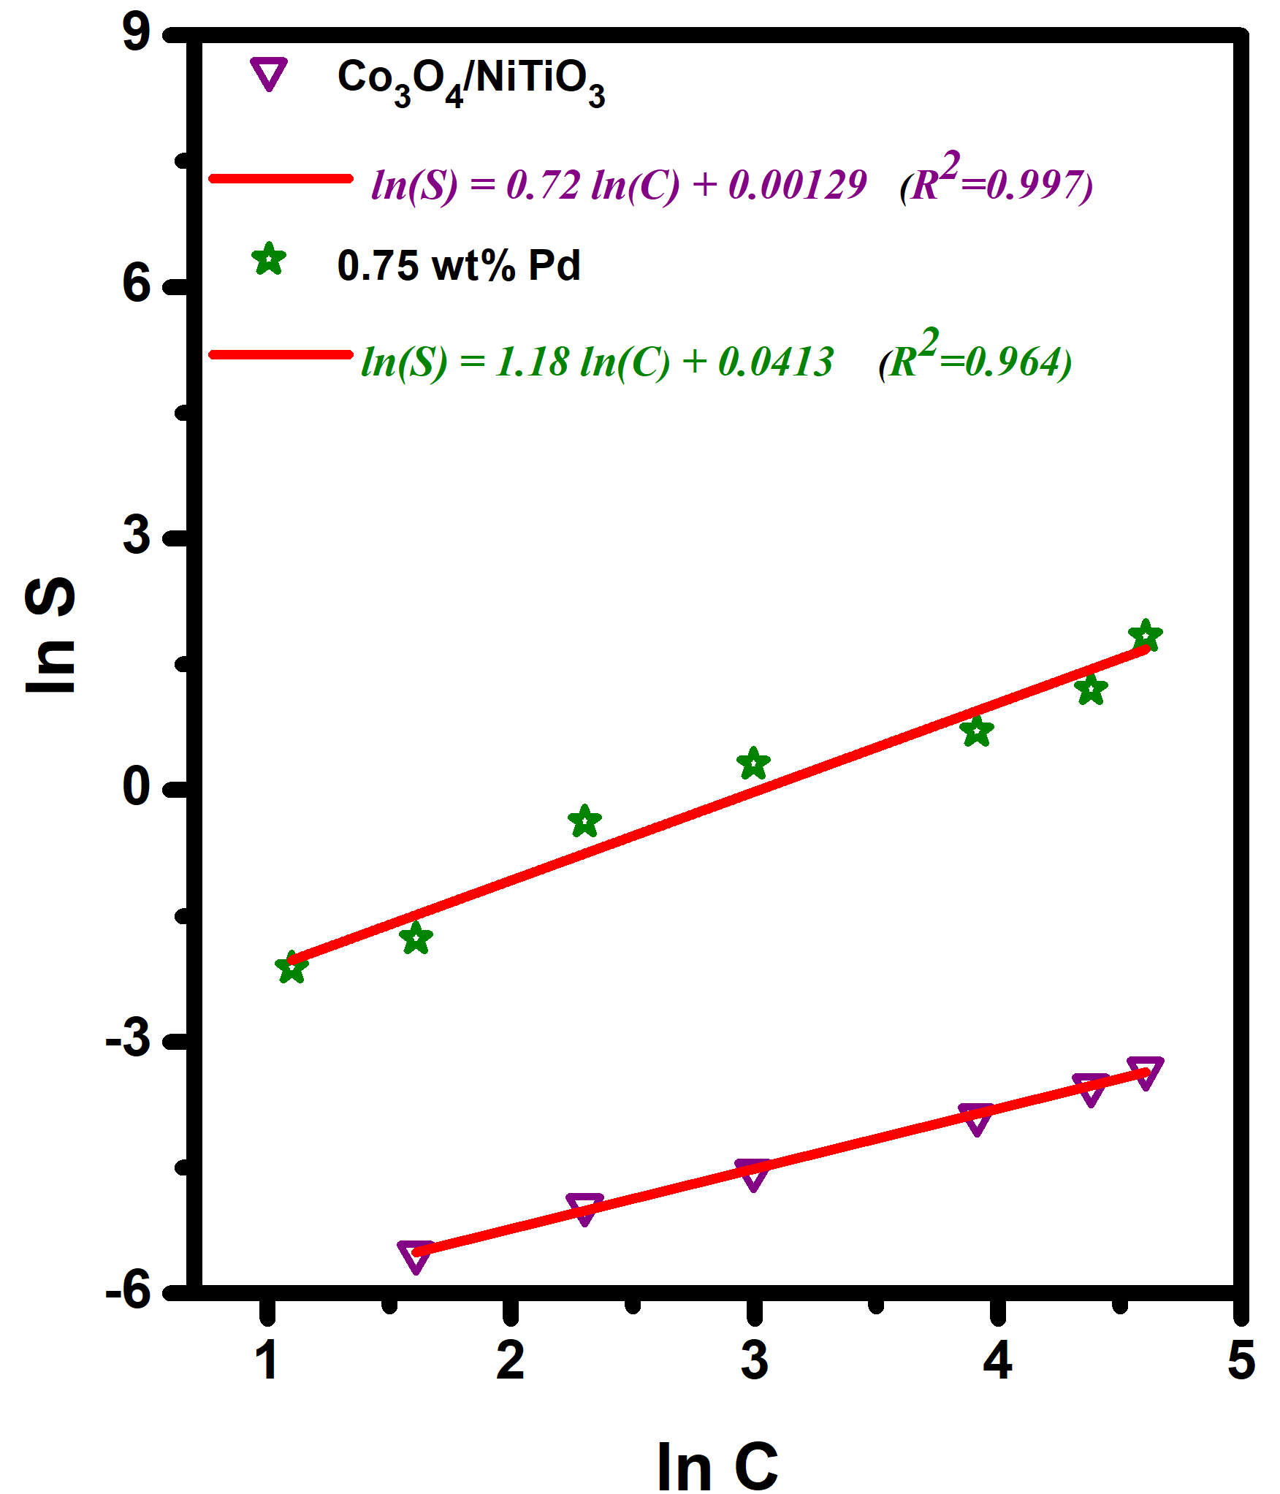

Results and Discussion
Pd improves Sensitivity
Natural logarithm of the sensor response and the gas concentration: $S=aC^{m}$
Sensitivity exponent reflects surface reaction kinetics:
  m ≤ 0.5: Oxygen ion-controlled adsorption (O⁻ dominant).
  m ≈ 1: Gas concentration dependent reaction.
  m > 1: Multi-step reactions and catalytic enhancement.
  Pristine (m < 1): Limited surface reaction or adsorption-controlled behavior.
  0.75 wt% Pd-loaded sensors (m > 1): Catalytic activated reactions improved charge transfer and gas conversion.
  Limit of detection (LOD) = 0.5 ± 0.04 ppb
Figure 4: log–log plot of sensor response (ln S) versus NO gas concentration (ln C).
SAIP 2026
6-10 July 2026
Notes:
The response-concentration dependence follows a power-law relationship, $S=aC^{b}$.
The significantly enhanced sensitivity achieved through Pd loading was further confirmed by the sensitivity exponent, estimated as the slope (m) of the linear relationship between the natural logarithm of the sensor response (ln S) and the gas concentration (ln C).
The slope reveals critical insights into the underlying surface reaction kinetics, where
m </= 0.5: reflects Oxygen ion-controlled adsorption mechanism,
m ≈ 1: reflect a gas concentration dependent reaction, while
m > 1: indicates complex multi-step reaction pathways which may include catalytic enhancements.
From Fig4, we observe a Limited surface adsorption-controlled behavior for Pristine and 0.75 wt% Ag-loaded sensors. While, 0.75 wt% Pd-loaded sensors (m > 1) revealed Catalytic activated reactions which improves charge transfer and gas conversion.
The presence of Pd nanoparticles promotes NO adsorption, dissociation, and surface redox processes, thereby enhancing charge transfer between the adsorbed species and the sensing material. Consequently, more efficient gas conversion and stronger modulation of the electrical properties are achieved, resulting in superior sensitivity.
Furthermore, the lowest detection limited was estimates form the slope of the Resp vs Concentration graph and the root mean square (RMS) noise of the sensor baseline. The calculated LOD was found to be [~0,5 ppb] ppb, demonstrating the sensor's capability to detect ultra-low concentrations of NO and underscoring its potential for trace gas monitoring applications.

Slide 9
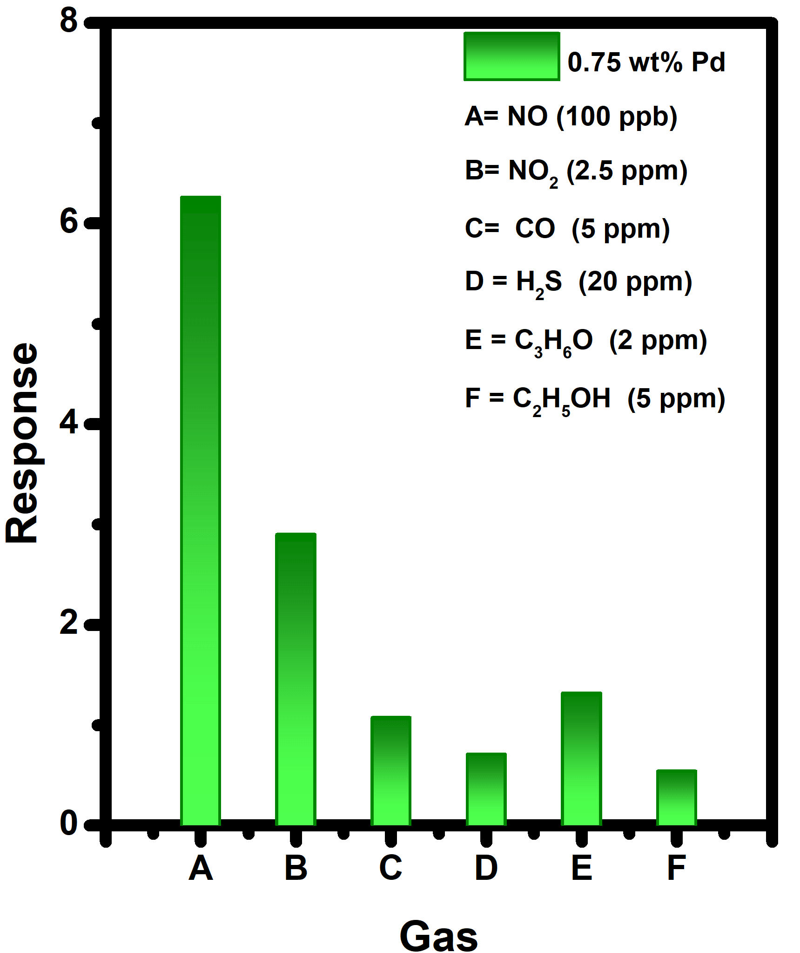
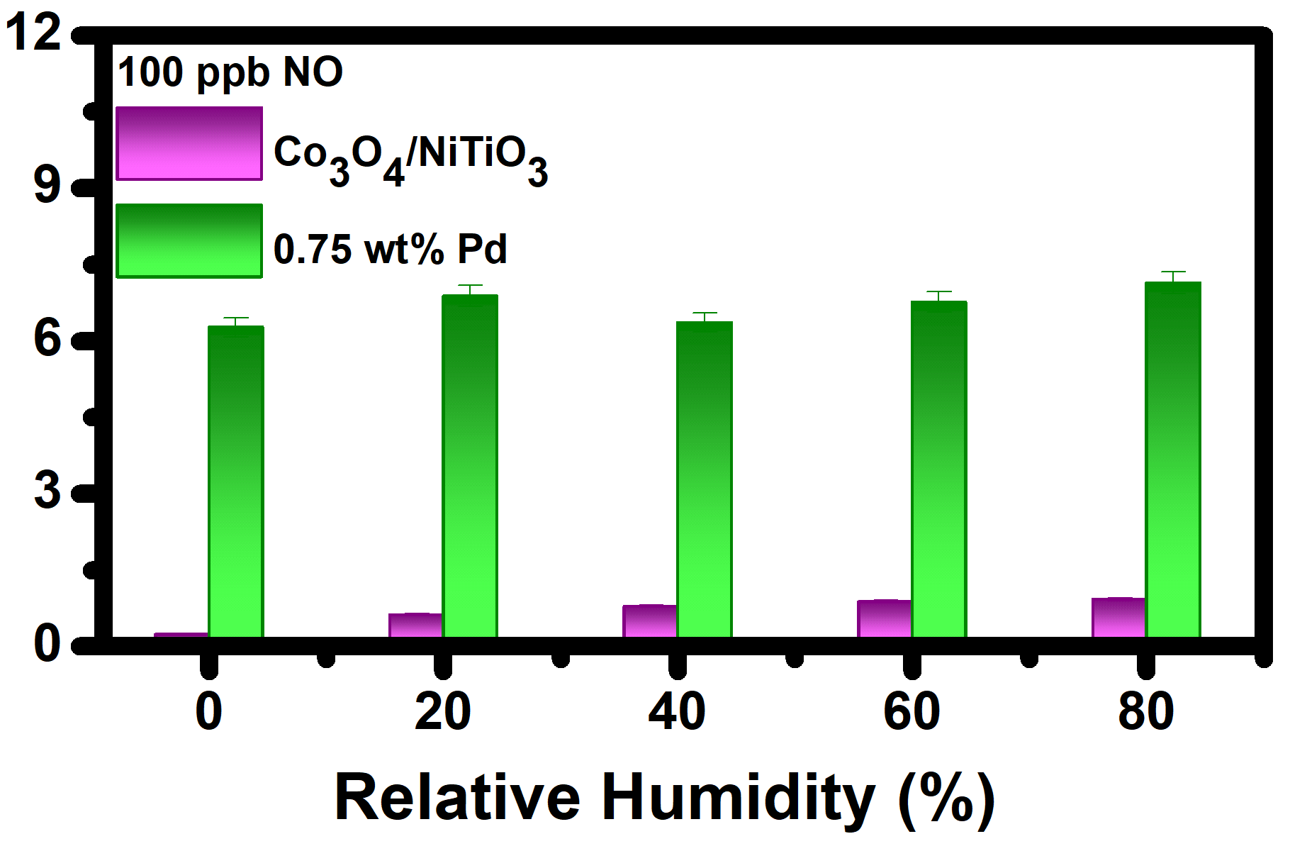

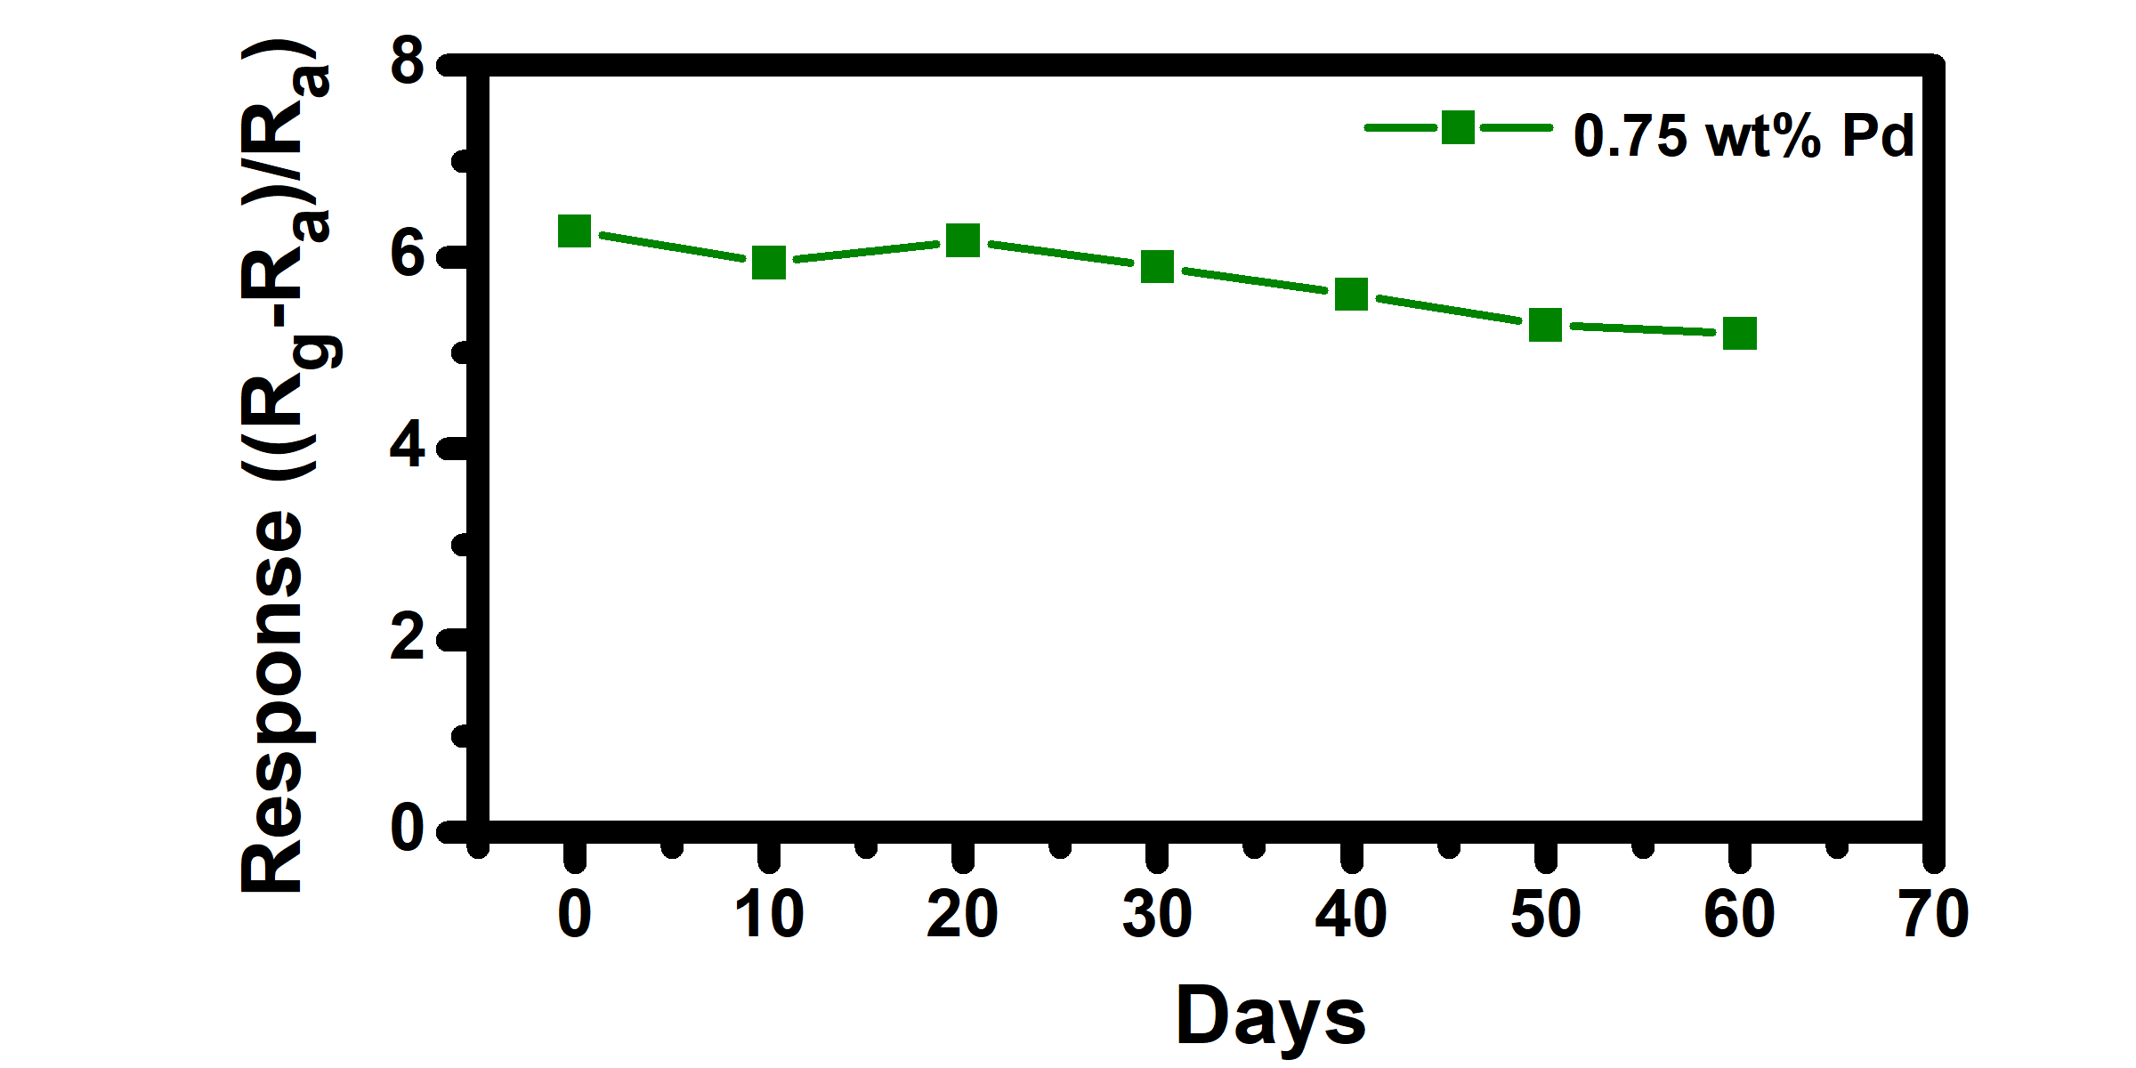
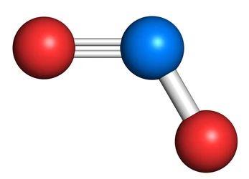
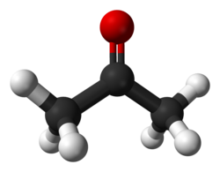
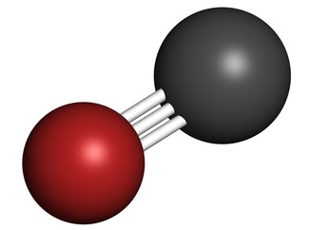
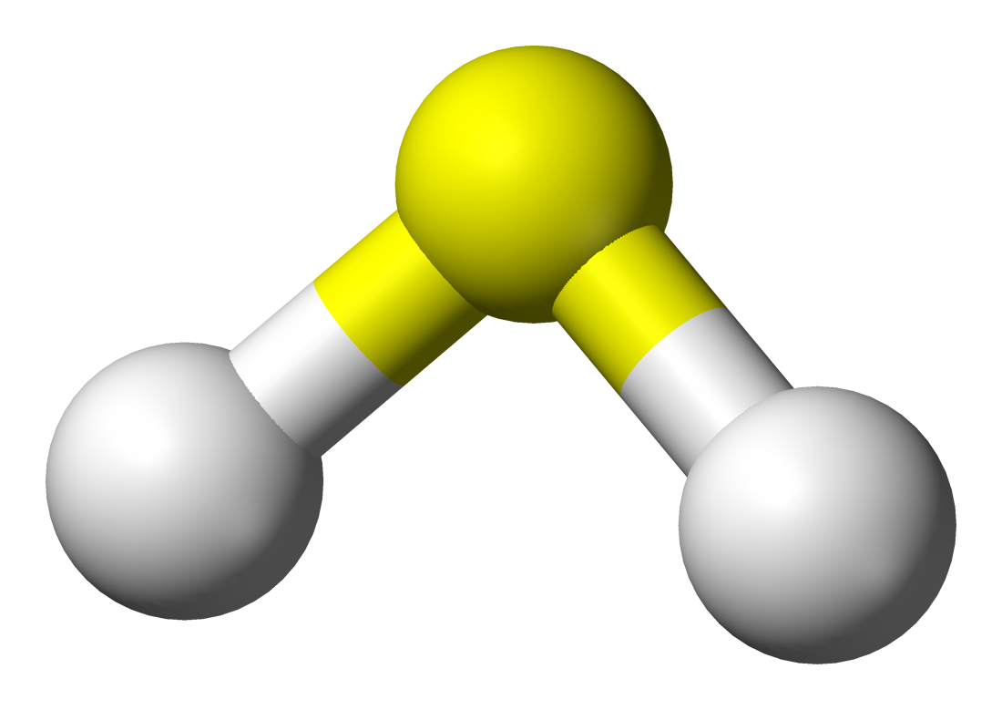
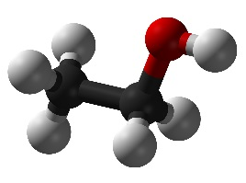
Results and Discussion
APPLICABILITY
  SELECTIVITY at 100 °C
  Pd acts as a Catalytic filter of VOCs
  NO is a radical with an unpaired electron
  Strong chemisorption of H₂S results to surface poisoning.
(a)
(b)
  RELATIVE HUMIDITY
  Pristine sensor: RH dependence (≈ 293%)
  Pd-loaded sensor: Tolerance (≈ 14%)
  STABILITY
  minor signal drift, gradual, degradation
  ≈17 % over 60 days
(c)
Figure 5: (a) Selectivity plot, (b) Response against Relative humidity plot and (c) Long term stability.
SAIP 2026
6-10 July 2026
Notes:
The Pd-sensitized Co/Ni heterostructures demonstrated promising practical applicability,
exhibiting high selectivity towards NO when compared with other interfering gases at their respective permissible exposure limits (PELs) as defined by OSHA standards.
The Selectivity towards NO is governed by distinct reversible surface interaction energetics and catalytic pathways.
While CO and volatile organic compounds exhibit weak physisorption with negligible charge transfer, Pd nanoparticles selectively reduce the chemical activation energy barrier specifically for NO chemisorption, leading to accelerated reaction kinetics and a dominant response.
In contrast, strong chemisorption of H2S induce surface poisoning through the formation of stable sulfur-containing species. These species block the active adsorption sites and hinder subsequent gas-surface reactions, thereby reducing sensor performance.
Robustness of the sensor with:
Strong tolerance to humidity with minor variation ~14% while Pristine Co/Ni had major dependence with >200% interference.
Additionally, Pd-loaded show improved life cycle over 60 days with minor signal drifts confirming the durability of the Pd-sensitized heterostructure.
The drift can be mitigated by minimizing common long-term vulnerabilities, such as surface contamination, catalyst aging, and the partial deactivation of active catalytic sites.

Slide 10
Discussion
Table 1: Comparison of Heater Performance and Energy Consumption
Parameter | Co₃O₄/NiTiO₃ | 0.75 wt% Pd- Co₃O₄/NiTiO₃
Operating temperature (°C) | 200 | 100
Applied voltage (V) | 5.53 | 3.51
Pt heater resistance (Ω) @ 25 °C | 15 | 15
Pt heater resistance (Ω) @ OT | 24.04 | 18.93
Power consumption (W) | 1.27 | 0.65
Conduction loss (W) | 0.77 | 0.47
Convection loss (W) | 0.35 | 0.15
Energy consumption (8 h) (Wh) [2000 mAh battery] | 10.2 | 5.18
Energy consumption (3 min) (Wh) [2000 mAh battery] | 0.00635 | 0.00324
Suitable for portable & battery-powered devices

Slide 11
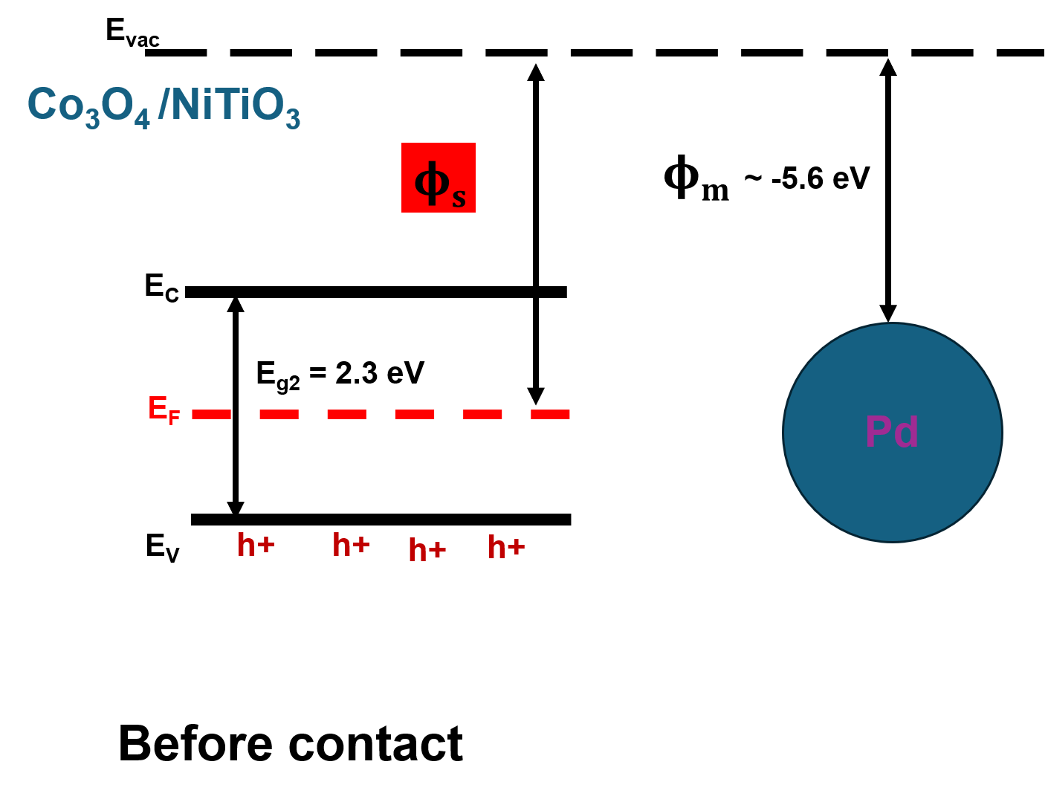
Sensing mechanism
Sensing Mechanism
1: Electronic sensitization: Charge carrier modulation
  p-n Heterojunction
  Localized metal-semiconductor junction
Co₃O₄/NiTiO₃ barrier modulation at the interface promotes charge transfer and gas adsorption
Pd⁰ nanoparticles provide localized metal-semiconductor contact further enhancing charge modulation
Figure 6: Schematic representation of the proposed sensing mechanism.
SAIP 2026
6-10 July 2026

Slide 12
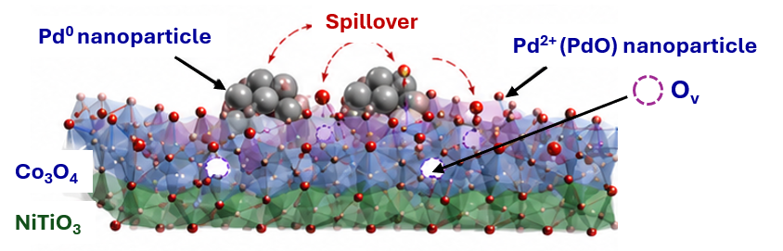


Sensing mechanism
Sensing Mechanism
2: Chemical sensitization: Surface Chemistry
  Catalytic spillover effect
  Enhanced adsorption & reaction of NO
Amplified charge transfer >> enhanced sensitivity and rapid response
Pd⁰ nanoparticles catalyses O₂ activation and NO oxidation
Spillover of reactive oxygen species form the metal particles to the Co₃O₄/NiTiO₃ surface ultimately increasing adsorption sites.
$$NO+O^{−}→{NO}_{2}+e^{−}$$
$$NO+O^{−}→{NO}_{2}^{−}$$
$O_{2(gas)}+e^{−}→O_{2}^{−}$_{(ads)}
$O_{2(ads)}^{−}+e^{−}→{2O}^{−}$ _{(ads)}
Figure 6: Schematic representation of the proposed sensing mechanism.
SAIP 2026
6-10 July 2026

Slide 13
Conclusions
Pd outperformed Ag in overall gas-sensing performance.
Lower activation energy (0.68 eV) accelerated surface reaction kinetics, enabling low-temperature operation (100 °C).
Enhanced surface reactions and efficient charge transfer leading to Ultra-high sensitivity (LoD = 0.5 ppb).
Faster response–recovery dynamics, improved long-term stability, and better humidity tolerance (~14%).
Lower operating temperature directly reduces power consumption (~50%), demonstrating suitability for portable and battery-powered sensing platforms.
SAIP 2026
6-10 July 2026

Slide 14
References
[1] B.C. Tladi et al. Sensors and Actuators B: Chemical 446 (2026) 138687. https://doi.org/10.1016/j.snb.2025.138687
[2] C. Alex et al. ACS Appl. Energy Mater. 3 (6) (2020) 5439–5447. https://doi.org/10.1021/acsaem.0c00297
[3] T. Wei et al. Sensors & Actuators: B. Chemical 444 (2025) 138335. https://doi.org/10.1016/j.snb.2025.138335
[4]K. Zeng et al. Sensors and Actuators B: Chemical 441 (2025) 138033. https://doi.org/10.1016/j.snb.2025.138033
[5]T. Wei et al. Journal of Alloys and Compounds 947 (2023) 169651. https://doi.org/10.1016/j.jallcom.2023.169651
SAIP 2026
6-10 July 2026

Slide 15



This work is based on the research supported by the South African Research Chairs Initiative of the Department of Science and Innovation and the National Research Foundation of South Africa.
Siyabonga
Tshabalala.ZP@ufs.ac.za І www.ufs.ac.za

Slide 16





Introduction
Problem Context
  Increasing NOₓ (NO, and NO₂) emissions with severe impact on: Air quality, environment and human health, and medical diagnostics
  Demand for real-time, ultra-sensitive, low-cost monitoring technologies
Limitations of Current Sensors
  Poor sensitivity
  humidity interference
  High operating temperature
AIM: Develop a low-power, highly sensitive (ppb-level) NOₓ sensor Noble metal-sensitized Co₃O₄/NiTiO₃ heterojunctions
Nox Emission: Automotive, Metallurgy, Energy production, Cement manufacturing, and FeNO biomarker.
Notes:
There is a global surge in the emission of Nitrogen oxide (NOx) gases, which are primarily nitric oxide (NO), nitrogen dioxide (NO₂)
> These gases are highly reactive and toxic posing severe impact on Air quality, Environment sustainability and human health.
Primary sources of NOx emissions include human activities and industrialization such as energy production, metallurgical operations, and automotive exhaust emissions.
Furthermore, recent medical studies have identified NO as an important biomarker for respiratory diseases, detectable in exhaled breath. Therefore, there is a critical need for real-time, ultra-sensitive, selective and low-cost monitoring technologies.
Current gas sensor devices based on semiconducting metal oxides have limitation/drawbacks such as poor sensitivity, limited selectivity, humidity interference, and most importantly they operate at elevated temperatures leading to high energy consumption and shorter life span.
Here in we present low-power, highly sensitive NOₓ gas sensors with improved stability owing to Pd-sensitized Co₃O₄/NiTiO₃ heterostructures.

Slide 17
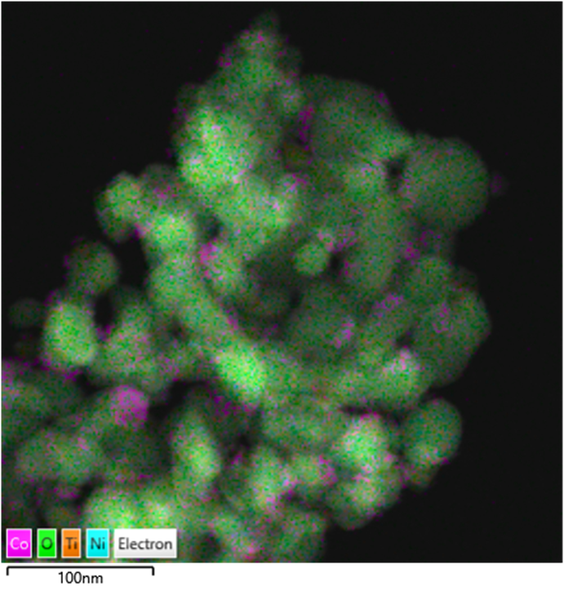
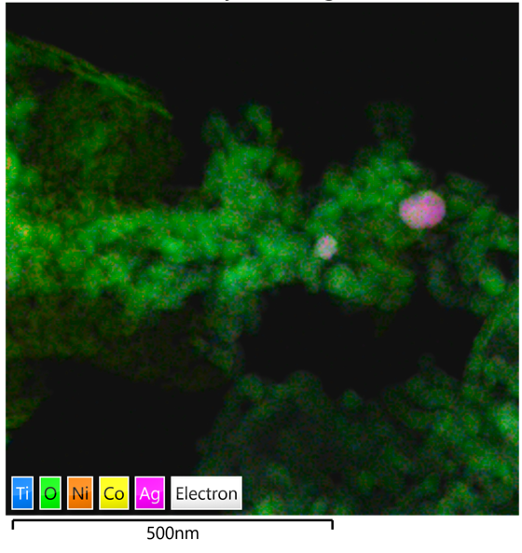
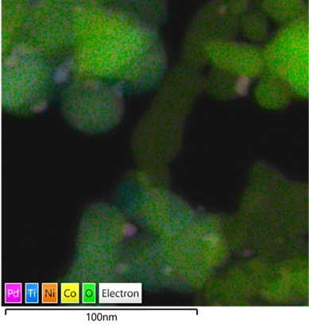
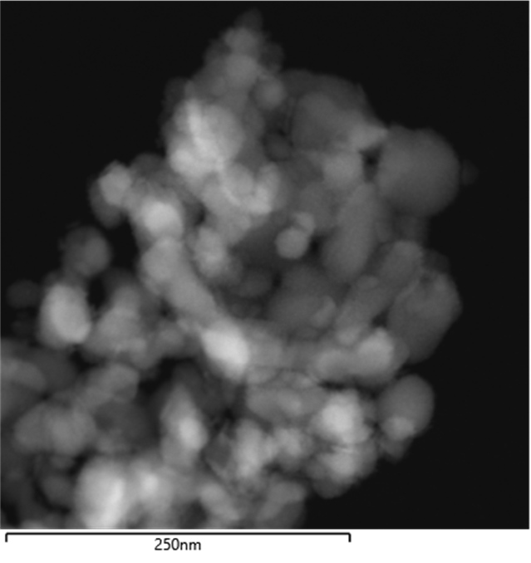
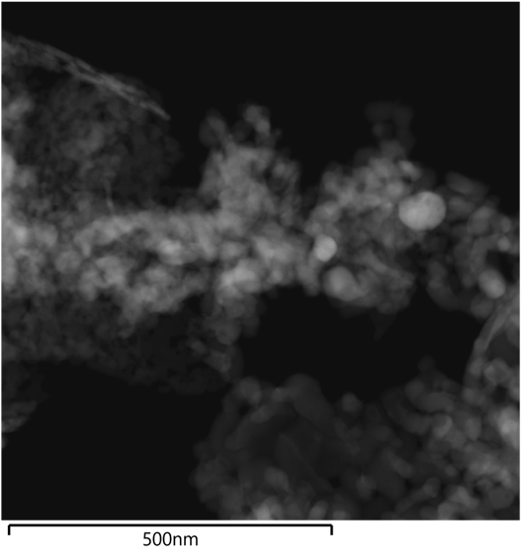
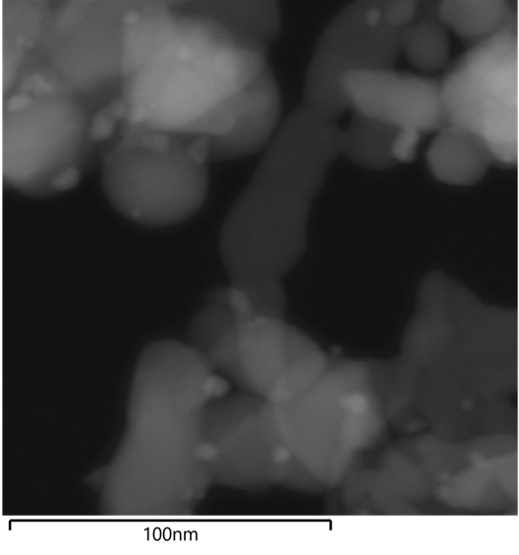
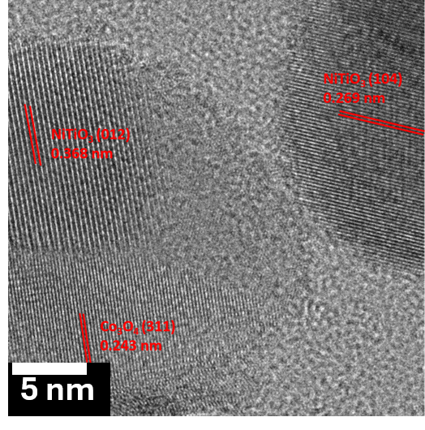
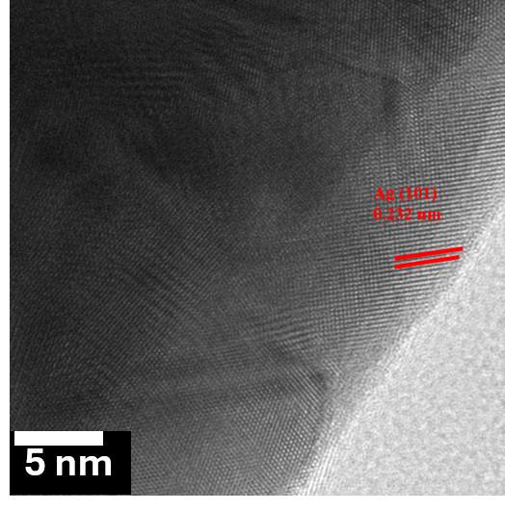
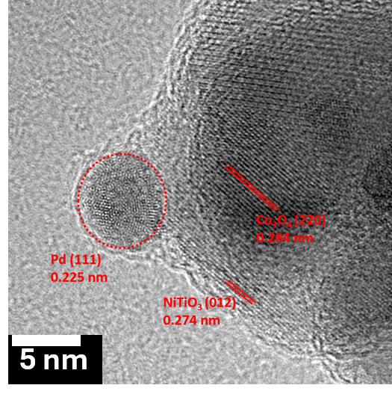
Results and Discussion
(a)
(b)
(c)
Figure 7: (a-c) Elemental mapping spatial distribution, (d-f) Dark Field TEM, (g-i) HR-TEM images of pristine Co₃O₄/NiTiO₃ and those loaded with 0.75 wt% Ag and Pd.
(d)
(e)
(f)
(g)
(h)
(i)

Slide 18
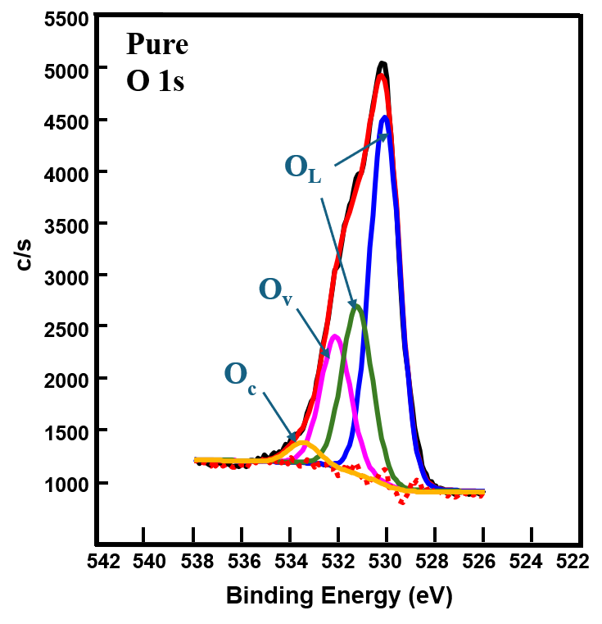
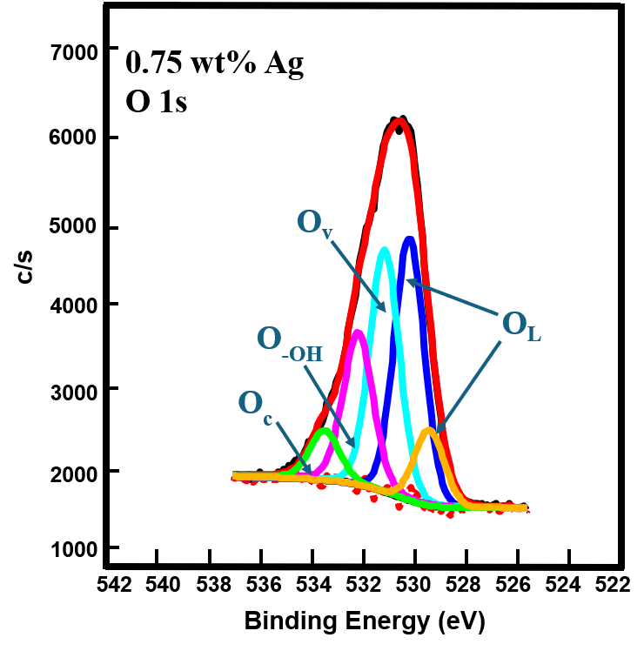
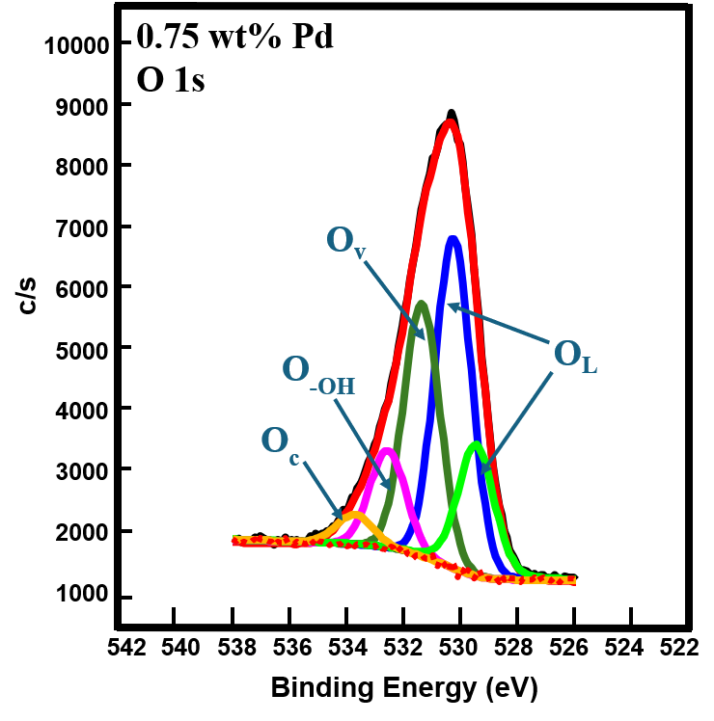
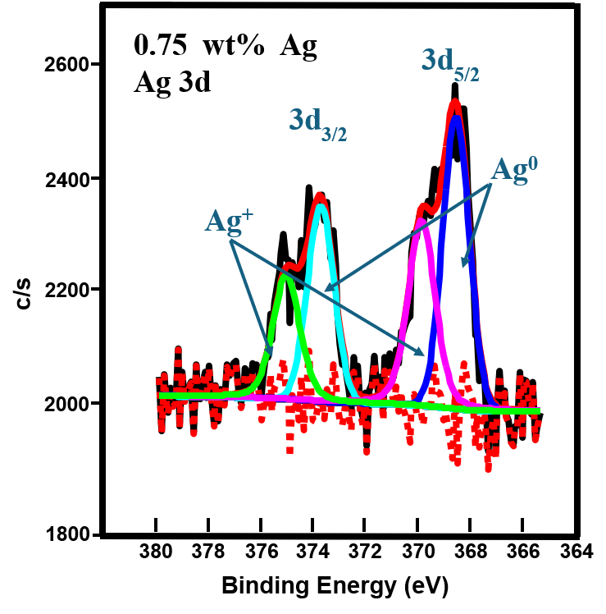
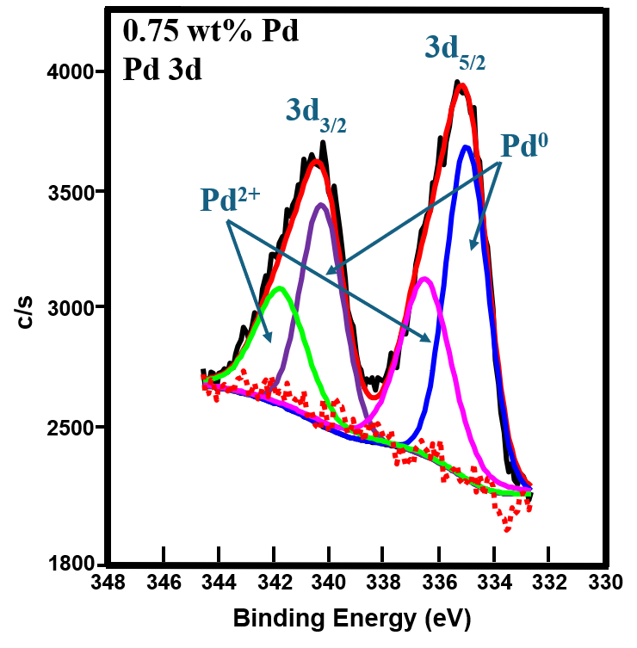
Results and Discussion
Figure 7: XPS analysis of the O 1s, Ag 3d and Pd 3d core spactra.
SAIP 2026
6-10 July 2026

Slide 19
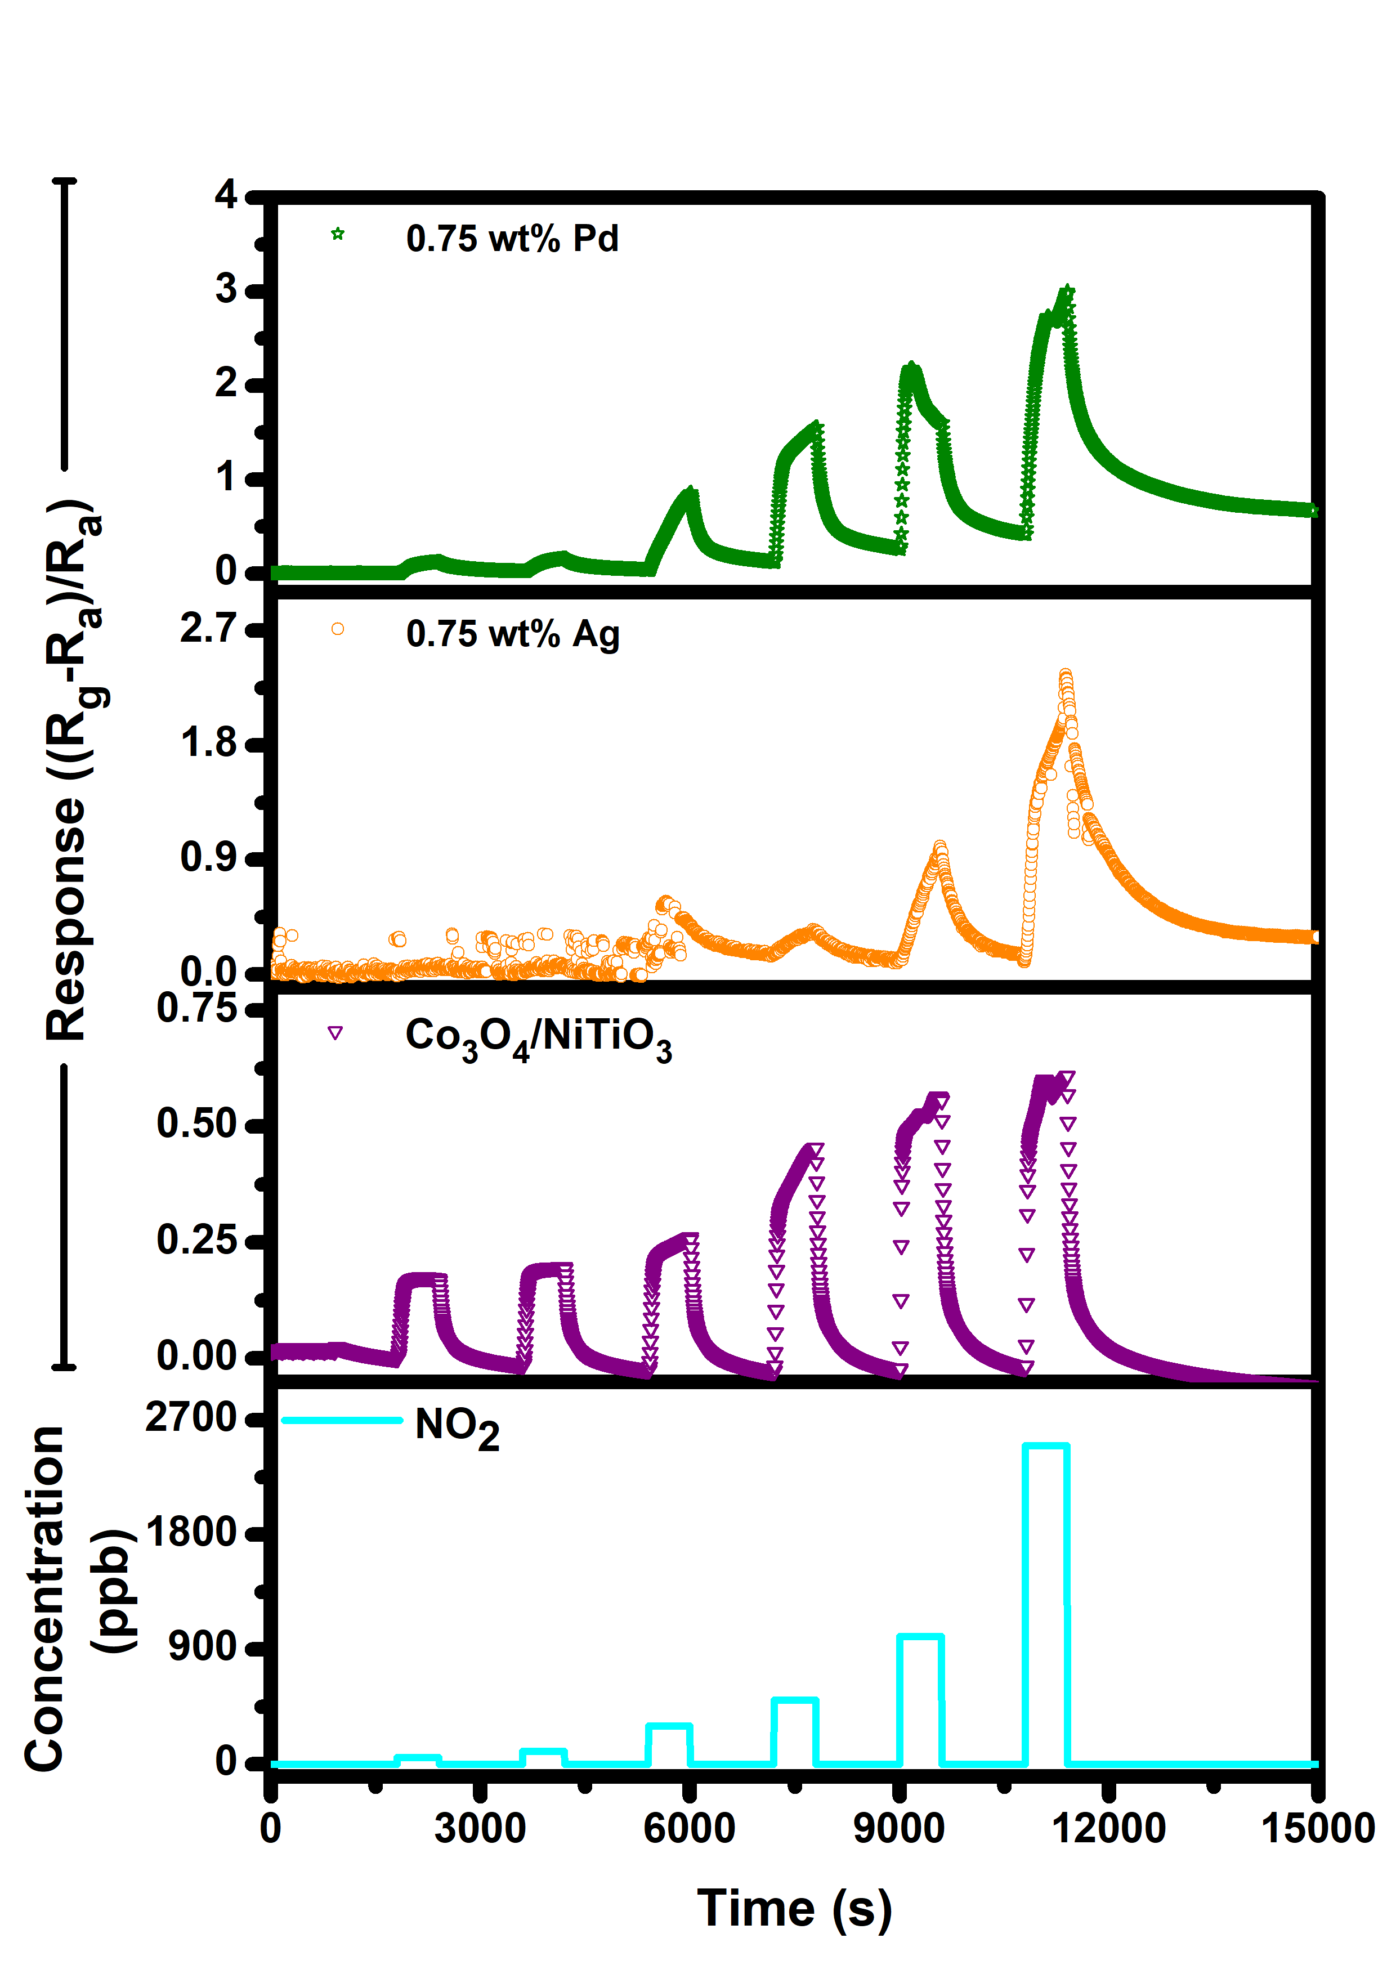
Results and Discussion
(a)
(b)
Gas Sensor Performance
  Response-Recovery Dynamics:
  Pristine and 0,75 wt% Ag-loaded sensors are unreliable due to poor recovery resulting to major signal drift.
  0,75 wt% Pd-loaded Co₃O₄/NiTiO₃ sensors high response and improved signal drift.
Figure 2: Dynamic sensing curve under varying (a) NO and (b) NO₂ concentration at 100 $℃$.
SAIP 2026
6-10 July 2026

Slide 20
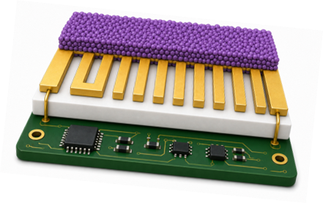
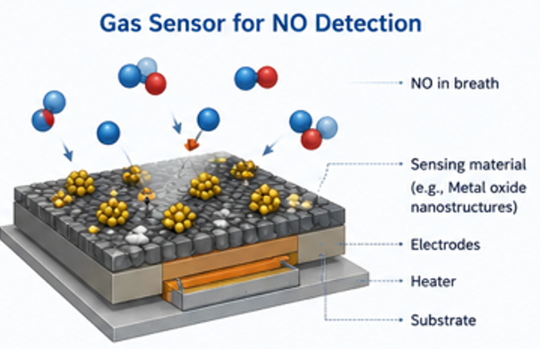
Synthesis
Gas sensor layered structure
Target gas molecules
Sensing material (Active layer)
Pd-Co₃O₄/NiTiO₃
Interdigitated electrodes
Au/Pt conductive finger
microheater
Al₂O₃ substrate
Electronics base
6-10 July 2026

Slide 21
Data/results/discussing
Material Cost:
Co₃O₄/NiTiO₃ : moderate cost
Pd precursors: dominant cost
Fabrication processes:
Sol–gel / hydrothermal synthesis
Calcination (energy cost)
Drop-casting / coating
Substrate fabrication/Purchase
SAIP 2026
6-10 July 2026

Slide 22
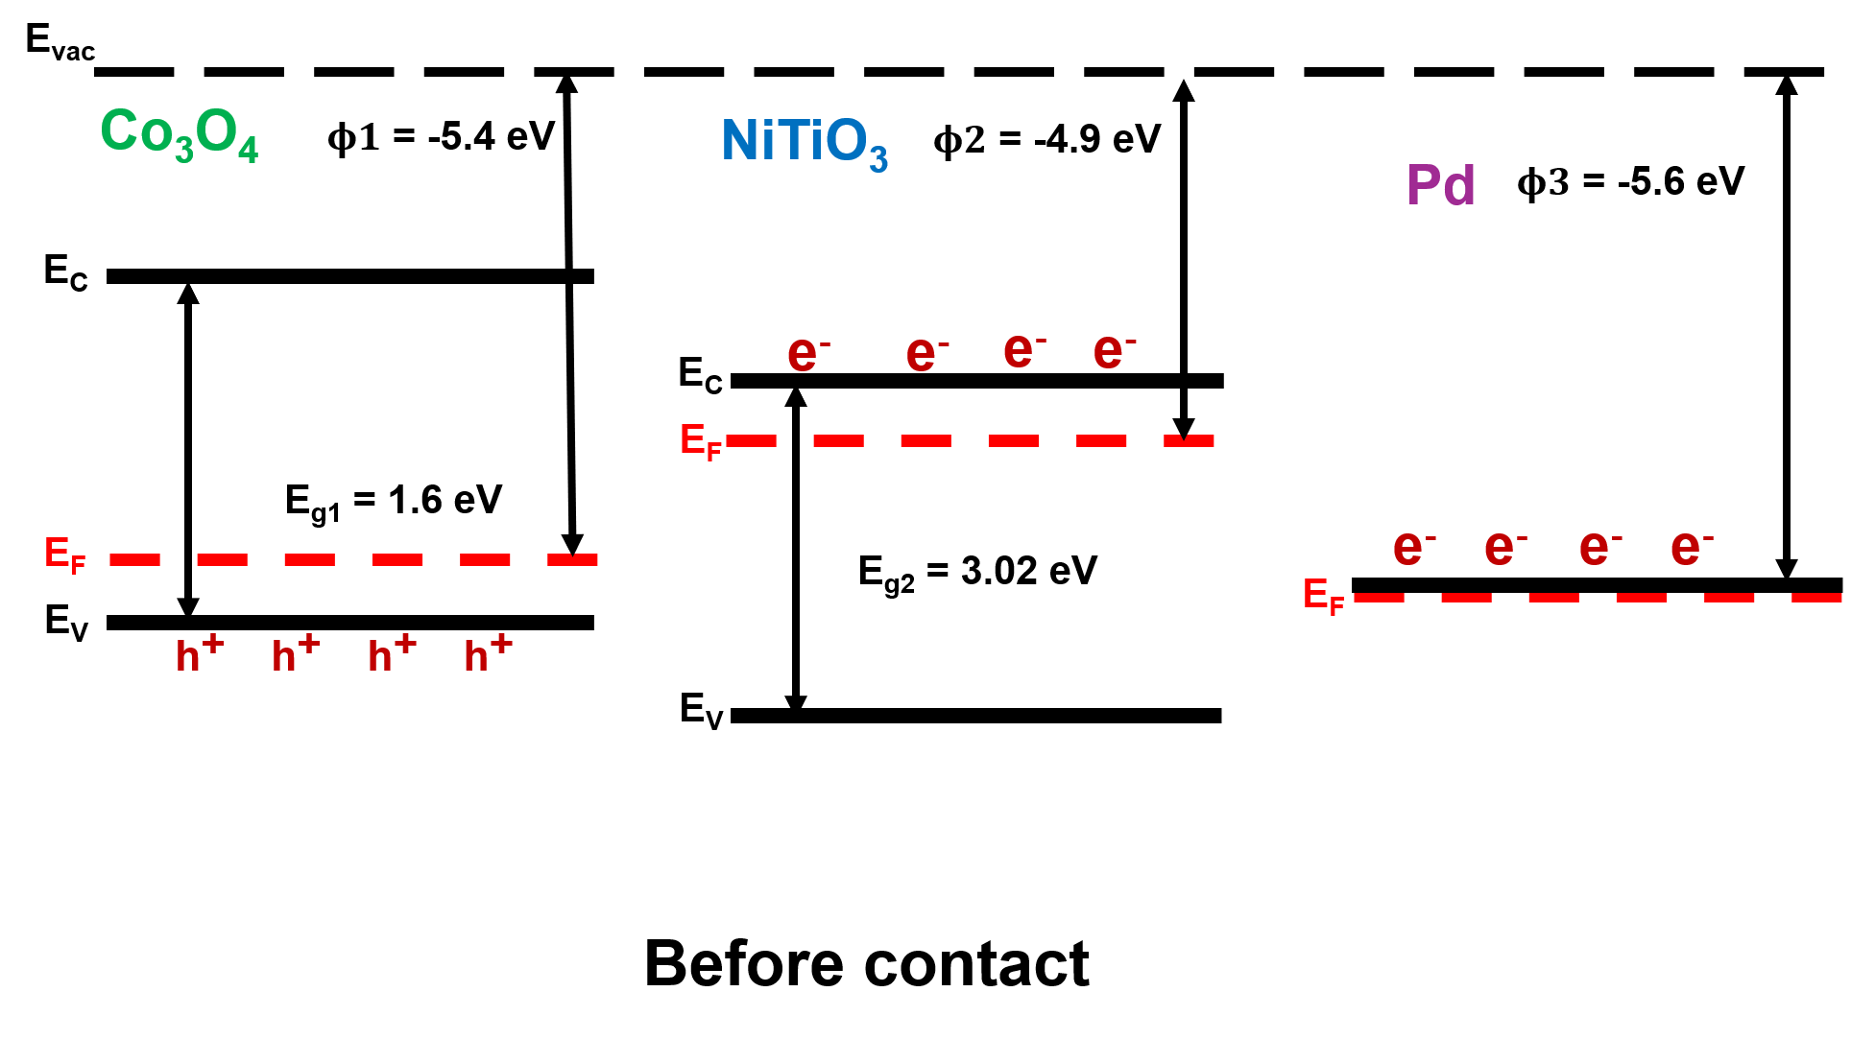

Slide 23
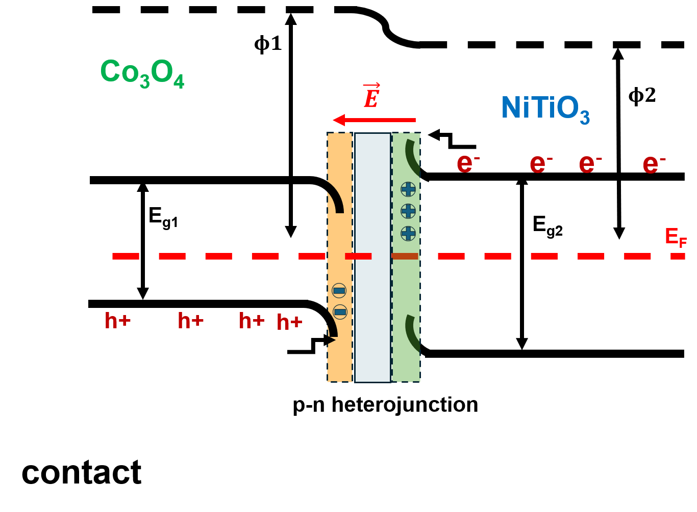

Slide 24
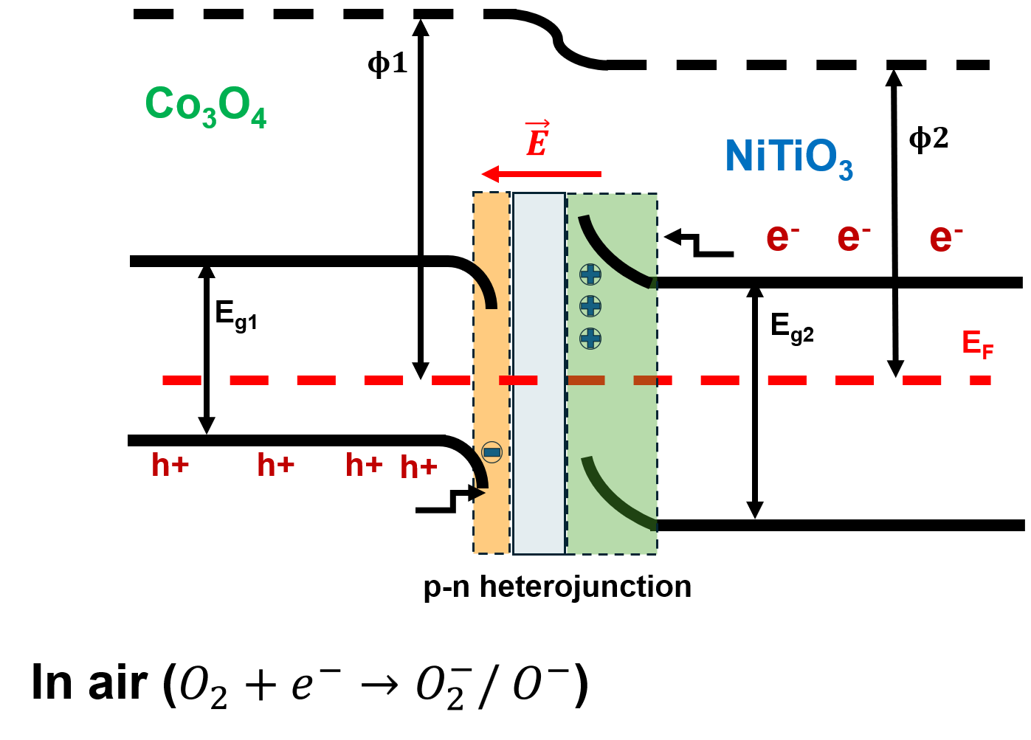

Slide 25
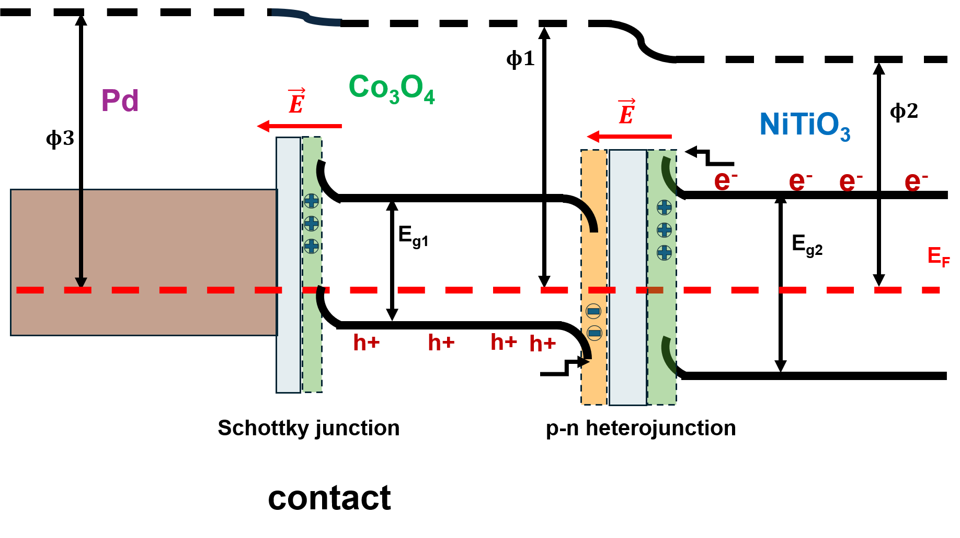

Slide 26
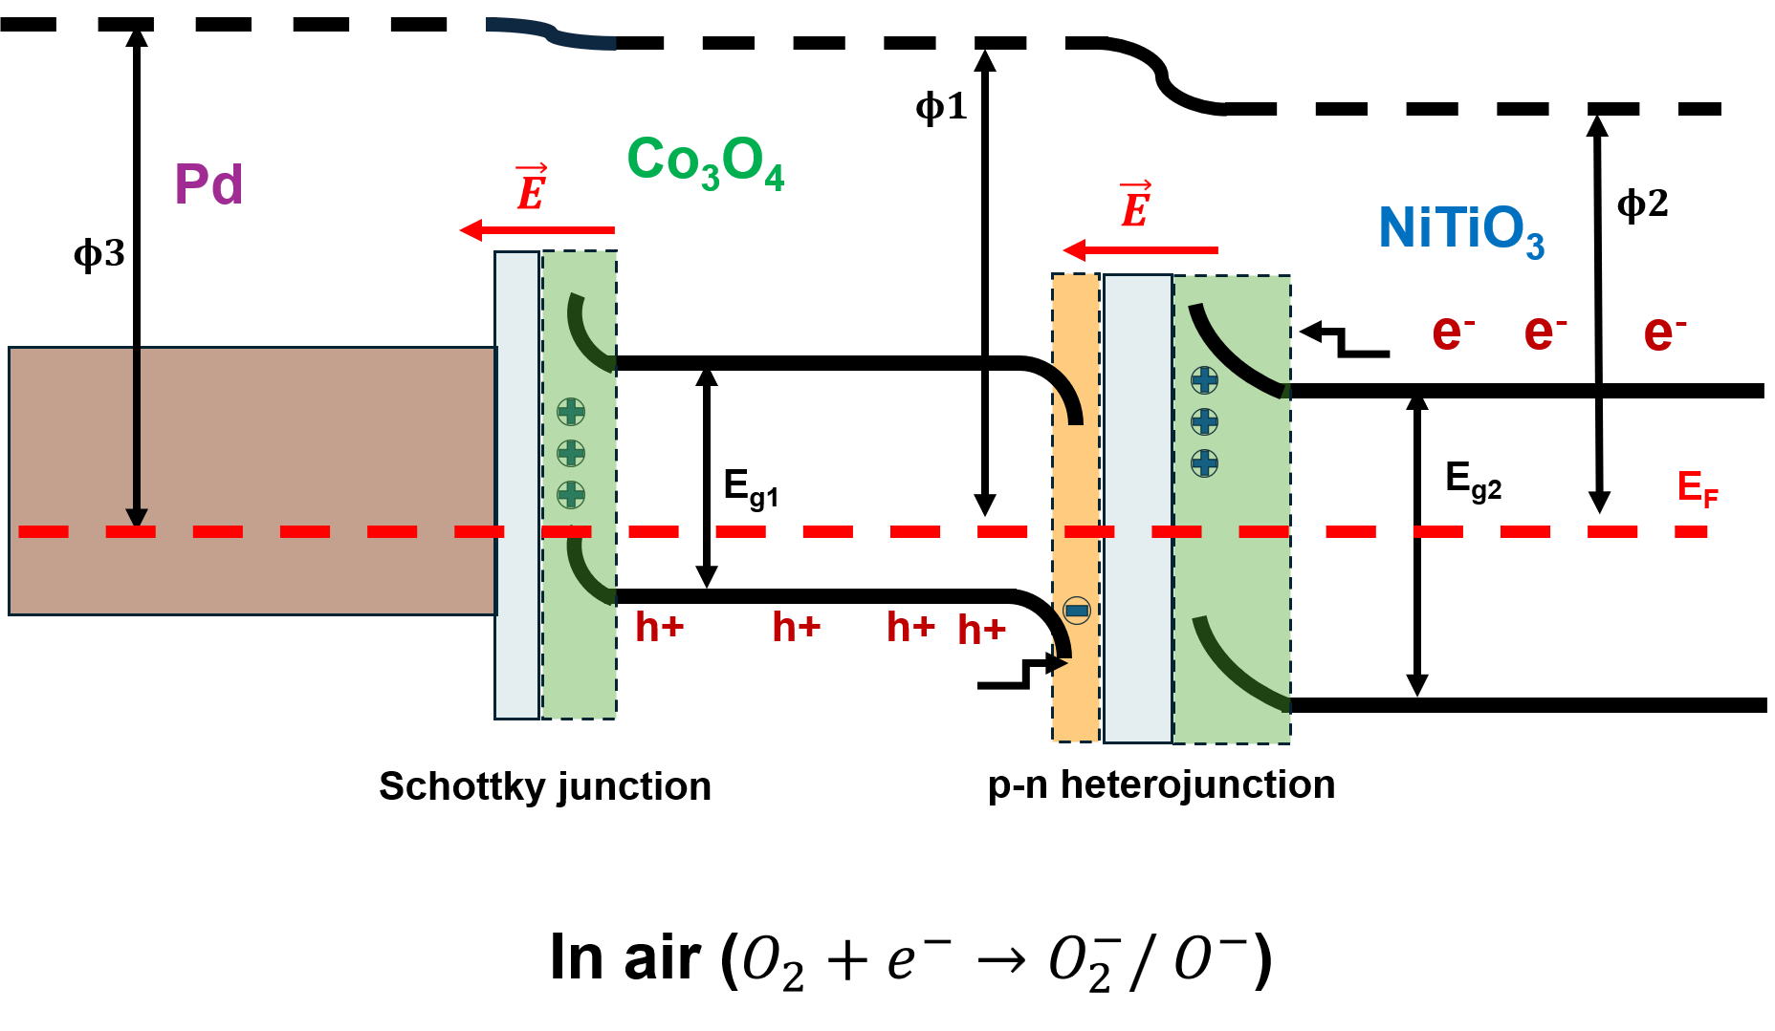

Slide 27
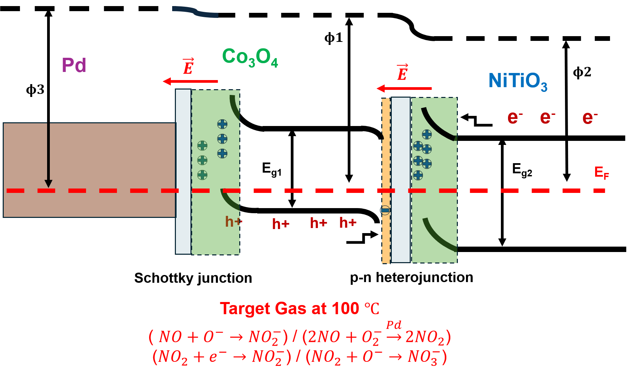

Slide 28
