Slide 1

Operational Variability in Platinum Flotation Systems:
Feed Complexity, Ultrafine Physics and Sustainability in South African PGM Processing
Ndivhuwo Nthai
PhD Candidate of Johannesburg
Supervisor: Prof A.F Mulaba-Bafubiandi
07 July 2026

Slide 2
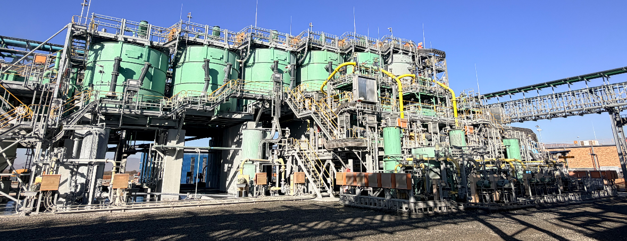
Overview
From an industrial problem to a new physics question
Understanding the Problem
Why Has Platinum Flotation Become More Difficult?
Where Are the Platinum Losses?
Why Do Ultrafine Particles Escape Flotation?
Testing the Hypothesis
How Do You Test a Physics Hypothesis in an Operating Mine?
First Evidence
Second Evidence
Third Evidence
The Scientific Discovery
The Moment Everything Made Sense
The Question We Could Not Answer
Why Physics?
Where the Research Leads
The Research Journey
Closing Thought
Problem
Evidence
Physics
Vision

Slide 3
Why Has Platinum Flotation Become More Difficult?
UG2 Ore
Platreef Ore
TSF Material
Fine PGM grain size
High chromite content
Mineralogical variability
Complex sulphide associations
Ultrafine Particles
Surface Oxidation
UG2, Platreef, and TSF
Declining grades and increasing ultrafines
Operational variability
Can conventional flotation still recover these increasingly fine particles efficiently?

Slide 4
The Hidden Platinum Problem
43%
PGMs reporting to the −25 µm fraction
(RoM ore)
64%
PGMs reporting to the −25 µm fraction
(TSF tailings)
51%
of −25 µm fraction is finer than 10 µm
The platinum is still there. The challenge is recovering it.

Slide 5
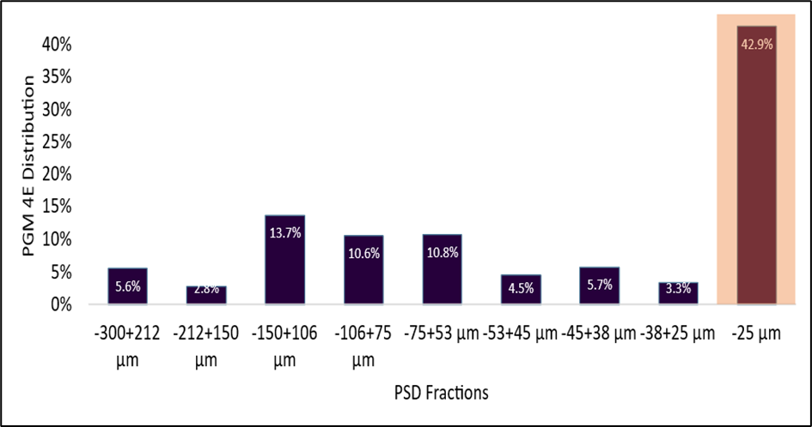
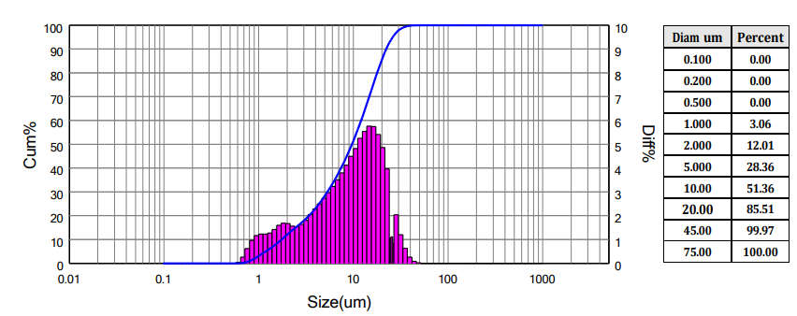
Where Is the Platinum?
Key observations
Valuable PGMs are concentrated in the ultrafine region.
More than half of the −25 µm fraction is <10 µm.
Conventional flotation becomes increasingly inefficient in this size range.
Assay by size of the final tail sample
The platinum has not disappeared—it has migrated into an ultrafine size range where conventional
flotation struggles to recover it efficiently.

Slide 6
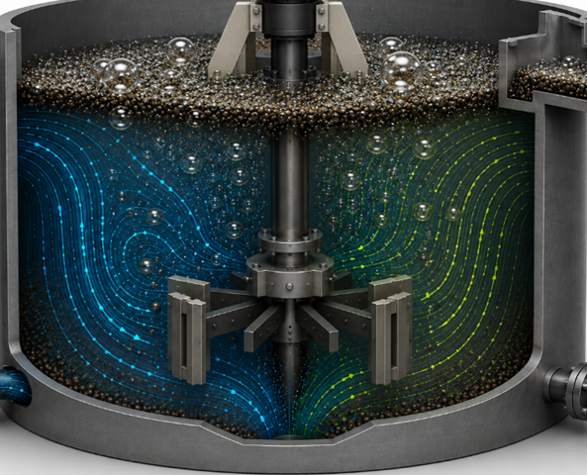
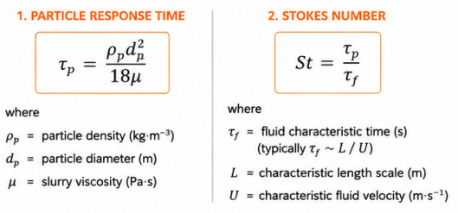
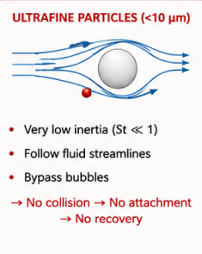
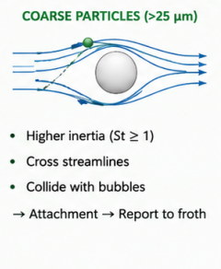
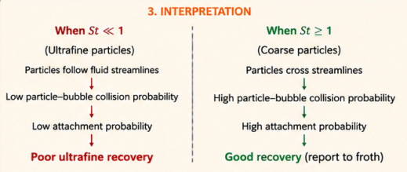
Why Do Ultrafine Particles Escape Flotation?
Flotation cell – Hydrodynamic environment
The governing physics
The ability of a particle to collide with a bubble is governed by its inertia relative to the surrounding fluid. Reducing or modifying the hydrodynamic environment can increase St, improve collisions and enhance ultrafine recovery

Slide 7
Testing the Hypothesis
Can Changing Hydrodynamics Improve Ultrafine Recovery?
Hypothesis:
Hydrodynamic environment governs ultrafine PGM recovery
Column flotation
Long residence time
Reduced entrainment
FloatForce® Rotor–Stator
Improved gas dispersion
Enhanced suspension
Industrial Validation
Low turbulence
High mixing intensity
Plant implementation
Full-scale operation
Metallurgical validation
Three independent investigations were designed to determine whether this hypothesis remained valid across fundamentally different hydrodynamic environments.

Slide 8
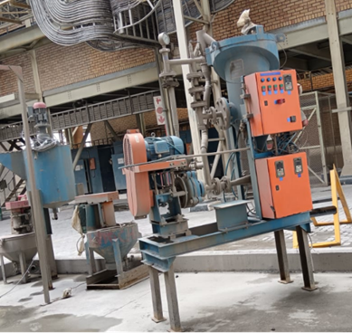
First Evidence
Low turbulence hydrodynamic environment
150mm column cell
Stream selection
Stream | %Recovery
TSF: Primary rougher high grade | 49.77
TSF: Secondary rougher high grade concentrate | 80.61
TSF: Primary rougher high grade and primary cleaner concentrate combined | 69.61
TSF: Primary cleaner concentrate | 39.65
TSF: Primary Cleaner tail | 50.22
RoM: Primary rougher high grade concentrate | 35.36
RoM: Primary cleaner concentrate | 74.6
RoM: Primary cleaner tail | 68.78
RoM: Secondary rougher high grade concentrate | 83.18
Secondary rougher high grade concentrate was identified as the optimum feed stream for both TSF and RoM test work.

Slide 9

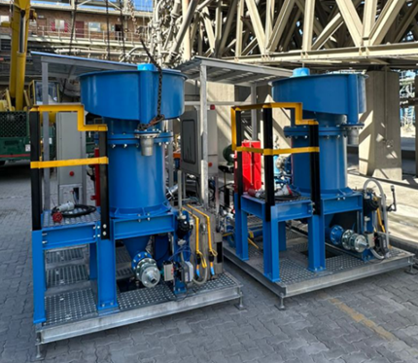
First Evidence
Low turbulence hydrodynamic environment
150mm dual pilot column circuit
Proof of concept
400mm column and 800mm turbo column circuit
Industrial pilot scale-up validation
Same feed stream SRHG
Evaluated with TSF and RoM ore
Industrial pilot scale circuit
TSF Recovery: 52.83 → 64.52% (Peak of 67% at 6.2 mass pull)
Upgrade Ratio: 9.33 → 10.07
RoM Recovery: 69% (Peak of 73% at 5.9% mass pull)
Cr₂O₃ in PGM concentrate below 2%m
52.83% Overall Recovery - TSF
5.18→1.88% drop in Cr₂O₃ in PGM concentrate
The column circuit demonstrated that payable concentrate could be recovered directly from the Secondary Rougher High-Grade stream, bypassing the conventional cleaner and re-cleaner circuits and creating the opportunity to recover ounces earlier in the flotation process.

Slide 10
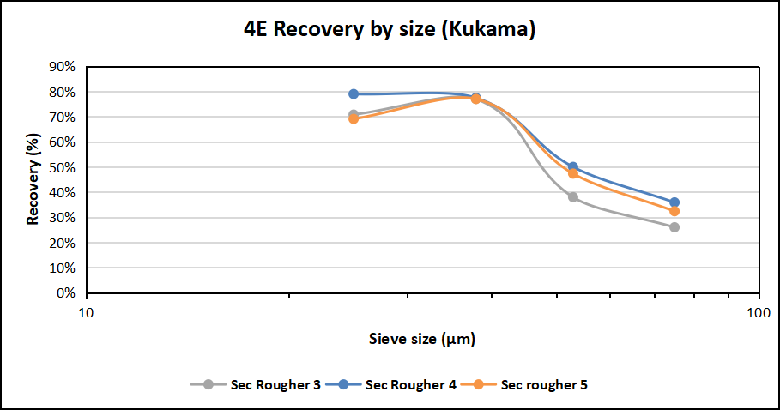
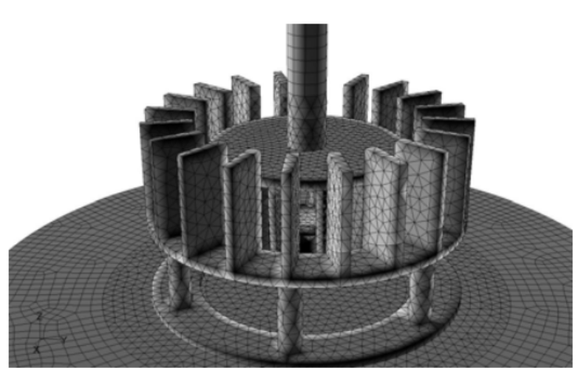
Second Evidence
High-Intensity Hydrodynamic Environment
Cell 4 performance
Improved recovery across all size fractions
(Wierink et al., 2009)
The same improvement in ultrafine recovery was achieved under a fundamentally different hydrodynamic regime, strengthening the hypothesis that hydrodynamics—not equipment—governs flotation performance.

Slide 11
Third Evidence
Plant Validation
The hypothesis remained valid under full industrial operating conditions. Recovery increased, concentrate quality improved and Cr₂O₃ decreased despite a lower feed grade.

Slide 12
The Moment Everything Made Sense
HYDRODYNAMIC ENVIRONMENT
GOVERNS
ULTRAFINE PGM RECOVERY
Three independent investigations.
Three fundamentally different hydrodynamic environments.
One consistent governing principle

Slide 13
The Question We Could Not Answer
The experiments demonstrated that hydrodynamics matter.
But they could not explain WHY.
The experiments answered the engineering question, but revealed a deeper physics question - WHAT IS HAPPENING INSIDE THE FLOTATION CELL?

Slide 14
Why Physics Question?
The experiments identified WHAT improves flotation.
Physics is required to explain WHY
Experimental observations
Computational fluid dynamic
Machine learning
Predictive flotation optimization
CFD will quantify the hidden hydrodynamics, while machine learning will transform those physics into predictive operating intelligence

Slide 15
Closing thought
THE NEXT BREAKTHROUGH
IN PLATINUM FLOTATION
WILL COME
NOT FROM MEASURING MORE…
…BUT FROM UNDERSTANDING
THE PHYSICS THAT GOVERNS RECOVERY.
The first fully autonomous platinum flotation plant should be developed in South Africa. That journey has already begun.

Slide 16
THANK YOU
nthain@Ivanplats.co.za
amulaba@uj.ac.za

