Slide 1

Traveling Ionospheric Disturbance Detection
Hudson D. Mims

Slide 2

Outline.
Introduction
What is the Ionosphere?
What is the data?
What is the problem?
My Approach
Results

Slide 3
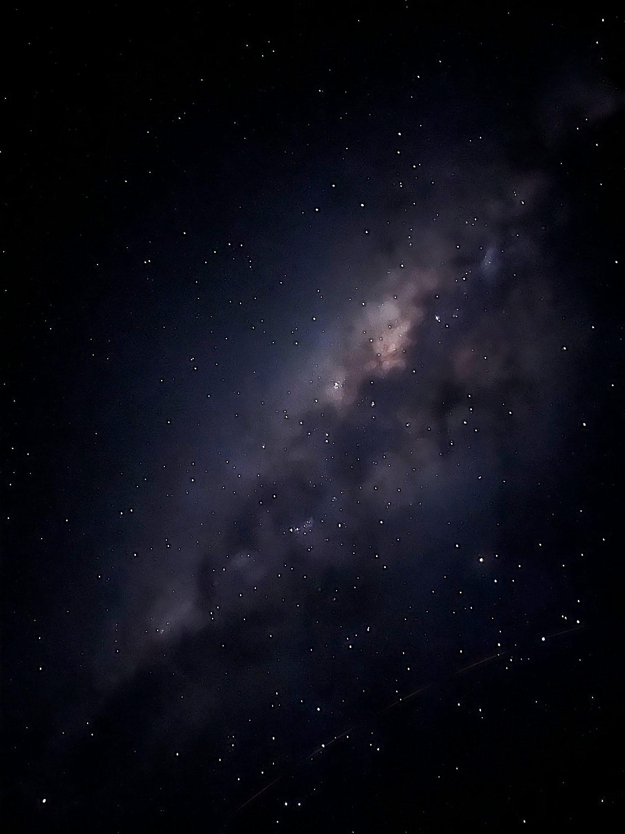

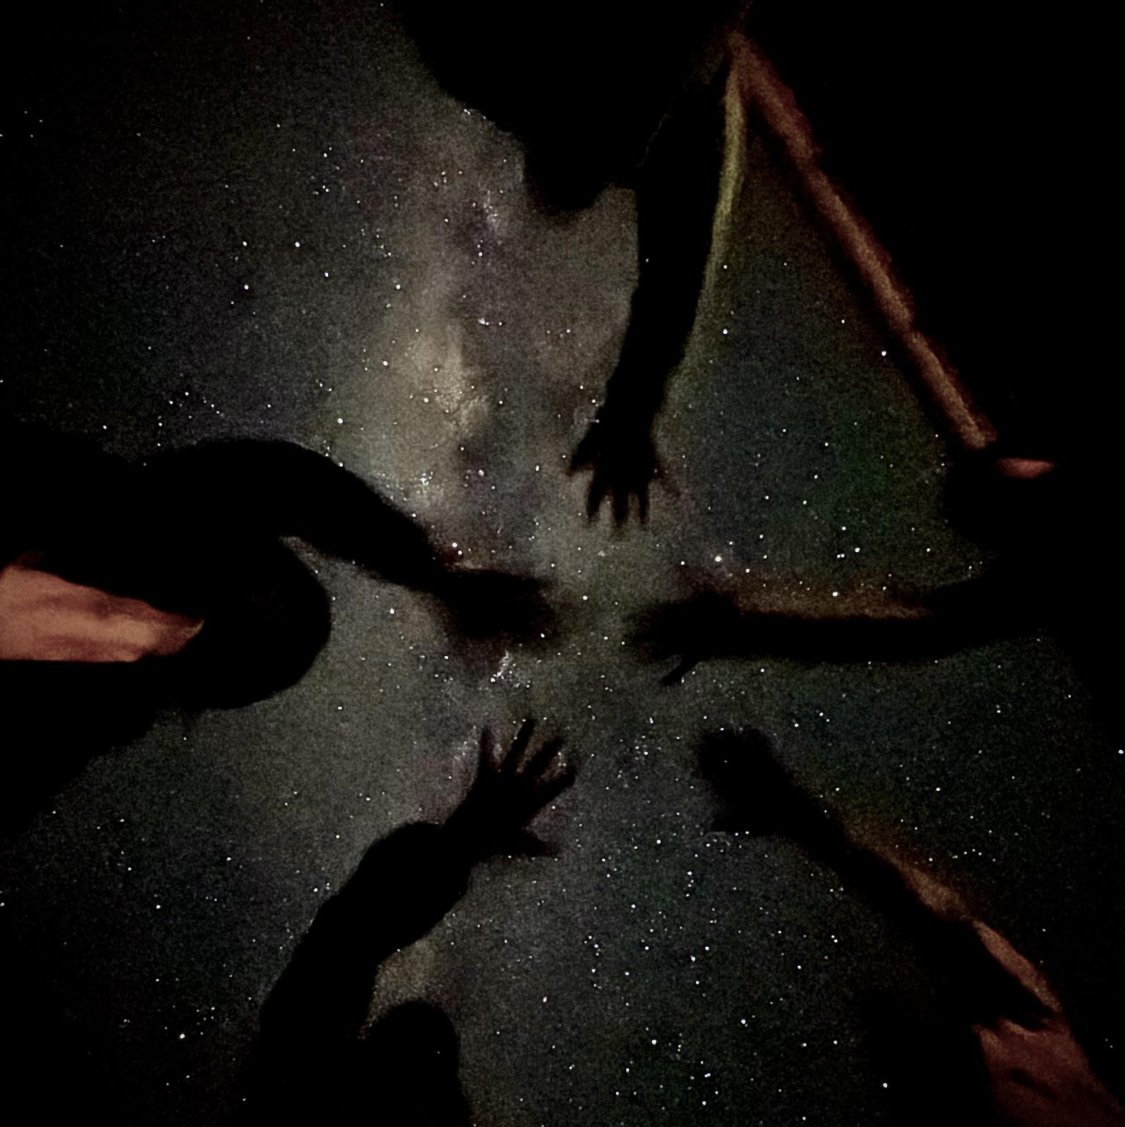
Who am I?
4th Year Undergraduate at
The University of Michigan
  Majoring in Aerospace Engineering
  Minoring in Space Sciences
South African National Space Agency (SANSA)
  Research-Abroad program
  Mentored by John Bosco Habarulema
Loving South Africa
  Just got to see the Milky Way core for the first time in my life! →

Slide 4
Context.

Slide 5
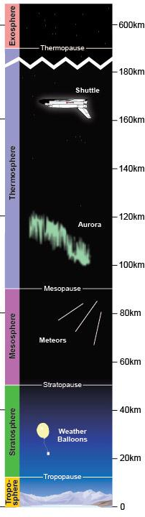
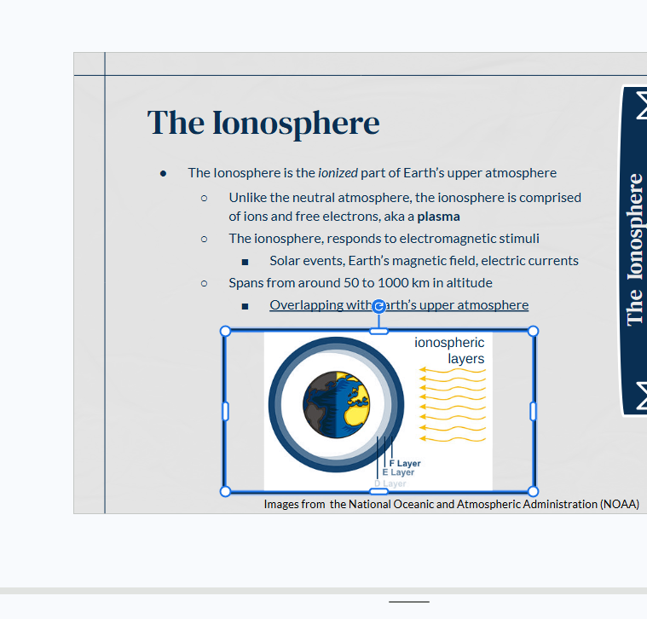
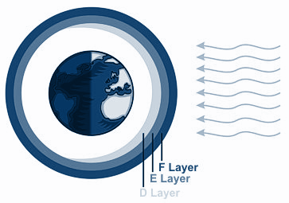
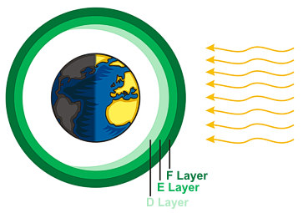

The Ionosphere
The Ionosphere
The Ionosphere is the ionized part of Earth’s upper atmosphere
  Unlike the neutral atmosphere, the ionosphere is comprised
  of ions and free electrons, aka a plasma
  Spans from around 50 to 1000 km in altitude
    Overlaps with and Interacts with Earth’s upper atmosphere
Ionospheric layers
Not to Scale
Images from the National Oceanic and Atmospheric Administration (NOAA)

Slide 6

Atmospheric Gravity Waves (AGWs) &
Traveling Ionospheric Disturbances (TIDs)
AGWs are imbalances in the neutral atmosphere
  Form when air becomes displaced from equilibrium
    Buoyancy & Gravity create oscillation
  Propagate as waves, and give rise to TIDs when they reach ionospheric heights
TIDs are the ionospheric manifestations of AGWs
  Two main sources: tropospheric and auroral
  Large-Scale TIDs (typically from auroral sources), have periods from 0.5-4 hours, wavelengths 300-3000km, and speeds from 250-1000 m/s
Image of the sky yesterday evening (June 7th 2026)

Slide 7
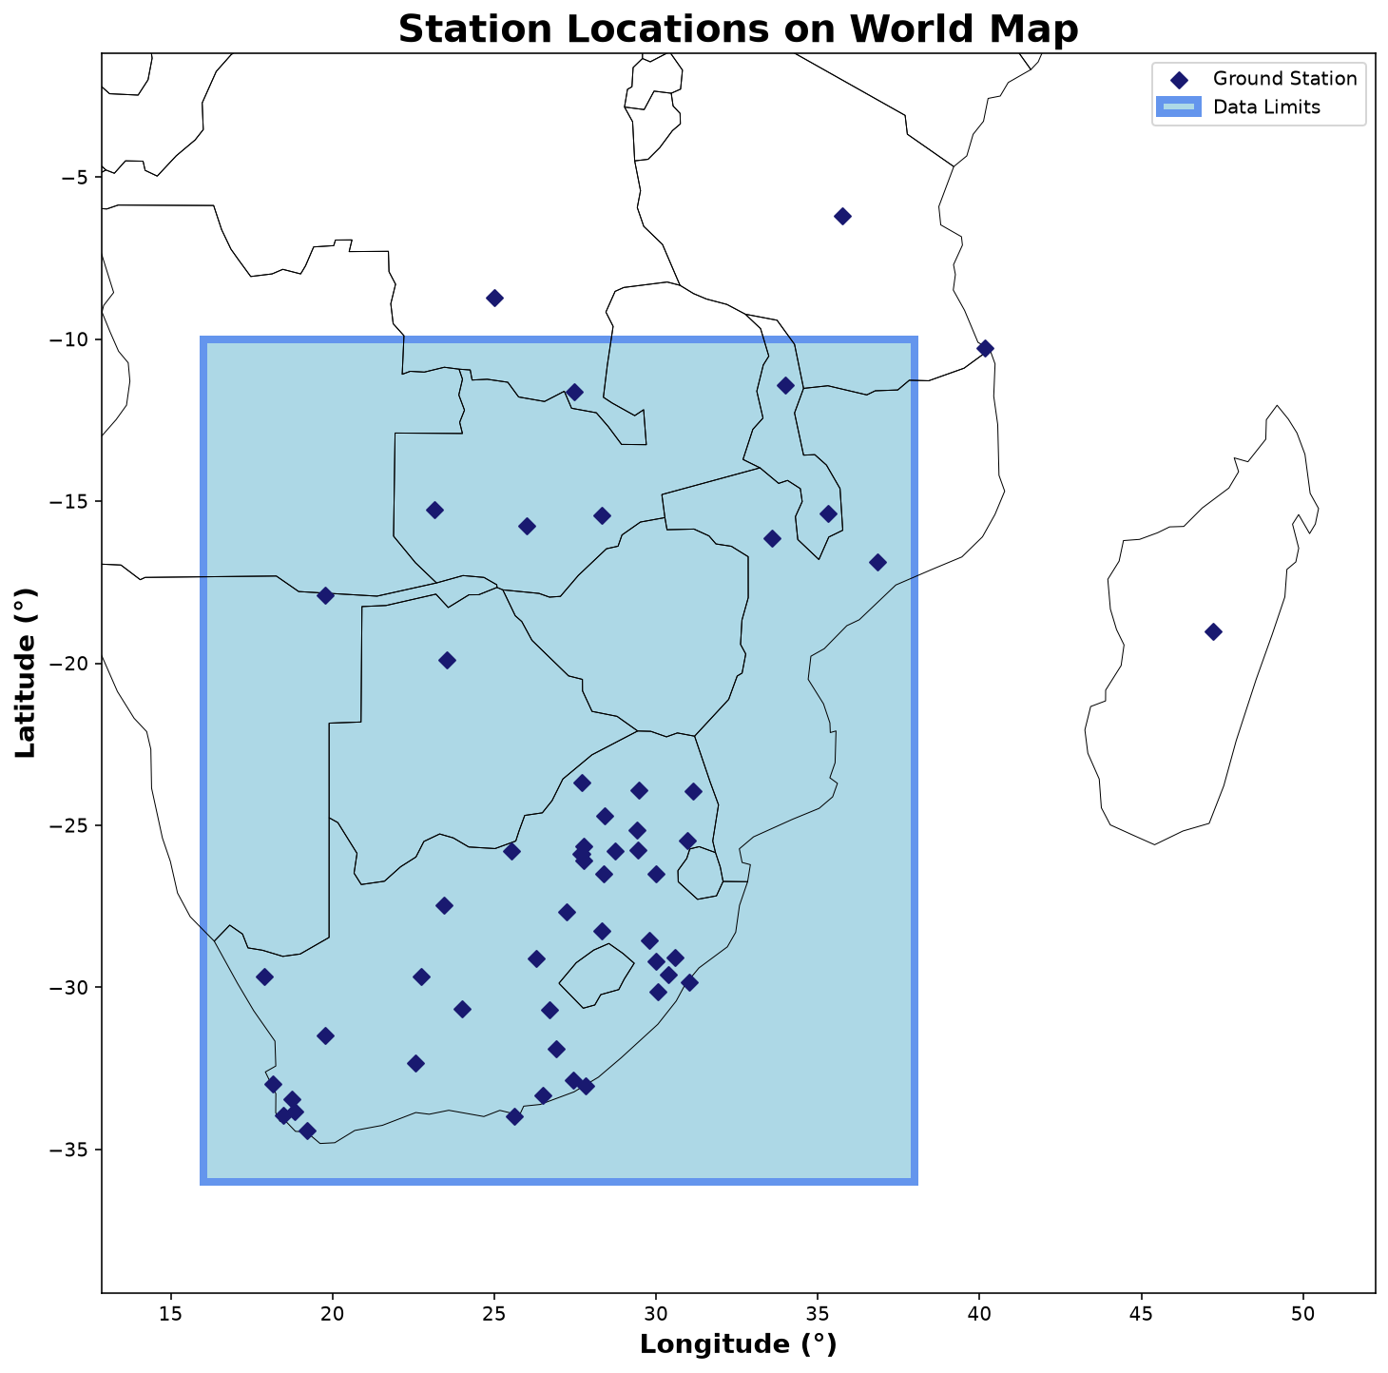
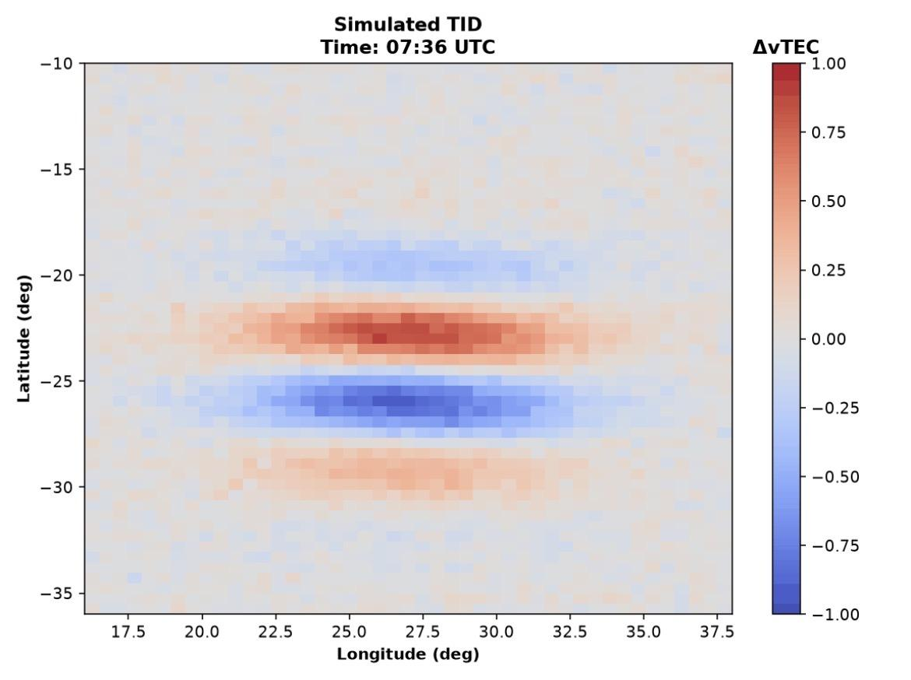
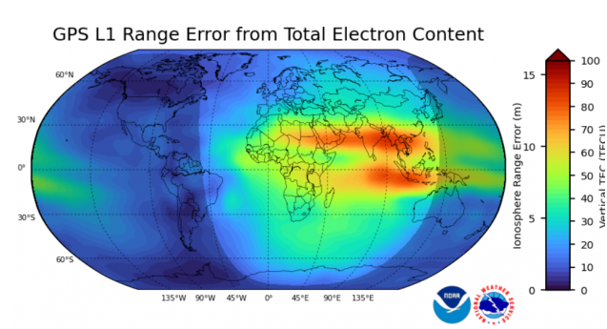
Total Electron Content
Total Electron Content (TEC) is the measure of ionospheric electron concentration
  It is measuring the total number of electrons (1 TECu = 10^16 e-/m^2) from GNSS satellites to ground stations →
TIDs show up as small perturbations in the TEC
  One must detrend the TEC background to see these TID perturbation signals
TID in TEC perturbation data
Example LSTID: Latitude vs Longitude | TEC Perturbation
Ground stations
Image credit: NOAA Space Weather Prediction Center

Slide 8
What is the Problem?
The best method for detecting TIDs from TEC data is still an ongoing debate.
Maletckii et al. (2020): Notes that the majority of studies utilize centered moving averages or polynomial fitting. Concluding that they are indeed among the best options.
Guerra et al. (2024): Concluded that the Savitzky-Golay (SGOLAY) filter and a unique method called Fast Iterative Filtering (FIF) were the best.
I aim to put many methods to the test, and systematically determine which methods are the best and in what scenarios.

Slide 9
Methodology.

Slide 10
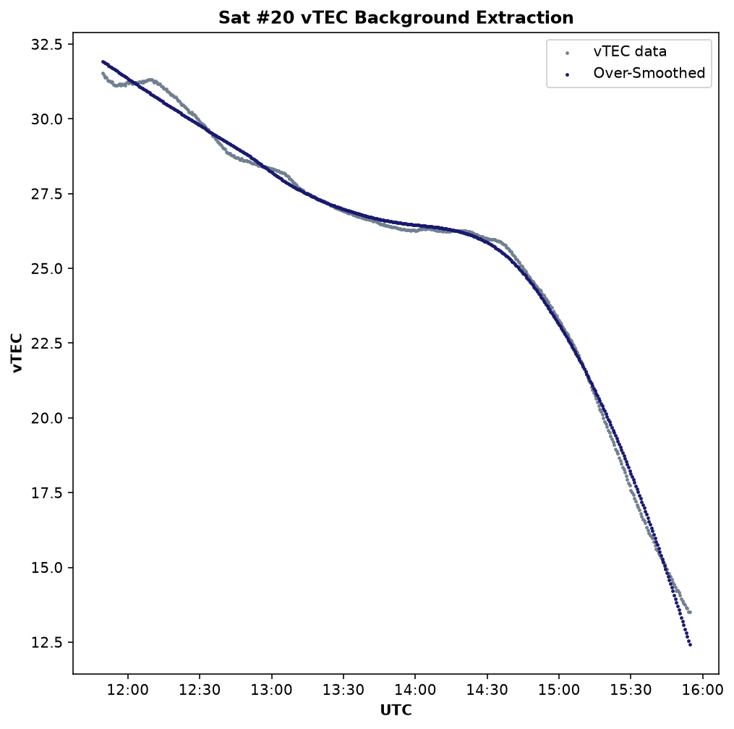
TEC Detrending
In order to find TIDs, we must first extract the background TEC
  With the background, we can compute TEC perturbation to extract the TID signal
Perturbation = Data - Background
Satellites pass over ground stations at
different points in time and space
  Detrending is applied per satellite pass over each individual ground station
  The data is then re-combined after detrending locally per-satellite
One satellite pass over one ground station, showing real vTEC data and the background extraction using a Savitzky-Golay filter

Slide 11
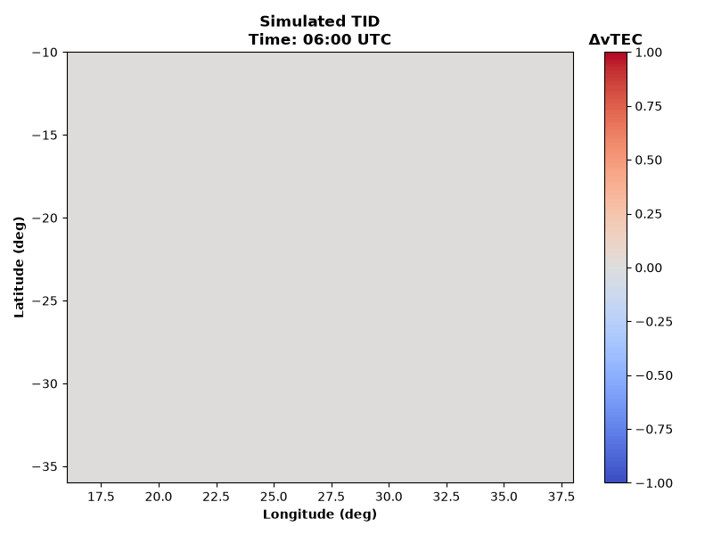
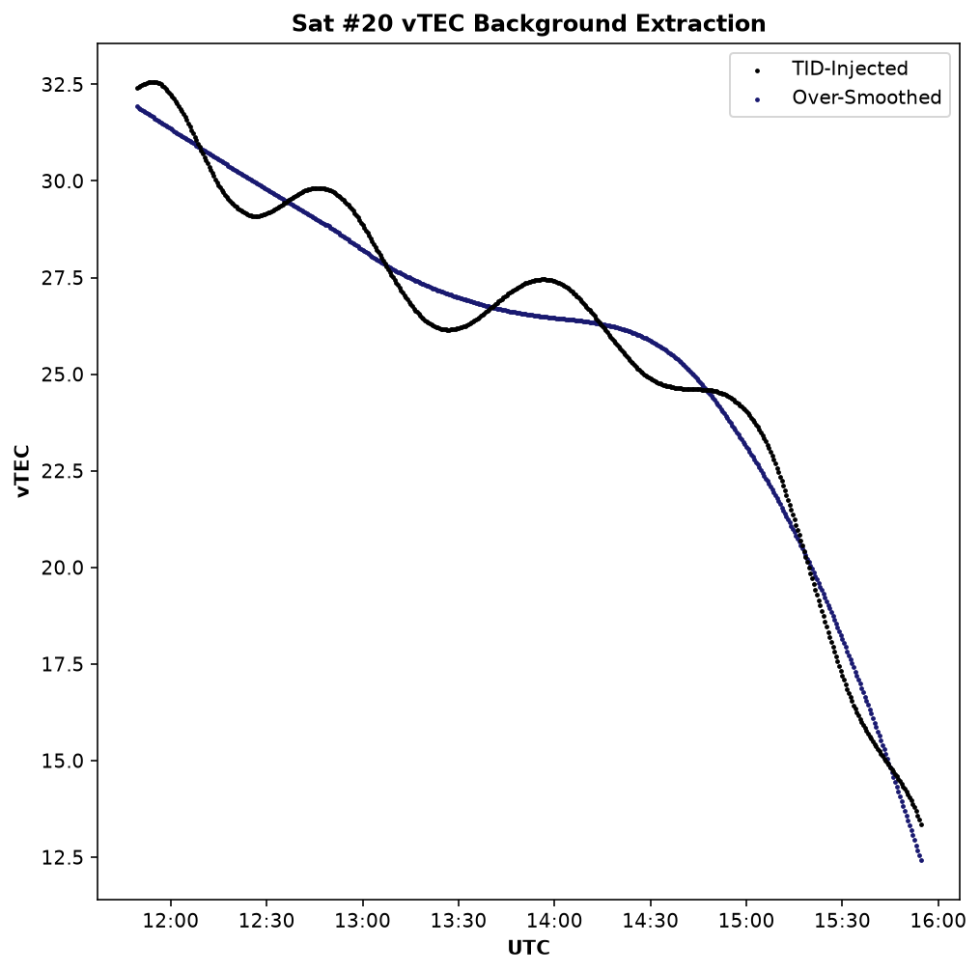
Creating a Synthetic TID
Create a TID with known parameters, and apply it to real TEC background data (March 8th, quiet day)
This gives a clear known signal to quantify how well each method can extract the true background
TID Parameters:
-Amplitude = 1TECu
-Wavelength = 1000km
-Direction = 0 degrees
-Period = 1.5 hours
Synthetic TID in latitude vs longitude, propagating in time
One satellite pass over one ground station, TID imposed

Slide 12
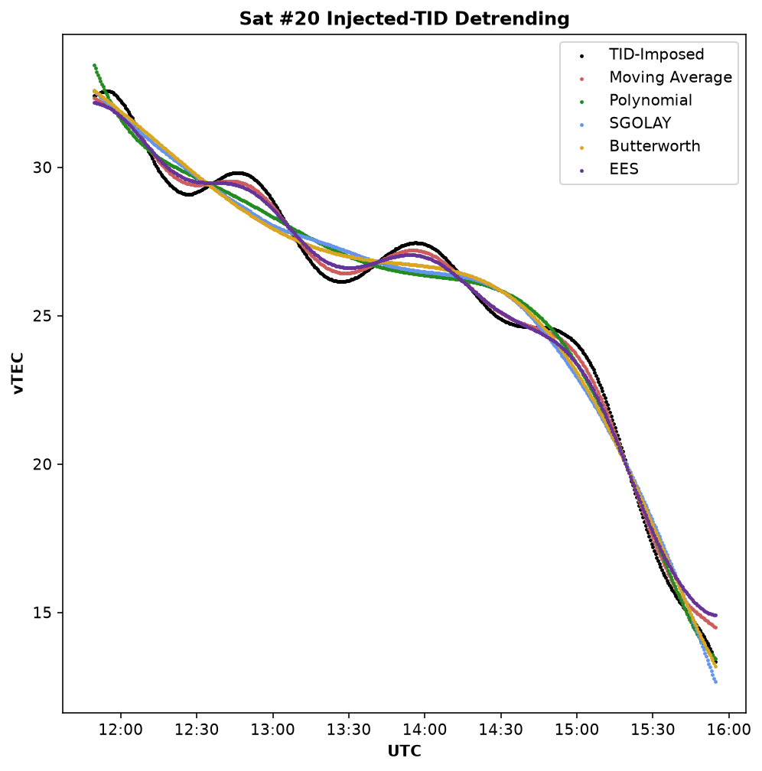
Detrending Methods
Moving Average: Replaces values with the arithmetic mean of all points in a sliding 30 minute window
Savitzky-Golay Filter (SGOLAY): ) 120 minute sliding window fits a 2nd degree polynomial, the central value of that polynomial creates a continuous curve
  Guerra et al. 2024 and Guerra et al. 2025
Adaptive Polynomial Fit: Fits one polynomial to an entire pass simultaneously, with varying degrees
  Degree scales to the duration of the pass (1-8)
Butterworth Bandpass Filter: Zero-phase, 8th-order bandpass that removes frequencies outside of the LSTID range, leaves desired frequencies unattenuated
Exponentially Weighted Moving Window (EWM): Zero-phase moving average, with an infinite and exponentially decaying sliding window (alpha = 0.05)
EWM
Detrending of a TID-imposed satellite pass

Slide 13
Results.

Slide 14
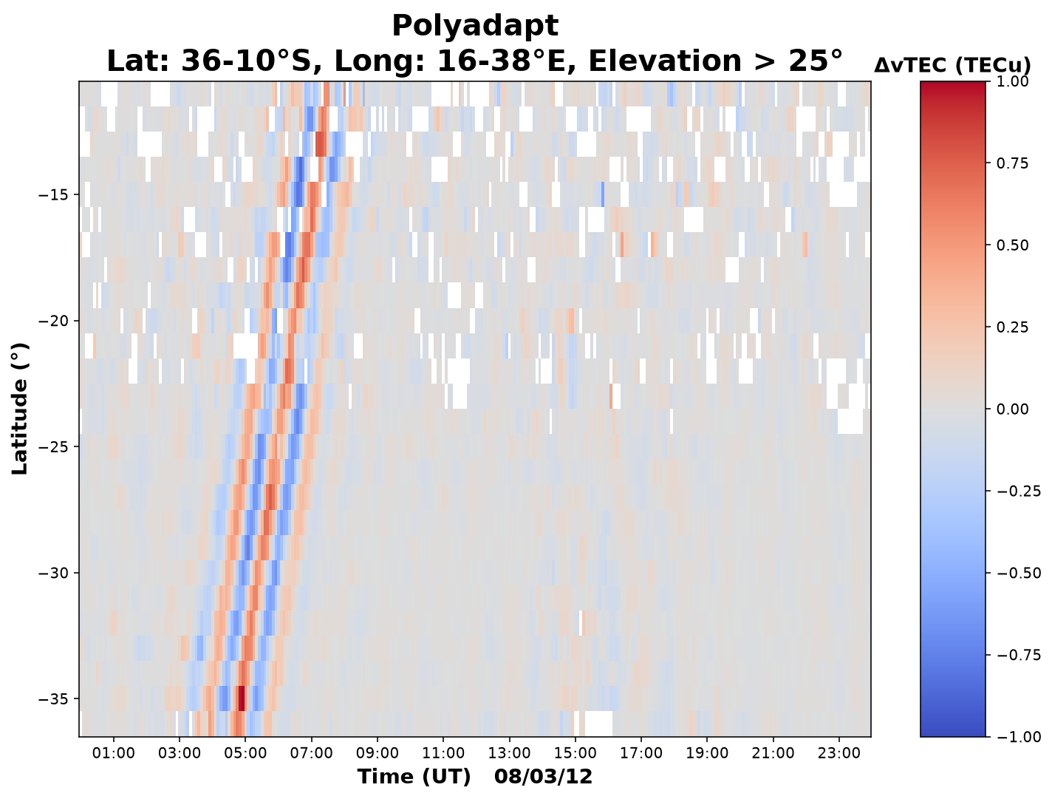
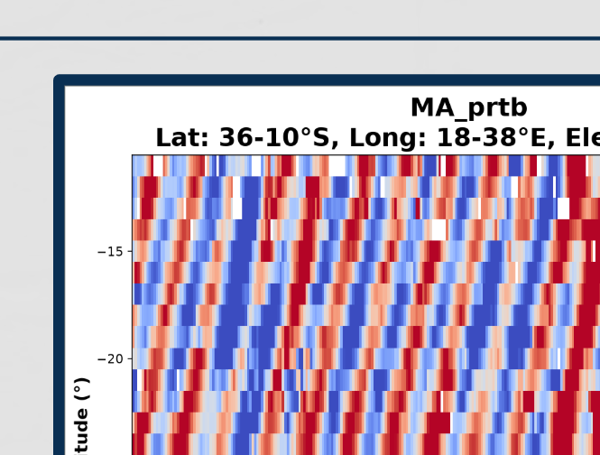
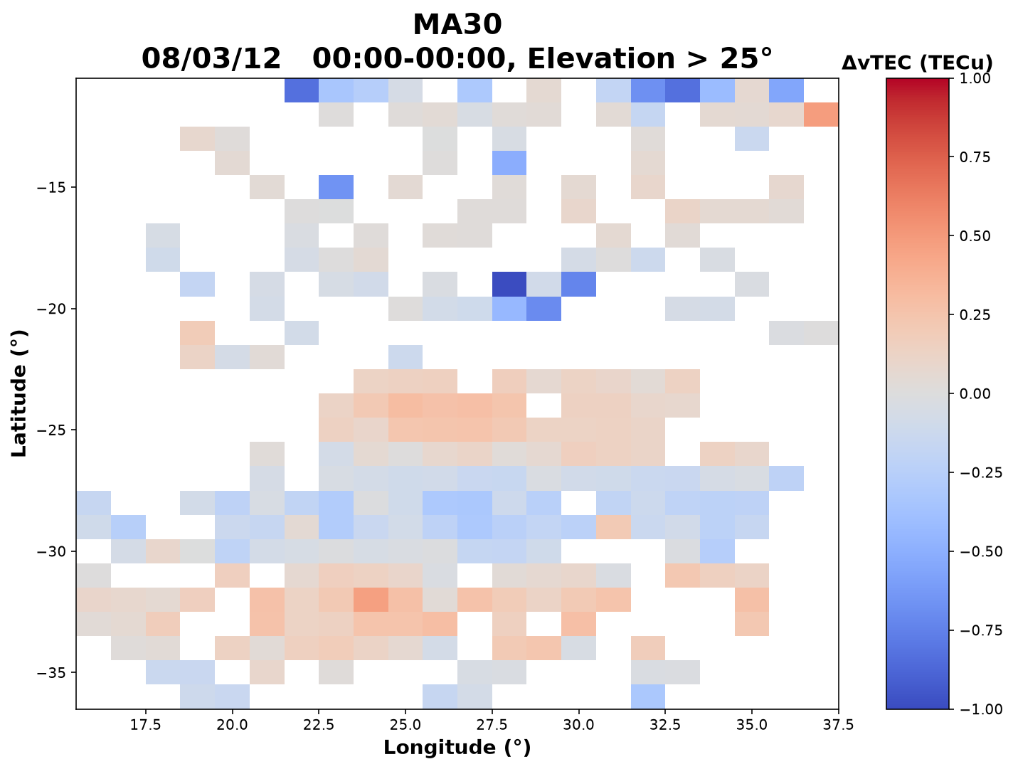
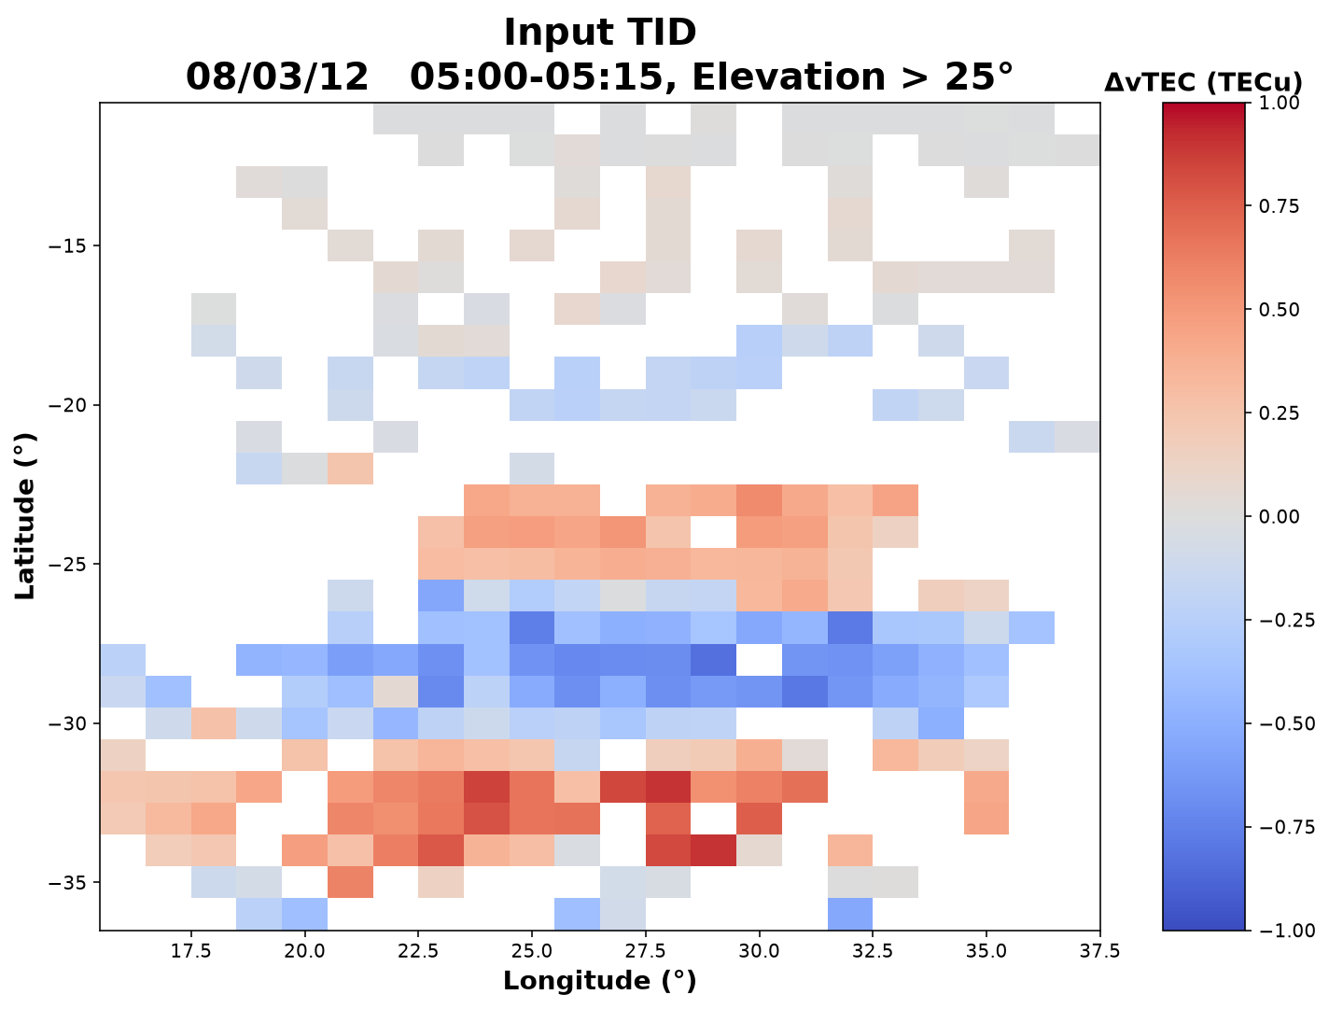
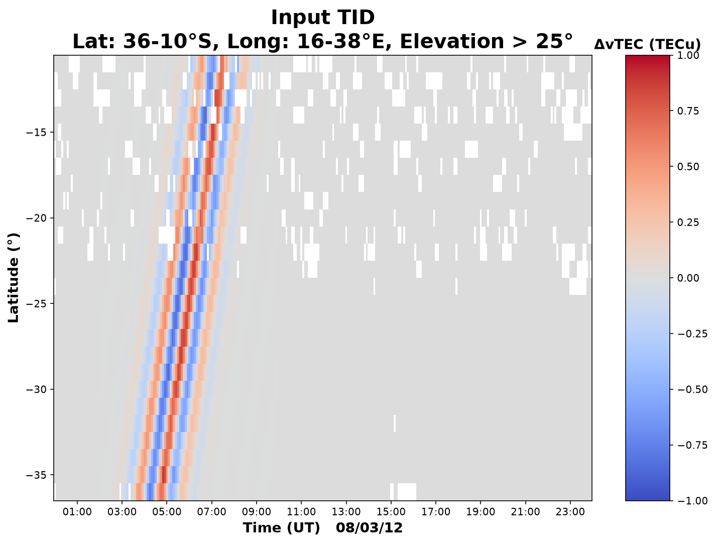
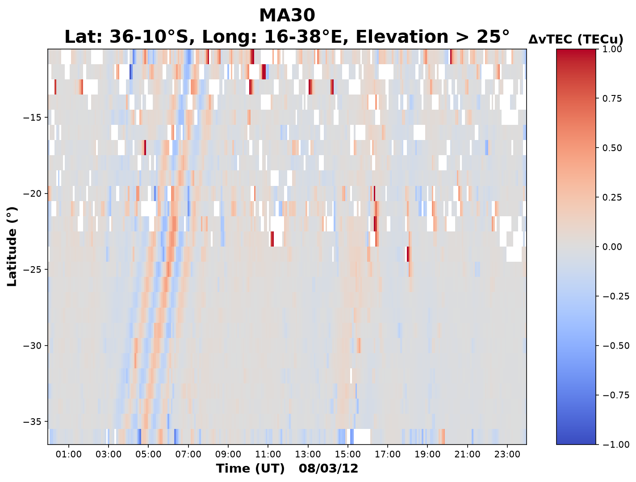
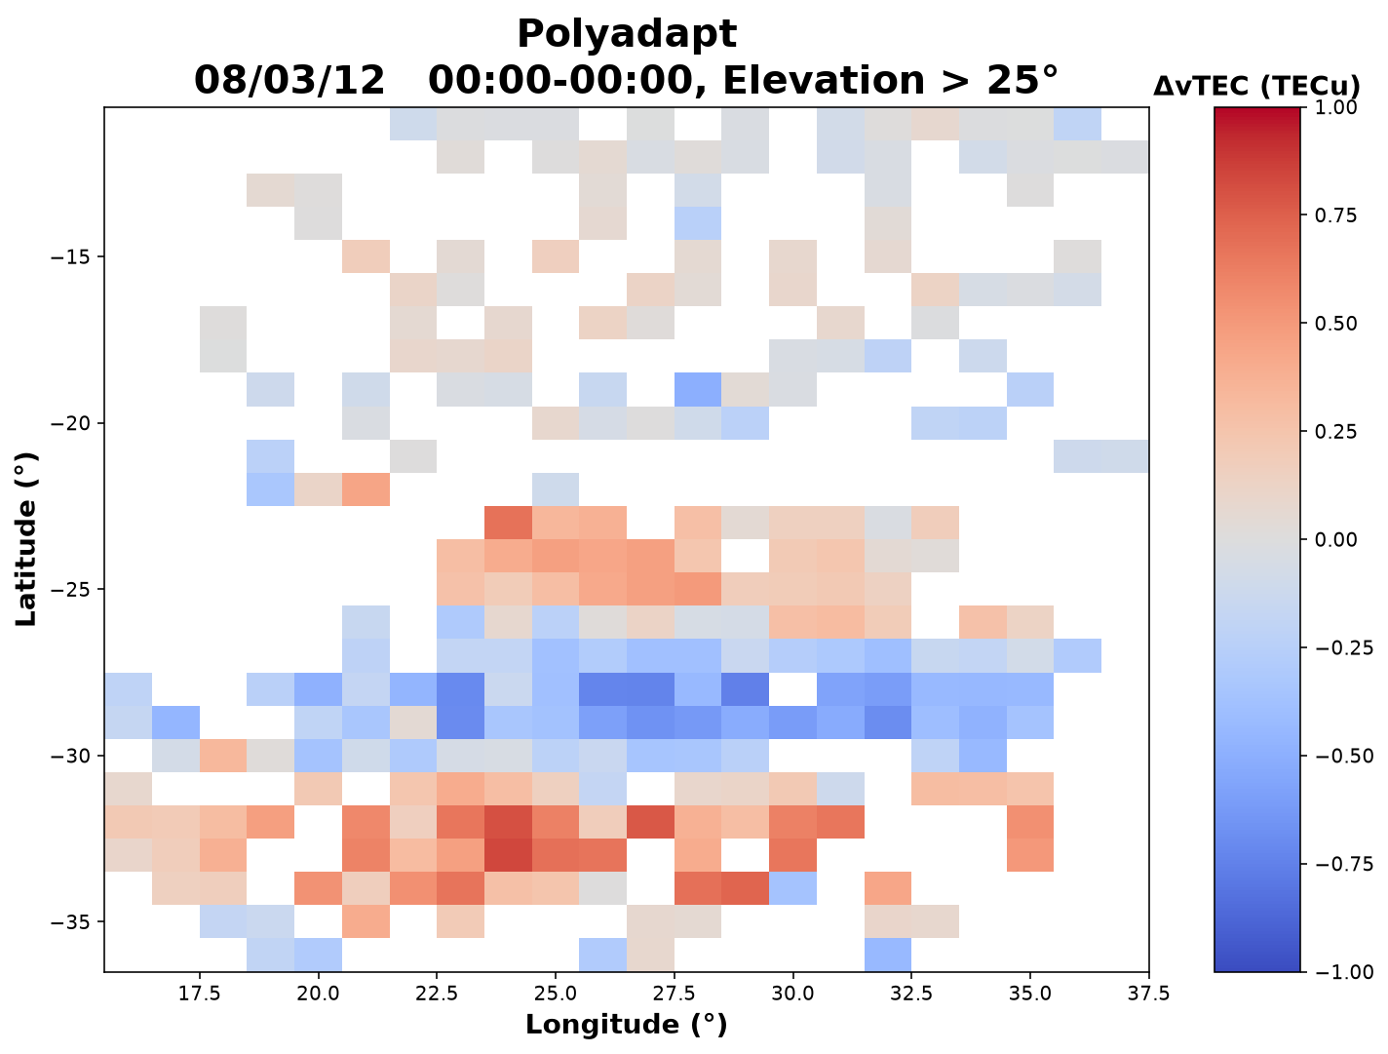
Detrending Results
Extracted TID perturbation for two detrending methods
Adaptive Polynomial
Each method’s data is binned and averaged in 1 degree & 5 minute intervals
  Perturbation data is plotted in latitude vs time, clear diagonal oscillations are expected as seen below
30 Minute Moving Average
Less great results
Great results
Synthetic TID in latitude vs time and latitude vs longitude

Slide 15
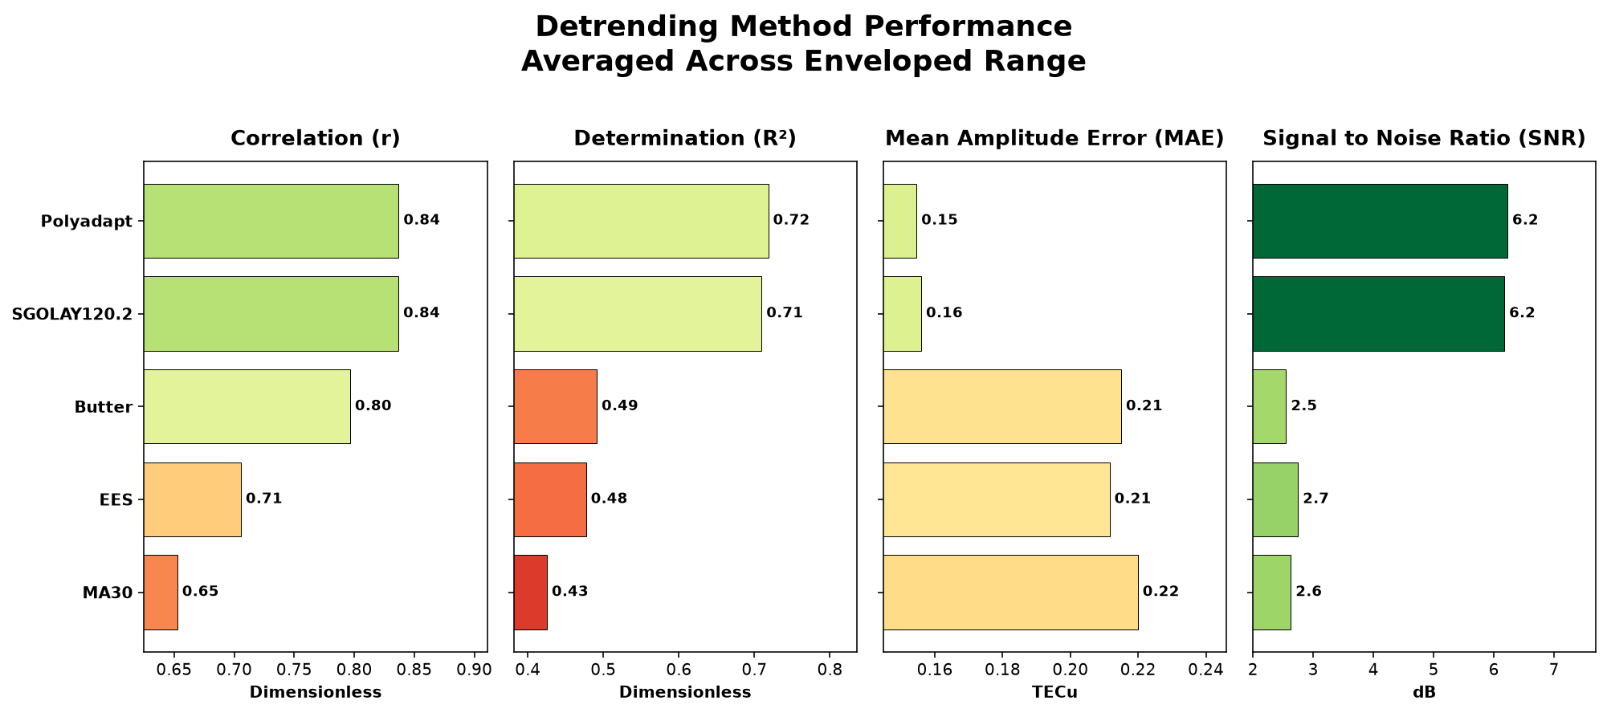
Quantitative Detrending Results
Once 3D perturbation data has been obtained for each method, the results can be compared to the input
  The four metrics below will be used to evaluate detrending success
This example plot is the averaged result across all TID inputs
EWM
TEC detrending results across all TID inputs

Slide 16
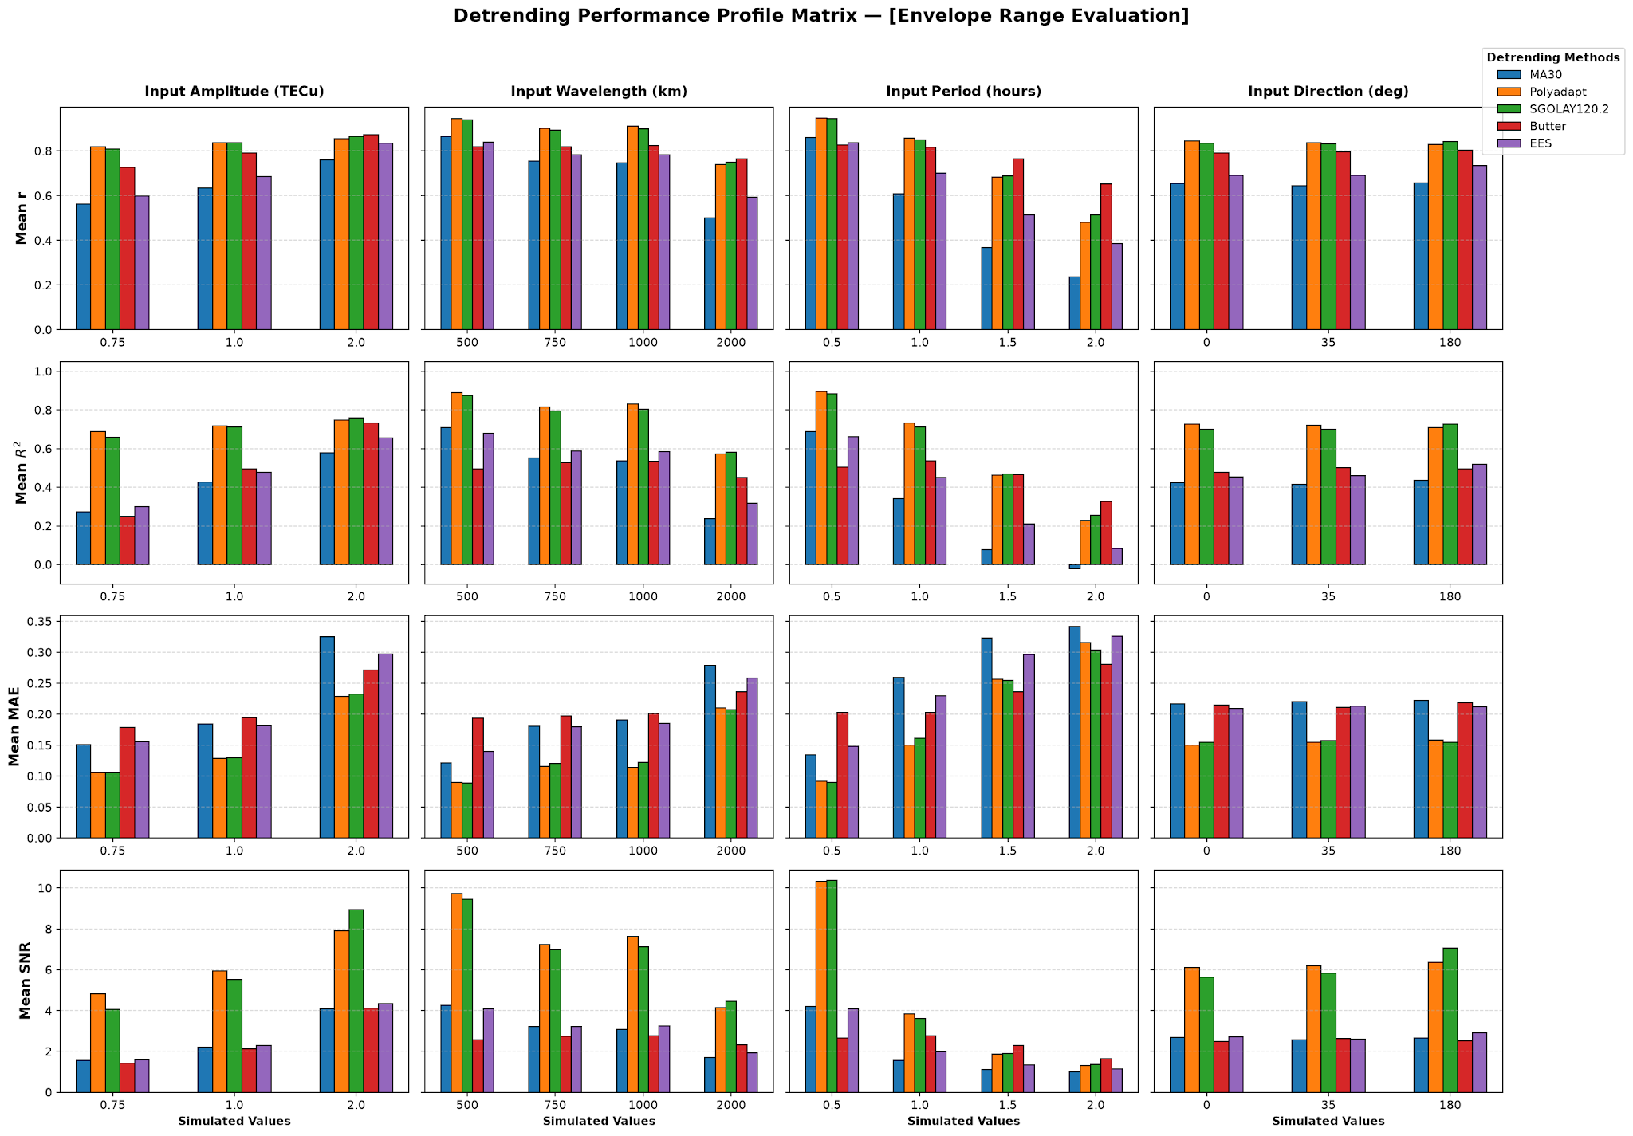
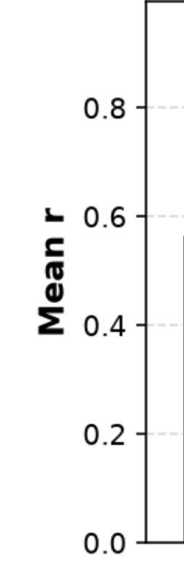
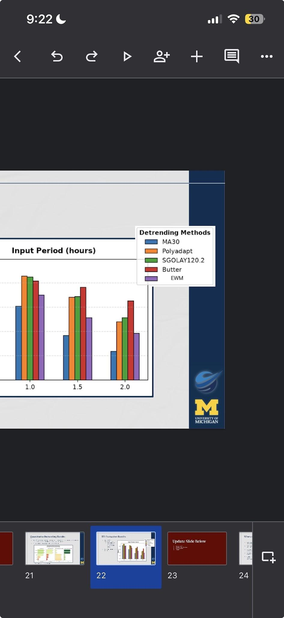
TID Extraction Results
Over 100 TID Configurations tested
  Gives insight into which methods perform in which settings
  Butterworth underperforms at lower periods, but dominates at higher periods
Lots of ways to analyze, this plot is just one of many
Correlation for each detrending method as the TID input period changes
(Averaged across other input parameters)

Slide 17
Summary
Maletckii, B., & Astafyeva, E. (2020). Near-real-time classification of traveling ionospheric disturbances of natural hazards and space weather by GNSS data. URSI Atlantic Radio Science Conference (AT-RASC), Gran Canaria. https://doi.org/10.23919/URSI-AT-RASC49751.2020.9369997
Guerra, M., Cesaroni, C., Ravanelli, M., & Spogli, L. (2024). Travelling ionospheric disturbances detection: A statistical study on detrending techniques, induced period error and near real-time observables. URSI Atlantic Radio Science Conference (AT-RASC), Gran Canaria. https://doi.org/10.23919/URSI-AT-RASC2024
Habarulema, J. B., Katamzi, Z. T., Yizengaw, E., Yamazaki, Y., & Seemala, G. (2016). Simultaneous storm time equatorward and poleward large-scale TIDs on a global scale. Geophysical Research Letters, 43(13), 6678–6686. https://doi.org/10.1002/2016GL069740
TIDs are the ionospheric manifestations of AGWs, and are observed as small perturbations in the TEC
The best method for TEC detrending is still a debated topic
By imposing a synthetic TID onto real TEC background data, we can evaluate each detrending method
Confirmed the results of Guerra et al. 2024 that Savitzky Golay is one of the best options
Additionally found that the new adaptive polynomial works wonderfully as well
There is not one method that dominates in every TID regime

Slide 18
Backup Slides

Slide 19
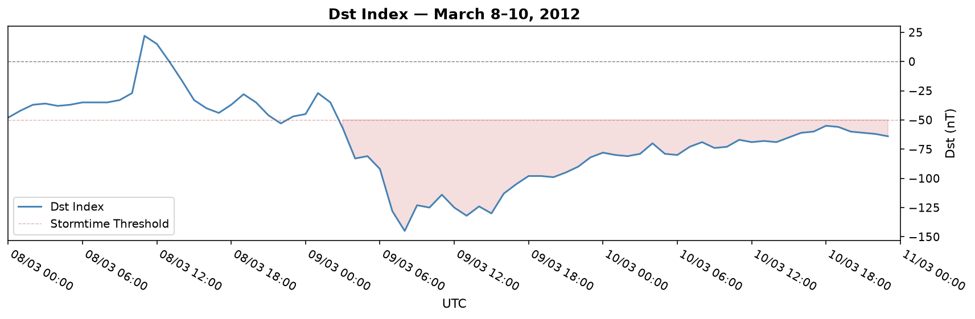
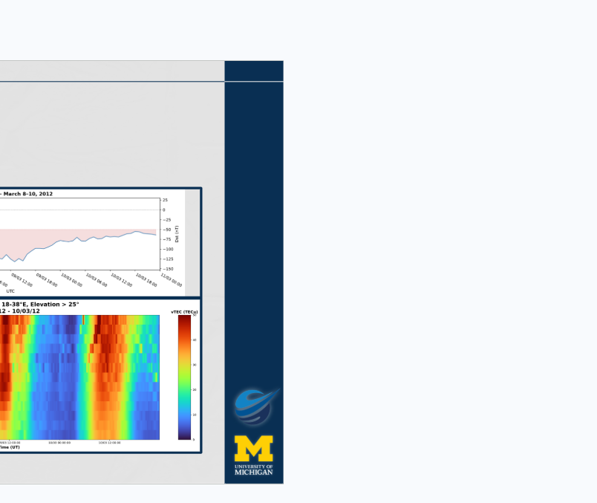
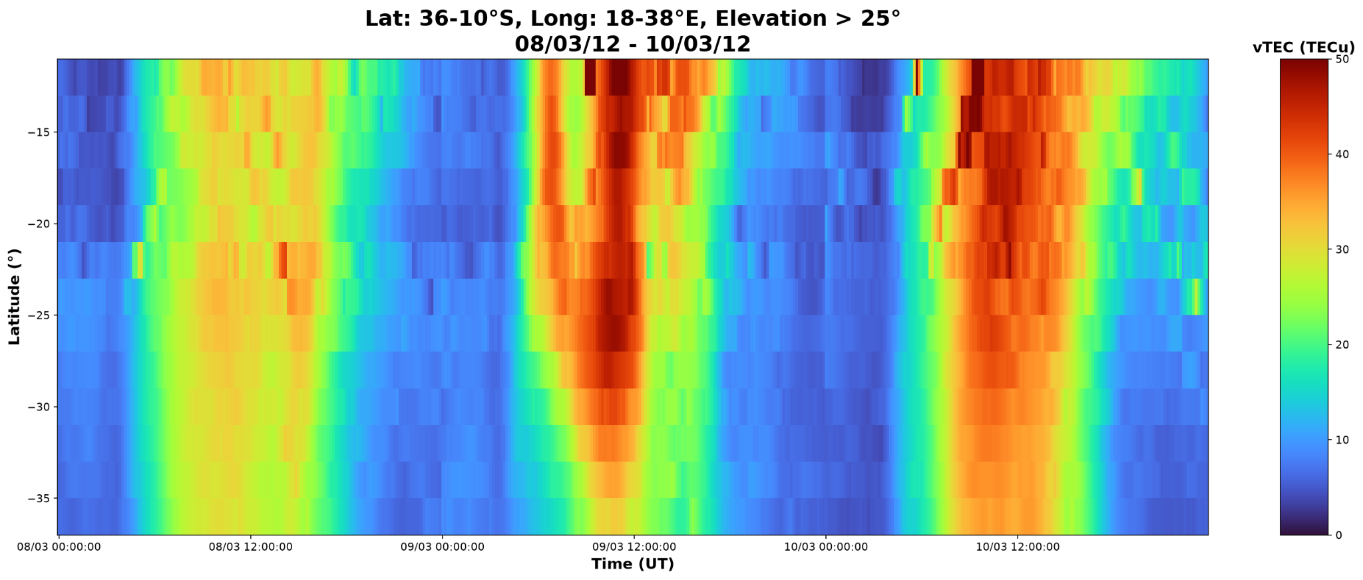
Data of Choice
Disturbance Storm Time Index (DST):
Measures the decrease in strength of Earth’s magnetic field, metric for geomagnetic storm magnitude
March 2012: geomagnetic storm
Southern Africa sector
Bounding applied to ensure higher data concentration
Latitude vs Time (vTEC), March 8th to March 11th

Slide 20
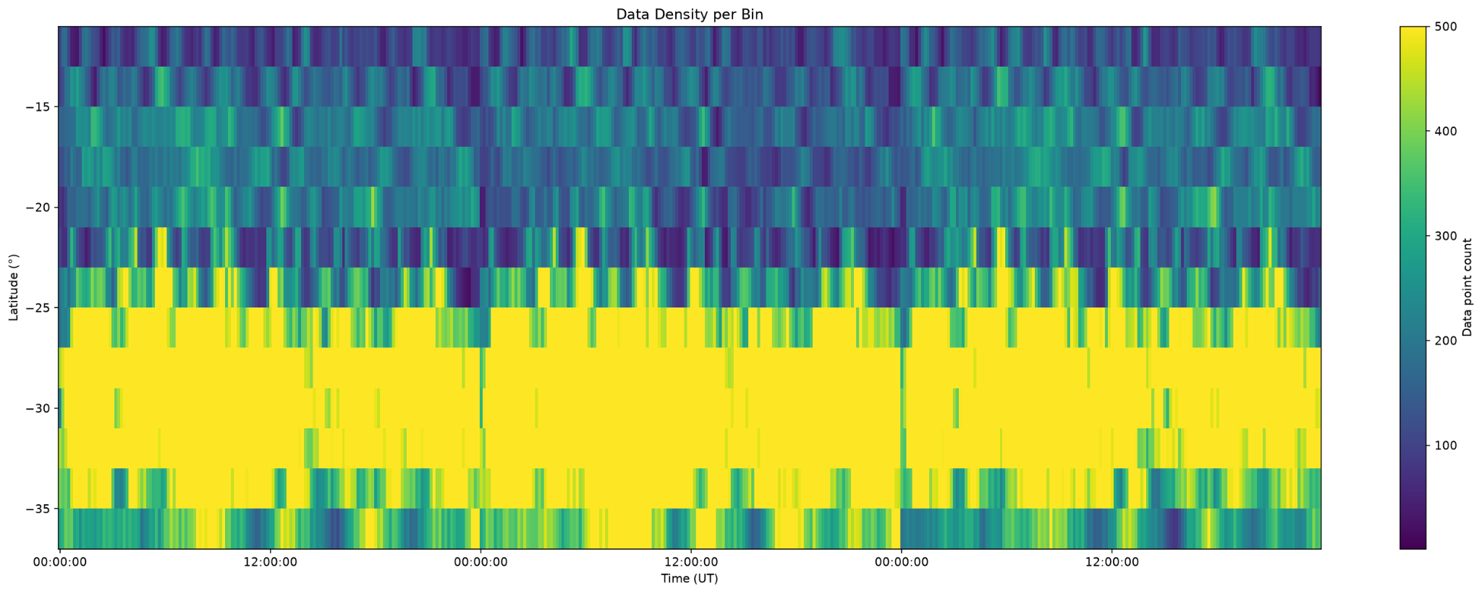
Data Density
Data density latitude vs time over the full march 8th to march 11th time range

Slide 21
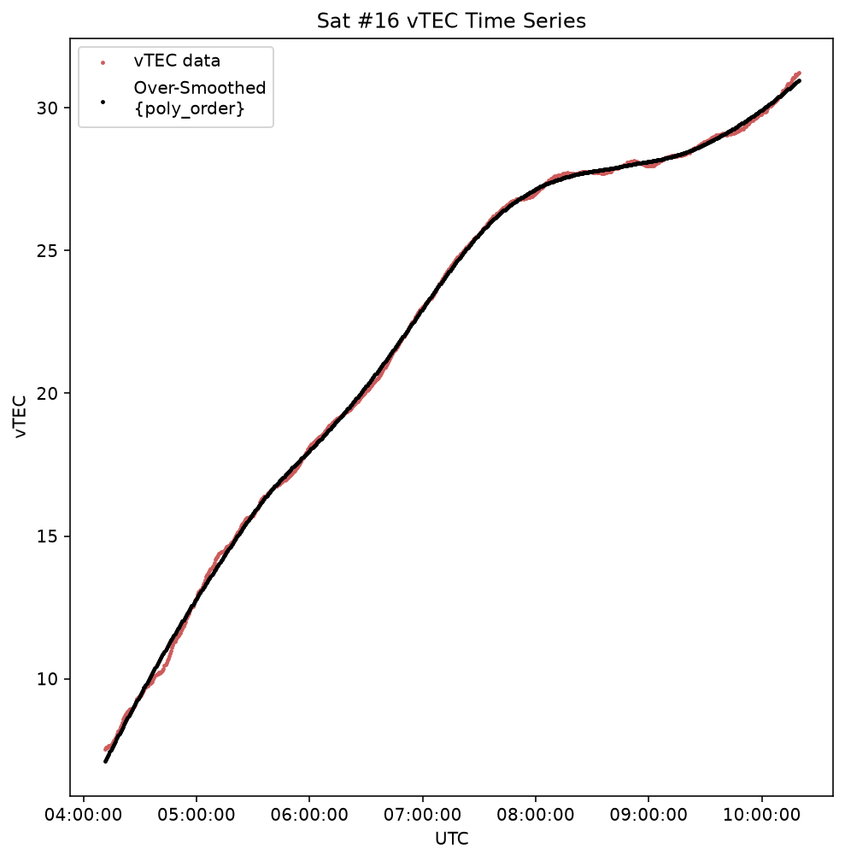
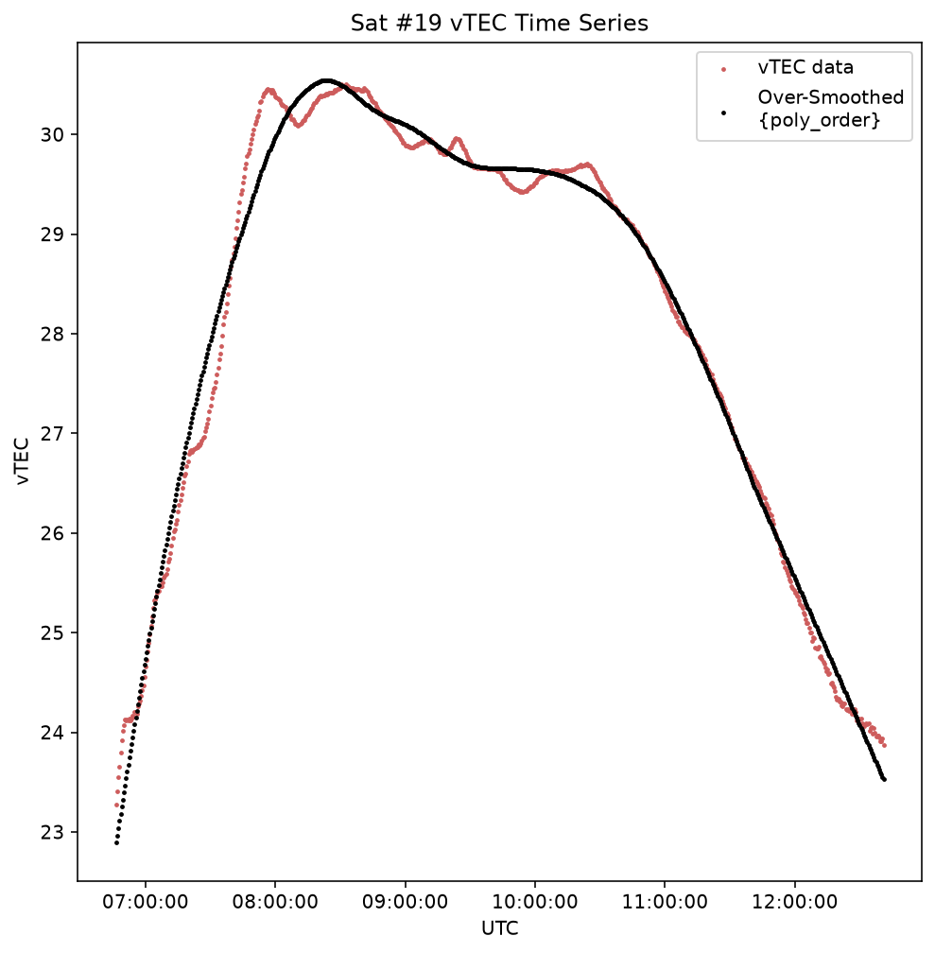
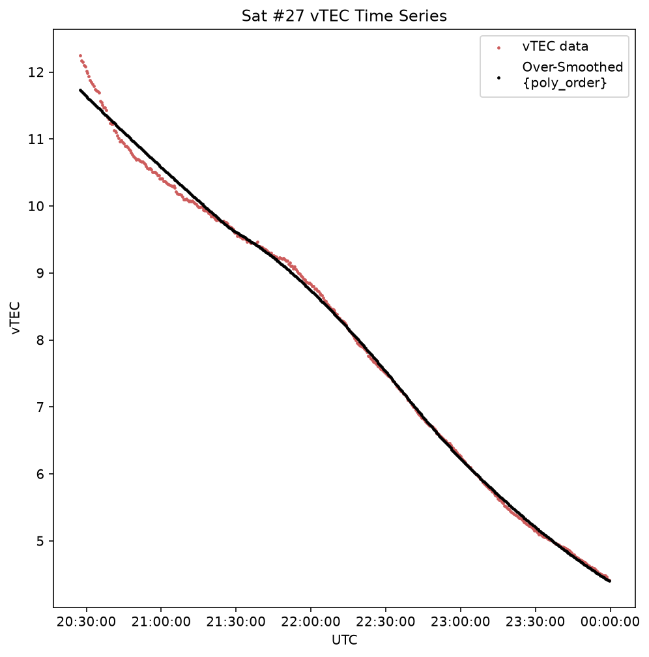
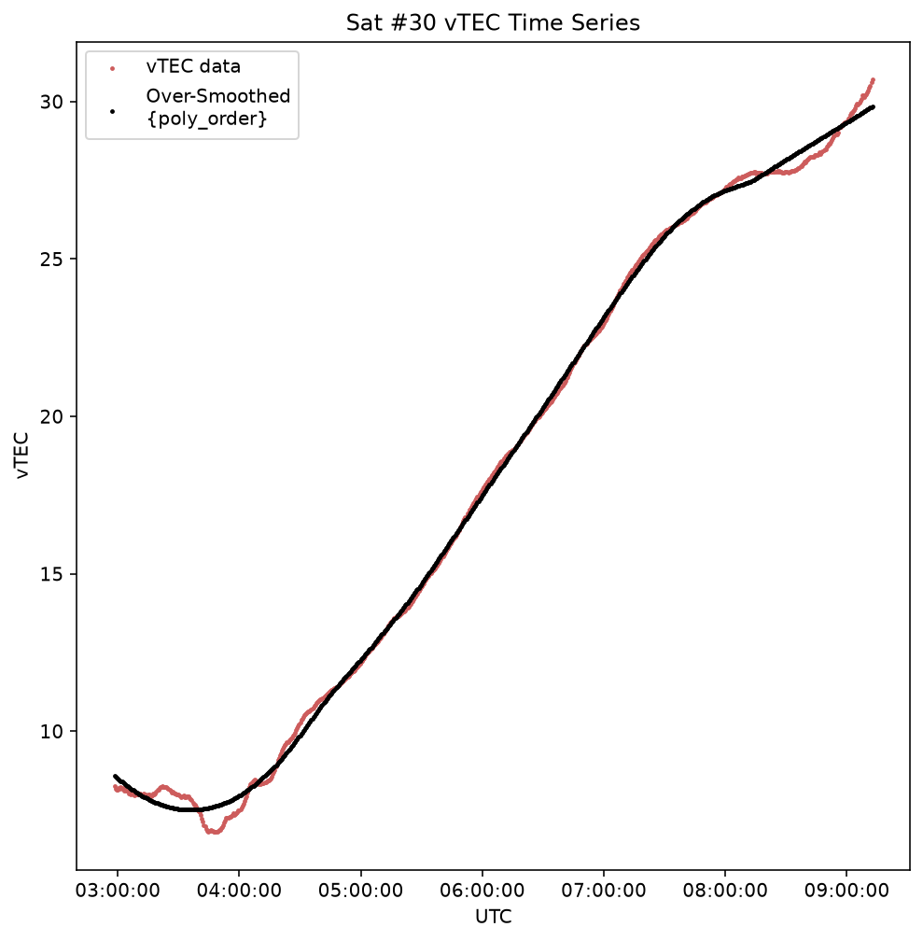
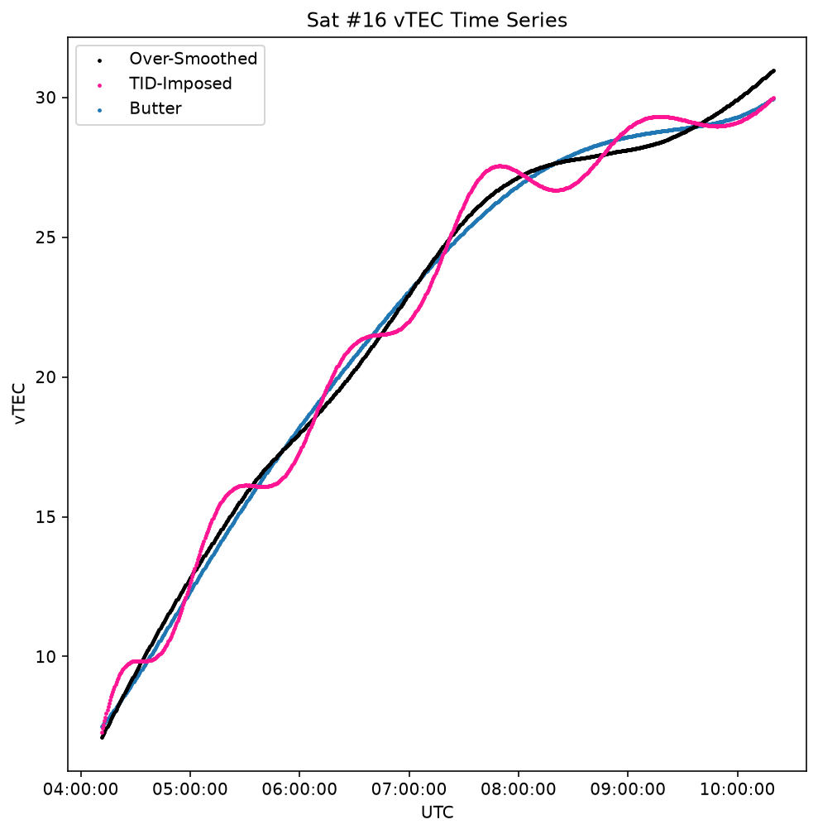
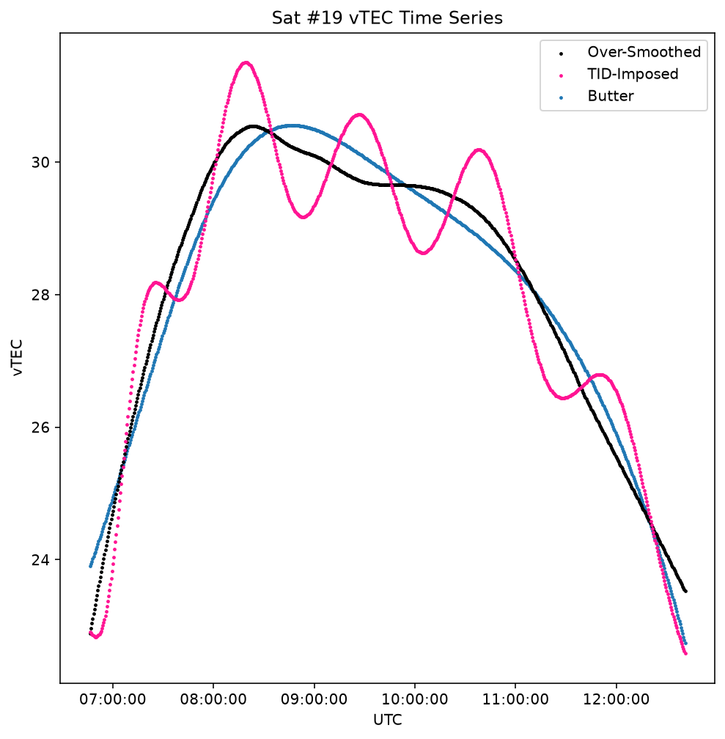
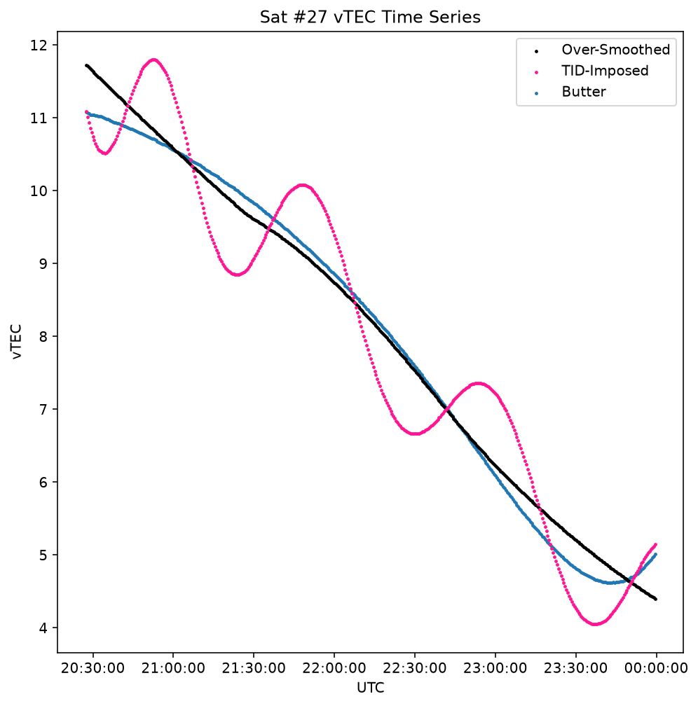
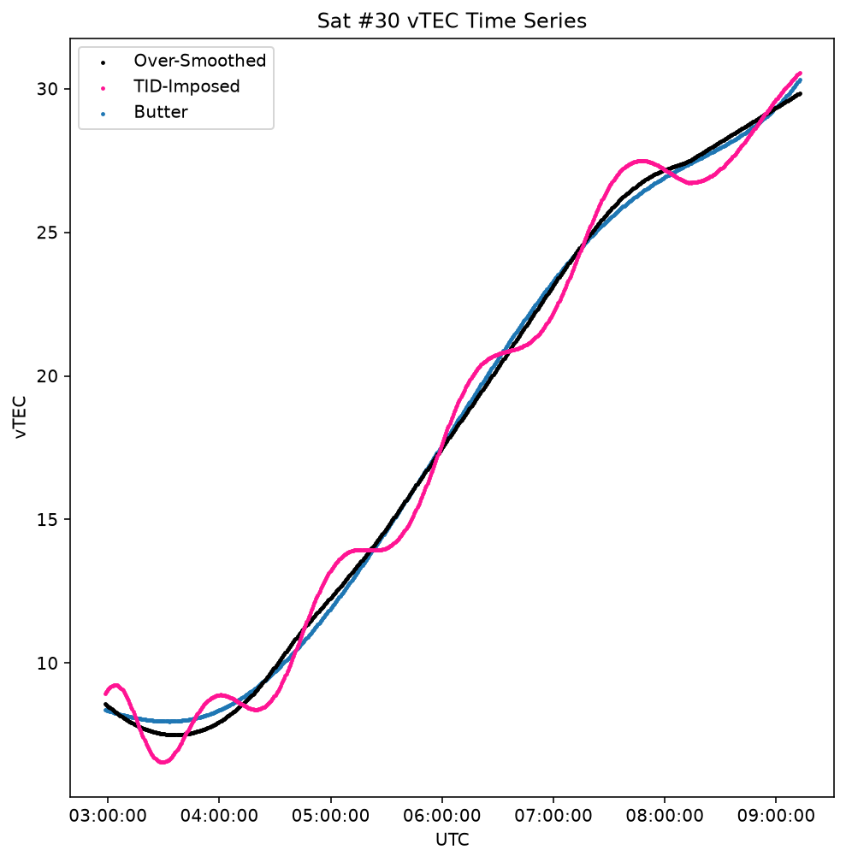
Detrending Examples
Background Extraction
TID Injection & Detrending

Slide 22
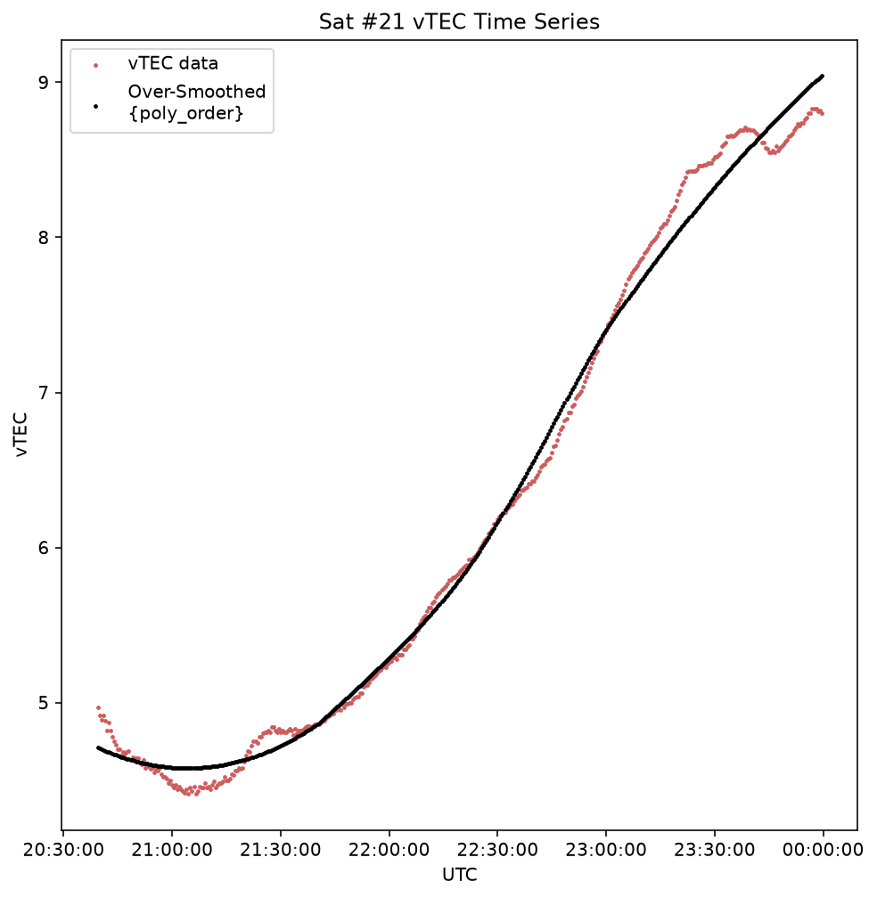
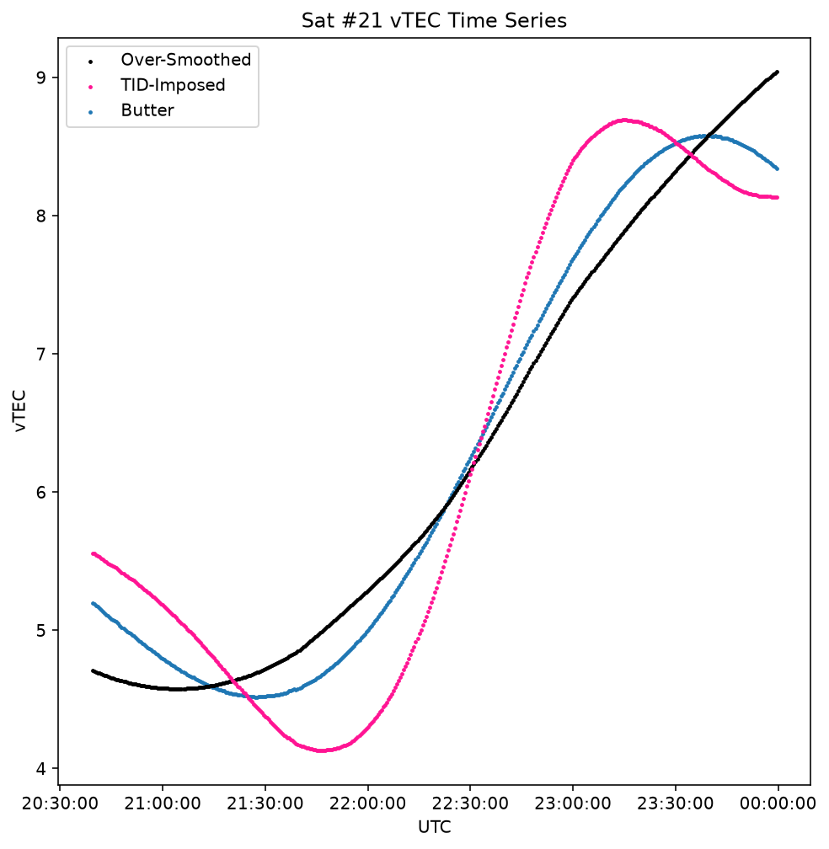
Detrending, Poor Example

Slide 23
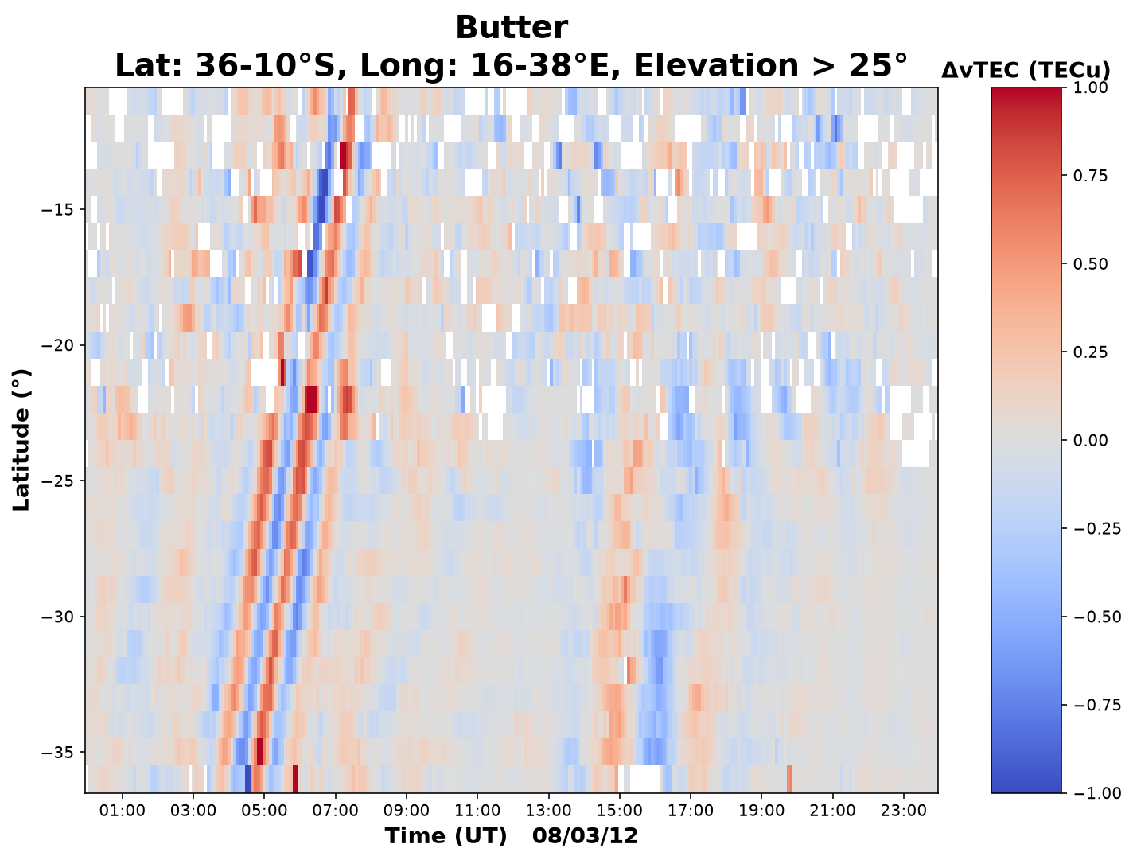
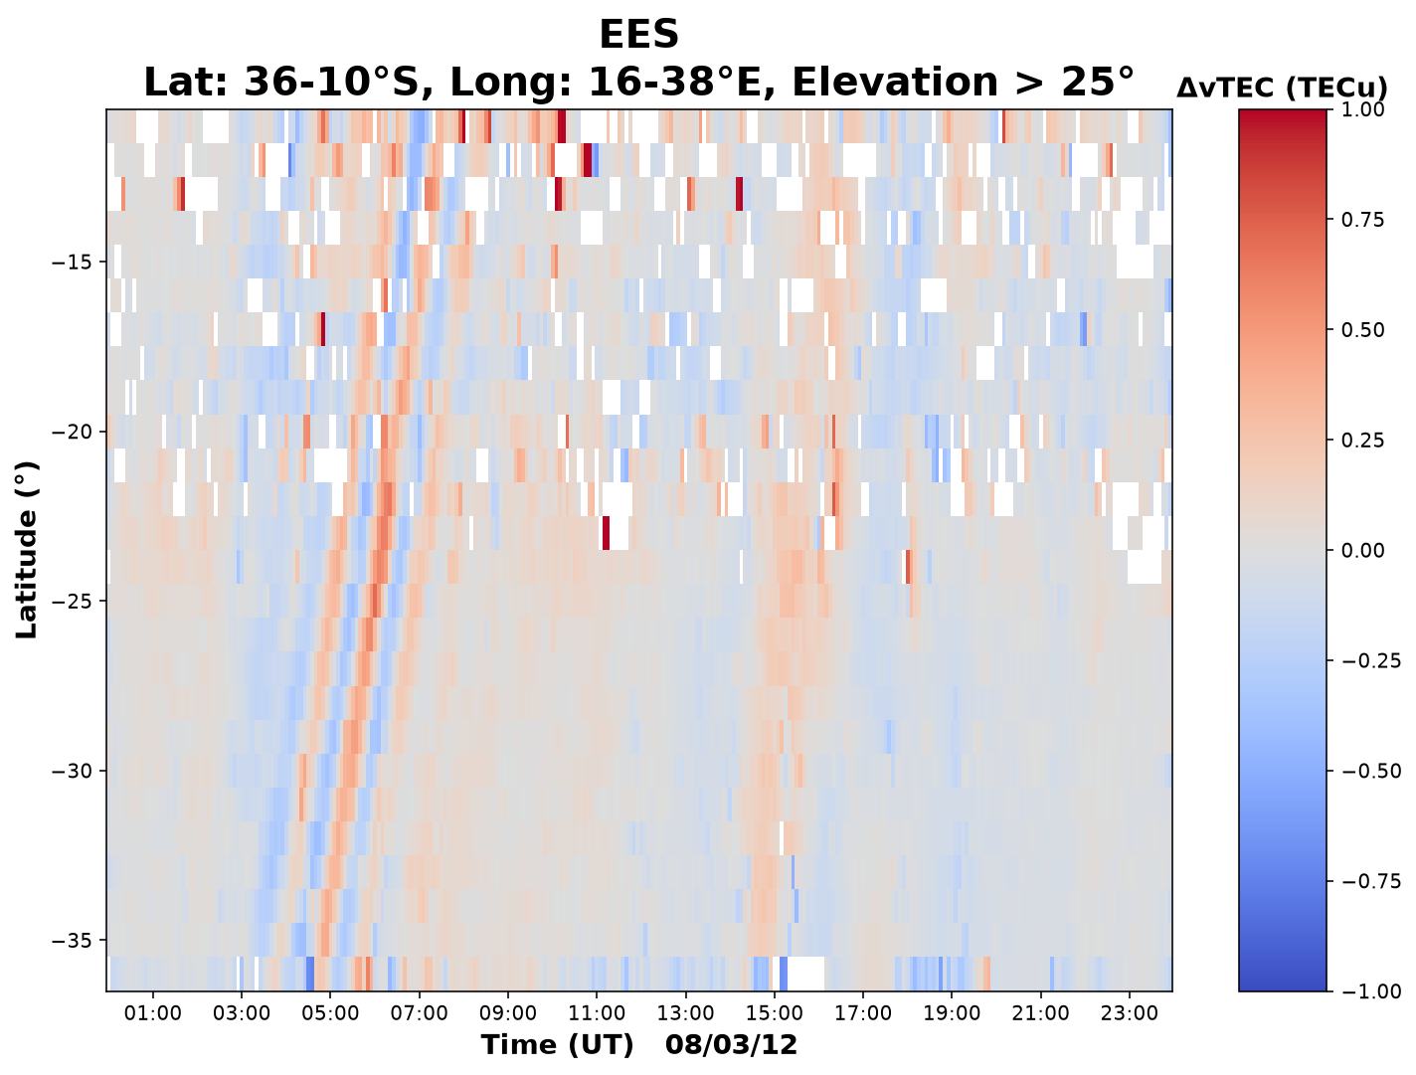
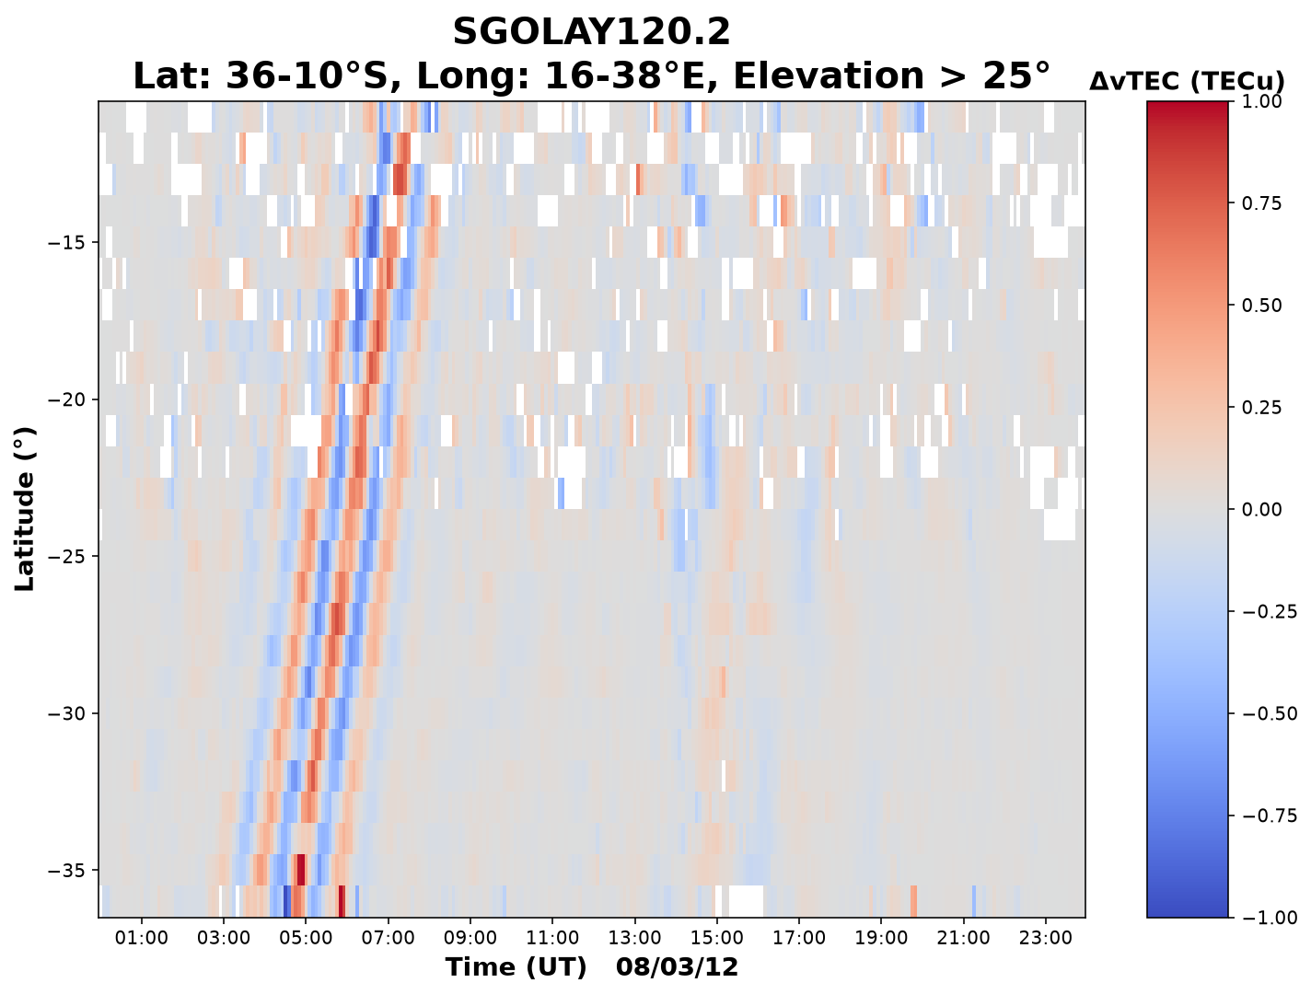
Detrending

Slide 24
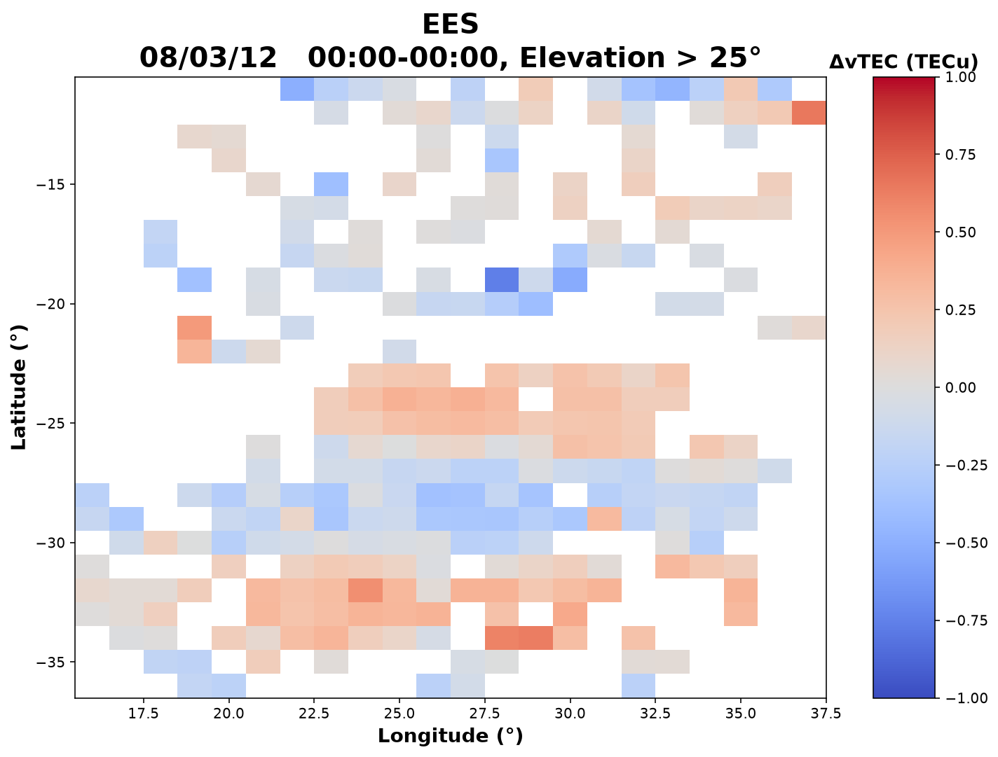
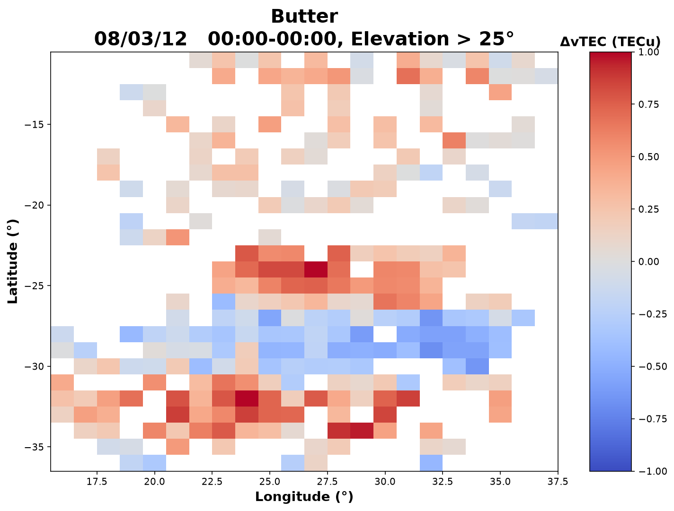
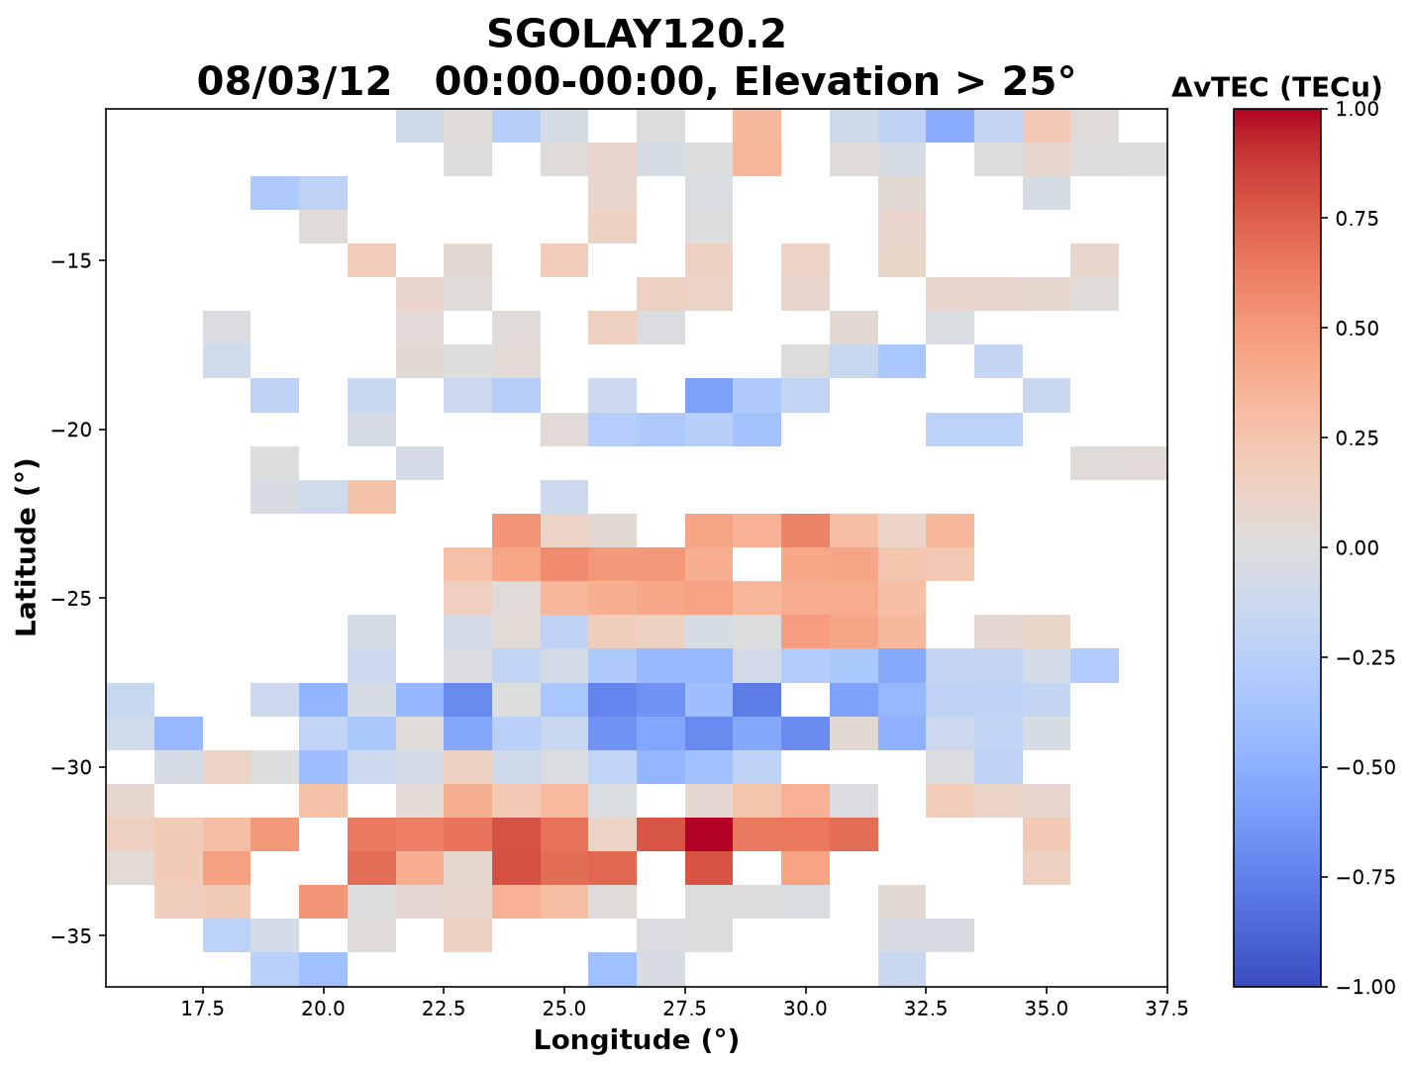
Detrending

Slide 25
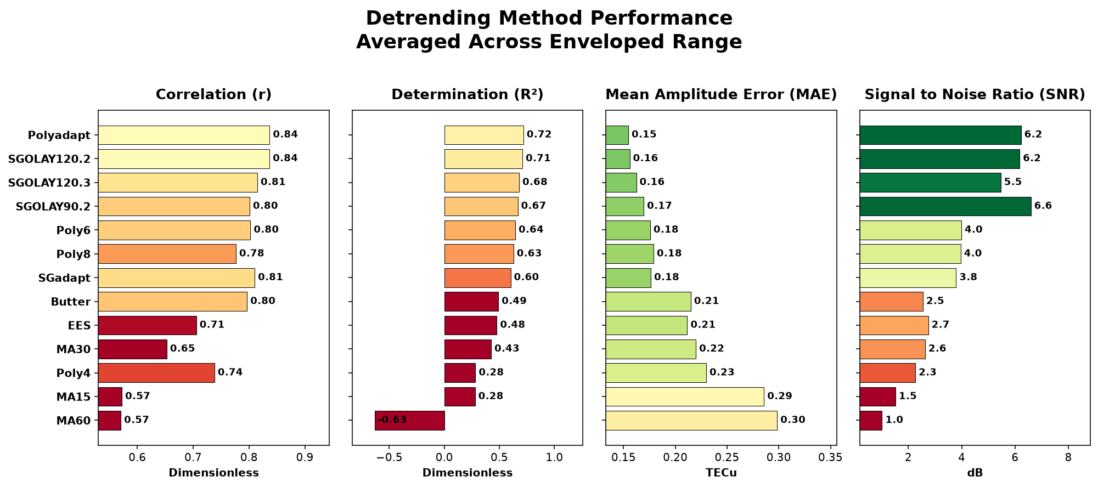
Full Results

Slide 27
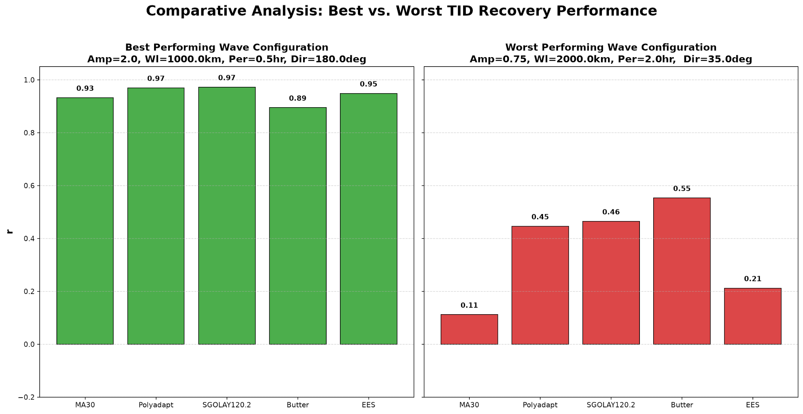

Slide 28
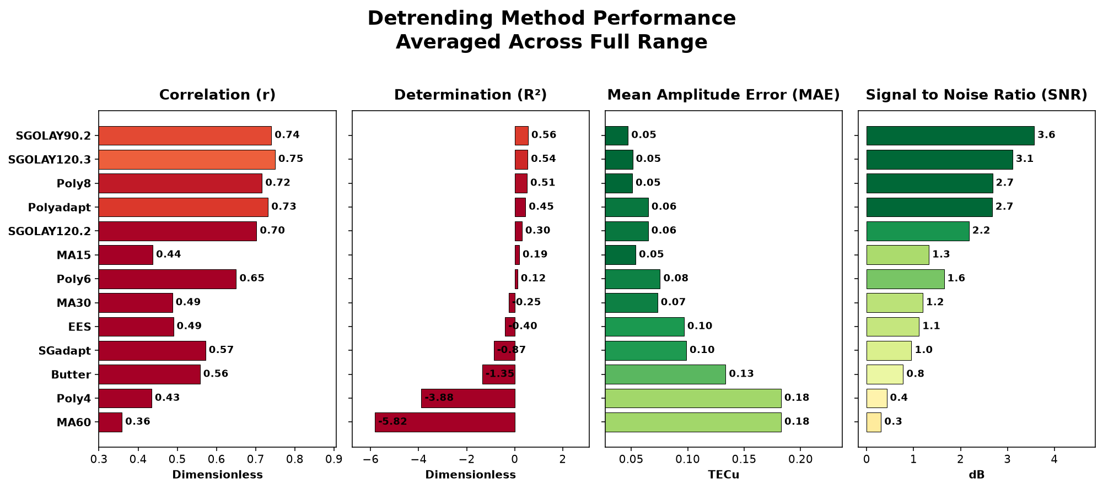
Full Results

Slide 29
