Slide 1
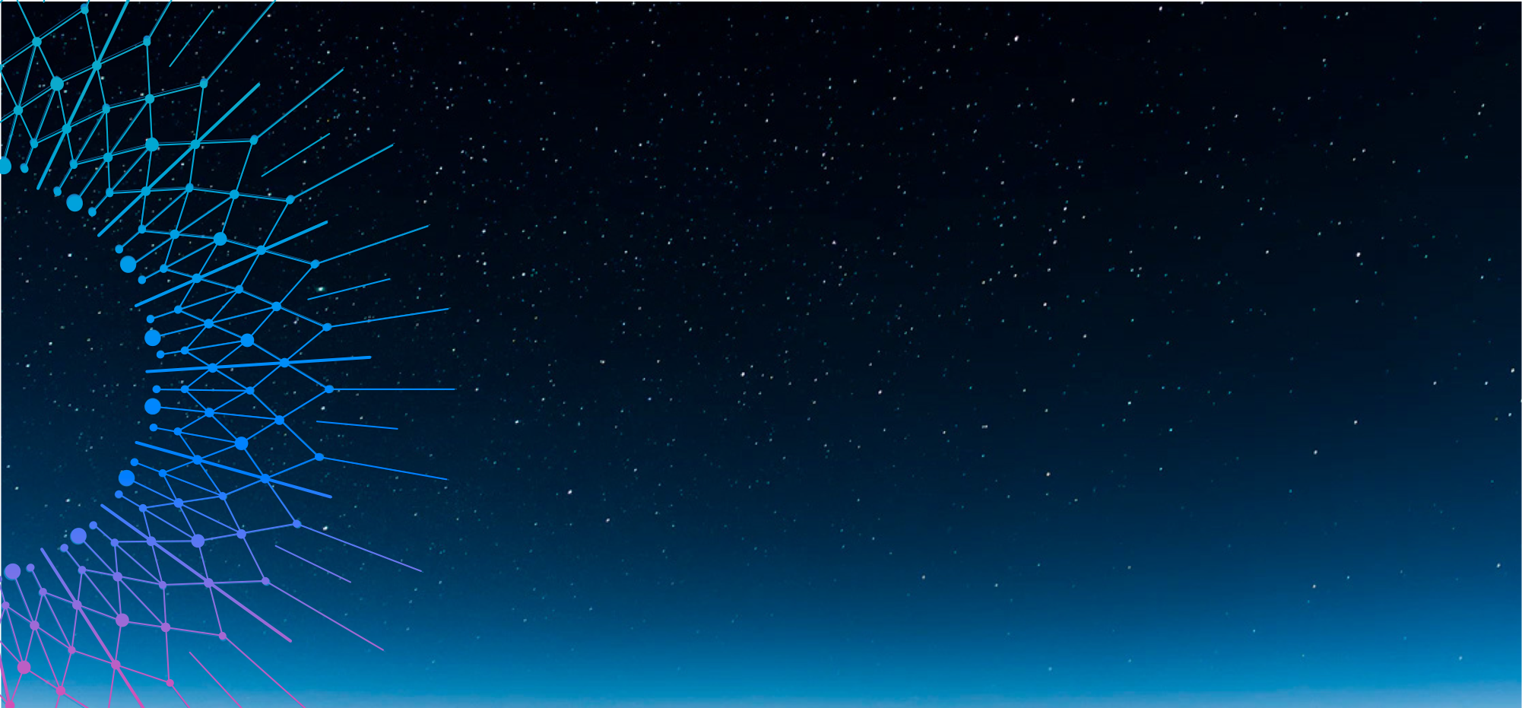


Investigating the Impact of Auroral arcs on ionospheric electric fields, thermospheric Neutral Winds, and Joule Heating.
Siyanda Hlathi
Supervisors :
Prof. Michael Kosch
Dr. Judy Stephenson

Slide 2
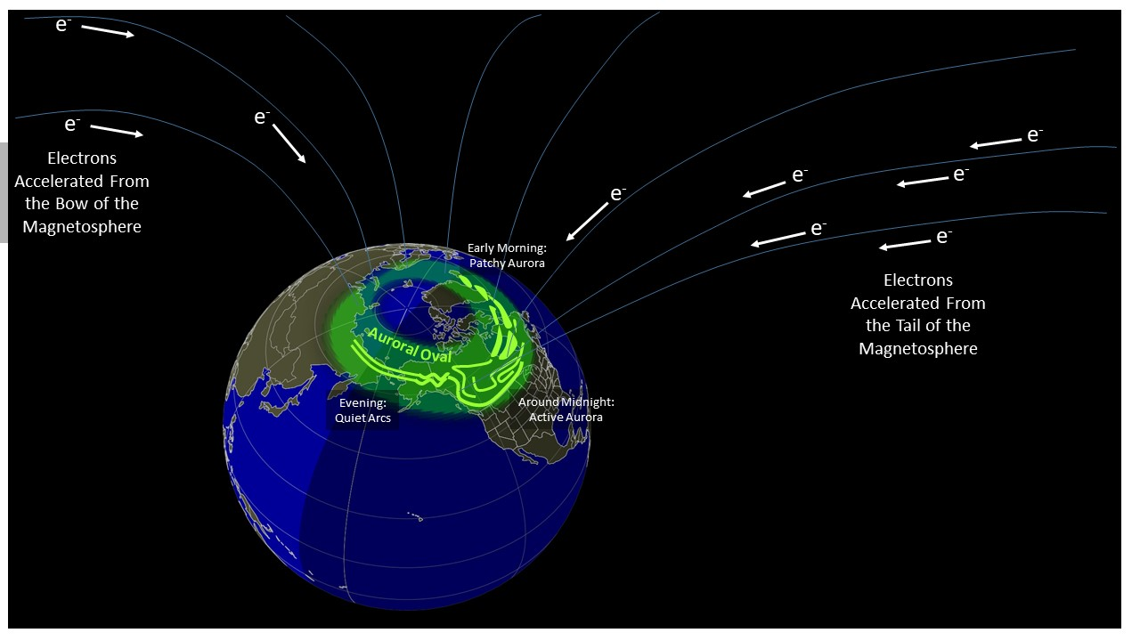
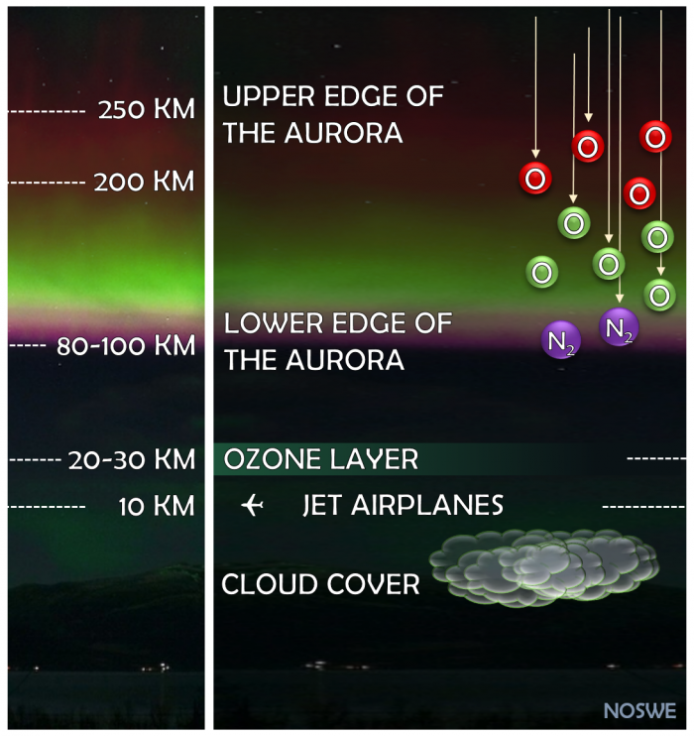
The Physics of Auroral Displays
https://www.spaceweather.gov/content/aurora-tutorial
https://mindthegraph.com/blog/northern-lights-science/

Slide 3
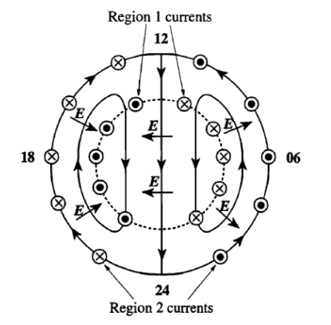
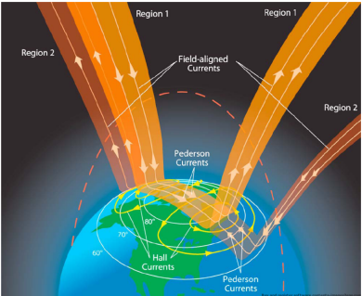
High-latitude ionospheric current system
Solar wind energy enters the magnetosphere and is carried into the polar ionosphere by field-aligned (Birkeland) currents.
In the ionosphere, the current spread horizontally into Pedersen and Hall currents.
Together, these currents form a closed magnetosphere–ionosphere electrical circuit.
Dungey cycle

Slide 4
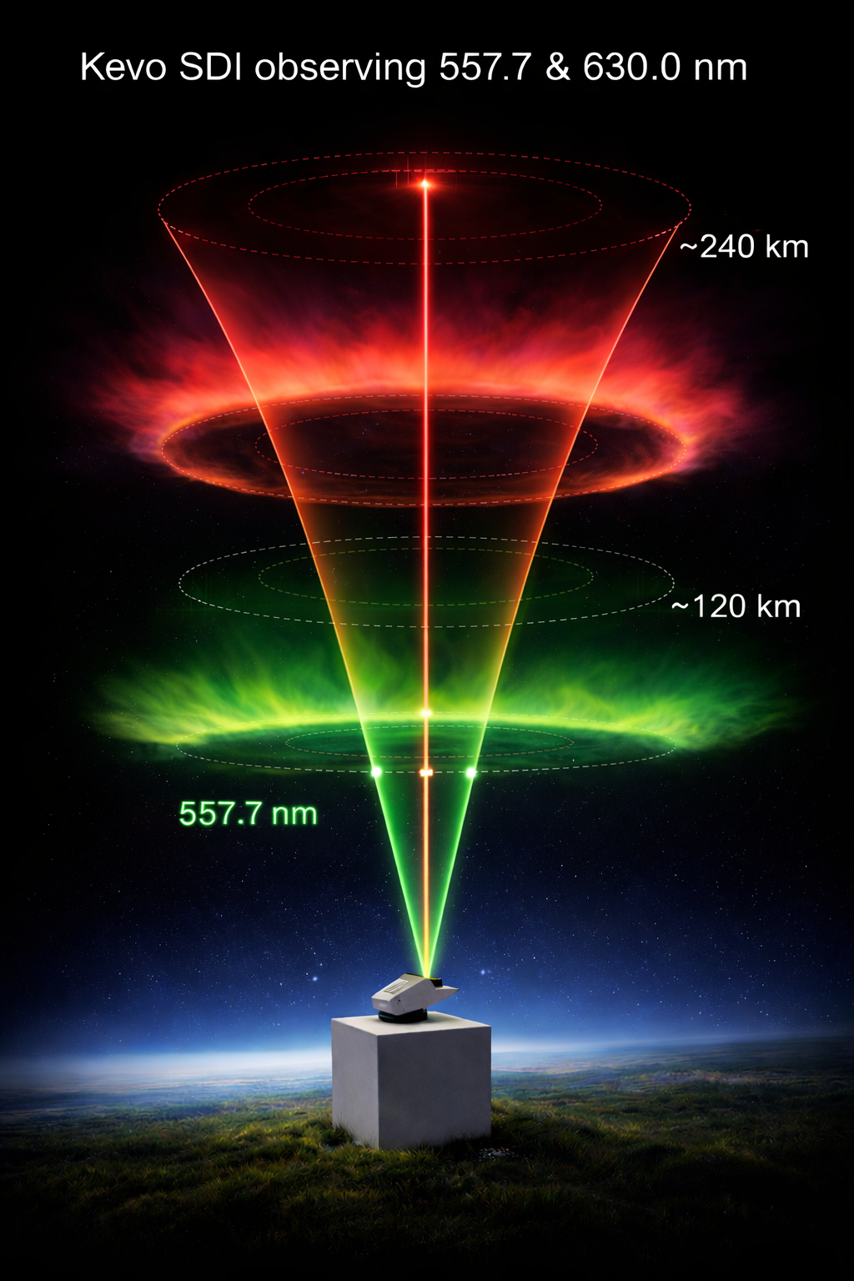
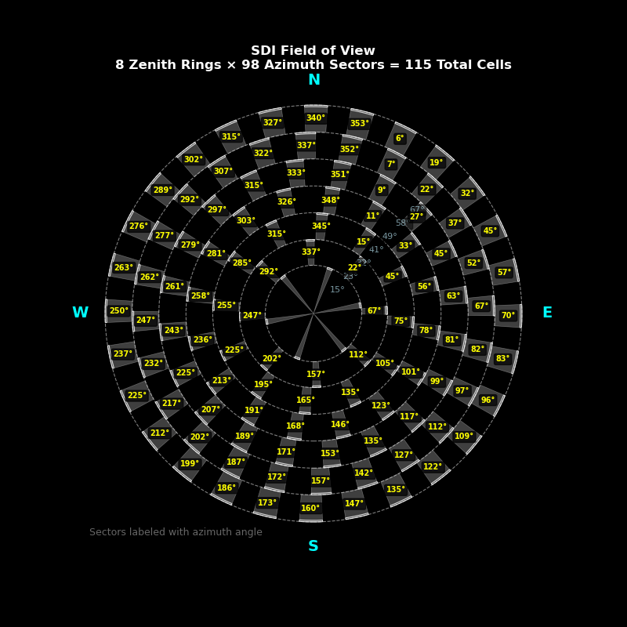
Scanning Doppler Imager (SDI)
Scanning Doppler Imager (SDI) is an optical instrument that measures neutral winds in the high-latitude thermosphere using the Doppler shift of airglow emissions.
630.0 nm
Conde et al., 1997

Slide 5
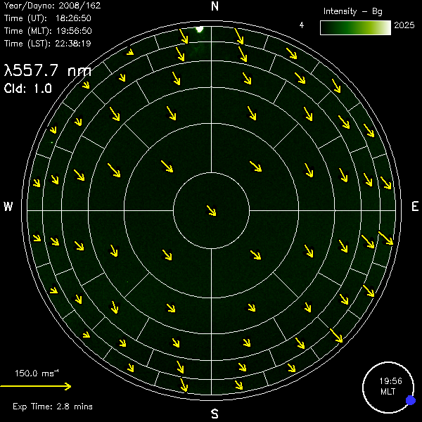
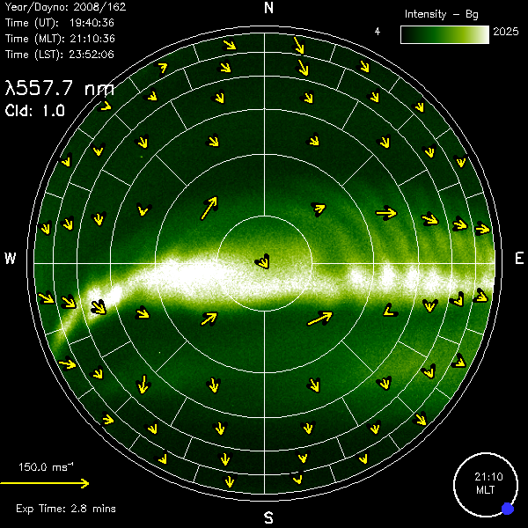
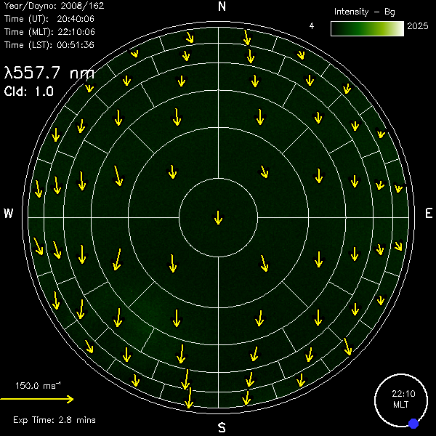
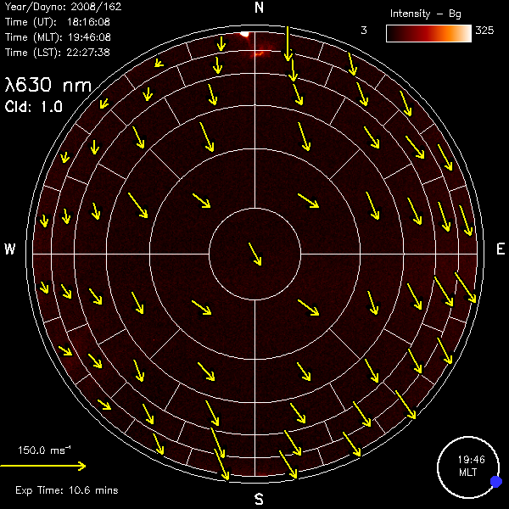
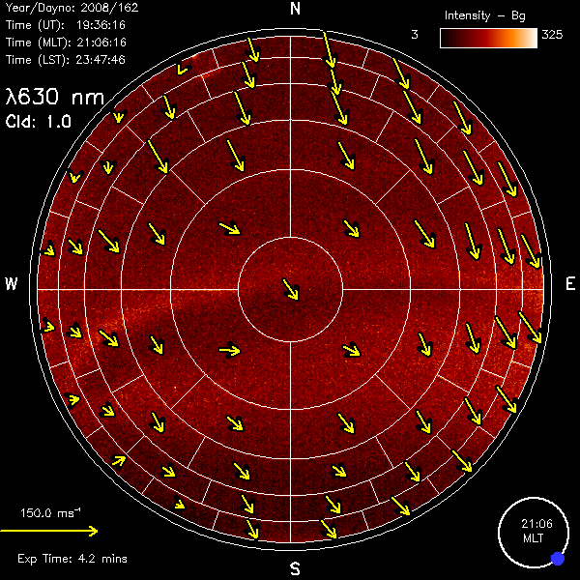
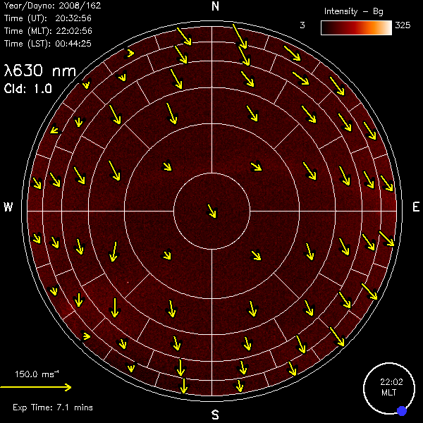
Interaction of E-region neutral winds with auroral arcs
BEFORE
DURING
AFTER
E-region 557.7 nm
F-region 630.0 nm
Mawson SDI, 10 June 2008
Kosch et al., 2010

Slide 6
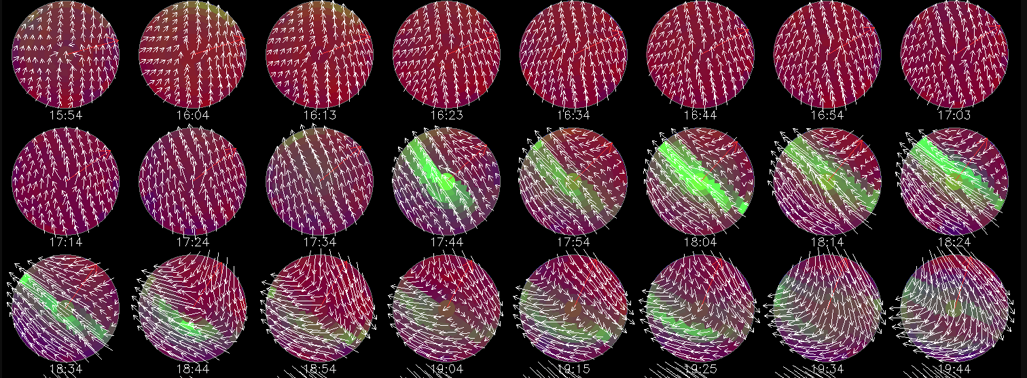
SDI Observations on 19 February 2025 at Kevo, Finland
In the F-region, the most likely mechanisms affecting the neutral wind are ion drag from plasma convection and pressure-gradient forces generated by solar and Joule heating.
630.0 nm 245 km altitude

Slide 7
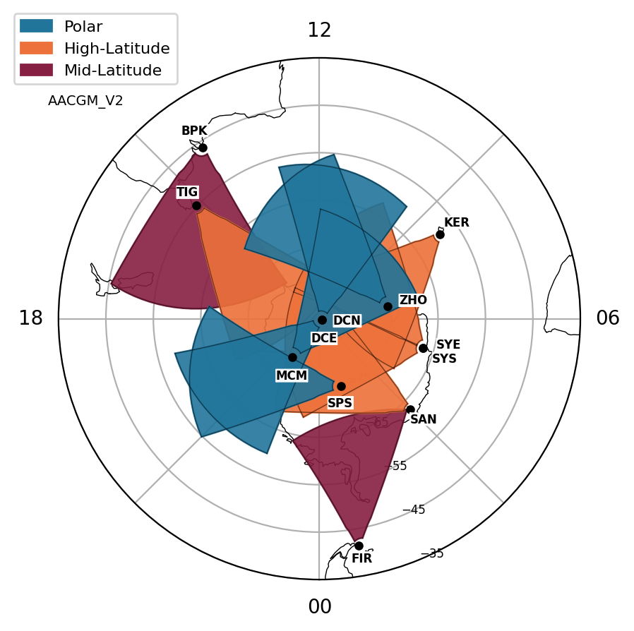
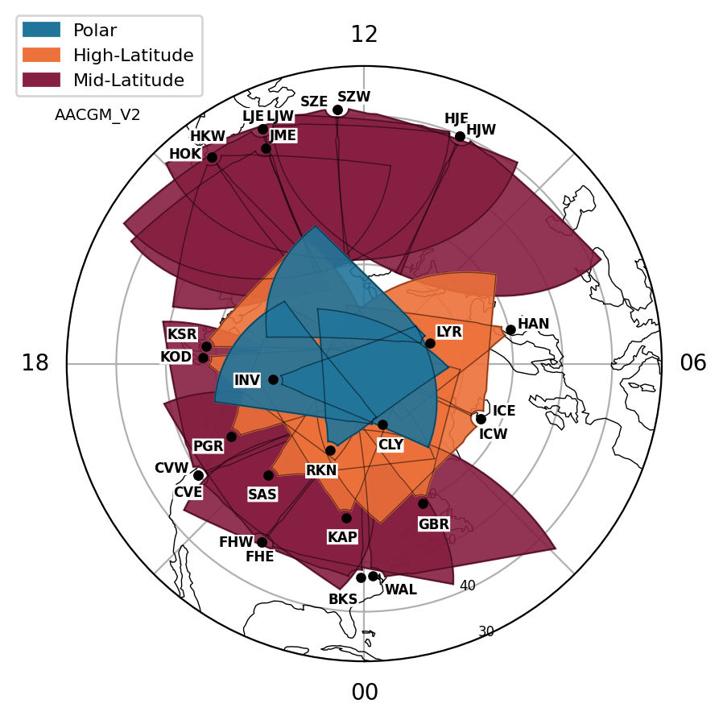
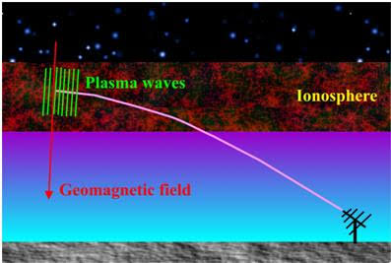
Super Dual Auroral Radar Network(SuperDARN)
SuperDARN is a global network of HF radars that measures plasma flows in the high-latitude ionosphere of both hemispheres from the Doppler shift of plasma irregularities.
The observations are used to map ionospheric convection and electric fields, providing insight into the transfer of solar wind energy into the magnetosphere-ionosphere system.
Southern Hemisphere
Northern Hemisphere

Slide 8
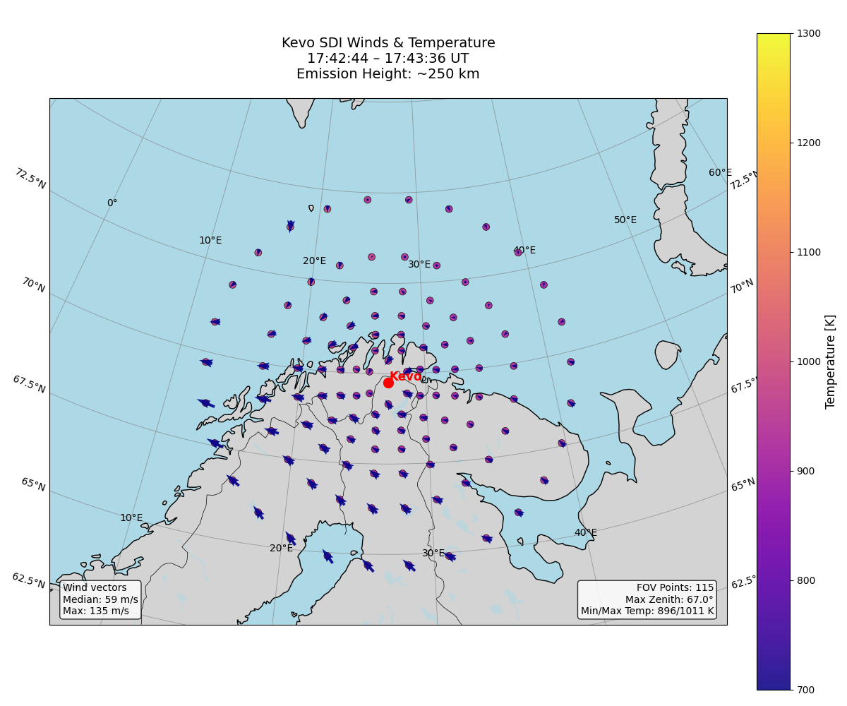
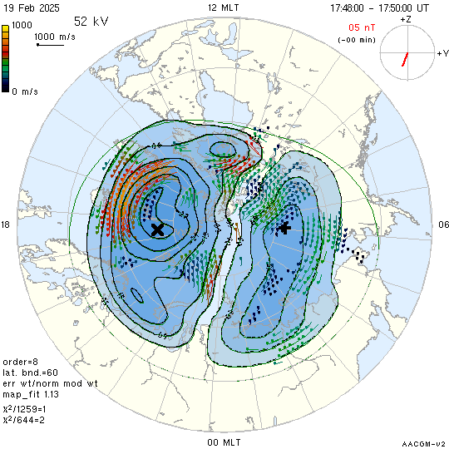
SuperDARN Convection Map and SDI field of view overlaid at the Kevo site, northern Finland
19 Feb 2025 ~17:45 UT

Slide 9
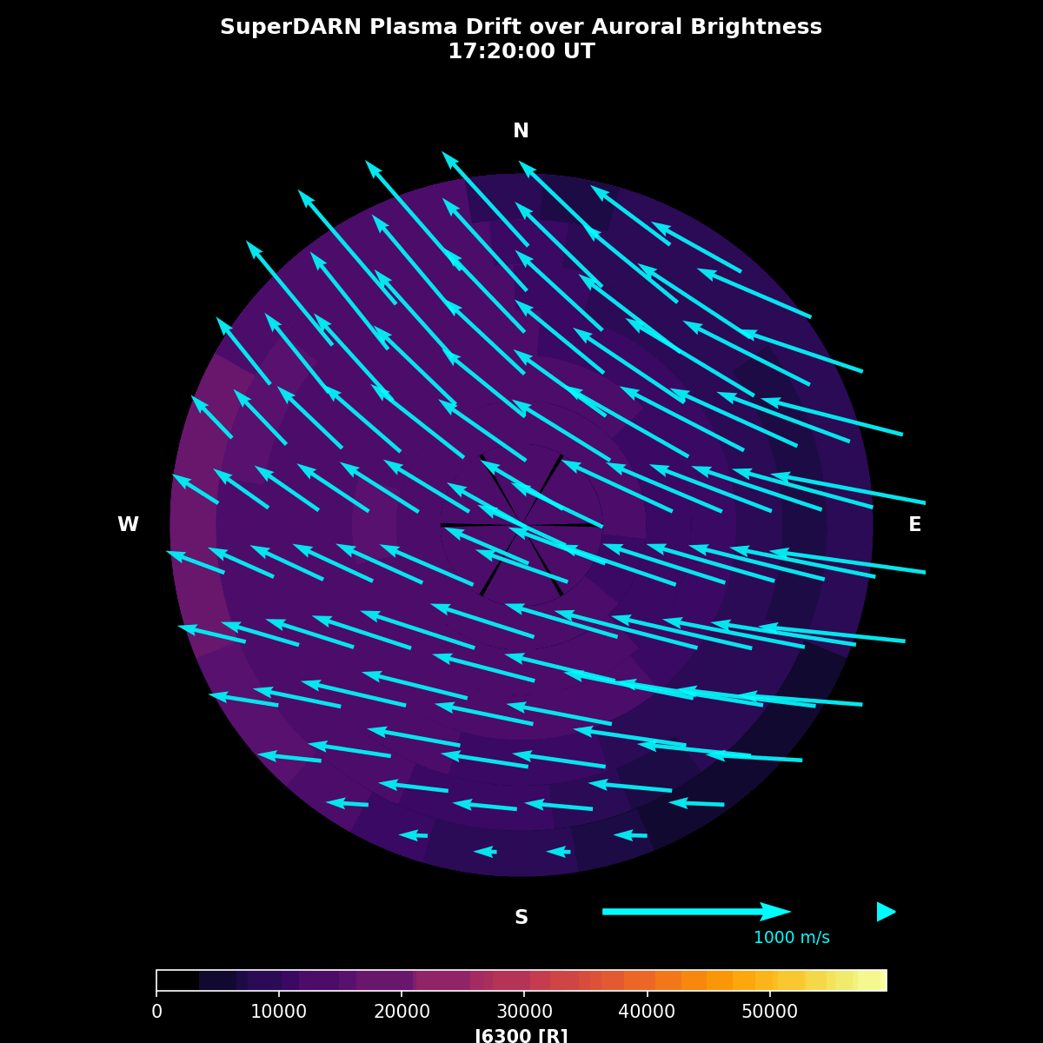
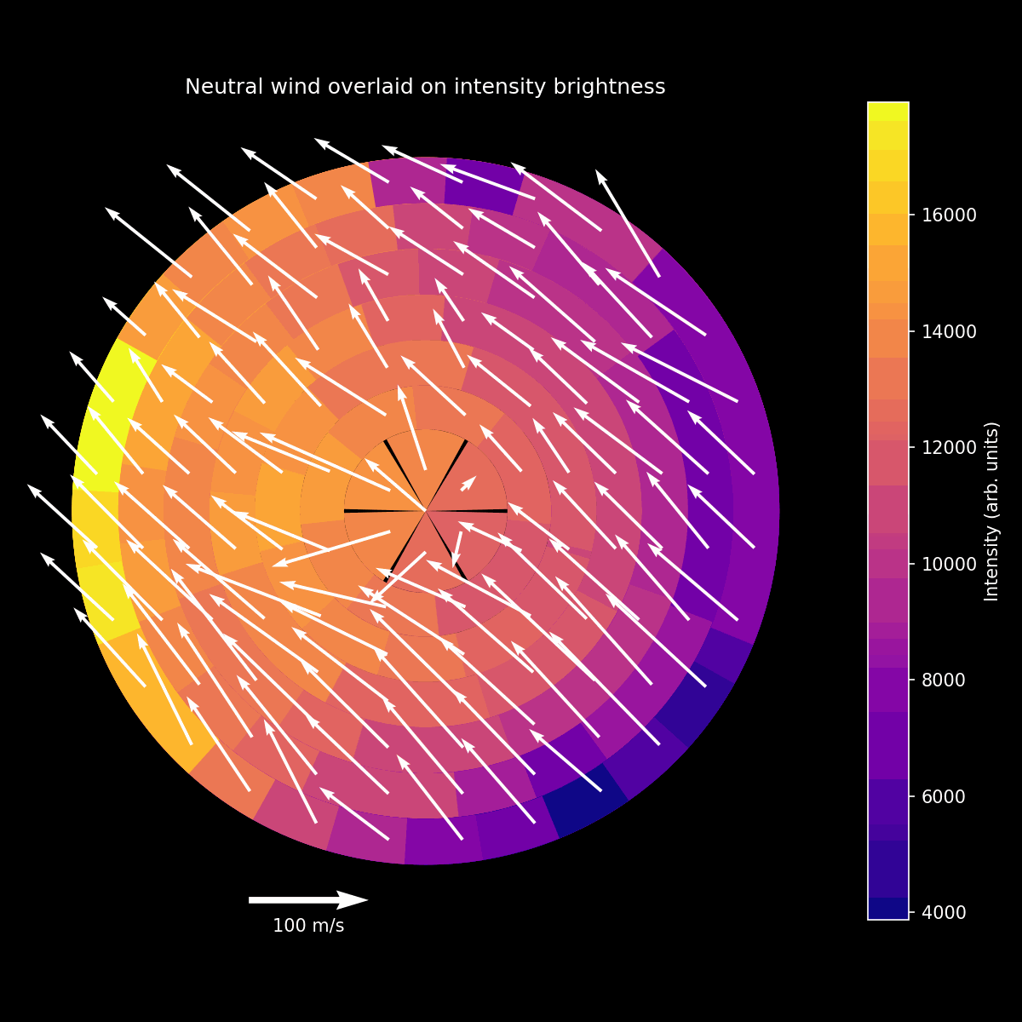
Ion And Neutral Wind Flow Around the Arc (19 February 2025)
Field of view ~ 1150 km
245 km altitude

Slide 10
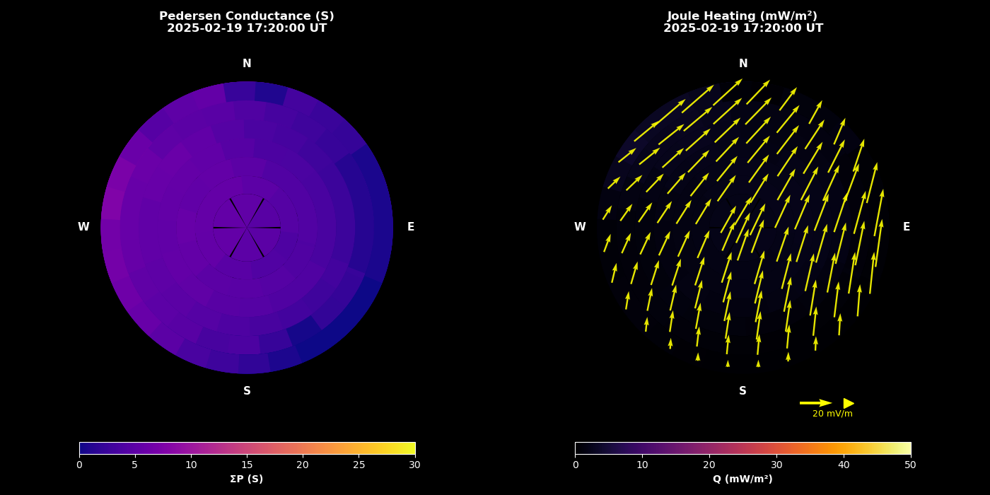
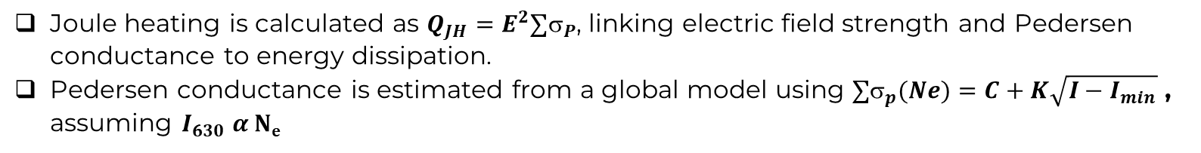
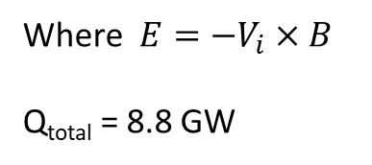
Pedersen Conductance and Joule Heating
Joule heating is calculated as $Q_{JH}=E^{2}{∑}_{P}$, linking electric field strength and Pedersen conductance to energy dissipation.
Pedersen conductance is estimated from a global model using ${∑σ}_{p}(Ne)=C+K\sqrt{{I−I}_{min}}$ , assuming $I_{630} α Ne$
Where ${E=−V}_{i}×B$
Q_{total} = 8.8 GW
The AE dependent empirical model of ionospheric Pedersen conductivity by Spiro et al. (1982)

Slide 11
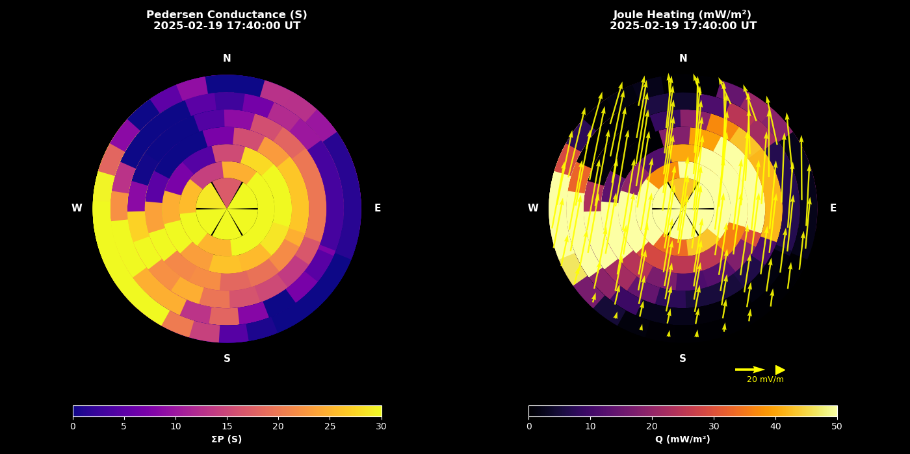
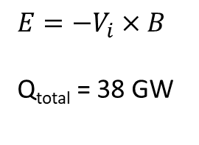
Pedersen Conductance and Joule Heating
$${E=−V}_{i}×B$$
Q_{total} = 38 GW

Slide 12
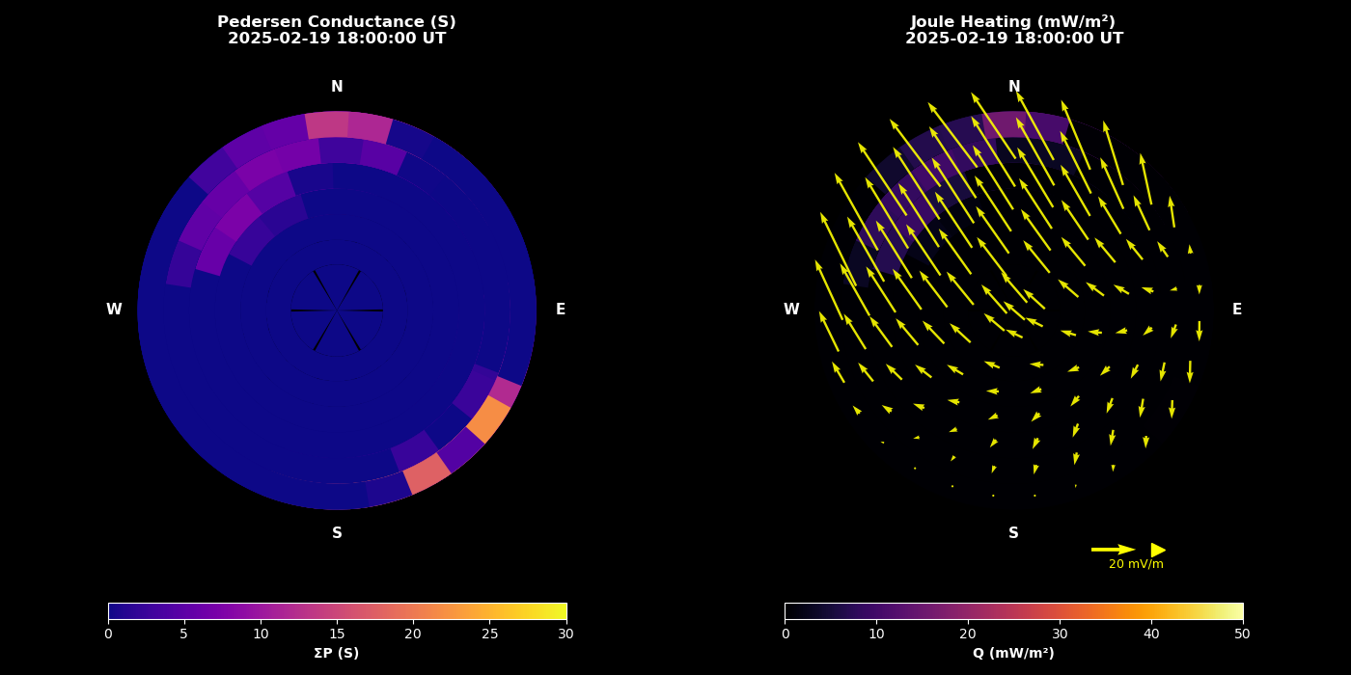
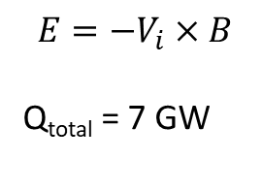
Pedersen Conductance and Joule Heating
$${E=−V}_{i}×B$$
Q_{total} = 7 GW

Slide 13
Summary
The event studied occurred at Kevo (69.76° N, 27.01° E), Northern Finland on 19 February 2025 at approximately 17:40 UT.
We successfully extracted and mapped SuperDARN plasma flow data within the field of view (FOV) of the SDI.
The observations reveal related changes in both plasma flow and neutral wind flow during the event.
The correspondence between plasma and neutral wind behaviour indicates that ion drag may have been the dominant force driving the neutral wind response in this case.
Conclusion
Joule heating showed enhanced values (approximately an order of magnitude) in the vicinity of the auroral arc, indicating increased energy deposition into the upper atmosphere (about 4 times greater in the SDI FOV), which is not accounted for in global Joule heating models.
Future work
Find the SDI data set with E-region winds (557.7 nm). At the E-region is where the Joule heating maximises. Look for pressure gradient effect.

Slide 14
References
https://www.spaceweather.gov/content/aurora-tutorial
https://www.spaceweather.gov/content/aurora-tutorial
Le, G.; J. A. Slavin; R. J. Strangeway (2010). "Space Technology 5 observations of the imbalance of regions 1 and 2 field-aligned currents and its implication to the cross-polar cap Pedersen currents". J. Geophys. Res. 115 (A07202): A07202. Bibcode:2010JGRA..115.7202L. doi:10.1029/2009JA014979.
Kosch, M. J., and E. Nielsen (1995), Coherent radar estimates of average high‐latitude ionospheric Joule heating, J. Geophys. Res., 100, 12,201-12,215.
Kosch, M. J., et al. (1998), Extrapolating EISCAT height‐integrated Ped ersen conductivities to other parts of the sky using ground‐based auroral images, Ann. Geophys., 16, 583–588.
Kosch, M. J., et al. (2010). First observations of simultaneous inter hemispheric conjugate high-latitude thermospheric winds. Journal of Geophysical Research, 115, A09328. https://doi.org/10.1029/ 2009JA015178
Zou,Y., et al. (2018). Mesoscale F region neutral winds associated with quasi-steady and transient nightside auroral forms. Journal of Geophysical Research: Space Physics, 123, 7968–7984. https://doi.org/ 10.1029/2018JA025457
Spiro, R. W., P. H. Reiff, and L. J. Maher Jr., Precipitating electron energy flux and auroral zone conductance: An empirical model, J. Geophys. Res., 87, 8215-8227, 1982.
Conde, M., et al. (2001), Assimilated observations of thermospheric winds, the aurora, and ionospheric currents over Alaska, J. Geophys. Res., 106, 10,493–10,508.

Slide 15




THANK YOU
www.sansa.org.za
@SANSA7
South African National Space Agency
South African National Space Agency
South African National Space Agency (SANSA)

