Slide 1
DEVELOPMENT OF A REMOTE, SELF-SUSTAINED, LOW-COST, LOW-POWER GNSS RTK BASE STATION FOR CONTINUOUSLY OPERATING REFERENCE STATION (CORS) NETWORKS
Presenter: Mbhasobhi Manqele
Degree: MSc in Space Science
Institution: University of KwaZulu-Natal (UKZN)
Supervisors: Prof. Riaan Stopforth (UKZN) & Prof. Michael Kosch (SANSA)
07 July, 2026.

Slide 2



OUTLINE
Introduction
Methodology
GNSS fundamentals
RTK & CORS concept
GNSS receiver selection
System design and implementation
RINEX
Testing and evaluation
Contribution and future work
2

Slide 3
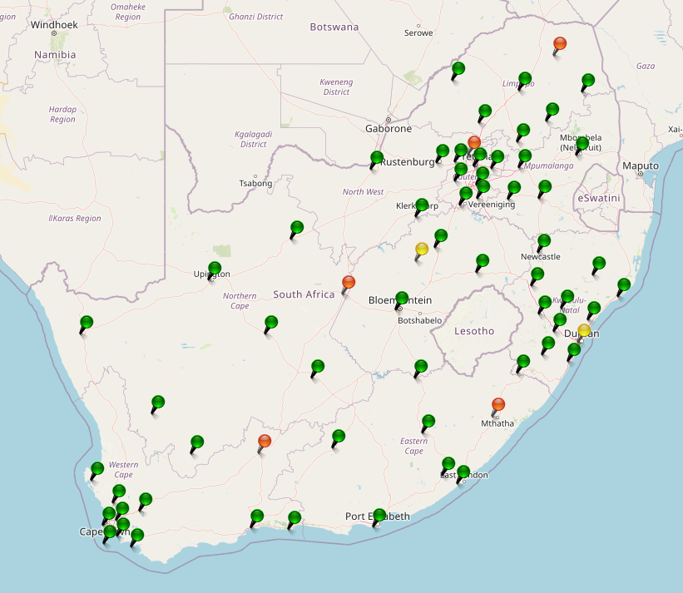
INTRODUCTION
Why a Low-Cost CORS Station?
Professional GNSS reference stations with high accuracy are expensive & difficult to deploy (slide 3)
Low-cost dual-frequency GNSS receivers now provide Raw observations, Multi-constellation capability, and RTCM output.
Impact Areas:
Precision agriculture, Surveying and infrastructure development, Geodetic research, and Space weather monitoring
Objectives:
Design, integrate, and deploy a working prototype of a low-cost hardware system.
A system that delivers GNSS data to a centralized server based at SANSA
Evaluate the performance of the GNSS prototype in terms of data quality
Estimate TEC capability
3

Slide 4
RESEARCH METHODOLOGY
Literature Review
Establish the theoretical foundation required for GNSS RTK and CORS station development.
Identified the technical requirements for a low-cost scientific GNSS reference station.
Design specifications
Requirement Analysis
Hardware Development
Software Integration
Field Testing
Performance Evaluation
Translate research objectives and operational requirements into measurable system specifications.
4

Slide 5

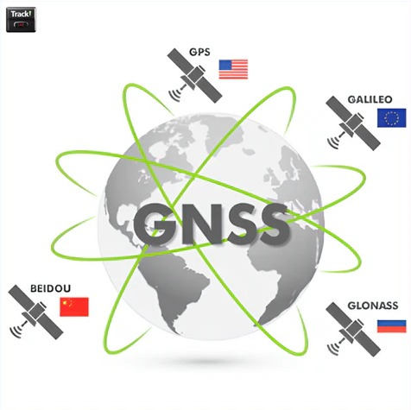
GNSS FUNDAMENTALS
GLOBAL NAVIGATION SATELLITE SYSTEMS (GNSS)
GPS
(USA)
GLONASS
(Russia)
Galileo
(EU)
BeiDou
(China)
Regional Systems
QZSS (Japan)
NavIC (India)
~31
~24
~28
~30
Global satellite (18-30 operational satellites)
Contents of the GNSS signals:
Carrier wave
Pseudo-Random Noise (PRN) code
Navigation Message
5

Slide 6
LOW-COST GNSS RECEIVER VS HIGH-GRADE GEODETIC GNSS RECEIVER
Feature | Low-Cost Receiver (u-blox ZED-F9P) | High-Grade Receiver
Cost | ~R4,000–R6,000 | R80,000–R300,000+
Power Consumption | < 1 W | 3–10 W
Size & Weight | Compact and lightweight | Larger and heavier
GNSS Constellations | GPS, Galileo, GLONASS, BeiDou | All major constellations
Multi-frequency Support | Dual-frequency (L1/L2/E5b/B2I) | Multi-frequency (L1, L2, L5, E5, E6, etc.)
RTK Positioning | ✔ Centimeter-level | ✔ Survey-grade centimetre-level
Raw Data Output | UBX, RTCM, RINEX | SBF, RTCM, RINEX
Real-time Streaming | ✔ RTCM MSM7 | ✔ RTCM MSM7
Ionospheric Monitoring | ✔ Suitable for TEC estimation | ✔ Scientific-grade
Scintillation Monitoring | Possible through post-processing | Often includes dedicated scintillation capabilities
Internal Storage | Limited | Large internal memory
Environmental Protection | Requires external enclosure | Rugged industrial enclosure
Intended Application | Low-cost CORS, UAVs, Robotics, Research | National CORS, Geodesy, Scientific Observatories
6

Slide 7
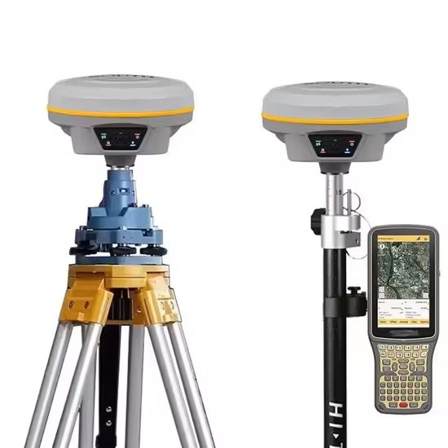
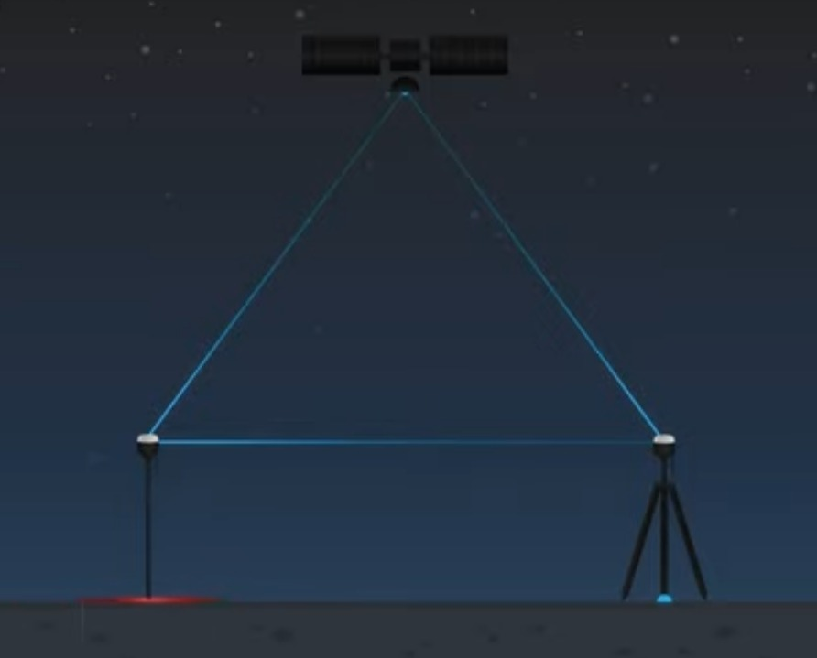
RTK AND CORS CONCEPT
Achieving Centimeter-Level Positioning
RTK principle:
A fixed base station provides correction data
Rover receiver applies corrections
Common GNSS errors are reduced
CORS network:
Permanent RTK reference stations
Continuously collect GNSS observations
Provide corrections through communication networks
NTRIP communication:
Standard protocol for transmitting RTCM corrections over the internet
Figure 1: GNSS RTK Base (left) and Rover (right)
7

Slide 8
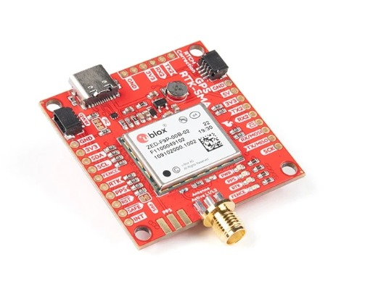
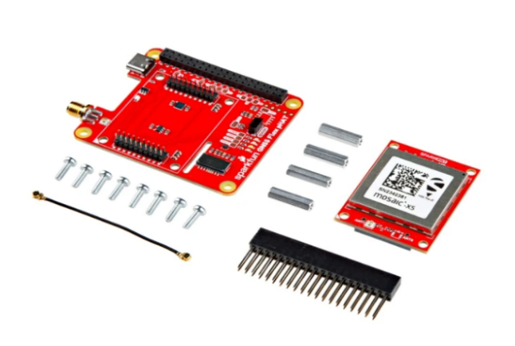
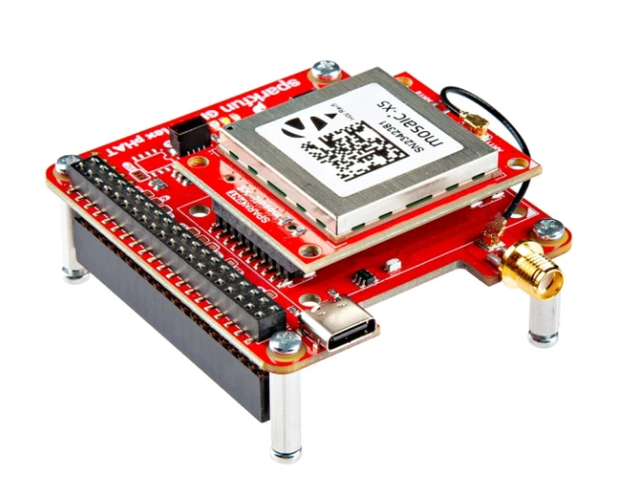
GNSS RECEIVER SELECTION
ZED-F9P:
Affordable & Low power consumption
Dual-frequency GNSS capability
Multi-constellation support
RTCM MSM7 output
Suitable for autonomous CORS
Septentrio mosaic-X5:
High accuracy
Multi-frequency GNSS tracking
Professional grade
Scientific benchmark
Suitable for:
Geodesy
Atmospheric monitoring
Space weather research
Permanent GNSS networks
U-blox ZED-F9P
SparkFun GNSS Flex pHAT
Mosaic-X5 GNSS pHAT
8

Slide 9
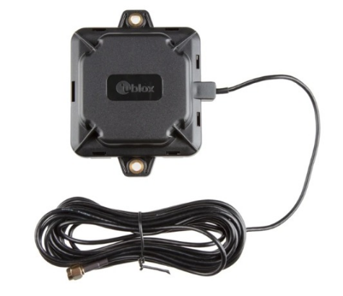
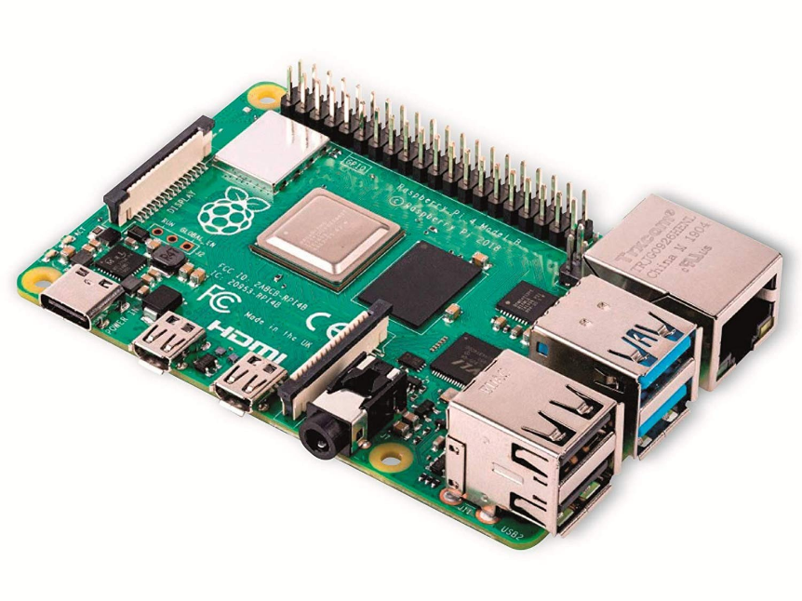
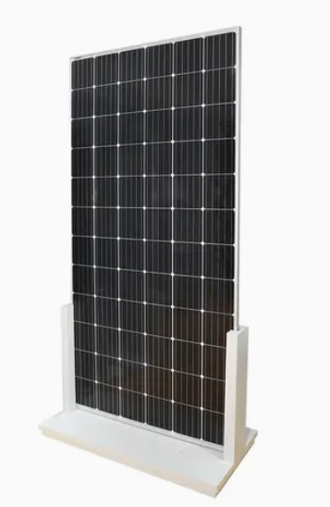
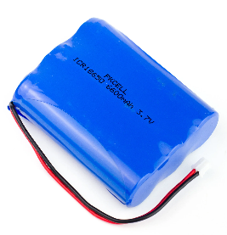
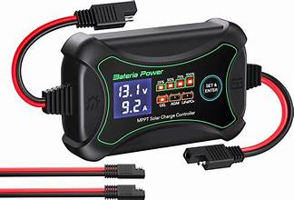
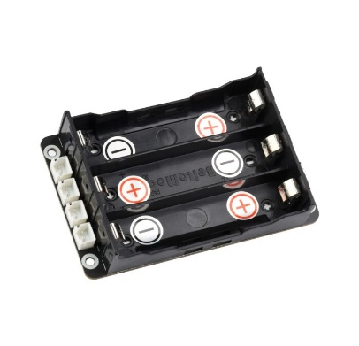
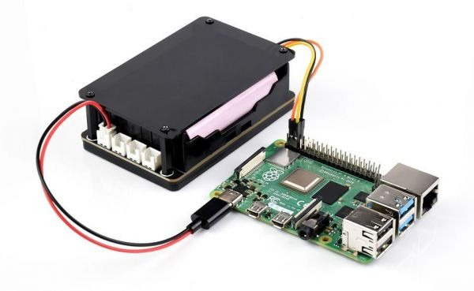
COMPONENTS
GNSS Antenna
ZED-F9P
LiFePO4 Battery Pack
Raspberry Pi 4
Solar Panel
MPPT Charge controllers
UPS Module
UPS module+RPi
9

Slide 10
SYSTEM ARCHITECTURE
GNSS Satellite – GPS.GLONASS.Galileo.BeiDou
Sensing
GNSS Antenna
u-blox ANN-MB-00
U-blox ZED-F9P
RTCM 3.3 MSM7 output
Computer
Raspberry Pi 4 (8GB)
Streaming & logging host
Local storage
Communications
RINEX 3 logging
RINEX files
NTRIP
Streams RTCM MSM7
Power
Battery & UPS
3-5 day autonomy
MPPT controllers
Charge regulation
Solar panel
100W panel
10

Slide 11
RINEX: THE STANDARD FORMAT FOR SCIENTIFIC GNSS DATA
Receiver Independent Exchange Format (RINEX)
International standard for storing & exchanging raw GNSS observations
Supports precise positioning and ionospheric research
Information Stored
Pseudorange, Carrier phase, Doppler & Signal strength
Receiving GNSS Data
Conversion script
Satellite Signals
ZED-F9P
UBX Binary
RINEX Obs. files
Logging script
Scientific Processing
FTP Server
ZED-F9P:
.UBX
RINEX files
TEC+S4+SigmaPhi (approx.)
Conversion
formats
Mosaic-X5
SBF
RINEX/ISMR
TEC+S4+SigmaPhi
11

Slide 12
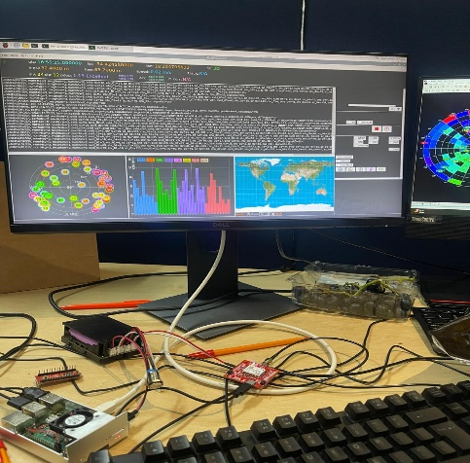
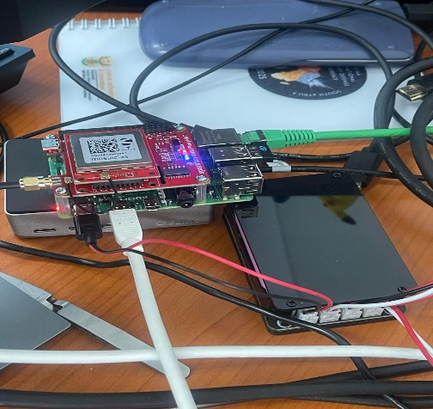
TESTING: PROTOTYPE HARDWARE INTEGRATION
Hardware Assembly
Raspberry Pi 4 is used as the embedded processing platform.
Real-time GNSS observations monitored using PyGPSClient.
Purpose for Testing before deployment
Enable SSH for remote monitoring
Confirm receiver communication with the Raspberry Pi.
Test data acquisition workflow.
Identify hardware or communication issues before deployment.
Ensure stable operation for autonomous field use.
Figure 1: u-blox ZED-F9P
Figure 2: Septentrio Mosaic-X5
12

Slide 13
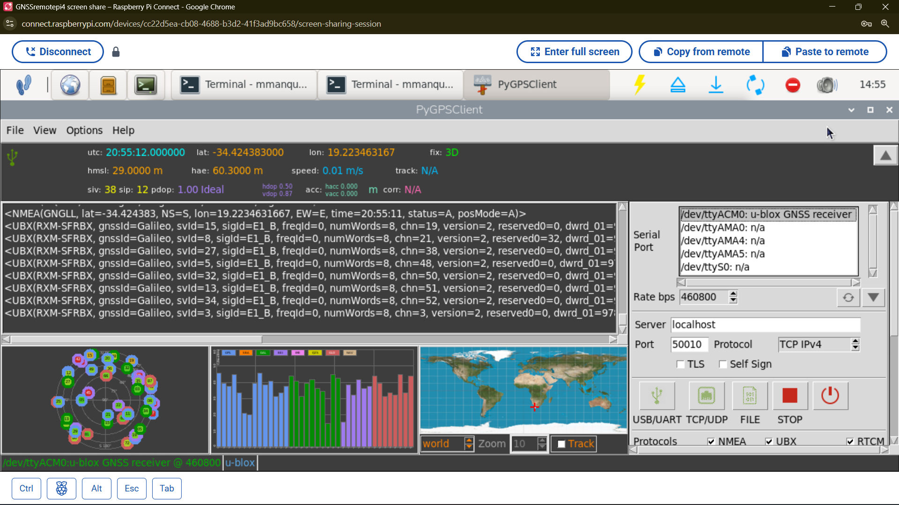
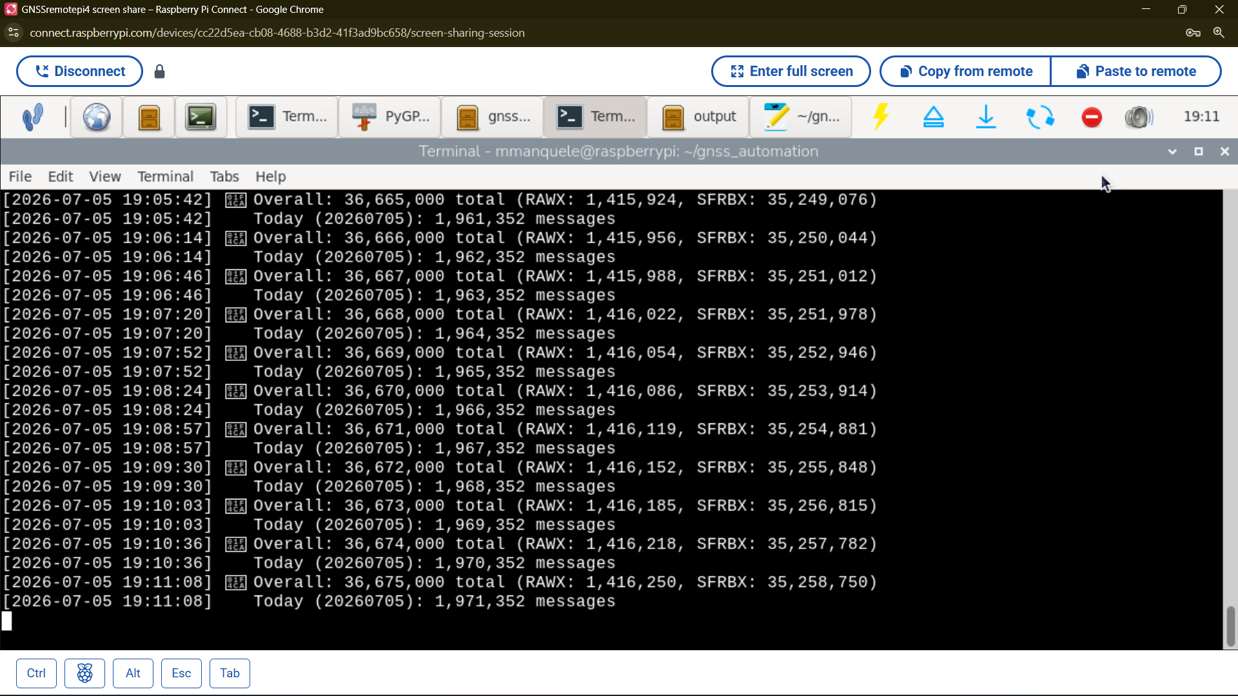
TESTING: REAL-TIME GNSS DATA ACQUISITION
The ZED-F9P GNSS receiver is connected
Receiving live satellite signals
Decoding multiple GNSS constellations
Displaying the observations in PyGPSClient.
PyGPSClient Window
UBX provides:
raw measurements, carrier phase, pseudorange, Doppler, receiver status
Used for:
RINEX generation, TEC estimation & scientific processing
Data Logging
13

Slide 14
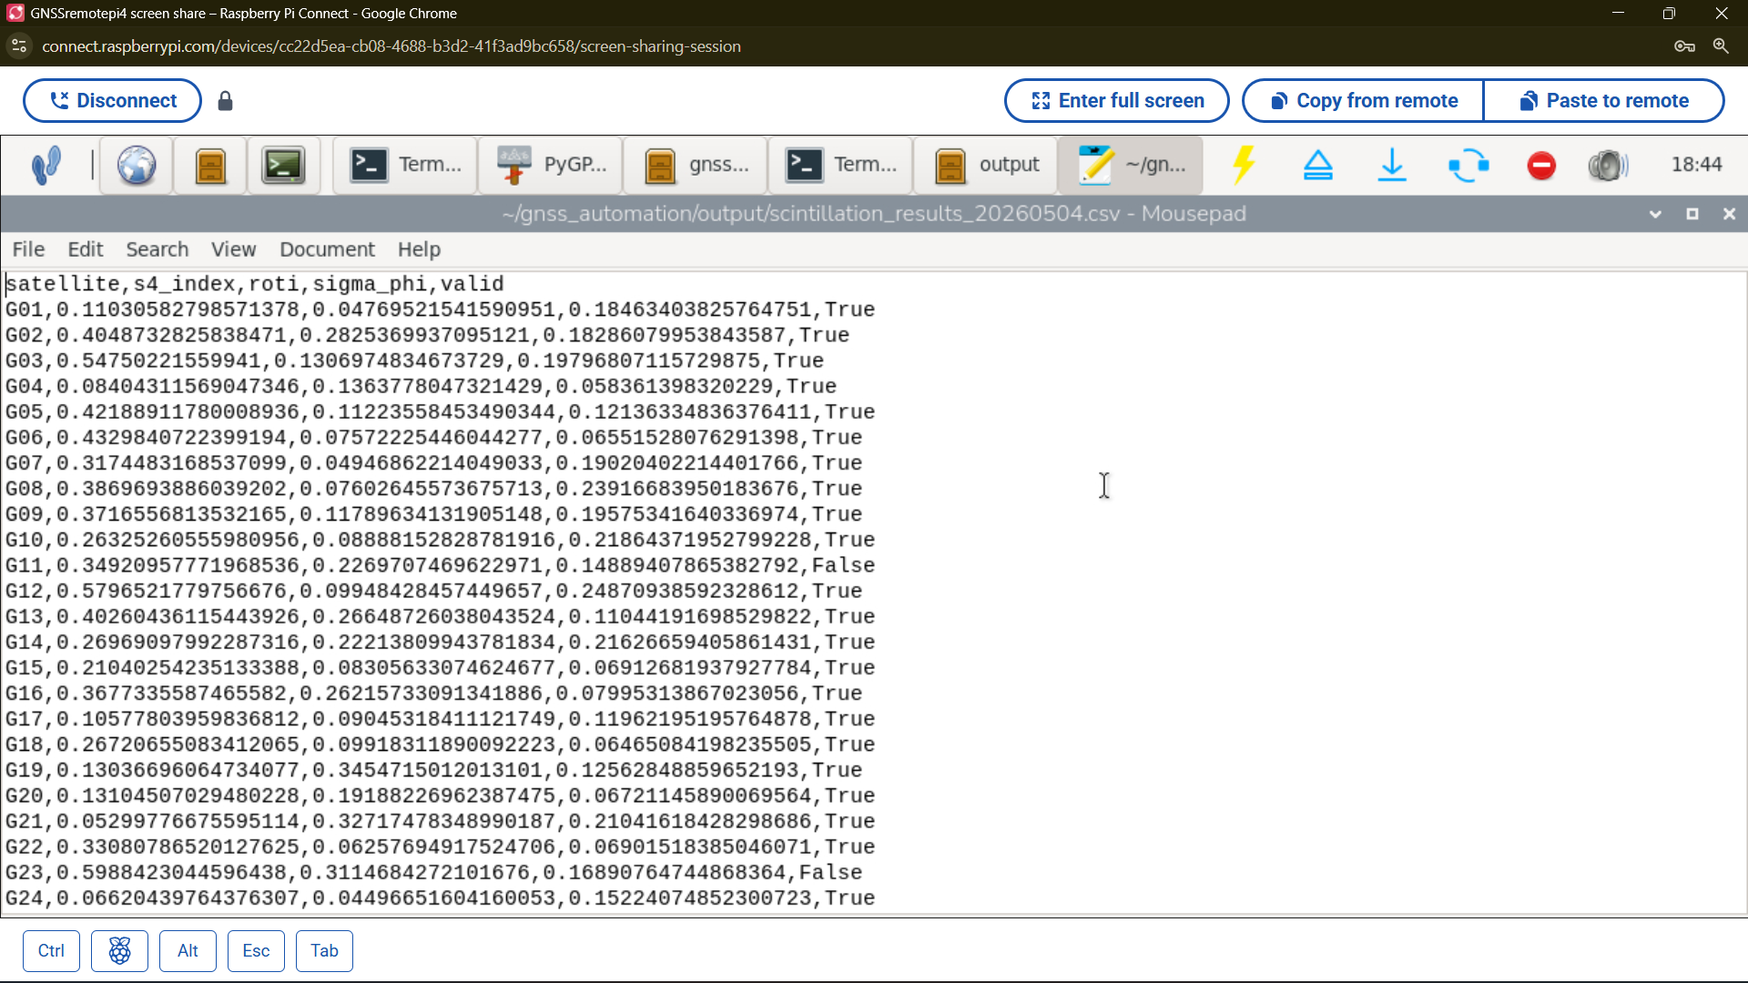
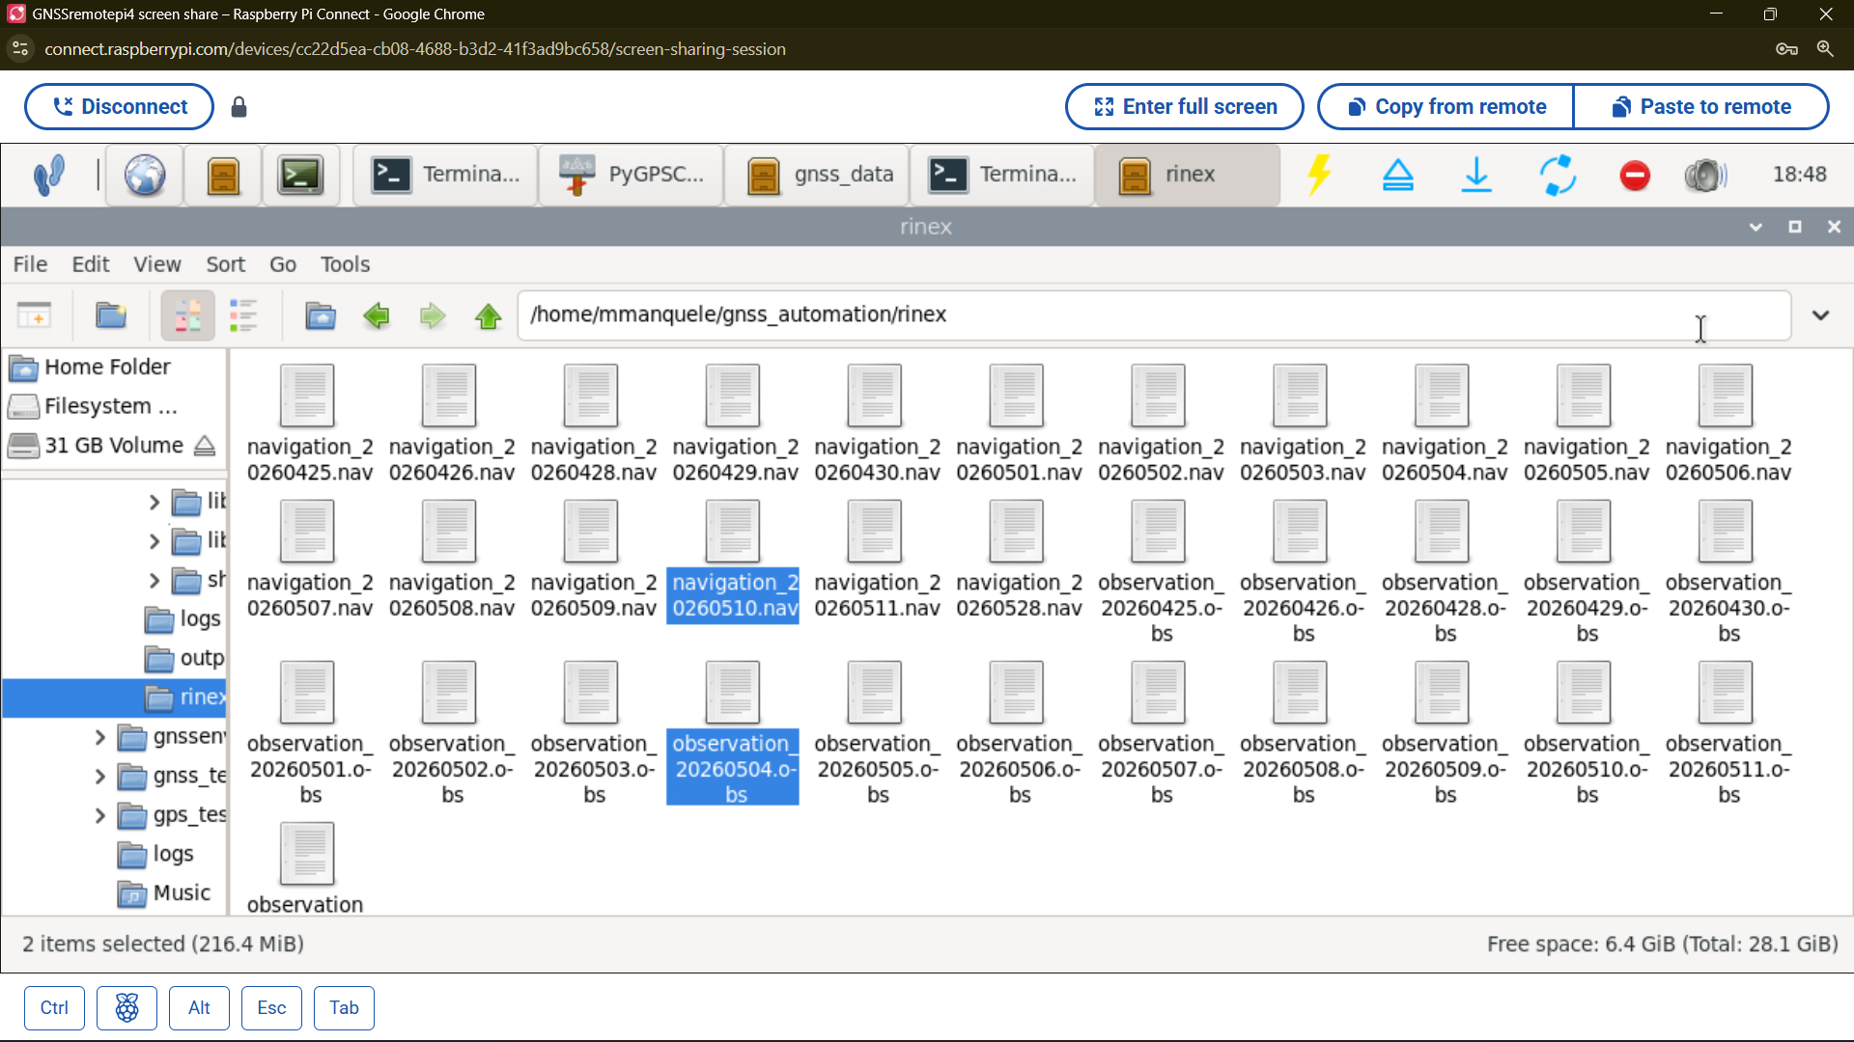
TESTING: AUTOMATIC COMPUTATION
Automatically converting and archiving binary files into standard RINEX files.
A directory on the Raspberry Pi where the automatically generated RINEX files are stored
Satellite Data
The system is doing more than simply collecting GNSS data.
Processing the raw observations into ionospheric scintillation parameters,
The primary scientific objectives of your project.
RINEX files
14

Slide 15
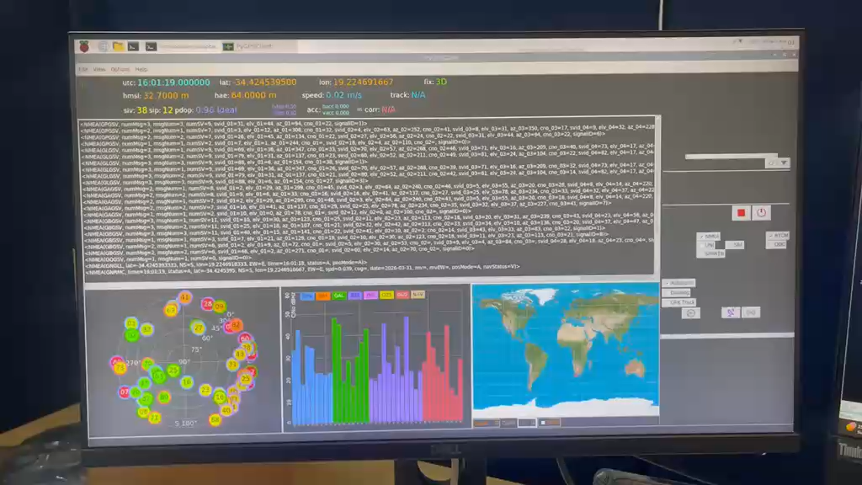
TESTING: RAW GNSS DATA LIVE MONITORING
15

Slide 16
CONCLUSION
Successfully designed and developed a low-cost, low-power GNSS RTK base station prototype using COTS components
Demonstrated reliable multi-constellation, dual-frequency GNSS data acquisition.
Developed an autonomous software framework capable of continuous data acquisition, health monitoring, automatic file generation, local storage, and remote data transmission without user intervention.
Demonstrated the ability to compute ionospheric scintillation parameters (S4, and Sigma Phi), highlighting the prototype's capability for space weather and ionospheric monitoring.
Proposed Future Research: OrbitSense AI Platform
Extend the low-cost GNSS base station into a network of autonomous CORS stations deployed across South Africa.
Integrate multiple GNSS stations into the OrbitSense AI Platform for centralized data collection, storage, monitoring, and management.
Develop an AI-powered analytics platform capable of processing real-time GNSS observations from multiple stations simultaneously.
16

Slide 17

……….......
_________________________
_________________________
……….......
17

Slide 18
REFERENCES
N. Wielgocka, T. Hadas, A. Kaczmarek, and G. Marut, “Feasibility of using low-cost dual-frequency gnss receivers for land surveying,” Sensors, vol. 21, no. 6, p. 1956, 2021.
V. Hamza, B. Stopar, and O. Sterle, “Testing the performance of multi-frequency low-cost gnss receivers and antennas,” Sensors, vol. 21, no. 6, p. 2029, 2021
18

