Slide 1
An unsupervised deep learning approach to McIntosh sunspot classification
Presenter: Bernard Swanepoel¹
Co-authors: Gunther Drevin¹, Heystek Grobler¹ ², Roelf du Toit Strauss², Petrus Johannes Steyn², Calmay Lee²
¹ School of Computer Science and Information Systems, North-West University,
Potchefstroom Campus, Potchefstroom, 2520, North West, South Africa
² Centre for Space Research, North-West University, Potchefstroom Campus, Potchefstroom, 2520,
North West, South Africa
E-mail: BernardSwanepoel1510@gmail.com
SAIP 2026
Notes:
Good day, everyone. My name is Bernard Swanepoel, and I will be presenting the work titled “An unsupervised deep learning approach to McIntosh sunspot classification.”
This work was conducted at North-West University in collaboration with Gunther Drevin and Heystek Grobler from the School of Computer Science and Information Systems and Roelf du Toit Strauss, Petrus Johannes Steyn, and Calmay Lee from the Center for Space Research.

Slide 2
Abstract
The McIntosh sunspot classification system categorises sunspots according to their morphology and size. Because this process is typically performed manually, it is susceptible to labeling errors. In contrast, deep learning methods learn features directly from the data and classify samples based on these learned representations. In this paper, an unsupervised approach to McIntosh sunspot classification is presented, and how the models group sunspot data into clusters is examined. The results indicate that the unsupervised approach outperformed the conventional supervised approach trained on the ground-truth labels. The findings highlight the potential for developing an AI-based McIntosh classification framework.
Notes:
The main idea of this work is to investigate whether deep learning can learn useful visual features directly from sunspot images, without relying on the original ground truth Mcintosh labels. An unsupervised approach was therefore used to group sunspot data into clusters based on the visual patterns learned by the model.

Slide 3
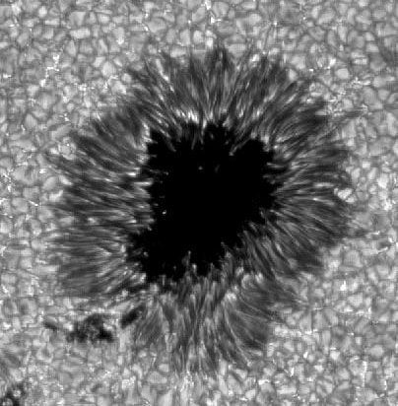
Introduction
Sunspots are magnetic features on the solar surface that appear dark due to reduced temperatures compared to the surrounding photosphere. Each sunspot consists of a dark central region called the umbra, surrounded by a lighter penumbra [1]. An example of a sunspot is shown in Figure 1.
Sunspots vary in size, with the largest reaching up to 60,000 km in diameter, while smaller ones measure only a few thousand kilometers across [2].
Depending on magnetic strength and size, sunspots can persist from hours to several weeks [3].
The number and distribution of sunspots follow the approximately 11-year solar cycle [4].
High-resolution imaging instruments, such as the Helioseismic and Magnetic Imager (HMI) aboard the Solar Dynamics Observatory (SDO), capture photospheric continuum and magnetic field data that make sunspots highly visible for monitoring and classification [5].
Figure 1: Example of a sunspot.
Notes:
Sunspots are magnetic features on the solar surface that appear dark because they are cooler than the surrounding photosphere. Each sunspot has a dark central umbra and a lighter surrounding penumbra, as shown in Figure 1.
They vary significantly in size and lifetime, from small short-lived spots to large sunspots that can persist for several weeks. Their number and distribution also follow the approximately 11-year solar cycle, which makes them important indicators of solar activity.
Because instruments such as HMI aboard SDO can capture high-resolution solar images, sunspots can be monitored and classified using image-based methods.

Slide 4
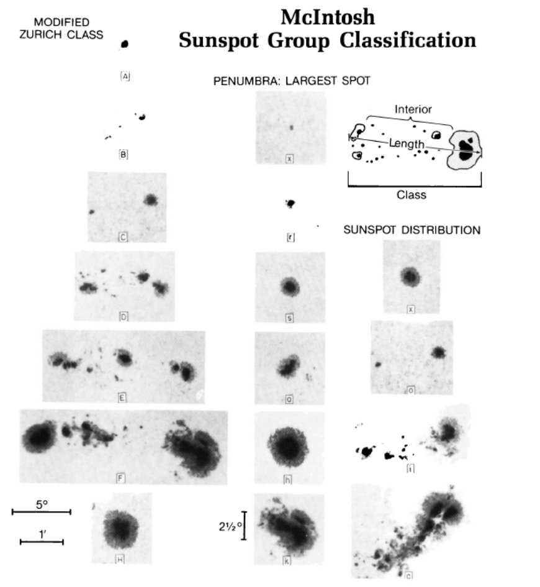
The McIntosh classification system
The McIntosh classification system is widely used to describe sunspot groups and is applied in this paper to categorise them by their morphological and magnetic properties.
As summarised in Figure 1, this classification scheme uses three parameters: Z, representing the modified Zurich class; p, describing the type of the principal sunspot; and c, indicating the compactness of the group’s interior [6].
This system distinguishes between unipolar and bipolar groups and provides insight into the relationship between magnetic complexity and solar activity, including flare productivity.
Figure 2: The three component McIntosh classification with examples [6].
Notes:
Sunspot can be grouped according to the McIntosh Classification scheme using three components: Z, p, and c. The Z component represents the modified Zurich class, p describes the type of the principal sunspot, and c indicates the compactness of the group’s interior.
Together, these components describe the morphology and magnetic structure of a sunspot group. This is useful because it helps distinguish between unipolar and bipolar groups and provides insight into magnetic complexity and solar activity.
In this work, the unsupervised classification was applied separately to each of these three components, meaning that an individual dataset was used per subcomponent of the McIntosh classification which will be described in the next slide.

Slide 5
Dataset collection
The dataset used for this paper consists of 3,501 solar disk photos containing 14,014 sunspots, collected from the SDO via the Joint Science Operations Center (JSOC) database.
All solar disk images were masked to remove sunspots present at the limb of the Sun.
To ease the annotation of solar disk images, a semi-automated approach was developed using coordinates signifying the McIntosh classification of sunspots and object detection techniques to detect sunspot regions of interest, where the region detection labels were replaced with the coordinates containing the sunspot classification.
With this approach, three datasets were constructed, one for each of the McIntosh subclassifications: Z, p, and c.
Notes:
The dataset consists of 3,501 solar disk photos containing 14,014 sunspots. These images were collected from the Solar Dynamics Observatory through the Joint Science Operations Center database.
Before annotation, the solar disk images were masked to remove sunspots located at the limb of the Sun. This was done because sunspots near the limb may be distorted or less reliable for classification.
To make annotation easier, a semi-automated approach was developed. Coordinates containing the McIntosh classifications were used together with object detection techniques to identify the sunspot regions of interest. The detected regions were then extracted and linked to the corresponding McIntosh classification information.
Using this approach, three separate datasets were created: one for the Z component, one for the p component, and one for the c component of the McIntosh classification system.

Slide 6
Model architecture - Vision transformer (ViT)
ViTs adapt the transformer architecture introduced by Vaswani et al. [7] for the processing of two-dimensional images [8].
An input image is partitioned into N non-overlapping patches, which are flattened and linearly projected into one-dimensional token embeddings that are then processed by a transformer encoder.
ViTB16 was used as the primary model in this paper for both the supervised and unsupervised approaches and was initialised using pretrained weights from PyTorch.
Notes:
The deep learning architecture used was the Vision Transformer, or ViT. Vision Transformers are based on the transformer architecture introduced by Vaswani et al., but adapted for vision tasks.
Instead of processing an image in the same way as a traditional convolutional neural network, a ViT divides the input image into non-overlapping patches. Each patch is flattened and converted into a one-dimensional token embedding. These token embeddings are then passed through a transformer encoder, where the model learns relationships between different regions of the image.
In this study, ViTB16 was used as the main transformer model for both the supervised and unsupervised approaches. The model was initialised using pretrained PyTorch weights, which allowed it to start from already learned visual representations instead of training completely from scratch.

Slide 7
Unsupervised learning
The unsupervised models were applied separately to the three McIntosh subclassifications, Z, p, and c. For each subclassification, a pretrained ViTB16 model was used to extract feature embeddings from the sunspot images, allowing visually similar samples to be represented close together in feature space.
These embeddings were then clustered using HDBSCAN, after which the cluster assignments were adjusted to match the required number of classes for each task, namely seven for Z, six for p, and four for c.
The resulting cluster labels were treated as pseudo-labels and used to iteratively train the models, with the feature representations being re-extracted and reclustered after each training stage.
In this way, the models learned to group sunspot images according to underlying visual patterns without relying on the original ground-truth labels during training.
Notes:
The unsupervised approach was applied separately to the three McIntosh components: Z, p, and c. For each component, a pretrained ViTB16 model extracted feature embeddings from the sunspot images. These embeddings represent the visual characteristics learned by the model, with similar sunspots positioned closer together in feature space.
The embeddings were then clustered using HDBSCAN, and the resulting cluster assignments were converted into pseudo-labels. These pseudo-labels were used to train the model, after which new feature embeddings were extracted and clustered again.
This iterative process allowed the feature representations and cluster assignments to be progressively refined based on the visual structure of the data, without using the original ground-truth McIntosh labels during training.
The final cluster structure was constrained to the required number of classes for each McIntosh component. The next slide explains how this adjustment was performed.

Slide 8
HDBSCAN
HDBSCAN is a hierarchical clustering algorithm that identifies clusters with varying shapes and densities and, unlike K-means, does not require a predefined number of clusters [9].
Because the McIntosh classification system contains fixed class counts, the HDBSCAN cluster assignments were adjusted after clustering to match seven classes for Z, six for p, and four for c.
If too many clusters were produced, the cluster structure was reduced to the required number of final pseudo-label groups; if too few were produced, broader clusters were subdivided until the required class count was reached.
This adjustment allowed the pseudo-labels to be directly compared with the ground-truth labels and used to train models under the same class-count constraints.
HDBSCAN therefore discovered natural density-based visual groupings in feature space, while the final pseudo-labels were constrained to the McIntosh class structure for evaluation.
Notes:
HDBSCAN was selected because it can identify density-based cluster structures without requiring the number of clusters to be specified in advance. This allowed the algorithm to first discover natural groupings within the learned sunspot feature space.
However, direct comparison with the McIntosh system required a fixed number of final groups. For example, the Z component contains seven classes. If HDBSCAN identified more than seven clusters, the cluster structure was reduced to seven final groups. If fewer than seven clusters were identified, broader clusters were subdivided until seven final groups were obtained.
The same procedure was applied to the p and c components, using six and four final groups, respectively.
Therefore, HDBSCAN first discovered the underlying density-based structure of the data, while the subsequent adjustment ensured that the final pseudo-labels followed the same class-count constraints as the McIntosh system. This allowed a direct comparison between models trained on the clustered dataset and those trained on the original ground-truth dataset.
The following slides will visualise the clusters produced by the trained unsupervised models for each McIntosh component in feature space, followed by the clustering metrics for each component.

Slide 9
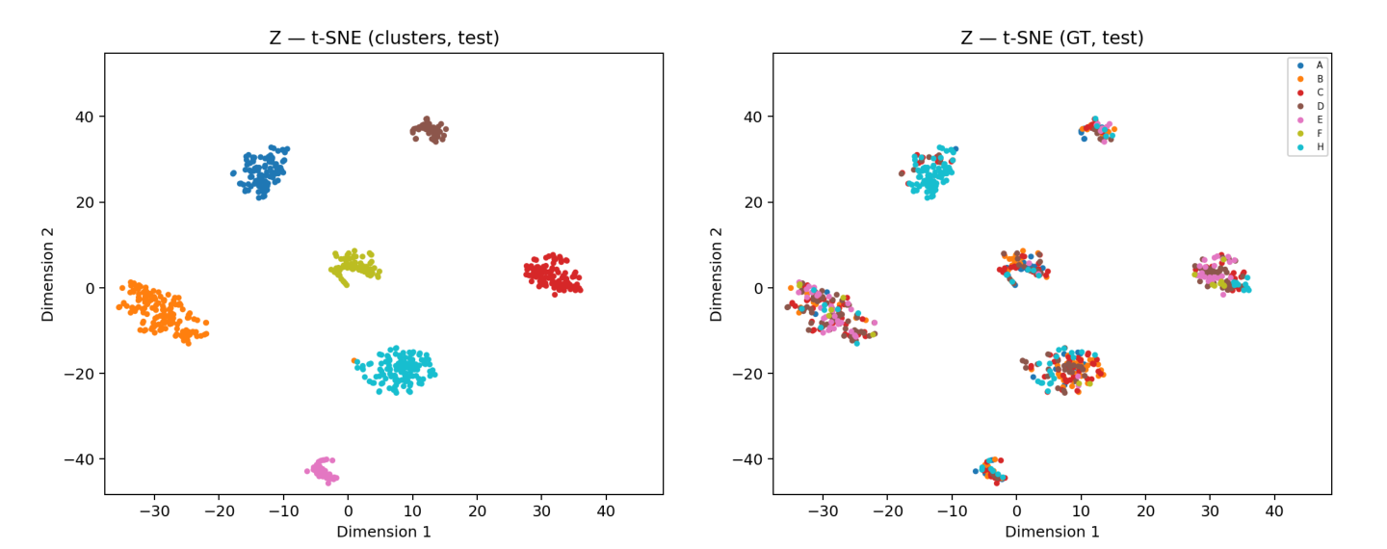
Z component clustering results
Figure 3: The left figure shows the unsupervised clustering results for the Z component, while the right figure shows the clusters coloured by ground-truth labels.
Notes:
t-SNE is used as a visualization technique to project the high-dimensional feature embeddings into a two-dimensional space, allowing the cluster separation and label overlap to be visually inspected.
The left figure shows the t-SNE cluster results for the Z component on the test set, showing clear separation between classes. The right figure shows the same data points coloured according to the ground-truth labels. This shows that the data points form clear clusters in feature space, but that these clusters do not align directly with the ground-truth class separation. This is also observable in the p component and c component.

Slide 10
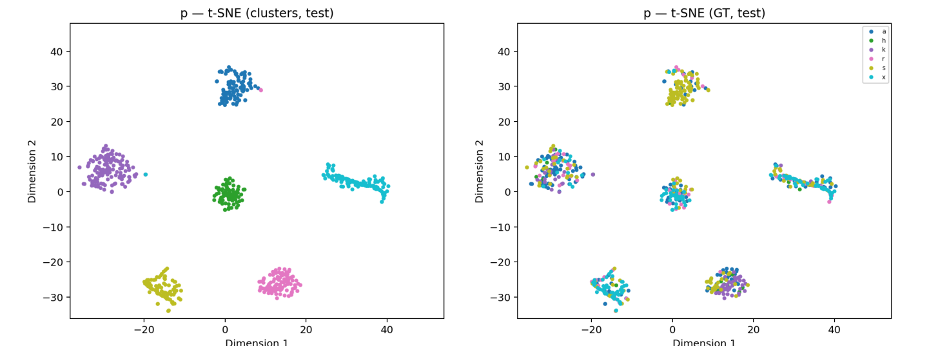
p component clustering results
Figure 4: The left figure shows the unsupervised clustering results for the p component, while the right figure shows the clusters coloured by ground-truth labels.

Slide 11
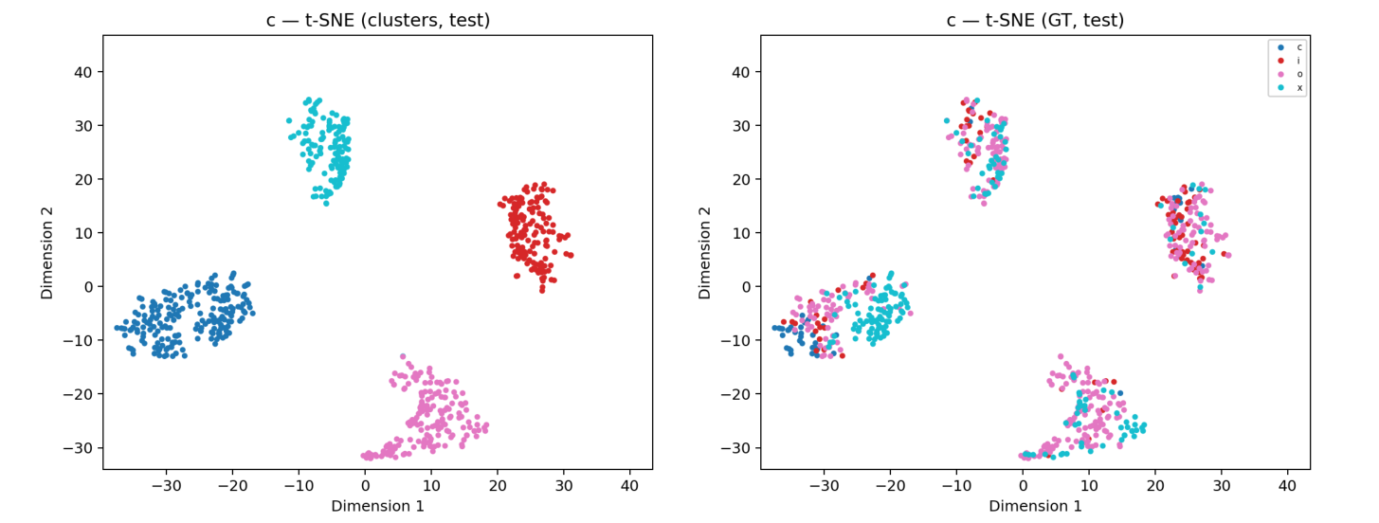
c component clustering results
Figure 5: The left figure shows the unsupervised clustering results for the c component, while the right figure shows the clusters coloured by ground-truth labels.

Slide 12
Analysis of clustering results
The clustering results indicate good internal clustering quality across all three McIntosh components. The high Silhouette and Calinski–Harabasz scores, together with the low Davies–Bouldin values, suggest that the clusters were compact and well separated in feature space. The clustering metrics per McIntosh subclassification are summarised in Table 1.
Table 1: Unsupervised clustering performance metrics for the Z, p, and c subclassifications.
Classification | Silhouette | Calinski–Harabasz | Davies–Bouldin
Z | 0.781 | 3818.2 | 0.331
p | 0.810 | 5247.7 | 0.279
c | 0.801 | 7355.9 | 0.277
Notes:
This slide summarises the clustering metrics for the Z, p, and c McIntosh components.
The Silhouette score measures how well each sample fits within its own cluster compared to other clusters. The best case is close to 1, while values near 0 indicate overlap and negative values indicate poor clustering.
The Calinski-Harabasz score measures how separated the clusters are compared to how compact they are internally. There is no fixed maximum value, but higher values are better.
The Davies-Bouldin score measures how similar clusters are to one another. In this case, lower values are better, with values closer to 0 indicating better-separated clusters.
For the results, all three McIntosh components show good clustering performance. The p component achieved the highest Silhouette score, while the c component achieved the highest Calinski-Harabasz score and the lowest Davies-Bouldin value, indicating particularly strong separation.

Slide 13
Supervised learning
Supervised ViTB16 models were trained on both the original ground-truth dataset and the results of the unsupervised model, the clustered dataset, and the resulting classification accuracies are summarised in Table 2 for the Z, p, and c subclassifications, together with the average accuracy.
As observed in Table 2, the models trained on the clustered dataset achieved higher accuracy than the models trained on the ground-truth dataset per component of McIntosh, having an overall accuracy that was 14.6% percentage points higher than that of the ground-truth dataset.
Table 2: Classification accuracies for the original ground-truth and clustered datasets.
Dataset | Z accuracy | p accuracy | c accuracy | Average accuracy
Clustered dataset | 81.2% | 80.2% | 85.6% | 82.3%
Ground-truth dataset | 63.9% | 65.2% | 73.9% | 67.7%
Notes:
Supervised ViTB16 models were trained using both the original ground-truth dataset and the clustered dataset produced by the unsupervised approach.
Across all three McIntosh components, the clustered dataset achieved higher accuracy than the ground-truth dataset.
Overall, the clustered dataset achieved an 82.3% average accuracy, which was 14.6 percentage points higher than the ground-truth dataset.
In Table 2 you can also observe the per component performance for Z, p and c.
These results indicate a potensial for a AI-based Mcintosh classification.

Slide 14
LIME XAI techniques applied to unsupervised ViT predictions
LIME is an explainable artificial intelligence (XAI) technique that explains the predictions of regression and classification models by approximating them locally with an interpretable model [10]. It is designed to provide explanations that are simple to interpret while maintaining local fidelity.
LIME XAI image samples were generated for each McIntosh component. These images can assist physicists in understanding the predictions made by the unsupervised clustering model.
In the LIME images, green segments highlight features that supported the classification, while red segments indicate features that caused confusion for the model. These LIME images can be viewed in Figure 6.
Notes:
LIME is an explainable artificial intelligence technique that explains model predictions by highlighting the image regions that influenced the classification. In the LIME images, green segments indicate features that supported the classification, while red segments indicate features that caused confusion for the model.
In this study, LIME was used as an XAI technique to highlight the features that influenced the supervised model’s classification of the clustered dataset.
This can be used by physicist to verify the validity of this unsupervised approach.

Slide 15
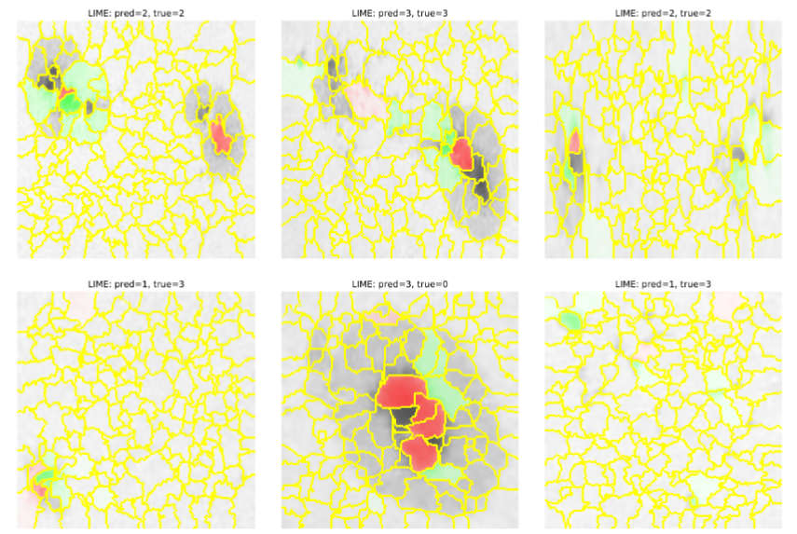
LIME XAI visualised.
Figure 6: LIME-annotated samples for the Z, p, and c components. From left to right, the columns correspond to Z, p, and c. The first row shows correctly classified samples, while the second row shows incorrectly classified samples.
Notes:
Figure 6 shows LIME-annotated samples for the Z, p, and c components. From left to right, the columns correspond to Z, p, and c. The first row shows correctly classified samples, while the second row shows incorrectly classified samples.
The yellow lines show the superpixel boundaries used by LIME, where the image is divided into larger meaningful segments instead of individual pixels. LIME then masks different superpixels and observes how the model prediction changes. Green regions indicate superpixels that supported the classification, while red regions indicate superpixels that contributed to confusion.

Slide 16
Conclusion
This study has covered the use of unsupervised techniques for the classification of sunspots. This study shows that there is potential for unsupervised techniques to be used in the development of an AI-based classification framework for sunspots.
Future work can include using other XAI techniques such as SHapley Additive exPlanations (SHAP), using larger and more complex architectures that have been developed after the publication of this study, and using an algorithm such as HDBSCAN without constraining it to the McIntosh classification system to create a fully AI-based classification framework.

Slide 17
Acknowledgements
This work relates to Department of Navy award N62909-25-1-2077 issued by the Office of Naval Research.

Slide 18
References
[1] Solanki S K 2003 Sunspots: an overview The Astronomy and Astrophysics Review 11 153–286
[2] Wilkinson J 2012 New Eyes on the Sun: A Guide to Satellite Images and Amateur Observation (Berlin, Heidelberg: Springer) ISBN 978-3642228384
[3] Jaeggli S A, Lin H and Uitenbroek H 2011 An observational study of the formation and evolution of sunspots AAS/Solar Physics Division Abstracts 42 3–02
[4] Hathaway D H 2015 The solar cycle Living Reviews in Solar Physics 12 4
[5] Scherrer P H, Schou J, Bush R I, Kosovichev A G, Bogart R S, Hoeksema J T, Liu Y, Duvall T L, Zhao J, Title A M et al. 2012 The Helioseismic and Magnetic Imager (HMI) investigation for the Solar Dynamics Observatory (SDO) Solar Physics 275 207–227
[6] McIntosh P S 1990 The classification of sunspot groups Solar Physics 125 251–267
[7] Vaswani A, Shazeer N, Parmar N, Uszkoreit J, Jones L, Gomez A N, Kaiser Ł and Polosukhin I 2017 Attention is all you need Advances in Neural Information Processing Systems vol 30
[8] Arnab A, Dehghani M, Heigold G, Sun C, Lučić M and Schmid C 2021 ViViT: a video vision transformer Proceedings of the IEEE/CVF International Conference on Computer Vision pp 6836–6846
[9] Ibraimoh R and Aderoba A 2024 Comparison of K-means and HDBSCAN clustering approaches to enhance marketing strategies Iconic Research and Engineering Journals 8 272–282 ISSN 2456-8880
[10] Ribeiro M T, Singh S and Guestrin C 2016 “Why should I trust you?” Explaining the predictions of any classifier Proceedings of the 22nd ACM SIGKDD International Conference on Knowledge Discovery and Data Mining pp 1135–1144

