Slide 1


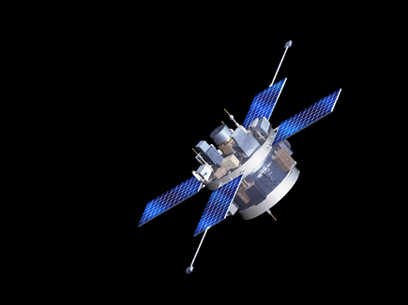
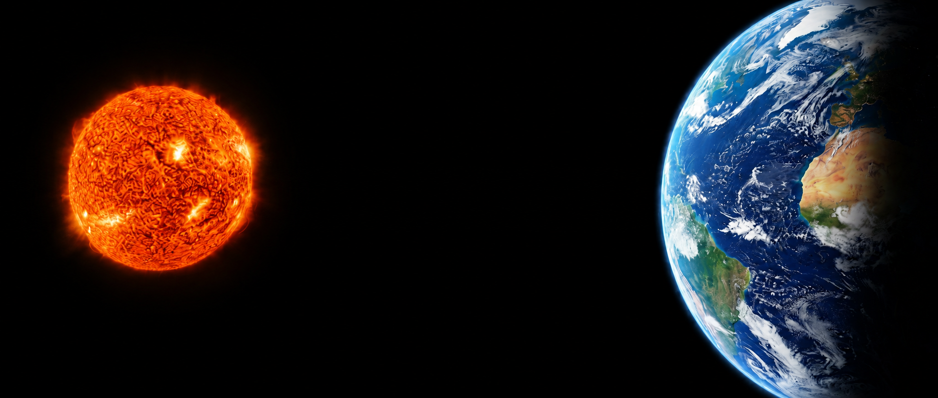


Linking Coronal Structures to L1 Solar
Wind Disturbances over Three Solar
Minima
Thembalethu Zulu¹ Presenter
Dr. Ruhann Steyn¹ Supervisor
North-West University¹
Centre for Space Research
SAIP 2026 Conference
Financially supported by:

Slide 2



PRESENTATION ROADMAP
Objective
Methodology
Results
Heavy ions charge state ratios
Conclusion
2

Slide 3
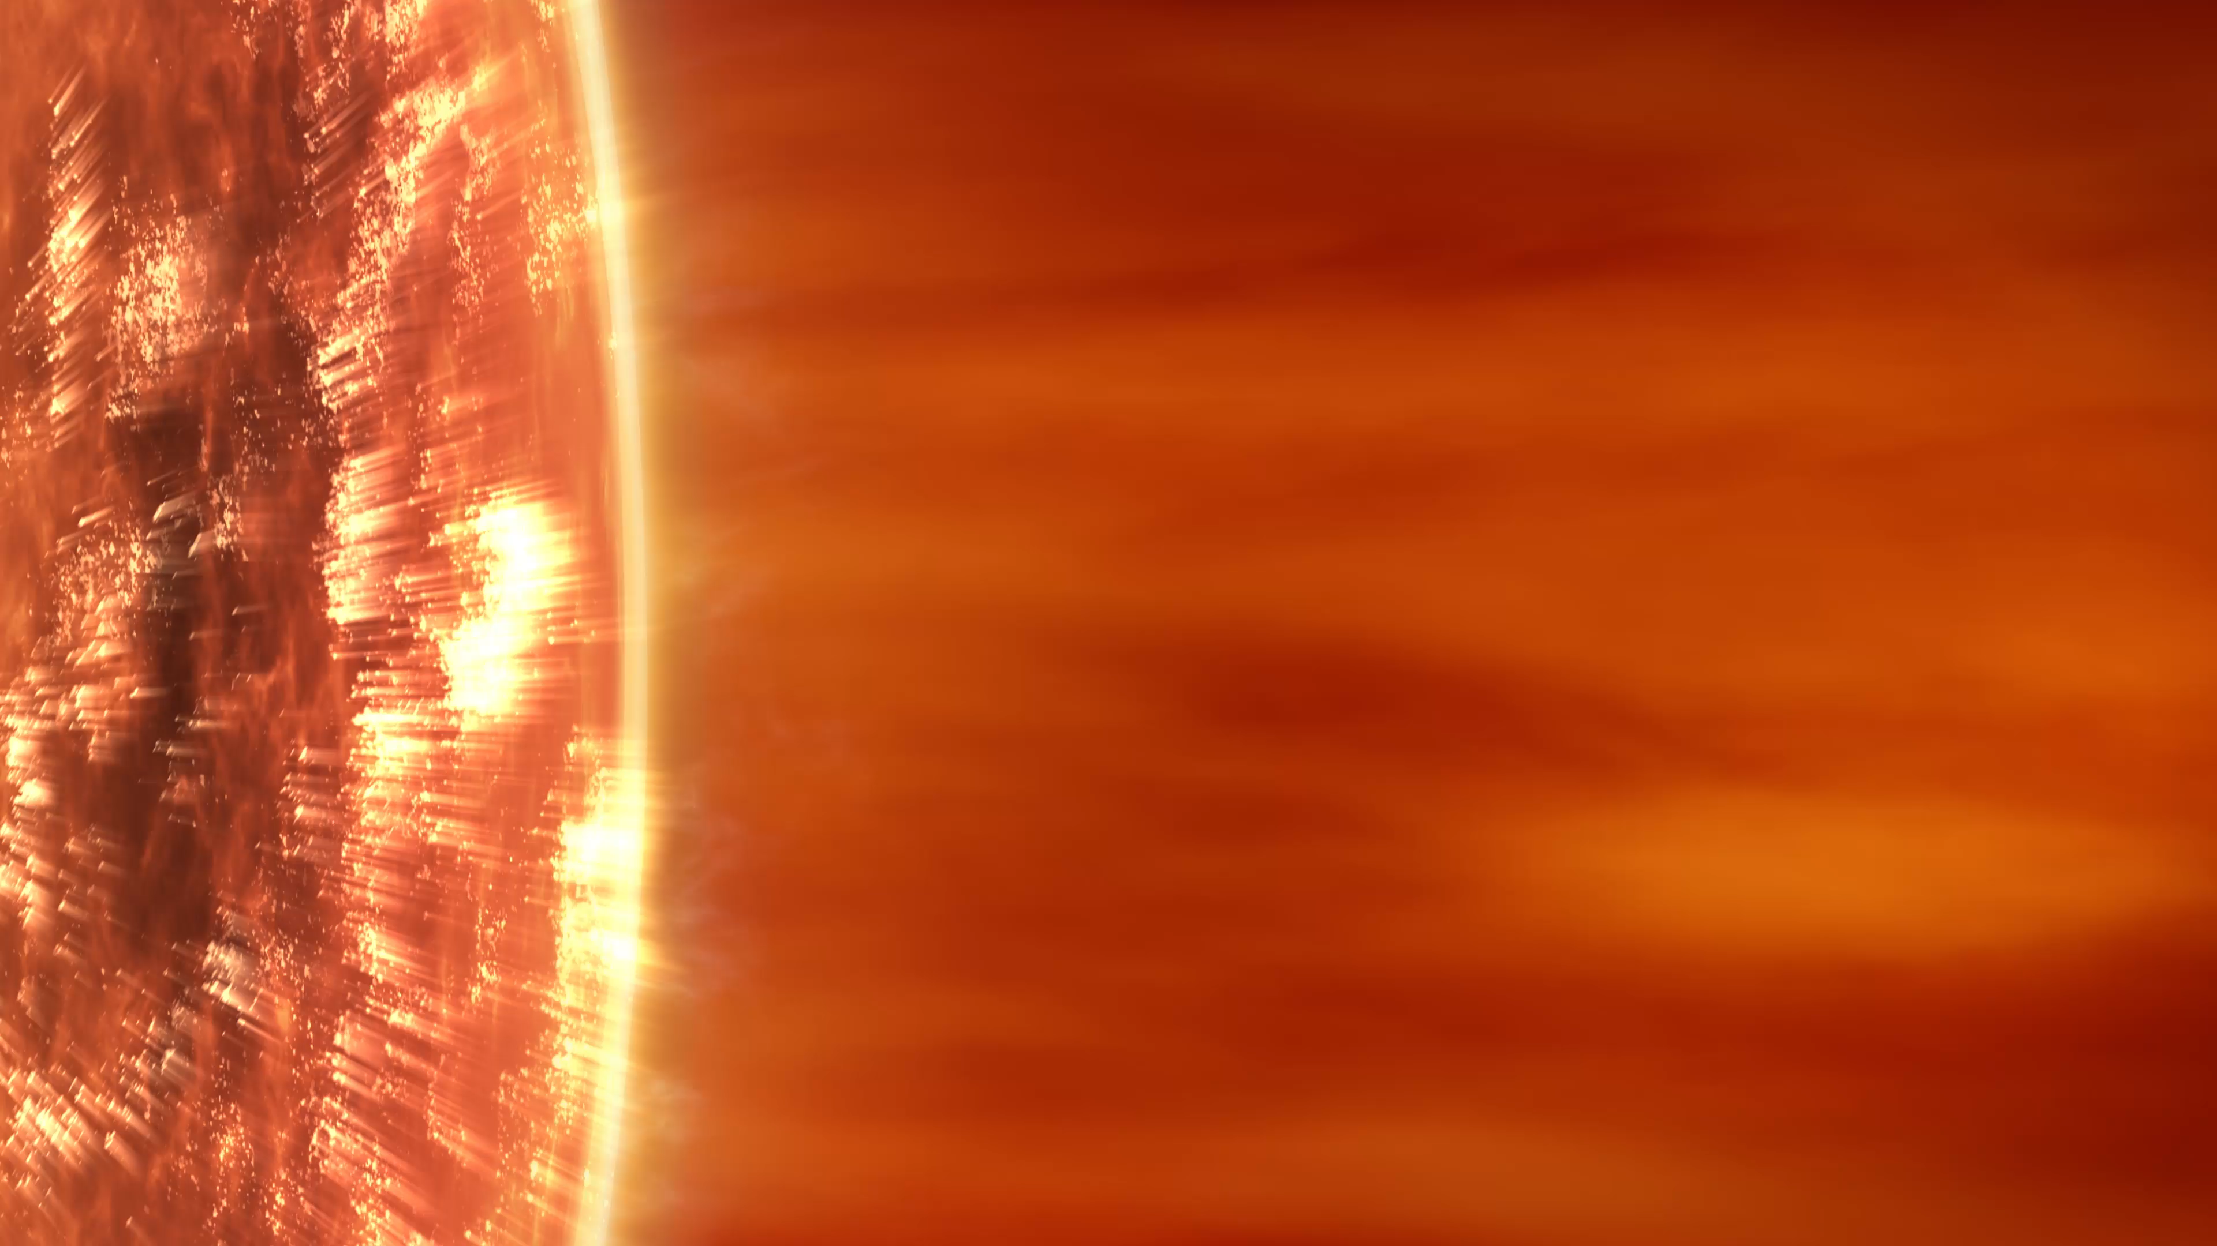
OBJECTIVE
The Solar Wind
Study Aim
Connecting L1 solar wind disturbances to polar coronal holes (PCHs) across the last three solar cycle minima 22-23, 23-24, and 24-25.
Courtesy of NASA Goddard/CIL/Adriana Manrique Gutierrez
3

Slide 4
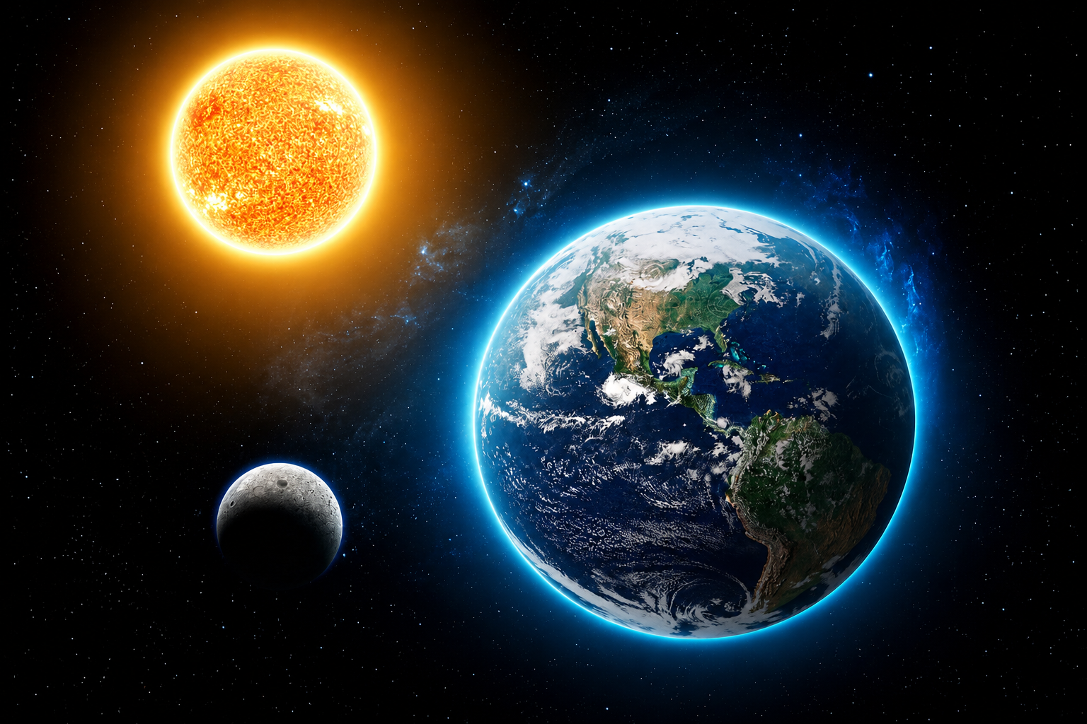

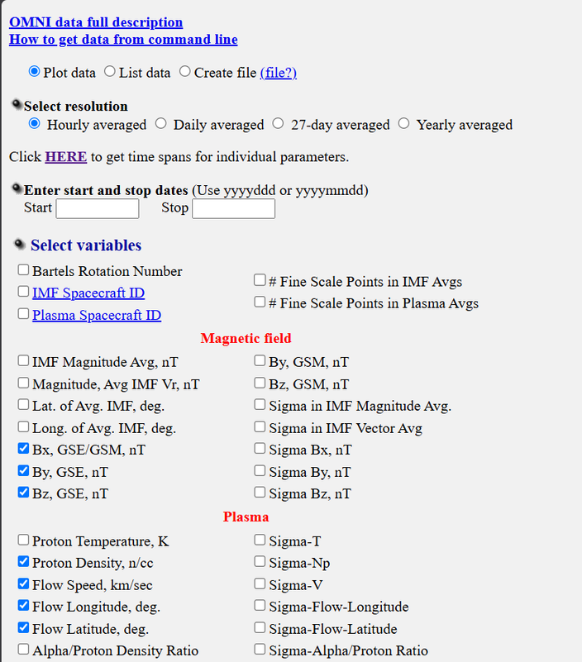




SOLAR WIND DATA
Data source: Wind spacecraft
Date(s): 1) 1 Feb 1996 - 31 Jan 1997 (Solar Cycle 22-23)
2) 6 July 2008 – 6 July 2009 (Solar Cycle 23-24)
3) 1 June 2019- 31 May 2020 (Solar Cycle 24-25)
Cadence: 1 Hour
Solar wind components: $V_{r}$ , $V_{t}$ , $V_{n}$ , $n_{i}$ , $B_{r}$ , $B_{t}$ , $B_{n}$
Useful conversion:
$B_{r}={−B}_{x}$ , $B_{t}$ = ${−B}_{y}$ , $B_{n}$ = $B_{z}$ (e.g. Steyn et al., 2024)
$V_{x}$ = $−V\cos{θ}\cos{φ}$, $V_{y}$ = $V\cos{θ}\sin{φ}$, $V_{z}$ = $V\sin{θ}$
$V_{r}={−V}_{x}$ , $V_{t}$ = ${−V}_{y}$ , $V_{n}$ = $V_{z}$
https://omniweb.gsfc.nasa.gov/form/dx1.html
4

Slide 5
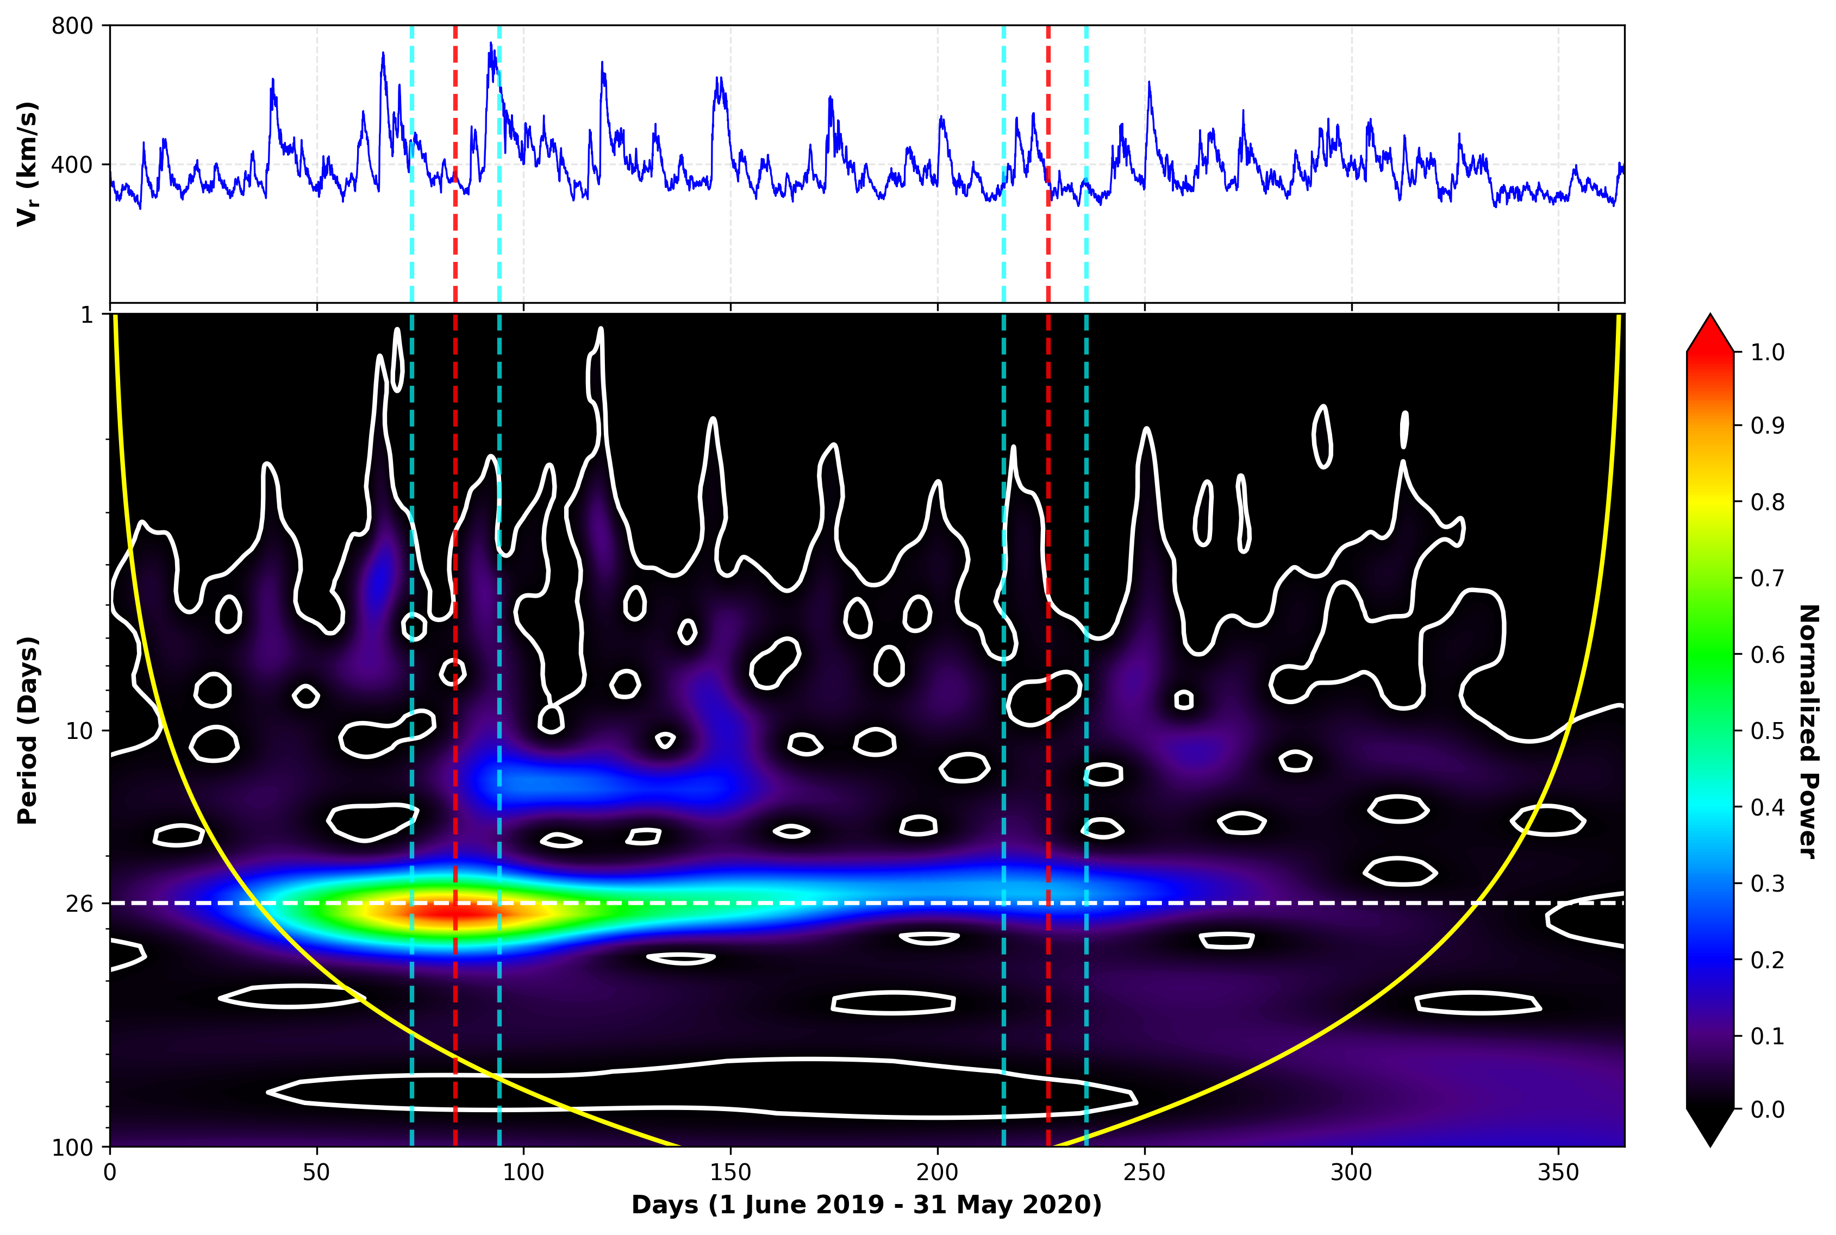
WAVELET ANALYSIS
Solar cycle 24-25
Signal 1:
5% left: 2019/08/13
Peak: 2019/08/23
5% right: 2019/09/03
Signal 2
5% left: 2020/01/02
Peak: 2020/01/13
5% right: 2020/01/23
Signal 1
Signal 2
5

Slide 6
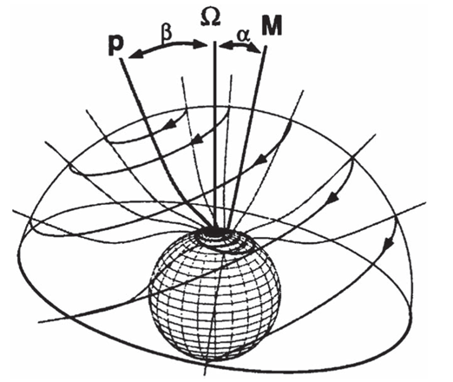

FISK HMF MODEL
The solar wind carries with it the magnetic field lines from the Sun.
Assumptions:
    The Sun rotates differentially.
    Open magnetic field lines expand super-radially as they leave the Sun.
Most of the Fisk-type field lines are assumed to originate from the higher latitudes.
The Fisk HMF equation as reported by Zurbuchen et al. (1997) is given by:
$B=B_{0}{(\frac{r_{0}}{r})}^{2}\left[\hat{r} − \frac{rω}{V}\hat{θ} − \frac{\left(\text{Ω}−ω\right)r\sin{θ}}{V}\hat{φ}\right]$
Figure adapted from Zurbuchen et al. (1997)
6

Slide 7
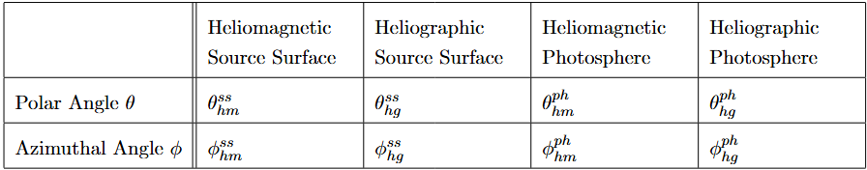


FISK TRACING EQUATIONS
The Fisk tracing equations are given by:
$θ_{hm}^{ss}=\cos^{−1}{(\cos{θ_{hg}^{ss}}\cos{α}+\sin{θ_{hg}^{ss}\sin{α}\cos{φ_{hg}^{ss}}})}$ (1)
$φ_{hm}^{ss}=\cos^{−1}{(\frac{\sin{θ_{hg}^{ss}}\cos{φ_{hg}^{ss}}\cos{α}−\cos{θ_{hg}^{ss}\sin{α}}}{\sin{θ_{hm}^{ss}}})}$ (2)
$θ_{hm}^{ph}=\sin^{−1}{(\sqrt{\frac{(1−\cos{θ_{hm}^{ss}})\sin^{2}{θ_{mm}^{ph}}}{(1−\cos{θ_{mm}^{ss})}}})}$ (3)
$φ_{hm}^{ph}=φ_{hm}^{ss}$ (4)
Table adapted from Steyn (2016).
$θ_{hg}^{ph}=\cos^{−1}{(\cos{θ_{hm}^{ph}}\cos{α}−\sin{θ_{hm}^{ph}\cos{φ_{hm}^{ph}}\sin{α}})}$ (5)
$φ_{hg}^{ph}=\cos^{−1}{(\frac{\cos{θ_{hm}^{ph}}\sin{α}−\sin{θ_{hm}^{ph}}\cos{φ_{hm}^{ph}\cos{α}}}{\sin{θ_{hg}^{ph}}})}$ (6)
7

Slide 8
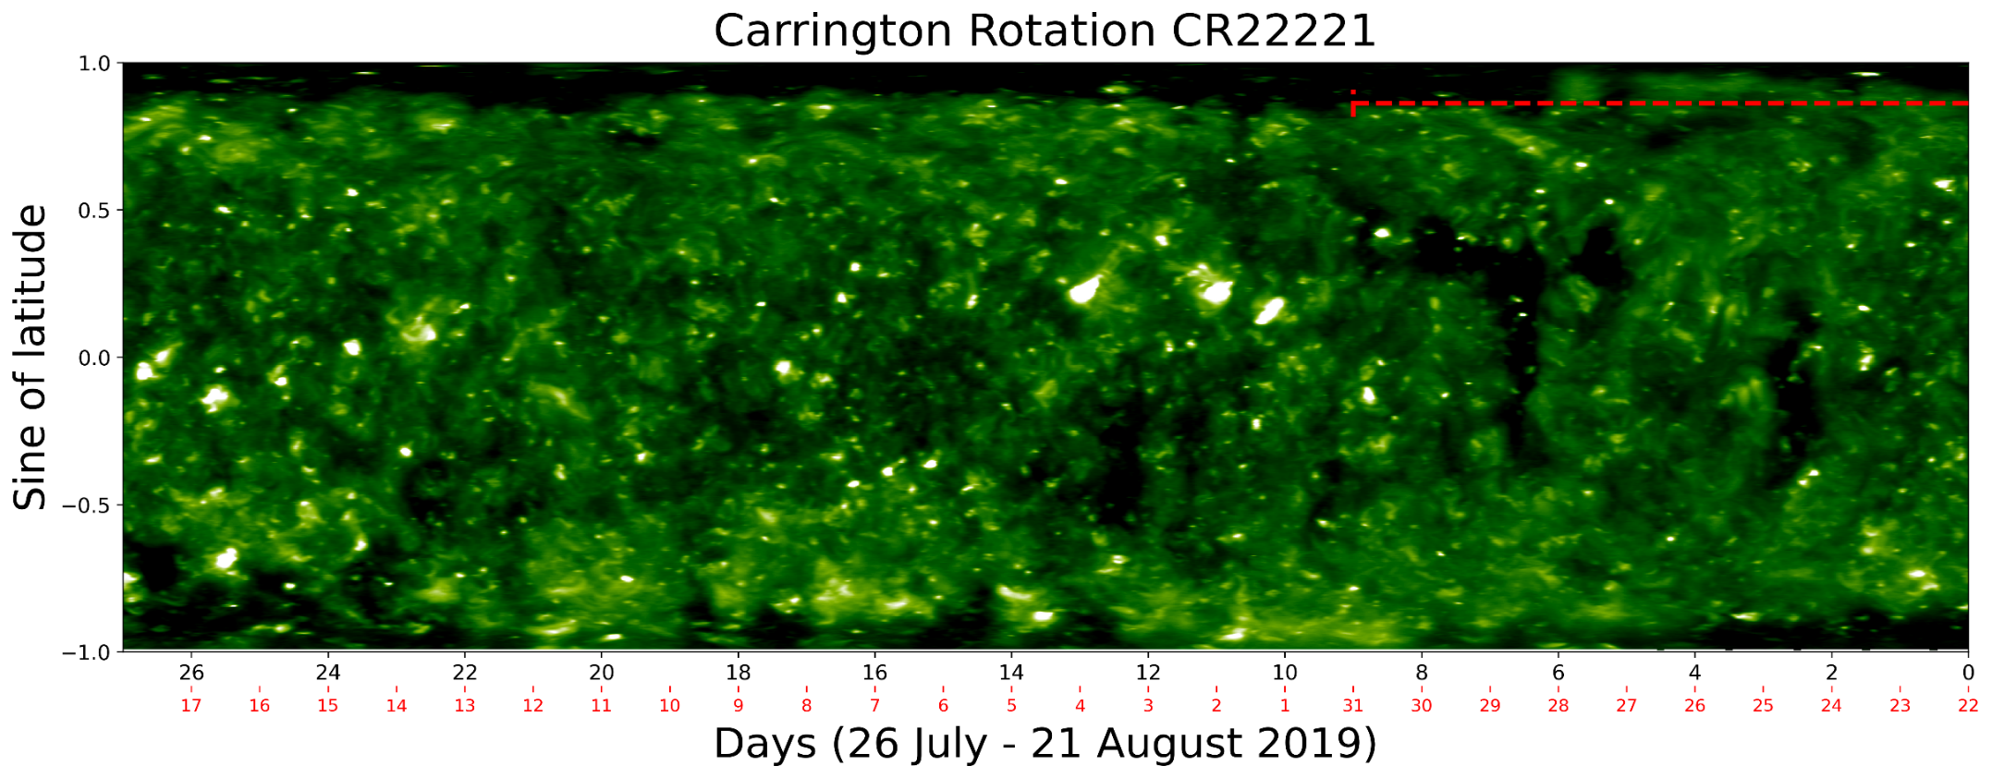
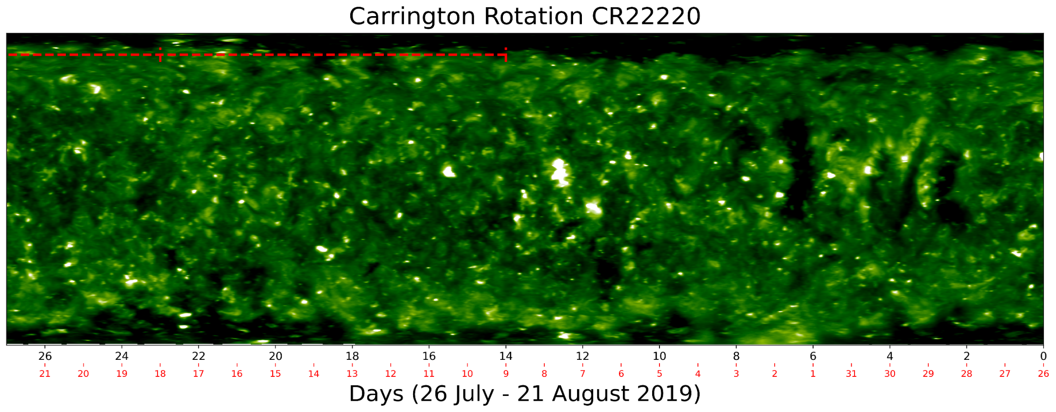

RESULTS – CARRINGTON MAPS
 | Signal 1 date at L1 | Signal 1 date on the Sun
5% left of max signal | 2019/08/13 01:00:00 UTC | 2019/08/09 02:15:14 UTC
Max signal | 2019/08/23 11:00:00 UTC | 2019/08/18 17:17:11 UTC
5% right of max signal | 2019/09/03 04:00:00 UTC | 2019/08/31 10:43:04 UTC
8
Signal 1
Signal 2

Slide 9
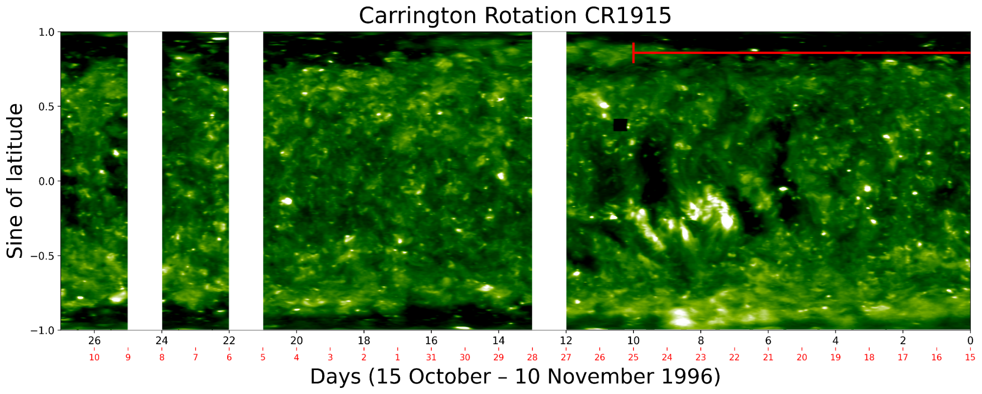
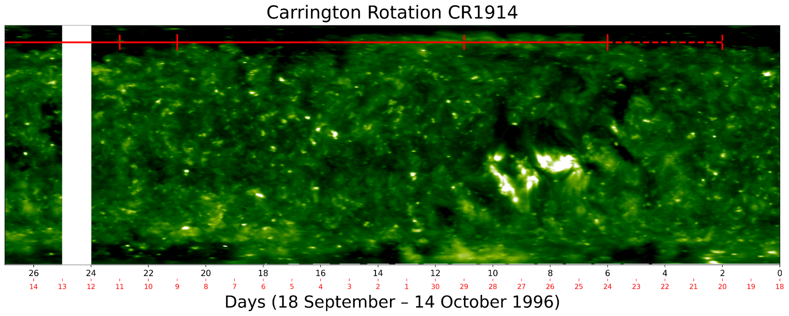
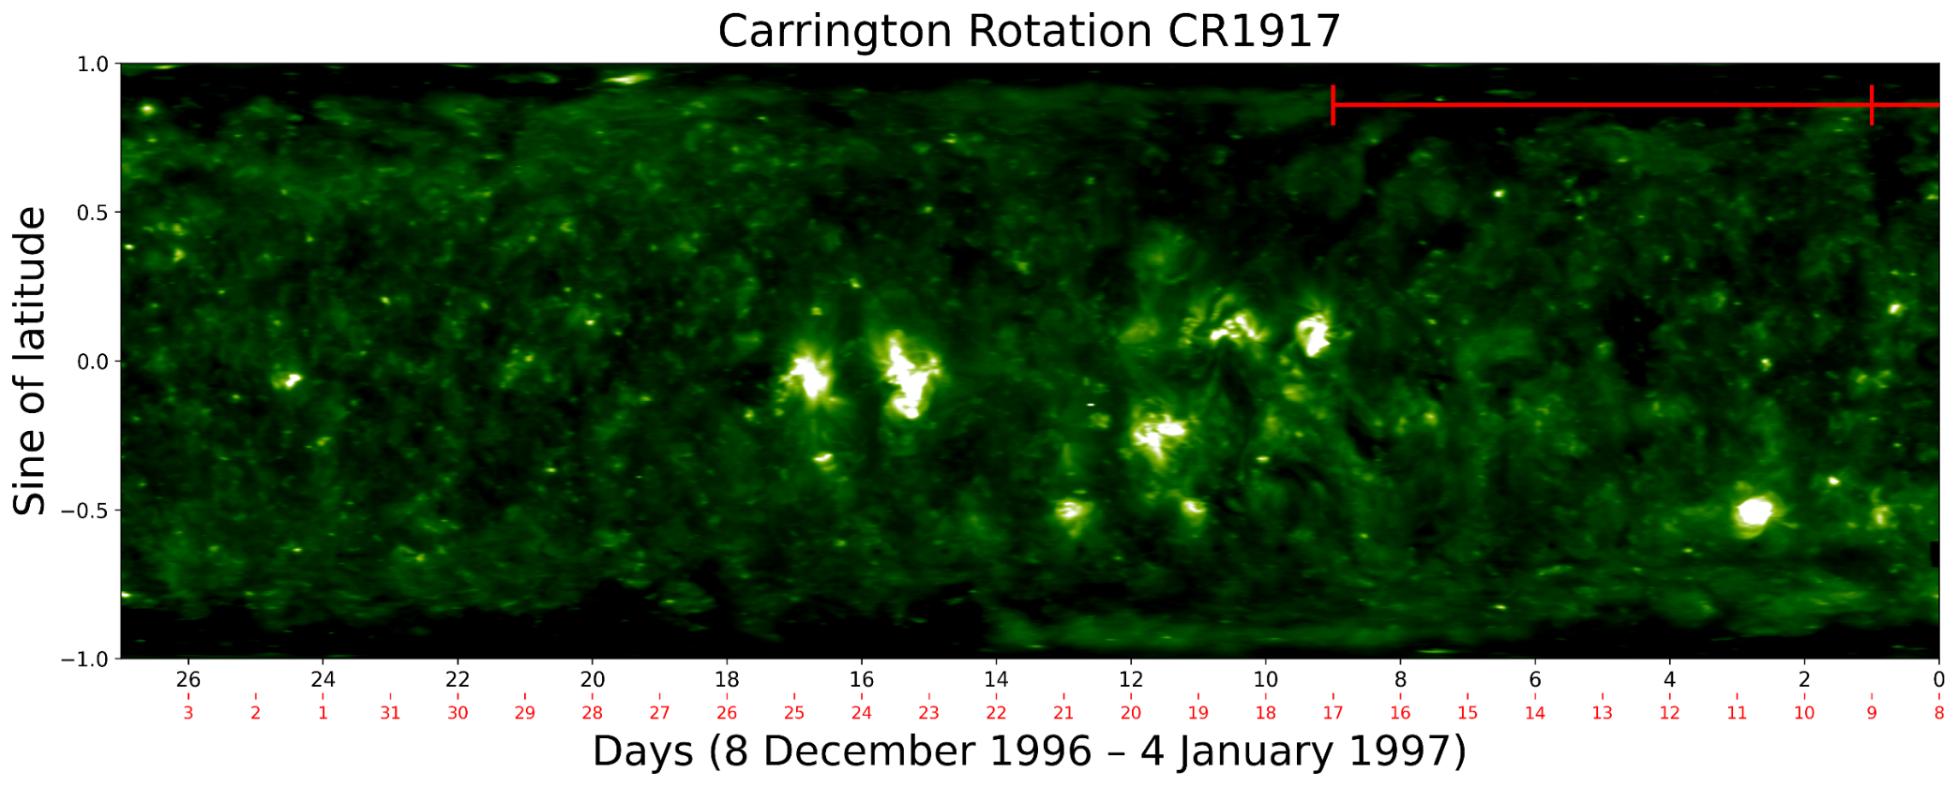
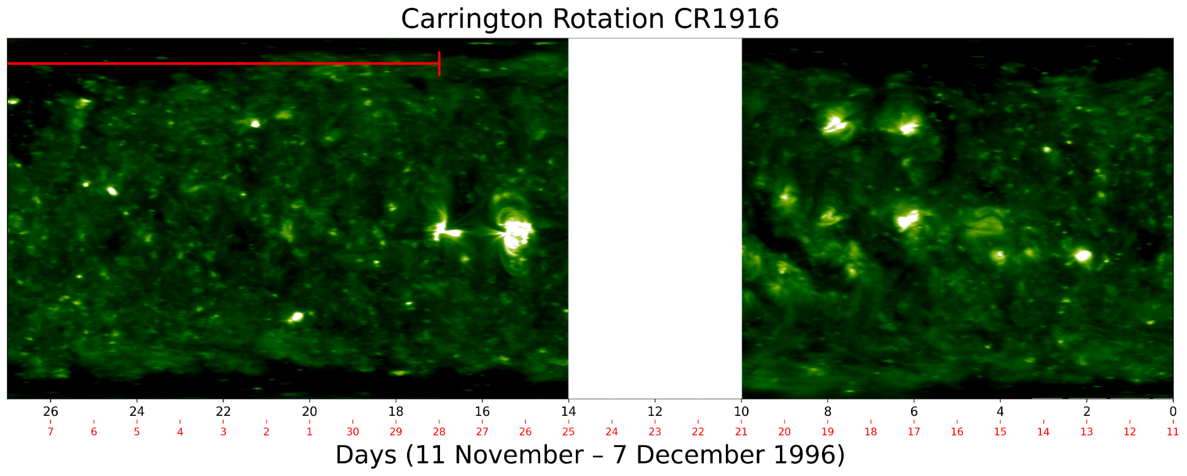
RESULTS – SOLAR CYCLE 22-23
NO DATA
NO DATA
NO DATA
NO DATA
NO DATA
9

Slide 10
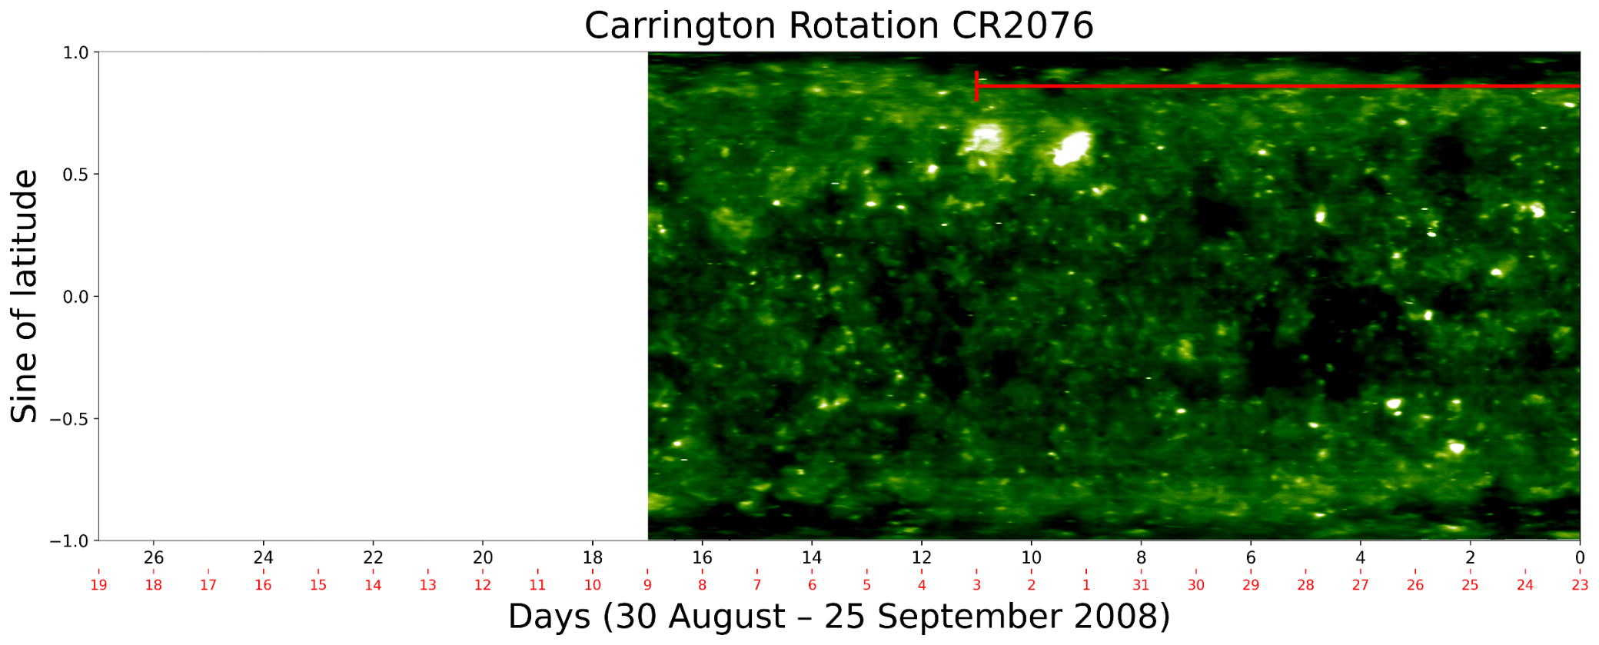
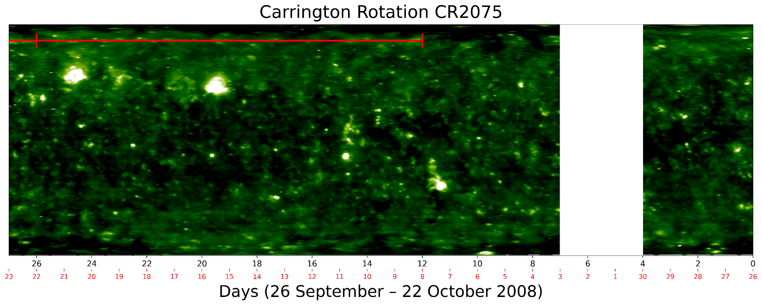
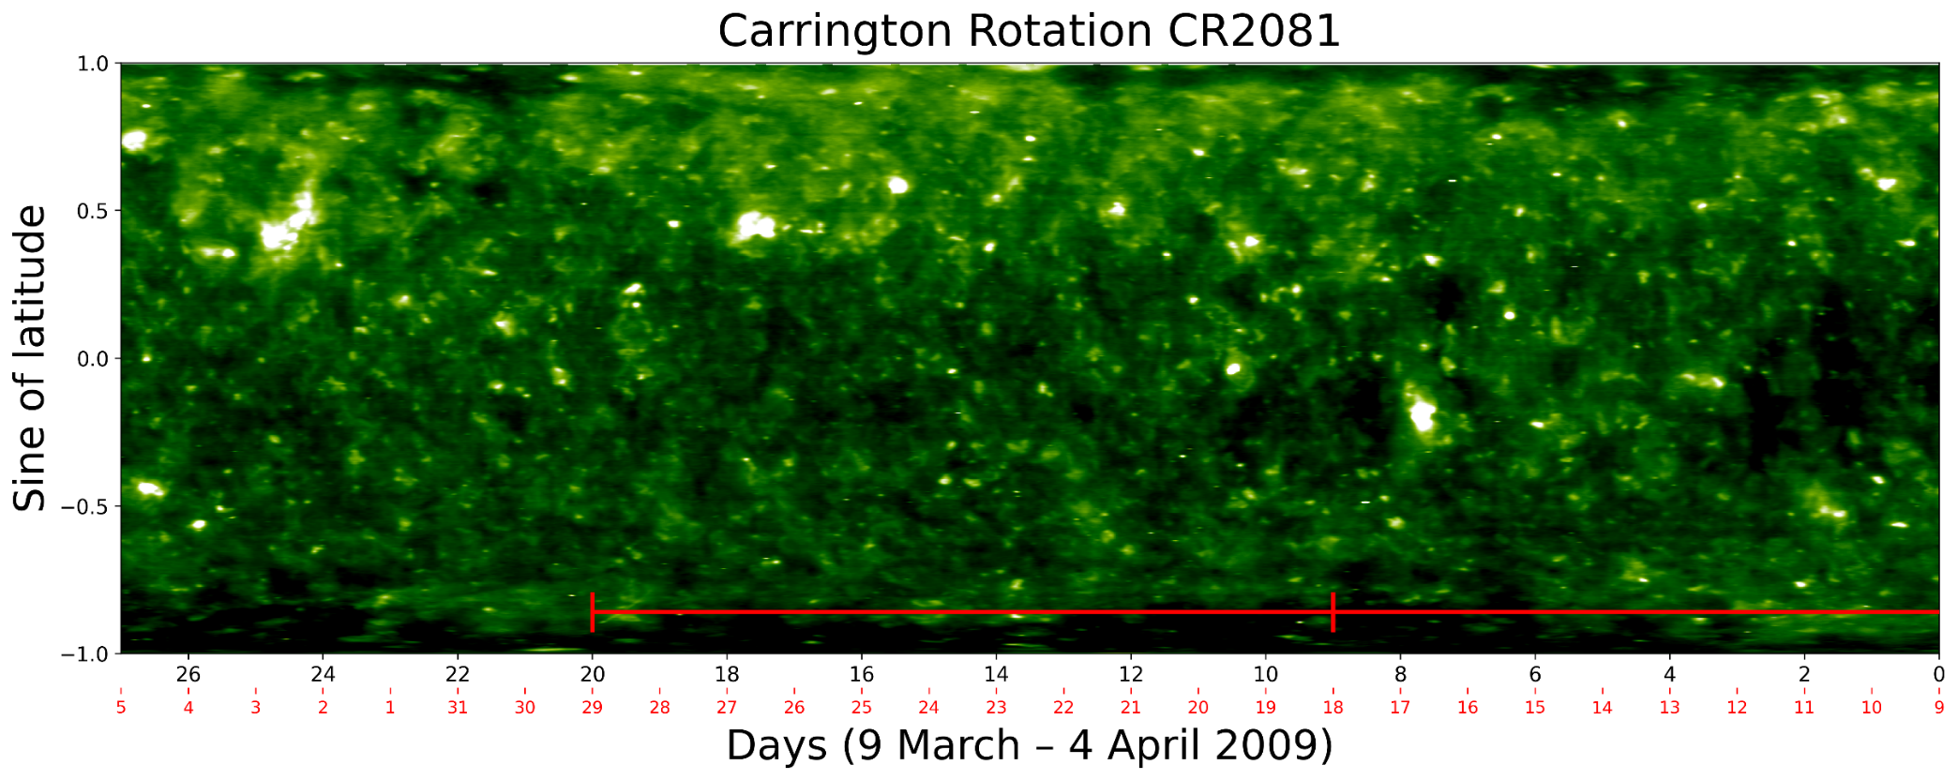
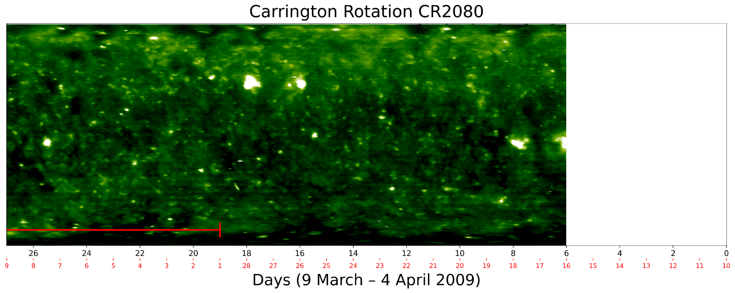
RESULTS – SOLAR CYCLE 23-24
NO DATA
NO DATA
NO DATA
10

Slide 11

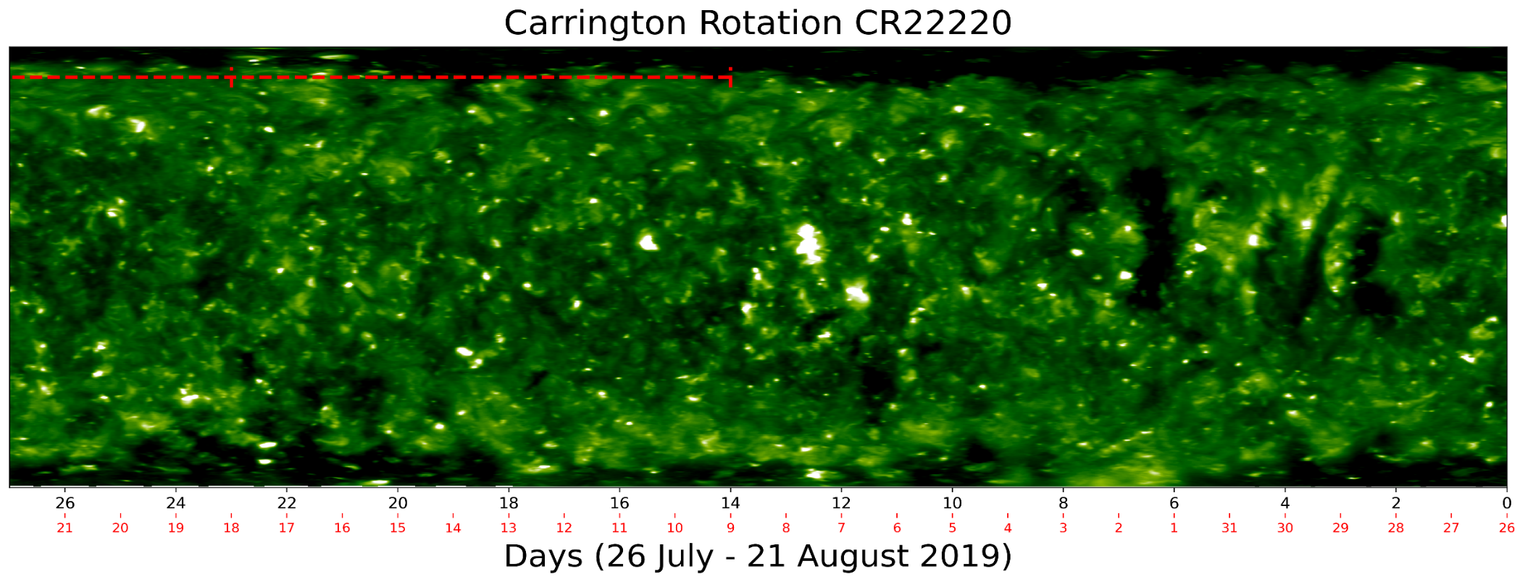
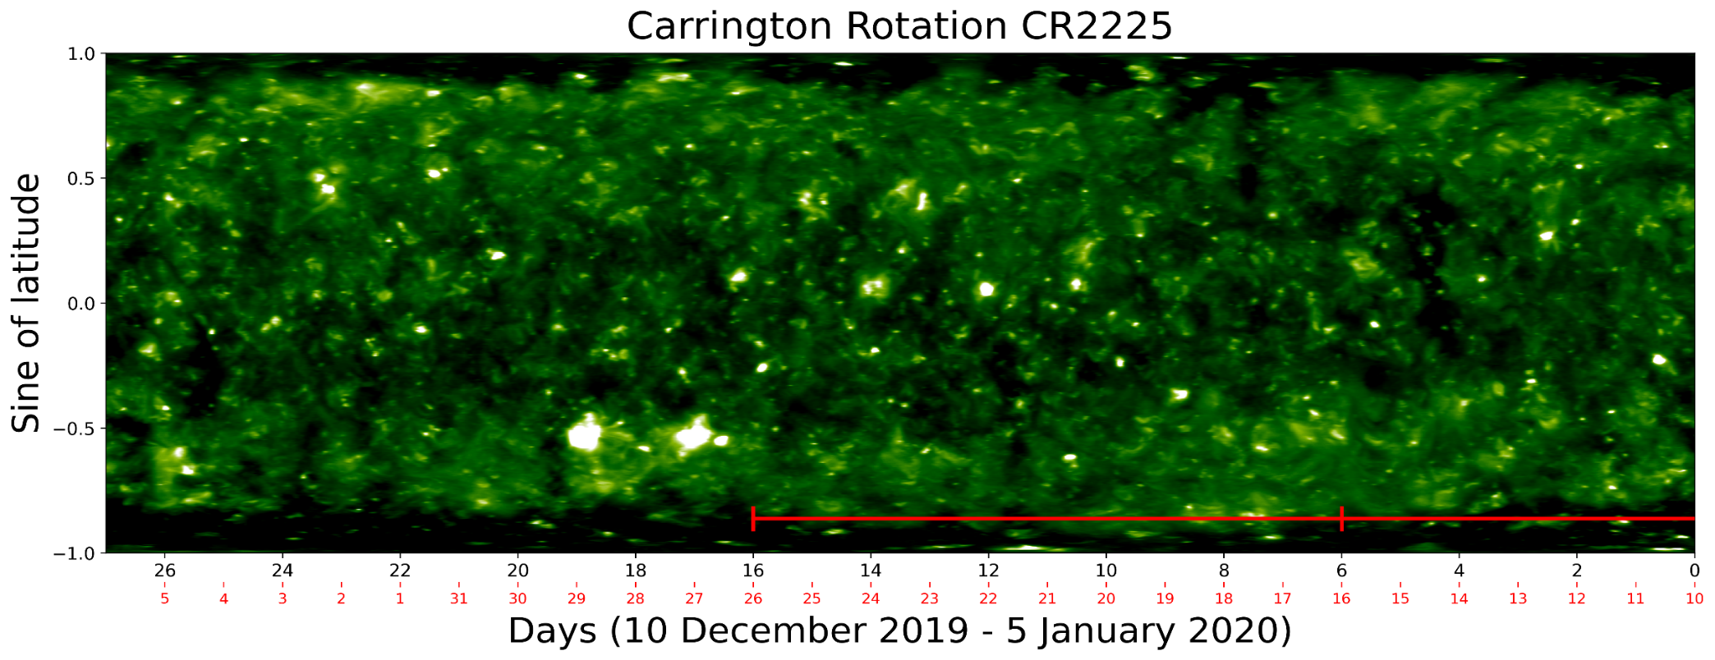
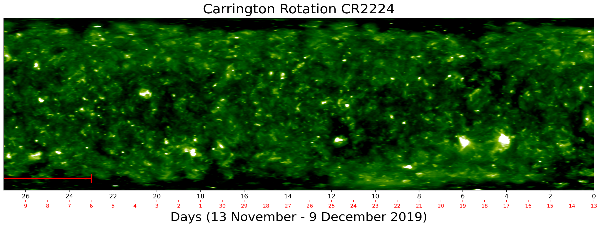
RESULTS – SOLAR CYCLE 24-25
11

Slide 12
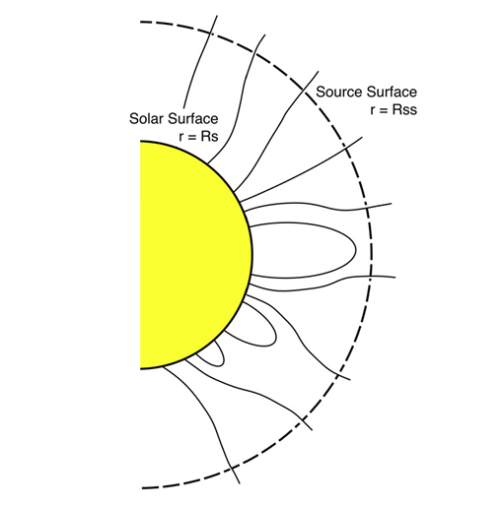




PARKER HMF & PFSS EXTRAPOLATION
We use the Parker HMF model to trace the field lines from L1 to the SWSS.
From the SWSS, we then use the PFSS extrapolation to trace the field lines back to their photospheric and, consequently, their CH origin.
PFSS extrapolation model assumption:
    Current free solar corona.
This assumption ensures that $∇×B=0$ where $B=−∇φ.$
Here $φ$ satisfies the Laplace equation $∇^{2}φ=0$.
$${45}^{°}$$
$${90}^{°}$$
$${135}^{°}$$
Courtesy of Arden et al. (2016).
12

Slide 13
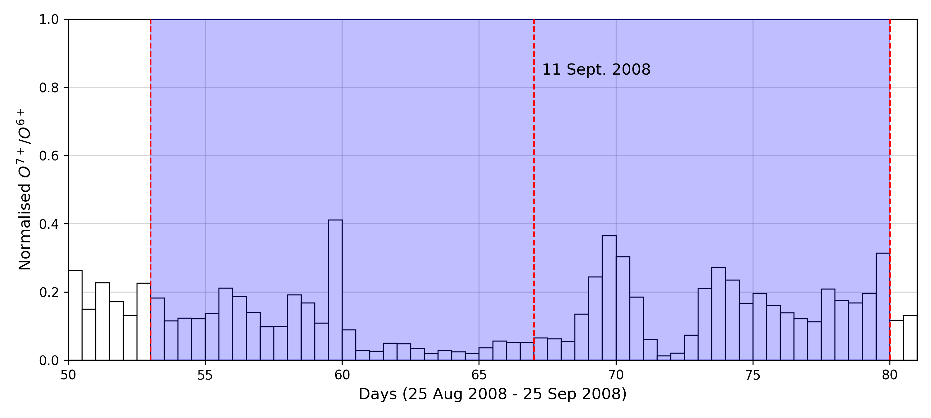
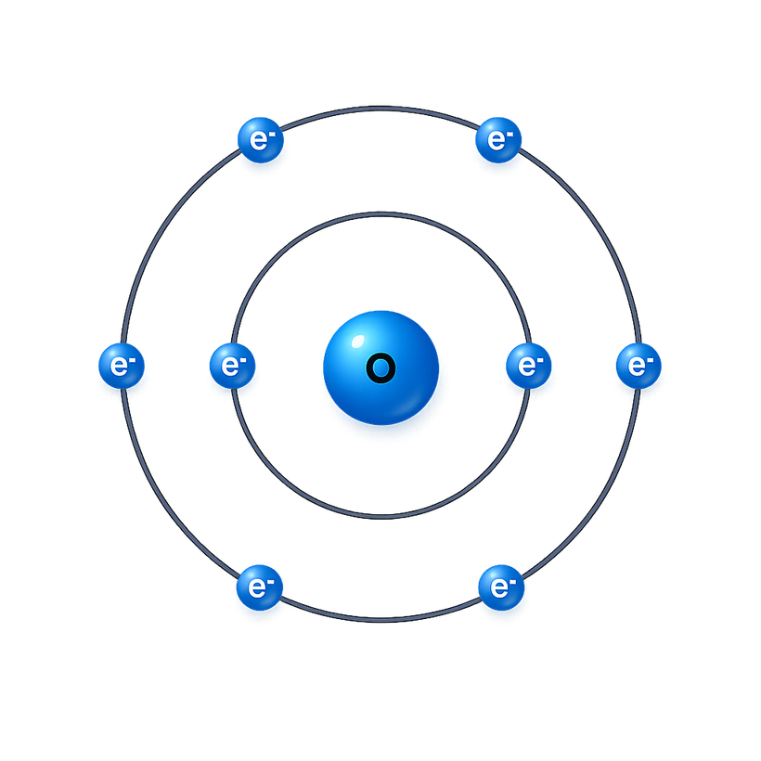
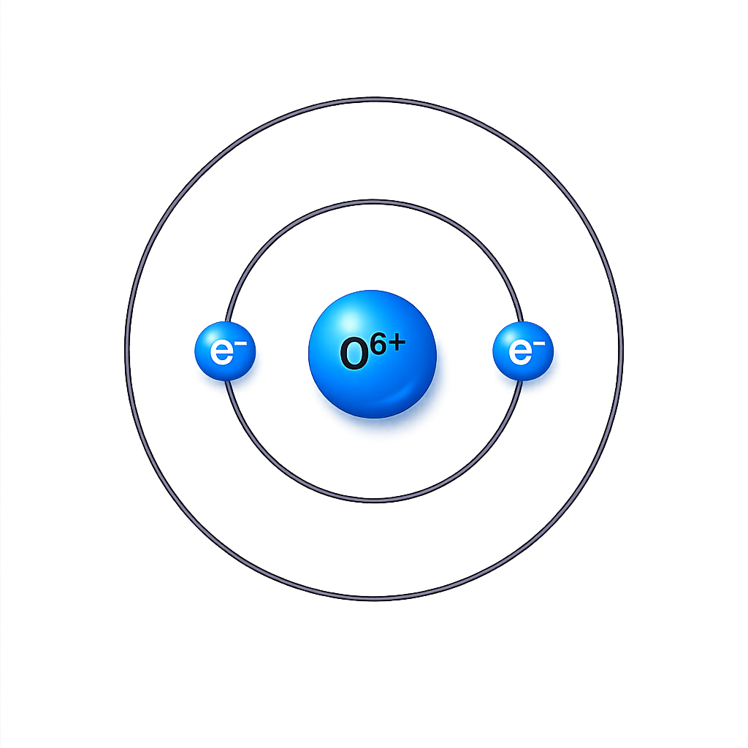
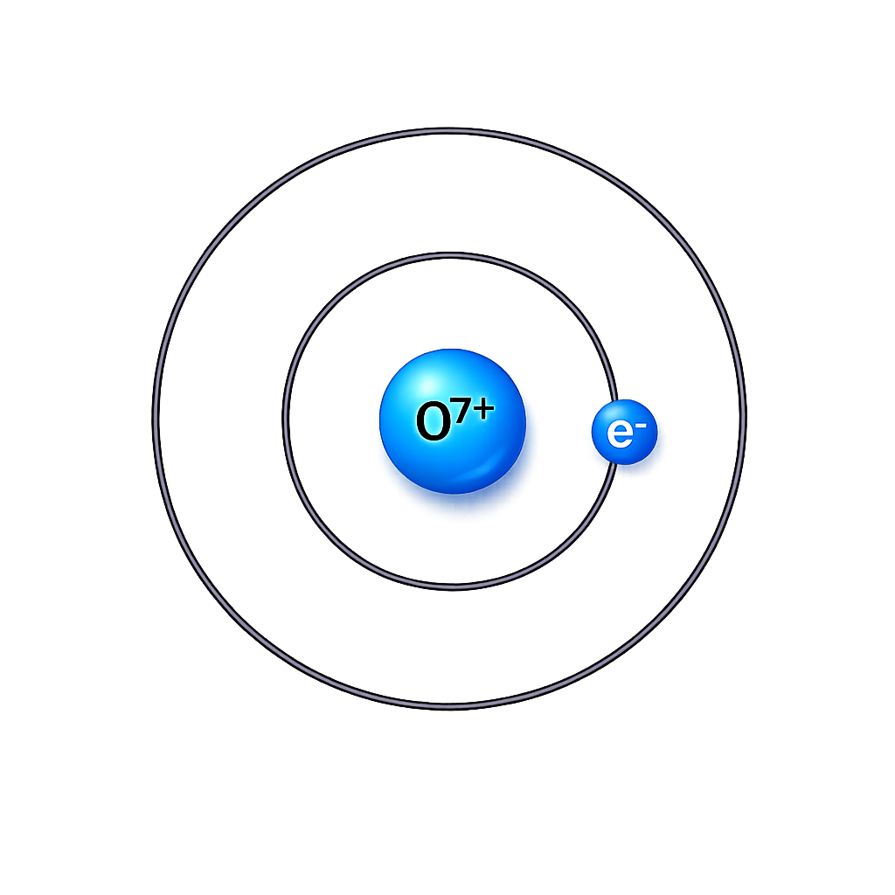
HEAVY IONS CHARGE STATE RATIOS
Data source: Solar Wind Ion Composition Spectrometer (SWICS) on-board the Advanced Composition Explorer (ACE) spacecraft.
Dates: 1) 5% left: 28 August 2008
2) Peak: 11 September 2008
3) 5% right: 24 September 2008
Heavy ions carry a permanent record of how hot it was at the exact spot on the Sun where they come from.
Bohr atomic model for the oxygen ions.
13

Slide 14
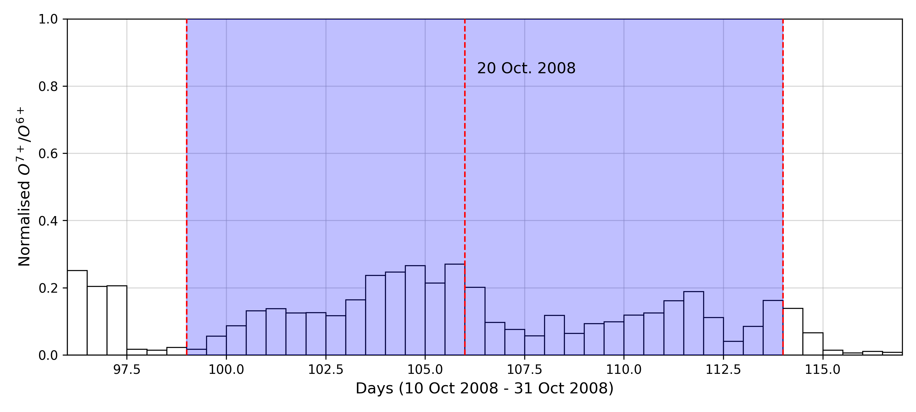
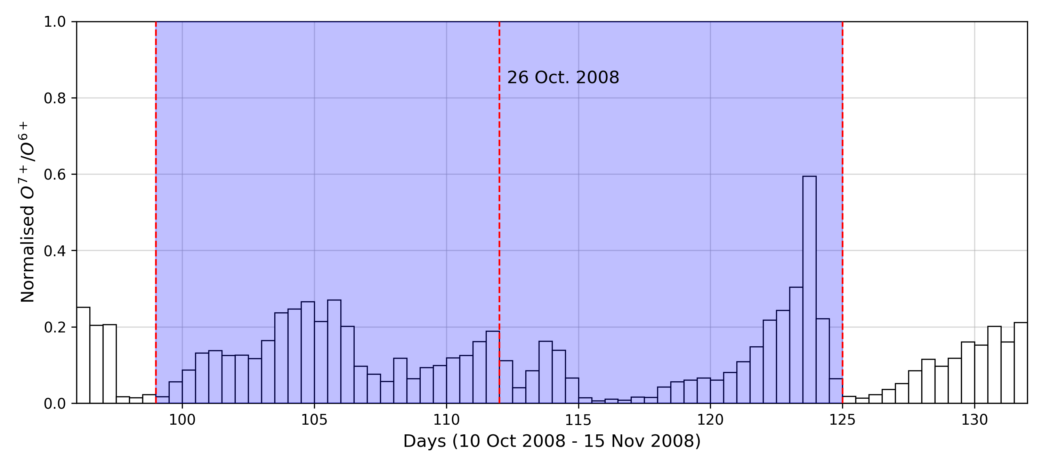
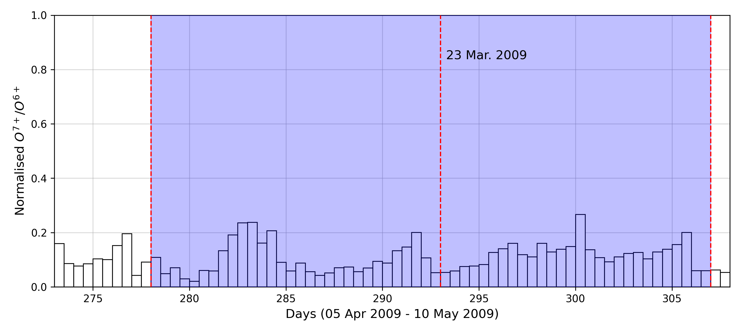
RESULTS – SOLAR CYCLES 23-24
13

Slide 15
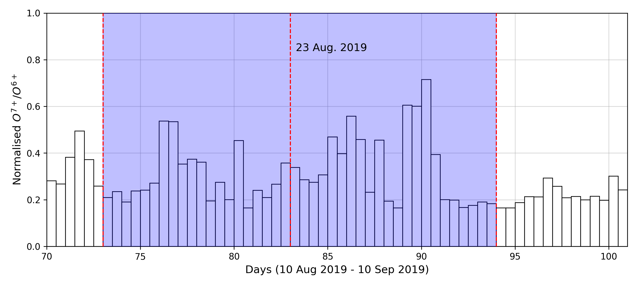
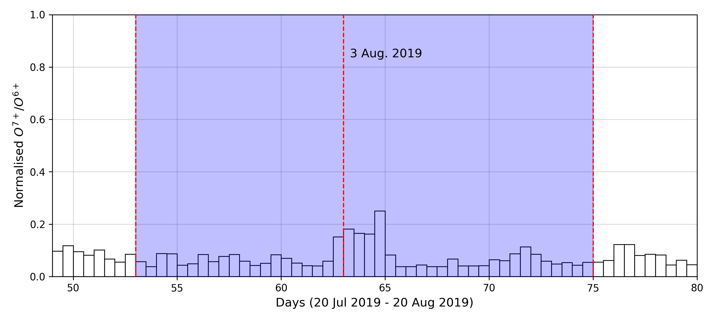
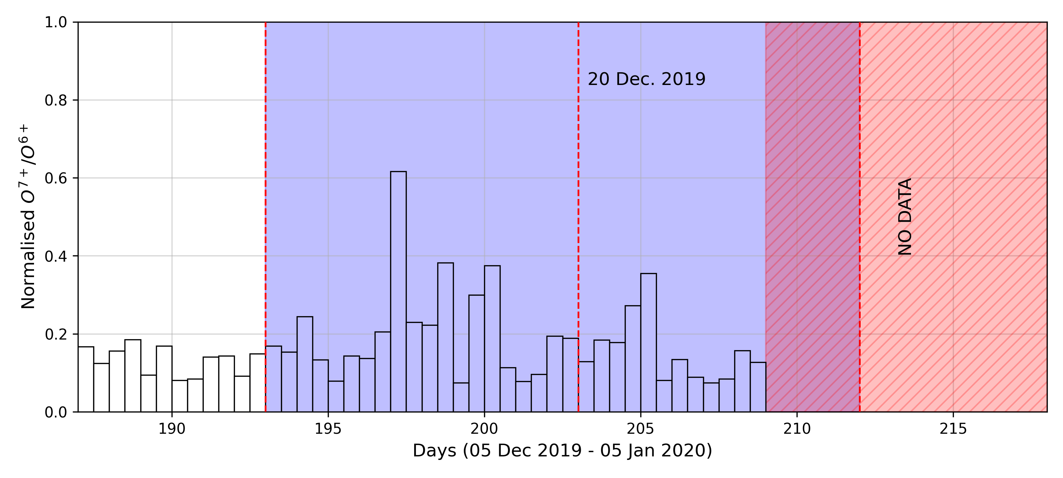
RESULTS – SOLAR CYCLES 24-25
15

Slide 16

CONCLUSION & FUTURE WORK
Fisk HMF model was used to trace the field lines from L1 to their PCH origins.
The Fisk model confirms that L1 solar wind disturbances during solar minima consistently originate from PCHs.
O⁷⁺/O⁶⁺ charge state ratios provide independent chemical evidence that these disturbances are associated with CHs.
Next steps:
    Tracing using the Parker + PFSS extrapolation.
    Investigate other heavy ions charge state ratios such as $C^{6+}/C^{5+}$ and $Fe/O$.
16

Slide 17

THANK YOU.
QUESTIONS ?
17

