Slide 1





Searches for Scalar Resonances in Diphoton Final States in Association with Multileptons at the Electroweak Scale in the ATLAS Detector at the LHC: Monte Carlo Generation
Presenter: Njokweni Mbuyiswa
Arnav Chauhan, Francesco Curcio, Vuyolwethu Kakancu, Mukesh Kumar, Thapelo Leboho, Bruce Mellado, Rachid Mazini, Phodiso Maroeshe, Edward Nkadimeng, Chinedu Nnaji, Paballo Ndhlovu, Phuti Rapheeha, Kgothatso Ntumbe, Sijing Zhang

Slide 2
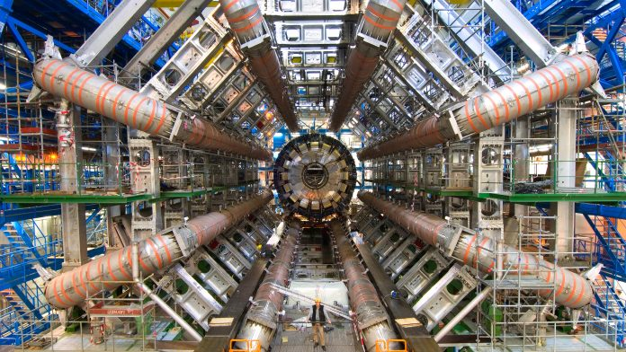
OUTLINE
Motivation
Analysis Strategy
Channels of Interest
Simplified Model and Real Triplet Benchmarks
Monte Carlo Request Workflow
Selections and Filtering
Validation
Conclusion and Future Work

Slide 3
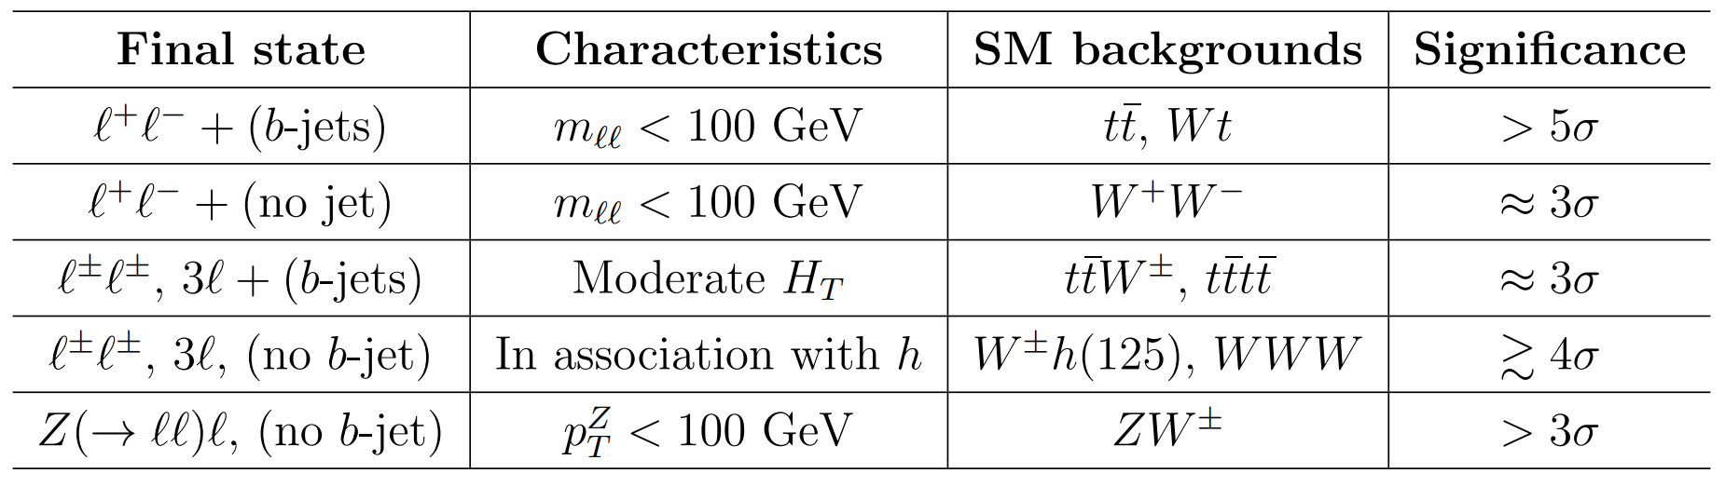
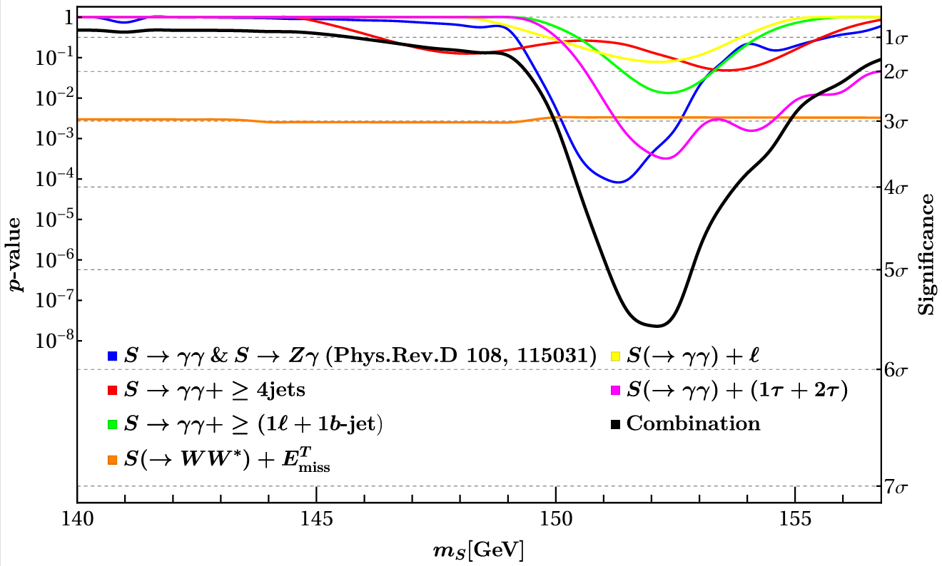
Multilepton anomalies and Diphoton spectra
Nat Rev Phys 6, 294–309 (2024). https://doi.org/10.1038/s42254-024-00703-6

Slide 4
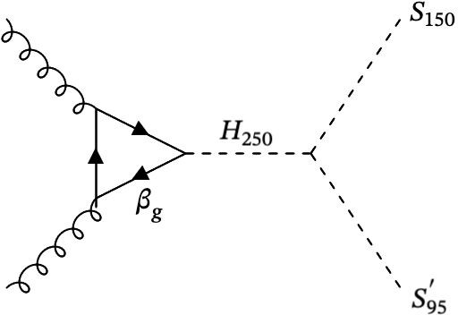
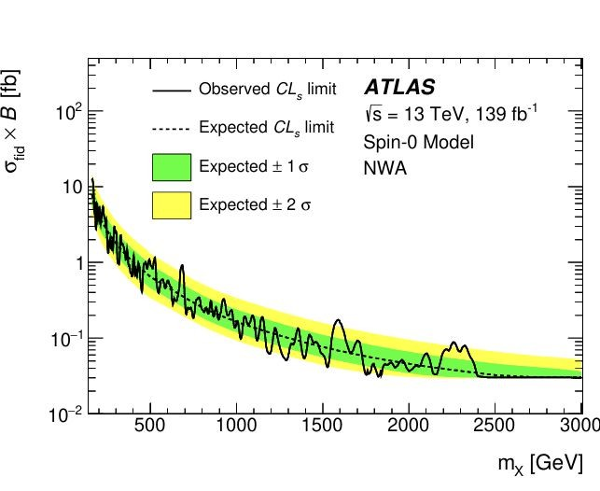
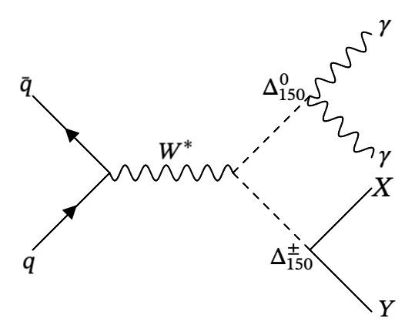
Motivation for the Search from Diphoton spectra
2HDM+S
ATLAS searches for resonant diphoton production have focused on two mass regions: a low mass window of 66-110 GeV and a high-mass window of 200-3000 GeV. https://doi.org/10.1016/j.physletb.2021.136651
As such an intensive resonant diphoton search has not been conducted in the mass range 130-200 GeV.
https://doi.org/10.1140/epjc/s10052-016-4435-8
The Real triplet model (RHTM)
https://doi.org/10.1007/JHEP04%282025%29003
http://indico.cern.ch/event/1526165/#b-610424-scalar-resonance-sear

Slide 5
Analysis Strategy
Model-independent search
Reconstruct $γγ+X$ final states
Reconstruct 𝛾𝛾+𝑋 final states
Look for excesses over background
Benchmark MC:
Design the event selection
Estimate acceptance x efficiency
Validate the reconstruction
Evaluate the expected sensitivity
Motivate realistic signal topologies
NOT used to optimise for a single model

Slide 6
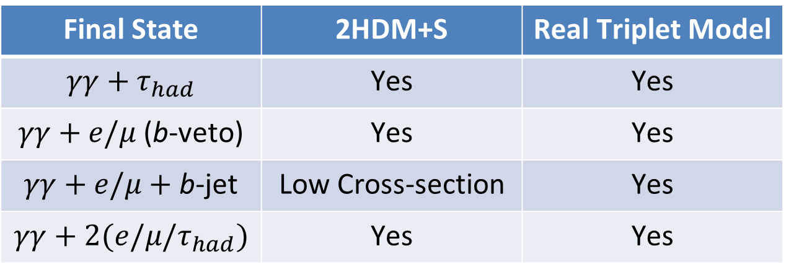
Channels Of Interest
Final State | 2HDM+S | Real Triplet Model
$$γγ+τ_{had}$$ | Yes | Yes
$γγ+e\text{/}μ$ (b-veto) | Yes | Yes
$γγ+e\text{/}μ+$b-jet | Low Cross-section | Yes
$$γγ+2(e\text{/}μ\text{/}τ_{had})$$ | Yes | Yes

Slide 7
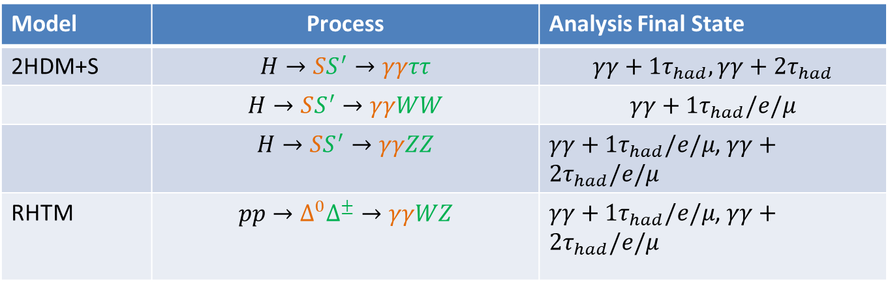
Models and their decay channels
In Association with
Model | Process | Analysis Final State
2HDM+S | $$H→SS^{′}→γγττ$$ | $$γγ+1τ_{had},γγ+2τ_{had}$$
 | $$H→SS^{′}→γγWW$$ | $$γγ+1τ_{had}\text{/}e\text{/}μ$$
 | $$H→SS^{′}→γγZZ$$ | $γγ+1τ_{had}\text{/}e\text{/}μ$, $γγ+2τ_{had}\text{/}e\text{/}μ$
RHTM | $$pp→Δ^{0}Δ^{±}→γγWZ$$ | $γγ+1τ_{had}\text{/}e\text{/}μ$, $γγ+2τ_{had}\text{/}e\text{/}μ$

Slide 8
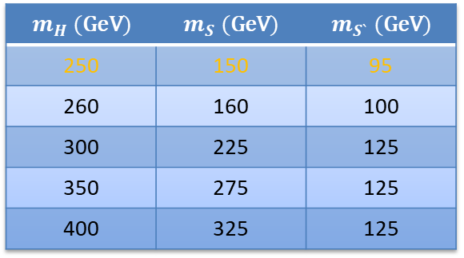
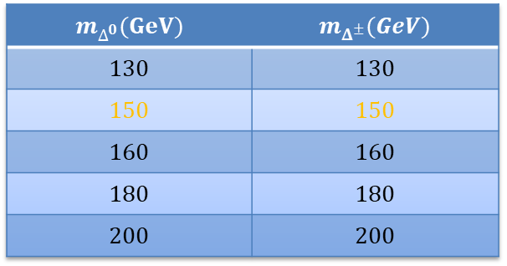
Models and Benchmark masses considered
In Association with
$$m_{H} (\text{GeV})$$ | $$m_{S} (\text{GeV})$$ | $$m_{S`} (\text{GeV})$$
250 | 150 | 95
260 | 160 | 100
300 | 225 | 125
350 | 275 | 125
400 | 325 | 125
$$m_{Δ^{0}}(GeV)$$ | $$m_{Δ^{±}}(GeV)$$
$$130$$ | $$130$$
$$150$$ | $$150$$
$$160$$ | $$160$$
$$180$$ | $$180$$
$$200$$ | $$200$$

Slide 9

MC Request Workflow
Physics Idea
Job Options
In Association with
Used Generators:
MG5 + Pythia 8 + EVTGen
AthGeneration: 23.6.40
Distributions
Validation Complete
JIRA Ticket submission
Review and Comments
Approval and Production
Dataset appears on GRID
Use Dummy DSIDs, make Excel spreadsheet, Present to relevant physics group
ATLAS MC production team reviews, may request changes. New DSIDs are assigned

Slide 10
MC Request Workflow and Pile-Up Campaigns
Event Generation
Detector Simulation
Digitization
Reconstruction
ROOTification
In Association with
Full Simulation / Geant4
Detailed particle-by-particle simulation of the ATLAS detector response.
Models how particles interact with detector material.
Highest-fidelity detector simulation.
Provides the reference used to validate faster simulation.
AF3 / AtlFast3
Uses fast parameterised detector-response models instead of simulating every interaction in full detail.
Built and validated using Full Simulation and detector performance studies.
Useful for producing large MC samples and many benchmark points.
240k events requested
Full Sim:
Low pile-up level = 20k
Medium pile-up level = 20k
High pile-up level = 80k
AF3:
Low pile-up level = 20k
Medium pile-up level = 20k
High pile-up level = 80k

Slide 11
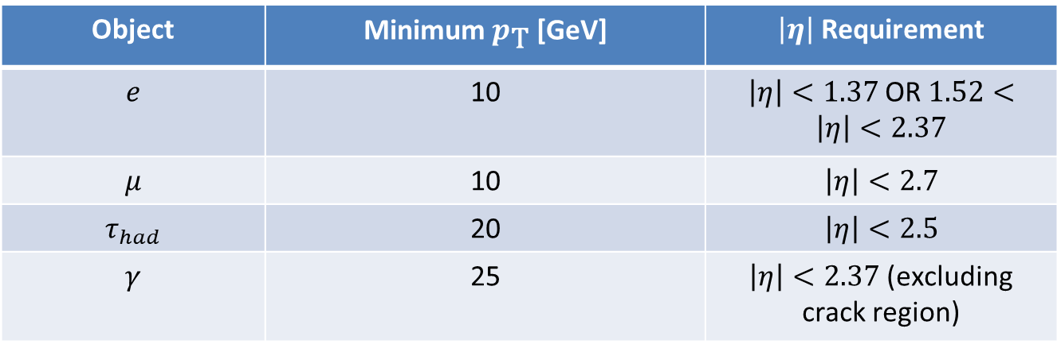
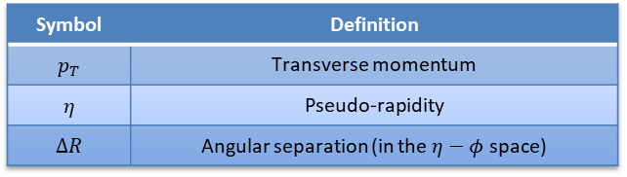
Reference Object Selections from $γγ+ML$ study
Symbol | Definition
$$p_{T}$$ | Transverse momentum
$$η$$ | Pseudo-rapidity
$$ΔR$$ | Angular separation (in the $η−φ$ space)
Object | Minimum $p_{\text{T}}$ [GeV] | $\left|η\right|$ Requirement
$$e$$ | 10 | $\left|η\right|<1.37$OR $1.52<\left|η\right|<2.37$
$$μ$$ | 10 | $$\left|η\right|<2.7$$
$$τ_{had}$$ | 20 | $$\left|η\right|<2.5$$
$$γ$$ | 25 | $\left|η\right|<2.37$ (excluding crack region)

Slide 12
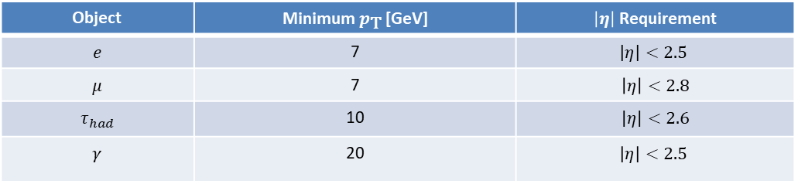
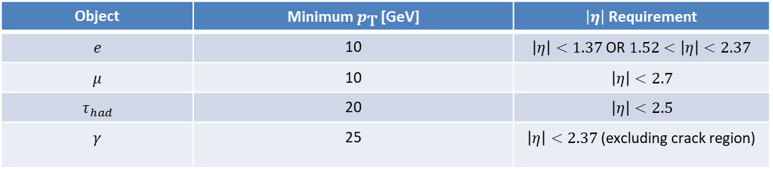
Filters
Object Selections:
Object | Minimum $p_{\text{T}}$ [GeV] | $\left|η\right|$ Requirement
$$e$$ | 10 | $\left|η\right|<1.37$OR $1.52<\left|η\right|<2.37$
$$μ$$ | 10 | $$\left|η\right|<2.7$$
$$τ_{had}$$ | 20 | $$\left|η\right|<2.5$$
$$γ$$ | 25 | $\left|η\right|<2.37$ (excluding crack region)
Filter Selections used are slightly looser than object selections:
Object | Minimum $p_{\text{T}}$ [GeV] | $\left|η\right|$ Requirement
$$e$$ | 7 | $$\left|η\right|<2.5$$
$$μ$$ | 7 | $$\left|η\right|<2.8$$
$$τ_{had}$$ | 10 | $$\left|η\right|<2.6$$
$$γ$$ | 20 | $$\left|η\right|<2.5$$

Slide 13
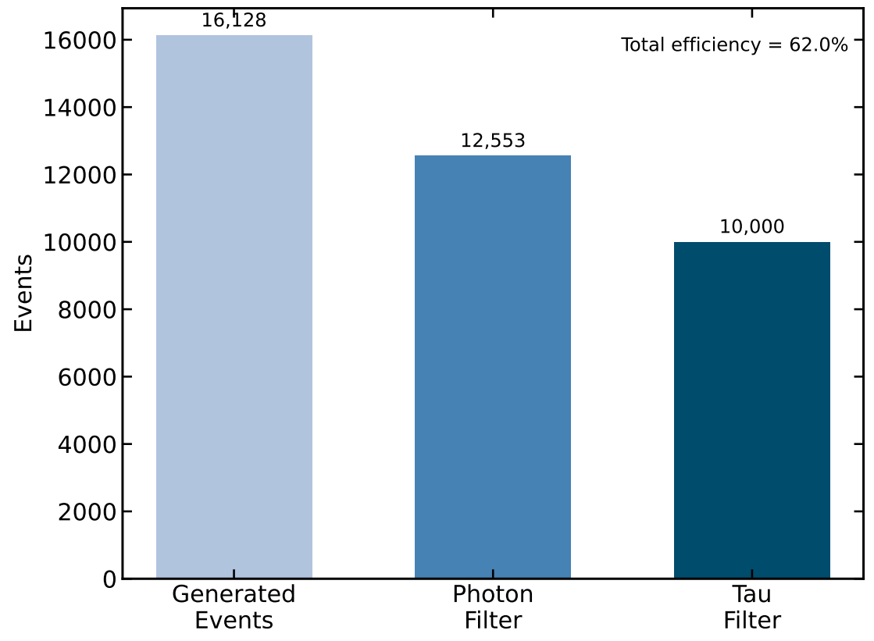
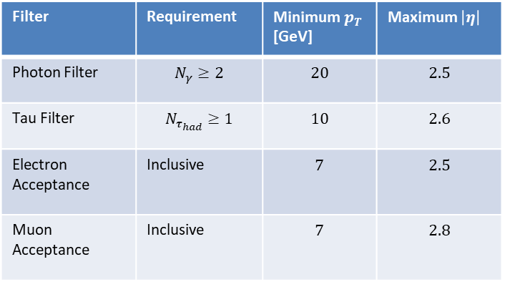
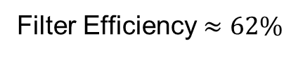
$γγ+τ^{+}τ^{−}$ generated for $γγ+1τ_{had}$
In Association with
Filter | Requirement | Minimum $p_{T}$ [GeV] | Maximum $\left|η\right|$
Photon Filter | $$N_{γ}≥2$$ | $$20$$ | $$2.5$$
Tau Filter | $$N_{τ_{had}}≥1$$ | $$10$$ | $$2.6$$
Electron Acceptance | Inclusive | $$7$$ | $$2.5$$
Muon Acceptance | Inclusive | $$7$$ | $$2.8$$
Filter Efficiency $≈62\%$

Slide 14
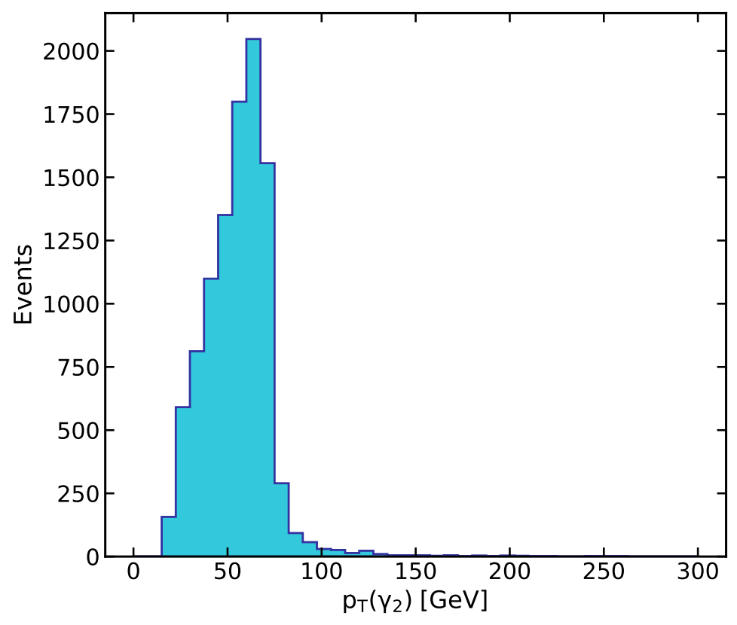
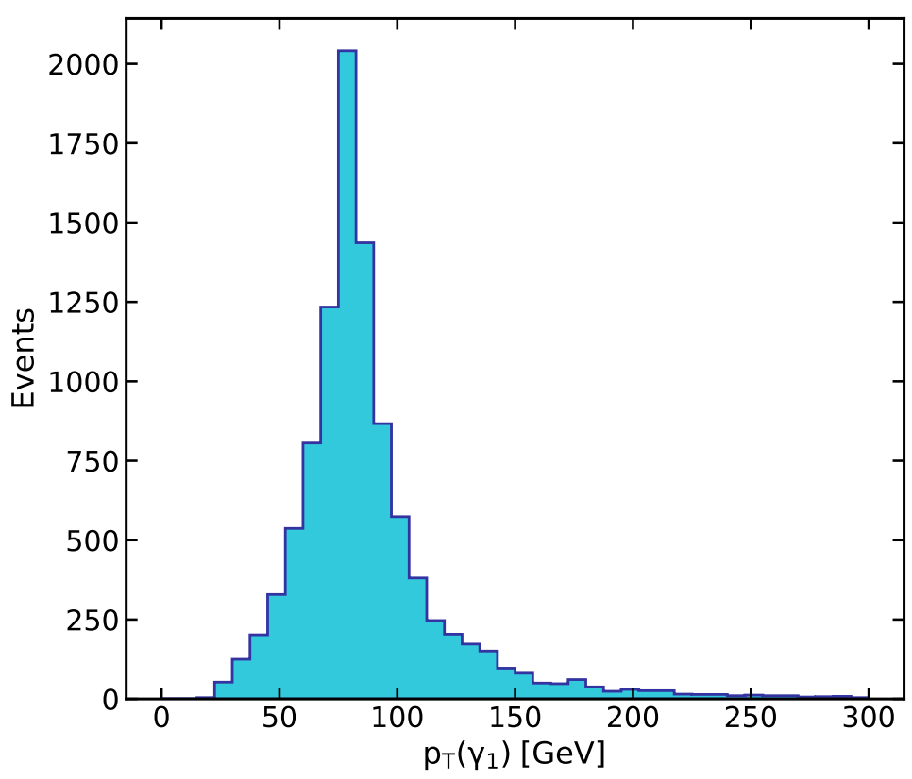
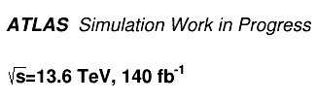
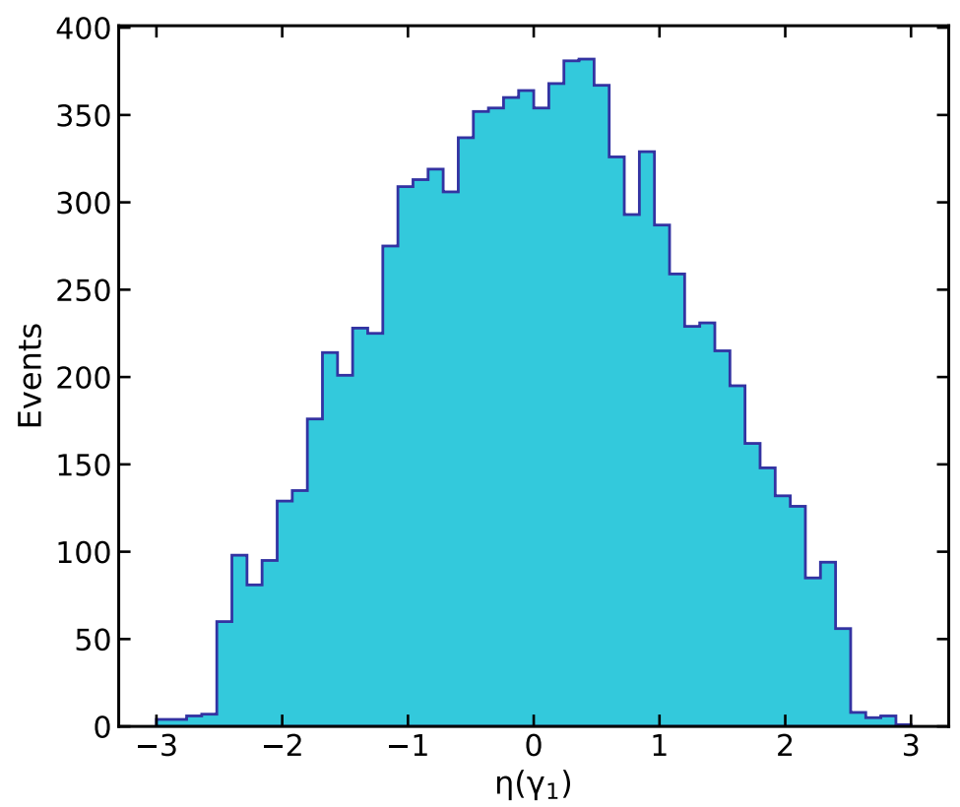
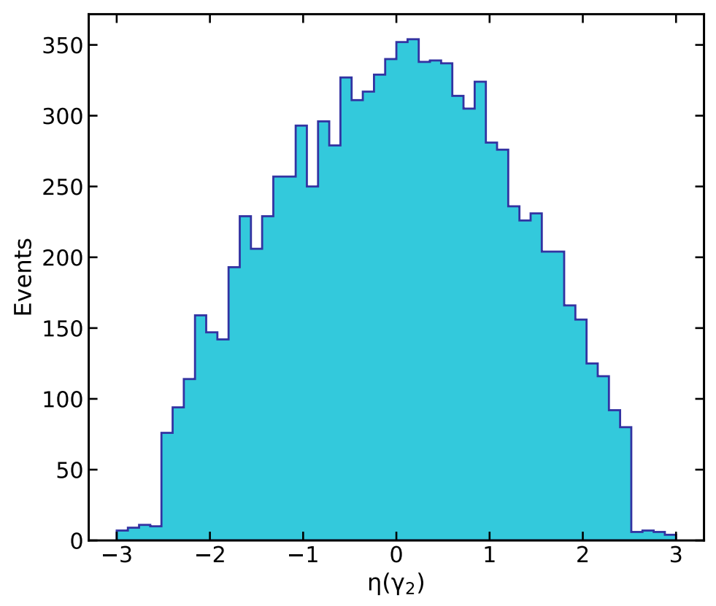
Validation Plots
In Association with

Slide 15
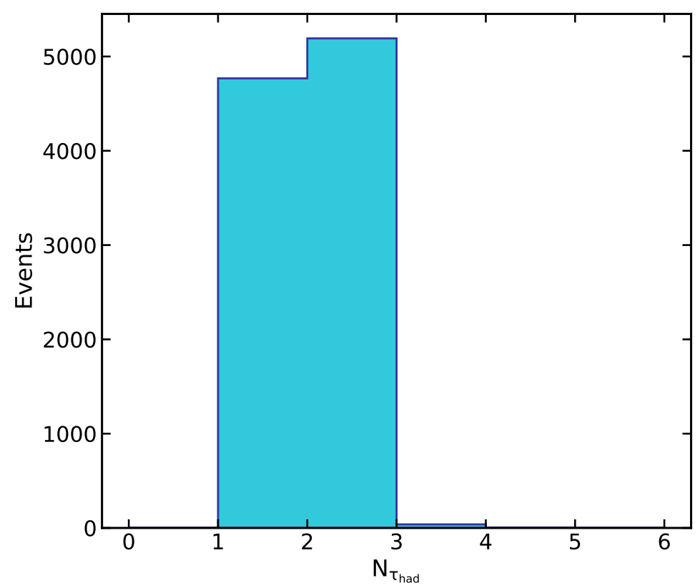
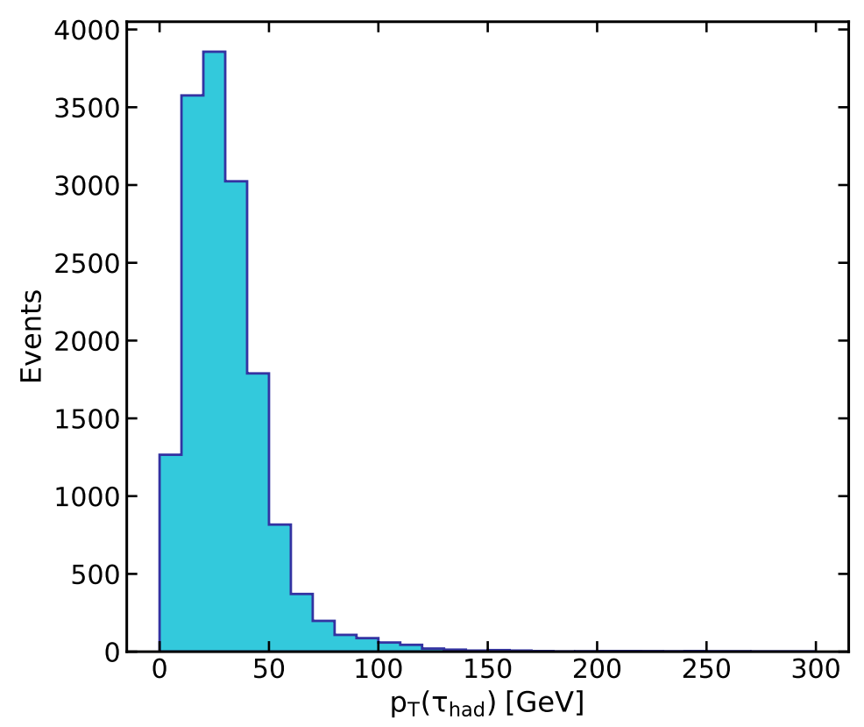
Validation Plots
In Association with

Slide 16
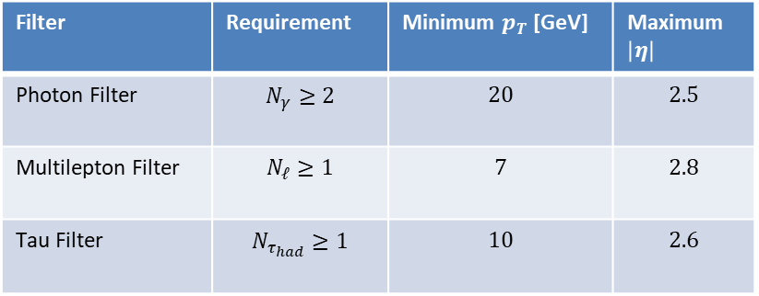
$γγ+WW$ generated for $γγ+1(e,μ,τ_{had})$
Generated
29 554
In Association with
Filter | Requirement | Minimum $p_{T}$ [GeV] | Maximum $\left|η\right|$
Photon Filter | $$N_{γ}≥2$$ | $$20$$ | $$2.5$$
Multilepton Filter | $$N_{ℓ}≥1$$ | $$7$$ | $$2.8$$
Tau Filter | $$N_{τ_{had}}≥1$$ | $$10$$ | $$2.6$$
Photon Filter
22 713
Multilepton Filter
8 772
OR
Tau Filter
1 228
Final Sample
10 000
Filter Efficiency = 33.8%

Slide 17
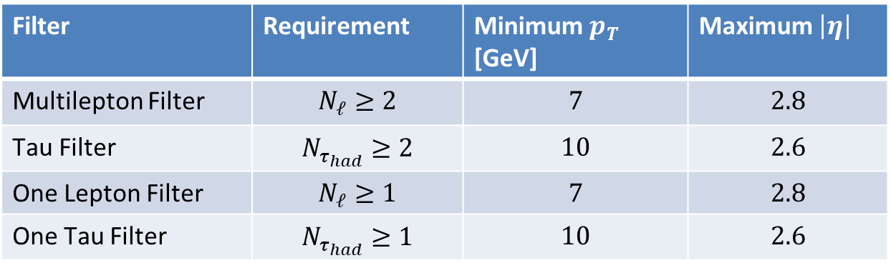
$$γγ+2(e,μ,τ_{had})$$
In Association with
Filter | Requirement | Minimum $p_{T}$ [GeV] | Maximum $\left|η\right|$
Multilepton Filter | $$N_{ℓ}≥2$$ | $$7$$ | $$2.8$$
Tau Filter | $$N_{τ_{had}}≥2$$ | $$10$$ | $$2.6$$
One Lepton Filter | $$N_{ℓ}≥1$$ | $$7$$ | $$2.8$$
One Tau Filter | $$N_{τ_{had}}≥1$$ | $$10$$ | $$2.6$$
Filter Efficiency = 16.8%

Slide 18
$$γγ+2(e,μ,τ_{had})$$
Generated
59 582
In Association with
Multilepton Filter
5 024
One Lepton AND One Tau Filter
1 631
OR
Tau Filter
3 345
OR
Total Events
10 000
Filter Efficiency = 16.8%

Slide 19
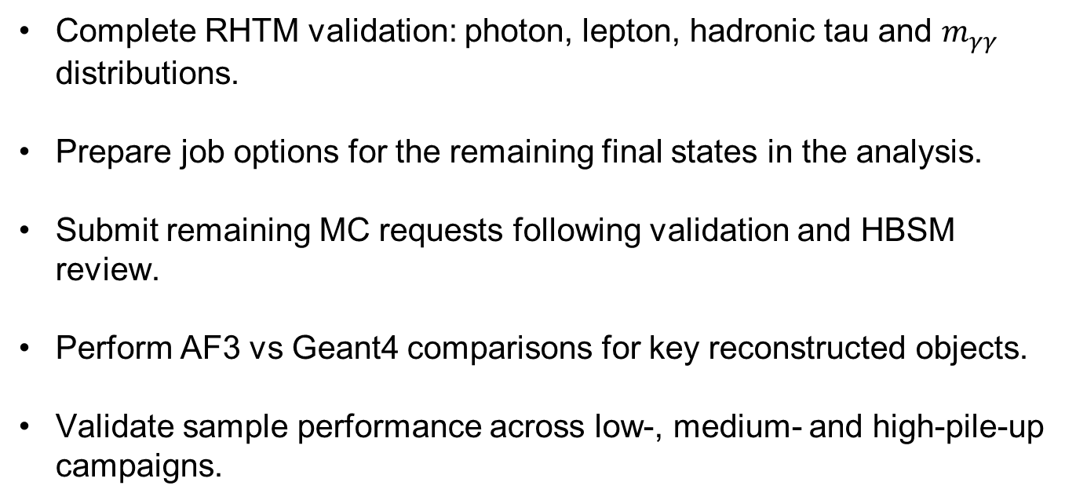
Future Work
Complete RHTM validation: photon, lepton, hadronic tau and $m_{γγ}$ distributions.
Prepare job options for the remaining final states in the analysis.
Submit remaining MC requests following validation and HBSM review.
Perform AF3 vs Geant4 comparisons for key reconstructed objects.
Validate sample performance across low-, medium- and high-pile-up campaigns.
In Association with

Slide 20


Slide 21
In Association with
Backup Slides

Slide 22
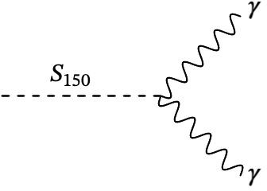
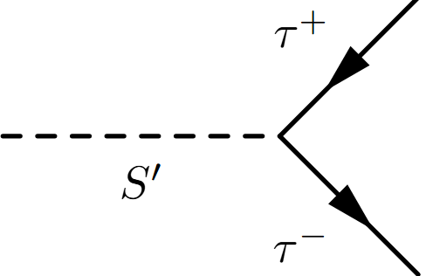
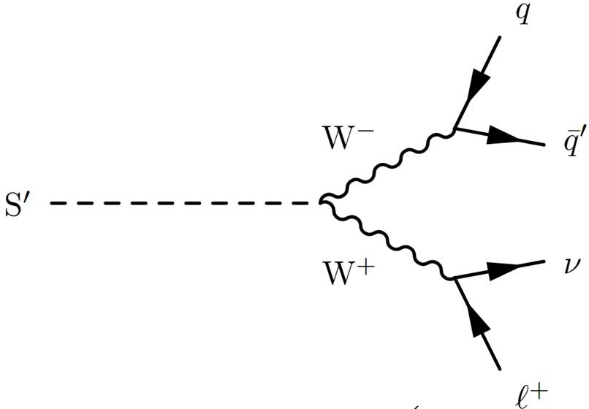
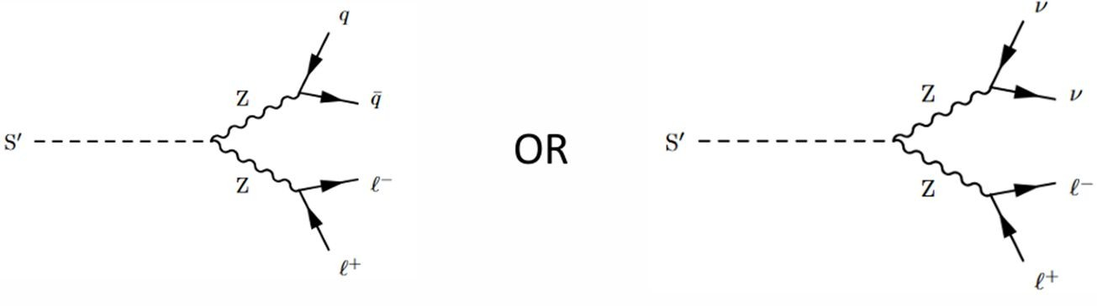
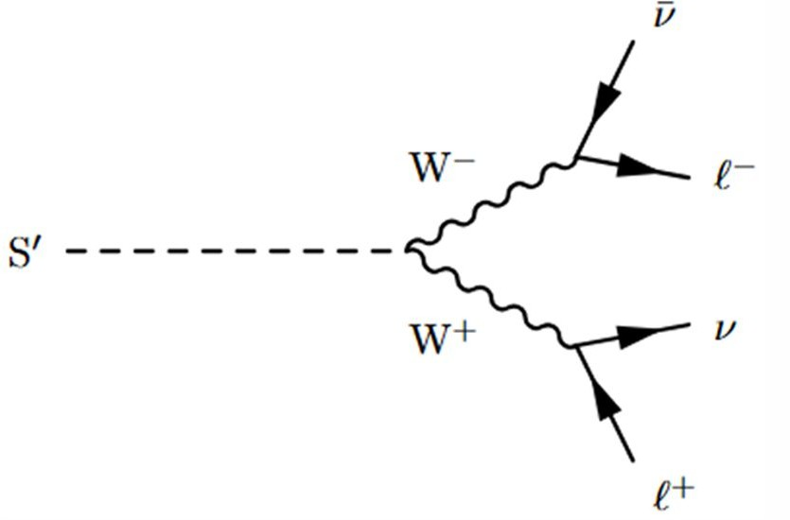
Simplified Model
2 taus
In Association with
95
1 lepton
2 lepton
95
95
95
95

Slide 23


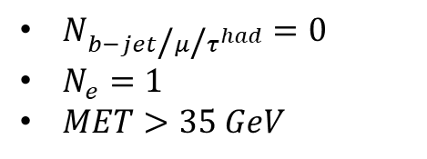
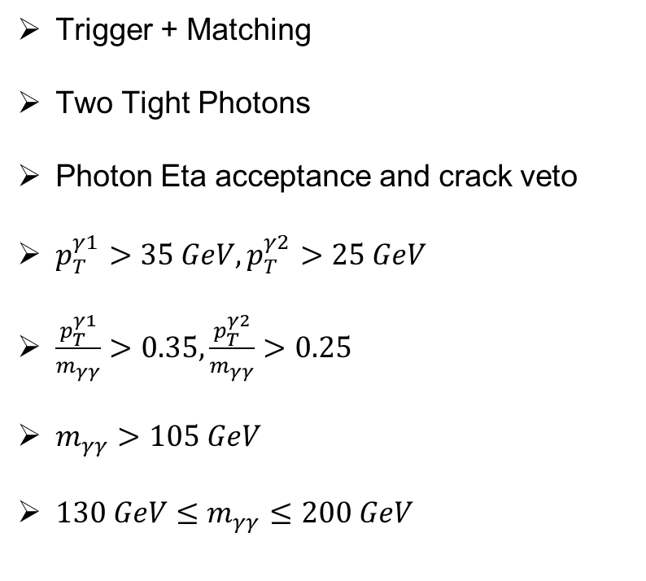
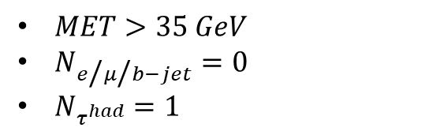


Selection Criteria Used in the Analysis
Trigger + Matching
Two Tight Photons
Photon Eta acceptance and crack veto
$p_{T}^{γ1}>35 GeV, p_{T}^{γ2}>25 GeV$
$\frac{p_{T}^{γ1}}{m_{γγ}}>0.35,\frac{p_{T}^{γ2}}{m_{γγ}}>0.25$
$m_{γγ}>105 GeV$
$130 GeV≤m_{γγ}≤200 GeV$
$$γγ+1τ^{had}$$
$MET>35 GeV$
$N_{e\text{/}μ\text{/}b−jet}=0$
$N_{τ^{had}}=1$
$$γγ+1e$$
$N_{b−jet\text{/}μ\text{/}τ^{had}}=0$
$N_{e}=1$
$MET>35 GeV$
$$γγ+1μ$$
$N_{b−jet\text{/}e\text{/}τ^{had}}=0$
$N_{μ}=1$

Slide 24
$γγ+WW$ generated for $γγ+1(e,μ,τ^{had})$
xAODPhotonFilter
AND
xAODMultiLeptonFilter
OR
xAODTauFilter
In Association with
Selection Step | Events Passed | Step Efficiency (%) | Cumulative Efficiency (%)
Initial Events | 29597 | - | 100.0
xAODPhotonFilter | 22747 | 76.8 | 76.8
xAODMultiLeptonFilter | 8785 | 38.6 | -
xAODTauFilter | 1215 | 5.3 | -
Combined (xAODMultiLeptonFilter OR xAODTauFilter) | 10000 | 44.0 | 33.8

Slide 25
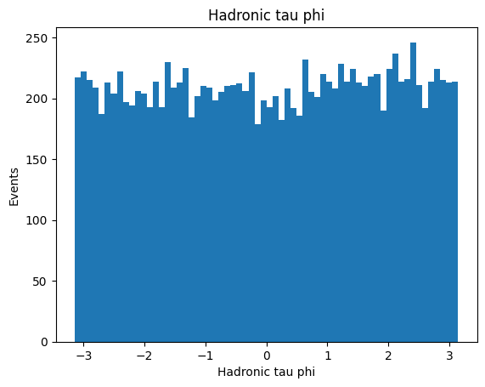
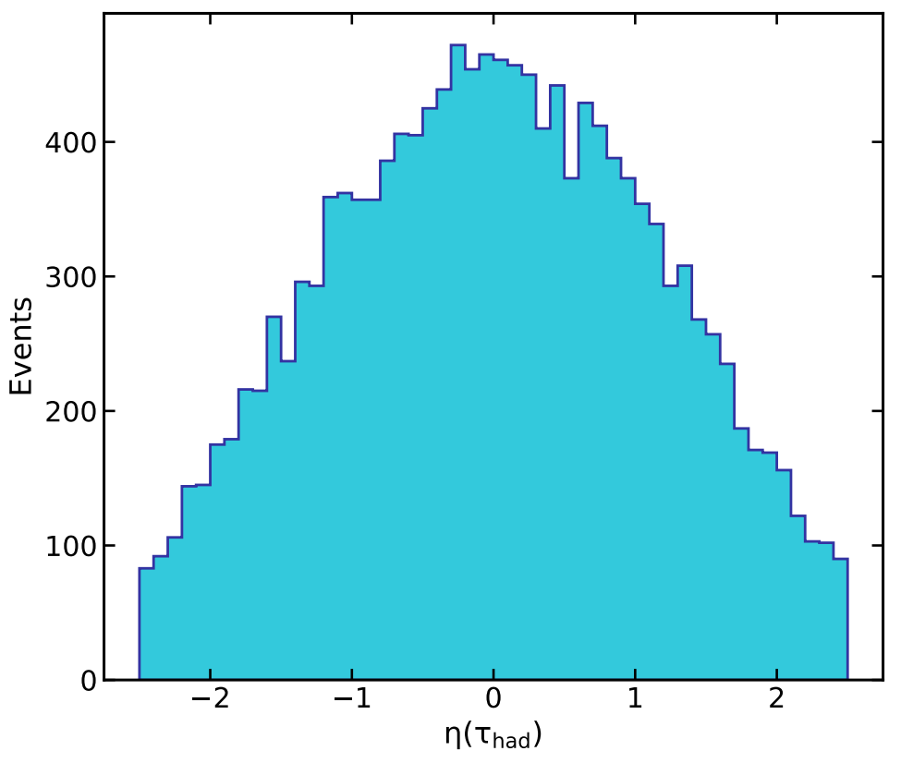
Validation Plots
In Association with

Slide 26
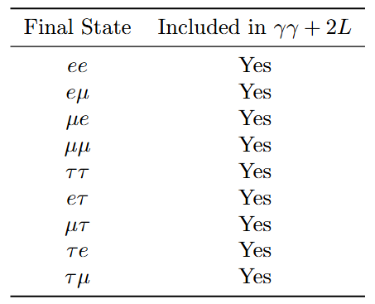
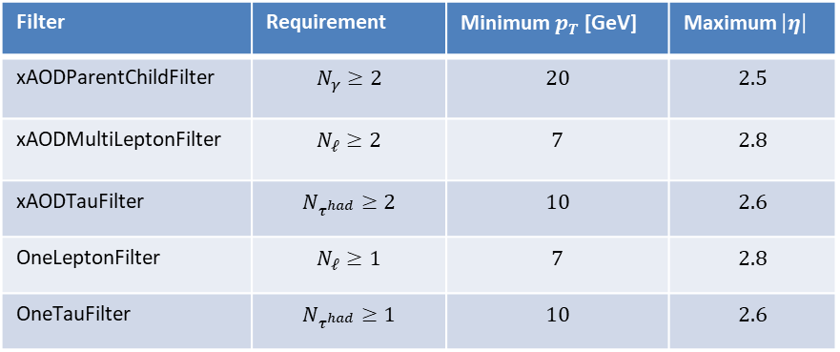
$$γγ+2(e,μ,τ^{had})$$
In Association with
xAODParentChildFilter AND [ xAODMultiLeptonFilter OR xAODTauFilter OR ( OneLeptonFilter AND OneTauFilter ) ]
Filter | Requirement | Minimum $p_{T}$ [GeV] | Maximum $\left|η\right|$
xAODParentChildFilter | $$N_{γ}≥2$$ | $$20$$ | $$2.5$$
xAODMultiLeptonFilter | $$N_{ℓ}≥2$$ | $$7$$ | $$2.8$$
xAODTauFilter | $$N_{τ^{had}}≥2$$ | $$10$$ | $$2.6$$
OneLeptonFilter | $$N_{ℓ}≥1$$ | $$7$$ | $$2.8$$
OneTauFilter | $$N_{τ^{had}}≥1$$ | $$10$$ | $$2.6$$

Slide 27
$$γγ+2(e,μ,τ^{had})$$
Selection Step | Events Passed | Step Efficiency (%) | Cumulative Efficiency (%)
Initial Events | 59552 | - | 100.0
xAODParentChildFilter | 59552 | 100.0 | 100.0
xAODMultiLeptonFilter | 5040 | 8.46 | -
xAODTauFilter | 2917 | 4.90 | -
OneLeptonFilter | 14907 | 25.0 | -
OneTauFilter | 2043 | 3.43 | -
Combined Final Selection | 10000 | 16.79 | 16.79
In Association with

Slide 28
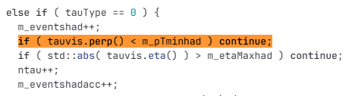
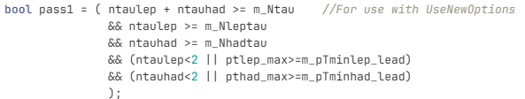
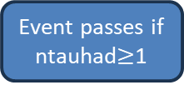
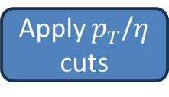
Core Filter Logic
xAODTauFilter
All taus
Apply $p_{T}$/$η$ cuts
Count accepted Taus
Event passes if ntauhad$≥$1

Slide 29
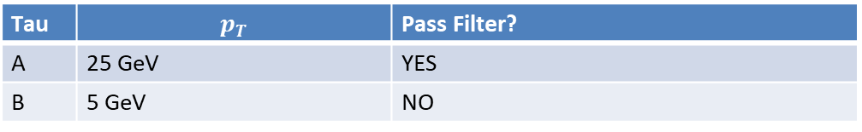


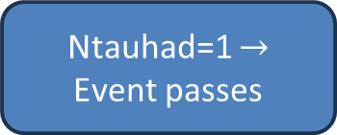
Why Low-$p_{T}$ Taus Still Appear (Example)
Tau | $$p_{T}$$ | Pass Filter?
A | 25 GeV | YES
B | 5 GeV | NO
But TRUTH1 Output contains:
Filter sees:
[25 GeV, 5 GeV]
Ntauhad=1 $→$ Event passes
At least one tau must satisfy $p_{T}>10 GeV$
All taus in the event must satisfy $p_{T}>10 GeV$

Slide 30
Event Selection vs Object Cleaning
Operation | What it does
Generator Filter | Accept/reject events
Truth Slimming/Thinning | Remove objects
The same event-level filtering logic applies to both xAODPhotonFilter and xAODTauFilter. However, the effect is much more visible for taus because tau events frequently contain additional low visible-pT tau objects arising from neutrino subtraction and tau decay topology, whereas diphoton events are typically dominated by the two hard prompt photons used in the selection.

Slide 31
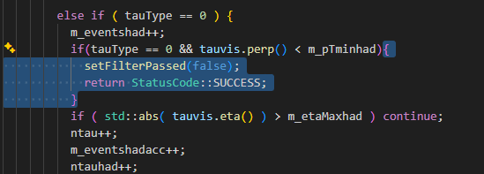
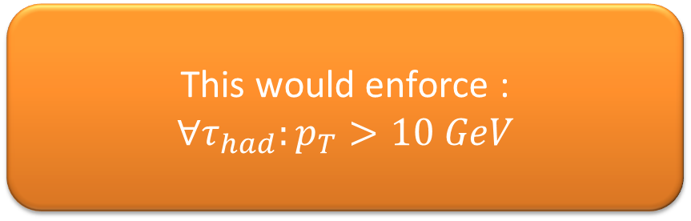
How we would reject such events entirely
Proposed change in xAODTauFilter code:
This would enforce :
$$∀τ_{had}:p_{T}>10 GeV$$
Lower Efficiency

Slide 32
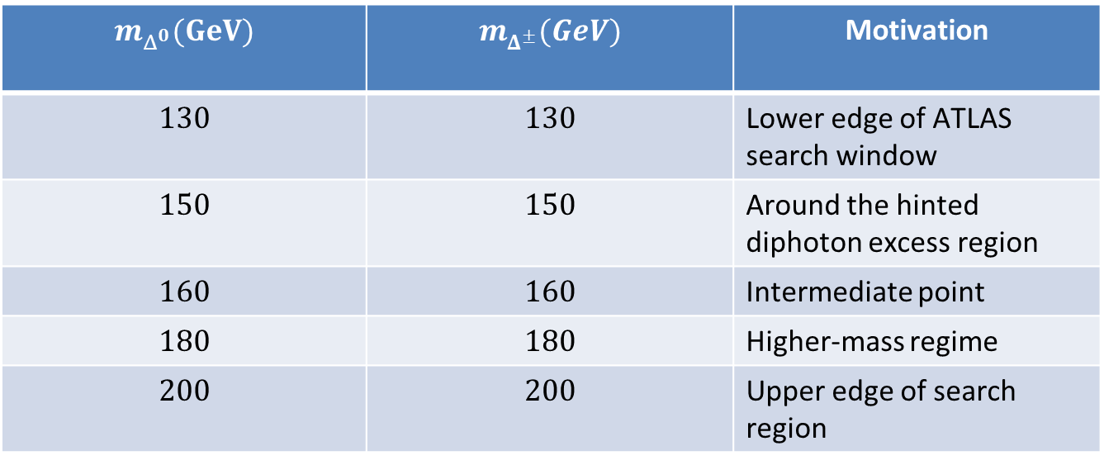
RHTM Proposed Benchmark masses
$$m_{Δ^{0}}(GeV)$$ | $$m_{Δ^{±}}(GeV)$$ | Motivation
$$130$$ | $$130$$ | Lower edge of ATLAS search window
$$150$$ | $$150$$ | Around the hinted diphoton excess region
$$160$$ | $$160$$ | Intermediate point
$$180$$ | $$180$$ | Higher-mass regime
$$200$$ | $$200$$ | Upper edge of search region

