Slide 1
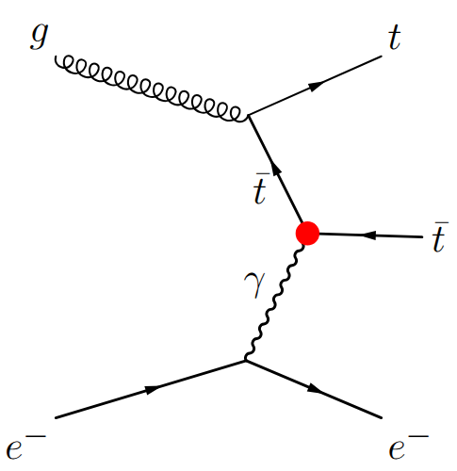
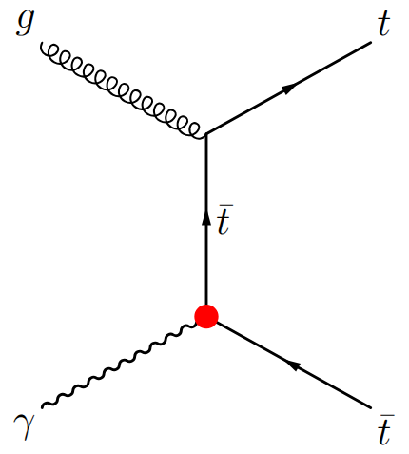



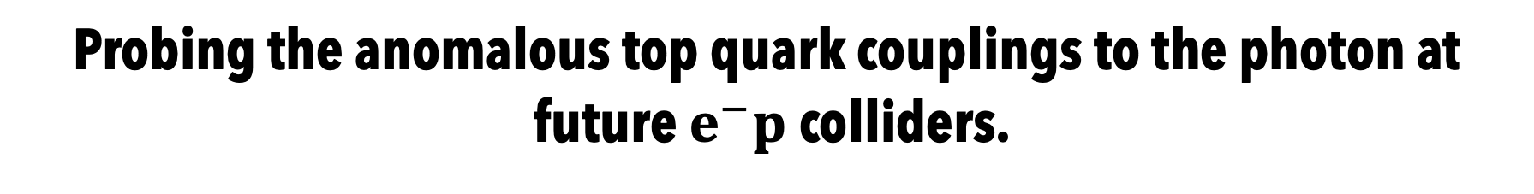
Probing the anomalous top quark couplings to the photon at
future $e^{−}p$ colliders.
Mukesh Kumar
In collaboration with: Katlego Machethe

Slide 2
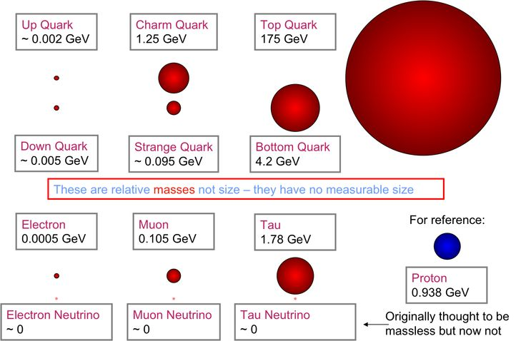
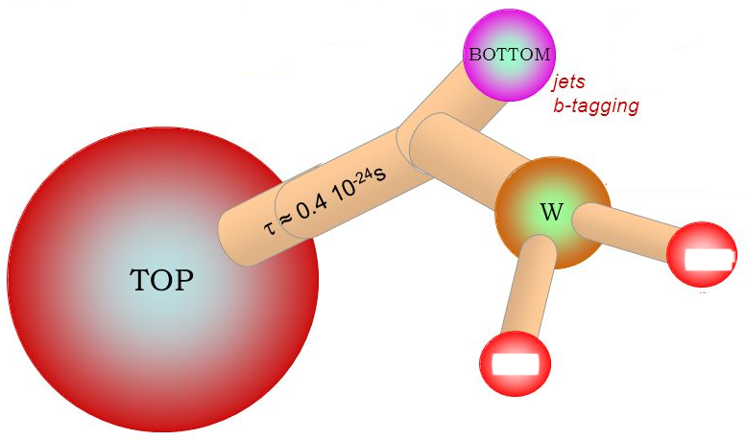
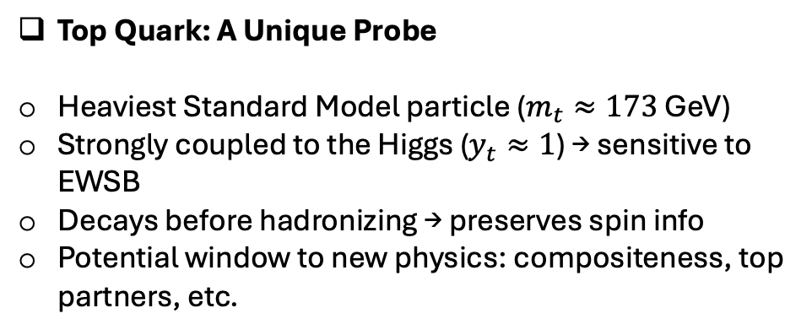

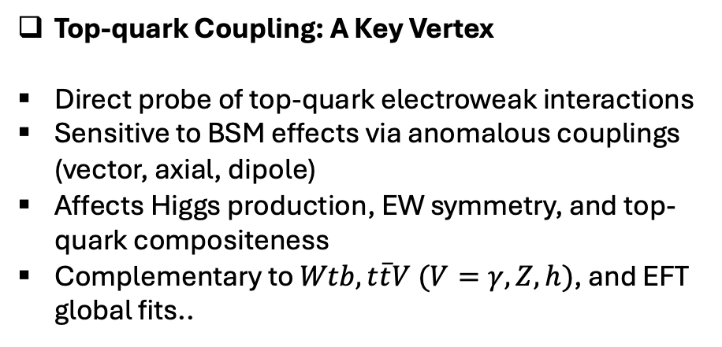
Top Quark: A Unique Probe
Heaviest Standard Model particle ($m_{t}≈173$ GeV)
Strongly coupled to the Higgs ($y_{t}≈1$) → sensitive to EWSB
Decays before hadronizing → preserves spin info
Potential window to new physics: compositeness, top partners, etc.
Top-quark Coupling: A Key Vertex
Direct probe of top-quark electroweak interactions
Sensitive to BSM effects via anomalous couplings (vector, axial, dipole)
Affects Higgs production, EW symmetry, and top-quark compositeness
Complementary to $Wtb, t\overline{t}V (V=γ,Z, h)$, and EFT global fits..
$$t→W^{+}b \left(\overline{t}→W^{−} \overline{b}\right); W^{±}→ℓ^{±}ν_{ℓ}/jj$$

Slide 3
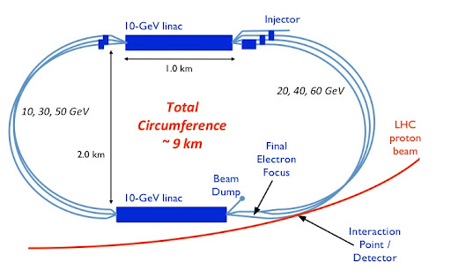
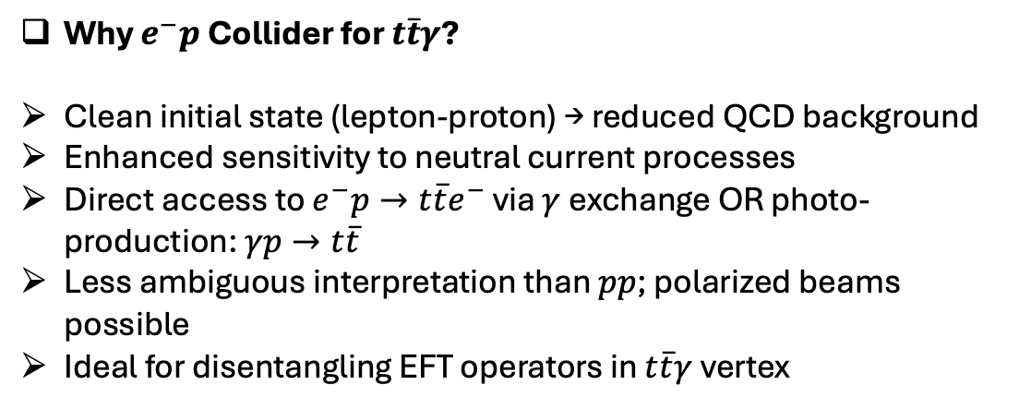

Why $e^{−}p$ Collider for $t\overline{t}γ$?
Clean initial state (lepton-proton) → reduced QCD background
Enhanced sensitivity to neutral current processes
Direct access to $e^{−}p→t\overline{t}e^{−}$ via $γ$exchange OR photo-production: $γp→t\overline{t}$
Less ambiguous interpretation than $pp$; polarized beams possible
Ideal for disentangling EFT operators in $t\overline{t}γ$vertex
The interaction for the $t\overline{t}γ$ vertex is:
+

Slide 4
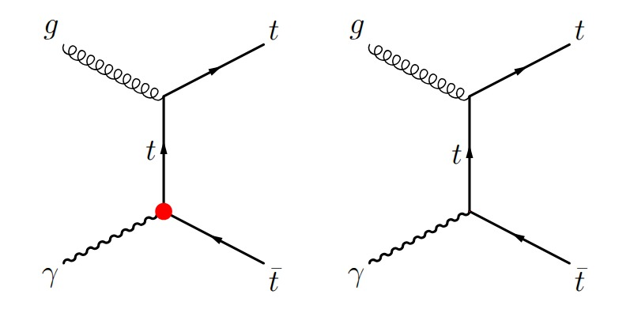
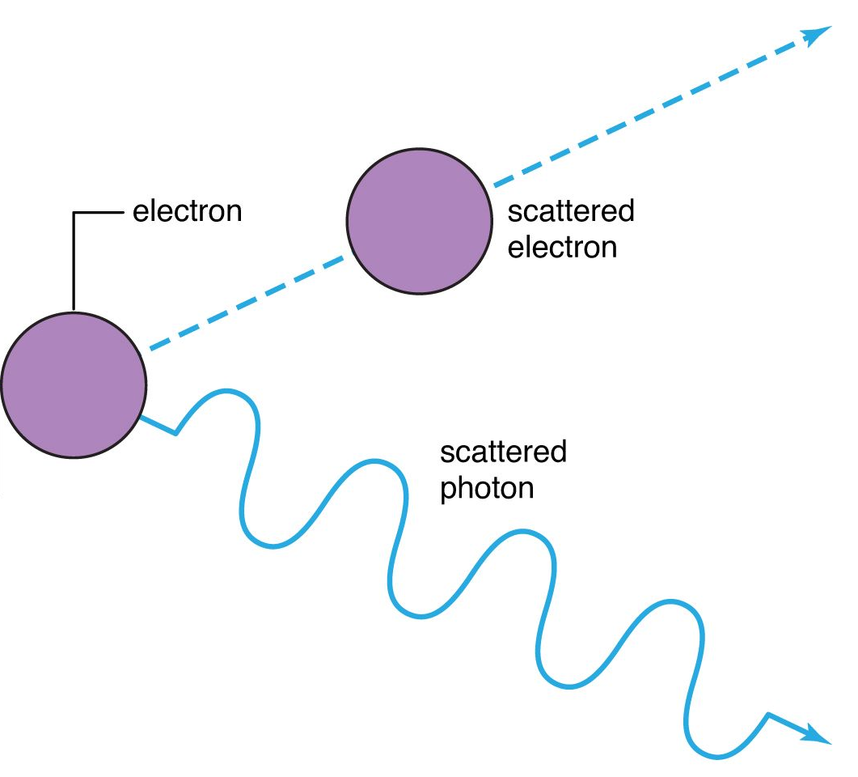
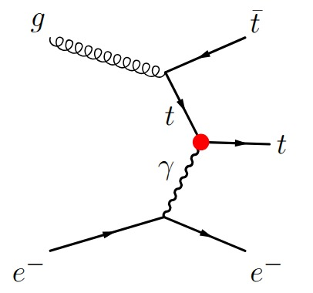
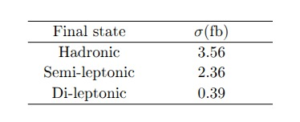
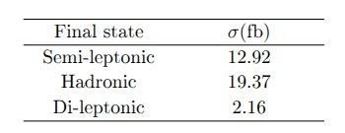

Cross section(s) studies:
The $t\overline{t}γ$ couplings at $e^{−}p$
Photoproduction

Slide 5



Cross section(s) studies in photo-production: $γp→t\overline{t}$ [semi-leptonic top-decay]
$$t→W^{+} \left(→ℓ^{+}ν_{ℓ}/jj \right)b$$
$$\overline{t}→W^{−} \left(→{jj/ℓ}^{−}ν_{ℓ} \right)b ̅$$
$$ℓ^{±}=e^{±}, μ^{±}$$

Slide 6
Cross section(s) studies: photo-production: $γp→t\overline{t}$ [hadronic & di-leptonic top-decay]
$$t→W^{+} \left(→ℓ^{+}ν_{ℓ}/jj \right)b$$
$$\overline{t}→W^{−} \left(→{jj/ℓ}^{−}ν_{ℓ} \right)b ̅$$
$$ℓ^{±}=e^{±}, μ^{±}$$

Slide 7
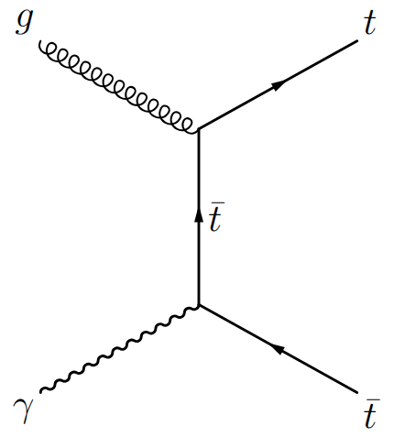

Significance studies:
photo-production: $γp→t\overline{t}$ [di-leptonic & semi-leptonic top-decay]
$$N_{SD}=S/\sqrt{S+B+{\left(δ_{S}⋅S\right)}^{2}+{\left(δ_{S}⋅B\right)}^{2}}$$

Slide 8
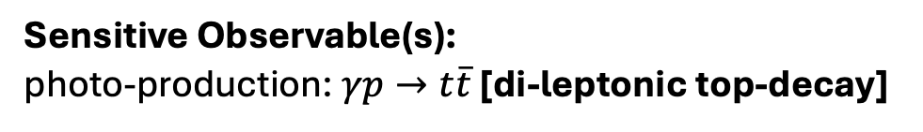
Sensitive Observable(s):
photo-production: $γp→t\overline{t}$ [di-leptonic top-decay]
Analysis and Results:
The dependence of the inclusive and differential cross sections on the BSM couplings can be modelled as a quadratic function:

Slide 9
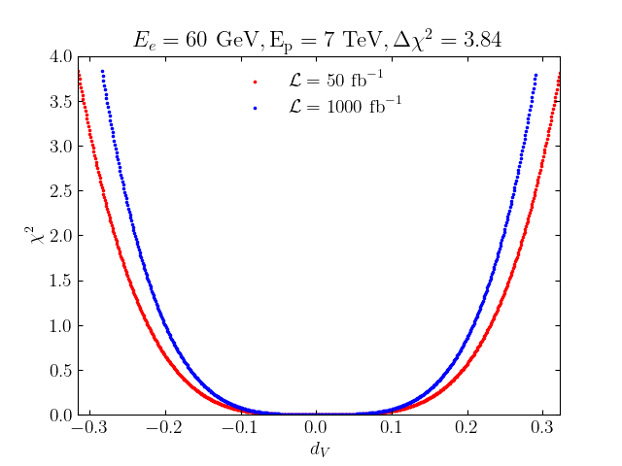
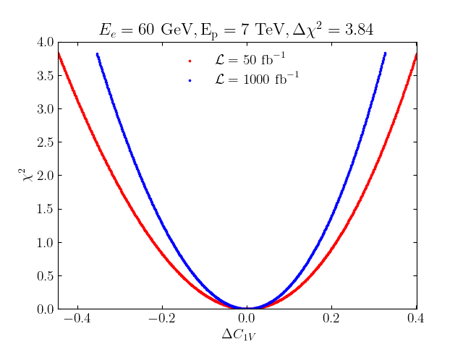
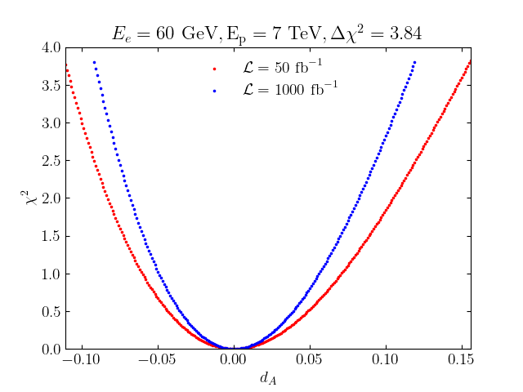
Analysis and Results:
+
photo-production: $γp→t\overline{t}$ [di-leptonic top-decay]

Slide 10
Sensitive Observable(s): photo-production: $γp→t\overline{t}$ [semi-leptonic top-decay]

Slide 11
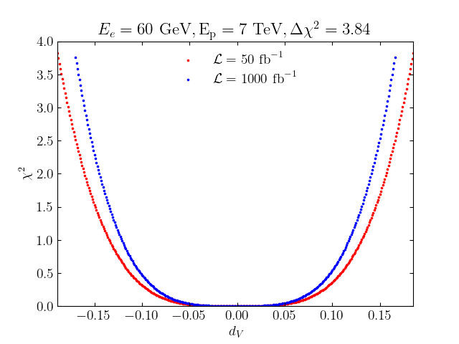
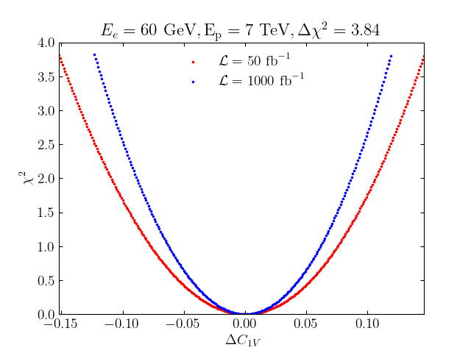
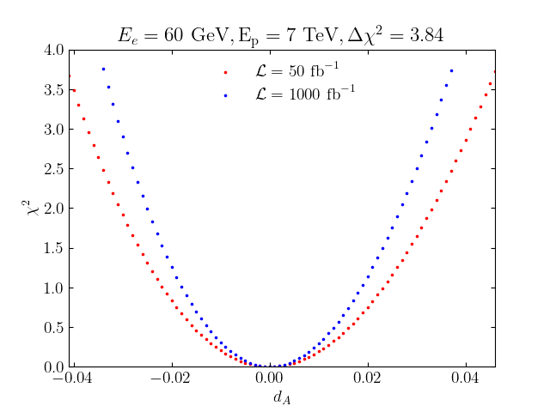
Analysis and Results:
+
photo-production: $γp→t\overline{t}$ [semi-leptonic top-decay]

Slide 12
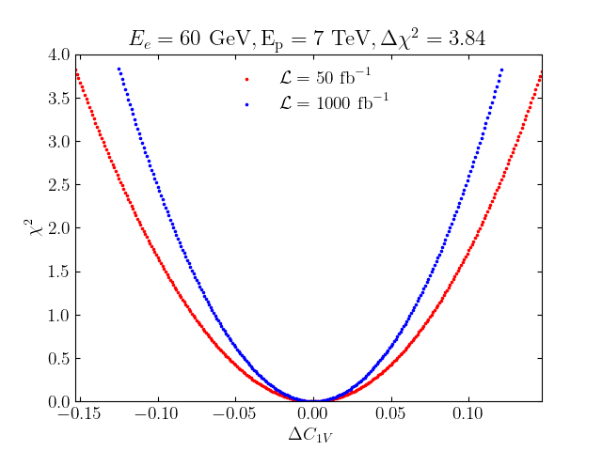
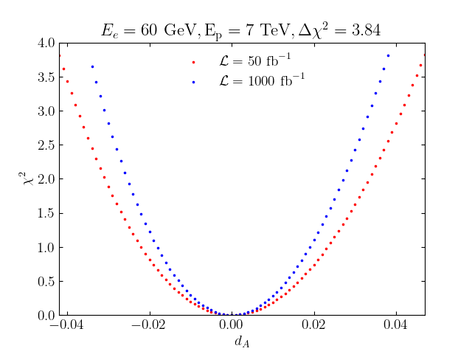
Analysis and Results:
+
photo-production: $γp→t\overline{t}$ [semi-leptonic top-decay]

Slide 13
Analysis and Results:
+
photo-production: $γp→t\overline{t}$ [semi-leptonic top-decay]

Slide 14
Results: Limits at 95% CL):
+

Slide 15
Conclusions and way forward:
The differential analysis is used to probe the sensitivity of couplings in SM as well as BSM in the photo-production mode for di-leptonic and semi-leptonic decay channels.
As the integrated luminosity increases from 50 fb⁻¹ to 1000 fb⁻¹, the bounds on ∆C_{1V} improve by ~35% in the di-leptonic channel, and ~18% in the semi-leptonic channel,
The bounds on dV improve by ~10% for both decay channels when moving from 50 fb⁻¹ to 1000 fb⁻¹, while dA improves by ~21% and ~18.5% for the di-leptonic and semi-leptonic channels respectively.
Compared to previous constraints as outlined in arXiv:1308.5634 obtained for LHeC @ 100 fb⁻¹, our constraints on dV are ~84% times wider for the di-leptonic channel at both 50 fb⁻¹ and 1000 fb⁻¹ luminosities.
In the semi-leptonic channel, our bounds on dV are ~70% wider than the LHeC results for both luminosities.

Slide 16
Conclusions and way forward:
On the hand, our constraints on dA are more stringent than the ones reported for LHeC @ 100 fb⁻¹.
At the integrated luminosity of 50 fb⁻¹, our limits are ~50% and 360% tighter than the LHeC limits for the di-leptonic channel and semileptonic channel respectively.
At 1000 fb⁻¹, the limits on dA are ~90% and ~460% tighter than the LHeC limits @100 fb⁻¹ luminosity for the di-leptonic and semi-leptonic channels respectively.
The study is currently in the preliminary stage and further investigation are underway.
Various other observables such at the spin correlation and asymmetry of the top quarks are currently under consideration in order to improve the constraints on the coupling parameter.
Correlation among the coupling parameters is under investigation (Correlation Matric).
Thank you!

