Slide 1



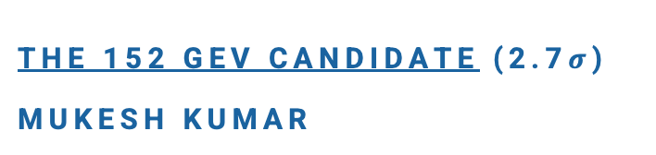
Radiative Signature of New Scalar Boson Decays in the $m_{ℓℓγ}$ Spectrum at the LHC
Pramod Sharma, Arnav Chauhan,
Mukesh Kumar, Andreas Crivellin,
Sukanta Dutta, Rachid Mazini and
Bruce Mellado arXiv: 2606.24801
The 152 GeV candidate (2.7$σ$)
Mukesh Kumar

Slide 2
[1] JHEP 04 (2026) 086

Slide 3
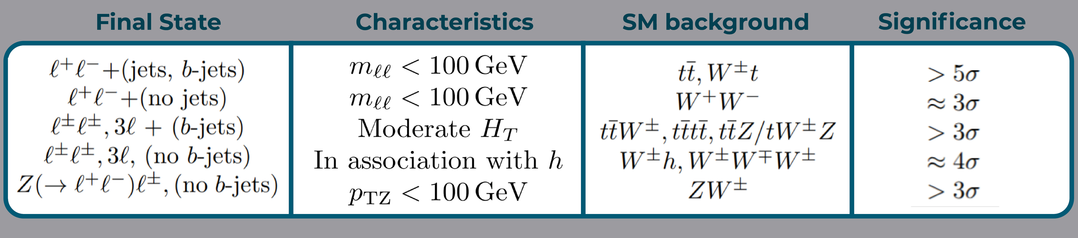
LHC Multi-Lepton Anomalies ($eμ(+b)$)
The “multi-lepton anomalies”, are LHC processes with two or more leptons in the final state, with and without b-jets, where statistically significant disagreements with the SM predictions have been observed.
Some of the excesses already emerged with Run-1 data (2011-2012) of ATLAS and CMS.
They were confirmed by independent and larger data sets taken during Run-2 leading to disagreements with the SM, exceeding the 5σ threshold:
Nature Rev.Phys. 6 (2024) 5, 294-309

Slide 4
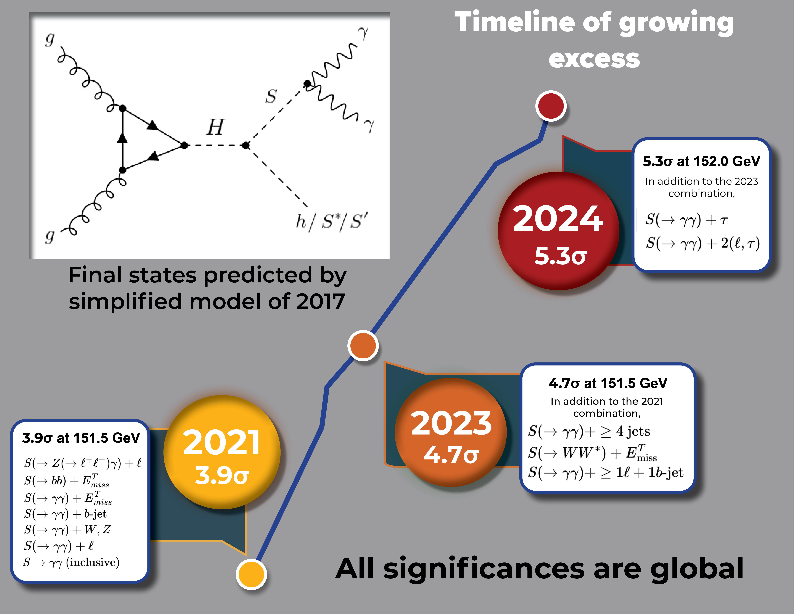
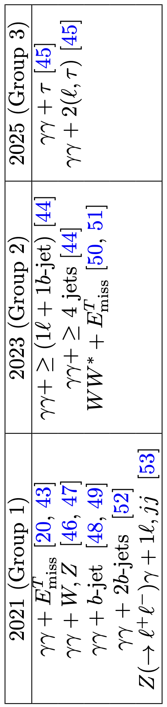

S.Battacharya, et al. 2503.16245
Multilepton Anomalies predict Scalar S of
mass 152$±$5 GeV candidate

Slide 5
1603.01208
1606.01674
1608.03466
J.Phys.Conf.Ser. 802 (2017)
1706.06659
1707.05997
1709.09419
1711.07874
1809.06344
1901.05300
1909.03969
1912.00699
2102.10596
2109.02650
2208.14767
2306.17209
2404.07822
2503.16245
2509.14378

Slide 6
The Timeline
Currently, continue to accumulate excesses at 152±1 GeV and exploring Triplet Y=0 leading to triboson excesses

Slide 7
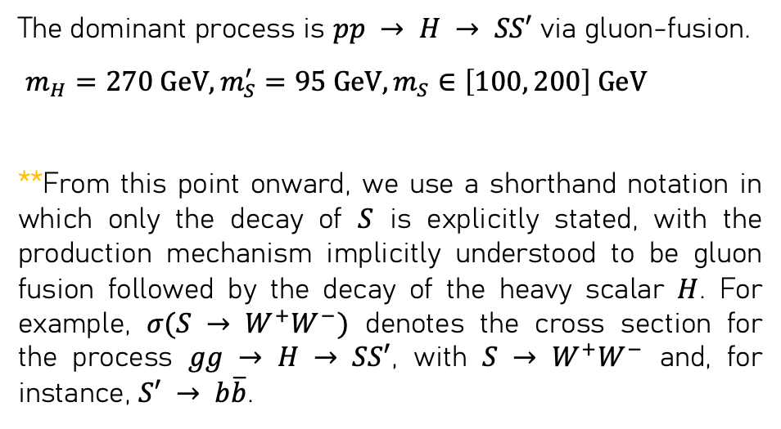
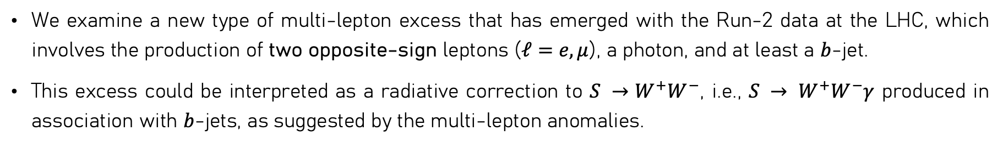
Emergence of New Type of multilepton excess
We examine a new type of multi-lepton excess that has emerged with the Run-2 data at the LHC, which involves the production of two opposite-sign leptons ($ℓ=e, μ$), a photon, and at least a $b$-jet.
This excess could be interpreted as a radiative correction to $S →W^{+}W^{−}$, i.e., $S → W^{+}W^{−}γ$ produced in association with $b$-jets, as suggested by the multi-lepton anomalies.
The dominant process is $pp → H → SS′$ via gluon-fusion.
$m_{H}=270 GeV, m_{S}^{′}=95 GeV, m_{S}∈\left[100, 200\right] GeV$
**From this point onward, we use a shorthand notation in which only the decay of $S$ is explicitly stated, with the production mechanism implicitly understood to be gluon fusion followed by the decay of the heavy scalar $H$. For example, $σ(S → W^{+}W^{−})$ denotes the cross section for the process $gg → H → SS′$, with $S → W^{+}W^{−}$ and, for instance, $S′ → b\overline{b}$.

Slide 8

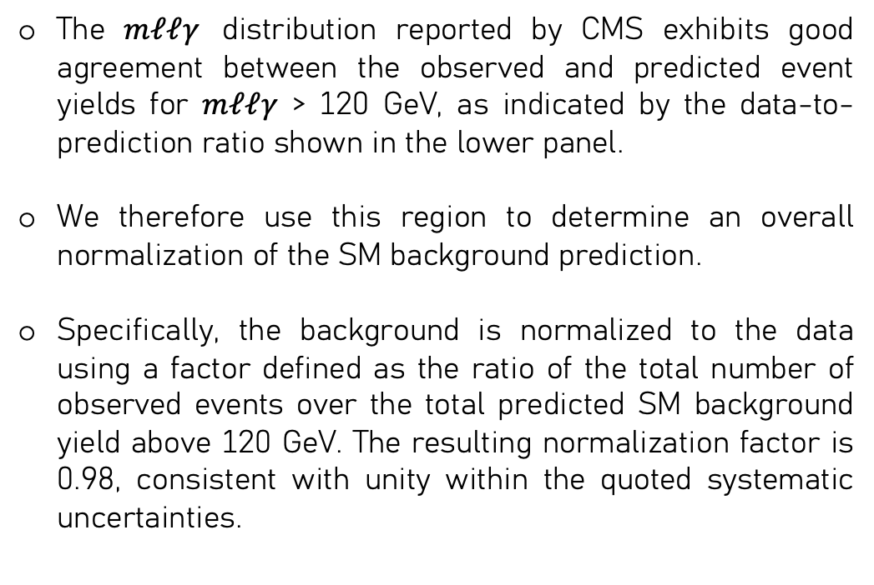
Dataset: [CMS Collaboration] Inclusive and differential measurements of the $t\overline{t}γ$ cross section and the $t\overline{t}γ/t\overline{t}$ cross section ratio in proton-proton collisions at √s= 13 TeV
The $mℓℓγ$ distribution reported by CMS exhibits good agreement between the observed and predicted event yields for $mℓℓγ$ > 120 GeV, as indicated by the data-to-prediction ratio shown in the lower panel.
We therefore use this region to determine an overall normalization of the SM background prediction.
Specifically, the background is normalized to the data using a factor defined as the ratio of the total number of observed events over the total predicted SM background yield above 120 GeV. The resulting normalization factor is 0.98, consistent with unity within the quoted systematic uncertainties.
Ref.[1] JHEP 04 (2026) 086
Figure 4-b:
Distributions of the invariant mass of the two leptons + photon system, for events with two same-flavour leptons, as estimated by the simulation before the fit.

Slide 9
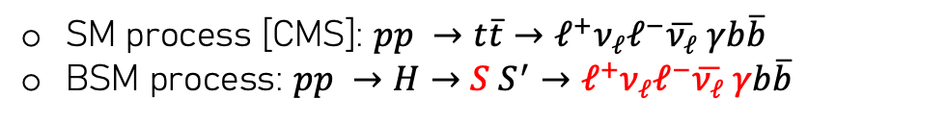
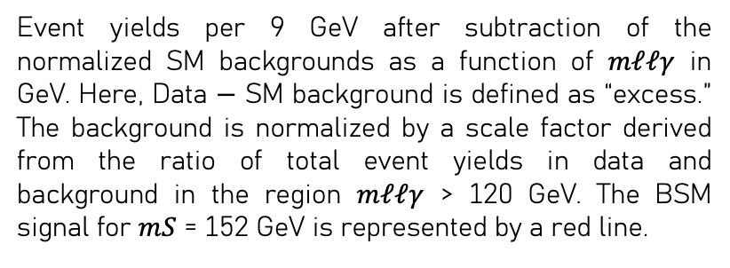
Dataset: Beyond the Standard Model (BSM) interpretation/fit
SM process [CMS]: $pp →t\overline{t}→ℓ^{+}ν_{ℓ}ℓ^{−}\overline{ν_{ℓ}} γb\overline{b}$
BSM process: $pp →H→S S^{′}→ℓ^{+}ν_{ℓ}ℓ^{−}\overline{ν_{ℓ}} γb\overline{b}$
Event yields per 9 GeV after subtraction of the normalized SM backgrounds as a function of $mℓℓγ$ in GeV. Here, Data − SM background is defined as “excess.” The background is normalized by a scale factor derived from the ratio of total event yields in data and background in the region $mℓℓγ$ > 120 GeV. The BSM signal for $mS$ = 152 GeV is represented by a red line.

Slide 10
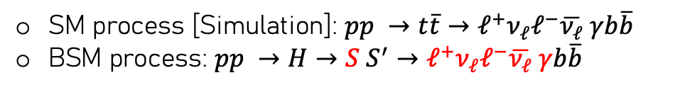
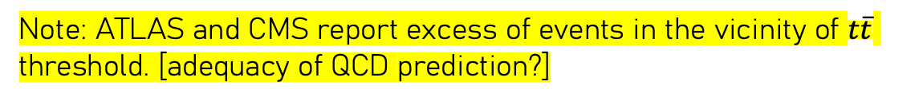
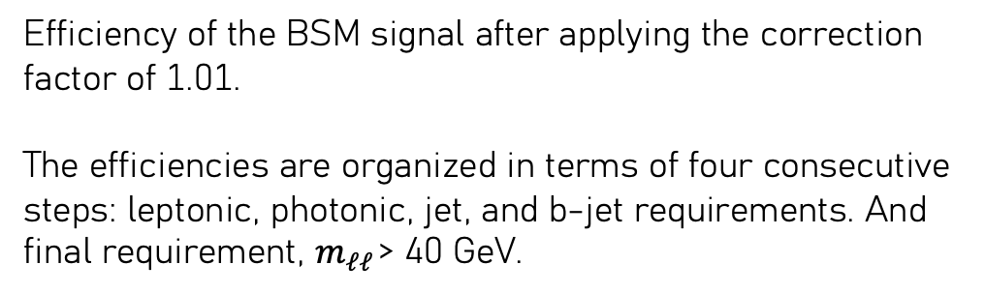
Dataset: Beyond the Standard Model (BSM) Selection efficiency
SM process [Simulation]: $pp →t\overline{t}→ℓ^{+}ν_{ℓ}ℓ^{−}\overline{ν_{ℓ}} γb\overline{b}$
BSM process: $pp →H→S S^{′}→ℓ^{+}ν_{ℓ}ℓ^{−}\overline{ν_{ℓ}} γb\overline{b}$
Efficiency of the BSM signal after applying the correction factor of 1.01.
The efficiencies are organized in terms of four consecutive steps: leptonic, photonic, jet, and b-jet requirements. And final requirement, $m_{ℓℓ}$ > 40 GeV.
Note: ATLAS and CMS report excess of events in the vicinity of $t\overline{t}$ threshold. [adequacy of QCD prediction?]
clearly strong overestimate of missing threshold effects
Interpreted as “toponium”. $σ\left(pp→η_{t}→t\overline{t}γ\right)={8.8}_{−1.4}^{+1.2} pb.$
Even with such a large cross-section impact on the $ℓℓγ (→m_{ℓℓγ})$ final state is very small

Slide 11
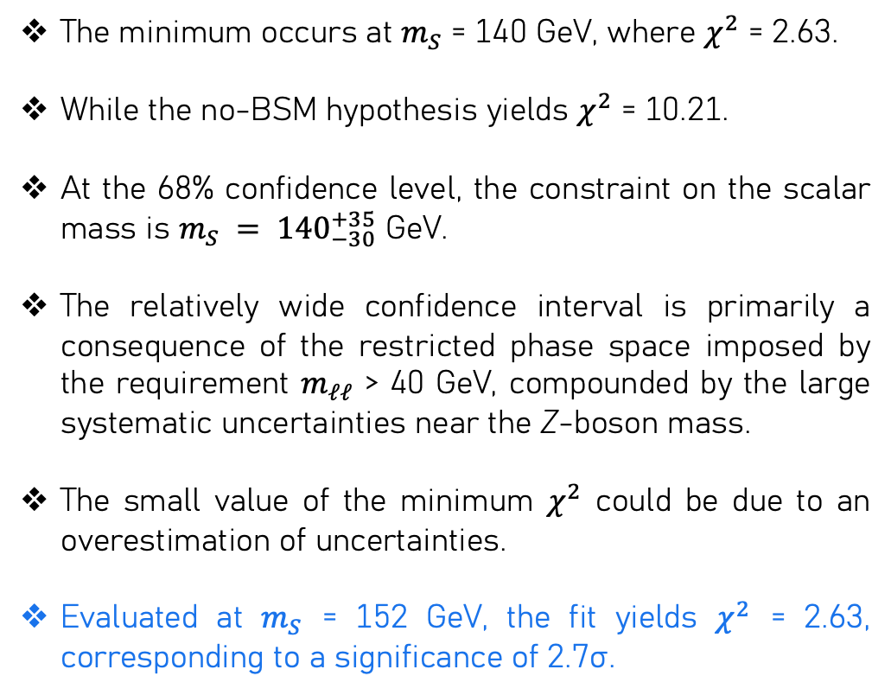
Results: Mass measurement
The minimum occurs at $m_{S}$ = 140 GeV, where $χ^{2}$ = 2.63.
While the no-BSM hypothesis yields $χ^{2}$ = 10.21.
At the 68% confidence level, the constraint on the scalar mass is $m_{S} = {140}_{−30}^{+35}$ GeV.
The relatively wide confidence interval is primarily a consequence of the restricted phase space imposed by the requirement $m_{ℓℓ}$ > 40 GeV, compounded by the large systematic uncertainties near the Z-boson mass.
The small value of the minimum $χ^{2}$ could be due to an overestimation of uncertainties.
Evaluated at $m_{S}$ = 152 GeV, the fit yields $χ^{2}$ = 2.63, corresponding to a significance of 2.7σ.

Slide 12
Conclusion(s): Mass measurements of Scalar Candidate around 150 GeV
The result provides additional support for the hypothesis of a narrow resonance near 152 GeV corresponding to an additional significance of 2.7σ.

Slide 13
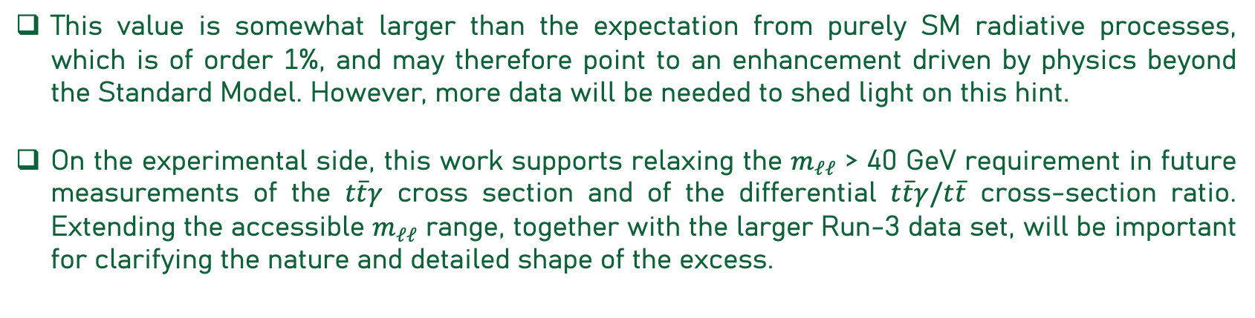
Conclusion(s): Cross-section Ratio of Scalar Candidate = 150 GeV
We also determine the ratio σ(S → W⁺W⁻γ)/σ(S → W⁺W ⁻) = 2.14 ± 0.77%, which is larger than expected from radiative corrections induced by SM processes alone.
This value is somewhat larger than the expectation from purely SM radiative processes, which is of order 1%, and may therefore point to an enhancement driven by physics beyond the Standard Model. However, more data will be needed to shed light on this hint.
On the experimental side, this work supports relaxing the $m_{ℓℓ}$ > 40 GeV requirement in future measurements of the $t\overline{t}γ$ cross section and of the differential $t\overline{t}γ/t\overline{t}$ cross-section ratio. Extending the accessible $m_{ℓℓ}$ range, together with the larger Run-3 data set, will be important for clarifying the nature and detailed shape of the excess.
Thank you.

