Slide 1


Enhancing sensitivity to tWZ production in the four-lepton channel with the ATLAS detector using machine learning
Kevin Barends
University of Cape Town
SAIP 2026

Slide 2
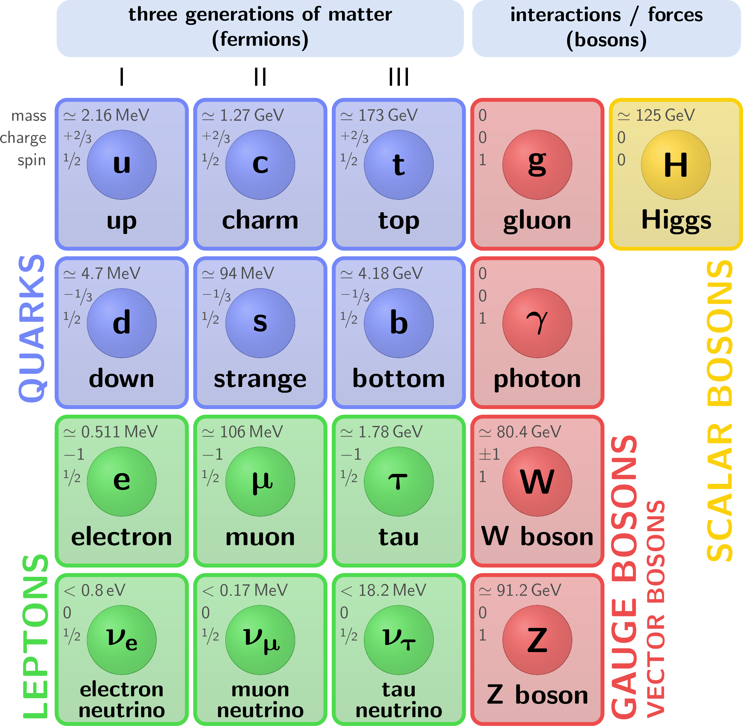
Standard Model of Particle Physics
Describes the building blocks of matter (fermions) and how these building blocks interact (bosons)
Bosons:
  Photon – mediator for the electromagnetic force
  Gluon – mediator for the strong nuclear force
  W & Z – mediators for the weak nuclear force
  Higgs – responsible for giving particles mass
Fermions:
  Leptons
    Electron, Muon, Tau
    Neutrinos: Electron-/Muon-/Tau-neutrino
  Quarks
    Up-type: Up, Charm, Top
    Bottom-type: Down, Strange, Bottom

Slide 3



The tWZ process
Three specific fundamental particles:
W & Z boson and top quark
Each known very well individually
tW, tZ, WZ extensively studied
tWZ not well studied – only recently observed by CMS (March 2026)
Never been observed by ATLAS
Motivation:
Electroweak Force Precision: Measures top quark interactions with W & Z bosons
Multi-Boson Dynamics: Probes complex particle scattering behaviors
Standard Model Validation: Confirms predictions of rarest interactions
New Physics Search: Deviations signal undiscovered particle phenomena.

Slide 4
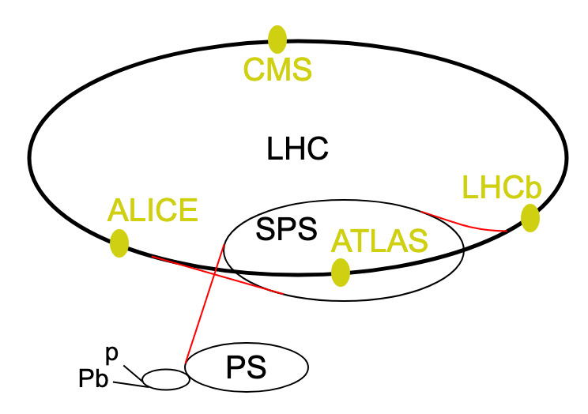
CERN & LHC
Many accelerators feed into each other to speed up particles to almost the speed of light
The largest is the Large Hadron Collider (or LHC)
  27 km ring
  4 major experiments (and detectors) sit along the ring
    ATLAS, CMS – general purpose, wide range of physics
    ALICE – heavy ion collisions, quark-gluon plasma studies
    LHCb – heavy-flavour quark studies
Types of collisions:
  Proton-proton collisions
  Lead-Lead
  Proton-Lead/Oxygen

Slide 5
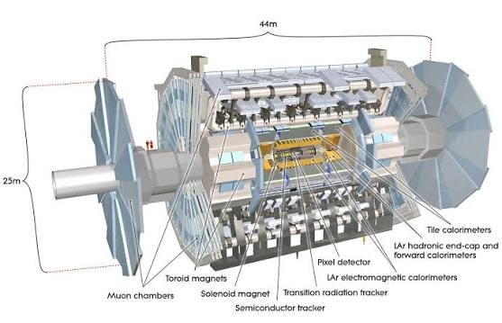
ATLAS detector
Many sub-detectors:
Inner Detector
  Measure tracks of particles
  Identify vertices
  Help in identifying types of particles
Electromagnetic Calorimeter
  Stop electromagnetic particles by absorbing their energy
  Specifically, to identify electrons and photons
Hadronic Calorimeter
  Stop hadrons by absorbing their energy
  Identify all sort of hadrons, including quarks
Muon Spectrometer
  Measure tracks of muons
  Identify muons

Slide 6
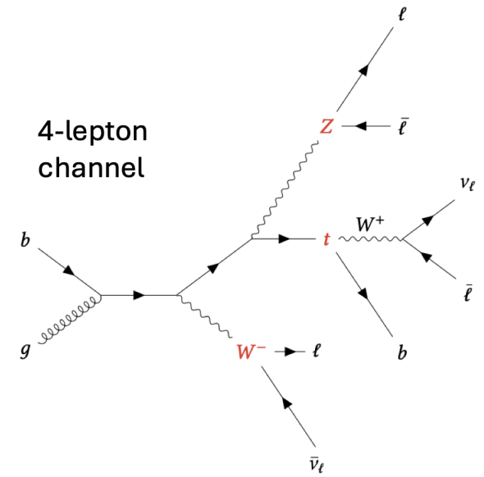
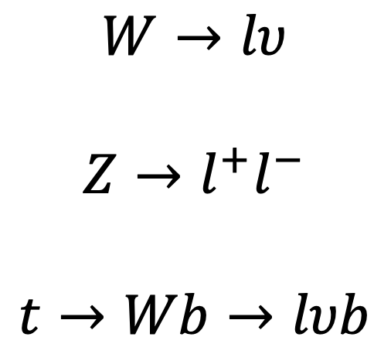
tWZ four-lepton decay channel
$$W→lυ$$
$$Z→l^{+}l^{−}$$
$$t→Wb→lυb$$
Cleaner signal due to low background rate of rare 4-lepton processes
However, statistically limited.

Slide 7
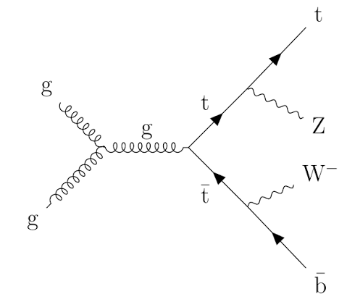
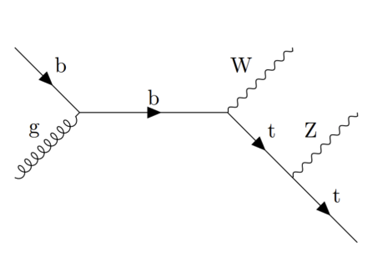
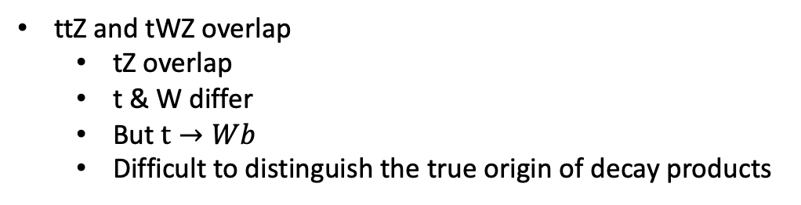
tWZ overlap with ttZ
ttZ and tWZ overlap
  tZ overlap
  t & W differ
  But $t→Wb$
  Difficult to distinguish the true origin of decay products

Slide 8
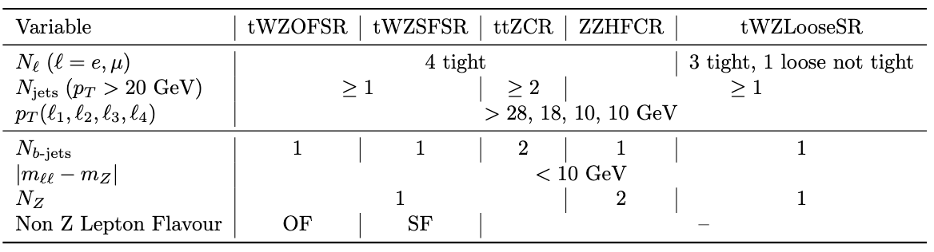
Signal and Control regions

Slide 9
Region contributions
tWZOFSR
  Minor contribution from tWZ and other backgrounds
  Dominated by ttZ
tWZSFSR
  Minor contribution from tWZ
  Dominated by ttZ and other backgrounds
tWZLooseSR
  Minor contribution from tWZ
  Dominated by ttZ and other backgrounds
ttZCR
  Dominated by ttZ
  Minor contributions from tWZ and other backgrounds
ZZHFCR
  Dominated by ZZ+b/c
  Minor contributions from tWZ and other backgrounds
WORK IN PROGRESS

Slide 10
Number of Jets
WORK IN PROGRESS
WORK IN PROGRESS
WORK IN PROGRESS
WORK IN PROGRESS
WORK IN PROGRESS
ttZ CR & ZZ CR:
  Reasonable data and simulation agreement

Slide 11
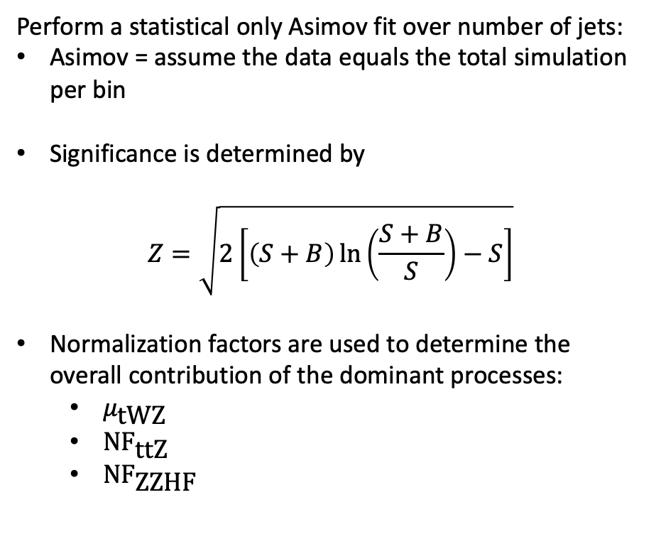

Asimov signal significance using number of jets
Perform a statistical only Asimov fit over number of jets:
Asimov = assume the data equals the total simulation per bin
Significance is determined by
$$Z=\sqrt{2\left[\left(S+B\right)\ln\left(\frac{S+B}{S}\right)−S\right]}$$
Normalization factors are used to determine the overall contribution of the dominant processes:
  $μ_{\text{tWZ}}$
  ${\text{NF}}_{\text{ttZ}}$
  ${\text{NF}}_{\text{ZZHF}}$
$$Z=1.02$$
Large uncertainty on signal strength
  Due to limited statistics
Reasonably low uncertainty on ttZ and ZZHF

Slide 12
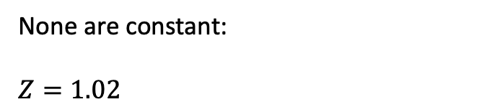
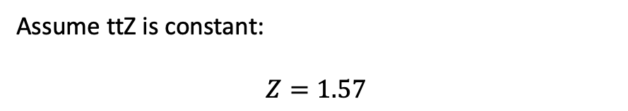
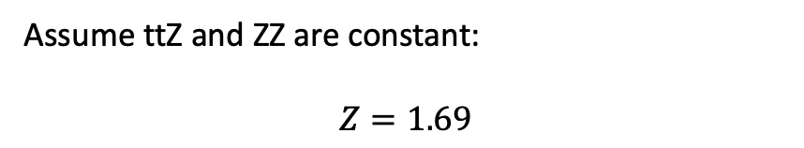
A deeper look into signal significance
Assume ttZ and ZZ are constant:
$$Z=1.69$$
Assume ttZ is constant:
$$Z=1.57$$
None are constant:
$$Z=1.02$$
ttZ normalization factor has the biggest impact on the signal significance
We need to find a better way to separate tWZ and ttZ

Slide 13
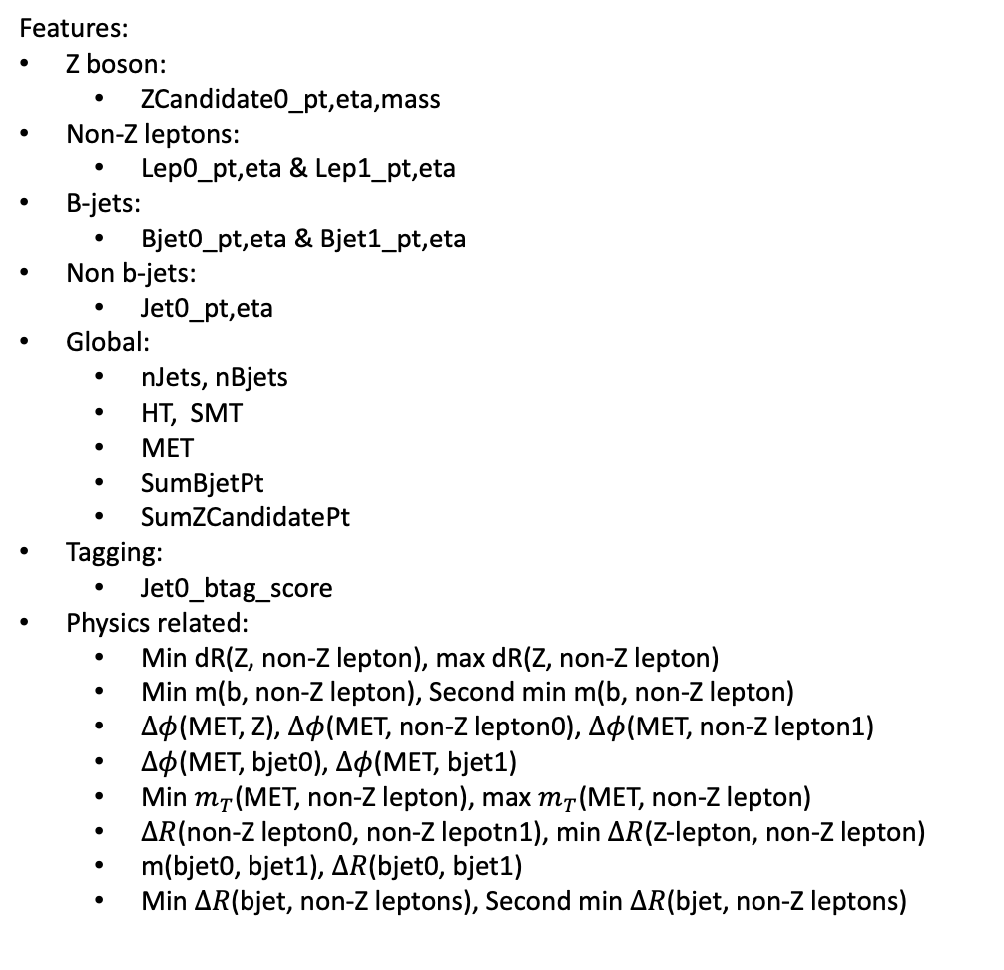
Machine learning: DNN
Features:
Z boson:
  ZCandidate0_pt,eta,mass
Non-Z leptons:
  Lep0_pt,eta & Lep1_pt,eta
B-jets:
  Bjet0_pt,eta & Bjet1_pt,eta
Non b-jets:
  Jet0_pt,eta
Global:
  nJets, nBjets
  HT, SMT
  MET
  SumBjetPt
  SumZCandidatePt
Tagging:
  Jet0_btag_score
Physics related:
  Min dR(Z, non-Z lepton), max dR(Z, non-Z lepton)
  Min m(b, non-Z lepton), Second min m(b, non-Z lepton)
  $∆φ$(MET, Z), $∆φ$(MET, non-Z lepton0), $∆φ$(MET, non-Z lepton1)
  $∆φ$(MET, bjet0), $∆φ$(MET, bjet1)
  Min $m_{T}$(MET, non-Z lepton), max $m_{T}$(MET, non-Z lepton)
  $∆R$(non-Z lepton0, non-Z lepotn1), min $∆R$(Z-lepton, non-Z lepton)
  m(bjet0, bjet1), $∆R$(bjet0, bjet1)
  Min $∆R$(bjet, non-Z leptons), Second min $∆R$(bjet, non-Z leptons)
Approach:
Regions: tWZOFSR, tWZSFSR, tWZLooseSR, ttZCR
4-class model
  tWZ, ttZ, ZZ, other
4-fold using event numbers
  Train = 50%
  Validation = 25%
  Test = 25%
Hyperparameter tuning:
Determined best hyperparameters 25% of the data
Different:
  Number of layers
  Number of nodes per layer
  Learning rates
  Dropout rates
  Batch sizes
  The use of batch normalization of not
Determined best model based on highest asimov significance

Slide 14

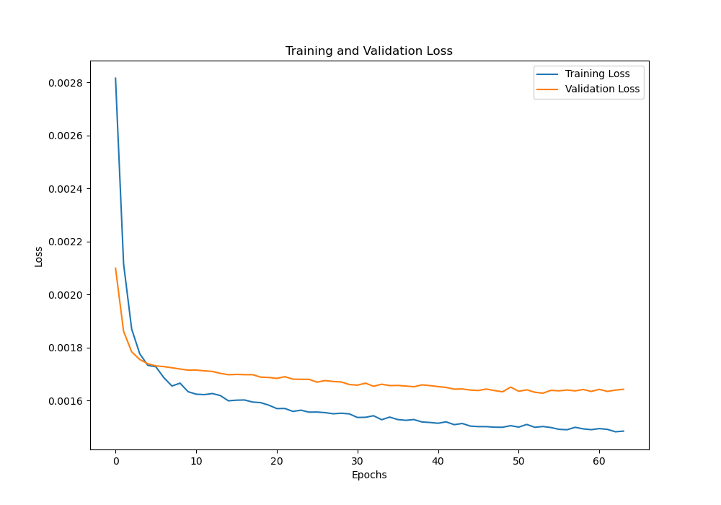
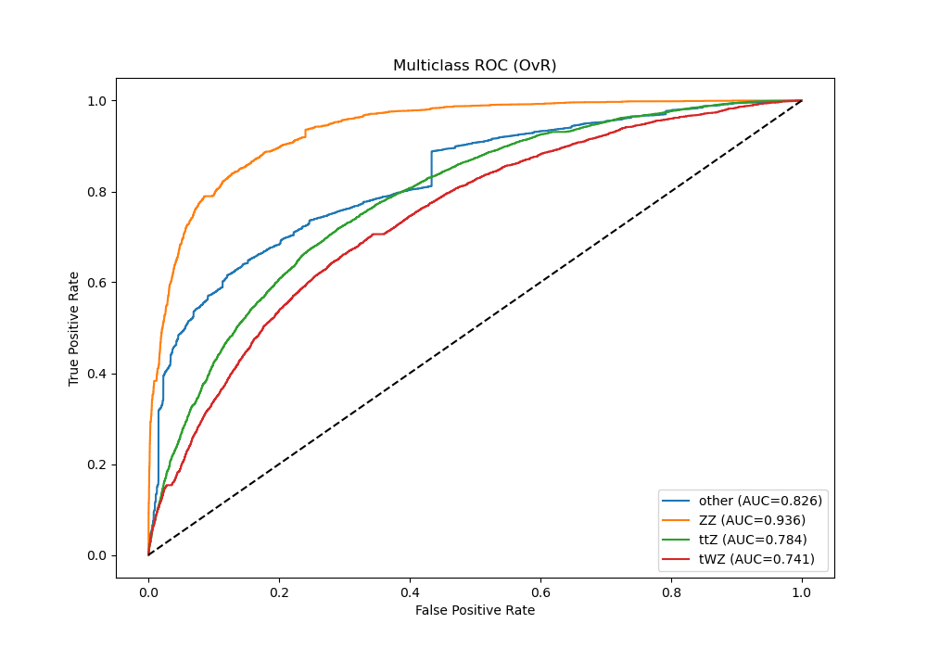
Best model from hyperparameter tuning
Input layer:
38 nodes
Output layer:
4 | Softmax
Early stopping (10 epochs)
  Restore to best weights
Learning rate = 0.001
2 hidden layers:
64 nodes & 32 nodes
Batch size: 256
Dropout rate: 0.2
BatchNormalization
Relu activation

Slide 15
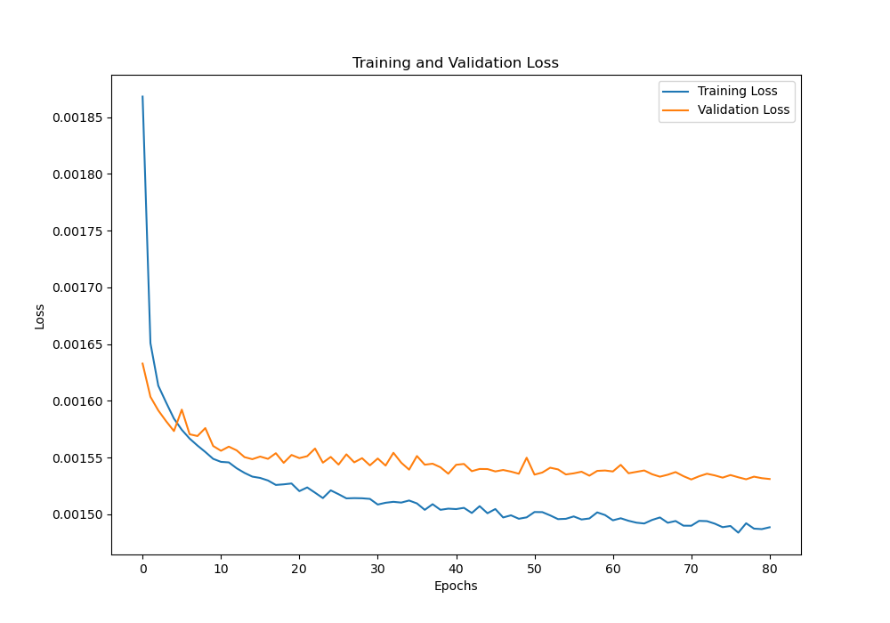
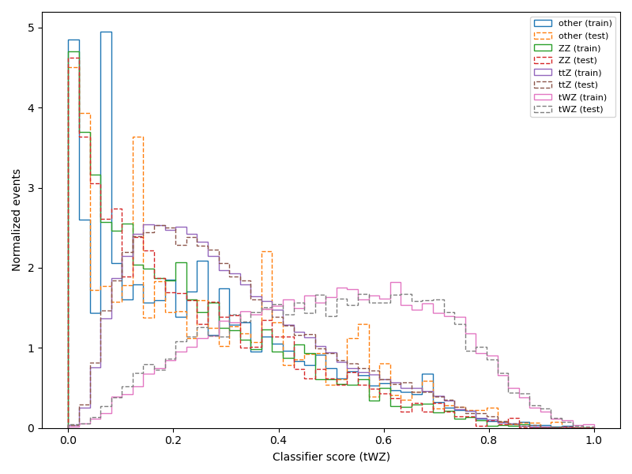
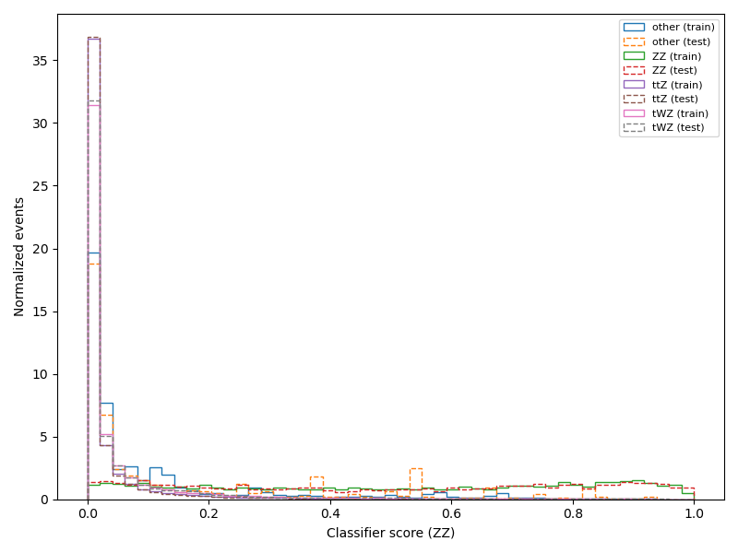

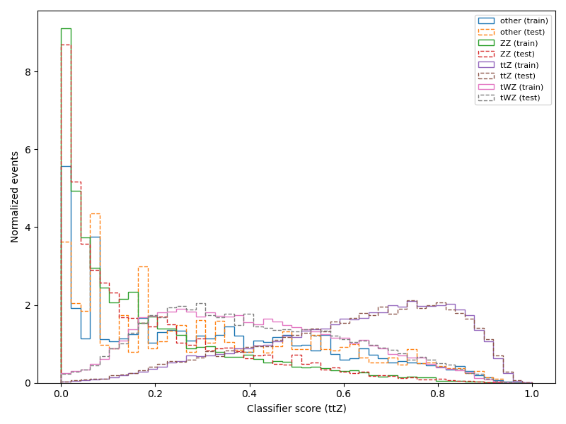
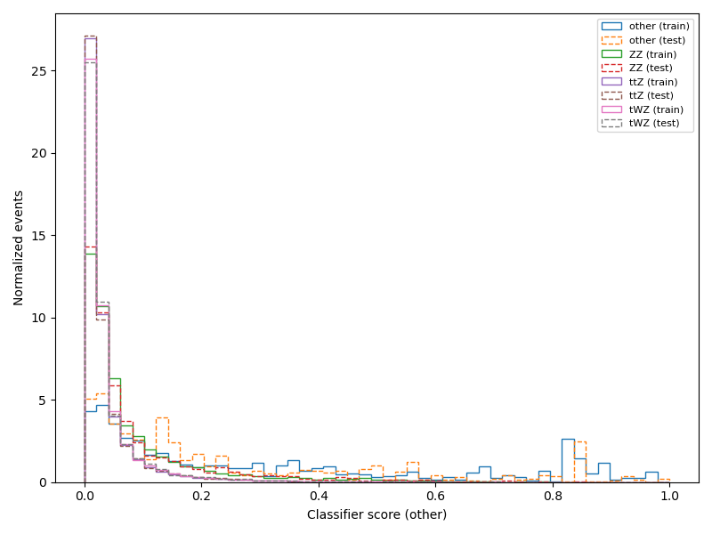
Training results on full data from one-fold

Slide 16
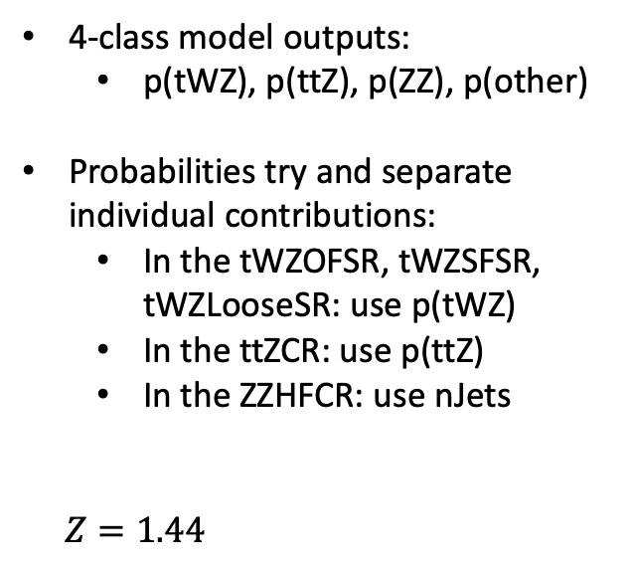
Asimov signal significance using DNN output
4-class model outputs:
  p(tWZ), p(ttZ), p(ZZ), p(other)
Probabilities try and separate individual contributions:
  In the tWZOFSR, tWZSFSR, tWZLooseSR: use p(tWZ)
  In the ttZCR: use p(ttZ)
  In the ZZHFCR: use nJets
$Z=1.44$
WORK IN PROGRESS
WORK IN PROGRESS
WORK IN PROGRESS
WORK IN PROGRESS
WORK IN PROGRESS

Slide 17


Comparison between number of jets and DNN output
Massive improvement in:
  Signal significance when using DNN output
  Uncertainty in signal strength
Minor improvement in uncertainty in ttZ normalization factor
$$Z=1.02$$
$$Z=1.44$$
Number of jets
DNN output

Slide 18

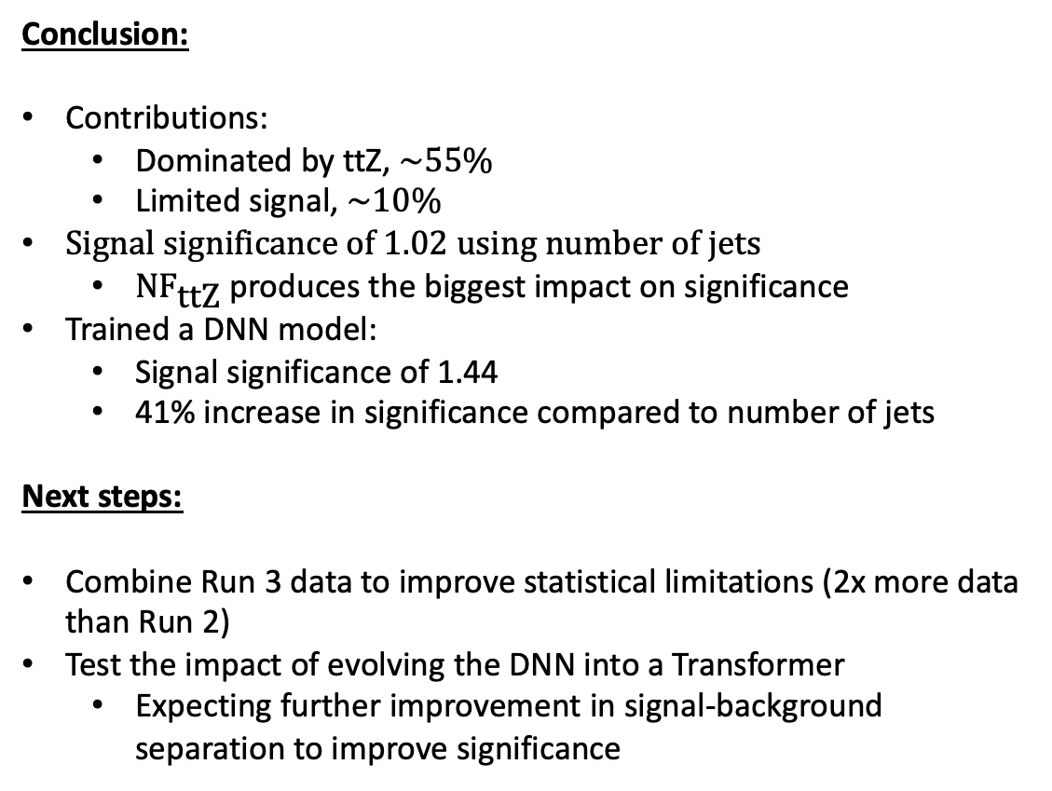
Conclusion and Next steps
Conclusion:
Contributions:
  Dominated by ttZ, $\sim 55\%$
  Limited signal, $\sim 10\%$
Signal significance of 1.02 using number of jets
  ${\text{NF}}_{\text{ttZ}}$ produces the biggest impact on significance
Trained a DNN model:
  Signal significance of 1.44
  41% increase in significance compared to number of jets
Next steps:
Combine Run 3 data to improve statistical limitations (2x more data than Run 2)
Test the impact of evolving the DNN into a Transformer
  Expecting further improvement in signal-background separation to improve significance

Slide 19
Thank you

Slide 20
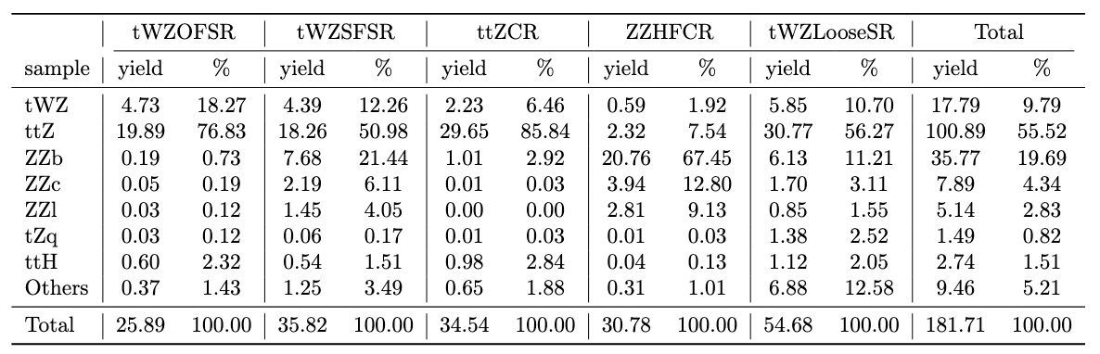
Yields

