Slide 1

Studying particle multiplicity observables in p+Pb collisions using the microscopic model (UrQMD 3.3p2) at 300 AGeV.
Presenter : Mr Tendani Oliver Munyai
Supervisors: Dr Thendo Nemakhavhani
: Prof Azwindini Muronga

Slide 2
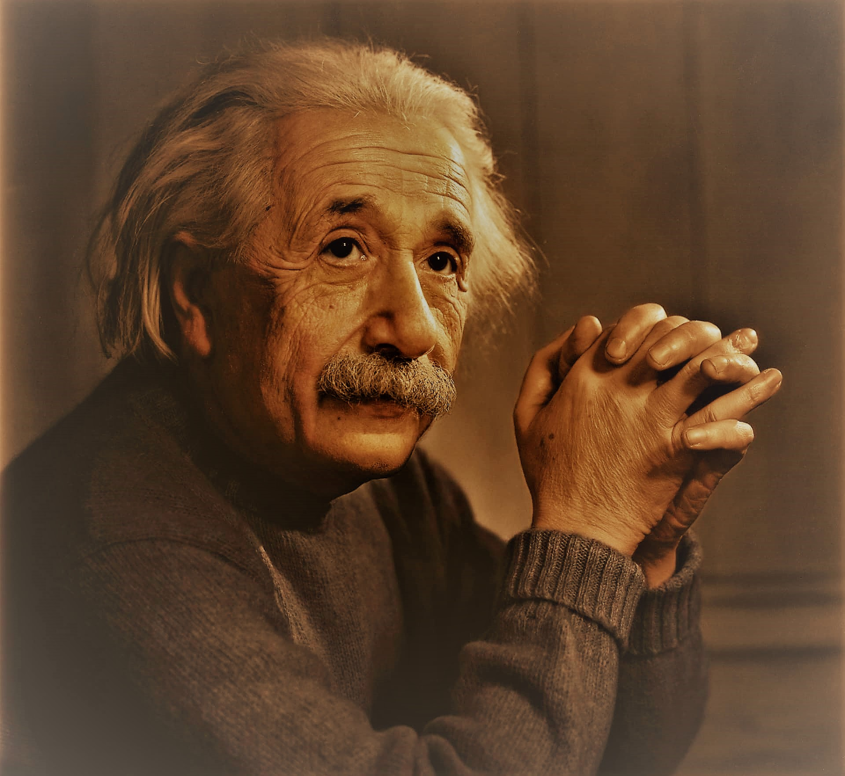

Outline
Aim
Introduction
Motivation
Rapidity distribution
UrQMD 3.3p2 model
UrQMD Model 3.3p2 input and output file
Results and Discussion
Conclusion and Future Work
Reference
Acknowledgement

Slide 3
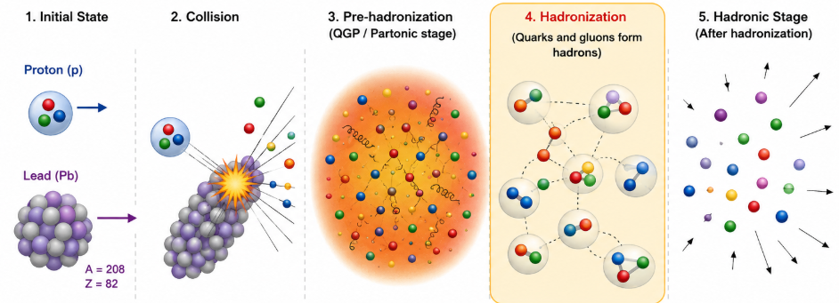
Aim
To investigate the hadronisation stage in p+Pb collisions by studying the rapidity distribution of meson and baryon particles using the UrQMD 3.3p2 model.
Participant particles
Spectators' particles

Slide 4
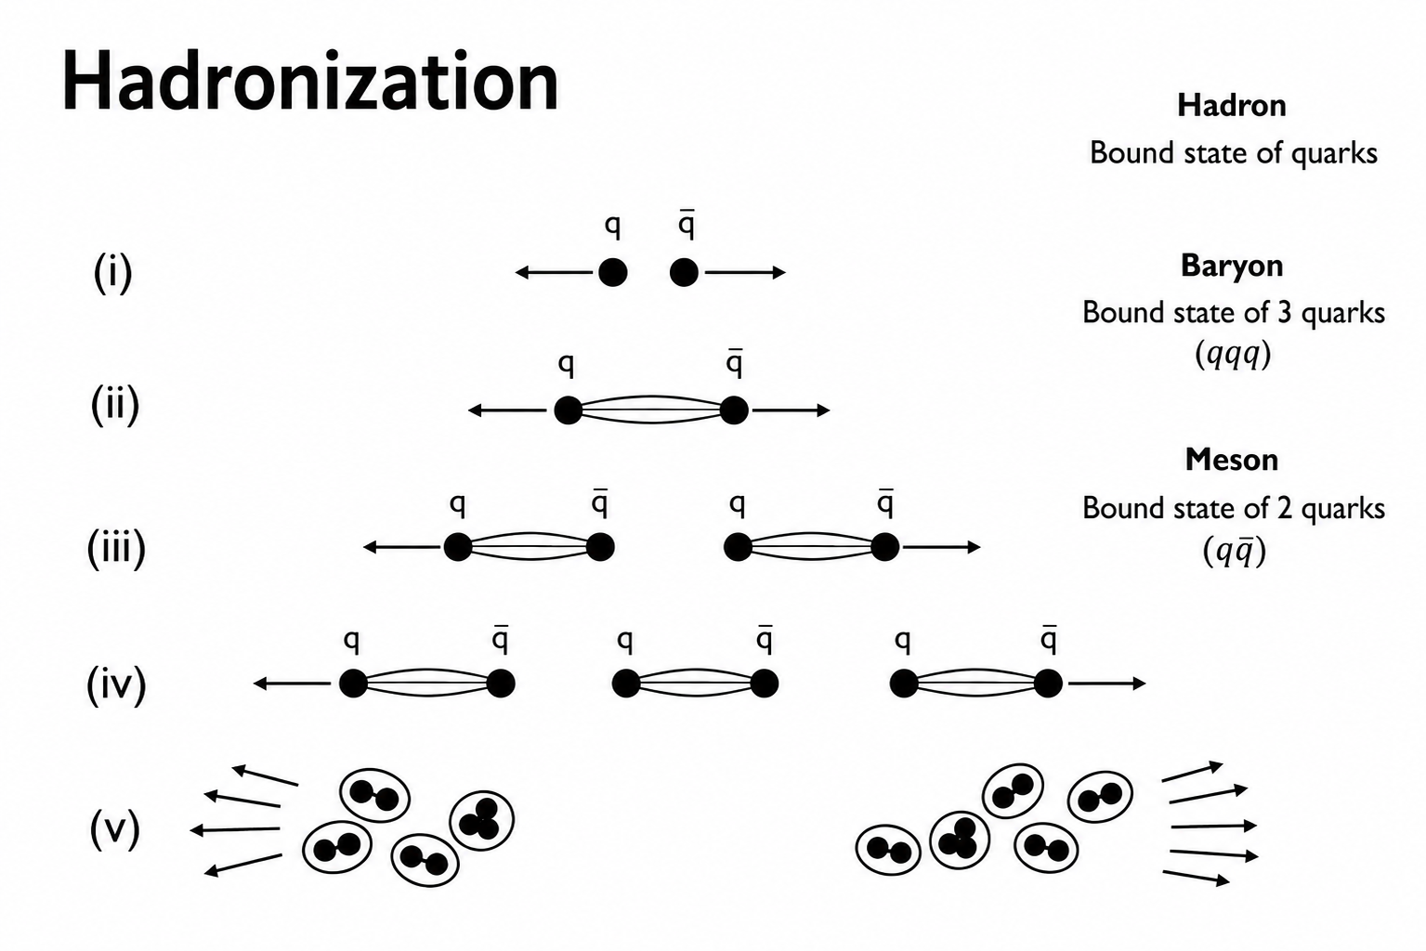
Introduction
After the formation of the quark-gluon plasma (QGP), it will undergo expansion and cooling where the quarks and gluons will combine again to form hadron particles.
Then these particles will arrive at the freeze-out stage where the matter will be formed.

Slide 5

Motivation
p+Pb collisions provide an opportunity to study how strongly interacting matter evolves into ordinary matter.
Studying meson and baryon rapidity distributions at different evolution times provides insight into the time evolution of particle production.
At what evolution time do particle multiplicity and rapidity distributions reach a stable state in p+Pb collisions?
The UrQMD model enables the microscopic simulation of these collision dynamics and the investigation of particle multiplicity throughout the evolution.

Slide 6
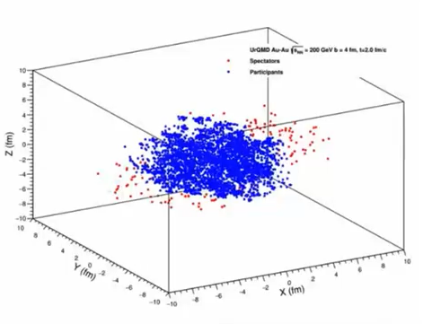
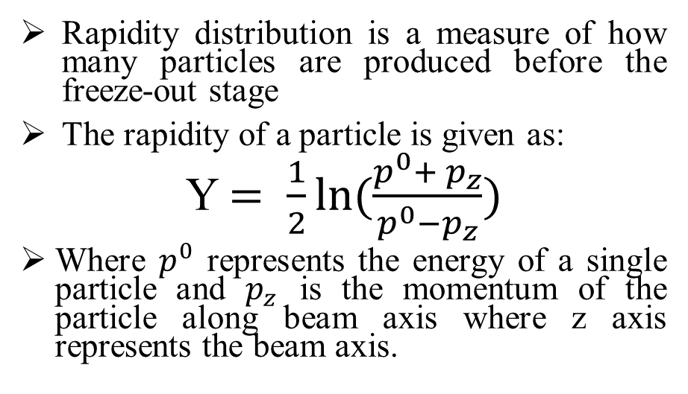
Rapidity distribution
Rapidity distribution is a measure of how many particles are produced before the freeze-out stage
The rapidity of a particle is given as:
Y $= \frac{1}{2}ln⁡(\frac{p^{0}+ p_{z}}{p^{0}−p_{z}})$
Where $p^{0}$ represents the energy of a single particle and $p_{z}$ is the momentum of the particle along beam axis where z axis represents the beam axis.

Slide 7
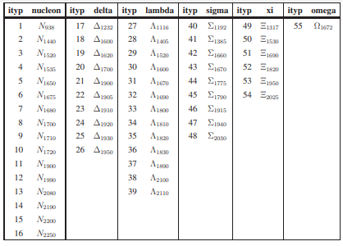
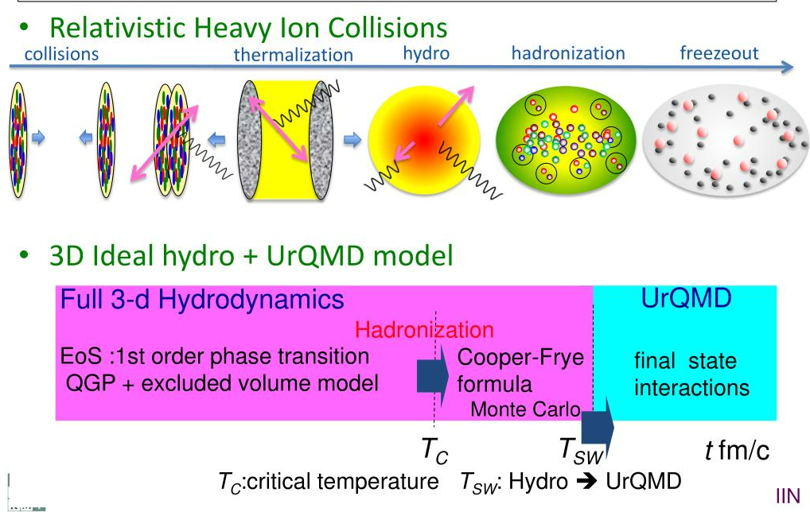
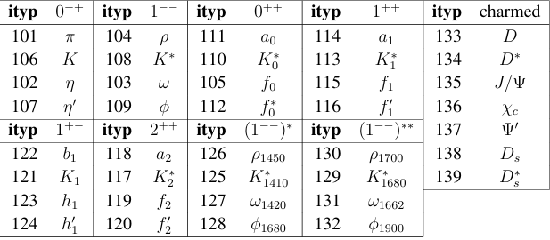
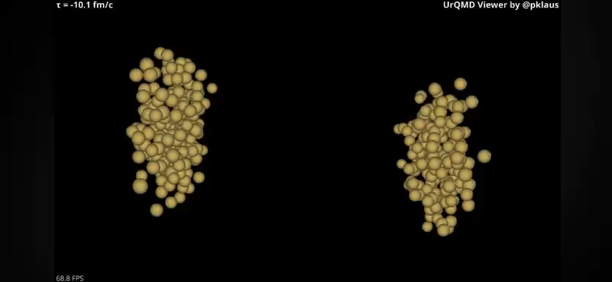
UrQMD Model 3.3p2
UrQMD (Ultra relativistic Quantum Molecular Dynamics) is a fully integrated Monte Carlo simulation package for Proton+Proton, Proton+nucleus and nucleus+nucleus interactions.
The meson and charmed species
The baryon species

Slide 8
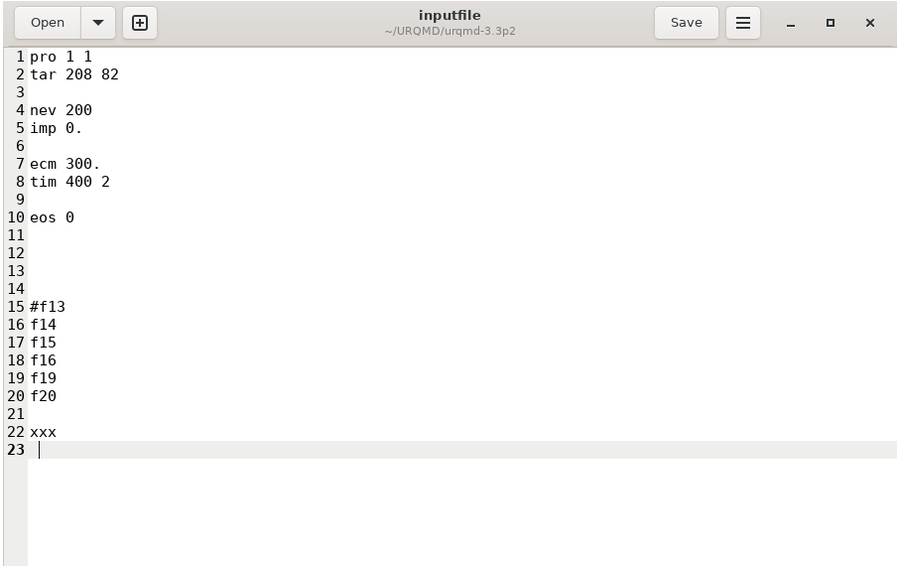
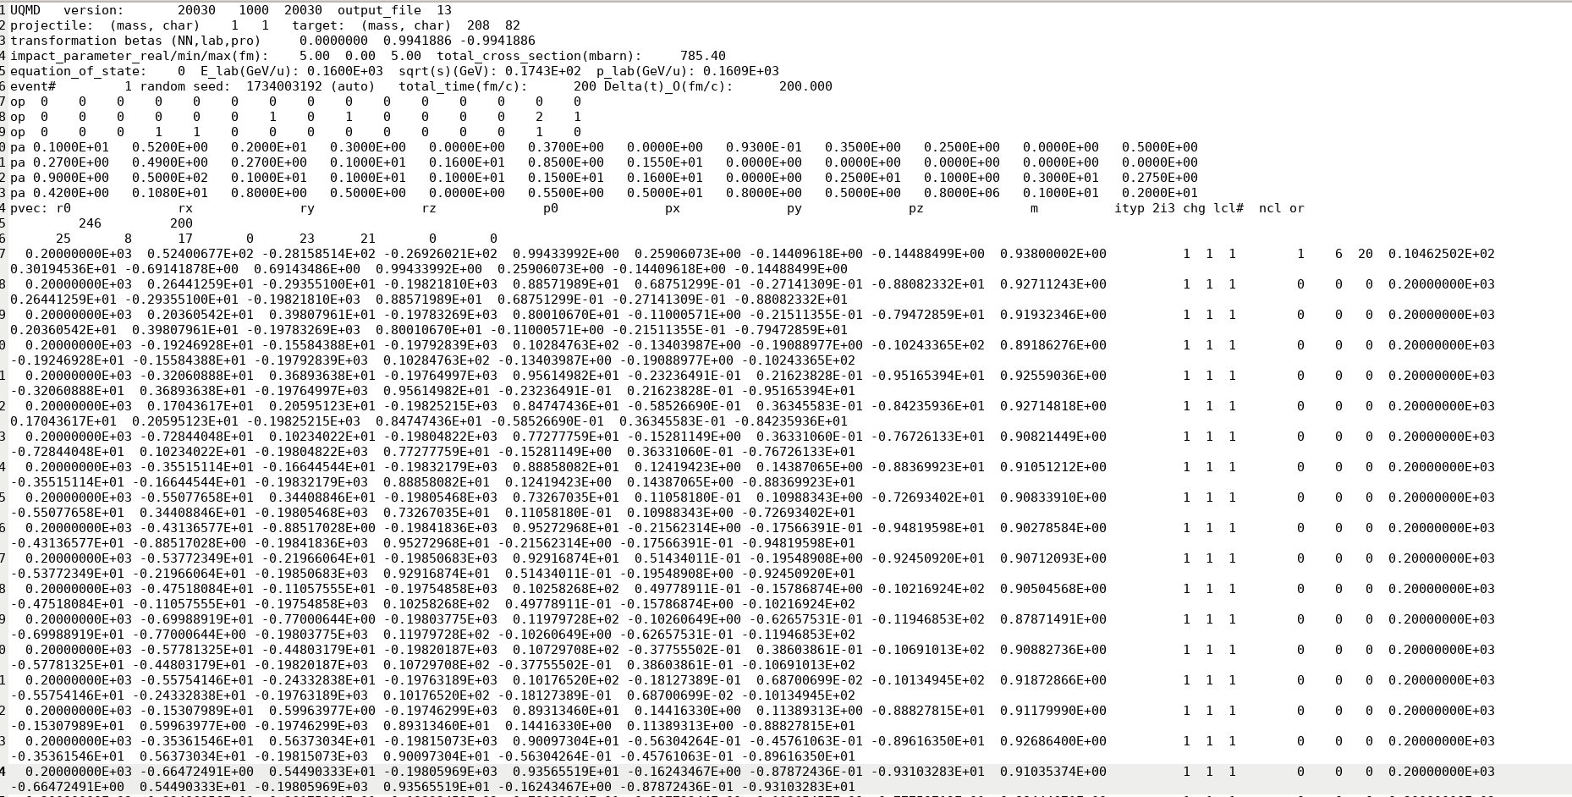
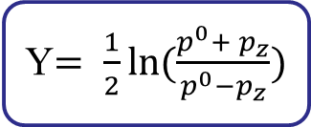
UrQMD Model 3.3p2 input and output file
Input file
Output file
Rapidity distribution calculation
Y$= \frac{1}{2}ln⁡(\frac{p^{0}+ p_{z}}{p^{0}−p_{z}})$

Slide 9
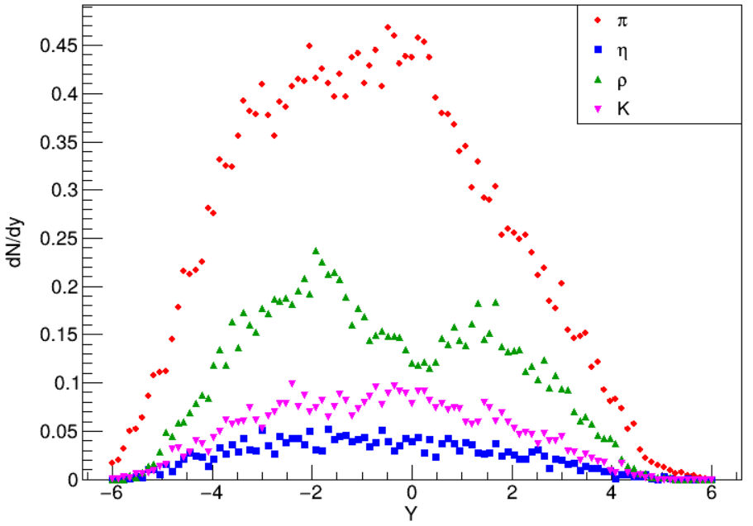
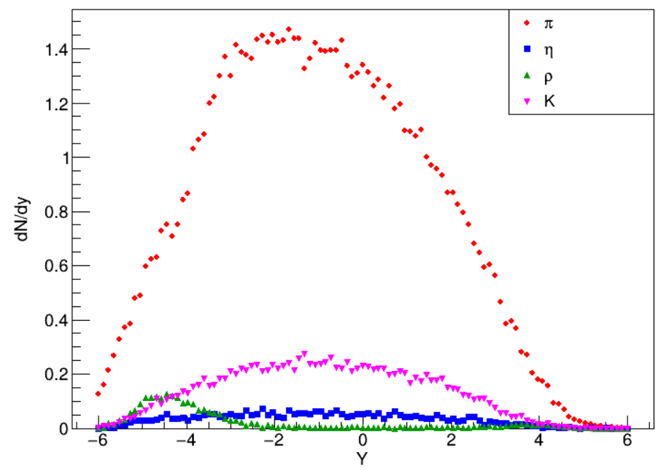
Results: Meson rapidity distribution
Figure 1: Meson rapidity at t = 2 fm
Figure 2: Meson rapidity at t = 100 fm

Slide 10
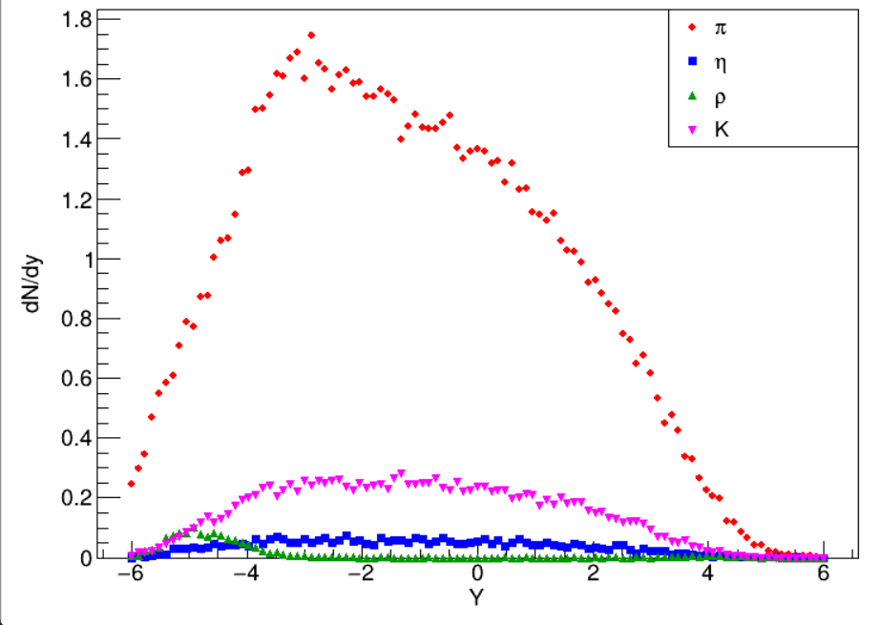
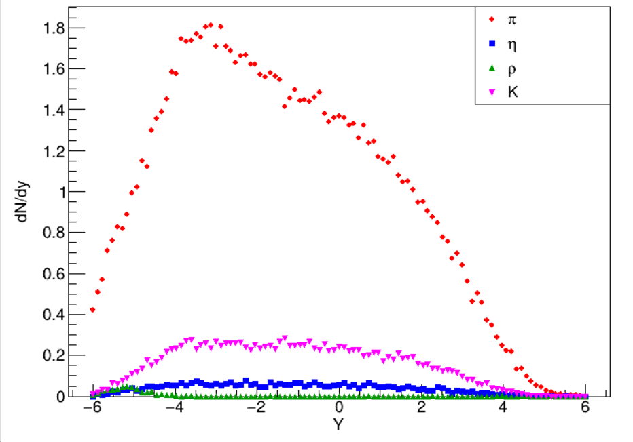
Figure 3: Meson rapidity at t = 200 fm
Figure 4: Meson rapidity at t = 398 fm

Slide 11
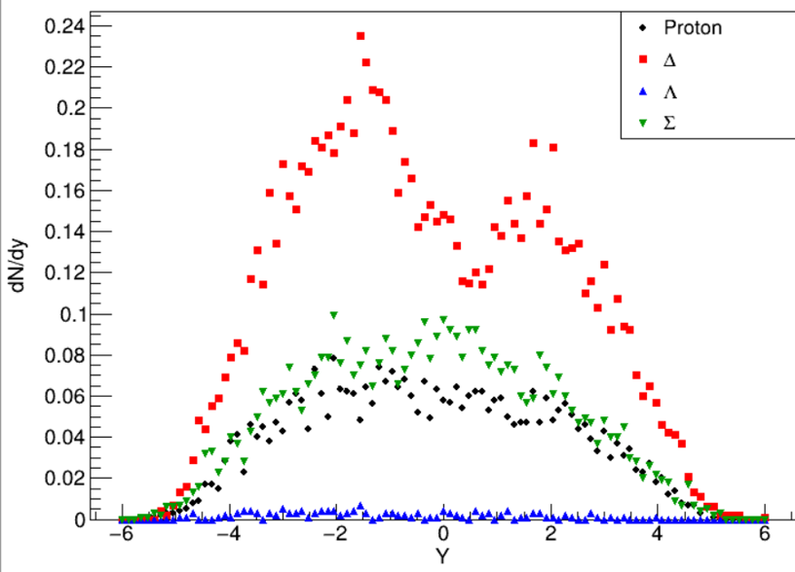
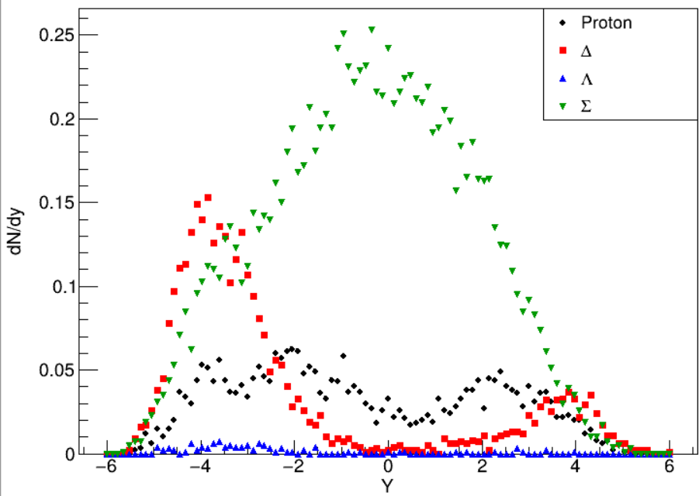
Results: Baryons rapidity distribution
Figure 5: Baryon rapidity at t = 2 fm
Figure 6: Baryon rapidity at t = 50 fm

Slide 12
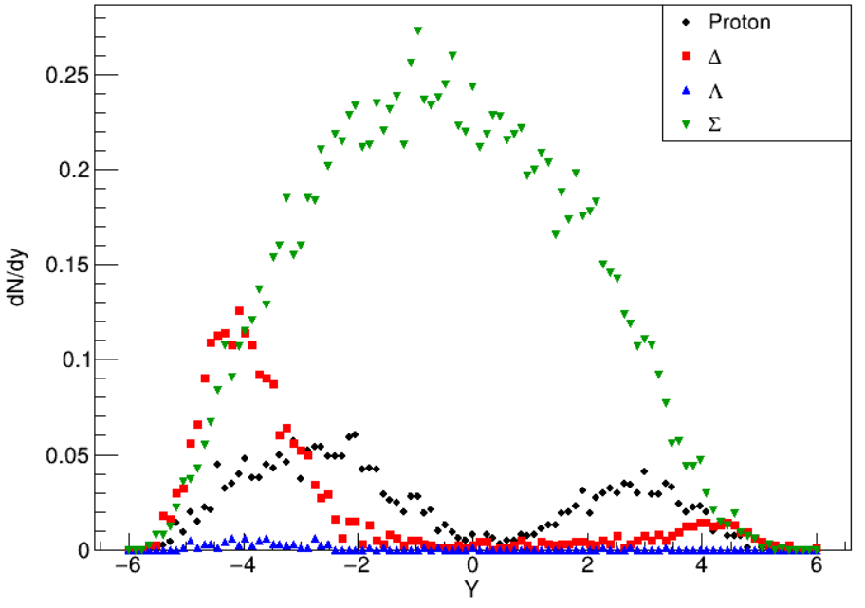
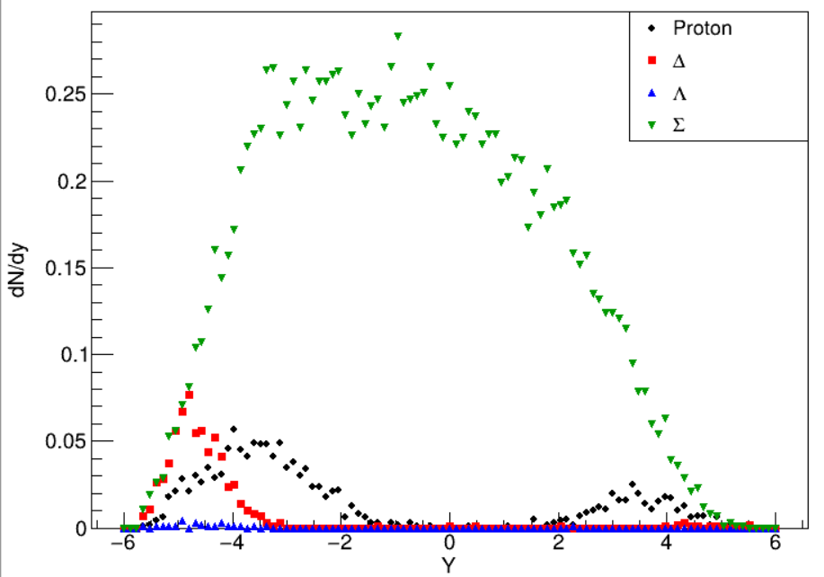
Figure 7: Baryon rapidity at t = 100 fm
Figure 8: Baryon rapidity at t = 300 fm

Slide 13
Conclusion and Future Work
Conclusion
The UrQMD model effectively facilitates the investigation of hadronisation through the rapidity distributions of produced mesons and baryons.
The rapidity distributions evolve with time and stabilize at approximately ((300 fm/(c)) for baryons and (398 fm/(c)) for mesons, indicating freeze-out.
Baryon production is significantly suppressed compared to mesons due to the energetically demanding formation of diquark-antidiquark pairs.
The matter formed in small collision systems (p+Pb) is not as fully equivalent to that formed in large systems (Pb+Pb)
Future Work
Further studies will involve additional collision systems to explore baryon production, with special attention given to strangeness production.

Slide 14
References
Vovchenko, V.Y., Anchishkin, D.V. and Gorenstein, M.I., 2014. System-size and energy dependence of particle-momentum spectra: The UrQMD analysis of p+p and Pb+Pb collisions. arXiv preprint arXiv:1407.0629.
Da Silva, A.V., Serenone, W.M., Chinellato, D.D., Takahashi, J. and Bierlich, C., 2020. Studies of heavy-ioncollisions using PYTHIA Angantyr and UrQMD. arXiv preprint arXiv:2002.10236
Staudenmaier, J., Weil, J., Steinberg, V., Endres, S. and Petersen, H., 2018. Dilepton production and resonance properties within a new hadronic transport approach in the context of the GSI-HADESexperimental data. Physical Review C, 98(5), p.054908
A. Hayrapetyan et al. (CMS Collaboration), “Observation of Λ Hyperon Local Polarisation in p-Pb Collisions at √sNN = 8.16 TeV,” Phys. Rev. Lett. 135, 132301 (2025).
S. Belforte et al. (LHCb Collaboration), “Multiplicity dependence of charm baryon and baryon meson production in pPb collisions at √sNN = 8.16 TeV,” Phys. Lett. B 868, 1–25 (2025).

Slide 15






Acknowledgement

Slide 16




