Slide 1



Quantum Computing for Sodium-Ion Battery Modeling: A Comprehensive Technical Analysis
Author: Khanyisile Masemola
Co-authors: Prof. Cuthbert Nyamupangedengu
(School of Electrical & Information Engineering, University of the Witwatersrand)
Prof. David G. Dorrell
(Department of Mechanical & Material Engineering, University of Turku)

Slide 2

CONTENT
Introduction
01
Computational Challenges in Battery Modeling
02
Quantum Algorithms for Battery Simulation
03
Industry and Real-World Deployment
04
Current State of Quantum Hardware
05
Competitive Advantages and Fundamental Limits
06

Slide 3
INTRODUCTION
1
EVs & Energy
Storage
Traditional
Methods
LIB vs SIB
Why Quantum
Computing…?
Quantum
Computing
Battery
Performance
Density Functional Theory
Notes:
EVs and renewable energy storage demand batteries that are cheaper, longer-lasting, and more powerful than current lithium-ion technology.
depends on electrochemical processes occurring at atomic scales where quantum mechanics dominates.
Traditional computers struggle to model these quantum interactions accurately.
Quantum computing represents a paradigm shift in how we model battery materials at the atomic and molecular level.
While classical computational methods like (DFT) have enabled significant progress in battery research, they face fundamental limitations when modeling the strongly correlated electronic systems that govern battery chemistry.

Slide 4
INTRODUCTION
2
Scope of This Study
This report provides a comprehensive technical analysis of how quantum computing is being applied to battery modeling, the specific algorithms being deployed, current results from industry partnerships, and the transformative potential for next-generation energy storage.

Slide 5
INTRODUCTION CONT’D
2
Quantum information is processed through the exploitation of superposition within vector spaces referred to as Hilbert spaces. Quantum computers have the capability to run quantum systems simulations directly.
Paris Agreement
Paris Agreement
Why classical methods fall short? The fundamental challenge is solving the many-body Schrödinger equation for systems containing dozens to hundreds of electrons.
Traditional classical modeling approaches, while effective, often struggle with high-dimensional parameter spaces and computational bottlenecks when simulating real-world scenarios.
DFT is the workhorse of computational materials science, but it relies on approximations (exchange-correlation functionals).
cv
Overall welfare
Overall welfare
Notes:
Unlike classical systems…
… offering a far more efficient and precise means of modeling complex molecular structures, advanced materials, and scenarios that are beyond the reach of classical computing.

Slide 6
COMPUTATIONAL CHALLENGES IN BATTERY MODELING
3
The Many-Body
Problem:
2
Density Functional Theory (DFT) Limitations:
1
Standard DFT functionals approximate the exchange-correlation functional using local (LDA) or semi-local (GGA) densities. For strongly correlated systems, these approximations produce systematic errors: GGA under binds d-electrons, self-interaction error & static correlation.
Sodium cathode materials predominantly utilize first-row transition metals (Mn, Fe, Co, Ni) whose 3d electrons exhibit strong on-site Coulomb repulsion.
DFT struggles with strongly correlated systems, excited states and multi-reference character (systems where a single electronic configuration cannot adequately describe the ground state.)
As the number of electrons increases, the computational complexity grows exponentially.
3
A system with N electrons requires describing a wavefunction in 3N-dimensional space.
Classical methods face limitations when dealing with the quantum effects and non-linear processes involved in battery operation. DFT calculations can take weeks for systems with ~100 atoms, and accuracy degrades for materials with strong electron correlations.
Notes:
The electronic wavefunction for a system with N electrons evolves according to the time-independent Schrödinger equation.
Local (LDA) and Semi-Local (GGA) densities are fundamental approximations in density functional theory (DFT) used to represent the unknown universal exchange-correlation functional. LDA models systems as locally uniform, while GGA incorporates density gradients to improve structural descriptions of materials.

Slide 7
COMPUTATIONAL CHALLENGES IN BATTERY MODELING
4
Voltage and Energy Density:
Ionic Diffusion:
Solid Electrolyte Interphase (SEI):
1
2
3
The open-circuit voltage of a battery depends on the ground-state energies of the charged and discharged electrode materials.
Sodium-ion mobility through electrode materials and the solid-electrolyte interphase (SEI) depends on activation barriers that are quantum mechanical in nature.
This nanoscale passivation layer forms from electrolyte decomposition and critically determines battery life, safety, and performance.
Understanding SEI formation requires modeling:
Electron transfer reactions at electrode surfaces.
Radical formation and propagation.
Complex reaction networks with competing pathways.
Dynamic interface chemistry during cycling
Small errors in these energies (0.1-0.2 eV) can translate to significant voltage prediction errors.
Classical force fields cannot capture bond-breaking and formation processes accurately.
Notes:
- Let’s take a look at Battery Phenomena Requiring Quantum-Level Modeling

Slide 8
QUANTUM ALGORITHMS FOR BATTERY SIMULATION
5
Variational Quantum Eigensolver (VQE)
VQE is a hybrid quantum-classical algorithm designed for near-term quantum computers (NISQ era).
It leverages the variational principle: the expectation value of the Hamiltonian for any trial state provides an upper bound to the true ground-state energy.
Quantum Phase Estimation (QPE)
QPE is an efficient quantum algorithm for finding eigenvalues of unitary operators.
It can determine energy eigenvalues with exponential precision compared to classical methods.
Sample-Based Quantum Diagonalization (SQD)
SQD is a hybrid approach that uses quantum hardware to generate a representative sample of quantum states, then performs classical diagonalization in this reduced space.
Can scale to larger active spaces (~30-50 orbitals) than VQE alone.
Provides systematic route to near-exact energies.
Less sensitive to quantum hardware noise than deep circuit methods.
Quantum Equation of Motion (qEOM)
Quantum Annealing for Configurational Optimization
While VQE and QPE focus on ground states, qEOM extends these methods to calculate excited-state energies.
Quantum annealing (QA) solves combinatorial optimization problems by encoding them as Ising model spin glasses.
Essential for understanding:
Photostability of battery electrolytes
Oxidative stability
Degradation mechanisms
X-ray absorption spectra

Slide 9
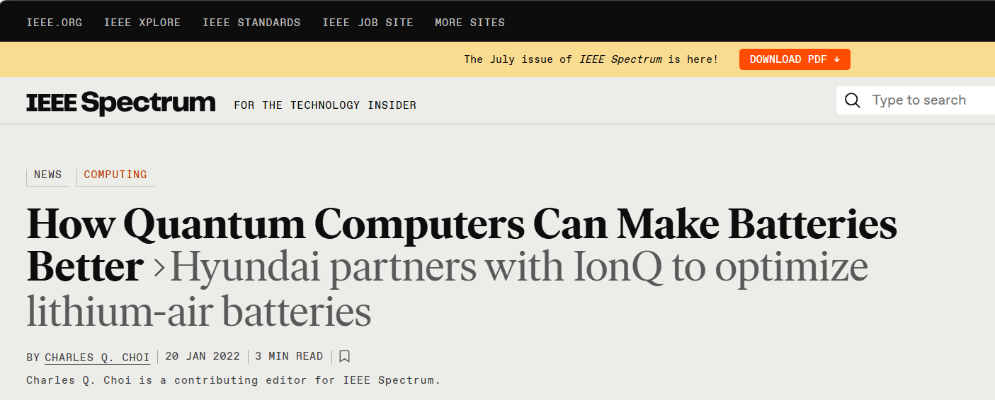
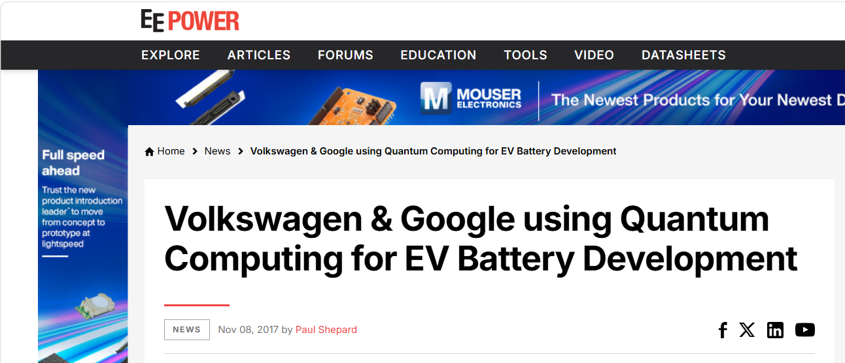
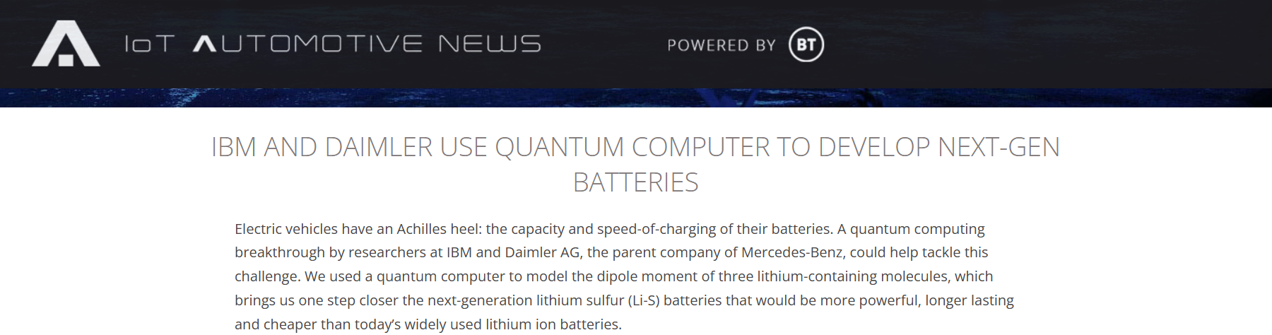

INDUSTRY AND REAL-WORLD DEPLOYMENT
6

Slide 10
CURRENT STATE OF QUANTUM HARDWARE
7
Hardware Constraints (as of 2025):
Algorithmic Adaptations:
1
2
VQE designed specifically for shallow circuits.
Error mitigation techniques (zero-noise extrapolation, readout error correction).
Active space reduction to minimize qubit requirements.
Hybrid classical-quantum approaches.
Qubit counts: 100-1,000 qubits available, but only 10-50 can be used coherently.
Gate fidelity: 99-99.9% for single-qubit gates, 95-99% for two-qubit gates.
Coherence times: 10-100 microseconds, limiting circuit depth.
Connectivity: Not all qubits can interact directly.

Slide 11
COMPETITIVE ADVANTAGES AND FUNDAMENTAL LIMITS
8
Where Quantum Computing Wins
Exponential Advantage: For strongly correlated systems, quantum computers can solve problems that are fundamentally intractable classically. The computational cost scales polynomially with system size on quantum hardware versus exponentially on classical computers.
Exact Simulation: Quantum computers can represent quantum superposition and entanglement natively. Classical methods like DFT approximate these effects → introducing systematic errors.
Multi-Reference Systems: Battery materials with transition metals often require multiple electronic configurations to describe accurately → quantum algorithms handle this naturally.

Slide 12
COMPETITIVE ADVANTAGES AND FUNDAMENTAL LIMITS
9
Where Classical Methods Still Lead
Scalability: For weakly correlated systems, classical DFT can handle thousands of atoms. Current quantum computers are limited to ~50 atoms maximum.
Maturity: Decades of development have optimized classical codes with excellent libraries, basis sets, and error estimates.
Near-Term Cost: Classical supercomputers are cheaper and more accessible than quantum computers for most applications today.

Slide 13


Thank You!
Questions/comments
are welcome…

