Slide 1



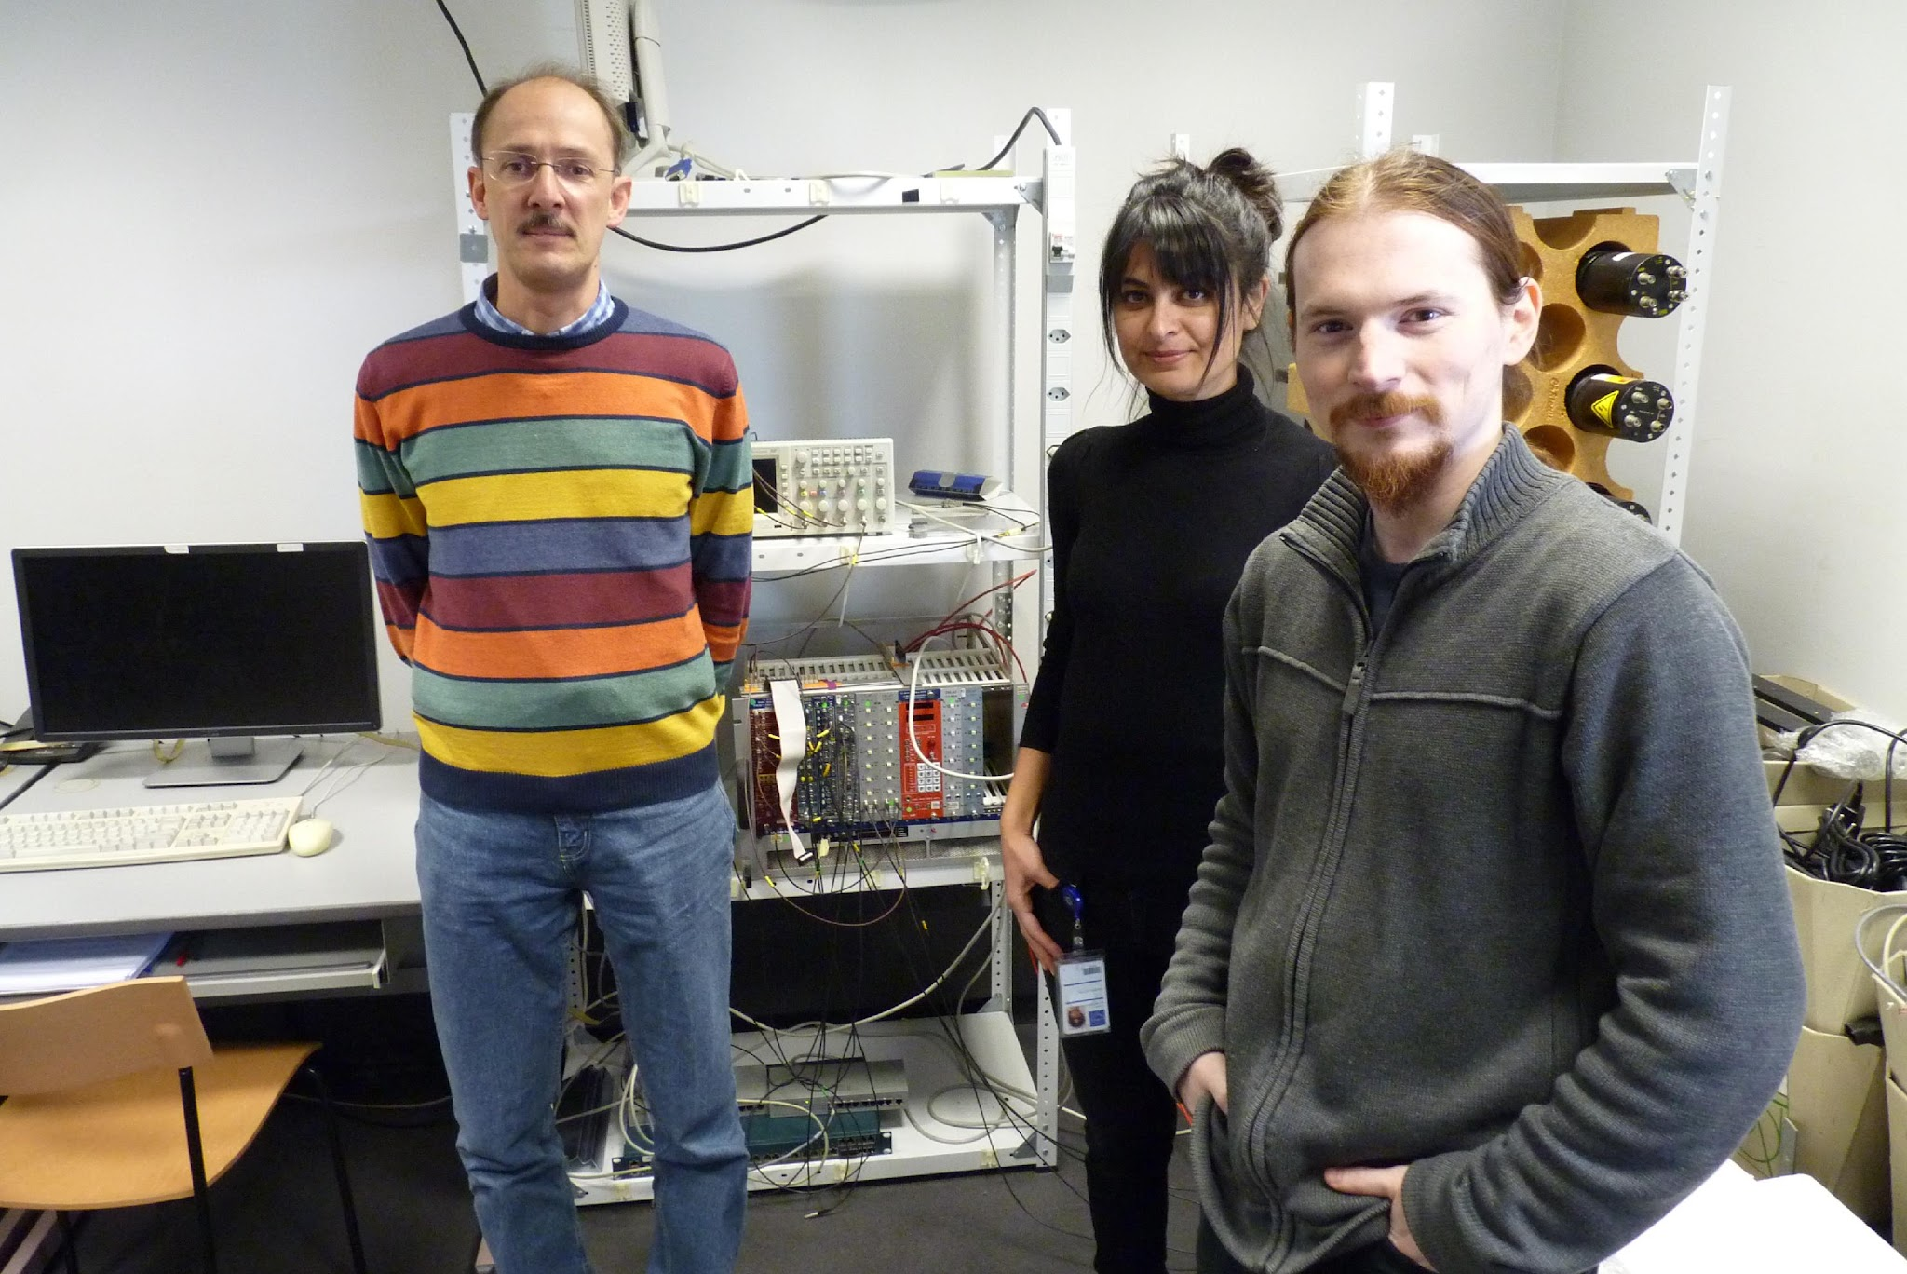



Extracting Radioisotope Lifetimes from a 100 MeV Gamma Irradiation Experiment Using HPGe Spectroscopy
T Nemakhavhani¹ , TM Mpai¹, T Brooks¹, N Connell¹, SH Connell¹, C Harley¹
University of Johannesburg, Johannesburg, South Africa.
Presenter: Thendo Emmanuel Nemakhavhani
July 8th , 2026

Slide 2
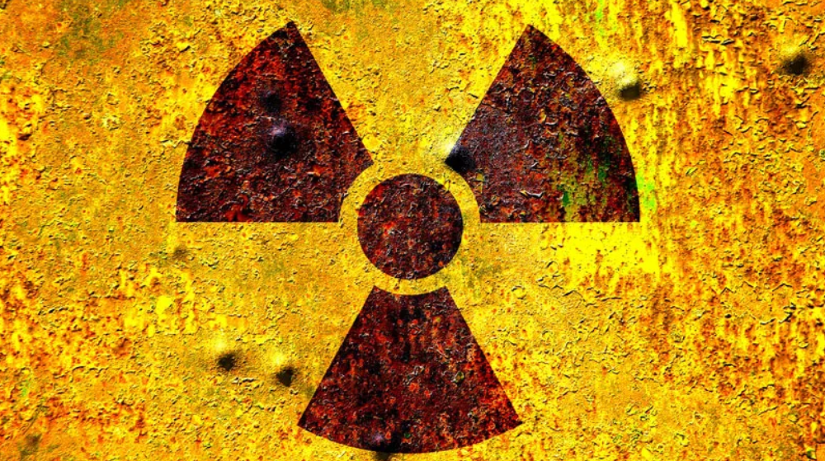
Outline
The MinPET Technology
Aim and Objectives
Background Theory
Methodology and Experimental Procedure
Results:
  Århus FDR Results: Background Analysis for MinPET Technology (lifetimes)
  Future work: Geant4 Simulations
Discussion and Conclusion
Future work
References

Slide 3
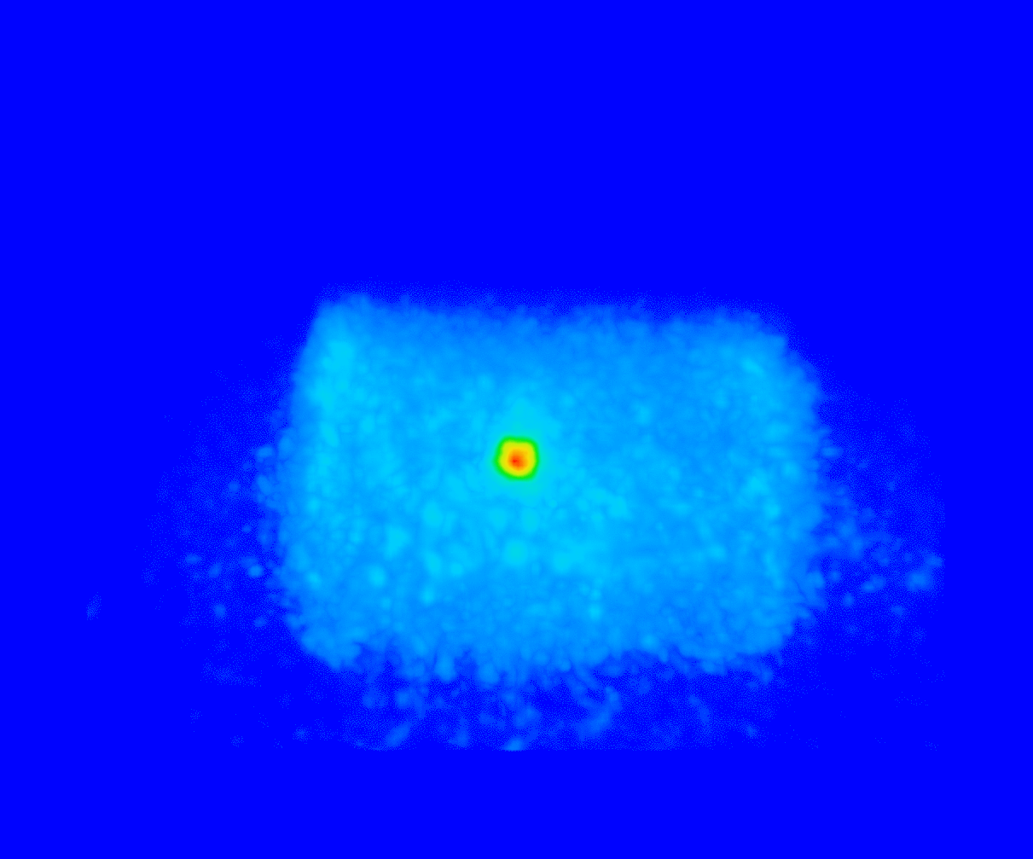
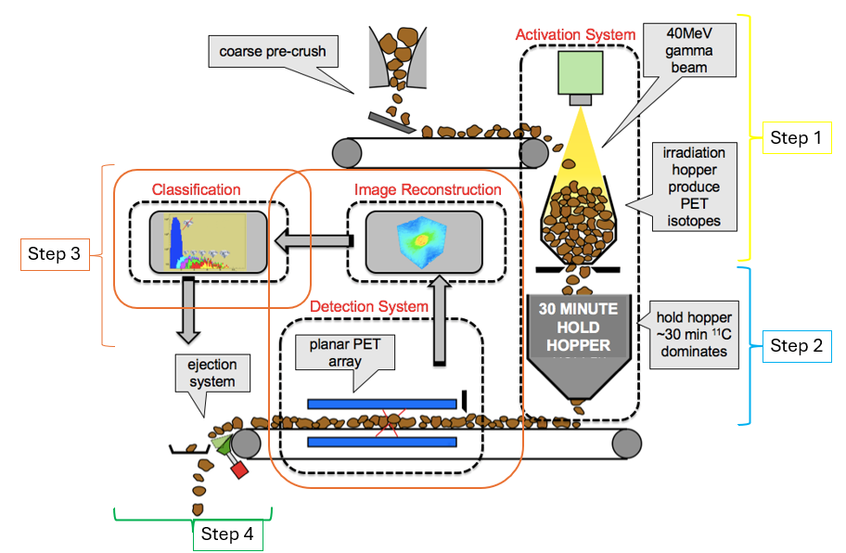

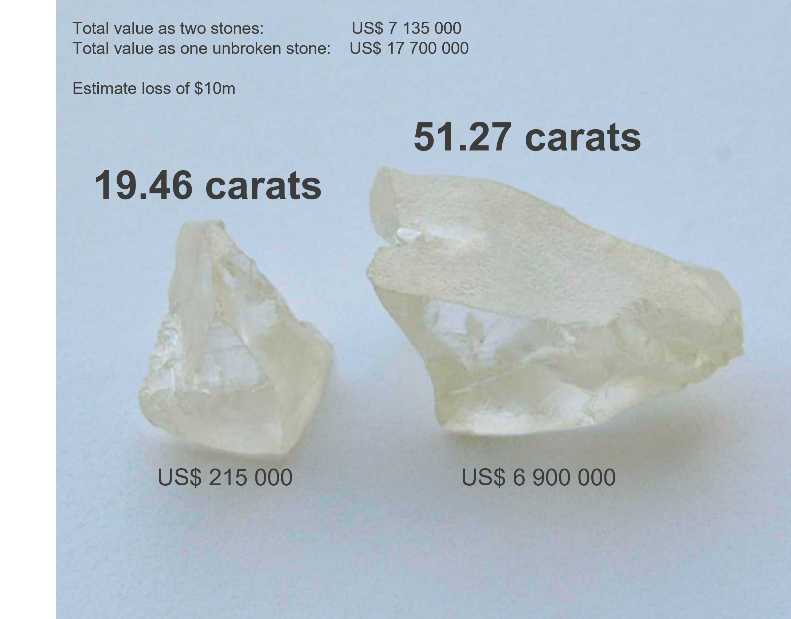
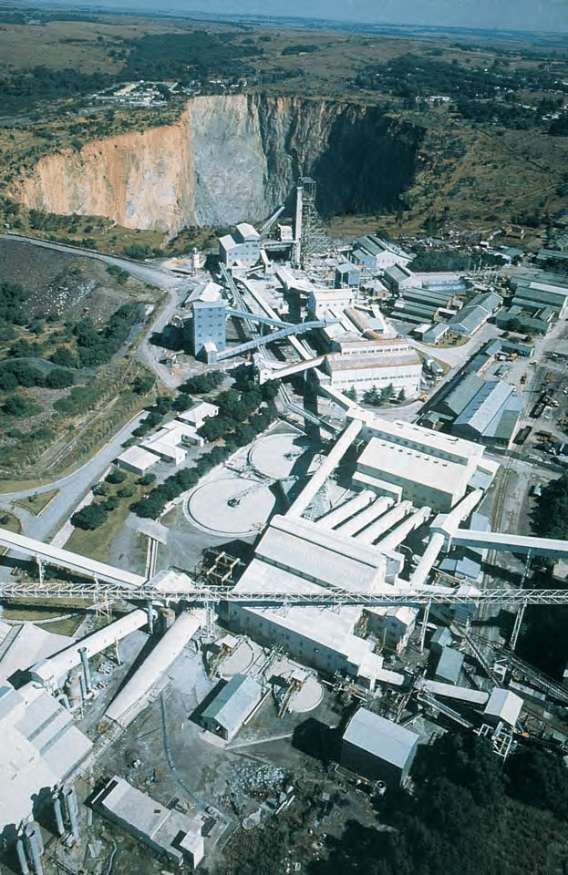
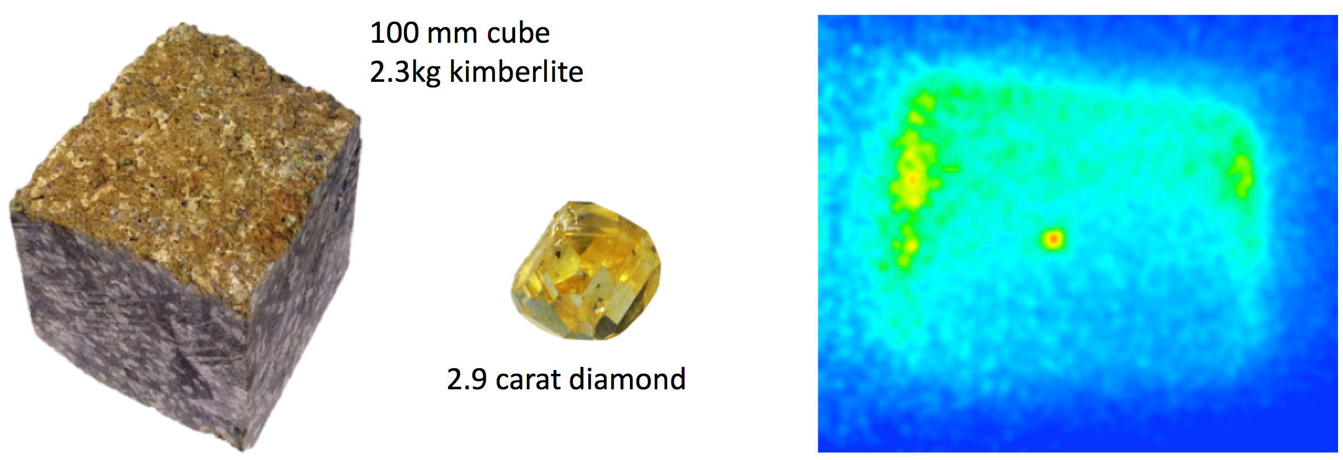
The MinPET Technology
3D imaging of kimberlite ore in real time
Saves much water (a scarce resource)
Reduced environmental impact
A schematic diagram of the MinPET technology setup:
Requires a 40 MeV electron beam corresponding to 3.54×10¹² e⁻/cm²
MinPET Unit of Dose in 1 s of irradiation
The technology will prevent diamond breakage, increasing recovery size and profits
Detect a Diamond of at least 6 mm within a 10x10x10 cm3 kimberlite rock, and increase diamond recovery
[1] Opened in 1903, the Premier mine in South Africa
(source: Characterizing Natural-Color Type IIb Blue Diamonds - Scientific Figure on ResearchGate. Available from: https://www.researchgate.net/figure/Opened-in-1903-the-Premier-mine-in-South-Africa-is-considered-the-principal-producer-of_fig3_273664968 [accessed 26 Feb 2026]

Slide 4
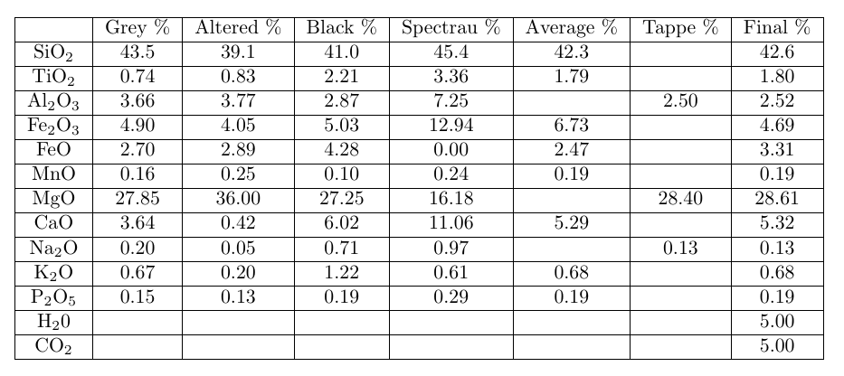
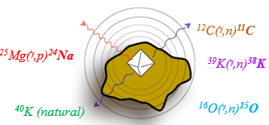
Aim and Objectives
Extracting Radioisotope Lifetimes from a 100 MeV Gamma Irradiation Experiment Using HPGe Spectroscopy
Signal–background discrimination – Activation of kimberlite produces a mixed inventory of background isotopes that must be understood to distinguish diamond signals from host rock activity.
Radiological safety assessment – The isotopic inventory generated during MinPET operation must be characterised to confirm no long-term radiological hazards.
XRF derivation of the average kimberlite composition
Experimental validation – A Full-Dress Rehearsal (FDR) experiment at Aarhus University was conducted to replicate MinPET activation under realistic conditions using a 100 MeV beam-line.
Lifetime characterisation – Extracting and validating radioisotope lifetimes against literature data enables construction of a reliable activation product inventory for safety and operational use.
[3] B. L. Green, A. T. Collins, and C. M. Breeding, “Diamond spectroscopy, defect centers, color, and treatments,” Reviews in Mineralogy and Geochemistry, vol. 88, no. 1, pp. 637–688, 2022.
[4] S. Tappe, “Report on Global Kimberlite Major Element Compositions,” Private UJ report, 2016.

Slide 5
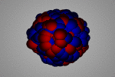
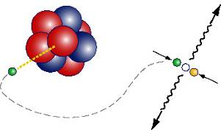
Background Theory of Positron Emission Tomography
Used in Nucl. Med. (PET scans)
β+ emitter in tracer molecule
e⁺e⁻ → γγ
detector ring (Note that the detectors must be selective for coincident directions)
image reconstruction
Photon
positron
¹²C(γ,n)¹¹C
electron
Beta decay
Diamond is carbon ... (¹²C)
Small amounts of ¹¹C isotope induced by photon irradiation (short half-life: t_{1/2}= 20.3 minutes)
¹¹C is a beta+ emitter (PET isotope)
“PET scan” for diamond in kimberlite
The PET Facility is like a Medical PET scan
Signature of an ¹¹C
2 photons, E = 511keV
Co-incident
Co-linear
Very little non-¹¹C PET noise, very little non-PET noise

Slide 6
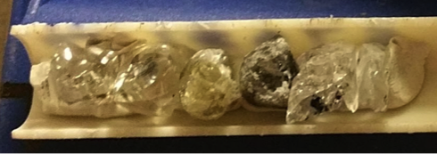
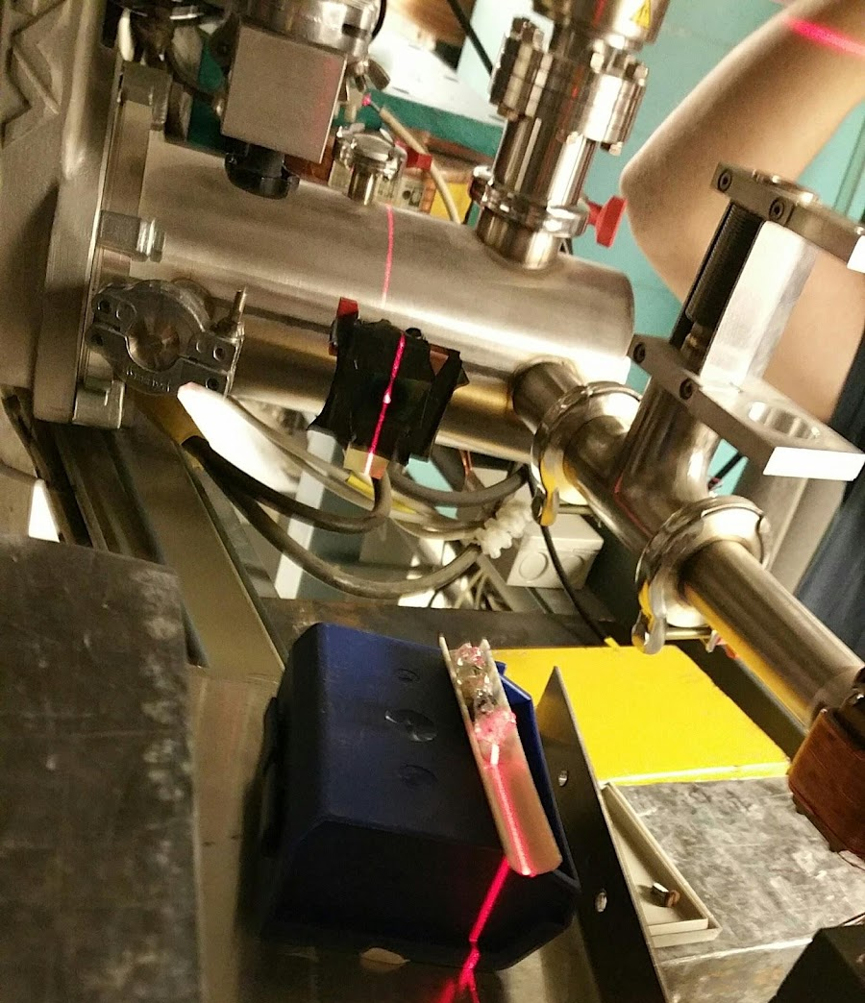
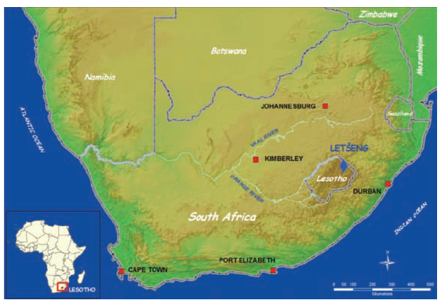
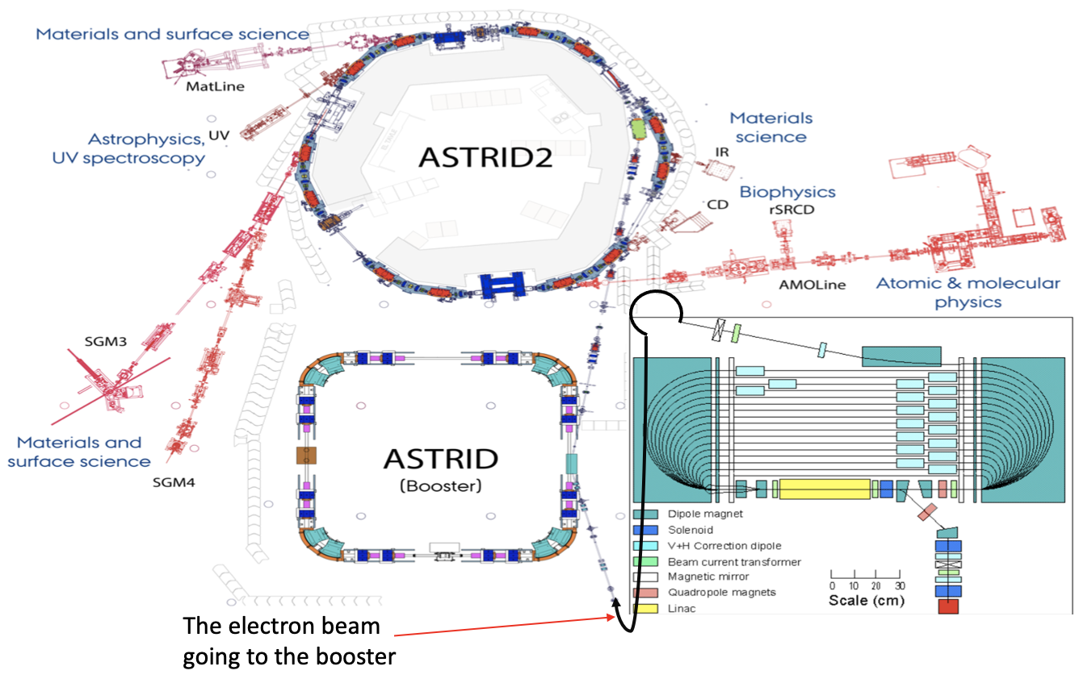
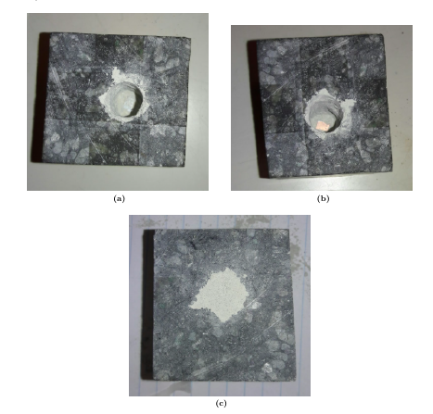

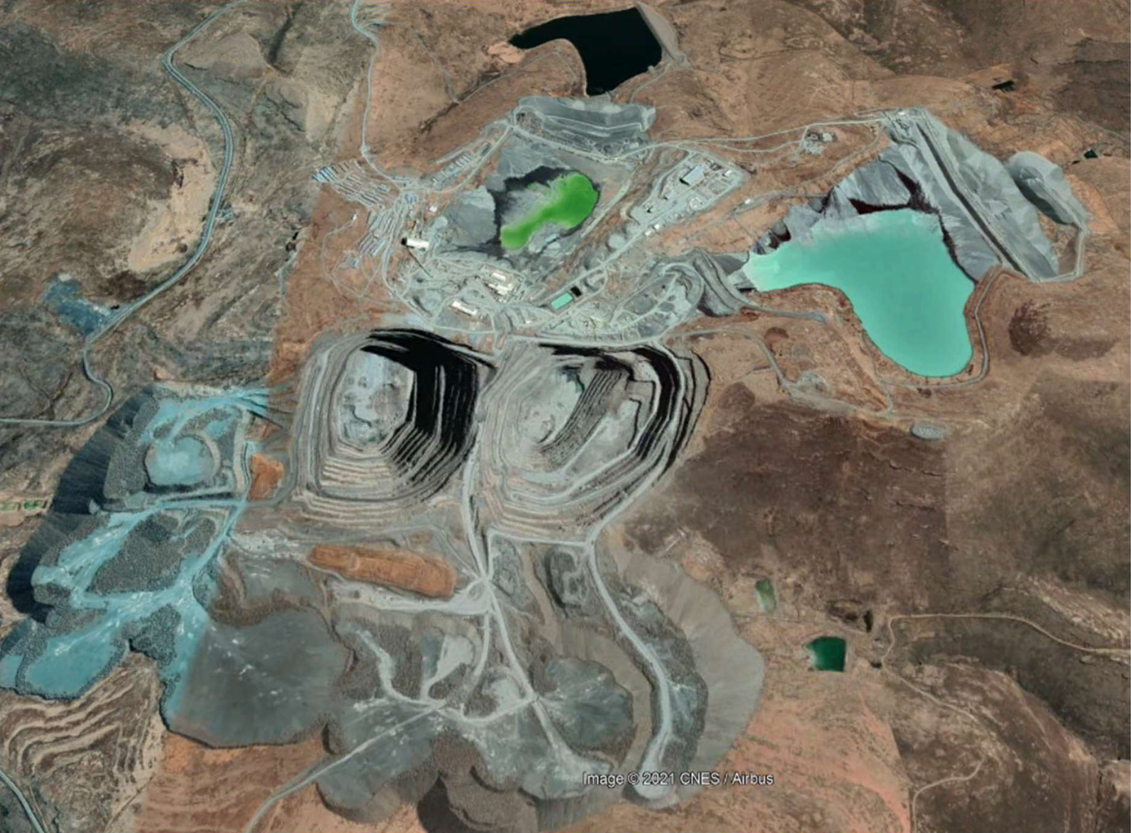
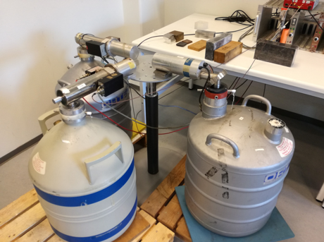
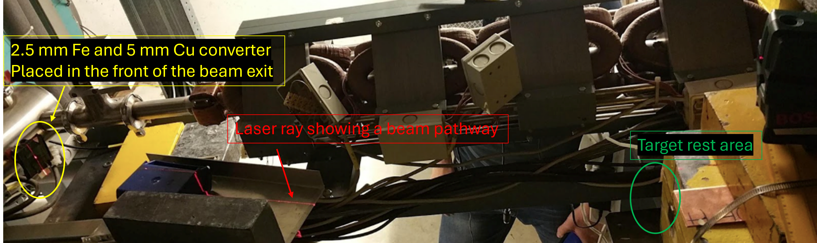
Methodology
Letšeng Diamond Mine is situated in the high mountains of Lesotho and owned by a company called Gem Diamonds and the government of Lesotho
We test with 100 MeV electron accelerator
Degrader / Converter at exit port (2.5 mm Fe and 5 mm Cu) [converter - to force the electron beam into producing the gamma photons we want]
ISA, Centre for Storage Ring Facilities, Aarhus University,
ASTRID2 – THE ULTIMATE SYNCHROTRON RADIATION SOURCE
Rock and diamond samples irradiation setups
[5] T. Nkotsi, C. M. Hetman, J. A. Robey, B. H. S. Smith, and M. Mohapi, “Letseng diamond mine , lesotho : Recent advances in the open pit geology of the satellite kimberlite pipe,” 2017.
[6]. “Isa, centre for storage ring facilities, aarhus.”

Slide 7
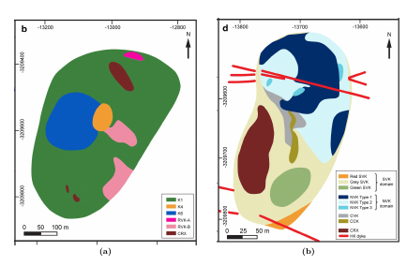
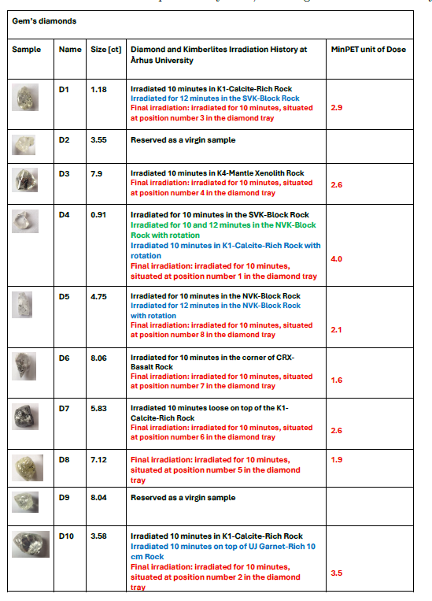
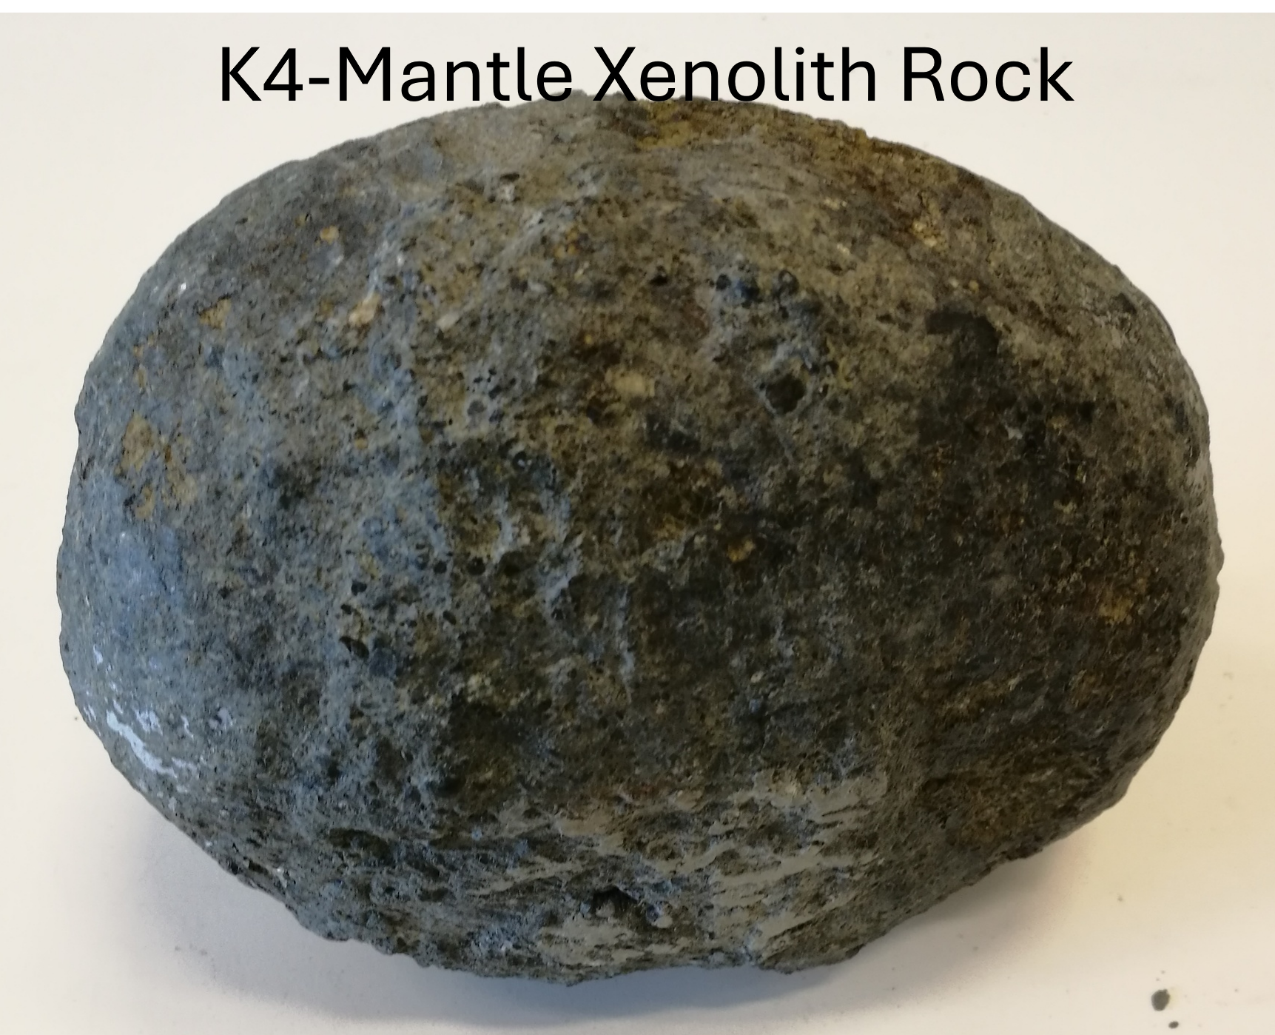
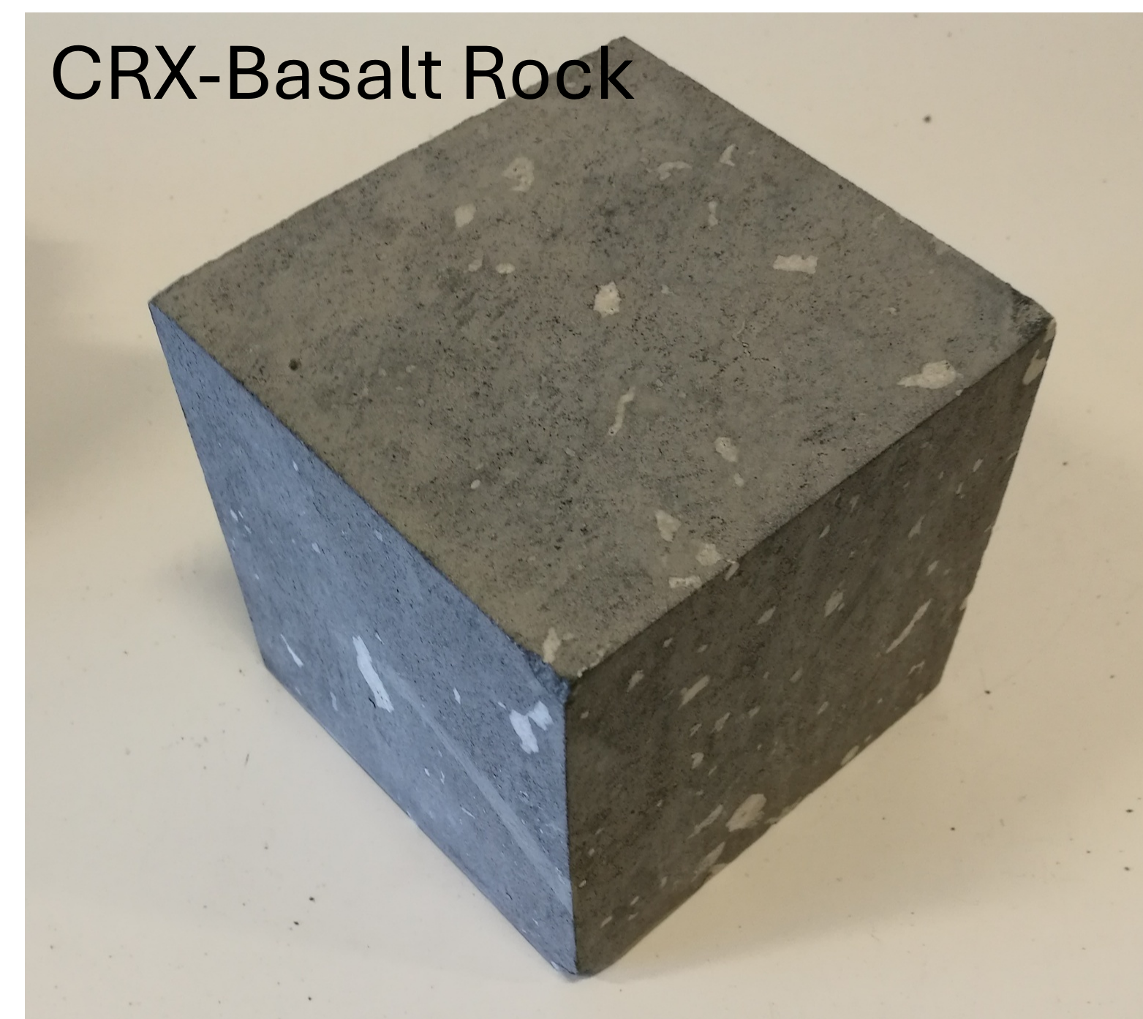
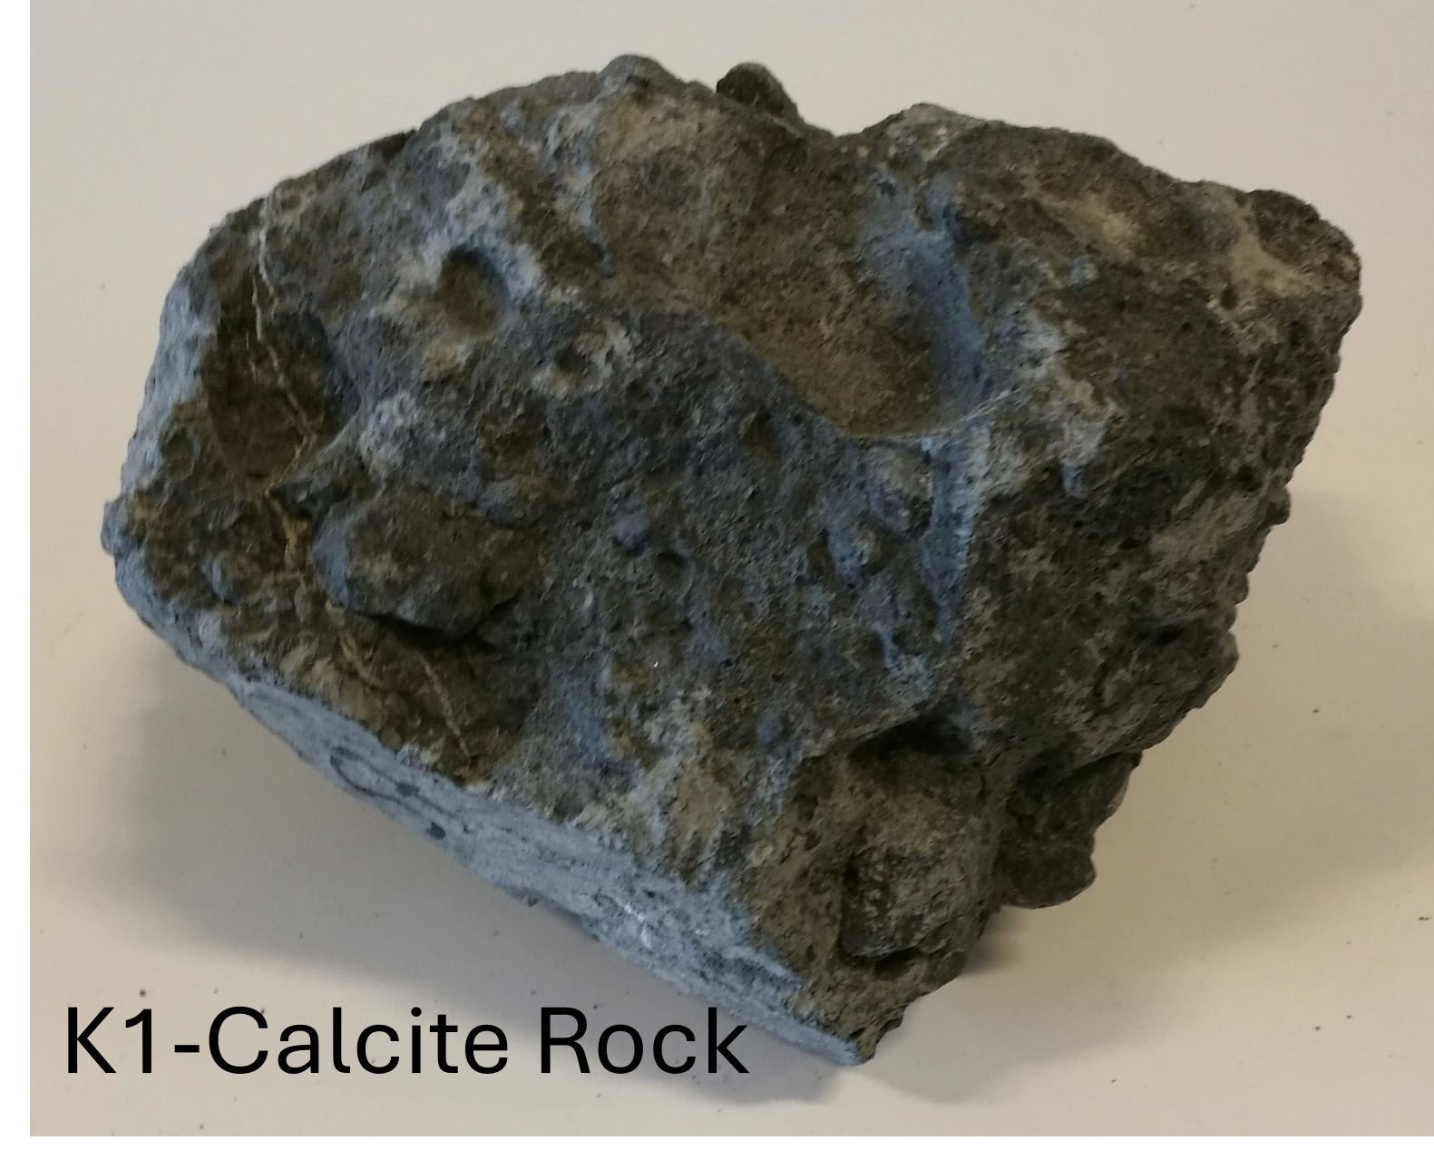
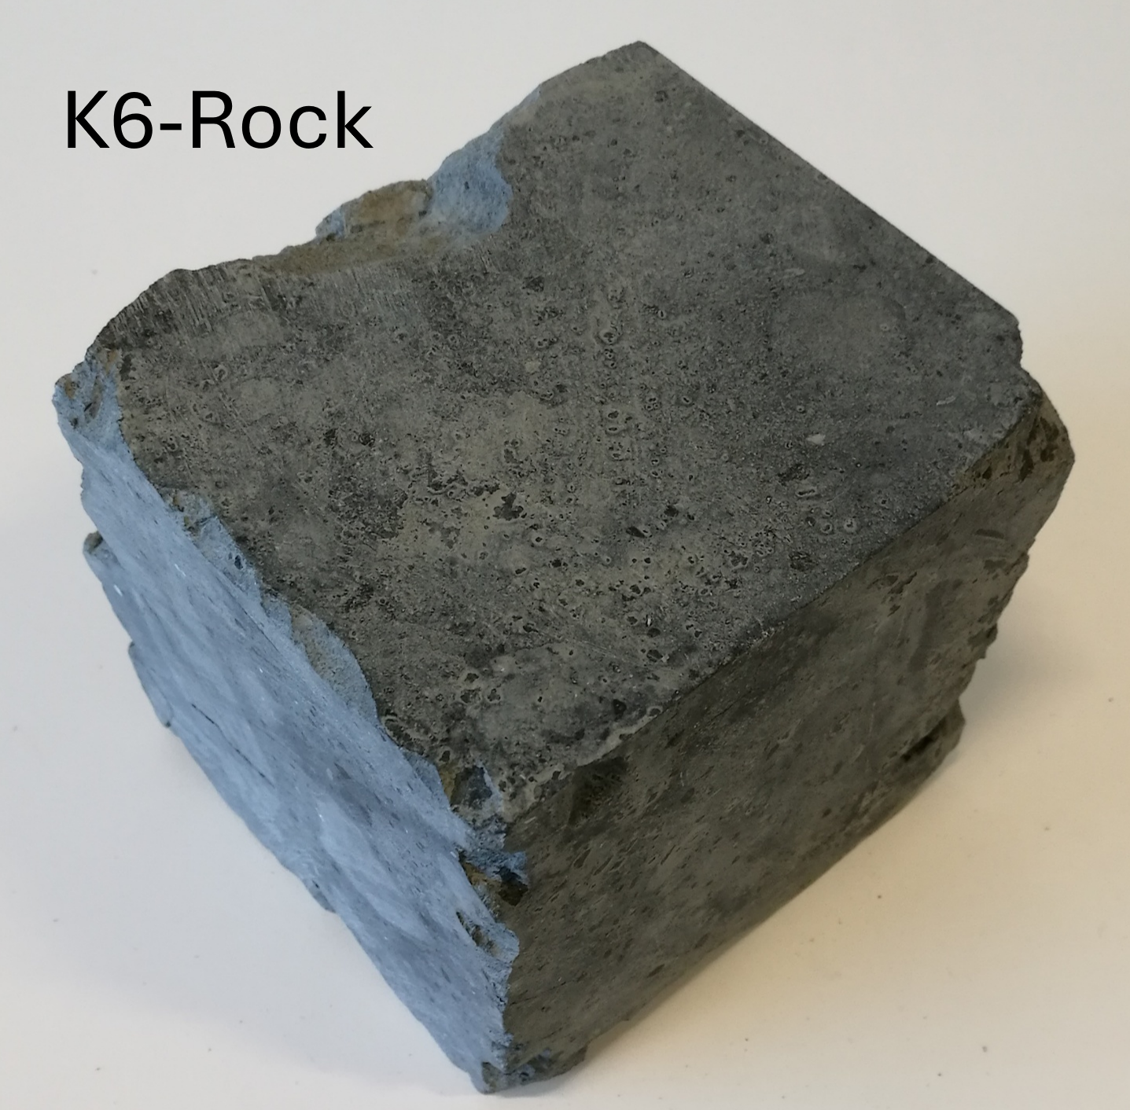
Methodology
Summary of the irradiated rock and diamond samples
Irradiated CRX-Basalt rock was used to study long-lived radioisotopes by monitoring the decline in peak energies of the emission spectrum measured with HPGe detectors
The sample was irradiated for 10 minutes with 2.50×10¹¹~ e⁻ /cm² dose, cooled for 3 days, and counted for 9 days
Irradiated K1-Calcite rock originating from an alluvial was used as a worst-case scenario for diamond detection and radiological safety assessment
The sample was irradiated for 10 minutes with a 9.50×10¹⁰~e⁻/cm² dose, cooled for 29 hours, and counted for 19 hours
Irradiated K6 rock was used to compare the activities of irradiated and NORM backgrounds measured with HPGe detectors
The sample was irradiated for 10 minutes with 2.30×10¹¹~ e⁻ /cm² dose, cooled for 10-minutes, and counted for 3.5 hours
Irradiated K4-Mantle Xenolith rock was used for short- and medium-term activation assessments
The sample was irradiated for 10 minutes with 1.18×10¹¹~ e⁻ /cm² dose, cooled for 10-minutes, and counted for 12 hours
[7] T. Nkotsi, C. M. Hetman, J. A. Robey, B. H. S. Smith, and M. Mohapi, “Letseng diamond mine , lesotho : Recent advances in the open pit geology of the satellite kimberlite pipe,” 2017.

Slide 8
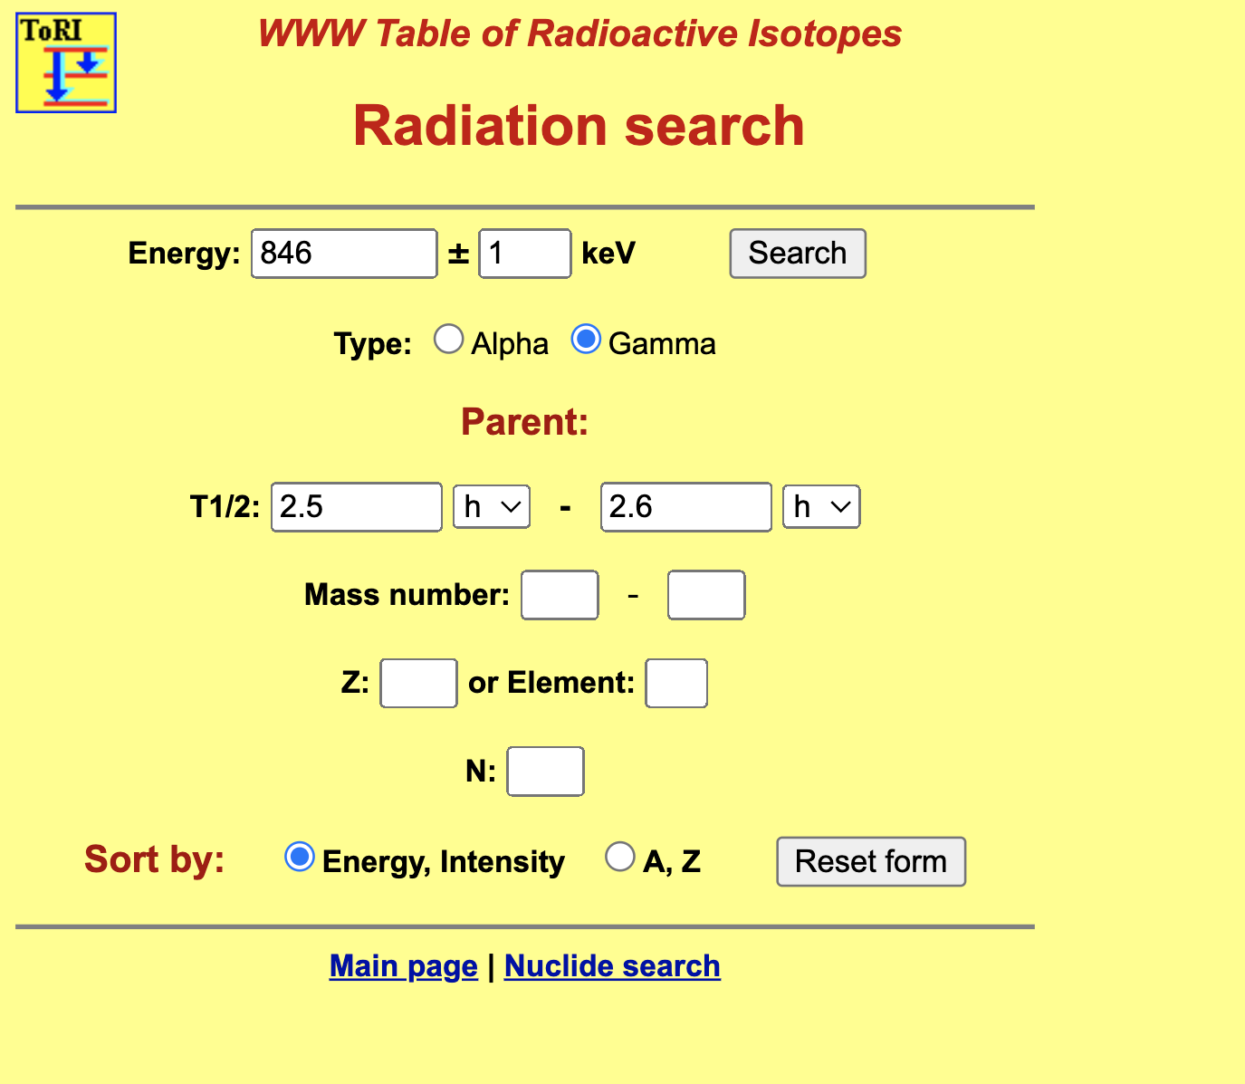
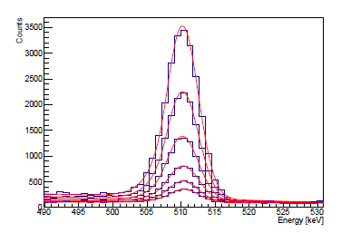
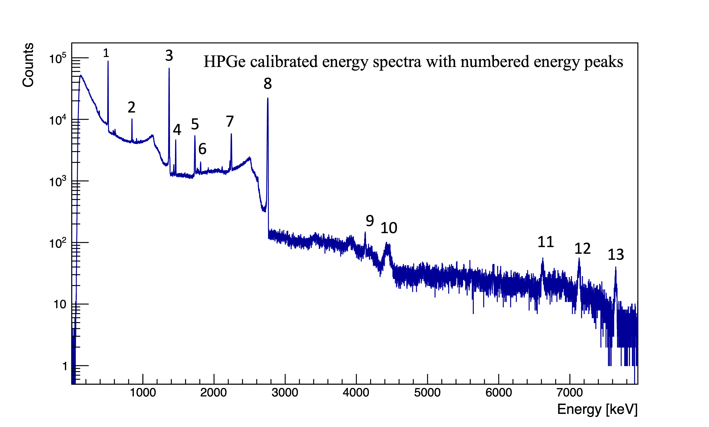
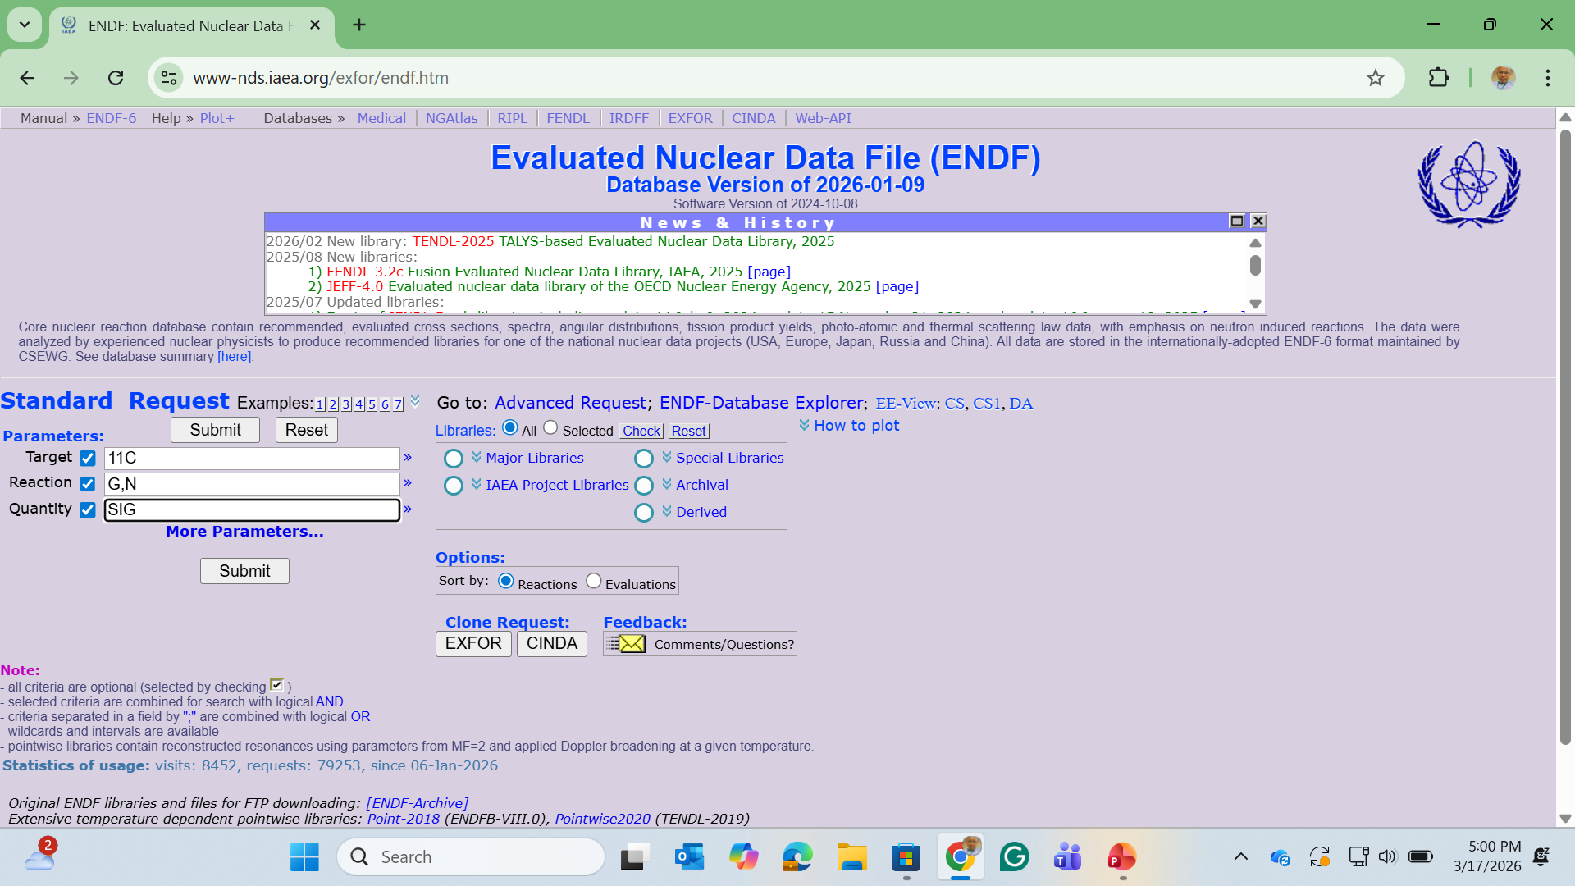
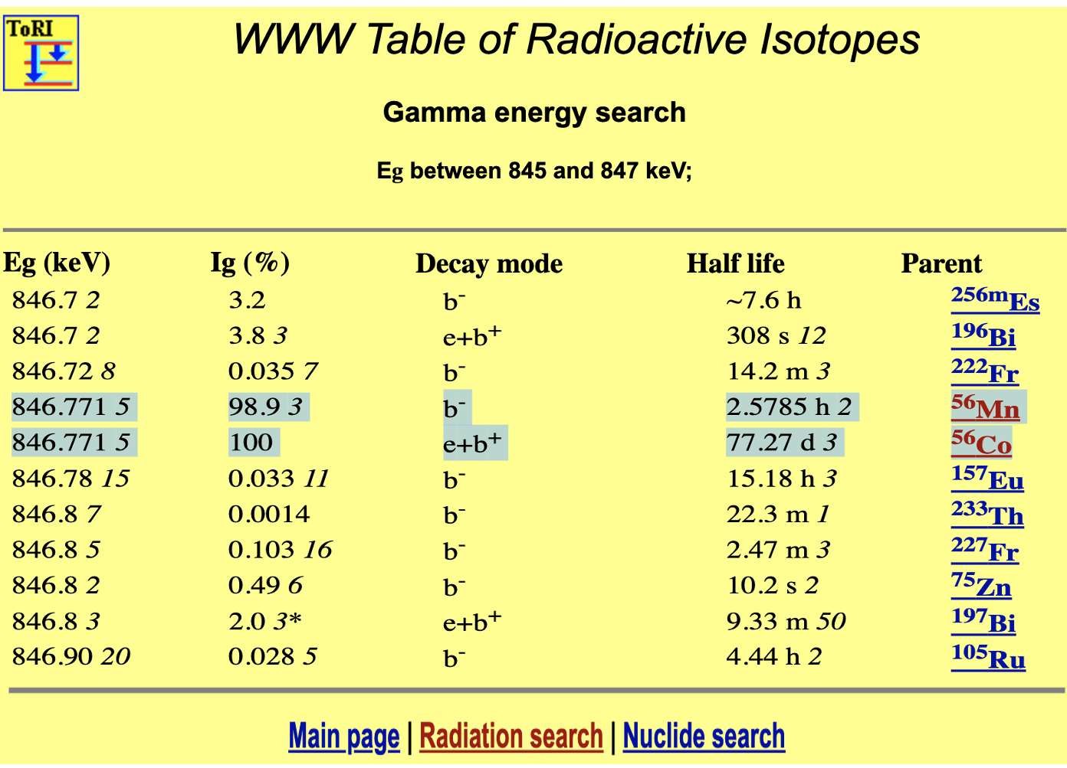
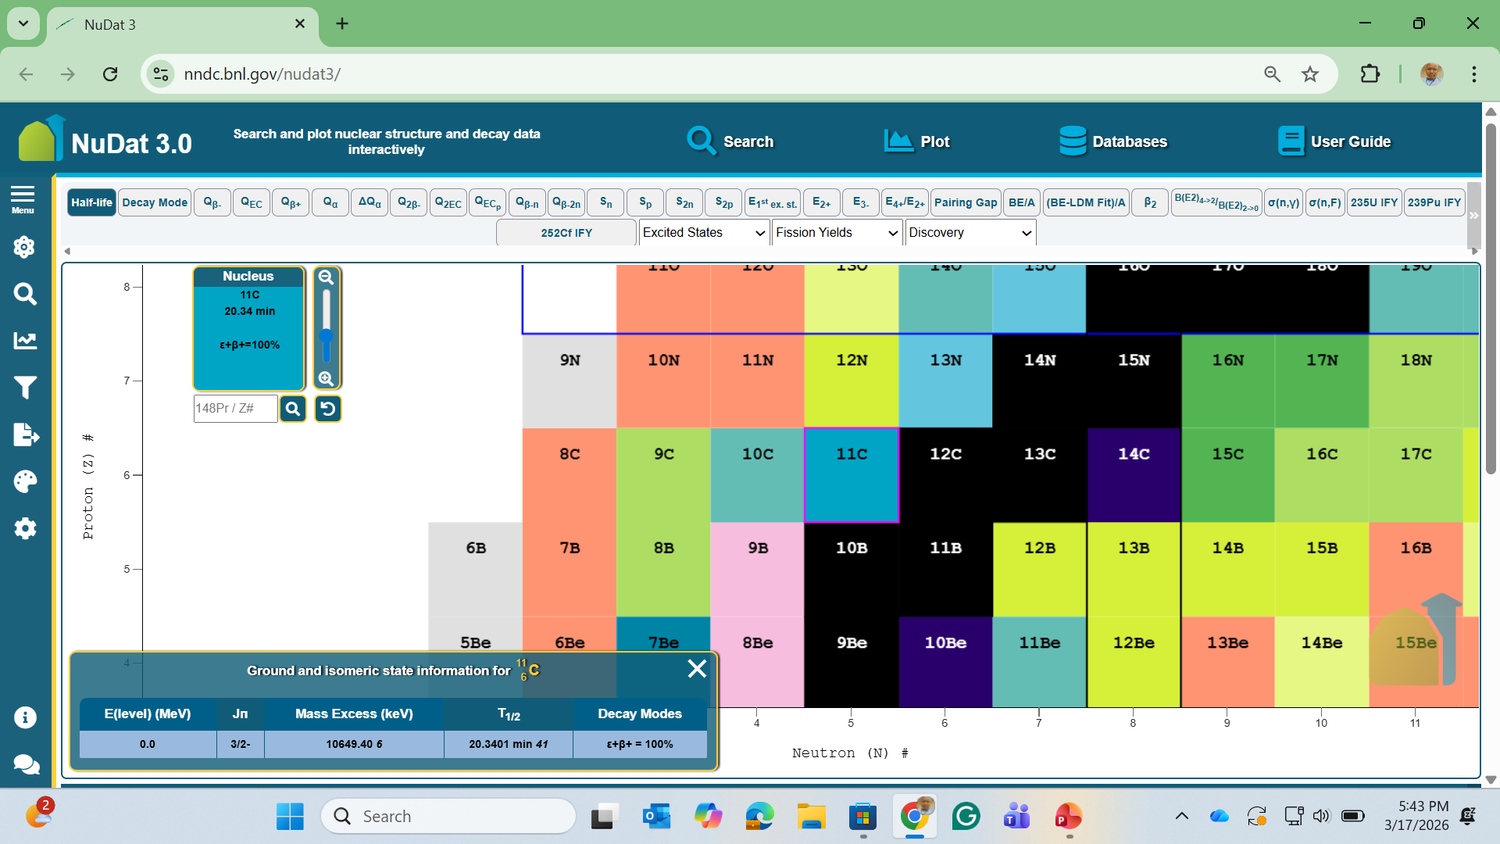
Results: Århus FDR Results: Background Analysis for MinPET Technology
How to search for activated isotope?
We explore the chart of nuclides to understand concepts like isotope stability, decay chains, and nuclear structure
The time differential spectroscopy, list mode to get both lifetime and energy in the nuclide ID
→Identify an energy peak in the energy spectra
→ Fit the peak with a Gaussian to confirm its energy
→ Note the peak energy and search it on the online Table of Radioactive Isotopes database
→ Use the search results to identify which isotope is more suitable for the identified energy peak
→ Fit the identified isotope(s) and check agreement with the isotope lifetime
ENDF provides quantitative data describing how radiation and neutrons interact with matter: Cross Sections, Angular and Energy Distributions, Decay Data, and Fission Product Yields.
[8] “Decay data search.” http://nucleardata.nuclear.lu.se/toi/radSearch.asp.

Slide 9
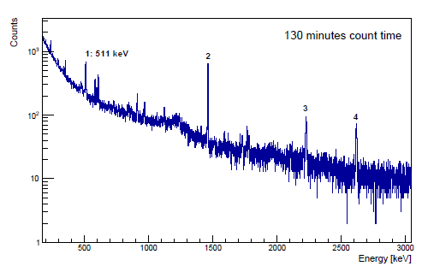
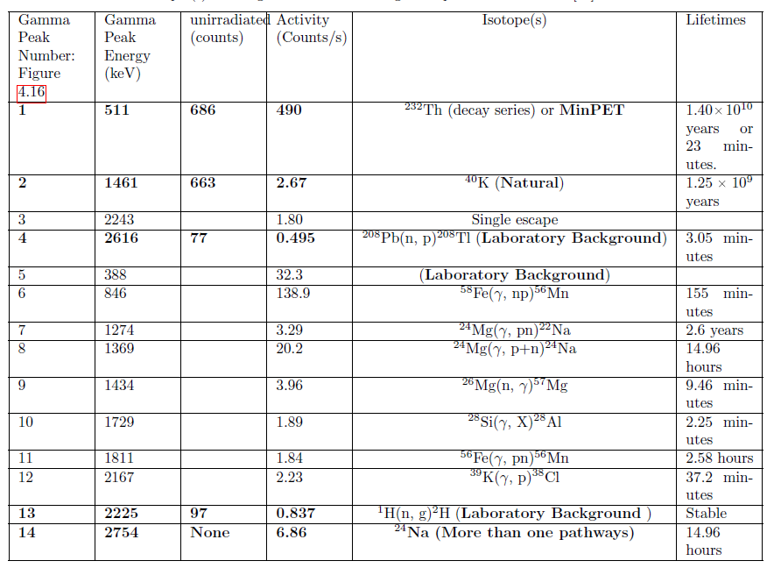
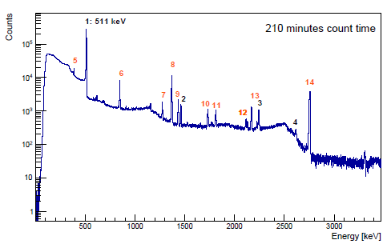
Results: Århus FDR Results: Background Analysis for MinPET Technology
Time-integrated gamma-ray energy spectra of the unirradiated K6 rock sample were measured
for 130 minutes.
Comparison between HPGe detector results of K6 unirradiated and K6 irradiated rocks’ gamma peaks. Gamma peaks found in both samples are compared based on their counts.
Time-integrated gamma-ray energy spectra of the irradiated K6 rock sample were measured
for 130 minutes.
[8] “Decay data search.” http://nucleardata.nuclear.lu.se/toi/radSearch.asp.

Slide 10
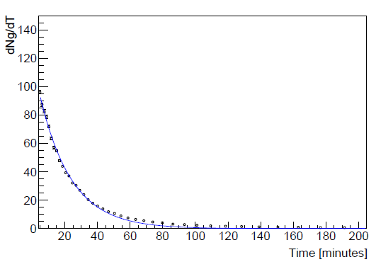
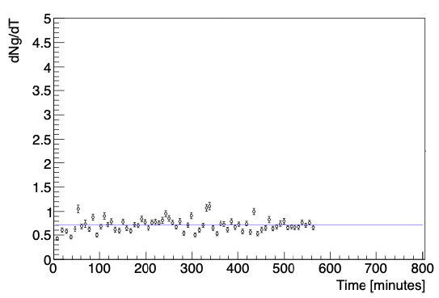
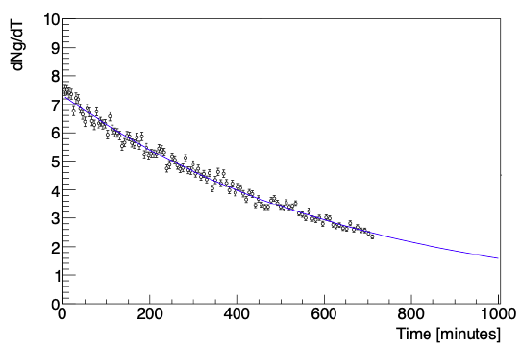
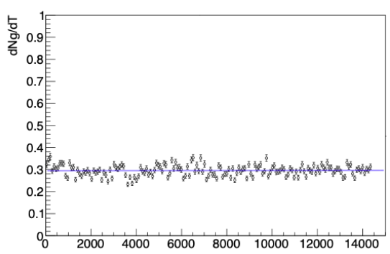
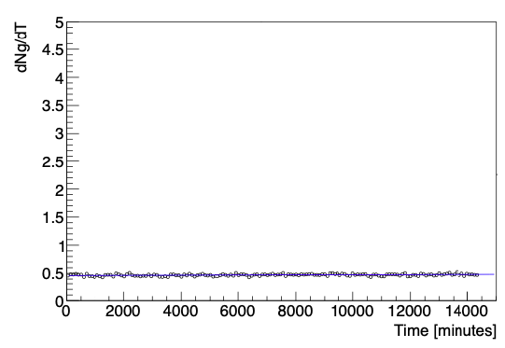
Results: Århus FDR Results: Background Analysis for MinPET Technology
511 keV
1461 keV
2754 keV
Fast decay: 2754 keV peak disappears within 15 hours.
Mainly from Mg and Al via photon reactions.
To prove that it decays below the IAEA limit (< Bq/g) within hours.
Activated 511 keV (¹¹C) decays rapidly – Lifetime of t_{1/2} = 22.7 ± 2.09 minutes, dropping to background levels (~0.3 counts/min) within ~100 minutes.
Natural 511 keV (²³²Th) remains constant – Persists at ~0.3 counts/min even after 3 days cooling and 12 days measurement, confirming NORM origin.
Exponential decay vs. constant background enables clear differentiation.
⁴⁰K activity is constant – In both irradiated and unirradiated samples, the 1461 keV peak shows no decay over time.
Extremely long half-life – ⁴⁰K is effectively stable on experimental timescales, confirming it as NORM.
Constant activity in both samples confirms ⁴⁰K is the natural background, unaffected by irradiation.
[8] “Decay data search.” http://nucleardata.nuclear.lu.se/toi/radSearch.asp.

Slide 11
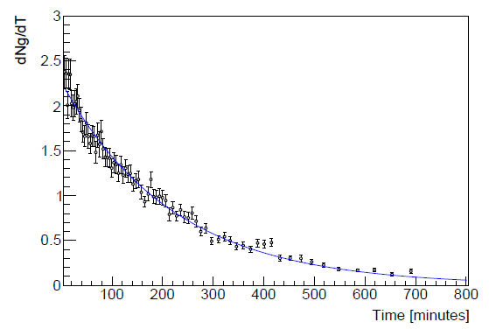
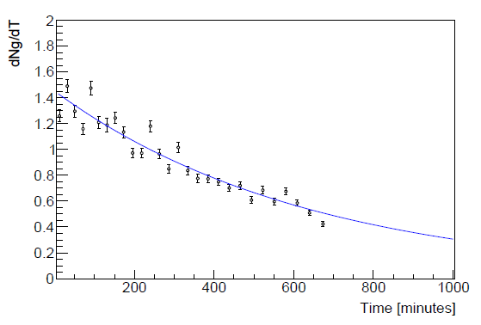
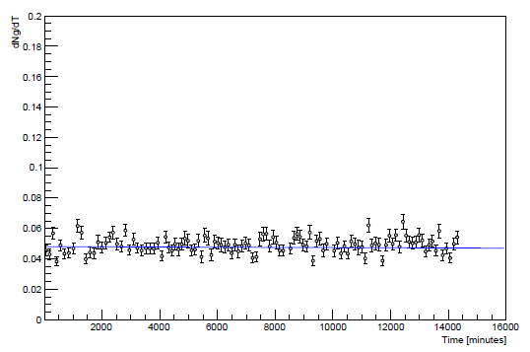
Results: Århus FDR Results: Background Analysis for MinPET Technology
846 keV
2243 keV
2614 keV
The resulting fit yielded an effective half-life of t_{1/2} = 17.1 ± 1.3 hours.
There are no good isotope candidates with this energy and half-life that can be reasonably linked to an activation pathway originating from the kimberlite constituent elements.
Notably, the energy difference of 2754 - 511 = 2243 keV suggests that this gamma peak is likely a single escape peak.
The original gamma ray would then be for 24Na. The half-life is also a sufficiently close match. A single escape peak occurs when a gamma photon undergoes.
The peak intensity was too weak to yield meaningful statistical information, and no reliable data could be extracted for further analysis.
Based on these results, we conclude that the 2617 keV feature is most likely attributable to laboratory background rather than to activation of the kimberlite sample. A plausible explanation is that the peak arises from a neutron-induced reaction in the laboratory environment.
²⁰⁸Pb(n, p)²⁰⁸Ti.
The decay fit yielded a half-life of t_{1/2} = 151 ± 2.6 minutes.
The most plausible candidate corresponding to this half-life is ⁵⁶Mn, which has a well-established half-life of 155 minutes and a strong gamma energy at 846.8 keV with an intensity of 99%.
The in this context is likely associated with the photonuclear reaction ⁵⁸Fe(γ, np)⁵⁶Mn, originating from the stable iron content present in the kimberlite rock.
[8] “Decay data search.” http://nucleardata.nuclear.lu.se/toi/radSearch.asp.

Slide 12
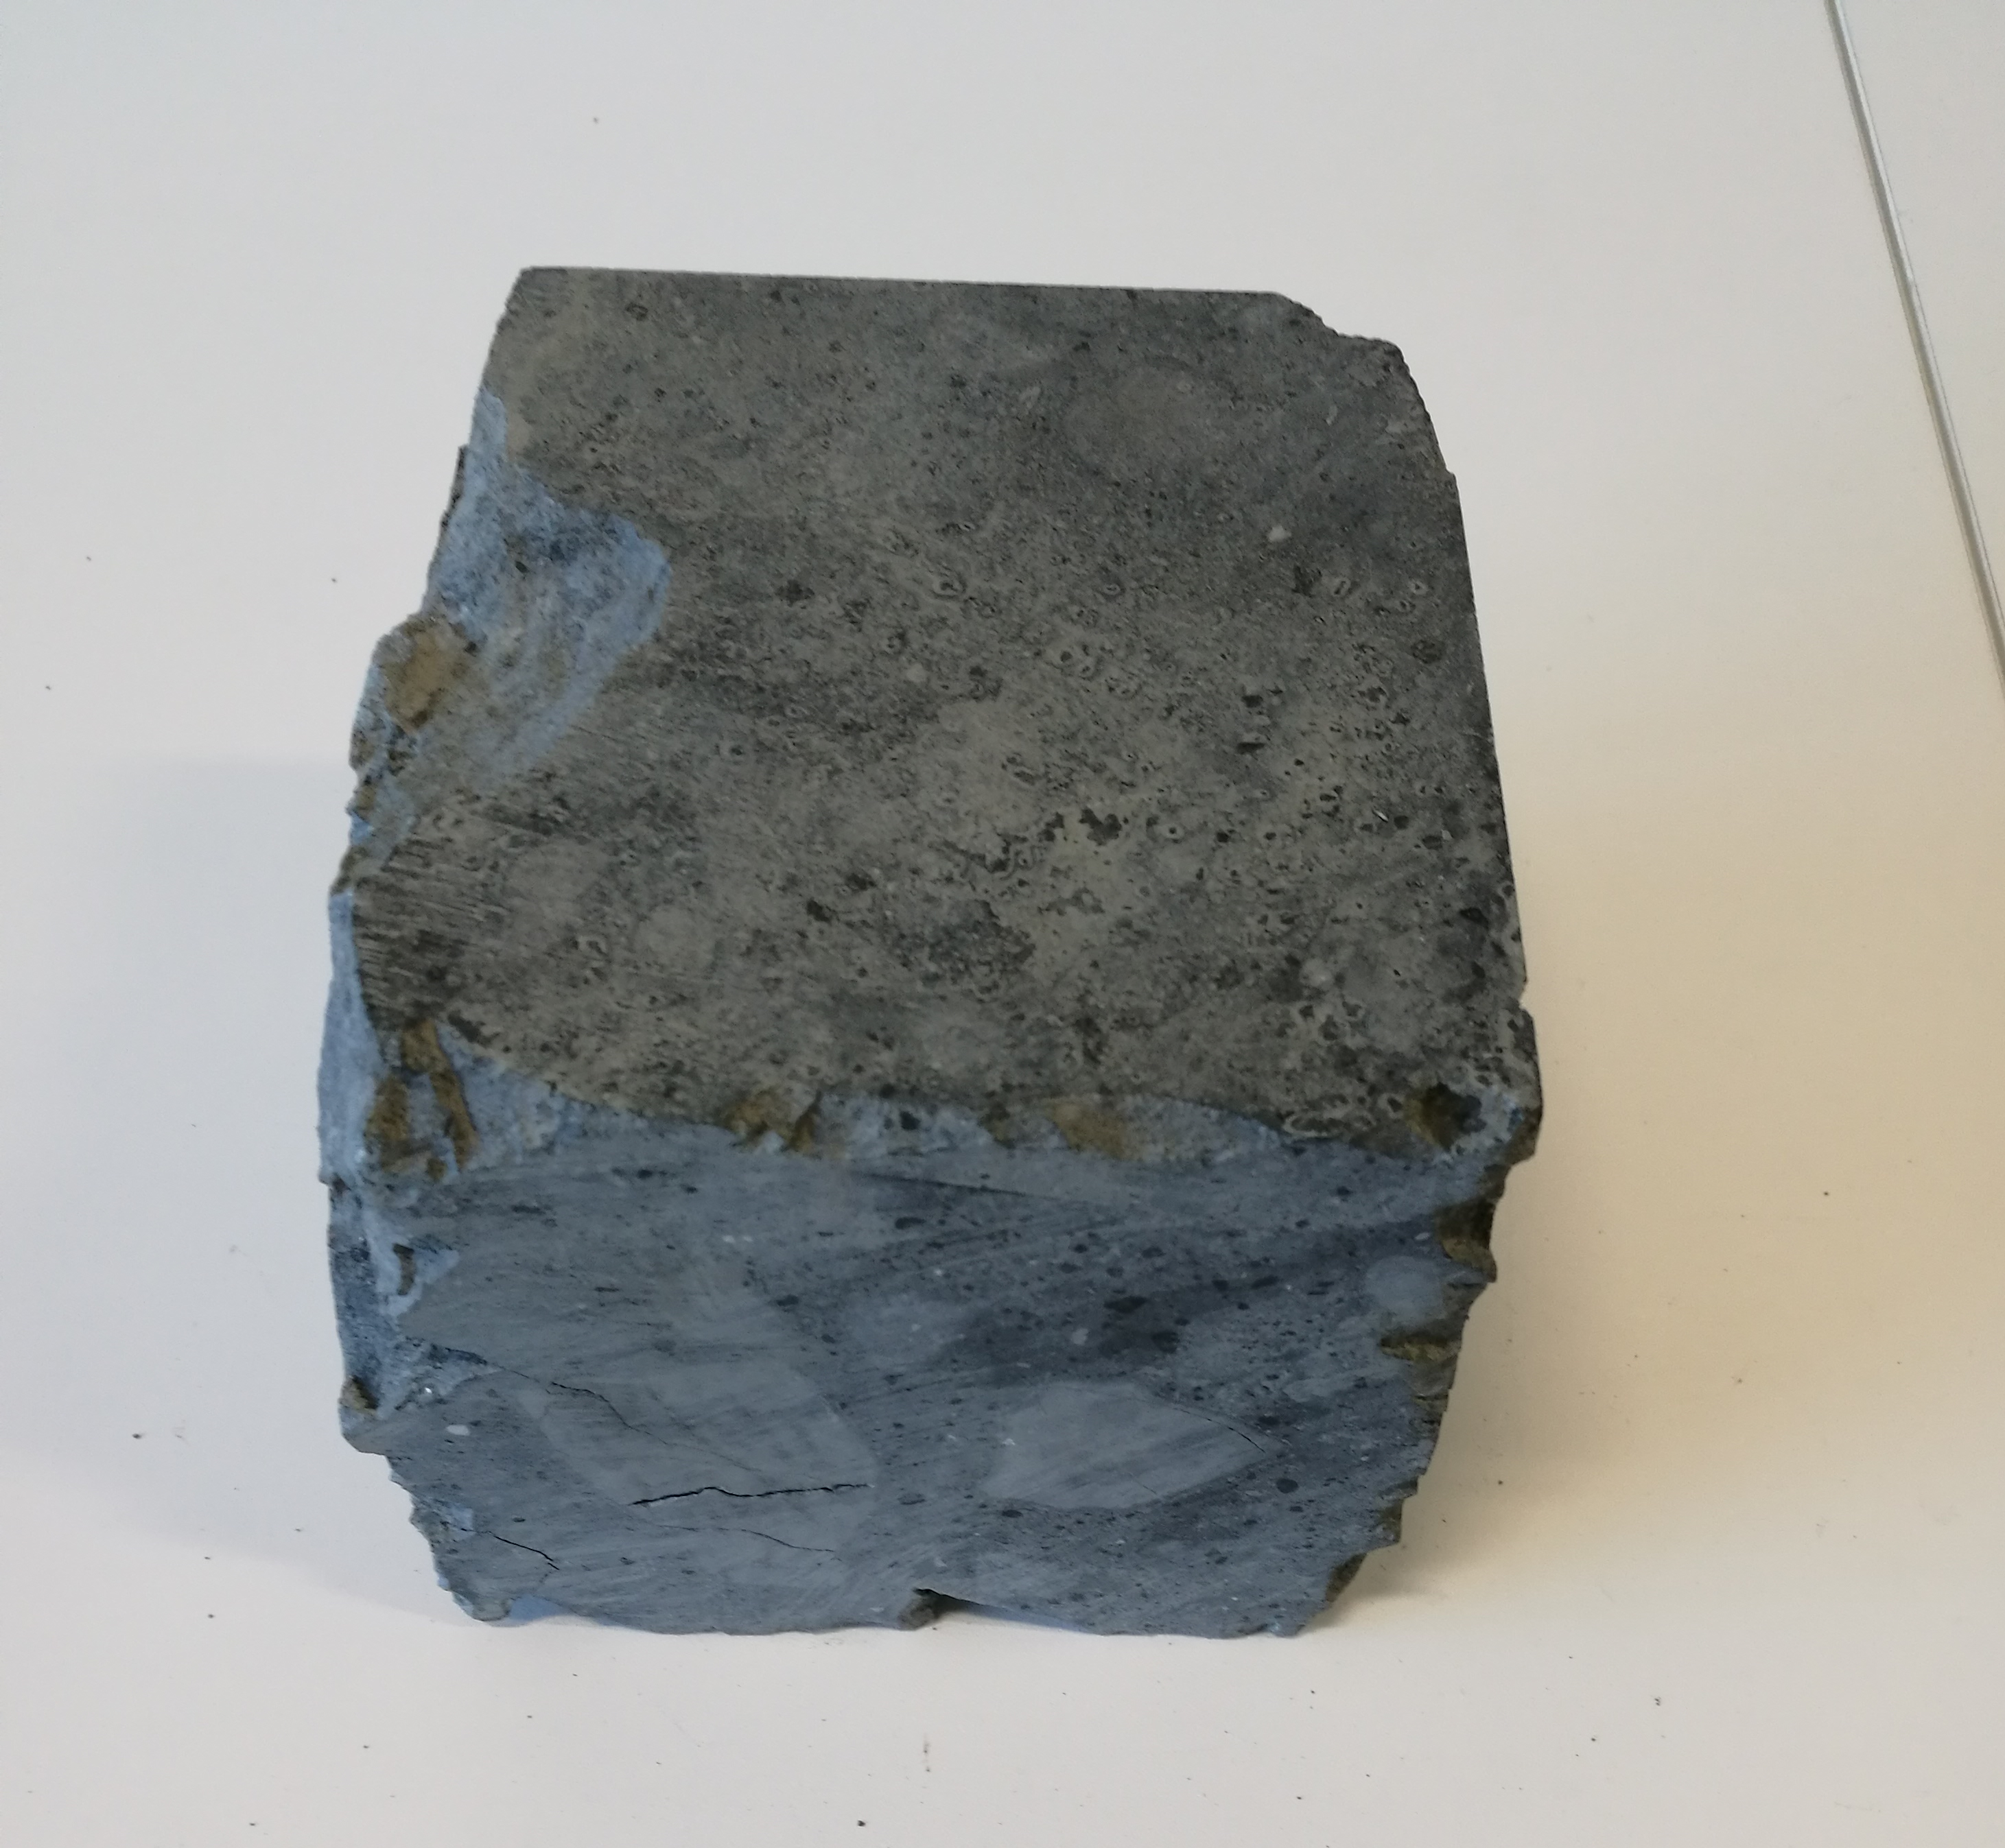
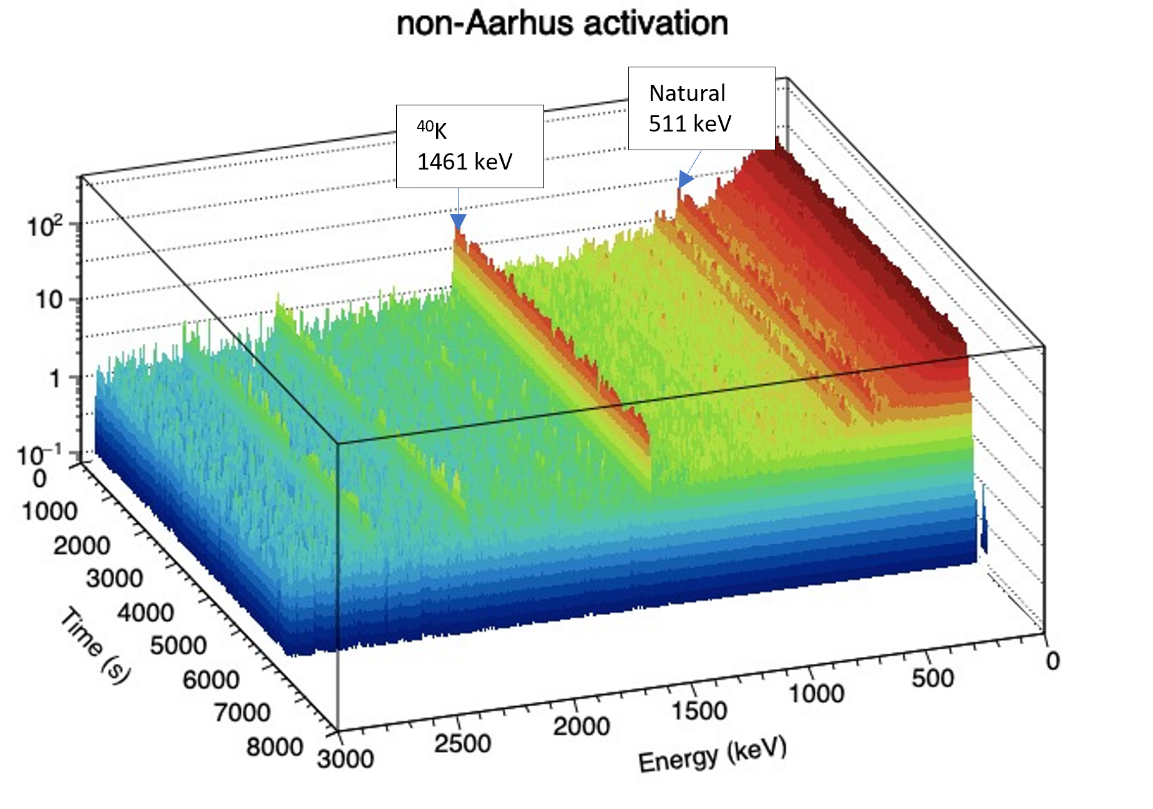
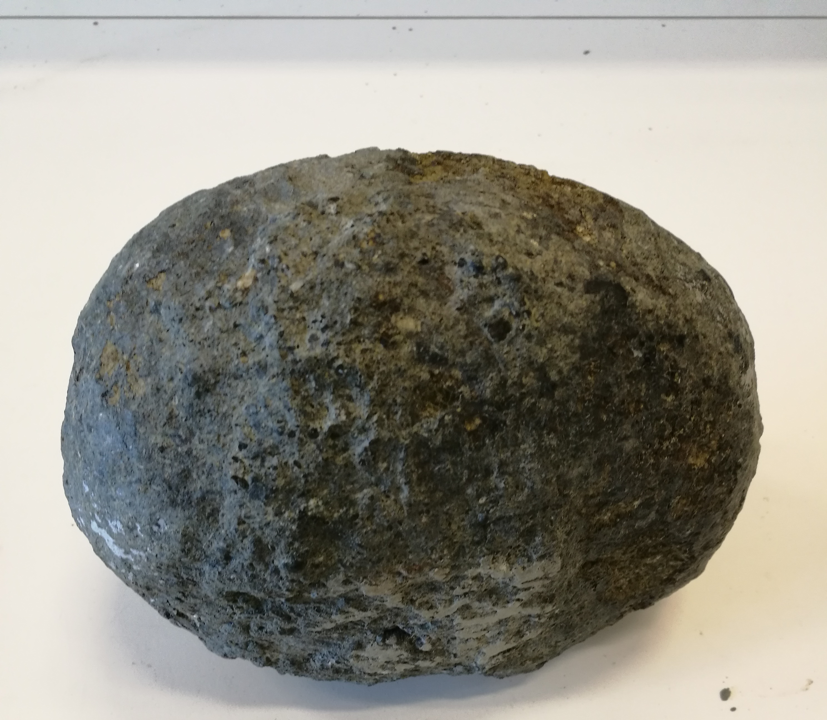
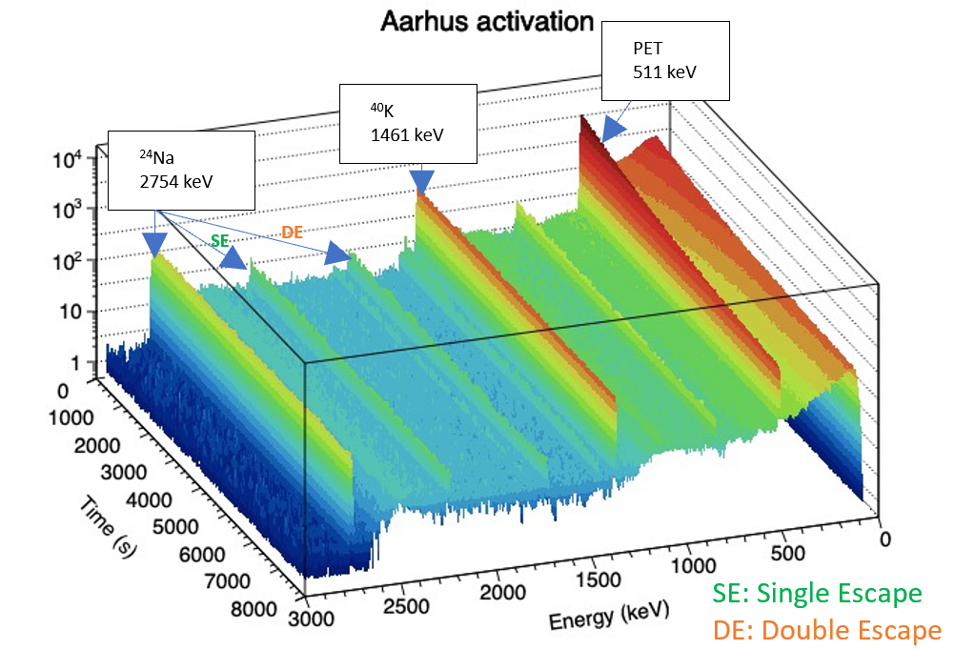
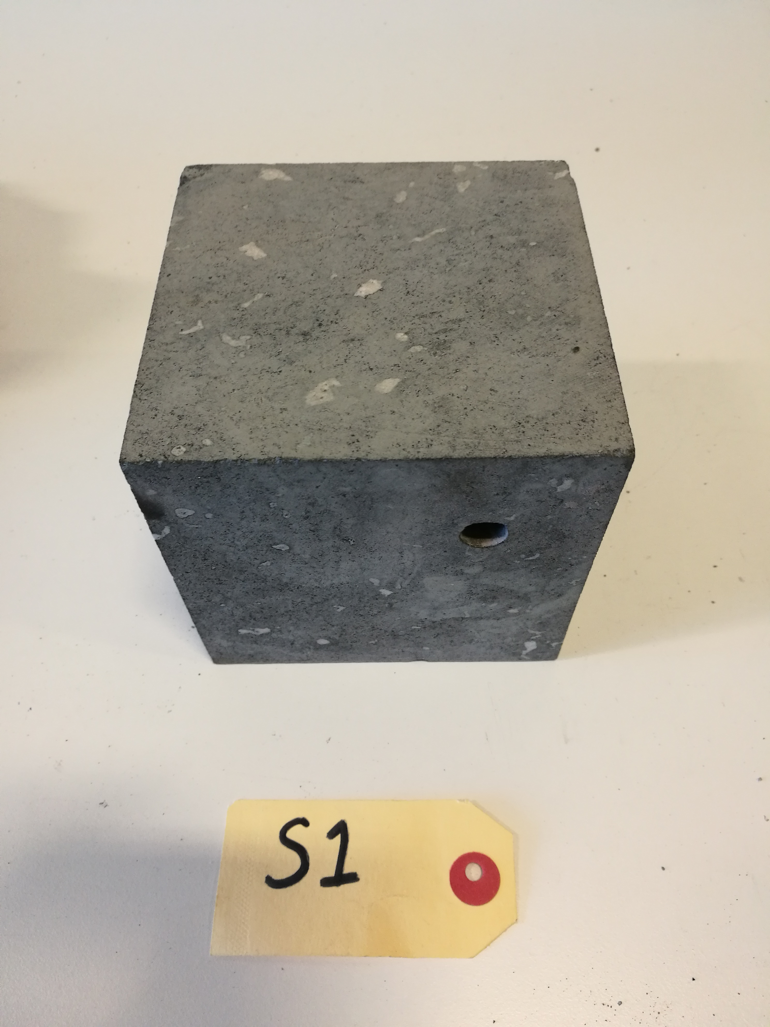
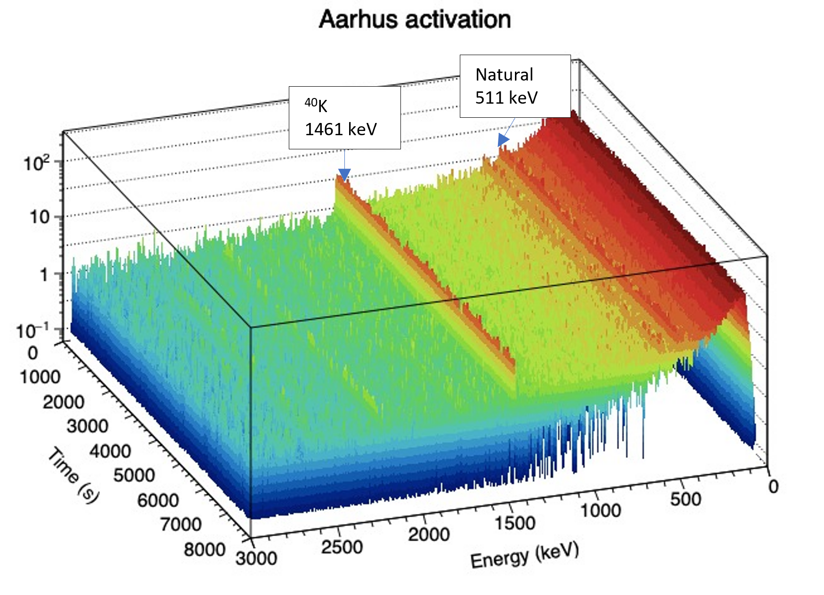
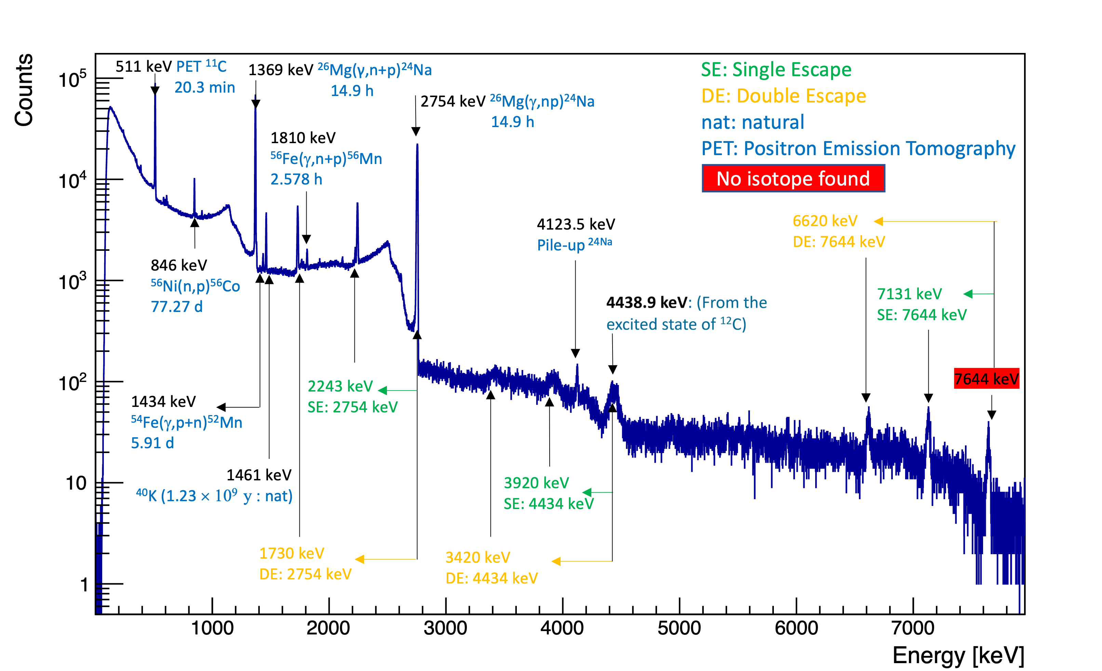
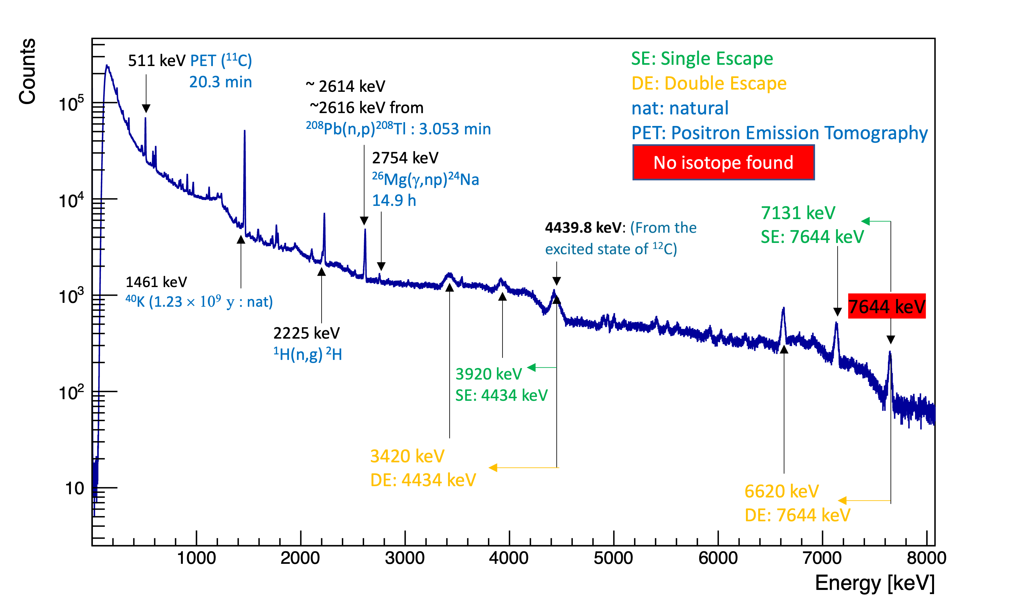

2D and 1D comparison of NORM and Activated Sample Spectra
Results: Århus FDR Results: Background Analysis for MinPET Technology
K4-Mantle Xenolith rock (shielded)
CRX-Basalt rock
K6 rock
Gamma Spectra After Irradiation — Short Cooling and Counting.
Long Cooling and Counting — ⁴⁰K Dominates as Other Isotopes Decay.
⁴⁰K: Visible, Constant, NORM
Notes:
Slide 2. 2D and 1D Energy spectra show the comparison between NORM and activated radioisotopes at different measurement times, showing the decay of activated PET isotopes over time. Long term cooling reduce the activity to background activity

Slide 13

Discussion and Conclusion
Industrial Need: MinPET addresses the demand for non-destructive 3D diamond detection while ensuring gem quality and radiological safety.
Experimental Foundation: FDR experiments at Århus University using kimberlite, basalt, and diamonds established activation signatures under MinPET-relevant conditions.
Radiological Safety: Activation is short-lived (hours), dominated by ¹¹C, ¹⁵O, and ²⁴Na. Long-lived activity matches natural NORM (⁴⁰K) — no lasting radiological footprint.
The results of this study demonstrate that the isotopes responsible for the observed gamma-ray peaks can be reliably identified and traced via spectral fitting.
Validated Simulations: Geant4 and FISPACT simulations, benchmarked against experiments, enabled the prediction of long-term activation and damage beyond measured intervals.
1986 Chernobyl nuclear disaster

Slide 14




Future work: Geant4 Simulations
The simulation models NORM activities—including uranium, potassium, and thorium—within mine dumps.
It provides insight into how varying soil cover thickness over tailings can reduce radiological exposure to the surrounding environment.
Future work will involve an experimental validation study using HPGe detectors to measure NORM activities from different soil profiles in the mine.
2 layers: 15 cm
2 layers: 4 cm
2 layers: 30 cm
Simulation results of the gamma spectra indicate that the addition of a second soil layer on top of the tailings decreases NORM activity exposure. The reduction is dependent on the thickness of the added layer.
Geant4 simulation of Naturally Occurring Radioactive Material (NORM) distribution across varying soil levels in mine dumps (green lines/regions indicate gamma radiation).
[9] J. Allison, K. Amako, J. Apostolakis, H. Araujo, P. A. Dubois, M. Asai, G. Barrand, R. Capra, S. Chauvie, R. Chytracek, et al., “Geant4 developments and applications,” IEEE Transactions on nuclear science, vol. 53, no. 1, pp. 270–278, 2006.

Slide 15
References
[1] S. Ballestrero, A. Roodt, M. Dalton, D. Unwucholaa, W. Mampe, R. Caveney, M. Phoku, N. Ives, S. Connell, M. Cook, et al., “Mineral-pet: Kimberlite sorting by nuclear-medical technology,” 2010.
[2] P. Mampe, The application of nuclear physics processes for diamond detection within kimberlite. PhD thesis, 2013.
[3] S. M. Phoku, The mineral-PET rock sorter: a study of the (y, n) activation process. PhD thesis, 2014.
[4] M. Cook, Remote Detection of Light Elements Using Positron Emission Tomography. PhD thesis, 2014
[5] S. Tappe, “Report on Global Kimberlite Major Element Compositions,” Private UJ report, 2016.
[6] R. Hart, “Table of kimberlite compositions,” Private Correspondence, 2007.
[7] “Decay data search.” http://nucleardata.nuclear.lu.se/toi/radSearch.asp.
[8] “Table of nuclides.” https://www-nds.iaea.org/relnsd/vcharthtml/VChartHTML.html. Accessed: 2017-09-27.
[9] A. Koning, D. Rochman, J.-C. Sublet, N. Dzysiuk, M. Fleming, and S. Van der Marck, “Tendl: complete nuclear data library for innovative nuclear science and technology,” Nuclear Data Sheets, vol. 155, pp. 1–55, 2019.
[10] “ENDF: Evaluated Nuclear Data File.

Slide 16



