Slide 1


Rare Earth Elements as Geochemical Tracers for Environmental Radioecological Monitoring: A Multivariate Assessment of Surface Soils from Mrima hills, Kenya
Ruth Wabwileª, Liteboho Ntsohiª, Iyabo Usmanª,, Dazmen Mavunda^{b}, Pamela Kageliza Kilavi^{c}
School of Physics, University of the Witwatersrand, Johannesburg, South Africa.
School of Mechanical Engineering, University of Johannesburg, South Africa.
School of Computing and Engineering Sciences, Strathmore University, Nairobi, Kenya.

Slide 2
Content
Introduction
Study Area
Methodology
Results and Discussions
Conclusion
Acknowledgements & Future Work

Slide 3
Introduction
Rare Earth Elements (REEs), are a group of metals comprising of the lanthanides (Lanthanum – La, Cerium – Ce, Praseodymium – Pr, Neodymium – Nd, Samarium – Sm, Europium – Eu, Gadolinium – Gd, Terbium – Tb, Dysprosium – Dy, Holmium – Ho, Erbium– Er, Thulium – Tm, Ytterbium – Yb, and Lutetium – Lu), Yttrium (Y) and Scandium (Sc), according to the International Union of Pure and Applied Chemistry (IUPAC), due to their shared periodic group alignment, chemical properties, and co-occurrence in similar ore deposits (Magdas et al., 2025).
Based on their atomic mass, REEs can be categorized into light REEs (LREEs): La, Ce, Pr, Nd, Sm, Eu, and Gd, that are less mobile and heavy REEs (HREEs): Tb, Dy, Ho, Er, Tm, Yb, Lu, as well as Y and Sc that are slightly more mobile (Magdas et al., 2025).
The most REE-enriched igneous or magmatic rocks are carbonatites (RE Harmer and PAM Nex, 2016) mostly found in rift zones of Eastern Africa as radiothermic carbonatite complexes which are unique (Gregory et al., 2022)].
Mrima hills contain thorium (232Th) and uranium (238U), iron (Fe) , depleted 40K levels, nickel (Ni), zirconium (Zr), zinc (Zn) lead (Pb), titanium, phosphates, barium, rare earth elements, niobium, Monazite minerals (Adri´an et al., 2020, Kilavi P. K. 2018).
REEs exhibit relatively low mobility (Nimila et al., 2020, Larissa et al., 2021); these make them valuable geochemical tracers for tracing natural processes as they preserve the geochemical signature of the parent material (Kun and Graham, 2023, Ver´onica et al., 2023, Wilkin et al., 2021) to monitor environmental distribution of radionuclides (controlled primarily by lithology, weathering, adsorption, or anthropogenic inputs).
The REE-Th-U relationship makes the rare earth elements suitable geochemical tracers for environmental radioecological monitoring.

Slide 4
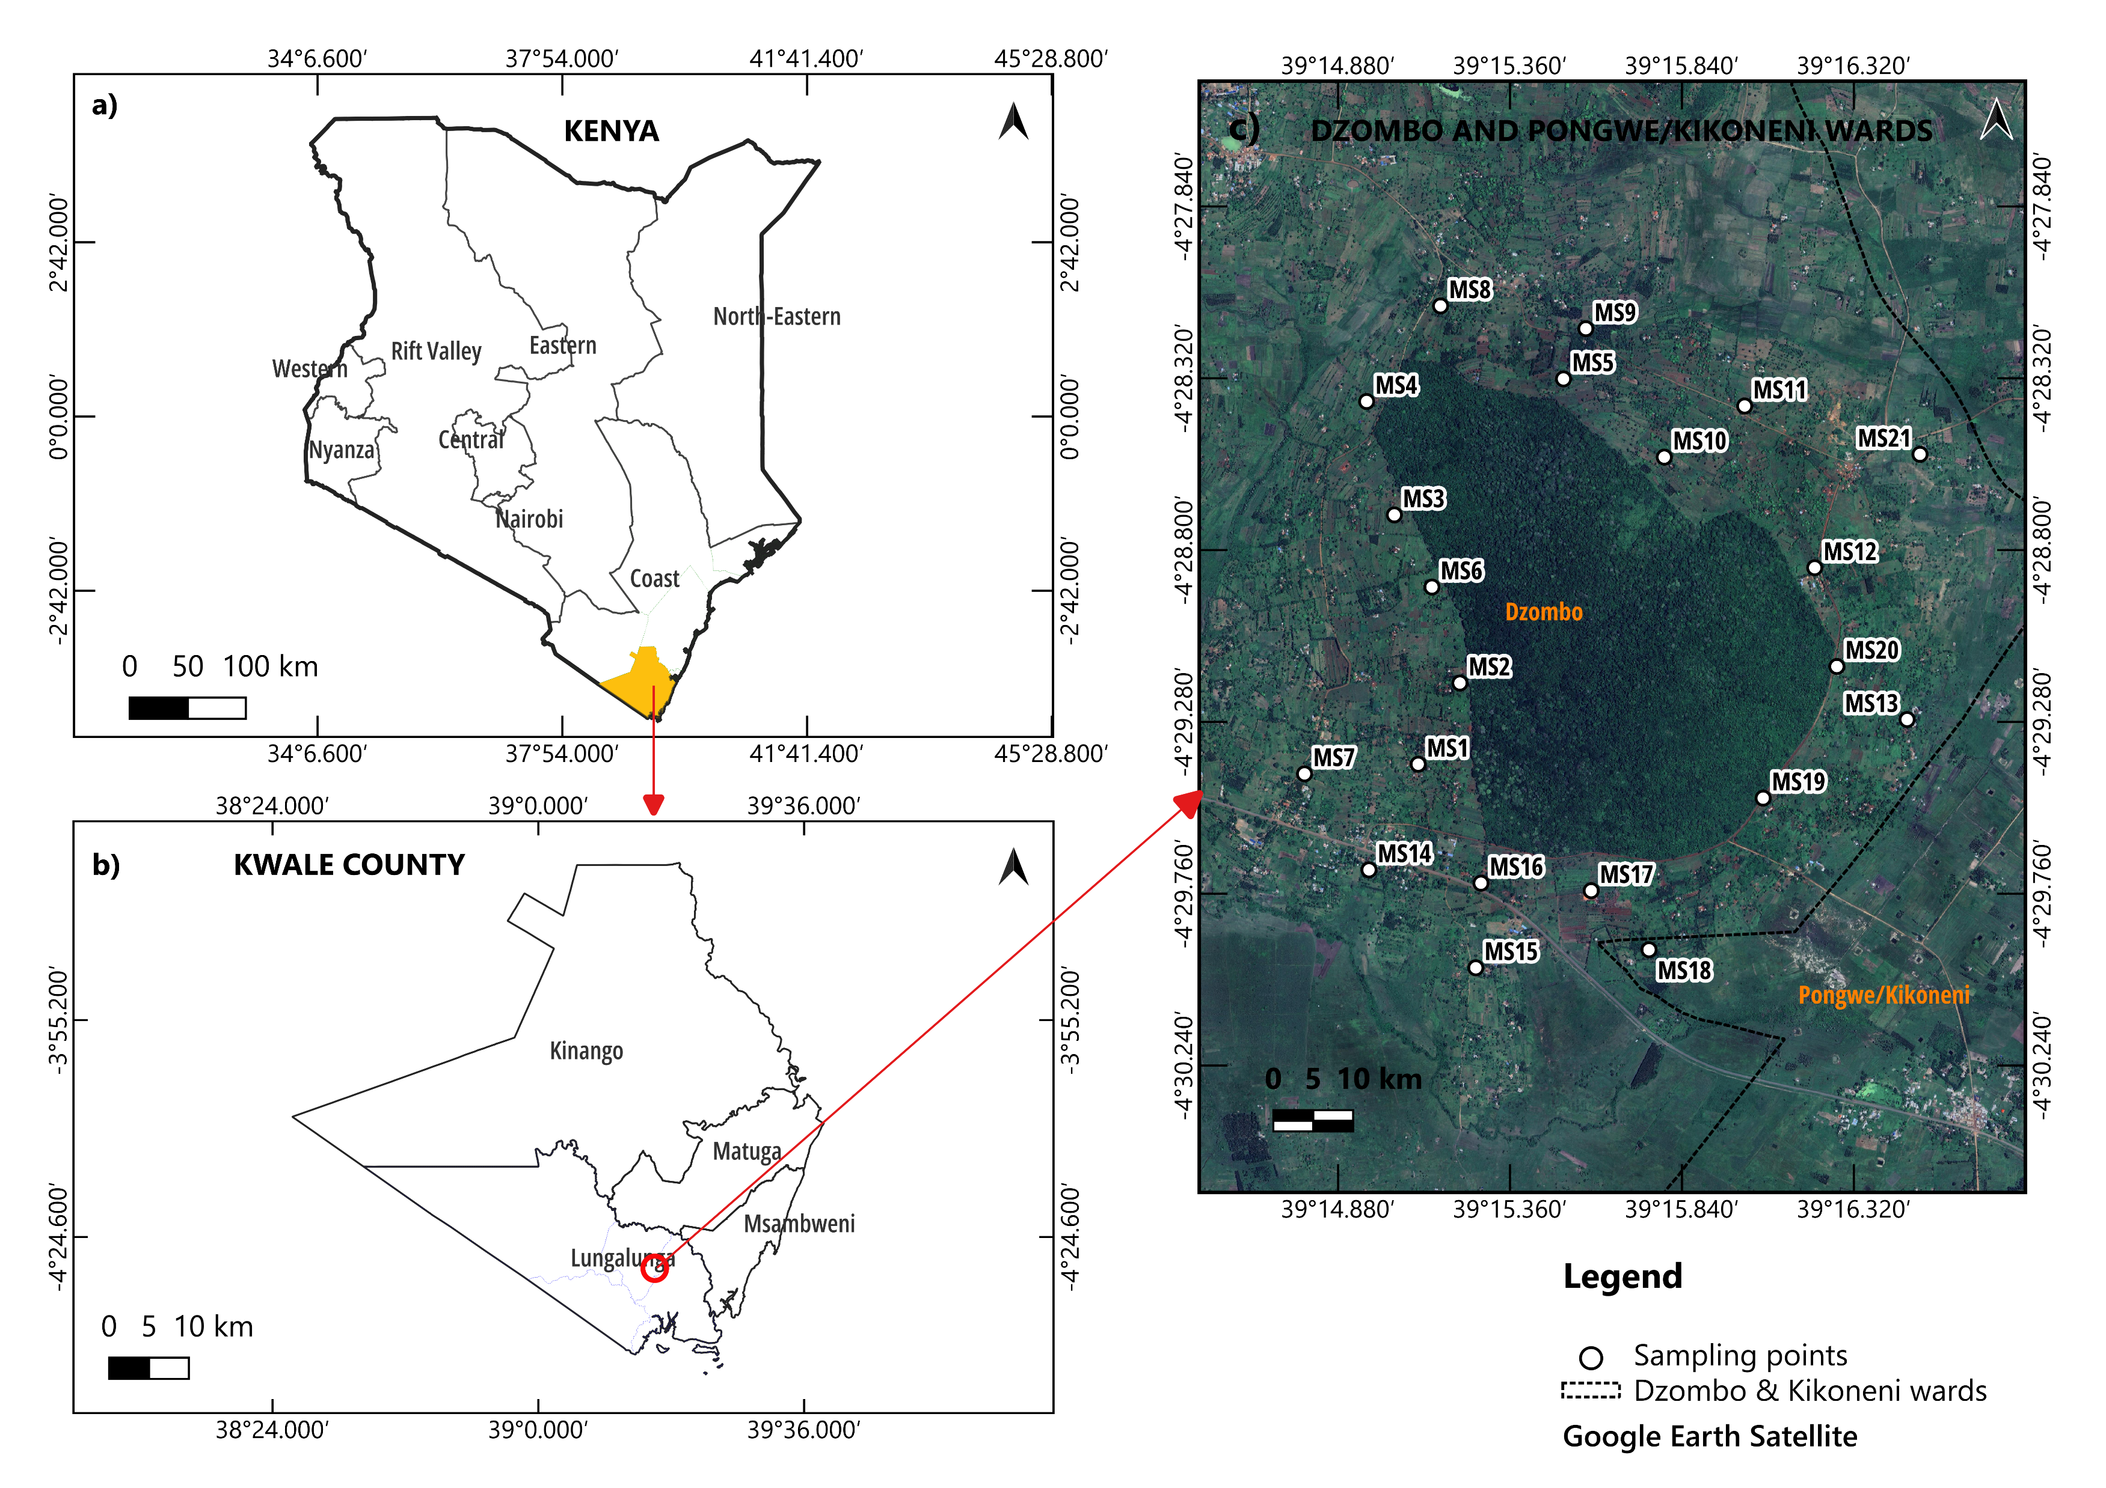
Study Area
a) Map of Kenya (b) Administrative map of Kwale county (c) Sampling locations in Mrima hills, overlaid on Google Earth Satellite map.

Slide 5
Methodology
Sample collection (21soil samples 0-20 cm depth collected at four nodes at each sampling point in March 2019 Kilavi P. K. (2018))
Sample preparation (Soil air-dried at ambient temperature, crushed into smaller sizes using a mortar and pestle, auto-sieved to a particle size of 25 μm through a Retsch AS 200® 3-stage vibratory sieve shaker operating at 460 W and 100 Hz, and soil at each sampling point was mixed into a composite sample
Wavelength Dispersed XRF (WDXRF) Panalytical X-ray fluorescence spectrometer, fused disk, (SiO₂, Al₂O₃, Fe₂O₃, TiO₂, MnO, MgO, CaO, Na₂O, K₂O, P₂O₅, Cr₂O₃, NiO, L,O,I)
ICP-MS Thermo Scientific iCAP RQ, samples digested in an open beaker/hotplate method, (REEs, Sc, Y, Pb, Th, U)
QA/QC (synthetic oxide mixtures and international standard rocks as well as in-house controls (100% SiO₂, 60% CaO+40%SiO₂, 40%Fe₂O₃+60% SiO₂). USGS Certified reference materials(BCR-2, BHVO-2, BIR-1a), AGV2, G2, GSP2, NIM-D, NIM-G, NIM-N, NIM-P, NIM-S, and W2
Statistical analysis (Major oxides, ΣREE, ΣLREE, ΣHREE, Ce/Ce*, Eu/Eu*, Pearson correlation, PCA, and geoaccumulation index)
Interpretation

Slide 6
Statistics

Slide 7
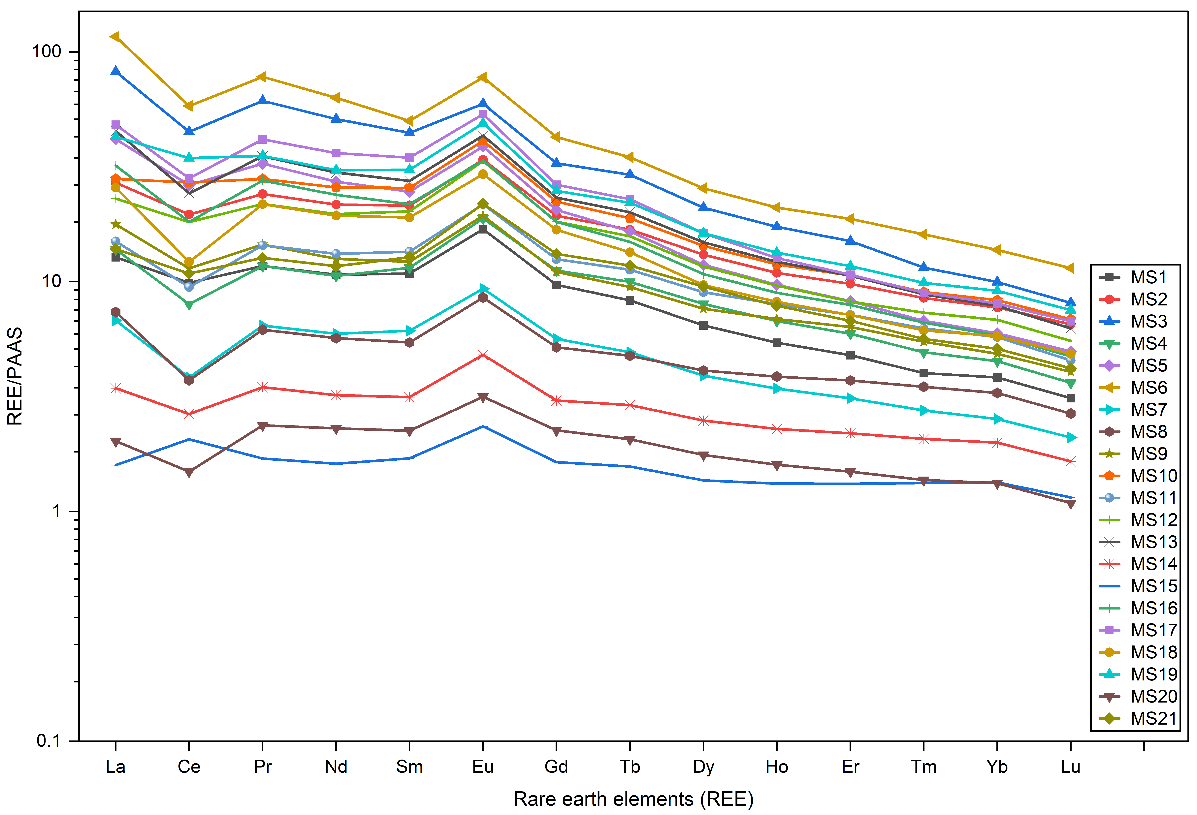
Results and Discussion
Geochemical Characteristics
Post-Archean Australian shale (PAAS)-normalized patterns (to clear Oddo–Harkins/zig-zag patterns) for rare earth elements concentrations in Mrima soils. PAAS for REEs obtained from Taylor, S. R., & McLennan, S. M. (1985).
Negative Ce anomalies are indicators of natural geochemical processes, where Ce remains in its trivalent form (Ce³⁺) and is less likely to be removed from the dissolved phase.
Positive Eu anomalies indicates minerals derived from source rocks.

Slide 8
Radioecological Characteristics
(a)
(b)
(a) Soil concentrations relative to PAAS composition in different locations.
(b) Pb concentration and the activities of 232Th and 238U.
Trace elements (Pb, Th, U) relative enrichment compared with PAAS. The PAAS for Pb, Th and U obtained from Taylor, S. R., & McLennan, S. M. (1985).
232Th activities vary considerably suggesting differing abundances of Th-bearing minerals.
238U activities low: natural uranium abundance, uranium's greater mobility and follows the Th pattern.
Pb concentration shows several pronounced peaks, is either dominated by geological sources or localized anthropogenic activities.
Thus observed natural radioactivity is due to geochemical enrichment of Th.

Slide 9
Rare Earth Elements Fractionation
ΣPAAS normalized REE
Variation in Ce/Ce*, Eu/Eu*, and ΣPAAS-normalized REE across the sampling locations. The left y-axis (Ce/Ce* and Eu/Eu*) is displayed on a linear scale, whereas the right y-axis (ΣPAAS-normalized REE) is displayed on a base-10 logarithmic scale.
Both Ce and Eu anomalies vary independently of total REE (ΣREE) abundance.
Ce anomalies are not directly controlled by total REE abundance but rather by localized redox and weathering processes.
Eu anomalies exhibit comparatively limited spatial variation, suggesting relatively uniform mineralogical control across the study area.

Slide 10
Geoaccumulation Index (Igeo)
The geoaccumulation index of ΣREE derived using the summed PAAS background concentration to evaluate the relative geochemical enrichment of the total rare earth element. The index is interpreted as an indicator of natural REE enrichment not contamination (Muller, 1979).
Relative geochemical enrichment of ΣREE, Pb, Th and U in the soil. ΣREE exhibits the highest relative enrichment, Th generally exceeds U, and Pb exhibits moderate enrichment.
MS15 and MS20, ΣREE remained slightly enriched despite lower Igeo values for the radionuclides and might be due to variations in the abundance of REE-bearing accessory minerals and greater mobility of uranium under near-surface weathering conditions. It indicates heterogeneity in the study area.
Elevated IgeoΣREE values represent relative lithogenic enrichment rather than anthropogenic contamination.

Slide 11
Pearson’s Correlation matrix heatmap
Pearson’s Correlation matrix heatmap showing the correlation between Major oxides, Log10(Sc), Log10(Y), Log10(Pb), Log10(²³²Th), Log10(²³⁸U), Log10(ΣLREE), Log10(ΣHREE), ΣLREE/ΣHREE, Log10(ΣREE), Ce /Ce*, and Eu/Eu* in soil samples
 | Pearson Correlation (r- and -p values heatmap)
 | SiO2 | Al2O3 | Fe2O3 | TiO2 | MnO | MgO | CaO | Na2O | K2O | P2O5 | Cr2O3 | NiO | L,O,I, | Log10(Sc) | Log10(Y) | Log10(Pb) | Log10(232Th) | Log10(238U) | Log10(ΣLREE) | Log10(ΣHREE) | ΣLREE/ΣHREE | Log10(ΣREE) | Ce /Ce* | Eu/Eu*
SiO2 | 1 | -0.7784 | -0.93831 | -0.78077 | -0.9044 | -0.1523 | -0.422 | 0.620414 | 0.32803 | -0.8089 | -0.875 | -0.7992 | -0.8744 | -0.93219 | -0.9172 | -0.74759 | -0.85132873 | -0.8988055 | -0.9210896 | -0.88213891 | -0.76504222 | -0.9201381 | 0.1766 | -0.706
Al2O3 | -0.778*** | 1 | 0.57483 | 0.524202 | 0.55979 | 0.0356 | 0.1256 | -0.44068 | -0.16568 | 0.31853 | 0.50471 | 0.67917 | 0.70491 | 0.82224 | 0.71186 | 0.58314 | 0.80036716 | 0.59284667 | 0.68669981 | 0.664872341 | 0.523009075 | 0.68574582 | -0.187 | 0.7978
Fe2O3 | -0.938*** | 0.575** | 1 | 0.739026 | 0.94481 | 0.1213 | 0.3505 | -0.65851 | -0.46544 | 0.91352 | 0.93781 | 0.74743 | 0.73732 | 0.82703 | 0.89056 | 0.64245 | 0.761200484 | 0.90137257 | 0.90973628 | 0.862489915 | 0.800123242 | 0.90872981 | -0.177 | 0.5272
TiO2 | -0.781*** | 0.524* | 0.739*** | 1 | 0.6892 | -0.3346 | 0.2881 | -0.52127 | -0.45356 | 0.63616 | 0.76655 | 0.60923 | 0.77314 | 0.69069 | 0.63562 | 0.66103 | 0.600430941 | 0.75080955 | 0.64047771 | 0.589616356 | 0.61255892 | 0.63876962 | -0.34 | 0.3351
MnO | -0.904*** | 0.56** | 0.945*** | 0.689*** | 1 | 0.1985 | 0.3179 | -0.65498 | -0.36819 | 0.88789 | 0.93619 | 0.76293 | 0.70995 | 0.83908 | 0.87521 | 0.62942 | 0.75803963 | 0.84885654 | 0.88624514 | 0.859190361 | 0.716446188 | 0.88617665 | -0.095 | 0.5682
MgO | -0.152 | 0.036 | 0.121 | -0.335 | 0.199 | 1 | 0.3065 | 0.153422 | 0.57248 | 0.28983 | 0.08319 | 0.1076 | 0.00708 | 0.22593 | 0.2182 | 0.0028 | 0.111366541 | 0.15418536 | 0.21555878 | 0.221706219 | 0.122064521 | 0.21576112 | 0.4713 | 0.3346
CaO | -0.422 | 0.126 | 0.35 | 0.288 | 0.318 | 0.307 | 1 | -0.12539 | 0.1661 | 0.4597 | 0.23477 | 0.17288 | 0.46173 | 0.33282 | 0.30342 | 0.54926 | 0.203715032 | 0.35587257 | 0.33014279 | 0.32035512 | 0.251696732 | 0.33006213 | 0.0096 | 0.2878
Na2O | 0.62** | -0.441* | -0.659** | -0.521* | -0.655** | 0.153 | -0.125 | 1 | 0.80015 | -0.5428 | -0.6934 | -0.6715 | -0.6811 | -0.56713 | -0.7543 | -0.4644 | -0.72018737 | -0.5194925 | -0.73577644 | -0.75768059 | -0.48058603 | -0.7384444 | 0.7577 | -0.544
K2O | 0.328 | -0.166 | -0.465* | -0.454* | -0.368 | 0.572** | 0.166 | 0.8*** | 1 | -0.3085 | -0.4892 | -0.4224 | -0.3979 | -0.24396 | -0.4497 | -0.21104 | -0.43172574 | -0.2915238 | -0.4602373 | -0.46131022 | -0.35151417 | -0.4616561 | 0.7414 | -0.142
P2O5 | -0.809*** | 0.319 | 0.914*** | 0.636** | 0.888*** | 0.29 | 0.46* | -0.543* | -0.3089 | 1 | 0.89116 | 0.64969 | 0.58664 | 0.70975 | 0.79883 | 0.57641 | 0.634958563 | 0.84496862 | 0.81729523 | 0.7796693 | 0.711906272 | 0.81676113 | -0.059 | 0.4019
Cr2O3 | -0.875*** | 0.505* | 0.938*** | 0.767*** | 0.936*** | 0.083 | 0.235 | -0.693*** | -0.489* | 0.891*** | 1 | 0.78066 | 0.70744 | 0.82232 | 0.85806 | 0.58213 | 0.72321242 | 0.86569369 | 0.87032307 | 0.836663194 | 0.73272107 | 0.87007594 | -0.232 | 0.5105
NiO | -0.799*** | 0.679*** | 0.747*** | 0.609** | 0.763*** | 0.108 | 0.173 | -0.671*** | -0.422 | 0.65** | 0.781*** | 1 | 0.7159 | 0.85877 | 0.80353 | 0.56756 | 0.770808883 | 0.6506408 | 0.82424987 | 0.781840926 | 0.688330478 | 0.82293926 | -0.205 | 0.7111
L,O,I, | -0.874*** | 0.705*** | 0.737*** | 0.77*** | 0.71*** | 0.007 | 0.462* | -0.681*** | -0.398 | 0.587** | 0.707*** | 0.716*** | 1 | 0.8099 | 0.81004 | 0.75599 | 0.800705196 | 0.72572873 | 0.80015431 | 0.795035757 | 0.573718369 | 0.80079517 | -0.394 | 0.7156
Log10(Sc) | -0.932*** | 0.822*** | 0.827*** | 0.691*** | 0.839*** | 0.226 | 0.333 | -0.567** | -0.244 | 0.71*** | 0.822*** | 0.859*** | 0.81*** | 1 | 0.90054 | 0.7444 | 0.864326637 | 0.78181391 | 0.90555403 | 0.872886431 | 0.717347285 | 0.90464556 | -0.142 | 0.8317
Log10(Y) | -0.917*** | 0.712*** | 0.891*** | 0.636** | 0.875*** | 0.218 | 0.303 | -0.754*** | -0.45* | 0.799*** | 0.858*** | 0.804*** | 0.81*** | 0.901*** | 1 | 0.68988 | 0.94150262 | 0.83480129 | 0.98540328 | 0.988611288 | 0.682827005 | 0.98668706 | -0.319 | 0.7872
Log10(Pb) | -0.748*** | 0.583** | 0.642** | 0.661** | 0.629** | 0.003 | 0.549** | -0.464* | -0.211 | 0.576** | 582** | 0.568** | 0.756*** | 0.744*** | 0.69*** | 1 | 0.709607762 | 0.63746385 | 0.69042532 | 0.675175225 | 0.521017726 | 0.69026238 | -0.223 | 0.6078
Log10(232Th) | -0.851*** | 0.8*** | 0.761*** | 0.6** | 0.758*** | 0.111 | 0.204 | -0.72*** | -0.432 | 0.635** | 0.723*** | 0.771*** | 0.801*** | 0.864*** | 0.942*** | 0.71*** | 1 | 0.71167462 | 0.91941655 | 0.926608828 | 0.618604409 | 0.9206058 | -0.359 | 0.8117
Log10(238U) | -0.899*** | 0.593** | 0.901*** | 0.751*** | 0.849*** | 0.154 | 0.356 | -0.519* | -0.292 | 0.845*** | 0.866*** | 0.651** | 0.726*** | 0.782*** | 0.835*** | 0.637** | 0.712*** | 1 | 0.81496659 | 0.778880795 | 0.69304904 | 0.81408084 | -0.101 | 0.4822
Log10(ΣLREE) | -0.921*** | 0.687*** | 0.91*** | 0.64** | 0.886*** | 0.216 | 0.33 | -0.736*** | -0.46* | 0.817*** | 0.87*** | 0.824*** | 0.8*** | 0.906*** | 0.985*** | 0.69*** | 0.919*** | 0.815*** | 1 | 0.976628848 | 0.766582728 | 0.99993595 | -0.279 | 0.7655
Log10(ΣHREE) | -0.882*** | 0.665** | 0.862*** | 0.59** | 0.859*** | 0.222 | 0.32 | -0.758*** | -0.461* | 0.78*** | 0.837*** | 0.782*** | 0.795*** | 0.873*** | 0.989*** | 0.675*** | 0.927*** | 0.779*** | 0.977*** | 1 | 0.61253956 | 0.97897129 | -0.326 | 0.787
ΣLREE/ΣHREE | -0.765*** | 0.523* | 0.8*** | 0.613** | 0.716*** | 0.122 | 0.252 | -0.481* | -0.352 | 0.712*** | 0.733*** | 0.688*** | 0.574** | 0.717*** | 0.683*** | 0.521* | 0.619** | 0.693*** | 0.767*** | 0.613** | 1 | 0.75959385 | -0.091 | 0.4418
Log10(ΣREE) | -0.92*** | 0.686*** | 0.909*** | 0.639** | 0.886*** | 0.216 | 0.33 | -0.738*** | -0.462* | 0.817*** | 0.87*** | 0.823*** | 0.801*** | 0.905*** | 0.987*** | 0.69*** | 0.921*** | 0.814*** | 0.9999*** | 0.979*** | 0.76*** | 1 | -0.282 | 0.767
Ce /Ce* | 0.177 | -0.187 | -0.177 | -0.34 | -0.095 | 0.471* | 0.01 | 0.758*** | 0.741*** | -0.059 | -0.232 | -0.205 | -0.394 | -0.142 | -0.319 | -0.223 | -0.359 | -0.101 | -0.279 | -0.326 | -0.091 | -0.282 | 1 | -0.236
Eu/Eu* | -0.706*** | 0.798*** | 0.527* | 0.335 | 0.568** | 0.335 | 0.288 | -0.544* | -0.142 | 0.402 | 0.511* | 0.711*** | 0.716*** | 0.832*** | 0.787*** | 0.608** | 0.812*** | 0.482* | 0.766*** | 0.787*** | 0.442* | 0.767*** | -0.236 | 1
 | 1.00
 | 0.75
 | 0.50
 | 0.25
 | 0
 | -0.20
 | -0.50
 | -0.75
-1 | -1.00
The colour scale limits and p-value ranges. Circle size and colour indicate the strength and direction of correlation (dark blue = negative, dark red = positive).
Asterisks denote the statistical significance of correlations; ***p < 0.001 (highly significant), **p < 0.01 (very significant), *p < 0.05 (significant), and (no asterisk) p ≥ 0.05 (not significant),
Good correlation between REEs, Pb, Th, and U indicates common geochemical behaviour.

Slide 12
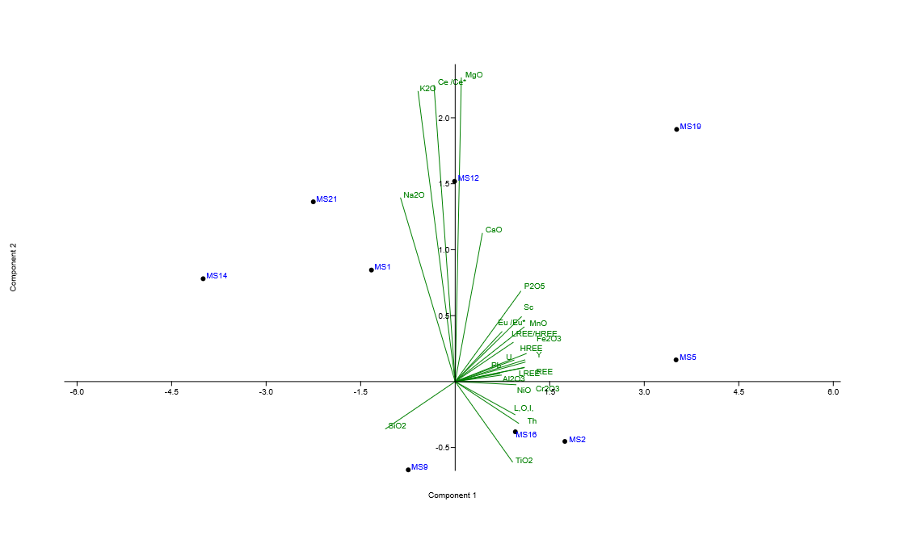
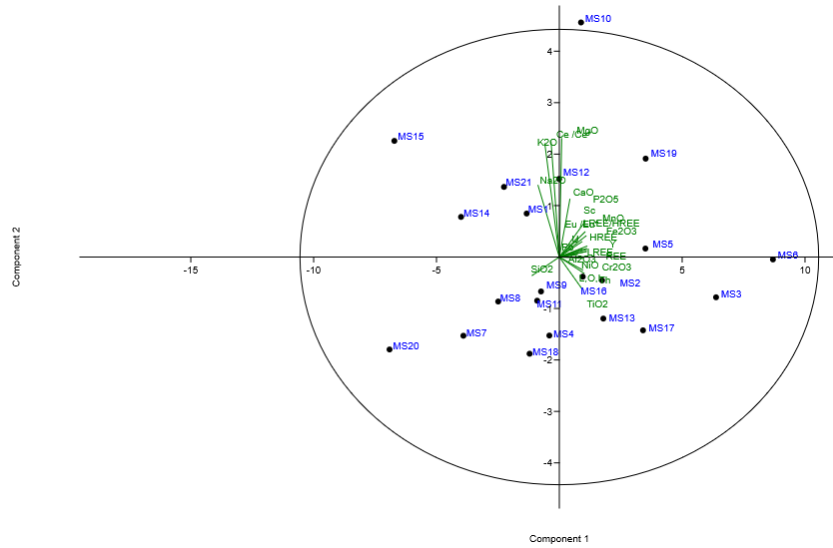
Principal Component Analysis (PCA)
(b)
(a)
PC2, 11.002%
PC1, 62.62%
(a) PCA 2D biplot (PC1 and PC2) (Cumulative variance of 73.622%) of major oxides, rare earth elements, Pb, Th, and U and the sampling locations. (b) Magnified area of interest of the PC1 and PC2.
PC1 shows the lithogenic control and PC2 the weathering/redox.
REEs cluster with Pb, Th and U, Ce anomaly behaves independently, and Eu anomaly represents mineralogical processes.
Pb concentration is not due to localized anthropogenic activities.

Slide 13
Results and Discussion
Geochemical evidence:
REEs show considerable natural variability, Th generally exceeds U and a strong LREE enrichment observed
ΣLREE/ΣHREE ratio: Range 9.83–26.82, thus a strong LREE enrichment, lithogenic control and limited HREE mobility.
Strong LREE enrichment.
Natural radioactivity is due to geochemical enrichment.
Elevated ΣREE Igeo values represent relative lithogenic enrichment rather than anthropogenic contamination
Positive association between REEs and radionuclides.
Good correlation between REEs, Pb, Th, and U indicates common geochemical behaviour.
Ce anomaly reflects weathering/redox.
Eu anomaly reflects mineralogical differentiation.
Both Ce and Eu anomalies vary independently of total REE abundance.
PCA indicates common lithogenic origin.
PCA indicates that REEs are effective tracers of the natural radioecological environment.
REEs preserve both elemental abundance and geochemical processes, so are reliable geochemical tracers for environmental radioecological monitoring.

Slide 14
Conclusion
  The QA/QC analysis confirmed reliable analytical measurements.
  ΣLREE/ΣHREE ratio (9.83–26.82) demonstrates significant LREE enrichment, while PCA identified lithogenic processes as the dominant control.
  The Mean activities of 232Th and and 238U are 393.180864 ± 206.3955629 Bq kg⁻¹ and 121.2472865±76.64988684 Bq kg-1 respectively, where 232Th ranges from 59.50378511 Bq kg⁻¹ to 752.0999582 Bq kg⁻¹ ) and 238U from 36.8703761 Bq kg⁻¹ to 365.5915631 Bq kg⁻¹ . This high variability indicates pronounced spatial heterogeneity in the study area and characteristic of natural geochemical datasets influenced by lithological and geochemical controls. Kaniu et al., 2018, used a portable γ-ray spectrometer to measure activity concentrations of 232Th and 238U around Mrima hills and obtained their means as 386±12–1817±51 Bq/kg and 68±6–326±24 Bq/kg respectively. The world average for soil of 238U is 33 Bq/kg and 232Th is 45 Bq/kg, adapted from UNSCEAR (2000) .
  The REEs exhibit strong geochemical affinity with Th, U and major oxides, consequently with naturally occurring radionuclides.
  Thus REEs are reliable geochemical tracers for establishing environmental baselines and supporting radioecological monitoring.

Slide 15
Acknowledgements & Future Work
Acknowledgements
Funding agency: African Engineering and Technology Network (Afretec)
Future Research
Spatial geochemical modelling.
GIS-based environmental assessment.
CNN-based predictive modelling for radioecological monitoring.
Long-term environmental baseline monitoring.

Slide 16
Thank you

Slide 17
References
Adri´an Carrillo Garc´ıa, Mohammad Latifi, Ahmadreza Amini, and Jamal Chaouki (2020). Separation of radioactive elements from rare earth element-bearing minerals. Metals, 10(11):1524, 2020.
Brewer, Cynthia A and Hatchard, Geoffrey W and Harrower, Mark A (2003). ColorBrewer in Print: A Catalog of Color Schemes for Maps. Journal Cartography and geographic information science, volume 30, number 1, pages 5-32, publisher Taylor \& Francis.
Caldeira Gabriela Santos, Pedro Costa Evangelista, Mariana Melo Lage, Fernando Barboza Egreja Filho, Tereza Cristina Souza de Oliveira, Keila Cristina Aniceto, Rog´erio Ribeiro Marinho, Naziano Pantoja Filizola Junior, Caroline de Jesus Santos, Ednaldo Bras Severo , Cl´audia Carvalhinho Windm¨oller (2026). Rare Earth Elements as Emerging Contaminants in Negro River Sediments During an Extreme Drought Event (Central Amazon). Journal homepage: www.elsevier.com/locate/envpol.
Crameri, F. and Shephard, G. E. and Heron, P. J. (2020). The misuse of colour in science communication. Nat. Commun., 11, 5444.
Dana Alina Magdas, Maria David, Ariana Raluca Hategan, Adriana Filip, Ioana Baldea, & Tudor Mihai Magdas (2025). Rare earth elements: Between technological critical elements and emerging contaminants. Journal of Agriculture and Food Research 21 (2025) 101818.
Deniz Talan and Qingqing Huang (2022). A review of environmental aspect of rare earth element extraction processes and solution purification techniques. Minerals Engineering, 179:107430, 2022.
Gregory M Yaxley, Michael Anenburg, Sebastian Tappe, Sophie Decree, and Tibor Guzmics (2022). Carbonatites: classification, sources, evolution, and emplacement. Annual Review of Earth and Planetary Sciences, 50(1):261–293, 2022.

Slide 18
References
Kaniu M.I., H.K. Angeyo, I.G. Darby, L.M. Muia (2018). Rapid in-situ radiometric assessment of the Mrima-Kiruku high background radiation anomaly complex of Kenya. Journal of Environmental Radioactivity 188 (2018) 47–57.
Kilavi P. K. (2018). Human Health Risks Associated with Radioactivity and Heavy Metals around Mrima Hill and the Kwale Heavy Mineral Sand Mine, Kenya. Doctor of Philosophy in Physics Thesis
Kun Zhang and Graham A Shields (2023). Early diagenetic mobilization of rare earth elements and implications for the ce anomaly as a redox proxy. Chemical Geology, 635:121619, 2023.
Larissa Costa, Nicolai Mirlean, and Karen H Johannesson (2021). Rare earth elements as tracers of sediment contamination by fertilizer industries in southern brazil, patos lagoon estuary. Applied Geochemistry, 129:104965, 2021.
Nimila Dushyantha, Nadeera Batapola, IMSK Ilankoon, Sudath Rohitha, Ranjith Premasiri, Bandara Abeysinghe, Nalin Ratnayake, and Kithsiri Dissanayake (2020). The story of rare earth elements (rees): Occurrences, global distribution, genesis, geology, mineralogy and global production. Ore Geology Reviews, 122:103521, 2020.
Taylor, S. R., & McLennan, S. M. (1985). The Continental Crust: Its Composition and Evolution. Blackwell Scientific Publications.
UNSCEAR (2000). Sources and Effects of Ionizing Radiation: Report to the General Assembly, with Scientific Annexe, New York, (2000).

Slide 19
References
Ver´onica Romero, Francisco Ruiz, Mar´ıa Isabel Prudencio, Juan Manuel Mu˜noz, Joaqu´ın Rodr´ıguez Vidal, Paula G´omez, Manuel Abad, Tatiana Izquierdo, Mar´ıa Isabel Dias, Rosa Marques (2023). Rare earth elements as statistical sentinels of pollution and paleoenvironments?: Application to a highly polluted estuary in southwestern spain. Marine Pollution Bulletin, 186:114419, 2023.
Wilkin Richard T., Tony R. Lee, Ralph D. Ludwig, Claire Wadler, William Brandon, Brian Mueller, Eva Davis, Darryl Luce, and Tracy Edwards (2020) Rare-Earth Elements as Natural Tracers for In Situ Remediation of Groundwater. Environ. Sci. Technol. 2021, 55, 1251−1259.

