Slide 1

Evaluating the Impact of Physical Science Teachers Development Programme in the Vhembe District, South Africa
MAHANI N.S, RANWAHA T.S, BALOYI M.E, TAKALANI L, T.S MULAUDZI

Slide 2
OUTLINE
Background
Challenges in Physical Science Teaching
Aim of the Study
Research Questions
Teacher Confidence: Vhembe West
Key Improvements: Vhembe West
Teacher Confidence: Vhembe East
Key Improvements: Vhembe East
Participant Feedback
Conclusions and Recommendations

Slide 3
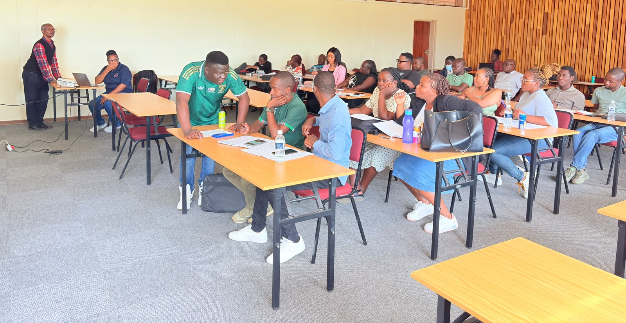
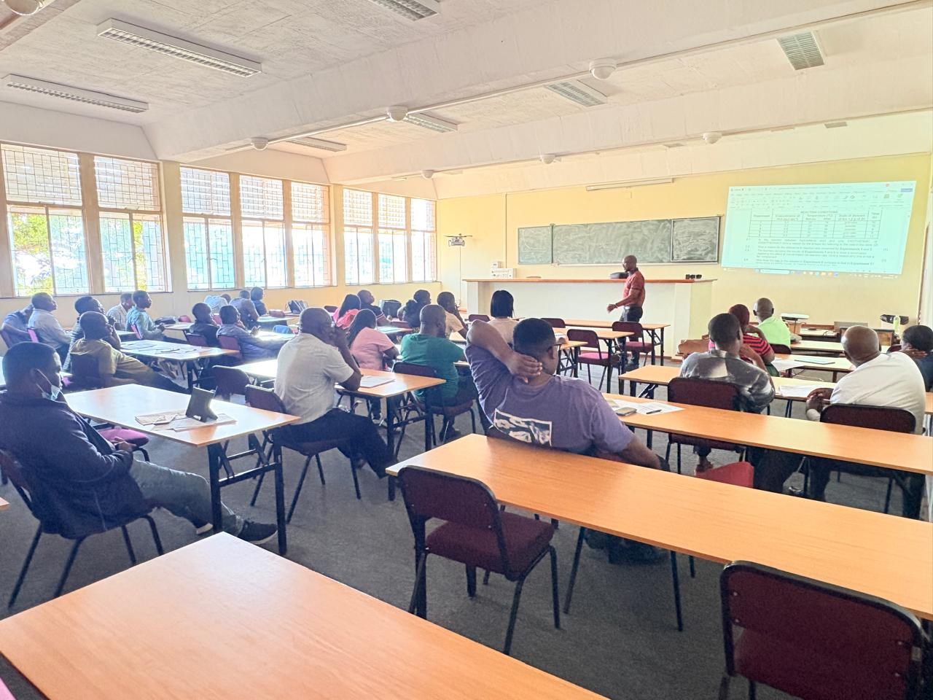
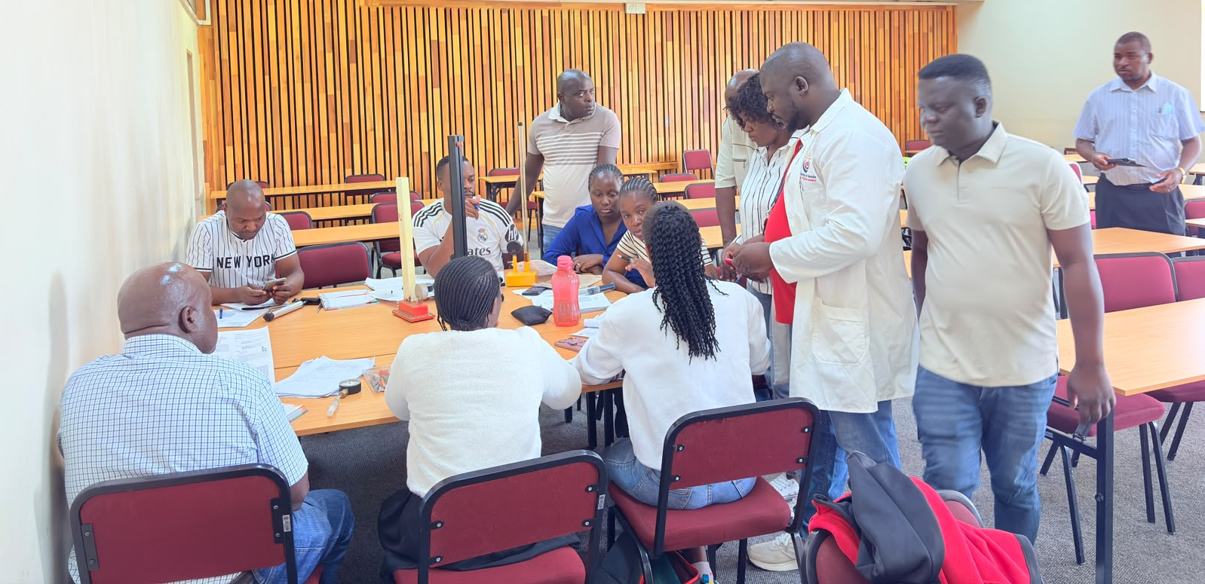
INTRODUCTION
Physical Science remains one of the most challenging school subjects
Many teachers’ experience:
low confidence
limited practical skills
Inadequate laboratory resources

Slide 4
INTRODUCTION
Challenges identified
Difficult concepts:
Limited laboratory equipment
Few opportunities for continuous professional development
Low confidence in conducting practical experiments
Key message
Teacher confidence affects classroom effectiveness.
Difficult concepts:
Work, Energy and Power
Doppler Effect
Electrostatics
Electric Circuits
Acids and Bases
Chemical Equilibrium
Rate and Extent of Reactions Intermolecular Forces
Atomic Combination (Chemical Bonding)

Slide 5
Research Questions and Objectives
Research Questions
Did teacher confidence improve?
Which topics showed the greatest improvement?
What challenges remained after training?
Objective:
Assess whether a structured teacher development programme enhances:
  Educator confidence
  Instructional effectiveness
  Practical teaching skills

Slide 6
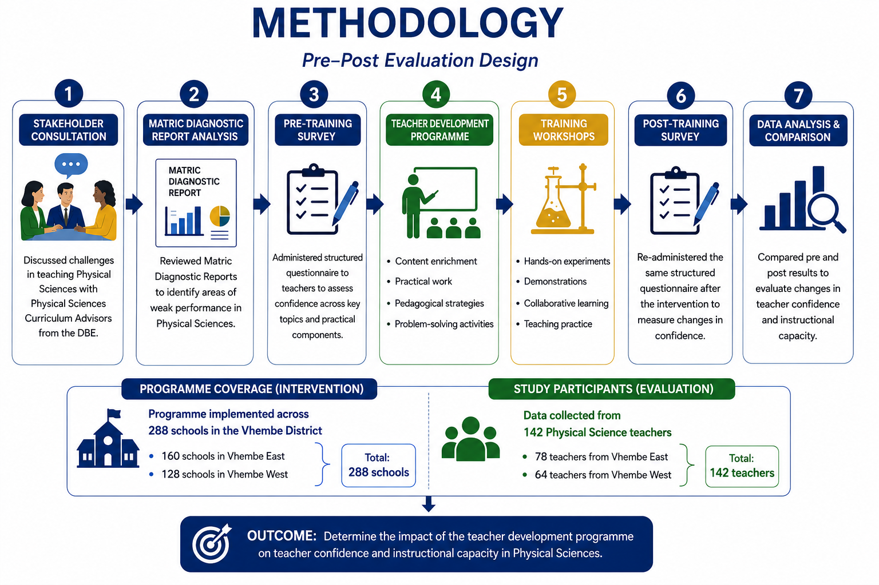

Slide 7
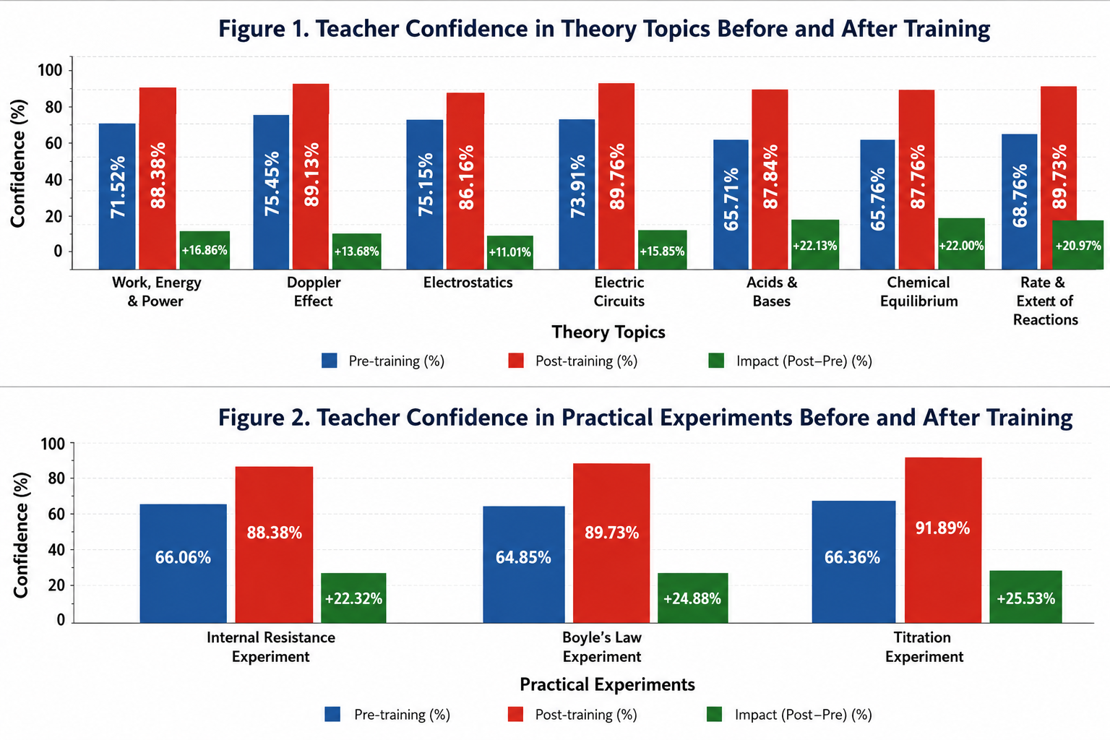
Teacher Confidence Before and after Training (VHEMBE WEST)

Slide 8
Key Improvements in Teacher Confidence (VHEMBE WEST)
Moderate improvements
Rate and Extent of Reactions 20.94%
Work, Energy and Power 16.86%
Smallest improvements
Electrostatics 11.61%
Electric Circuits 14.17%
Doppler Effect 14.27%
Greatest improvements
Titration Experiment | 25.53%
Boyle's Law Experiment | 24.88%
Chemical Equilibrium | 23.16%
Internal Resistance Experiment | 22.32%
Acids and Bases | 22.08%

Slide 9
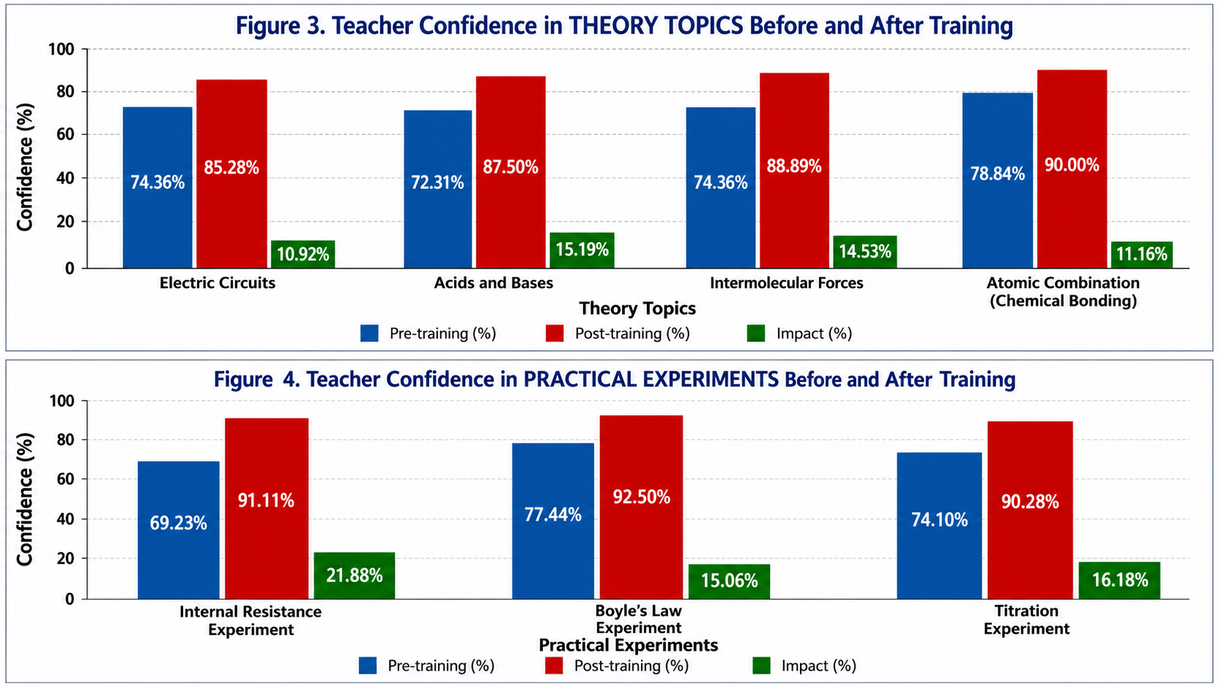
Teacher Confidence Before and after Training (VHEMBE EAST)

Slide 10
Key Improvements in Teacher Confidence (VHEMBE EAST)
Greatest Improvement
Moderate Improvements
Intermolecular Forces 14.53%
Lowest Improvements
Atomic Combination
(Chemical Bonding) 11.16%
Electric Circuits 10.92%
Internal Resistance Experiment | 21.88%
Titration Experiment | 16.18%
Acids and Bases | 15.19%
Boyle's Law Experiment | 15.06%

Slide 11
Participant Feedback
Teachers appreciated
Practical demonstrations
Content explanations
Collaboration
Teachers requested
Longer workshops
More practical activities
Better laboratory resources
Ongoing support

Slide 12
Conclusions and Recommendations
Main findings
Teacher confidence improved across both districts.
Practical teaching skills improved considerably.
Difficult topics became easier to teach.
Infrastructure limitations remain a major challenge.
Recommendations
Institutionalise regular teacher development programmes.
Extend workshop duration.
Increase investment in laboratories.
Provide continuous mentoring.
Strengthen practical science teaching.
Take-home messages:
Professional development works, but sustained support is essential.
Investing in teachers ultimately improves learner outcomes.

Slide 13






Acknowledgements
Dr B Masara
Prof N E Maluta
SAIP Teachers development LOC
FACILITATORS

