Slide 1
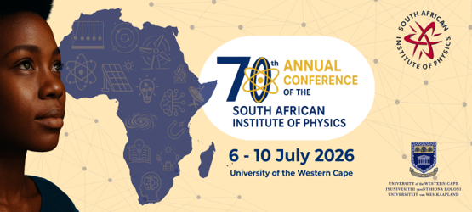
Barriers to Teachers’ Engagement in Laboratory Experiments for Physical Sciences in Vhembe District, Limpopo, South Africa.
Speaker: Lufuno Takalani (UniVen)
Supervisors: Prof. N.E. Maluta (UniVen)
Dr. T.S. Mulaudzi (UniVen)
Dr. T.S. Ranwaha (UniVen)
Dr. V. Nekhubvi(UniVen)

Slide 2
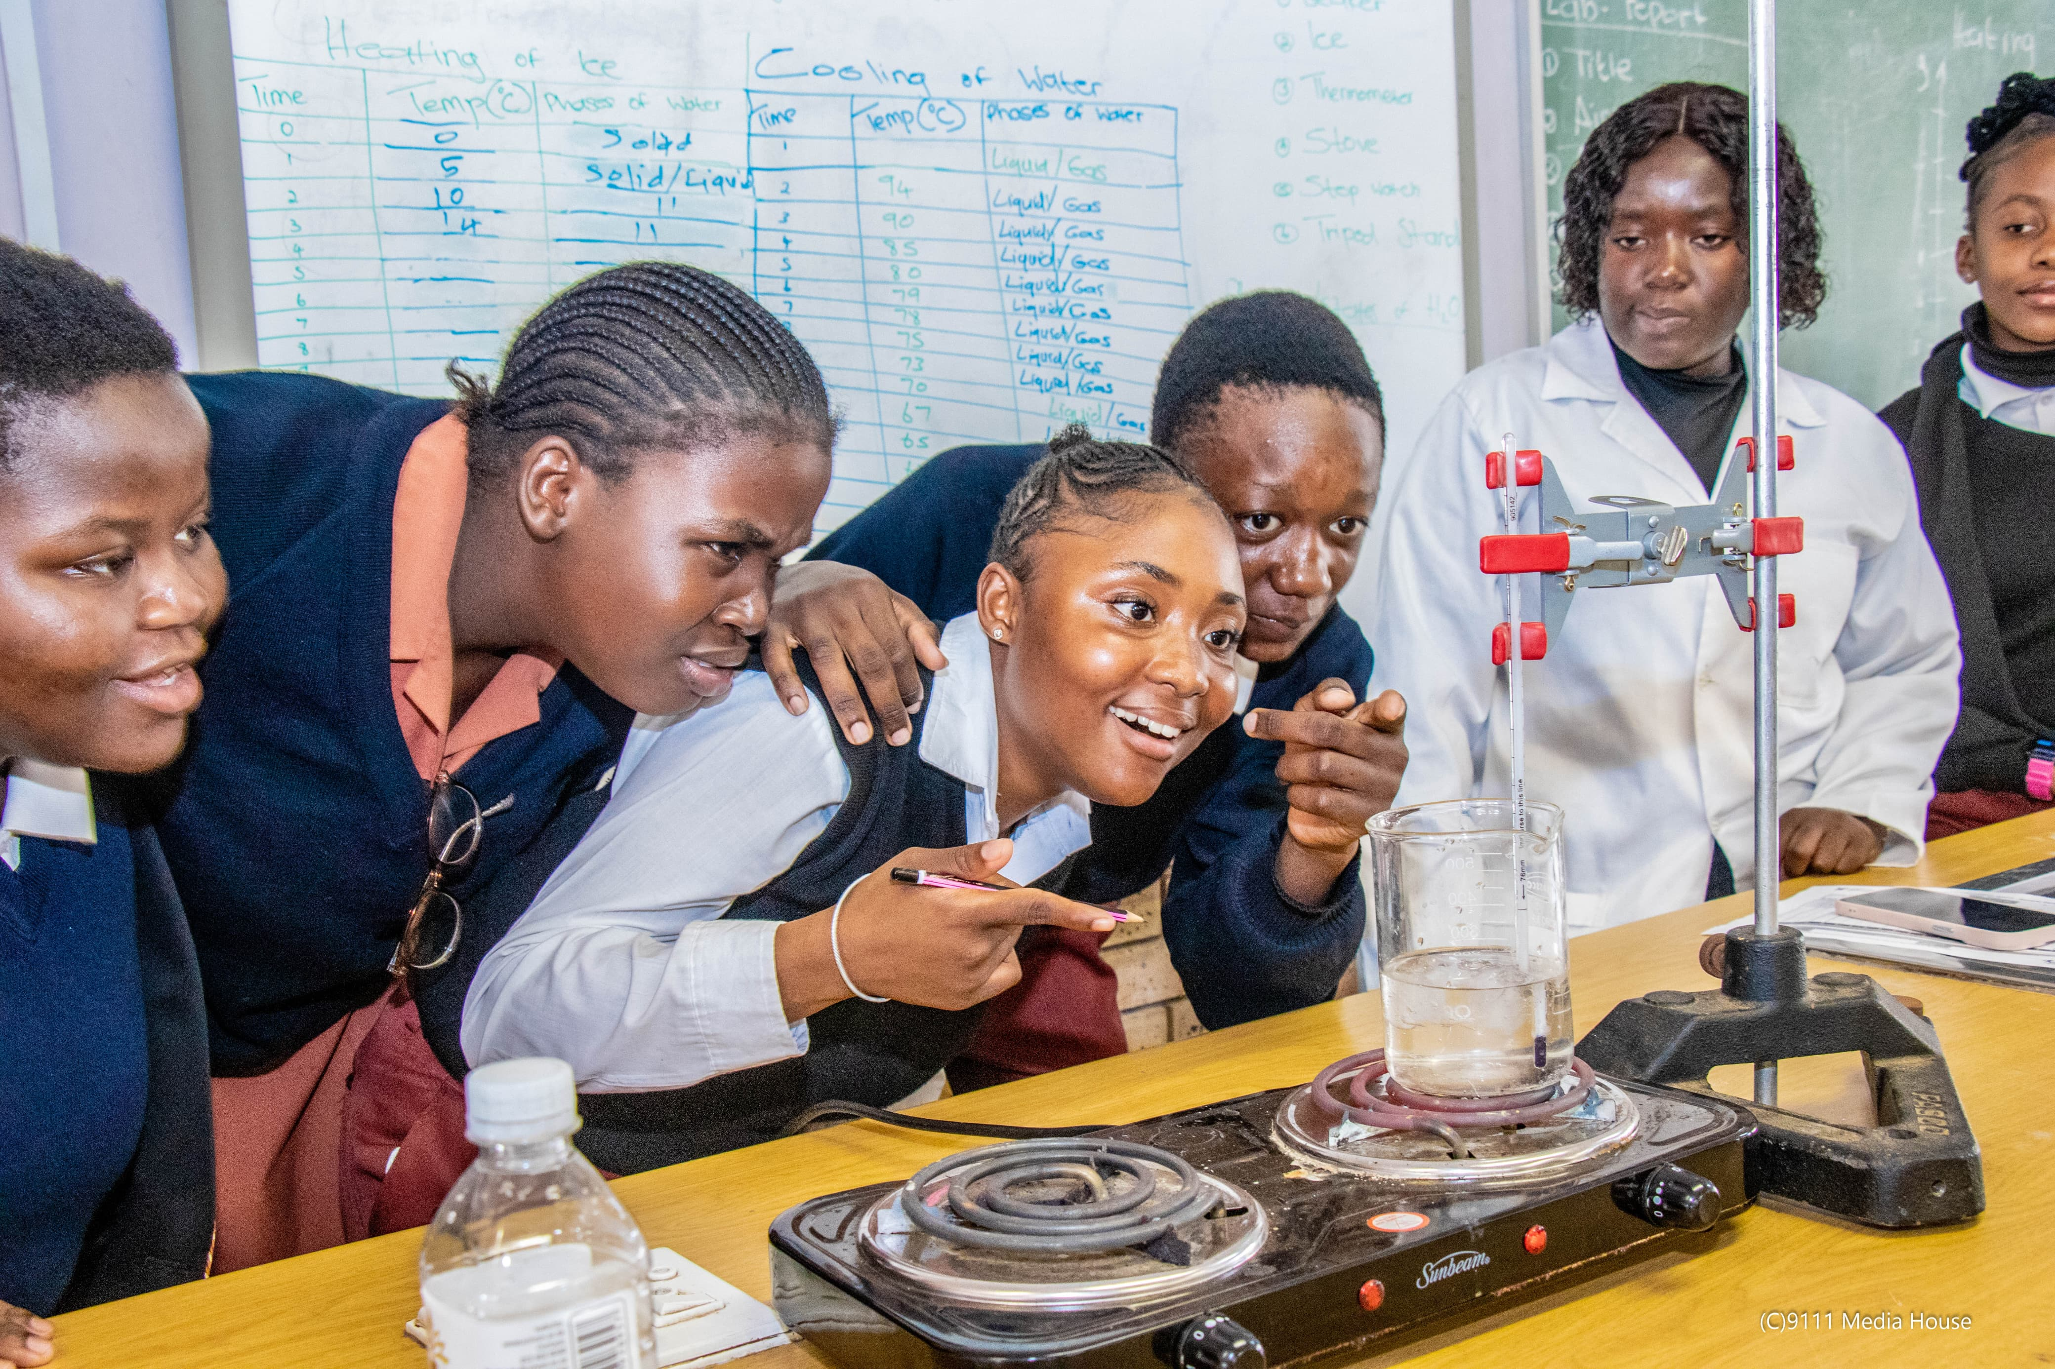
Introduction
Practical work improves learners' conceptual understanding, scientific inquiry skills, and academic achievement in Physical Sciences (Kibirige et al., 2014; Gudyanga & Jita, 2019).
Physical Sciences performance remains a challenge in the Vhembe District of Limpopo Province, South Africa, due to factors such as inadequate resources, limited laboratory facilities, and contextual socio-economic challenges (Mafukata, 2016; Zenda, 2024).
Although teachers recognise the educational value of practical work, they conduct relatively few laboratory experiments because of structural and resource-related barriers, including shortages of laboratory equipment, chemicals, infrastructure, curriculum time, and technical support (Kibirige, 2021; Gudyanga & Jita, 2019).
Figure 1. Learners from Vhembe East District are conducting a heating and cooling curve of water experiment.
2

Slide 3
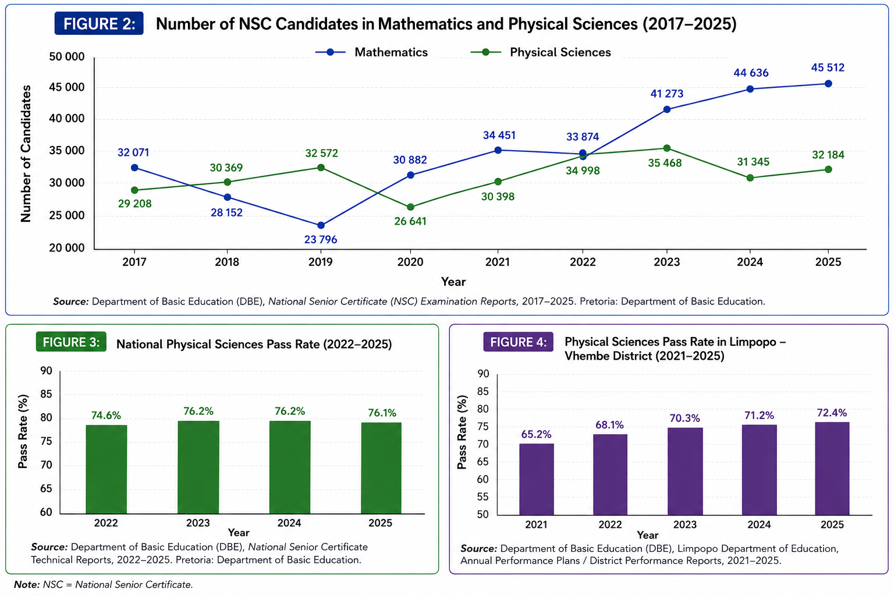
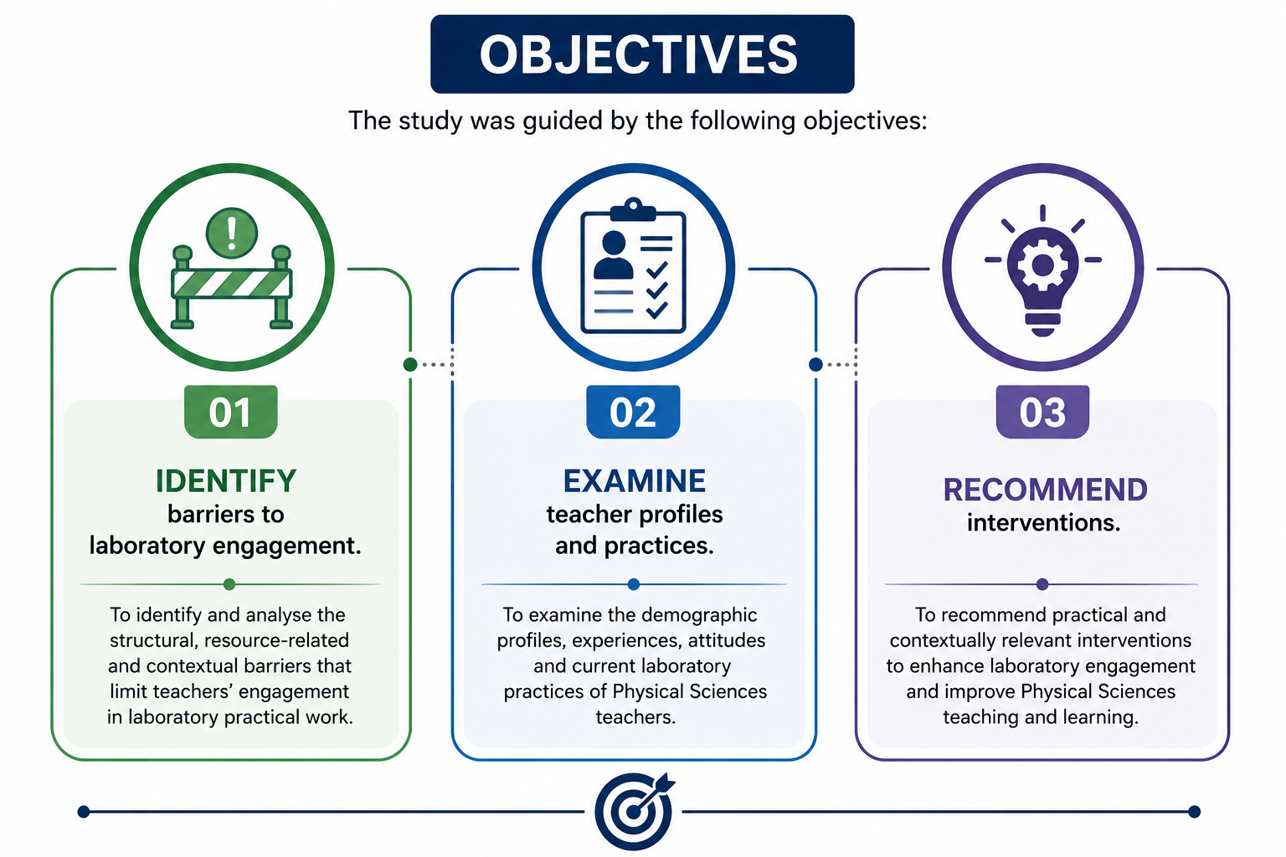
3

Slide 4
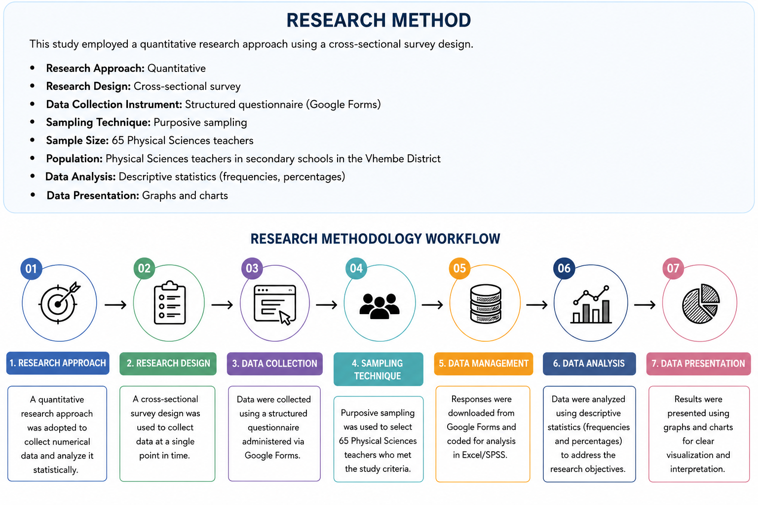
4

Slide 5
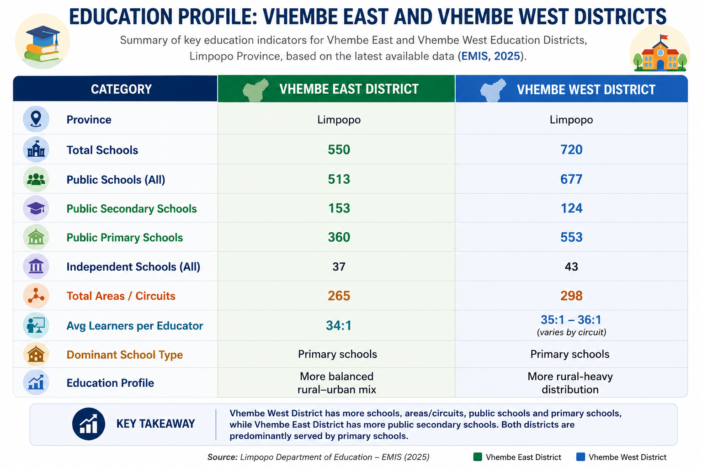
5

Slide 6
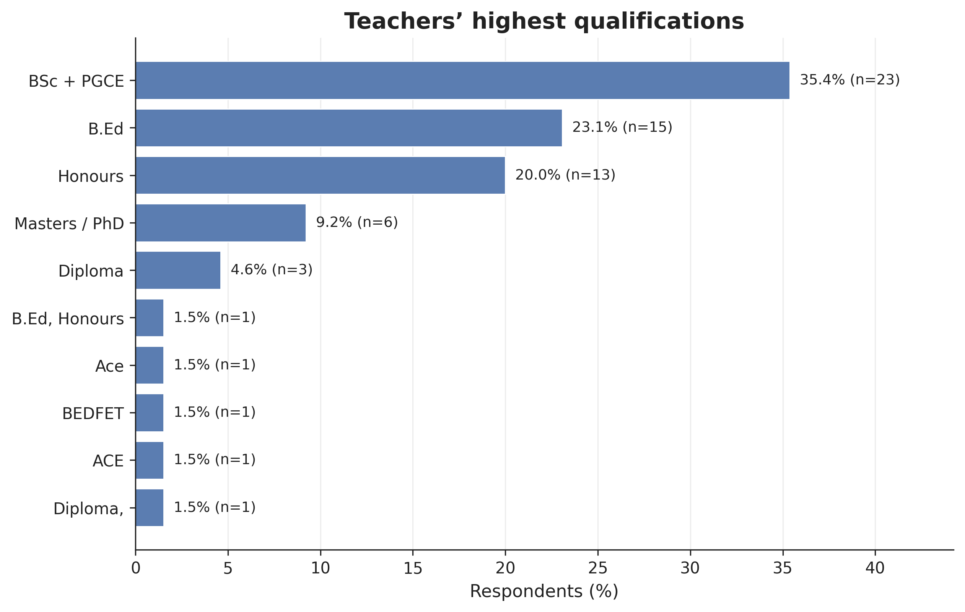
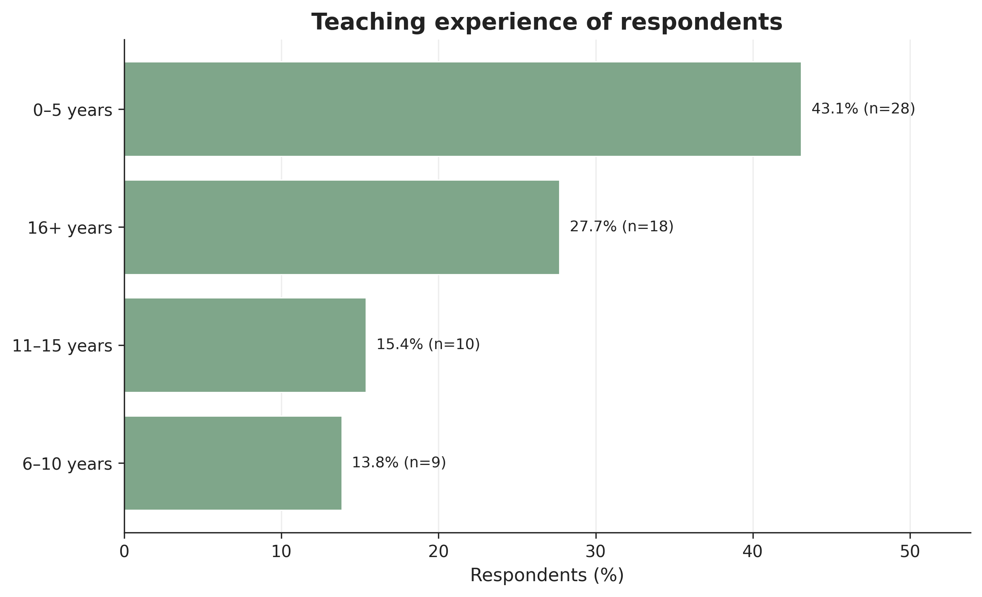
Key findings
The majority of participating teachers were well qualified, with 35.4% holding a BSc + PGCE, followed by 24.6% with a B.Ed. and 21.5% with an Honours degree, while only 9.2% had obtained a Master's or PhD qualification.
The largest proportion (43.1%) had 0–5 years of experience, indicating that many participants were early-career teachers, whereas 27.7% had 16 or more years of teaching experience, reflecting a substantial number of seasoned educators. Teachers with 6–10 years (13.8%) and 11–15 years (15.4%) of experience made up smaller proportions of the sample.
The study included a diverse group of teachers with strong academic qualifications and a balanced mix of novice and experienced educators, providing a broad perspective on Physical Sciences teaching in the Vhembe District.
Figure 5. The teacher's highest qualifications in Physical Sciences are in response to Vhembe District Schools.
6
Figure 6. The teacher’s years of experience in Physical Sciences laboratory experiments.

Slide 7
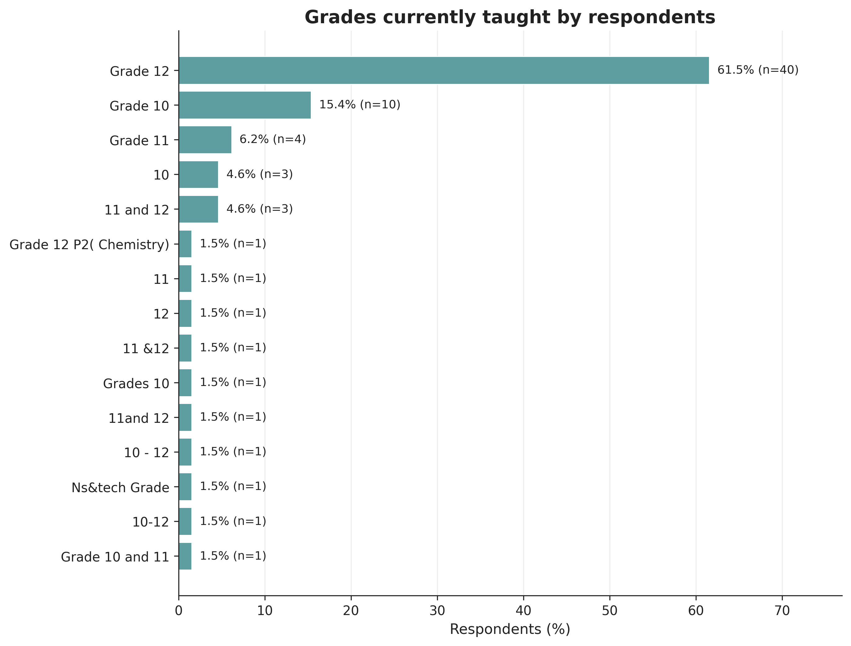
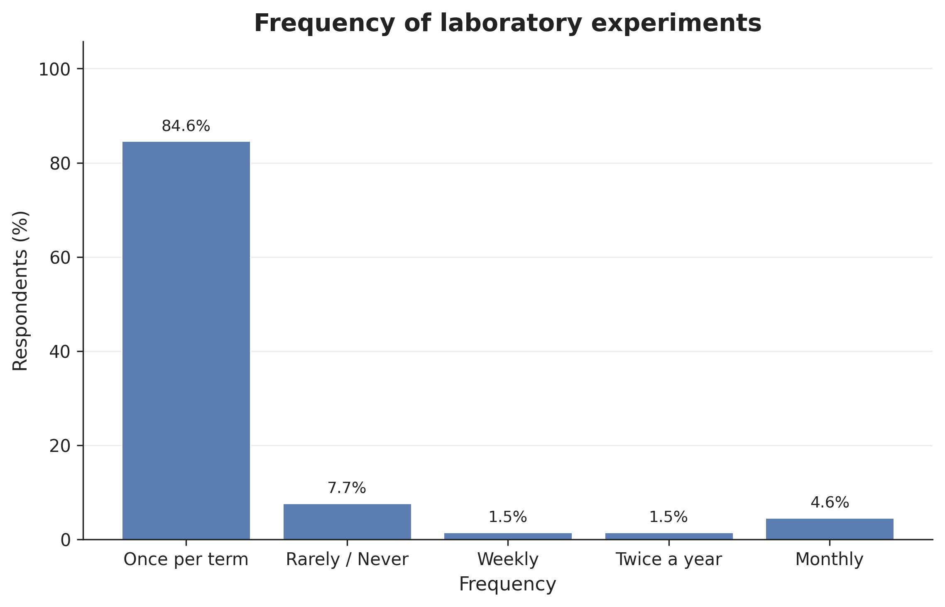
Figure 7: Grade allocation of Physical Sciences teachers in Vhembe District.
Figure 8: Frequency of Physical Sciences Lab in Vhembe District Schools.
61.5% were teaching Grade 12 Physical Sciences, 15.4% teaching Grade 10. Smaller proportions taught Grade 11 or multiple grade levels across the phase.
84.6% of teachers reported conducting laboratory experiments only once per term, with very few carrying out practical activities weekly or monthly, and some indicated that they rarely or never conducted experiments.
7

Slide 8
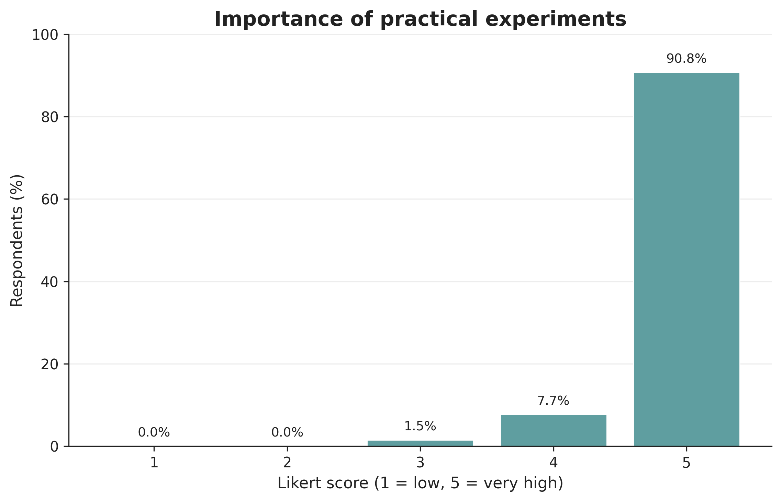
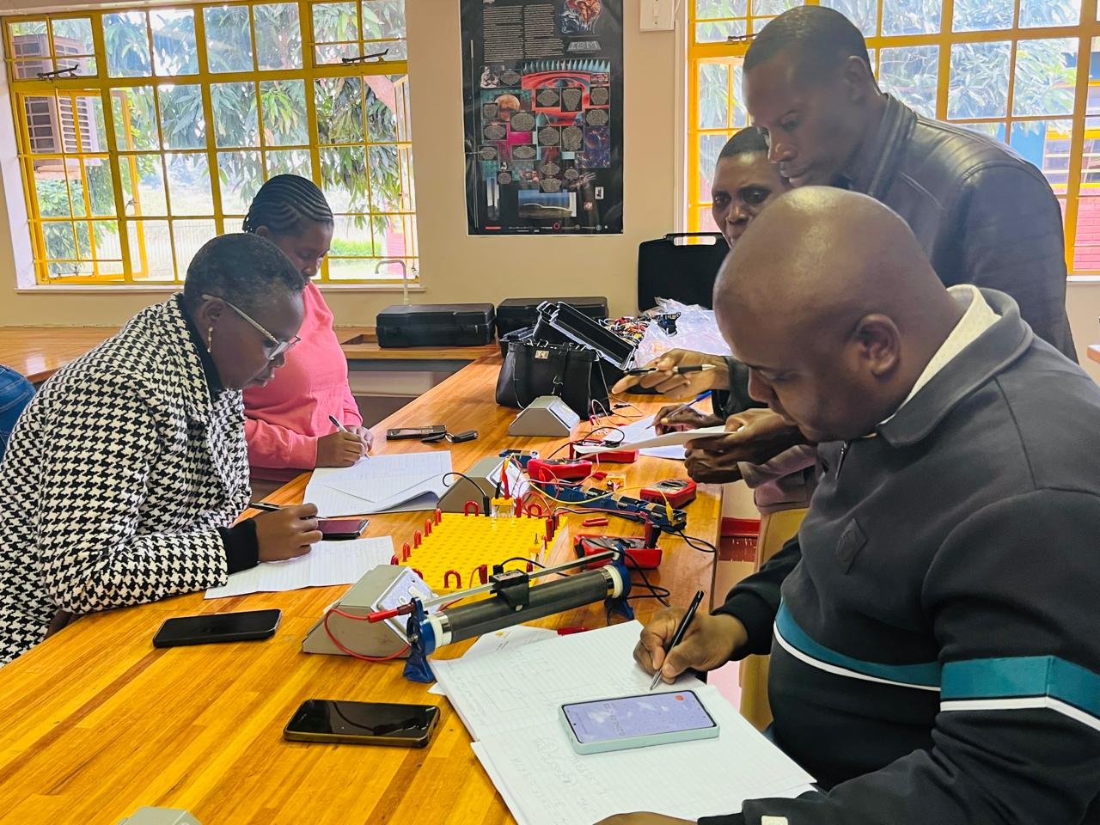
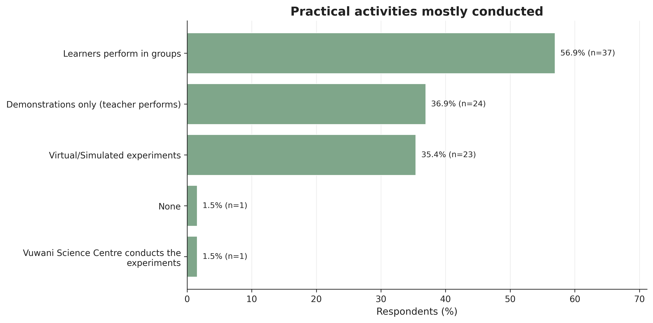
Figure 11: Vhembe East teachers’ workshop at Vuwani Science Centre, University of Venda.
Figure 9: Examples of CAPS-aligned practical activities across Grades 10–12 and modes of implementation
Majority of teachers (90.8%) rated practical experiments as extremely important for learning Physical Sciences. Most teachers (56.9%) conduct experiments where learners work in groups.
Teacher demonstrations (36.9%) and virtual/simulated experiments (35.4%) are also commonly used.
8
Figure 10: Contextual constraints and enabling support for practical work

Slide 9
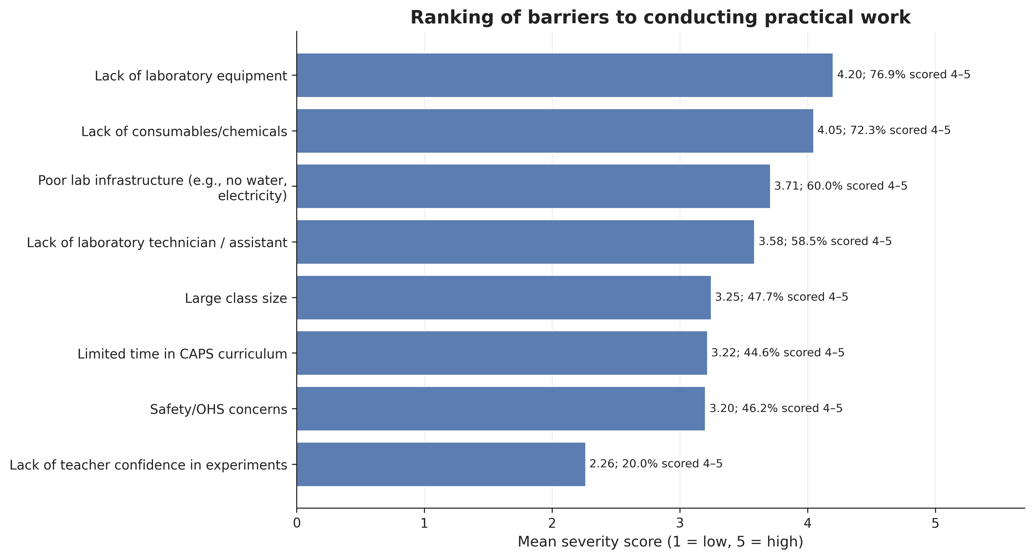
Barriers
9
Figure 12: Respondents’ views on the barriers to conducting experiments.

Slide 10
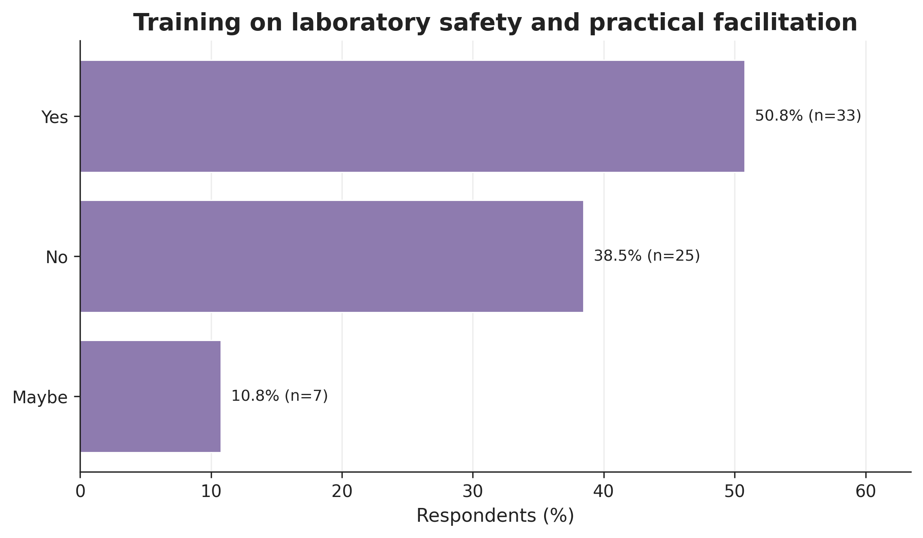
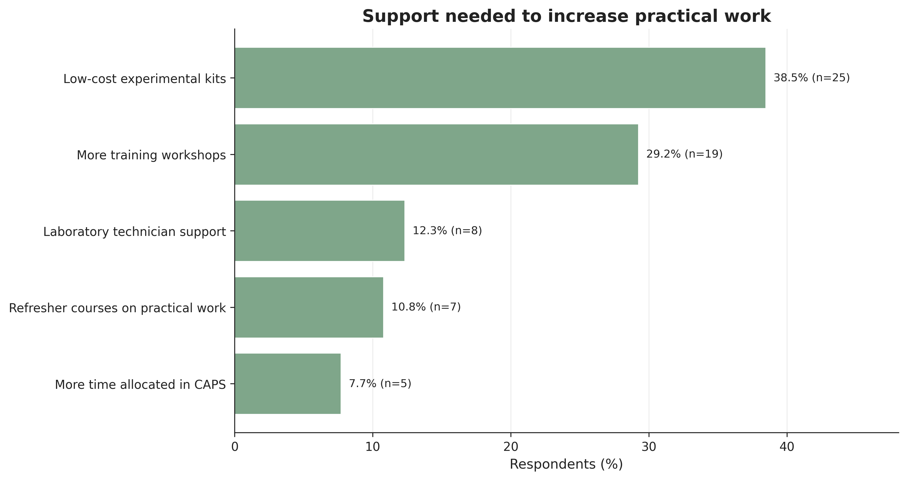
More than half of the teachers (50.8%) had received laboratory safety and practical facilitation training, while 38.5% had not.
The most requested support wasfor low-cost experimental kits (39.1%), followed by additional training workshops (29.7%). Smaller proportions requested laboratory technician support (12.5%) and refresher courses (10.9%).
Teachers highlighted the need for practical resources and ongoing training to improve experimental activities.
Figure 13: Participants’ responses regarding laboratory safety training and practical facilitation.
10
Figure 14: Required support mechanisms to facilitate more frequent experimentation.

Slide 11
Conclusion
Practical work is essential for effective Physical Sciences teaching and learning.
Teachers value practical experiments but conduct them infrequently.
Major barriers include inadequate laboratory resources, infrastructure, time, and technical support.
Teacher training and continuous professional development are needed to improve practical teaching.
Increased investment and stakeholder support are essential to strengthen practical science education and improve learner performance in the Vhembe District.
A gap exists between curriculum expectations and reality.
11

Slide 12
Recommendations for Teachers
Integrate practical experiments regularly into Physical Sciences lessons.
Participate in continuous professional development on practical work and laboratory safety.
Use low-cost and locally available materials where laboratory resources are limited.
Collaborate with colleagues to share practical activities and teaching resources.
Recommendations for Schools
Prioritise the procurement and maintenance of laboratory equipment and consumables.
Allocate sufficient time for practical activities within the school timetable.
Strengthen laboratory management by ensuring proper maintenance and safety compliance.
Encourage partnerships with universities, science centres, and industry to support practical science education.
Recommendations for the District Department of Basic Education (DBE)
Provide regular teacher training and practical skills workshops.Increase funding for laboratory infrastructure, equipment, and consumables.
Deploy laboratory technicians or technical support personnel to schools where possible.
Monitor and support the implementation of practical work through regular school visits and curriculum support.
Promote collaboration with higher education institutions and science organisations to strengthen STEM education initiatives.
12

Slide 13
References
Kibirige, I., Rebecca, M.M. and Mavhunga, F. (2014) ‘Effect of practical work on Grade 10 learners’ performance in science in Mankweng Circuit, South Africa’, Mediterranean Journal of Social Sciences, 5(23), pp. 1568–1577.
Kibirige, I. (2021) ‘Exploring Grade 11 Physical Sciences teachers’ perceptions regarding practical work in South Africa’, Journal of Turkish Science Education.
Gudyanga, R. and Jita, L.C. (2019) ‘Teachers’ implementation of laboratory practicals in the South African Physical Sciences curriculum’, Issues in Educational Research, 29(3), pp. 715–735.
Zenda, R., 2024. The importance of teaching resources on Physical Sciences learners' academic achievement in rural schools: A case of South Africa. Social Education Research, 5(2), pp.407–420. https://doi.org/10.37256/ser.5220244624
12

Slide 14



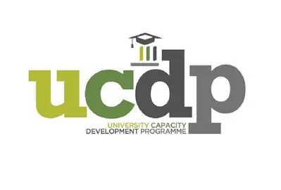
Acknowledgements
12

