Slide 1


Learning from Kahoot
Derek Fish: University of Zululand

Slide 2
Kahoot is a popular learning platform with a quiz-show format which is used for a quick review of student knowledge or to provide some variety in how material is presented. It is one of the most popular worldwide with over 70 million users per month. Many papers have been written on the effectiveness on using Kahoot in the classroom but few focussed specifically on science in general or science shows in particular. In addition most papers focus on formal classroom use of Kahoot, whereas this study took place in an interactive Science Centre (Unizulu Science Centre) and integrated Kahoot with simulations from PhET. Unizulu Science Centre has served the rural communities surrounding the University of Zululand for almost 40 years. Obtaining feedback and research data from visitors is challenging as contact time is limited. In the past clickers were used to this end but this paper explores using Kahoot instead of clickers and utilising a pre- and post- test format to gather data on student learning during a short science show. The author extended the clicker-based study performed for his Masters and PhD degrees (and presented at various stages at SAASTEC Conference) to one utilising Kahoot. Methodology and results will be presented and suggestions made for the effective use of this dynamic tool in out of school settings like Science Centres. The author will also report on using this methodology recently to evaluate science shows at the Science Gateway Visitors’ Centre at CERN in Switzerland.

Slide 3
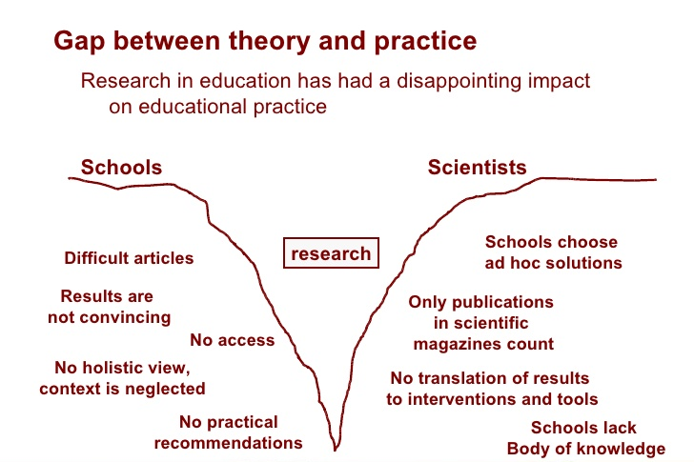
“In theory, there is no difference between theory and practice. But, in practice, there is!”

Slide 4
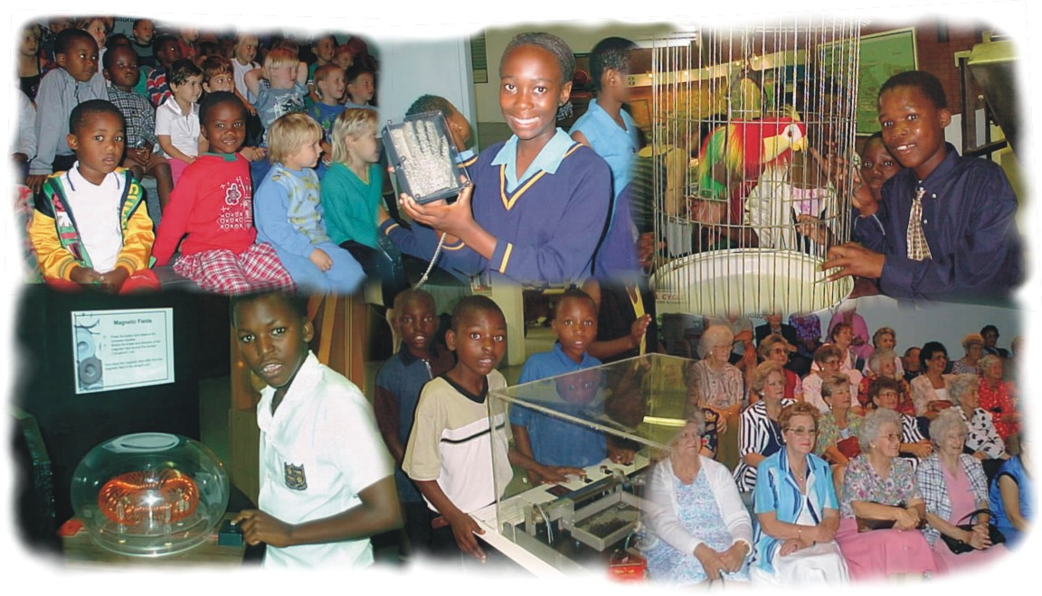

UNIZULU SCIENCE CENTRE

Slide 5
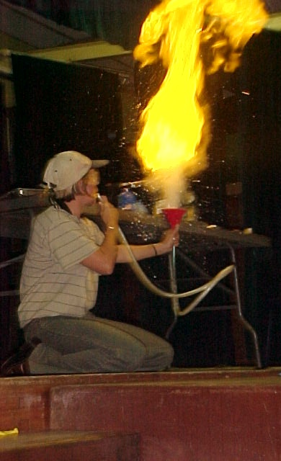
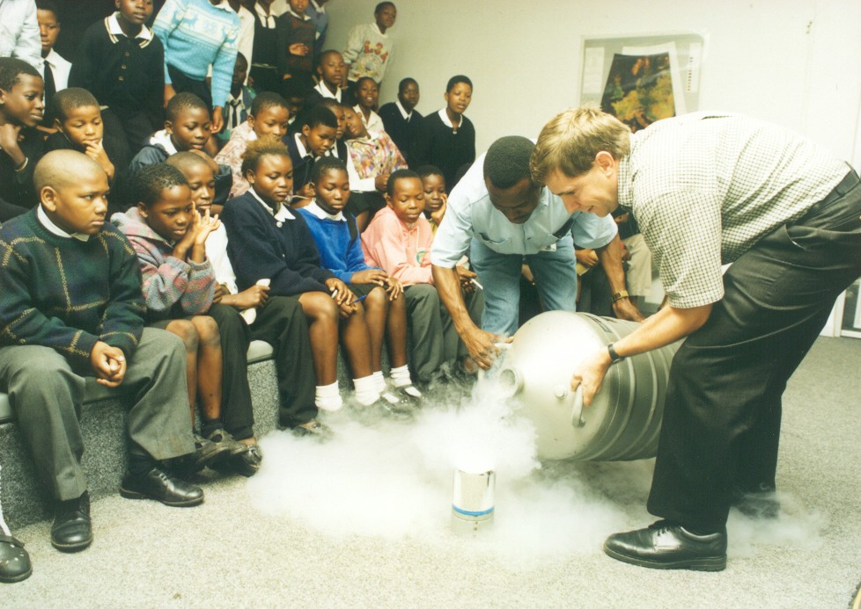
SCIENCE SHOWS

Slide 6




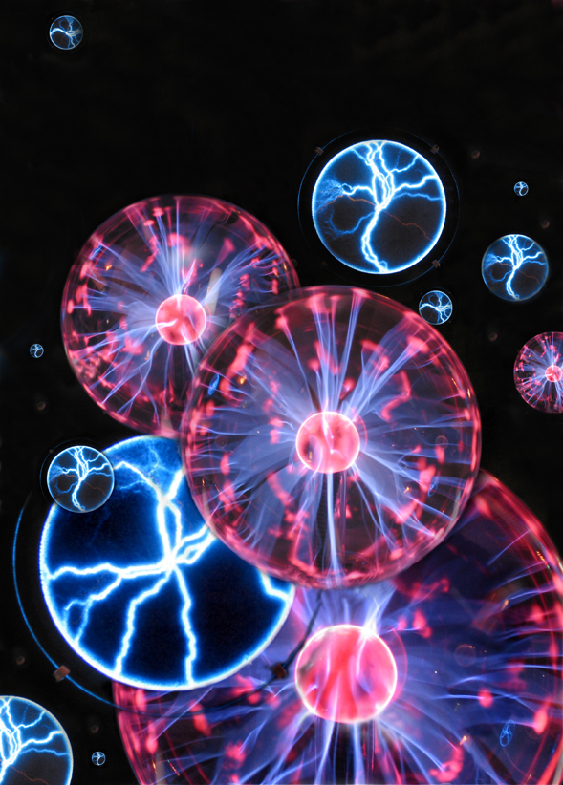
GOOD
VIBRATIONS
The Science of sound.
Notes:
Title and Introduction: Introduce self

Slide 7
Good Vibrations: 5 key facts
Sound travels in longitudinal waves, which start with a vibration.
The height of the wave (amplitude) indicates the intensity or volume of the sound. (How loud or soft)
The width of the wave (frequency) indicates the pitch of the sound. (How high or low it is)
Music has a repetitive, recognisable wave shape. Noise does not.
“Long is low, short is high.” A vibrating object which is longer vibrates more slowly (at lower frequency) giving a lower pitch.
Notes:
Kazoos, Al bar, stressed in all instruments (Vuvuzela)
DS: Kalimba and music box
DS: Slide flute
DS: Clap vs whistle
Straw, slide flute, guitar etc.

Slide 8

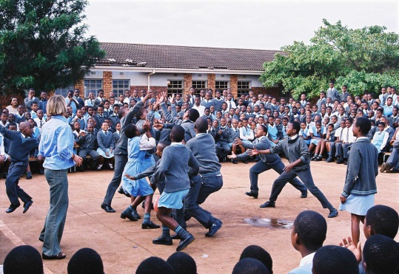
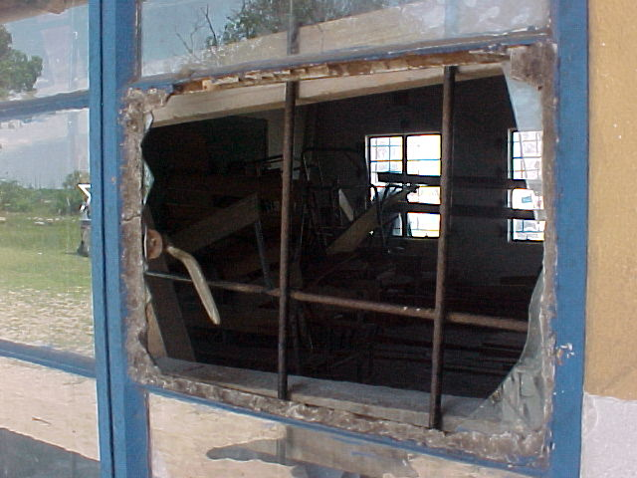

URBAN
RURAL
Confident
Cocky
Naughty
Questioning
High expectations
Broad general knowledge
English speaking
Technologically literate
Excited by interactives
Favour individual learning
Have computers at home
Lacking confidence
Reserved
Well behaved
Accepting
Low expectations
Poor general knowledge
isiZulu speaking
No access to technology
(Initially) Afraid of interactives
Favour group learning
Never used a computer
TOWNSHIP

Slide 9
Improve-ment: Pre- to Post-Test
GROUP | PRE-TEST: CORRECT = MOST CHOSEN | POST-TEST: CORRECT = MOST CHOSEN
URBAN | 3 | 8
TOWN | 0 | 6
RURAL | 2 | 2
ALL | 2 | 9
CORRECT

Slide 10
CORRECT

Slide 11
CORRECT

Slide 12
CORRECT

Slide 13
CORRECT

Slide 14
CORRECT

Slide 15
CORRECT

Slide 16
How will a longer guitar string vibrate?
HIGHER

Slide 17
How will a longer guitar string vibrate?
LOWER

Slide 18
Why can dogs hear sounds which humans can’t?

Slide 19
Why can dogs hear sounds which humans can’t?

Slide 20
Why can dogs hear sounds which humans can’t?

Slide 21
Why can dogs hear sounds which humans can’t?

Slide 22
Why can dogs hear sounds which humans can’t?

Slide 23
Improve-ment: Pre- to Post-Test
GROUP | PHD: PRE-TEST: CORRECT = MOST CHOSEN | PHD:POST-TEST: CORRECT = MOST CHOSEN | MSC
URBAN | 6 | 7 | 3 – 8
TOWN | 1 | 6 | 0 – 6
RURAL | 1 | 5 | 2 – 2
ALL | 2 | 7 | 2 - 9
CORRECT
?

Slide 24


ukuqhaqhazela
okuhle
GOOD VIBRATIONS
I-Science yomsindo.
Notes:
Title and Introduction: Introduce self

Slide 25
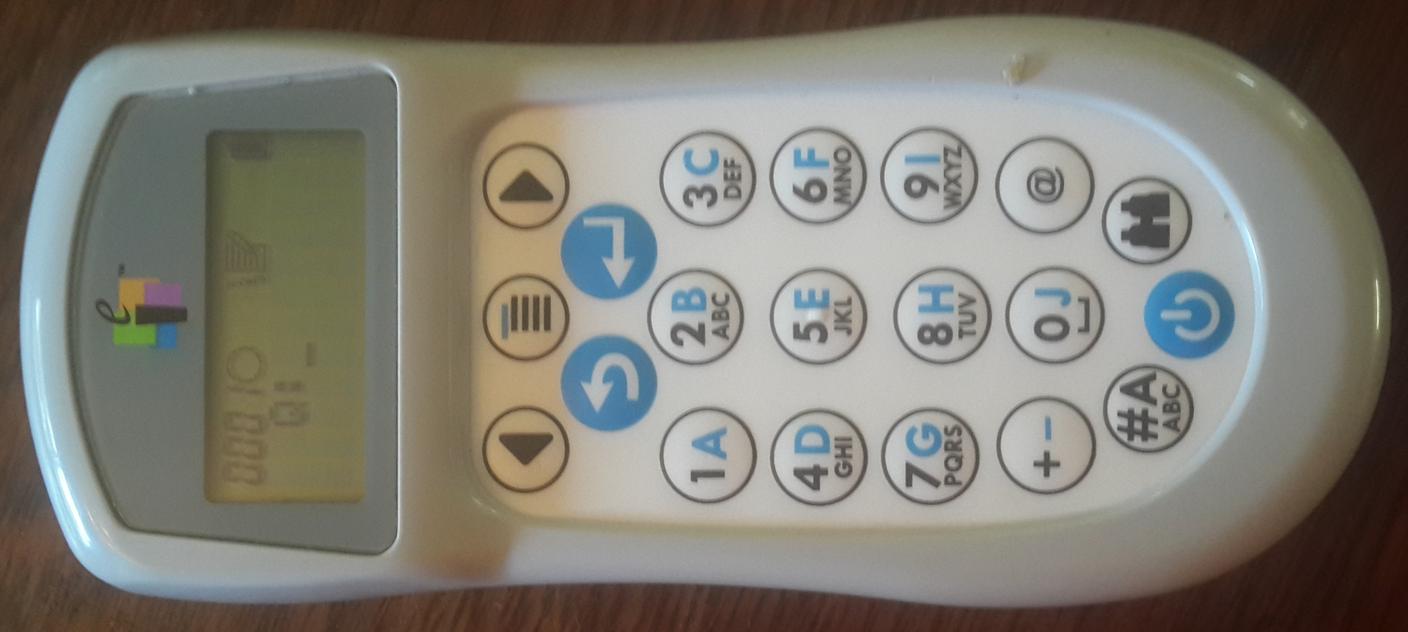
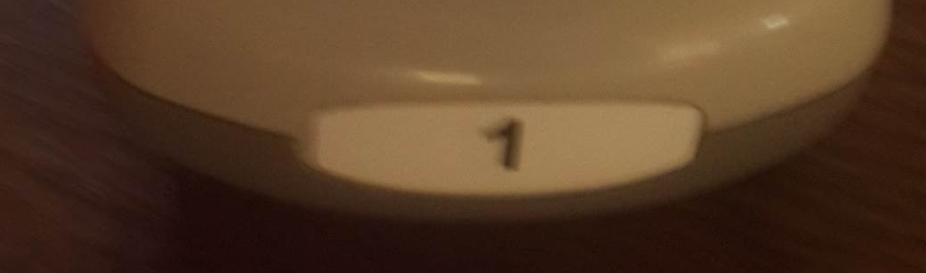
USING THE CLICKERS
Add clicker instruction at bottom of each page

Slide 26
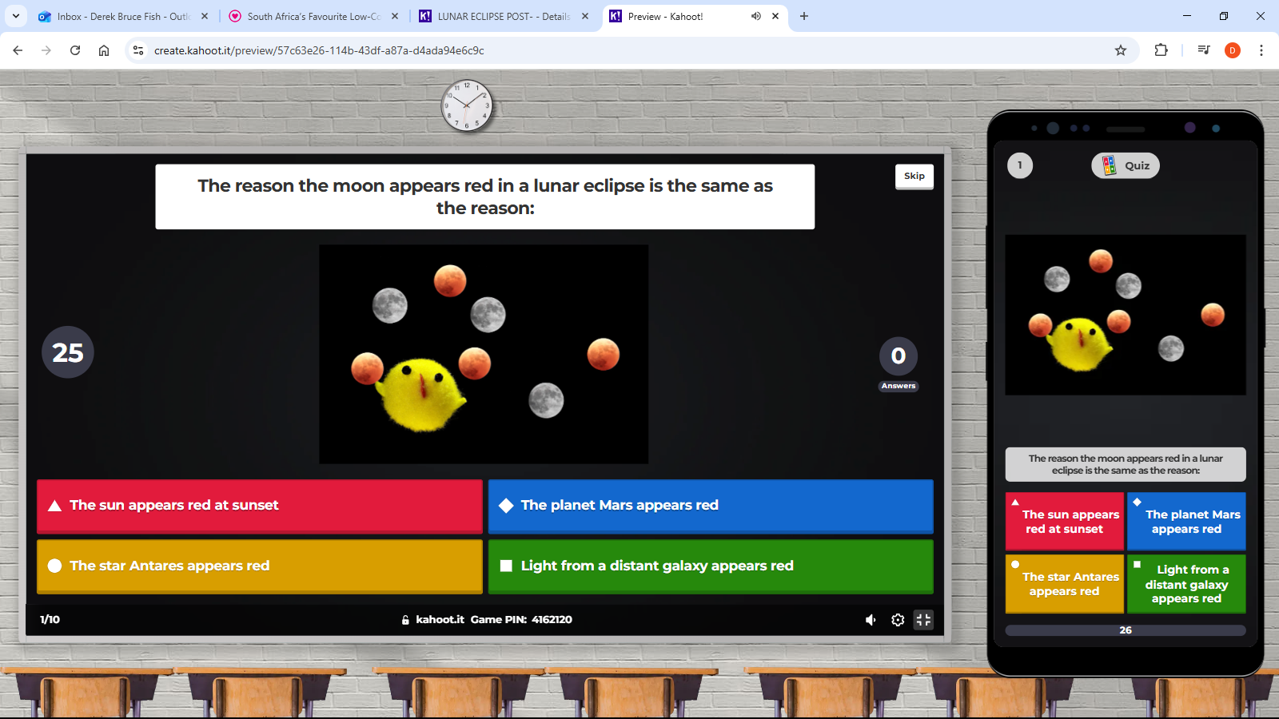

Slide 27
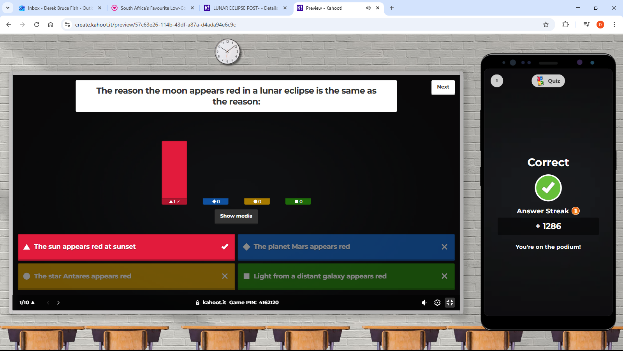

Slide 28
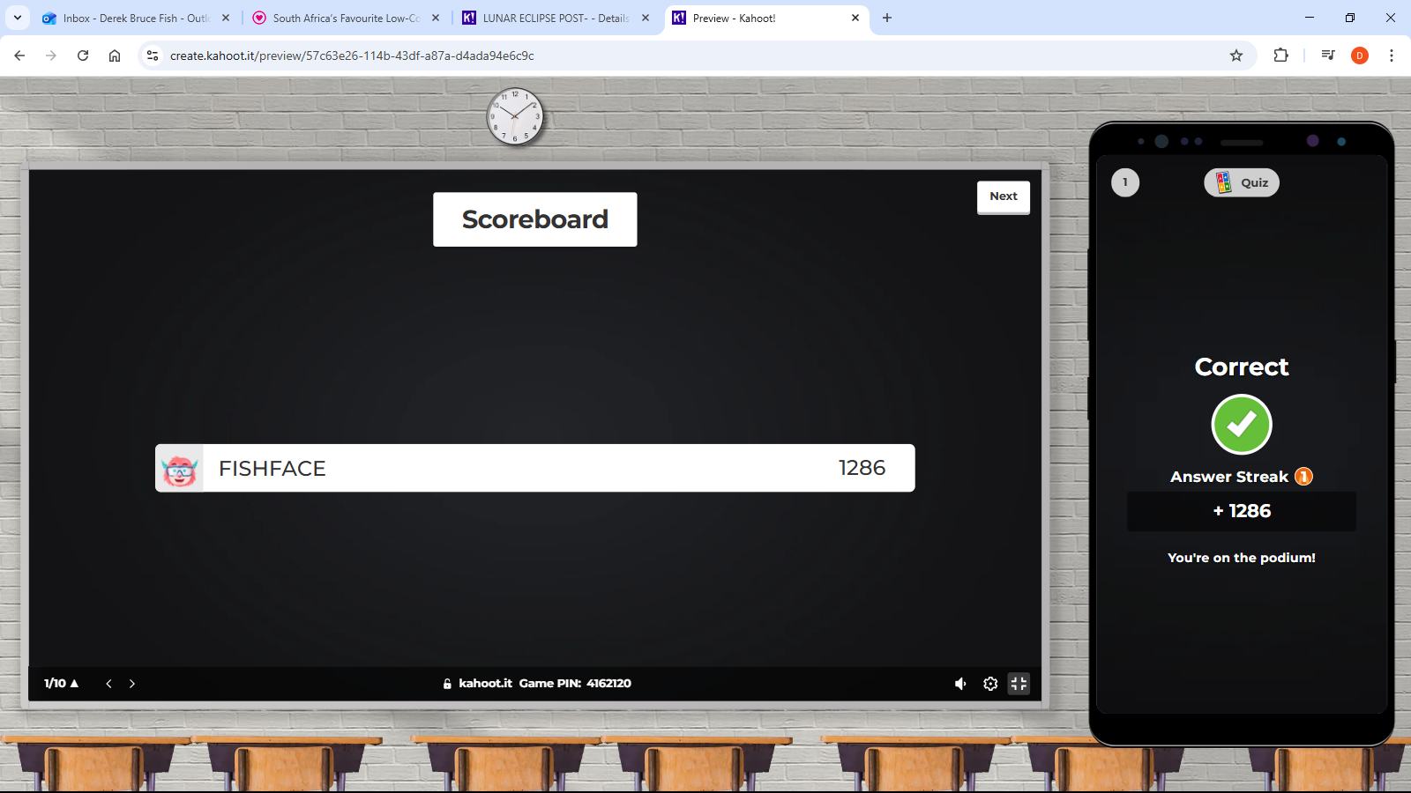

Slide 29
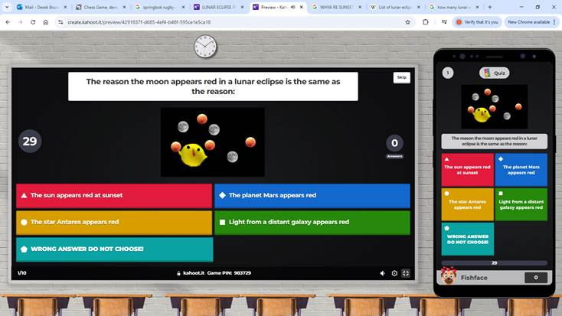

Slide 30
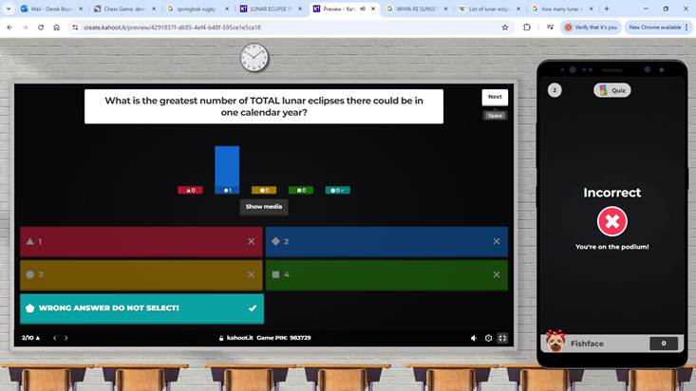

Slide 31
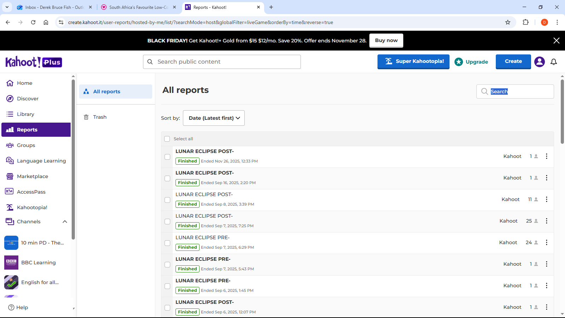

Slide 32
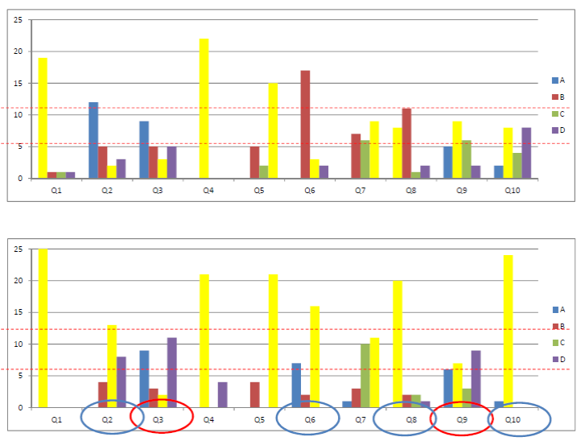
LUNAR ECLIPSE PRE-TEST
LUNAR ECLIPSE POST-TEST

Slide 33
Hi Derek! 11 Nov 2024
Thank you for your comment! You can rest assured that it is being considered, as the direction we are heading is towards being able to use Kahoot more and more for these types of activities.
I' sure we will see the option for this come along shortly, and I will advocate for it in our discussions towards product development.
Thank you for your constructive feedback!
Niclas Berg Account Executive, niclasb@kahoot.com
Fridtjof Nansens Plass 7, 0160 Oslo, Norway
On Mon, Nov 11, 2024 at 2:59 PM Derek Fish <thefish@iafrica.com> wrote:
Hi Niclas – I posted this on your kahoot teacher group. Answers would be appreciated!!
Dear Kahoot this is useful but could be so much more so! I appreciate that it doesn't show the leaderboard but it would be great if it didn't show correct/incorrect answers! That way it could gather data without showing pupils if they were correct or not so be used in a pre-test/ post-test scenario. This would be extremely useful for doing research in education as the same quiz could be used twice - before and after the lesson. Please get back to me on this in comments or at thefish@iafrica.com

Slide 34
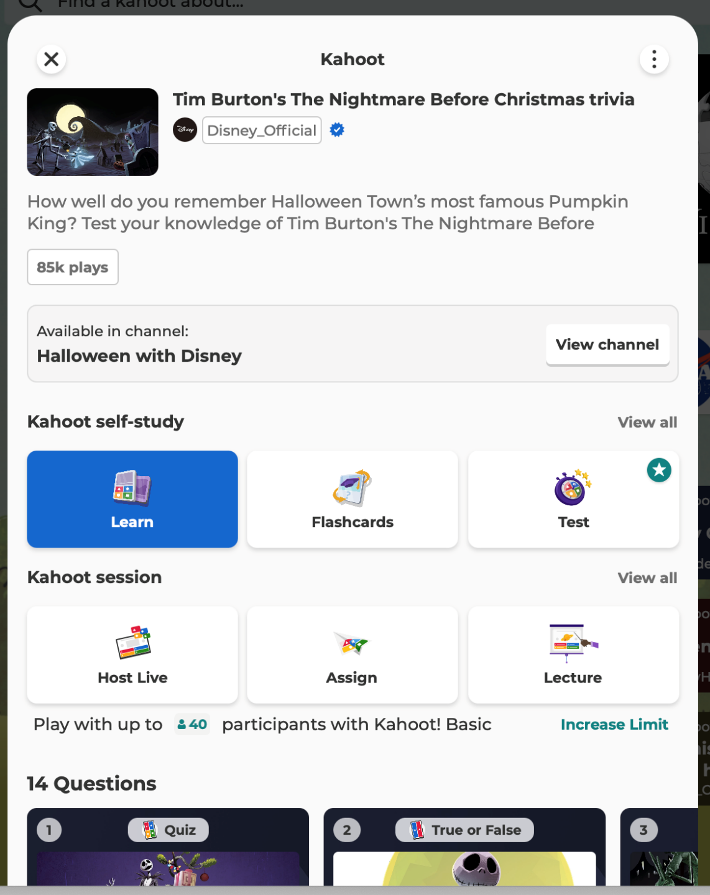
Hey, Derek! 13 Oct ‘25
Good news! The new "test prep" feature/game mode is available through the Kahoot! app. Soon, we'll transition the tool to be available on the web mode, too.
See attached for how to find on your own device! Let me know what you think.
Hannah
Kahoot Community Manager · New York City, USA

Slide 35
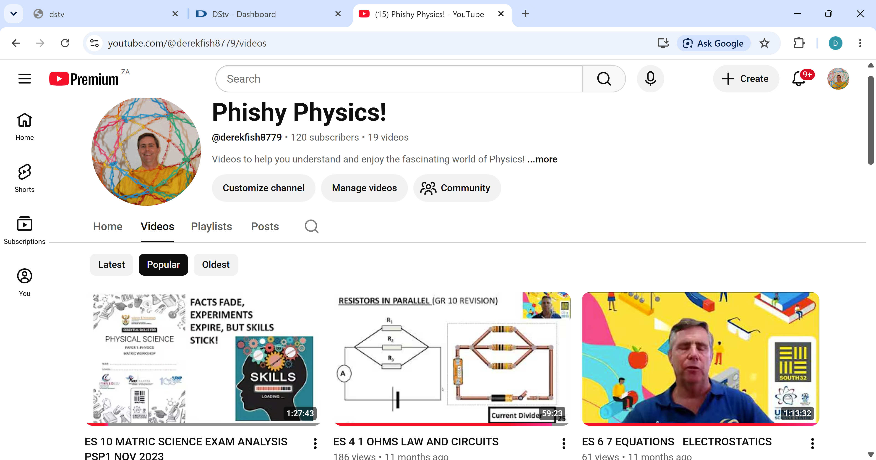
ESSENTIAL SKILLS

