Slide 1
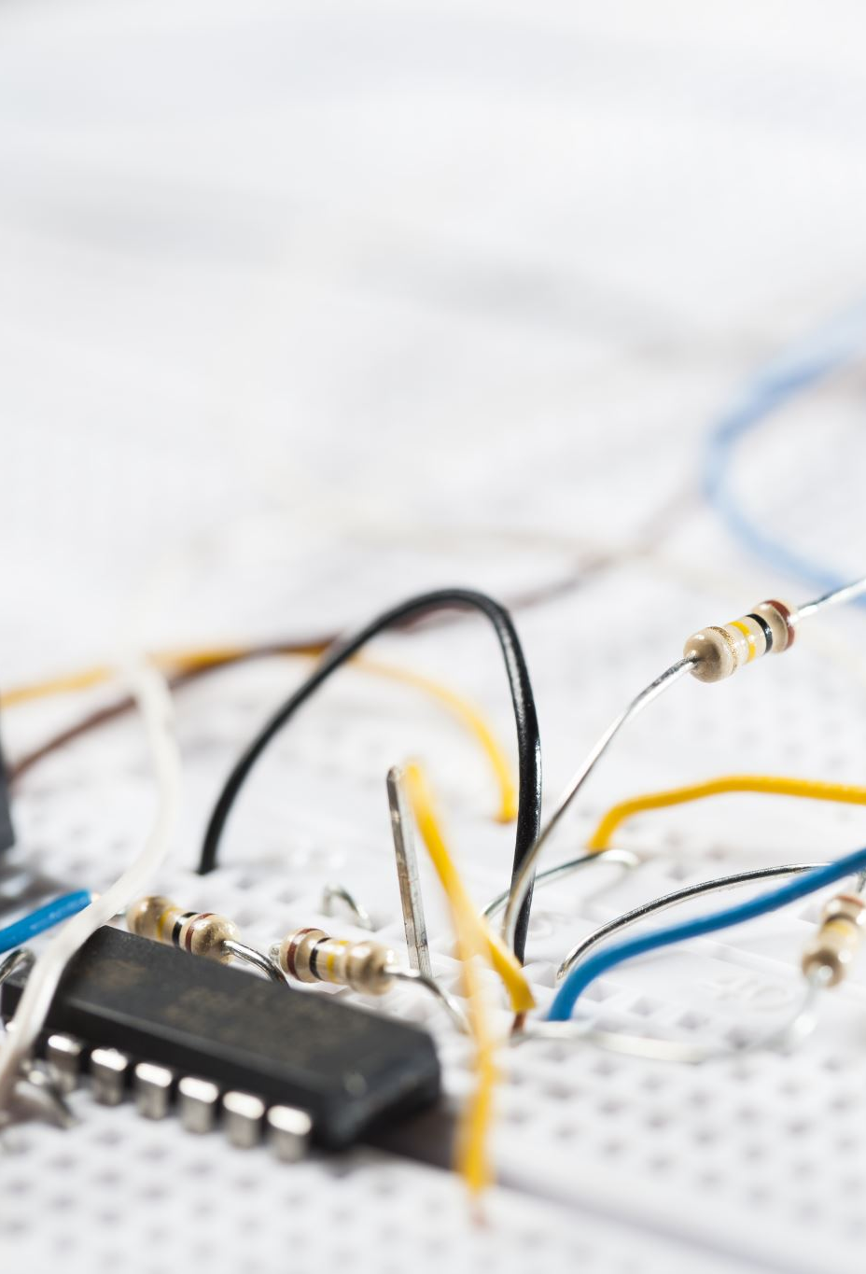
Problem-Based Learning approach for solving electric circuit problems for Grade 12 learners
Ms Manaka MM and Dr Masoga PW
University of Limpopo
School of Education
Department of Mathematics, Science and Technology Education

Slide 2

Background of the Study
Problem-solving and critical thinking is one of the key goals in the Physical Science curriculum.
Despite this, the topic of electricity has consistently been shown to be challenging for grade 12 learners in the National diagnostic report from NSC (Matric) results.
Many learners struggle interpreting electric circuit diagrams and applying concepts of current, potential difference, and Ohm's law in real-life problem-solving
Traditional teacher-centred instructional approaches tend to emphasise rote memorisation of content rather than developing learners' conceptual understanding and problem-solving skills.
PBL has been shown to be an effective learner-centred instructional approach for enhancing learners' problem-solving skills leading to enhanced conceptual understanding

Slide 3
⚠️ Problem Statement
📍
💡
Curriculum Goal
The Reality
The Response
CAPS promotes critical thinking, problem-solving skills, and the application of scientific knowledge to real-life problems.
However, Grade 12 learners struggle with interpreting, applying and solving complex real-life electricity problems, and there is a gap in literature focusing on how PBL can help with this topic. Most research focuses on the practical experimental aspect and not on the instructional approaches used by the teachers. Traditional teacher-centered teaching leans on rote memorization.
This study aimed to investigate how best PBL can be used to enhance grade 12 learners understanding of electric circuits through Vygotsky’s Social Constructivist lens.

Slide 4



Purpose of the study
To explore the effectiveness of the Problem-Based Learning approach in developing Grade 12 learners' problem-solving skills to aid in solving electric circuit problems.
Research Questions
How does PBL affect learners’ problem-solving skills?
What effect does PBL have on learners’ participation in the classroom?
🙋

Slide 5

Influential Authors
KEY FINDINGS | AUTHORS
Learners experience challenges interpreting electric circuits and applying ohms law to solve problems | Dewati et al. (2020)
Learners performed poorly across all stages of problem-solving in electricity | Anggraini et al. (2022)
PBL improved learners’ performance through collaboration and structured scaffolding. | Nicholus et al.( 2024)
Learners demonstrate stronger reasoning and problem solving skill when taught using PBL instead of traditional teaching method. | Adeline( 2024); Rahayu et al. (2025)
PBL improved learners performance through collaboration and structured scaffolding. | Nicholus et al. (2024)

Slide 6

Literature Review
The literature consistently shows that PBL:
Improves problem-solving skills
Enhances Collaboration
Strengthens reasoning abilities
However, limited evidence in South Africa exist on how effective Problem-Based Learning can improve Grade 12 learners problem solving skills in electric circuits.
Notes:
Improves problem-solving skills - Across multiple studies, PBL is associated with measurable gains in learners' problem-solving skills.
Enhances Collaboration - Working through real problems in groups strengthens how learners collaborate and support one another.
Strengthens reasoning abilities - Learners taught with PBL show stronger reasoning abilities than those taught traditionally.

Slide 7
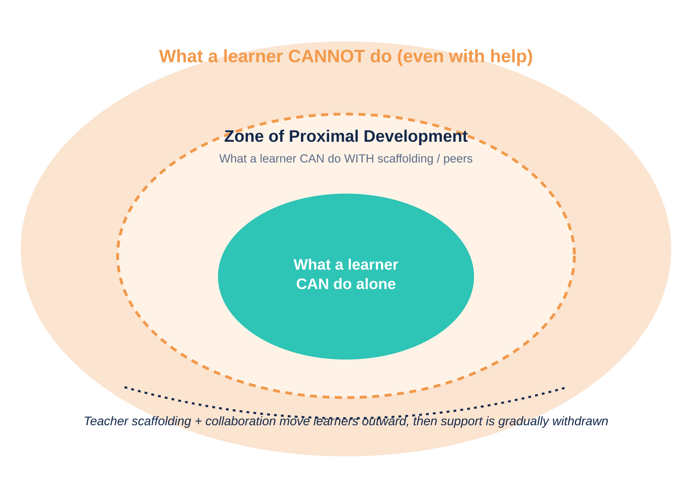
Theoretical Framework
Vygotsky's Social Development Theory
Learning happens through social interaction.
Teachers provide scaffolding.
Learners work within the Zone of Proximal Development (ZPD).
Collaboration helps learners solve difficult problems.
Connection to PBL in the study:
Learners work collaboratively
Teacher guide learners
And support is gradually withdrawn
Notes:
Vygotsky (1978) defined the ZPD as the gap between what a learner can accomplish independently and what they can achieve with guidance from a more knowledgeable person, such as a teacher, peer, or mentor. This gap forms a core of Vygotsky’s theory; he believed it is where meaningful learning takes place. Learning is therefore viewed as a socially mediated process in which knowledge is co-constructed through interaction rather than transmitted directly from a teacher to learner.
The ZPD aligns particularly well with Problem-Based Learning (PBL) because PBL presents learners with authentic problems that are slightly beyond their current level of understanding.
Within PBL, learners work collaboratively to: (1) identify what they already know, (2) determine what they need to learn, (3) investigate scientific evidence, (4) test explanations, (5) discuss alternative solutions, (6) apply scientific concepts to real-world situations.
Teachers act as facilitators by providing prompts, asking probing questions, and offering guidance only when necessary. This support (scaffolding) enables learners to solve increasingly complex and more difficult scientific problems independently over time.

Slide 8
Research Methodology
Research Design
Mixed-method approach - Quantitative and Qualitative
Quasi-experimental design
Participants
75 Grade 12 learners
Experimental Group (38)
Control Group (37)
Data Collection
Pre-test and post-test
Classroom observations
Focus group interviews
Notes:
The mixed-method approach was chosen because it allowed the investigator to use both qualitative data from the learners’ semi-structured interviews and classroom observations with the quantitative data from the post- and pretest results. This combination provided deeper insights into learners' experiences and perceptions of problem-based learning (PBL), as well as measurable evidence of changes in performance.
A quasi-experimental design enables researchers to compare the effectiveness of two different instructional approaches in supporting learning within the ZPD. Typically, two intact classes are used:
Experimental group: Learners are taught using a learner-centred PBL approach that incorporates collaboration, scaffolding, inquiry, and guided discussions.
In the Control group, Learners receive conventional teacher-centred instruction, where knowledge is primarily transmitted through lectures and demonstrations.
Because school classes are usually pre-existing, learners are not randomly assigned to groups, making the design quasi-experimental rather than a true experiment.

Slide 9
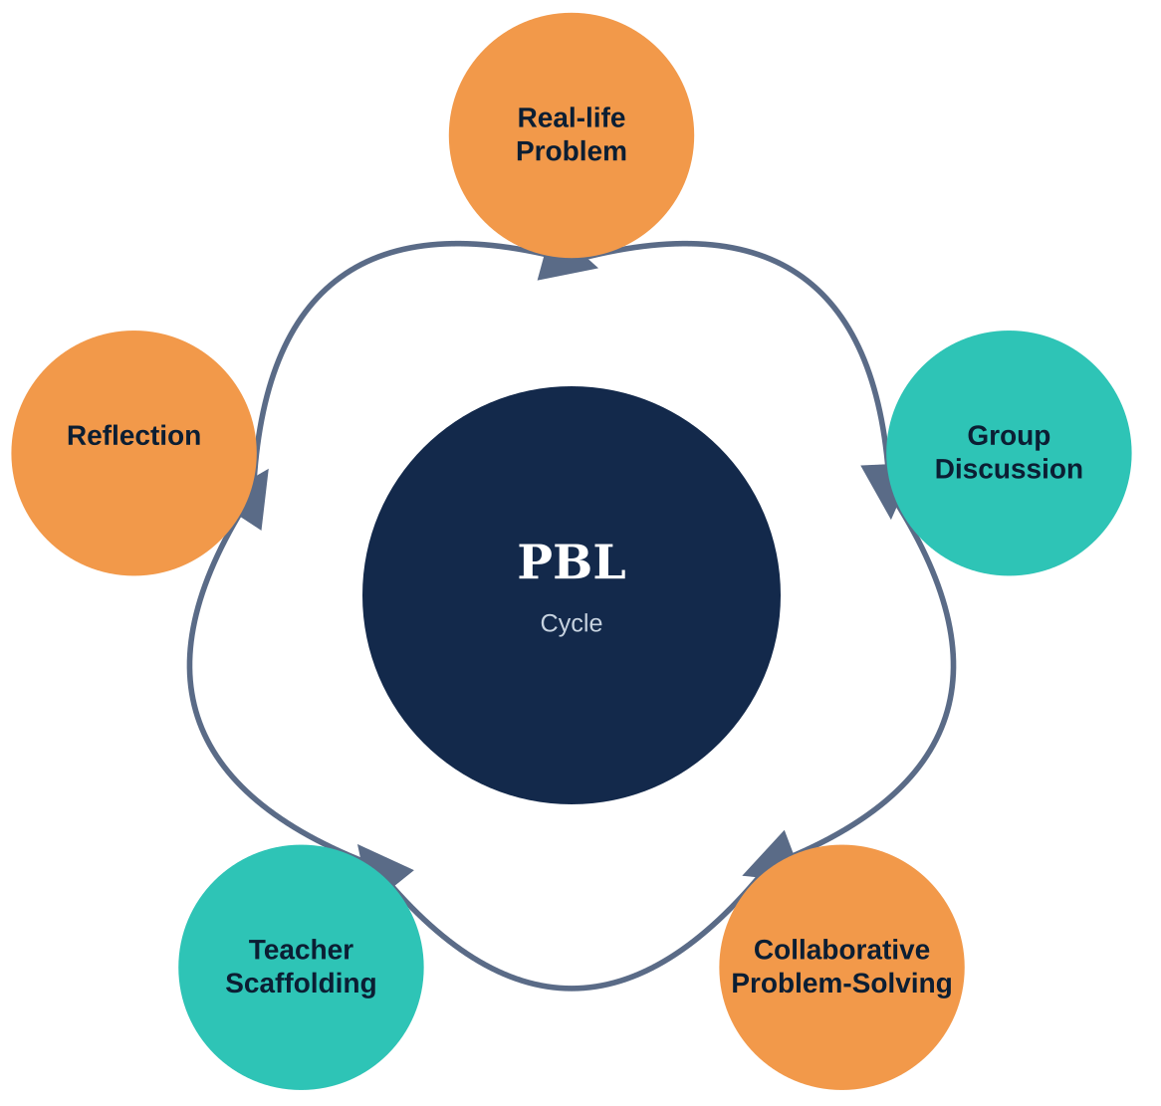
PBL Intervention
Learners participated in:
Solving real-life electricity problems
Group discussions
Collaborative problem-solving
Teacher scaffolded activities
Reflection
Activity examples:
High electricity bill
Slow charging phone
Blown fuse
Solar clinic

Slide 10
Quantitative Findings
Pre-test Results
Groups | Participants | Median | Standard Deviation | Range | Mean
Experiential group | 38 | 15.14 | 4.56 | 13 | 14
Control group | 37 | 11.86 | 4.74 | 15 | 12
Experimental learners already performed slightly better.
Control group showed greater variation in performance.
Experiential group had more consistent scores.

Slide 11
Experiential Group
Pre-test
Control Group
Notes:
Scores spread widely from 8 to 21 with no strong central cluster — a pattern typical of learners who have not yet developed a reliable problem-solving approach.

Slide 12
Post-Test Results
Groups | Participants | Median | Standard Deviation | Range | Mean
Experiential group | 38 | 32.25 | 3.65 | 10 | 32
After PBL
Mean increased from 15.14 to 32.25
Scores became more consistent.
Distribution improved from positively skewed to approximately normal.
Learners showed stronger problem-solving ability.
Conclusion
PBL positively influenced learner performance.
Notes:
PBL positively influenced learner performance — the shift from a wide, skewed pre-test spread to a tighter, near-normal post-test distribution is strong evidence of genuine skill development, not chance.

Slide 13
Qualitative Findings
Classroom Observation
Interview Findings
Learners were actively participating and collaborated effectively.
They asked questions and solved problems together.
Engagement increased as sessions progressed.
Some apprehensive learners who initially struggled with the unfamiliar real-life problems gained confidence and participated more.
PBL made lessons more interesting and improved understanding.
It encouraged teamwork and helped learners interpret questions.
Learners felt PBL connected science to everyday life.
Some high achieving learners preferred traditional teaching — they disliked group work or found PBL required more effort and time.

Slide 14
Conclusions
What the Study Concluded :-
PBL improved learners' problem-solving skills and learners became noticeably more active in class.
Collaboration improved understanding, and teacher scaffolding was a key support for learning throughout the intervention.
PBL supports the CAPS goals of critical thinking and learner-centred teaching, making it a natural fit for the curriculum.

Slide 15
Recommendations
What Should Happen Next
Use PBL in Physical Sciences classrooms more broadly.
Include more real-life problems in everyday teaching.
1
2
Train teachers to implement PBL effectively.
Include PBL guidance directly in CAPS documentation.
3
4
Conduct more research across different schools and contexts.
5

Slide 16
THANK YOU!!!

