Slide 1
1
GRADE 10 PHYSICAL SCIENCES EDUCATION
Grade 10 Learners' Conceptual Understanding of Electric Circuit Concepts Using PhET Simulations
A case study in a rural school, in the Dimamo Circuit, Capricorn South District, Limpopo Province, South Africa
Presenter: Dr P.W. Masoga
Authors: Dr P.W. Masoga • P.M. Mamabolo • Prof. S.K. Singh
Explore the Menu ▶

Slide 2








2
Presentation Menu
Background & Motivation
Research Problem
Literature Review
Purpose & Questions
Why circuits are hard to learn
The gap this study addresses
What prior research tells us
What the study set out to answer
Methodology
Research Findings
Conclusion
Recommendations
Case study design & sample
What learners revealed
What we now know
What should happen next

Slide 3

BACKGROUND & MOTIVATION
3
Physical Sciences: A Subject Many Learners Find Difficult
Learners consistently report Physical Sciences as one of their most difficult subjects.
Much of the difficulty stems from the abstract nature of the concepts and the complexity of the systems being described.
Learners often arrive with limited prior knowledge — or with prior ideas that are not scientifically accurate — which makes new concepts harder to build on.
Electric circuits are a clear example: current, potential difference and resistance cannot be seen directly, only their effects.
Menu
Background
Problem
Purpose
Literature
Method
Findings
Conclusion
Recommend

Slide 4
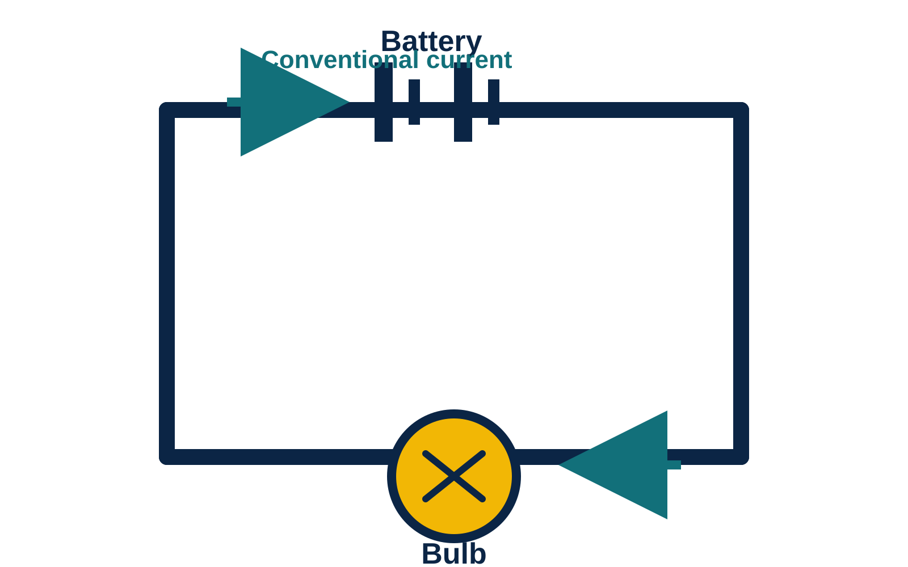
BACKGROUND & MOTIVATION
4
Everyday Experience Shapes — and Sometimes Distorts — Understanding
Learners already interact with electricity every day: switches, plugs, cellphones, appliances.
This everyday familiarity feels like understanding, but it can mask an inaccurate mental model of what is actually happening inside a circuit.
A common example: learners describe current the way they would describe water flowing through a pipe.
This water-pipe mental model leads directly to the misconception that current is “used up” as it moves around a circuit.
Menu
Background
Problem
Purpose
Literature
Method
Findings
Conclusion
Recommend

Slide 5


BACKGROUND & MOTIVATION
5
“Current Gets Used Up” — A Persistent Myth
The myth
Why it persists
The consequence
Learners often believe current is a substance that is consumed by components as it travels around the circuit, so less current “arrives” at the far side.
Learners cannot visualise charge flow, so they substitute science with an intuitive but incorrect substance-based model rooted in everyday experience.
Guisasola (2014) argues teaching must target conceptual understanding directly — yet this gap is still evident in Grade 12 NSC performance on circuits.
Menu
Background
Problem
Purpose
Literature
Method
Findings
Conclusion
Recommend

Slide 6
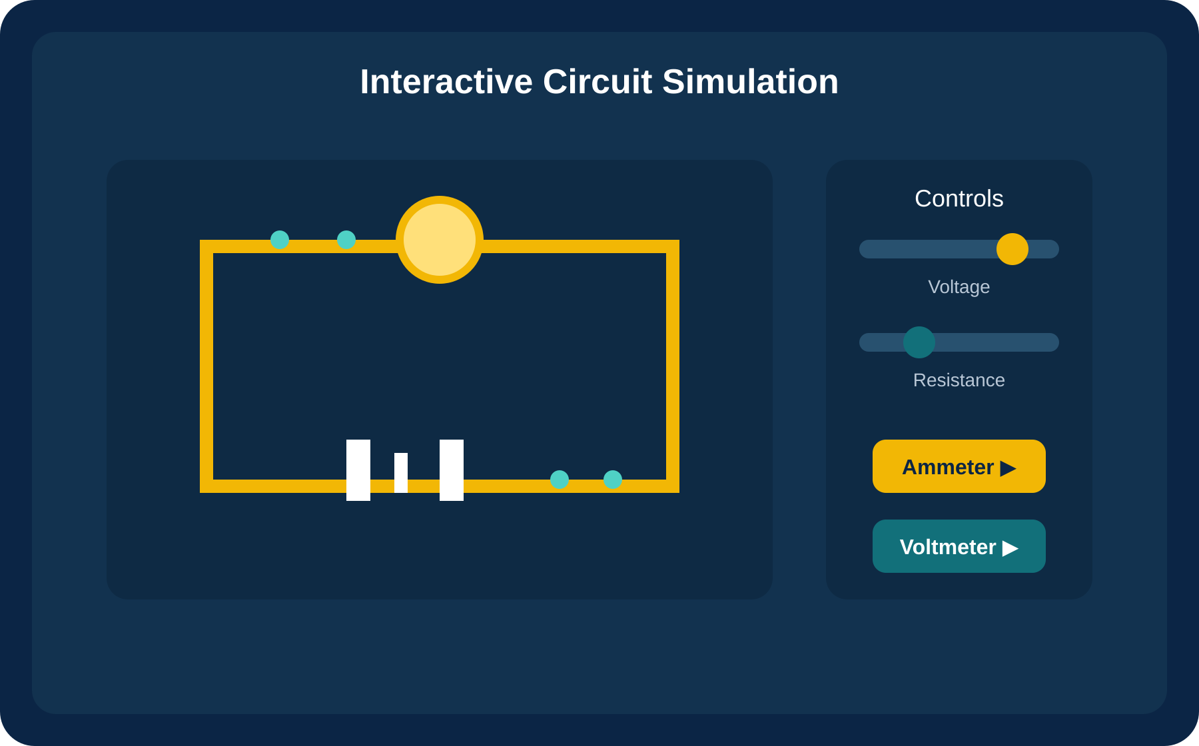
BACKGROUND & MOTIVATION
6
Stepans' Conceptual Change Model — Why Simulations Fit
Stepans' Conceptual Change Model (CCM) guides teaching that directly confronts learner misconceptions in a supportive environment.
It favours inquiry and reflection over memorisation — learners must test their own predictions against evidence.
Interactive simulations let learners manipulate circuit components, predict outcomes, and get immediate visual feedback.
This combination motivates for the use of PhET Interactive Simulations in this study.
Menu
Background
Problem
Purpose
Literature
Method
Findings
Conclusion
Recommend

Slide 7

RESEARCH PROBLEM
7
Understanding Charge Flow Demands Imagination Learners Don't Yet Have
Potential difference is conceptually foundational and ideally should be understood before current is introduced.
Learners must imagine the invisible flow of electrons to understand electric current, making it an abstract concept that cannot be observed directly with the naked eye (Ortega-Alvarez et al., 2018).
Without these mental images, learners struggle to connect potential difference, current and resistance into one coherent picture.
The result: learners can often follow a procedure but cannot explain what is really happening inside the circuit. Hence, they fail to connect and relate these concepts.
Menu
Background
Problem
Purpose
Literature
Method
Findings
Conclusion
Recommend

Slide 8


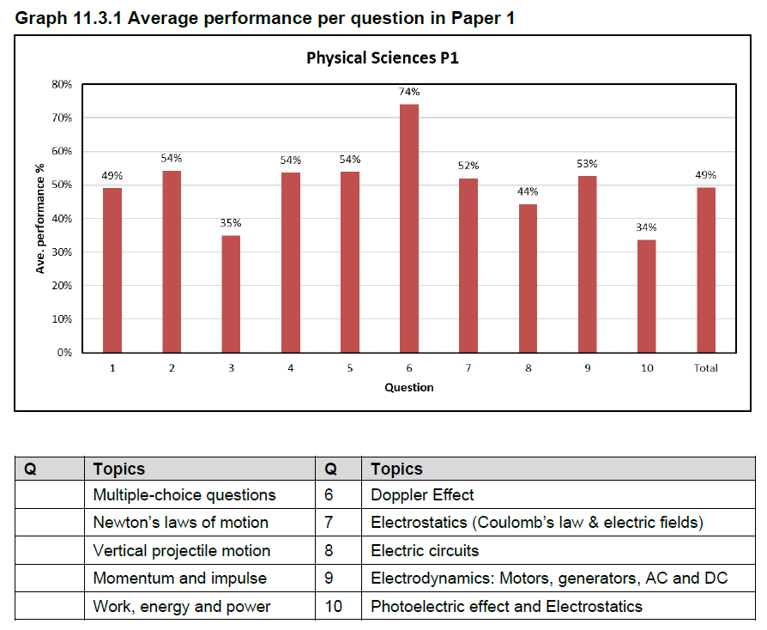

RESEARCH PROBLEM
8
The Evidence: 2024 Grade 12 NSC Examination Performance
Weaknesses in learners' conceptual grasp of electric circuits in Grades 10 and 11 do not stay hidden — they resurface as measurable underperformance in the electric circuits question of the Grade 12 Physical Sciences NSC examination.
NSC Questions
The electric circuits question consistently exposes gaps between procedural steps and genuine conceptual understanding.
45 %
Root cause
Misconceptions formed in Grade 10 are rarely corrected on their own — they persist unless directly confronted.
Menu
Background
Problem
Purpose
Literature
Method
Findings
Conclusion
Recommend
Notes:
This makes electric circuits a strategic entry point for early intervention, before misconceptions harden.

Slide 9
Subthemes emerging from the diagnostic test
Misconceptions about current and charge behaviour
Confusion about circuit configuration (series and parallel)
ncomplete understanding of potential difference and resistance
Misunderstanding of electric field in conductors
Surface-level and context-dependent reasoning
Theme | Description
Persistent misconceptions about current, charge and energy | Learners view electric current as a consumable or substance-like quantity rather than a continuous flow of conserved charge.
Fragmented understanding of circuit connection and behaviour | Learners recognise basic circuit symbols but cannot apply rules from series/parallel connection consistently.
Limited application of Ohm’s law and circuit logic | Learners fail to connect current, voltage and resistance meaningfully.
Weak conceptual transfer between macroscopic and microscopic models | Learners cannot link electric field and potential difference to charge movement within conductors.
Surface-level reasoning dominates over conceptual reasoning | Reasoning is driven by visual intuition or everyday experience rather than physics laws.

Slide 10
RESEARCH PROBLEM
9
Why PhET? Making the Invisible, Visible
This study turns to PhET Interactive Simulations because they can visualise what a real circuit cannot show — the movement of individual charges.
Learners can build circuits, flip switches, add components, and immediately watch current, voltage and resistance respond.
Freely available and browser-based, PhET is well suited to under-resourced South African classrooms.
The aim: stimulate learner interest and turn an abstract topic into something learners can see, test and reason about.
Menu
Background
Problem
Purpose
Literature
Method
Findings
Conclusion
Recommend

Slide 11



LITERATURE REVIEW
10
What Prior Research Tells Us
A known gap
CCM + Simulation fit
Making the abstract accessible
The literature shows a significant gap in understanding how durable conceptual change actually is once learners move on from a topic.
Stepans' Conceptual Change Model paired with interactive simulations is theoretically well suited to promoting sustained, not superficial, change.
Simulations are repeatedly identified as a way to make invisible, microscopic circuit behaviour accessible to learner reasoning.
Menu
Background
Problem
Purpose
Literature
Method
Findings
Conclusion
Recommend

Slide 12

PURPOSE & RESEARCH QUESTIONS
11
What This Study Set Out to Answer
Purpose: to investigate Grade 10 learners' conceptual understanding of electric circuits using PhET simulations — a case study in the Dimamo Circuit, Capricorn South District, Limpopo.
1
How will PhET simulations develop learners’ conceptual understanding of current, potential difference and resistance?
2
How can the conceptual change model (CCM) be used effectively to help learners understand the relationship between current, potential difference and resistance?
3
How do PhET simulations support learners in visualising and reasoning about abstract circuit concepts?
4
How can PhET simulations be used to show the effect of series and parallel connections on current, potential difference and resistance?
Menu
Background
Problem
Purpose
Literature
Method
Findings
Conclusion
Recommend

Slide 13




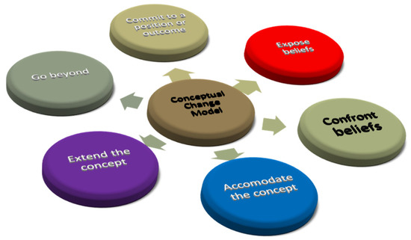
METHODOLOGY
12
A Qualitative Case Study Design
Qualitative approach following Merriam's case study design.
The case: Grade 10 Physical Sciences learners in the Dimamo Circuit, Capricorn South District, Limpopo.
Aligned with Stepans' Conceptual Change Model.
14 learners selected through purposive and convenience sampling.
Classroom
observations
Questionnaires
Interviews
Learning
activities
Collected Data — Inductive thematic analysis
Why a case study?
A case study allows an in-depth, contextualised look at how real learners' understanding actually shifts — not just whether test scores change.
Menu
Background
Problem
Purpose
Literature
Method
Findings
Conclusion
Recommend

Slide 14
RESEARCH FINDINGS
13
Where Learners Started: Deep-Rooted Misconceptions
Most learners were found to be in the pre-dissatisfaction and cognitive conflict stages according to the tenets of Stepan’s CCM.
Learner responses repeatedly described current as something produced by friction, or as already “moving fast” inside the wire before the circuit is even closed.
These patterns are consistent with a broader ‘current is consumed’ misconception documented across the literature.
Typical learner response
“The electricity is already present inside the wire, moving fast — the switch just lets it out.”
Reflects a substance / container model of current rather than a closed-loop charge-flow model.
Menu
Background
Problem
Purpose
Literature
Method
Findings
Conclusion
Recommend

Slide 15
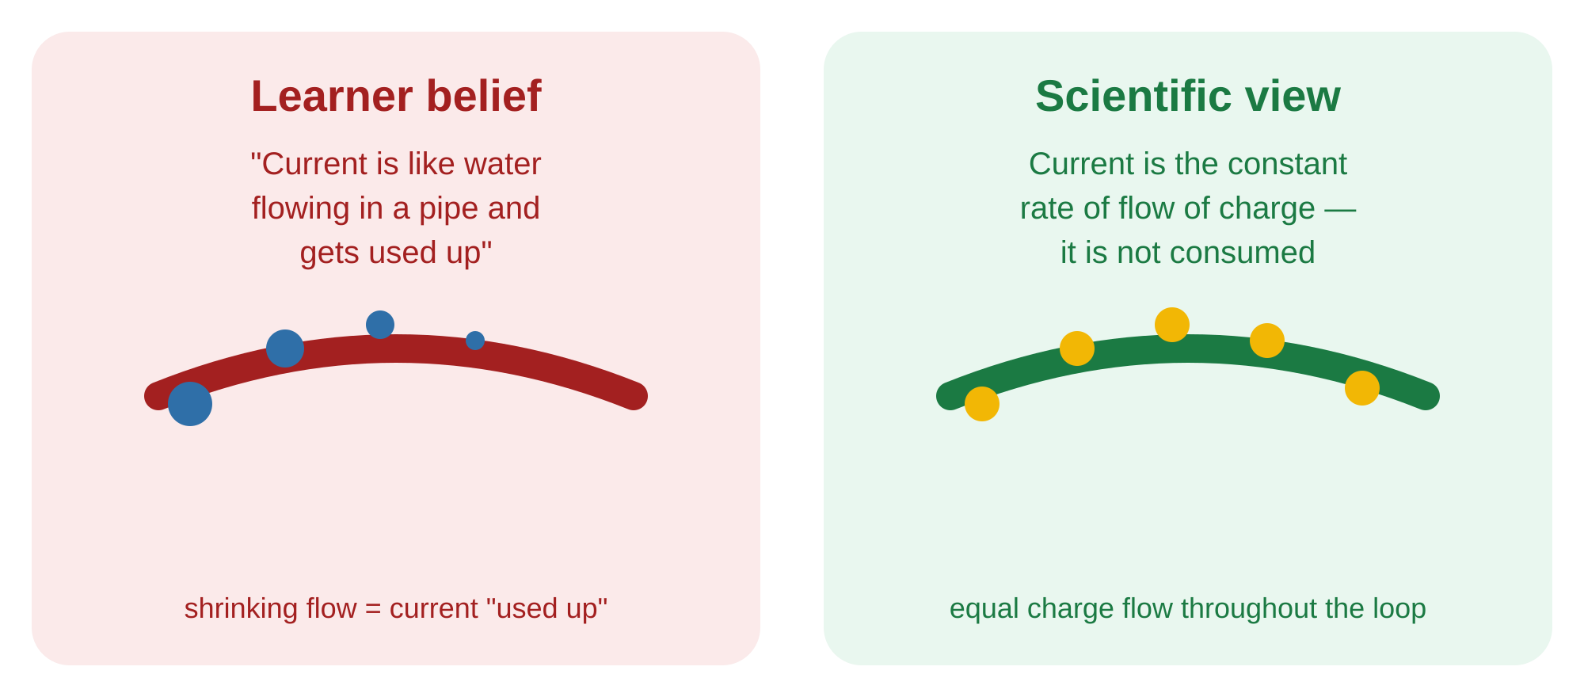
RESEARCH FINDINGS
14
Current as a Consumable, Not a Conserved Flow
This finding echoes long-standing literature (Shipstone; Duit & von Rhoneck; Engelhardt & Beicher): learners see current as consumed, not conserved.
These beliefs are resistant to change and typically require sustained, targeted teaching — a single lesson is not enough.
Menu
Background
Problem
Purpose
Literature
Method
Findings
Conclusion
Recommend

Slide 16


RESEARCH FINDINGS
15
Procedural Skill Is Not the Same as Conceptual Understanding
Many learners could follow the steps to build or read a circuit — but could not explain why current, potential difference and resistance relate the way they do.
This confirms that procedural competence and conceptual understanding are genuinely separate outcomes, especially in electricity.
Learners struggled most to connect what they could see (bulb brightness, meter readings) with what they could not (electric field, electron motion).
Macroscopic (observable)
Bulb brightness, meter readings, switch behaviour
Microscopic (explanatory)
Electron movement, electric field, charge conservation
Menu
Background
Problem
Purpose
Literature
Method
Findings
Conclusion
Recommend

Slide 17
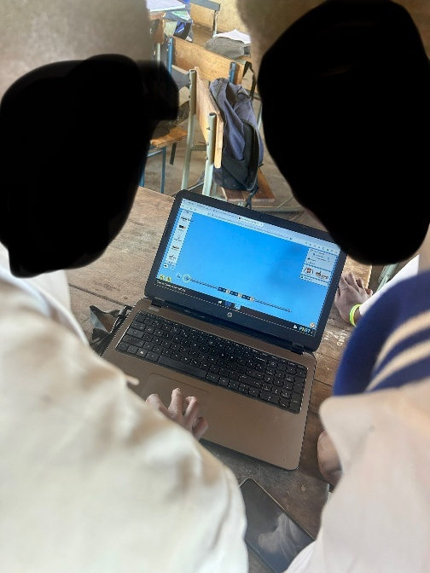
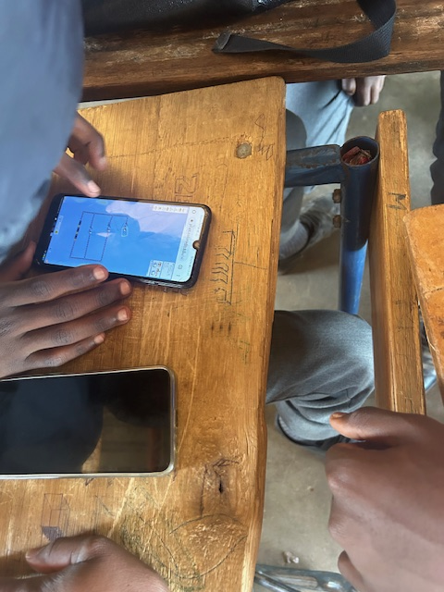
RESEARCH FINDINGS
16
Simulations in the Classroom
During PhET activities, learners tended to focus on what they could immediately observe — bulbs lighting, meter needles moving — rather than the underlying explanation, unless a facilitator prompted them to look deeper.
Cellphones and Tablets
Laptops
Because laptops were limited, other learners engaged with the browser-based simulation directly on their own cellphones and tablets.
Learners built and tested circuits individually on laptops running the PhET simulation.
Menu
Background
Problem
Purpose
Literature
Method
Findings
Conclusion
Recommend

Slide 18
RESEARCH FINDINGS
17
Visualisation Helps — But Needs Scaffolding
Simulations successfully let learners visualise electron flow for the first time.
Yet some learners still could not explain what actually causes electrons to move: the role of potential difference across the battery.
This matches Wieman et al. (2010): visualisation alone is not enough without explicit conceptual scaffolding around it.
Across observations and interviews, PhET simulations played a clearly positive role in engagement and emerging understanding — even where misconceptions remained.
Menu
Background
Problem
Purpose
Literature
Method
Findings
Conclusion
Recommend

Slide 19


CONCLUSION
18
What We Now Know
A real gain
Not a silver bullet
A call to the DBE
PhET simulations meaningfully improved conceptual understanding by making abstract behaviour visible and letting learners compare circuit configurations directly.
Simulation alone is not sufficient. Structured guidance and explicit teaching are still needed to connect what learners see to why it happens.
The study urges the Department of Basic Education to extend access to this kind of practical, visual learning in under-resourced schools.
Menu
Background
Problem
Purpose
Literature
Method
Findings
Conclusion
Recommend

Slide 20

RECOMMENDATIONS
19
For Teachers and the Department of Education
Teachers should incorporate PhET simulations regularly, not as a once-off thing.
Lessons should be deliberately designed around Stepans' CCM to produce sustainable conceptual change, not surface-level engagement.
Learners should predict and compute expected values before manipulating components — turning observation into genuine testing.
The DoE should invest in teacher training on simulation-based pedagogy, alongside reliable access to computers and internet connectivity.
Menu
Background
Problem
Purpose
Literature
Method
Findings
Conclusion
Recommend

Slide 21


RECOMMENDATIONS
20
For Government and Parents
Purpose
Government
Parents
The aim is to produce learners who scientifically understand concepts well enough to transfer that understanding into everyday experience.
Equip schools with computers, tablets, interactive boards and reliable internet access — the infrastructure this approach depends on.
Parents can reinforce classroom learning by creating a conducive home environment and staying engaged with what learners are studying.
Menu
Background
Problem
Purpose
Literature
Method
Findings
Conclusion
Recommend

Slide 22
21
THANK YOU
Questions and discussion are welcome.
Dr P.W. Masoga • P.M. Mamabolo • Prof. S.K. Singh
◀ Back to Menu

