Slide 1




HIGH-$p_{T}$ DIHADRON CORRELATIONS IN PROTON-PROTON AND HEAVY-ION COLLISIONS
Tiaan van der Merwe
Assoc Prof. Will Horowitz Cole Faraday Ben Bert

Slide 2
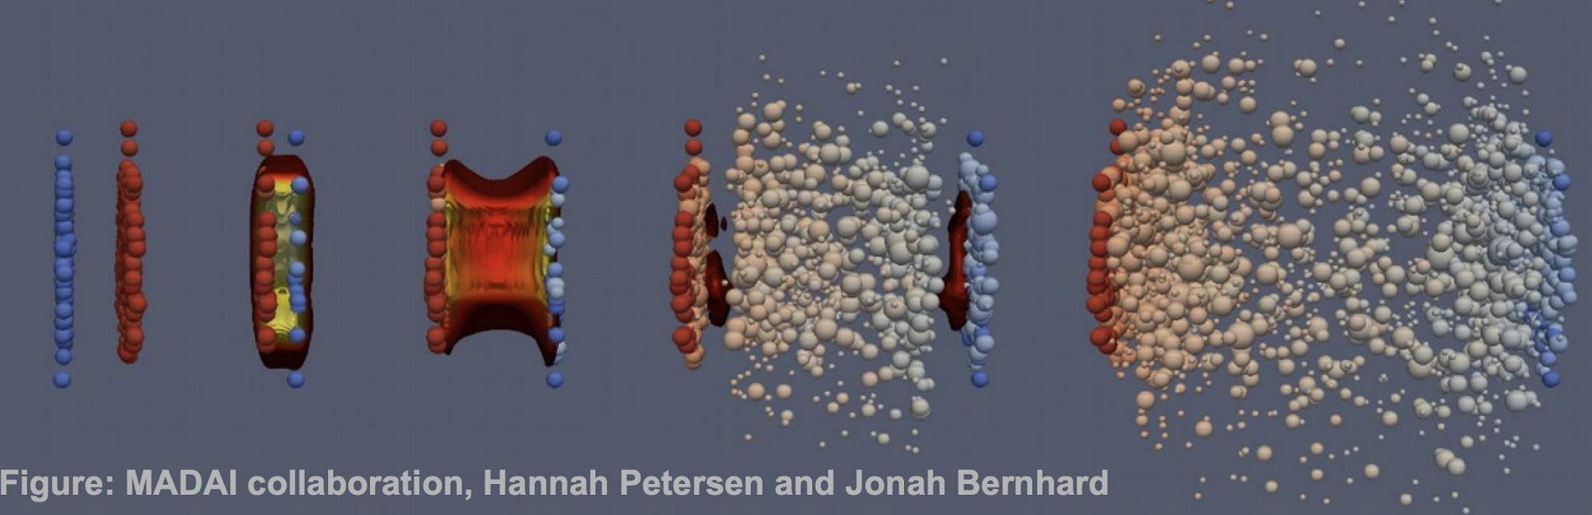
Quark Gluon plasma and heavy-ion collisions
Quarks and gluons interact with each other within the QGP
We observe particles that are created and modified via the quark-gluon interaction
Relativistic pancake
Smash two Pb atoms together
t
~ 10⁻²³ s
Notes:
Key points:
QGP: Medium comprised of deconfined quarks and gluons
Created at LHC and RHIC in heavy-ion collisions
Short lived – compare hadrons in AA vs pp

Slide 3
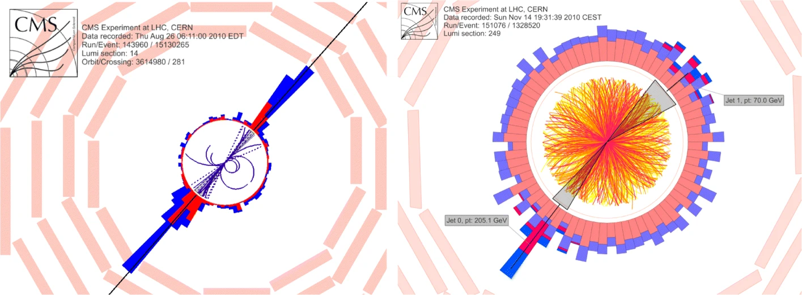
Jets and Jet quenching
Where did the energy go? Can we calculate this suppression?
Energy = 70 GeV
Jets!
Energy = 200 GeV
Notes:
Key points:
Observed hadrons come in jets: collimated spray of hadrons originating from the fragmentation of a parton
Momentum conservation – partons are b2b with equal momenta, so in the vacuum the b2b jets constituents should add up to the same energies
pp: this is the case, with any broadening due to the fragmentation and parton showers
AA: not the case, clear imbalance between the b2b jets
Energy dissipated in the QGP

Slide 4
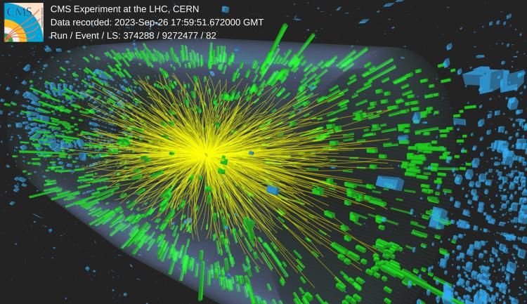
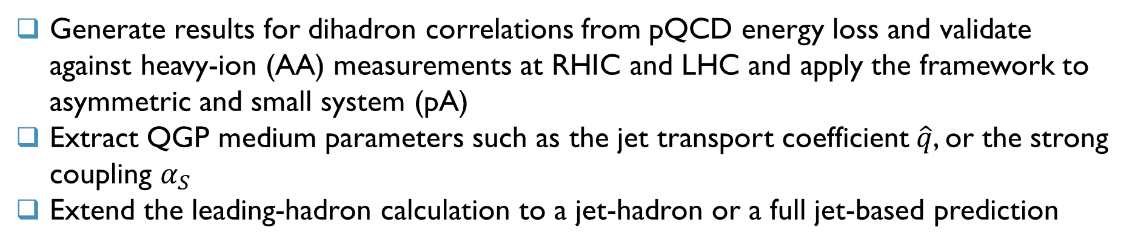
Physics goals
Generate results for dihadron correlations from pQCD energy loss and validate against heavy-ion (AA) measurements at RHIC and LHC and apply the framework to asymmetric and small system (pA)
Extract QGP medium parameters such as the jet transport coefficient $\hat{q}$, or the strong coupling $α_{S}$
Extend the leading-hadron calculation to a jet-hadron or a full jet-based prediction
Notes:
Key points:
Predict the suppression of b2b jets by calculating dihadron correlations where we use leading hadron instead of the entire jet
Extract medium parameters
Extend the dihadron calculation to a jet-hadron or a full dijet calculation

Slide 5
Physics approach
A proton-proton baseline is needed for:
characterizing vacuum QCD effects (ISR, FSR, MPI) on dihadron correlations,
serving as the reference for extracting medium (QGP) effects
pp dihadron correlation baseline
pQCD Radiative and Collisional energy loss
QGP Geometric modelling
AA dihadron correlation predictions!
Comparison

Slide 6
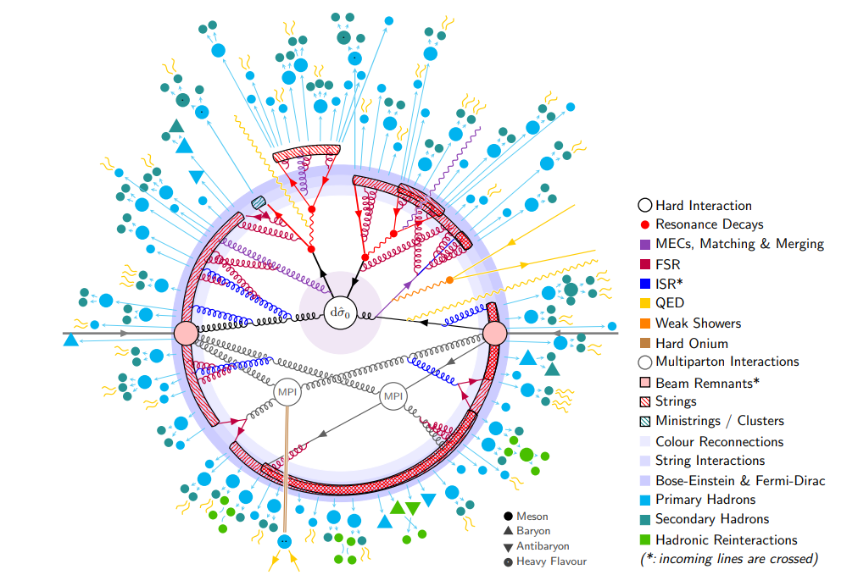
Pythia event generator
PYTHIA is a widely used Monte Carlo event generator for high-energy hadron collisions.
Decreasing
hardness
scale
Hard scatter (LO matrix elements)
Initial-state and final state parton shower
Multi-parton interactions
Hadronization (Lund string fragmentation)
Hadron Decay

Slide 7
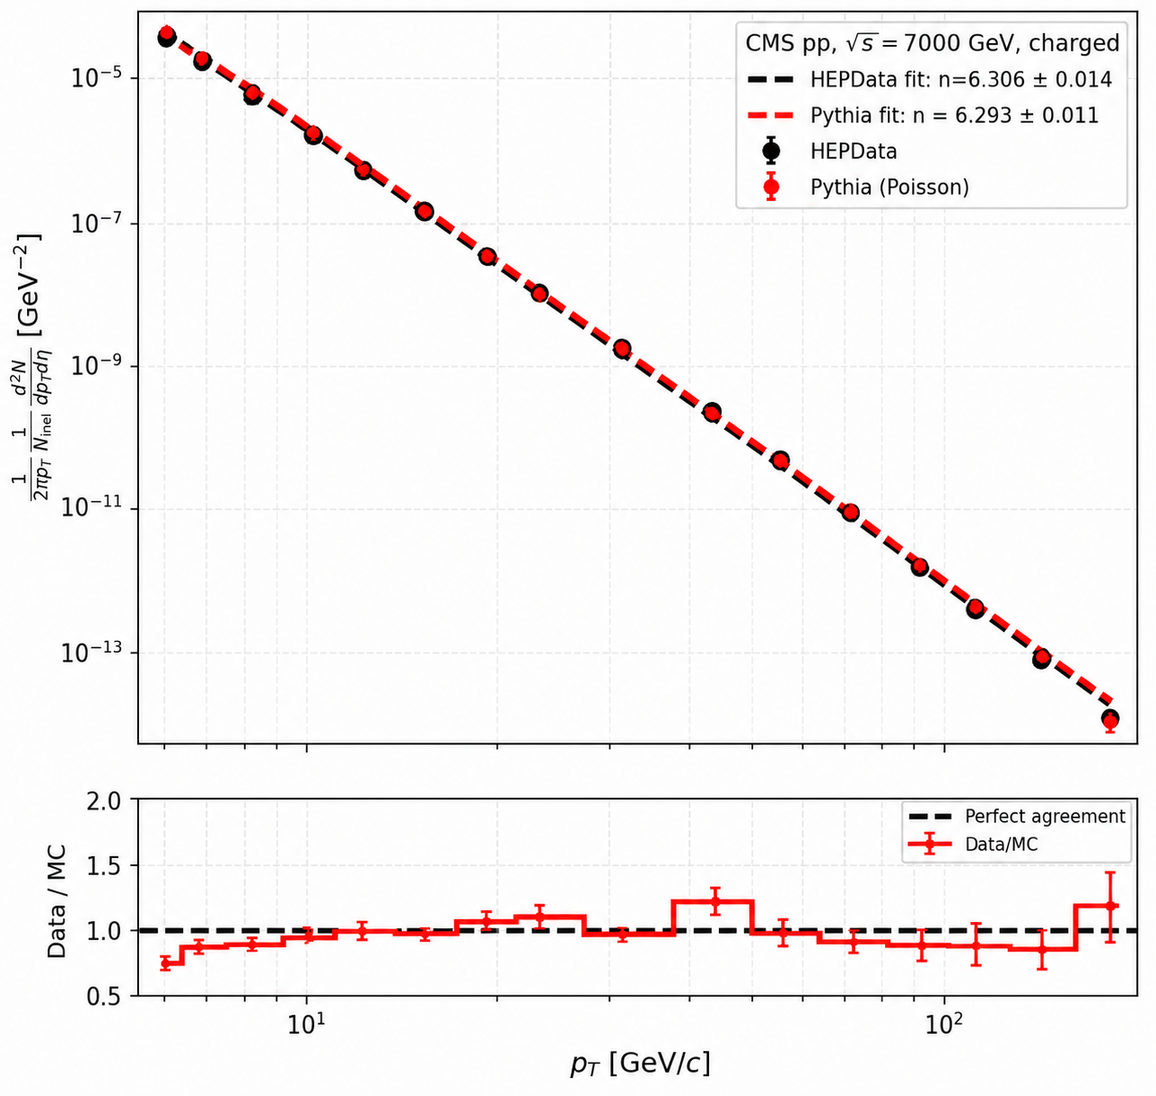
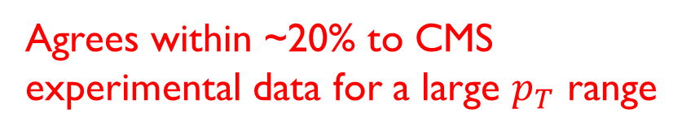


Pythia event generator
Charged particle invariant yield of PYTHIA vs CMS
PYTHIA has been validated and tuned against collision data since its inception.
Provides an excellent resource for experimental and theoretical particle and nuclear physics
Invariant yield $[{GeV}^{−2}]$
Agrees within ~20% to CMS experimental data for a large $p_{T}$ range
Ratio to CMS
$$p_{T} [GeV/c]$$

Slide 8
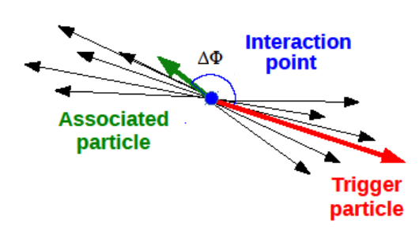
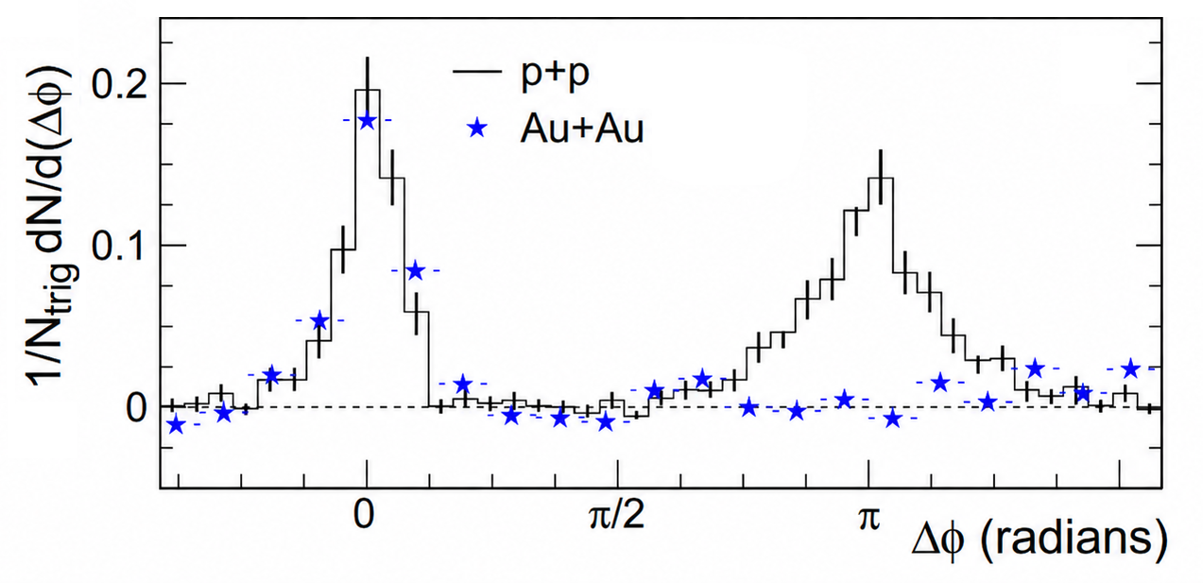

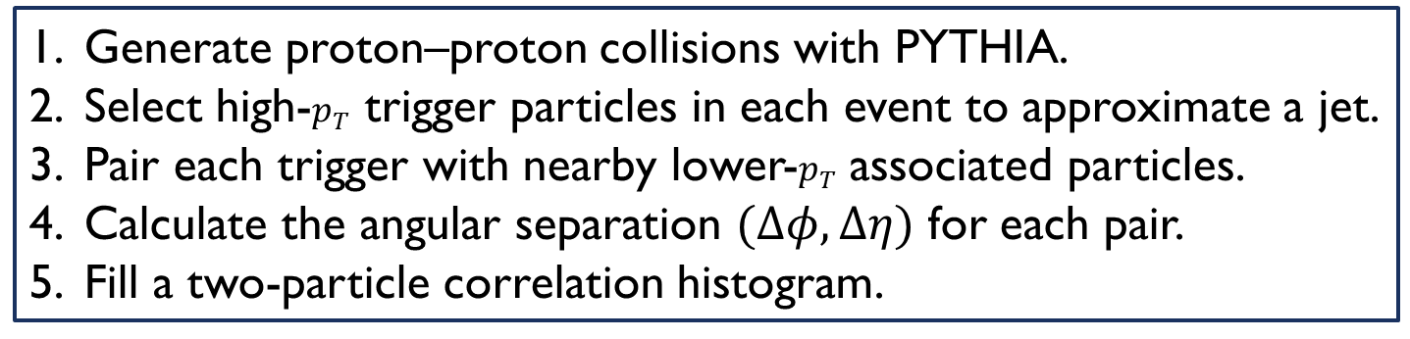

Dihadron correlations in pythia
Generate proton–proton collisions with PYTHIA.
Select high-$p_{T}$ trigger particles in each event to approximate a jet.
Pair each trigger with nearby lower-$p_{T}$ associated particles.
Calculate the angular separation $(Δφ, Δη)$ for each pair.
Fill a two-particle correlation histogram.
Connors et al, Rev. Mod. Phys. 90 (2018), 025005
STAR Dihadron $Δφ$ Projection
Medium suppression!
$$\frac{1}{N_{trig}}\frac{dN}{d(∆φ)}$$

Slide 9
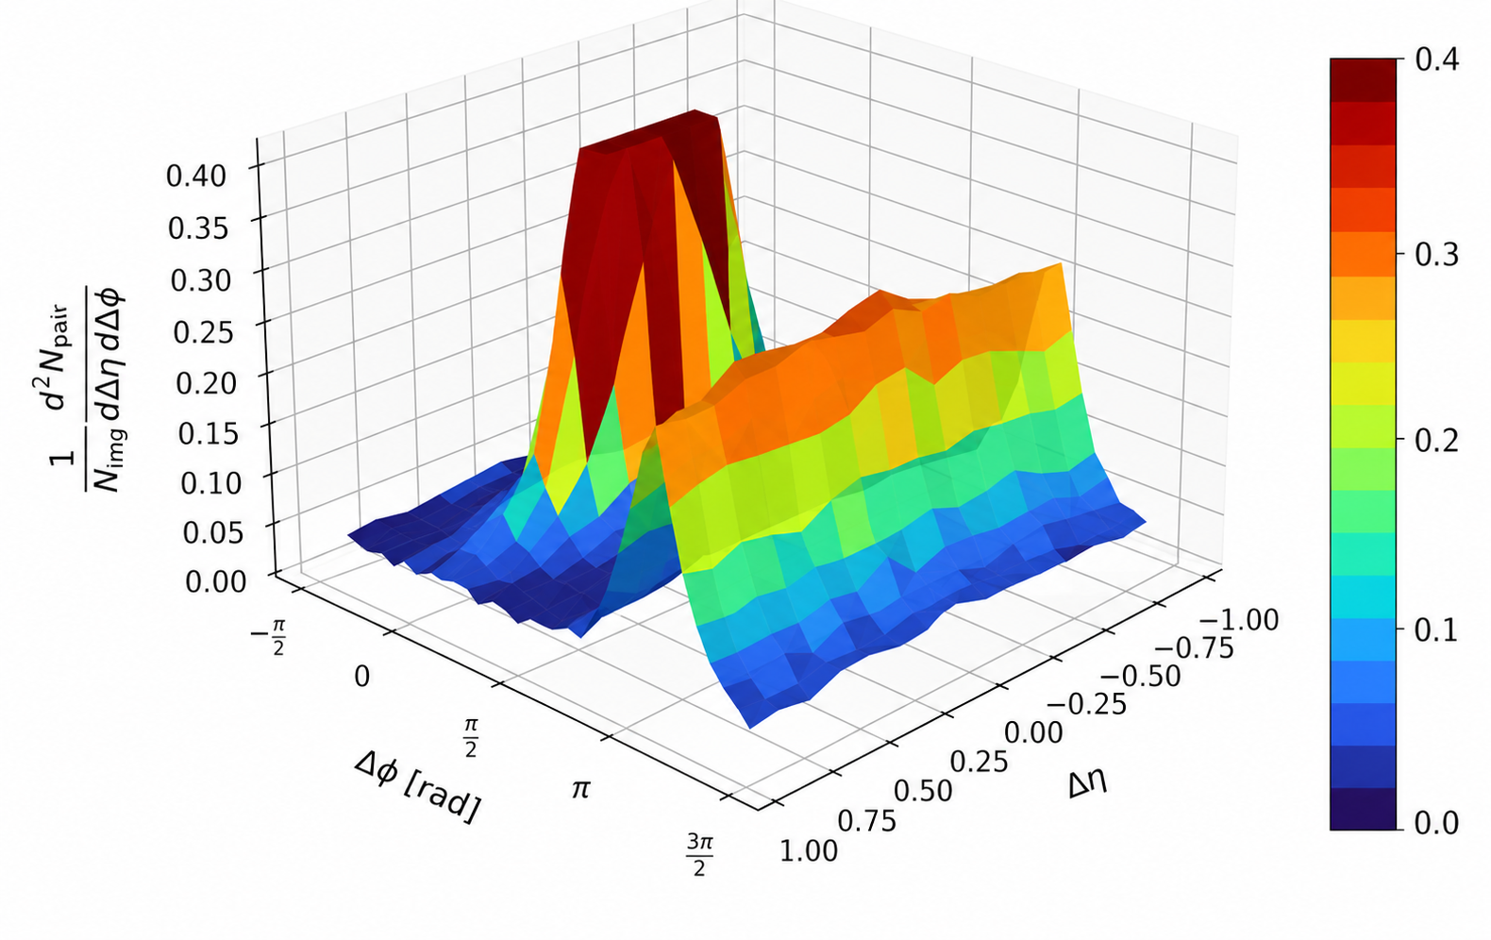
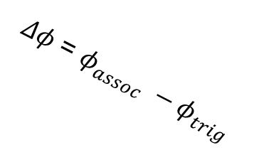

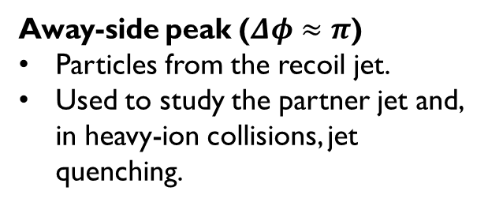

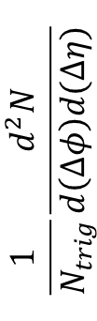
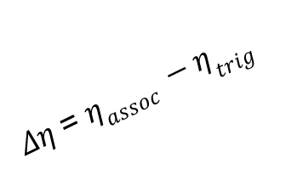
Results: The associated yield distributions
$(Δφ,Δη)$ Associate Particle Yield Distribution
Near-side peak ($Δφ≈0, Δη≈0$)
Particles produced in the same jet as the trigger hadron.
Measures the trigger jet's fragmentation.
$$\frac{1}{N_{trig}}\frac{d^{2}N}{d\left(∆φ\right)d(Δη)}$$
Connors et al, Rev. Mod. Phys. 90 (2018), 025005
Away-side peak ($Δφ≈π$)
Particles from the recoil jet.
Used to study the partner jet and, in heavy-ion collisions, jet quenching.
$Δφ$ = $φ_{assoc} −φ_{trig}$
$Δη$ = $η_{assoc} −η_{trig}$

Slide 10
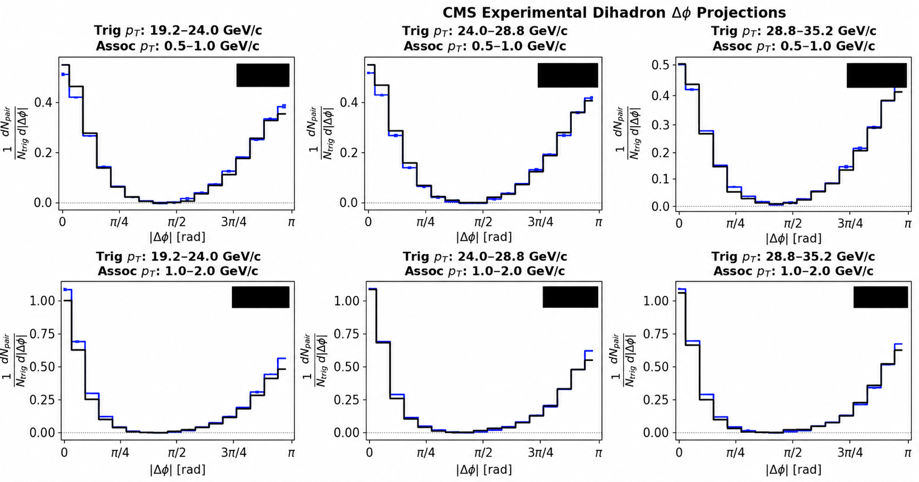
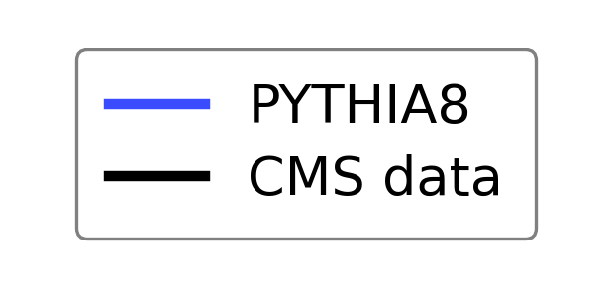
Results: The ∆φ-distributions of CMS
CMS Experimental Dihadron $Δφ$ Comparison
PYTHIA agrees well with CMS analysis data!
CMS Collaboration,
CMS-PAS-HIN-12-010 (2011)

Slide 11
To-Do: pqcd energy loss
pQCD energy loss is needed for:
modelling medium-induced interactions between the medium constituents and propagating partons,
extracting medium properties
✓
pp dihadron correlation baseline
pQCD Radiative and Collisional energy loss
QGP Geometric modelling
AA dihadron correlation predictions!
Comparison

Slide 12
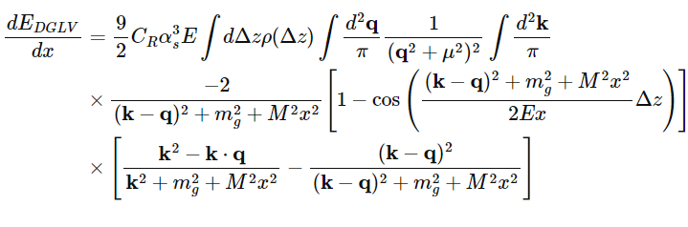
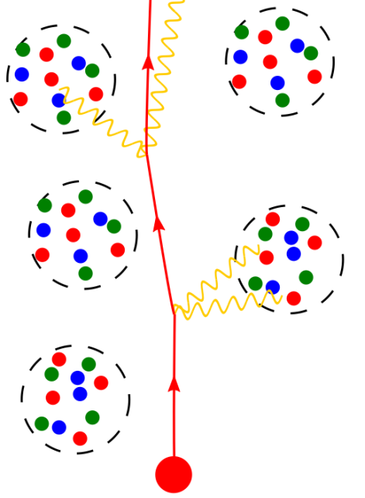
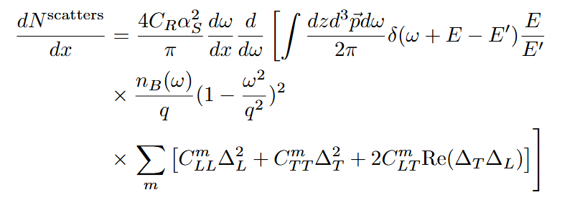
To-Do: pqcd energy loss
Radiative energy loss
Two energy loss mechanisms:
Radiative energy loss: DGLV formulation
Collisional energy loss: HTL framework
Elastic energy loss
Radiative
Elastic
Illustration by C. Faraday
Notes:
Expand on energy loss. Simple DGLV sampling

Slide 13
Summary
Energy loss is a key signal of the formation of QGP in heavy-ion collisions
This project aims modelling to calculate the suppression of the away-side jet in heavy-ion collisions
We will combine MC event generation with PYTHIA, pQCD radiative and collisional energy loss calculations, and QGP medium modelling
Quantitative constraints on QGP properties, strong coupling constant and the jet transport coefficient, will be extracted from measurements of dihadron correlations
QUESTIONS?

Slide 14
Back up

Slide 15
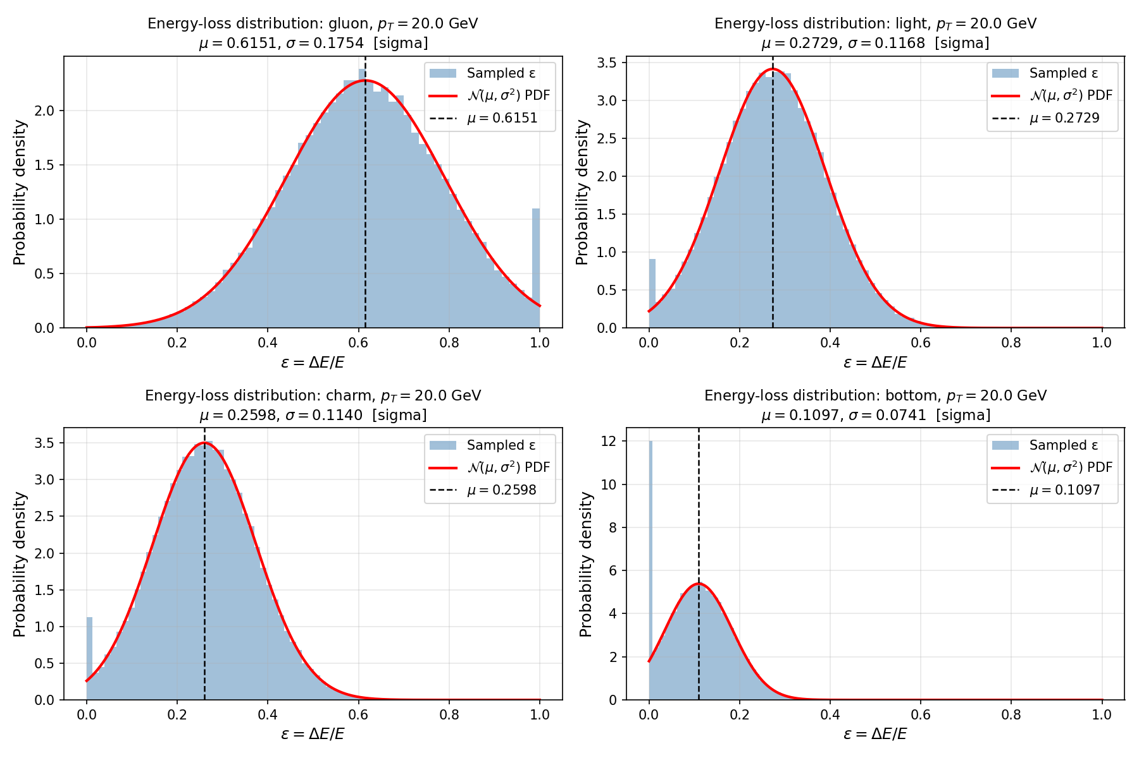
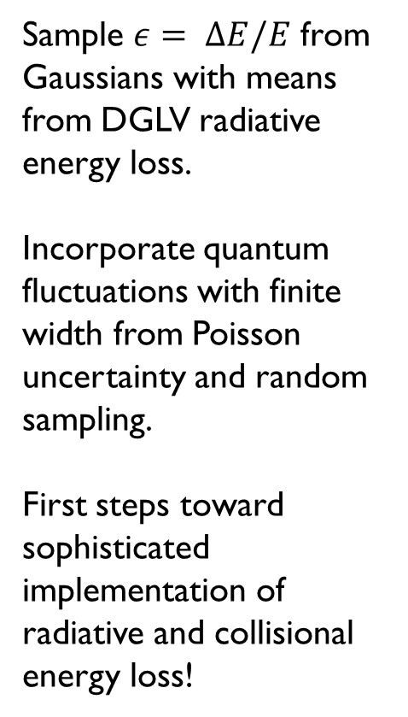
SIMPLE RADIATIVE energy loss
Sample $ε= ∆E/E$ from Gaussians with means from DGLV radiative energy loss.
Incorporate quantum fluctuations with finite width from Poisson uncertainty and random sampling.
First steps toward sophisticated implementation of radiative and collisional energy loss!
Notes:
Expand on energy loss. Simple DGLV sampling

Slide 16
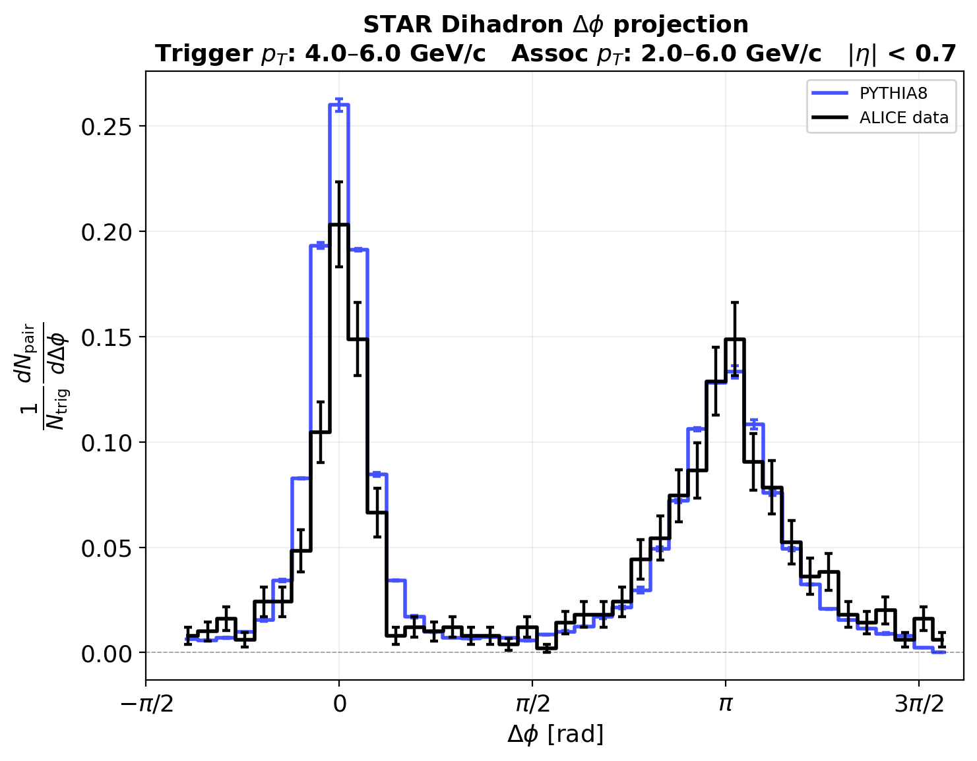
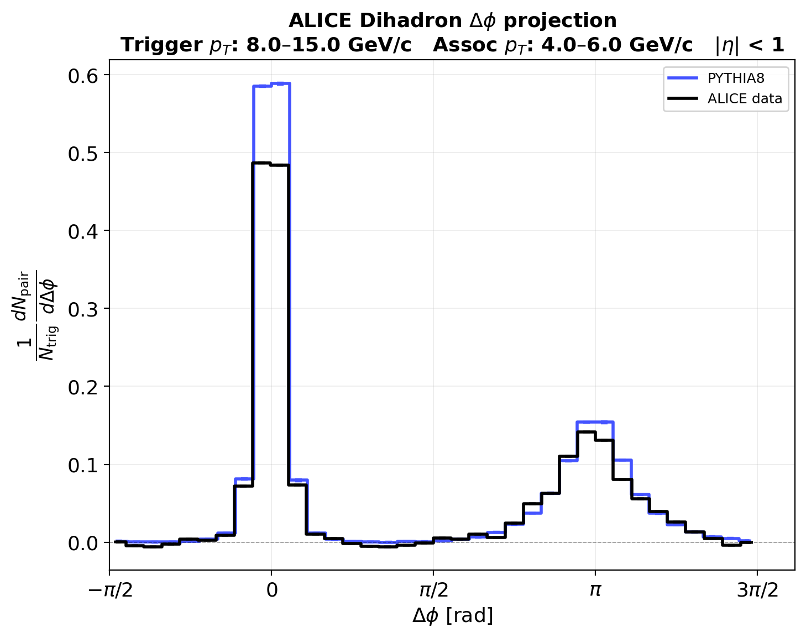


Results: The ∆φ-distributions of Alice and STAR
PYTHIA 8 agrees well with published ALICE and STAR data!
STAR Dihadron $Δφ$ Projection
ALICE Dihadron $Δφ$ Projection
STAR Collaboration,
Phys. Rev. Lett. 91, 072304 (2003)
ALICE Collaboration,
Phys. Rev. Lett. 108, 092301 (2012)

Slide 17
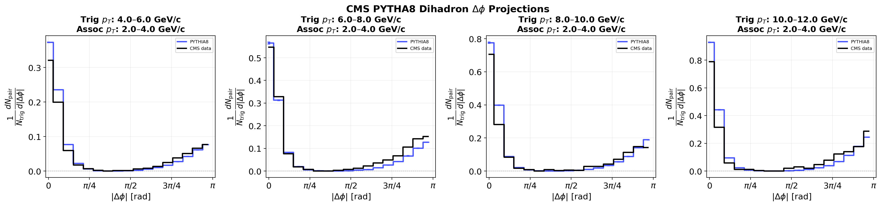

Results: The ∆φ-distributions of CMS in PYTHIA
...and with a published CMS PYTHIA implementation!
CMS PYTHIA8 Dihadron $Δφ$ Projections
CMS Collaboration,
JHEP 07, 076 (2011)

