Slide 1
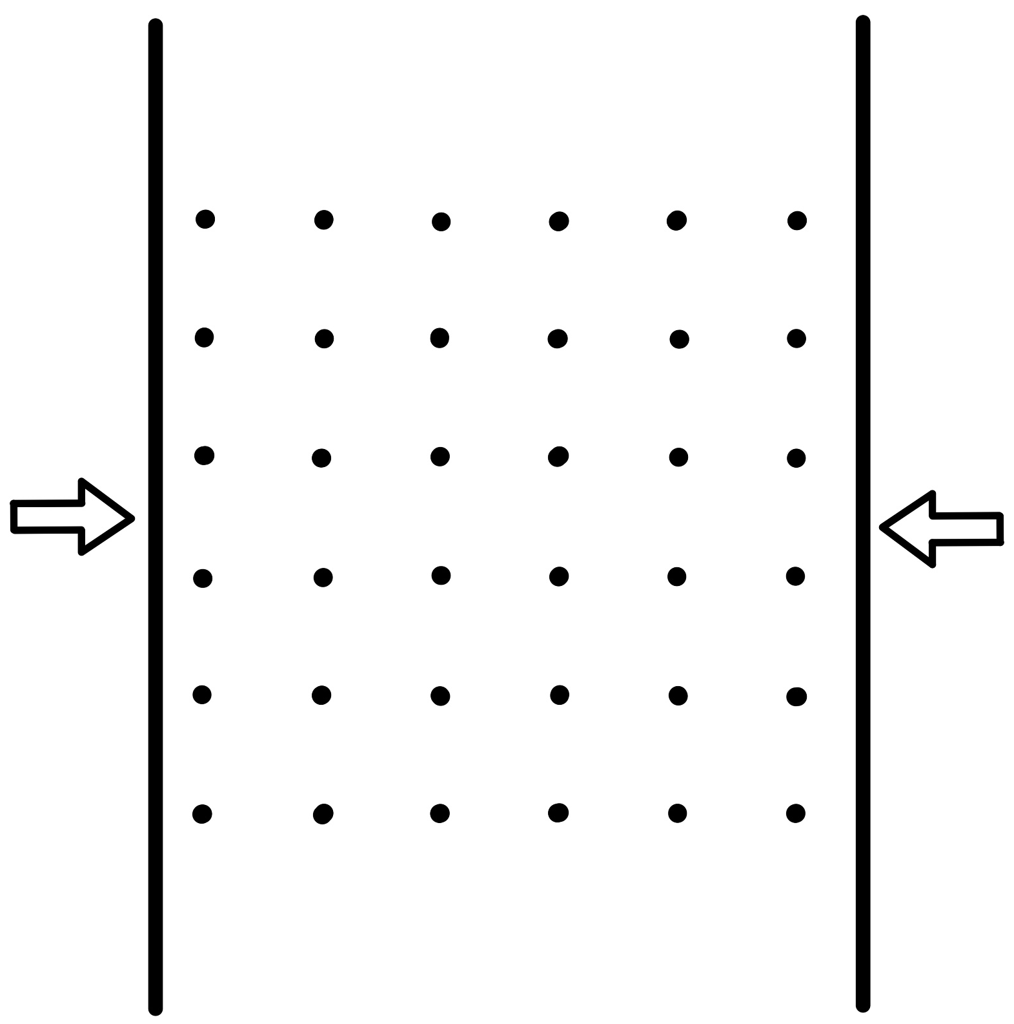



Thermodynamics of Quantum Fields on a Finite Lattice
Rens Roosenstein
SAIP
9 July 2026
Notes:
So… this is the title.
At first glance that sounds like three talks rolled into one — but I promise it’s really just one idea.
The short version is: I want to understand what thermal quantum field theory really looks like when the volume is not taken to infinity, and in this research, we have found some tentative results for the Path integral formulation of the partition function which can be found in our recent paper and I will also show in this talk.
Many solutions in TFT are not known, and we aim to fill some of those gaps by revisiting the derivation of the path integral formulation of the partition function without taking the Volume to infinity.
1

Slide 2
1
Background:
Casimir Effect, Quark-Gluon Plasma
Outline
How does one construct a path integral on a finite volume
2
Outline of Methodology:
Statistical Physics, Finite Volume QFT
3
Path Integral Derivation
4
Consequences
5
Conclusions
Rens Roosenstein | University of Cape Town | SAIP 2026 |
1/18
Notes:
I will first give a little bit of an outline, I will first provide some background information as to what we are interested in, namely small systems, such as the Quark-Gluon Plasma, which require some thermal field theory.
I will then outline the methodology we have used in order to correctly capture the finite temperature and finite Volume physics of our QFT
This brings us to a path integral derivation, which will yield the unexpected result we have found for the partition function, after which I will conclude.
2

Slide 3
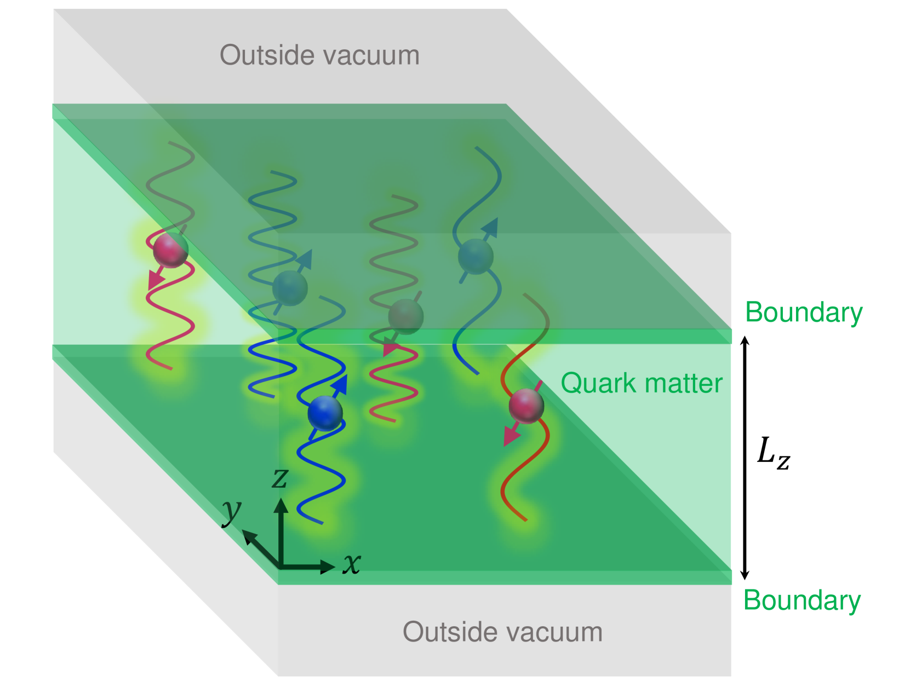
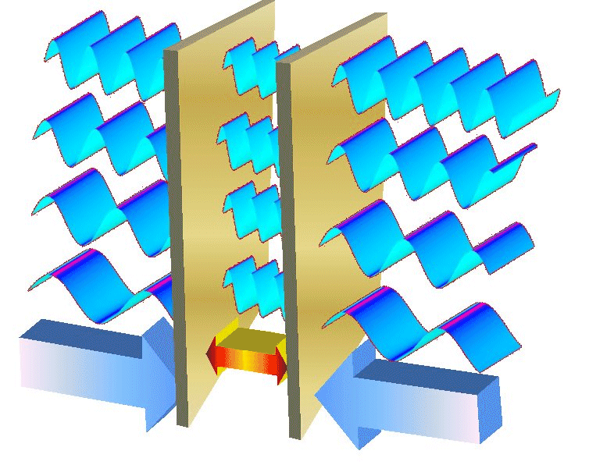
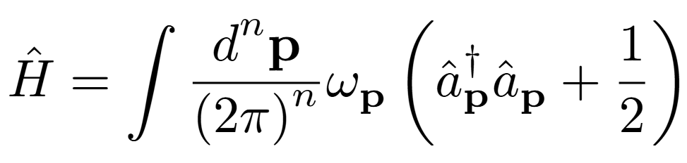
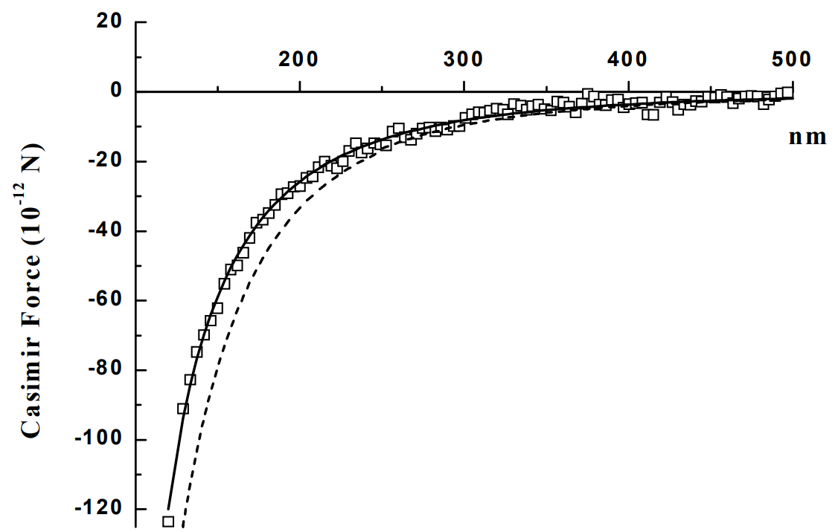
1
QCD Casimir Effect
System size effects
Vacuum fluctuations
Casimir force
Addition of quark matter
This is a QGP
arXiv:quant-ph/0609145 (2006)
10nm 1 atm !
Rens Roosenstein | University of Cape Town | SAIP 2026 |
2/18
Notes:
I first want to explain what the Casimir effect is, as this is where the interesting part of our research lies.
Vacuum fluctuations, in math comes from the vacuum energy term in the Hamiltonian
Leads to the Casimir force, which has been measured. As depicted in the cited plot
10 nm already amounts to 1 atm, which are quite large numbers
Addition of matter inside of the plates leads to a figure like this, where the boundary (similar to the plates) is defined by the edge of our quark matter, where inside the boundary we have all of our matter and outside we have a vacuum. At high enough temperatures this is the definition of a Quark gluon plasma as it is created in our particle accelerators.
3

Slide 4
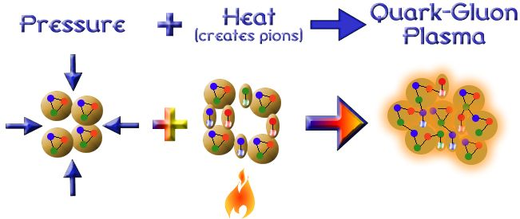
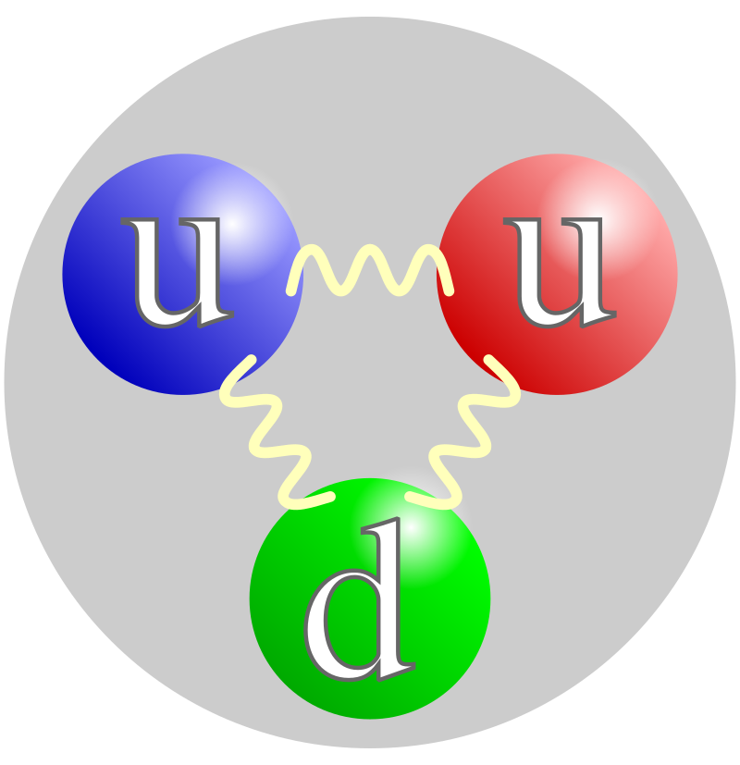
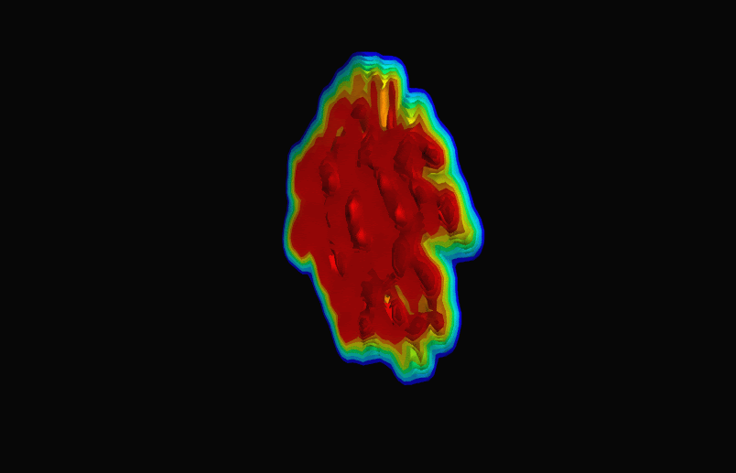
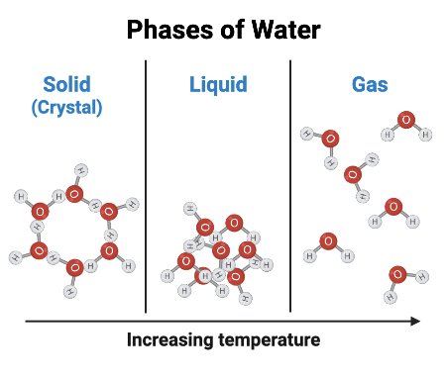
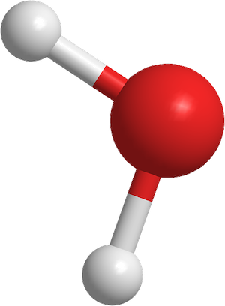
1
What is a QGP?
Quarks in Hadron
The QGP behaves like a nearly perfect fluid!!!
H2O molecule
Macroscopic:
Hydrodynamics
Microscopic:
QFT
Rens Roosenstein | University of Cape Town | SAIP 2026 |
3/18
Notes:
So what is a QGP, it is a system of deconfined quarks and gluons. This exotic state of matter is created by increasing the energy density of Hadrons such as protons and Neutrons that consist of Quarks and Gluons. Due to this increase in energy density, the strong force is overcome and the QCD matter deconfines to form a statistical system that depends on temperature, pressure, very similar to how other liquids and gasses behave in statistical physics.
A remarkable discovery is that this quark–gluon plasma does not behave like a weakly interacting gas, but instead like a nearly perfect fluid. As a result, its macroscopic evolution can be successfully described using relativistic second-order hydrodynamics, with an equation of state computed from lattice QCD. In this sense, the system is naturally described within the framework of thermal field theory, which provides the bridge between the microscopic dynamics from our Thermal QFT and the emergent hydrodynamic behavior.

Slide 5
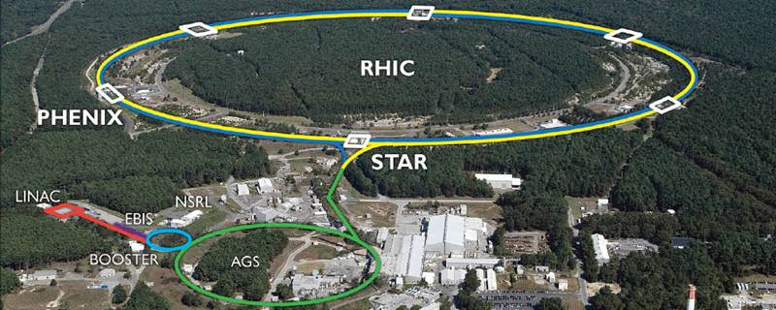
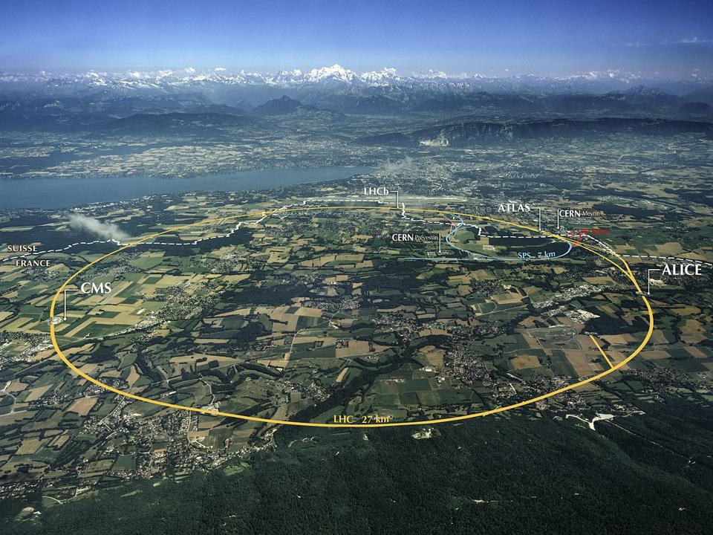
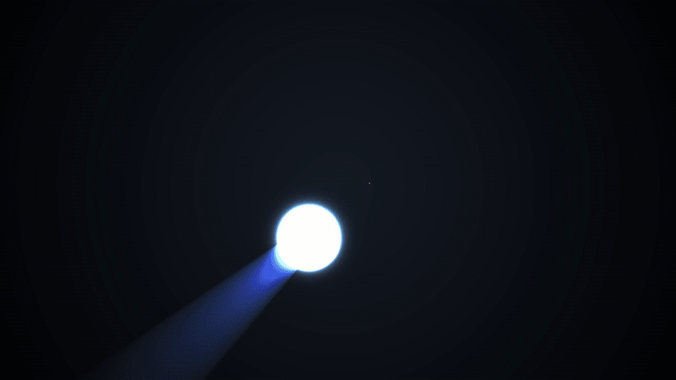
1
Relativistic Heavy-Ion Collisions
LHC
Rens Roosenstein | University of Cape Town | SAIP 2026 |
4/18
Notes:
So where do we see this exotic state of matter. We make it inside our particle accelerators such as the LHC and RHIC.

Slide 6
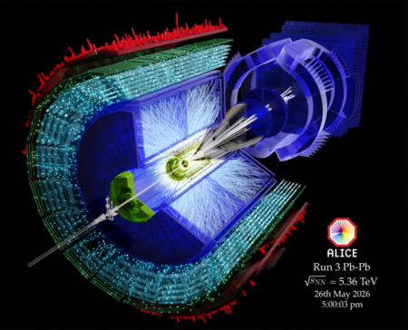
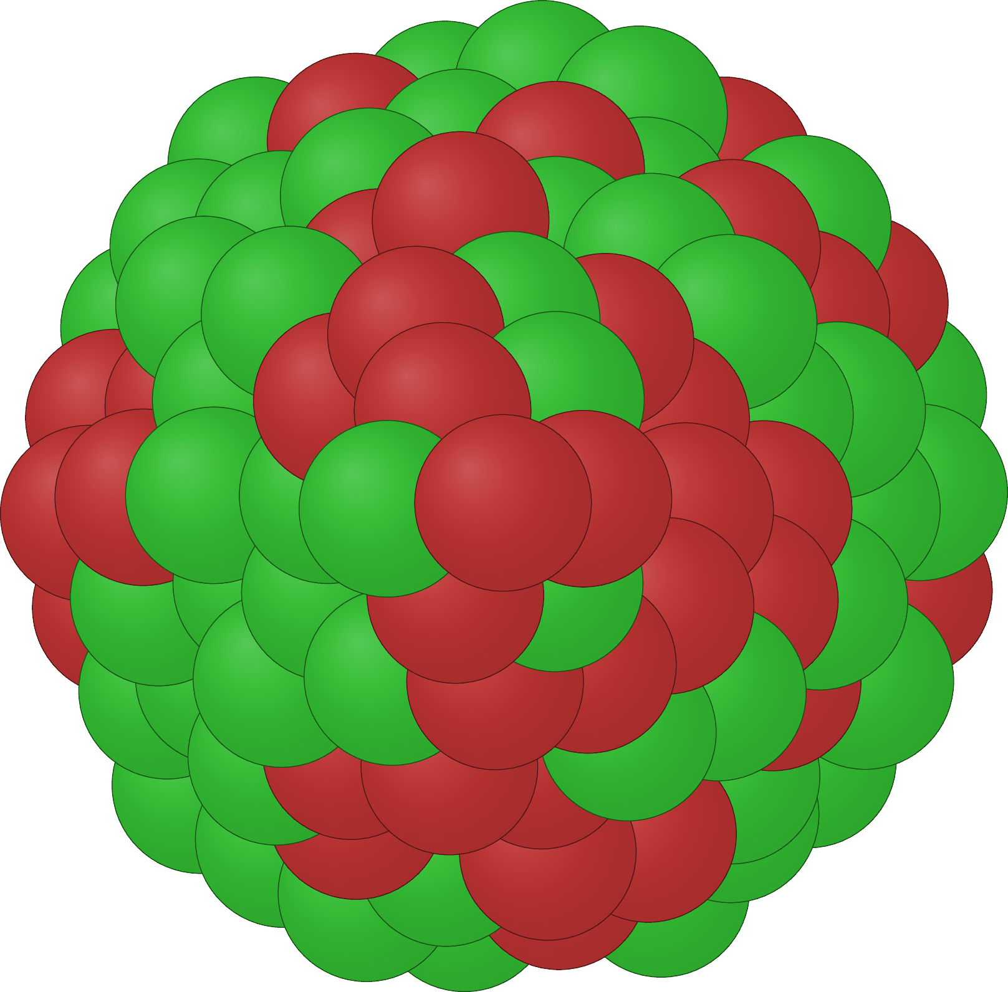

1
Quark-Gluon Plasma in Heavy-Ion Collisions
"Large systems” Pb-Pb
"Small systems“ p-p (Casimir effect?)
Quark-Gluon Plasma formation
~ 10 fm
~ 1 fm
Rens Roosenstein | University of Cape Town | SAIP 2026 |
5/18
Notes:
Inside of these colliders us physicists collide various types of matter. And for nuclei that consist of QCD matter, a QGP can be formed. Here I want to make the connection to what we consider a small enough system such that the casimir effect might play a role. A large type of system would be a Lead-Lead collision.
The smallest type of collision with QCD matter is a proton proton collision, and the question is whether or not a clear QGP is actually formed and whether or not this system is affected by the Casimir effect.
6

Slide 7
1
Background:
(Casimir Effect, Quark-Gluon Plasma)
Outline
How does one construct a path integral on a finite volume
2
Outline of Methodology:
(Statistical Physics, Finite Volume QFT)
3
Path Integral Derivation
4
Consequences
5
Conclusions
Rens Roosenstein | University of Cape Town | SAIP 2026 |
6/18
Notes:
I will first give a little bit of an outline, I will first provide some background information as to what we are interested in, namely small systems, such as the Quark-Gluon Plasma, which require some thermal field theory.
I will then outline the methodology we have used in order to correctly capture the finite temperature and finite Volume physics of our QFT
This brings us to a path integral derivation, which will yield the unexpected result we have found for the partition function, after which I will conclude.
7

Slide 8
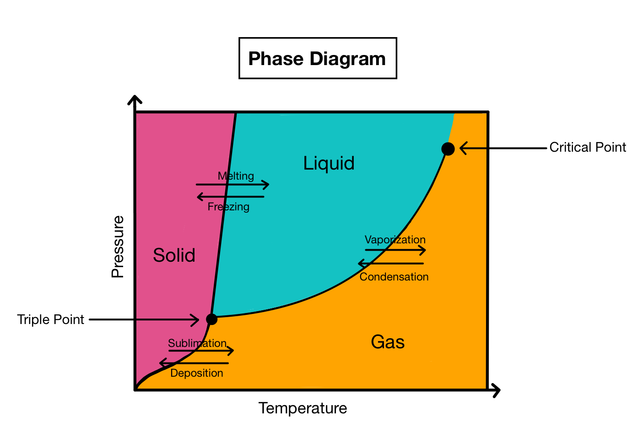
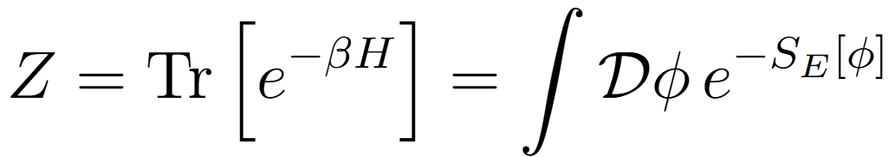
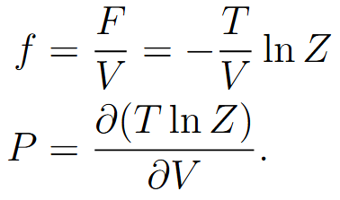
2
Relativistic Finite Temperature QFT ~ Statistical Mechanics
QFT for systems at finite temperature and finite volume.
Partition function
​Enables first-principles calculations of all thermodynamic quantities in QFTs
Free Energy:
Pressure:
Rens Roosenstein | University of Cape Town | SAIP 2026 |
7/18
Notes:
Now we are going to dive into the theoretical physics, and I am going to explain our methodology. We want to describe highly relativistic system of quantum particles at finite temperature and finite volume. And it just so happens that the perfect formalism to work in is that of Statistical mechanics. We can use the partition function, and our complicated field theory Hamiltonian to derive a path integral formulation of the partition function.
This path integral allows us to actually calculate all thermodynamic observables of our QFT at finite temperature such as the free energy, the pressure, the entropy, and the equation of state, with which we can subsequently make a phase diagram for our QCD matter.
8

Slide 9
1
Background:
(Casimir Effect, Quark-Gluon Plasma)
Outline
How does one construct a path integral on a finite volume
2
Outline of Methodology:
(Statistical Physics, Finite Volume QFT)
3
Path Integral Derivation
4
Consequences
5
Conclusions
Rens Roosenstein | University of Cape Town | SAIP 2026 |
8/18
Notes:
I will first give a little bit of an outline, I will first provide some background information as to what we are interested in, namely small systems, such as the Quark-Gluon Plasma, which require some thermal field theory.
I will then outline the methodology we have used in order to correctly capture the finite temperature and finite Volume physics of our QFT
This brings us to a path integral derivation, which will yield the unexpected result we have found for the partition function, after which I will conclude.
9

Slide 10
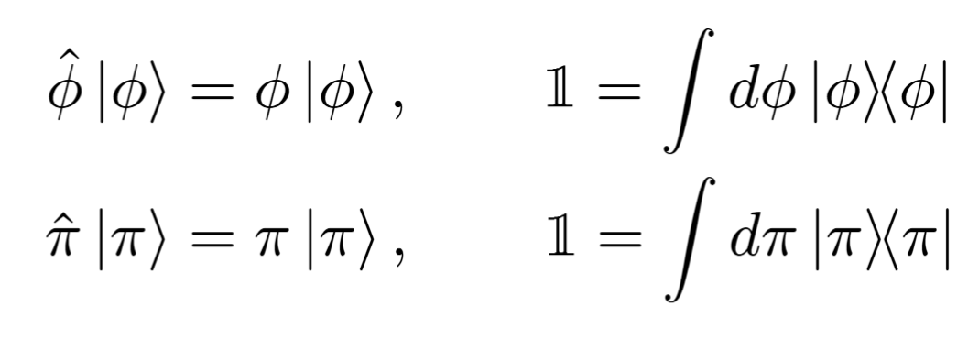
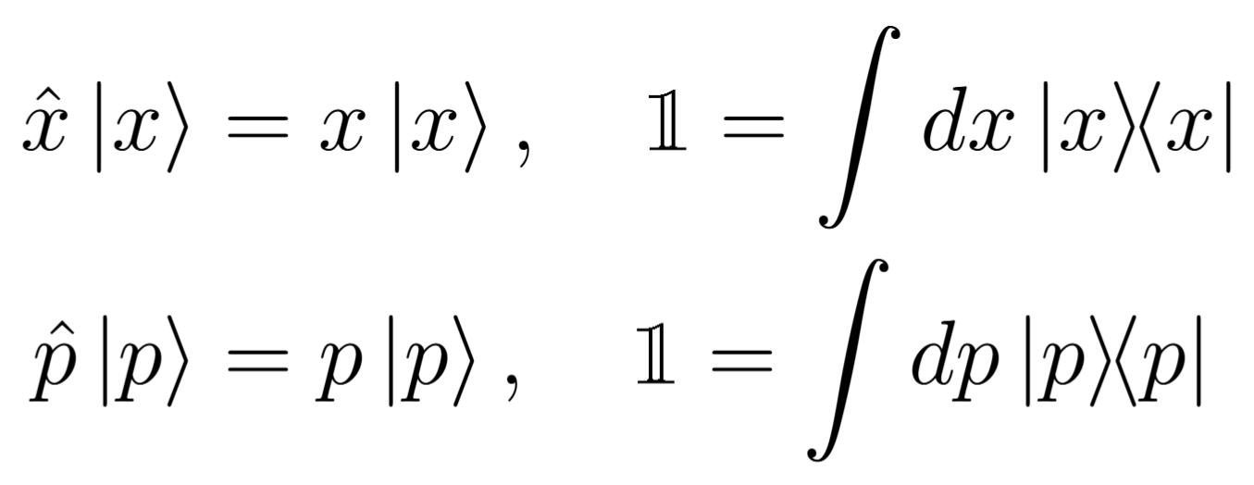
3
Step 1: Decomposition of Unity
Field operator eigenstates?
Rigged Hilbert space
Rens Roosenstein | University of Cape Town | SAIP 2026 |
9/18
Notes:
We can construct the path integral by inserting resolutions of the identity operator into the trace of the partition function. In standard derivations, these identities are written in terms of field-operator eigenstates, but such states are typically introduced only heuristically by analogy with the position and momentum eigenstates of QM, states which themselves require a nontrivial rigged-Hilbert space treatment that I will not go into here, but the point is that their definition is not straightforward. Even though these QM eigenstates are well defined, their construction does not straightforwardly extend to field theory, so to maintain full analytic control, we instead use coherent states.
Emphasize that the field eigenstate method is the usual method, and we get something different
10

Slide 11
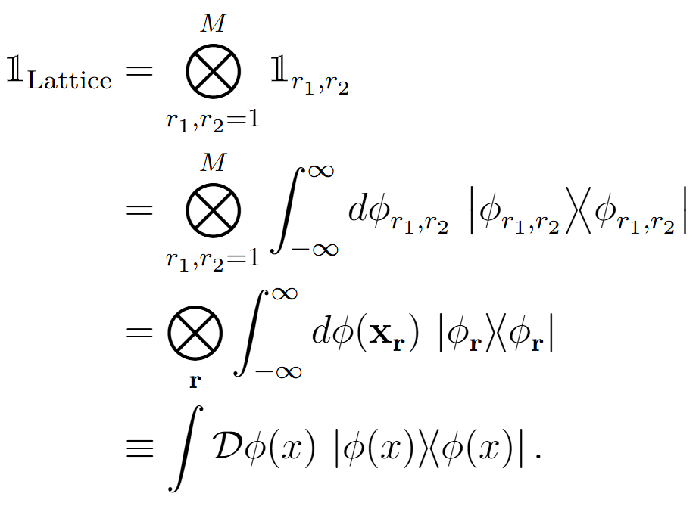
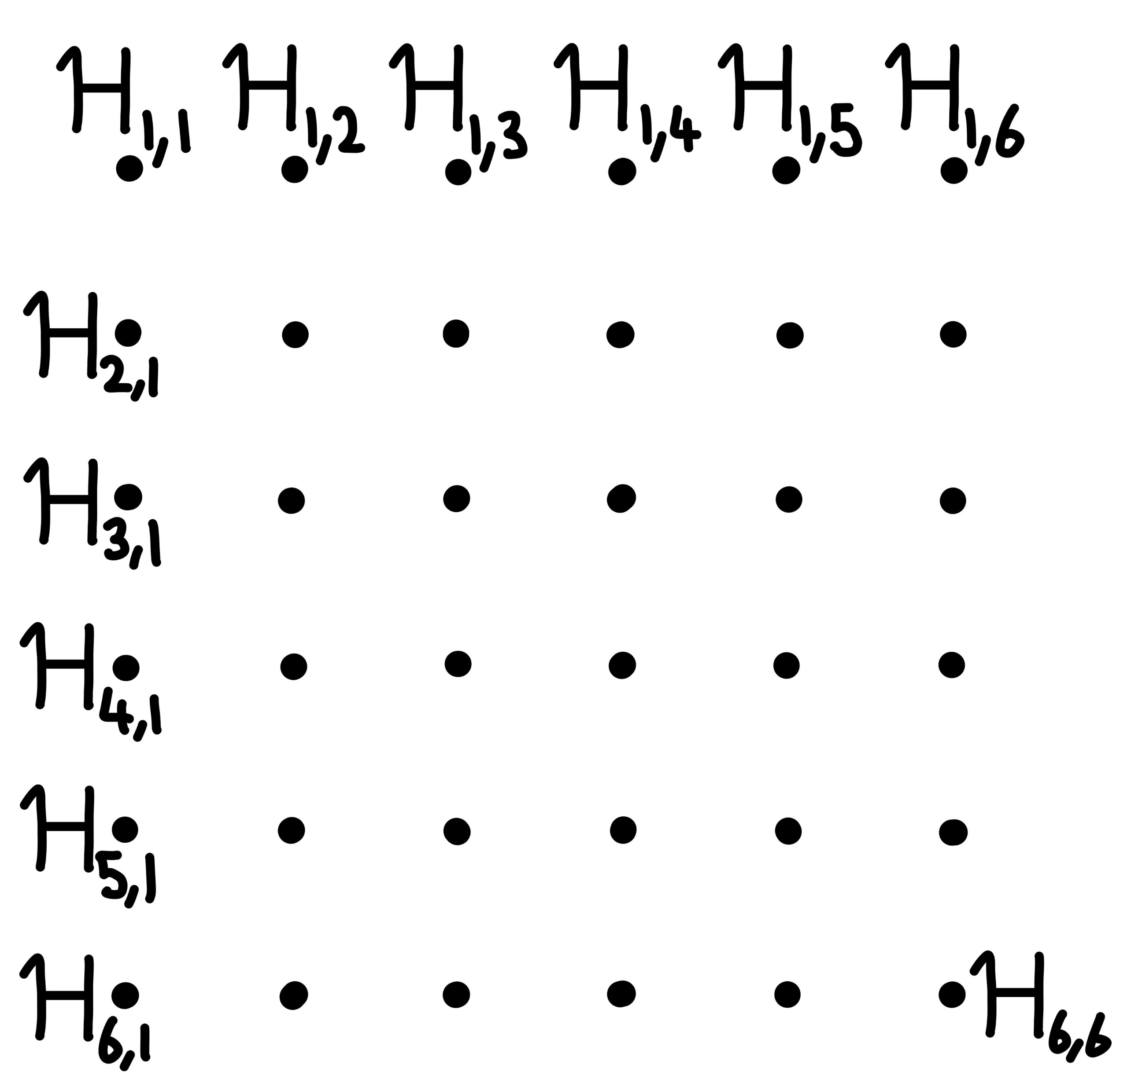
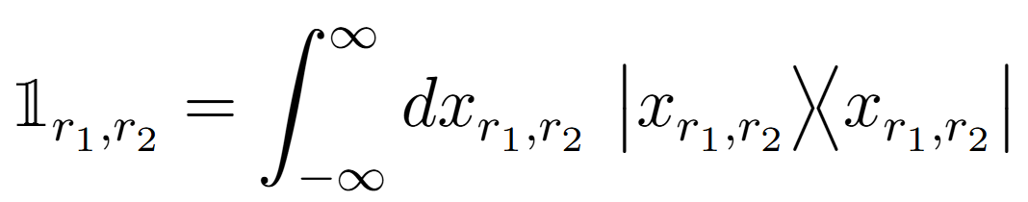

3
Step 0: Lattice Field Theory Construction
Shorthand
Rens Roosenstein | University of Cape Town | SAIP 2026 |
10/18
Notes:
To compute the φ⁴ partition function, we start from the renormalized Lagrangian, Legendre-transform to the renormalized Hamiltonian, and define the partition function as a trace of the Boltzmann operator over the HIlbert space of the Hamiltonian. This trace can be represented as a path integral, from which we can compute thermodynamic quantities like the free-energy density, pressure, but also trace anomaly and the equation of state.
11

Slide 12
3
Step 1: Path Integral On the Lattice
Field operator eigenstates
Compute thermodynamics
Free Energy:
Pressure:
Rens Roosenstein | University of Cape Town | SAIP 2026 |
11/18
Notes:
We can construct the path integral by inserting resolutions of the identity operator into the trace of the partition function. In standard derivations, these identities are written in terms of field-operator eigenstates, but such states are typically introduced only heuristically by analogy with the position and momentum eigenstates of QM, states which themselves require a nontrivial rigged-Hilbert space treatment that I will not go into here, but the point is that their definition is not straightforward. Even though these QM eigenstates are well defined, their construction does not straightforwardly extend to field theory, so to maintain full analytic control, we instead use coherent states.
Emphasize that the field eigenstate method is the usual method, and we get something different
12

Slide 13
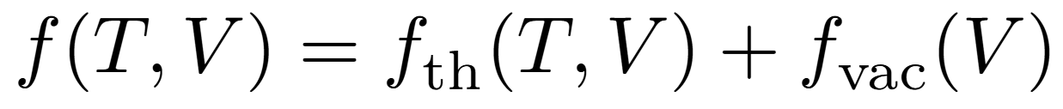
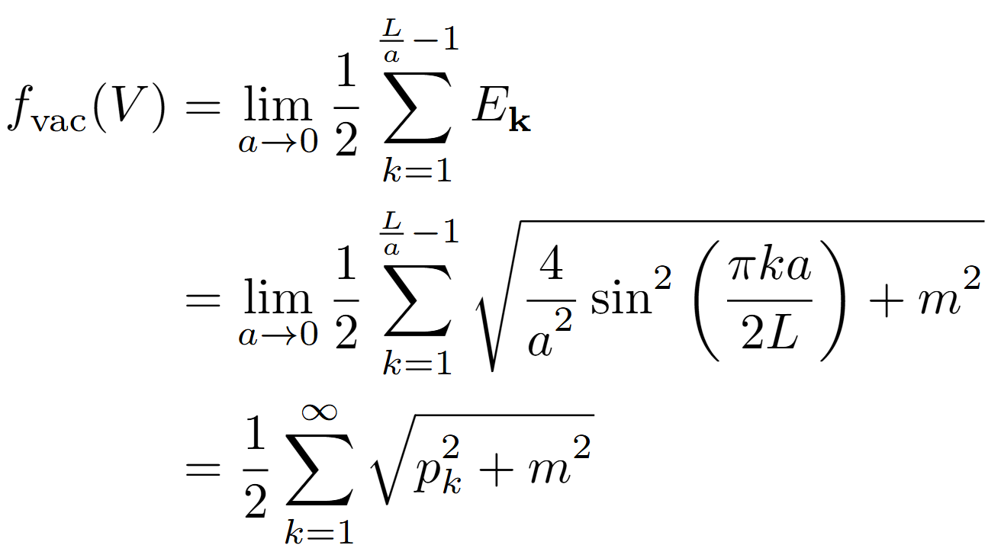
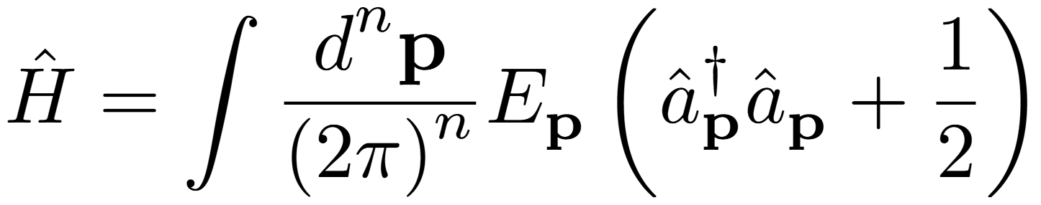
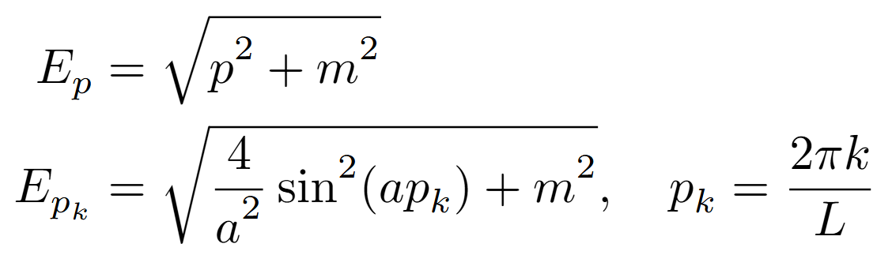
3
Lattice Vacuum Free Energy
Casimir effect
Lattice dispersion relation
UV modes obstruct a straightforward continuum limit
Rens Roosenstein | University of Cape Town | SAIP 2026 |
12/18
Notes:
To compute the φ⁴ partition function, we start from the renormalized Lagrangian, Legendre-transform to the renormalized Hamiltonian, and define the partition function as a trace of the Boltzmann operator over the HIlbert space of the Hamiltonian. This trace can be represented as a path integral, from which we can compute thermodynamic quantities like the free-energy density, pressure, but also trace anomaly and the equation of state.
13

Slide 14
1
Background:
(Casimir Effect, Quark-Gluon Plasma)
Outline
How does one construct a path integral on a finite volume
2
Outline of Methodology:
(Statistical Physics, Finite Volume QFT)
3
Path Integral Derivation
4
Consequences
5
Conclusions
Rens Roosenstein | University of Cape Town | SAIP 2026 |
13/18
Notes:
I will first give a little bit of an outline, I will first provide some background information as to what we are interested in, namely small systems, such as the Quark-Gluon Plasma, which require some thermal field theory.
I will then outline the methodology we have used in order to correctly capture the finite temperature and finite Volume physics of our QFT
This brings us to a path integral derivation, which will yield the unexpected result we have found for the partition function, after which I will conclude.
14

Slide 15
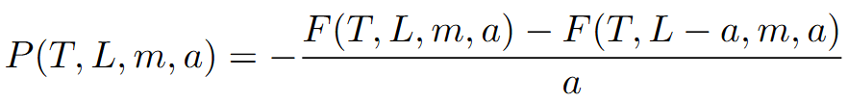
4
Consequences
Lattice regularization (Lattice spacing couples to)
Bulk divergence, boundary divergence, “mass” divergence
Momentum integrals become momentum sums
Discrete derivatives
Poisson summation/ Abel-Plana
Topological asymmetry (1D, 2D,3D)
Must calculate our thermodynamics on the lattice
​Ordering of Limits
Rens Roosenstein | University of Cape Town | SAIP 2026 |
14/18
Notes:
Lattice spacing couples to: the bulk, the Boundary, the mass
15

Slide 16

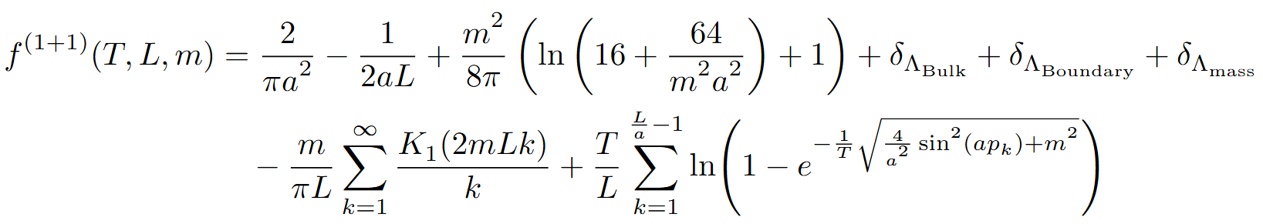
4
Result
Renormalization conditions
Vacuum divergences
Counter terms
Casimir term
Thermal sum
Rens Roosenstein | University of Cape Town | SAIP 2026 |
15/18
Notes:
To compute the φ⁴ partition function, we start from the renormalized Lagrangian, Legendre-transform to the renormalized Hamiltonian, and define the partition function as a trace of the Boltzmann operator over the HIlbert space of the Hamiltonian. This trace can be represented as a path integral, from which we can compute thermodynamic quantities like the free-energy density, pressure, but also trace anomaly and the equation of state.
16

Slide 17
1
Background:
(Casimir Effect, Quark-Gluon Plasma)
Outline
How does one construct a path integral on a finite volume
2
Outline of Methodology:
(Statistical Physics, Finite Volume QFT)
3
Path Integral Derivation
4
Consequences
5
Conclusions
Rens Roosenstein | University of Cape Town | SAIP 2026 |
16/18
Notes:
I will first give a little bit of an outline, I will first provide some background information as to what we are interested in, namely small systems, such as the Quark-Gluon Plasma, which require some thermal field theory.
I will then outline the methodology we have used in order to correctly capture the finite temperature and finite Volume physics of our QFT
This brings us to a path integral derivation, which will yield the unexpected result we have found for the partition function, after which I will conclude.
17

Slide 18

4
Conclusions & Outlook
How to be rigorous when computing the Casimir effect in Thermal QFTs
MUST work on the lattice
Be careful with continuum limits
Counterterms in the free theory
Outlook​
Compute finite size NLO corrections to the equation of state and the trace anomaly for φ⁴
Extension to QED and QCD​
Rens Roosenstein | University of Cape Town | SAIP 2026 |
17/18
Notes:
Conclusion
Outlook
Our results from TFT and first-principles QFT also provide unique opportunities to gain...., such as … and energy-energy correlators which are currently being explored as precision probes of high energy QCD.
18

Slide 19
Thank you!
Rens Roosenstein | University of Cape Town | SAIP 2026 |
18/18
Notes:
Thank you all for listening and if you have any questions, please ask away!
19

Slide 20
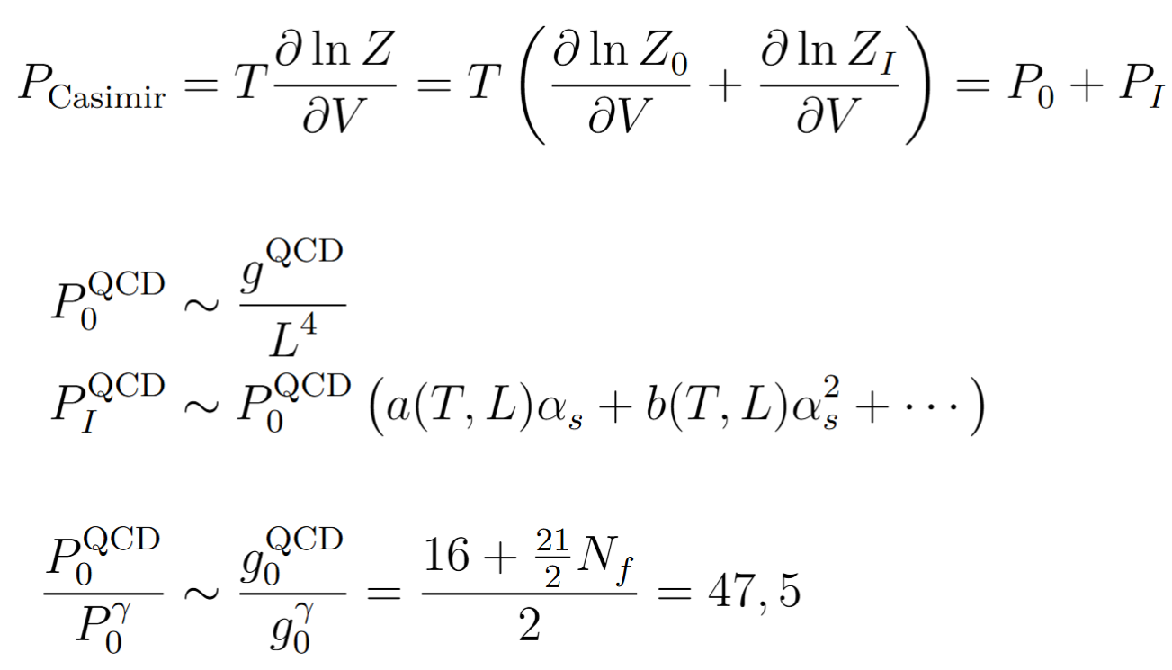
Backup slides: QCD Casimir effect size
13
Notes:
20

Slide 21
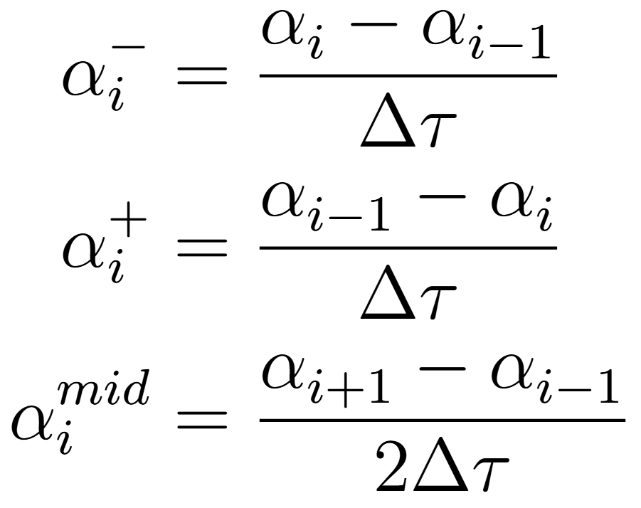
Backup slides: Discretization procedures
Backward:
Forward:
Midpoint:
14
Notes:
21

Slide 22
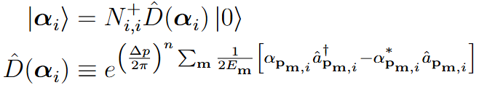
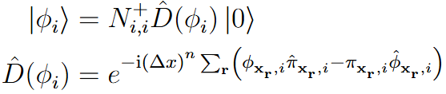
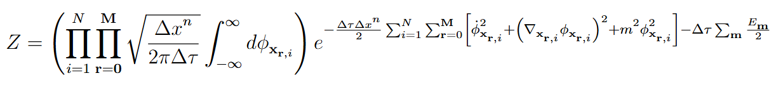
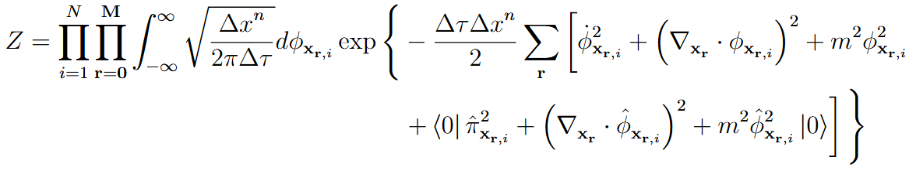
Backup slides: Free Scalar Field Partition Function
15
Notes:
After computing this matrix element and doing the proper change of variables, we get this final expression. Here we have the path integral measure, the free theory action and, as shown before, the vacuum energy. Note that we can do the same derivation of these matrix elements in the field basis, where we get a bunch of corrections in terms of vacuum expectation values, that, most importantly, add up exactly to the vacuum expectation value of the Hamiltonian. Meaning these two expressions are equivalent.
22

Slide 23
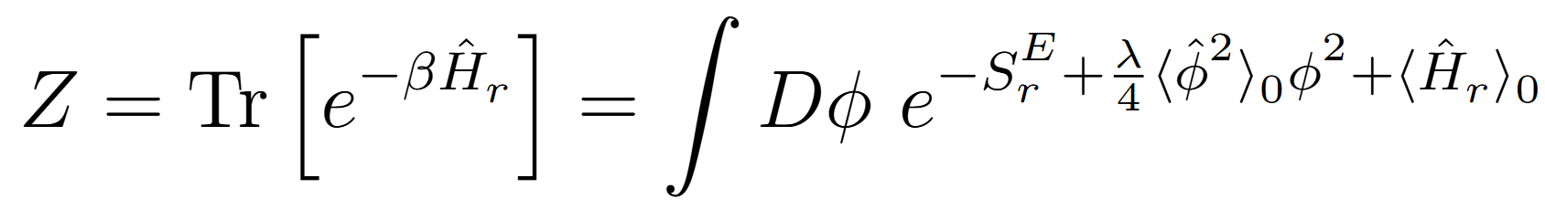
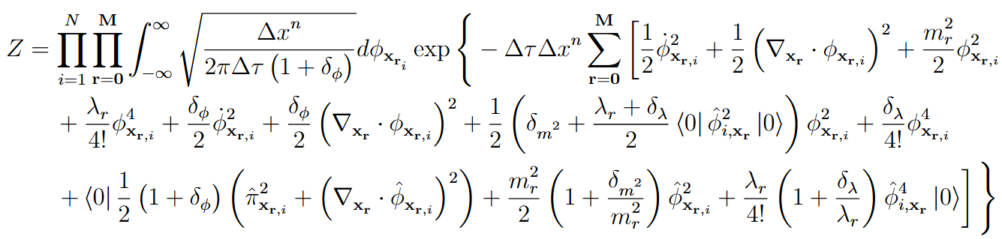
Backup slides: Interacting φ⁴ Partition Function
16
Notes:
In our discretized notation, this results looks like this. Click
First line = free
Second line = interacting part plus mass counterterm correction
Last line = VEV of H
23

Slide 24
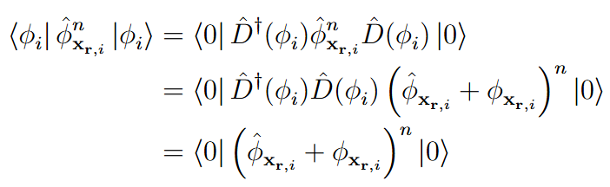
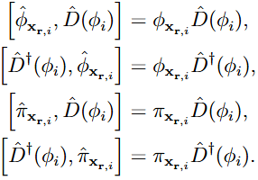
Backup slides: Displacement operators
17
Notes:
24

Slide 25
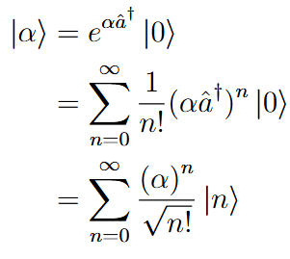
Backup slides: Coherent states, Fock Space (gaussian)
18
Notes:
25

Slide 26


Backup: Classical Equations of motion
19
Notes:
26

