Slide 1
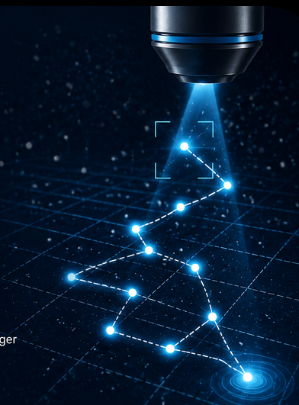


Parameter study and optimization of real-time single-particle tracking
Jessica Wells
Co-Authors: Bertus van Heerden ,Salomon van Niekerk ,Prof. Tjaart Kruger
Department of Physics
University of Pretoria
1

Slide 2
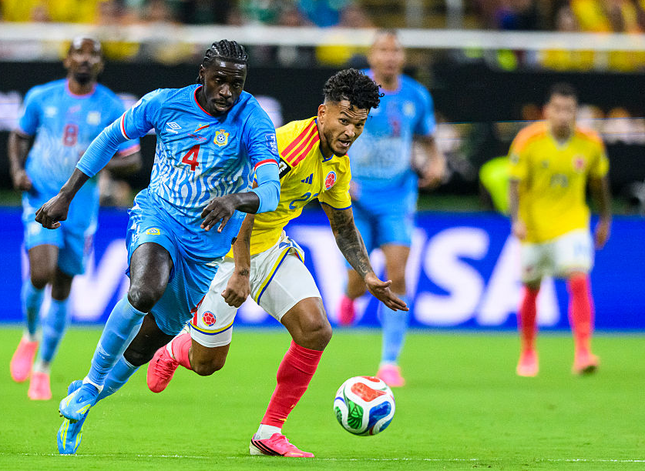
How do we Track Something in Real Time?
Collect visual information
Estimate position + Predict motion
Move accordingly
Micro/Nanoscale
2
Macroscopic

Slide 3
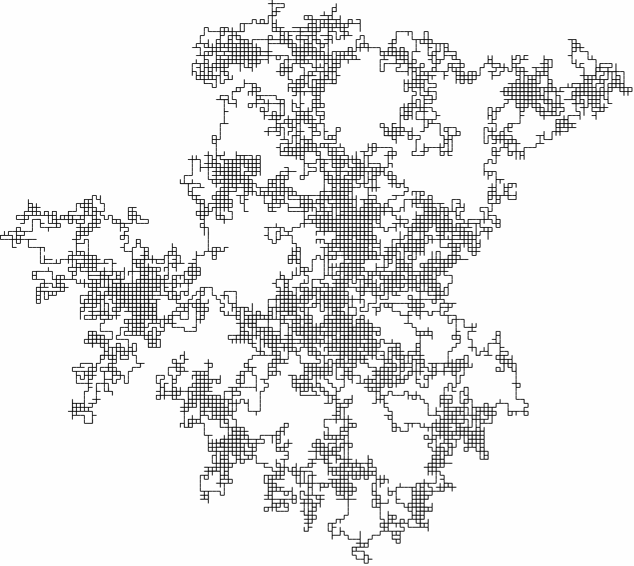
Why Real-Time Single Particle Tracking?
3
MOLECULAR DYNAMICS
2D Brownian diffusion
Single Particles
limited noisy signal
challenge
Position estimated accurately, continuously in real time
Systems capable of rapid and precise position sensing to accurately track freely diffusing particles
Observation region

Slide 4
Real Time Single Particle Tracking (RT-SPT):
4
Three core components:
Position Sensing
Control System
Output Actuator
Information collected:
Filtering
Apply control signal
Signal detection
Motion prediction
Reposition beam centre
Scan pattern
Feedback control signal generation
Position estimate
Feedback loop

Slide 5
5
Current Challenges in RT-SPT:
1. SCAN PATTERN OPTIMIZATION:
2. ESTIMATOR DEPENDENCE ON SCAN GEOMETRY:
No consensus on the best scan geometry
Estimator performance relies on chosen scan pattern – fair comparisons are difficult
3. DETECTION STRATEGY COMPARISON:
Few studies directly compare iSCAT and Fluorescence within the same simulation frameworks
Optimized tracking configurations remain an open challenge in RT-SPT

Slide 6
6
Current Challenges in RT-SPT:
Fixed Scanning Pattern
Detection method
Estimator
What determines tracking performance?
Aim:
Investigate how scan geometry, detection strategy and estimator choice influence two-dimensional real-time particle tracking performance

Slide 7
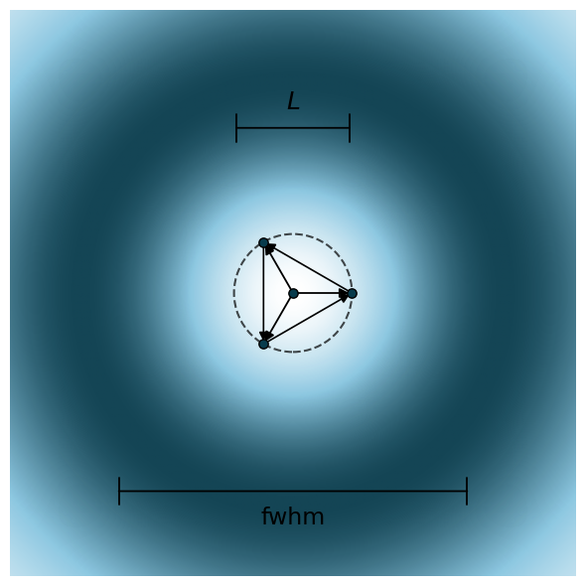
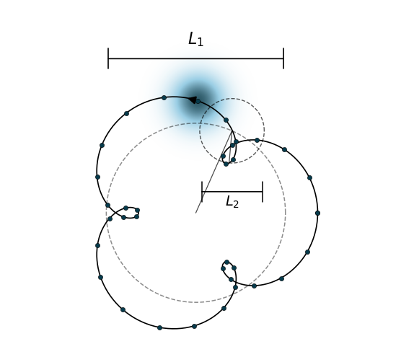
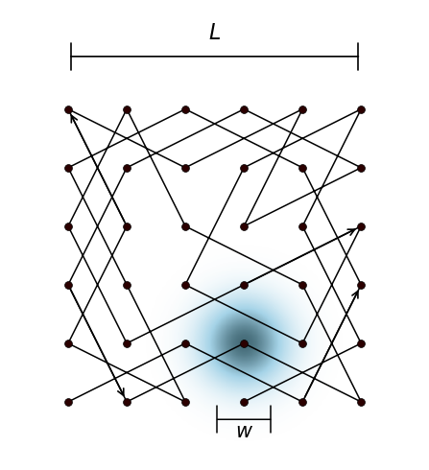
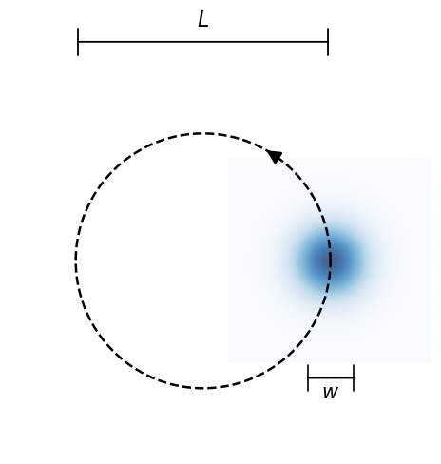
7
MINFLUX Scanning Pattern
Scan patterns:
Orbital Scanning Pattern
Epicycles Scanning Pattern
Knight’s Tour Scanning Pattern

Slide 8


Detection Strategies: Fluorescence
8
Laser excites fluorophore
Particle emits photons
Detector counts photons
Key Features:
Low photon count
Emitting particles
Particles emit photons when excited by a laser
Shot-noise limited localization
$$σ^{2}=N$$
High uncertainty
Photon detection follows Poisson statistics
High photon count
Precision improves with photon count
Low uncertainty
Limitation: Photobleaching
Fluorophore degrades over time
Takeaway: Number of detected photons directly influences position estimation accuracy

Slide 9

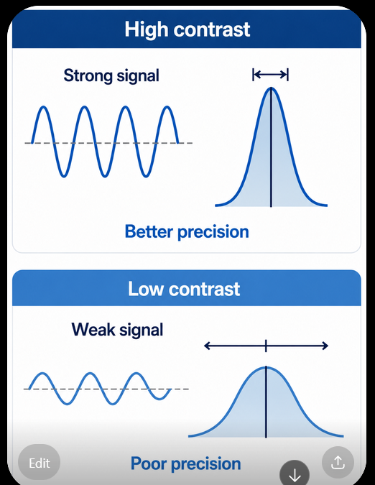
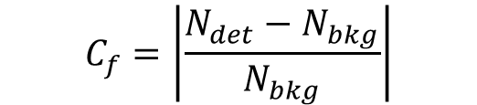



Detection Strategies: iSCAT
9
Laser
Scatter
Interfere
Photons detected
Key Features:
DETECTED SIGNAL:
$$N_{det}=N_{i}{\left|r+s\right|}^{2}=N_{i}\left({\left|r\right|}^{2}+{\left|s\right|}^{2}+2\left|r\right|\left|s\right|\cos{θ}\right)$$
Non-emitting particles
Background/Reference field – noise limited
$$=N_{r}+N_{s}+N_{int}$$
CONTRAST:
$$C_{f}=\left|\frac{N_{det}−N_{bkg}}{N_{bkg}}\right|$$
High contrast
Strength of detected signal
$$σ_{N}^{2}≈\frac{2N_{int}}{C_{f}}$$
Better precision
Low contrast
Interference contrast directly influences position estimation accuracy
Different detection methods
Different signal detected
Poor precision

Slide 10
From Light to Position:
10
1. SIGNAL MEASUREMENT
2. INFORMATION AND PRECISION
3. POSITION ESTIMATION
Detected signal depends on particle position relative to the beam centre
Detected signal contains information about the particle position.
Photon counts
Estimator
What We have so far?
Position estimate
w
Quantified by Fisher information
Position estimate
Particle position
Low information
True position
High information
Beam centre position
Cramer-Rao Bound (CRB):
Scan point
Lower CRB
Higher Precision
Estimator choice depends on scanning pattern
iSCAT/Fluorescence

Slide 11
11
How were scan patterns evaluated?
Particle at true position
Laser beam scanned through fixed pattern
Fluorescence
Measurement signal generated
Apply detection model
Initialization
Repeat
Repeat over tracking duration
Dynamic tracking loop
iSCAT
Estimator
Recentre beam
Static performance metric:
Dynamic performance metric:
Calculate CRB
Apply feedback
Estimate position
Theoretical localization precision
Tracking error
All scan configurations were evaluated under identical beam parameters, diffusion conditions and photon budgets

Slide 12
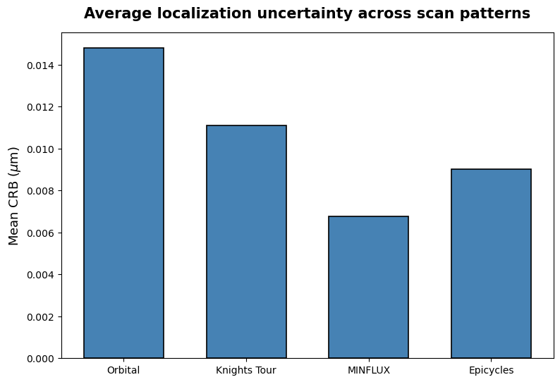
1. Static Performance:
12
Which scan pattern performs the best theoretically?
Cramer-Rao bound (CRB) represents the theoretical lower bound on measurement uncertainty
Method | Improvement against Orbital
Knight’s Tour | 27% better
Epicycles | 40% better
MINFLUX | 55% better
Worst
KEY FINDING:
MINFLUX has the lowest theoretical localization uncertainty
Best
Does the lowest average CRB necessarily translate into the best tracking performance?

Slide 13
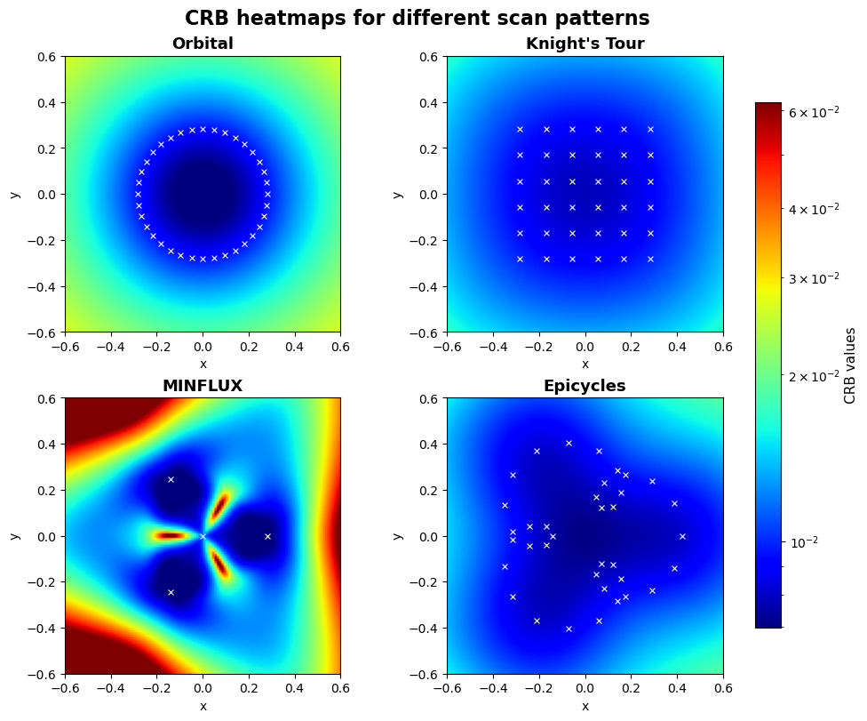
13
Does Localization Precision Vary Across Space?
Worse Precision
Method | Peak Precision | Spatial Uniformity
Orbital
Knight’s Tour
MINFLUX
Epicycles
Key Observations:
Higher peak precision
Greater spatial uniformity
Takeaway: Average CRB hides important variation. Uniformity and precision present a trade-off across scan patterns
Best
Precision

Slide 14
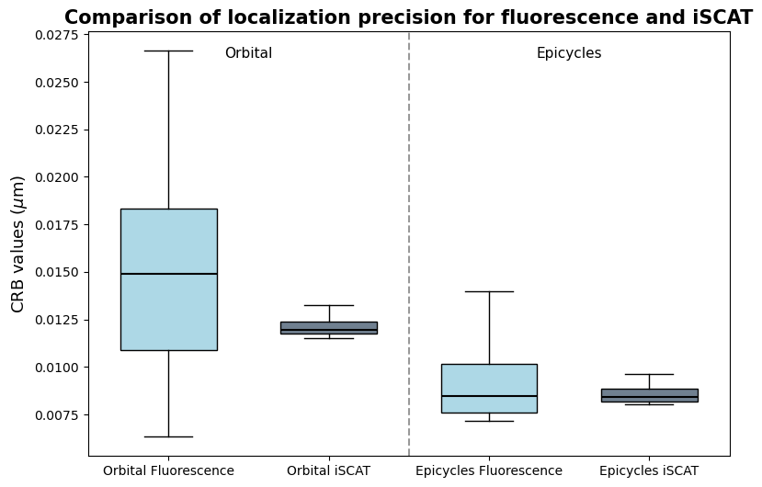
14
2.Detection Strategy Influences Scan Pattern Performance
Previous CRB analysis assumed fluorescence detection
Orbital:
Epicycles:
But what happens if change the detection strategy?
Substantial improvement
Similar precision performance
Key Observation:
Scan pattern performance is dependent on detection physics
Optimal scan pattern is not universal
Representative scan patterns to illustrate detection model dependence

Slide 15
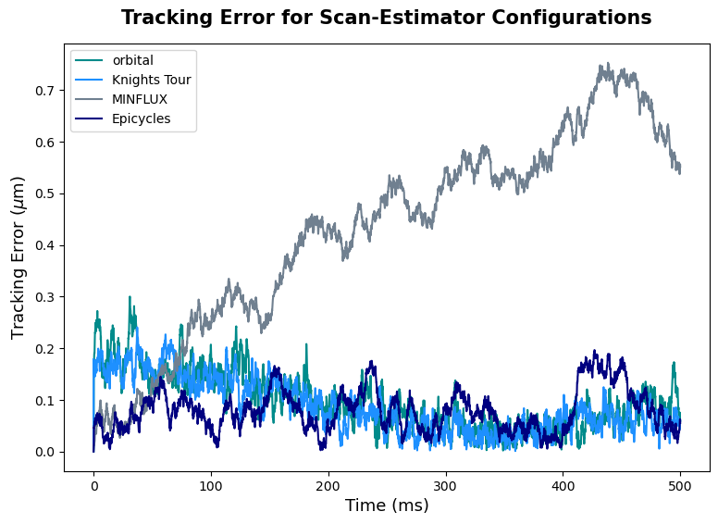
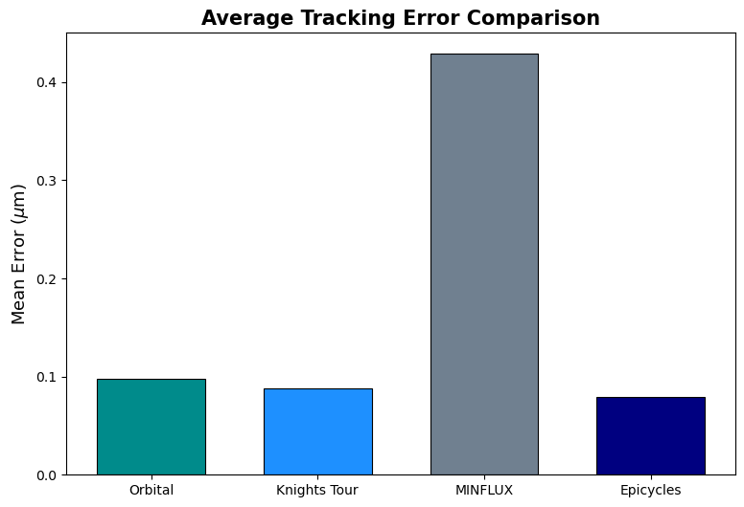
3. Dynamic Tracking Performance
Does the lowest CRB lead to the lowest tracking error?
15
Lower error = better tracking performance
MINFLUX
Continuous error growth
Eventual divergence
Bounded = Tracking stability
MINFLUX significantly underperforms
Spatial dependence Error accumulation
Why diverge?
Localization error
Feedback applied repeatedly
Errors accumulate
Tracking failure
System increasingly uncertain about position
Small estimation errors
Error fed into the updated position
Errors compounded

Slide 16
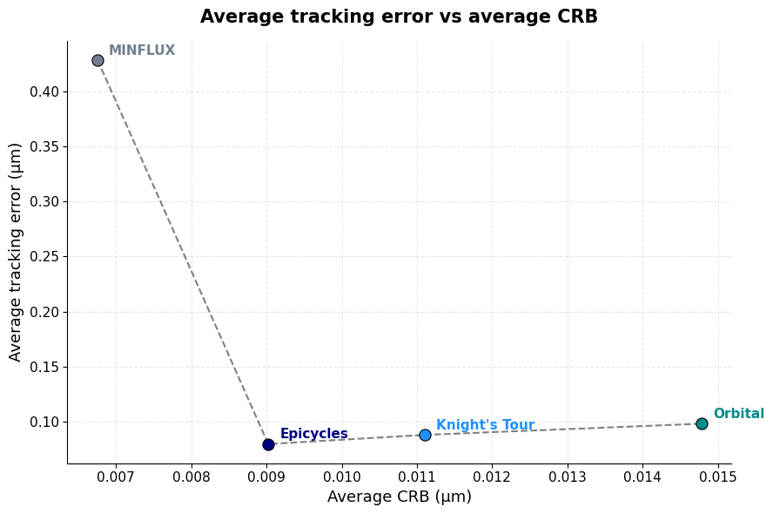
Theoretical Precision and Dynamic Performance are NOT Equivalent
16
Low CRB ≠ Optimal tracking performance
Greatest discrepancy
Epicycles provides the strongest overall compromise
Trade off:
Localization Precision
Tracking stability
Most balanced performance

Slide 17


17
Conclusion: Tracking performance is multi-factorial
Tracking performance depends on:
Localization Precision
Spatial Robustness
Dynamic Tracking Robustness
$$+$$
$$+$$
Determined by:
Scan pattern
Detection method
Position estimator
Key finding: Low CRB ≠ Optimal tracking performance
Effective tracking depends on the combined interaction between scan geometry, detection models and estimator behaviour
Epicycles provided the strongest overall performance trade-off among the configurations studied

Slide 18

Acknowledgements:
Bertus van Heerden
Salomon van Niekerk
Prof. Tjaart Kruger

