Slide 1


SAIP 2026
What the Cell Sees
Modelling the Bionano Interface
Vladimir Lobaskin
School of Physics · University College Dublin
Notes:
What the cell sees is not the pristine nanoparticle but the corona of proteins and lipids that forms on it. This talk is about making that interface computable — predicting adsorption energies and the corona — by combining physics-based simulation with data-driven models.

Slide 2

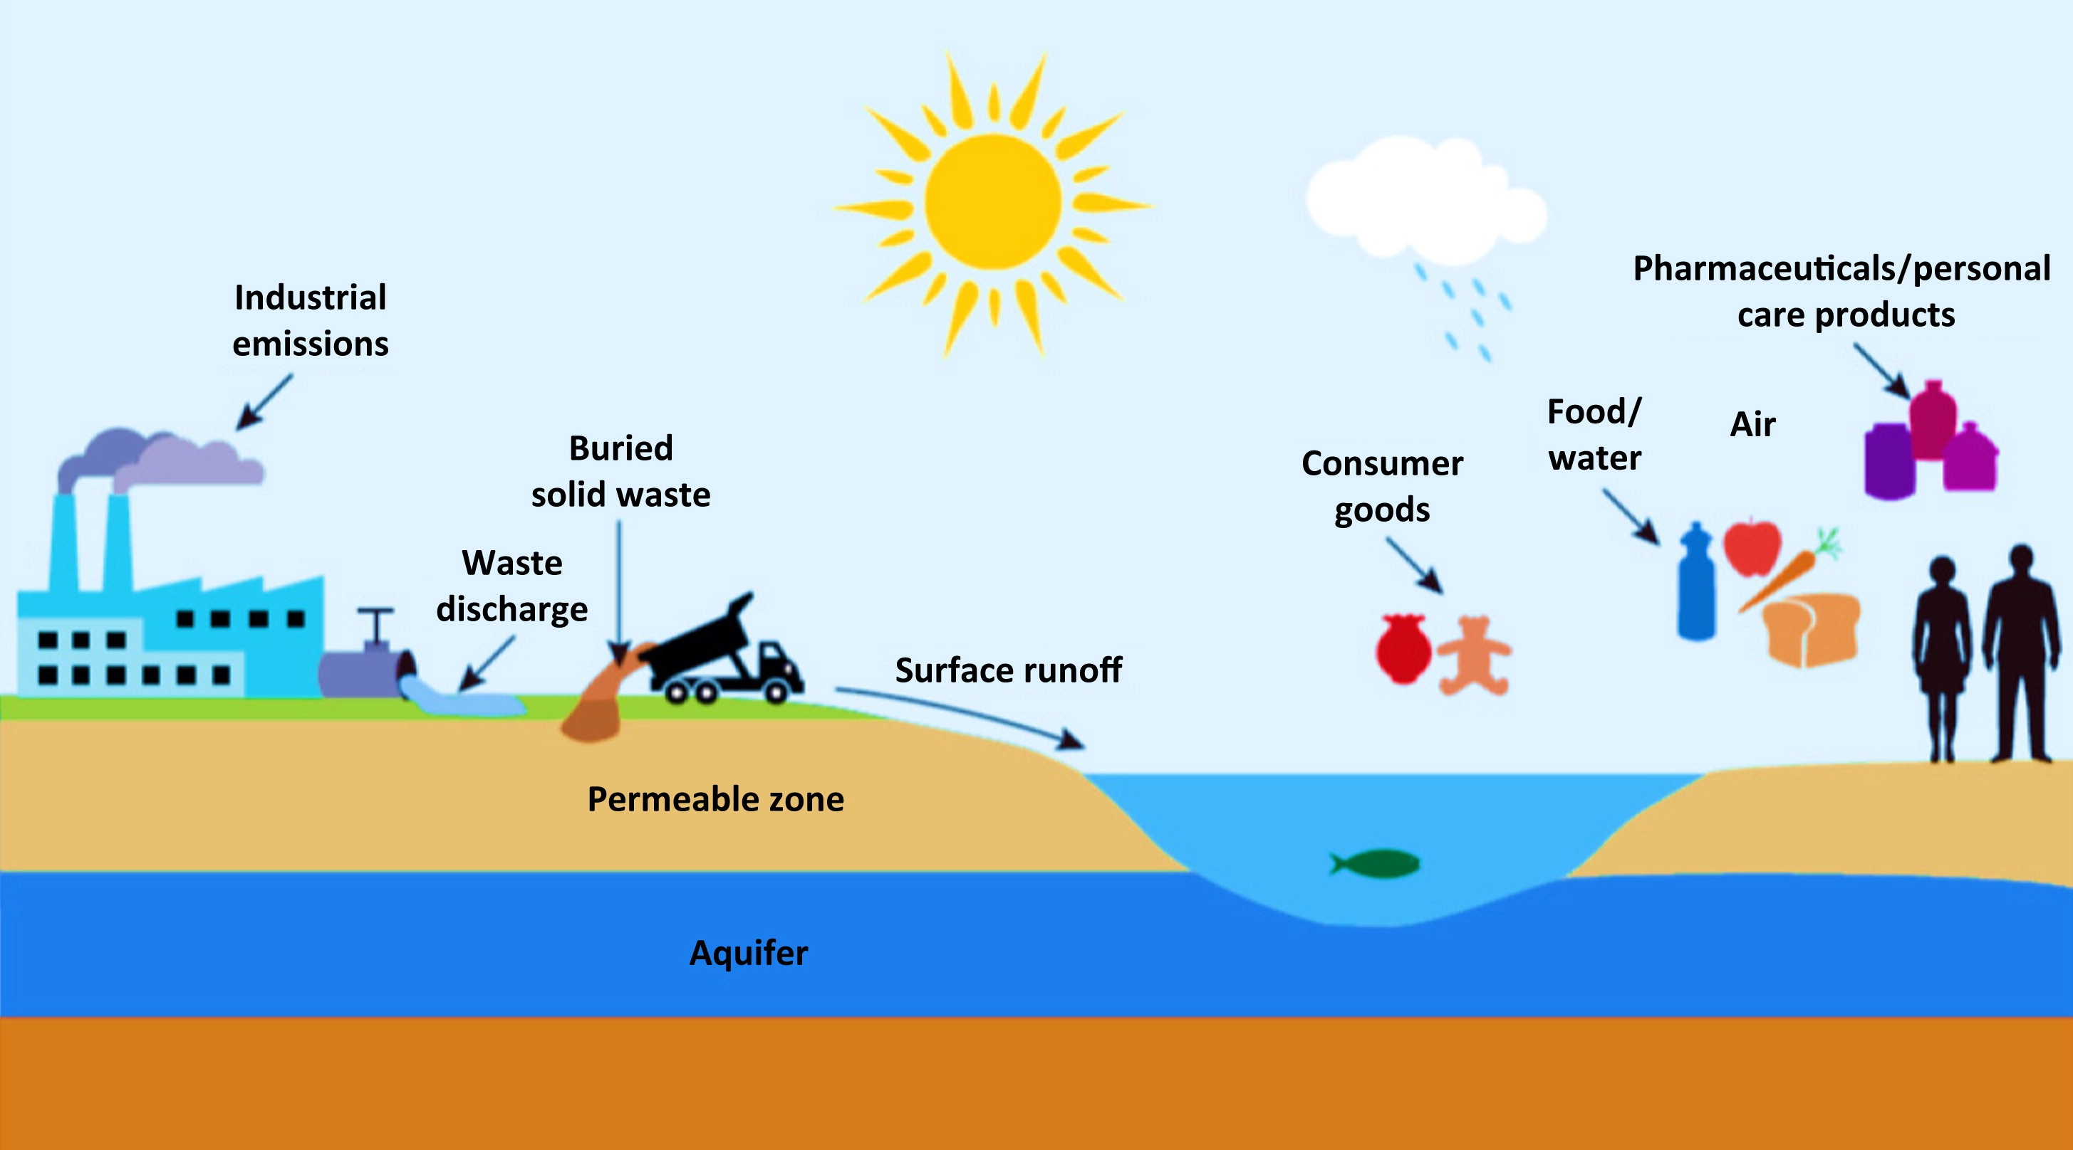
MOTIVATION
We are all exposed to nanomaterials
Air pollution is responsible for up to 7 millions premature deaths worldwide annually (WHO, 2021).
A part of it is nanoparticles (dust, soot, asbestos) moving through the environment into living things.
In daily life food · medicine · combustion · industry · construction · agriculture · natural events
Four ways in inhalation · ingestion · skin · injection
Once inside, the bio-nano interface decides the outcome.
Natural and engineered nanoparticles cycle through air, water and soil and into us.
Kurwadkar et al., J. Hazard. Toxic Radioact. Waste (2015)
Notes:
Let's start with why this matters to everyone. Nanomaterials are already all around us — natural ones and engineered ones — cycling through air, water and soil, as this environmental schematic shows. In daily life they are in cosmetics, food, medicine, combustion soot and industry, and we meet them by breathing, eating, through the skin and by injection. And the moment a particle gets inside and touches blood, lung fluid or the inside of a cell, everything that follows is decided at the bio-nano interface. Predicting that interface is what this talk is about.

Slide 3
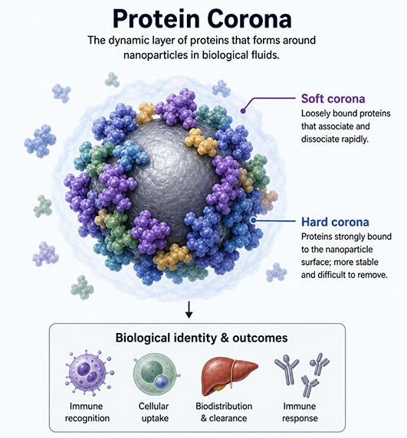
THE CENTRAL FACT
The cell never sees the pristine particle
Our bodily fluids contain proteins (blood 6-8%, tear 0.6-1%, saliva 0.1-0.3% w/w), and other biomolecules.
The inhaled or ingested nanoparticles bind biomolecules and form a dynamic corona.
The cell reads the corona, not the surface you engineered
1
It directs recognition, uptake and intracellular trafficking
2
It ultimately determines the fate of the particle
3
Walczyk, Lynch & Dawson (JACS 2010), Monopoli et al., Nat. Nanotechnol. (2012).
Nanowerk:
https://www.nanowerk.com/biotechnology-glossary/protein-corona.php
Notes:
The idea everything hangs on — and the origin of this talk's title. What matters is not the pristine nanomaterial but the dynamic corona of proteins and lipids that reshapes its surface on contact with a biological fluid. The cell recognises the corona — through membranes and receptors — and that recognition directs uptake and intracellular trafficking and ultimately determines the fate of the particle. The phrase 'what the cell sees' comes from Walczyk, Lynch and Dawson (JACS 2010); the biological-identity picture from Monopoli and Dawson (Nature Nanotech 2012).

Slide 4
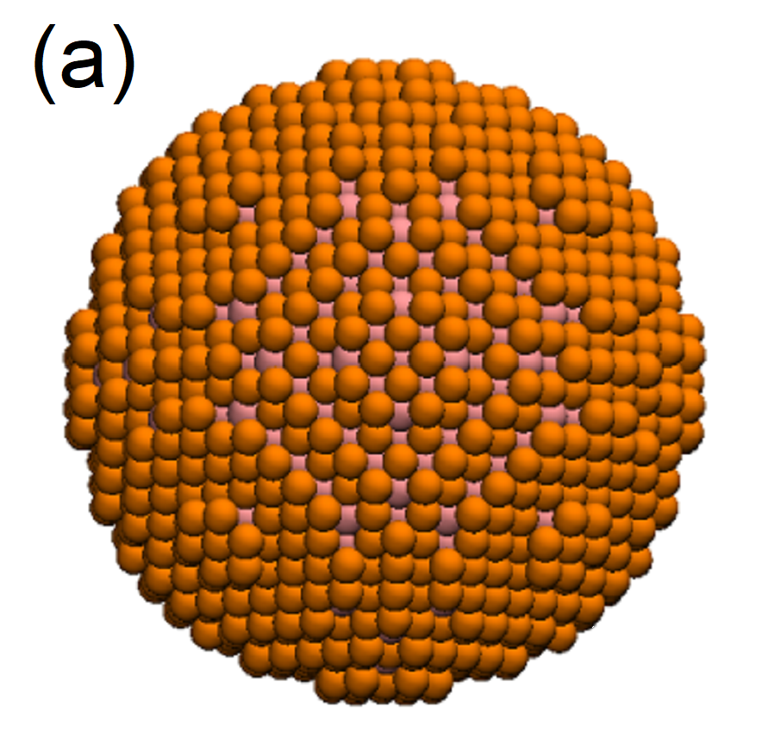
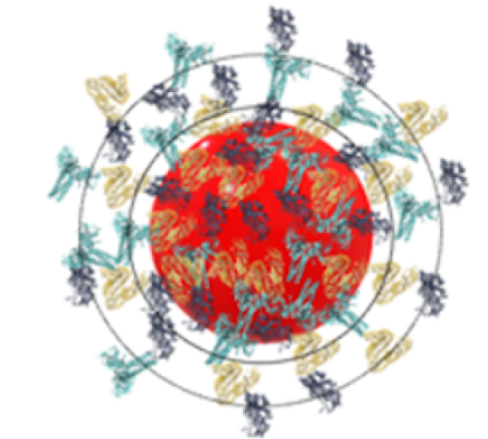
THE CONCEPT & ITS IMPORTANCE
The corona gives the nanoparticle a biological identity
Protein-corona concept reframes how we classify nanomaterials in toxicology and nanomedicine.
From material to biological identity
A biological identity: the cell reads the corona, not the material Monopoli, Åberg, Salvati & Dawson, Nat. Nanotechnol. (2012)
+ corona
Material determines the corona, corona determines the fate Walkey et al. ACS Nano (2014)
Material
Biological
It can switch on/off targeting: an adsorbed corona masks targeting ligands or adds a ligand Salvati et al., Nat. Nanotechnol. (2013)
size · shape · chemistry
what the cell reads
Notes:
It's worth being clear about where this idea comes from and why it matters. The protein-corona concept was established by Ken Dawson and the Centre for BioNano Interactions here at UCD, and it reframed the whole field. Three points. First, the corona gives the particle a biological identity: the cell reads the corona, not the underlying material (Monopoli, Aberg, Salvati and Dawson, Nature Nanotechnology 2012). Second, the phrase 'what the cell sees' — the title of this talk — comes directly from Walczyk, Lynch and Dawson (JACS 2010). Third, it has real consequences: an adsorbed corona can switch off active targeting, as when transferrin-coated particles lose their targeting once a corona forms (Salvati et al., Nature Nanotechnology 2013). The foundations were laid by Cedervall and colleagues in 2007 and Lynch and Dawson in 2008.

Slide 5
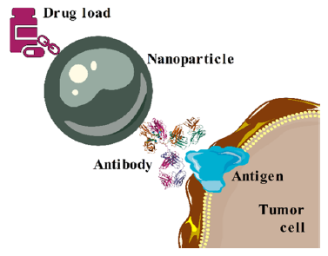
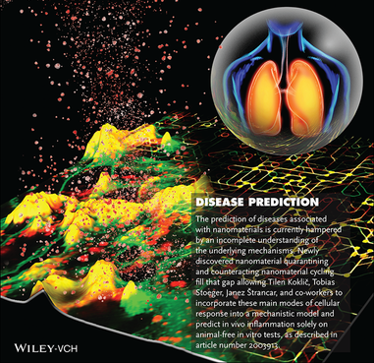
WHY IT MATTERS
One interface behind many questions
Targeted drug delivery
mRNA & lipid-nanoparticle vaccines
Biosensors & theranostic agents
Regenerative-medicine interfaces
…and the same corona is the key to nanotoxicity. Promise and hazard share one interface.
The corona governs recognition, uptake, trafficking and biological response.
Subbotina et al., J Phys Chem B (2022); Kokot et al. Adv. Mat (2021)
Notes:
The bio-nano interface sits behind many of the most promising technologies of the decade — targeted drug delivery, mRNA and lipid-nanoparticle vaccines, biosensors and theranostics, engineered interfaces for regenerative medicine. And the very same corona is the key to nanotoxicity. Promise and hazard share one interface, and the corona governs recognition, uptake, trafficking and the downstream biological response.

Slide 6
THE QUESTIONS
What would we like to understand?
What material properties determine uptake, hazard, circulation time and biocompatibility?
?
How do materials affect biotechnology, medicine,and food production?
?
How can we improve drug delivery with nanocarriers?
?
WE NEED
Can we recognise the patterns?
Advanced material characterisation
?
Can new materials be made safe and sustainable by design?
?
Notes:
So what exactly are we trying to answer? A handful of questions drive the whole programme. What material properties set a particle's uptake, circulation time and biocompatibility? How do materials affect biotechnology, medicine and food production? How can we improve drug delivery with nanocarriers? Can we recognise the patterns across many materials? And ultimately, can materials be made safe and sustainable by design? Every one of these comes back to the same requirement — we need advanced characterisation of the material and its interface. That is what the rest of the talk builds.

Slide 7

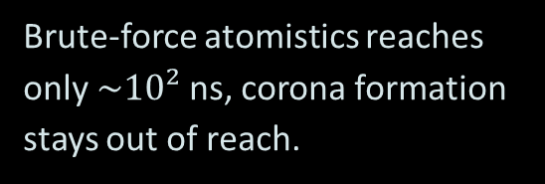
THE CHALLENGE
Can we do this in silico?
Yes, we can do first-principles calculations, but …
Diverse biomolecules & particles; complex, active responses
THE HARDEST PART
1
A multiscale gap
2
Immense sizes ($>10²$ nm) and high energies ($\sim {10}^{3}k_{B}T$)
LENGTH
Å → nm → µm
3
Heterogeneity, many-body interactions and water
TIME
fs → ns → ms–s
4
No force fields tuned for interfacial properties
Variable conditions: pH, ionic strength, temperature, chemistry
Brute-force atomistics reaches only $\sim 10²$ ns, corona formation stays out of reach.
5
6
Nanoparticles poorly defined in shape, size and surface
Notes:
Can we do all this in silico? Yes — but there are real challenges. The biomolecules and particles are hugely diverse, with complex, active responses. The systems are immense — over a hundred nanometres — and the energies large, thousands of kBT. There's heterogeneity, many-body effects and water everywhere. We lack force fields tuned for these interfaces. Conditions vary — pH, ionic strength, temperature, chemistry — and the materials evolve. And the particles are often poorly defined in shape, size and surface. The hardest part is the multiscale gap: the essential physics lives at ångströms and femtoseconds, but the corona forms over nanometres–micrometres and milliseconds–seconds, while brute-force atomistics stalls at a few hundred nanoseconds.

Slide 8
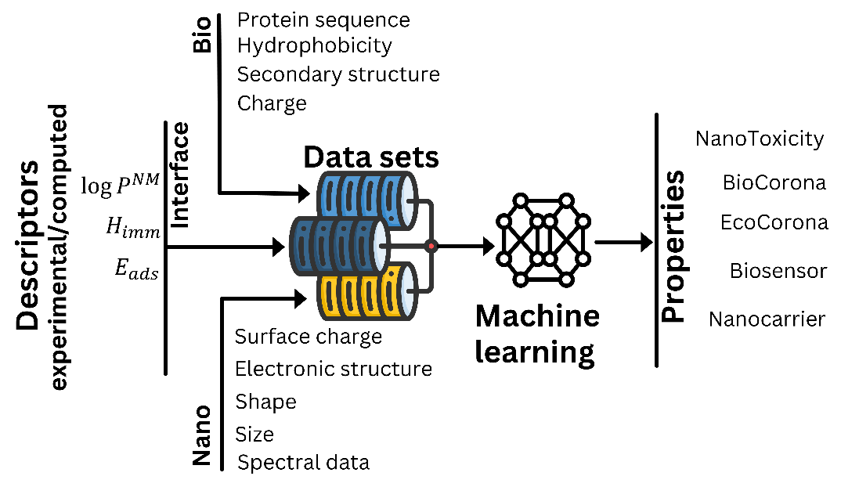
STRATEGY
Multiscale and Multiphysics approach
1
Physics-based characterisation
Assume everything is made of atoms. Multiscale physics evaluates the relevant properties from atomistic and electron structures.
2
Data-driven prediction
Machine learning maps the advanced descriptors onto functionalities and complex properties.
Lobaskin et al., EPL 143, 57001 (2023)
Notes:
The strategy is to split the problem: first, advanced materials characterisation to compute the relevant interfacial properties bottom-up, exploiting repeat units in biomolecules to speed things up; second, feed those descriptors into statistical / machine-learning models to predict functionality (Lobaskin, EPL 2023).

Slide 9
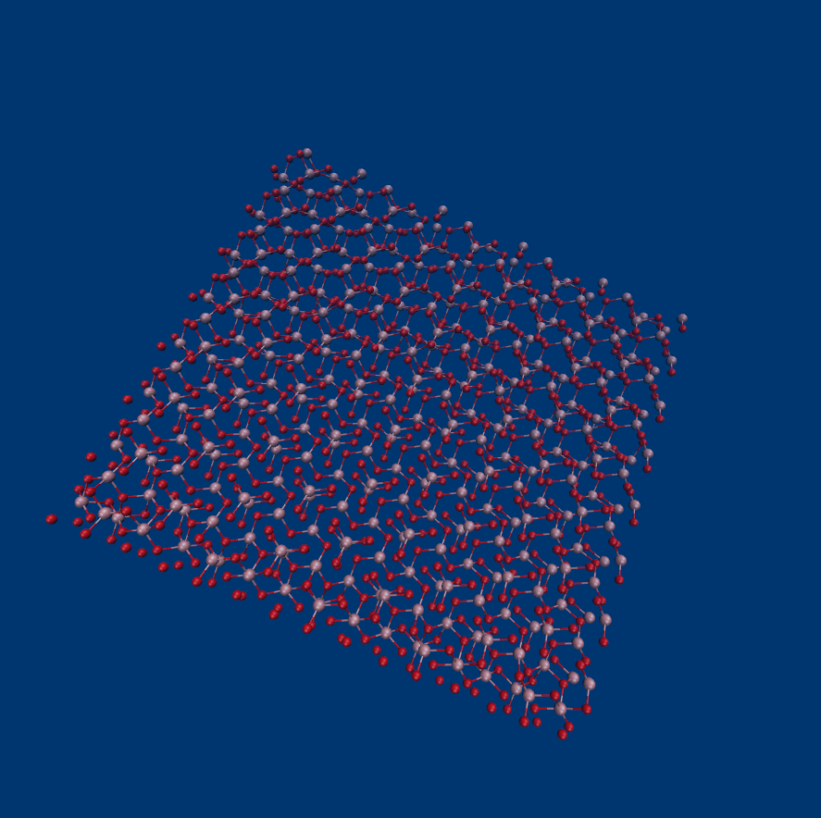
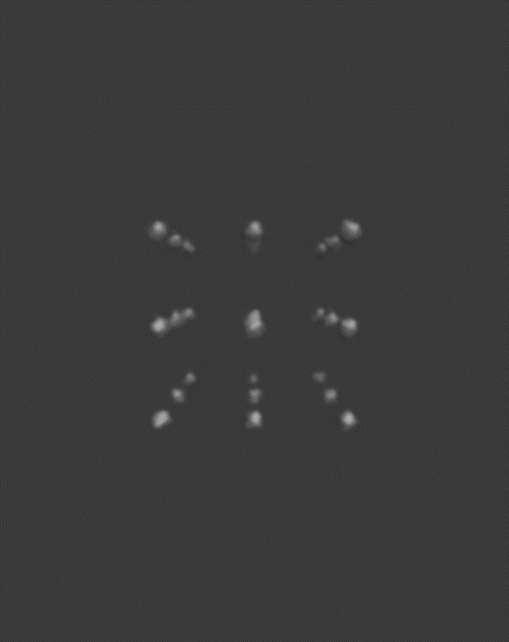
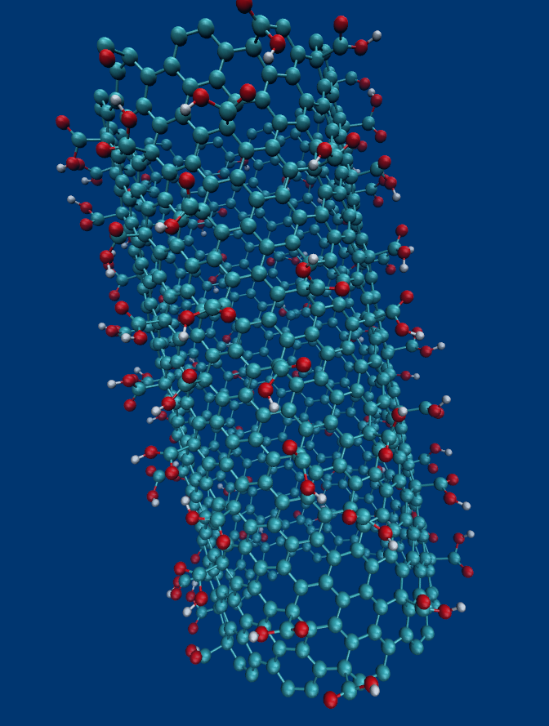
DESCRIPTORS
Two families of nanomaterial descriptors
i
Intrinsic (quantum / semi-empirical)
ii
Extrinsic (atomistic / coarse-grained)
Band gap, HOMO / LUMO
Mulliken electronegativity, hardness
Electrophilicity, polarisability, dipole moments
Ionisation potential, electron affinity
Adsorption energies (GROMACS + PLUMED / UnitedAtom)
Hamaker constants (Lifshitz theory)
Immersion enthalpies → log P
PM6-D3 (MOPAC) · PBE (SIESTA) · GFN-xTB
Wyrzykowska, Nat. Nanotechnol. (2022) · del Giudice, Nat. Nanotechnol. (2023) · Rouse, PCCP (2021)
Notes:
Descriptors come in two families. Intrinsic ones are quantum / semi-empirical — band gap, electronegativity, hardness, and so on, from MOPAC, SIESTA, GFN-xTB. Extrinsic ones come from atomistic and coarse-grained MD — adsorption energies, Hamaker constants, immersion enthalpies giving log P. It's the extrinsic, interfacial descriptors that are the hard, distinctive part.

Slide 10
THE INGREDIENTS
Evaluating atom-atom interactions
A force field is the rule book for atomistics simulations: bonds, charges, polarisabilities, van der Waals forces for all atoms.
Standard force fields aren't tuned for inorganic surfaces in water, or for interactions with biomolecules so we derive our own from quantum (DFT) simulations, evaluating the electron density distributions around atoms in contact with water.
Why it matters: our TiO₂ surface comes out less polar than usually assumed, which changes which residues stick, and so the whole corona.
Rouse et al., PCCP (2021)
Notes:
To simulate this interface we need a force field — essentially the rule book for how strongly atoms attract and repel. The catch is that standard force fields were never tuned for inorganic surfaces sitting in water, so we derive our own from quantum, density-functional simulations, classifying each atom by its local bonding environment. Why does this matter? As an example, our titanium-dioxide surface turns out less polar than people usually assume — and that single change alters which amino acids stick, and therefore the whole corona downstream (Rouse, PCCP 2021).

Slide 11
THE KEY IDEA
Coarse-graining: from atoms to beads
Group atoms into effective beads
Each bead keeps the interactions that matter: van der Waals, electrostatics, hydration, short-range chemistry.
Integrate out the fast, small detail
So the simulation can reach the sizes (nm) and times (ms) where the corona actually forms.
Proteins are made of only 20 amino acids and 6 atom types, there is much repetitiveness
Water molecules and ions are small and fast their contributions can be averaged out
All-atom
Coarse-grained
10³–10⁴ atoms
1 bead per amino acid
10² beads
Notes:
The idea that makes all of this possible is coarse-graining. Instead of tracking every atom, we group atoms into a few effective 'beads' — for a protein, one bead per amino acid. A protein of ten thousand atoms becomes a chain of a few hundred beads. Each bead still carries the physics that matters: van der Waals attraction, electrostatics, and the short-range chemistry. By averaging out the fast, small-scale detail, we can reach the nanometre sizes and millisecond times where the corona actually forms. The analogy: you can describe a crowd by its density instead of tracking every single person.

Slide 12
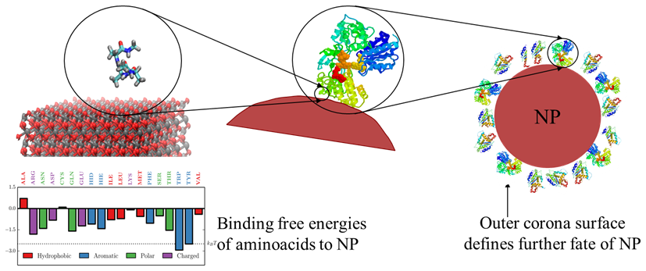
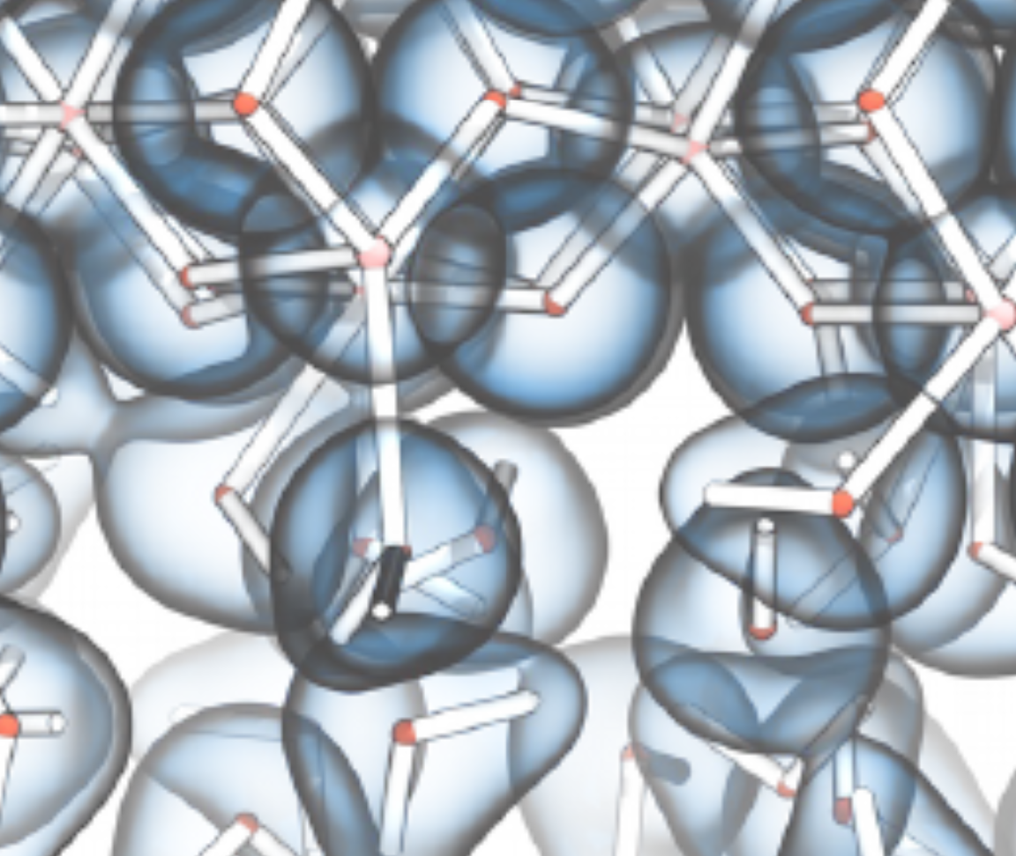
COUPLING THE METHODS
A four-step multiscale surface interaction pipeline
Quantum
Atomistic
United atom
Mesoscale
1
2
3
4
Power et al. Model. Simul. Mater. Sci. Eng. (2019); Rouse et al. PCCP (2021), JCIM (2024)
Notes:
The physics engine is a four-step coarse-graining pipeline: quantum (DFT) for force fields and charges; atomistic MD for the free-energy profiles of the molecular building blocks; the united-atom level where each amino acid becomes a single bead; and a mesoscale level for corona evolution. The figure shows the sequence — binding free energies of amino acids feed the corona, whose outer surface then sets the particle's fate (Power 2019; Rouse PCCP 2021, JCIM 2024).

Slide 13
THE BUILDING BLOCKS
Potentials of mean force: sampling the building blocks
Biomolecules are built from a small alphabet: amino acids, nucleic acids, sugars, lipid fragments.
Only 20 amino acids in proteins, only 6 elements (C, O, H, N, P, S) in most biomolecules.
Compute each fragment’s free-energy profile (thermodynamically ensemble-averaged interaction potential) once, then reuse it for any molecule.
Free-energy profiles of amino acids approaching a surface.
Power et al. (2019); Subbotina & Lobaskin, JPCB (2022)
The INTERFACE force field
Heinz et al. Langmuir (2012)
Notes:
The second challenge is the biomolecules. But they are built from a small alphabet — amino acids, sugars, lipid fragments. So we compute the potential of mean force for each fragment against the surface just once, using all-atom MD with enhanced sampling, and reuse it for any molecule assembled from those pieces (Power 2019; Subbotina & Lobaskin JPCB 2022).

Slide 14
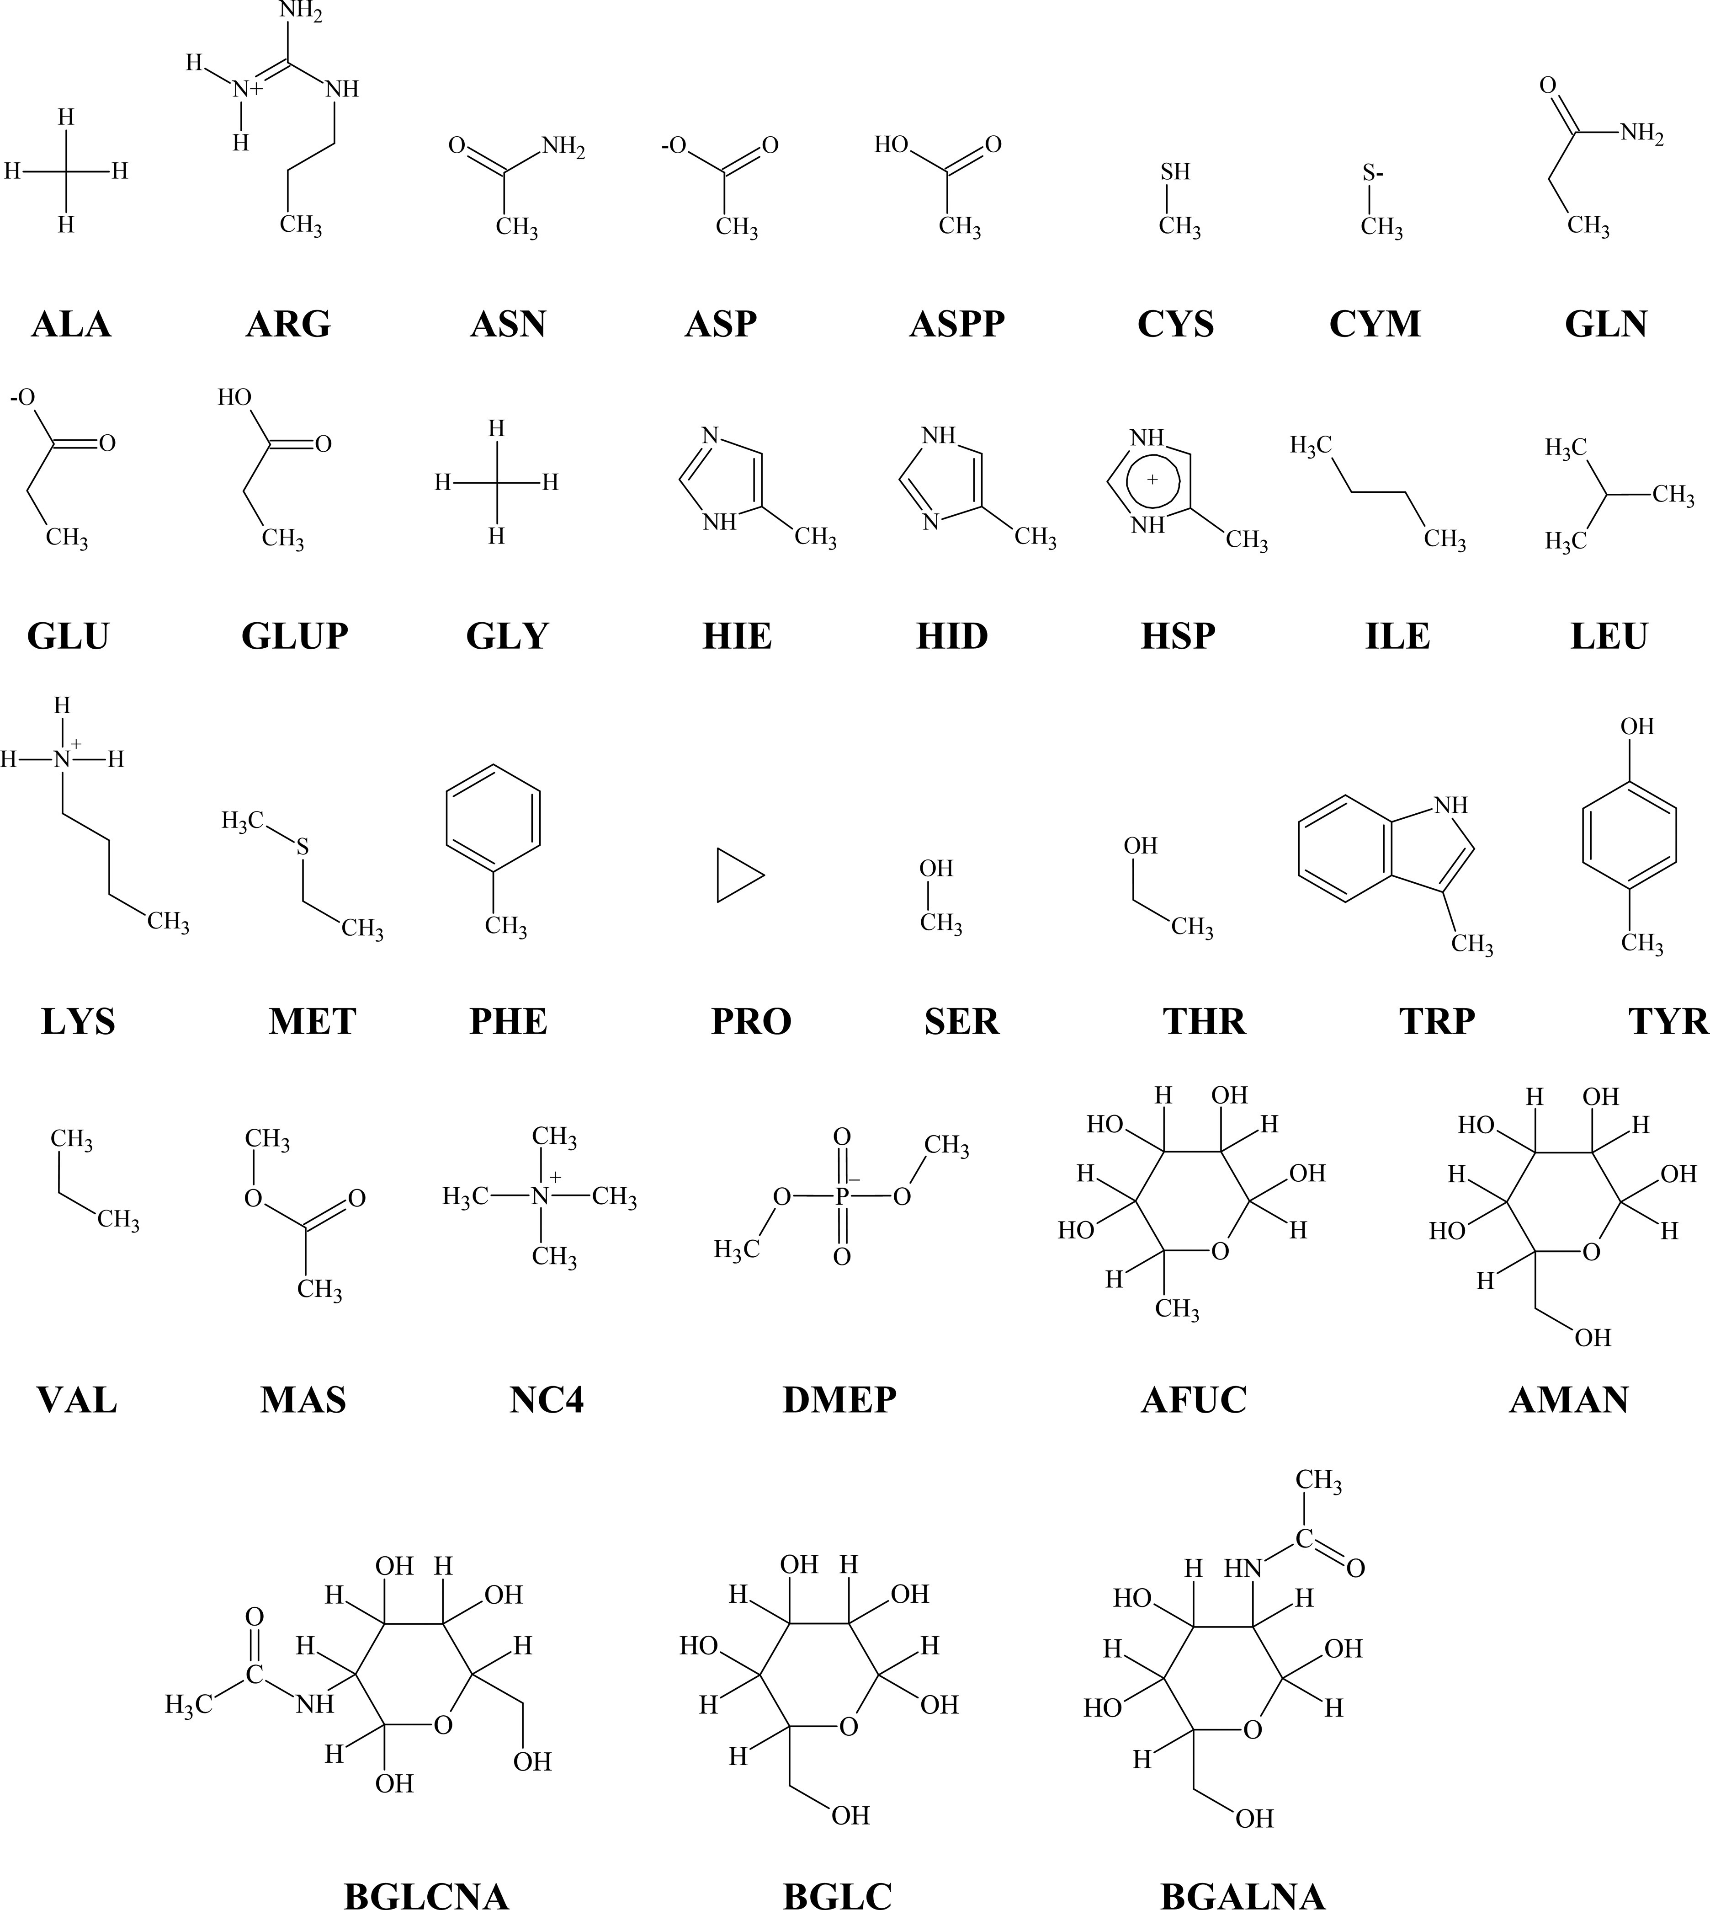
THE BUILDING BLOCKS
Potentials of mean force: sampling the building blocks
Free-energy profiles of amino acids approaching a surface.
Power et al. (2019); Subbotina & Lobaskin, JPCB (2022)
The INTERFACE force field
Heinz et al. Langmuir (2012)
Notes:
The second challenge is the biomolecules. But they are built from a small alphabet — amino acids, sugars, lipid fragments. So we compute the potential of mean force for each fragment against the surface just once, using all-atom MD with enhanced sampling, and reuse it for any molecule assembled from those pieces (Power 2019; Subbotina & Lobaskin JPCB 2022).

Slide 15
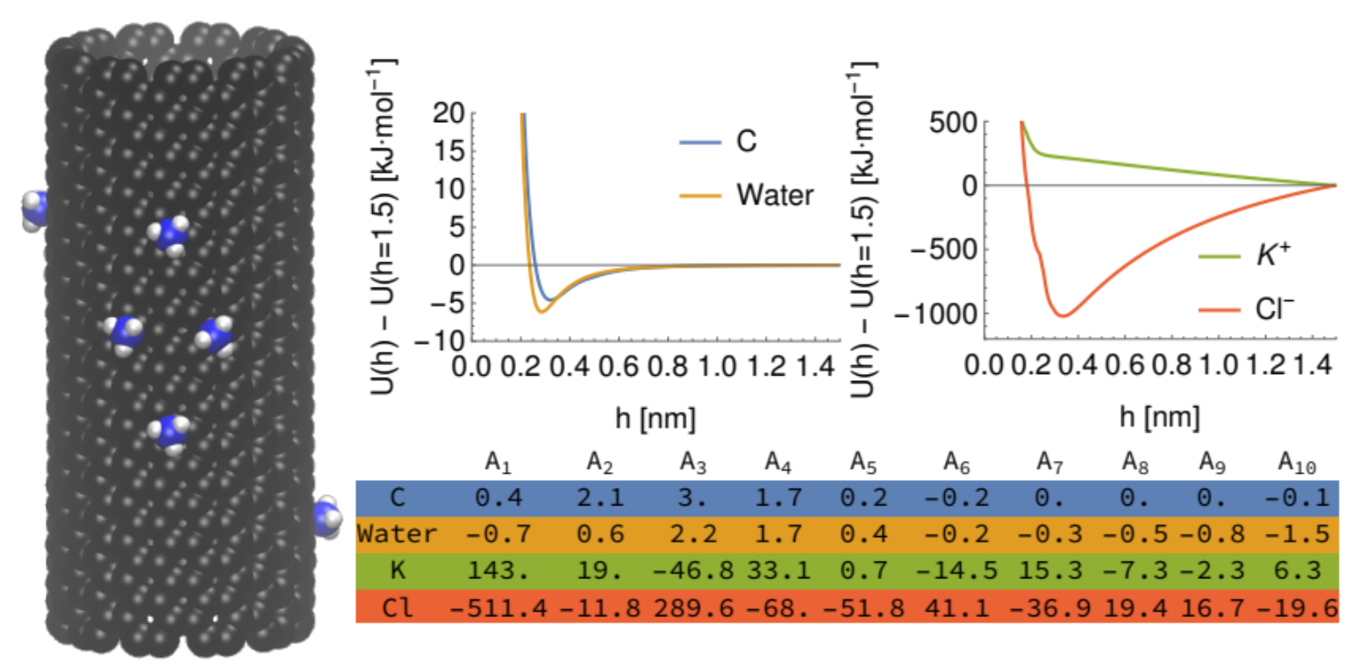
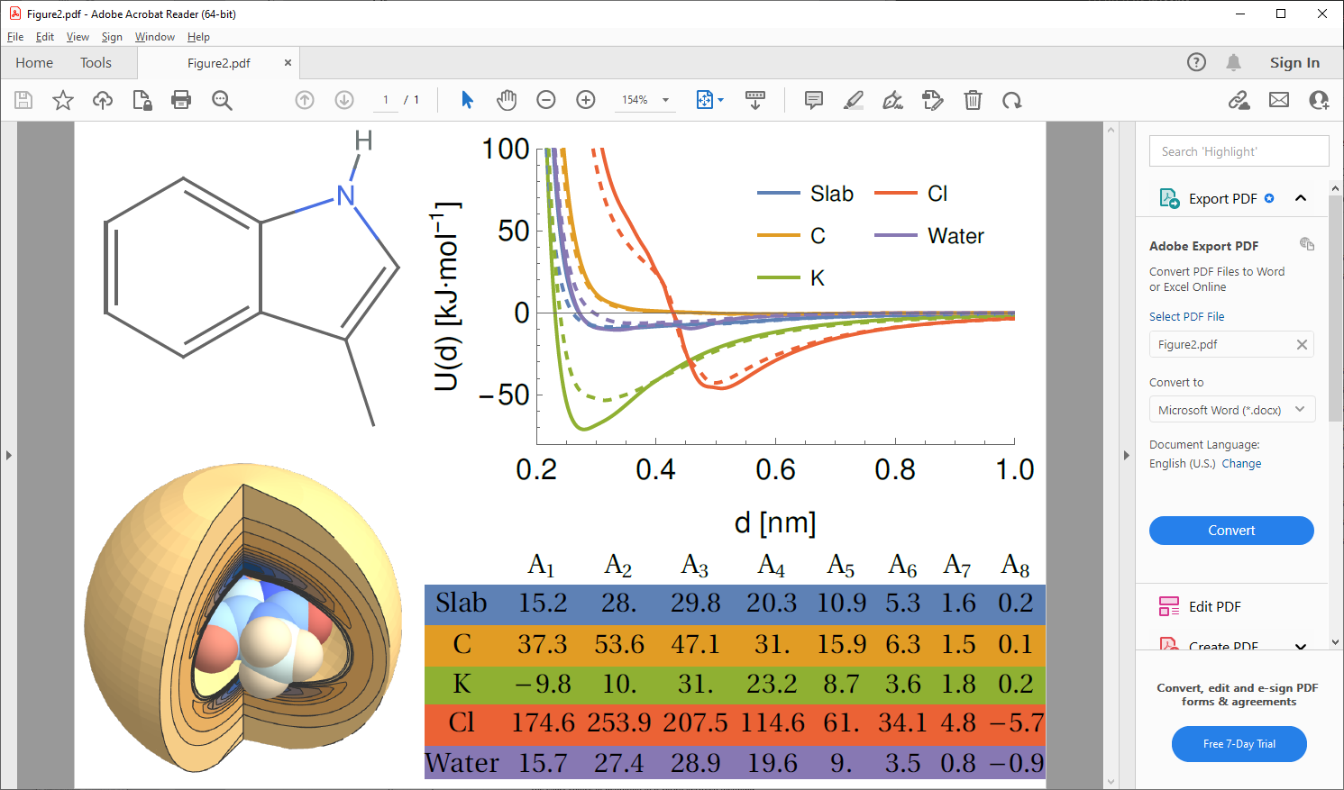
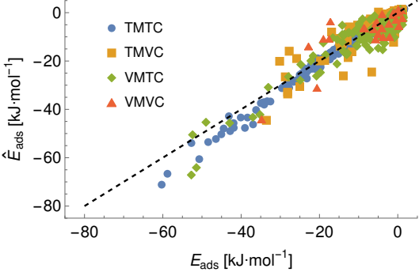
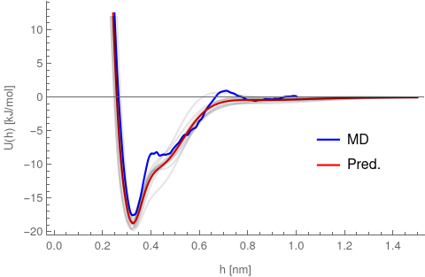
LEARNING THE PATTERNS
ML potentials for any molecule, any surface
Predicted molecule–surface interaction potential (left) and adsorption energy (right).
Rouse & Lobaskin, Faraday Discuss. 244, 306 (2023)
A machine-learned PMFPredictor extends the fragment library to arbitrary materials and molecules
200+ small molecules parameterised; new inputs via SMILES / CHARMM-GUI.
Notes:
To generalise beyond what we've simulated, a machine-learned PMFPredictor predicts the molecule–surface potential — and the resulting adsorption energy — for arbitrary materials and molecules, taking structure via SMILES or CHARMM-GUI. Over 200 small molecules are parameterised (Rouse & Lobaskin, Faraday Discussions 2023).

Slide 16
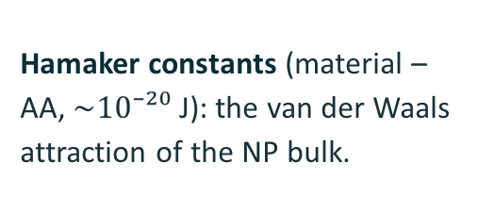
NP DESCRIPTORS
Interaction descriptors and fingerprints
Amino-acid adsorption strength on titania (more negative = binds more strongly, positive – no binding)
Two descriptors per small molecule
Hamaker constants (material –AA, $\sim 10⁻²⁰$ J): the van der Waals attraction of the NP bulk.
Adsorption energies — the short-range chemistry, ranking residues by affinity.
Rouse et al. PCCP 2021
Notes:
For each material we tabulate interaction parameters per residue: Hamaker constants — the van der Waals attraction of the particle bulk, of order 10 to the minus 20 joules for gold–amino-acid pairs — and the short-range adsorption energies that rank residues by affinity. Aromatic and charged residues like tryptophan, phenylalanine, arginine and glutamate bind most strongly (Power 2019).

Slide 17
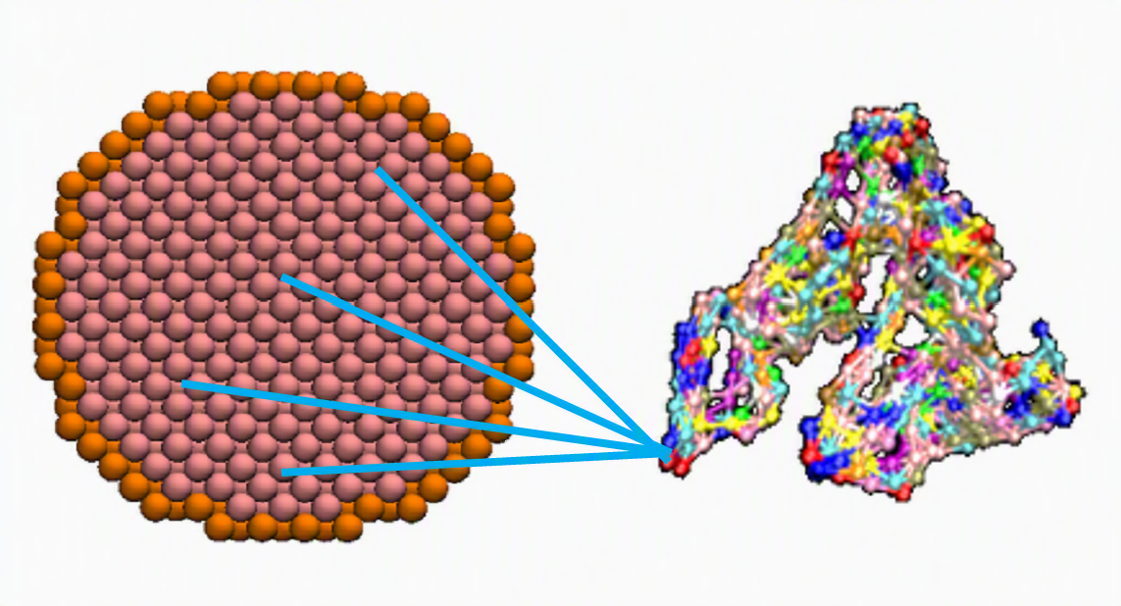
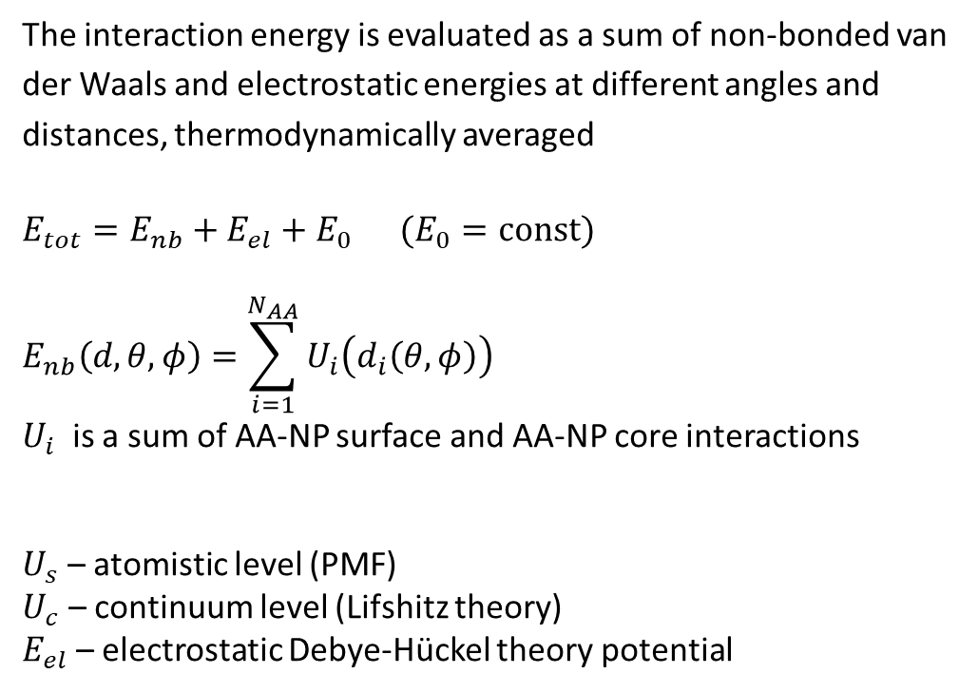

PREDICTION · PROTEINS
From small blocks to large molecules
The interaction energy is evaluated as a sum of non-bonded van der Waals and electrostatic energies at different angles and distances, thermodynamically averaged
$E_{tot}=E_{nb}+E_{el}+E_{0} (E_{0}=const)$
$$E_{nb}\left(d,θ,φ\right)=\sum_{i=1}^{N_{AA}}{U_{i}\left(d_{i}\left(θ,φ\right)\right)}$$
$U_{i}$ is a sum of AA-NP surface and AA-NP core interactions
$U_{s}$ – atomistic level (PMF)
$U_{c}$ – continuum level (Lifshitz theory)
$E_{el}$ – electrostatic Debye-Hückel theory potential
$$U_{i}\left(h_{i}\left(d,θ,φ\right)\right)={\left.{\left(U\right.}_{s}\right)}_{i}+{\left.{\left(U\right.}_{c}\right)}_{i}$$
United atom approach
Power et al. Modeling Simul. Mater. Sci. Eng. (2019)
Notes:
Summing bead energies over orientations gives not just how strongly a protein binds but which face it presents. Here is the orientation-resolved binding-energy heatmap for immunoglobulin G, built on an AlphaFold structure in about a minute with our NPCoronaPredict tool (Rouse JCIM 2024; Subbotina JCIM 2025).

Slide 18
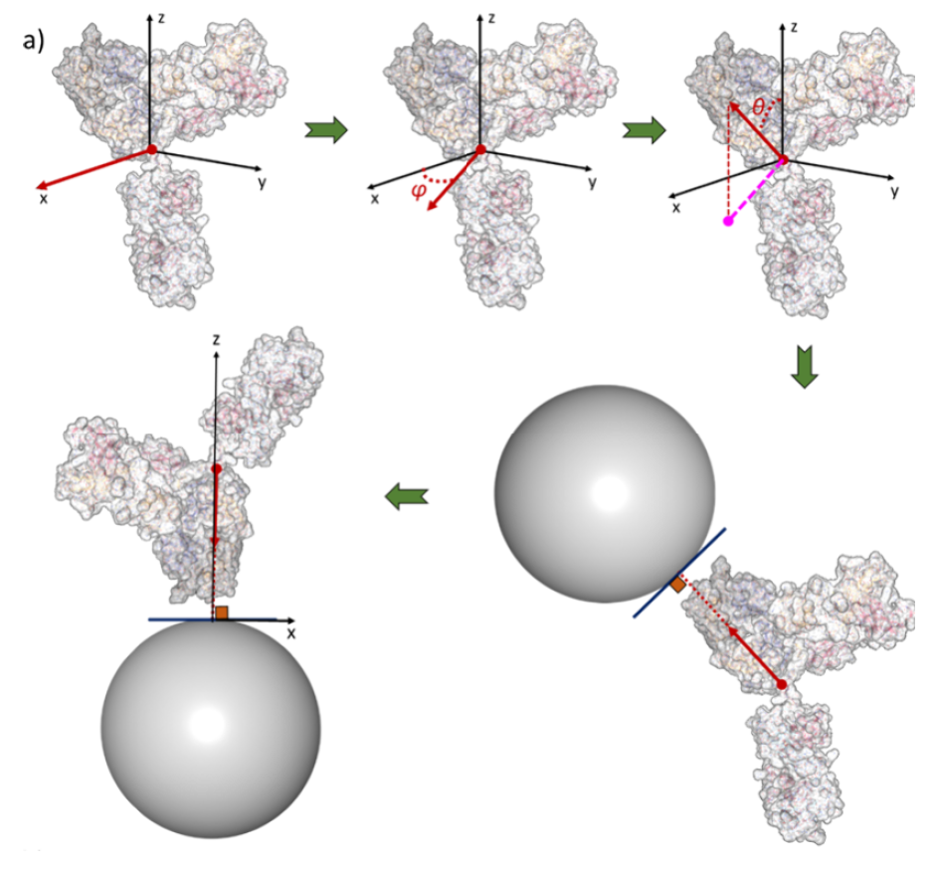
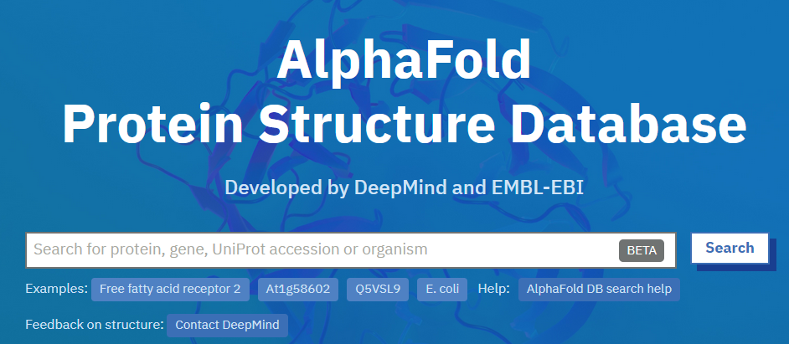
PREDICTION · PROTEINS
Which face does a protein present?
Now our interaction model is orientation-resolved: it returns the binding energy for every way a protein can meet the particle.
This heatmap reveals the preferred orientations of IgG computed on an AlphaFold structure in about a minute.
Orientation-specific binding energies for IgG on a NP. NPCoronaPredict
Rouse et al. JCIM (2024); Subbotina et al. JCIM (2025)
Notes:
Summing bead energies over orientations gives not just how strongly a protein binds but which face it presents. Here is the orientation-resolved binding-energy heatmap for immunoglobulin G, built on an AlphaFold structure in about a minute with our NPCoronaPredict tool (Rouse JCIM 2024; Subbotina JCIM 2025).

Slide 19
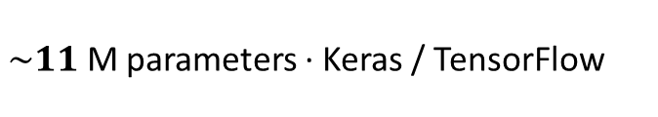
LEARNING THE PATTERNS
A neural network for protein binding energies
$\sim 11$ M parameters · Keras / TensorFlow
Inputs: Protein AA sequence, van der
Waals energies and AA binding energies
Trained on 20,000 AlphaFold proteins x 40 surfaces (metals, oxides, carbon, polymer)
Accurate energy prediction for new proteins and materials.
Directly computed vs NN-predicted NP-protein adsorption energies
Rouse et al. (in preparation)
Notes:
To reach genome scale we trained a neural network. A residue branch assigns eight trial energies to each residue from the NP parameters; a sequence branch uses an LSTM summary and a Transformer to weight residues; the weighted sum gives the total binding energy. About 11 million parameters, trained on 20,000 AlphaFold proteins across 40 metal, oxide, carbon and polymer surfaces with varied size and surface potential.

Slide 20
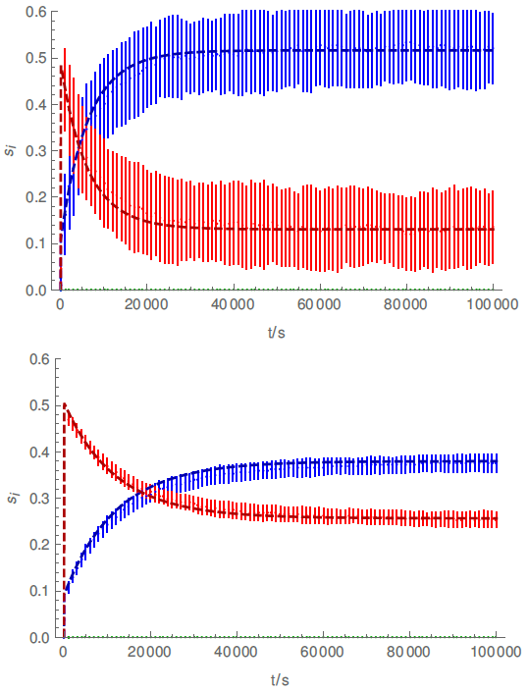
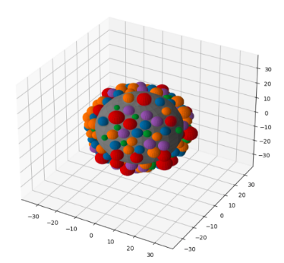
PREDICTING THE CORONA
Competitive adsorption & corona evolution
A kinetic Monte Carlo model is a stochastic simulation of binding and unbinding that evolves the corona over long times, up to minutes and hours.
Proteins as spheres, each with its own size and binding rate from the multiscale model
Spherical or cylindrical nanoparticles
Reproduces the Vroman effect: fast movers first, then displaced
Strong dependence on particle size (curvature)
Coverage of two proteins on 5 nm (top) and 50 nm (bottom) NPs
Rouse et al., Biophys. J. 120, 4457 (2021)
Notes:
The third challenge is kinetic barriers and long-time evolution. A kinetic Monte Carlo model evolves the corona, treating proteins as spheres with orientation-specific sizes and binding rates on spherical or cylindrical particles, validated against rate equations with scaled-particle theory. It reproduces the Vroman effect and a strong dependence on curvature — compare the 5 and 50 nanometre particles (Rouse, Biophysical Journal 2021).

Slide 21
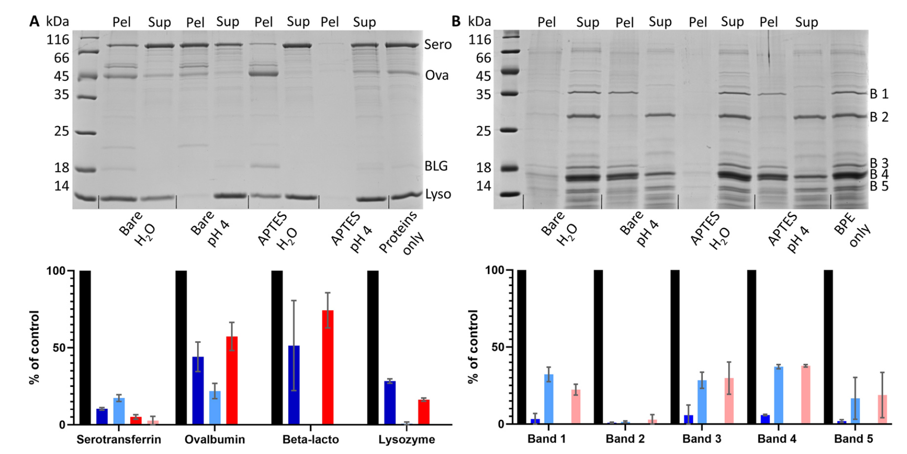
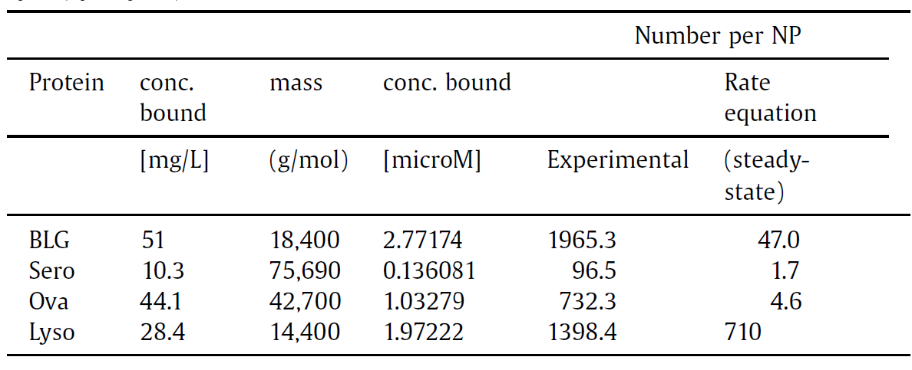
VALIDATION
Computational predictions agree with experiments
Experiment
Simulation
Hasenkopf et al. Nano Today (2022)
The multiscale simulation predictions reproduce the protein adsorption ranking in experiments (blood serum and allergen proteins on silica NPs).
Notes:
Crucially, these fast predictions hold up: the preferred orientations agree with those from full molecular docking, giving us validation at a tiny fraction of the cost (Annapoorani JCP 2026).

Slide 22
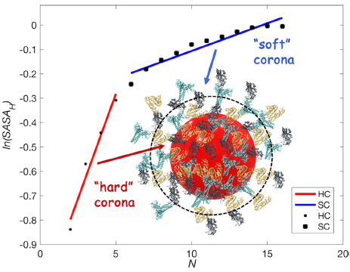
PREDICTING THE CORONA
Soft coronas need protein–protein interactions
Single-protein affinities are not enough.
Adding protein–protein interactions distinguishes a tightly bound hard corona from a loosely associated soft corona, and the two differ systematically in their physicochemical character.
Docking: hard and soft coronas differ in physicochemical properties. Annapoorani et al., JPCL (2025)
Notes:
A refinement: single-protein affinities aren't the whole story. Including protein–protein interactions lets us separate the tightly bound hard corona from the loosely associated soft corona, and docking shows the two differ systematically in physicochemical properties (Annapoorani, JPCL 2025).

Slide 23
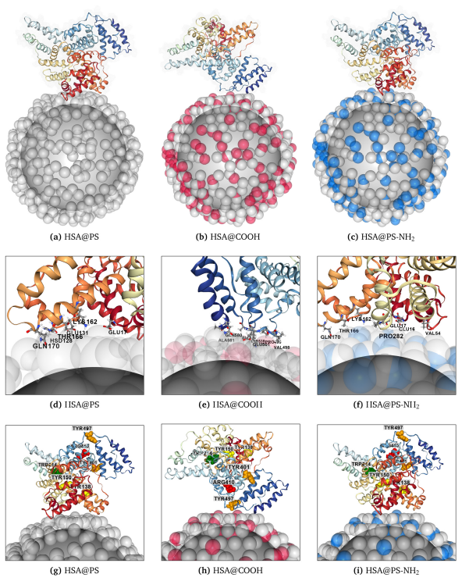
APPLICATION
Corona on nanoplastics
The same machinery tackles micro- and nanoplastic biointeractions.
Composite particle: solid polystyrene core + coarse-grained beads
1
Fragment PMFs obtained from atomistic simulations
2
Assesses protein adsorption where experimental data are scarce
3
Composite PS nanoparticles + proteins.
Subbotina et al., Environ. Sci. Nano (2026)
Notes:
The same framework now addresses nanoplastics. We build a composite particle — a solid polystyrene core plus coarse-grained tetramer beads — and get the fragment PMFs by Boltzmann inversion, letting us assess protein adsorption on plastics where experimental data are thin (Subbotina, Environ. Sci. Nano 2026).

Slide 24
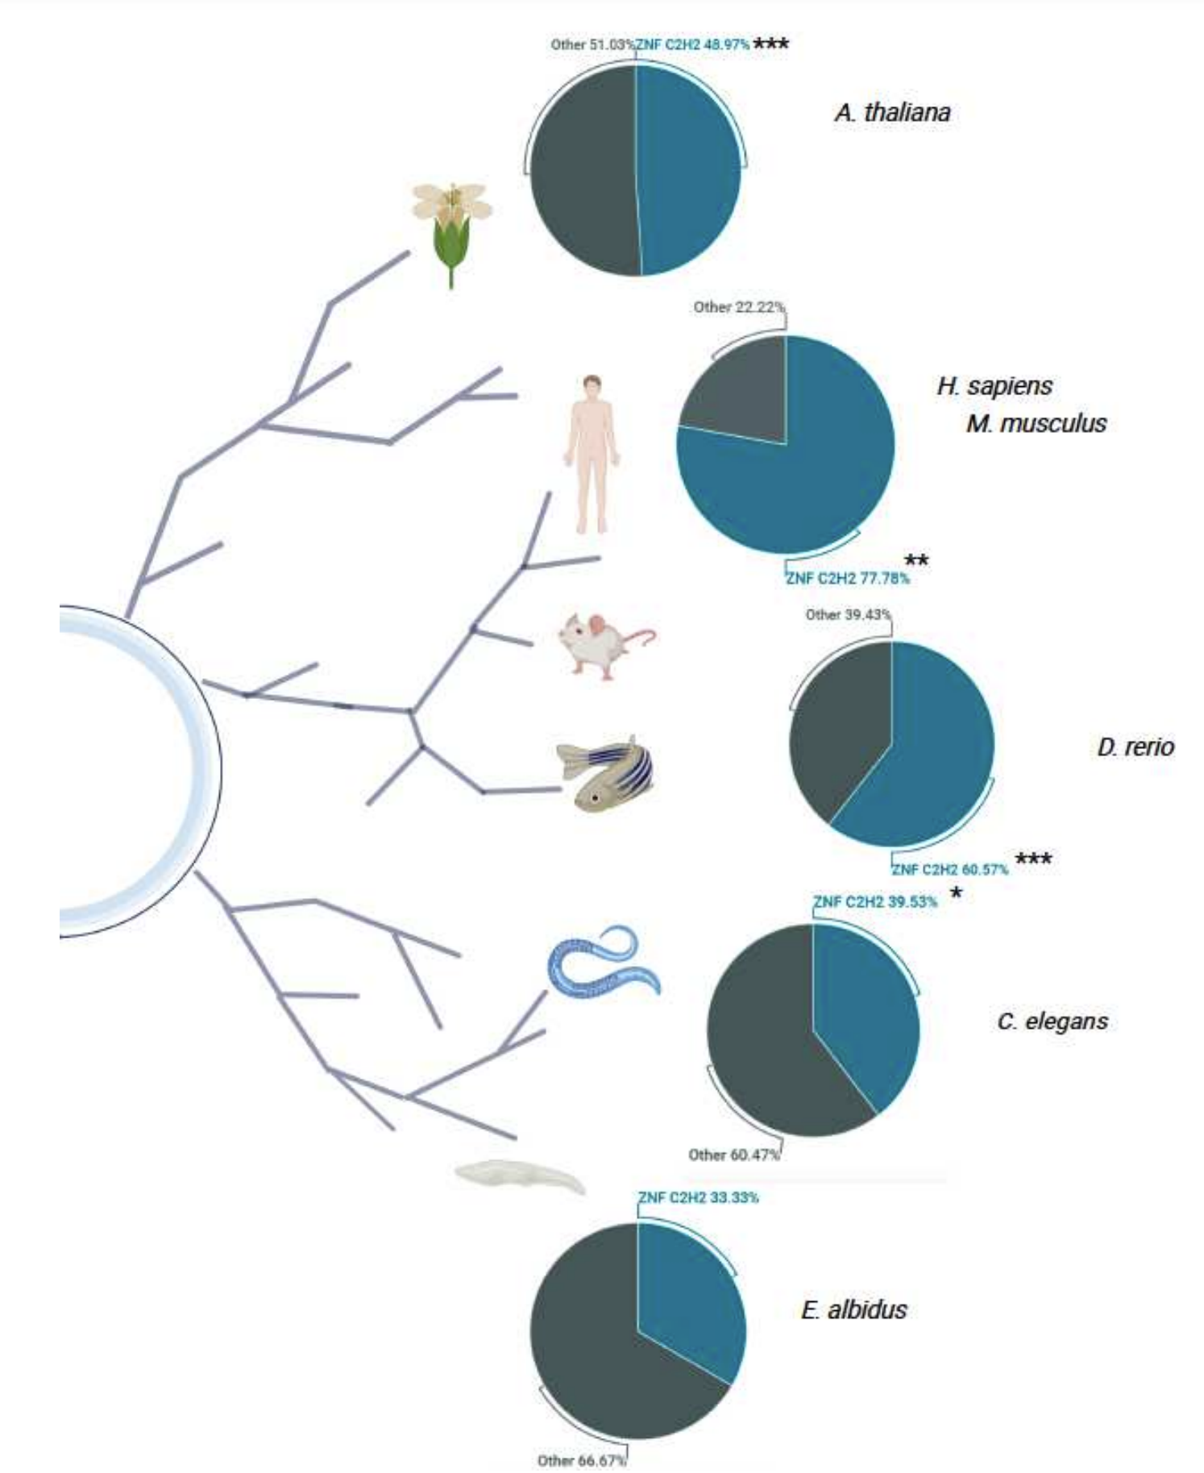
DO THE DESCRIPTORS HELP?
Bionano interaction descriptors track the real biology
The bionano descriptors (surface charges, van der Waals forces) correlate with gene expression in exposed organisms and point to the toxicity mechanism.
Not just correlation for prediction: the descriptors carry mechanistic meaning, linking what the particle does at the interface to how cells respond.
Advanced descriptors correlate with gene expression across different species. del Giudice et al., Nat. Nanotechnol. (2023)
Notes:
Do these advanced descriptors actually help? Yes — they correlate with gene expression and give mechanistic insight, linking the interfacial physics to the cellular response rather than being mere fitting variables (del Giudice, Nature Nanotechnology 2023).

Slide 25
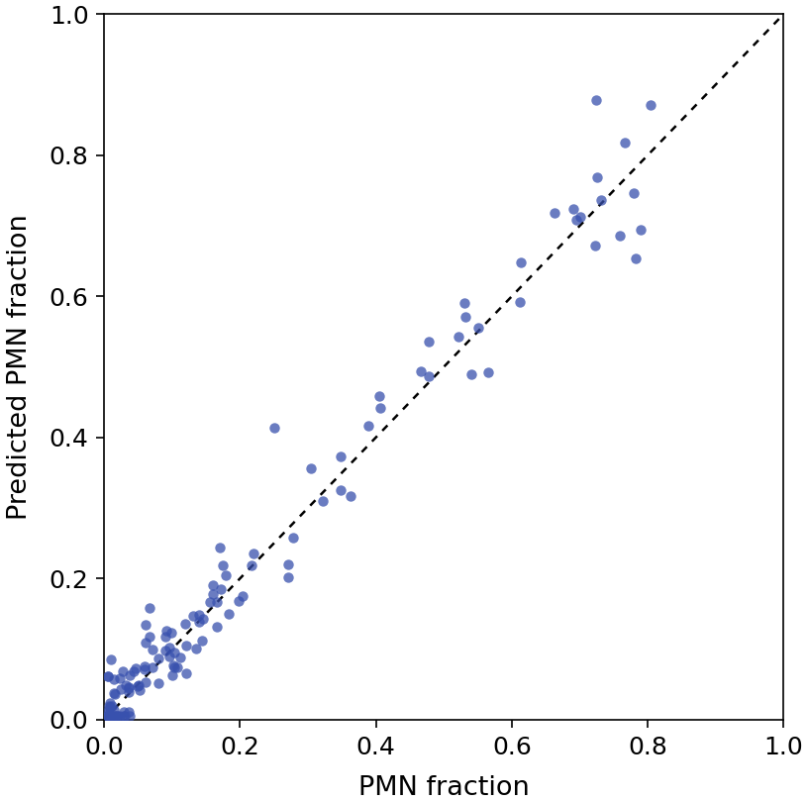


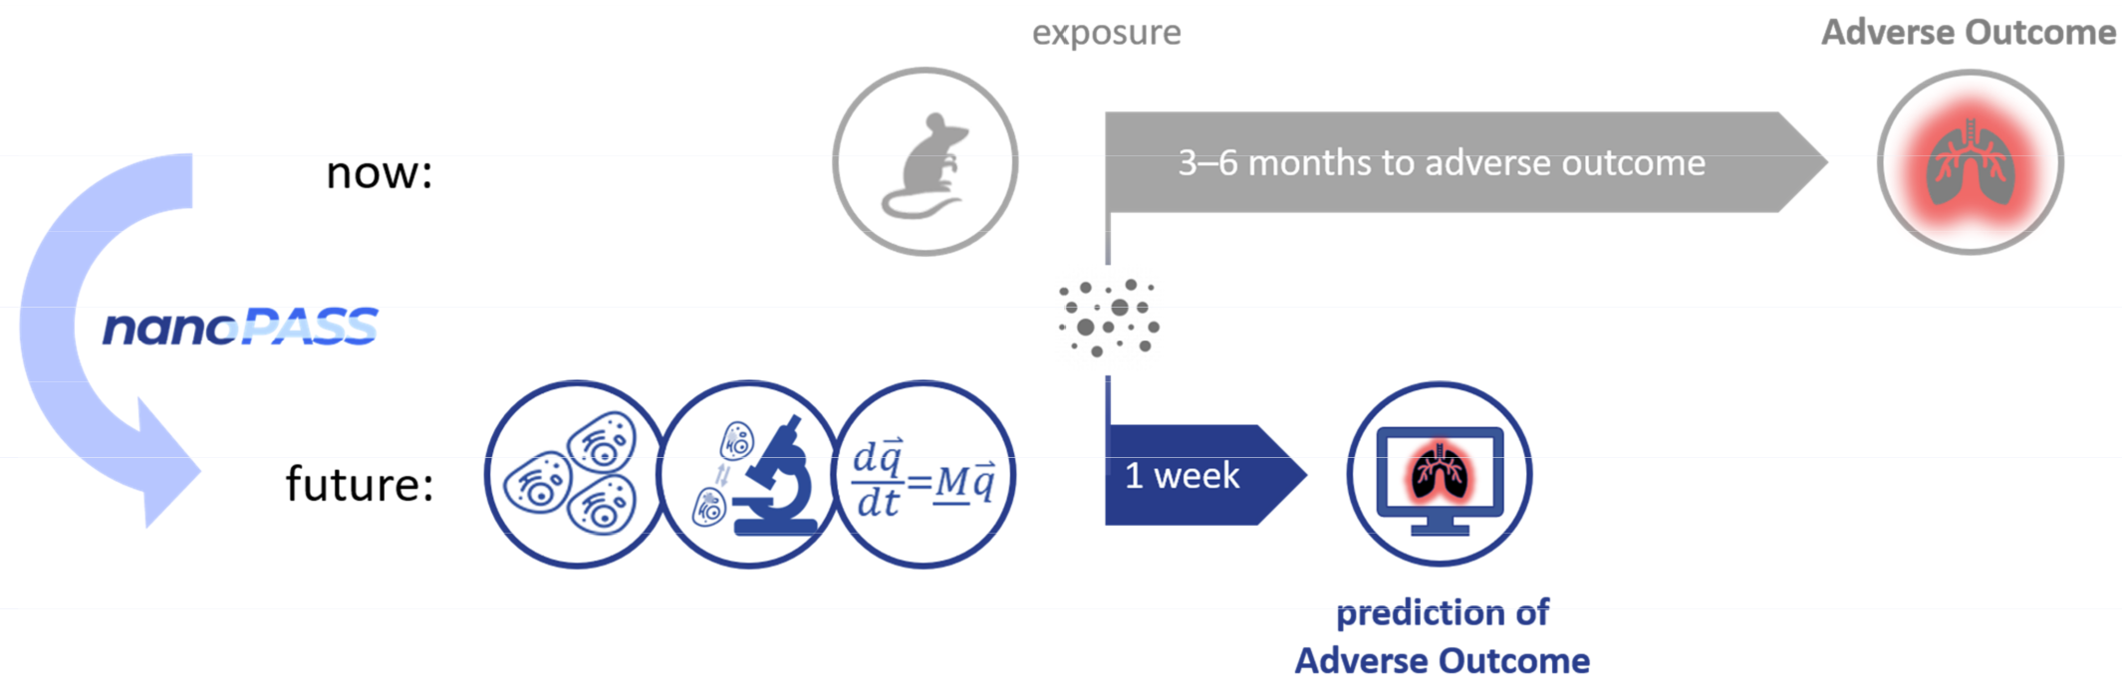
RESULT
Predicting in-vivo lung inflammation
Bio-nano descriptors (AA binding, aspect ratio, …) predict the degree of lung inflammation across 52 materials.
Fully in silico, no wet-lab data for novel materials
Mechanistically anchored to hazard via protein–surface interactions
Transferable beyond the training set (cement, plastics)
Predicted vs experimental neutrophil influx, 52 materials. Jacobsen et al. (in preparation)
Notes:
And the payoff: those descriptors predict in-vivo lung inflammation — neutrophil influx — across 52 materials, fully in silico with no wet-lab measurements for novel particles, mechanistically anchored, and transferable to materials outside the training set like cement and plastics (Jacobsen, in preparation). This is the goal: predict a biological outcome from physics alone.

Slide 26
CONCEPT
Describing nanomaterials algorithmically
InChI for Nano: Structure encoding for nanomaterials
Lynch et al. Nanomaterials (2020)
Notes:
And the payoff: those descriptors predict in-vivo lung inflammation — neutrophil influx — across 52 materials, fully in silico with no wet-lab measurements for novel particles, mechanistically anchored, and transferable to materials outside the training set like cement and plastics (Jacobsen, in preparation). This is the goal: predict a biological outcome from physics alone.

Slide 27
CONCEPT
Describing nanomaterials algorithmically
InChI for Nano: Structure encoding for nanomaterials
Lynch et al. Nanomaterials (2020)
Notes:
And the payoff: those descriptors predict in-vivo lung inflammation — neutrophil influx — across 52 materials, fully in silico with no wet-lab measurements for novel particles, mechanistically anchored, and transferable to materials outside the training set like cement and plastics (Jacobsen, in preparation). This is the goal: predict a biological outcome from physics alone.

Slide 28
THE TAKE-HOME
Soft matter physics provides the mechanistic backbone that both next-generation nanotechnologies and regulatory science increasingly need. Nanoinformatics connects it to in silico predictive models.
Notes:
What the cell sees is not the pristine nanoparticle but the corona of proteins and lipids that forms on it. This talk is about making that interface computable — predicting adsorption energies and the corona — by combining physics-based simulation with data-driven models.

Slide 29
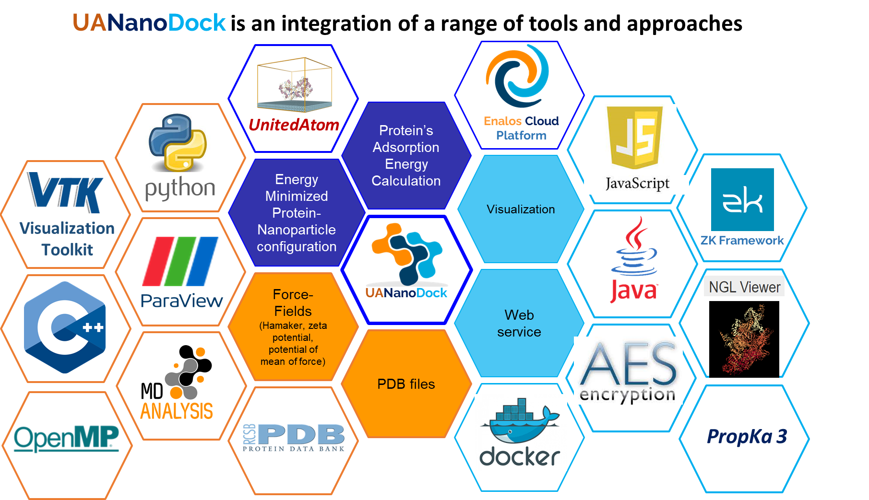
SUMMARY · OUTLOOK
What the approach delivers
Adsorption energies from first principles
Multiscale physics-based pipeline
1
The corona predicted
Arbitrary materials, arbitrary molecules
2
Descriptors that reach the biology
gene expression and in-vivo inflammation, fully in silico
3
Notes:
To summarise: multiscale physics-based modelling predicts properties for new materials and composites from first principles; the bio-nano interface data and advanced descriptors carry real predictive power for biological activity; and physics plus data together open the door to safe-by-design.

Slide 30
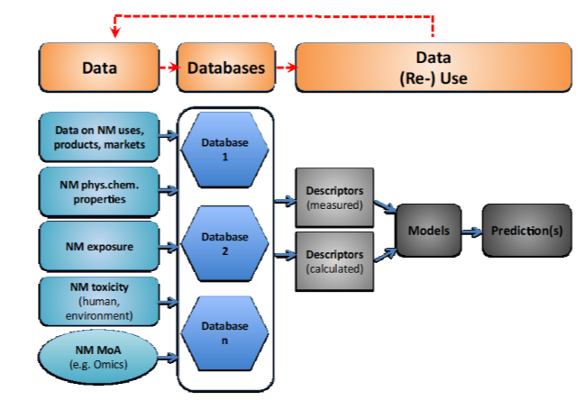
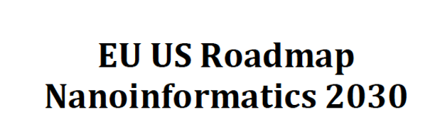
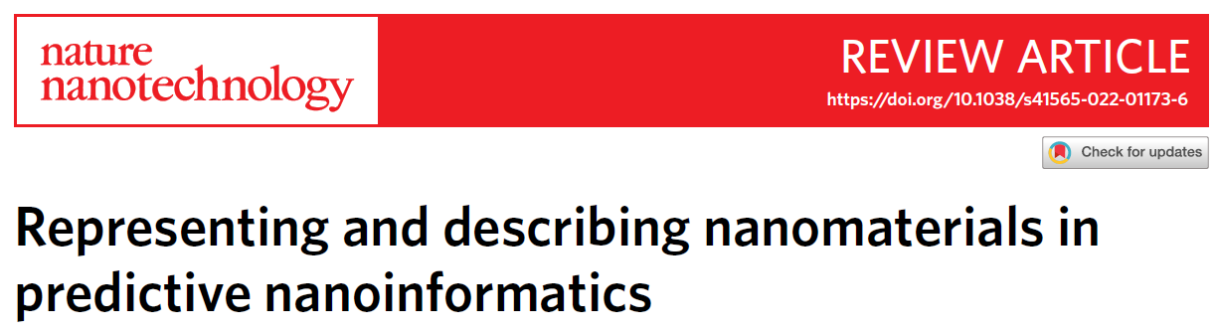
SUMMARY · OUTLOOK
Can physics be enhanced by AI?
Good quality data on materials are needed
Experiments, simulations, theories
1
Metadata, ontologies are important
Experiment conditions, extraction methods
2
Advanced characterisation
Extrinsic descriptors, real-life materials
3
Notes:
To summarise: multiscale physics-based modelling predicts properties for new materials and composites from first principles; the bio-nano interface data and advanced descriptors carry real predictive power for biological activity; and physics plus data together open the door to safe-by-design.

Slide 31
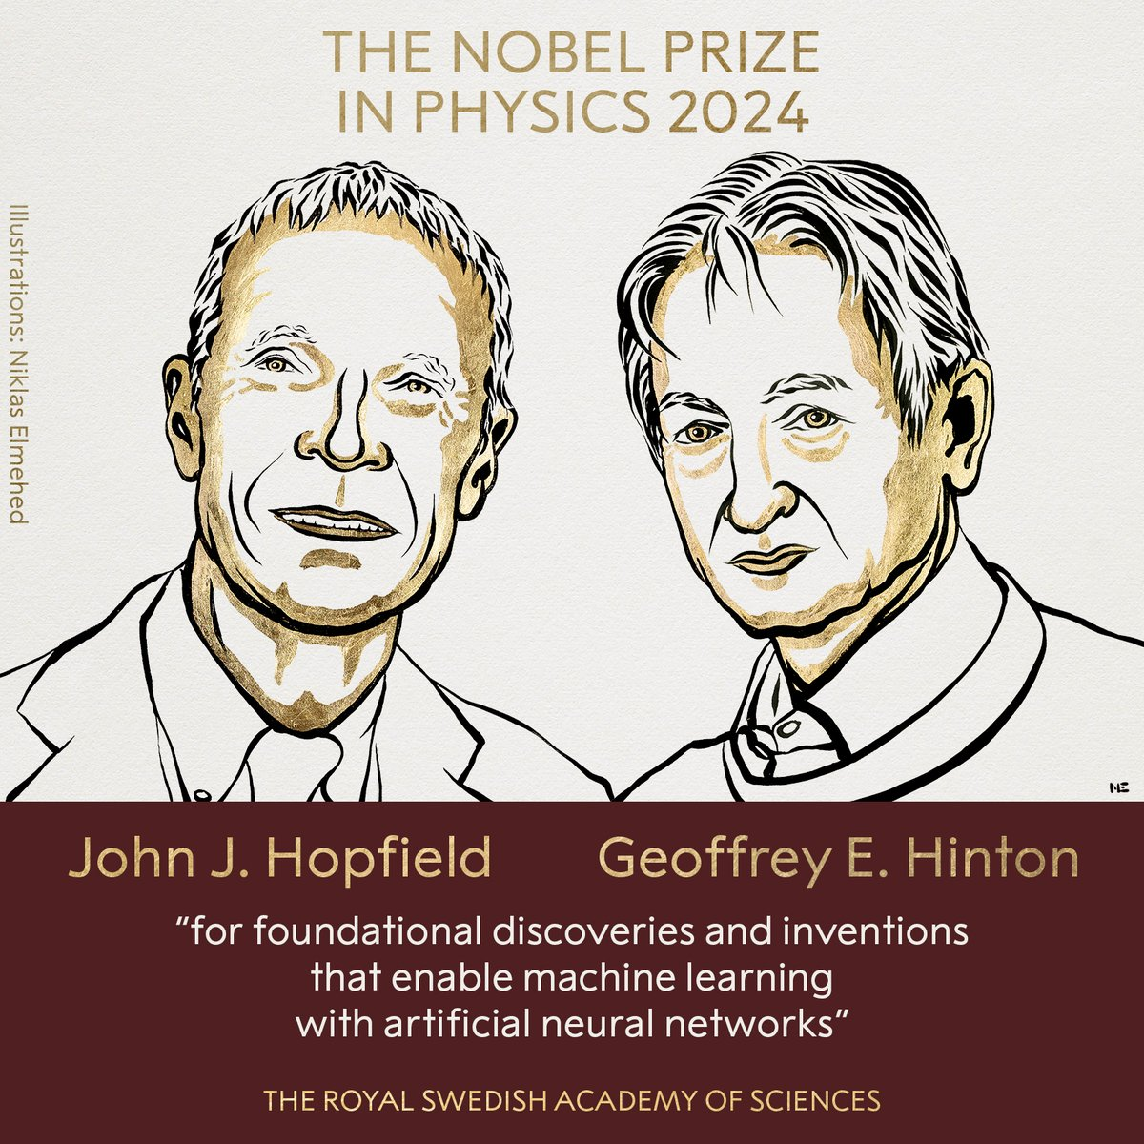
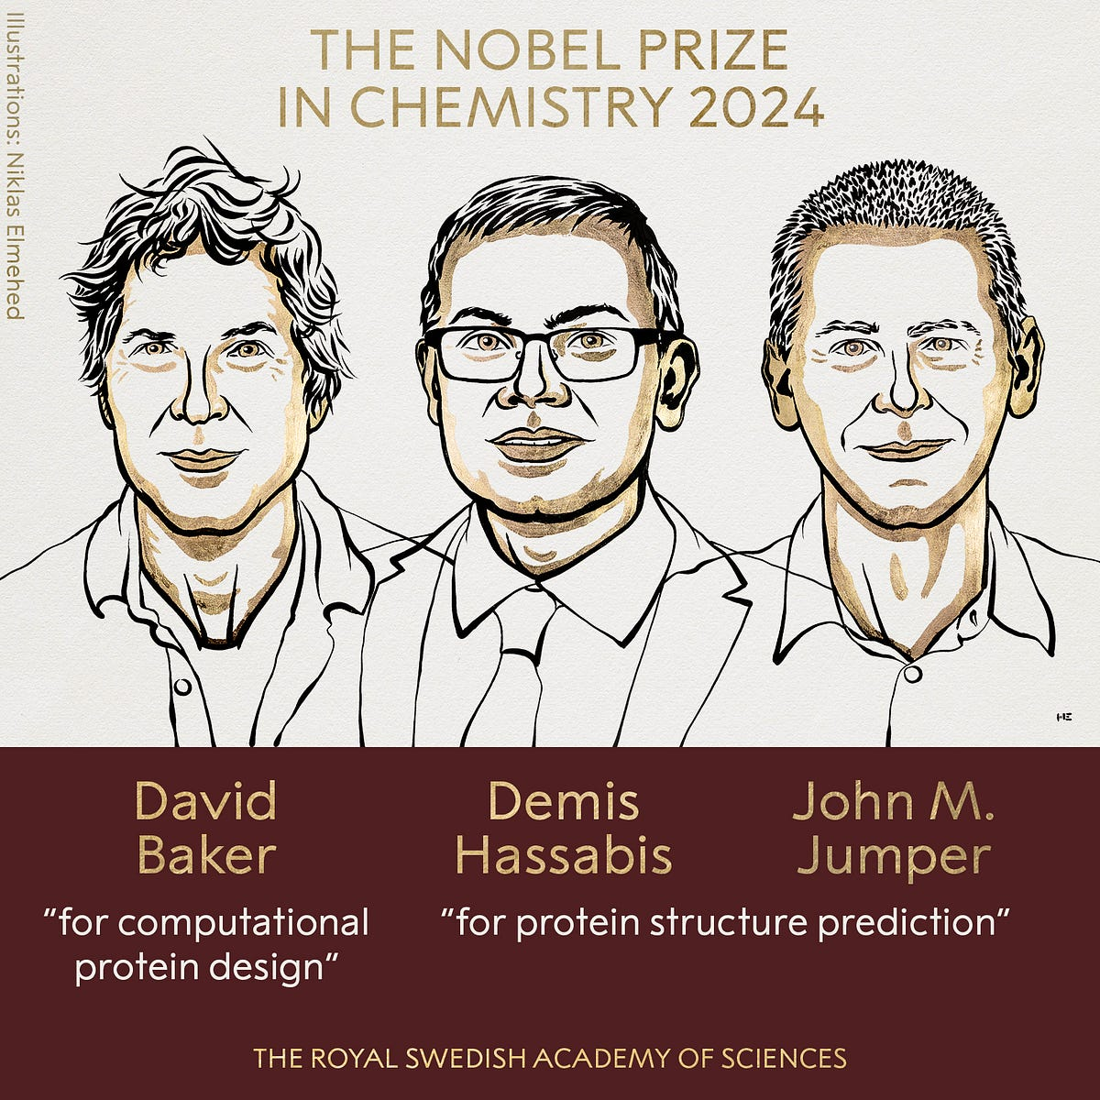
SUMMARY · OUTLOOK
AI in science
Notes:
To summarise: multiscale physics-based modelling predicts properties for new materials and composites from first principles; the bio-nano interface data and advanced descriptors carry real predictive power for biological activity; and physics plus data together open the door to safe-by-design.

Slide 32
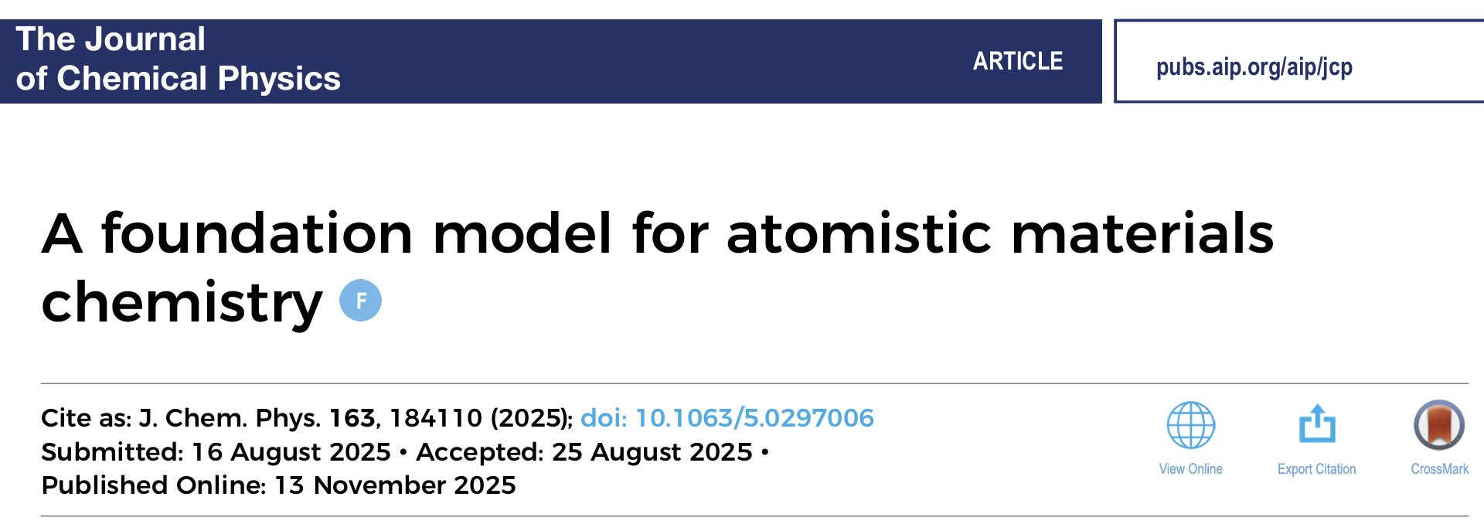
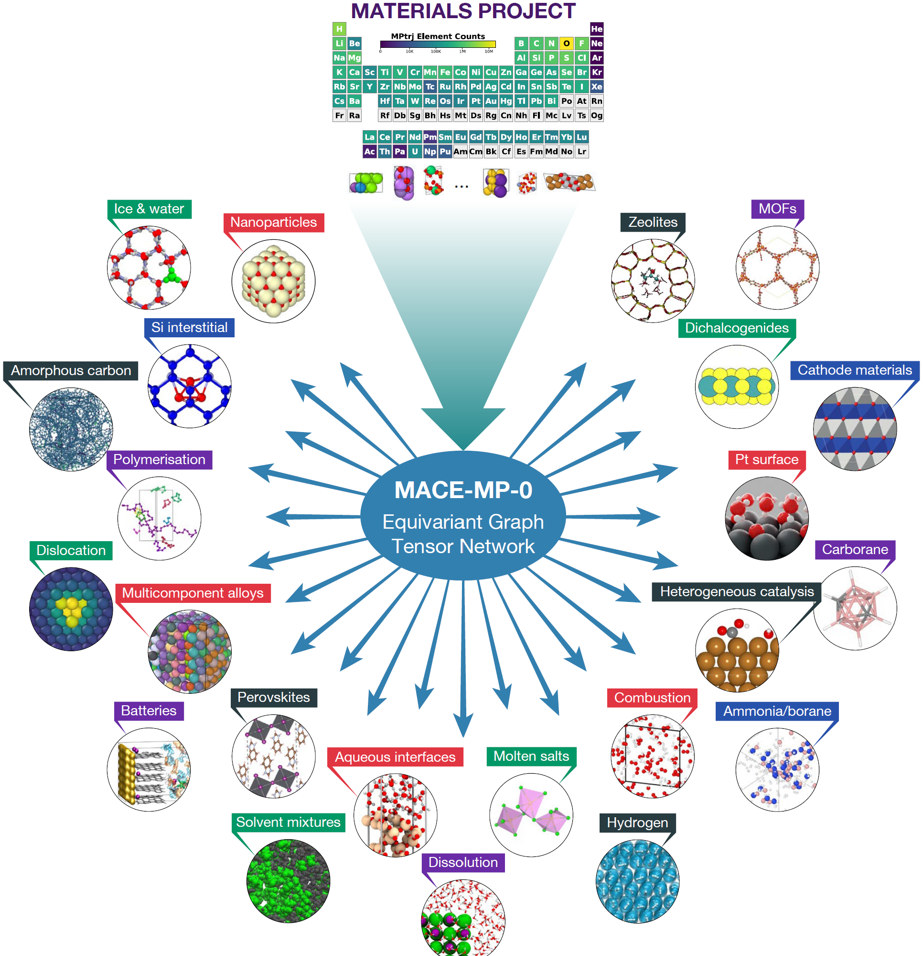
SUMMARY · OUTLOOK
Patterns are predictive
A general-purpose ML force field from first principles
Trained on data beyond single atoms
1
Data from 200,000+ structures and properties from
The Materials Project
2
Properties of solids, liquids, gases, interfaces predicted
3
Notes:
To summarise: multiscale physics-based modelling predicts properties for new materials and composites from first principles; the bio-nano interface data and advanced descriptors carry real predictive power for biological activity; and physics plus data together open the door to safe-by-design.

Slide 33





THANK YOU
Acknowledgements
Horizon 2020 / Europe RIA / INFRAIA · SFI · MSCA-RISE
SmartNanoTox · NanoCommons · NanoSolveIT · CompSafeNano · Bio-Interface · nanoPASS
Julia Subbotina · Ian Rouse · David Power · Anais Colibaba · Stefano Poggio · Konstantinos Kotsis · Shada Alsharif · Parinaz Mosaddeghi Amini · Oran McElligott · Brian Maloney
UCD SOFT MATTER MODELLING LAB
FUNDING
Vladimir Lobaskin · University College Dublin · vladimir.lobaskin@ucd.ie
Notes:
With thanks to the UCD Soft Matter Modelling Lab and our collaborators, and to the EU Horizon and SFI programmes that funded this work. Happy to take questions.

