Slide 1


End-to-End Performance Analysis of an Analog Radio-over-Fibre System for 5G Small Cell Fronthaul
Lilian Mutia, James Jena, David Waswa
Centre for Broadband Communication, Nelson Mandela University
6th – 10th July, 2026

Slide 2

Presentation Outline
Motivation & Background
System Architecture
Channel Impairment Model
Results & Discussion
Conclusions & Future Work

Slide 3
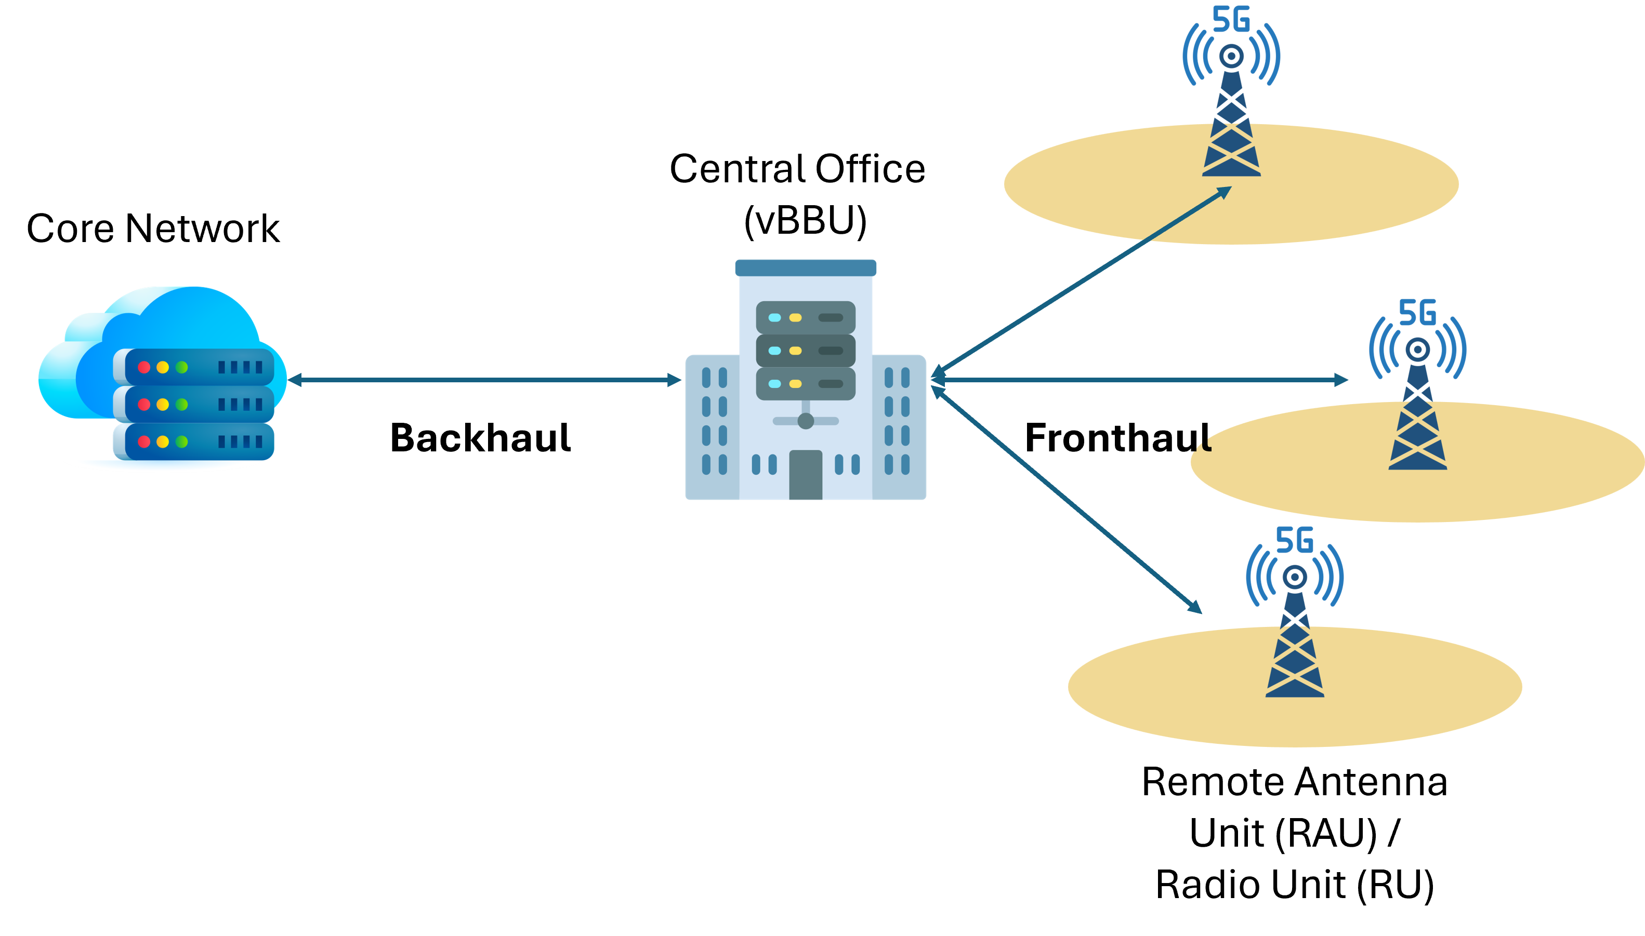

Motivation & Background
5G mobile network architecture
Fronthaul Transport Media Types
Fibre
(P2P, WDM, PON, WDM-PON)
Wireless
(mmWaves, microwaves, FSO, sub-THz frequencies)
Copper
(coax, twisted-pair copper)
Technical requirements:
High capacity and bandwidth
Low latency
Fig. 1: An overview of a 5G mobile network architecture.

Slide 4
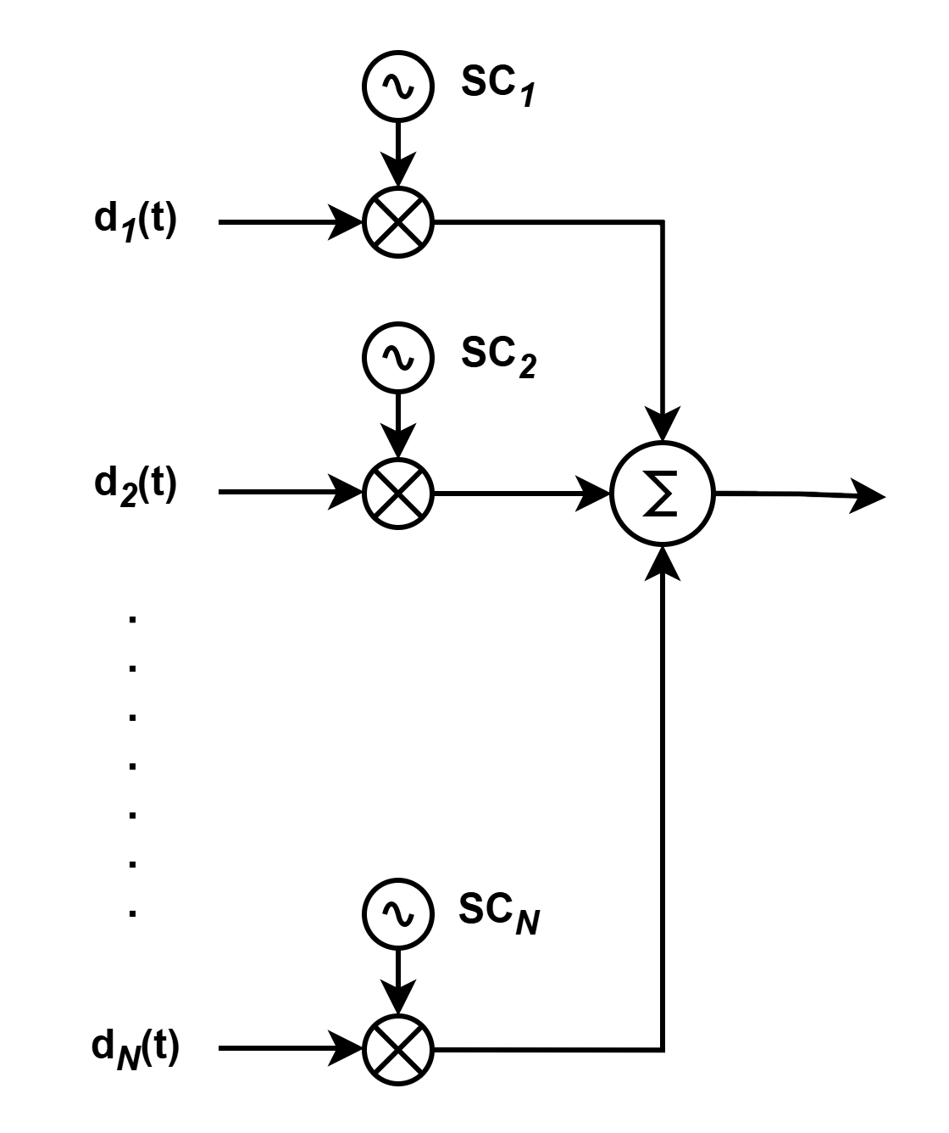
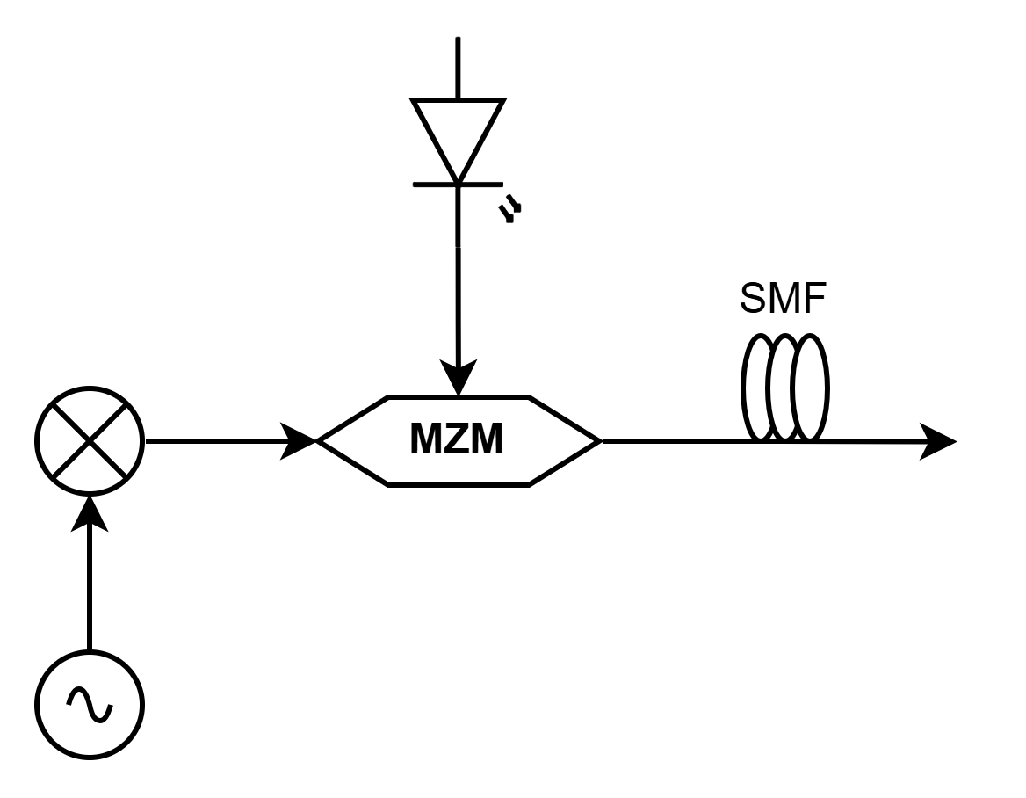
Subcarrier Multiplexed Intermediate Frequency-over-Fibre (SCM-IFoF)
Analog Fronthaul
Central office handles all baseband processing and generates the RF / IF waveform.
Low RAU complexity.
High spectral efficiency.
SCM-IFoF
SCM
IFoF
Laser
  SCM-IFoF
Balances cost and capacity
Ideal for dense small cells: supports multiple users/services on a single wavelength
Seamless hybrid transport
Scalable
Phase noise
Combiner
Mixer
Signal Generator
Fig. 2: SCM-IFoF architecture

Slide 5
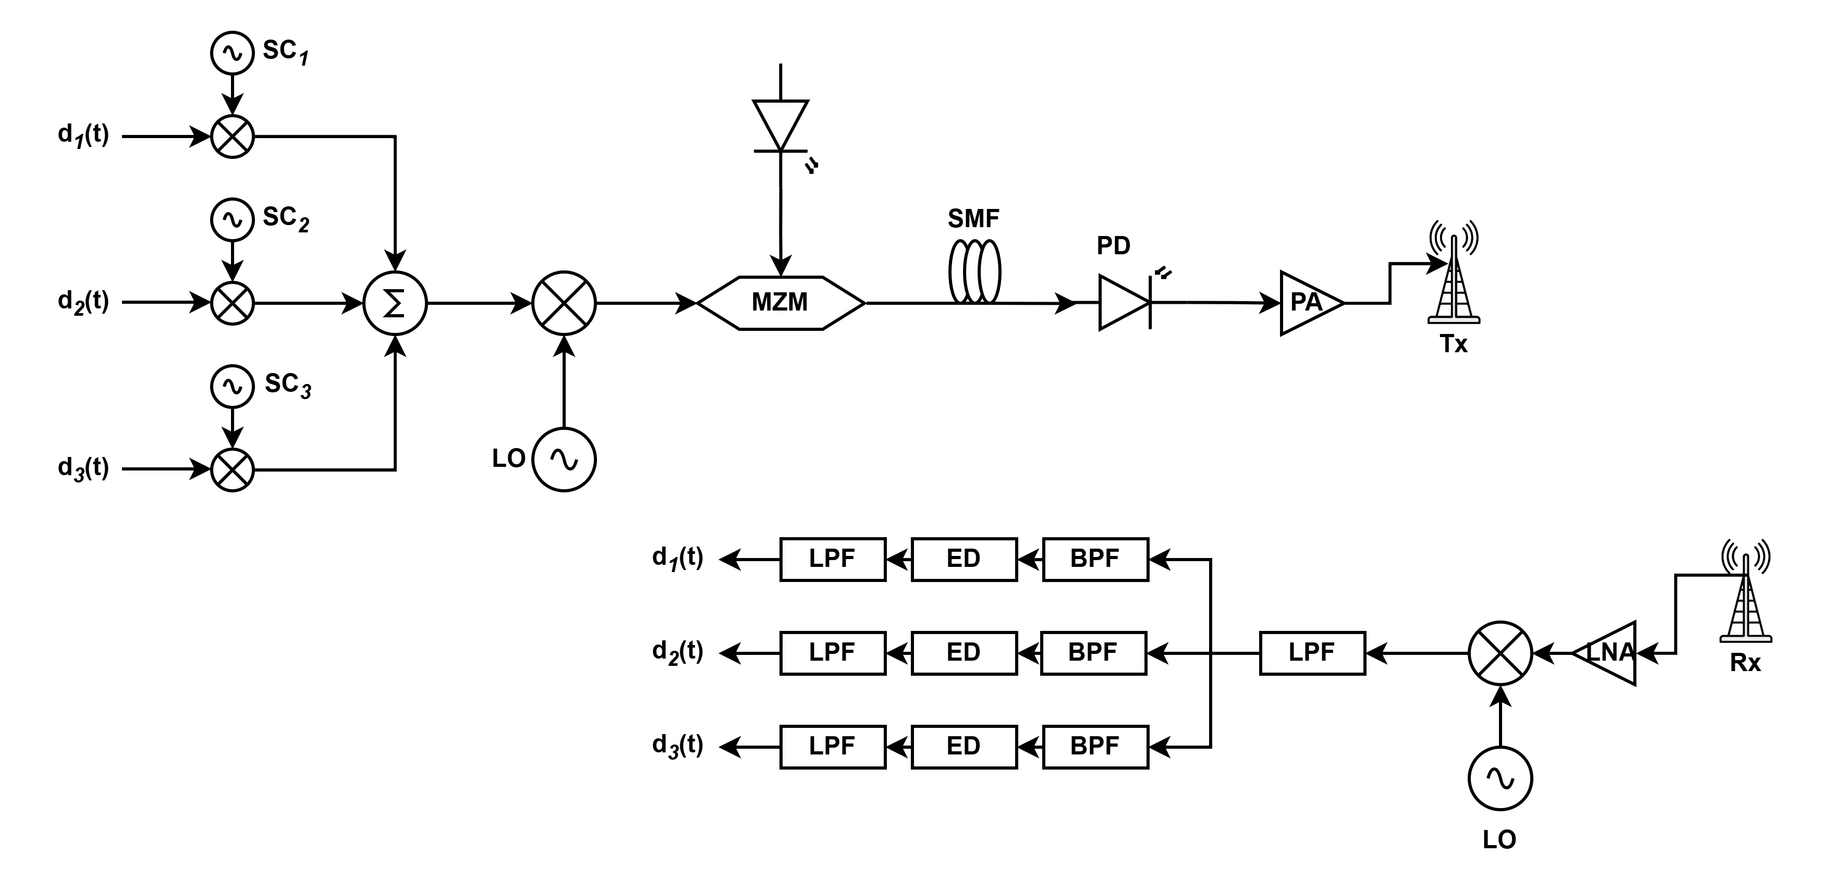
System Architecture
Central Office (CO)
RAU
User Equipment (UE)
Fig. 3: End-to-end schematic of the analog SCM-IFoF architecture across the CO, RAU, and UE.
LO: local oscillator, MZM: Mach-Zehnder modulator, SMF: Single mode fibre, PD: photodetector, PA: power amplifier, LNA: low noise amplifier, LPF: low pass filter, ED: envelope detection

Slide 6
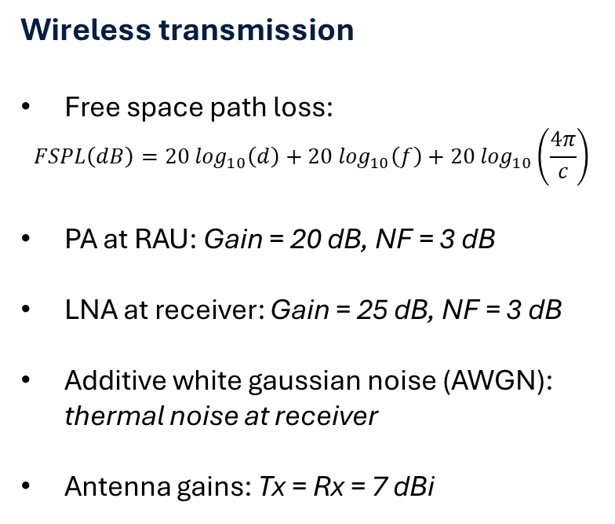
Channel Impairment Model
Optical fibre transmission
Attenuation: 0.2 dB/km
Chromatic dispersion: D = 17 ps/nm·km
Laser phase noise: 100 kHz linewidth (Wiener process model)
MZM: quadrature bias point
Photodetector noise: shot noise, thermal noise
Wireless transmission
Free space path loss:
$$FSPL\left(dB\right)=20 \log_{10}\left(d\right)+20\log_{10}\left(f\right)+20 \log_{10}\left(\frac{4π}{c}\right)$$
PA at RAU: Gain = 20 dB, NF = 3 dB
LNA at receiver: Gain = 25 dB, NF = 3 dB
Additive white gaussian noise (AWGN): thermal noise at receiver
Antenna gains: Tx = Rx = 7 dBi

Slide 7
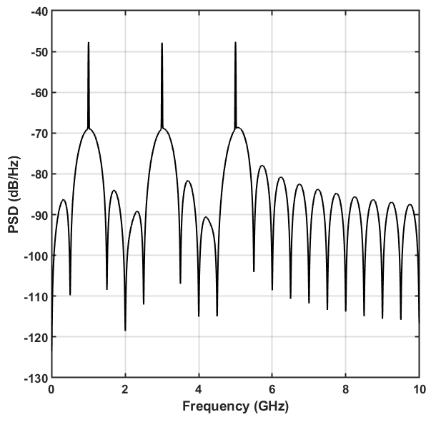
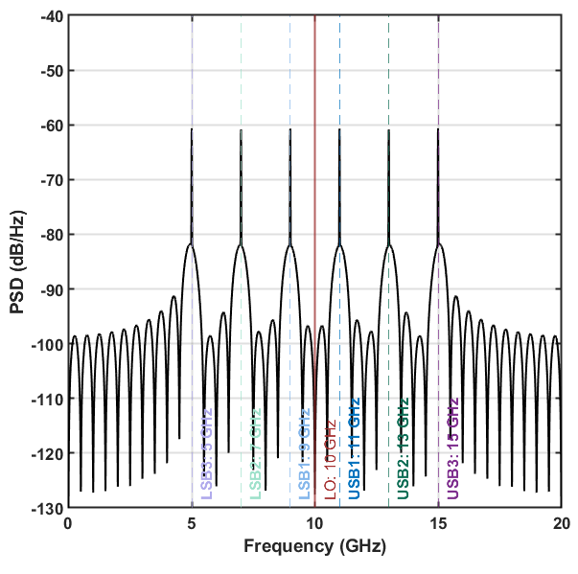
Results & Discussion
(a)
(b)
13 dB
Fig. 4: PSD of the signal (a) before and (b) after up-conversion.

Slide 8
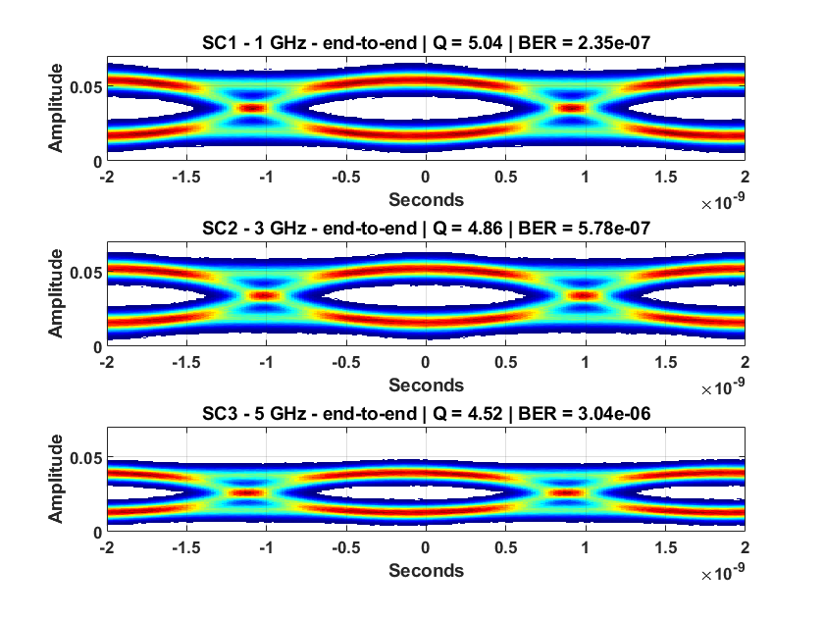
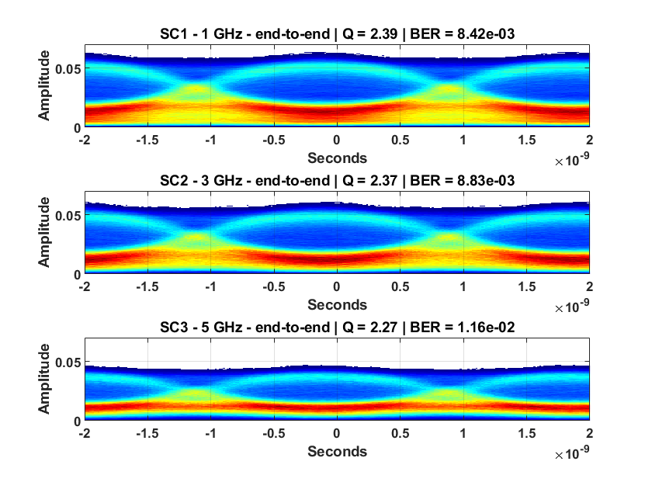
(a) Ideal LO
(b) Independent LO
Fig. 5: Eye diagrams of the received signals when ideal and independent LOs are used, respectively.

Slide 9
Fig. 6: PSD of the received SCM signals when ideal and independent LOs are used
Fig. 7: BER vs LNA gain curves when ideal and independent LOs are used.

Slide 10
Conclusions & Future Work
Conclusions
Validated that the analog SCM-IFoF architecture is physically highly viable under ideal phase synchronization.
Un-synchronized, standalone LOs breaks phase correlation, creating a severe performance barrier driven by uncompensated phase noise.
Standard architectures require massive, power-hungry DSP at the receiver, and PLLs to counteract this specific floor, defeating the low-cost purpose of an analog small cell.
Subcarrier 3 (5 GHz / 15 GHz) exhibits the worst overall performance due to CD-induced power fading, and IMD3 products.
Future work
Model a self-homodyne architecture to see how much of this specific phase noise can be physically cancelled out without excessive DSP.
A non-uniform subcarrier grid to isolate IMD3 beats into empty guard bands.
OSSB & M-QAM for spectral efficiency.

Slide 11
References
C. Ranaweera et al., “Optical Transport Network Design for 5G Fixed Wireless Access,” Journal of Lightwave Technology, vol. 37, no. 16, pp. 3893–3901, Aug. 2019, doi: 10.1109/JLT.2019.2921378.
A. Fayad, T. Cinkler, J. Rak, and M. Jha, “Design of Cost-Efficient Optical Fronthaul for 5G/6G Networks: An Optimization Perspective,” Sensors, vol. 22, no. 23, p. 9394, Jan. 2022, doi: 10.3390/s22239394.
S. S. Jaffer, A. Hussain, M. A. Qureshi, J. Mirza, and K. K. Qureshi, “A low cost PON-FSO based fronthaul solution for 5G CRAN architecture,” Optical Fiber Technology, vol. 63, p. 102500, May 2021, doi: 10.1016/j.yofte.2021.102500.
R. I. Rony, E. Lopez-Aguilera, and E. Garcia-Villegas, “Cost Analysis of 5G Fronthaul Networks Through Functional Splits at the PHY Layer in a Capacity and Cost Limited Scenario,” IEEE Access, vol. 9, pp. 8733–8750, 2021, doi: 10.1109/ACCESS.2021.3049636.
A. Hilt, “Microwave Hop-Length and Availability Targets for the 5G Mobile Backhaul,” in 2019 42nd International Conference on Telecommunications and Signal Processing (TSP), Jul. 2019, pp. 187–190. doi: 10.1109/TSP.2019.8768870.
M. Jiang et al., “Wireless Fronthaul for 5G and Future Radio Access Networks: Challenges and Enabling Technologies,” IEEE Wireless Communications, vol. 29, no. 2, pp. 108–114, Apr. 2022, doi: 10.1109/MWC.003.2100482.
I. A. Alimi, A. L. Teixeira, and P. P. Monteiro, “Toward an Efficient C-RAN Optical Fronthaul for the Future Networks: A Tutorial on Technologies, Requirements, Challenges, and Solutions,” IEEE Communications Surveys & Tutorials, vol. 20, no. 1, pp. 708–769, 2018, doi: 10.1109/COMST.2017.2773462.

Slide 12










Thank You!
… questions?
Change the World

