Slide 1



Centre for Broadband Communication (CBC)
Interferometric Optical Fibre Based Non-destructive Evaluation of Concrete Compressive Strength
Authors: Sandisiwe Bangani, James Jena, Victor C. Agbakoba, David Waswa and Stephen Ekolu
Notes:
In this talk, I will present the design, implementation, and validation of a Mach-Zehnder Interferometer sensor system that estimates compressive strength of a concrete material in real time based on embedded fibre sensor.

Slide 2
Centre for Broadband Communication (CBC)
PRESENTATION OUTLINE

Slide 3
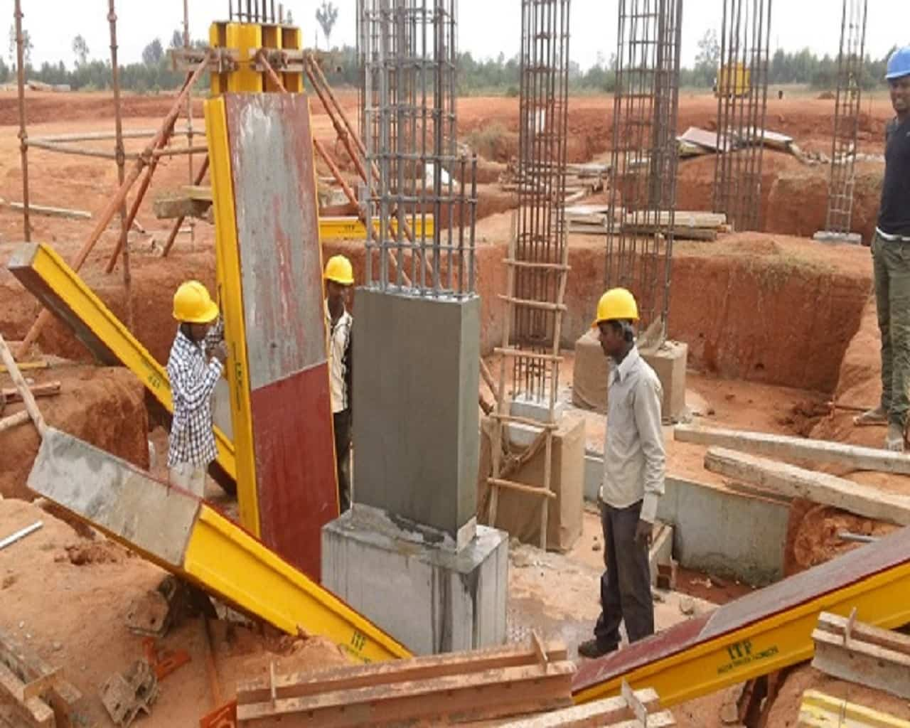
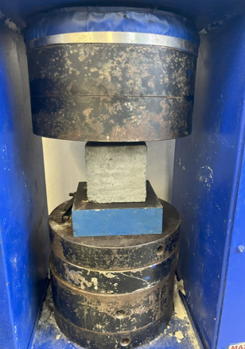
Introduction & Background
Centre for Broadband Communication (CBC)
Concrete strength development governs formwork removal, prestress transfer, and construction scheduling
Conventional strength assessment relies on destructive
compression tests on cubes or cylinders,
  discrete, labour-intensive, and do not reflect in-situ conditions
Purpose:
  There is a need for continuous, in-situ, and automated monitoring of
  strength gain to enhance safety, optimize construction timelines,
  and support structural health monitoring
Notes:
Monitoring the development of compressive strength in concrete during curing is a vital aspect in assessing structural integrity and quality control of concrete.

Slide 4
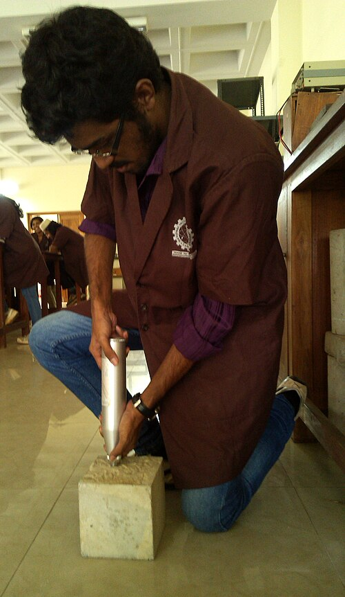
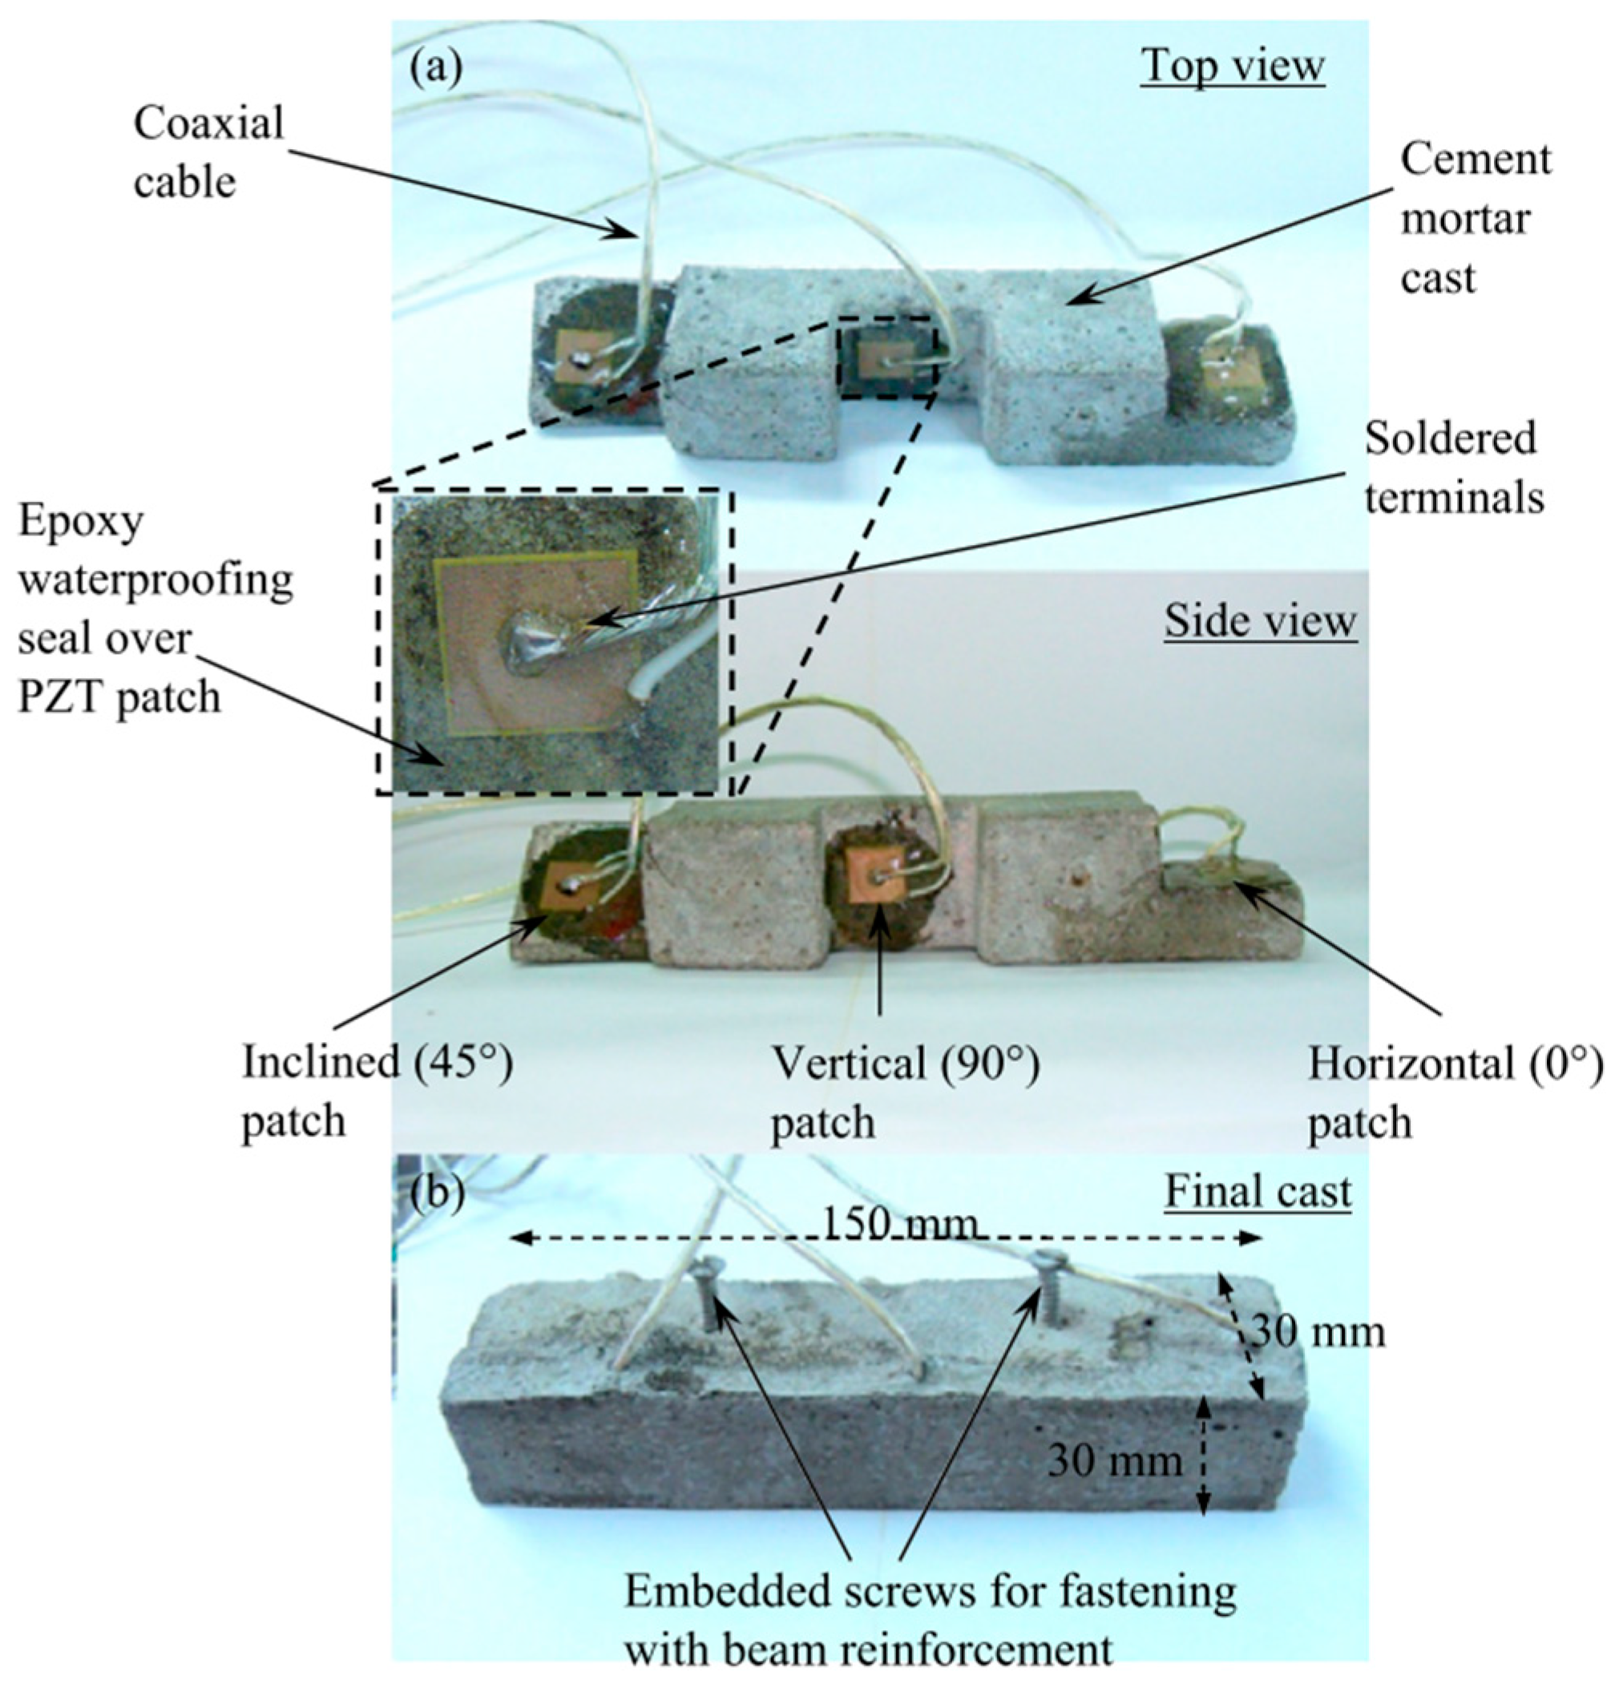
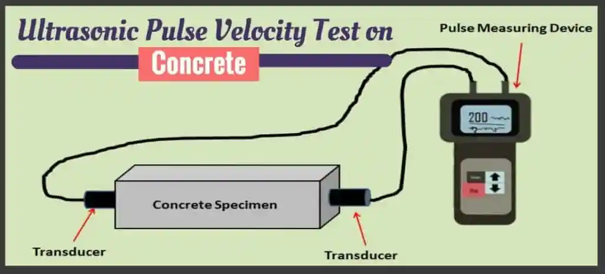
Limitations of Existing NDT Techniques
Centre for Broadband Communication (CBC)
Embedded electrochemical or electrical sensors can suffer from corrosion, and electromagnetic interference, limiting long-term reliability, less sensitive to small changes
Surface-based NDT (ultrasonics pulse velocity, rebound hammer) provides snapshot data and is sensitive to surface conditions
Notes:
Ultrasonic Pulse Velocity (UPV) Test is a non-destructive method used to assess the quality and uniformity of concrete. It works by sending high-frequency sound waves through the concrete and measuring the time it takes for them to travel.

Slide 5
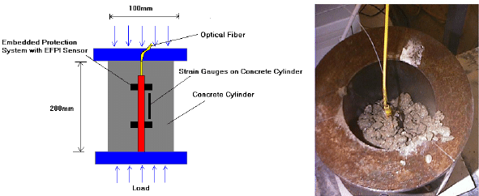
Why Optical Fibre Sensors?
Centre for Broadband Communication (CBC)
Optical fibre sensors are compact, lightweight, immune to electromagnetic interference, and can be multiplexed along a single fibre for quasi-distributed or fully distributed measurements
They can measure strain and temperature with high resolution, enabling continuous monitoring of structural behavior and environmental changes
The small diameter of fibres facilitates embedding within concrete without significantly disturbing structural health
Cross-sensitivity (strain and temperature)
High equipment costs
Fragile

Slide 6
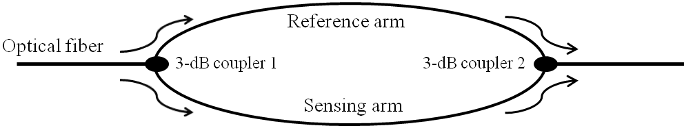

Mach-Zehnder Interferometer Working Principle
Centre for Broadband Communication (CBC)
MZI principle: coherent laser light is split into sensing and reference arms, strain in the sensing arm causes phase shifts, changing the interference signal
Pros
Cons
Sensitive to environmental disturbances
Real-time monitoring
Excellent in vibration monitoring, etc.
Needs a coherent light source for high interference visibility
The reference arm should be isolated completely

Slide 7
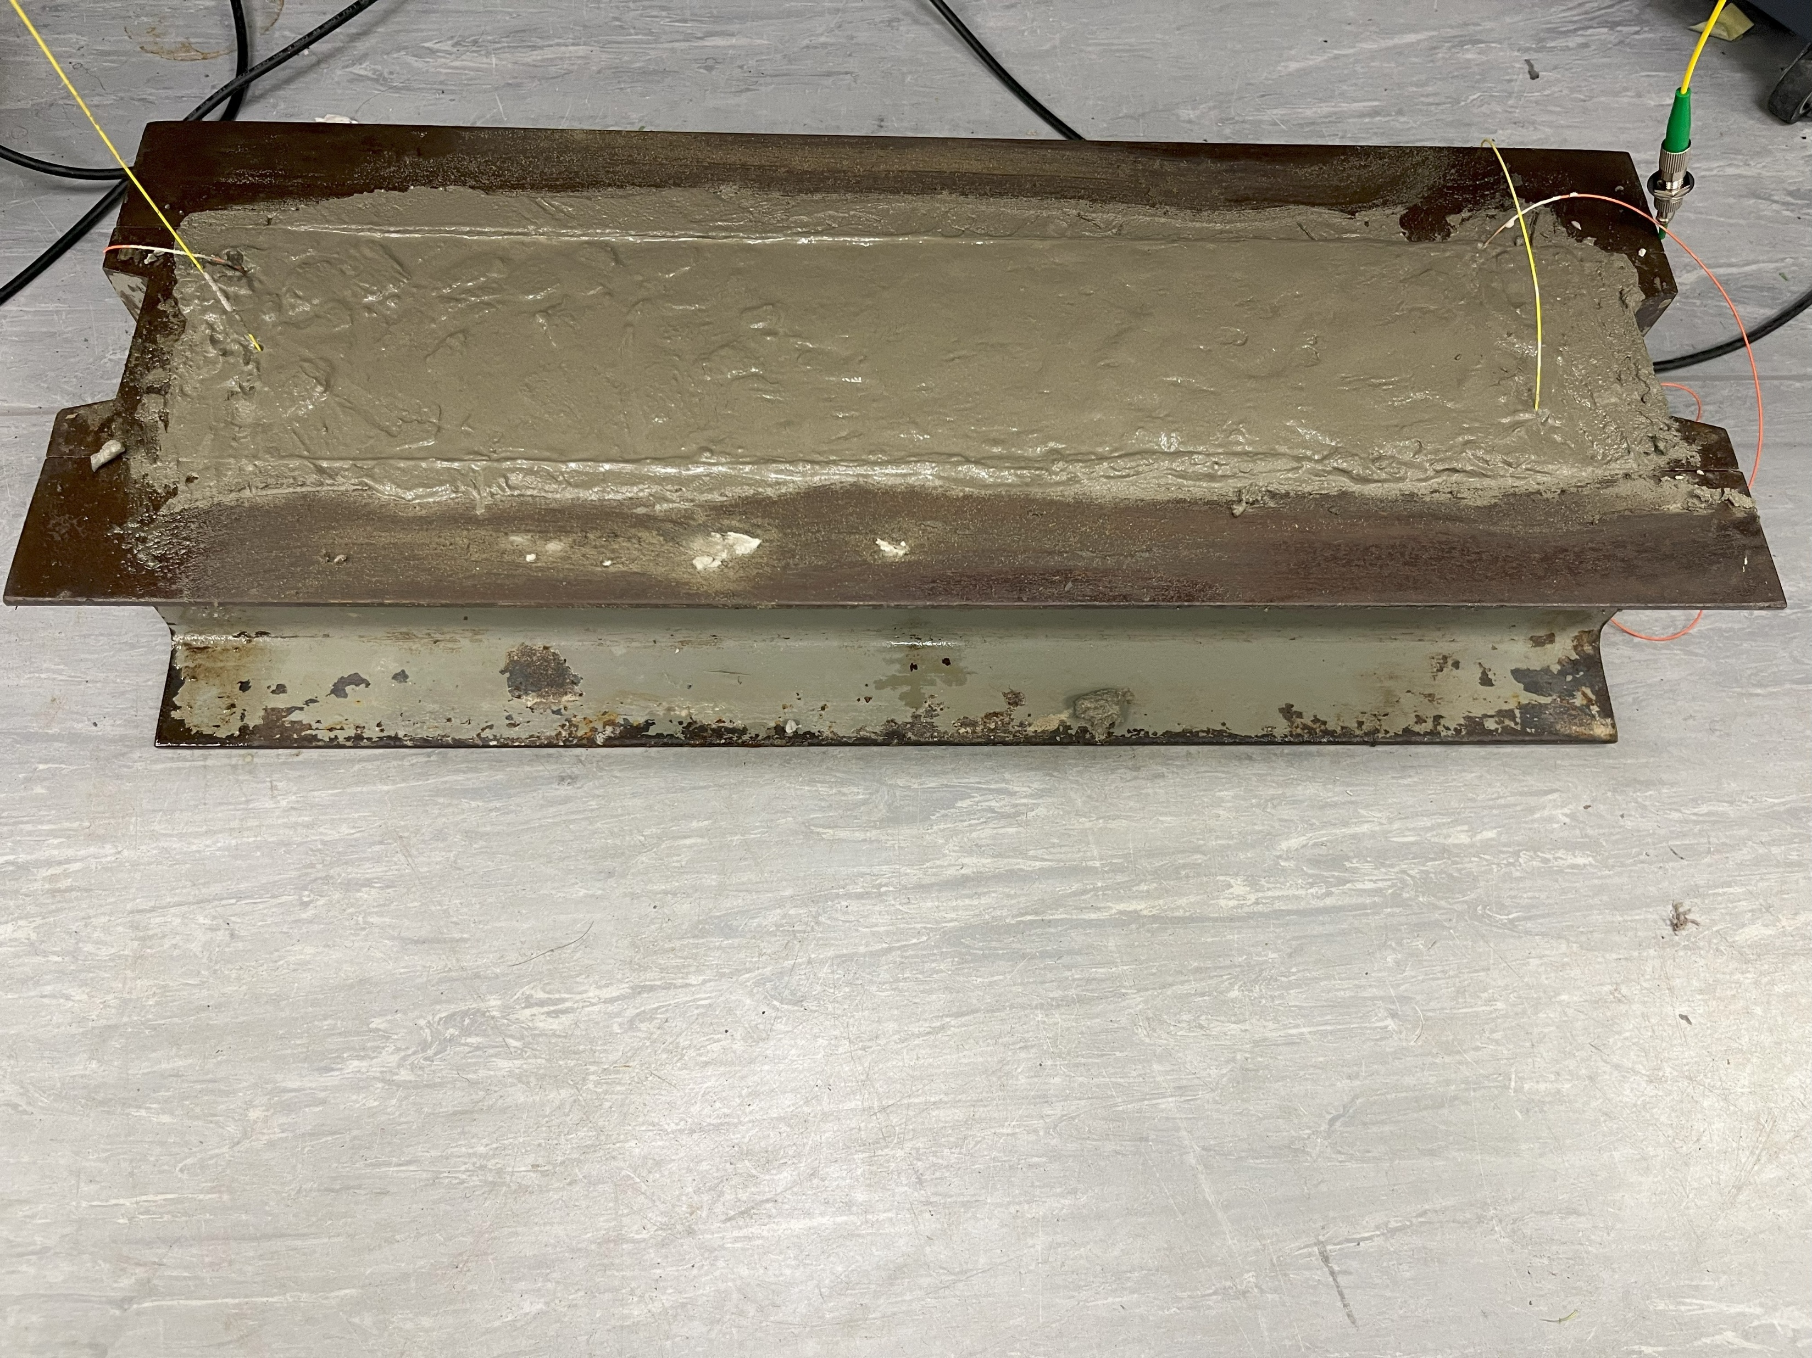
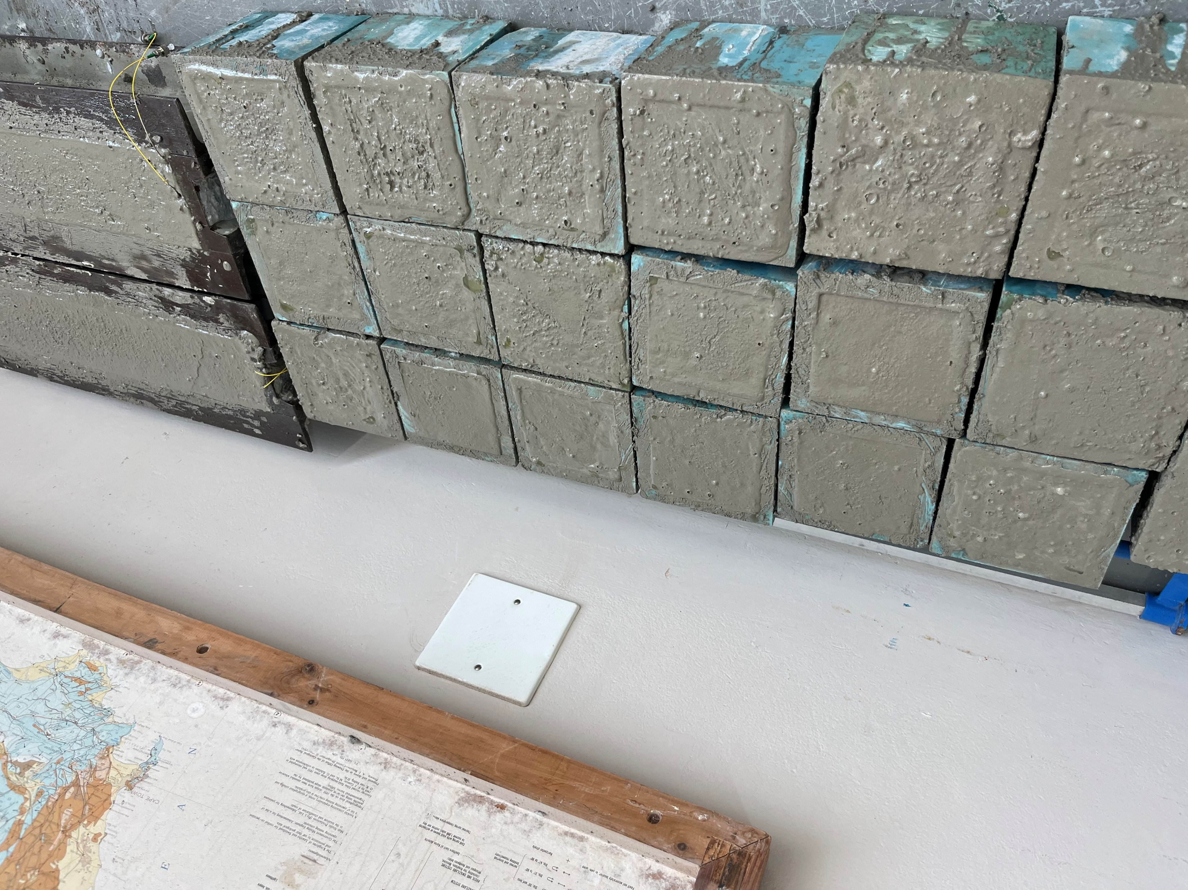
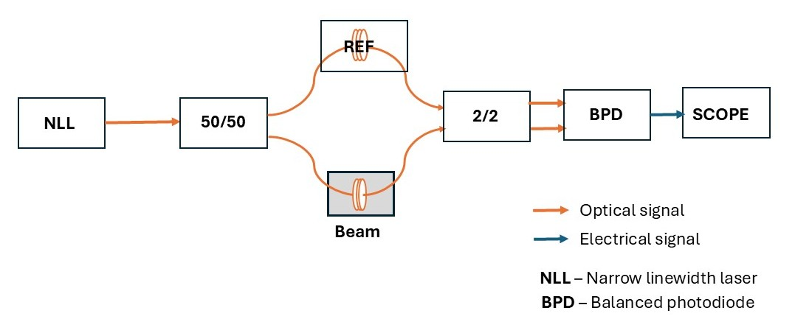

Experimental Setup
Centre for Broadband Communication (CBC)
Material | Low Strength (kg) | High Strength (kg)
Crusher sand | 29.7 | 26.4
Stone (19 mm) | 31.4 | 32.7
Cement | 10.7 | 15.7
Water | 8.10 | 5.90
Superplasticizer (ml) | 0.00 | 150
100 mm
100 mm
500 mm
Freshly cast concrete samples
Destructive
testing method
Experimental setup for the non-destructive testing
Notes:
Slump of:
Low mixture = 173 mm
High mixture = 203 mm
For each mixture, 2 beams of dimensions 10 x 10 x 50 cm and 27 cubes of dimensions 10 x 10 x 10 cm were cast for each mixture
Reference arm was covered on a vibration damped bench.
For the destructive testing: Cubes were placed on the destructive testing machine, and load was applied at a rate of 180 kN/min until failure.
The failure load was recorded and an average of 3 cubes was calculated.

Slide 8

Mathematical Modelling
Centre for Broadband Communication (CBC)
Notes:
ASTM –American Society for Testing and Materials
ACI - American Concrete Institute
Where a and b are constants which are dependent on the curing condition, and the type of cement used.

Slide 9
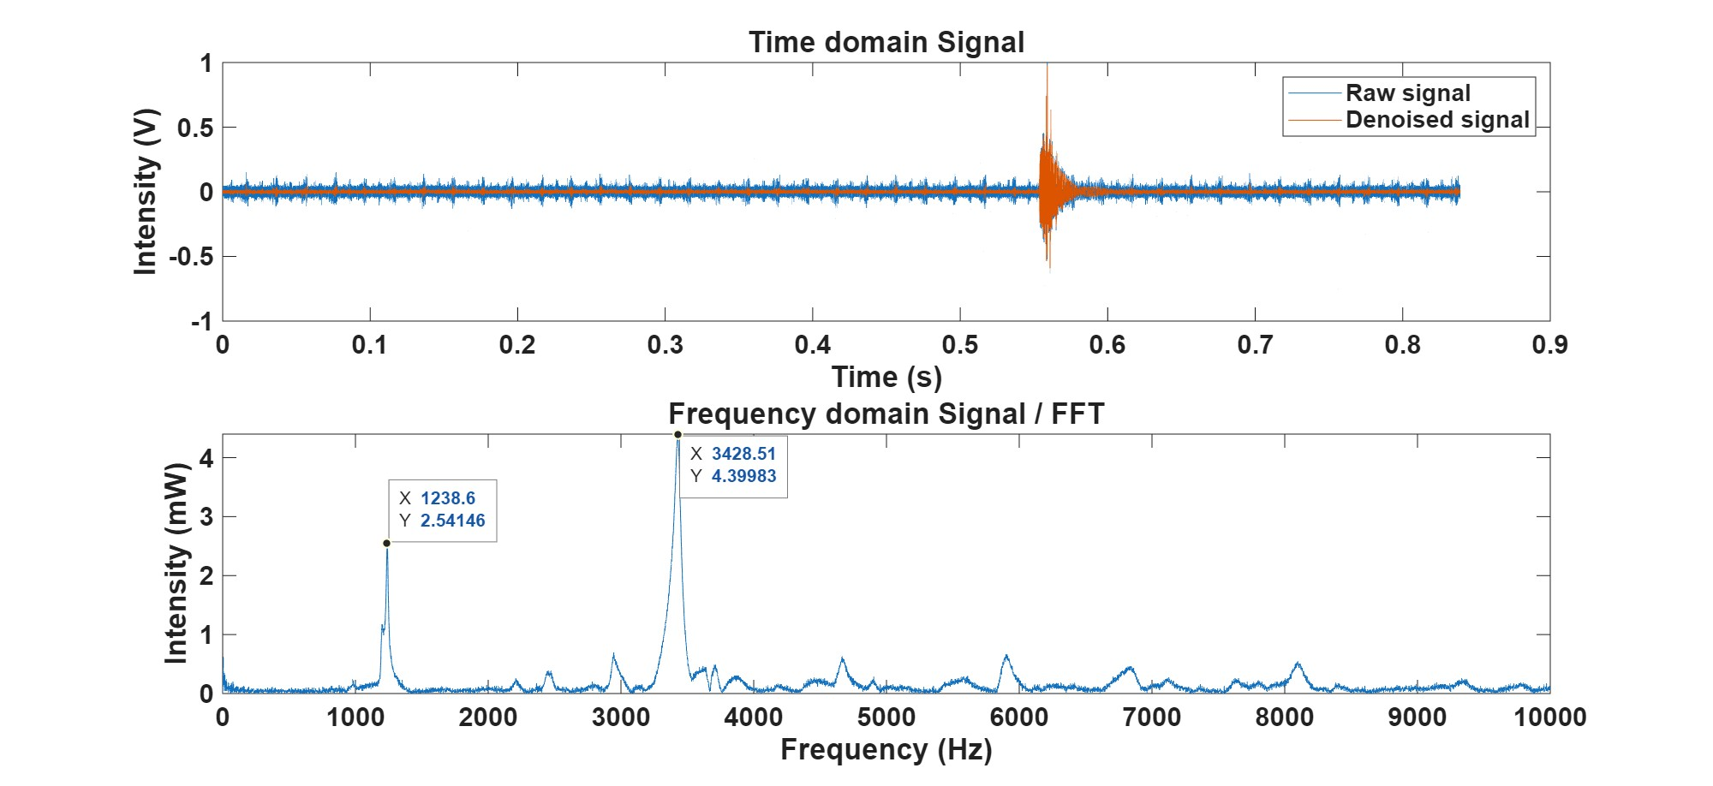
Raw Interference Signal and FFT
Centre for Broadband Communication (CBC)
Transverse Resonance Frequency
Longitudinal Resonance Frequency
Notes:
We chose to monitor the longitudinal resonance frequency due to its high intensity.

Slide 10
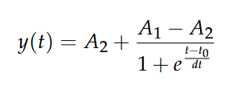
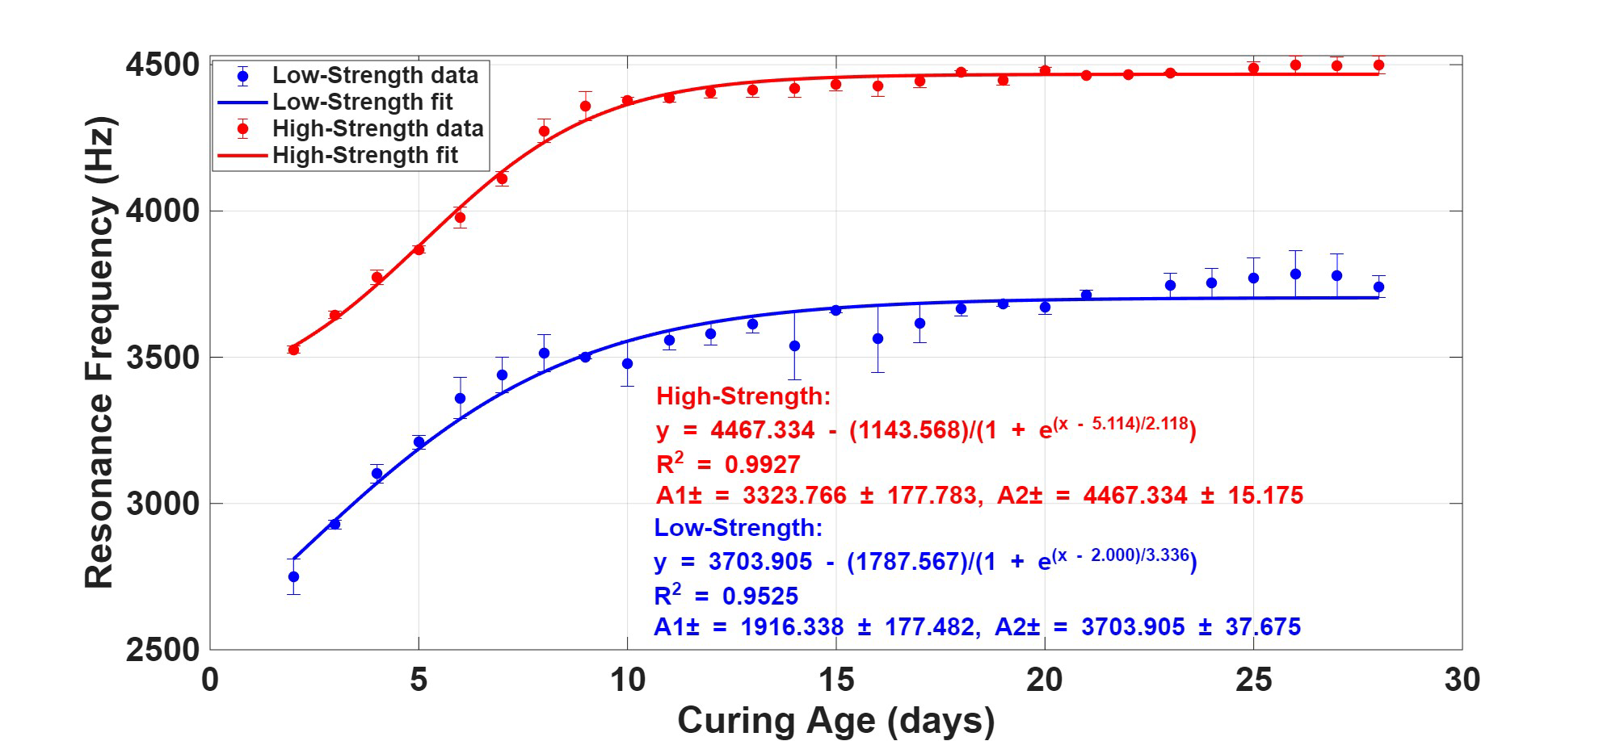
Resonance Frequency Shift
Centre for Broadband Communication (CBC)
Notes:
A1 = initial resonance frequency, i.e., at t = 0 days
A2 = asymptotic resonance frequency
t0 = inflection point, i.e., time at which the rate of increase is at maximum
dt = constant related to steepness

Slide 11
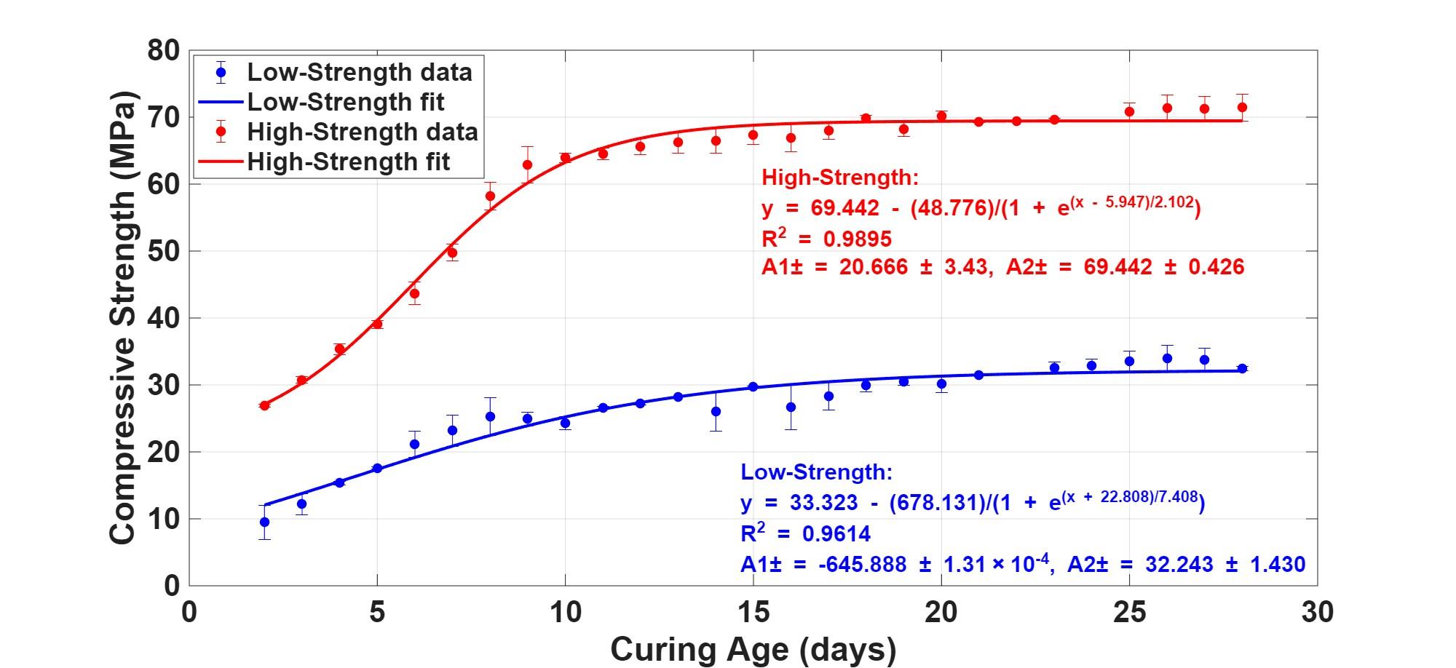
Compressive Strength Shift
Centre for Broadband Communication (CBC)

Slide 12

MZI vs Cube Estimated Strength
Centre for Broadband Communication (CBC)

Slide 13
Comparison: MZI & Cube Strength
Centre for Broadband Communication (CBC)
High strength
Low strength
H. J. Jo, D. Y. Park, K. W. Kim, and T.-J. Ahn, “Real-time monitoring of concrete curing using fiber Bragg grating sensors: Strain and temperature measurement,” Sensors Actuators A: Phys. 362, 114650 (2023).
Notes:
Possible reasons for the overestimation of compressive strength:
Hydration in the early ages of concrete curing generates a quick temperature increase; optical fibre sensors are extremely sensitive to temperature changes
Another factor that may result in less cube strength is poor compaction at the edges during the casting of the cube samples
Sensitivity:
And this is likely attributable to its inherent sensitivity to internal hydration, which may progress more rapidly than the surface-dominated maturation of the cube.

Slide 14

Conclusion
Centre for Broadband Communication (CBC)
MZI system for non-destructive evaluation of compressive strength was designed, implemented, and validated
Experimental validation shows that the proposed approach achieves accuracy suitable for practical decision-making and can be embedded within broader structural health monitoring frameworks
The technology offers a promising pathway toward smarter, safer, and more efficient concrete infrastructure, while highlighting the need for standardized deployment and calibration practices

Slide 15

Future Work
Centre for Broadband Communication (CBC)
Extend the model to account explicitly for damage, cracking, and long-term shrinkage, not only early-age strength development
Explore integration with distributed optical fibre sensing to capture the spatial variability of strength and damage across larger structural elements
Develop standardized protocols and open-source tools for calibration, data processing, and fusion with other SHM modalities (e.g., acoustic, vibration)

Slide 16










Thank You!
… questions?
Change the World

