Slide 1
Quantitative Phase Imaging via
Single-Shot Optical Quadrature Microscopy
Calvin Groenewald, MSc Student
Supervisor: Prof. Pieter Neethling
Co-supervisor: Dr. Gurthwin Bosman
Notes:
Good morning/afternoon, my name is Calvin Groenewald and I am a masters student at University of Stellenbosch currently doing my research project under the supervision of Professor Neethling. Today I will be presenting the work I’ve done this year on building a single-shot quantitative phase imaging system using Optical Quadrature Microscopy.

Slide 2
Motivation & Background
Notes:
Let me start with a little bit of background and explain why we are doing this research. Why we need Quantitative Phase Imaging in the first place.

Slide 3
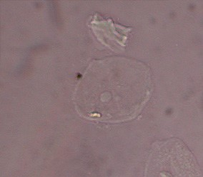
Imaging Transparent Objects
Standard microscopy techniques are unable to resolve detail in transparent objects as they rely on measuring light intensity
Transparent objects alter the phase of light passing through making them near-invisible in standard bright-field microscopy
We refer to these types of samples as phase objects:
  Live cells
  Microorganisms
  Liquid droplets
  Microfluidic interfaces
Image Source: Dr Graham Beards - Own work, CC BY-SA 4.0, https://commons.wikimedia.org/w/index.php?curid=122474860
Notes:
As many of you, especially the ones who work in imaging would know, transparent samples are notoriously difficult to visualize. They don’t absorb or scatter much light. In other words, they produce little to no intensity contrast in standard bright field microscopy. Instead, they shift the phase of the light. We refer to them as phase objects, examples include cells, microorganisms. Droplets and microfluidic interfaces.

Slide 4
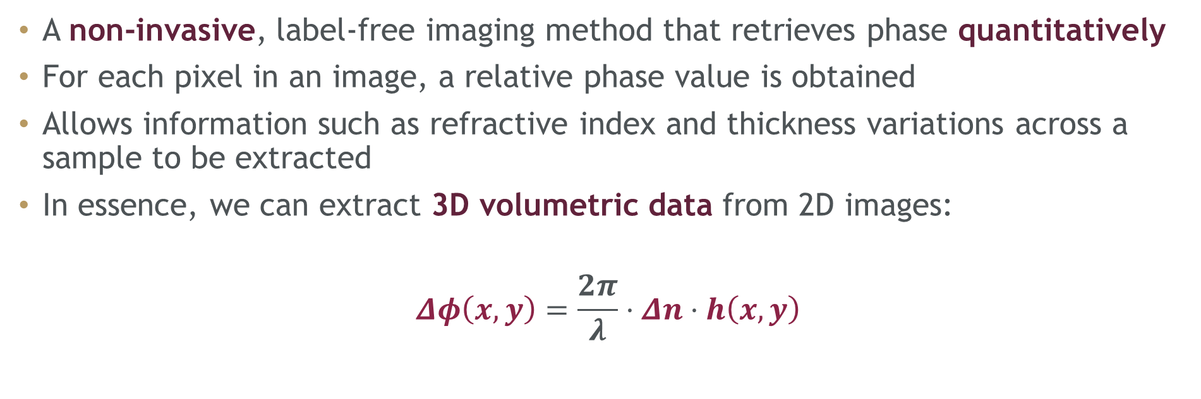

What is Quantitative Phase Imaging (QPI)?
A non-invasive, label-free imaging method that retrieves phase quantitatively
For each pixel in an image, a relative phase value is obtained
Allows information such as refractive index and thickness variations across a sample to be extracted
In essence, we can extract 3D volumetric data from 2D images:
$$Δφ\left(x,y\right)=\frac{2π}{λ}⋅Δn⋅h\left(x,y\right)$$
$$Δ\text{OPD}$$
Notes:
This is where Quantitative Phase Imaging comes in, offering a non-invasive, label free method of extracting a quantitative phase from phase objects.
For each pixel in an image we extract an actual phase value
Can calculate some parameters like refractive index differences and thickness variations across a sample
Essentially, we are extracting 3D volumetric data from 2D images
This relationship between height and phase is captured here in this equation.

Slide 5
Phase Shifting Interferometry and
Optical Quadrature Microscopy
Notes:
With the background and motivation established, let’s look into the specific QPI method in question for my research project.
And before I introduce you to the specific technique we use, I first need to discuss the overarching class of QPI techniques, PSI.

Slide 6
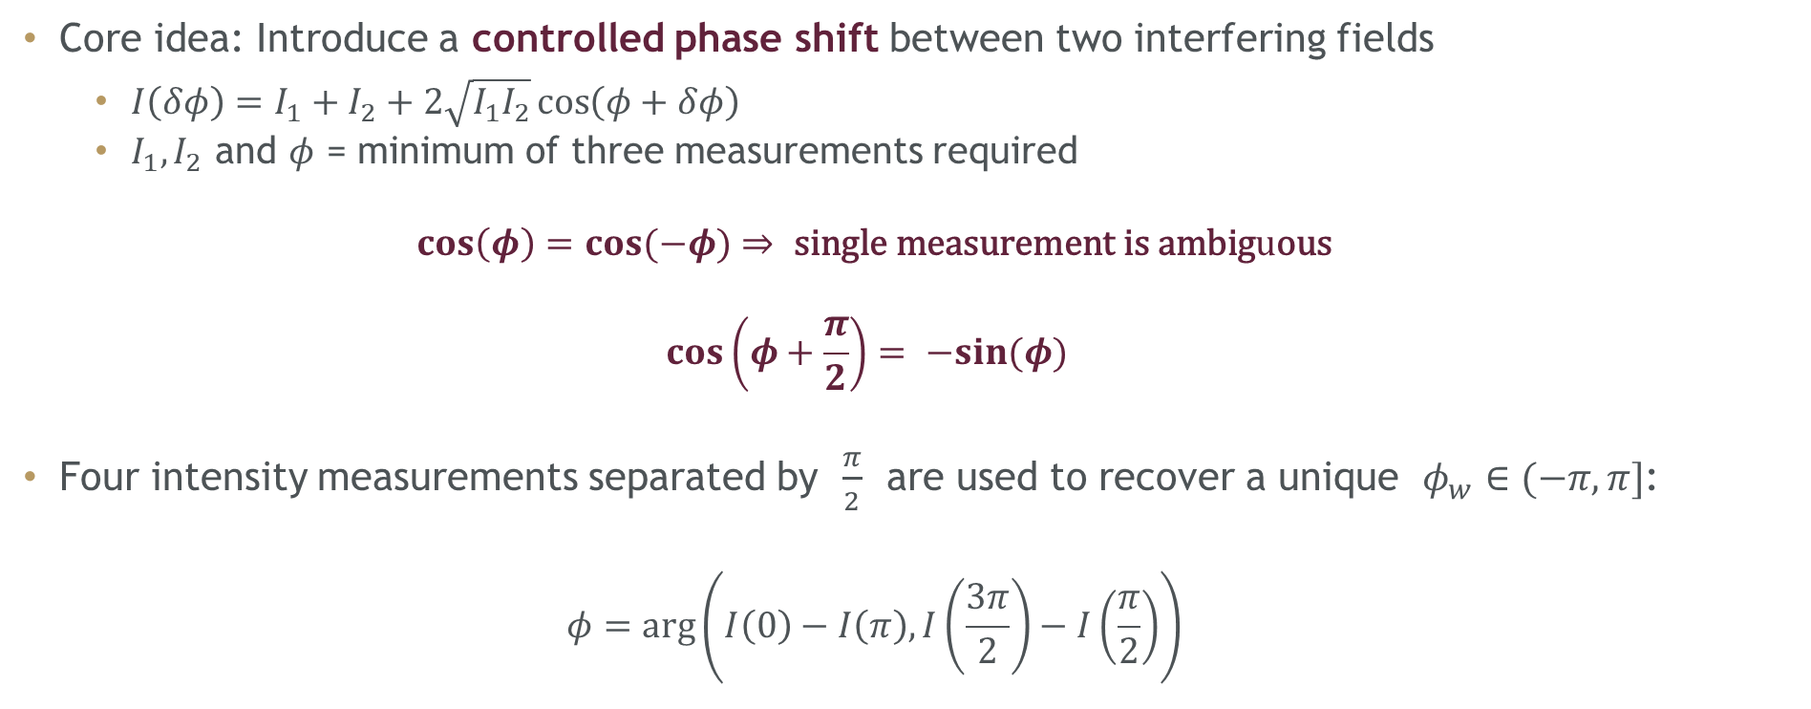
Phase Shifting Interferometry (PSI)
Core idea: Introduce a controlled phase shift between two interfering fields
  $I\left(δφ\right)=I_{1}+I_{2}+2\sqrt{I_{1}I_{2}}\cos\left(φ+δφ\right)$
  $I_{1}, I_{2}$ and $φ$ = minimum of three measurements required
  $$\cos\left(φ\right)=\cos{(−φ)}⇒ \text{single} \text{measurement} \text{is} \text{ambig}u\text{ous}$$
  $$\cos\left(φ+\frac{π}{2}\right)= −sin{(φ)}$$
Four intensity measurements separated by $\frac{π}{2}$ are used to recover a unique $φ_{w}∈(−π, π]$:
  $$φ=\arg\left(I\left(0\right)−I\left(π\right), I\left(\frac{3π}{2}\right)−I\left(\frac{π}{2}\right)\right)$$
Notes:
The core idea behind phase shifting interferometry is introducing an intentional phase shift between two interfering fields and observe how the intensity changes.
We are all familiar with the interference equation for intensity, where you have two fields interfering, the two DC components I1 and I2 and then the modulation or cross term that manifests as the interferogram.
Now in order to recover the phase we need to know what I1 and I2 are of course. But if you do a measurement with just the cosine function, because it is symmetric we have an ambiguity. We can’t tell a positive and negative phase apart, they’ll produce the same intensity. So to get around this, we use the fact that cos plus pi/2 is equal to minus sin, and we take four intensity measurements separated by pi/2 to obtain a unique wrapped phase.

Slide 7
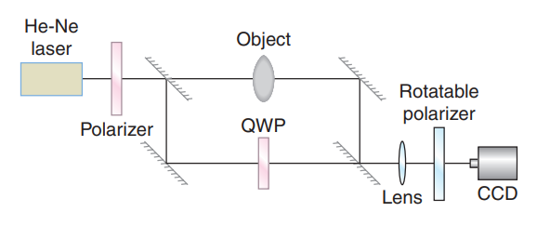


Optical Quadrature Microscopy (OQM)
Interference between circularly polarized reference and linearly polarized sample field
Rotatable analyser projects the interference onto controlled polarization angles
With measurements in quadrature and individual measurements of the sample and reference fields, the phase is uniquely retrieved
$$\sin{\&\cos{ }}$$
$$I_{1}\& I_{2}$$
Image source: G. Popescu, Quantitative Phase Imaging of Cells and Tissues, McGraw-Hill, 2011, p. 174.
Notes:
One way that PSI can be approached is using Optical Quadrature Microscopy.
Instead of using, for example, an optical wedge to physically delay the light on a reference arm, OQM is a clever twist on PSI that uses polarization to carry the phase information.
This is done by interfering a circularly polarized reference field with a linearly polarized sample field, and then projecting this interference onto controlled polarization angles using an analyser placed before the detector.
Taking two measurements in quadrature (sin and cos ANIMATION), and individual measurements of the reference and sample fields (I1 and I2 from before ANIMATION), a unique phase value is obtained.
One of the biggest drawbakcs though is that you require four acquisitions for a single phase retrieval, making it a slow QPI technique. The separate acquisitions means that the phase retrieval is also sensitive to environmental noise or sample movement between captures.

Slide 8




Single-Shot OQM with Polarization Camera
  Our approach uses a polarization (Division of Focal Plane) camera:
    Each 2x2 ‘superpixel’ contains four sub-pixels
    Each sub-pixel contains a micro-polarizer aligned to one of four polarization directions
    This allows simultaneous measurement of the four necessary phase shifts with only a single detector!
  This approach theoretically limits the impact of sample movement as well as environmental vibrations and enables real-time analysis at the framerate of the camera
$$H$$
$$A$$
$$D$$
$$V$$
Notes:
With that in mind, we decided to implement a Division of Focal Plane camera.
The polarization camera allows single shot capture of all four polarization states on a single sensor, due to its clever design which consists of 2x2 super pixels, containing a micropolarizer on each subpixel, orientating the light in the H, V, D and A directions.
This approach theoretically limits the impact of both sample movement and environmental noise, and enables real time phase analysis at the framerate of the camera!

Slide 9
System and Results
Notes:
Now that the theory has been laid out let’s look at the initial system I built and the initial results

Slide 10

Experimental Setup
Notes:
Now that we’ve covered the core concept behind OQM, let me show you the full experimental setup.
We have a laser illumination source that is split by a polarizing beam splitter into the two arms of a modified mach Zehnder interferometer.
Crucially, there is now a QWP on both arms instead of just one, and the two arms are cicrcularly polarized orthogonal to one another. The two fields then recombine at another beam splitter and the four phase shifted interference patterns are recorded simultaneously by the DoFP camera.

Slide 11
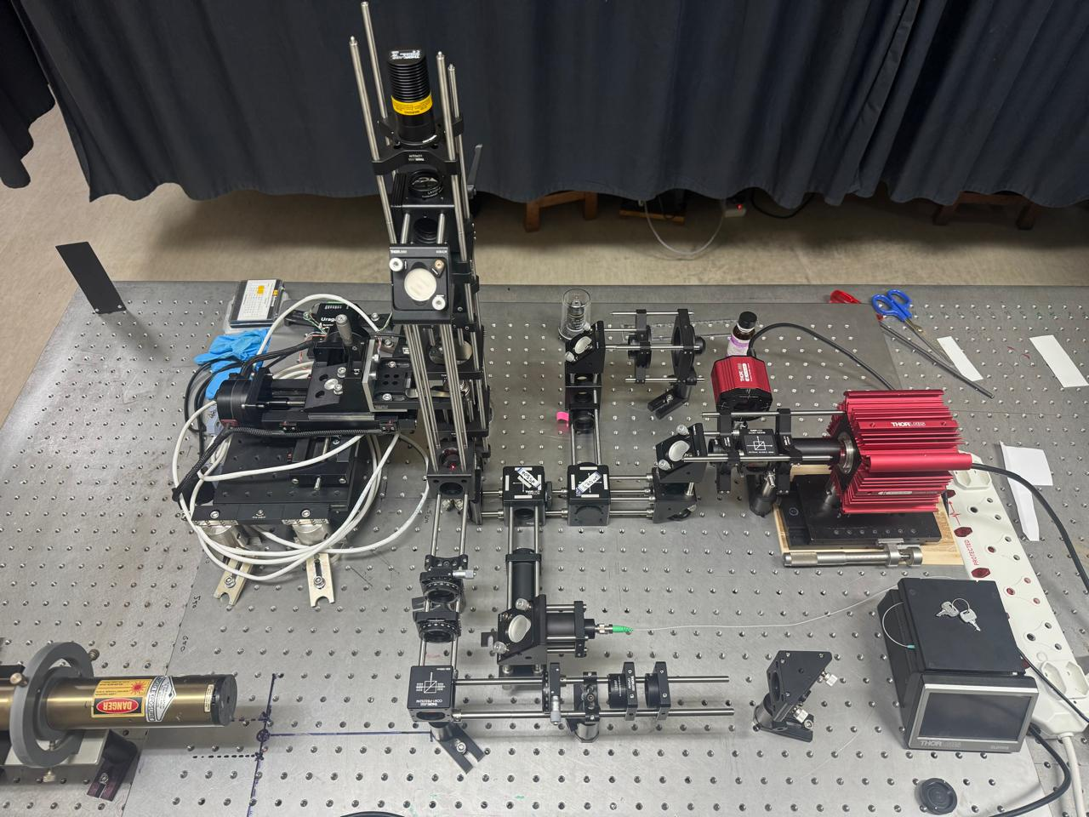
Integrated Platform
Shared Trapping and Sample Arm
Shared Trapping and Sample Arm
632nm
976nm
632nm Laser
Reference Arm
Notes:
One of the goals from the outset was not only to measure phase objects, but eventually to manipulate them while measuring them.
Here the SSOQM system is integrated into an existing optical tweezing platform built by Le Roi du Plessis during his Master’s. He will be presenting this platform in more detail after me.
The underlying Mach-Zehnder structure is still visible, but the important modification is the shared vertical trapping and sample arm. This allows the same region of the sample to be both trapped and imaged.
That is useful practically, because microscopic samples can drift during measurements, but it is also scientifically useful because it opens the possibility of controlled manipulation while recording quantitative phase.

Slide 12
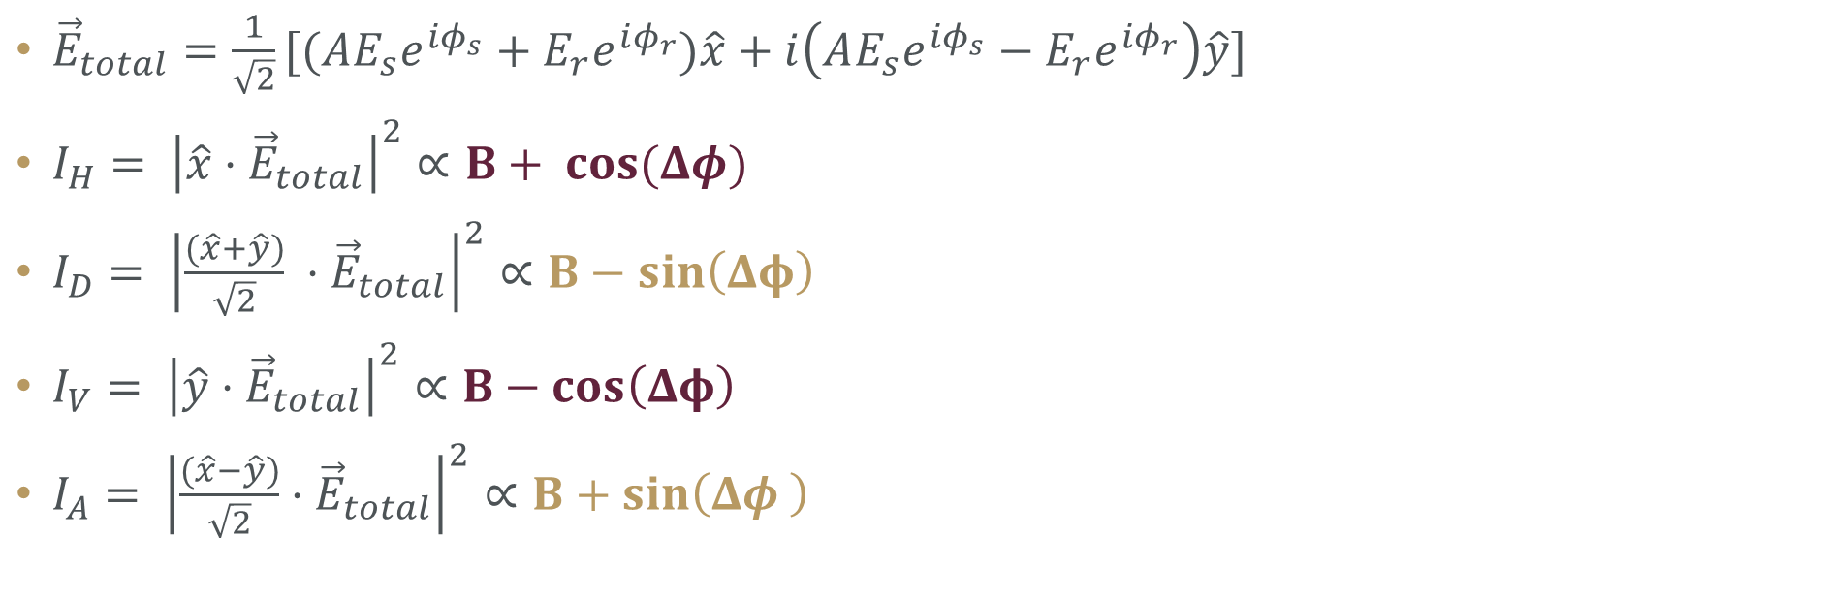


Phase Retrieval
${\vec{E}}_{total}=\frac{1}{\sqrt{2}}[(AE_{s}e^{iφ_{s}}+E_{r}e^{iφ_{r}})\hat{x}+i\left(AE_{s}e^{iφ_{s}}−E_{r}e^{iφ_{r}}\right)\hat{y}]$
$I_{H}= {\left|\hat{x}⋅{\vec{E}}_{total}\right|}^{2}∝B+ cos{(Δφ)}$
$I_{D}= {\left|\frac{(\hat{x}+\hat{y})}{\sqrt{2}} ⋅{\vec{E}}_{total}\right|}^{2}∝B−sin\left(Δφ\right)$
$I_{V}= {\left|\hat{y}⋅{\vec{E}}_{total}\right|}^{2}∝B−cos\left(Δφ\right)$
$I_{A}= {\left|\frac{(\hat{x}−\hat{y})}{\sqrt{2}}⋅{\vec{E}}_{total}\right|}^{2}∝B+sin\left(Δφ \right)$
$$\frac{I_{A}−I_{D}}{I_{H}−I_{V}}=\frac{sin\left(Δφ\right)}{cos\left(Δφ\right)}$$
$$Δφ=tan^{−1}\left(\frac{I_{A}−I_{D}}{I_{H}−I_{V}}\right)$$
$$\text{M}\text{ATLAB} \text{atan}\text{2(}\text{y}\text{, }\text{x})∈(−π, π]$$
Notes:
Now if you recall the PSI slide where I laid out the theory behind these techniques, this slide is where I sell you on the fact that you can indeed retrieve phase using SSOQM.
At the top here is the total field after the NPBS.
To recover the intensity in each polarization direction, we project the total field onto the corresponding polarization unit vectors.
What is very important to notice, and they key insight, they form a set of four intensity signals that are pi/2 phase shifts of one another! If you strip away the constants and focus on the modulated terms, youll notice the progression of cos, negative sine, negative cos and sine.
This means that by subtracting the correct intensity pairs, we can extract a clean sin and cosine term, which means we have a tan relationship and can recover the phase using atan2. We use atan2 because it is also sensitive to the quadrant we are in and as I mentioned earlier, we don’t want any ambiguity in the phase we recover.

Slide 13
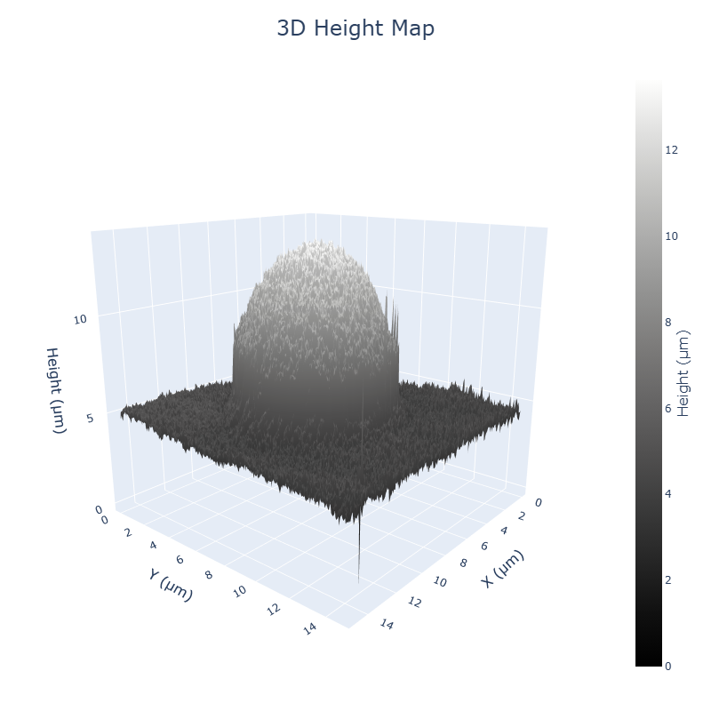
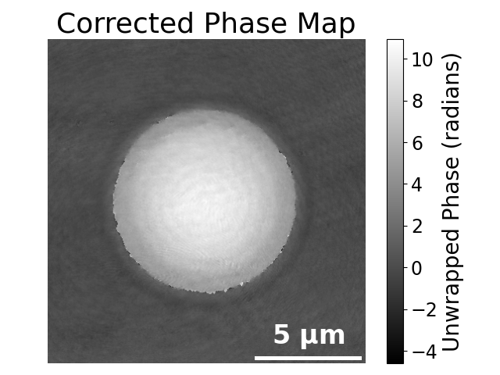
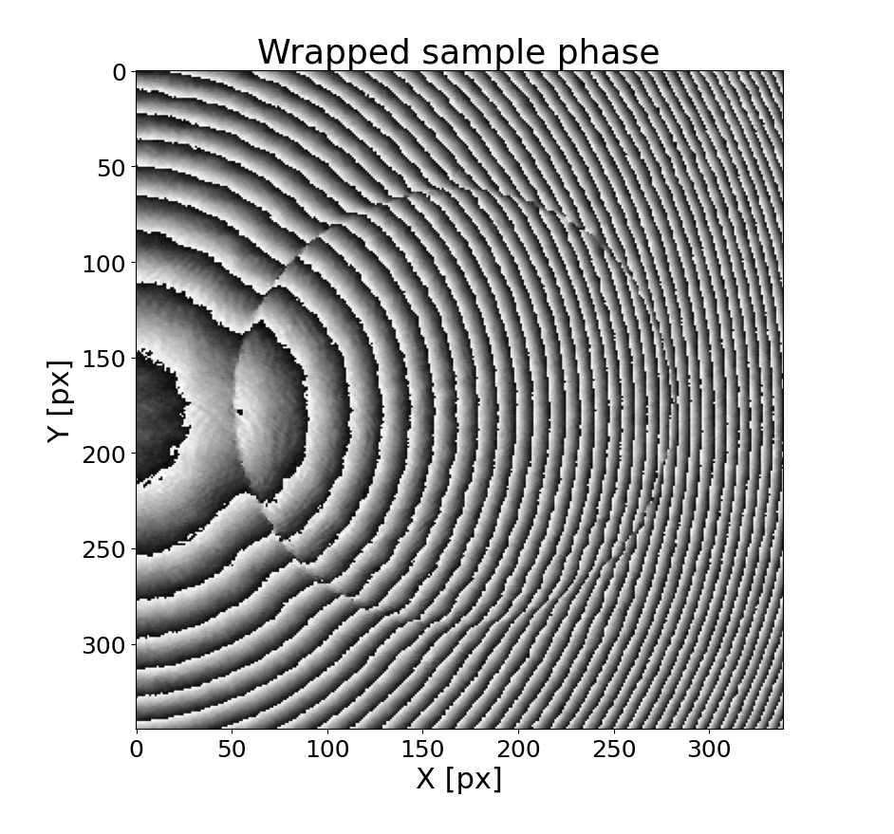
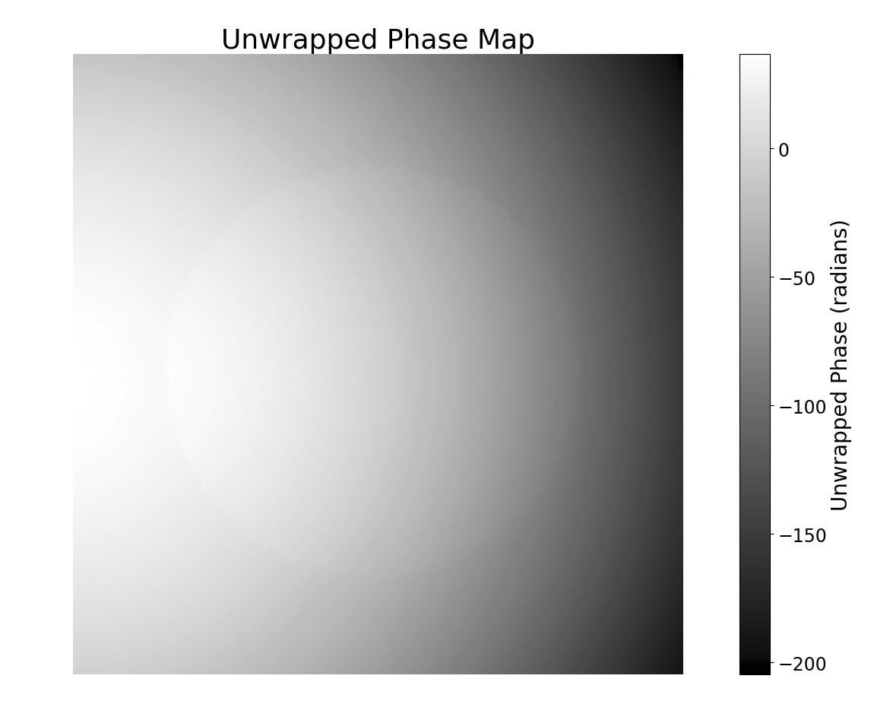
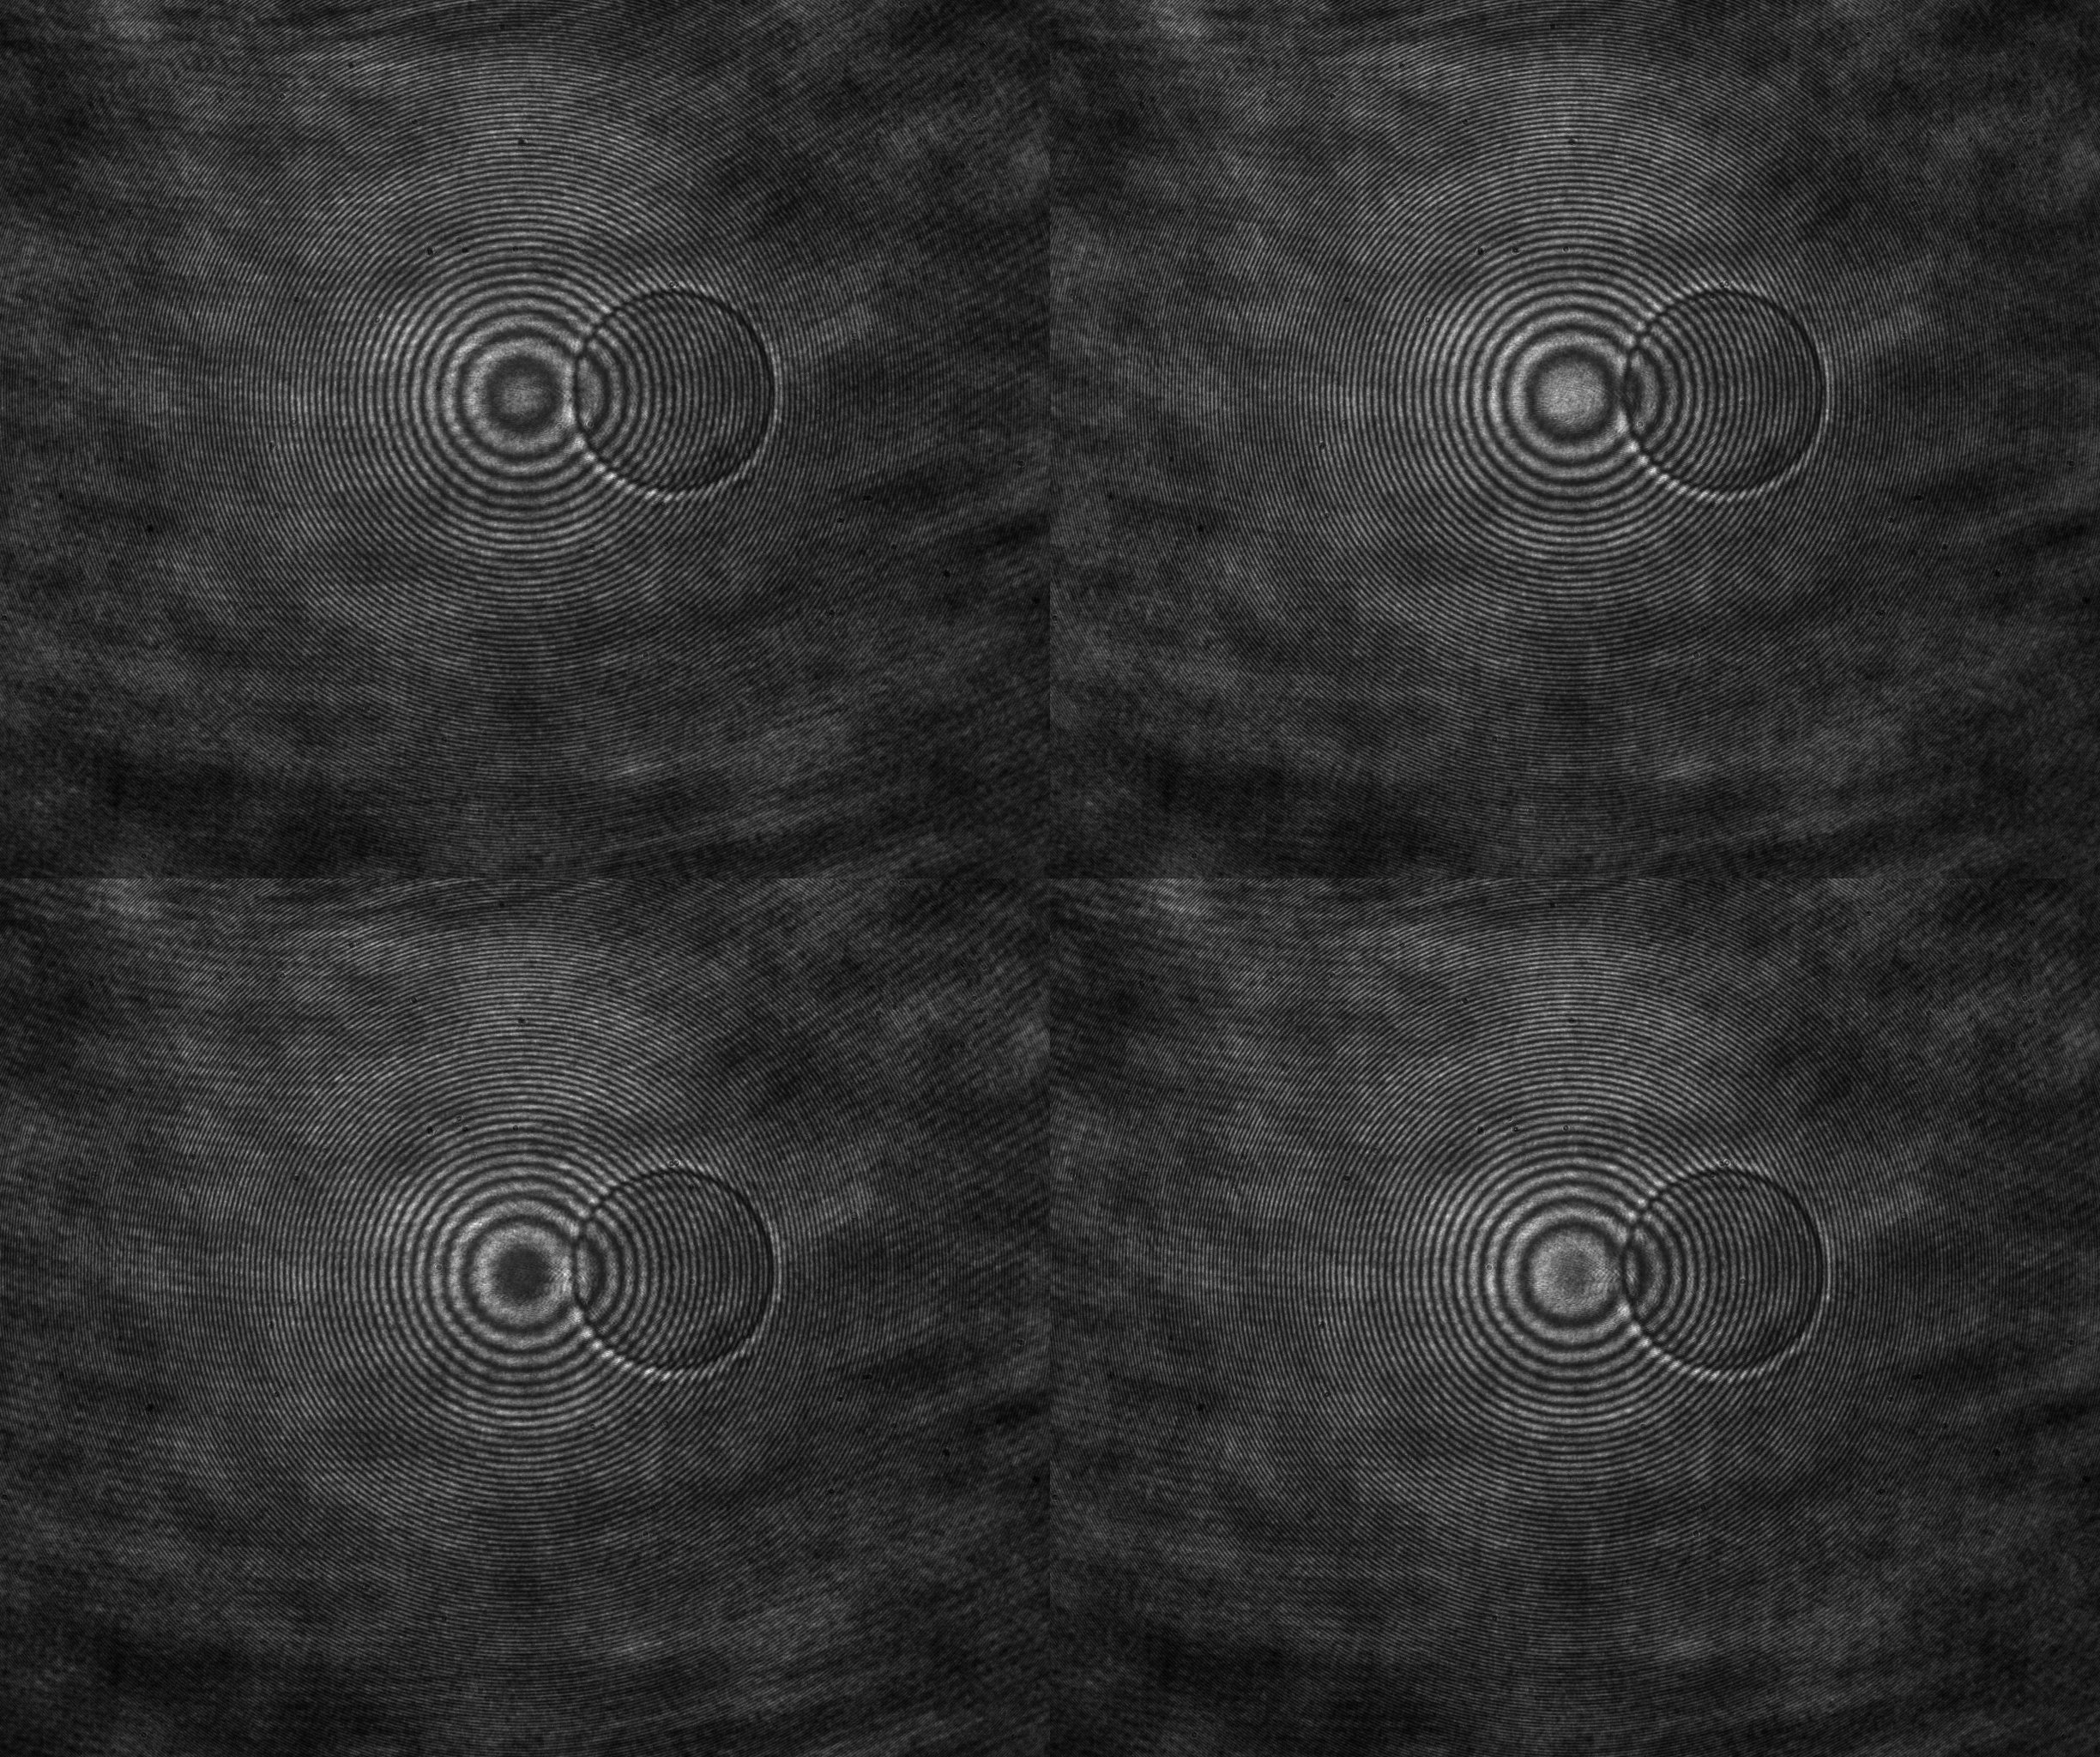

Measuring Polystyrene Beads
$$h\left(x,y\right)=\frac{λ⋅Δφ\left(x,y\right)}{2π⋅Δn}$$
Notes:
So what is the actual measurement process?
Well here we have the raw acquisition of an 8.9um polystyrene bead suspended in glycerol, and you can see the four phase shifted interferograms here. These are the raw images I plug into the maths I just explained, to obtain this phase.
But as you can see, this first phase we obtain is actually wrapped and that’s because phase is naturally periodic by nature of how we represent it, and our atan2 function returns that wrapped representation. Physically the phase can obviously accumulate beyond 2pi, but when we measure it its is folded back into this 0 to 2pi range. Which naturally means we need an algorithm called a PU algorithm to search for these 2 pi phase jumps and then add or subtract 2pi where it sees fit. That way the true continuous phase is unravelled and we obtain this. But now this is also not perfect, and that’s because the system itself, whether its optics or misalignment somewhere introduces a constant phase offset that you subtract from the final unwrapped phase by taking a background measurement.
And finally we obtain our desired corrected phase measurement of the bead. Since we have the phase now, and we have a refractive index for polystyrene, we can obtain a height map using the equation from the beginning.

Slide 14
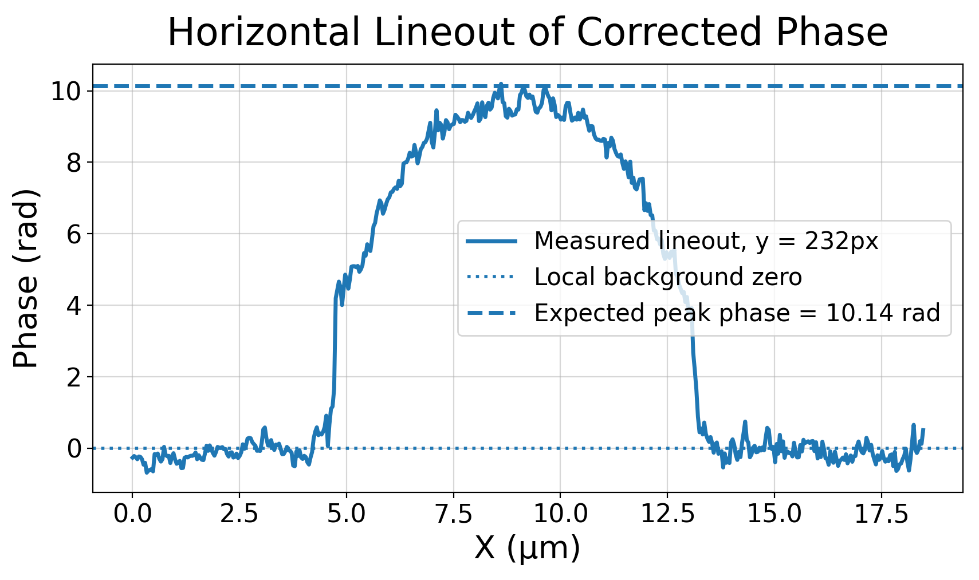
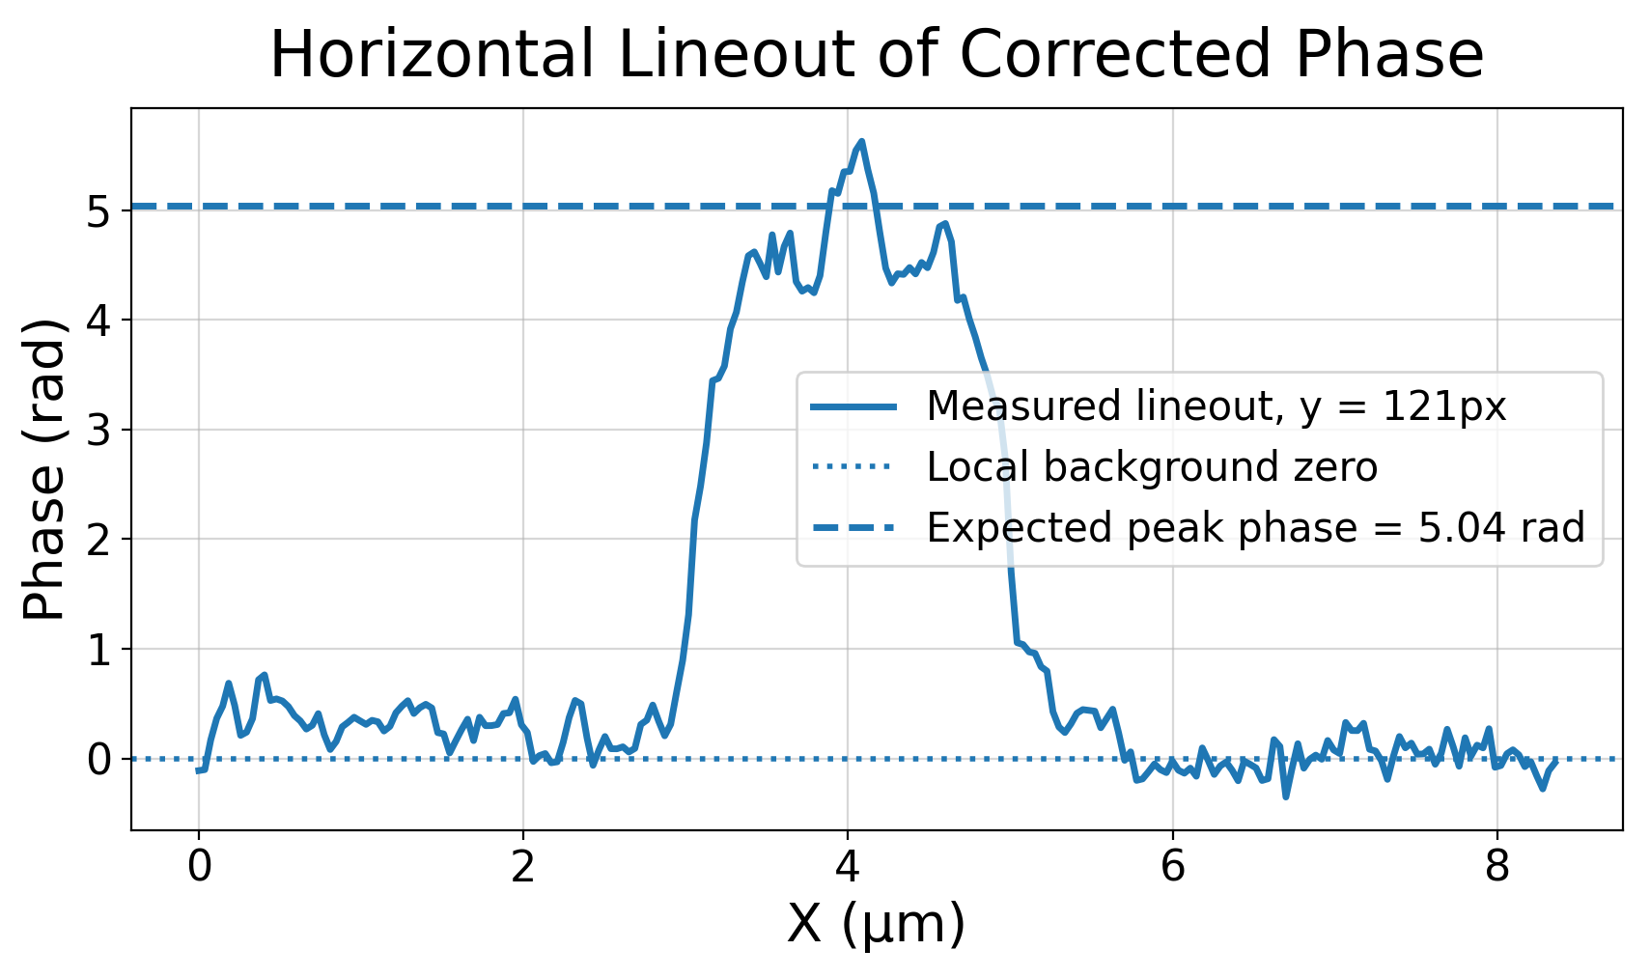
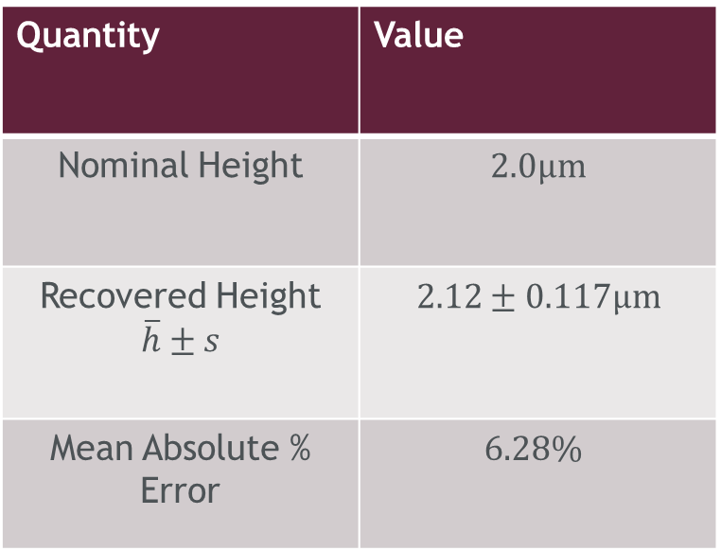
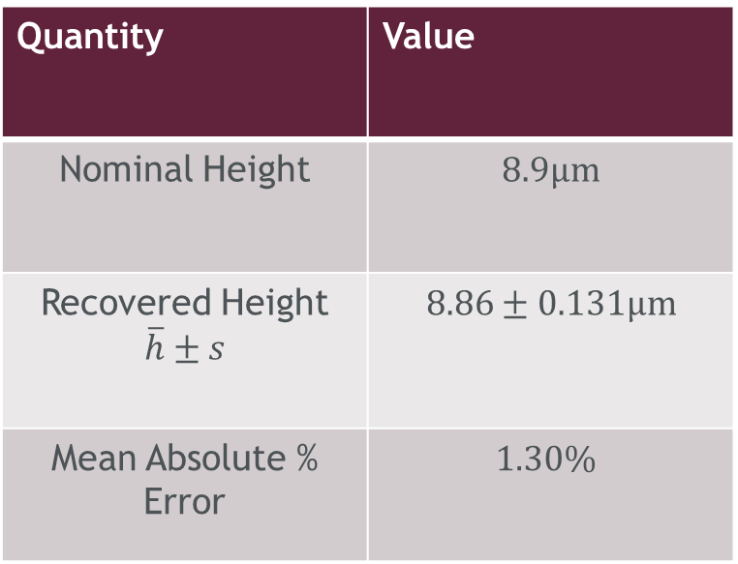
Phase Validation (2.0$μ\text{m}$ Polystyrene Beads N=10)
Phase Validation (8.9$μ\text{m}$ Polystyrene Beads N=5)
Quantity | Value
Nominal Height | $$8.9μ\text{m}$$
Recovered Height $\overline{h}±s$ | $$8.86±0.131μ\text{m}$$
Mean Absolute % Error | $$1.30\%$$
Quantity | Value
Nominal Height | $$2.0μ\text{m}$$
Recovered Height $\overline{h}±s$ | $$2.12±0.117μ\text{m}$$
Mean Absolute % Error | $$6.28\%$$
Notes:
Now in order to validate my retrieved phase values, I imaged 5 separate 8.9um beads. The nice thing about using microspheres is they have well characterized dimensions and refractive indices, meaning I can calculate an expected phase value to compare with. Here is a lineout through one of the measurements, and you can see that the profile peaks right around the expected phase peak for these beads.
The recovered average height is listed here, with a mean absolute percentage error of around 1.30%.
I also measured 10 separate 2um beads and had similar success, with the average showing around a 6.28% absolute percentage error.

Slide 15
Digital Holographic Microscopy (DHM)
Notes:
This is a good point for me to segue to a different QPI technique entirely then, so let’s talk about DHM for a bit.

Slide 16
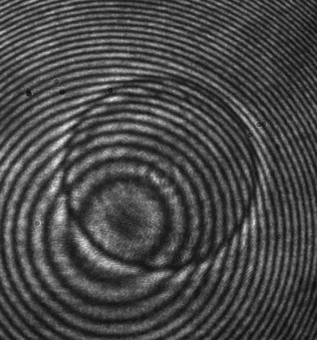
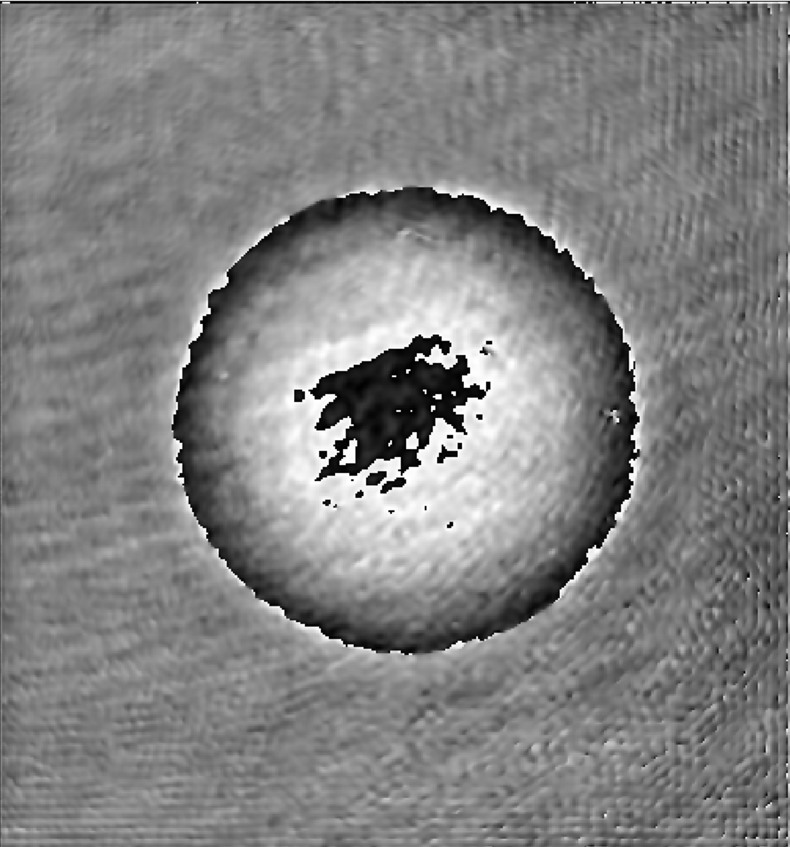
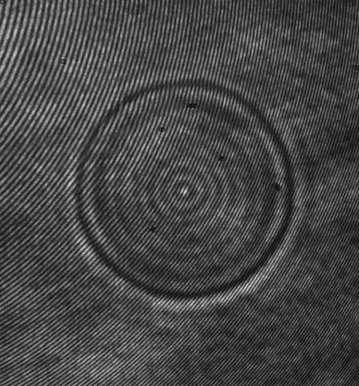
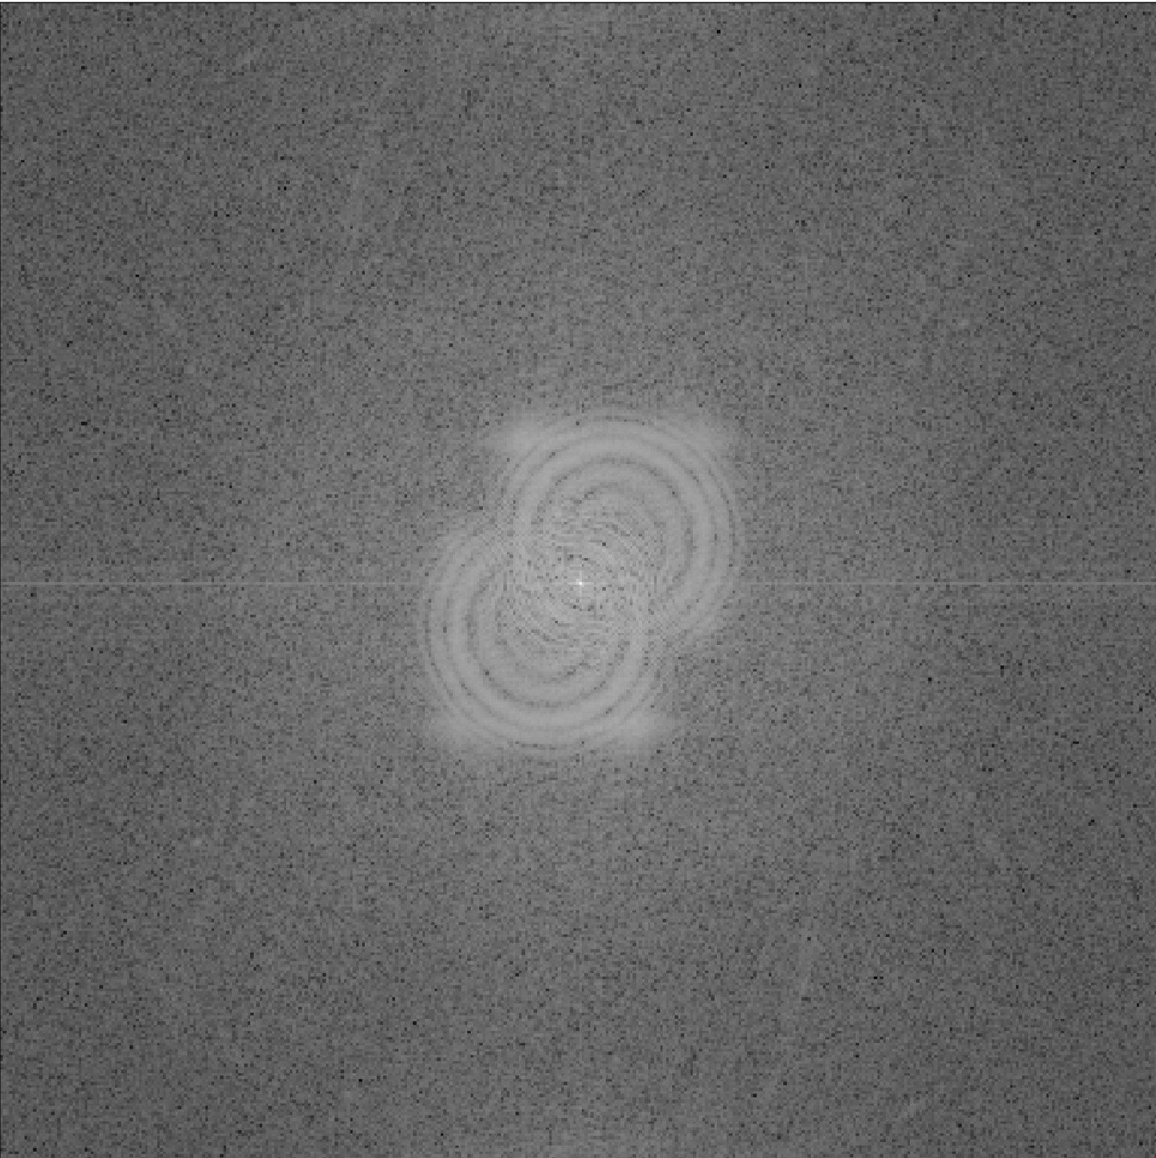
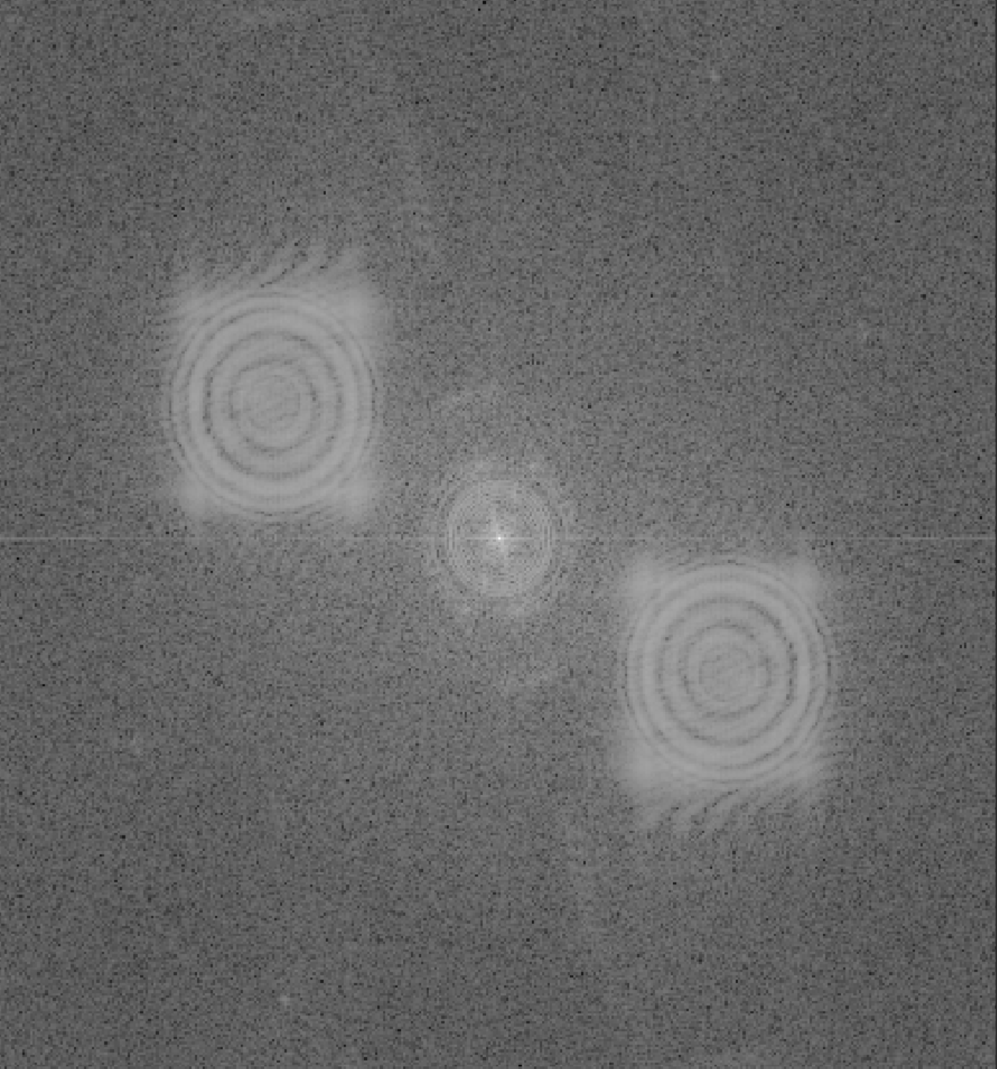
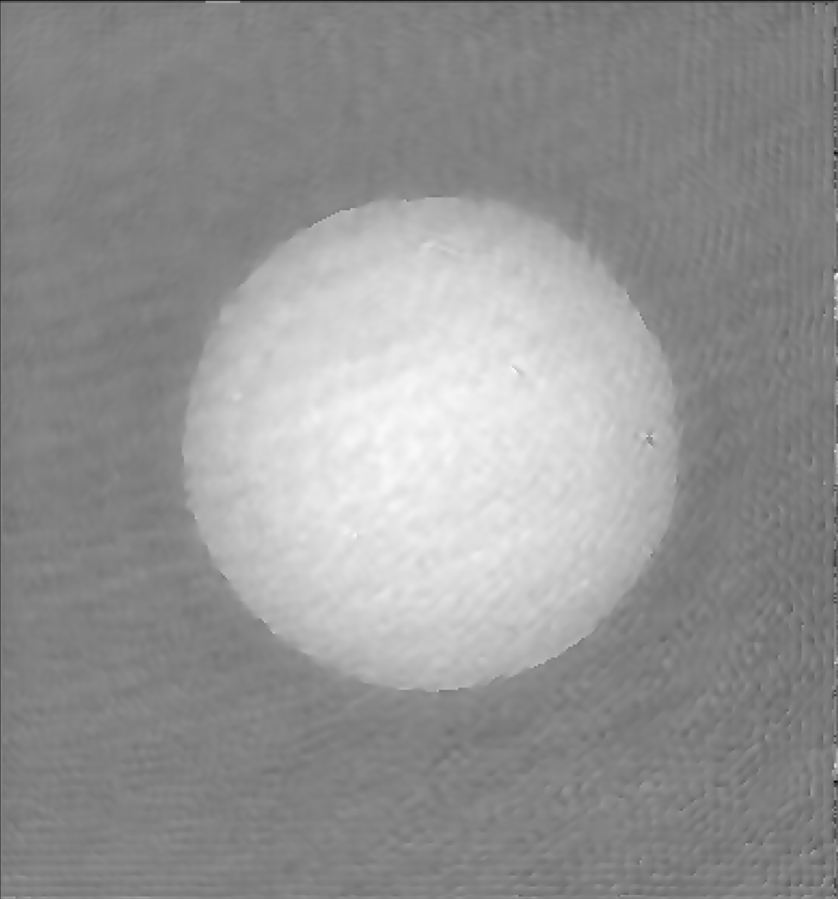
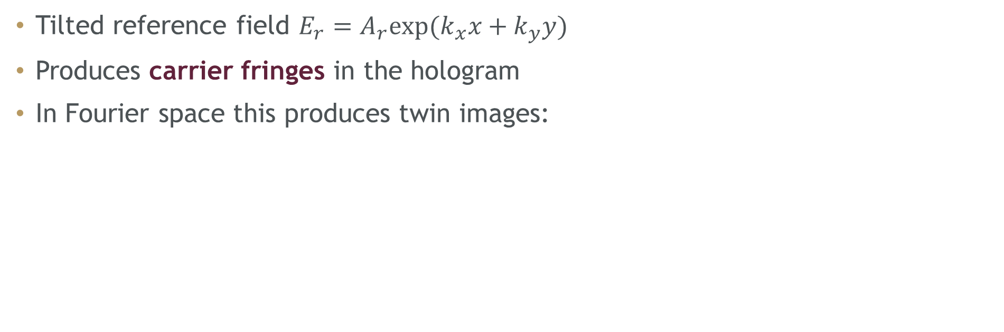
Digital Holographic Microscopy (DHM)
Tilted reference field $E_{r}=A_{r}\text{exp}\text{(}k_{x}x+k_{y}y)$
Produces carrier fringes in the hologram
In Fourier space this produces twin images:
Notes:
So what is DHM?
Digital holographic microscopy is also an interferometric QPI technique, but instead of using quadrature polarization channels like SSOQM, it uses an off-axis reference beam.
By tilting the reference field, we introduce a spatial carrier into the hologram. This produces the closely spaced carrier fringes shown on the left.
In Fourier space, that carrier shifts the phase-containing sideband image terms away from the central DC term. One of these sidebands can then be isolated with a Fourier filter and transformed back to recover the complex optical field.
From that complex field, we extract the wrapped phase and then unwrap it to obtain the final phase map.

Slide 17
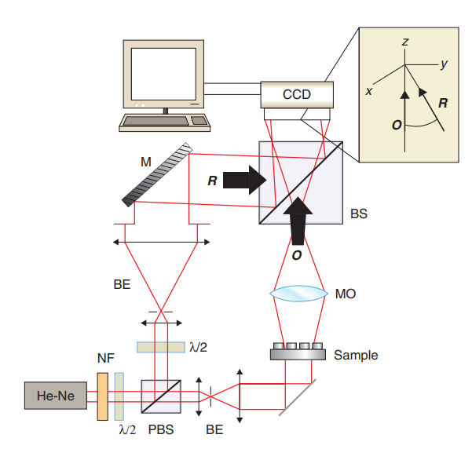
DHM
Mach-Zehnder configuration
The SSOQM design is capable of DHM and the only change required is the phase recovery process
Can be performed with the sample both in and before the Image Plane (numerical refocusing capability)
Image source: G. Popescu, Quantitative Phase Imaging of Cells and Tissues, McGraw-Hill, 2011, p. 142.
Notes:
And the cool thing is, DHM is also done in a MZ style setup. Here is a diagram from a textbook of a standard DHM setup. Since it doesn’t care about the difference between different acquisitions (its inherently single shot), the polarization optics in our setup don’t matter meaning the SSOQM setup is inherently capable of performing a DHM measurement. The only thing I adjust is how I recover the phase from the image.
Another useful feature of DHM is that the hologram contains complex field information. This means the field can, in principle, be numerically propagated to different axial planes, allowing digital refocusing. In this work, however, I use image-plane DHM simply as an independent comparison to validate the SSOQM phase reconstructions.

Slide 18
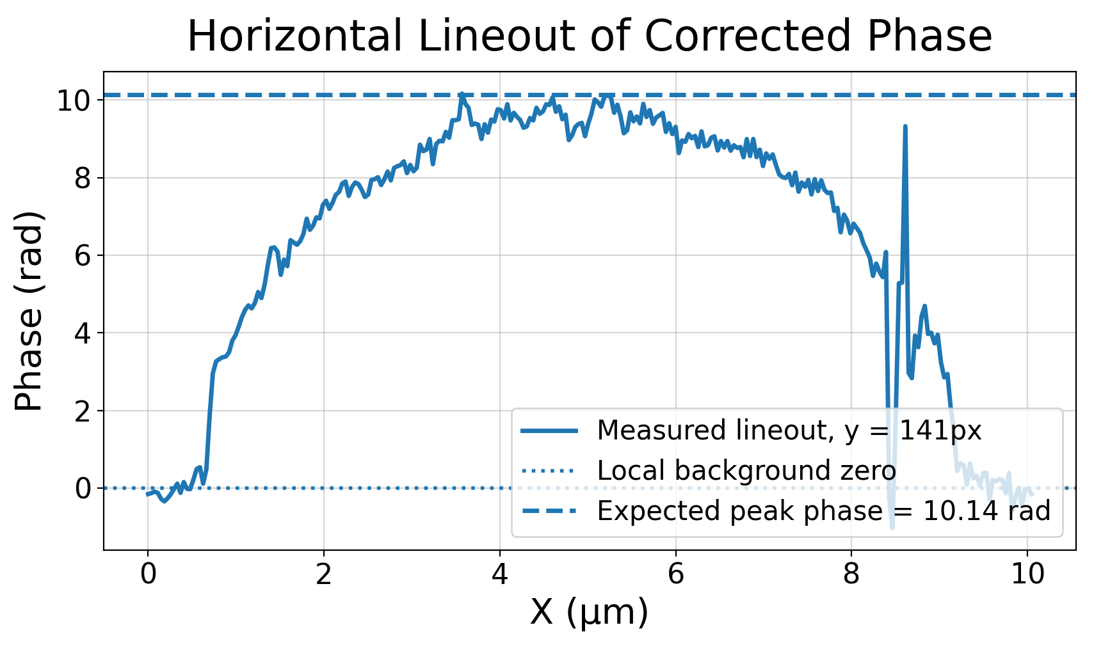
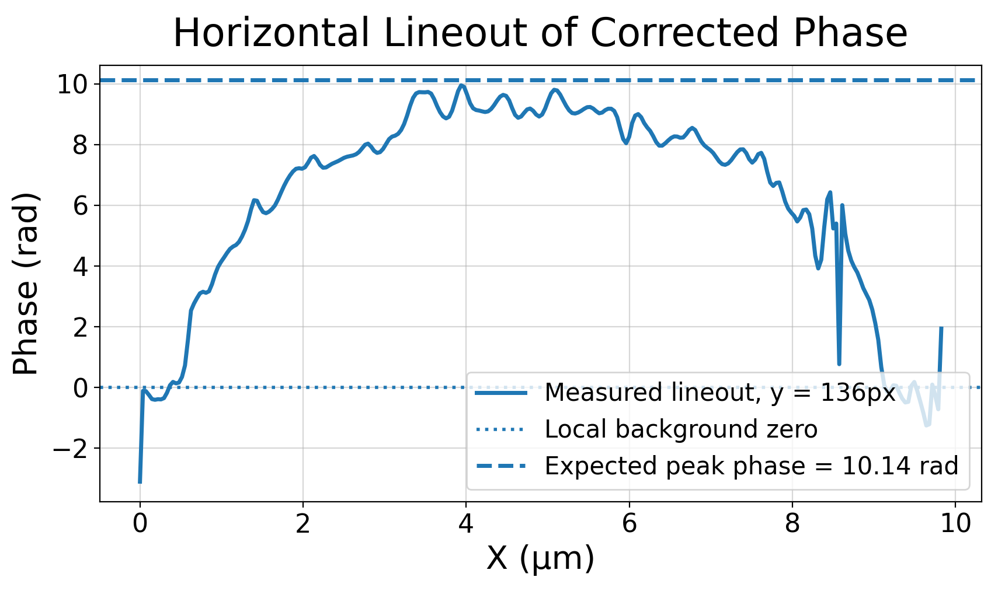


SSOQM vs DHM
$$P_{99}\left(h\right)=8.68μ\text{m}$$
$$P_{99}\left(h\right)=8.71μ\text{m}$$
Notes:
Here I compare the same $8.9 μ\text{m}$bead measured using SSOQM on the left and DHM on the right. The lineouts show very similar phase profiles, and the $P_{99}$-based height estimates agree within about $0.03 μ\text{m}$. This agreement is important because the two measurements use different phase-retrieval methods: polarization quadrature for SSOQM and Fourier sideband filtering for DHM.

Slide 19
Cell Measurements
Notes:
Alright, so I’ve talked a lot about calibrative measurements and perfect or ideal spheres, but what else can this setup measure? So here I show that we can measure some biological phase objects too.

Slide 20
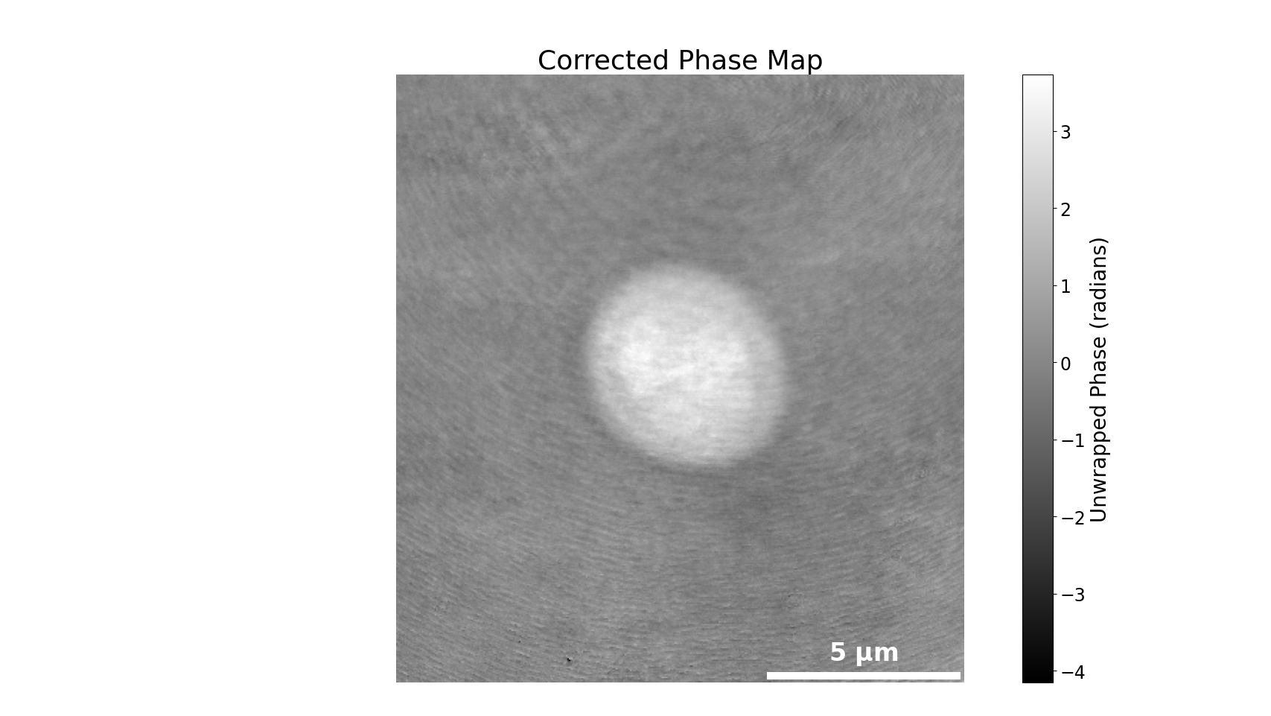
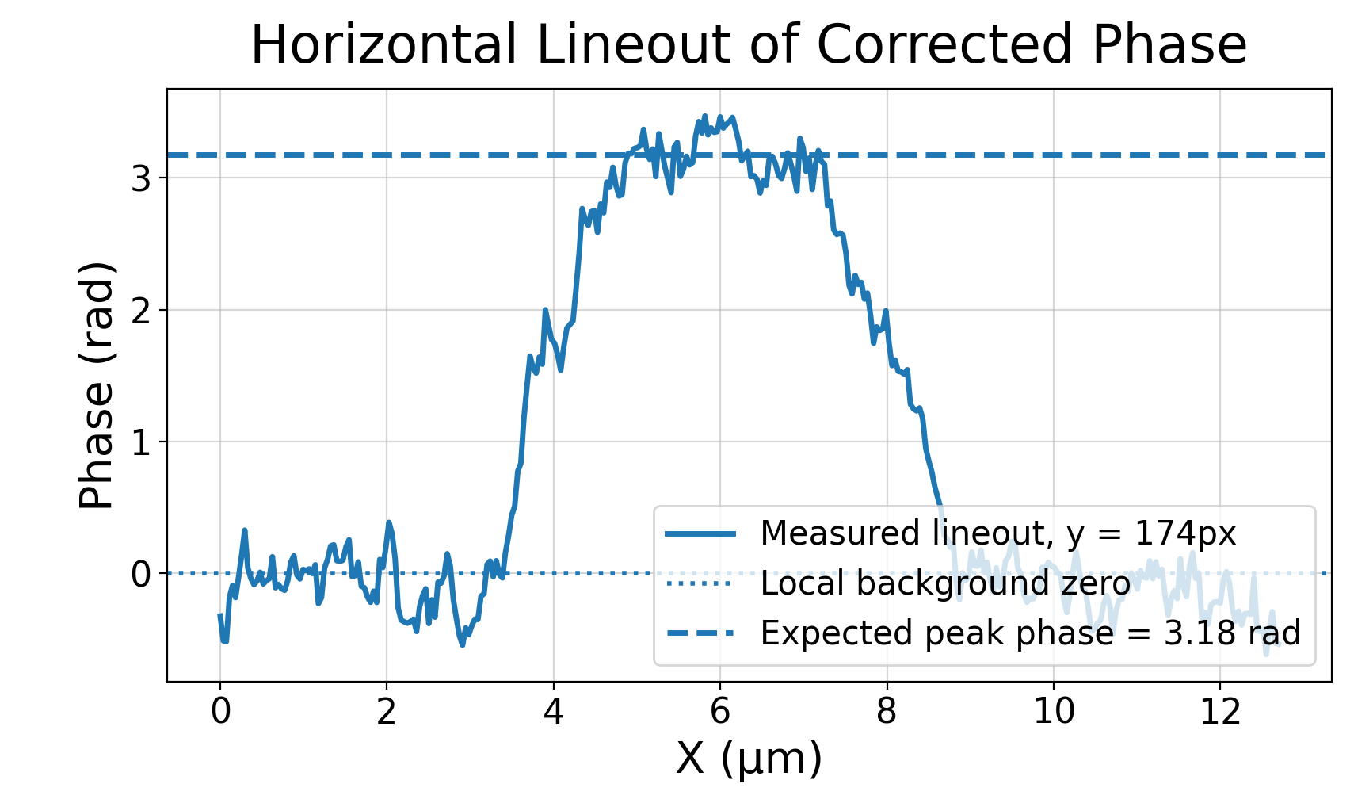
Yeast Cells ($n≈1.38−1.40$)
Notes:
First are yeast cells, which are ironically pretty spherical themselves. Here we have a measurement of a trapped yeast cell, and this one is around 6 micron in diameter. We can see a pretty good agreement here if we assume a nominal height of around 6um as well, or converted to phase around 3.18 radians.

Slide 21
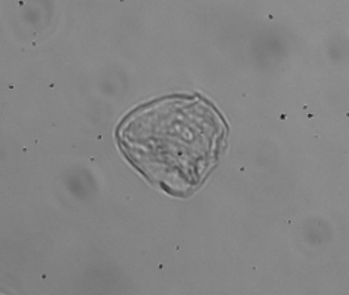
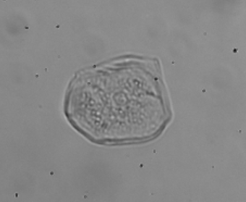
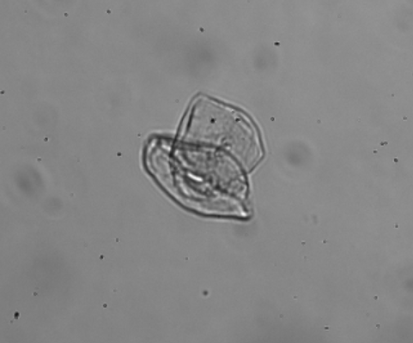
Buccal Epithelial Cells ($n≈1.36−1.39$)
Notes:
Then for some more oddly shaped samples, I also did some measurements on buccal or cheek epithelial cells, which are pictured here in brightfield.

Slide 22
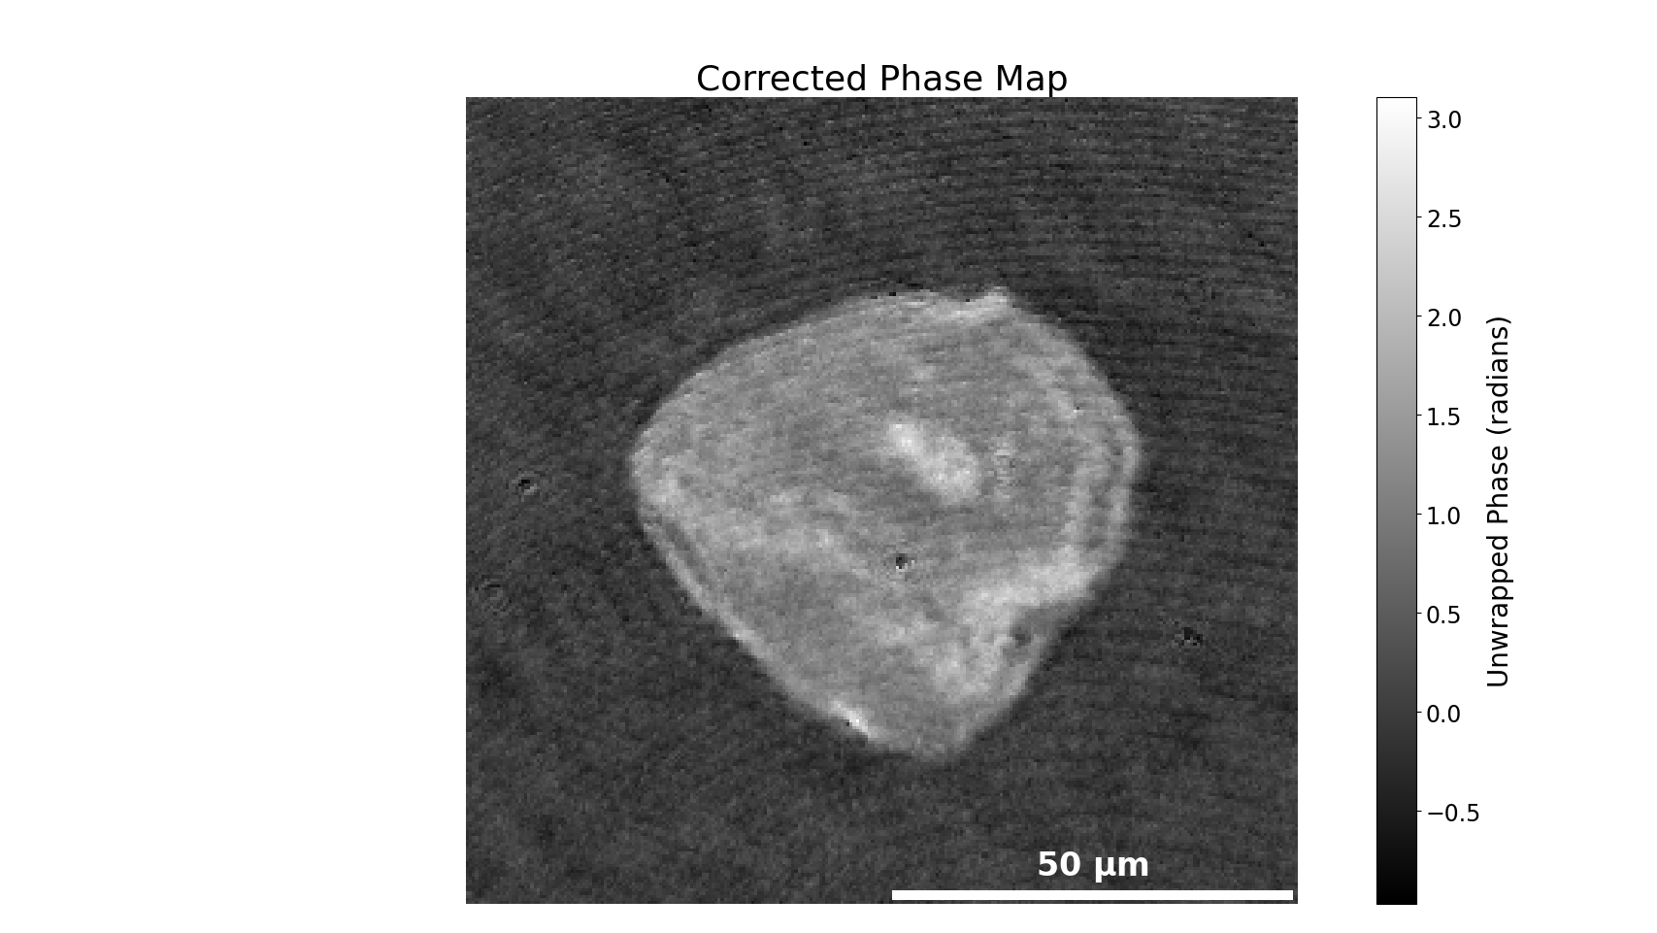
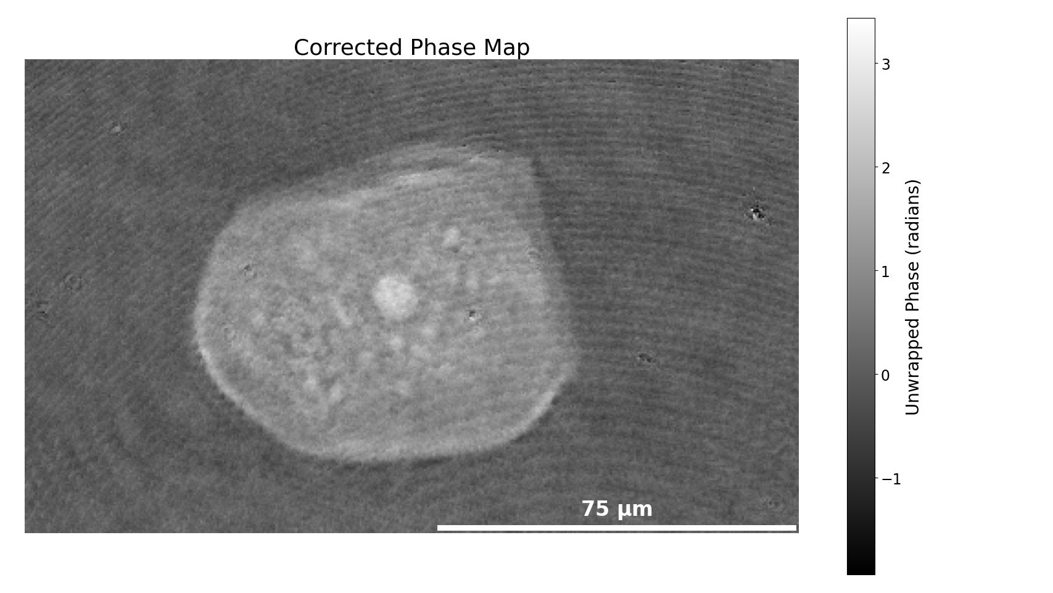
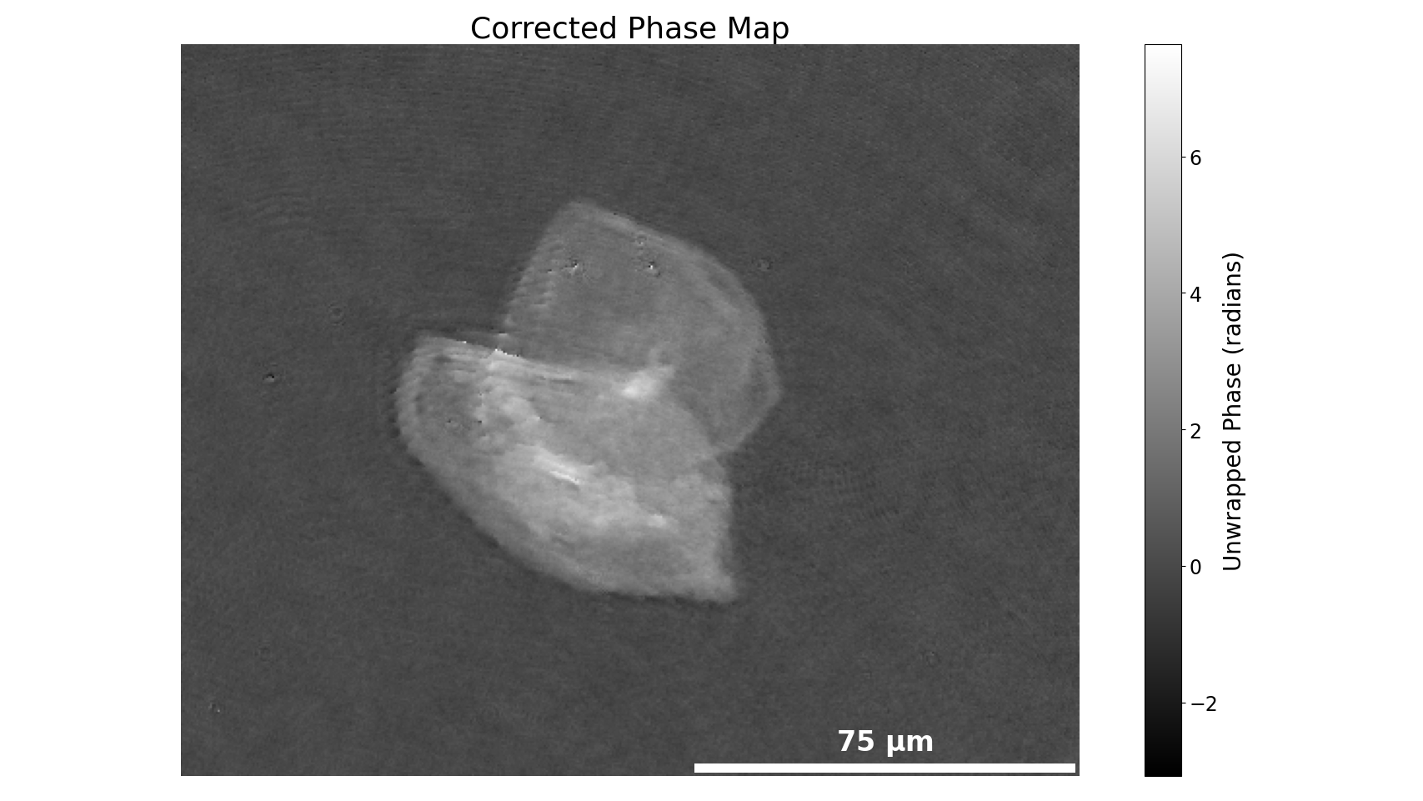
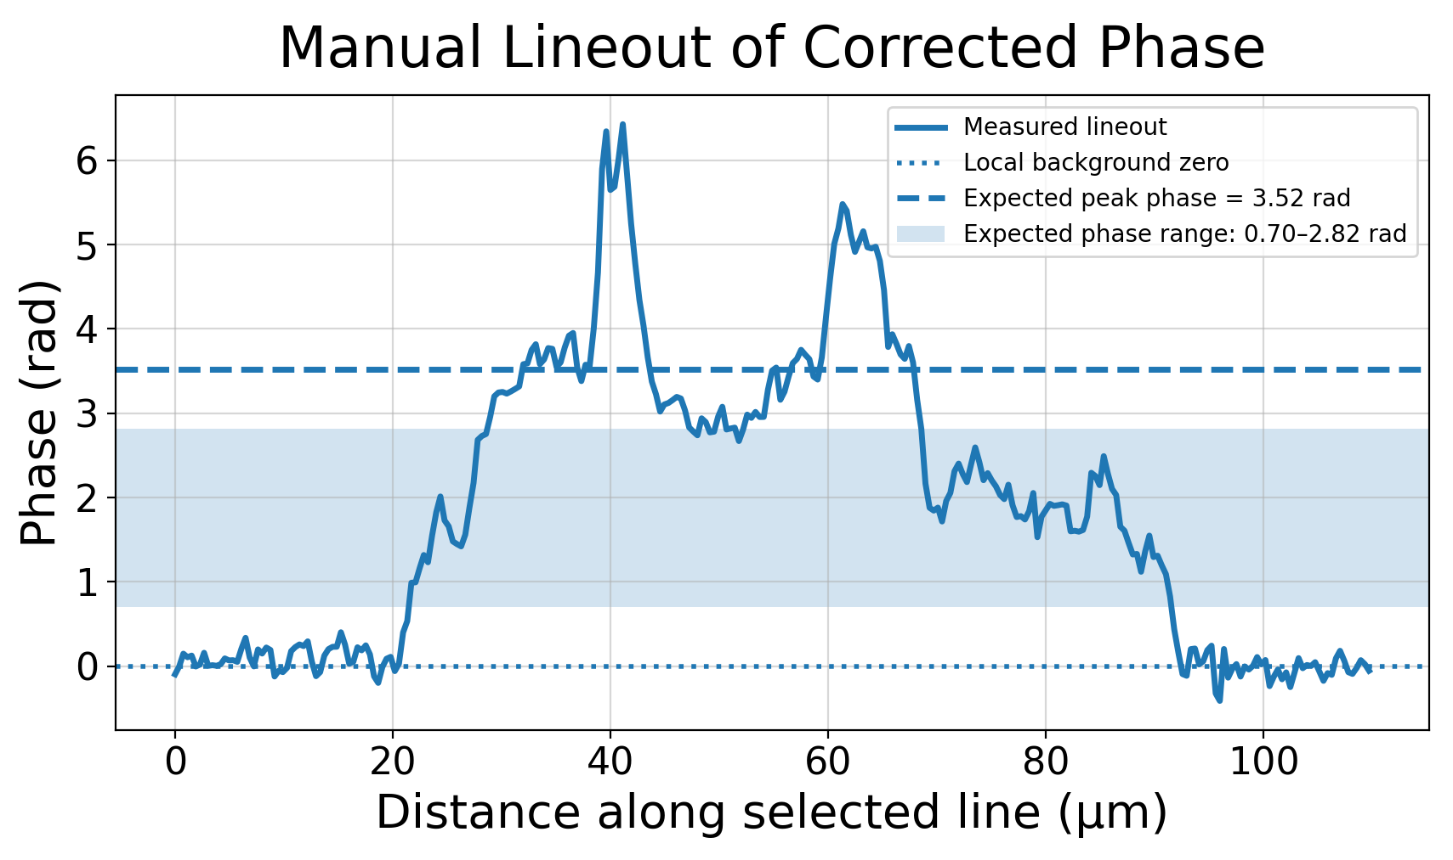
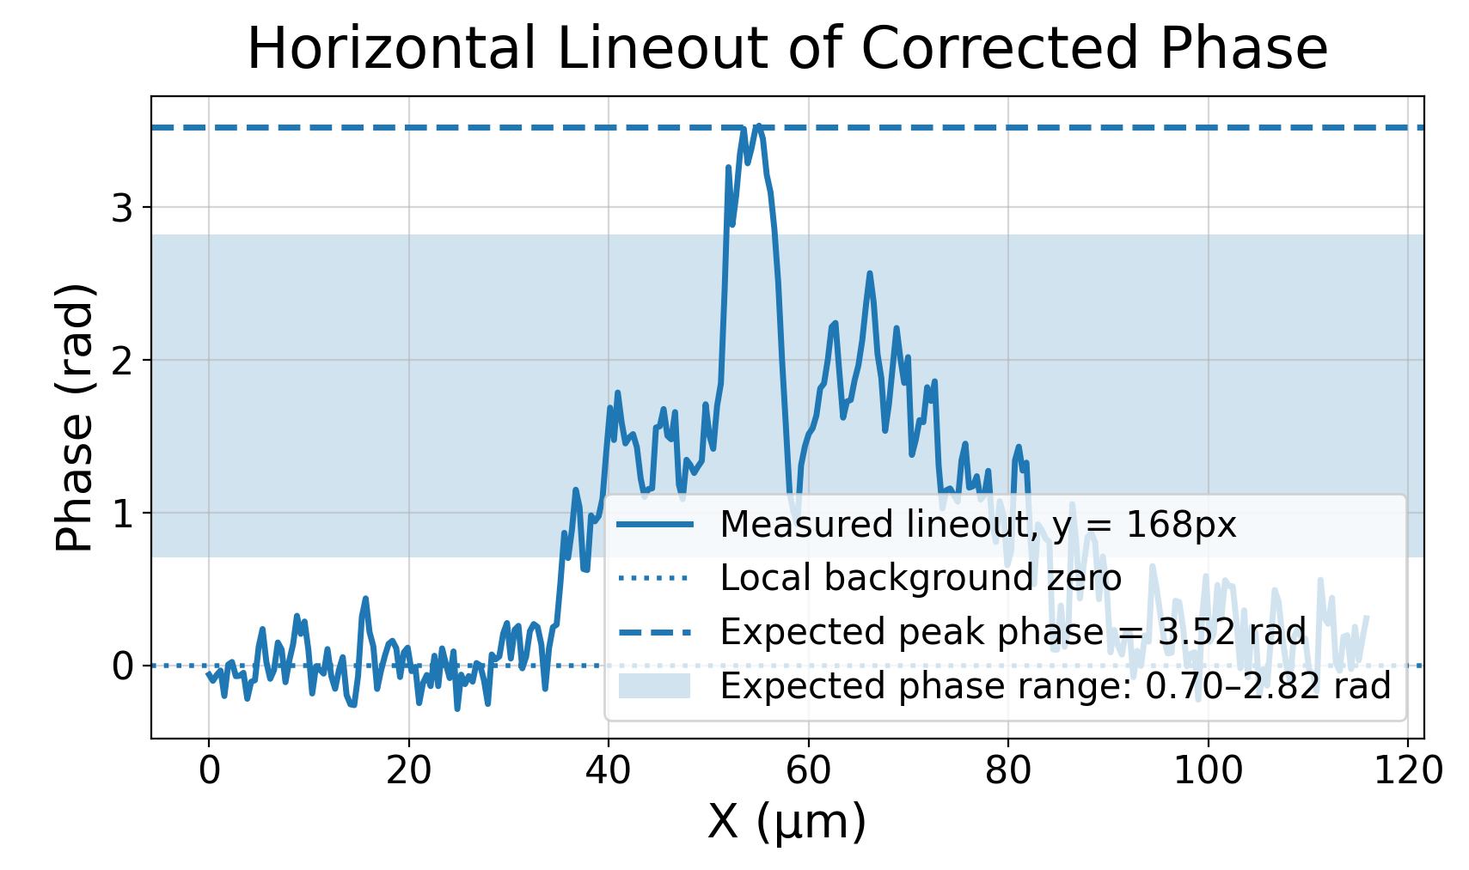
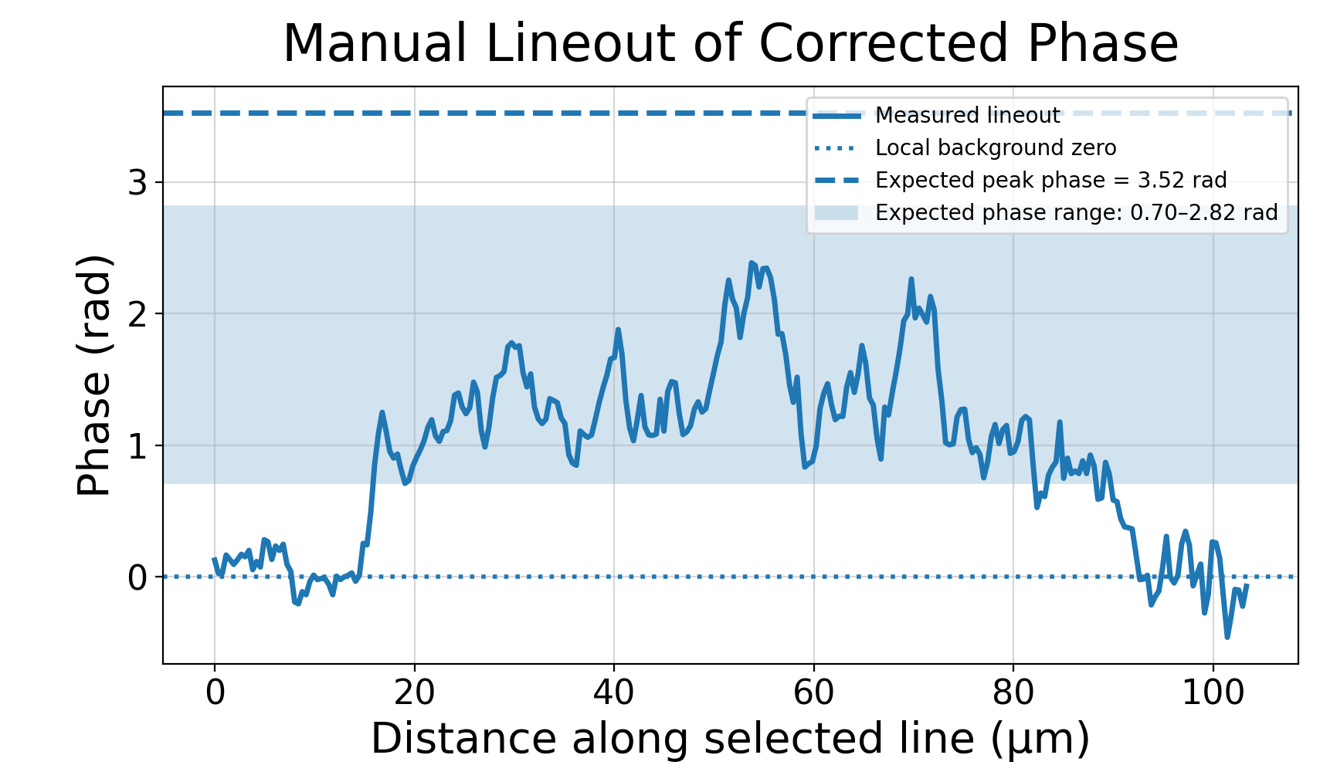
Buccal Epithelial Cells ($n≈1.36−1.39$)
Notes:
And here they are in phase with lineouts through them. The shaded region shows the phase range expected for a plausible flattened-cell thickness under our assumed refractive index and the dashed line indicates a thicker nuclear-region estimate based on literature.
An important point though is that these biological measurements should be interpreted as optical phase or optical path length maps, not simple physical height maps. Because the cell is not homogenous, local changes in the refractive index like in the nucleus can produce these stronger phase features.
I’ve also displayed some of the other cells here, for example this one which I believe you can see some organelle structure internally. And then here we have two cells stacked on top of one another.

Slide 23
Next Steps
  Birefringent QPI Measurements:
    Urea crystals
    Microtubules inside epithelial cells
  Measure phase resolution target to get lower limit on phase resolution
  Video rate SSOQM measurements:
    Trapped yeast cells in different solutions
  Continue improving SNR:
    Different normalization techniques
    Noise reduction algorithms (post-processing)
Notes:
So what are my next steps?
Well if you were at my poster session yesterday, you would’ve heard me speak about birefringent QPI measurements. We very much plan on doing more of these measurements, specifically with urea crystals as well as perhaps looking deeper into the cheek cells, and finding these microtubule structures that should induce a polarization response.
We are also obtaining a fabricated phase resolution step target from our engineering department in order to better characterize the phase sensitivity and determine the lower limit of measurable phase contrast in our system.
A major goal as well is video-rate QPI. So a likely experiment we plan on doing is trapping a yeast cell and moving it between two channels of different salinity and observing how the volume changes.
Alongside this, I will continue improving the measurement quality, particularly through better channel normalization, background correction, and post-processing noise reduction.
Thank you very much for your attention. I’d be happy to take any questions.

Slide 24
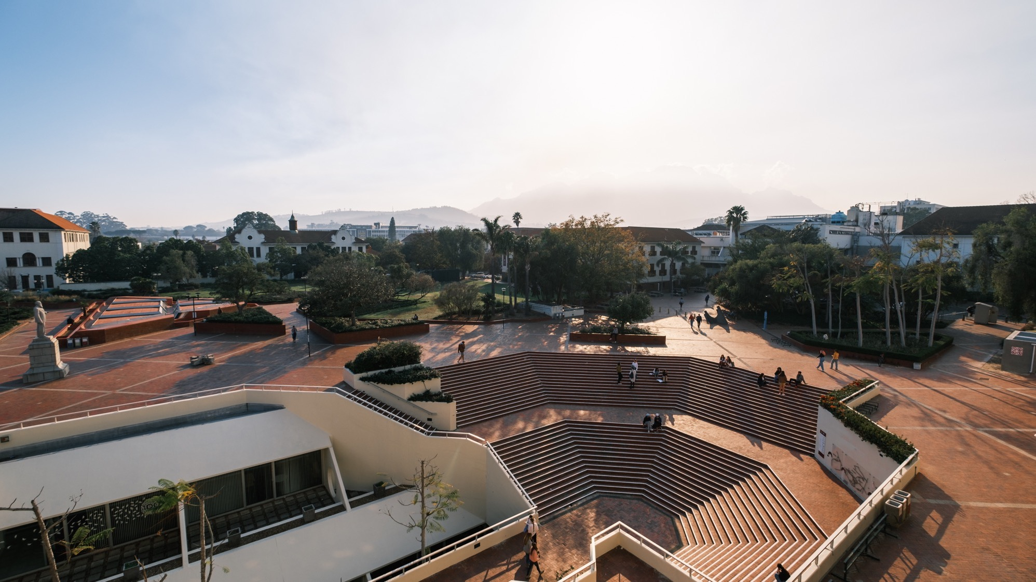
Thank you
Enkosi
Dankie
Photo by Stefan Els
Notes:
Cover/End slide layout
To change the picture:
Select the picture by clicking on it near the bottom of the slide (under the title placeholder), then click on the Picture Format tab.
Click on the Change Picture icon and choose the From a File/This Device… option.
Browse and select a picture and click on the Insert button.
Use the Crop command to adjust the image.
Click on the Crop command again to apply the changes.
Remember to add image attributions to photographs or artworks.

