Slide 1

TEMPORALLY STRUCTURED SUPERCONTINUUM PULSES FOR HIGH AXIAL RESOLUTION IMAGING
Eugene Fouche
Dr Gurthwin Bosman
Prof Pieter Neethling

Slide 2
CONTENTS
Motivation
Super-resolution Radar
Pulse retrieval
Custom pulse shaping
Results

Slide 3
MOTIVATION

Slide 4





WHY WE DO THIS
$$?$$
$$?$$
It’s interesting!
But also useful
$$?$$
$$?$$
1

Slide 5
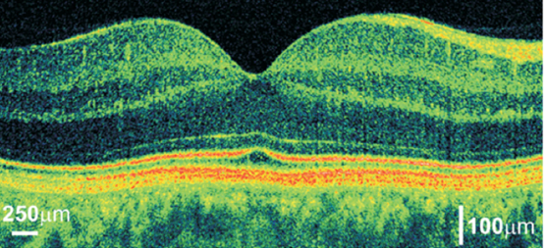
OPTICAL COHERENCE TOMOGRAPHY
Imaging technique
Axial scans (into the sample): Depth profile
Tile to create 2D or 3D images
Human Retina
Zheng, S. Bai, Y. Liu, P. and Ni, G. Optical coherence tomography for three-dimensional imaging in the biomedical field: a review. frontiers in Physics: Sept (9), 2021.
2

Slide 6
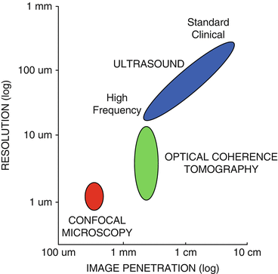
CONTEXT
Bridges gap between ultrasound and confocal microscopy
Ultrasound: Large area, low-res
Confocal: High-res, small area
OCT
mm penetration depths
1-10 μm resolution
Non-invasive
Non-destructive
Fujimoto, J. G. and Drexler, W. Optical coherence tomography: Technology and applications. 2008. Springer.
3

Slide 7
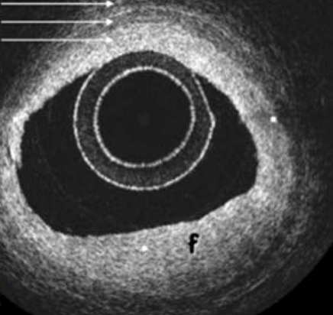
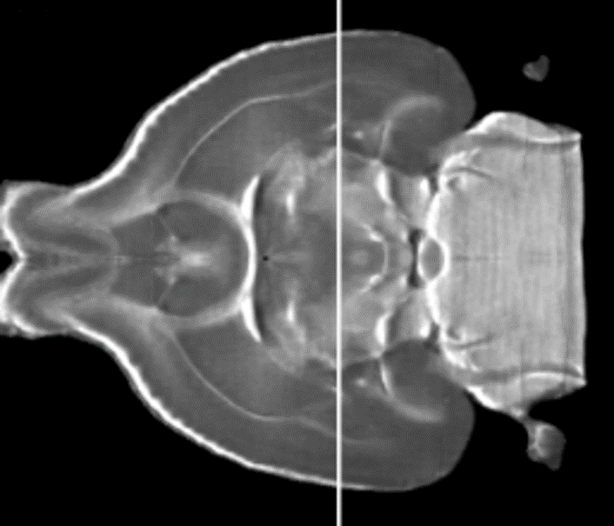
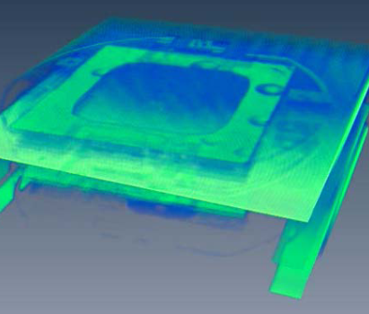
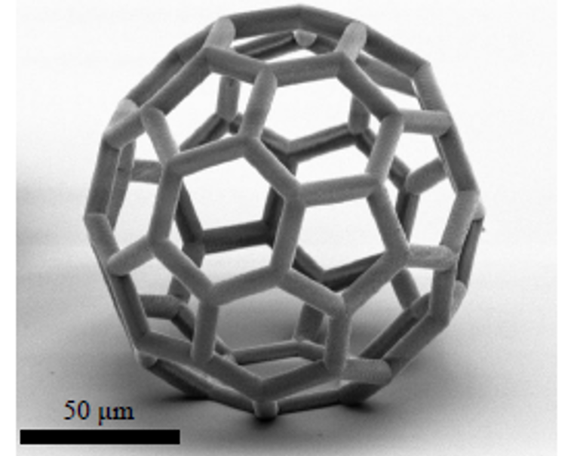
APPLICATIONS OF OCT
Coronary plaque
Mouse brain
Ophthalmology (retinal imaging)
Cardiology (fibre based)
Dermatology
Brain imaging
Industrial applications
Non-destructive testing
Silicon wafer imaging
Additive manufacturing: real-time inspection
MEMS
Additive manufacturing
4
Notes:
Opthalmology: First used for retinal imaging
Cardiology: coronary arteries using fibre based OCT
Dermatology: diagnosis of skin tumours
Brain imaging (fruit flies, mice)
Control additive manufacturing through real-time inspection

Slide 8

AXIAL RESOLUTION LIMITATIONS
Axial resolution: Depends on bandwidth, pulses with broader frequency spectrum lead to better resolution
$R_{a }=\frac{2ln(2)}{π}\frac{λ_{c}^{2}}{Δλ }$
$Δλ$ = bandwidth
$R_{a }∝\frac{1}{Δλ}$
5

Slide 9
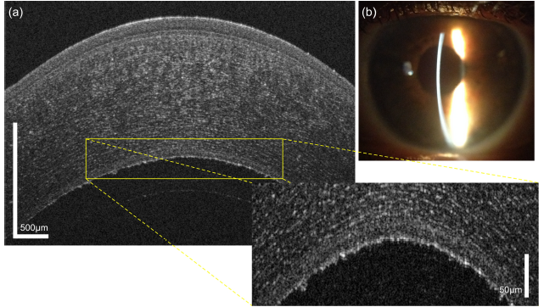
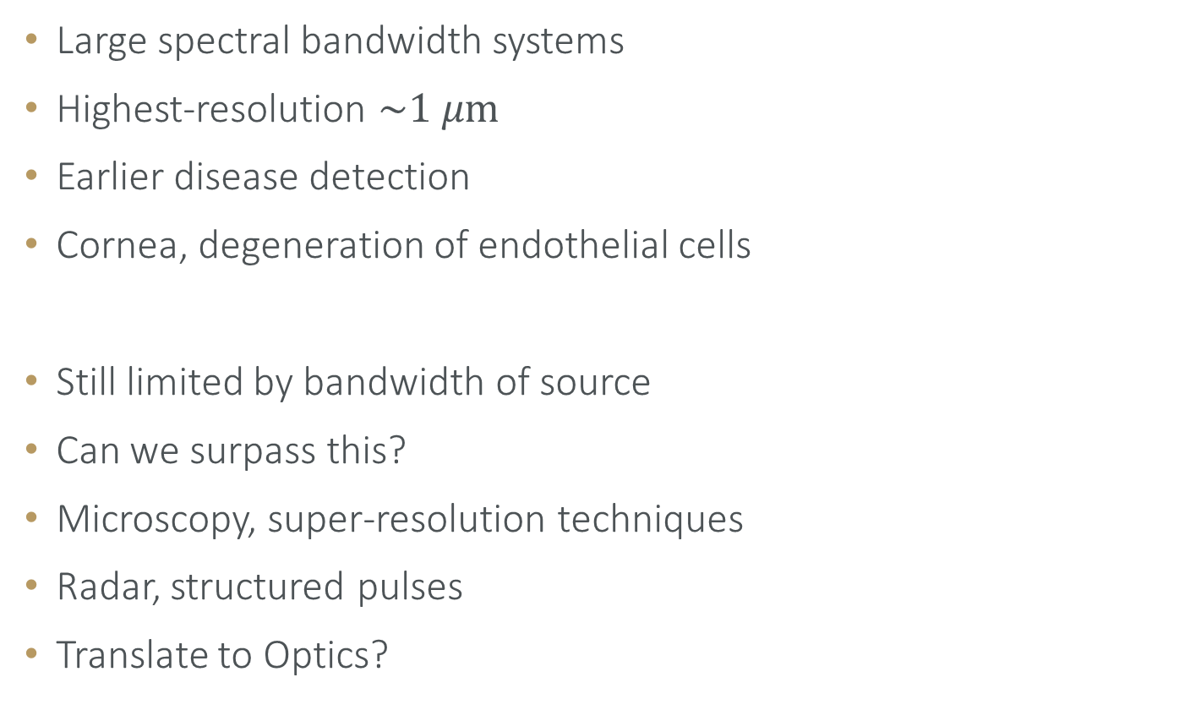
CURRENT STATE
Large spectral bandwidth systems
Highest-resolution $\sim 1 μ\text{m}$
Earlier disease detection
Cornea, degeneration of endothelial cells
Still limited by bandwidth of source
Can we surpass this?
Microscopy, super-resolution techniques
Radar, structured pulses
Translate to Optics?
R. M. Werkmeister et. al. “Ultrahigh-resolution OCT imaging of the
human cornea” , Biomed. Opt. Express, Feb 2017
6

Slide 10
SUPER-RESOLUTION
RADAR

Slide 11
SUPER RESOLUTION RADAR
Range finding with RADAR (Howell et. al. 2023)
Resolution improvement scheme
Use temporally structured pulse, rather than Gaussian
Pulses have same bandwidth
Structured pulse improves achievable resolution
Improves resolution beyond conventional limit set by inverse bandwidth
Translate from radio waves to optical regime
7
Notes:
In the field of Radar, many groups have worked on improving the resolution of their range finding setups.

Slide 12
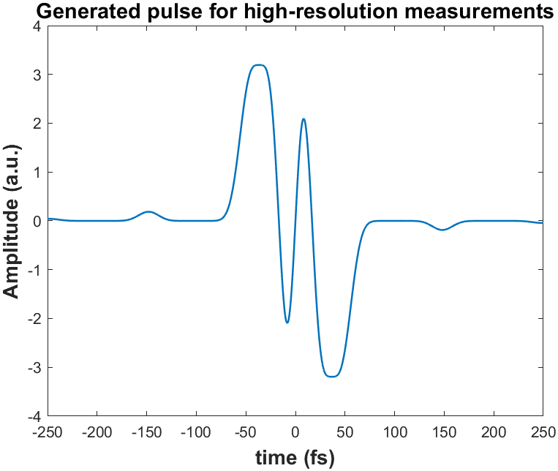
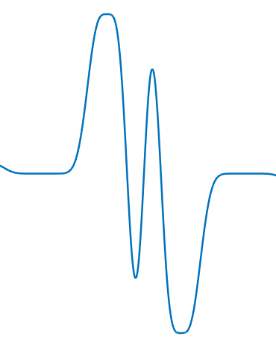

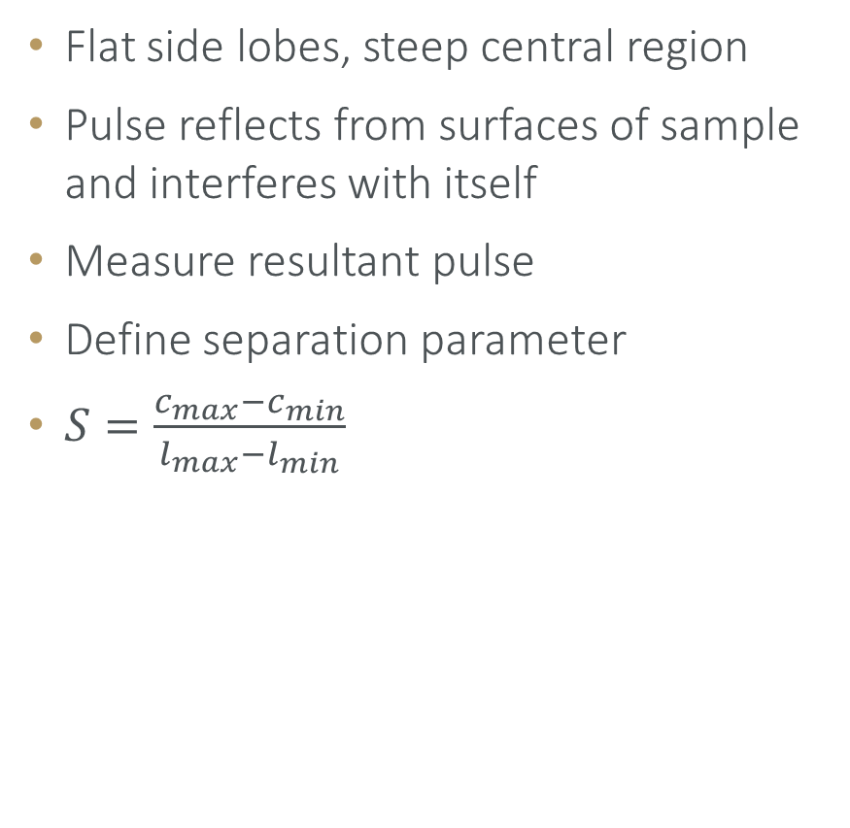


STRUCTURED PULSE SIMULATIONS
Flat side lobes, steep central region
Pulse reflects from surfaces of sample and interferes with itself
Measure resultant pulse
Define separation parameter
$S=\frac{c_{max}−c_{min}}{l_{max}−l_{min}}$
$$\text{R}\text{1}$$
$$\text{R}\text{2}$$
$$\text{d}$$
8

Slide 13


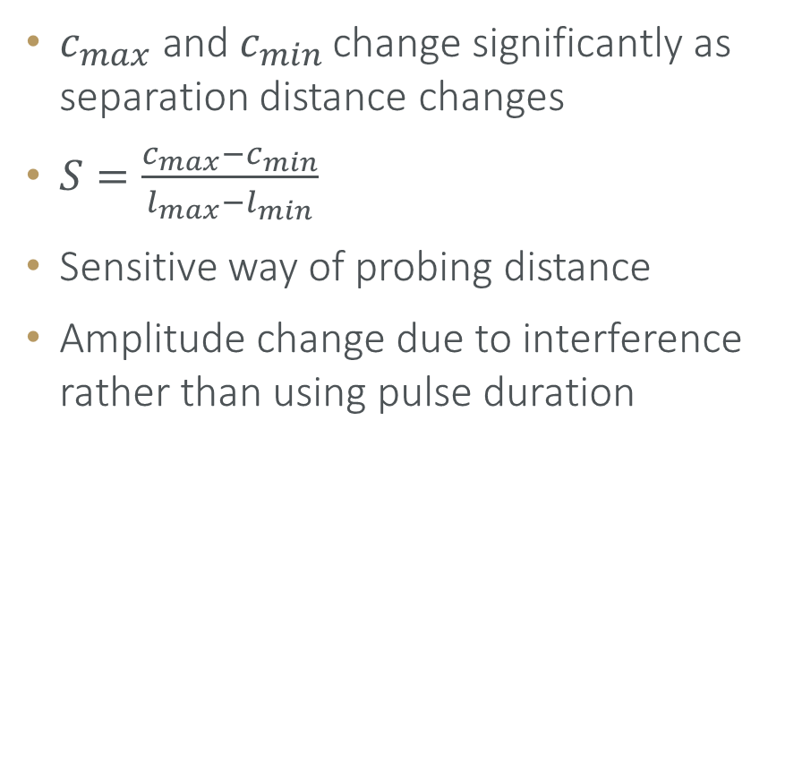




SEPARATION PARAMETER
$$\text{R}\text{1}$$
$$\text{R}\text{2}$$
$$\text{d}$$
$c_{max} \text{and} c_{min}$ change significantly as separation distance changes
$S=\frac{c_{max}−c_{min}}{l_{max}−l_{min}}$
Sensitive way of probing distance
Amplitude change due to interference rather than using pulse duration
$$\text{R}\text{1}$$
$$\text{R}\text{2}$$
$$\text{d}$$
9

Slide 14
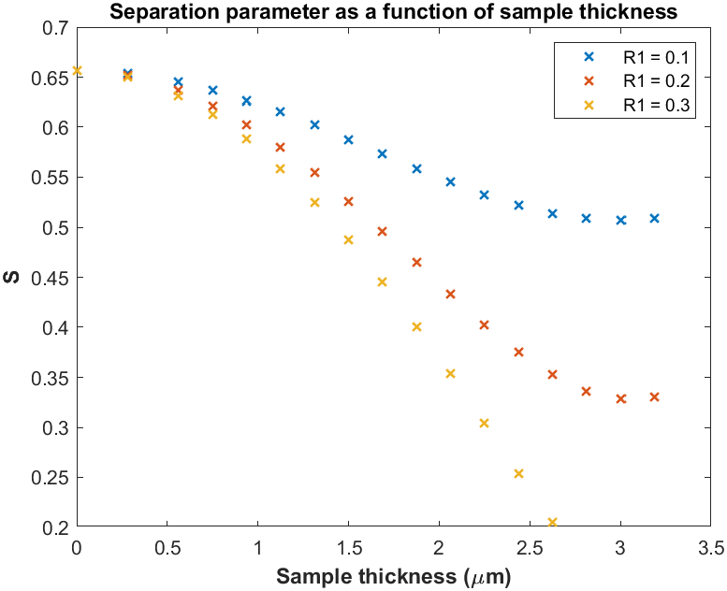
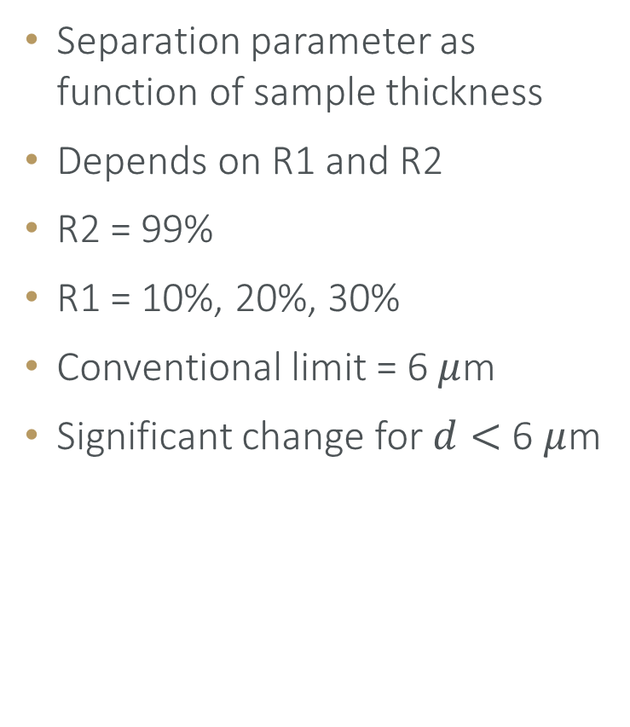
SIMULATED RESULTS
Separation parameter as function of sample thickness
Depends on R1 and R2
R2 = 99%
R1 = 10%, 20%, 30%
Conventional limit = 6 $μ$m
Significant change for $d<$ 6 $μ$m
10

Slide 15
FROM RADAR TO VISIBLE LIGHT
Challenges when translating from radio waves to visible light
Radio waves:
Can measure amplitude and phase
Visible light: much higher frequency
Pulse duration measurements: Intensity only
Phase information lost
Pulse retrieval techniques
Retrieve amplitude and phase of E-field
11

Slide 16
PULSE RETRIEVAL

Slide 17
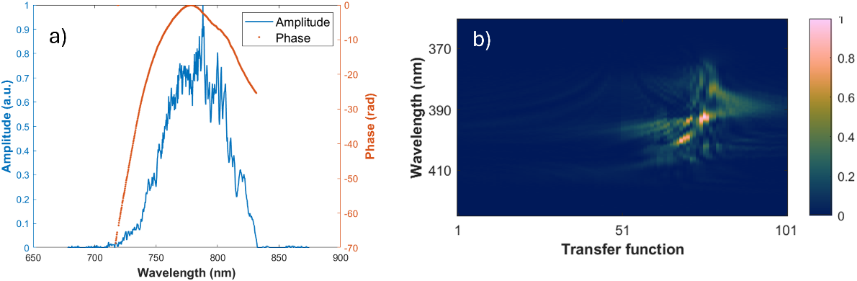

PULSE RETRIEVAL
Retrieve E-field amplitude and phase
FROG, SPIDER, MIIPS, d-scan, a-swing, FROSt
We use $\text{i}\text{2}\text{PIE}$
Apply sequence of known transfer functions
SHS measurements
Retrieve E-field amplitude and phase (spectral domain)
12

Slide 18


REMINDER OF PROCESS
$$⋯$$
Generate structured pulse (4f-shaper, SLM)
Illuminate sample with custom pulse
Retrieve pulse ($\text{i}\text{2}\text{PIE}$)
Calculate S, determine distance $d$ between surfaces
13

Slide 19
CUSTOM PULSE SHAPING

Slide 20
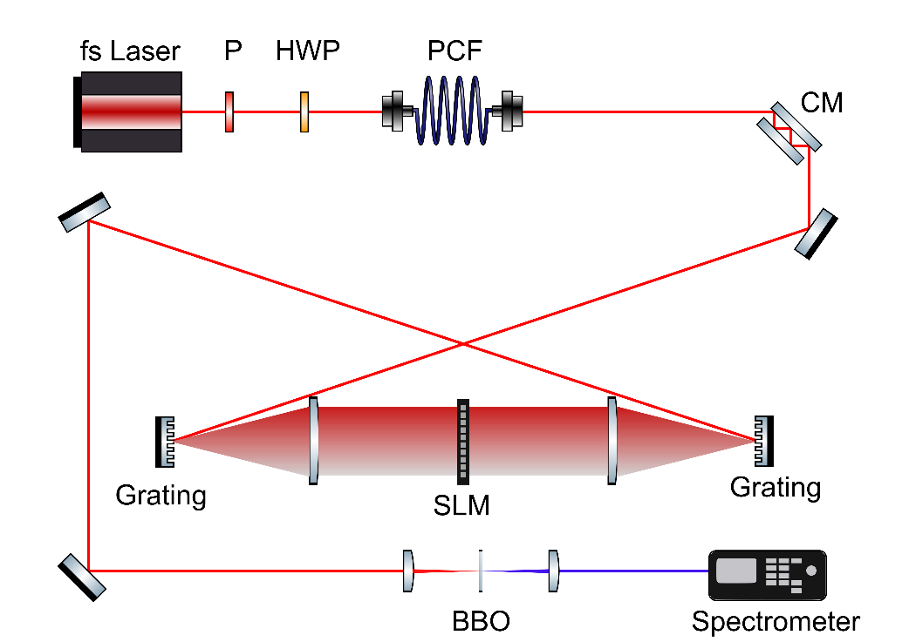
EXPERIMENTAL SETUP
14

Slide 21

CUSTOM PULSE SHAPING
Create desired pulse shape in time domain (“Target”)
FT to frequency domain
Target amplitude & phase
Known retrieved pulse amplitude & phase
Determine transfer function
$H_{A}=\frac{A_{T}}{A}$
$H_{φ}= φ_{T}−φ$
15

Slide 22
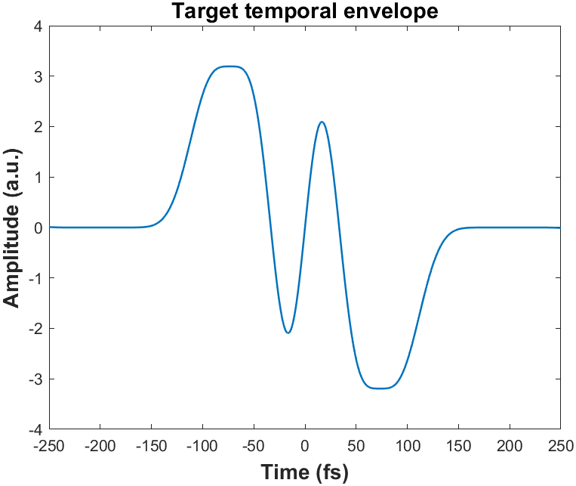
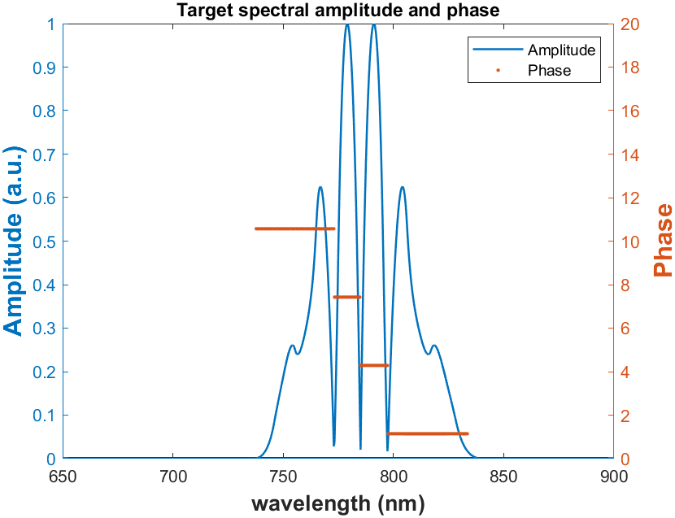
TARGET PULSE
16

Slide 23
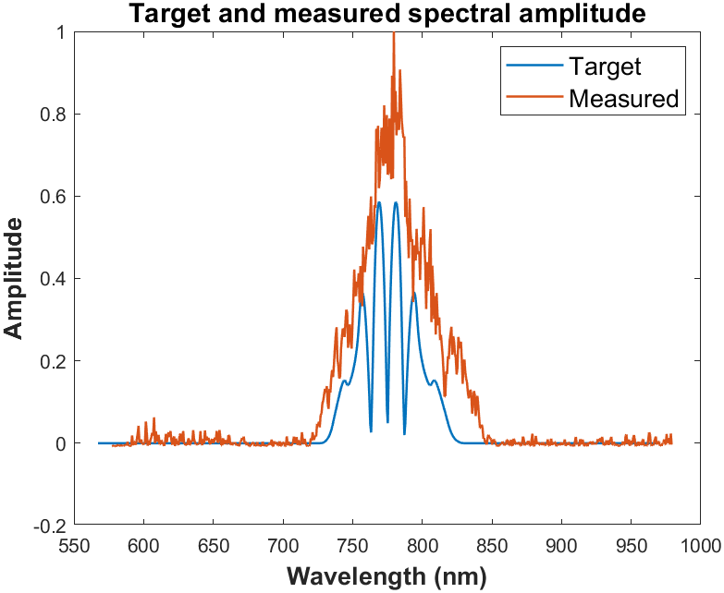
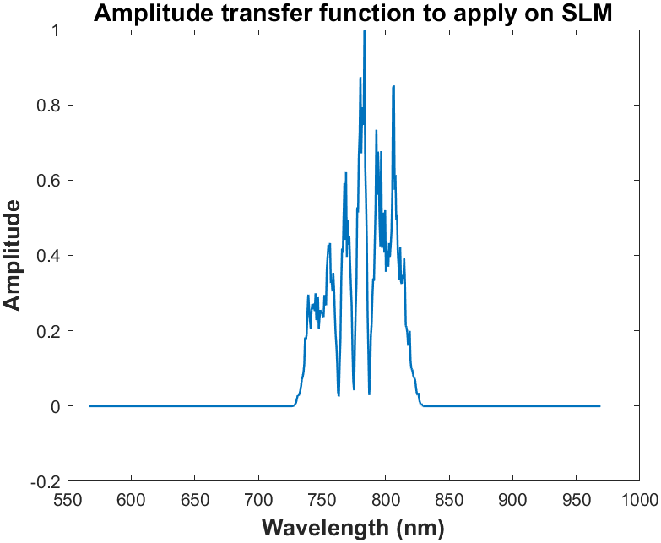
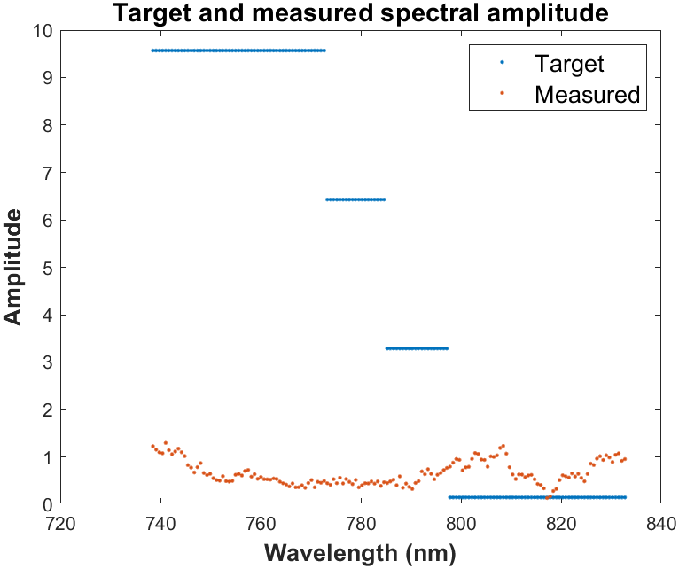
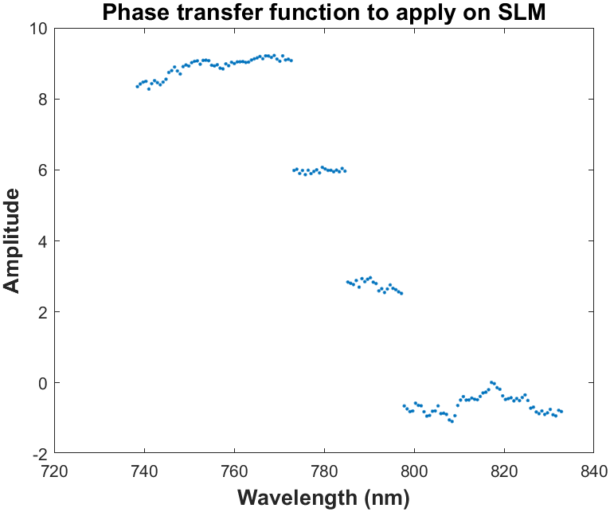
TRANSFER FUNCTION
Target and measured spectral phase
17

Slide 24
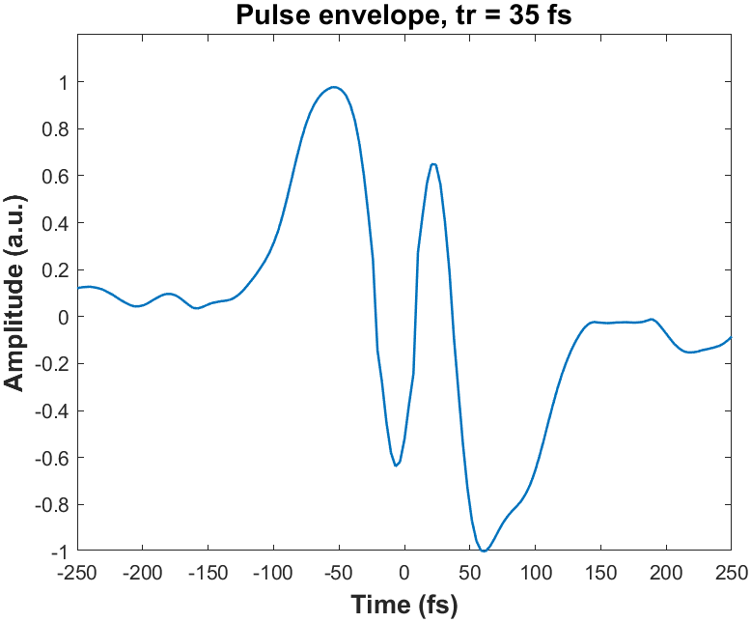
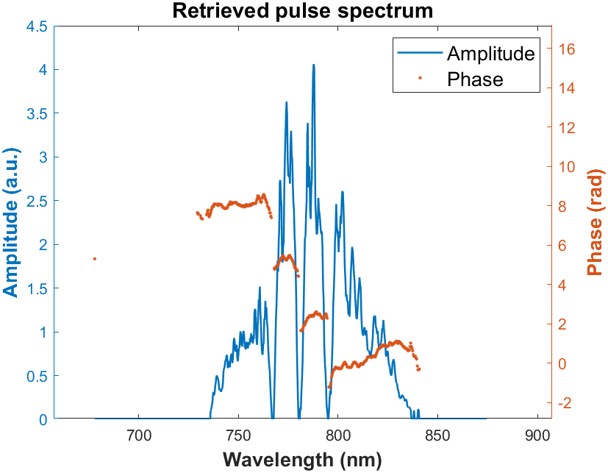
RETRIEVED PULSE
18

Slide 25
RESULTS

Slide 26


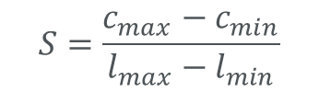

REMINDER
$$S=\frac{c_{max}−c_{min}}{l_{max}−l_{min}}$$
$$\text{R}\text{1}$$
$$\text{R}\text{2}$$
$$\text{d}$$
19

Slide 27
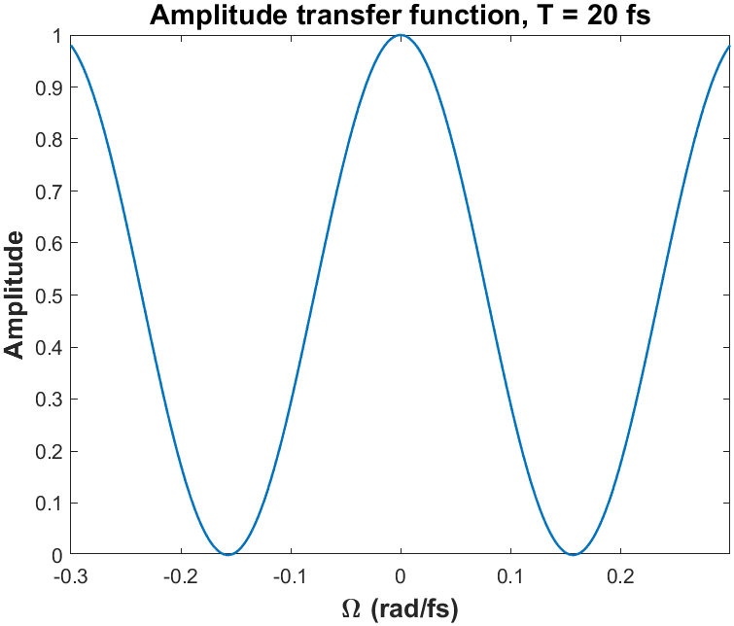
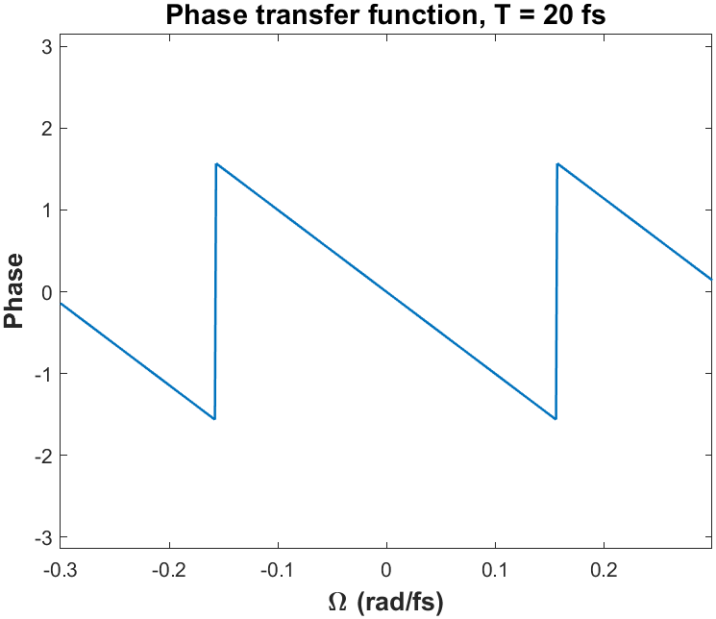

SHIFTED COPIES USING SLM
Simulate sample measurements using SLM
Apply amplitude and phase modulation on SLM to create shifted copy of a pulse
$H\left(Ω\right)= \left(\frac{1}{2} \right)\left( 1+\exp\left(−iΩT\right)\right)$
$T:$ Time delay
20

Slide 28
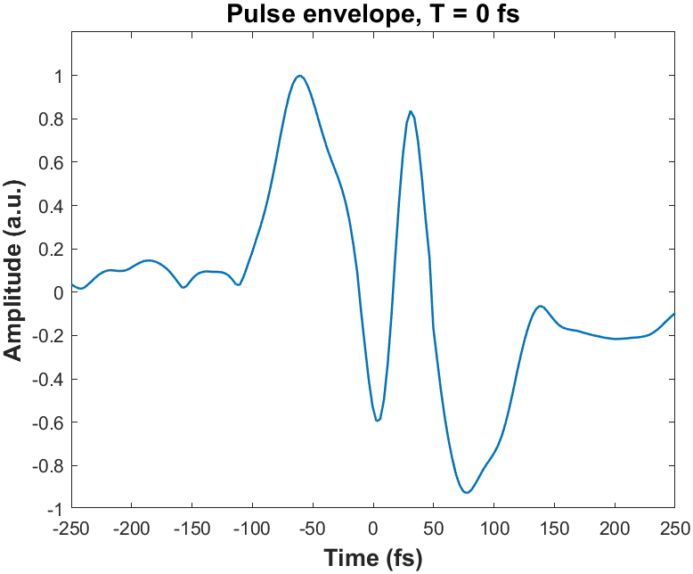
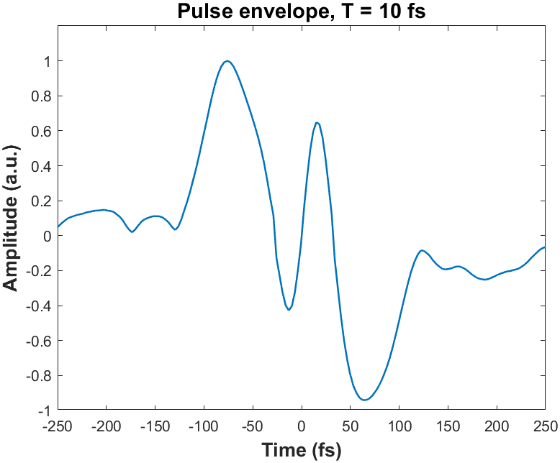
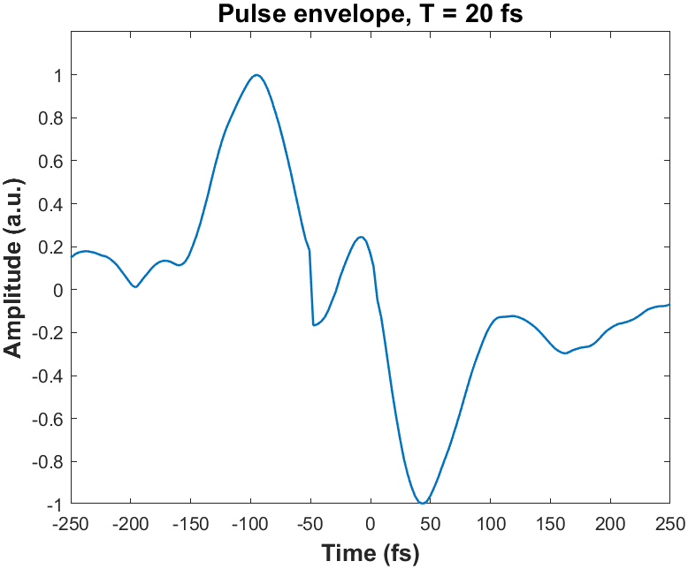
SHIFTED PULSE RETRIEVALS
T = 0, 10, 20 fs
21

Slide 29
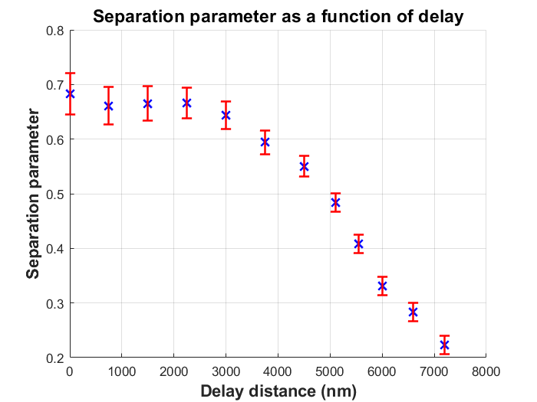
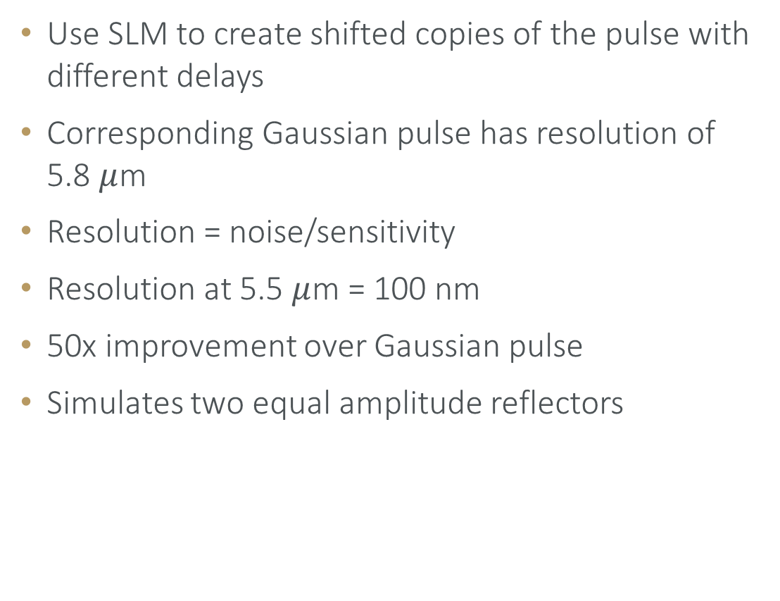
SHIFTED PULSES USING SLM
Use SLM to create shifted copies of the pulse with different delays
Corresponding Gaussian pulse has resolution of 5.8 $μ$m
Resolution = noise/sensitivity
Resolution at 5.5 $μ$m = 100 nm
50x improvement over Gaussian pulse
Simulates two equal amplitude reflectors
22

Slide 30
SAMPLES
Two mirrors with adjustable offset: surface profilometry
Spin coated thin films: stepping stone to OCT-like measurements
23

Slide 31
SUMMARY
Structured pulses for improved axial resolution in OCT
Create and retrieve custom pulses
SLM tests promising
Next:
  Real-world samples
  Multiple reflecting layers
  Biological samples
24

Slide 32
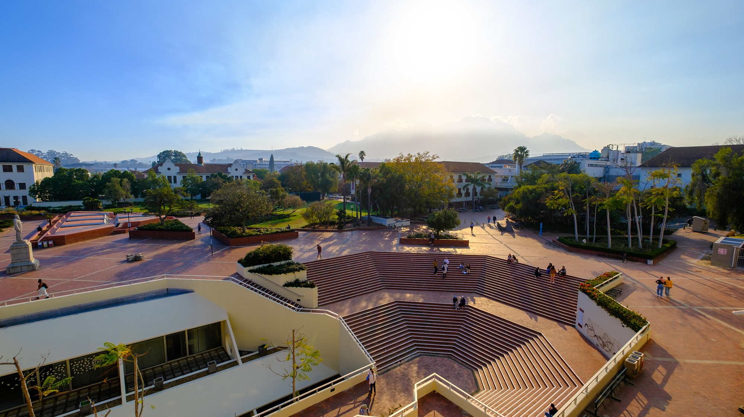
Thank you
Enkosi
Dankie
Wilhelm Frank Trust
Photo by Stefan Els

Slide 33
BLANK SLIDE
4

Slide 34
EXTRA SLIDES
4

Slide 35
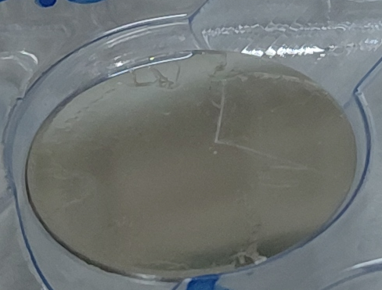
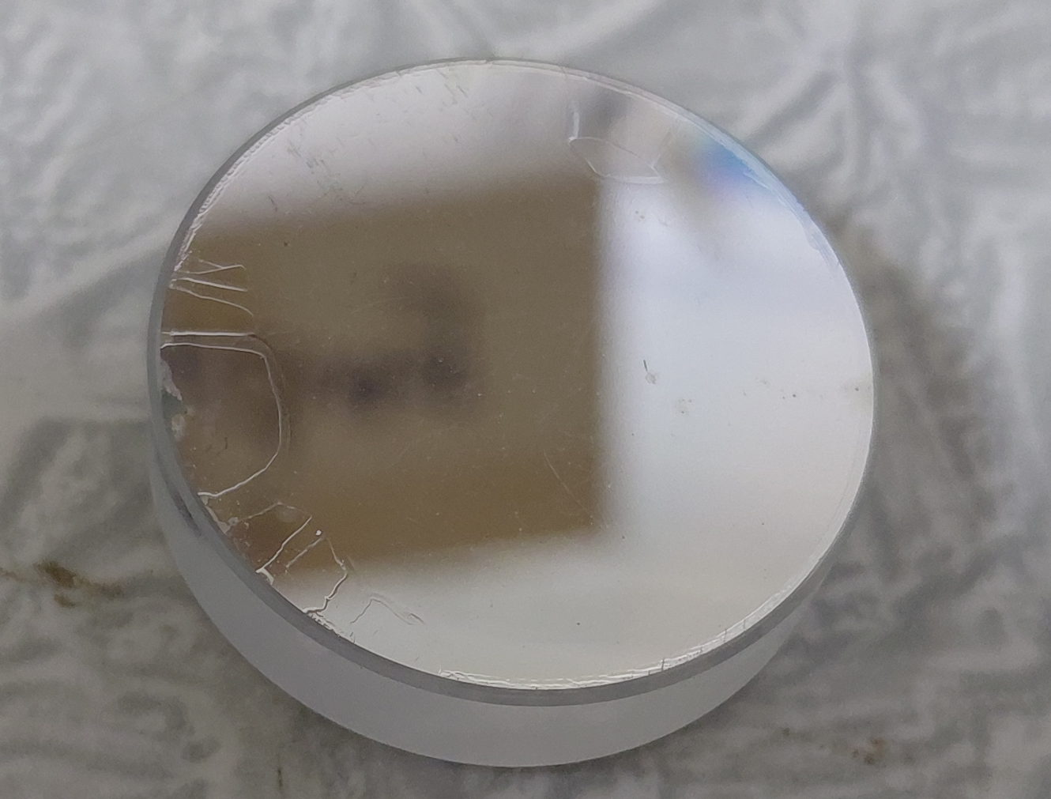

SAMPLES
Spin coat thin films on mirror
Polystyrene in Toluene
Thicknesses (1-10 $μ$m)
Verify with white light interferometry
Contrast low
Rather use freestanding films
22

Slide 36
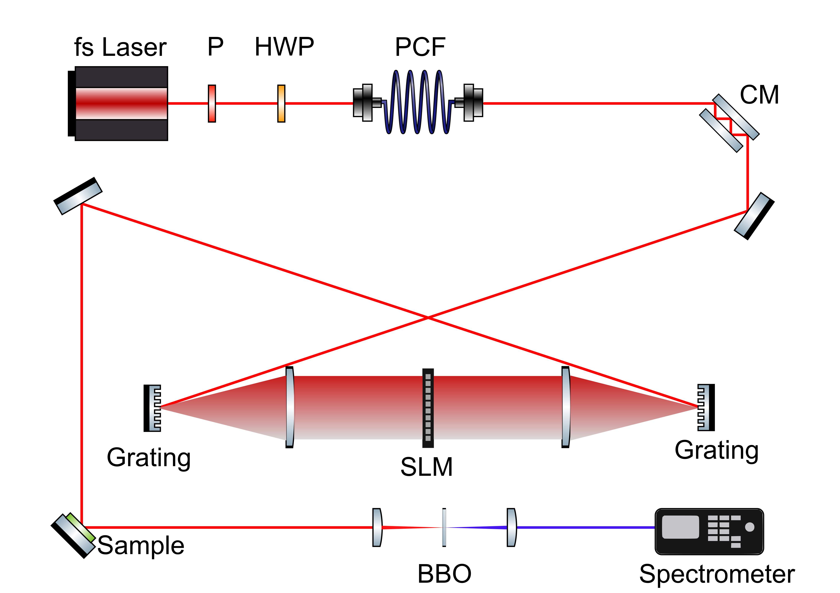
EXPERIMENTAL SETUP
11

Slide 37
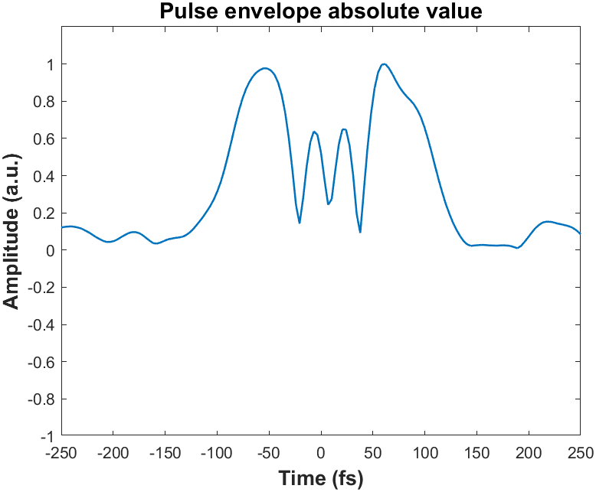
RETRIEVED PULSE
16

Slide 38

SHIFTED COPIES USING SLM
Apply amplitude and phase modulation on SLM to create shifted copy of a pulse
$H\left(Ω\right)= \left(\frac{1}{2} \right)\left( 1+\exp\left(−iΩT\right)\right)$
$T:$ Time delay
34

Slide 39
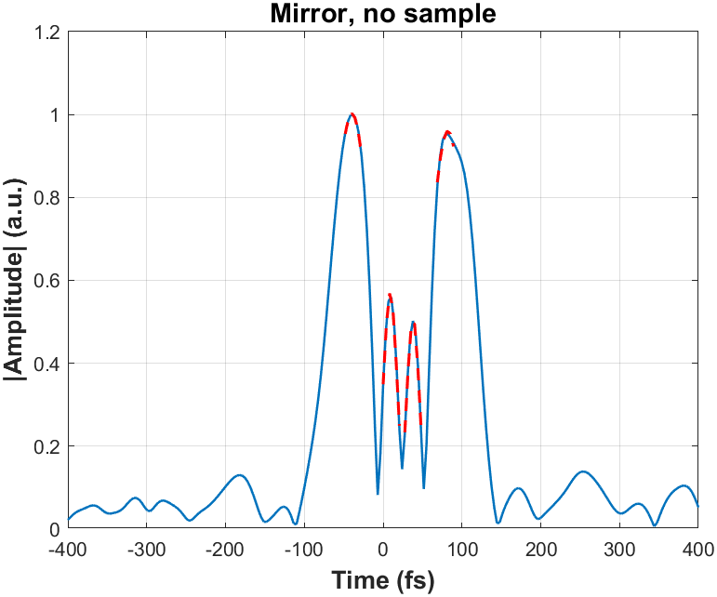
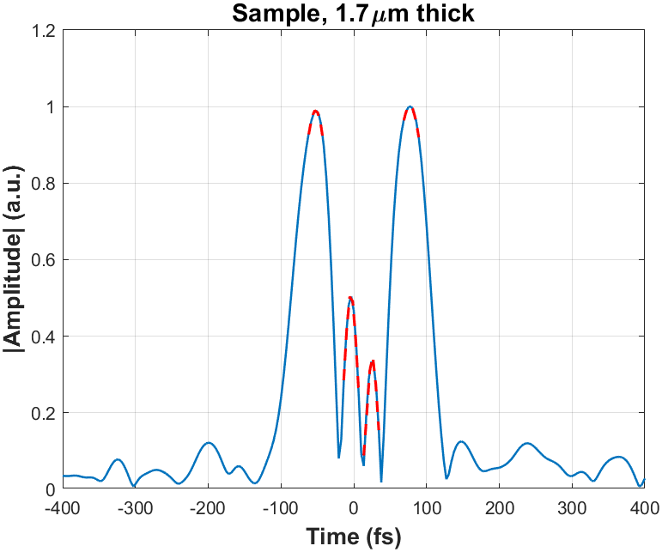
RESULTS: PULSE TEMPORAL PROFILE
Decrease in central peak heights for sample vs no sample
17

Slide 40
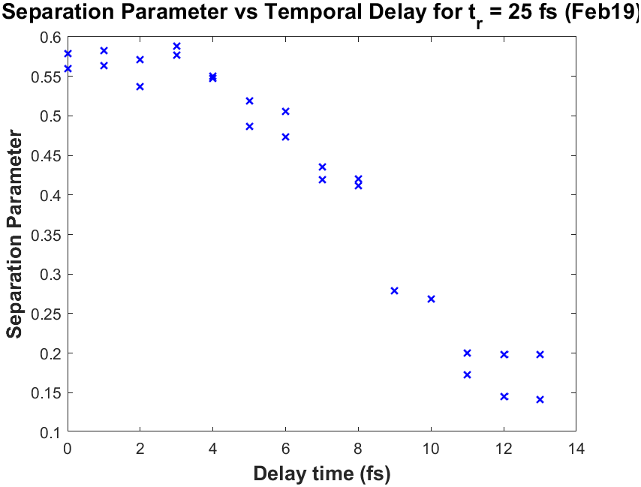
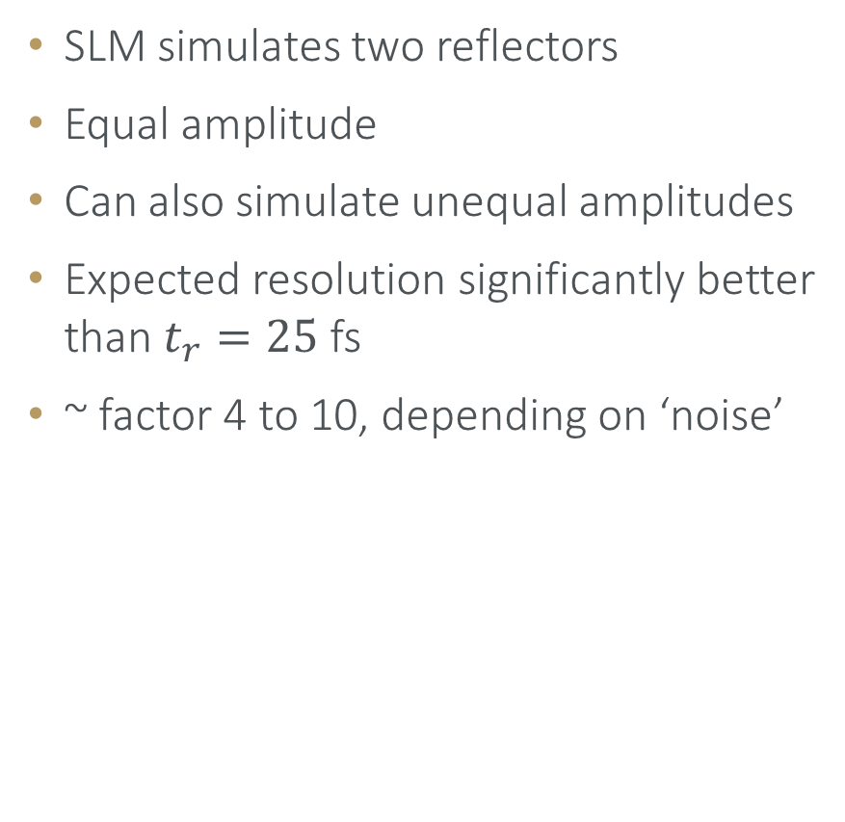
SHIFTED PULSE RETRIEVALS
SLM simulates two reflectors
Equal amplitude
Can also simulate unequal amplitudes
Expected resolution significantly better than $t_{r}=25$ fs
~ factor 4 to 10, depending on ‘noise’
36

Slide 41
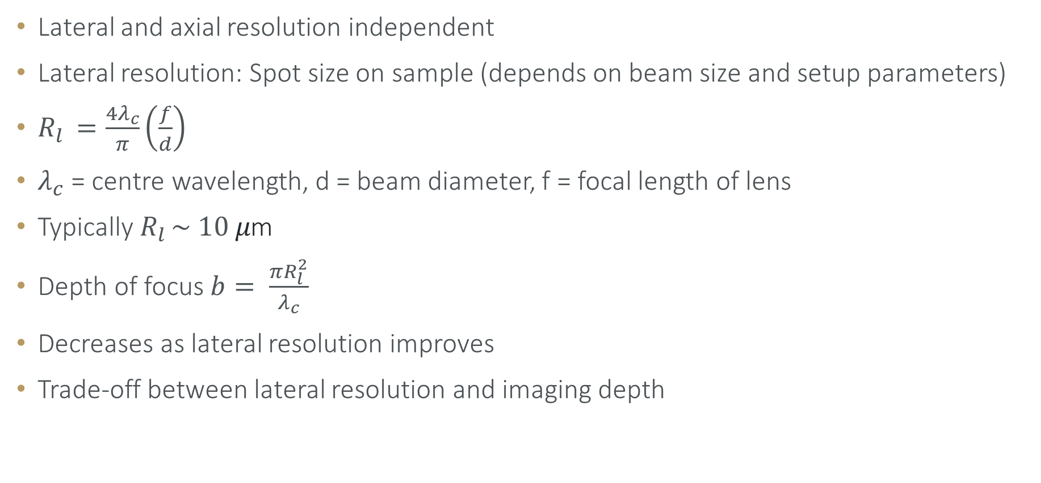
RESOLUTION
Lateral and axial resolution independent
Lateral resolution: Spot size on sample (depends on beam size and setup parameters)
$R_{l }=\frac{4λ_{c}}{π}\left(\frac{f}{d}\right)$
$λ_{c}$ = centre wavelength, d = beam diameter, f = focal length of lens
Typically $R_{l }\sim 10 μ\text{m}$
Depth of focus $b= \frac{πR_{l}^{2}}{λ_{c}}$
Decreases as lateral resolution improves
Trade-off between lateral resolution and imaging depth
11

Slide 42
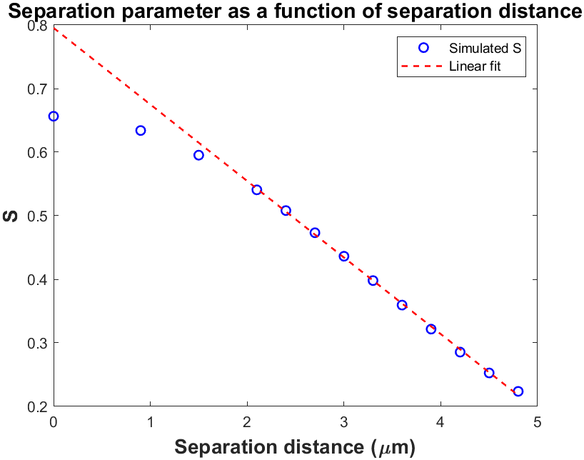


RESULTS
Change in S as distance changes
Use S to determine separation
$R_{a}=6$ $μ$m for standard OCT
Resolution improvement metrics
Minimum resolvable distance (MRD)
Assume noise = 10% S
MRD = 1.6 $μ$m
0.1*S
MRD = 1.6 $μ$m
14

Slide 43


RESOLUTION IMPROVEMENT METRICS
Smallest detectable change in distance (Resolution)
LOD = noise/sensitivity
Sensitivity = slope of S
At 3 $μ$m separation
LOD = (0.1)*(0.44)/(0.12/$μ$m)
Resolution = 370 nm
Order or magnitude improvement over standard OCT
LOD at 3 $μ$m: $\frac{0.1∗S}{0.12}$ = 370 nm
15

Slide 44

SHG INCREASE
SHG intensity increases for compressed pulse
5

Slide 45

OVERVIEW
Reconstruct $E_{in}$($Ω$)
Apply set of known transfer functions $H_{n}(Ω)$ to the pulse (SLM)
$H_{n}(Ω)$, $n=\left\{1,2,…N\right\}, N=101$
$Ω=ω−ω_{0}$
Apply transfer function to pulse
$o_{n}\left(Ω\right)=H_{n}(Ω)E_{in}(Ω)$
Measure second harmonic spectrum
$S_{n}\left(Ω\right)={\left|ℱ\{o_{n}^{2}(t)\}\right|}^{2}$
Use measured spectra together with known transfer functions to reconstruct pulse
7

Slide 46

PROCEDURE (Reconstruction)
Initial guess $E_{in}^{′}$($Ω$)
For $n=1,2,…N$
$o_{n}\left(Ω\right)=H_{n}\left(Ω\right)E_{in}^{′}\left(Ω\right)$ - estimated object
$g_{n}\left(t\right)=o_{n}^{2}\left(t\right)$ - estimated SH spectrum
$g_{n}^{′}\left(Ω\right)=\sqrt{S_{n}\left(Ω\right)}\exp\left(iarg\left(g_{n}\left(Ω\right)\right)\right)$ - update using measured spectrum
$o_{n}^{′}\left(t\right)=o_{n}\left(t\right)+βU_{n}\left(t\right)\left[g_{n}^{′}\left(Ω\right)−g_{n}\left(t\right)\right]$ - update object using measured spectrum
$U_{n}\left(t\right)= \frac{\left|o_{n}\left(t\right)\right|}{\max\left(\left|o_{n}\left(t\right)\right|\right)}\frac{o_{n}^{∗}\left(t\right)}{{\left|o_{n}\left(t\right)\right|}^{2}+α}$ - ptychography update step
$E_{in}^{′}\left(Ω\right)=H_{n}^{∗}\left(Ω\right)o_{n}^{′}\left(Ω\right)$ - i²PIE update step
End result: reconstructed pulse $E_{in}^{′}\left(Ω\right)$
10

Slide 47


TRANSFER FUNCTION
How to implement this?
Phase and amplitude modulation
Two screens (birefringent liquid crystals)
Polarizer after screen, transmission axis aligned with polarization of incoming light
$φ_{1}= φ+ \cos^{−1}{(A)}$
$φ_{2}= φ− \cos^{−1}{(A)}$
14

Slide 48
CUSTOM PULSE SHAPING (DETAILS)
Pulse in time
Angular frequency (ω)
Interpolate to SLM frequencies
Pulse in time
Angular frequency (ω)
Interpolate to SLM frequencies
6

Slide 49

PULSE IN TIME DOMAIN
Fourier transform to see pulse in time domain
$N$ points
$δω$
$T= \frac{2π}{δω}$
$t=$ N linearly spaced points from $\frac{−T}{2} \text{to} \frac{T}{2}$
Wavelength
Angular frequency (ω)
Interpolate
6

