Slide 1
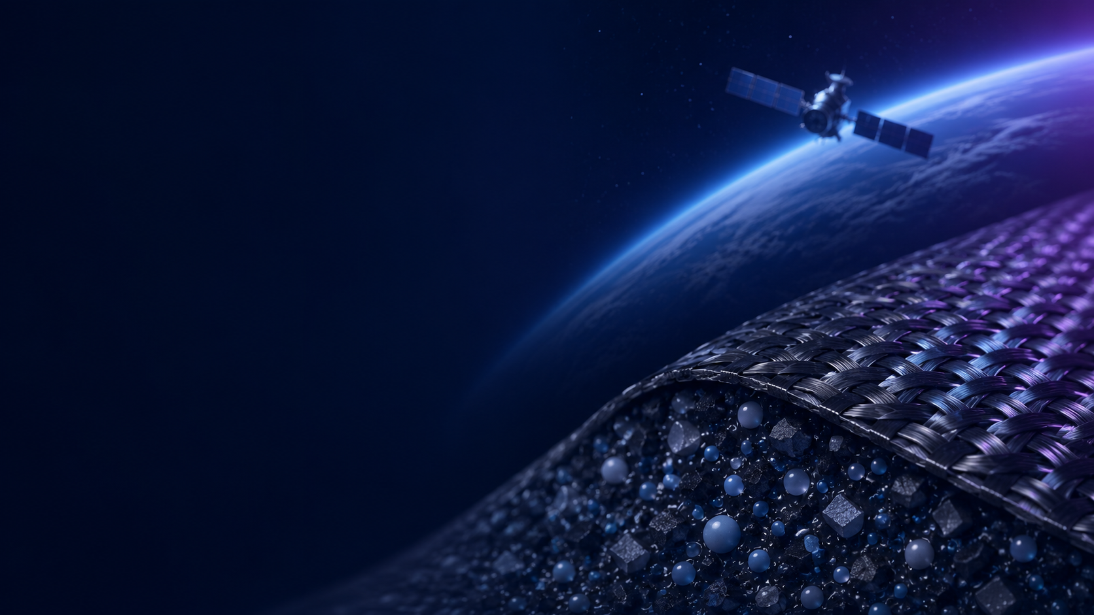




Non-linear Evolution of Wettability in ABPBI/MWCNT Composites
Under UV/Ozone Exposure: A Machine Learning Approach
S.A. Nkosi¹, C.J. Arendse², L.C. Square^{1,3} and M. Diro⁴
1. Centre for Space Research, North-West University, Potchefstroom, South Africa
2. Department of Physics, University of the Western Cape, Robert Sobukwe Road, Bellville, South Africa
3. National Institute for Theoretical and Computational Sciences (NITheCS), Potchefstroom, South Africa
4. Addis Ababa University, Entoto road, Addis Ababa, Ethiopia

Slide 2

Outline
1. Broader Study Context
2. Wettability in LEO
3. Research Gap and Motivation
4. ABPBI/MWCNT Material System
5. UV/Ozone Ageing Method
6. Contact Angle and Surface Free Energy
8. ML Framework and Small data
9. Feature Engineering and Model Building
10. Model Interpretation
11. Conclusions and Future Work

Slide 3
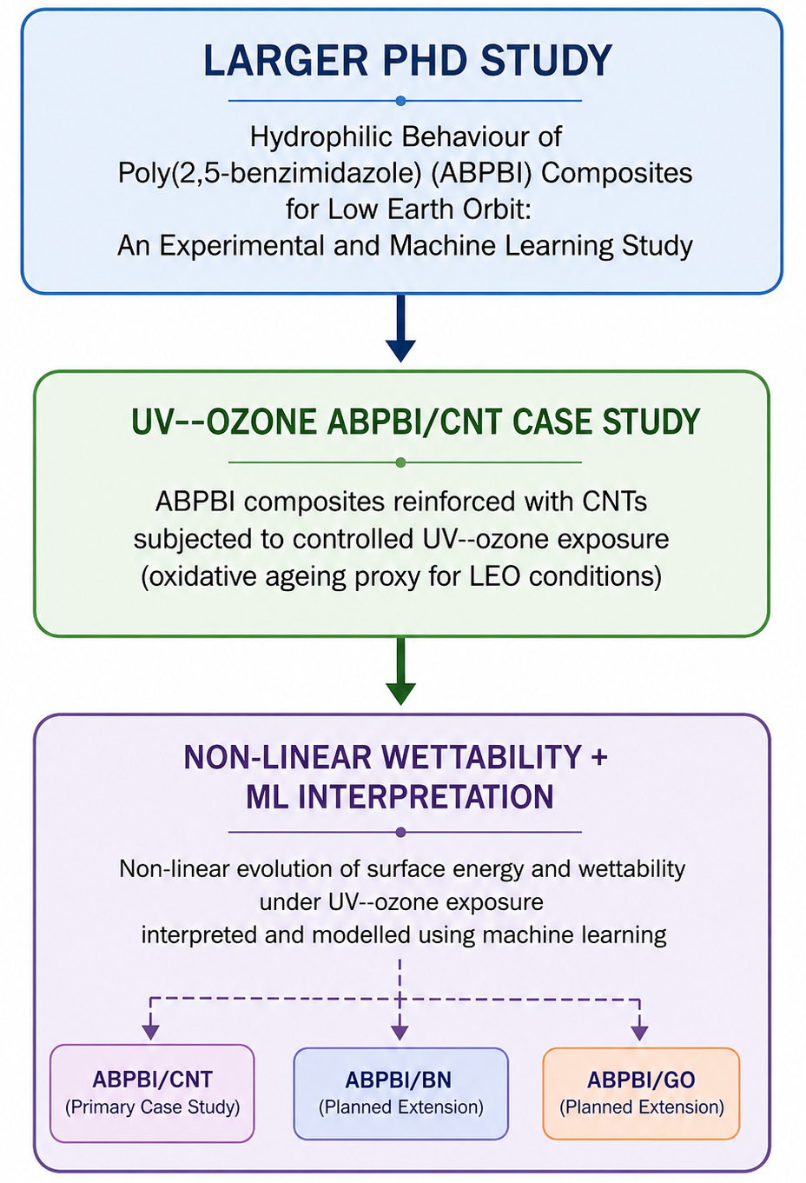
Broader Study Context
This presentation forms part of a larger PhD study on Poly[2, 5-benzimidazole] (ABPBI) composites for Low Earth Orbit (LEO).
Focus of this case study:
  ABPBI/Multi-Walled Carbon nanotubes (MWCNT) composites
  UV–ozone oxidative ageing
  Contact angle and surface free energy response
  Small-data machine learning interpretation
Framework for understanding wettability behaviour in ABPBI/CNT composites.
Fig. 1: Current ABPBI/CNT case study within the broader project framework.

Slide 4
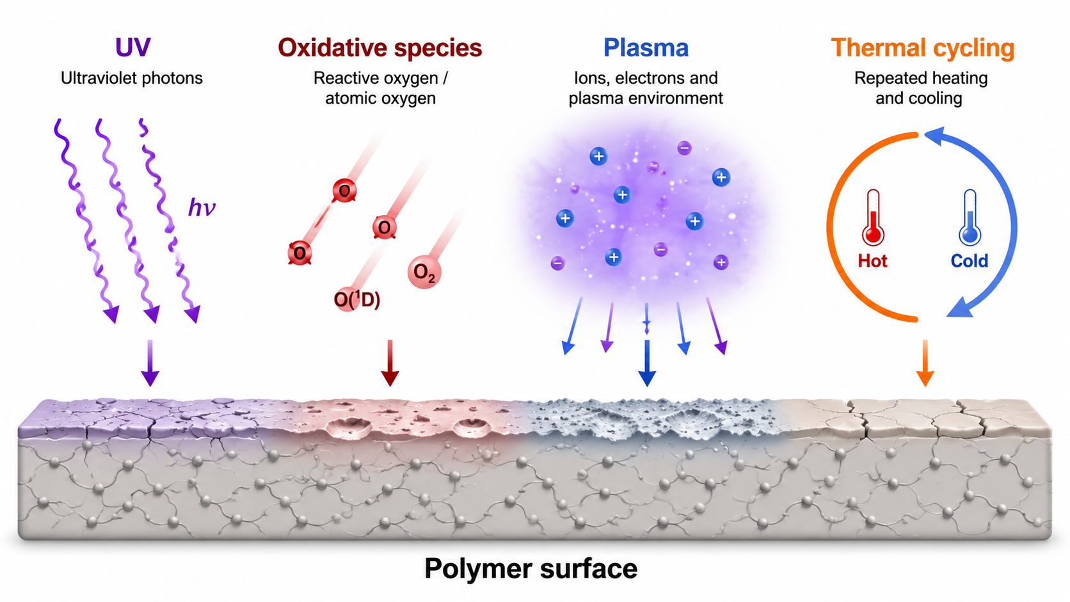
Wettability in LEO
Polymer degradation in LEO begins mainly at the surface.
Surface chemistry and morphology influence material–environment interactions.
Wettability is sensitive to near-surface modification.
Contact angle and surface free energy can indicate early surface changes.
Fig. 2: Polymer surface under LEO-like conditions: UV, oxidative species, plasma, and thermal cycling.

Slide 5
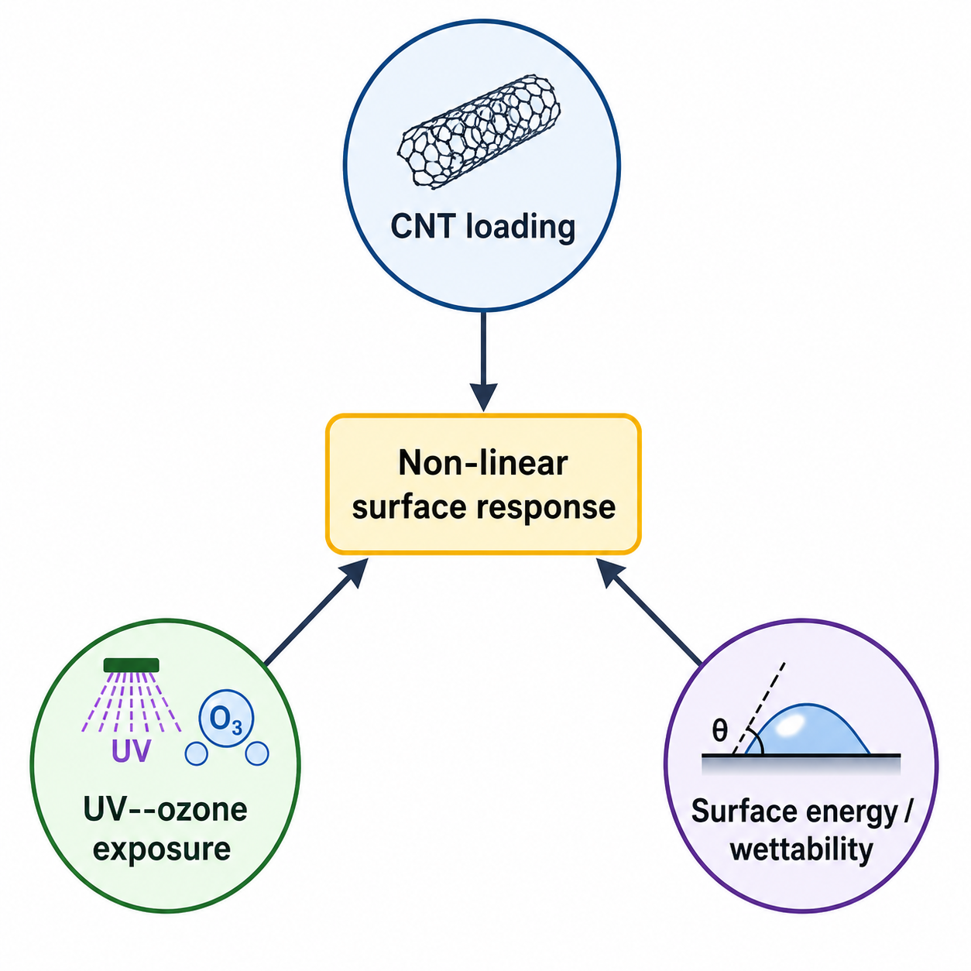
Motivation and Research Gap
ABPBI/MWCNT composites are relevant for harsh-environment applications,
including LEO radiation exposure and high-temperature operation
The near-surface wettability response of ABPBI/MWCNT composites under
LEO-like oxidative ageing remains less explored.
Use UV/ozone (UVO) exposure and small-data ML to interpret non-linear changes in contact angle and surface free energy
Fig. 3: Drivers of non-linear surface response in ABPBI/CNT composites.

Slide 6
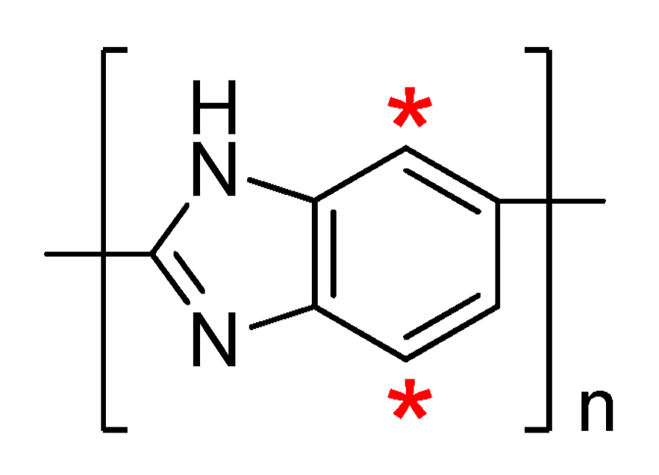
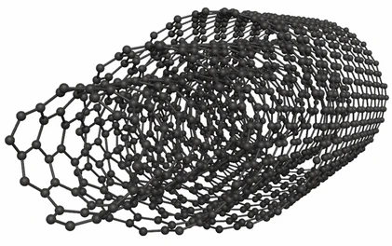
Material System: ABPBI/MWCNT Composites
ABPBI matrix
  High-performance aromatic polymer
  Thermally and chemically stable backbone
  Relevant for harsh-environment polymer studies
  Surface behaviour can indicate early degradation
MWCNT filler
  High-aspect-ratio carbon nanofiller
  Can modify mechanical, thermal, and interfacial behaviour
  Introduces surface heterogeneity and filler–matrix interfaces
  May change how the surface responds to UV/Ozone ageing
Fig. 4: Top: ABPBI repeat unit. Bottom: Multi-walled carbon nanotubes

Slide 7
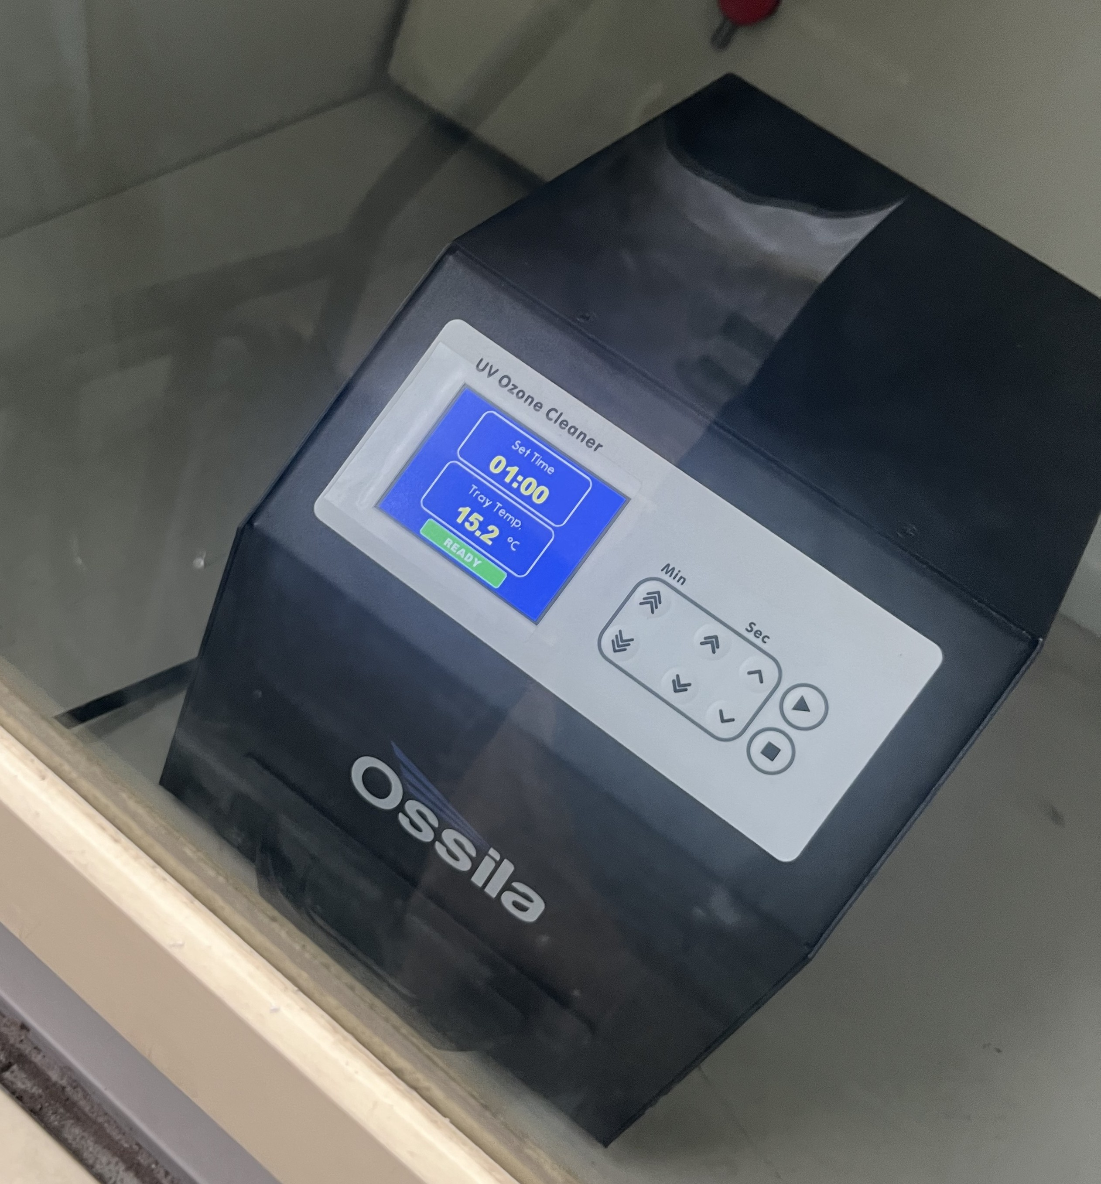
UV–Ozone Ageing
UV–ozone treatment was used as a controlled
oxidative ageing route.
The treatment is expected to modify mainly the
near-surface region.
Possible surface effects include:
  surface oxidation,
  formation of polar functional groups,
  surface restructuring or etching
Fig. 5: An Ossila UV–Ozone Cleaner

Slide 8
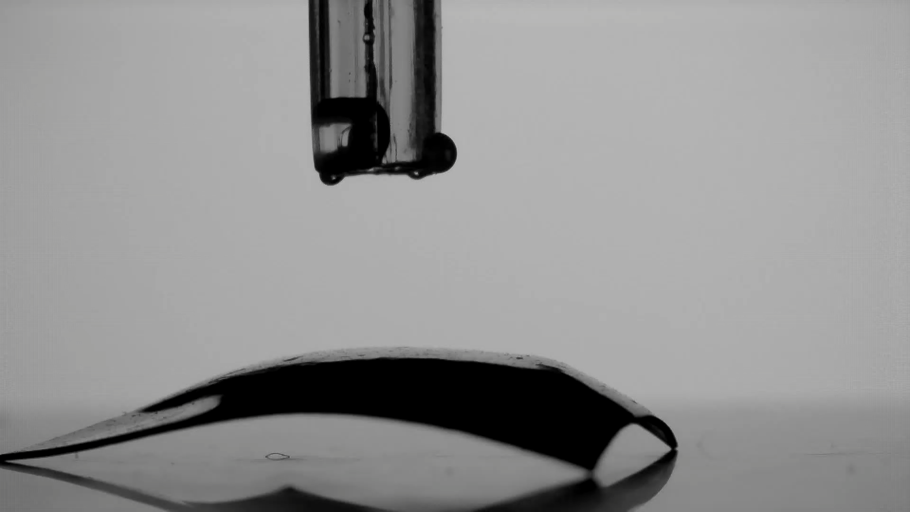
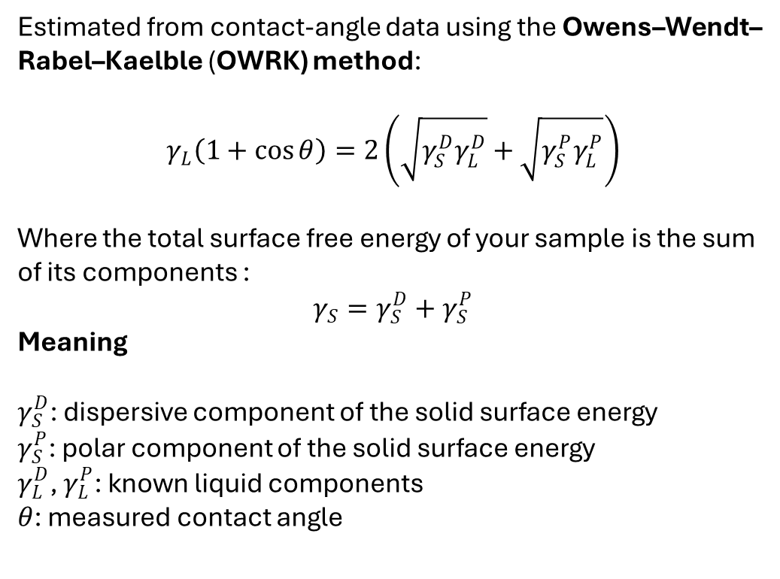
Contact Angle and Surface Free Energy
Sessile-drop method:
Surface free energy:
The contact angle, θ, is measured at the solid–liquid–vapour interface.
Lower θ → stronger wetting / more hydrophilic surface.
Higher θ → weaker wetting / more hydrophobic surface
Estimated from contact-angle data using the Owens–Wendt–
Rabel–Kaelble (OWRK) method:
$$γ_{L}\left(1+\cos{θ}\right)=2\left(\sqrt{γ_{S}^{D}γ_{L}^{D}}+\sqrt{γ_{S}^{P}γ_{L}^{P}}\right)$$
Where the total surface free energy of your sample is the sum
of its components :
$$γ_{S}=γ_{S}^{D}+γ_{S}^{P}$$
Meaning
$γ_{S}^{D}$: dispersive component of the solid surface energy
$γ_{S}^{P}$: polar component of the solid surface energy
$γ_{L}^{D}$, $γ_{L}^{P}$: known liquid components
$θ$: measured contact angle
Fig. 6: Sessile drop method.

Slide 9
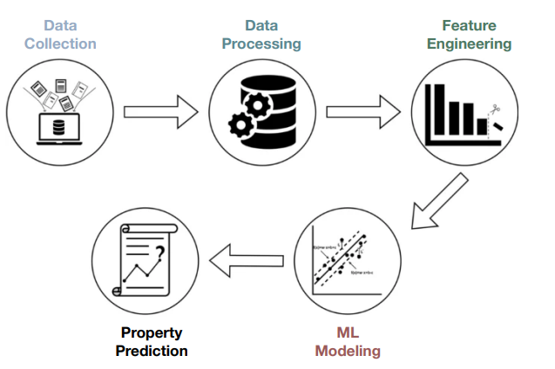
ML framework and small data problem
Use machine learning (ML) as an interpretive tool to understand non-linear wettability behaviour, not as a final predictive model.
Small data problem:
Materials Informatics, datasets are often small because each data point is expensive and time-consuming to produce.
ML models look more confident than they really are.
Risk | Safeguard
Overfitting | LOOCV / repeated cross-validation
False confidence | RMSE, MAE, and R²
Unstable feature importance | Physically informed descriptors
Overclaiming | SHAP interpreted cautiously
Fig. 7 : Main steps towards property predictions through the use of ML frameworks

Slide 10
Feature engineering and model building
Feature Engineering:
Base descriptors | Engineered descriptors
UV-ozone exposure time | Time transformations
MWCNT loading | Loading transformations
Contact Angle | Loading × time interactions
Surface free energy | SFE interaction terms
Feature engineering is where the physics enters before the model.
Engineered descriptors are added to represent possible non-linear behaviour.
Model Building:
Predictive - can formulation and exposure
history predict WCA?
Interpretive - what surface-response variables
help explain WCA?
Tab. 1: Base and Engineered features.

Slide 11
Model interpretation
Validation before interpretation
RMSE: Typical prediction error in WCA.
R² : WCA variation.
Oxidation, surface energy, heterogeneity and possible roughness/restructuring.
It highlights which measured descriptors deserve closer experimental attention.
Custom ABPBI composites with specific wettability and surface-stability targets.
Interpretability question:
Which descriptors most affect the predicted water contact angle?
SHAP / feature attribution
Used to identify influential features

Slide 12
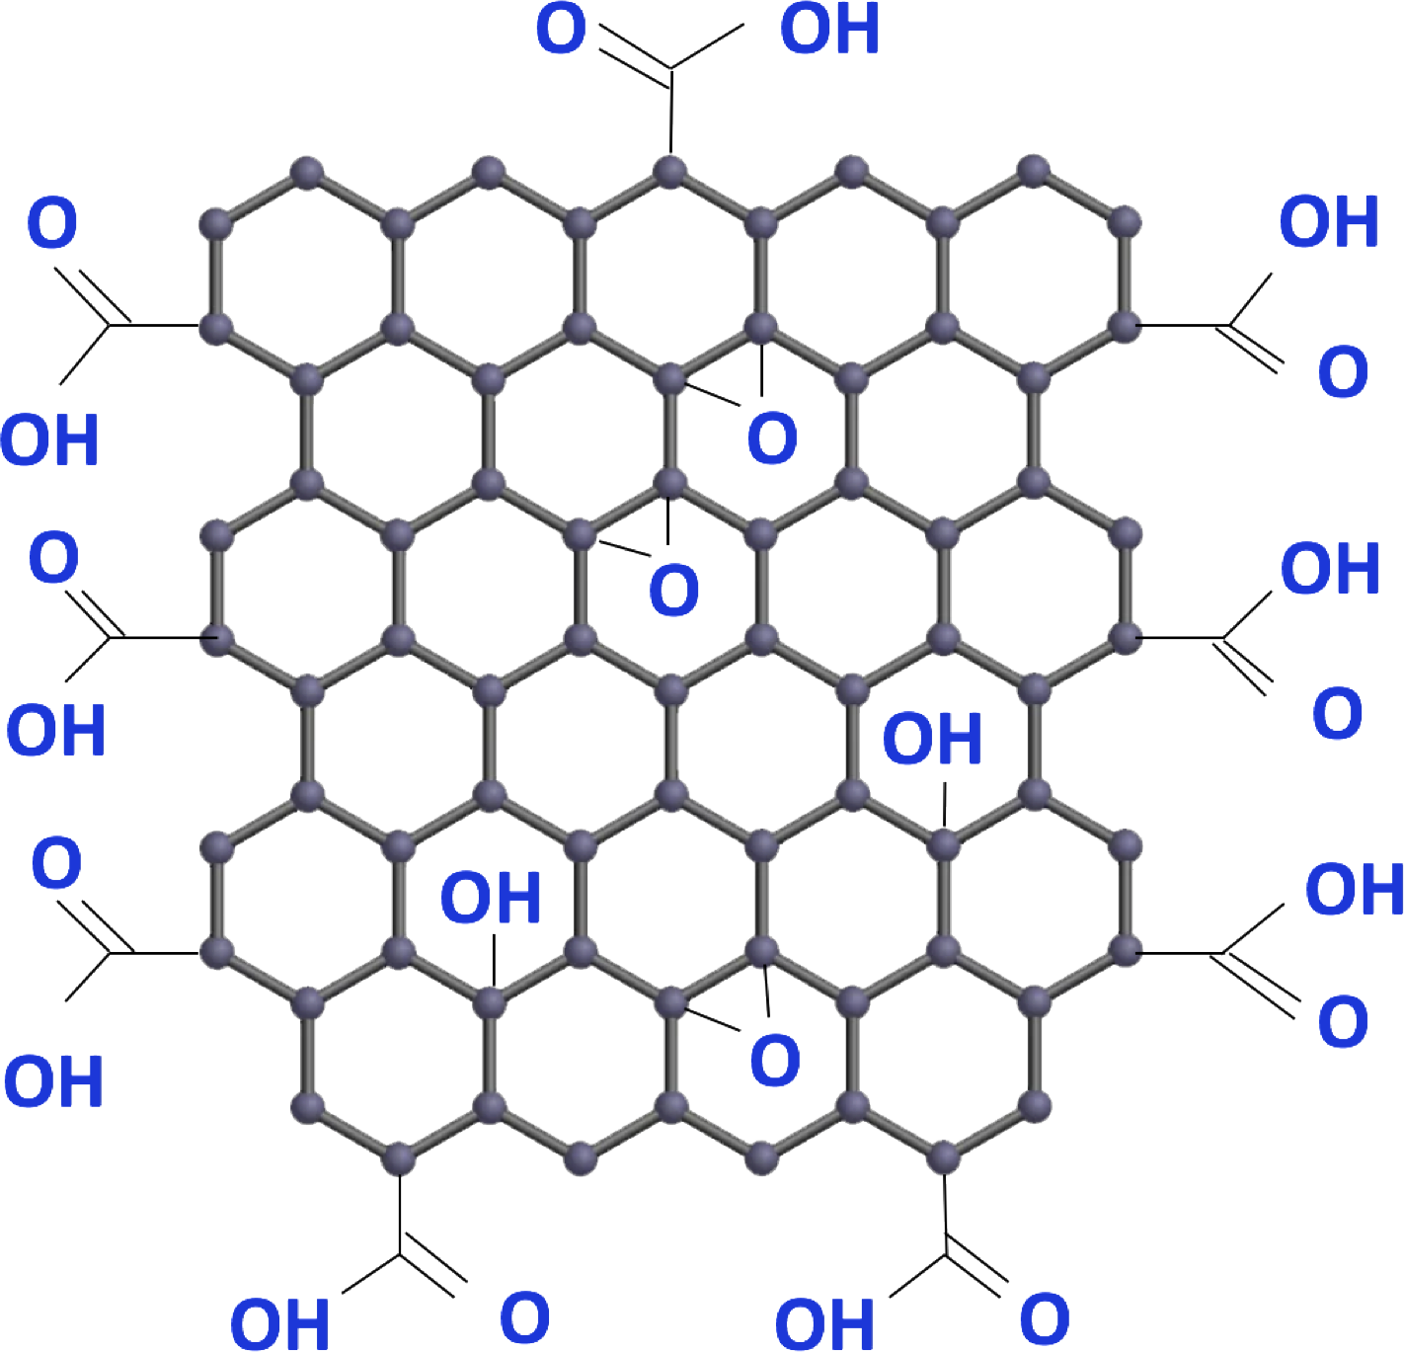
Conclusion and Future Work
ABPBI/MWCNT composites show measurable wettability changes after UV-ozone ageing.
The response is non-linear, consistent with competing surface processes.
Small-data ML is useful as an interpretive framework when paired with cautious validation.
Feature attribution supports future design of composites with targeted surface properties.
Expand the dataset by also including BN AND GO, and integrating Raman and SEM analysis data to the system.

Slide 13
Acknowledgments
North-West University Centre for Space Research for academic and research support.
South African National Space Agency (SANSA) for funding support.
My supervisors, Prof. L. Square and Dr M. Chaka, for their guidance and mentorship.
Prof. C. Arendse and James Mercuur for their valuable assistance and support.
Nano-Micro Manufacturing Facility, University of the Western Cape, for experimental support.
Laboratory for Electron Microscopy, North-West University, for microscopy support.

Slide 14
References
[1] Fourie et al., APL Materials, 2023.
[2] Square et al., Radiation Physics and Chemistry, 2025.
[3] Banks and de Groh, MRS Proceedings, 2004.
[4] Grossman and Gouzman, Nucl. Instrum. Methods Phys. Res. B, 2003.
[5] Vig, J. Vac. Sci. Technol. A, 1985.
[6] Young, Phil. Trans. R. Soc. Lond., 1805.
[7] Owens and Wendt, J. Appl. Polym. Sci., 1969.
[8] Kaelble, J. Adhesion, 1970.
[9] Coleman et al., Carbon, 2006.
[10] Lohokare et al., J. Membrane Science, 2018.
[11] Butler et al., Nature, 2018.
[12] Lundberg and Lee, NeurIPS, 2017.

