Slide 1
X-ray production cross section measurements for heavy ion induced X-ray emission spectroscopy of thin films
Lilian Moremi
69th SAIP Conference, WITS University, July 2025
Supervisor: Prof M.Msimanga
Co-Supervisor: Dr M.C Masekane

Slide 2
Presentation outline
Introduction
Problem statement
Aim and Objectives
Experimental procedure
Results and discussion
Conclusion
References
8. Acknowledgements

Slide 3
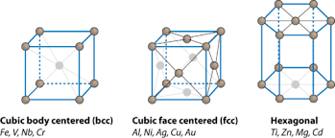
1. Introduction
Structure-property relationships in materials
Materials behavior
Materials development
Performance
https://www.google.com/url?sa=i&url=https%3A%2F%2Fflexbooks.ck12.org%2Fcbook%2Fck-12-chemistry-flexbook-

Slide 4
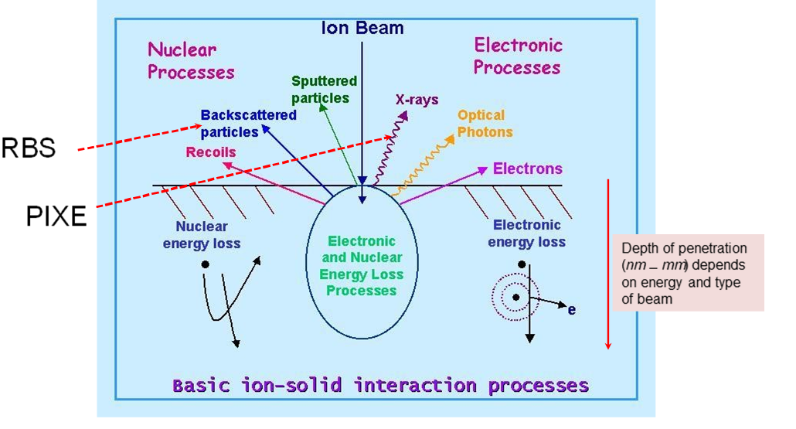
Ion Beam Analysis of materials
Ion Beam Analysis(IBA) uses high-energy (i.e MeV) ion beams to probe elemental composition, thickness and crystallinity of thin film materials
Common IBA techniques include PIXE, RBS and ERDA

Slide 5
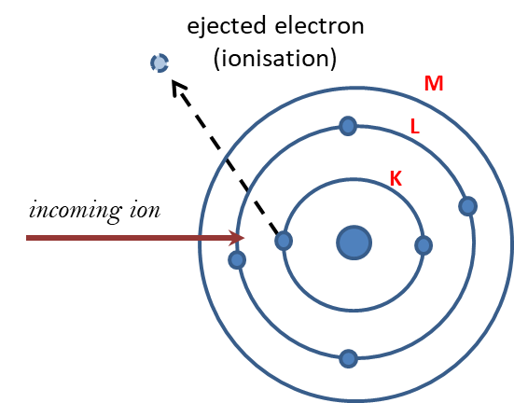
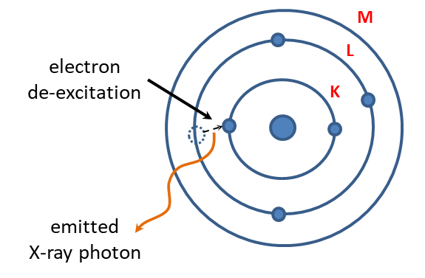
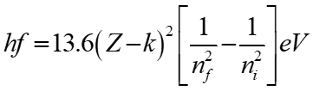
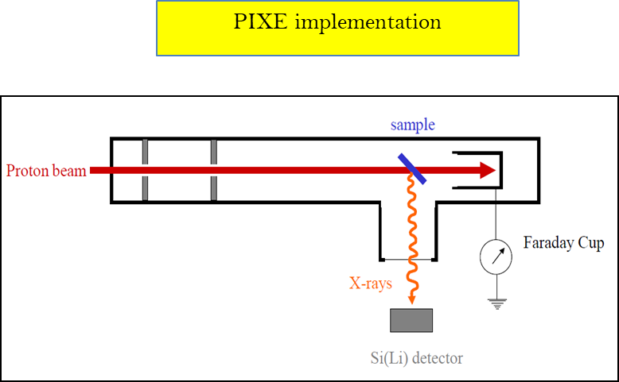
Particle induced X-ray Emission (PIXE)
Identification of atomic species: based on Moseley’s law
collisional ionisation
de-excitation

Slide 6
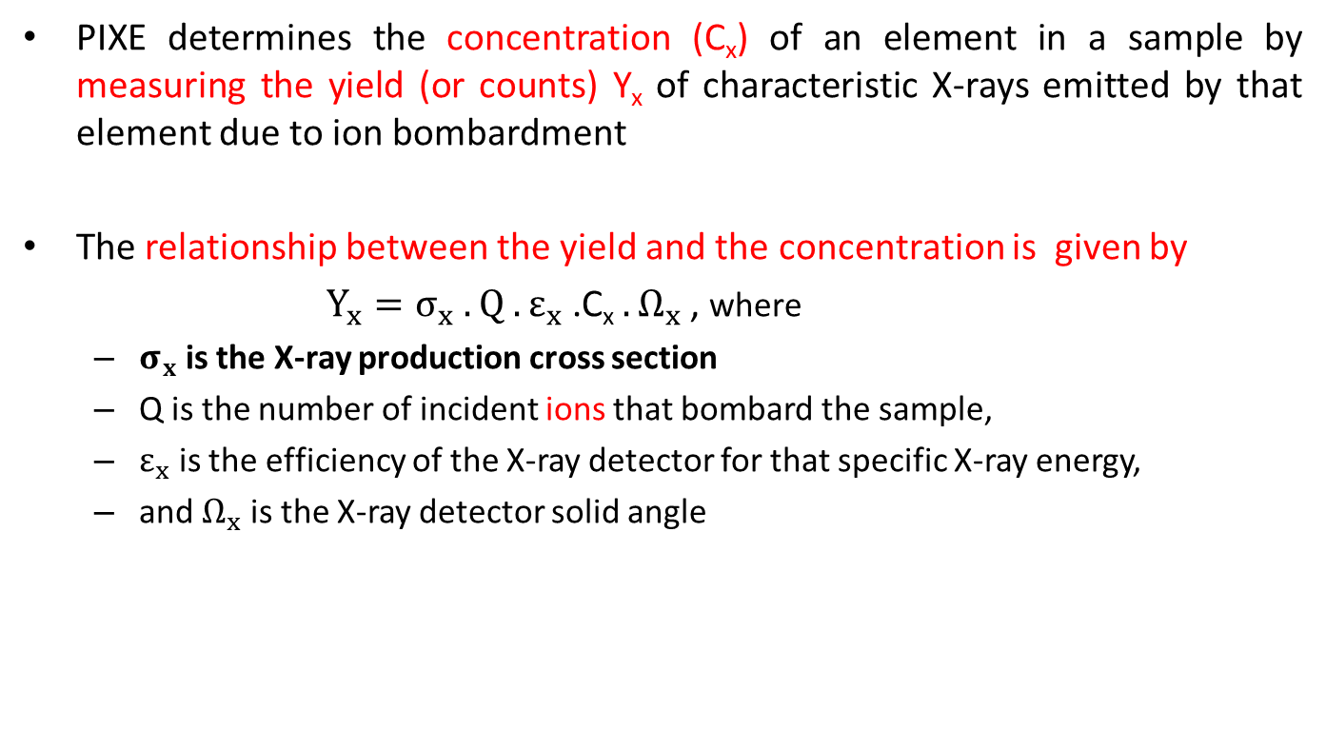
Quantification in PIXE
PIXE determines the concentration (C_{x}) of an element in a sample by measuring the yield (or counts) Y_{x} of characteristic X-rays emitted by that element due to ion bombardment
The relationship between the yield and the concentration is given by
$Y_{x}=σ_{x} .Q{ .ε}_{x}$ .C_{x}${ .Ω}_{x}$ , where
  $σ_{x}$ is the X-ray production cross section
  Q is the number of incident ions that bombard the sample,
  $ε_{x}$ is the efficiency of the X-ray detector for that specific X-ray energy,
  and $Ω_{x}$ is the X-ray detector solid angle

Slide 7
PIXE cross sections: theory vs experiment
ECPSSR
Energy Loss and Coulomb Deflection Perturbed Stationary State Relativistic is a theory used to predict X-ray production cross sections in ion beam analysis methods such as particle-induced X-ray emission (PIXE)

Slide 8
Structure-property studies of thin films: PIXE analysis
PIXE can provide information about the relative concentration of the heavy elements in a film.
Total Ion Beam Analysis (TIBA) is a combination of IBA techniques (e.g PIXE, RBS and ERDA) that uses a beam of energetic ions to probe the material and extract information about the elements present, their composition, thickness, etc.
TIBA is crucial in analysis of perovskites thin films to establish relationships between thickness and composition, and properties of films

Slide 9

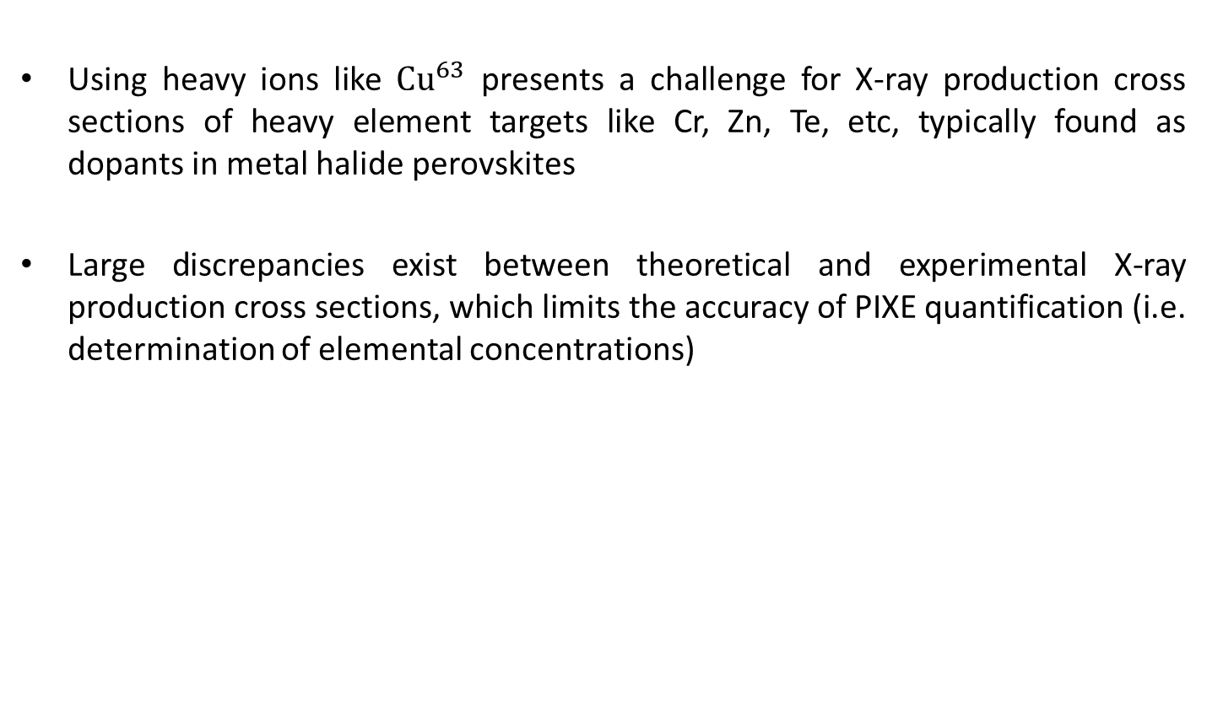
2.Research problem
Using heavy ions like ${Cu}^{63}$ presents a challenge for X-ray production cross sections of heavy element targets like Cr, Zn, Te, etc, typically found as dopants in metal halide perovskites
Large discrepancies exist between theoretical and experimental X-ray production cross sections, which limits the accuracy of PIXE quantification (i.e. determination of elemental concentrations)
${recall that Y}_{x}=σ_{x}Qε_{x}$C_{x}$Ω_{x}$

Slide 10
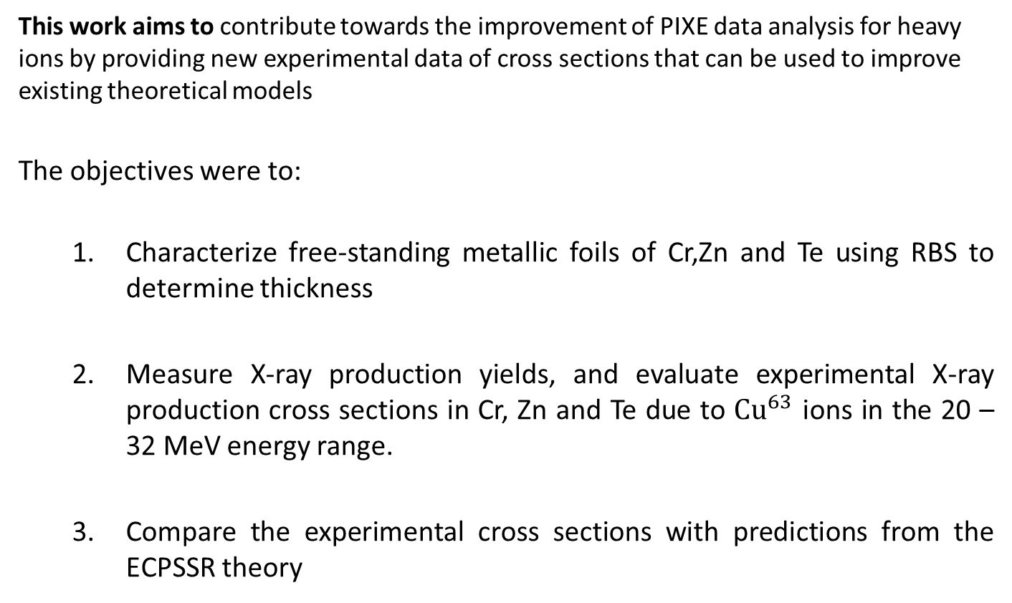
3. Aim and Objectives
This work aims to contribute towards the improvement of PIXE data analysis for heavy ions by providing new experimental data of cross sections that can be used to improve existing theoretical models
The objectives were to:
  Characterize free-standing metallic foils of Cr,Zn and Te using RBS to determine thickness
  Measure X-ray production yields, and evaluate experimental X-ray production cross sections in Cr, Zn and Te due to ${Cu}^{63}$ ions in the 20 – 32 MeV energy range.
  Compare the experimental cross sections with predictions from the ECPSSR theory

Slide 11
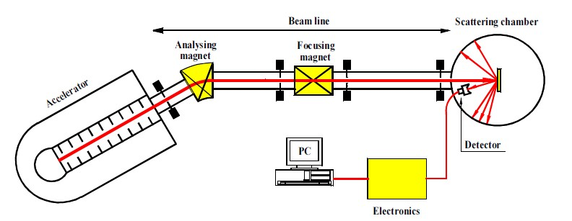
4. Experimental procedure
RBS and XPCS Setup
Target foil
RBS, PIXE

Slide 12

XPCS measurement set up
${Cu}^{63 }$(20-32 Mev)
Cr, Zn, Te targets
RBS, PIXE

Slide 13

XPCS evaluation
  $$σ_{x}=\frac{N_{x}}{N_{i}}×\frac{4π}{Ω}×\frac{1}{∆x}×\frac{1}{ε}$$
Equation for X-ray detector efficiency
  $$ε=\frac{N_{x}}{N_{i}}×\frac{4π}{Ω}×\frac{1}{∆x}×\frac{1}{σ_{x}}$$

Slide 14
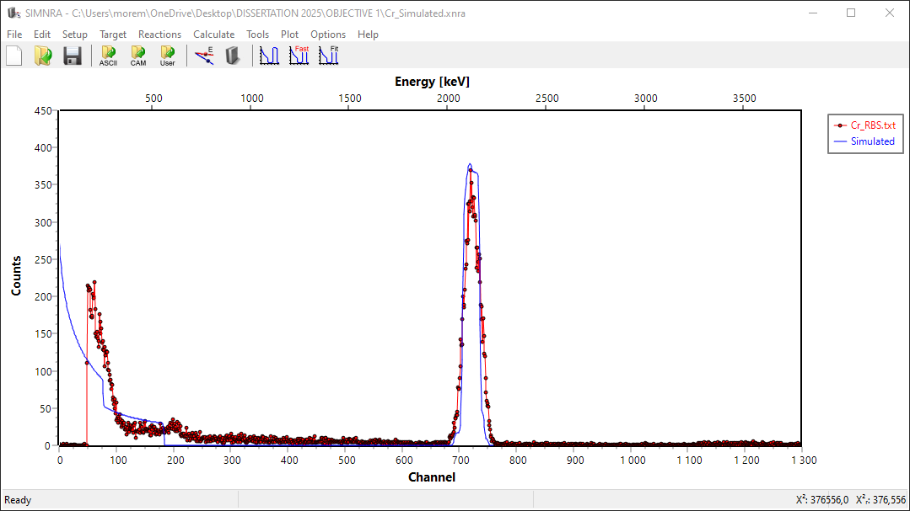
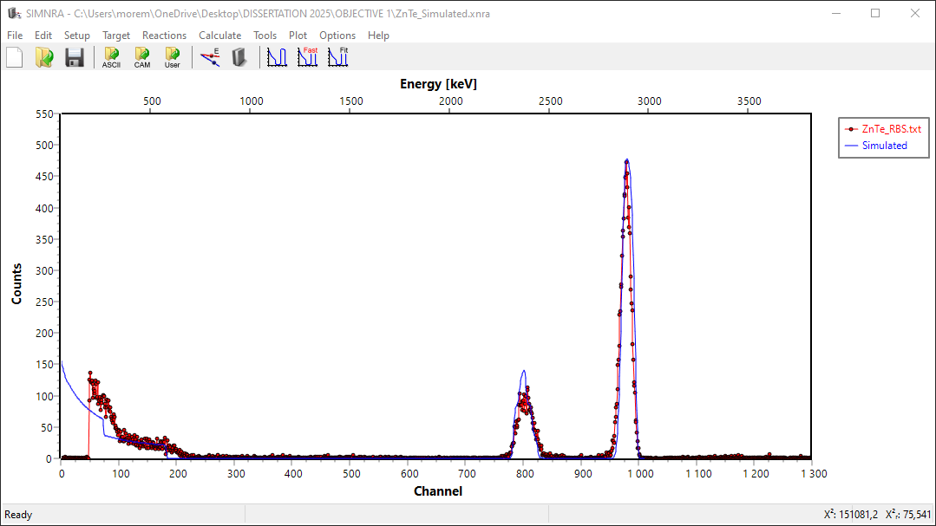
5. Results and discussion
Fitted RBS spectra for foil thickness evaluation
Cr
Thickness of Cr foil =3,59e17 at/cm2
(= 42 nm)
ZnTe
Thickness of ZnTe foil =1,97e17 at/cm2
(= 50 nm)

Slide 15
X-ray detector efficiency curve

Slide 16
Total Cr K-shell cross sections due to 20 – 32 MeV Cu ions

Slide 17
Total Zn K-shell cross sections due to 20 – 32 MeV Cu ions

Slide 18
Total Te L-shell cross sections due to 20 – 32 MeV Cu ions

Slide 19
6.Conclusion
XPCS were successfully measured for Cr, Zn and Te
Relatively better agreement between EXPCS(EXP) and XPCS(EC+DI)
Implications for heavy ion PIXE
Current theories can be modified/improved based on new experimental data
Future work
Empirical formulations can be developed using data intensive approaches like machine learning

Slide 20
7. General References
ISLAM, M.A., MOHAFEZ, H., SOBAYEL, K., WAN MUHAMAD HATTA, S.F., HASAN, A.K.M., KHANDAKER,M.U.,AKHTARUZZAMAN,M.,MUHAMMAD,G.,AMIN,N.2021. Degradation of Perovskite Thin Films and Solar Cells with Candle Soot C/Ag Electrode Exposed in a Control Ambient. Nanomaterials (12):3463.
JEROMEL, L., SIKETIĆ, Z., POTOČNIK, N. O., VAVPETIČ, P., RUPNIK, Z., BUČAR, K., & PELICON, P. 2014. Development of mass spectrometry by high energy focused heavy ion beam: MeV SIMS with 8 MeV Cl7+ beam. Nuclear Instruments and Methods in Physics Research. Section B (332):22–27. https://doi.org/10.1016/j.nimb.2014.02.022
JEYNES, C., BARRADAS, N. P., MARRIOTT, P. K., BOUDREAULT, G., JENKIN, M., WENDLER, E., & WEBB, R. P.2003. Elemental thin film depth profiles by ion beam analysis using simulated annealing - a new tool. Journal of Physics. D, Applied Physics, 36(7), R97–R126. https://doi.org/10.1088/0022-3727/36/7/201

Slide 21
8.Acknowledgements
I would like to thank the following individual for guidance and support :
  Prof M. Msimanga
  Dr MC Masekane
  Dr M Masenya

Slide 22
THANK YOU

