Slide 1

Systematic Analytical Regularisation
SAIP Oral Presentation
11 July 2025
Jarryd Bath

Slide 2
A special thanks to Professor William Alexand Horowitz for the supervision throughout this project
Stay tuned for our up-coming paper
I will be avoiding a lot of technicalities and will be more qualitative
If you want more details talk to me afterwards (or even better read the paper once it is out)

Slide 3
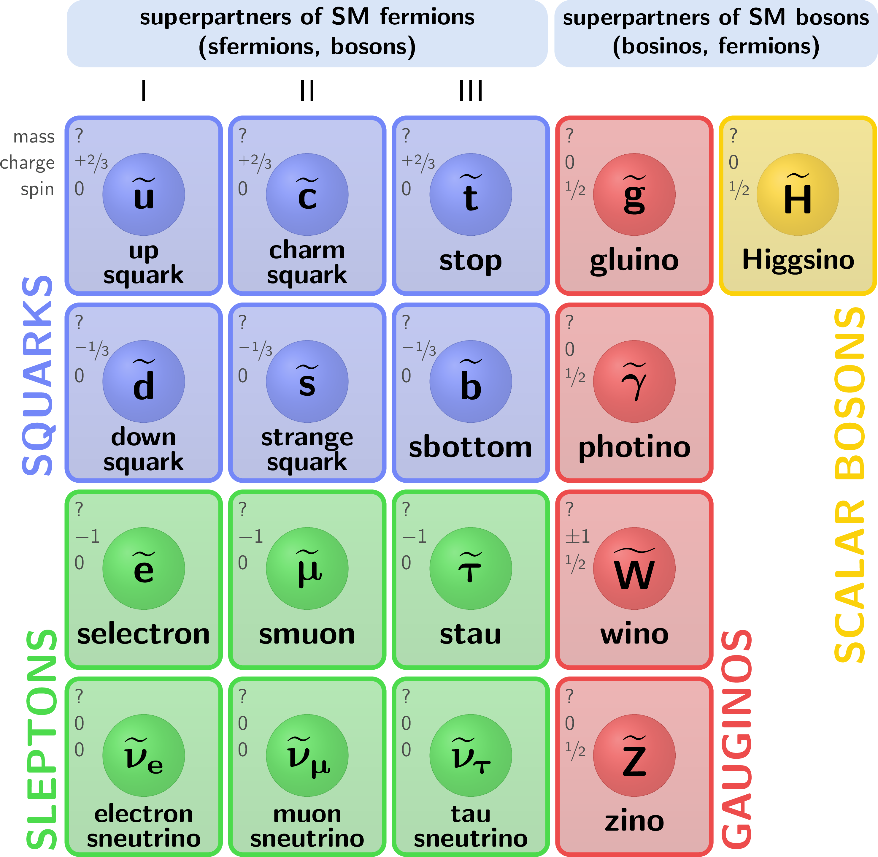
Background
Quantum field theory (QFT) combines quantum mechanics and special relativity (Lorentz invariance)
A famous examples of a QFT is the standard model which describes three of the four fundamental forces universe (electromagnetic, strong, weak)

Slide 4
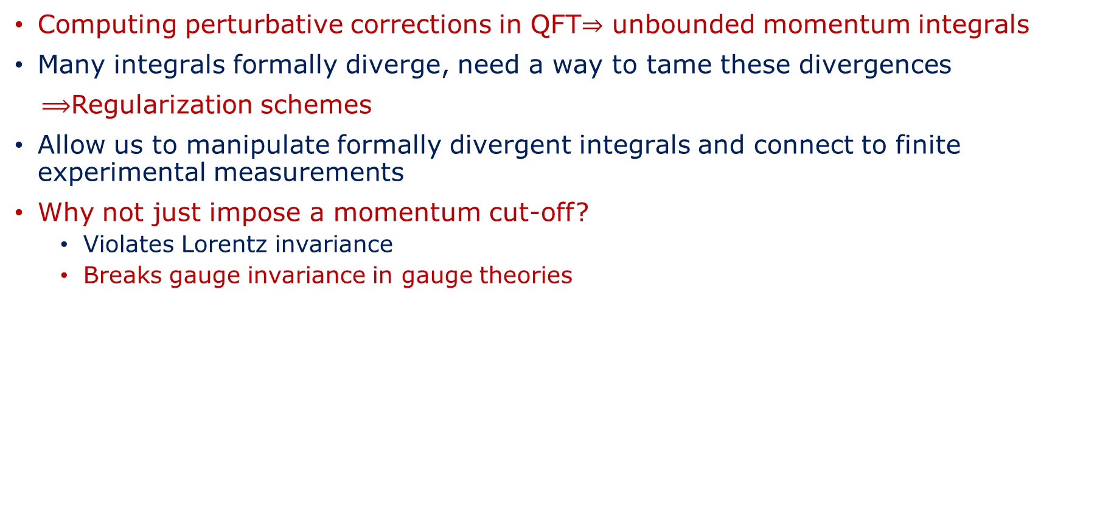
Background
Computing perturbative corrections in QFT$⇒$ unbounded momentum integrals
Many integrals formally diverge, need a way to tame these divergences
$⟹$Regularization schemes
Allow us to manipulate formally divergent integrals and connect to finite experimental measurements
Why not just impose a momentum cut-off?
  Violates Lorentz invariance
  Breaks gauge invariance in gauge theories

Slide 5
Background
If we have learned anything from modern physics: symmetries are king
Introduce systematic analytical regularization (SAR)
Modifies action of the QFT such that
  QFT is finite from step 0
  Original symmetries are preserved

Slide 6
Outline
Introduce superficial degree of divergence as a way to quantify divergences
In order to make measurements: we to consider theories with interactions
We consider the most basic interacting theories:
  Interacting scalar field theory
  Yukawa theory
These models may be simple but they do model real life physics: Higgs boson
Show that, at next to leading order, SAR results in finite results

Slide 7
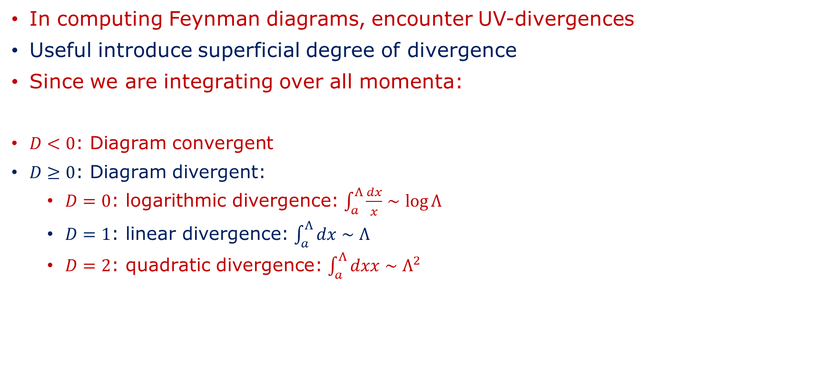

Superficial Degree of Divergence
In computing Feynman diagrams, encounter UV-divergences
Useful introduce superficial degree of divergence
Since we are integrating over all momenta:
$D<0$: Diagram convergent
$D≥0$: Diagram divergent:
  $D=0$: logarithmic divergence: $\int_{a}^{Λ}{\frac{dx}{x}∼\log{Λ}}$
  $D=1$: linear divergence: $\int_{a}^{Λ}{dx}∼Λ$
  $D=2$: quadratic divergence: $\int_{a}^{Λ}{dxx∼Λ^{2} }$
$D≡$power loop momenta numerator$−$power loop momenta denominator
$$⋮$$

Slide 8
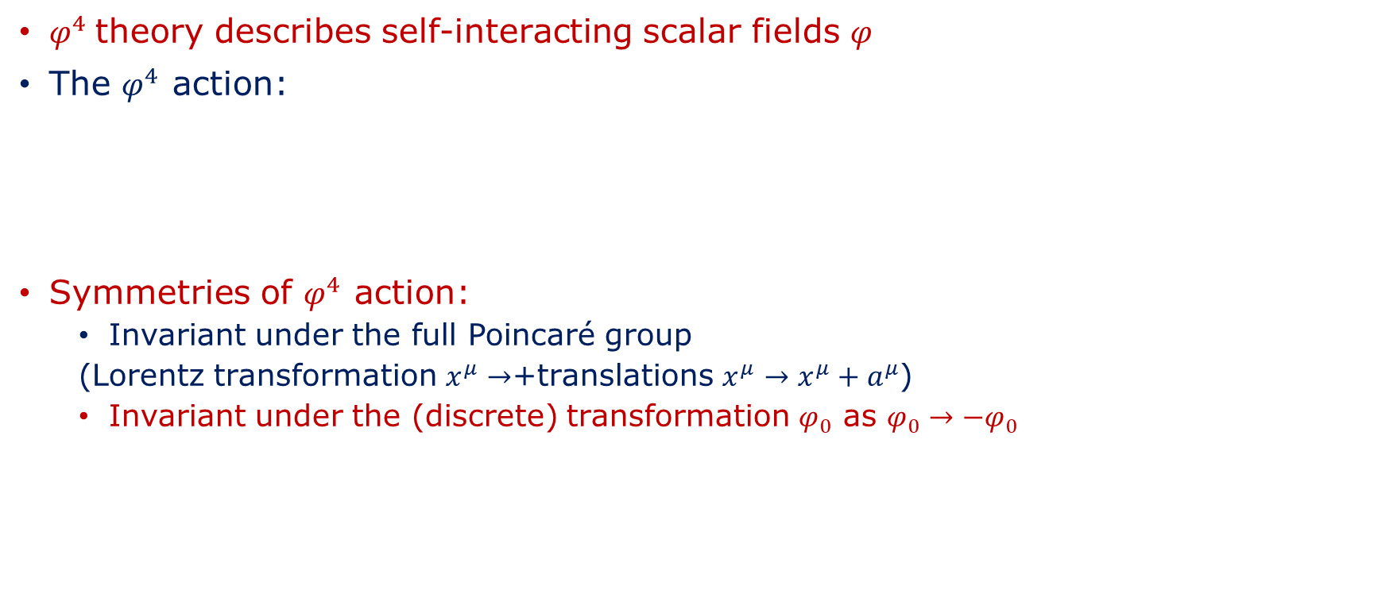
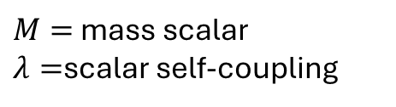
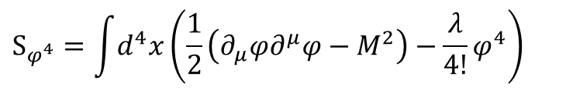
$φ^{4}$ Theory
$φ^{4}$theory describes self-interacting scalar fields $φ$
The $φ^{4}$ action:
Symmetries of $φ^{4}$ action:
  Invariant under the full Poincaré group
  (Lorentz transformation $x^{μ}→$+translations $x^{μ}→x^{μ}+a^{μ}$)
  Invariant under the (discrete) transformation $φ_{0}$ as $φ_{0}→−φ_{0}$
$$S_{φ^{4}}=\int{d^{4}x}\left(\frac{1}{2}\left(∂_{μ}φ∂^{μ}φ−M^{2}\right)−\frac{λ}{4!}φ^{4}\right)$$
$M=$ mass scalar
$λ=$scalar self-coupling
Free action
Interaction

Slide 9
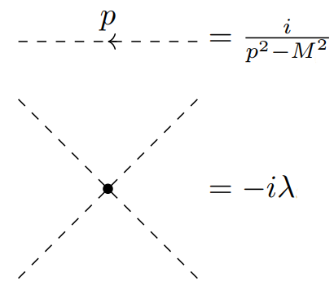



Quantum $φ^{4}$ theory
Superficial degree of divergence of $φ^{4}$ theory:
$D_{φ^{4}}≥0$ for $N_{φ}=0,1,2,3,4$
$$D_{φ^{4}}=4−N_{φ}$$
$N_{φ}≡$ number external scalar lines
Feynman rules:

Slide 10
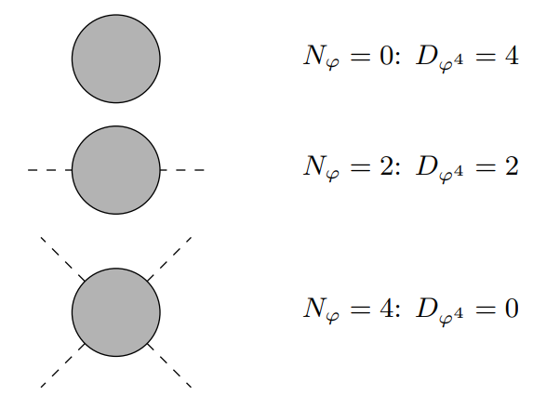


Quantum $φ^{4}$ Theory
Due transformation $φ→−φ$, diagrams with $N_{φ}$ odd vanish
Superficially divergent diagrams $φ^{4}$
Quartic divergence
Quadratic divergence
Logarithmic divergence

Slide 11
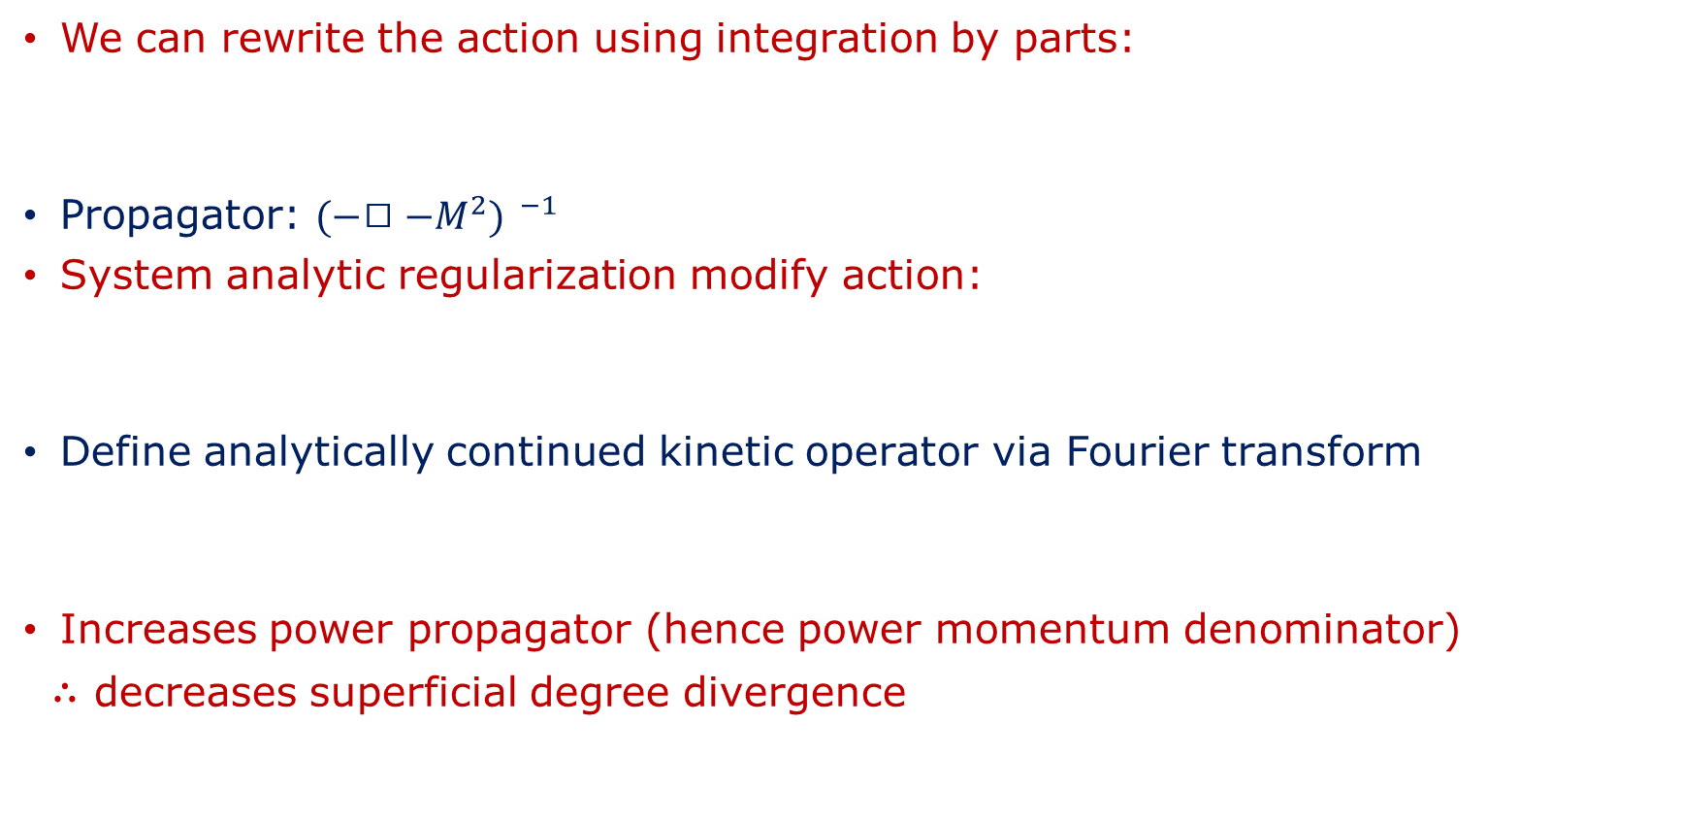
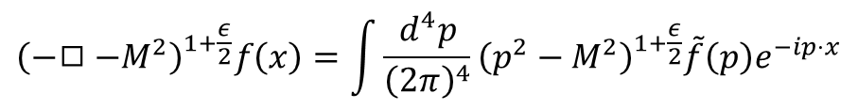


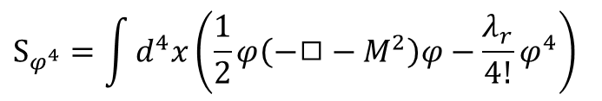
SAR $φ^{4}$
We can rewrite the action using integration by parts:
Propagator: ${(−◻−M^{2}) }^{−1}$
System analytic regularization modify action:
Define analytically continued kinetic operator via Fourier transform
Increases power propagator (hence power momentum denominator)
$∴$ decreases superficial degree divergence
$$S_{φ^{4}}=\int{d^{4}x\left(\frac{1}{2}φ\left(−◻−M^{2}\right)φ−\frac{λ_{r}}{4!}φ^{4}\right)}$$
$${\left(−◻−M^{2}\right)}^{1}→ μ^{ε}{\left(−◻−M^{2}\right)}^{1+\frac{ε}{2}}$$
$$ε>0$$
$μ$: fictious energy scale$→$ retain dimensions
$${\left(−◻−M^{2}\right)}^{1+\frac{ε}{2}}f\left(x\right)=\int{\frac{d^{4}p}{{\left(2π\right)}^{4}}{\left(p^{2}−M^{2}\right)}^{1+\frac{ε}{2}}\tilde{f}\left(p\right)e^{−ip⋅x}}$$

Slide 12
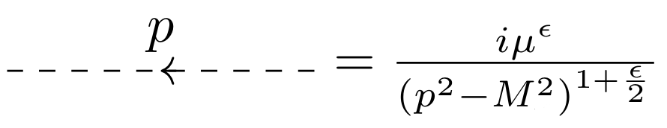
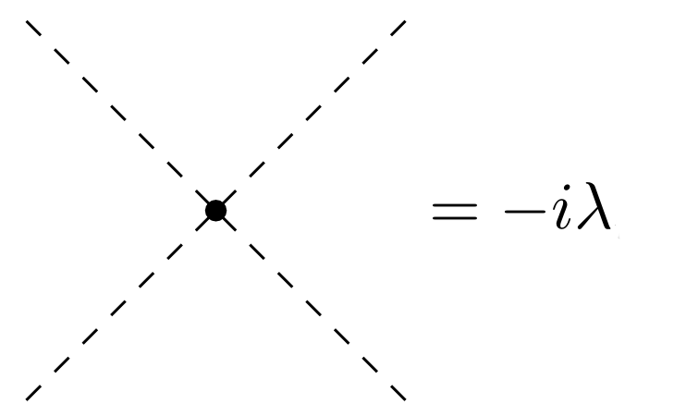
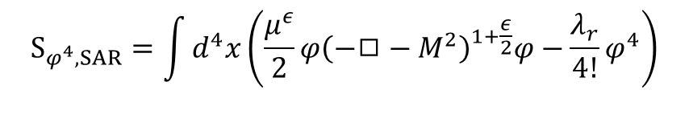
SAR $φ^{4}$
We now have the following action:
Preserved all the original symmetries
Feynman rules in SAR
$$S_{φ^{4},SAR}=\int{d^{4}x\left(\frac{μ^{ε}}{2}φ{\left(−◻−M^{2}\right)}^{1+\frac{ε}{2}}φ−\frac{λ_{r}}{4!}φ^{4}\right)}$$

Slide 13
Divergent diagrams
Vacuum bubble: only shifts vacuum energy
We can only measure differences in energy levels, so we ignore its contribution
However SAR can be applied to computing the diagrams that contribute to the vacuum energy

Slide 14
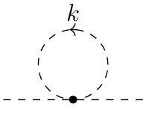
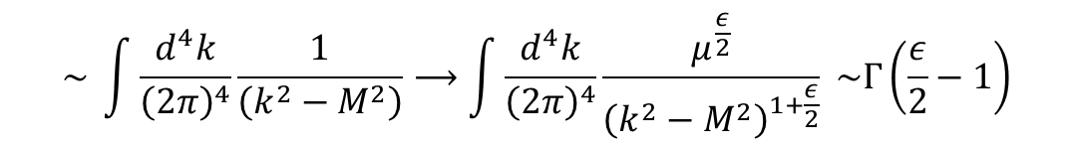
Divergent diagrams
Next to leading order (NLO) contribution:
$$\sim \int{\frac{d^{4}k}{{\left(2π\right)}^{4}}\frac{1}{\left(k^{2}−M^{2}\right)}⟶\int{\frac{d^{4}k}{{\left(2π\right)}^{4}}}}\frac{μ^{\frac{ε}{2}}}{{\left(k^{2}−M^{2}\right)}^{1+\frac{ε}{2}}} \sim Γ\left(\frac{ε}{2}−1\right)$$
Finite!

Slide 15
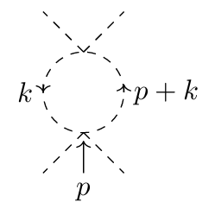
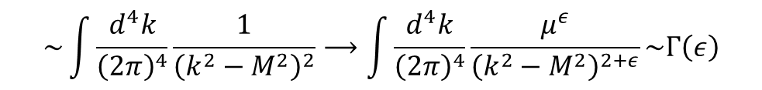
Divergent Diagrams
NLO contribution:
$$\sim \int{\frac{d^{4}k}{{\left(2π\right)}^{4}}}\frac{1}{{\left(k^{2}−M^{2}\right)}^{2}}⟶\int{\frac{d^{4}k}{{\left(2π\right)}^{4}}}\frac{μ^{ε}}{{\left(k^{2}−M^{2}\right)}^{2+ε}}\sim Γ\left(ε\right)$$
Finite!

Slide 16
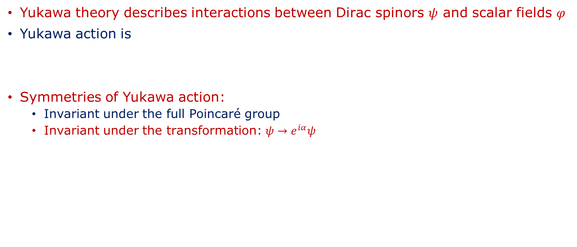

Yukawa Theory
Yukawa theory describes interactions between Dirac spinors $ψ$ and scalar fields $φ$
Yukawa action is
Symmetries of Yukawa action:
  Invariant under the full Poincaré group
  Invariant under the transformation: $ψ→e^{iα}ψ$
$$S_{Yukawa}=\int{d^{4}x\left(\overline{ψ}\left(γ^{μ}∂_{μ}−m\right)ψ+φ\left(−◻−M^{2}\right)φ−gφ\overline{ψ}ψ−\frac{λ}{4!}φ^{4}\right)}$$
$m=$mass spinor
$M=$mass scalar
$g=$scalar-spinor coupling
$λ=$scalar self-coupling

Slide 17
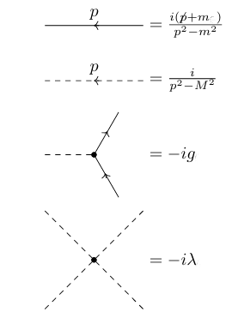
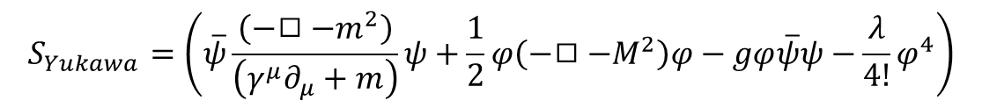
Quantum Yukawa Theory
Rewrite the action as
$$S_{Yukawa}=\left(\overline{ψ}\frac{\left(−◻−m^{2}\right)}{\left(γ^{μ}∂_{μ}+m\right)}ψ+\frac{1}{2}φ\left(−◻−M^{2}\right)φ−gφ\overline{ψ}ψ−\frac{λ}{4!}φ^{4}\right)$$

Slide 18
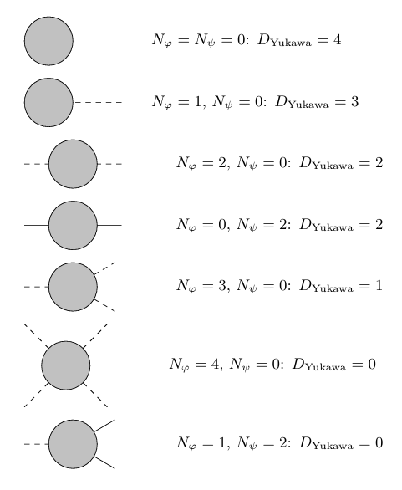
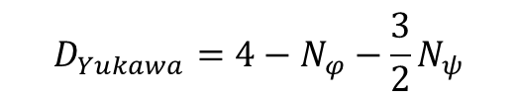

Quantum Yukawa
Superficially divergent diagrams Yukawa theory
Superficial degree of divergence
Diagrams with $N_{ψ}=0$ and
$N_{φ}=$odd do not contribute at NLO
Again vacuum diagram $N_{φ}=N_{ψ}=0$ is an
vacuum energy shift and we ignore it
$$D_{Yukawa}=4−N_{φ}−\frac{3}{2}N_{ψ}$$

Slide 19

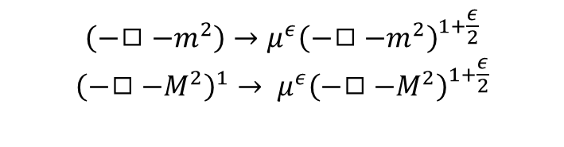
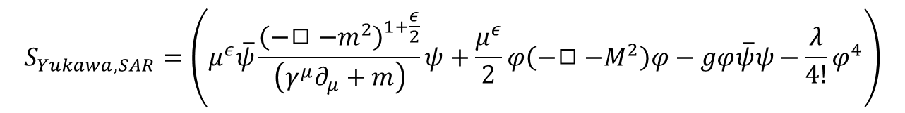
SAR Yukawa Theory
We take
Preserves original symmetries of the theory
$$\left(−◻−m^{2}\right)→{μ^{ε}\left(−◻−m^{2}\right)}^{1+\frac{ε}{2}}$$
$${\left(−◻−M^{2}\right)}^{1}→ μ^{ε}{\left(−◻−M^{2}\right)}^{1+\frac{ε}{2}}$$
$$ε>0$$
$μ$: fictious energy scale$→$ retain dimensions
$$S_{Yukawa, SAR}=\left(μ^{ε}\overline{ψ}\frac{{\left(−◻−m^{2}\right)}^{1+\frac{ε}{2}}}{\left(γ^{μ}∂_{μ}+m\right)}ψ+\frac{μ^{ε}}{2}φ\left(−◻−M^{2}\right)φ−gφ\overline{ψ}ψ−\frac{λ}{4!}φ^{4}\right)$$

Slide 20
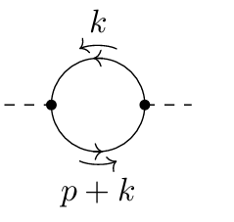
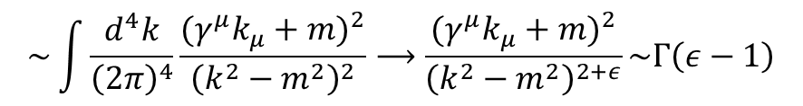
Divergent Diagrams
NLO contribution:
$$\sim \int{\frac{d^{4}k}{{\left(2π\right)}^{4}}\frac{{{(γ}^{μ}k_{μ}+m)}^{2}}{{\left(k^{2}−m^{2}\right)}^{2}}⟶\frac{{{(γ}^{μ}k_{μ}+m)}^{2}}{{\left(k^{2}−m^{2}\right)}^{2+ε}}\sim Γ\left(ε−1\right)}$$
Finite!

Slide 21
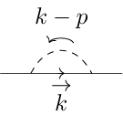

Divergent Diagrams
NLO contribution
$$\sim \int{\frac{d^{4}k}{{\left(2π\right)}^{4}}\frac{{(γ}^{μ}k_{μ}+m)}{{\left(k^{2}−m^{2}\right)}^{2}}⟶\frac{μ^{ε}{(γ}^{μ}k_{μ}+m)}{{\left(k^{2}−m^{2}\right)}^{2+ε}}\sim Γ\left(ε\right)}$$
Finite!

Slide 22
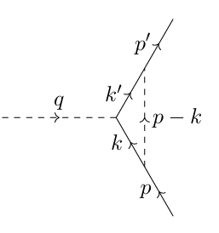
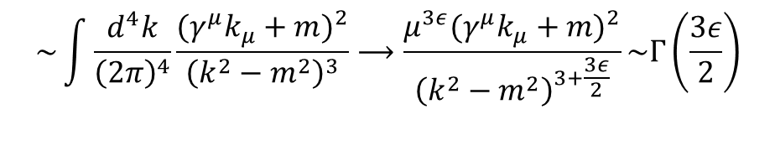
Divergent diagrams
NLO contribution:
$$\sim \int{\frac{d^{4}k}{{\left(2π\right)}^{4}}\frac{{{(γ}^{μ}k_{μ}+m)}^{2}}{{\left(k^{2}−m^{2}\right)}^{3}}⟶\frac{μ^{3ε}{{(γ}^{μ}k_{μ}+m)}^{2}}{{\left(k^{2}−m^{2}\right)}^{3+\frac{3ε}{2}}}\sim Γ\left(\frac{3ε}{2}\right)}$$
Finite!

Slide 23
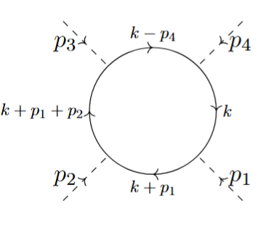
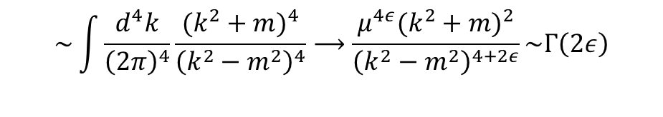
Divergent diagrams
NLO contribution:
$$\sim \int{\frac{d^{4}k}{{\left(2π\right)}^{4}}\frac{{(k^{2}+m)}^{4}}{{\left(k^{2}−m^{2}\right)}^{4}}⟶\frac{μ^{4ε}{(k^{2}+m)}^{2}}{{\left(k^{2}−m^{2}\right)}^{4+2ε}}\sim Γ\left(2ε\right)}$$

Slide 24
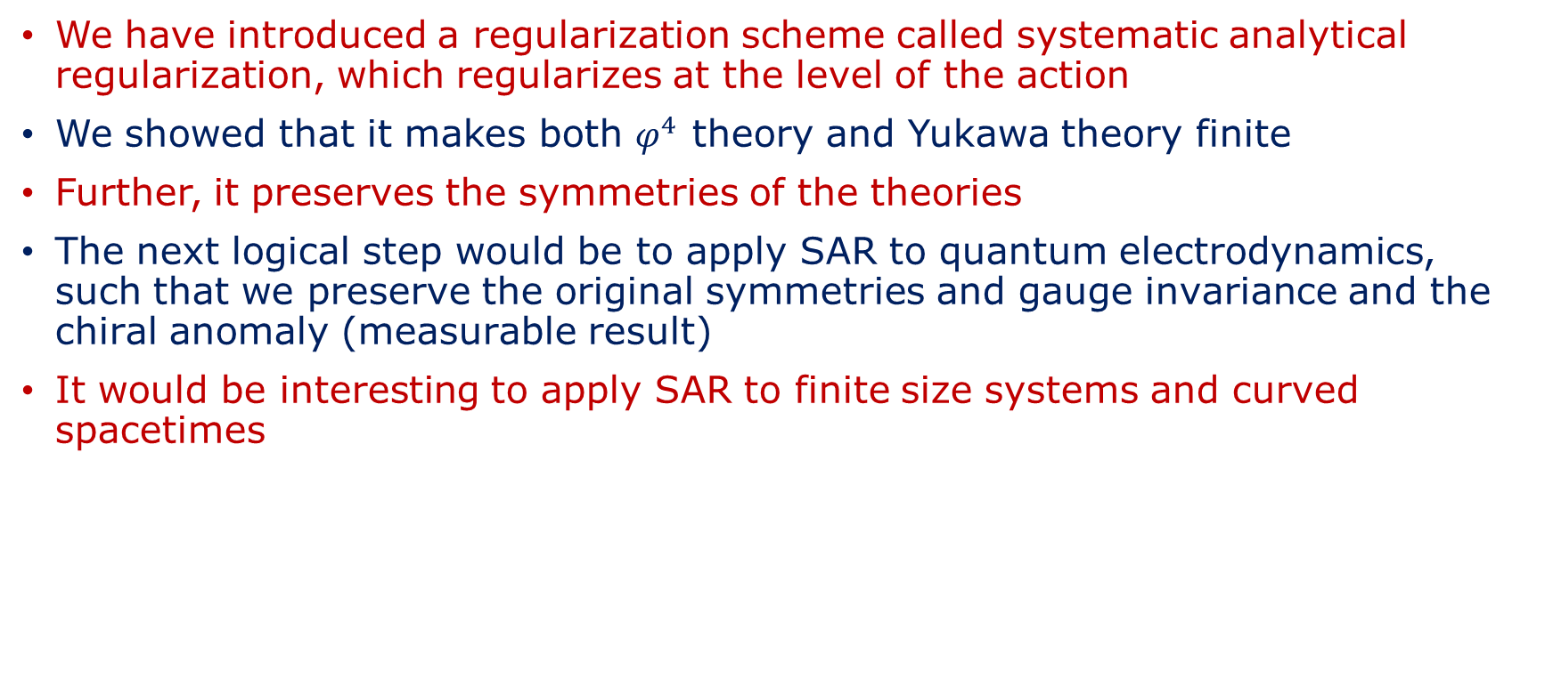
Conclusions and Outlook
We have introduced a regularization scheme called systematic analytical regularization, which regularizes at the level of the action
We showed that it makes both $φ^{4}$ theory and Yukawa theory finite
Further, it preserves the symmetries of the theories
The next logical step would be to apply SAR to quantum electrodynamics, such that we preserve the original symmetries and gauge invariance and the chiral anomaly (measurable result)
It would be interesting to apply SAR to finite size systems and curved spacetimes

Slide 25
Extra Slide

